Slide 1





The European EIC TWAC Project on Terahertz Dielectric Acceleration
Christelle Bruni
On behalf of TWAC consortium

Slide 2
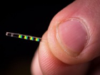
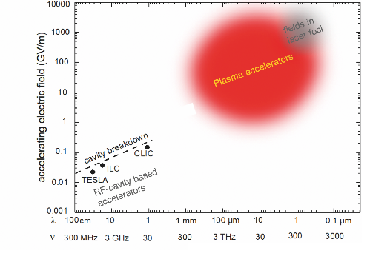


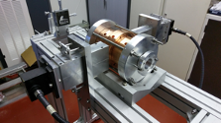



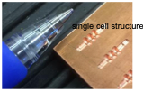
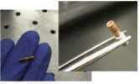
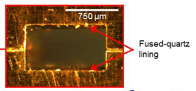
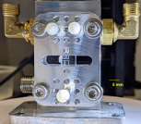
Towards compact accelerators ?
DLA
LPA
DLA
RF
DTA
[B. Hidding, et al., arXiv:1904.09205 (2019)]
DTA
[E. Nanni, et al. Nat Commun 6, 8486 (2015)], [F. Kartner et al., NIMA 829, 24(2016)],
[M.T. Hibberd et al., Nat. Phot. 14, 755 (2020)], [H. Tqng et ql., PhysRevLett.127.074801 (2021)]]
LPA

Slide 3
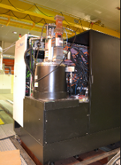
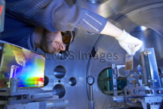

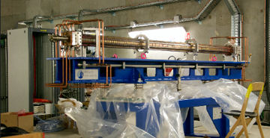
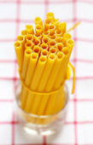
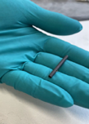

Compact, 'cleaner' and lighter accelerators
TWAC offers a new approach to simultaneously overcome multiple limitations while reducing the size of accelerators. It aims to serve both research and industrial purposes with the goal of moving towards 'cleaner' and lighter accelerators, catering to applications ranging from research accelerators to cancer treatments
TWAC proposes to simplify infrastructures by replacing RF sources with optical sources
ZITA (cannelonni pasta) : the accelerator structure will be able to withstand high accelerator field strengths within millimeter-scale dimensions

Slide 4
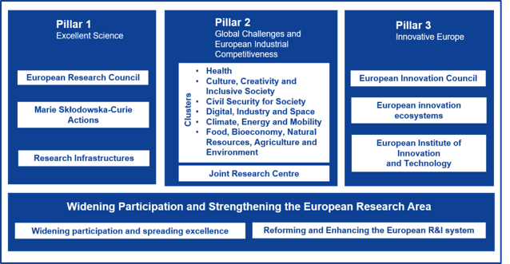

EIC Pathfinder Open – call 2021
Project funded by Europeen Innovation Concil, Pillar 3 of Horizon Europe, twin of ERC for Innovation
The EIC supports research teams in the research and development of innovative technologies that are high-risk and high-potential, fostering advanced interdisciplinary scientific collaborations
Granted in 2022 with 3.1 Meuros + 0.5 Meuros from sefri

Slide 5
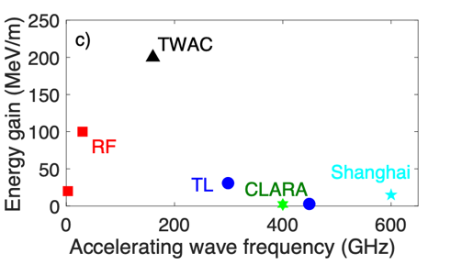
Objective: compact high gradient accelerator
To demonstrate a high energy gain per meter accelerating structure in the gap between the RF technologies and laser plasma accelerators
To demonstrate electron bunch compression
TWAC will offer a high current electron source on a metre scale compared to RF accelerators
Only a unique combination of ZITA with a state-of-the-art conventional and stable femtosecond electron source (RF-gun) can achieve this unique performance

Slide 6
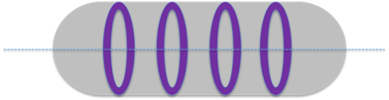
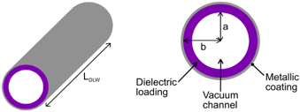
What is ZITA ? ZITA is the accelerator
Iris to slow down
—>In classical RF structures
—> Complex structures at cm scale
Circular wave guides are the basis of accelerating cavity to propagate an accelerating mode
But the phase velocity in such a perfectly conducting guide is always larger than the speed of light
To keep synchronism condition between electrons and accelerating field, we need to slow down the wave
Dielectric to modify the wave vector
—> ‘Simple’ structure shape, but at mm scale for THz
—> Metalic coating for field confinement

Slide 7
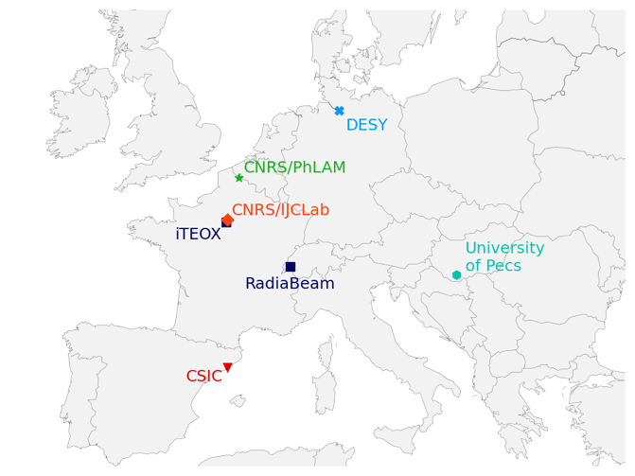
TWAC Partners
Partners & expertise:
• CNRS/IJCLab: Accelerator physics
+ High energy laser + TWAC prototype
• CNRS/PhLAM: Beam dynamics modelling
+ ultrafast THz/electron diagnostics
• CSIC: Dosimetry
FLASH radiotherapy
• DESY: Electron diagnostics
+ test facility for benchmarks
• iTEOX: Valorisation
• University of Pécs:
High power THz source
• RadiaBeam:
Valorisation

Slide 8


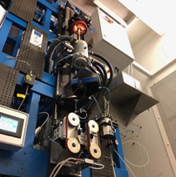

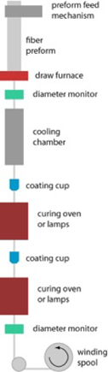



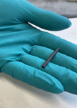

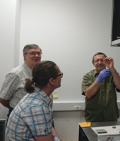
ZITA Is The Accelerator
ZITA
ZITA
Prototypes ready
8
Merci à Bruno Maffei@IAS

Slide 9
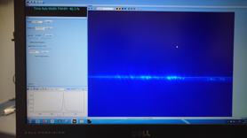
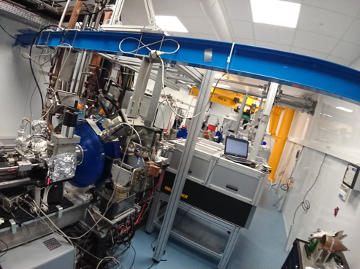
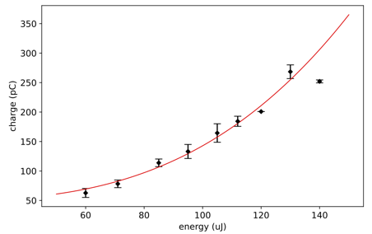
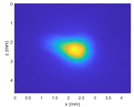
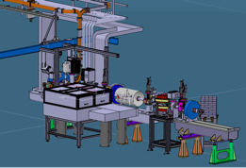
New infrastructure for photonics/accelerator interface
Photocathode
fs-IR laser
8 MeV electron source (PHIL)
Joule-class laser (LASERIX)
Laser plasma acceleration (PALLAS)
Autocorrelation trace
Pulse duration ~50 fs-FWHM
Electrons from multiphoton emission
IR
9

Slide 10
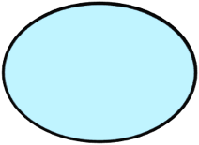
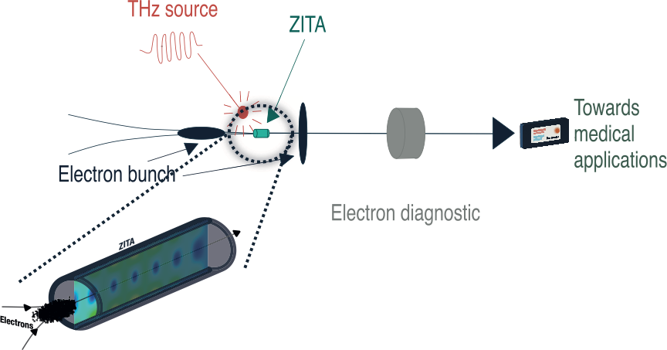

Slide 11
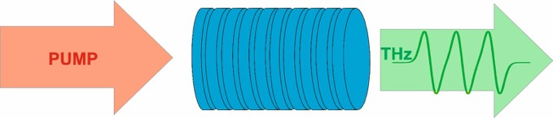
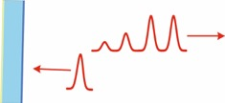
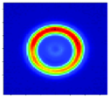
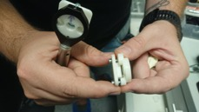
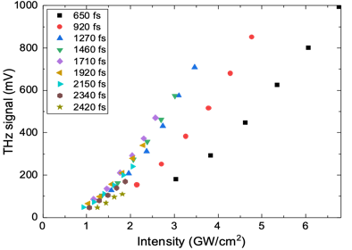
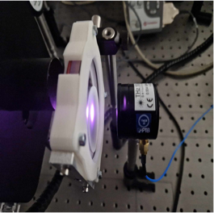
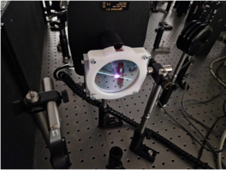
THz source
40 mm
K.-L. Yeh et al., Opt. Commun. 281, 3567 (2008)
Mode radial
K.-L. Yeh et al., Opt. Commun. 281, 3567 (2008)
LN wafer-stack
F. Lemery et al., Commun. Phys. 3, 150 (2020)
C. Mosley et al., Opt. Express 31, 4041 (2023)
CONFIENTIEL
Challenge : obtenir des gradients comparable à la RF, et des largeurs spectrales les plus petites possible
Validation theorique → OK 100MV/m
On-going exp.
with the high energy laser LASERIX @IJCLab
(Ti:Sa laser, ≳1 J)

Slide 12
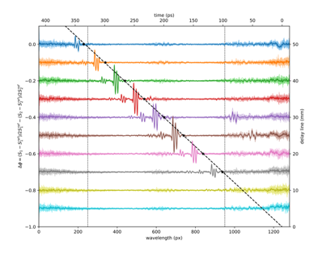
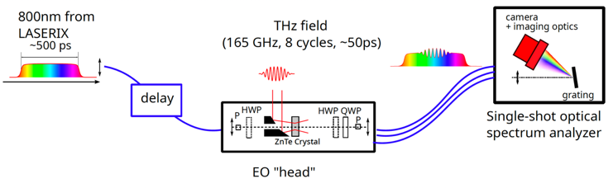
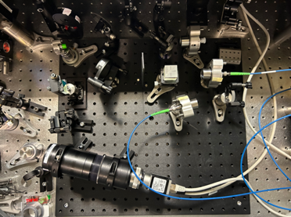
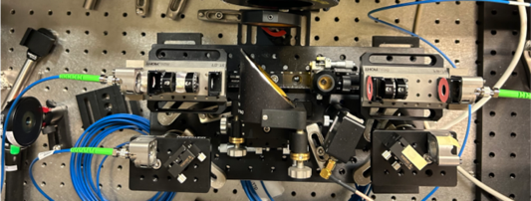
THz diagnostics: Electro-Optic detection
Task 2.4 THz detection:
EO setup for monitoring THz accelerating field
UNDER ASSEMBLY
(designed for LASERIX)
EO head and OSA are on separated boards (flexibility)
Challenge: long THz pulse (> 50 ps) to be recorded/monitored
→ New design for the spectrometer and EO head
EO head on a 15 cm x 30 cm breadboard
Spectrometer 42 cm x 45 cm board

Slide 13
Wakefield structure
Screen
e⁻ bunch
e⁻ bunch
Drift or Beam optics
Drift or Beam optics
p_{y}(s)
p_{y}(s) → y(s)

Slide 14
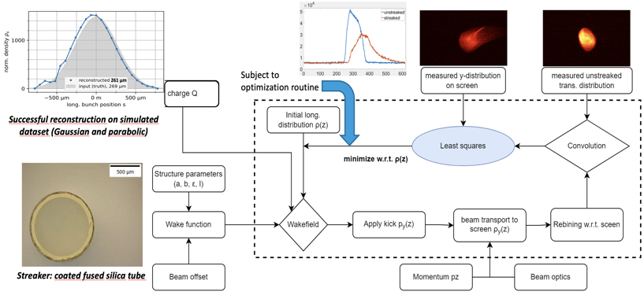
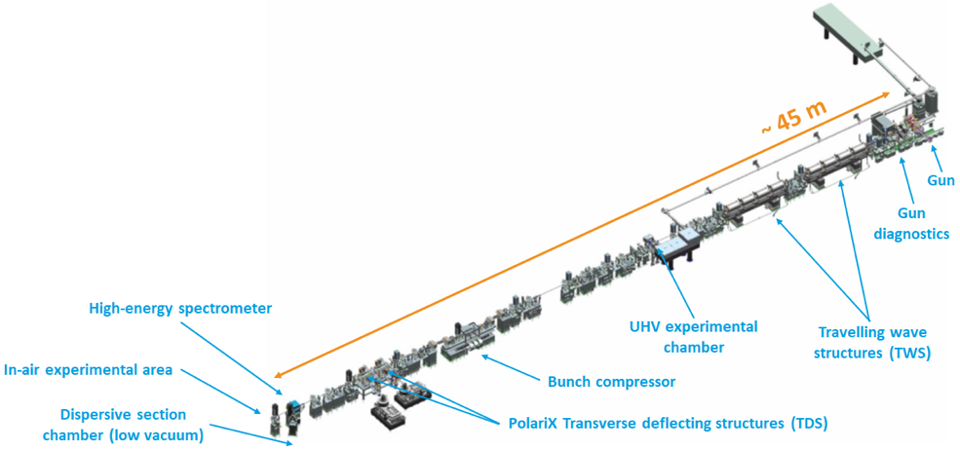
Passive streaking studies at ARES → ijclab
Data analysis ongoing: time profile reconstruction to be made through a forward propagation algorithm.
Chamber under design for IjClab
14

Slide 15

WP5 Towards societal applications ?

Slide 16
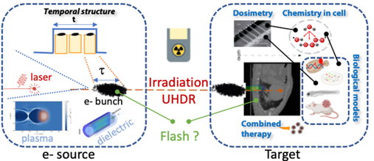
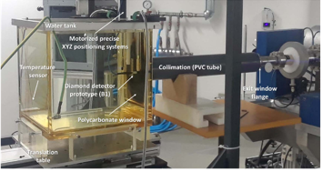
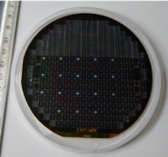
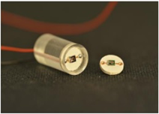

Dosimetry detector
52% of cancers are treated by Radiotherapy.
New paradigm: irradiation time triggers the Flash effect sparing healthy tissues compared to standard RT.
New groundbreaking accelerator technology is needed.
SiC Detectors@CSIC
16

Slide 17
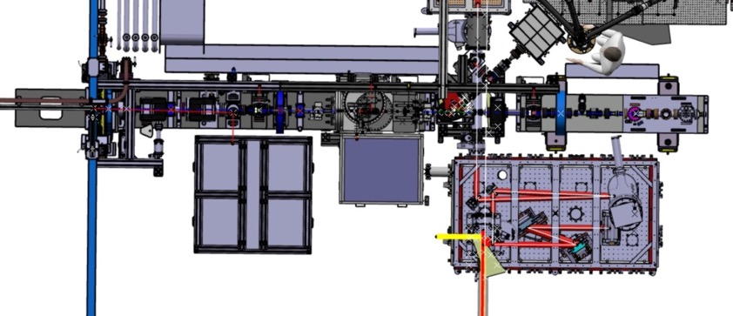
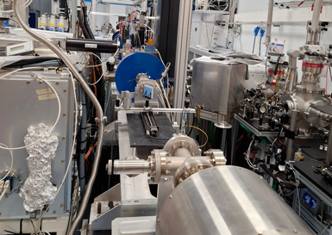
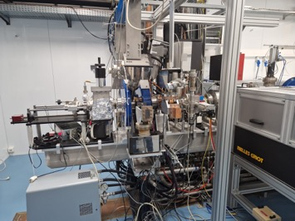
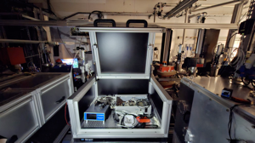
Prototype at CNRS/IJCLab
e⁻ beam
e⁻ beam
ZITA
Dosimetry area
THz
Photocatode table
THz table

Slide 18
