Slide 1

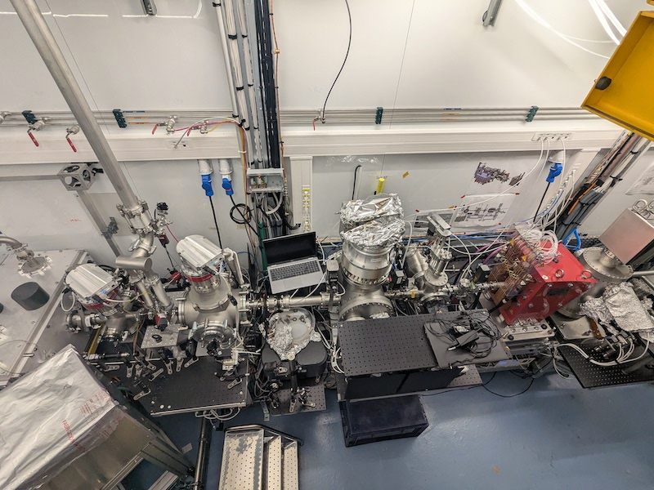



Prototype Accelerator Based
on Laser-Plasma Acceleration
The PALLAS Project: Compact and High Gradient Acceleration
Jana Serhal
Jana.serhal@ijclab.in2p3.fr

Slide 2
What is Plasma Wakefield Acceleration?

Slide 3
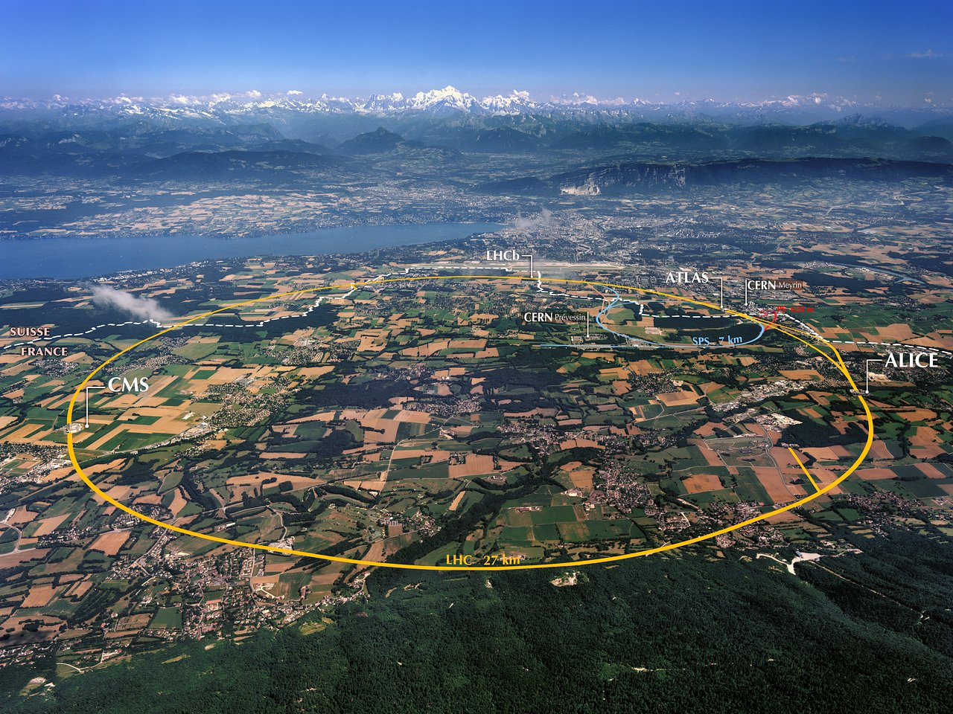
Conventional Accelerators
CERN and Large Hadron Collider.
The world’s largest particle accelerator, 27 km underground.
Uses radio-frequency (RF) cavities to boost particles in synchrony with oscillating electric fields.
These accelerators are massive and expensive, and huge facilities and complex infrastructure.
What if we can scale it down?

Slide 4

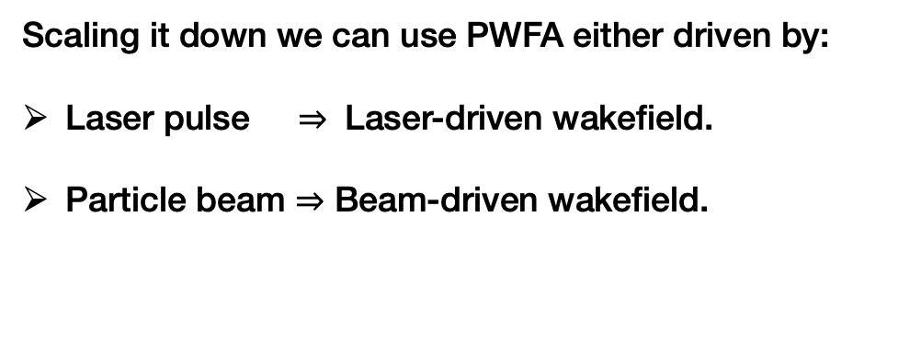
Plasma Wakefield Acceleration
Scaling it down we can use PWFA either driven by:
Laser pulse $⇒$ Laser-driven wakefield.
Particle beam $⇒$ Beam-driven wakefield.
Wake
When a duck travels through water, it produces a wave behind it, called a wake.
The speed of the wake is the speed of the duck, and in plasma acceleration, the electrons surf that wake.
Electrons
Driver

Slide 5
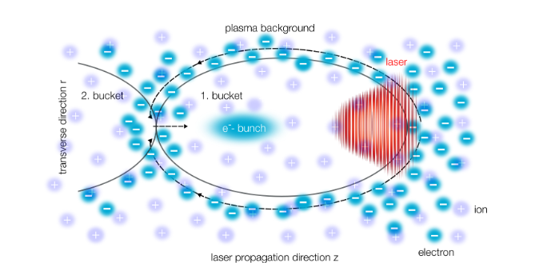
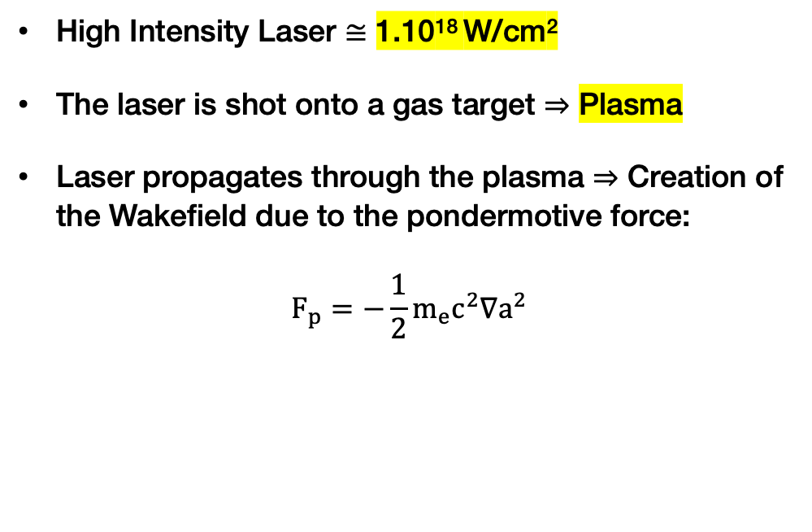
How to Surf a Plasma Wave: From Ducks to Electrons
High Intensity Laser ≅ 1.10¹⁸ W/cm²
The laser is shot onto a gas target ⇒ Plasma
Laser propagates through the plasma ⇒ Creation of the Wakefield due to the pondermotive force:
$$F_{p}=−\frac{1}{2}m_{e}c^{2}∇a^{2}$$
High accelerating gradient ≅ 100 GV/m
Accelerating gradient three orders of magnitude stronger than conventional accelerators.
5

Slide 6
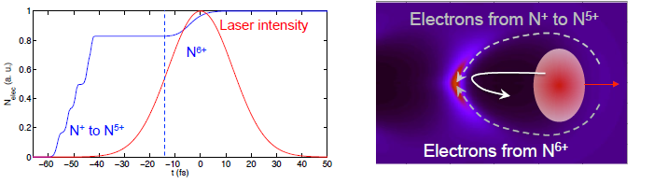
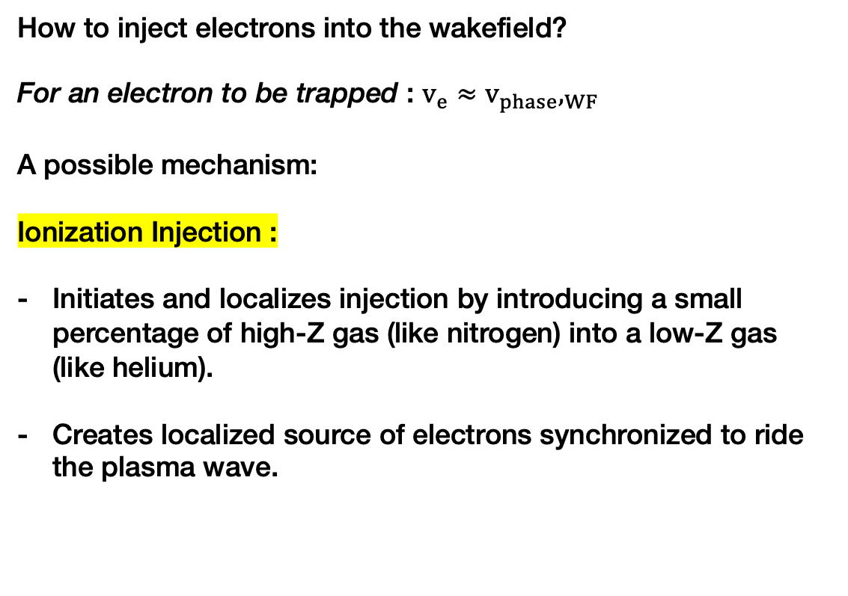
How Electrons Get Trapped: Injection
How to inject electrons into the wakefield?
For an electron to be trapped : $v_{e}≈v_{phase},_{WF}$
A possible mechanism:
Ionization Injection :
Initiates and localizes injection by introducing a small percentage of high-Z gas (like nitrogen) into a low-Z gas (like helium).
Creates localized source of electrons synchronized to ride the plasma wave.
6

Slide 7
So what about PALLAS ?

Slide 8
PALLAS: High-Quality Laser-Plasma Injector
Aiming for “high-quality beam” laser-plasma injector (LPI) facility working in continuous 10 Hz operation.
Advanced laser-control to improve:
Laser quality and stability: beam pointing, energy, wavefront…
Reliability of operation: up-time and operator dependence.
2. Target development toward high repetition rate
Structured gas cell target: electron injection control / beam quality
Material robustness: power and heat management
3. e- beam characterisation
Achieving reliability and control comparable to conventional RF accelerators,
critical milestone for future laser-plasma sources.
8

Slide 9
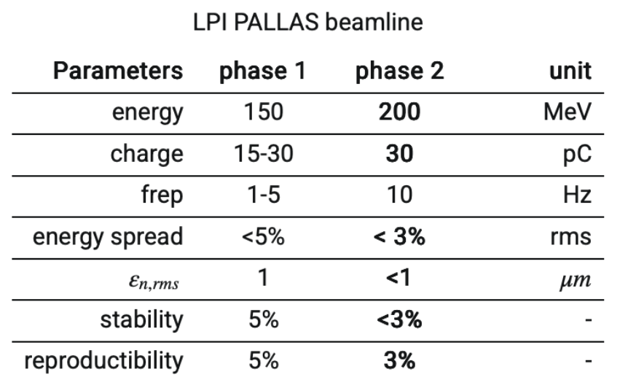
Target Electron Beam Parameters
Key Parameters:
High energy & low energy spread
High charge and repetition rate
Tight emittance control
Excellent stability and reproducibility
Phase 1: laser optimisation & control, target development first electron characterization, optimization.
Phase 2: electron beam stability studies, surrogate model for feedback control

Slide 10
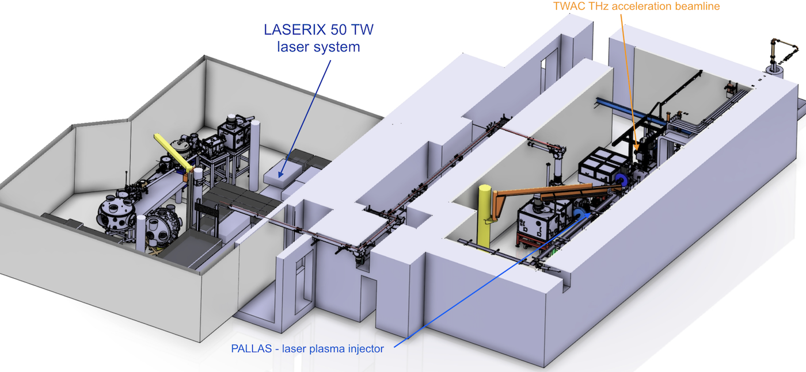
PALLAS installation overview
Location: IJCLab, building 200:
radiation shielded
cleanliness: ISO8
temperature controlled
laser room 21.5 ± 0.1 (RMS) °C (*)
2 × 10 Gb/s network

Slide 11
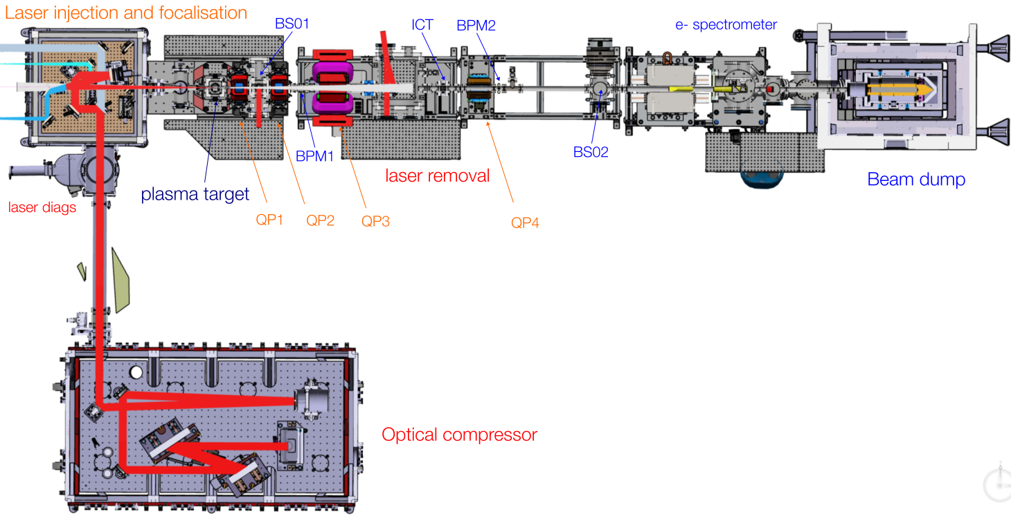
PALLAS Beamline Overview

Slide 12
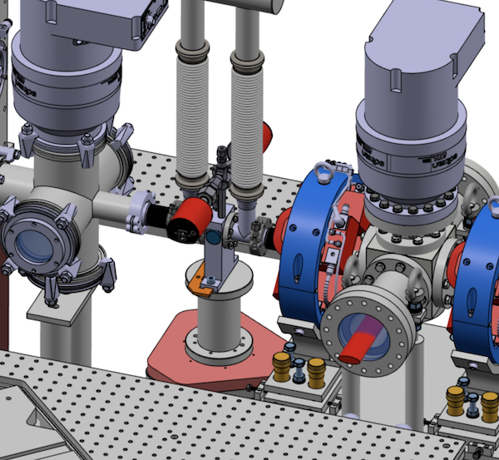
PALLAS Beamline Overview

Slide 13
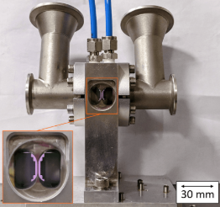
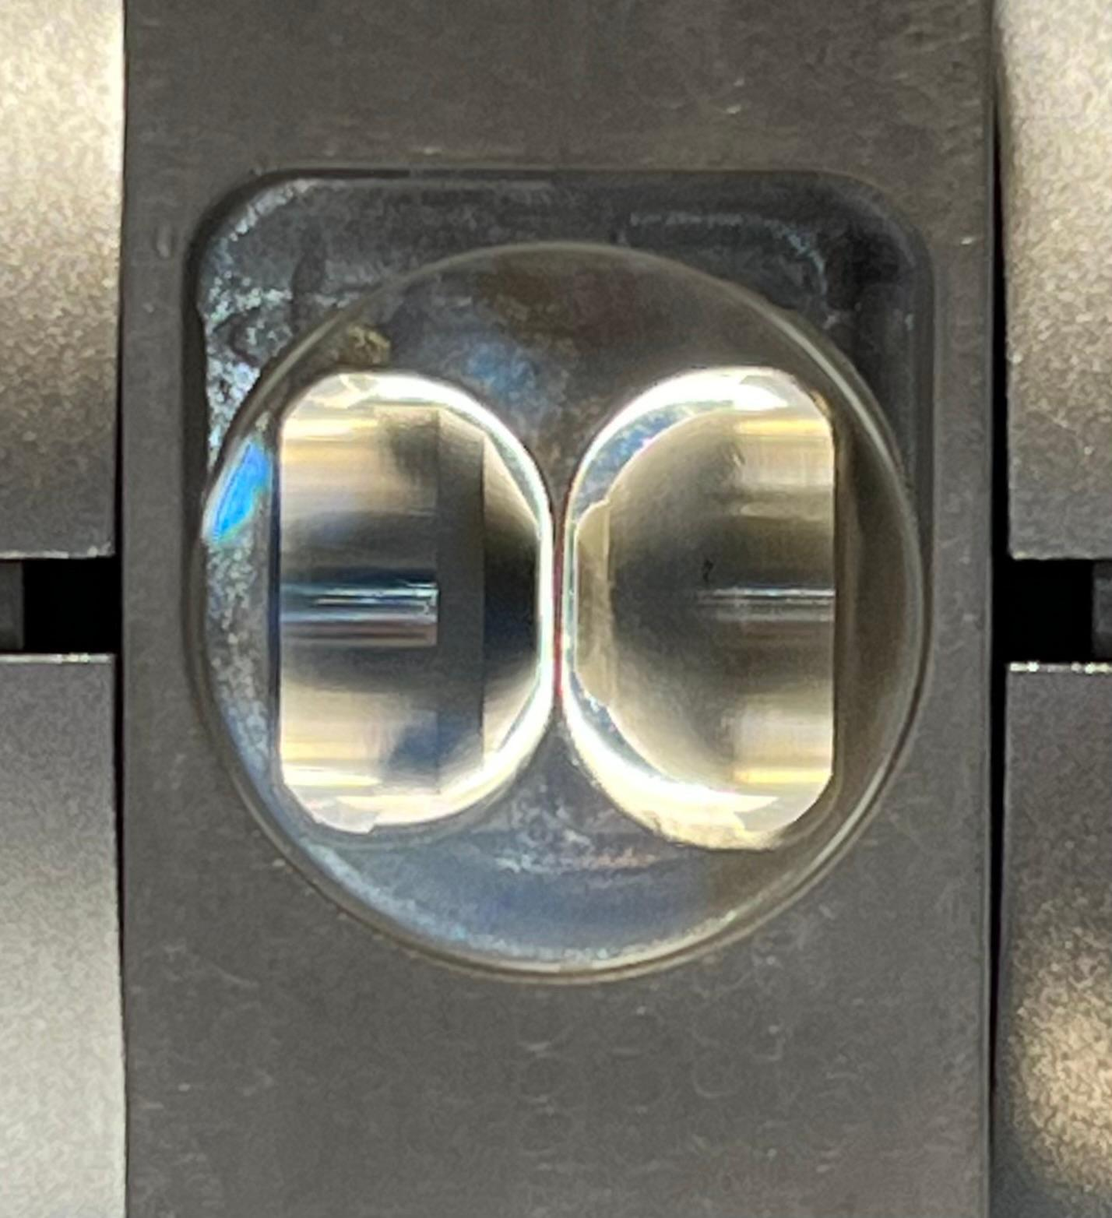
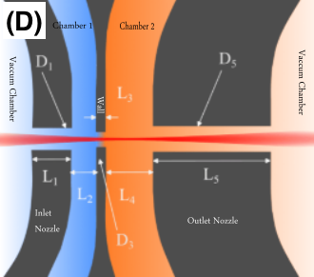
The Plasma Target
First Chamber : Injection Chamber. Mix of nitrogen with helium
Second Chamber : Acceleration Chamber. Pure helium.

Slide 14
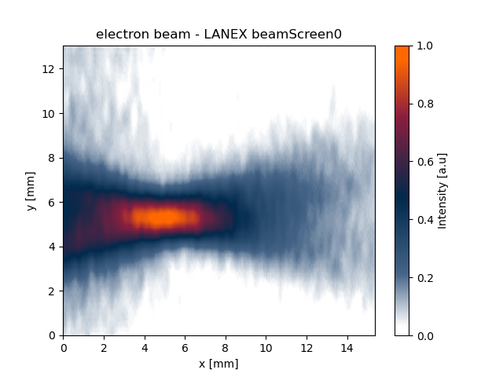
First Electrons 06/06/2025

Slide 15
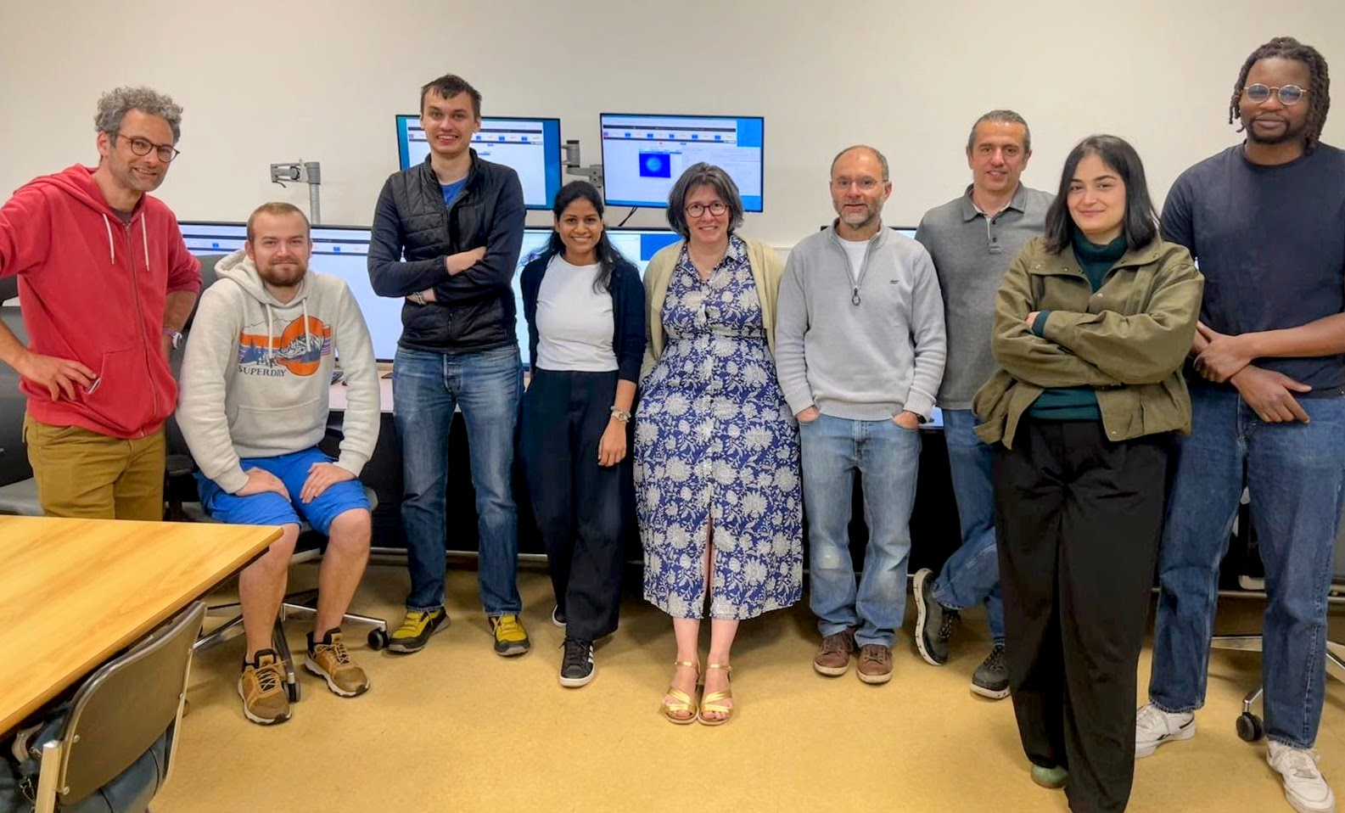
Conclusion
Laser-plasma test facility for advancing high-quality electron beams.
Focus on laser stabilisation, plasma targets, and beam control for reliable, reproducible operation.
Flexible beamline design for diverse tests and rapid optimisation.
Commissioning has started — first electron beams done! 🚀

