Slide 1
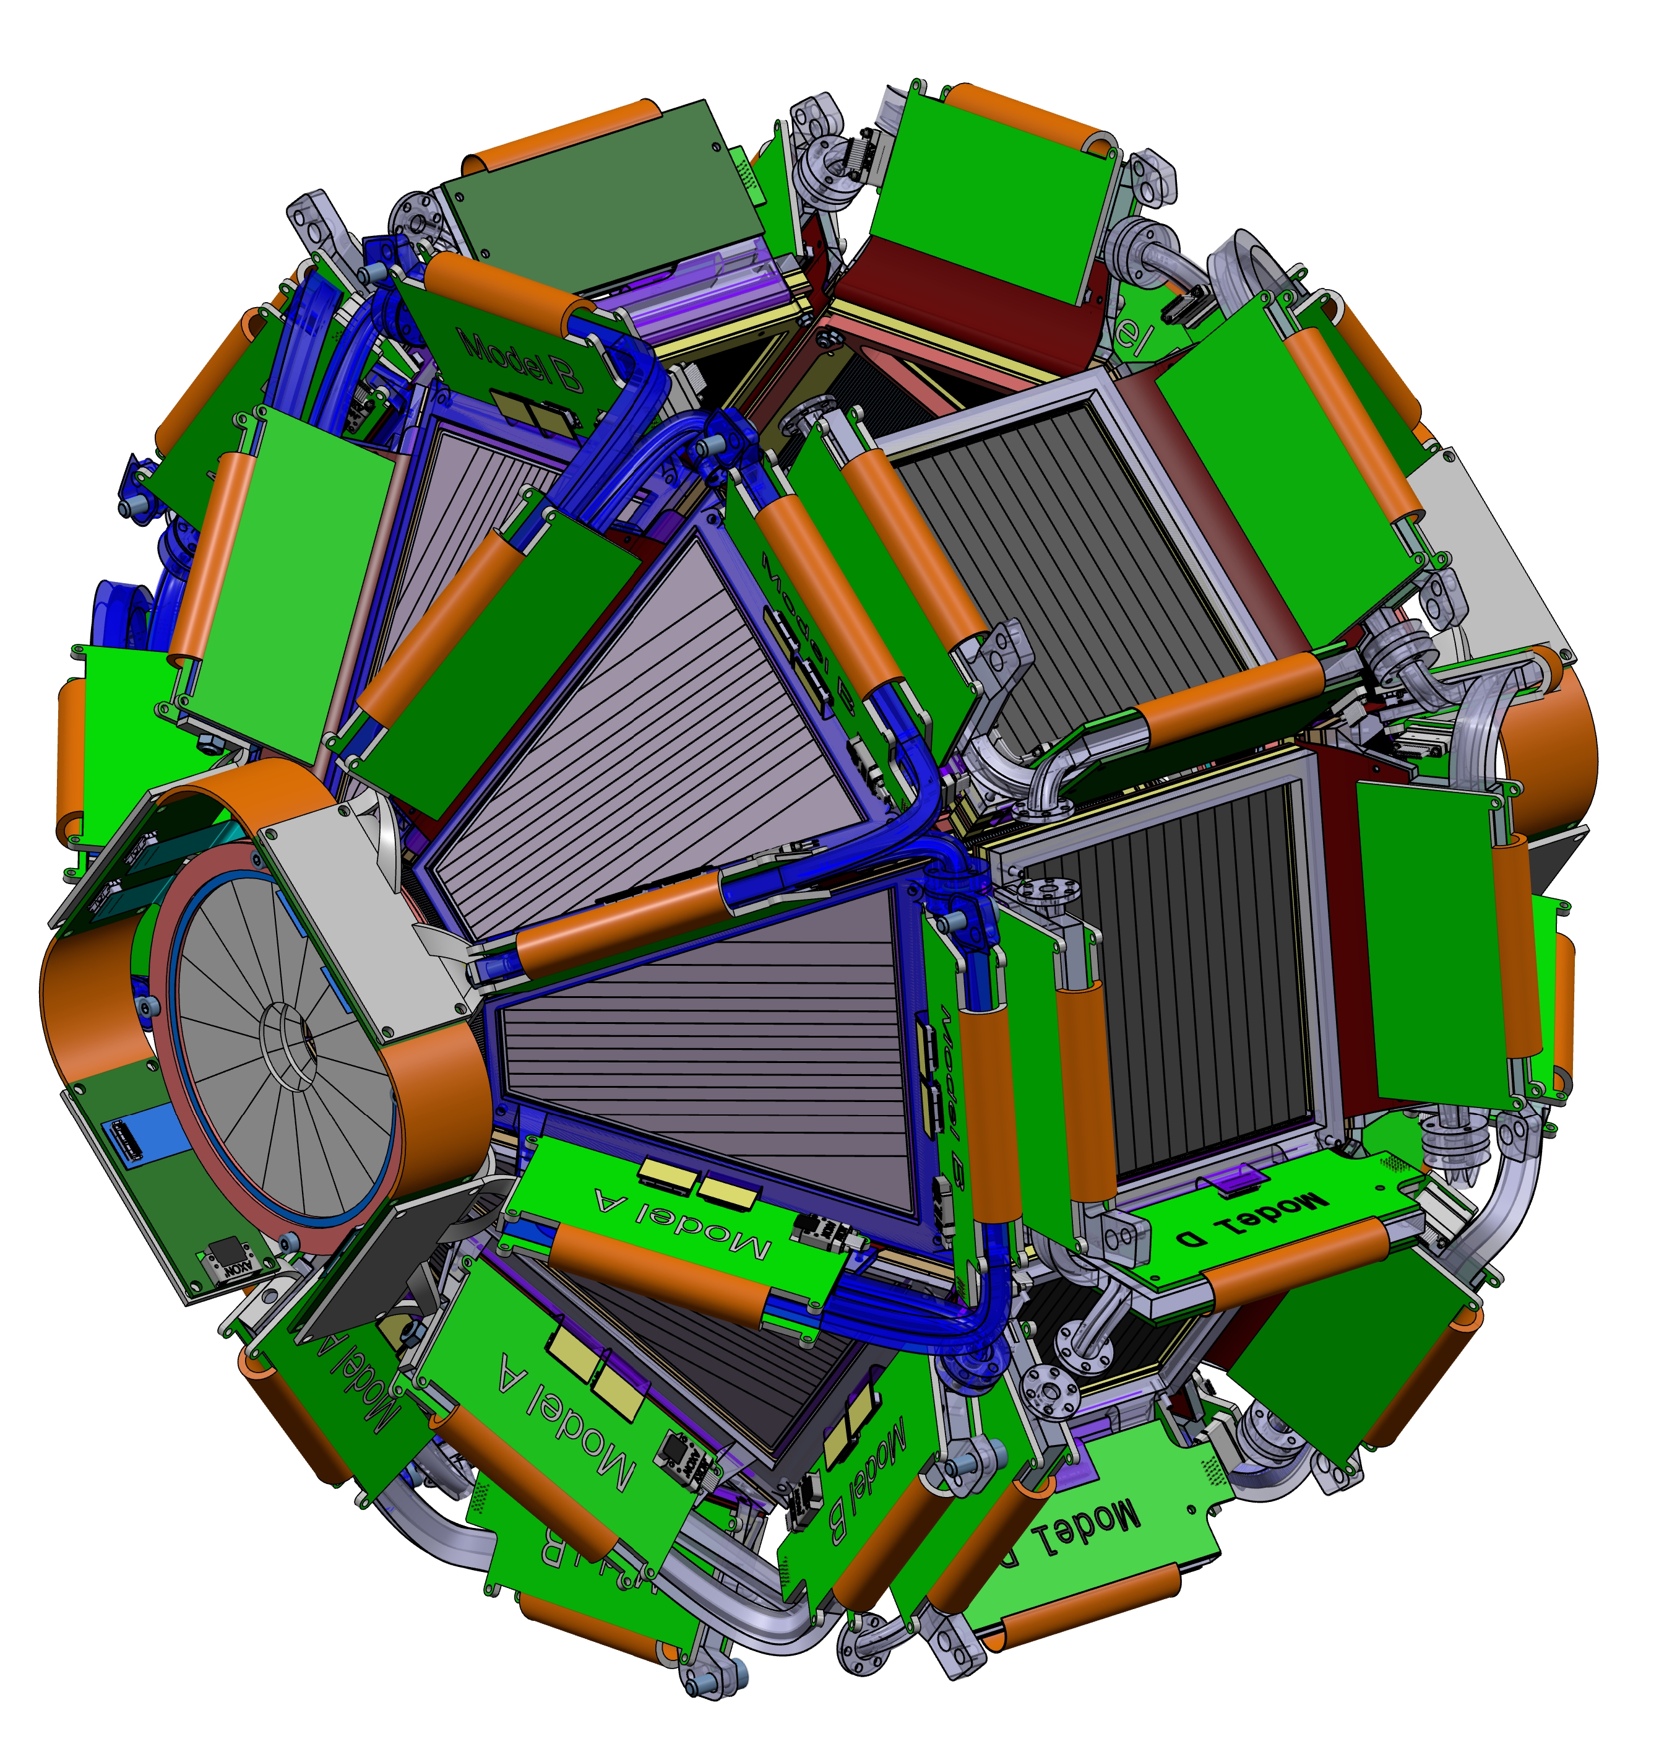
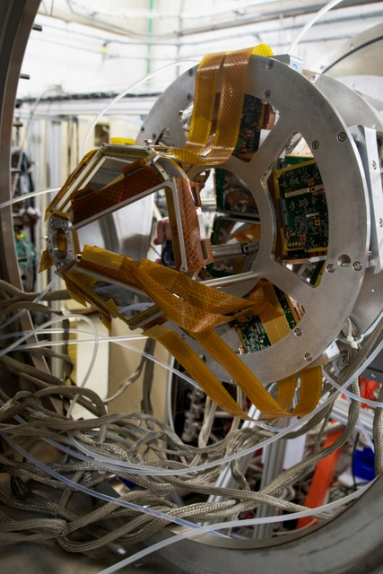
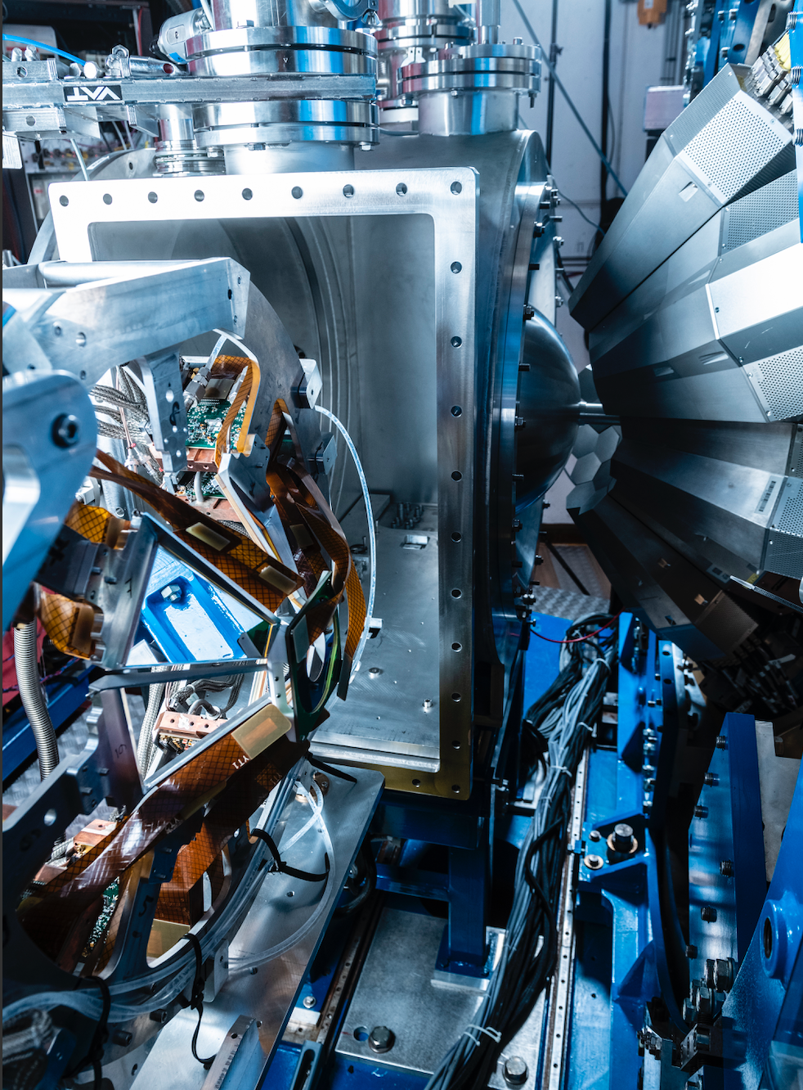
GRIT-MUGAST
Marlène Assié,
D. Beaumel, Valérian Girard-Alcindor,
IJCLab
©CEA/P.Stroppa

Slide 2

MUGAST campaigns

Slide 3
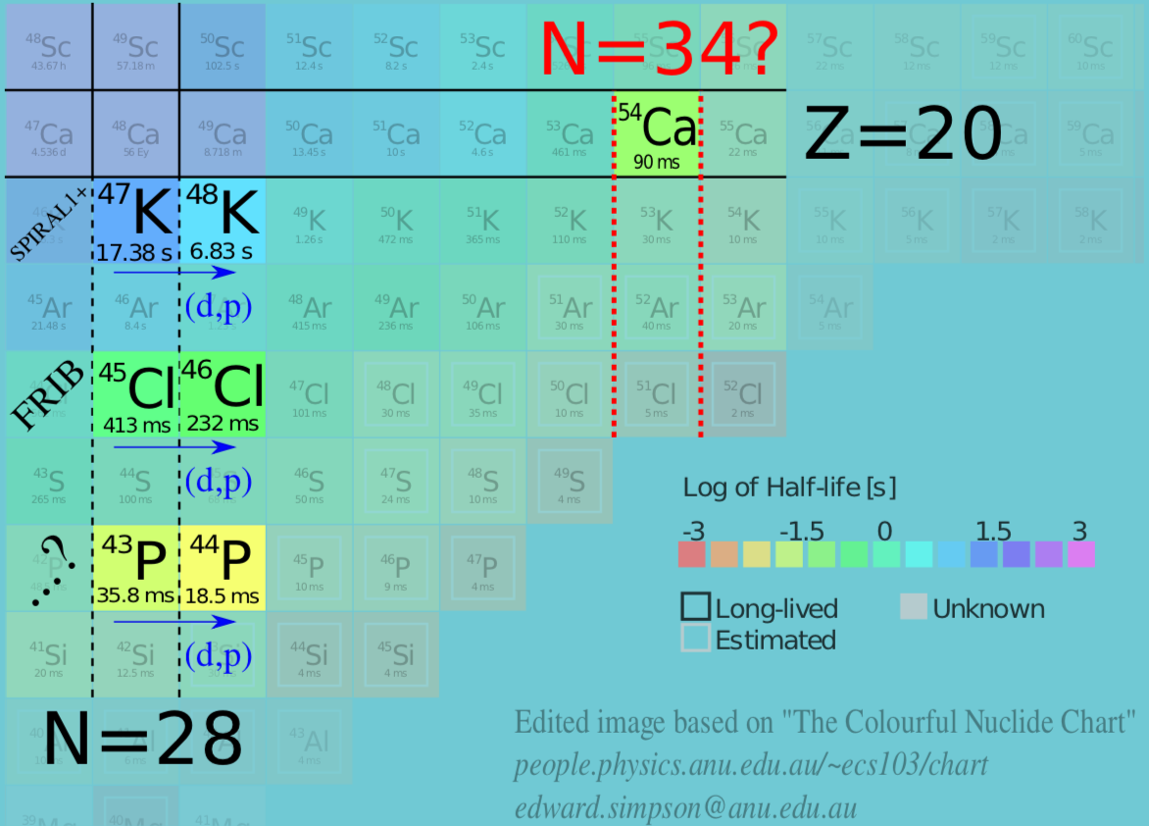
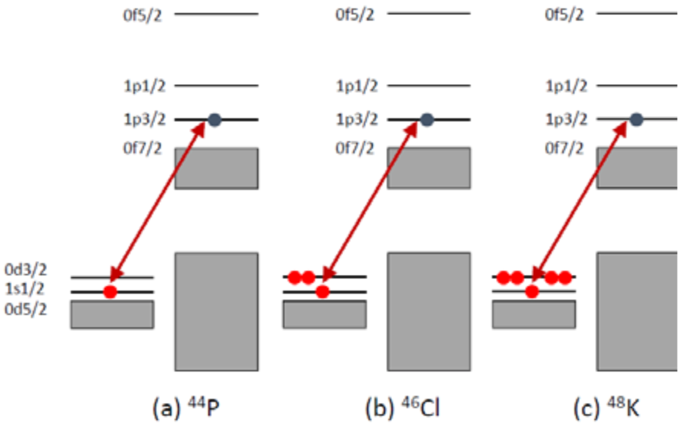
Recent highlights from MUGAST-AGATA-VAMOS campaign: study of ⁴⁷K(d,pg)
C.J.Paxman et al., Phys.Rev.Lett. 134,162504 (2025)
N=34 magic number in ⁵⁴Ca related to a significant gap between p_{1/2} and f_{5/2} orbitals
→ study of the interaction between an odd-proton below Z=20 and an odd neutron above N=28

Slide 4
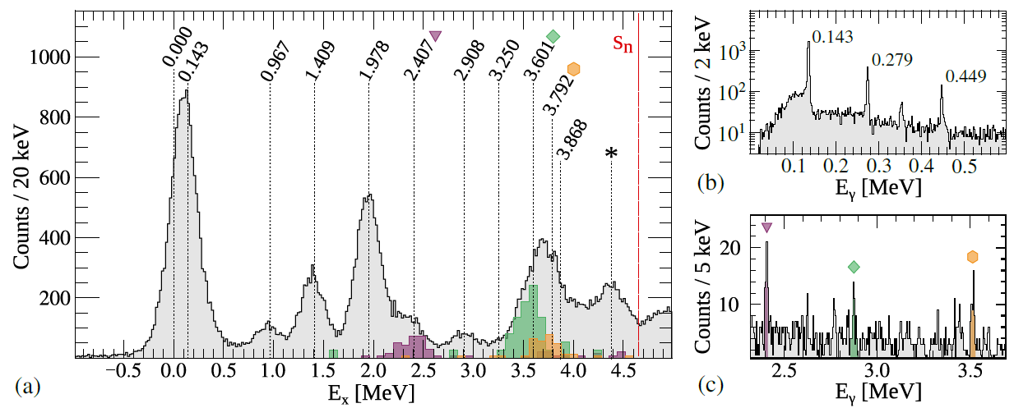
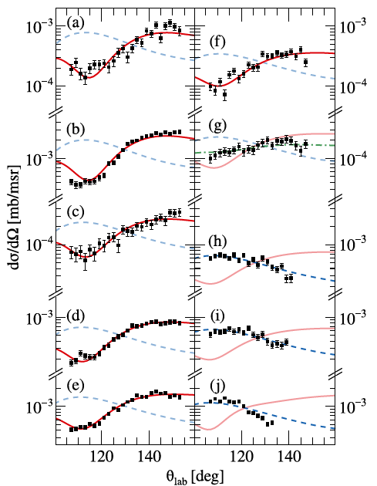
Recent highlights from MUGAST-AGATA-VAMOS campaign: study of ⁴⁷K(d,pg)
C.J.Paxman et al., Phys.Rev.Lett. 134,162504 (2025)
Detailed spectroscopy of populated states in ⁴⁸K
--> 9 new bound states uniquely identified
Benchmark for the πs_{1/2} – νfp interactions
→ adjustment of matrix elements
→ accurate predictions around N-28 e.g. ⁴⁴S
Spectros. Factors smaller than predictions
call for further investigations of proton shells

Slide 5
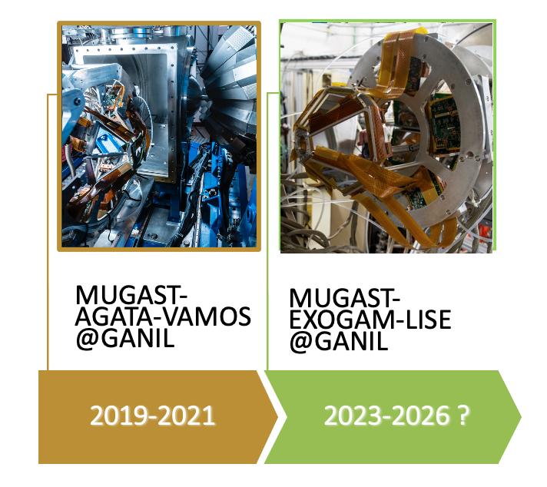
MUGAST timeline
Today

Slide 6
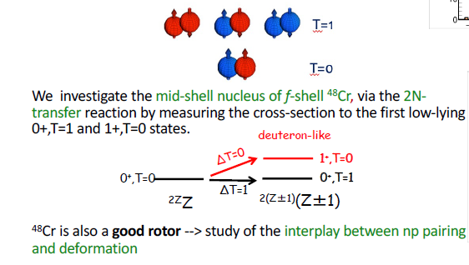
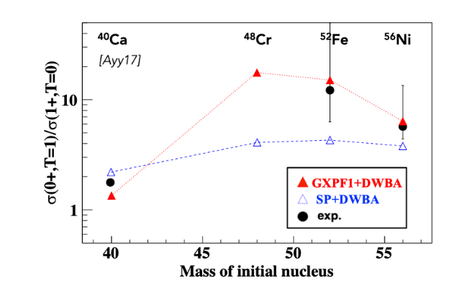
Recent highlights from MUGAST@LISE: np pairing and deformation
PRELIMINARY
H.Jacob , INPC 2025
Today

Slide 7
MUGAST@LISE physics program
Commissioning of the campaign
PAIRING : How does deformation influence neutron-proton pairing?
Study of ⁴⁸Cr(p,³Heγ)⁴⁶V
SHELL MODEL
Study of ⁶⁸Ni by neutron adding and removing reactions
2023
M.A. V. G-A (IJCLab)
M. Assié (IJCLab)
S. Koyama, O. Sorlin (GANIL)
PhD : H. Jacob
Post-doc : O. Atkas + P. Sharma
SHELL MODEL
Evolution of the neutron 1d_{3/2}-1d_{5/2} spin-orbit splitting at N = 19 and Fermi surface in ³⁴Si
CLUSTERING
Cluster structure of the g.s.of light exotic nuclei beyond alpha-clustering
2024
F. Galtarossa (INFN-LNL) ,O. Sorlin (GANIL)
V. Girard-Alcindor, D. Beaumel (IJCLAB)
PhD: Raquel Nicolas del Alamo
PhD : Tania Zanatta-Martinez
SHELL MODEL
Evolution of the neutron 1d_{3/2}-1d_{5/2} spin-orbit splitting at N = 19 and Fermi surface in ³⁴Si
CLUSTERING
The tetra-neutron Isobaric Analog State in ⁴H : The case for the ⁶He(p,³He) reaction
2025
F. Galtarossa (INFN-LNL) ,O. Sorlin (GANIL)
A.O. Macchiavelli (ORNL), M. Assié (IJCLab)
PhD: Raquel Nicolas del Alamo
Post-doc : Q. Delignac
NUCLEAR ASTROPHYSICS
Determining the thermonuclear ¹⁸Ne(α,p)²¹Na reaction rate by measuring ⁷Li(¹⁸Ne,t)²²Mg(p)²¹Na
COMMISSIONING ZDD
End of MUGAST@LISE campaign
2026
C. Diget (U. York), N. de Séréville (IJCLab), L. Lalanne (IJCLab)
Post-doc : N. Giha

Slide 8
Budget request for 2026
Thèses/Post-docs en cours
AP MUGAST for 2026
Demande TGIR GANIL
MUGAST experiments in 2026 :
- 18 k€ for the experiment (N. de Séréville)
- 3 k€ for commissioning
- 6 k€ for preparing and dismounting set-up
Other experiments
  If C. Fougères-N. de Séréville experiment rescheduled : 3 k€
  If I. Stefan experiment is scheduled (to study exotic heavy nuclei produced via MNT) on VAMOS
  - 7 k€ to produce the ⁹⁶Zr target
  - 10 k€ for the participation to the experiment
-------------------------------------------------
TOTAL = 47 k€
T. Zanatta-Martinez (IJCLab) PhD --> started Nov. 2023
H. Jacob (IJCLab) PhD --> started Sept 2022
R.Nicolas del Alamo (INFN) PhD --> started Oct. 2023
P. Sharma (GANIL) PhD --> started Oct 2024
O. Atkas (GANIL) post-doc --> ended june 2025
L. Heitz (GANIL) post-doc --> to start Oct. 2025
N. Giha (IJCLab) post-doc --> started Oct 2024
Q. Delignac (IJCLab) post-doc --> to start 1st of July 2025
Publications
MUGAST (depuis 2023):
D. Brugnara et al, submitted to PRL
C. Paxmann et al, PRL 134,162504 (2025)
J-L Fuentes et al, accepted in PLB (2025)
I. Zanon et al, PRL (2023)
L. Lalanne et al, PRL (2023)

Slide 9
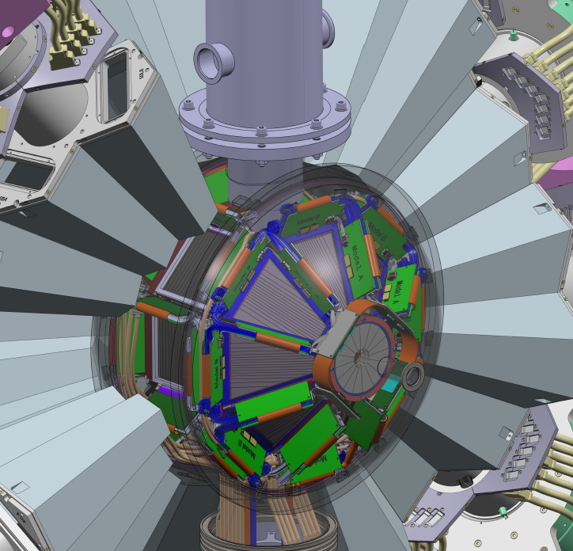
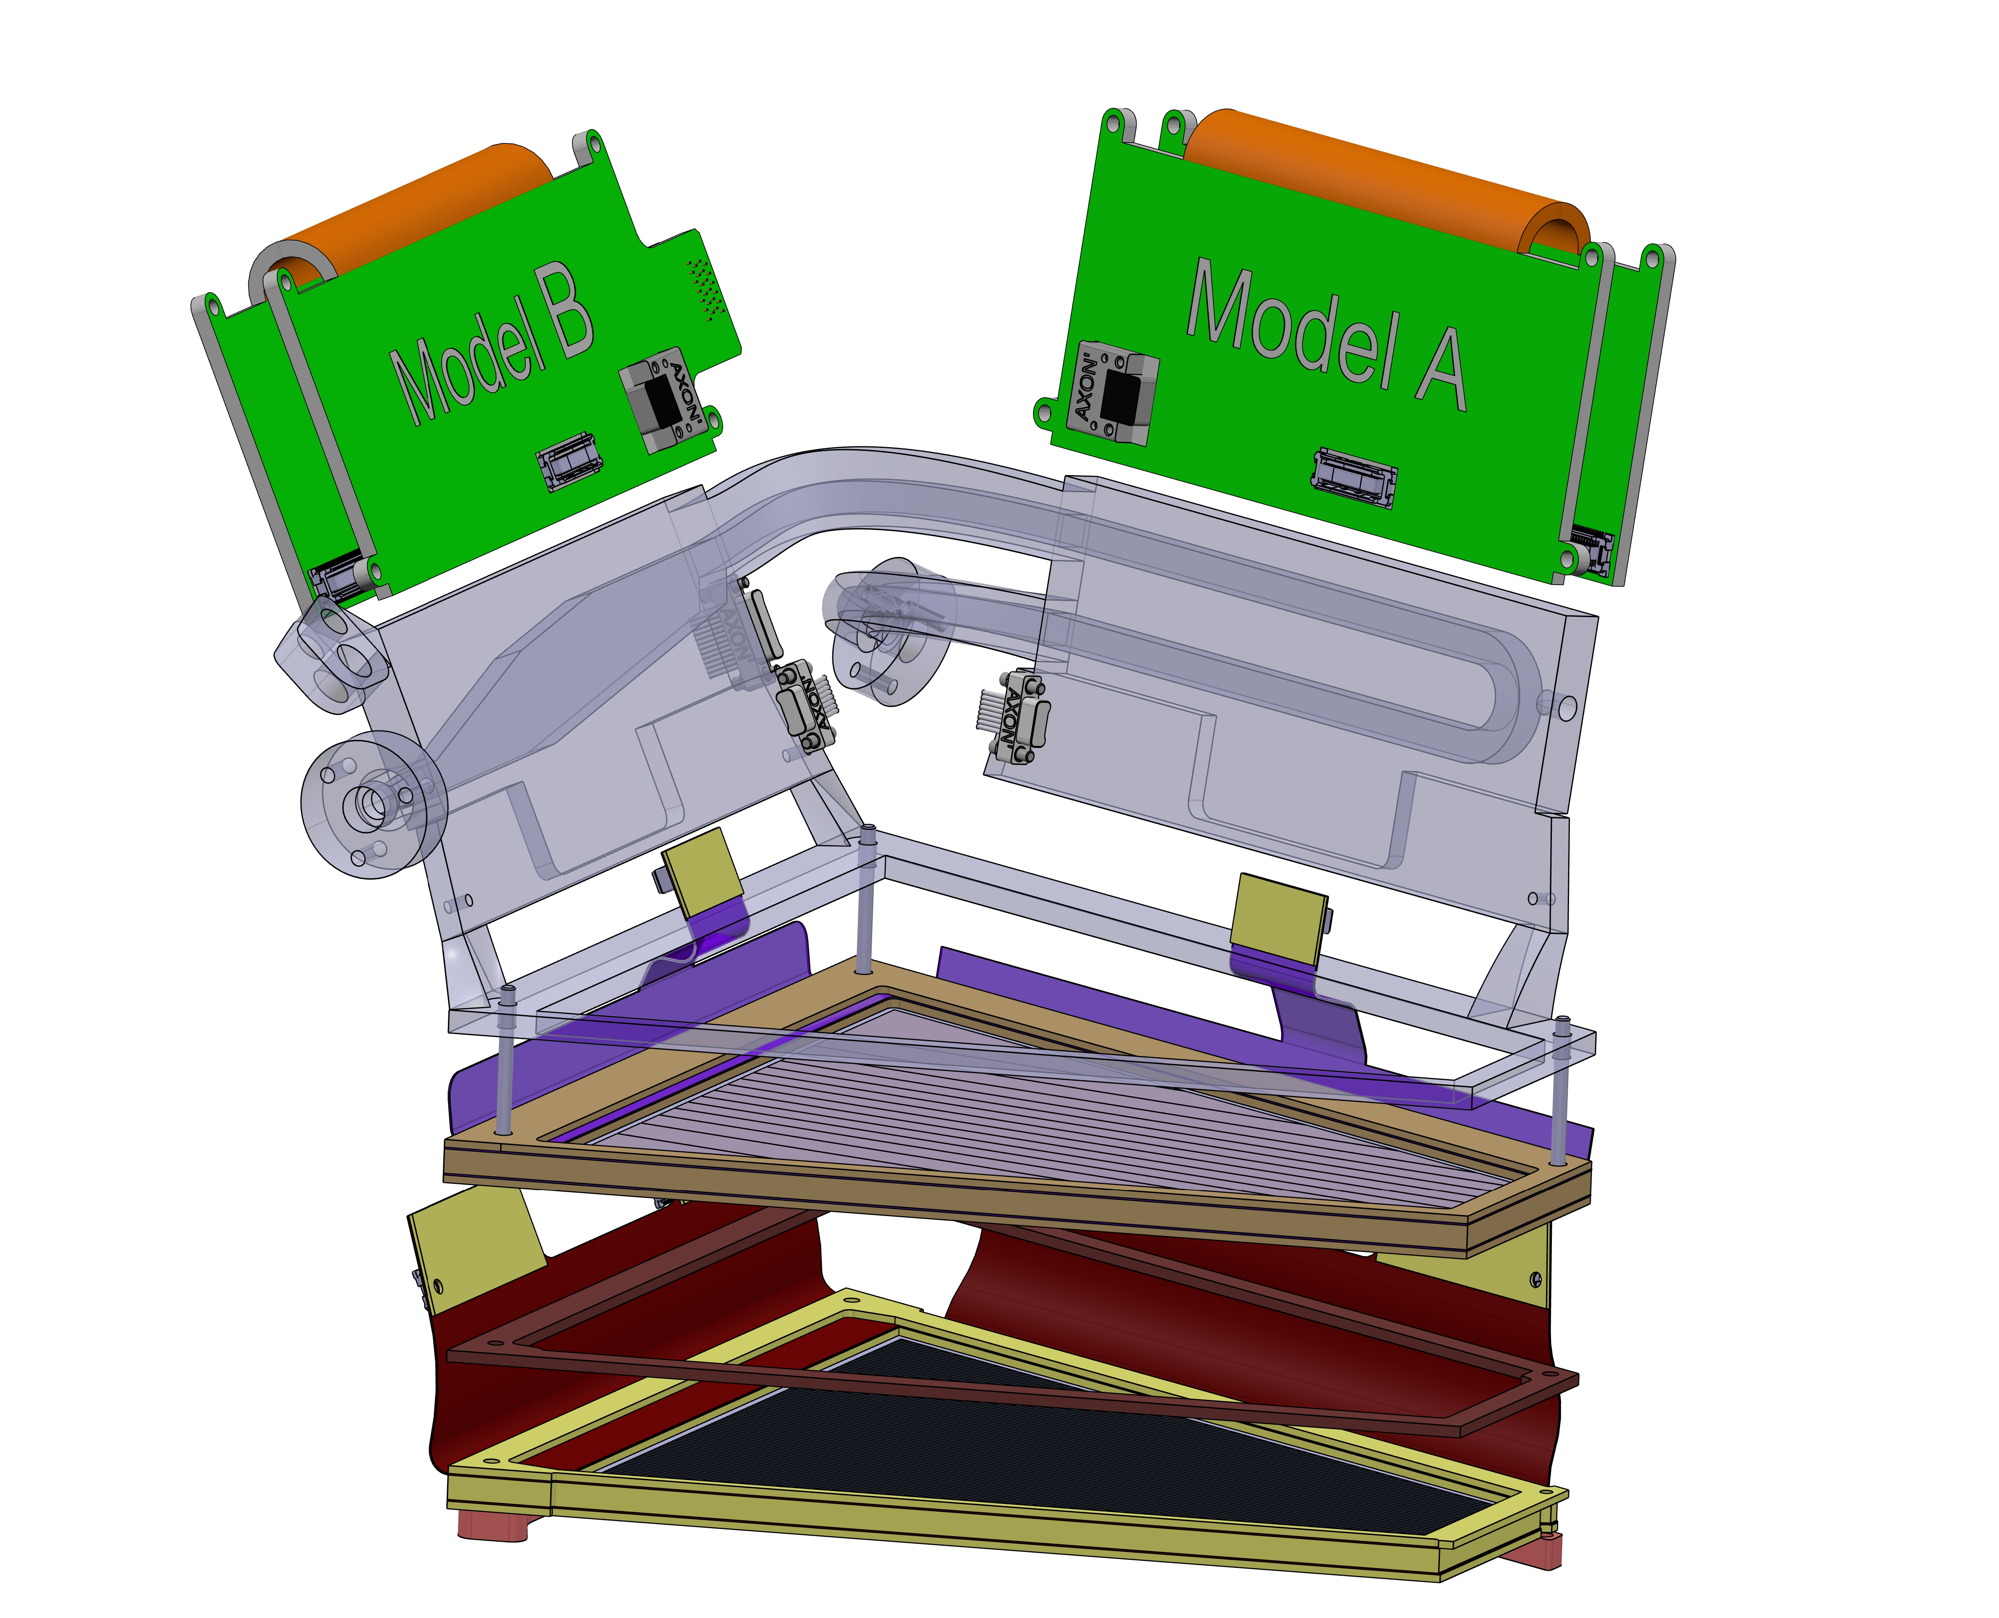
The GRIT array
2019
2020
Granularity, Resolution, Identification, Transparency
2025
2021
2022
2023
2024
High efficiency for particles
High granularity (strip pitch < 0.8 mm)
Large dynamical range
PID using Pulse Shape Analysis techniques
New Integrated Digital electronics
developed by LPC Caen, INFN, Valencia, IJCLab
Integration into AGATA (radius=23 cm)
transparency to gamma-rays
high compacity
Special targets : cryogenic, tritium, …
  500 um DSSD pitch < 0.8 mm
  1.5 mm DSSD pitch ~6mm
DETECTORS
Layers of Silicon
ELECTRONICS
MECHANICS
2019 ~ 2030 GANIL campaign with Phase0
2031 ~ SPES campaign with full GRIT

Slide 10
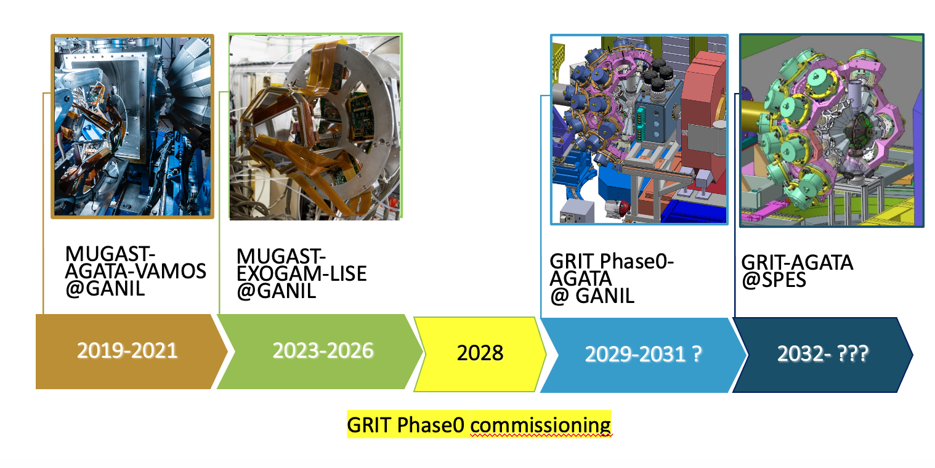
GRIT-MUGAST timeline
Today

Slide 11
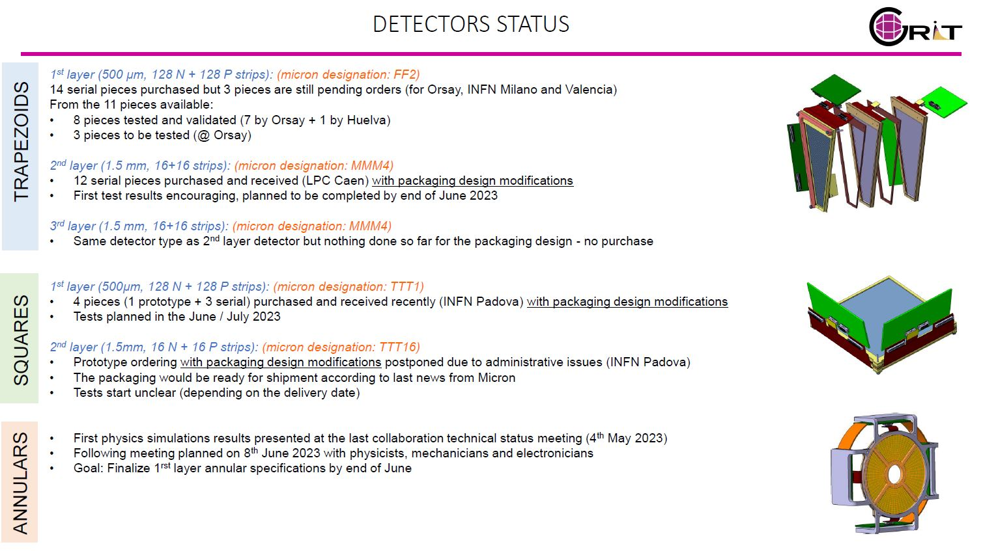
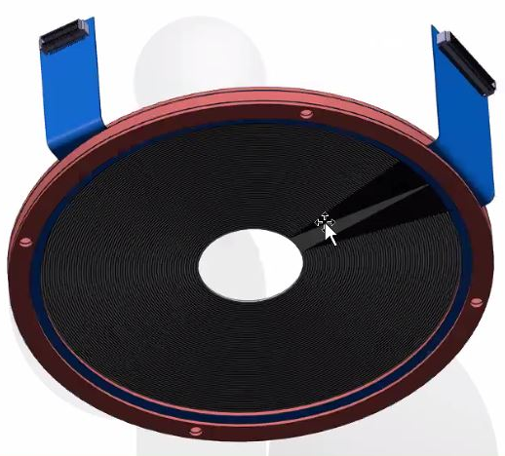
The GRIT array: Detectors
2019
2020
Granularity, Resolution, Identification, Transparency
2025
2021
2022
2023
2024
High efficiency for particles
High granularity (strip pitch < 0.8 mm)
  500 um DSSD pitch < 0.8 mm
  1.5 mm DSSD pitch ~6mm
DETECTORS
Layers of Silicon
To be purchased :
Thick annular (design to be validated by Micron)
Thick square + spare detectors

Slide 12
The GRIT array: FEE
2019
2020
Granularity, Resolution, Identification, Transparency
2025
2021
2022
2023
2024
Developments within the collaboration
Preamplifier ASICs for the first and the second stage (INFN Milano & LPC Caen)
Analog memory ASICs named PLAS (LPC Caen)
180nm techno from XFAB founder, 200 Mhz sampling, 224 samples (32 pre-trigger)
Front-end board for trapeze&square and for annular detectors (Padova univ. )
ELECTRONICS

Slide 13

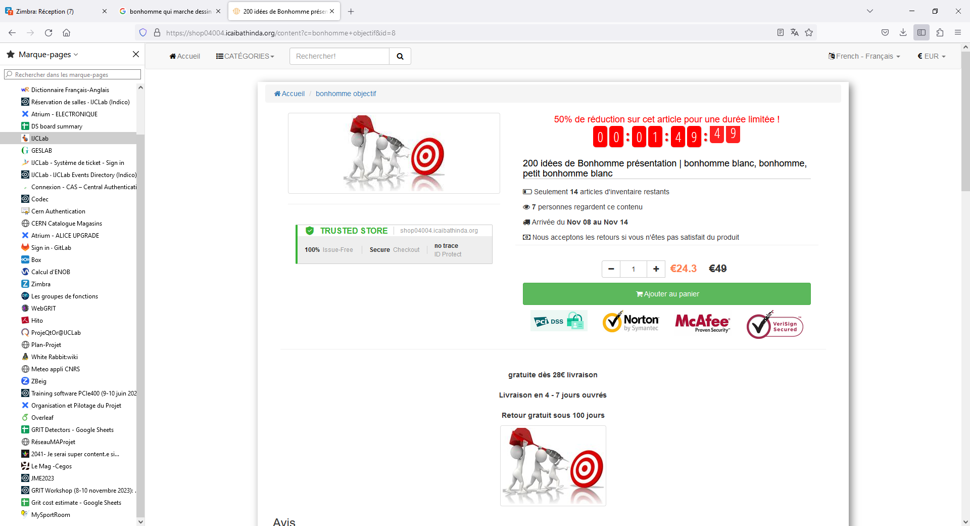
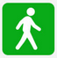
MAIN COMPLETION GOALS TIMELINE FOR PHASE 0
Ch. Soulet
Bricks preparation :
Vacuum chamber tested & validated
ASICs tested and validated
FEB test boards (all types) designed
FEBs boards for first trapezoid telescope available for test with back-end
FASTER FMC board available for test
All AXON (internal / external) cables manufactured
Safety controller (for cooling, vacuum and PS monitoring) software developed
WP2: Mechanics
Pre-studies :
Annular simulations finalised (2nd stage)
Outgassing and vacuum tests completed
MCC2SA preamplifier tests (beam + generator)
Front-end boards (FEBs) PCB feasibility done
WP3: Electronics
WP1: Detectors
WP3: Electronics
WP2: Mechanics
WP3: Electronics
WP3: Electronics
WP4: Back-end / DAQ
WP3: Electronics
WP4: Back-end / DAQ
Coupling / integration
Milestone 1: 31/07/2025
Milestone 3: 30/09/2027
2024
2025
2026
2027
2028
Milestone 2: 18/08/2026
Milestone 4: 01/09/2028
Here we are !
Ready for Phase0
commissioning
Ready for “tape out” :
Annular detectors (1st / 2nd stages) design completed
Vacuum chamber study finalised
ASICs submission (16-ch CSA, TOTv3, PLASv3)
FEBs design (all board types) finalised
FASTER / SMART coupling test @ GANIL done (tbc)
FMC board for FASTER (interfacing with FEBs) designed
All-in-one :
Chamber mechanical support available
PLAS on board calibration procedure completed
FEBs / back-end coupling tests with generator (pipelined)
Telescope integration in chamber & coupling with back-end
6 trapezoid telescopes (with 2 layers) tested with source
WP1: Detectors
WP2: Mechanics
WP2: Mechanics
WP3: FE electronics
WP3: Electronics
Coupling / integration
WP3: Electronics
Coupling / integration
WP4: Back-end / DAQ
Coupling / integration
WP4: Back-end / DAQ

Slide 14
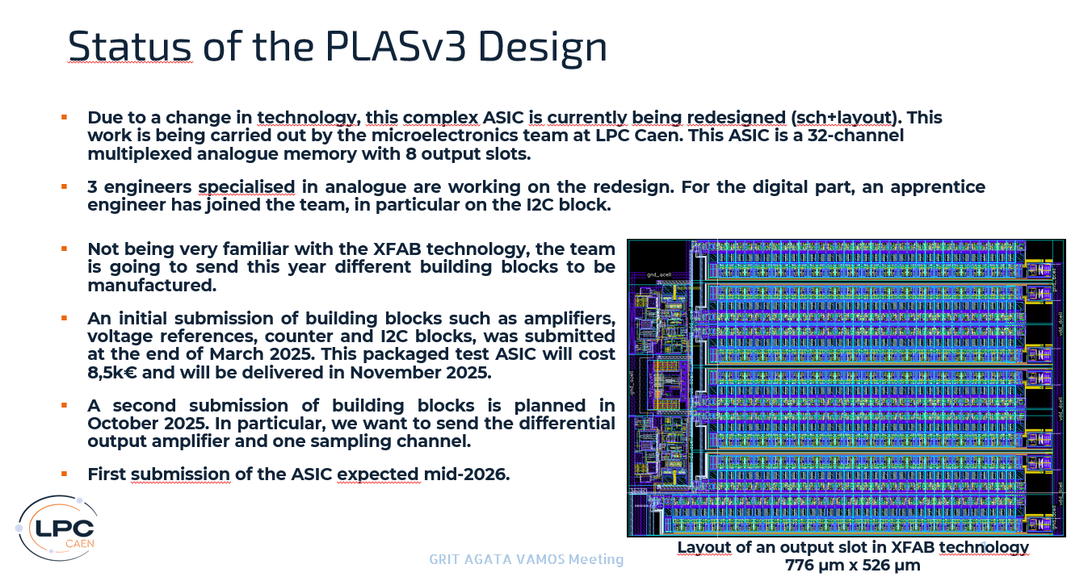
S.Drouet

Slide 15
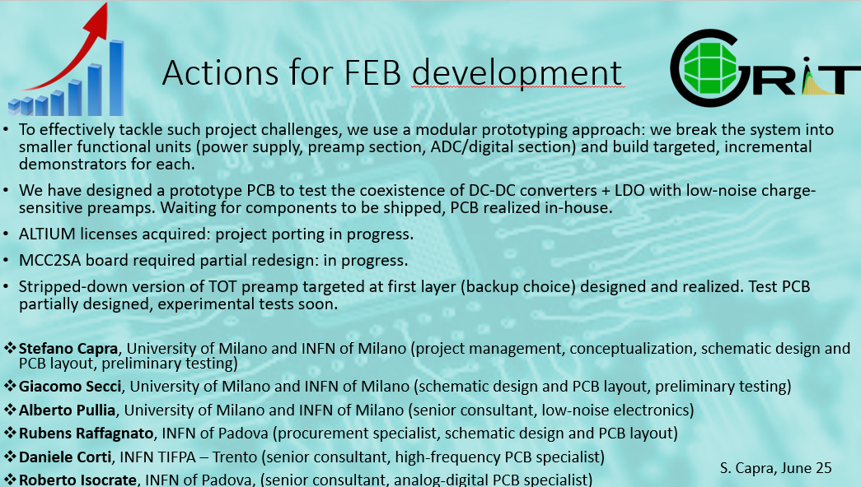

Slide 16
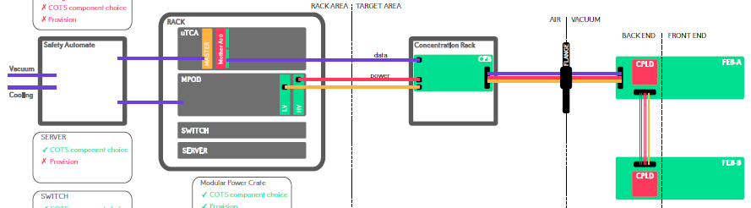
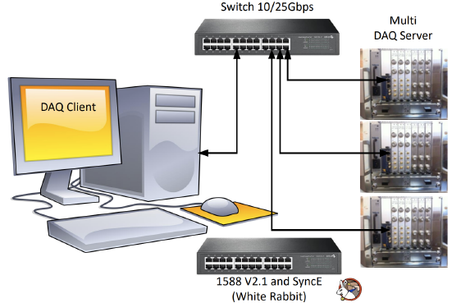
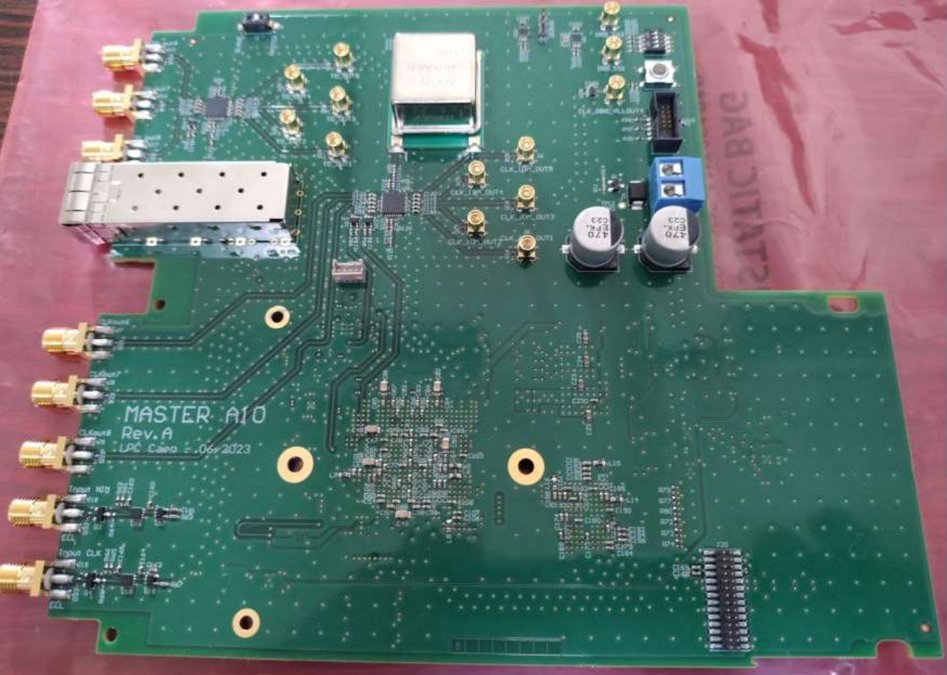
GRIT Backend Electronics and DAQ
AIR
VACUUM
Master A10 board
(GANIL + LPC Caen)
DAQ system : FASTER V3
(LPC Caen)
- 10MHz/T0 Synchr.
distribu. (slv or Mst)
- SMART timestamp
distribution
- MCH interface/Eth
A.Matta

Slide 17
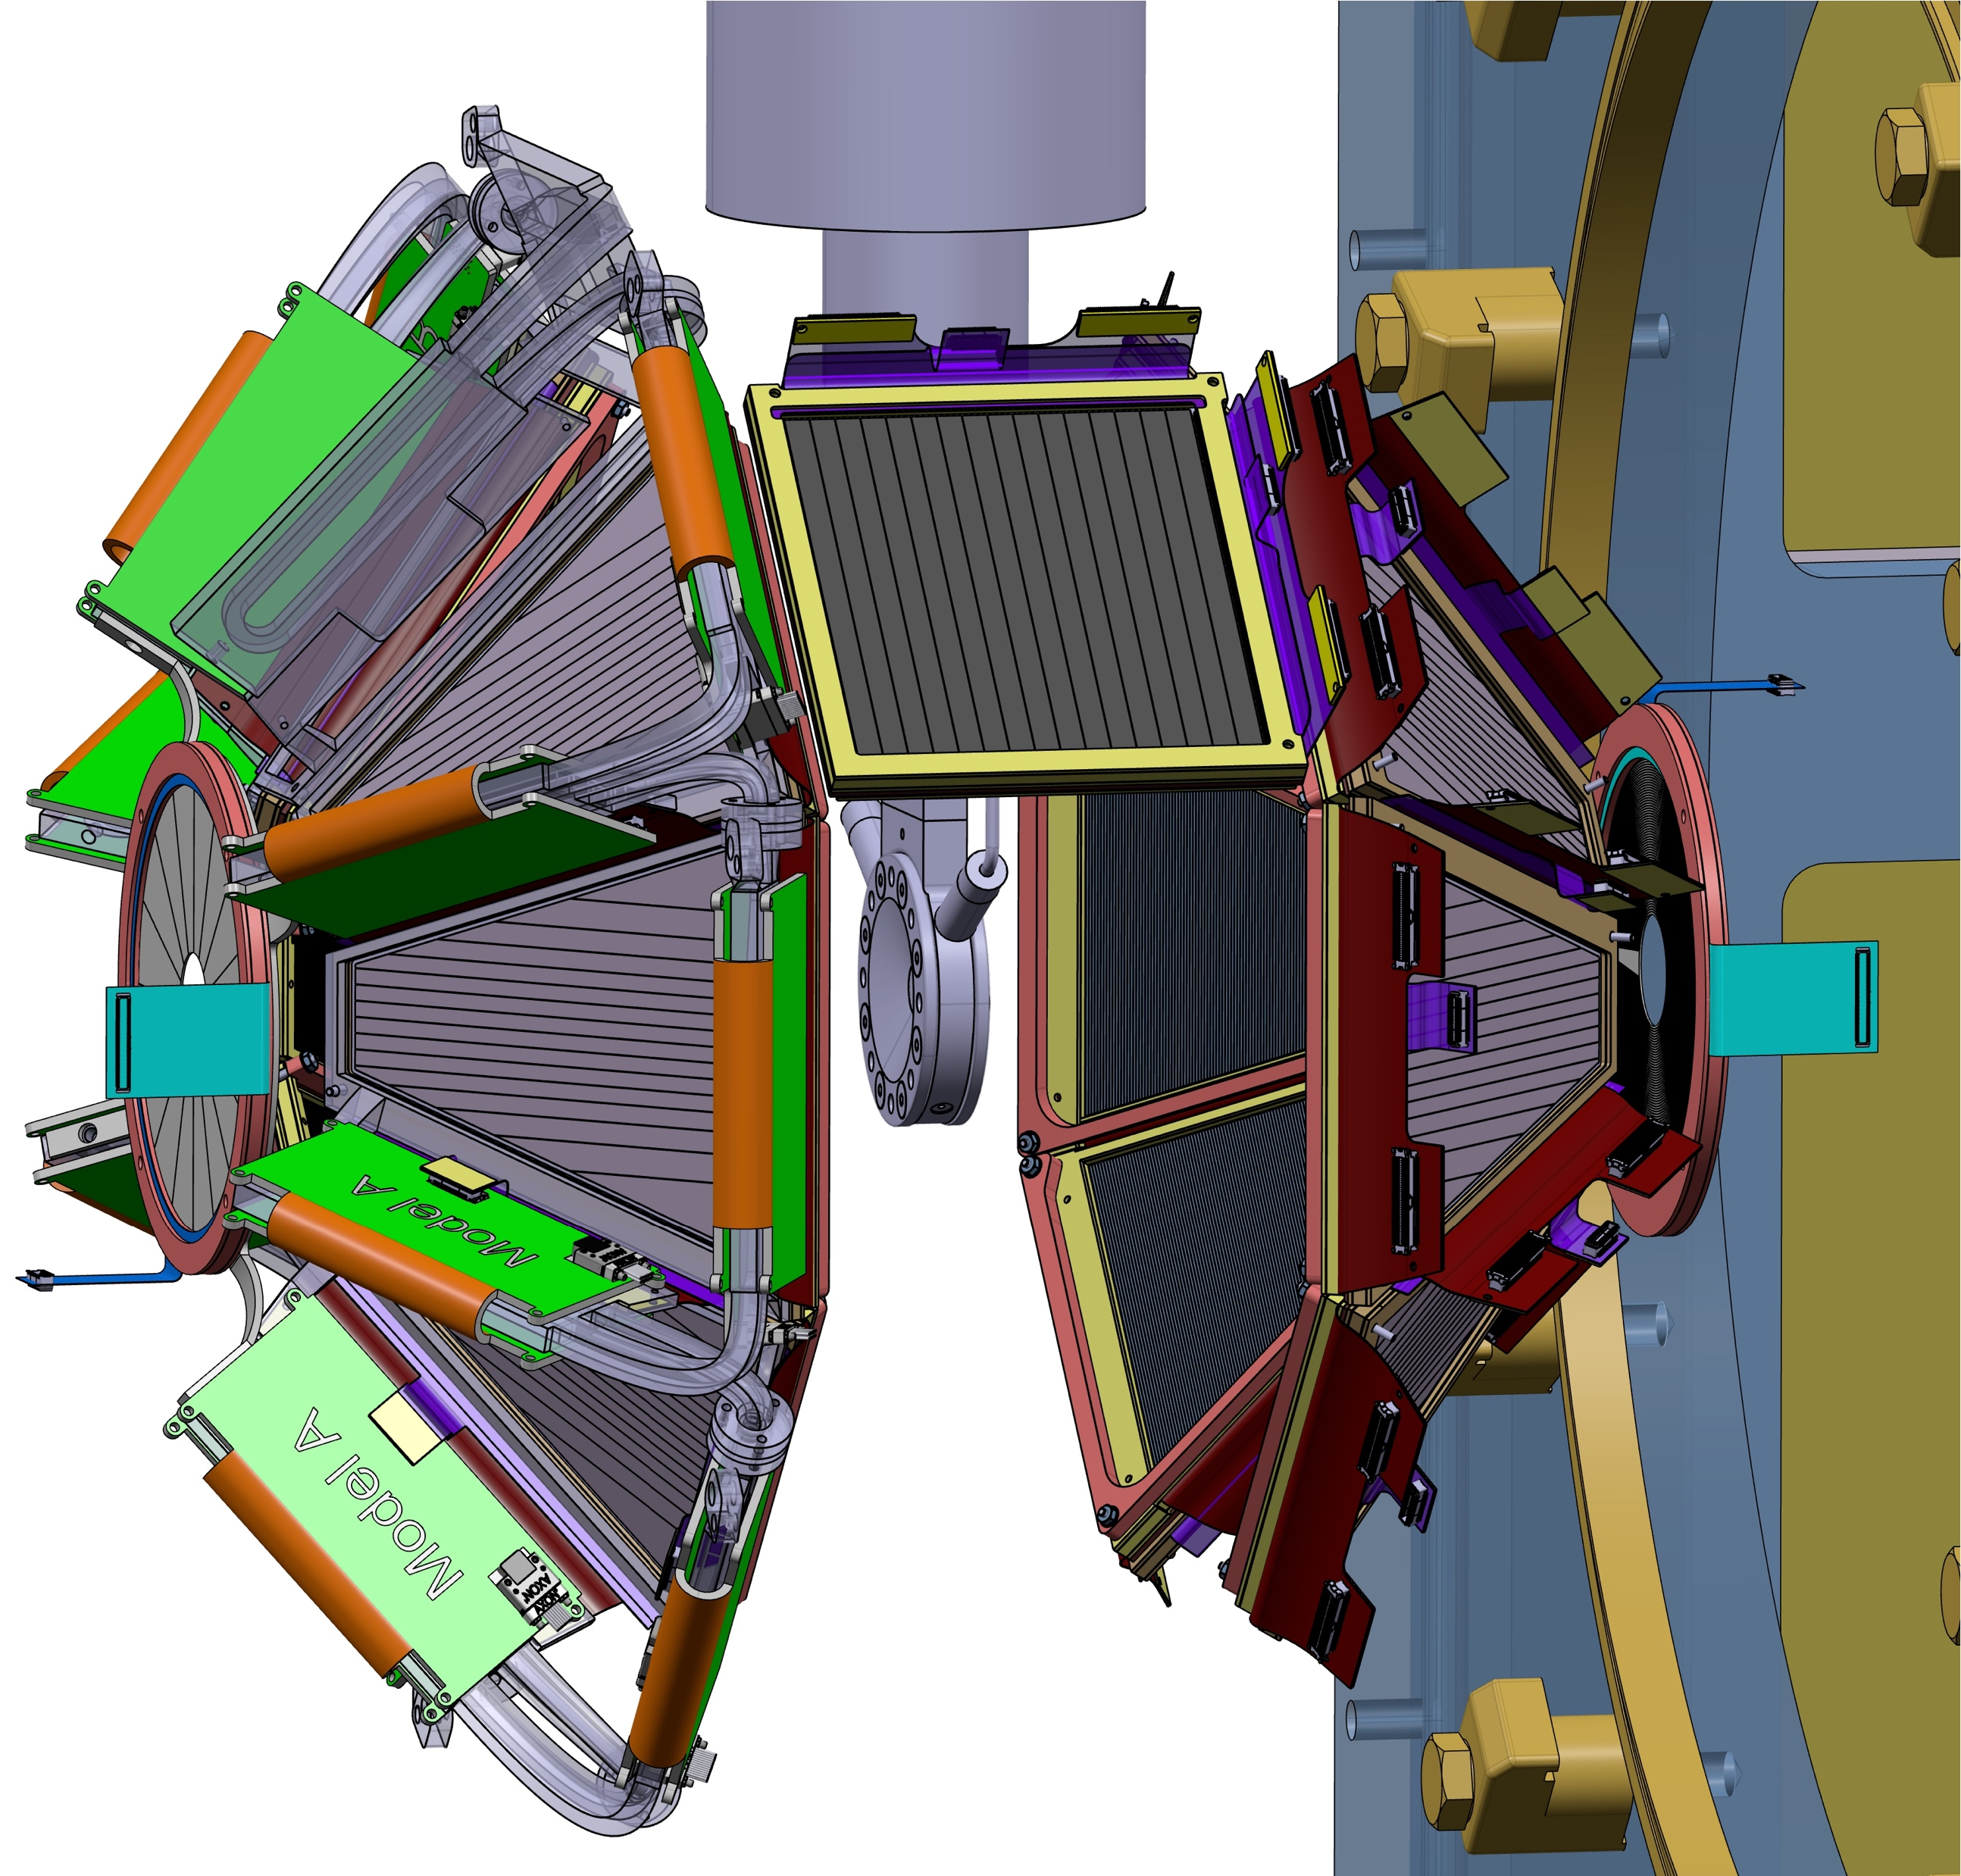
GRIT Phase 0 configuration
UPSTREAM (AGATA side)
90 degrees
DOWNSTREAM (VAMOS side)
1 square detector (1 or 2 stages ?)
read by Mesytec
Depending on Physics cases !
6 trapezoidal detectors (2 stages)
read by GRIT electronics (PLAS)
+ 1 annular detector (1stage)
read by Mesytec
Trapezoidal detectors (2 stages) and/or + 1 annular detector
read by Mesytec
1920 strips read by GRIT electronics)
Workshop GRIT-AGATA-VAMOS campaign (11-13 june):
-13 LoI, 20 reactions --> mostly focussed on stripping reactions (backward)
--> mostly with existing Spiral1 beams (5 new beam requests)
White book or Umbrella LoI to be written !

Slide 18
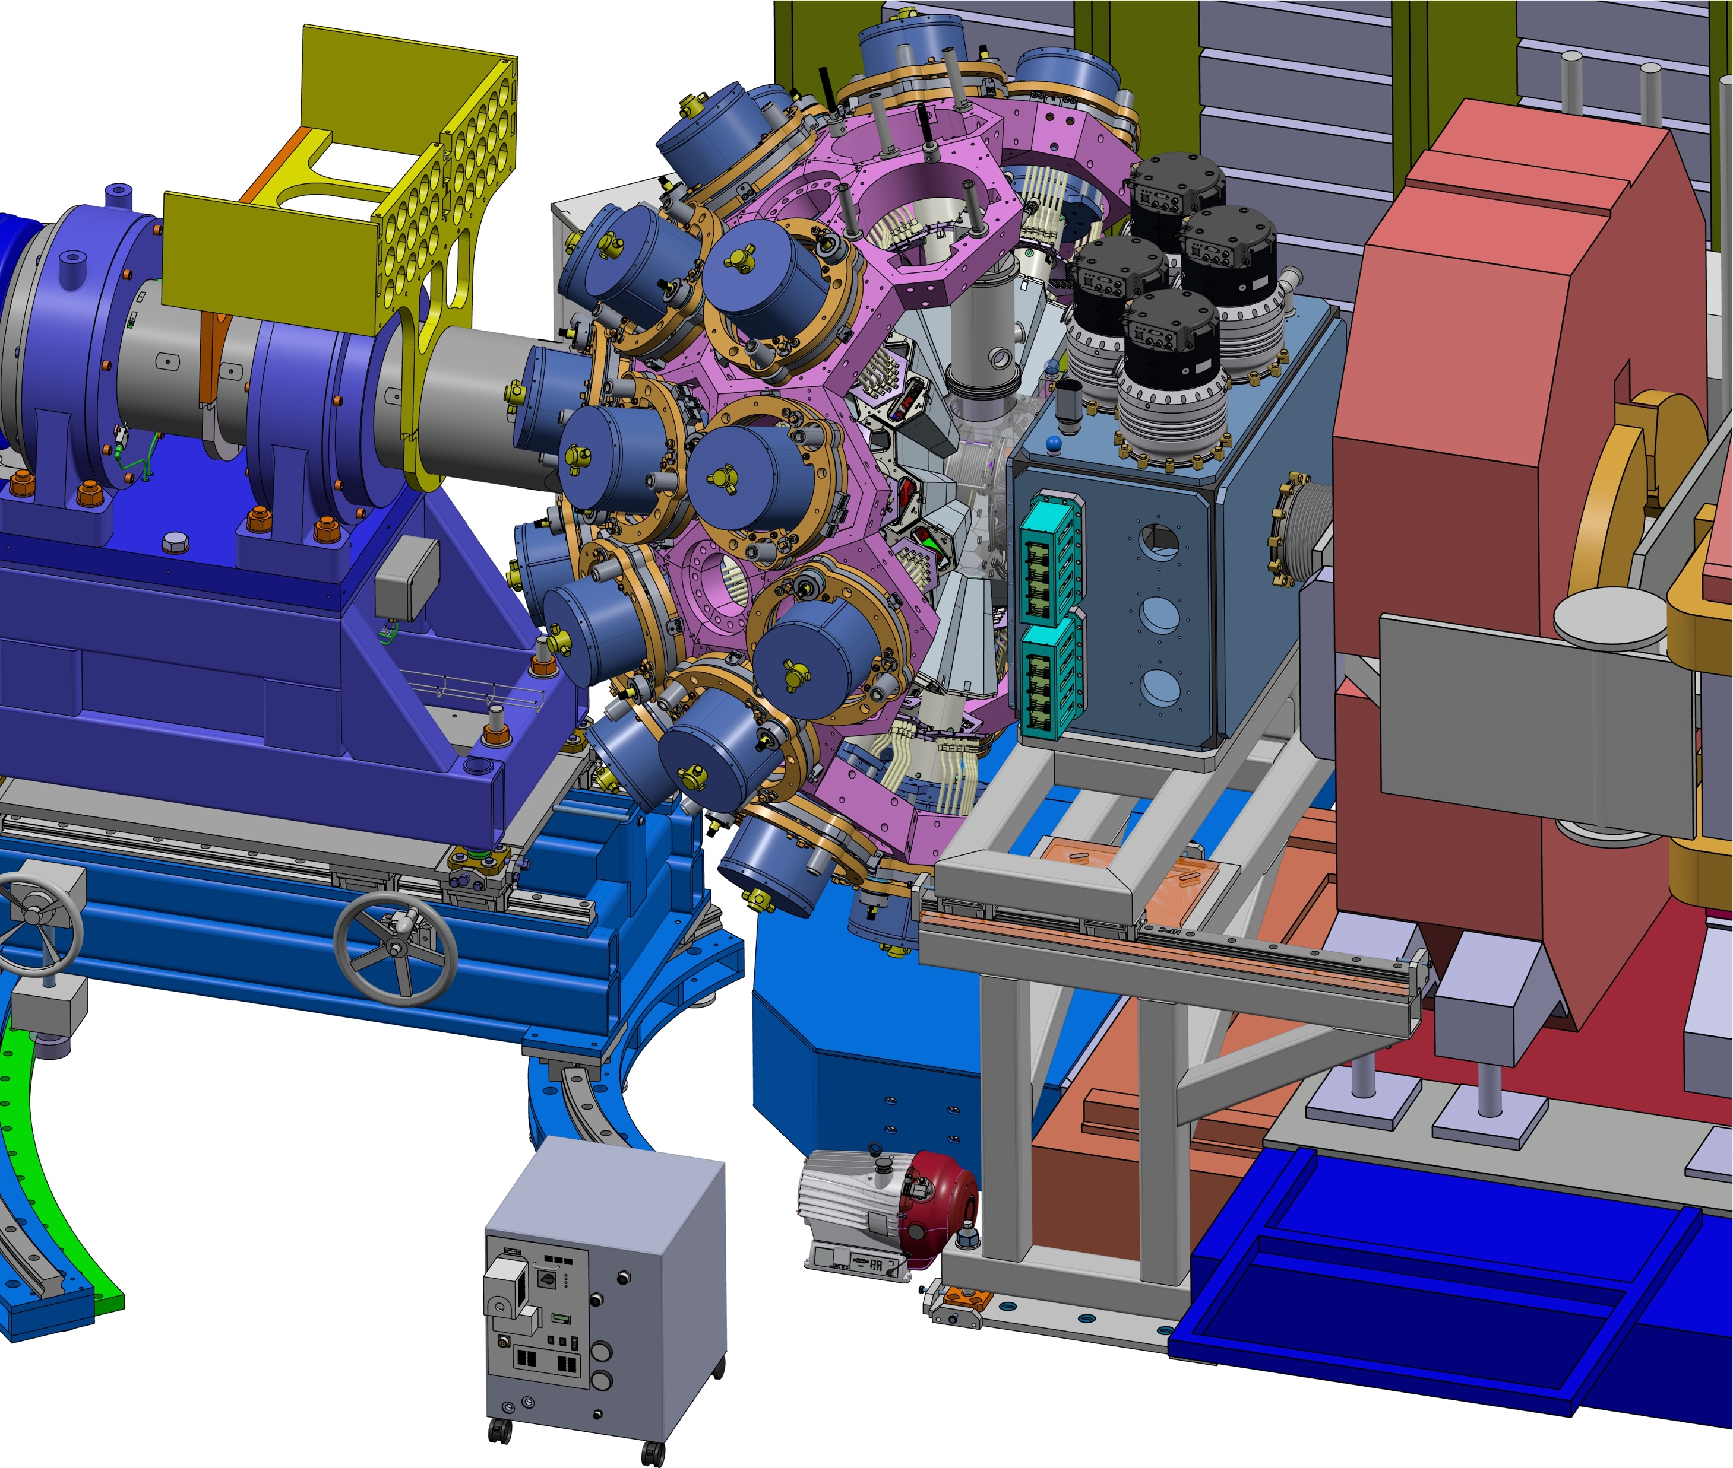
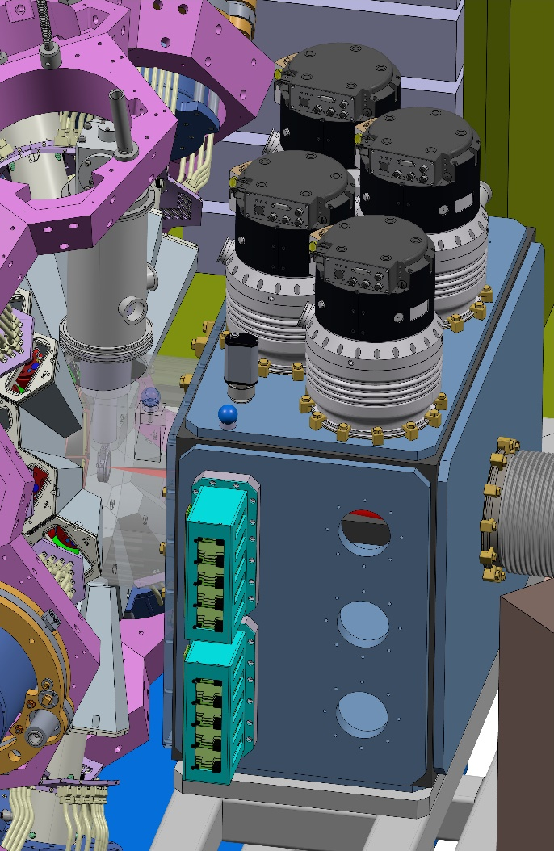
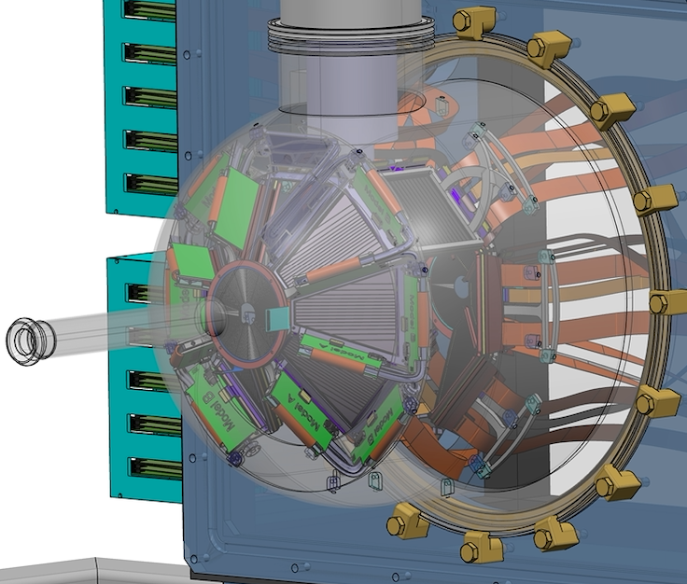
General view of GRIT Phase0 integration
Mechanical design for GRIT Phase0 (GANIL campaign)
3 mm Al main chamber
Utility chamber : vacuum, feedthroughs, electornics

Slide 19
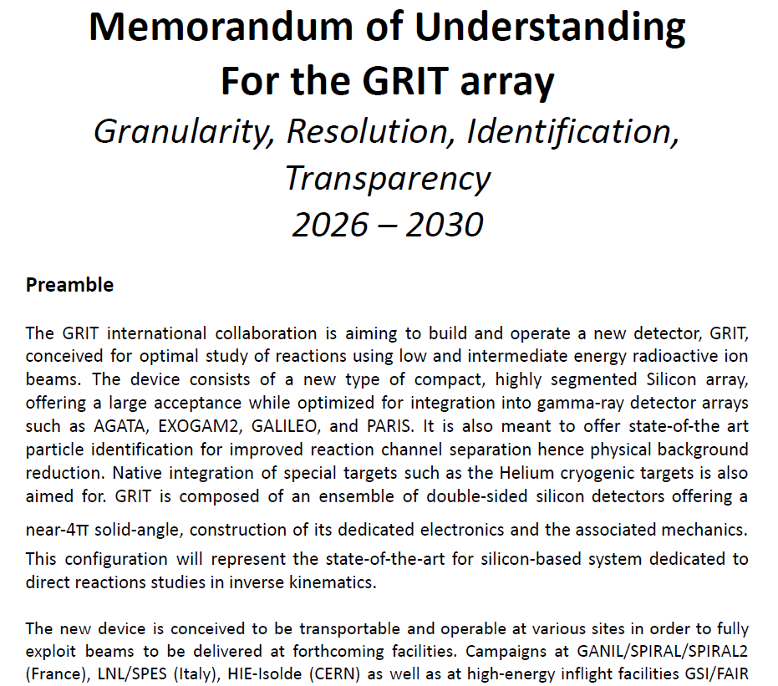
5 years
Covers both construction of the final
array and the AGATA-GRIT-VAMOS
campaign @GANIL
New collaboration structure
  Add Collab. Committee
to MB and SC
  Project manager (MB)
Contributions (K€)
  France (GANIL+In2p3) 215K
  INFN 215K
  UK 150K
  Spain (CSIC) 40K
  Croatia 50K

Slide 20
Budget request for GRIT
GRIT request for 2026
Planned purchase
- GRIT cooling blocks (3D metal printed)
- Part of the GRIT chamber (utility chamber)
150 k€ to be transferred by UK before mars 2026
essentially used for buying mechanics
2 k€ for missions
-------------------------------------------------
TOTAL = 2 k€

