Slide 1
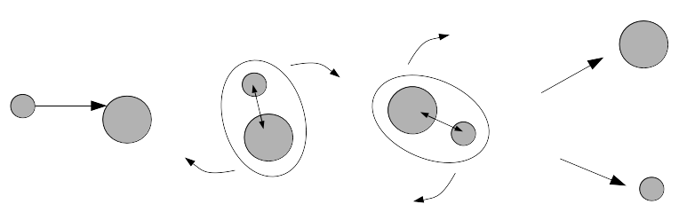
Study of the Heavy Fragment survival in Multi Nucleon Transfer reactions
I. Stefan, B. Sulignano, N. Alahari, D. Ackermann
IJCLab, IRFU, GANIL
MNT reactions
Z
Quasi-target
Neutron-deficient
Projectile
Target
Quasi-projectile
N/Z equilibrium
Neutron-rich
Quasi-Target, Quasi-Projectile will evaporate nucleons, clusters, gammas or/and fission
82
Z
126
N
MNT -> unique potential -> produce neutron rich trans uranium nuclei
Neutron-deficient
What energy?
What angle?
What beam target combination?
Fusion-evaporation -> can’t produce neutron-rich,
MNT might do it, and we intend to quantify this capability!
MNT
Neutron-rich
82
126
N

Slide 2
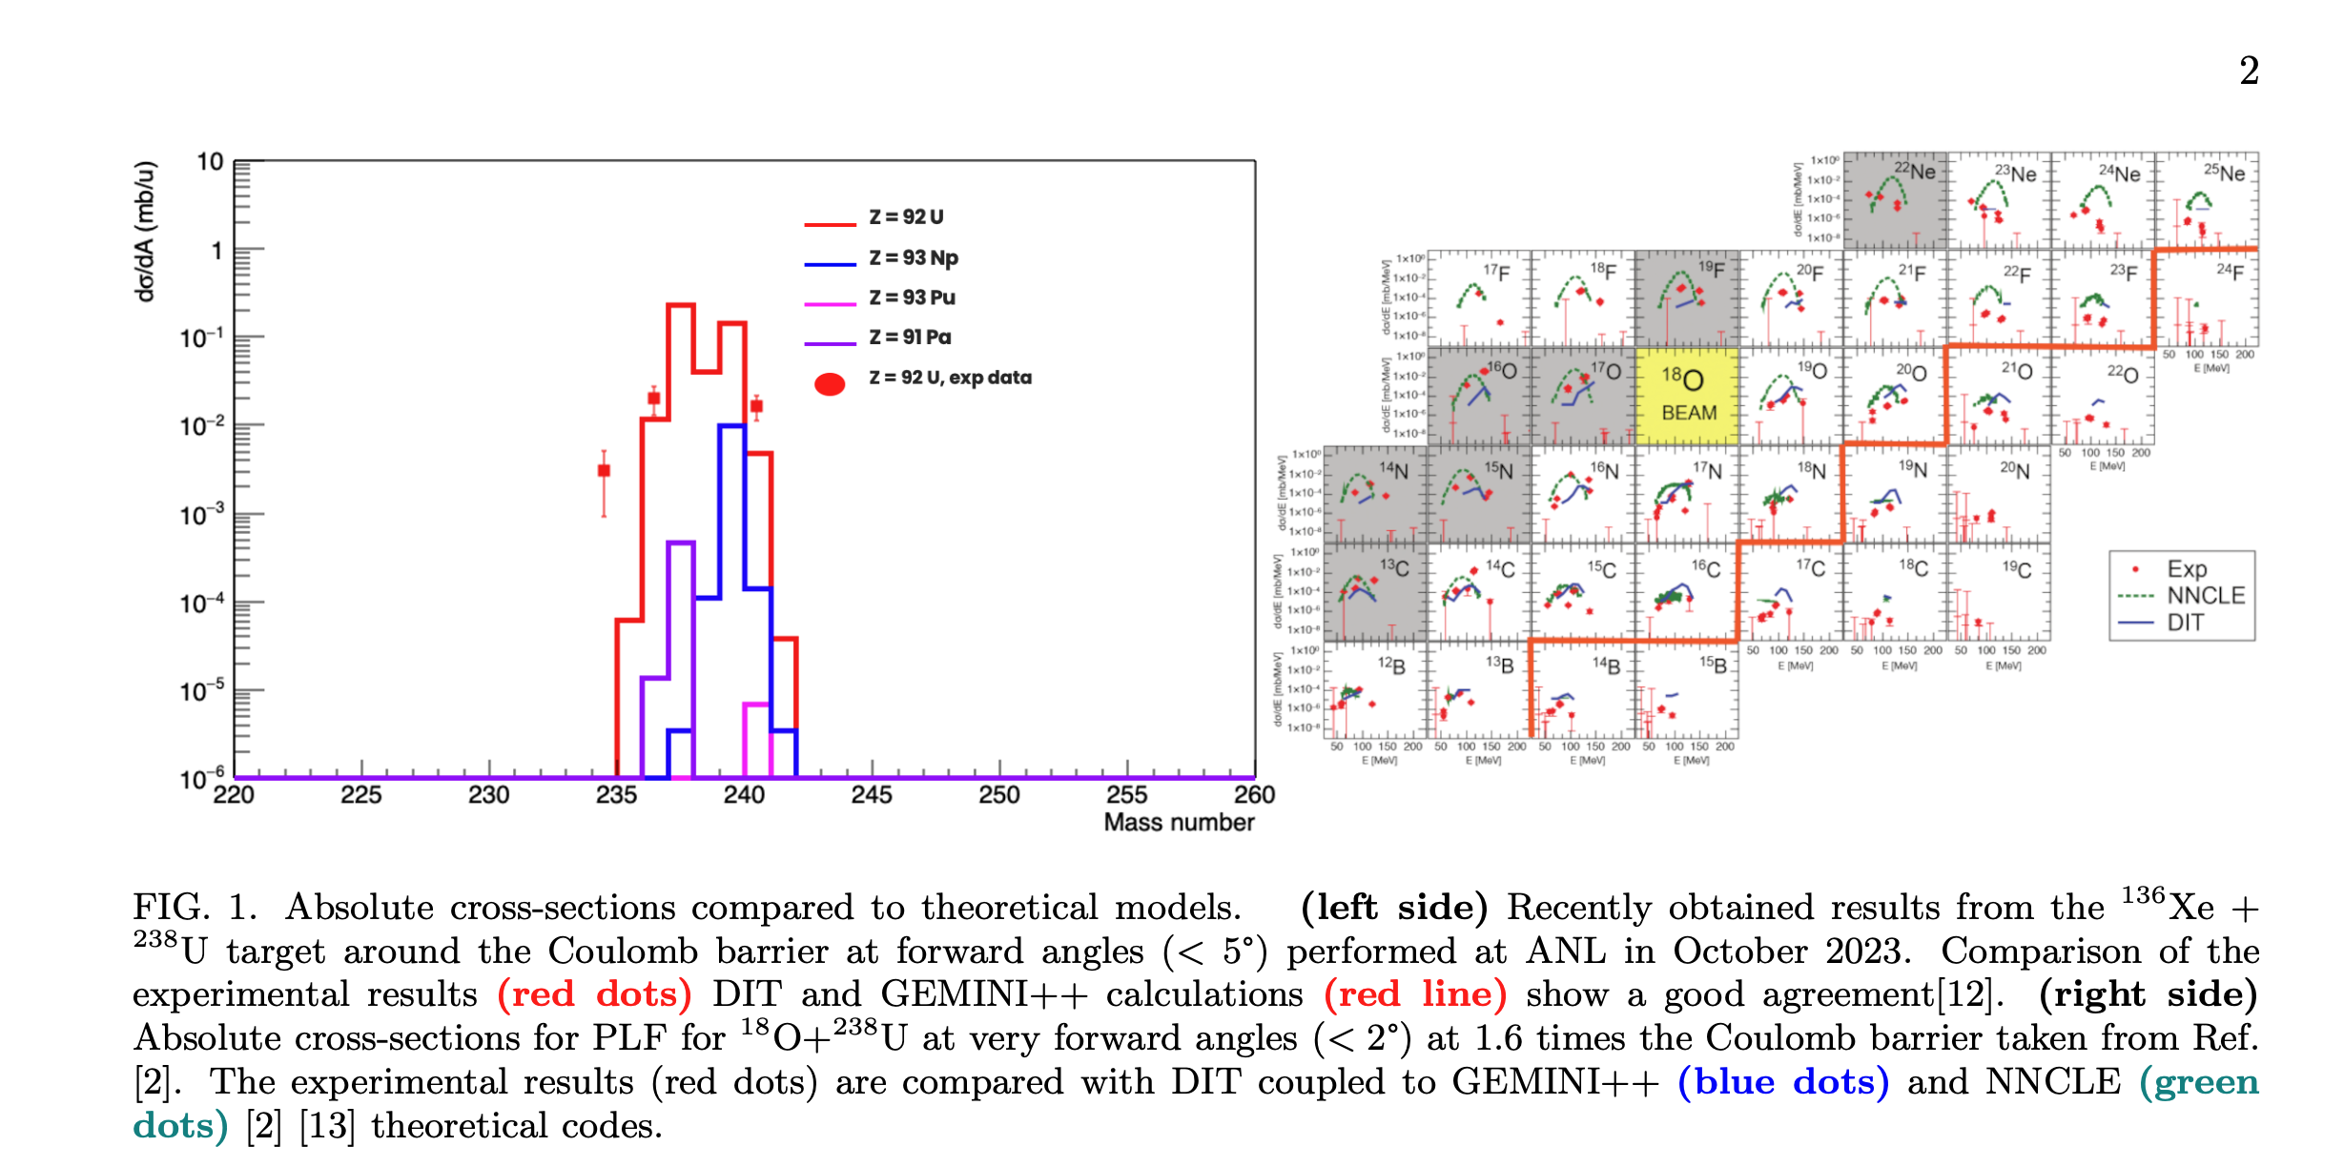
Study of the Heavy Fragment survival in Multi Nucleon Transfer reactions
PhD 3rd year
J. BEQUET (CEA, P2I)
Codirection B. Sulignano (IRFU), I. Stefan (IJCLab)
LIGHT Fragment study
¹³⁶Xe+²³⁸U 5 MeV/A ANL
¹⁸O+²³⁸U 7 MeV/A GANIL
⁴⁸Ca+²³⁸U 6 MeV/A GANIL
DIT L. Tassan-Got and C. Stéphan, NPA 524 (1991) 121
GEMINI ++ R.J. Charity et al., NPA 483 (1988) 371
NNCLE A. V. Karpov, PRC 96, 024618 (2017)

Slide 3
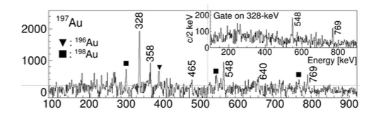
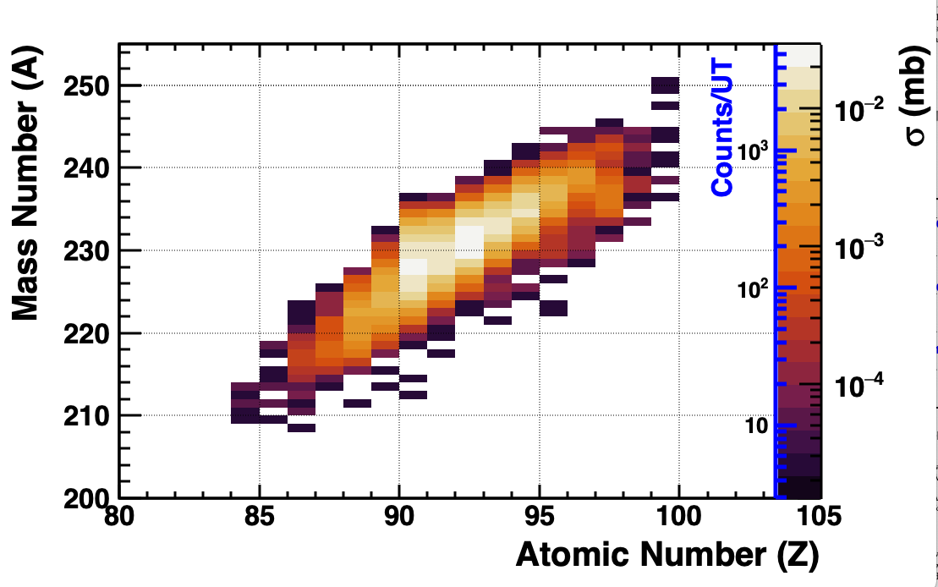
Study of the Heavy Fragment survival in Multi-Nucleon Transfer reactions
²³²Th beam 0.3 mg/cm2 ⁹⁶Zr enriched target @6 AMeV
Quantify the MNT capability to produce heavy nuclei
17°
Z
VAMOS second arm
Heavy fragments
Exogam
Neutron-deficient
Accepted in
December 2024
GANIL: unique beam, VAMOS++ best for N,Z identification (TLF), triple coincidence
126
target
²³²Th
MNT
Light fragments
⁹⁶Zr
Neutron-rich
82
VAMOS++
23°
N
DIT L. Tassan-Got and C. Stéphan, NPA 524 (1991) 121
GEMINI ++ R.J. Charity et al., NPA 483 (1988) 371
Tested on ¹⁸O+²³⁸U, ¹³⁶Xe+²³⁸U, ¹³⁶Xe +¹⁹⁸Pt systems
²³⁴Th
E896 acepted at GANIL ²³²Th + ⁹⁸Zr
LOI ²³⁸U+⁶⁴Ni @Legnaro
I. Stefan, B. Sulignano, A. Navin, D. Ackermann and E896_24 collaboration

Slide 4
Study of the Heavy Fragment survival in Multi-Nucleon Transfer reactions
²³²Th beam 0.3 mg/cm2 ⁹⁶Zr enriched target @6 AMeV
Quantify the MNT capability to produce heavy nuclei
17°
Z
VAMOS second arm
Heavy fragments
Exogam
Neutron-deficient
GANIL: unique beam, VAMOS++ best for N,Z identification (TLF), triple coincidence
126
target
²³²Th
MNT
Light fragments
⁹⁶Zr
Neutron-rich
82
VAMOS++
23°
Vamos efficiency >20%
Vamos second arm acceptance is 16 mstr
N
DIT L. Tassan-Got and C. Stéphan, NPA 524 (1991) 121
GEMINI ++ R.J. Charity et al., NPA 483 (1988) 371
Tested on ¹⁸O+²³⁸U, ¹³⁶Xe+²³⁸U, ¹³⁶Xe +¹⁹⁸Pt systems
²³⁴Th
Request:
PhD fellowship
⁹⁶Zr target: 7 kE
Preparation/participation Manip: 10 kEuro ( if 2026)
Total 17 kEuro
LOI ²³⁸U+⁶⁴Ni @Legnaro
I. Stefan, B. Sulignano, A. Navin, D. Ackermann and E896_24 collaboration

Slide 5
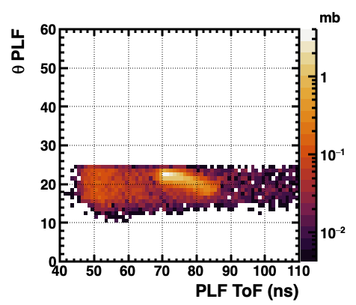
E896_24 Study of the Heavy Fragment survival in Multi-Nucleon Transfer reactions
²³²Th beam 0.3 mg/cm2 ⁹⁶Zr enriched target @6 AMeV
17°
VAMOS second arm
Heavy fragments
Exogam
Second arm
Second arm
target
²³²Th
VAMOS++
VAMOS second arm acceptance cut
Second arm
Light fragments
⁹⁶Zr
Angle vs Tof for Th like fragments (what we want)
Calculated using simulated transmission through VAMOS++ and accounting for proper VAMOS second arm acceptance
VAMOS++
23°
Vamos efficiency >20%
Vamos second arm acceptance is 16 mstr
About 800 6+ -> 4+ 𝛄 rays for nuclei such as ²³⁴Th
This is estimated assuming:
10 EXOGAM detectors placed at 15 cm from the target, giving 8% efficiency for 200 keV γ-ray
Simulating VAMOS++ acceptance and transmission
Accounting for 16 mstr acceptance for VAMOS second arm
Assuming 90% fission probability
24 UT total = 21 UT measurement +3 UT for setup
²³²Th
I. Stefan, B. Sulignano, N. Alahari, D. Ackermann and E896_24 collaboration

Slide 6
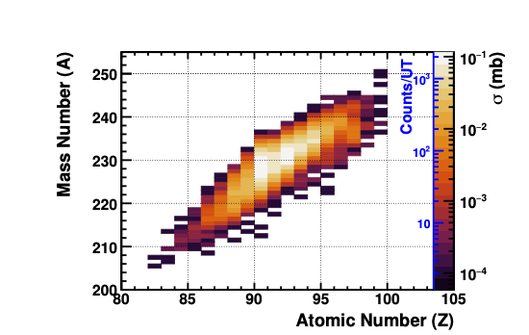
Study of the Heavy Fragment survival in Multi Nucleon Transfer reactions
Simulated Mass vs Atomic Number for Th-like fragments that can be identified in ²³²Th +⁹⁶Zr and the expected cross-section
1e+10 pps ²³²Th impinging a 0.3 mg/cm² ⁹⁶Zr target
Underestimated the Vamos efficiency to 1% -> is >20%
Overestimated Vamos second arm acceptance to 80 mstr . In fact, it is 16 mstr
²³²Th
²³²Th
Recalculated using simulated transmission through VAMOS++ and accounting for correct VAMOS second arm acceptance
In the proposal

Slide 7
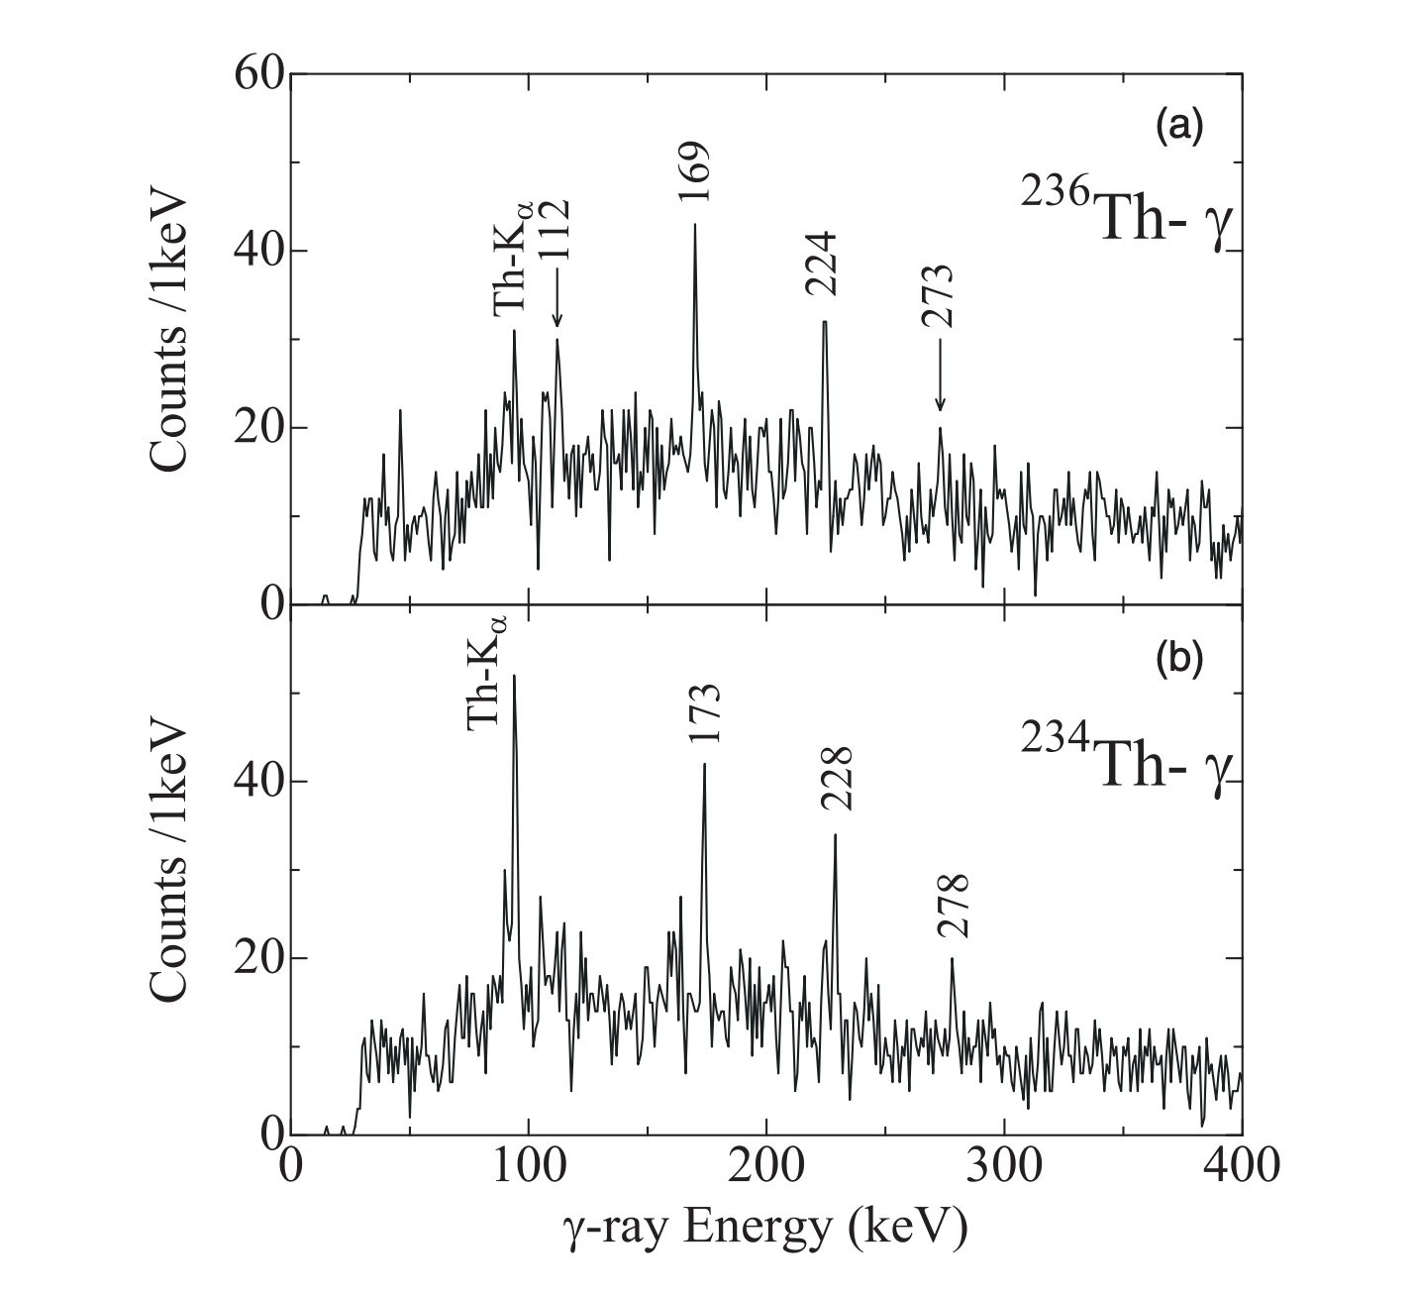
E896_24 Study of the Heavy Fragment survival in Multi-Nucleon Transfer reactions
²³²Th beam 0.3 mg/cm2 ⁹⁶Zr enriched target @6 AMeV
²³⁸U(¹⁸O,^{20+x}Ne)^{236-x}Th 6 MeV/A
²³⁴Th
Calculated using simulated transmission through VAMOS++ and accounting for proper VAMOS second arm acceptance
PRC 76, 011303(R) (2007) T. Ishii et al.
I. Stefan, B. Sulignano, N. Alahari, D. Ackermann and E896_24 collaboration

Slide 8
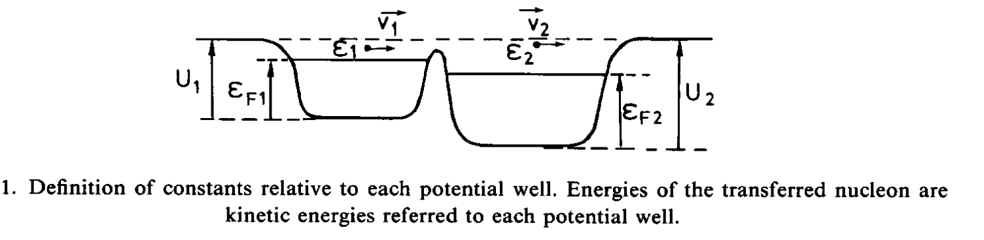
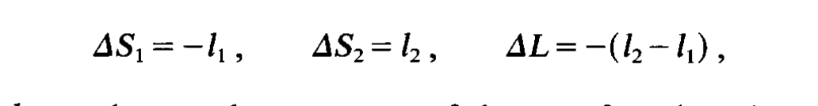
DIT
Hypothesis:
Double system of independant particles, potential with definite number of nucleons
Determined thermodynamics properties
Nuclei are supposed to move along classical trajectories
Step by step interactions
Based on Fermi gas modelisation
Transfer probability computation
Rundrup stochastic model evolution:
dissipation proceeds mainly through stochastic transfers of nucleons/clusters decoupled in time.
Nuclei are supposed to move along classical trajectories.
When they come close to each other, a window defined by potential barriers opens and stochastic transfers may occur. These transfers generate dissipation and fluctuations.

Slide 9
E896_24 Study of the Heavy Fragment survival in Multi-Nucleon Transfer reactions
²³²Th beam 0.3 mg/cm2 ⁹⁶Zr enriched target @6 AMeV
²³⁴Th
Calculated using simulated transmission through VAMOS++ and accounting for proper VAMOS second arm acceptance
I. Stefan, B. Sulignano, N. Alahari, D. Ackermann and E896_24 collaboration

Slide 10
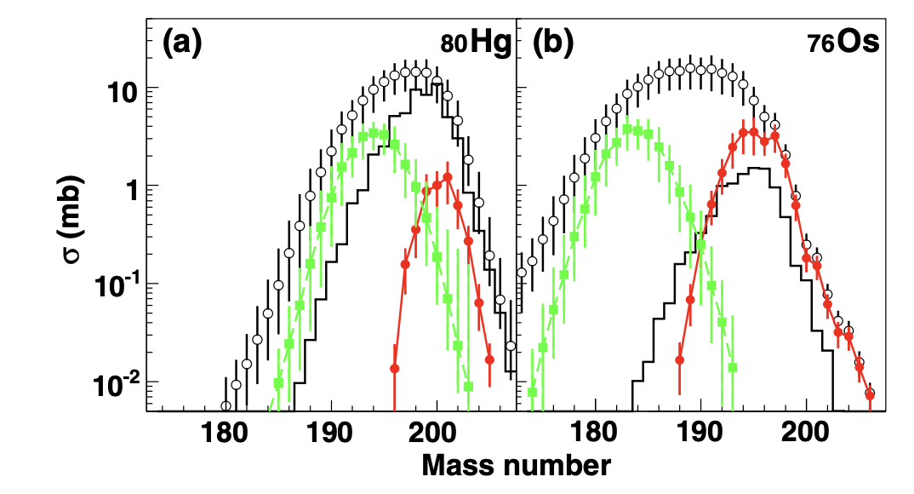
Study of the Heavy Fragment survival in Multi Nucleon Transfer reactions
¹³⁶Xe +¹⁹⁸Pt @8 MeV/A
Y. X. Watanabe, et al PRL 115, 172503 (2015)
Theoretical model: DIT for MNT coupled with GEMINI++ for evaporation and fission
DIT L. Tassan-Got and C. Stéphan, NPA 524 (1991) 121
GEMINI ++ R.J. Charity et al., NPA 483 (1988) 371
Experimentally deduced (open circles) and calculated by GRAZING code (histograms) cross sections for Hg (left) and Os (right) isotopes. Isotopic distributions for different windows of total kinetic energy loss from −25 to 25 MeV and from 175 to 225 MeV are indicated by different filled symbols of circles and squares, respectively

Slide 11
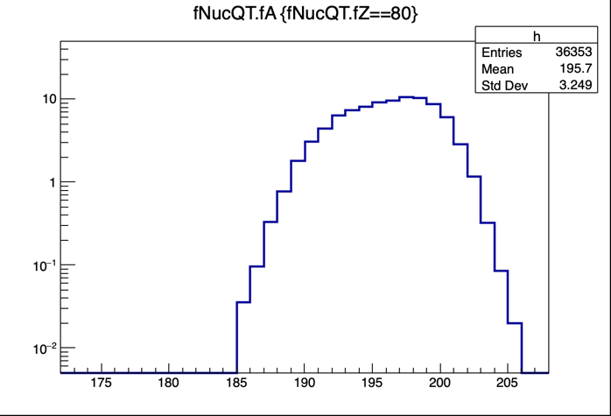
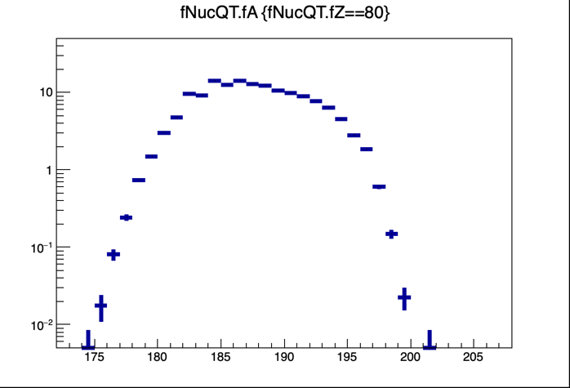
Study of the Heavy Fragment survival in Multi Nucleon Transfer reactions
¹³⁶Xe +¹⁹⁸Pt @8 MeV/A
Y. X. Watanabe, et al PRL 115, 172503 (2015)
Experimentally deduced (open circles) and calculated by GRAZING code (histograms) cross sections for Hg (left) and Os (right) isotopes. Isotopic distributions for different windows of total kinetic energy loss from −25 to 25 MeV and from 175 to 225 MeV are indicated by different filled symbols of circles and squares, respectively
Comparaison with DIT + Gemini++ calculation
Experiment produce more neutron rich nuclei

Slide 12
Study of the Heavy Fragment survival in Multi Nucleon Transfer reactions
Purpose: Understand the survival of the Heavy Fragment (HF) depending on incidence energy, emission angle, and beam and target combinations
How: ²³²Th+⁹⁶Zr @ 6 MeV/A
Maximum number of EXOGAM detectors ( around 10) , VAMOS++ at 23°, and VAMOS second arm at 17°
VAMOS second arm
Heavy fragments
Second arm
Second arm
Exogam
target
²³²Th
⁹⁶Zr
Second arm
Light fragments
VAMOS++
VAMOS++
VAMOS second arm acceptance cut
Angle vs Tof for Th like fragments (what we want)
VAMOS++

Slide 13
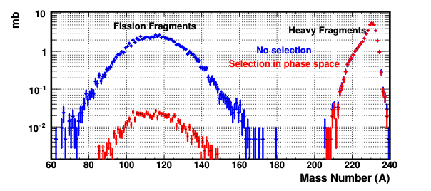
Study of the Heavy Fragment survival in Multi Nucleon Transfer reactions
Purpose: Understand the survival of the Heavy Fragment (HF)
How: ²³²Th+⁹⁶Zr @ 6 MeV/A
Maximum number of EXOGAM detectors ( around 10) , VAMOS++ at 23°, and VAMOS second arm at 17°
VAMOS second arm
Heavy fragments
Exogam
target
²³²Th
Light fragments
⁹⁶Zr
Second arm in strongly reduce the fission fragments background for easy identification with Exogam
VAMOS++

Slide 14
Study of the Heavy Fragment survival in Multi Nucleon Transfer reactions
Purpose: Understand the survival of the Heavy Fragment (HF) depending on incidence energy, emission angle, and beam and target combinations
How: ²³²Th+⁹⁶Zr @ 6 MeV/A
Maximum number of EXOGAM detectors ( around 10) , VAMOS++ at 23°, and VAMOS second arm at 17°
VAMOS second arm
Heavy fragments
Exogam
target
²³²Th
Doppler-corrected γ-ray spectra with AGATA in ¹³⁶Xe + ¹⁹⁸Pt system, obtained with VAMOS++ and a different VAMOS second
Y. X. Watanabe, et al PRL 115, 172503 (2015)
Light fragments
⁹⁶Zr
VAMOS++

Slide 15
Summary
Purpose: Quantify the capability of MNT to produce heavy neutron-rich nuclei
1e+10 pps ²³²Th at 6 MeV/A impinging a 0.3 mg/cm² ⁹⁶Zr target
VAMOS at 23°, second arm at 17°
3 UT for setup
21 UT for measurement
Total 24 UT
VAMOS second arm
²³²Th
Heavy fragments
Exogam
target
²³²Th
Light fragments
⁹⁶Zr
VAMOS++

Slide 16
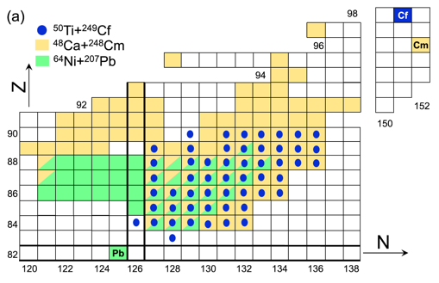
Study of the Heavy Fragment survival in Multi Nucleon Transfer reactions
MNT reactions for heavy elements @ 0° only
⁴⁸Ca+²⁴⁸Cm @ (5.3 MeV/n) At SHIP (GSI)
⁵⁰Ti+²⁴⁹Cf @ (6.1 MeV/n) At TASCA (GSI)
²¹⁶U, ²¹⁹Np, ^{223,229}Am and ²³³Bk
S. Heinz, et al. Eur. Phys. J. A (2016) 52: 278
¹A. Di Nitto, et al. PLB 784 (2018)199–205
SHIP
Mass identification via alpha decay correlation
Max corr. Time 1s; Small angular acceptance 0.3% at 0°
→only central collision with small angular momenta
TASCA
Gas-filled separator – short lenght
Mass identification via alpha decay correlations.
Notes:
In this direction are the results obtained at SHIP in 2015.. Deep-inelastic transfer reaction ⁴⁸Ca+²⁴⁸Cm was used to produce 100 residual nuclei with proton numbers between Z = 82 and 100. Among them, five new neutron-deficient isotopes have been produced: ²¹⁶U, ²¹⁹Np, ^{223,229}Am and ²³³Bk. The experiment was performed at SHIP, which is suitable only for decay spectroscopy. The results demonstrate that very exotic nuclei can be reached by multinucleon transfer reactions and that this mass region is ideally suited for future experiments using the Recoil Decay Tagging technique. Cross sections for production of nuclei with Z=84-95 in multinucleon transfer, measured at SHIP in collisions of ⁴⁸Ca+²⁴⁸Cm at 5.3 MeV/u [12], together with the chart of nuclei showing the isotopes produced during this experiment, are shown Since SHIP has a narrow angular acceptance in the forward direction, only the reaction products resulting from central collisions with very small angular momenta were selected, while those corresponding to larger impact parameters were scattered under larger angles and did not enter SHIP. In fact, one needs separators with wider angular acceptance, such as VAMOS, for measuring more heavy and neutron riche nuclei that are produced not in central collision .

Slide 17
Study of the Heavy Fragment survival in Multi Nucleon Transfer reactions
MNT reactions
Quasi-target
Projectile
Target
Quasi-projectile
N/Z equilibrium
Quasi-Target, Quasi-Projectile will evaporate nucleons, clusters, gammas or/and fission
Near the Coulomb barrier, the reaction is known to be governed by Quasi-elastic, with the products emitted around the grazing angle. At higher incident energy, the production of more neutron rich nuclei would decrease due to a larger evaporation of neutrons arising from increased excitation energy in the products. However higher energy will allow more damped collisions, leading to the exchange of more nucleons, thus enlarging the range of exit channels
Theoretical model: DIT coupled with GEMINI
L. Tassan-Got and C. Stéphan, NPA 524 (1991) 121
R.J. Charity et al., NPA 483 (1988) 371

