Slide 1
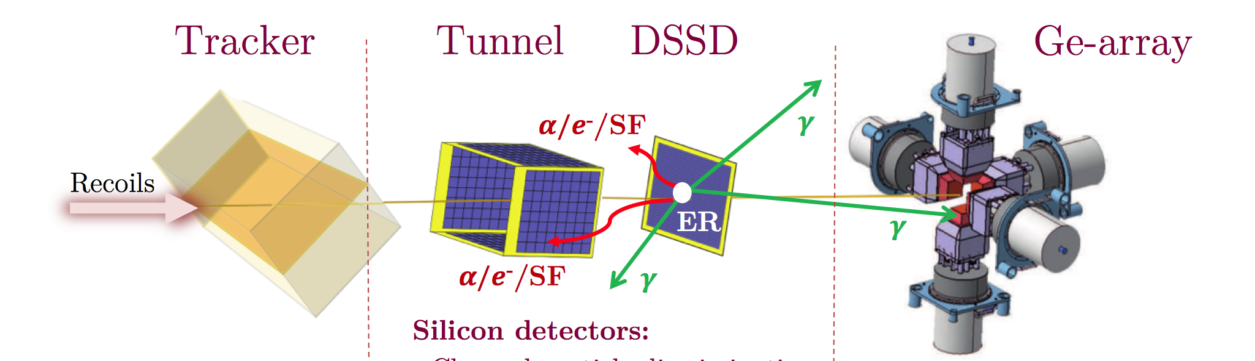
S3/SIRIUS
pôle nucléaire et pôle ingénierie
Master Projet S3: H. Savajols
sous-projet SIRIUS: J. Piot (scientifique) N. Karkour (technique)
IJCLab: K. Hauschild
SIRIUS: the detection system to be installed at the focal plane of S³ @ GANIL
for heavy element spectroscopy
Our implication
→ upgraded NUMEXO2 mezzanine cards for the DSSD and the tunnel
→ front- and back-end electronics for the tunnel (digital feedback CSP)
→ detector tests and analysis
→ Geant4 simulations
→ experimental know-how

Slide 2
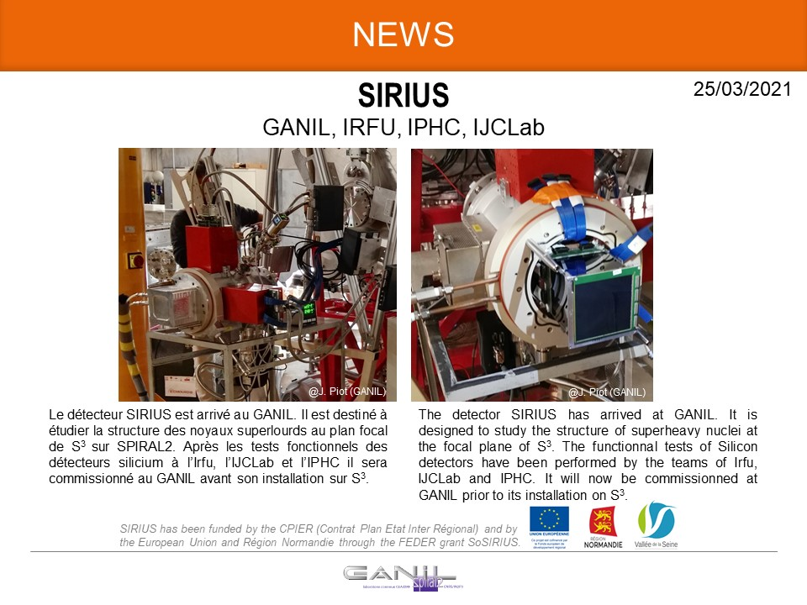
S3-SIRIUS: Dotation pour l’année 2024
 | Demandée (k€) | « Reçue » (k€)
Investissement | 14 (+ 41.2 SHEXI pt1) | 10 | 18.8
Fonctionnement | 0 | 0 | 0
Missions | 6 | 10 | ?
TOTAL | 20 (61.2)
Investment :
→ triple alpha & 133Ba sources @ IJCLab [8215] (I forgot the 10 yr return date)
→ high precision 4-channel HV @ IJCLab [5210]
→ PCB glue for repairs [1645] (not planned for)
→ cables / adapters @ IJCLab [ 900]
→ PCB repair [ 680] (not planned for)
→ composants / filters / stuff @ IJCLab [2160] (not all planned for)
Missions : reduced due to vacuum leak → PCB feedthrough needed repairing
the tunnel detectors also needed re-bonding
(partial Zakopane conference + SDFFON)
K. Hauschild, “The SHEXI concept: SuperHeavy Element X-ray Identification”; Acta Phys. Pol. B Proc. Suppl. 18 (2025) 2-A28
Maintenance (not done):
(UPS, jauge à vide, cryofluide) et mises à niveau (connecteurs swagelok, collimateurs, porte-sources, passages sous vide pour le contrôle des sources).

Slide 3
S3-SIRIUS: Dotation 2025
 | Demandée (k€) | Reçue (k€)
Investissement | 14 | 14
Fonctionnement | 0 | 0
Missions | 8 | 3
TOTAL | 22 | 17
Mission (GANIL): ~0.35k to date
→ electronics and detector tests + updates + EMC
→ more planned
Repairs (GANIL) : 9.4k
→ new set of cables & connectors (not planned)
Repairs (IJCLab) : 4.6k left
→ maintenance/upgrades of test benches used at the IJCLab
UPS, jauge à vide, cryofluide, connecteurs swagelok, collimateurs,
porte-sources, passages sous vide pour le contrôle des sources

Slide 4
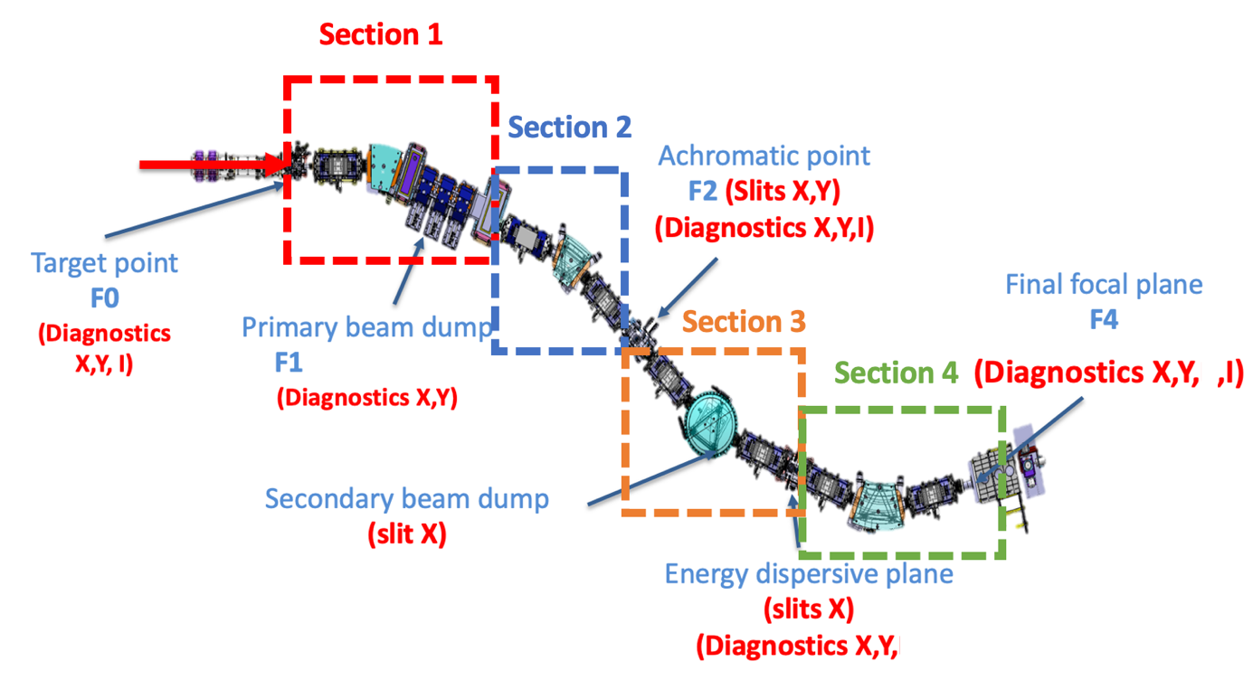
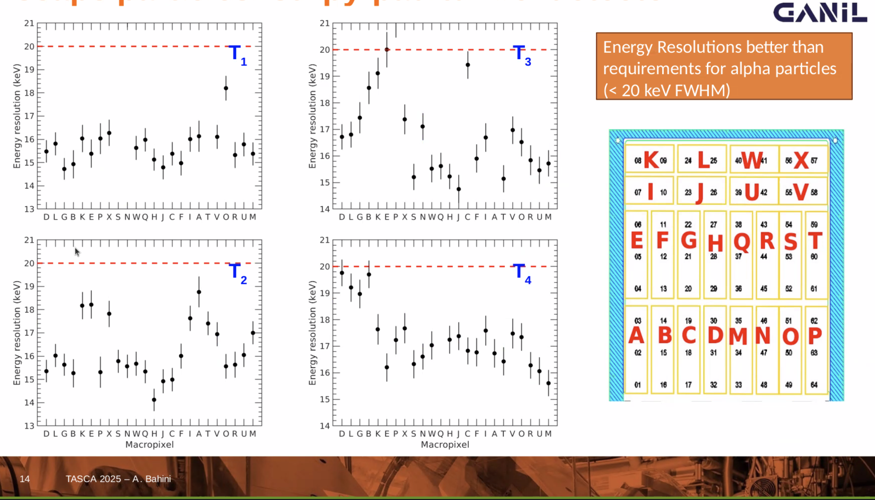
S3 General News
Superconducting Multipole Triplet #6 has been repaired and installed
→ optical tests of sections 1 and 2 programmed for 12/2025
The electric dipole (IJCLab) has been conditioned to +/- 200 kV
Latest SIRIUS news:
NK on recent trip tackled EMC issues
vast reduction in noise in area 51
tunnel detectors meet specifications
for alphas
To do:
¹³³Ba: thresholds and low e FWHM
²⁴¹Am: alpha-gamma coinc
Feedback firmware: X. Lafay
Sum instead of discard
  digitise @ 200 MH
  clock @ 100 MHz
1 | 2
3 | 4
5 | 6
→
1+2
3+4
5+6
X. Lafay needed

Slide 5
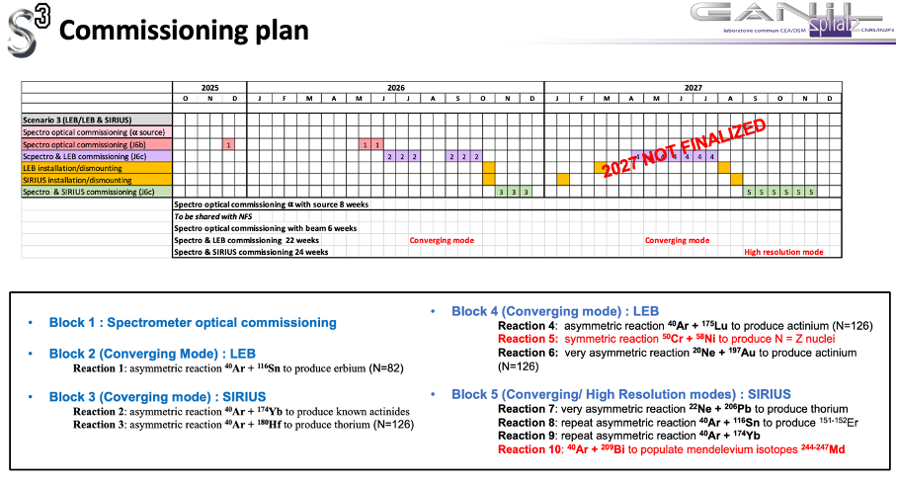
S3-SIRIUS: Demande 2026
 | Demandée (k€)
Investissement | 33.1
Fonctionnement | 0
Missions | 18.2
TOTAL | 51.3
Mission: 20 sem. sur place → (90 + 40) * 7 * 20
Equipement:
Malheureusement, deux câbles (avec des connecteurs spécialisés) pour SIRIUS ont dû être remplacés, ce qui n’était prévu dans le budget du 2025 (€9,4k) → achever la maintenance prévue pour 2025
Le remplacement du refroidisseur à circulation LAUDA, qui ne refroidit plus en dessous de +2C (acheté en 2012), par un monstre capable de refroidir jusqu'à -50C est nécessaire pour que SHEXI atteigne les spécifications. Câbles isolés supplémentaires, connecteurs swagelok et liquide de refroidissement. (€23.7k)

Slide 6
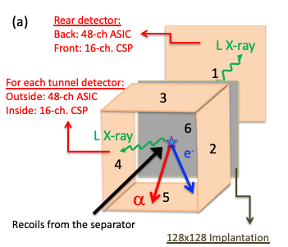
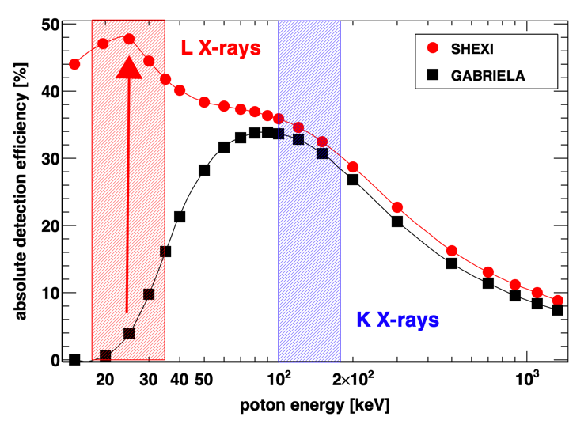
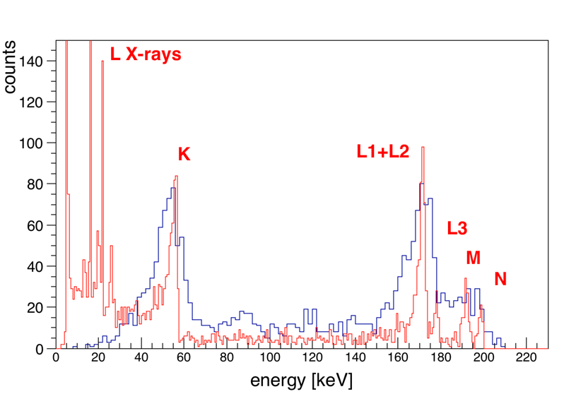
Recap: S3-SIRIUS upgrade →SHEXI (CODEC IJCLab & CS-GANIL)
Upgrade of the tunnel and veto detectors + associated electronics
→ L-Xray detection
Z identification of SHE
+ world leading ICE spectroscopy
²⁵¹Fm as an example:
GABRIELA data
vs
SHEXI simulation

Slide 7
SHEXI → SHEXI demonstrator (1)
SHEXI (demonstrator)…
CS du GANIL 01/2024 .. Promises promises…
P2I 2024, P.I. K. Hauschild 25k → ½ FEE for 1 detector
Région Normandie (2024):
« Projets Émergents »
→ projet précurseur/une nouvelle thématique X
« d’Excellence »
→ ERC doit être porté par le GANIL X
ANR 2024: 695k€ → 2nd round (resultats juillet)
budget factored in some of GANIL’s promises
What happens to S3-SIRIUS sub-project when in exploitation mode
→ generate an S3-SHEXI sub-project ?

Slide 8
“AP-SHE”
2024: €5k [awarded = requested] (€ 4650 “net”)
NN2024; ALM plenary session invited speaker + KH invited speaker “50 Years of cold fusion”
2025: €5k [awarded = requested] (€ 4650 “net”)
Still extracting results from GABRIELA data pre 03/2022
R. Chakma, S. Fritzsche, KH, ALM, “Geant4 atomic relaxation data for transfermium nuclei (Z = 101–104)”; Nucl. Instr. Methods A 1072 (2025) 170144
H.M. Devaraja , …, KH, ALM, …, et al, “Systematic studies to produce heavy above-target nuclides in multinucleon transfer reactions”, Physics Letters B 862 (2025) 139353
K. Kessaci, …, ALM, KH, et al, “Cascade of high-K isomers in ²⁵⁵No”; Physical Review C 110 (2024) 054310
B. Sailaubekov, …, KH, ALM, …, et al, “Prompt neutrons accompanying the spontaneous fission of ²⁵⁰No”; AIP Conference Proceedings 3020 (2024) 020007
R.S. Mukhin , …, KH, ALM, …, et al, “Analysis of the shape of multiplicity distributions of prompt neutrons emitted in spontaneous fission”; J. Radioanal. Nucl. Chem. 333 (2024) 1559
R.S. Mukhin , …, KH, ALM, “Prompt neutron emission in ²⁵⁰No spontaneous fission associated with ground and isomeric states decay”; Chinese Physics C 48 (2024) 1
R.S. Mukhin , …, KH, ALM, …, et al, “Prompt neutron multiplicity from spontaneous fission of ²⁴⁴Fm”; European Physical Journal A 60 (2024) 223
More papers already in the pipeline:
²⁵⁴No [PRL beyond the pale: suggest payment of €2800 for immediate open publishing]
→ €1850 would remain… GDR-Resanet ALM organising + JYFL discs/trgts ?
²⁵⁷Db – under (2nd) review
Still digging into the data:
reanalysis of ²⁵⁰No, ²⁵⁶Rf , ²⁵⁷Rf K-isomers + Digital Signal Processing algorithms
request 6k€ for 2026
→ Conference(s) + another analysis workshop @ IPHC

Slide 9
Summary
SIRIUS | Demandée (k€)
Investissement | 33.1
Fonctionnement | 0
Missions | 18.2
TOTAL | 51.3
Maintenance + LAUDA
Commissioning …. Wuhoo !
SHEXI (demonstrator): promise of 40k from GANIL (but 100k total for CNRS)
factored into ANR
[new sub-project ?]
SHE: request 6k€ 2026 [conf(s) + workshop]

Slide 11
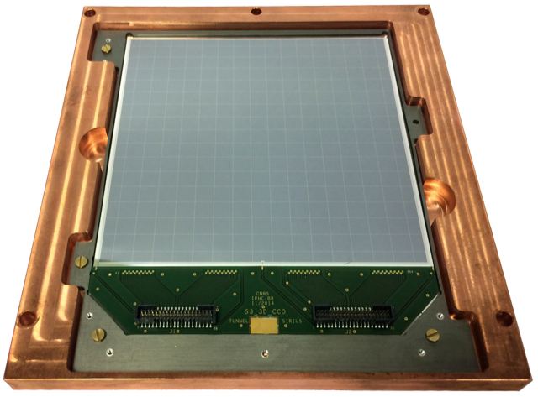
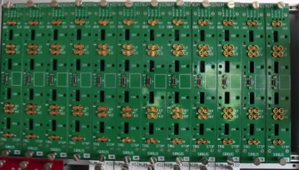
S3-SIRIUS (recap)
pôle nucléaire et pôle ingénierie
SIRIUS: the detection system to be installed at the focal plane of S³ @ GANIL
for heavy element spectroscopy
Our implication
→ upgraded NUMEXO2 mezzanine cards for the DSSD and the tunnel
→ front- and back-end electronics for the tunnel (digital feedback CSP)
NUMEXO2
+ FADC-DAC
P. Brionnet et al., Nucl. Instr. Meth. 1015 (2021) 165770
And experimental + Geant4 know-how

Slide 12
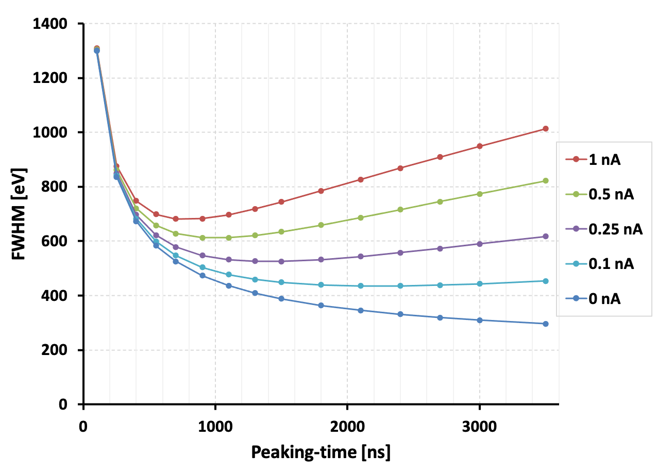
-50C ?
ENC^2 = (a*A1/tau + c*A2)*(Cd+Cg)^2 + b*A3*tau |  |  |  |  |  | where
ENC^2 = alpha/x + beta + gamma*x |  |  |  |  |  | Cd : detector + stray capacitance
 |  |  |  |  |  | Cg: input capacitance of the preamplifier
 |  |  |  |  |  | a: input FET thermal noise
 |  |  |  |  |  | c: input FET 1/f noise
 |  |  |  |  |  | b: shot noise associated with leakage current
 |  |  |  |  |  | tau: peaking time
 |  |  |  |  |  | A1,A2,A3 are the filter coefficients
Cd = 10 pF
“TTT6” det: I = 12 pnA @ RT
I → I/2 per 7C || per 10C
→ -30C || -50C

