Slide 1
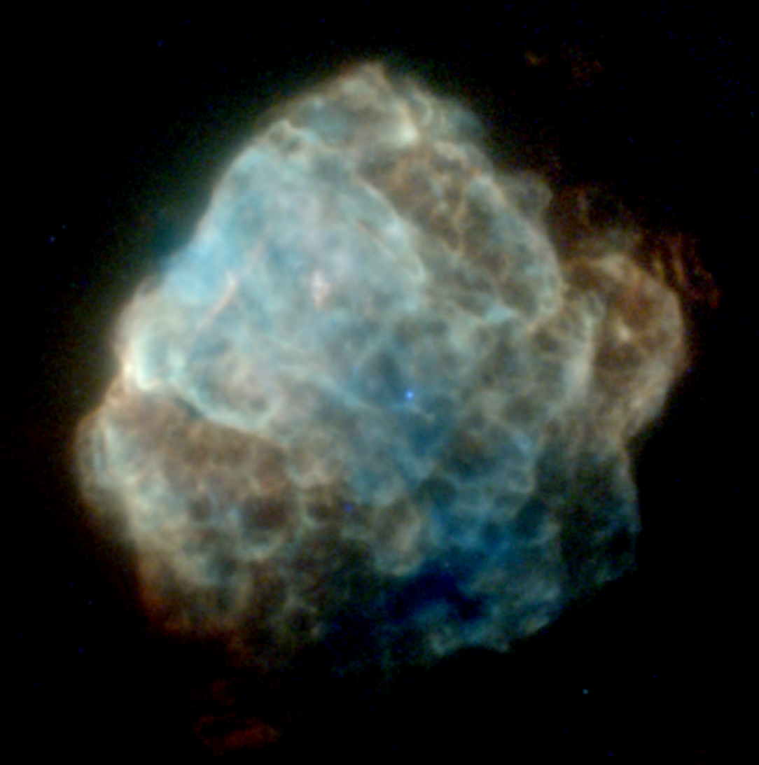




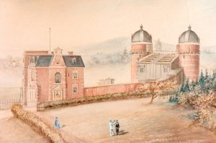
Quantifying the Spectacular
Applying Power-Spectral Analysis to X-ray Images of SNRs
Martin Mayer
Remeis Observatory Bamberg (ECAP/FAU Erlangen, Germany)
Lumière Workshop – 13.01.2026

Slide 2
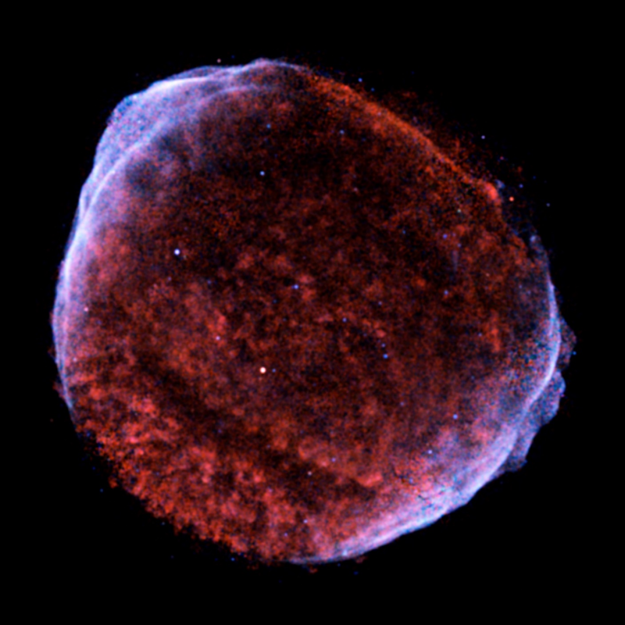
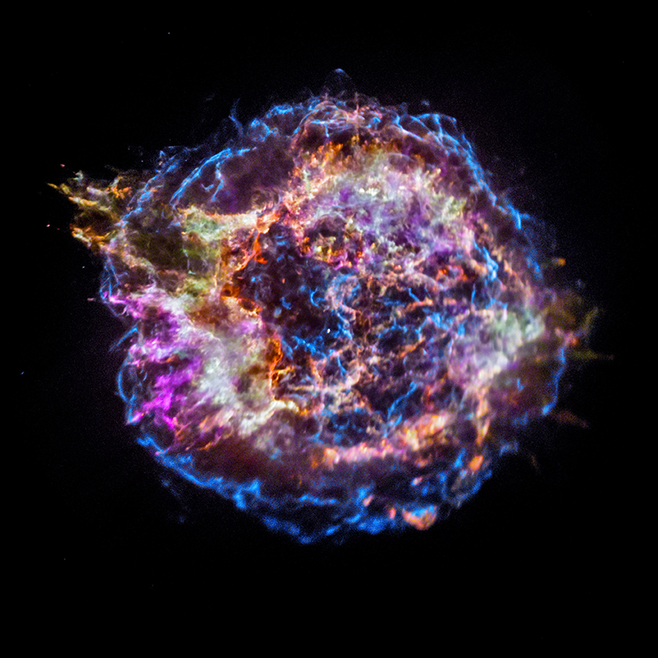
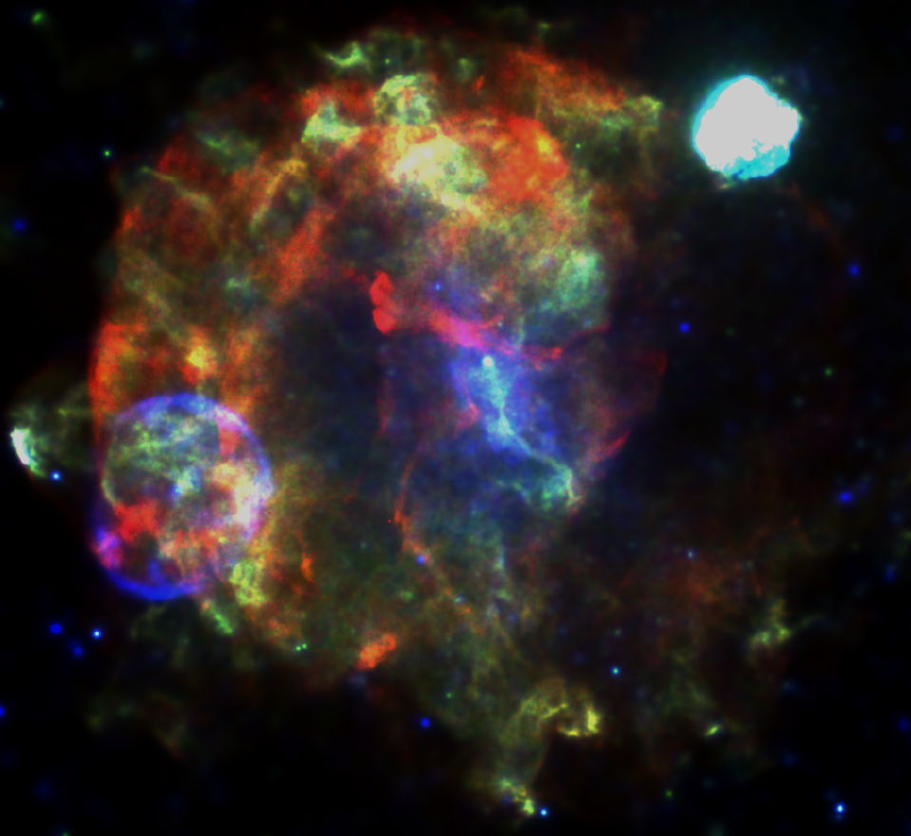
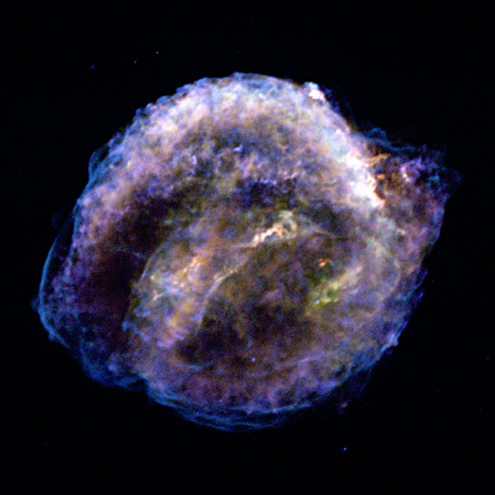
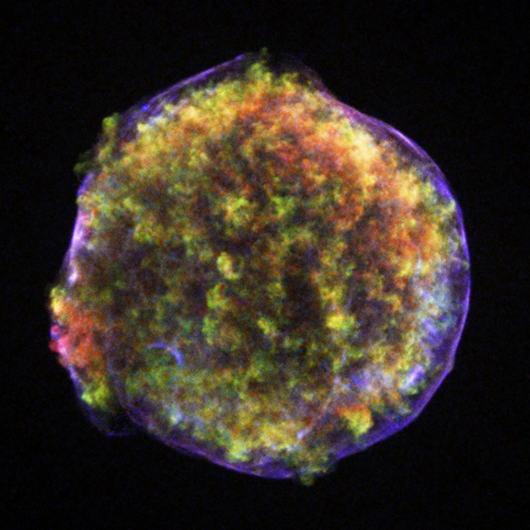
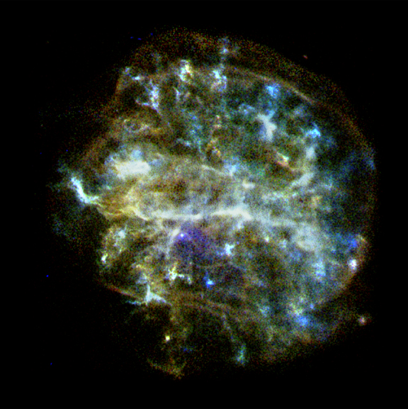
A Plethora of Spectacular Images
Credit: NASA/CXC, Mayer+22,23

Slide 3
A Plethora of Spectacular Images
Puppis A with eROSITA
Mayer+22
Northeast Rim
Ear
Ejecta Clump
How can we generalize morphological properties of SNRs?
Shocked Filament
Bright
Eastern Knot
Neutron Star
Absorption Hole
Credit: NASA/CXC, Mayer+22,23

Slide 4
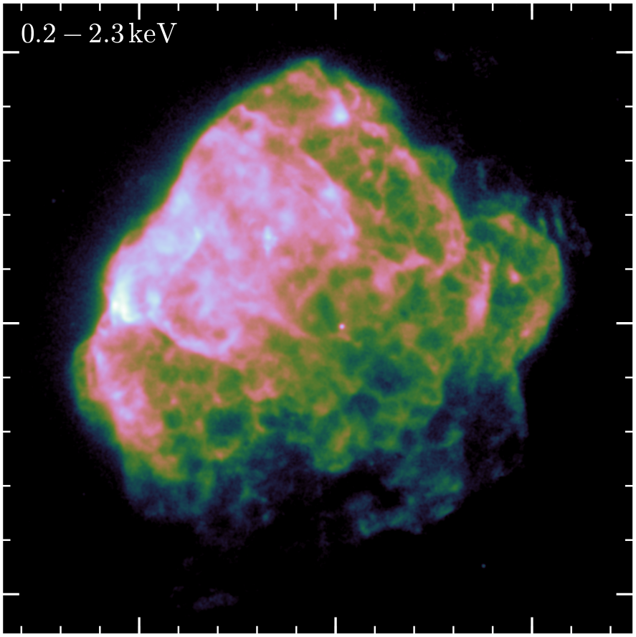
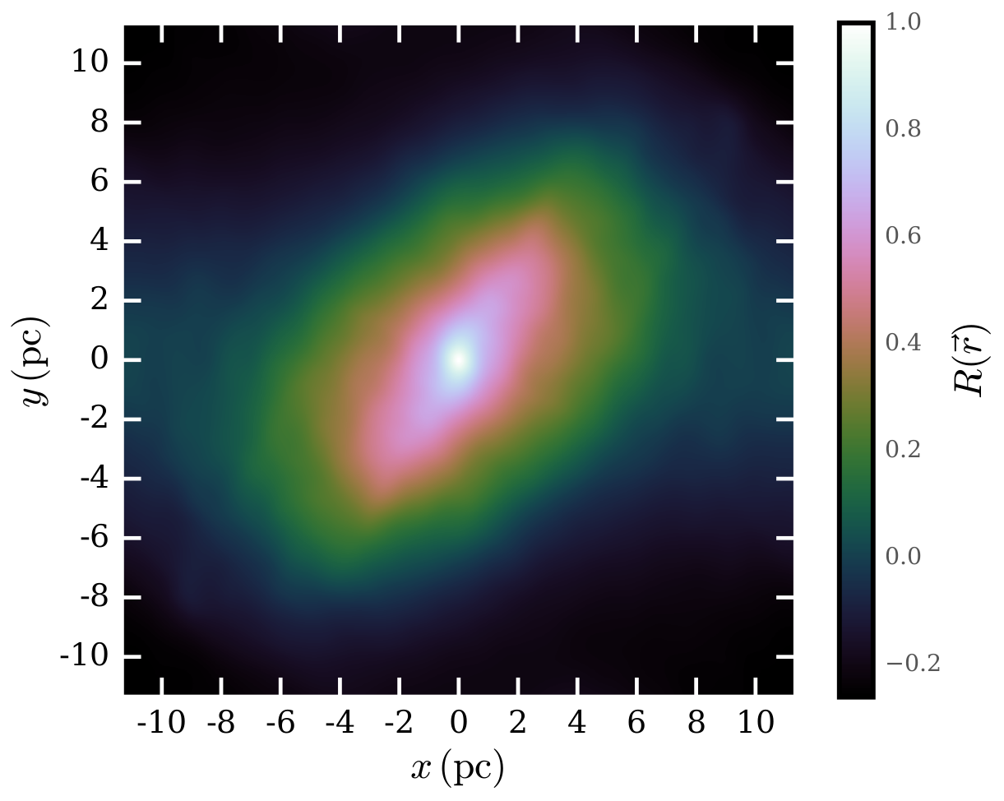
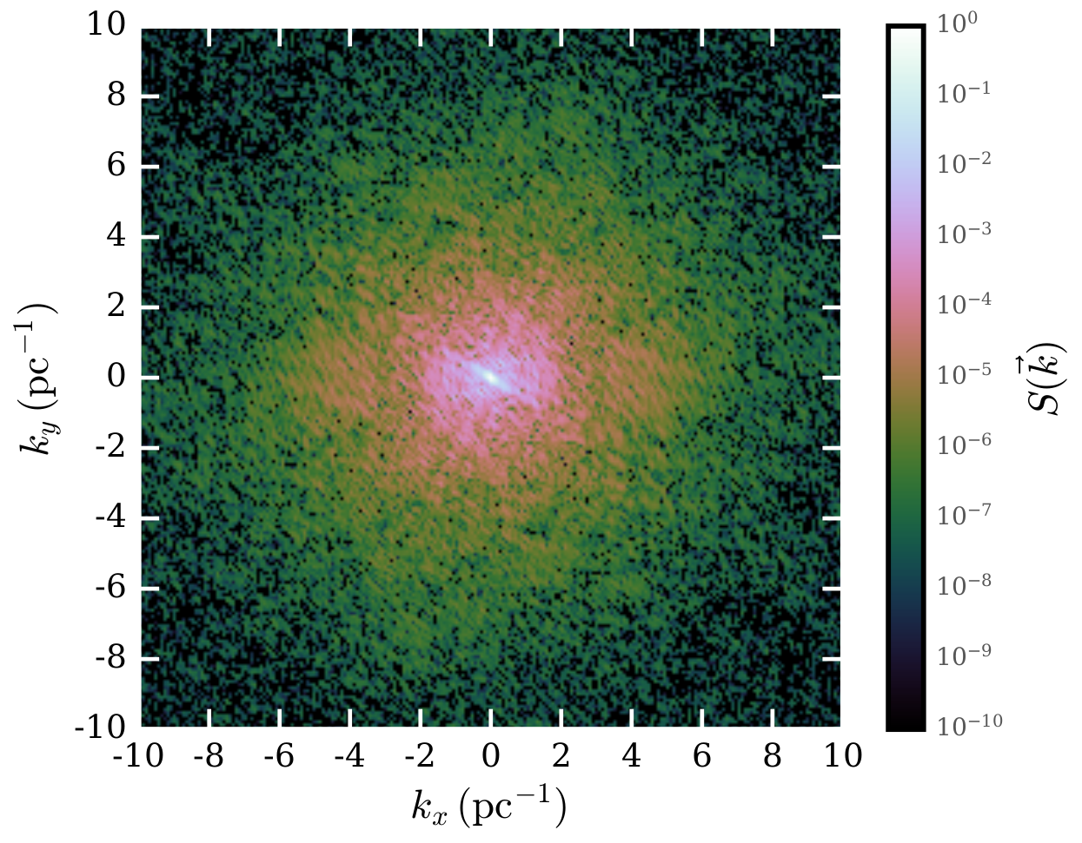


Tracing structures at different spatial scales
2D auto-correlation function
~ Similarity of image with offset version of itself
2D power spectrum
~ Amount of structure („power“) at different size scales
Puppis A with eROSITA
Mayer+22
r
r
r
r
5 pc

Slide 5
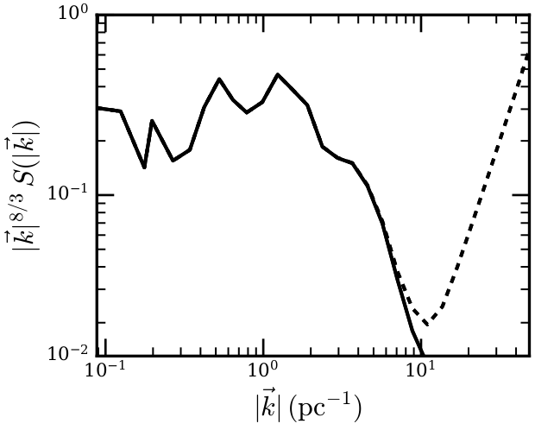
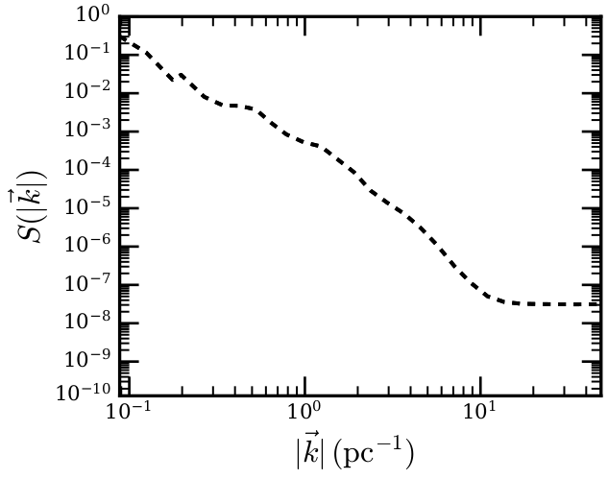
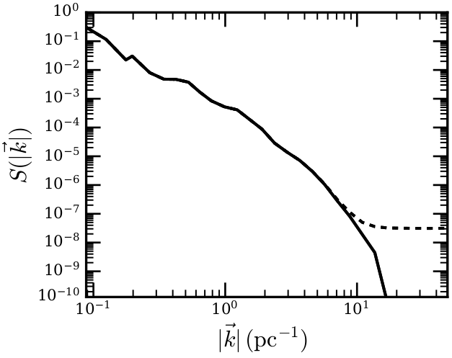
Quantifying spatial structure
Measure average power at different scales
Subtract power from photon counting (Poisson noise)
Exponent characteristic for Kolmogorov turbulence (Petruk+25)
Lack of power at scales < 0.5 pc
Pronounced peaks around ~ 1 - 2 pc
eROSITA PSF
~ k^{-8/3}
White Poisson noise
10‘

Slide 6
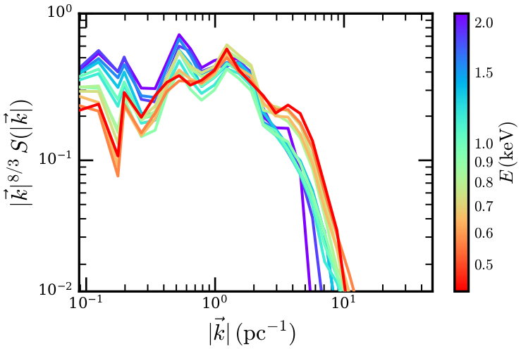
Quantifying energy-dependent spatial structure
Split into narrow energy bands reveals similar global structure
Soft energies (colder gas) show clumpier morphology
Hard bands (hot gas) with more large-scale structure
10‘

Slide 7
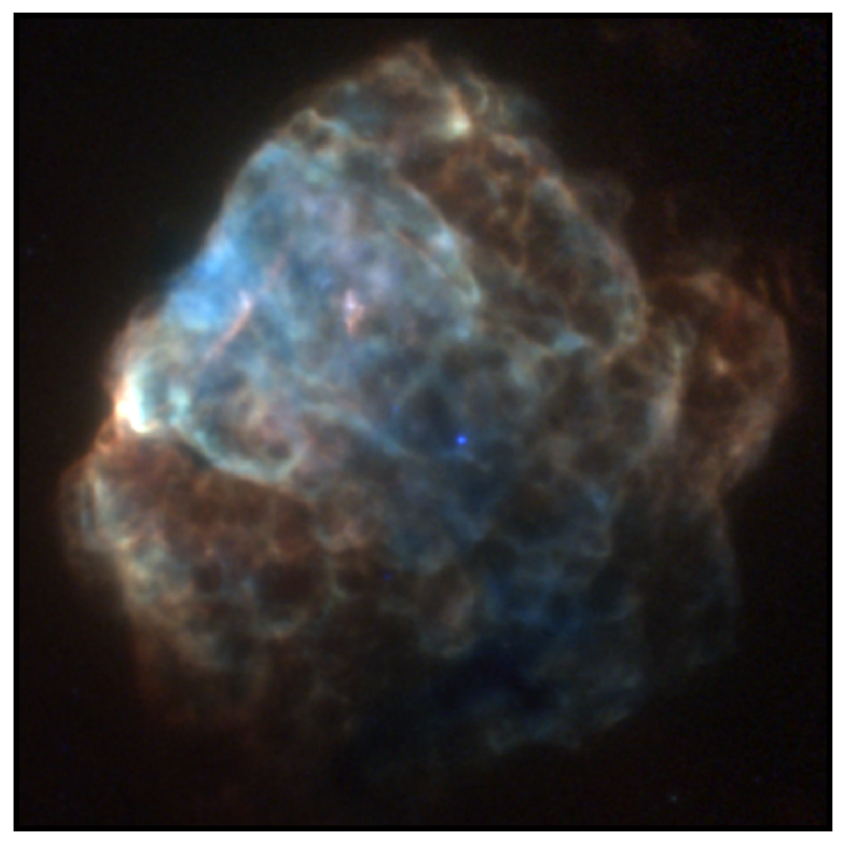
Relation to observed morphology?
10‘

Slide 8
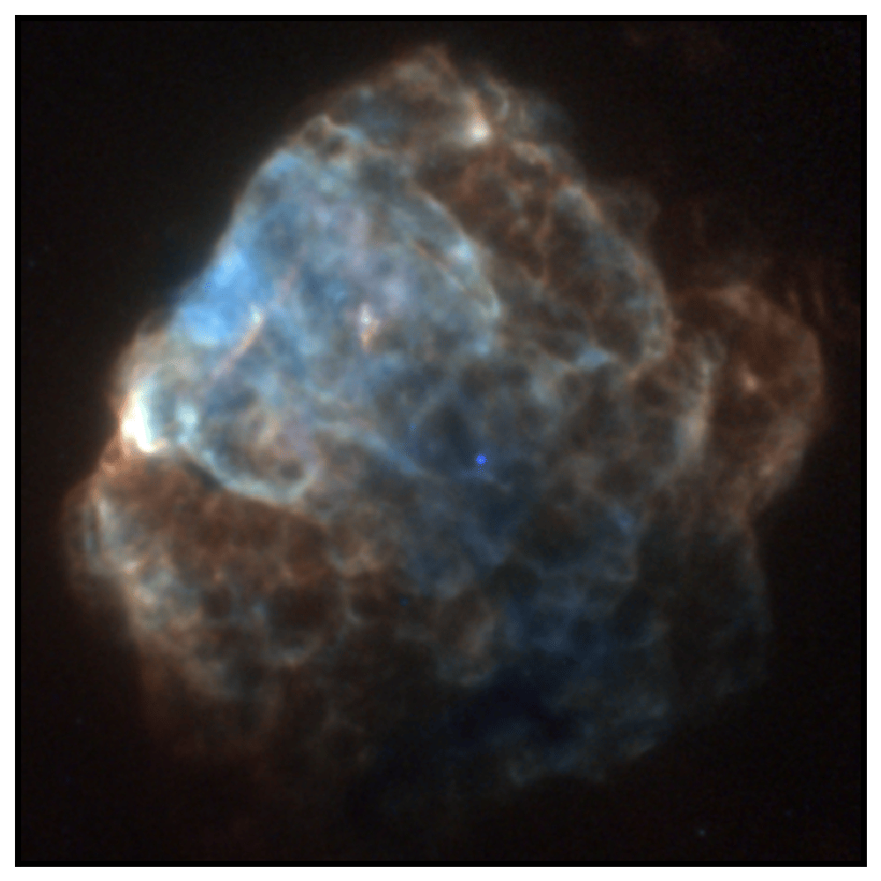
Relation to observed morphology?
10‘

Slide 9
Relation to observed morphology?
10‘

Slide 10
Relation to observed morphology?
10‘

Slide 11
Relation to observed morphology?
10‘

Slide 12
Relation to observed morphology?
10‘

Slide 13
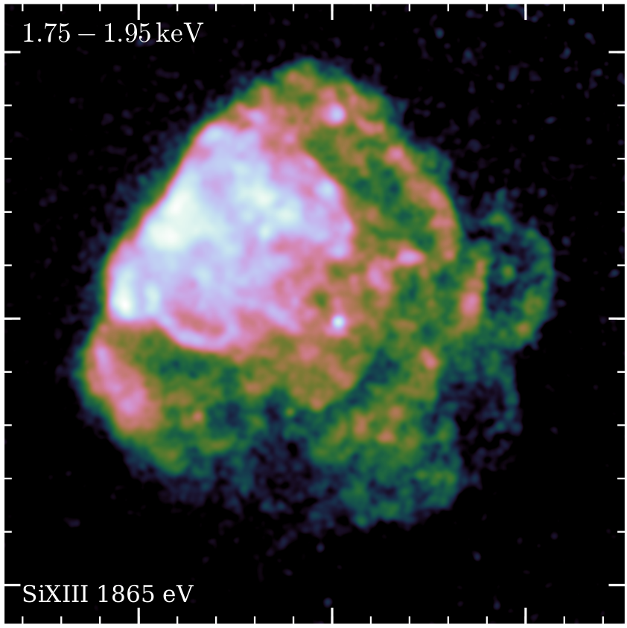
Cross-correlation between energy bands
r
r
r
r
Broad-band image
5 pc

Slide 14
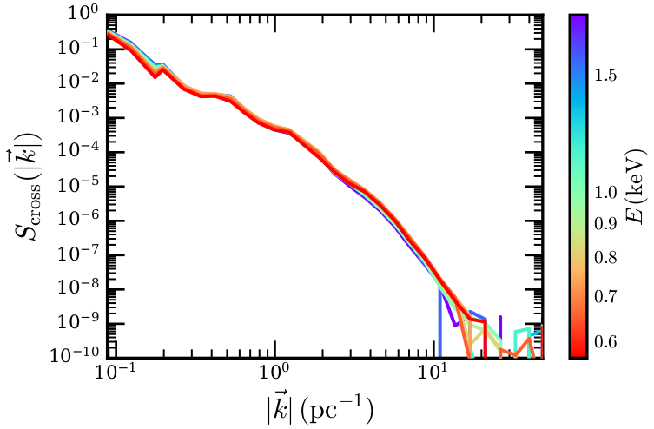
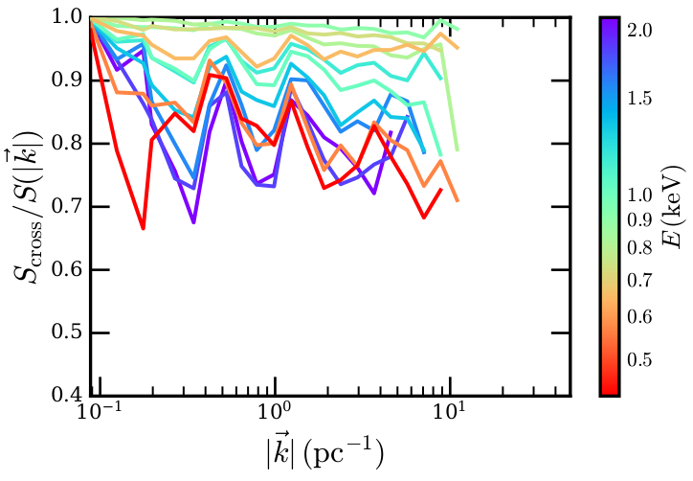
Cross-correlation between energy bands
Calculate cross-power spectrum between narrow bands and full band
Normalize to determine „coherence“ between energy bands
Strongest similarity at characteristic scales of filaments/clumps

Slide 15
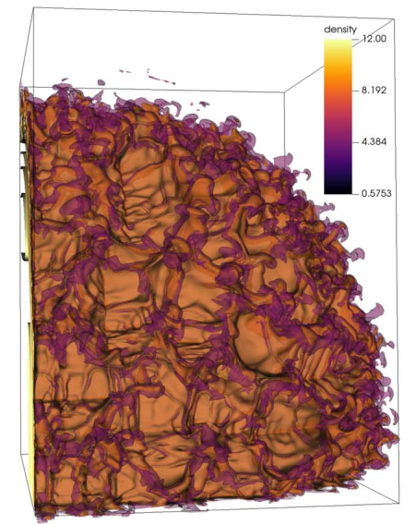
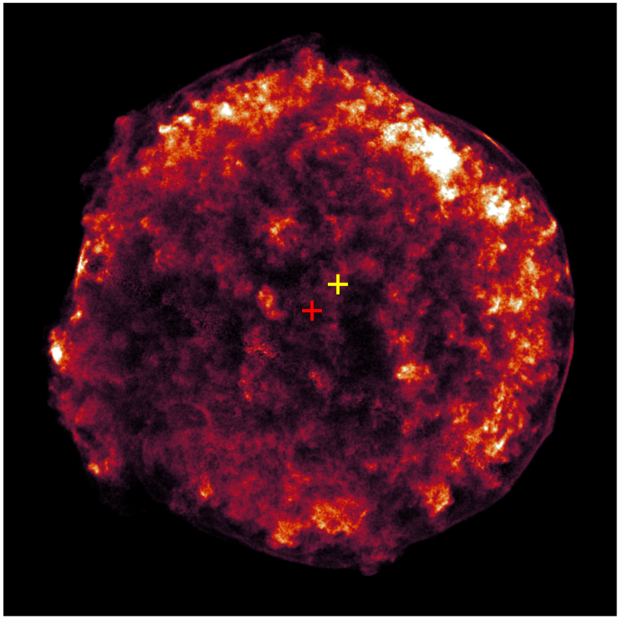
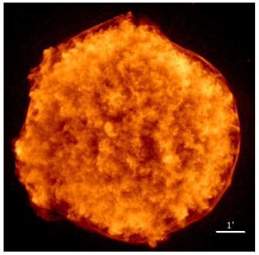
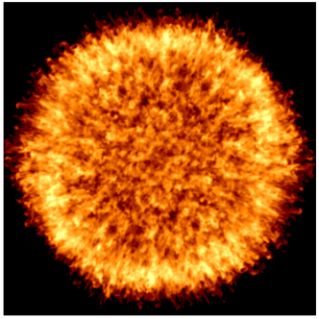
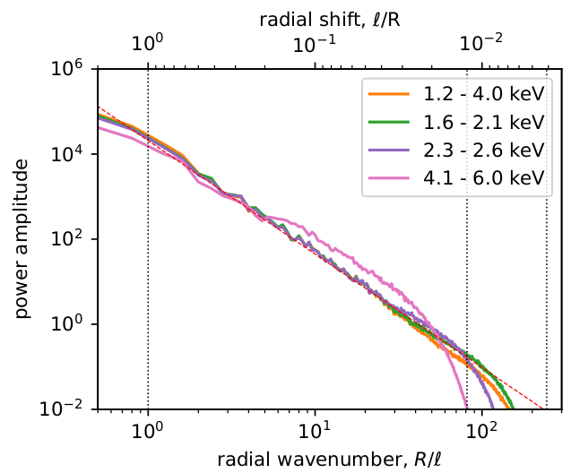
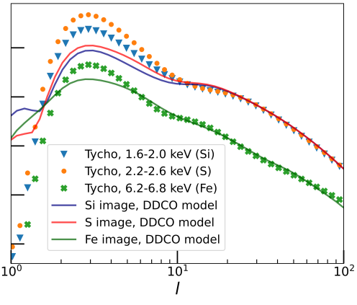
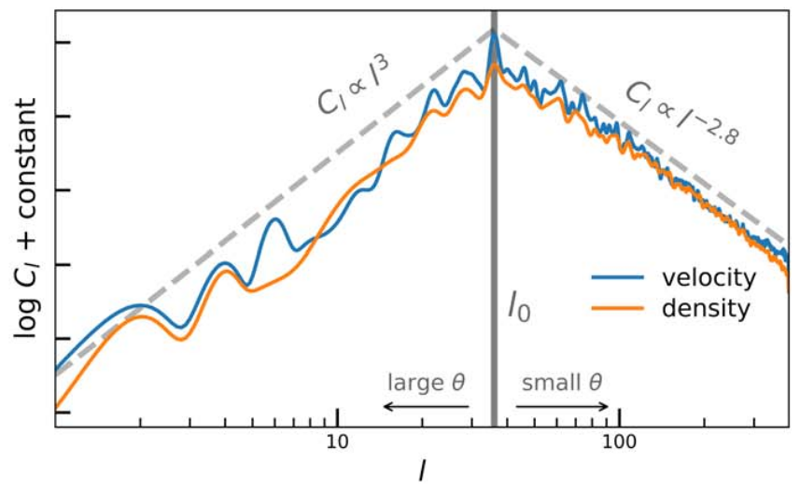
Applications of SNR power spectra
Tycho SNR in 1.2 – 4.0 keV
Petruk+25
Density contours of simulated SNR
Mandal+23
Observed vs. simulated Si-band image of Tycho
Mandal+25
Observationally: Quantify turbulent cascades, volume filling factors (e.g., Petruk+25, Saha+21)
Theoretically: Identify dominant angular modes in simulations (e.g., Mandal+23, Polin+22)
Combined: Identify origin of observed spatial features through simulations (e.g., Prete+25, Mandal+24,25)
Ideally: high spatial and spectral resolution to resolve lines in ejecta clumps
Angular power spectrum of simulated SNR
Mandal+23
Observed vs. simulated
Power spectra
Mandal+25
X-ray power-spectrum of Tycho
Petruk+25

Slide 16
Summary
Studying (X-ray) morphology of SNRs with power spectra
Puppis A: Turbulent cascade, excess power at parsec scales, more small-scale structure in colder gas
Quantitative comparison of observations and simulations without finetuning
Credit: NASA/CXC, Mayer+22,23

Slide 17
Extra Slides

Slide 18
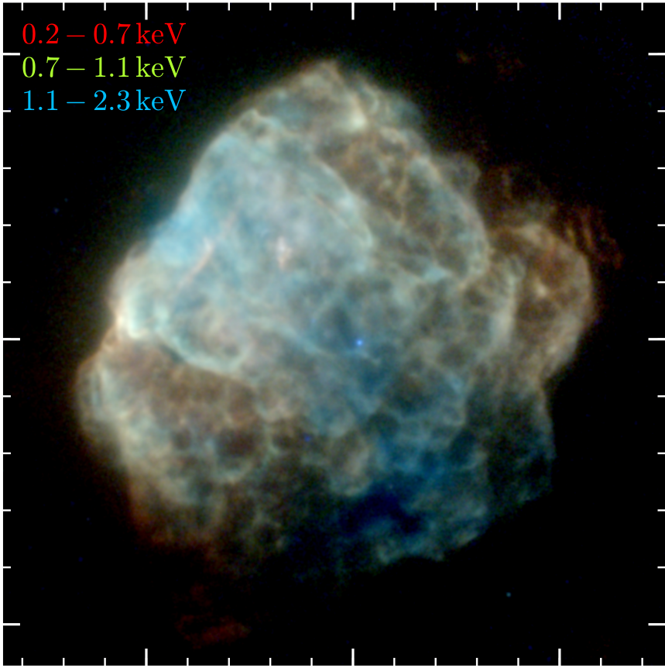
Introducing Puppis A
Core-collapse SNR
Central neutron star (Petre+96)
4000 yr old (Mayer+20, Winkler+88)
Interaction with dense ISM (Hwang+05)
eROSITA PV observation traces spectromorphological changes
Puppis A with eROSITA
Mayer+22
5 pc

Slide 19
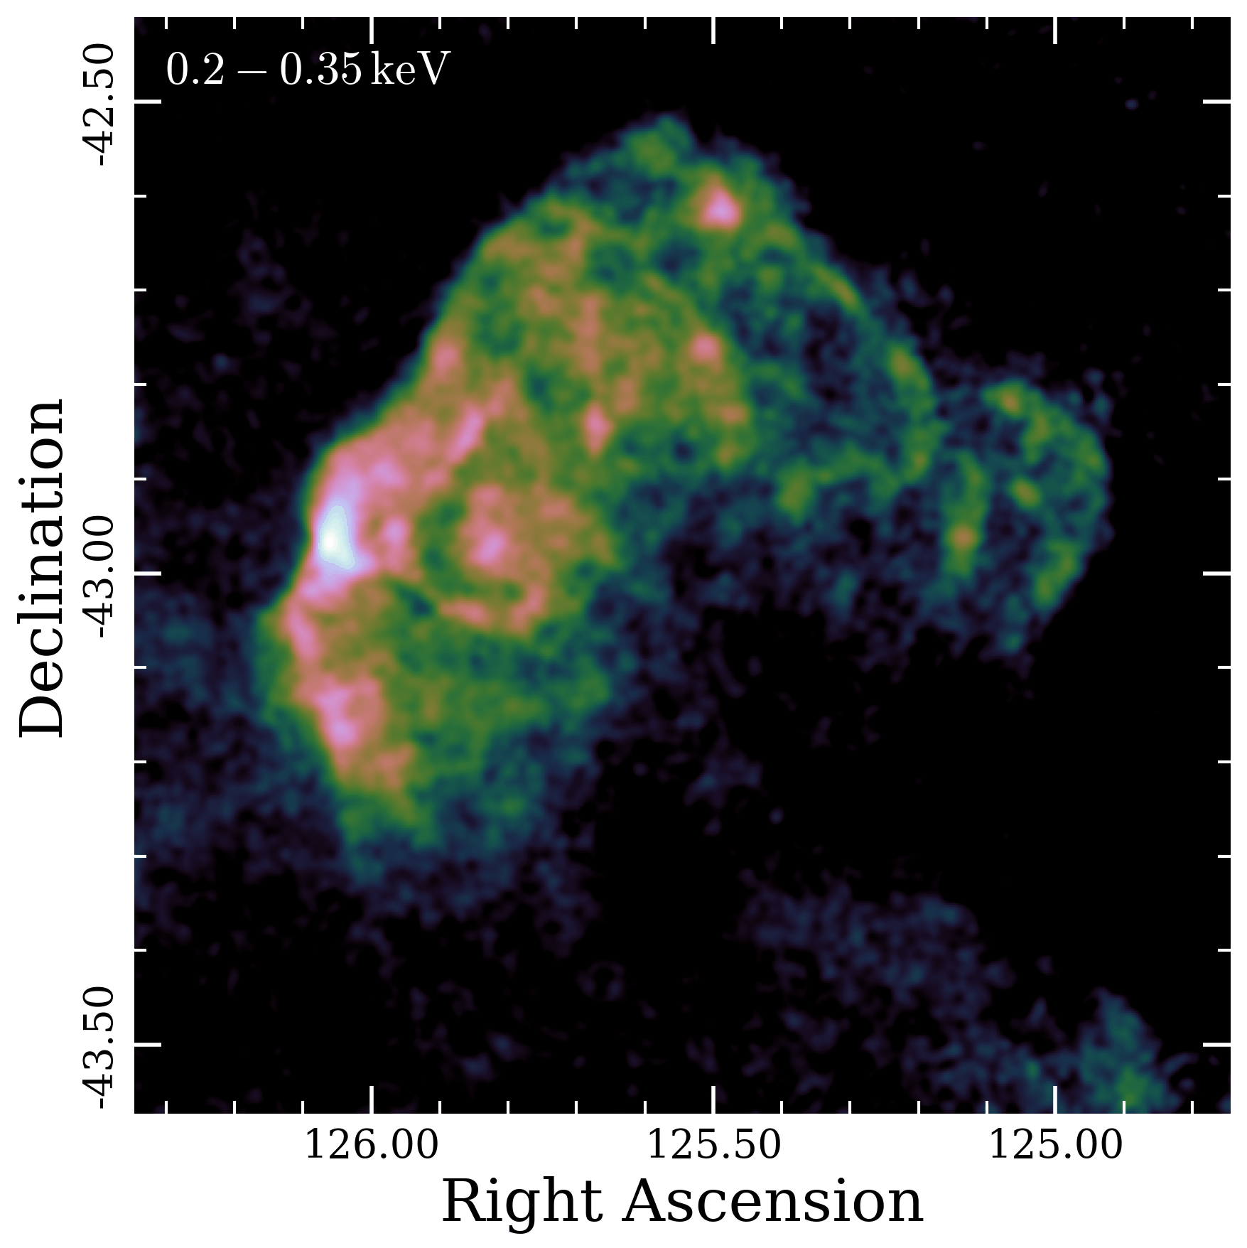
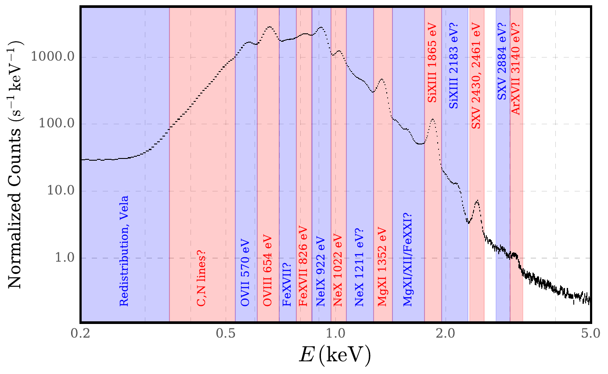
Introducing Puppis A
Core-collapse SNR
Central neutron star (Petre+96)
4000 yr old (Mayer+20, Winkler+88)
Interaction with dense ISM (Hwang+05)
eROSITA PV observation traces spectromorphological changes
Puppis A data cube
Mayer+22

Slide 20
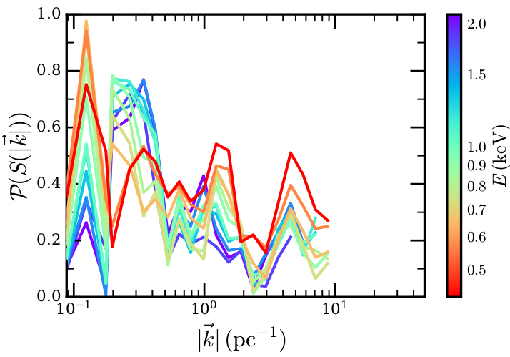
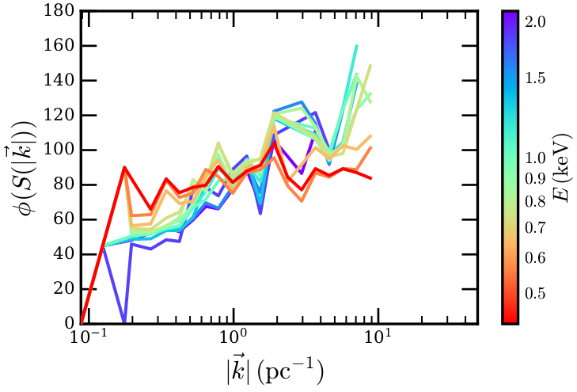
Quantifying asymmetries in spatial structure
Measure power in different azimuthal directions
Significant energy-dependent anisotropy at all scales
Direction of anisotropies evolves with spatial scale
Direction of anisotropy
Fraction of anisotropy
10‘

Slide 21
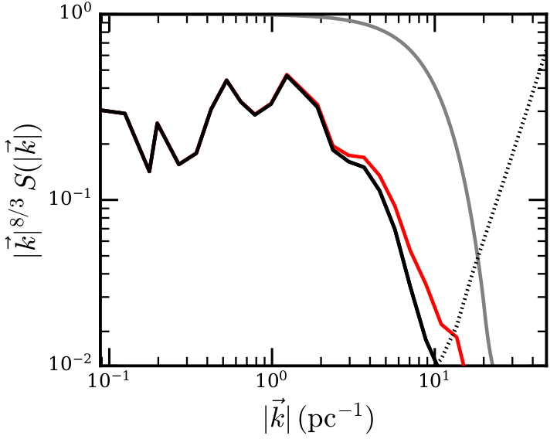
Impact of PSF shape
PSF-estimated power spectrum
PSF-corrected
power spectrum

Slide 22
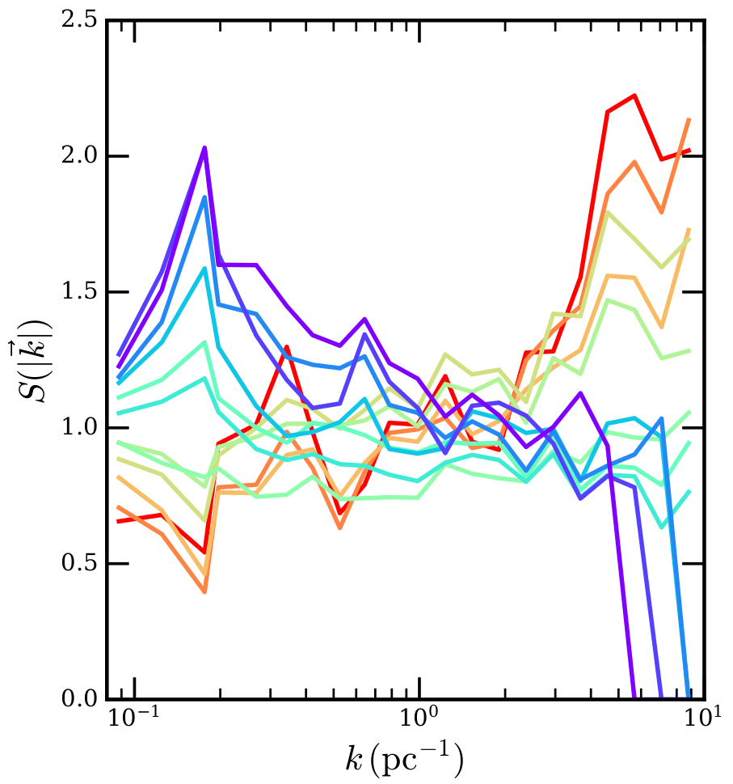
Relative energy band tendencies
Power spectrum divided by mean at given scale

Slide 23
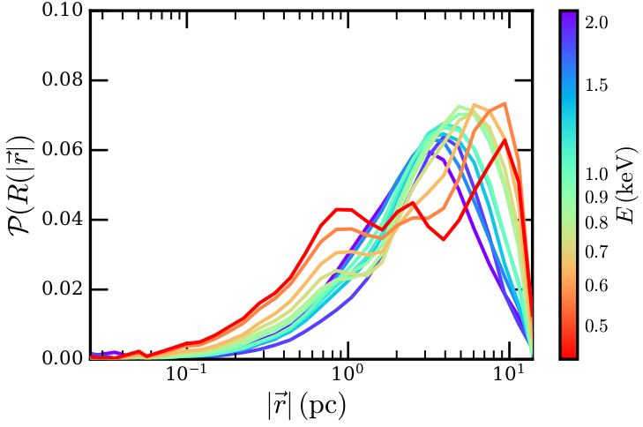
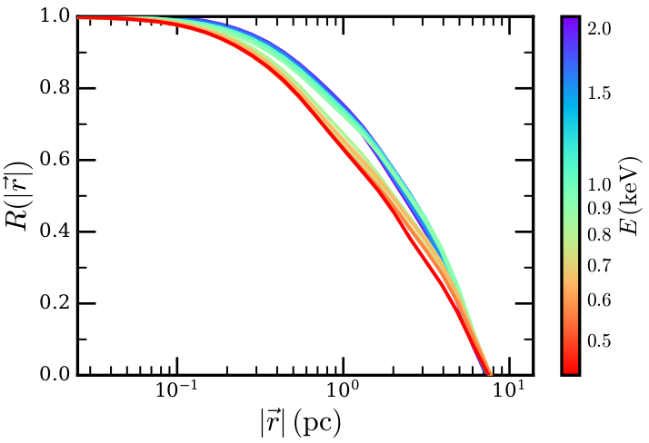
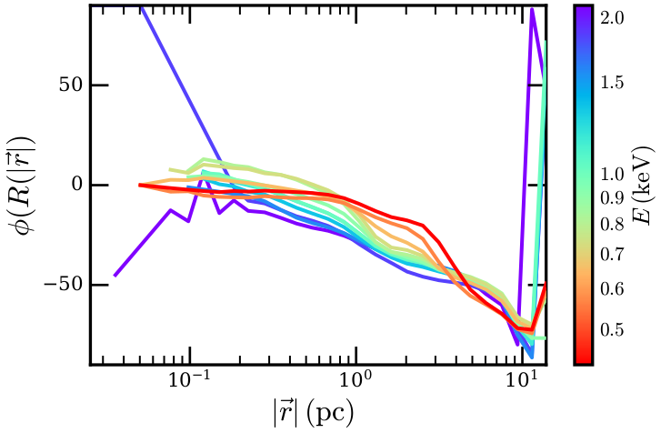
Using the Autocorrelation Function instead
Fraction of anisotropy
Direction of maximum correlation
10‘

Slide 24
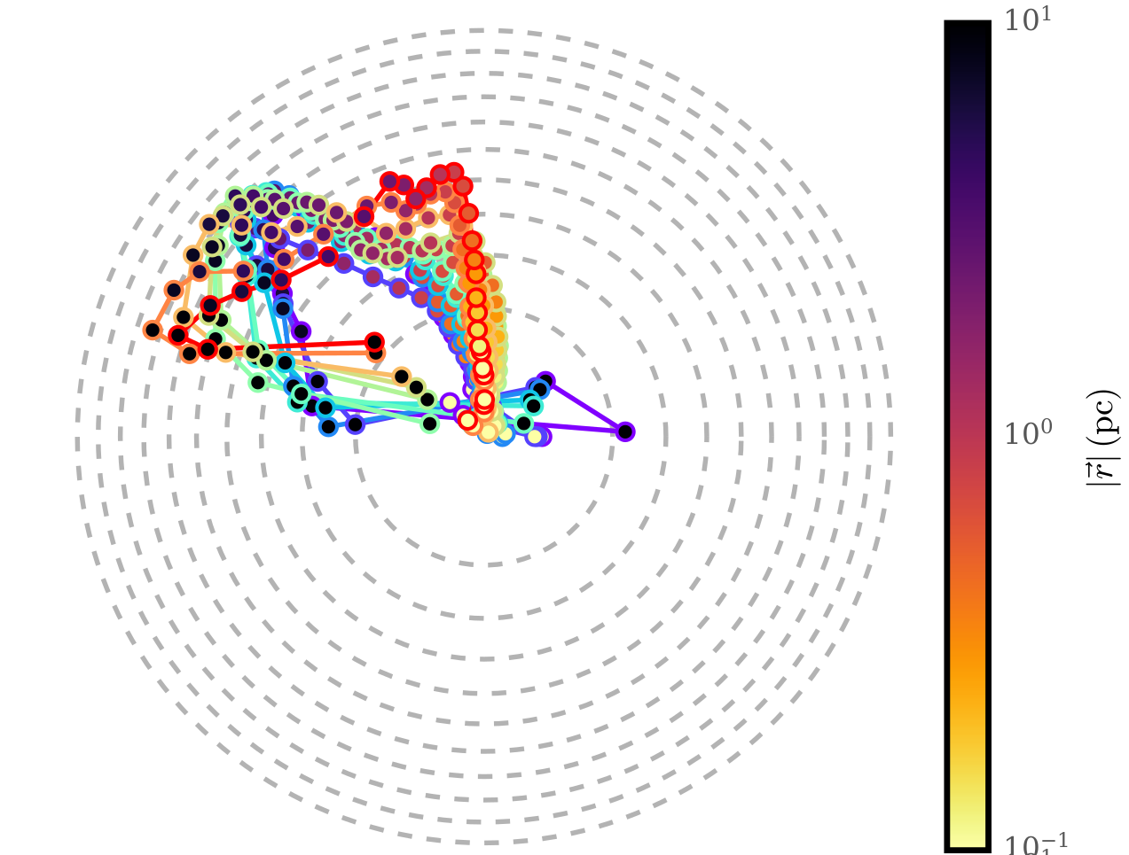
Anisotropy tracks in autocorrelation function

Slide 25
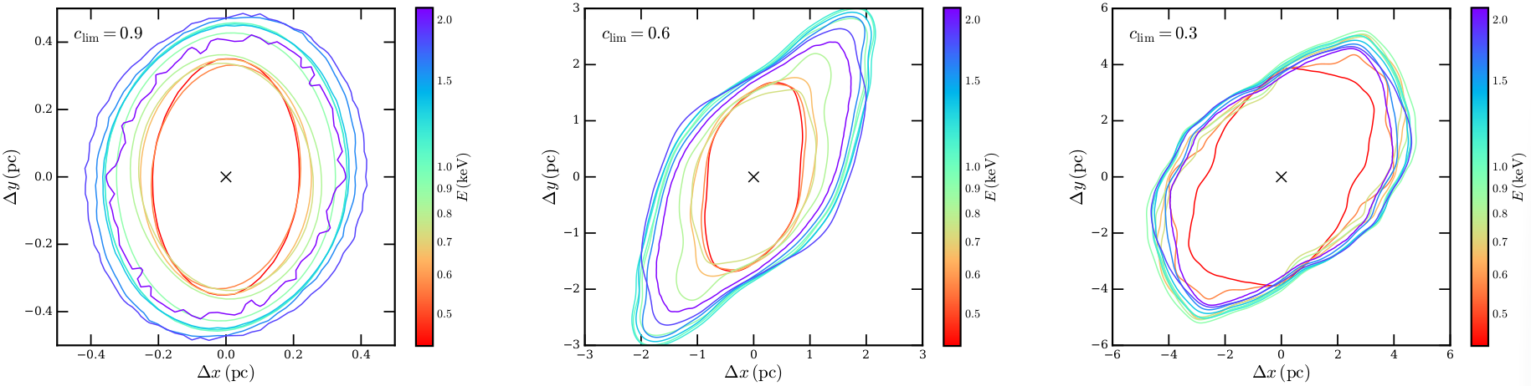
Correlation lengths dependent on energy

