Slide 1


Dendrogram clustering and quantum extreme learning for the study of supernova remnants images and optically-thin X-ray spectra
Marco Miceli
Department of Physics and Chemistry E. Segrè, University of Palermo - Italy
INAF-Observatory of Palermo - Italy

Slide 2



The project
QELM for spectral analysis
Dendrogram clustering for image analysis
Cross-fertilization grant at the Department of Physics and Chemistry (University of Palermo): Application of techniques adopted in the study of complex systems and in Quantum AI for the analysis of astrophysical X-ray observations

Slide 3
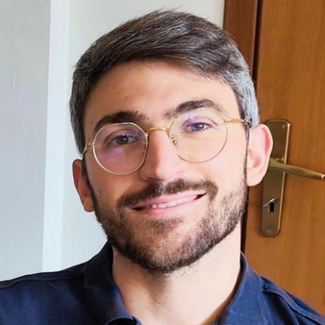
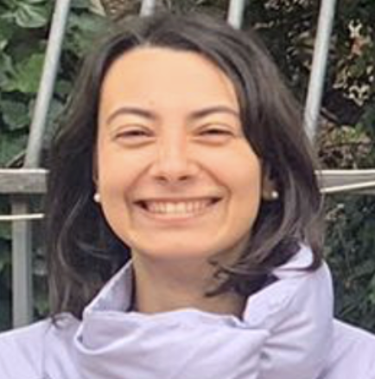
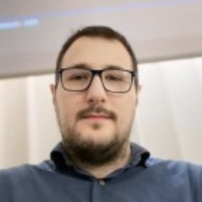
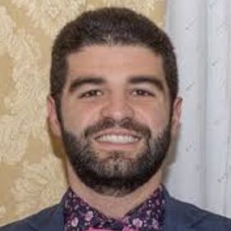
The people
Marco Miceli
Vincenzo Sapienza (INAF/UniPa)
Emanuele Greco (INAF)
Salvatore Orlando (INAF)
Salvatore Micciché
Rosario N. Mantegna
Giulia Parisi
Salvatore Calderaro
Massimo Palma
Salvatore Lorenzo
Marco Vetrano

Slide 4
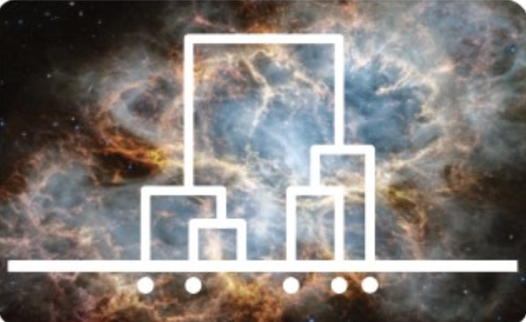
Part 1
Dendrogram-based study of SNR maps

Slide 5
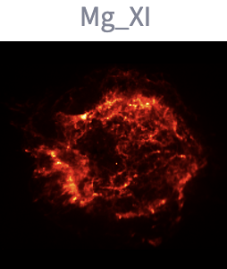
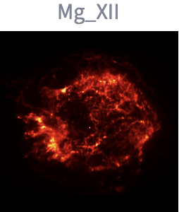
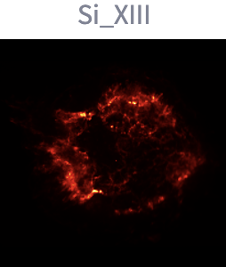
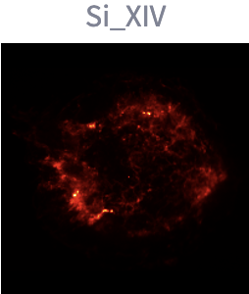
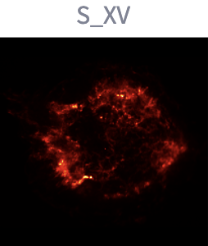
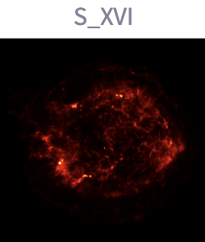
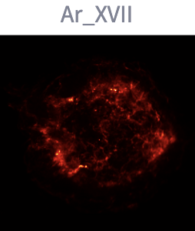
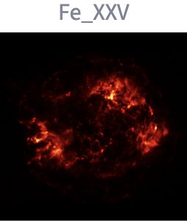
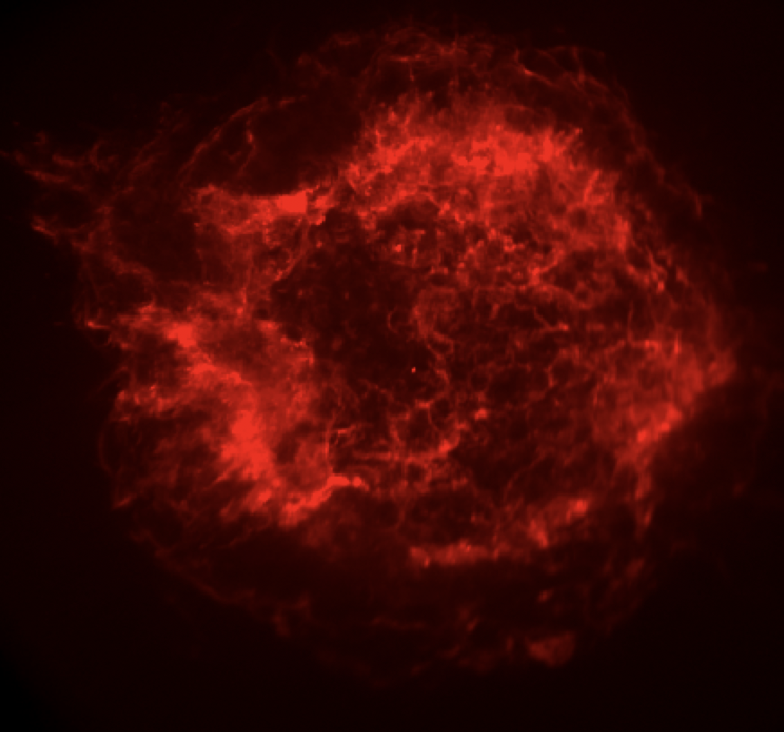
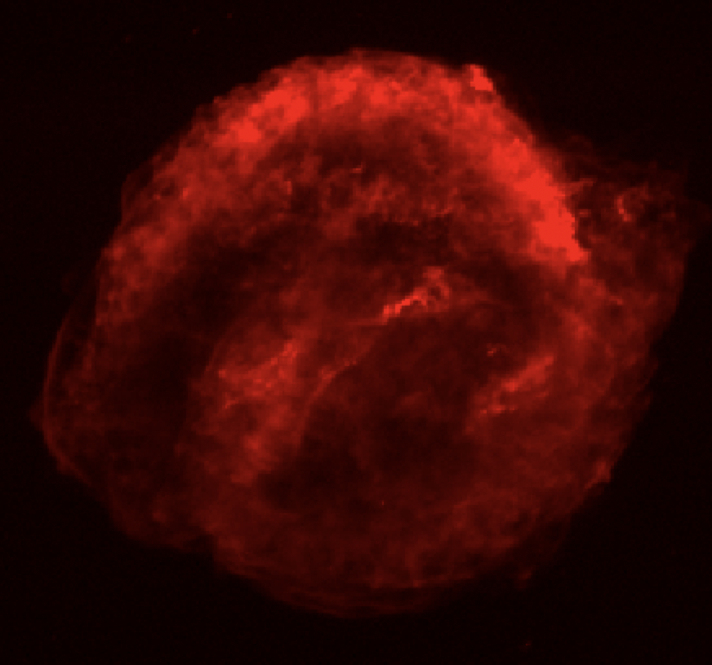
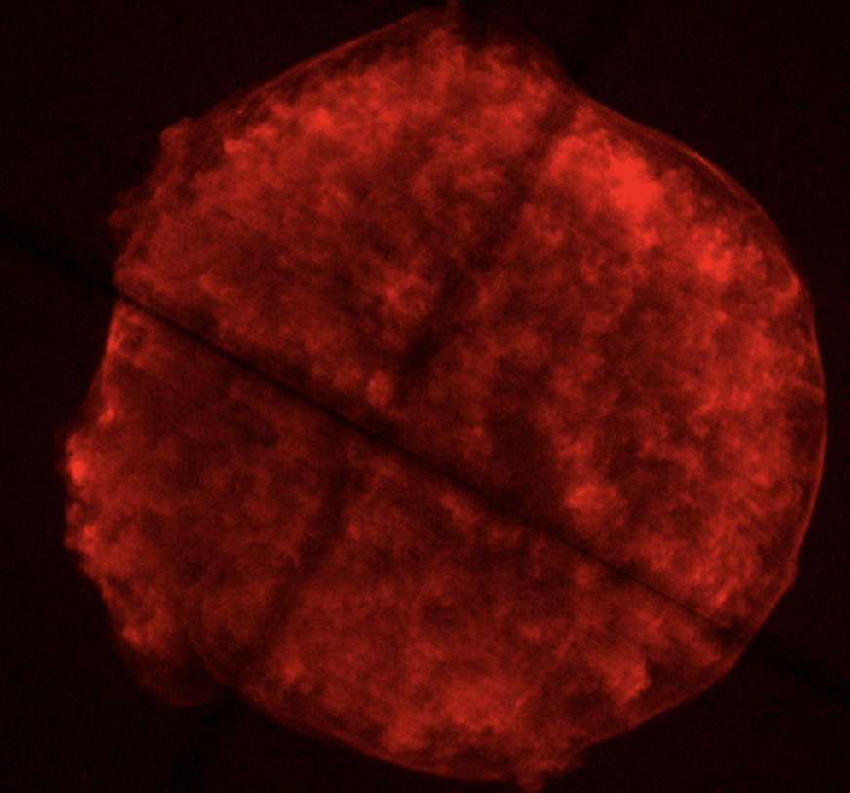
Dendrogram-based study of SNR maps
Aims:
Quantify similarities/differences among different narrow-band images (EW maps) of a given SNR
Cas A Kepler’s SNR Tycho’s SNR
Quantify similarities/differences among different SNRs

Slide 6
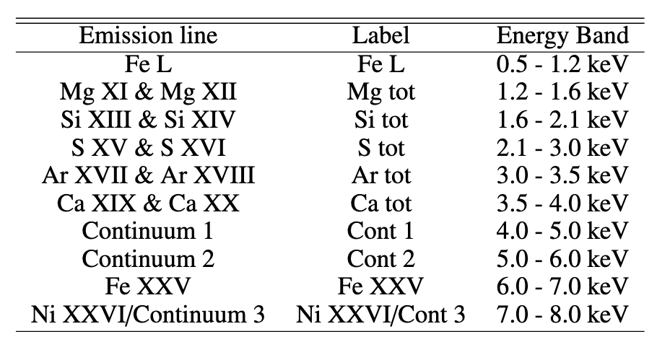
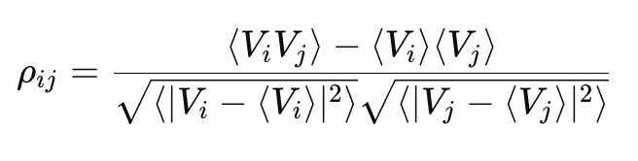
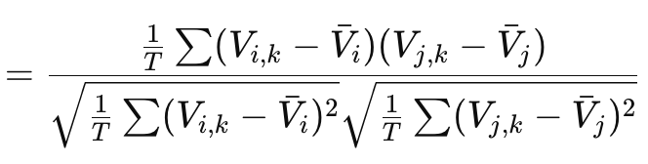

Dendrogram-based study of SNR maps
We produce narrow-band images and EW maps from Chandra archive observations of Cas A, G292.0+1.8, Kepler’s SNR, Tycho’s SNR, W49B and synthetic Chandra images from the MHD simulation of Cas A (Orlando et al. 2022).
We introduce a metrics, e.g.
Pearson coefficient
And calculate the distance between two images
We also investigated different metrics (Frobenius inner product, cosine) and results do not change significantly

Slide 7
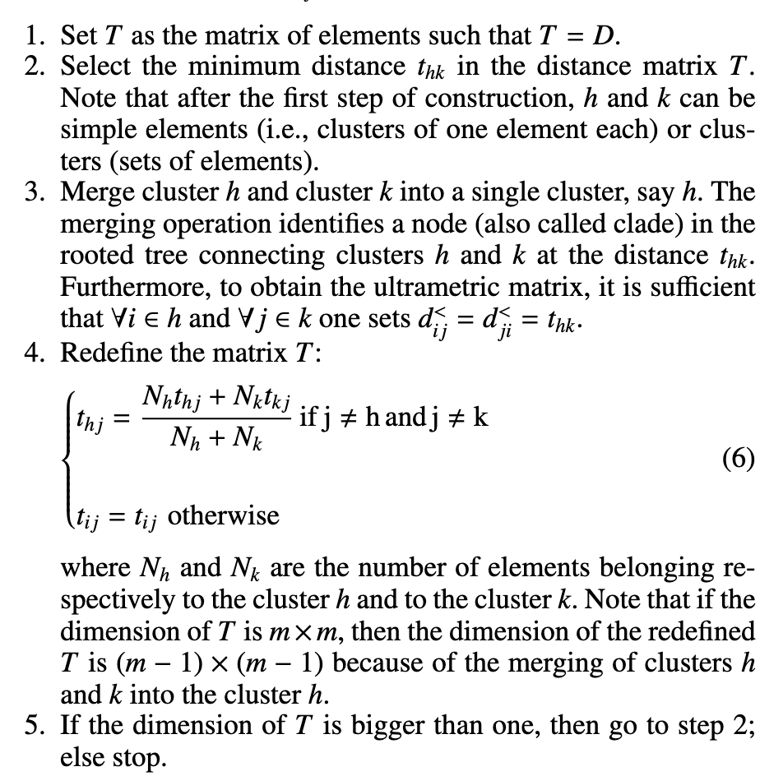

Dendrogram-based study of SNR maps
We implement a hierarchical clustering procedure on the distance matrix D, using ALCA (Average Linkage Cluster Analysis):
average of all pairwise distances
between clusters

Slide 8
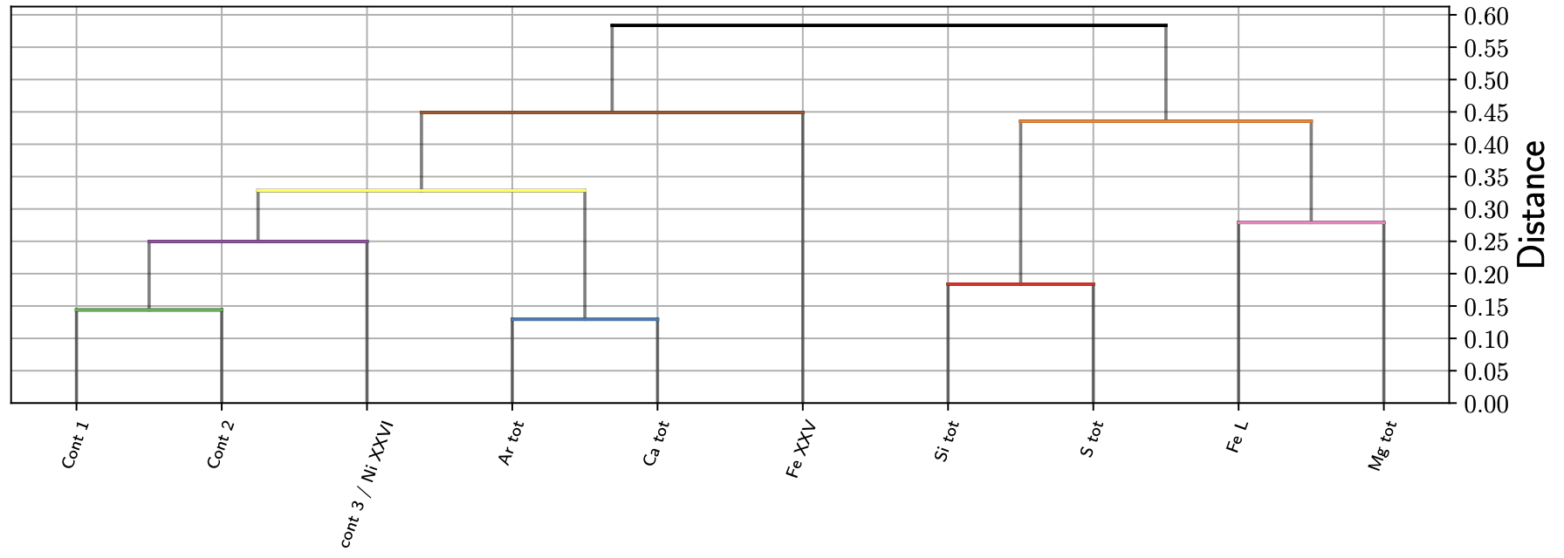
Dendrogram-based study of SNR maps: results
Cassiopeia A
Calderaro et al. in prep

Slide 9
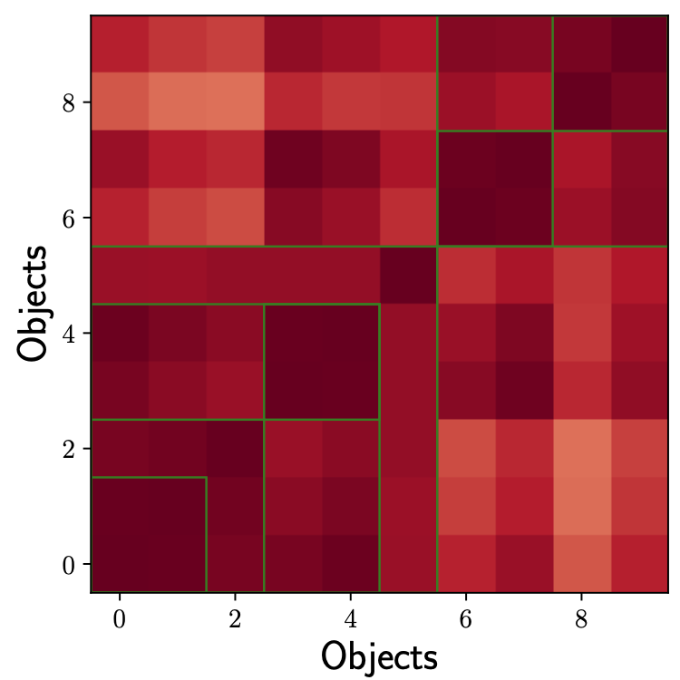
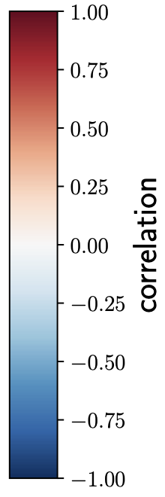
Dendrogram-based study of SNR maps: results
Cassiopeia A
Calderaro et al. in prep

Slide 10
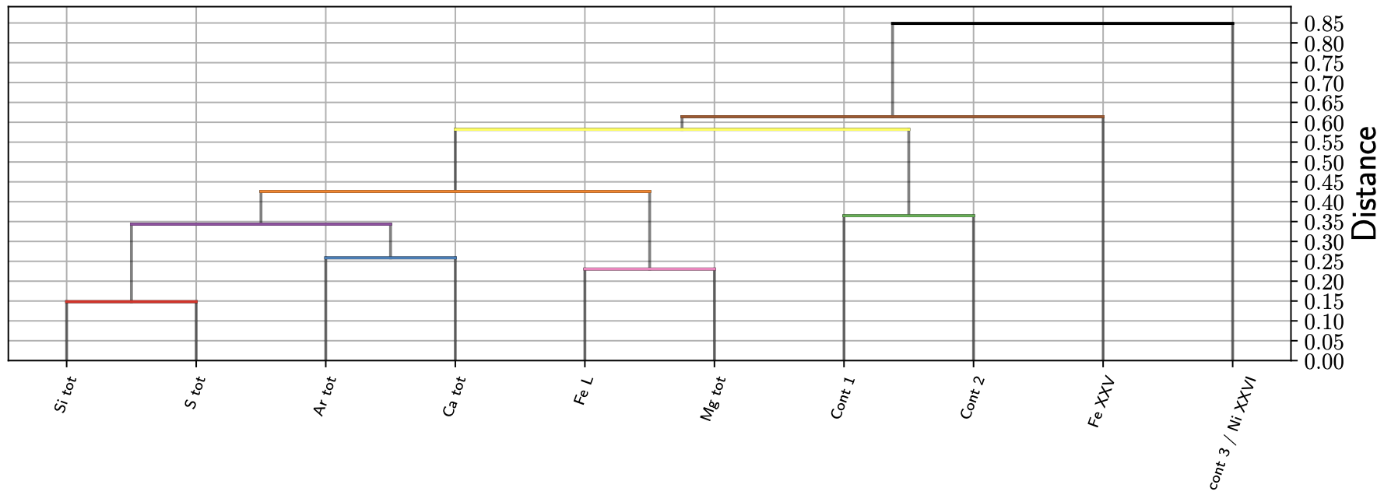
Dendrogram-based study of SNR maps: results
Kepler’s SNR
Similar results by using EW maps
Calderaro et al. in prep

Slide 11
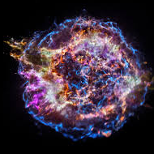
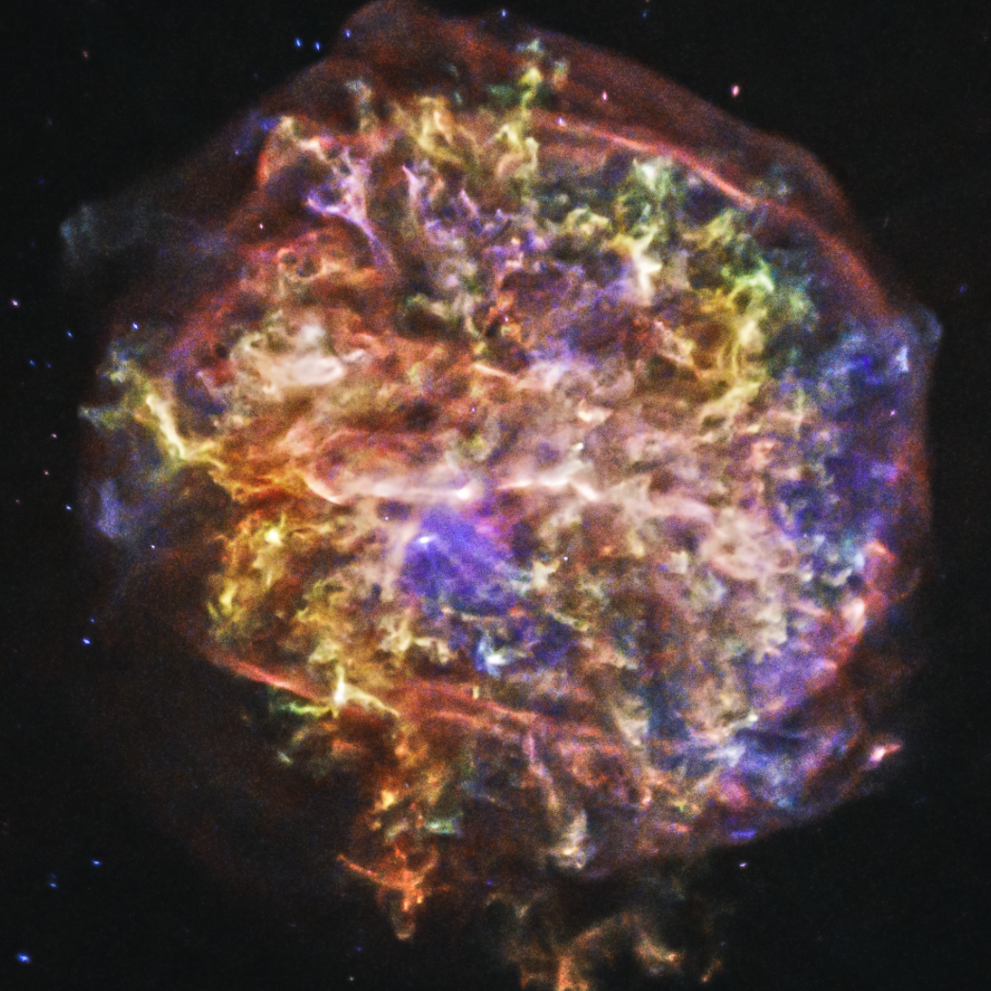
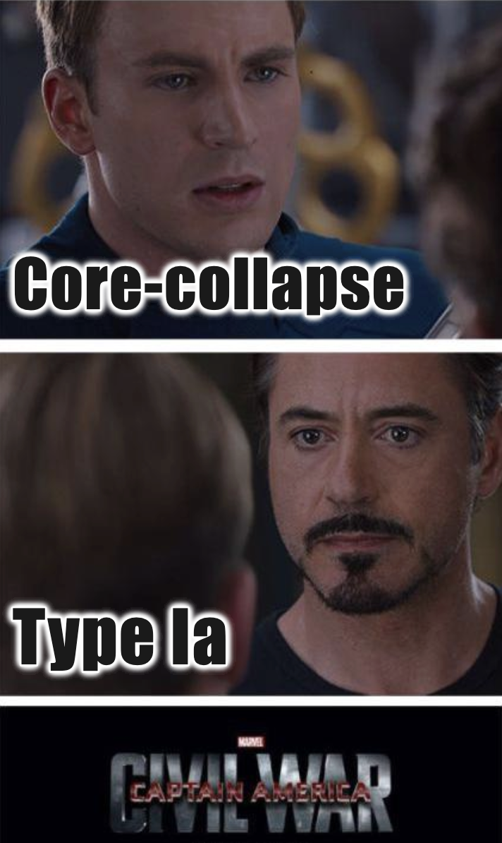
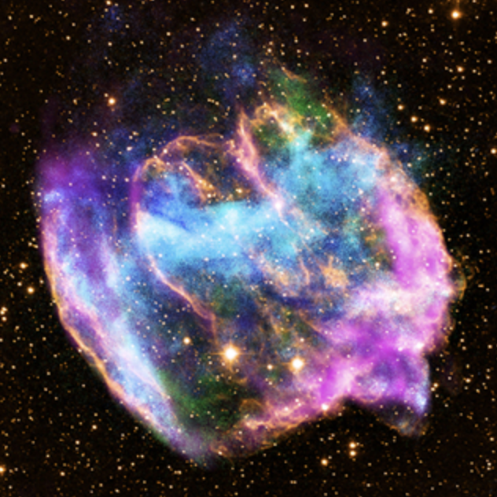
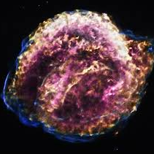
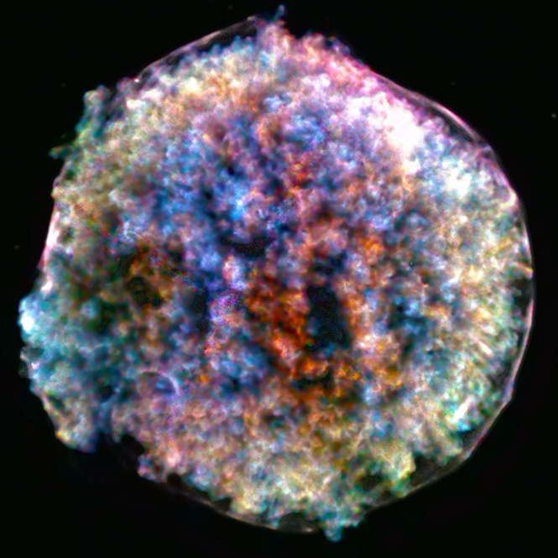
Dendrogram-based study of SNR maps: results
We produce a hierarchical clustering considering al the narrow band images (and EW maps) of the five remnant under exams
Cas A G292.0+1.8
W49B
Core-collapse
Kepler Tycho
Type Ia

Slide 12
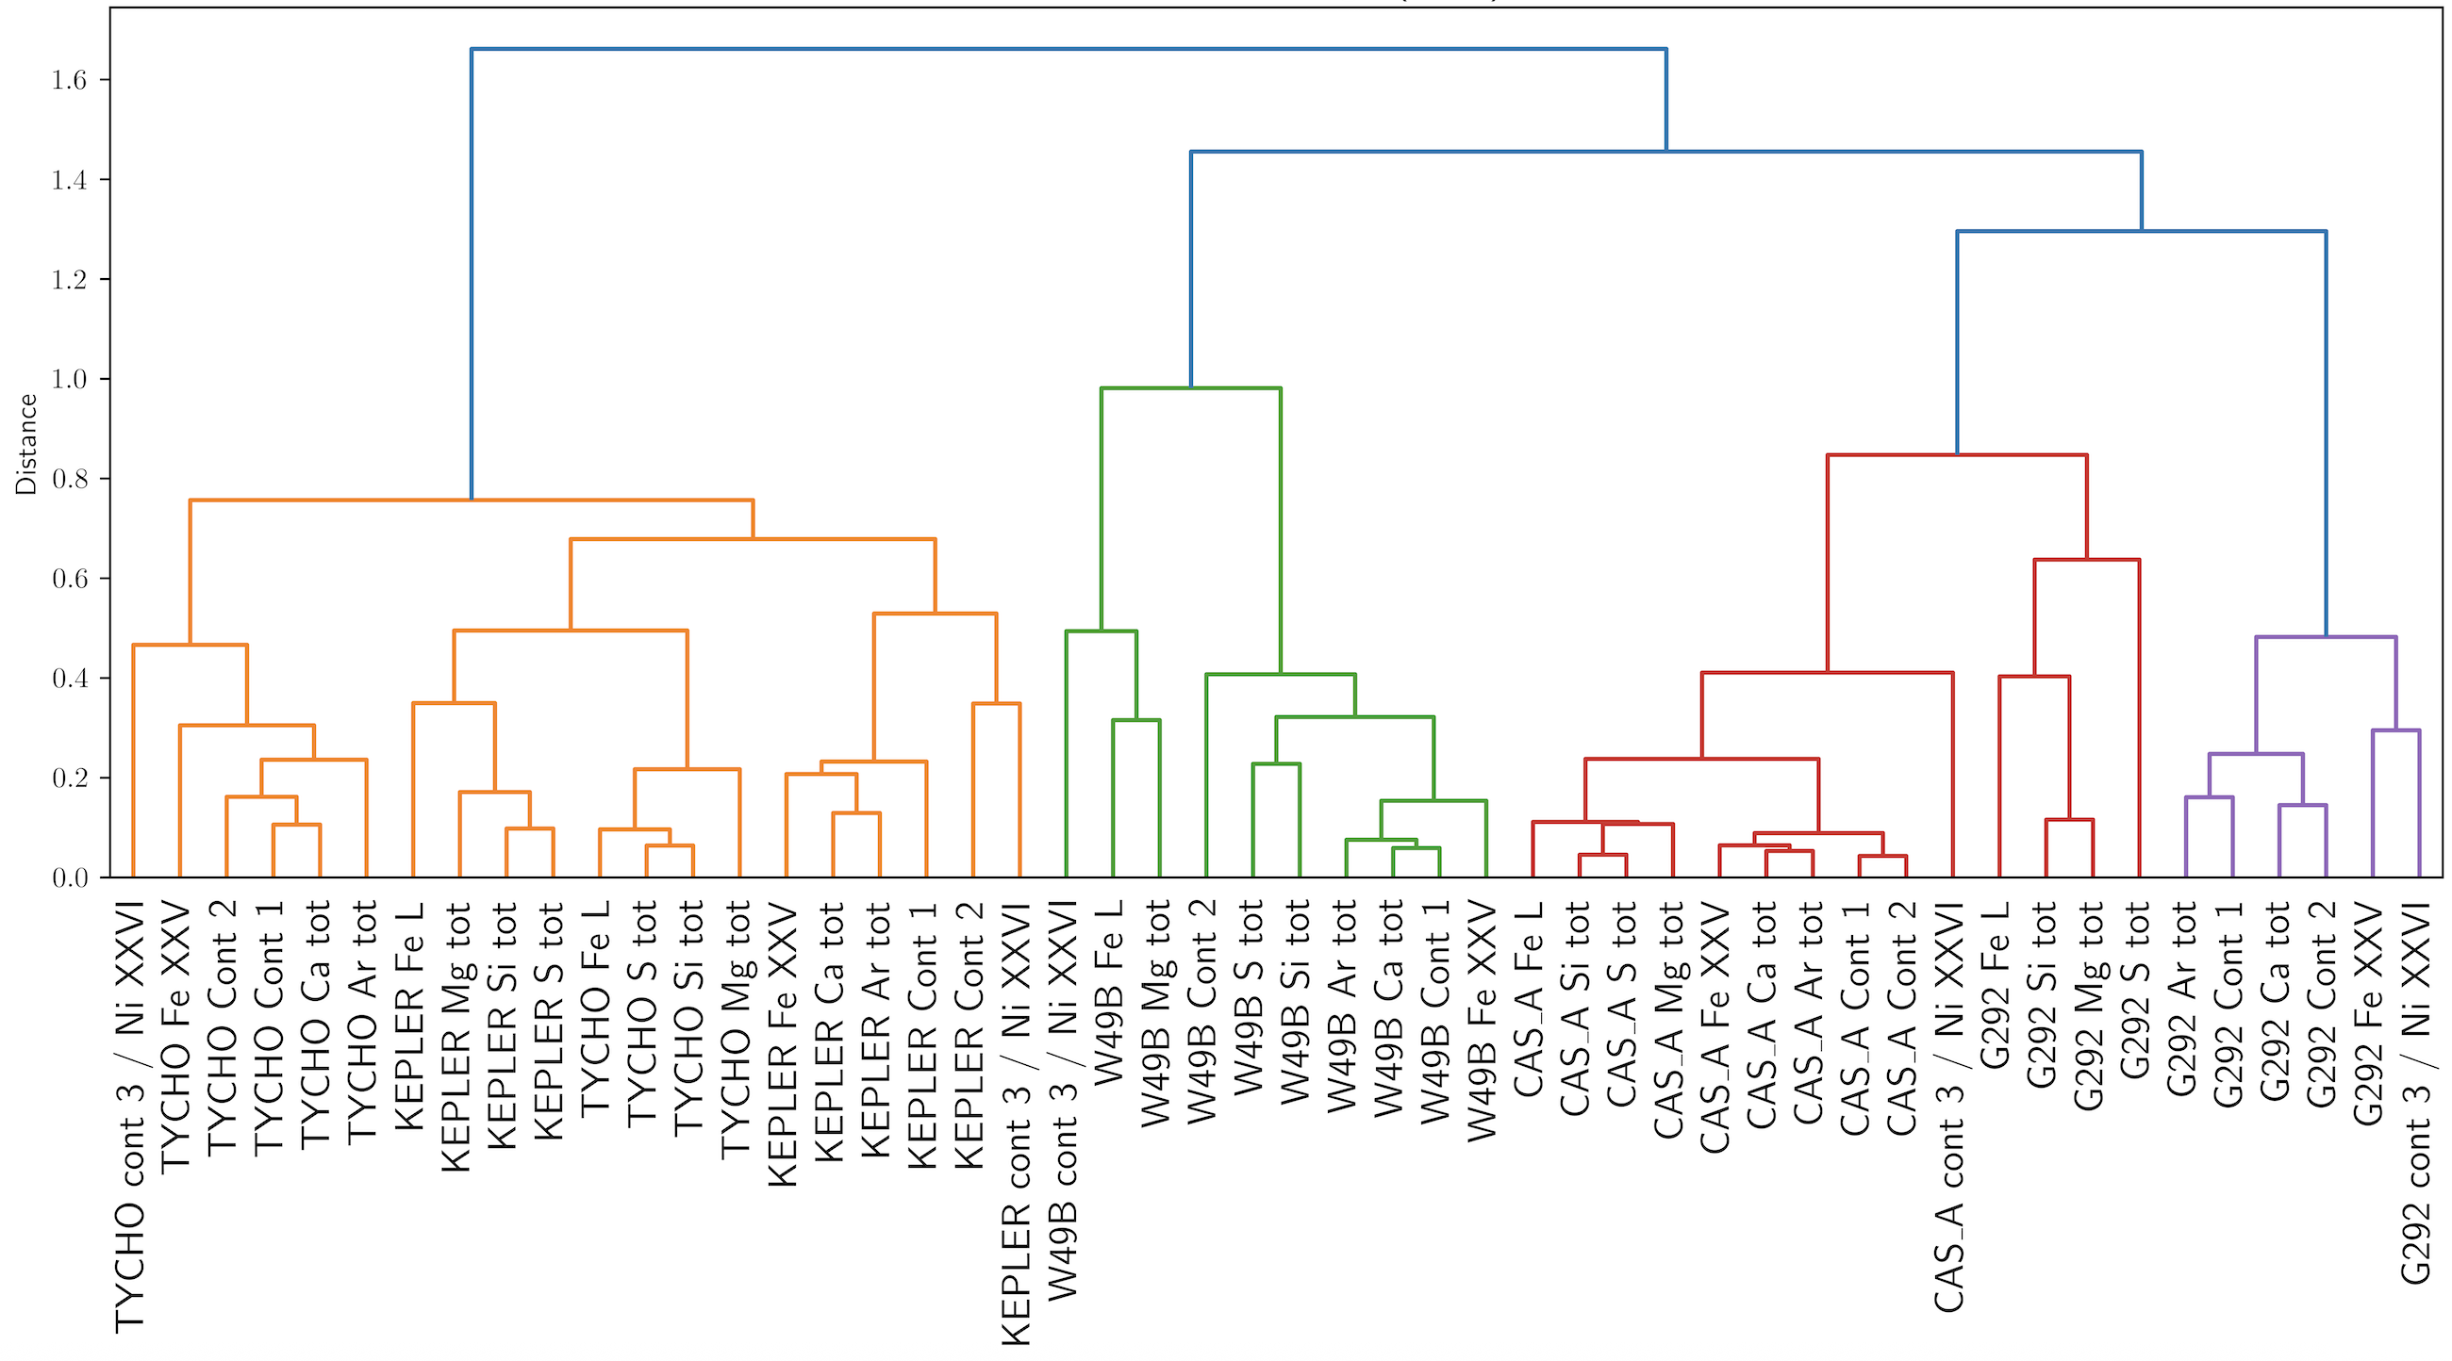

Dendrogram-based study of SNR maps: results
Calderaro et al. in prep

Slide 13
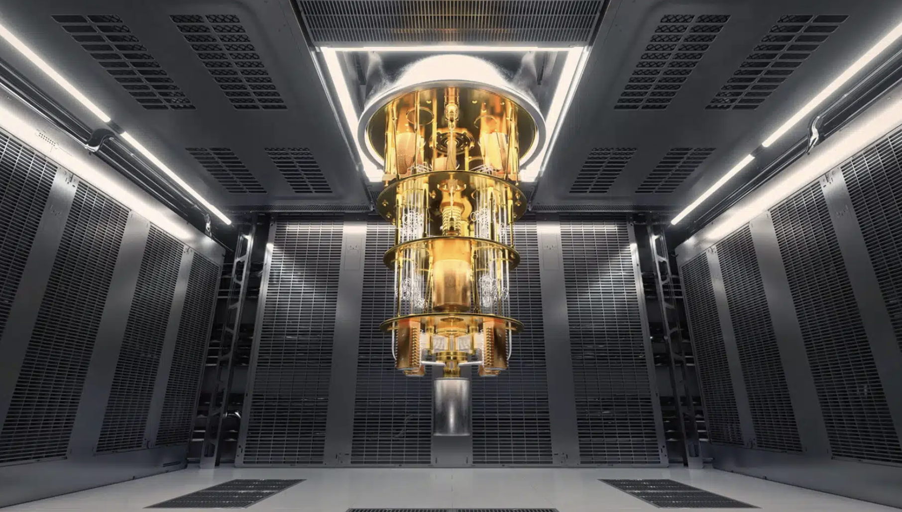
Part 2
Quantum extreme learning
for X-ray spectral analysis

Slide 14
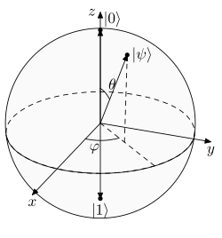
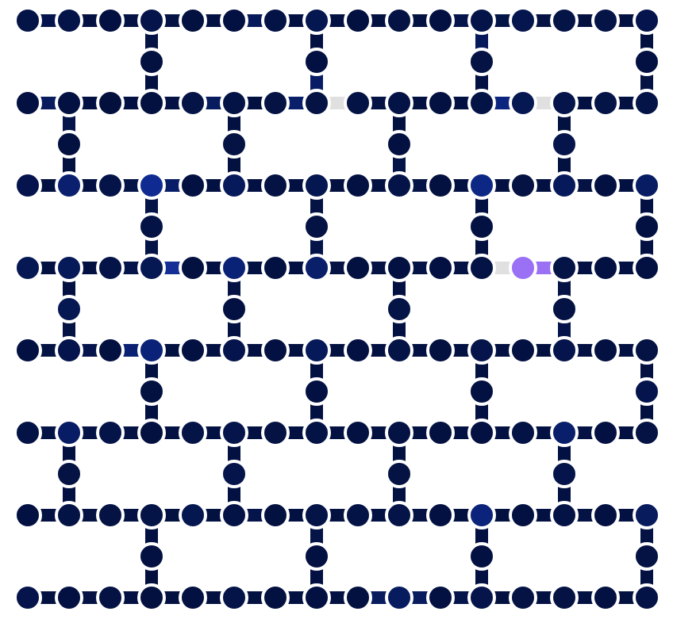
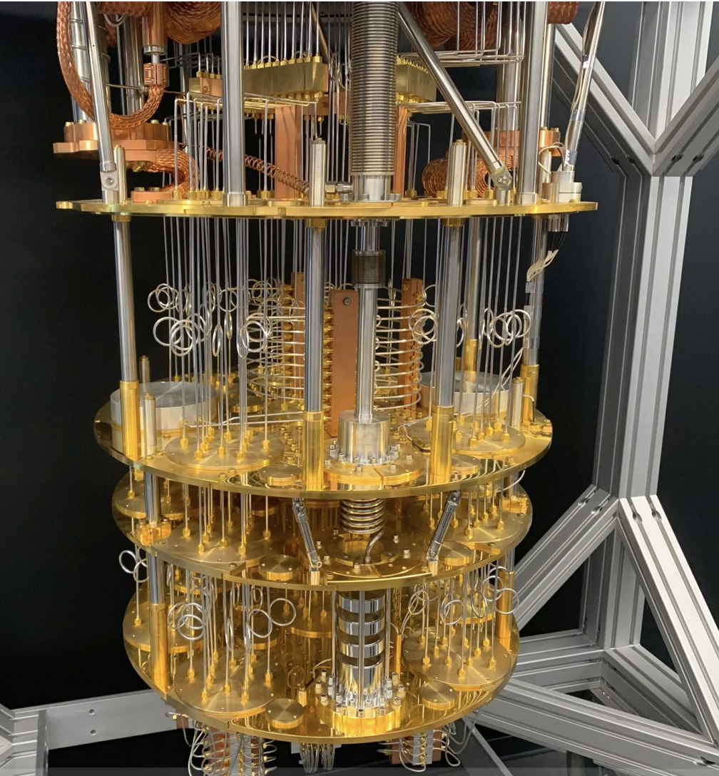
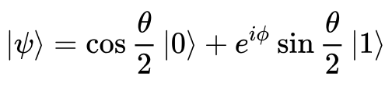
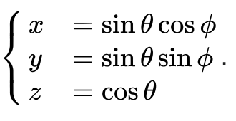
Quantum computers and Qbits
Qubit (Bloch sphere)
Unitary evolution provides a pure state on the surface of the sphere
IBM Fez (156 Qbits)

Slide 15
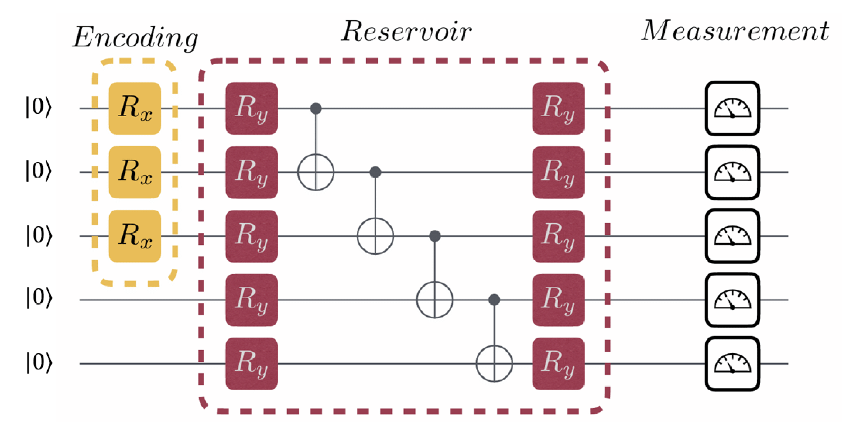
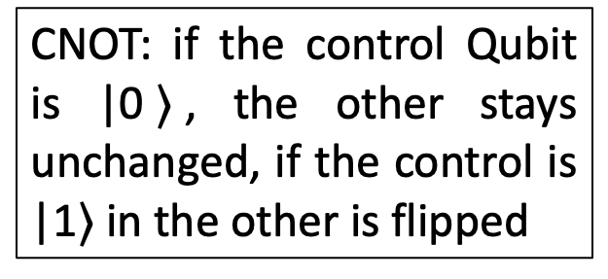
Quantum Extreme Learning
Quantum encoding of the input (R_{x}: vector rotation about x-axis)
The quantum computer acts as a neural network with logical gates to generate entanglement among Qubits (R_{y}: vector rotation about y-axis)
CNOT: if the control Qubit is |0$〉$, the other stays unchanged, if the control is |1$〉$ in the other is flipped

Slide 16
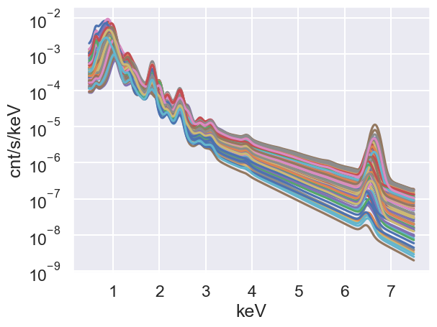
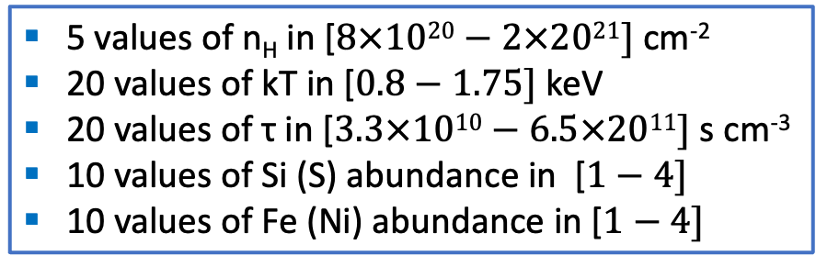
Quantum Extreme Learning for X-ray spectral analysis
We generate 200,000 synthetic EPIC-pn spectra of an optically thin thermal plasma in non equilibrium of ionization (including interstellar absorption) and assuming (up to now) infinite t_{exp}, where the “local minima nightmare” (Acero 2026) is very scary:
5 values of n_{H} in [$8×1020−2×2021]$ cm⁻²
20 values of kT in [$0.8−1.75]$ keV
20 values of τ in [$3.3×1010−6.5×2011]$ s cm⁻³
10 values of Si (S) abundance in [$1−4]$
10 values of Fe (Ni) abundance in [$1−4]$

Slide 17
Quantum Extreme Learning for X-ray spectral analysis
The Rx are tuned to encode the spectra (on the basis of a PCA analysis permormed on selected bands), Ry are chosen are chosen randomly, but uniquely.
Simulations on the actual Quantum Computer are ongoing. We simulated the IBM Fez (without including the device noise, which will likely worsen the efficiency of parameter retrieval)

Slide 18
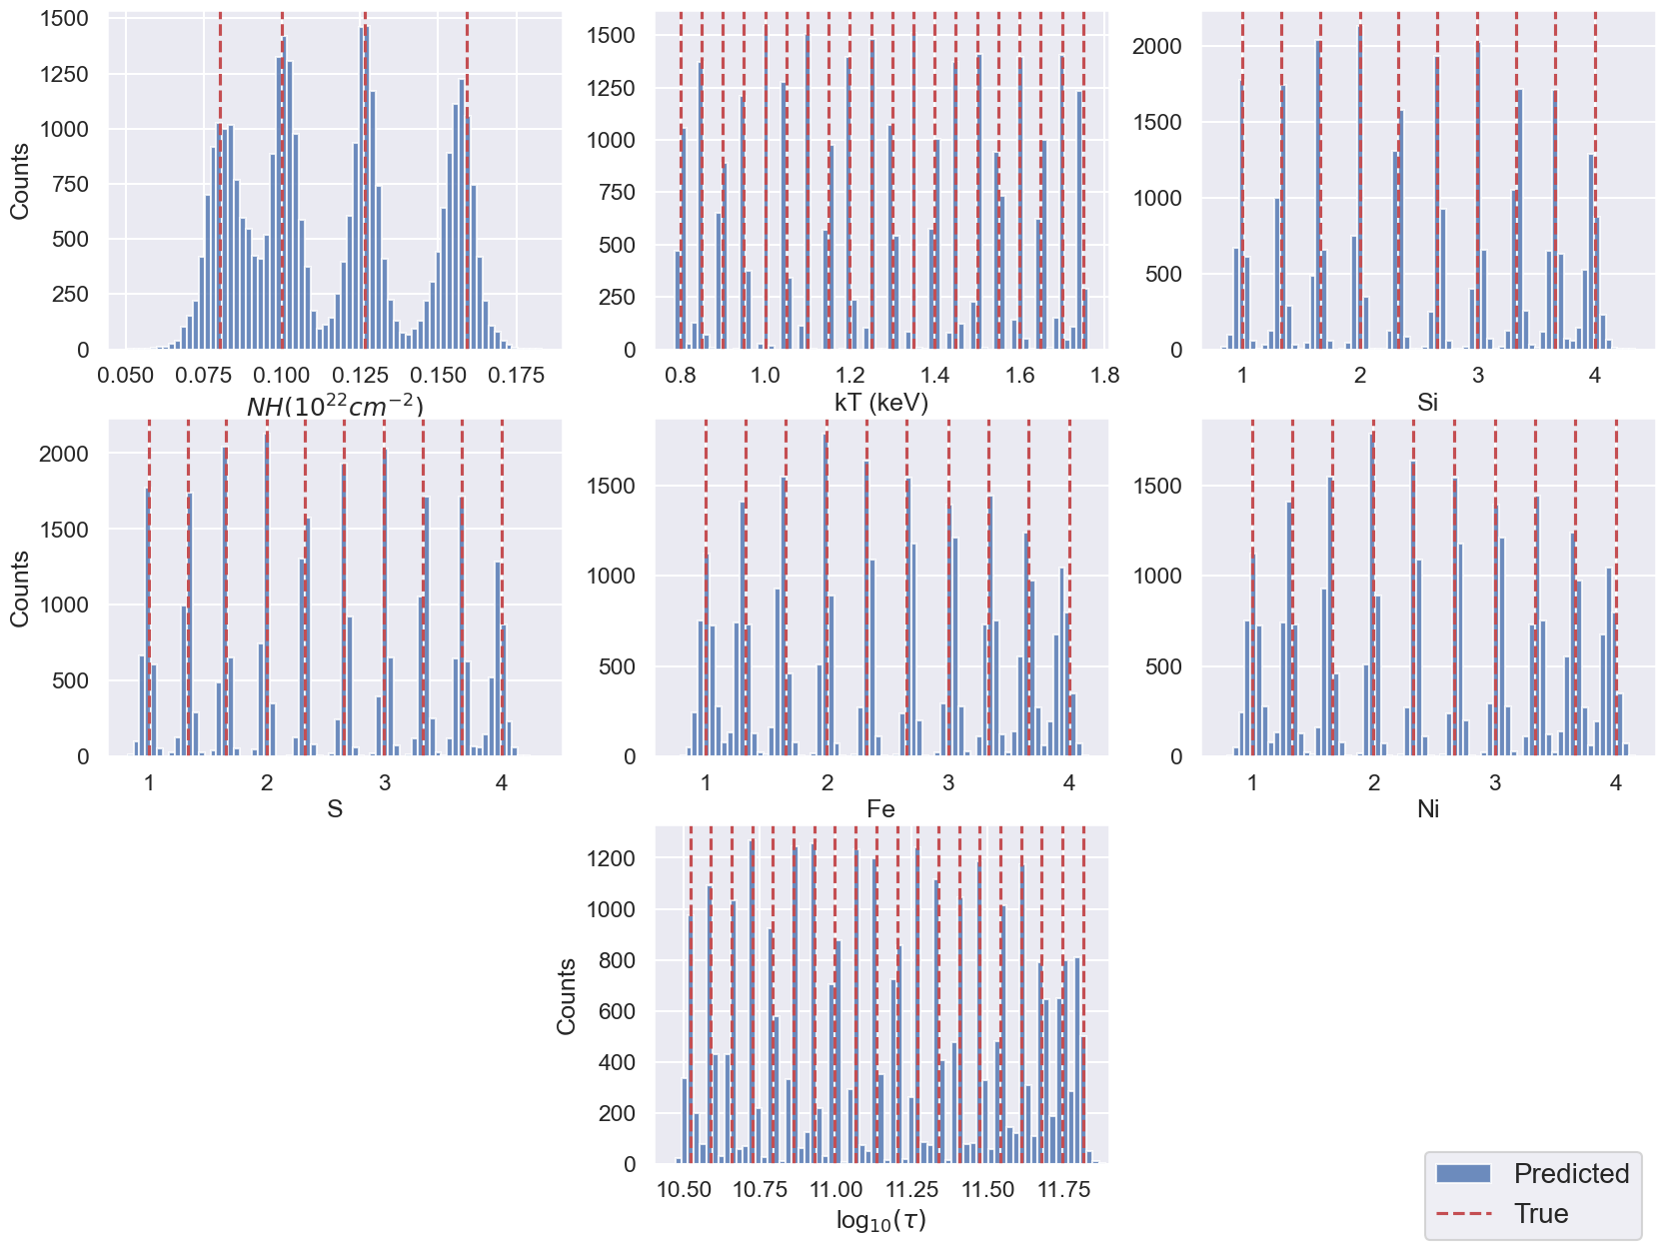
Quantum Extreme Learning for X-ray spectral analysis
Vetrano, Miceli et al. in prep.

Slide 19
Conclusions
Dendrogram clustering of X-ray maps of extended objects provides a quantitive measure of similarities and differences between narrow band images of different objects.
Different metrics and GNN provide similar results
Quantum Extreme Learning looks like a promising tool for the analysis of X-ray spectra
The role of the device noise still needs to be address
Comparison with ”classical” neural network is ongoing

