Slide 1
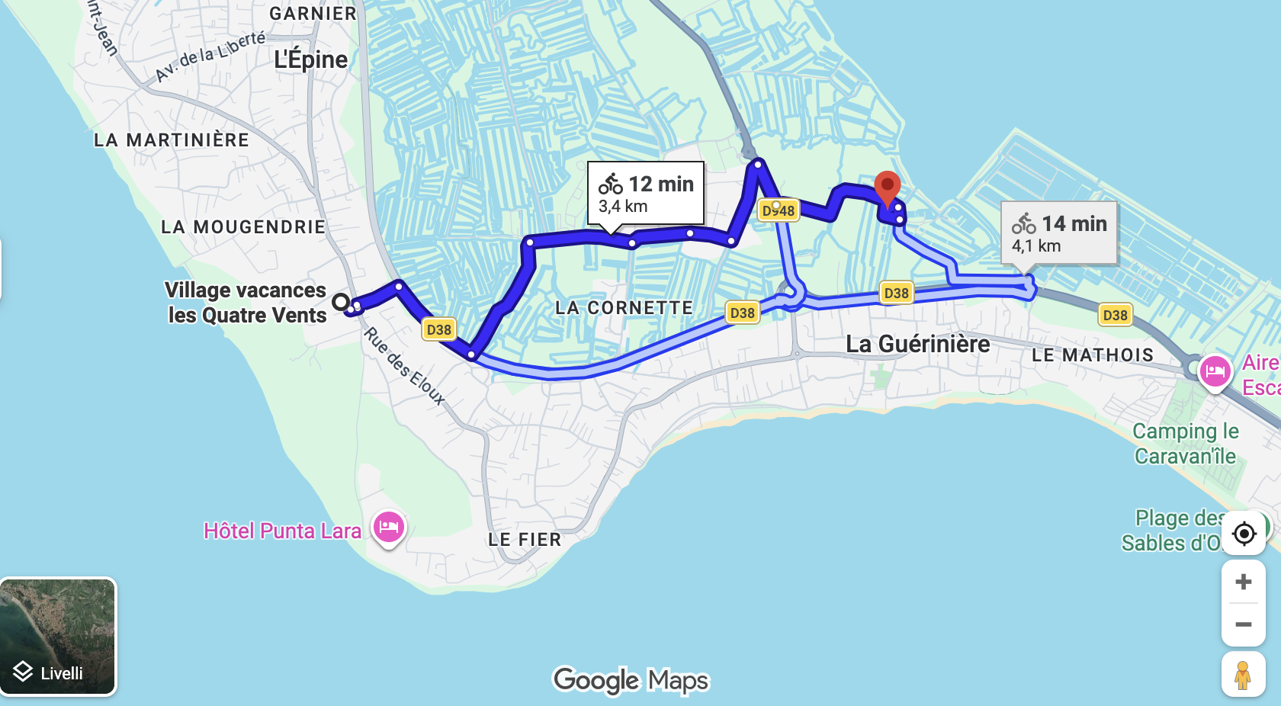
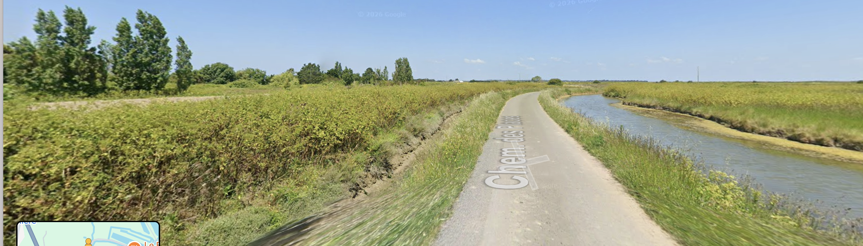

Tuesday social event
https://lespetitsbassets.fr/vente-et-degustation/
Chem. des Places, 85680 La Guérinière
~ ½ hour commented visit
~ ½ hour wine/oyster
(veg option) tasting
1st group : 17h30
2nd group : 18h
3 Options to go:
1) By yourself : meeting at the place at 17h25
2) Group by bike : meeting at 17h at the entrance (please collect your bike before)
3) By car with Dominique : meeting at the entrance at 17h40 (3 places left)

