Slide 1


Key messages from the IPCC assessment
of the physical science basis
9 August 2021
Sophie Szopa
Senior Scientist - Laboratoire des Sciences du Climat et de l’Environnement
Coordinating Lead Author (Chapter on Short lived Climate Forcers WGI)
Drafting Author of the Summary for Policy Makers WGI
Contributing Author Synthesis Report and its Summary for Policy Makers
Coordinating Lead Author in the Special Report on Cities and Climate Change (on going)
3 June 2026
Notes:
I will present the key results from the assessment of the Physical science basis, released last summer.

Slide 2
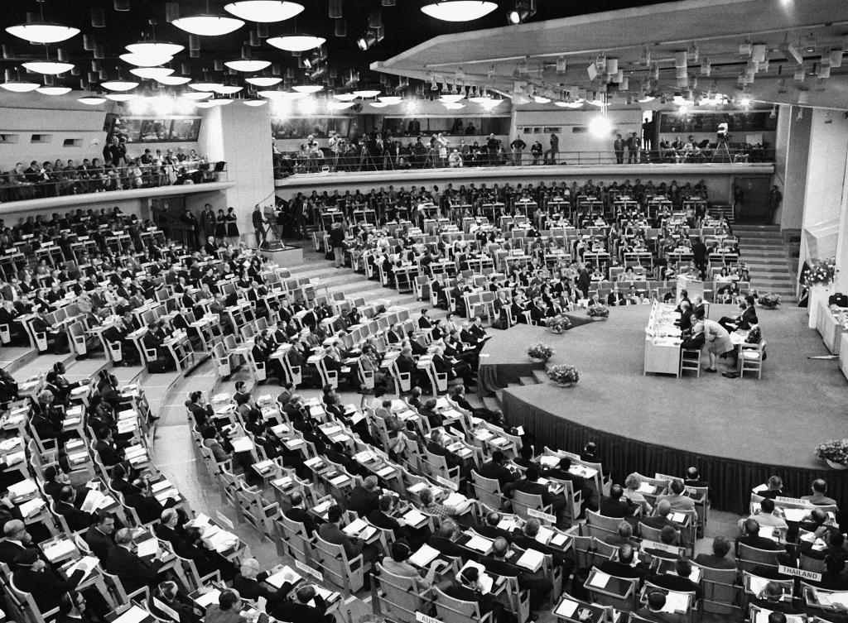
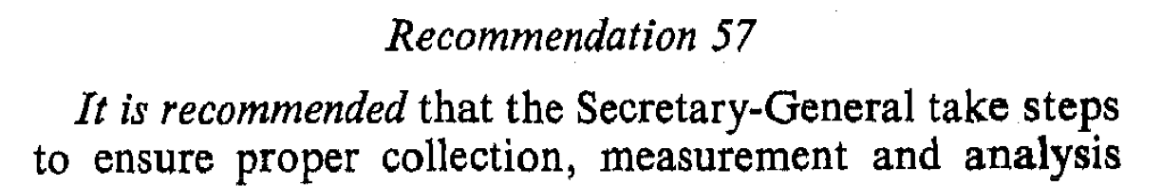
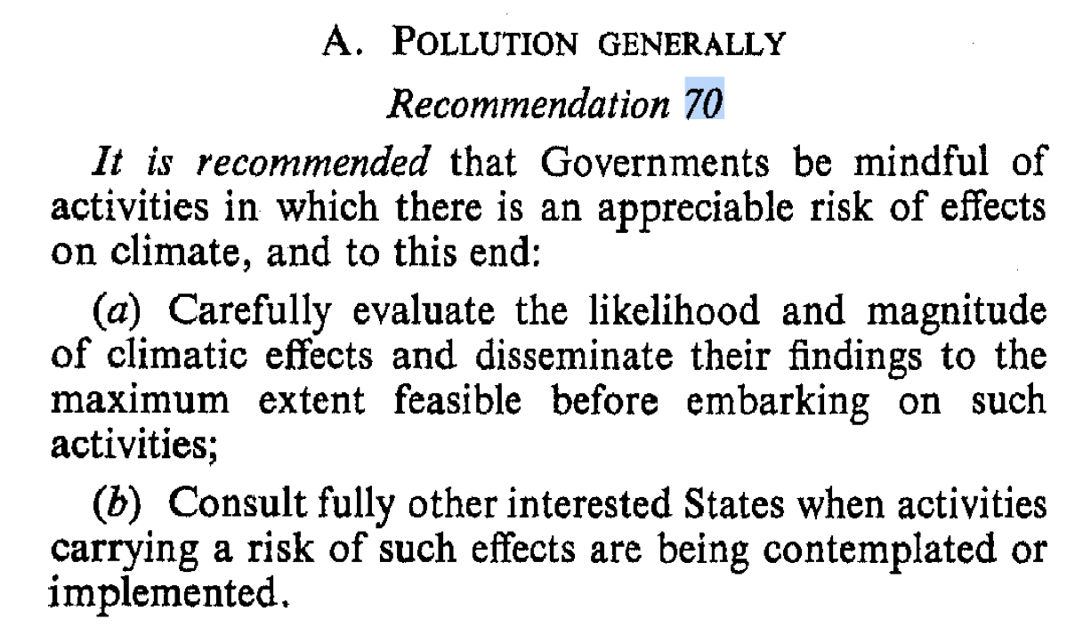
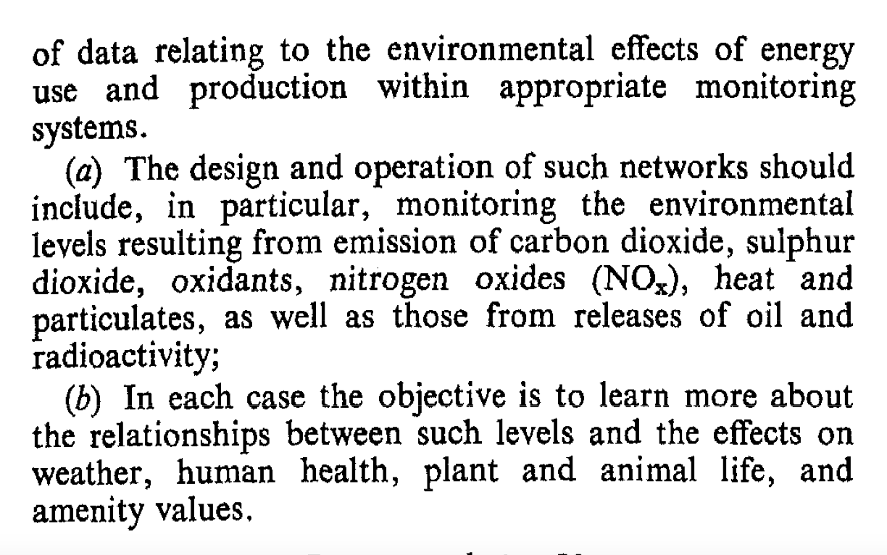
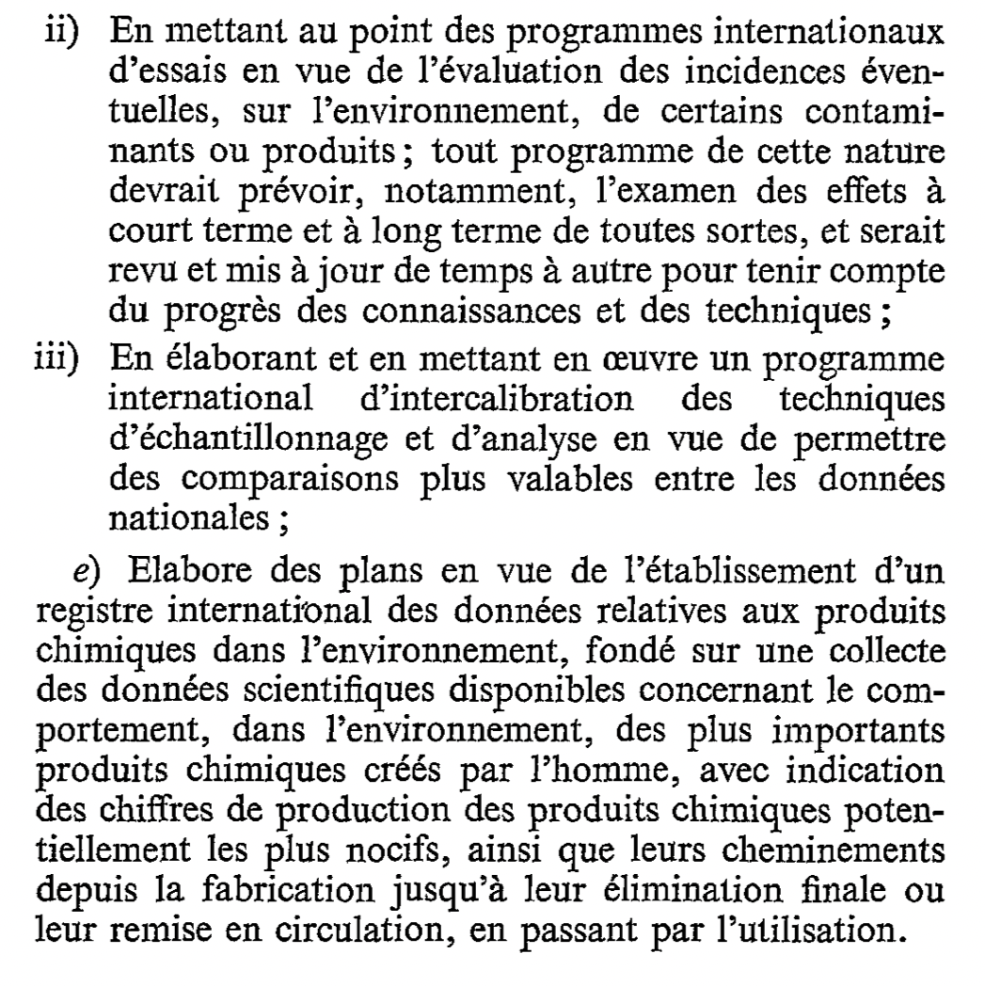
1972 Stockholm United Nations Conference on the Human Environment
declaration of 26 principles ;
action plan of 109 recommendations ;
creation of the UN Environment Programme (UNEP)
Principle 18
Science and technology, as part of their contribution to economic and social development, must be applied to the identification, avoidance and control of environmental risks and the solution of environmental problems and for the common good of mankind
Principle 20
Scientific research and development in the context of environmental problems, both national and multinational, must be promoted in all countries, especially the developing countries. In this connection, the free flow of up-to-date scientific information and transfer of experience must be supported and assisted, to facilitate the solution of environmental problems; environmental technologies should be made available to developing countries on terms which would encourage their wide dissemination without constituting an economic burden on the developing countries.
Principe 19
Il est essentiel de dispenser un enseignement sur les questions d'environnement aux jeunes génération aussi bien qu'aux adultes, tenant dûment compte des moins favorisés, afin de développer les bases nécessaires pour éclairer l'opinion publique et donner aux individus, aux entreprises et aux collectivités le sens de leurs irresponsabilités en ce qui concerne la protection et l'amélioration de l'environnement dans sa dimension humaine. Il est essentiel aussi que les moyens d'information de masse évitent de contribuer à la dégradation de l'environnement et, au contraire, diffusent des informations de caractère éducatif sur la nécessité de protéger et d'améliorer l'environnement afin de permettre à l'homme de se développer à tous égards.
Notes:
Actually, IPCC has its roots in the Stockholm conference which marks the start of environmental diplomacy. At this very first intergovenemental conference, recommendations to collect and analyze scientific data on pollution and climate under supervision of UN was already stated.
But the first global environmental issue that led to discussions btw scientists and government at an international level was the stratospheric ozone hole in the 80s. Rapidly followed by the necessity to assess and discuss knowledge with an internationnal view for climate change and the IPCC was created in 1988.

Slide 3
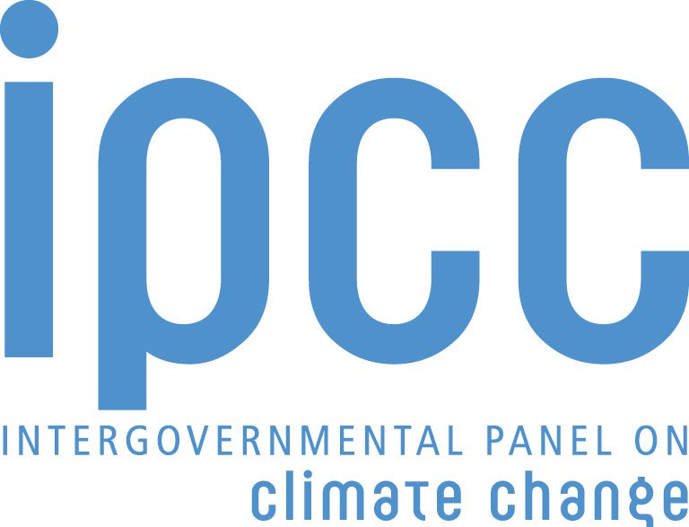
The role of the is …
“… to assess on a comprehensive, objective, open and transparent basis the scientific, technical and socio-economic information relevant to understanding the scientific basis of risk of human-induced climate change, its potential impacts and options for adaptation and mitigation.”
“IPCC reports should be neutral with respect to policy, although they may need to deal objectively with scientific, technical and socio-economic factors relevant to the application of particular policies.”
Principles Governing IPCC Work, paragraph 2
Source: http://www.ipcc.ch/pdf/ipcc-principles/ipcc-principles.pdf
Notes:
IPCC is an intergovernmental body of the United Nations created in 1988 ,
Important to remind that The climate crisis is not the first environmental crisis which required scientific /governements and stakholder around the same table and actually the ozone depletion has been managed through similar structur under the auspice of WMO and UNEP
The main point is the fact it has to be policy relevant but not policy prescriptive. Which is the reason behind the sometimes hard to understand the tone of such sentence

Slide 4
Notes:
To understand this coconstruction at the interface of science and policy, we need to come back to the proces to product such IPCC report. You see in red all the steps with intervention of governements through their delegates.
For example, at the beginning of the process, they agree on the outline of the chapters which is something very important as for example some countries refused to incorporate “nationally determined contribution” which are the volontay comitments planned by the Paris agreemen arguing it was too prescriptive t in the the SR1.5 and limited it to a more vague formulation.
They have the opportunity to comment intermediate draft and we as authors have the obligation not only to consider them but also to answer each of them
and Finally the approve line by line the SPM.
The full process takes about 3 years.
An important aspect of these report is the traceability of each statement and the caracterisation of the confidence level.

Slide 5
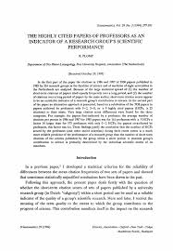
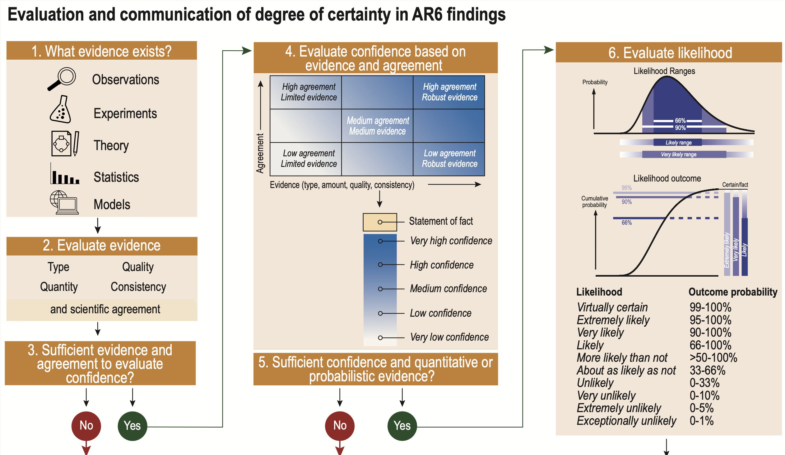

Slide 6
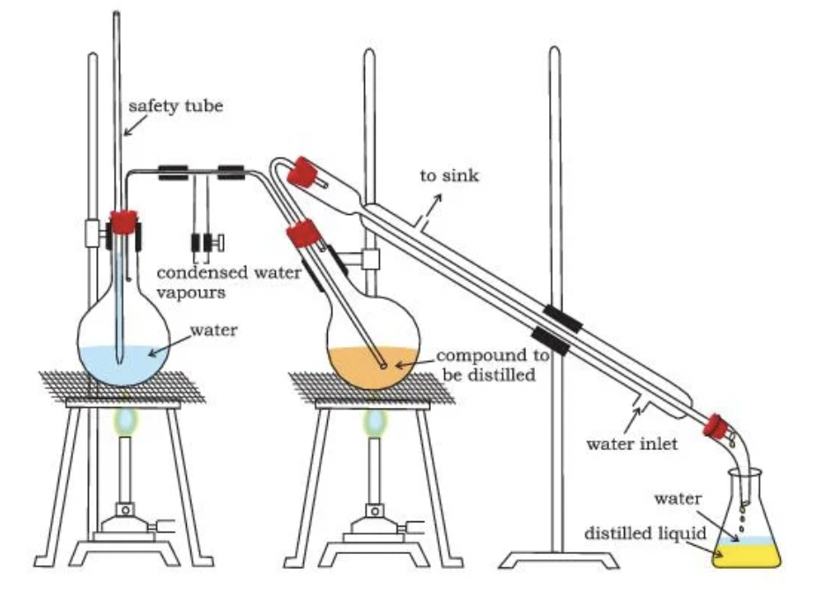
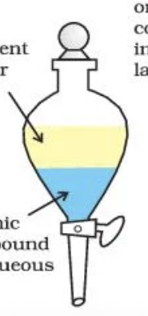
SIXTH ASSESSMENT REPORT
Chapters => Technical Summary
SPM
Summary for policymakers
- Approved by 195 member countries and scientists
- Summarizes the state of knowledge and serves as a support to decision making
TS
Notes:
You see on the left key nulbers and in particular the number of comments received for each report.
An impotrant document in these reports are the technical summaries which results from distillatin of all the chapters and which are written only by authors contrary to the SPM which is short and approved line by line by the delegates and scientists.
On one hand it means that it has a particular force, this is what is ercognized as obust by evryon around the table with some countries doing their best to limit the impact or readability of the sentence.

Slide 7
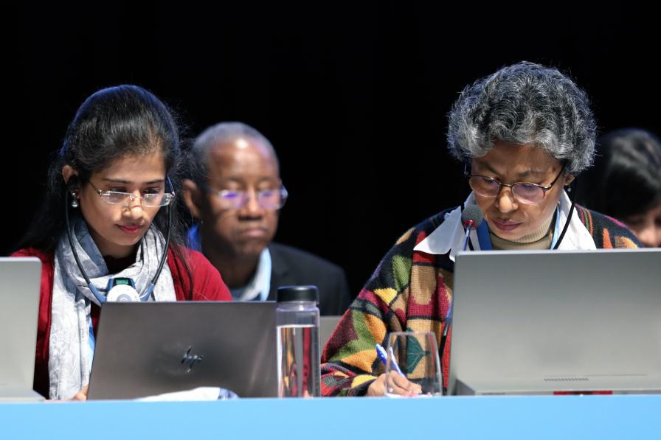
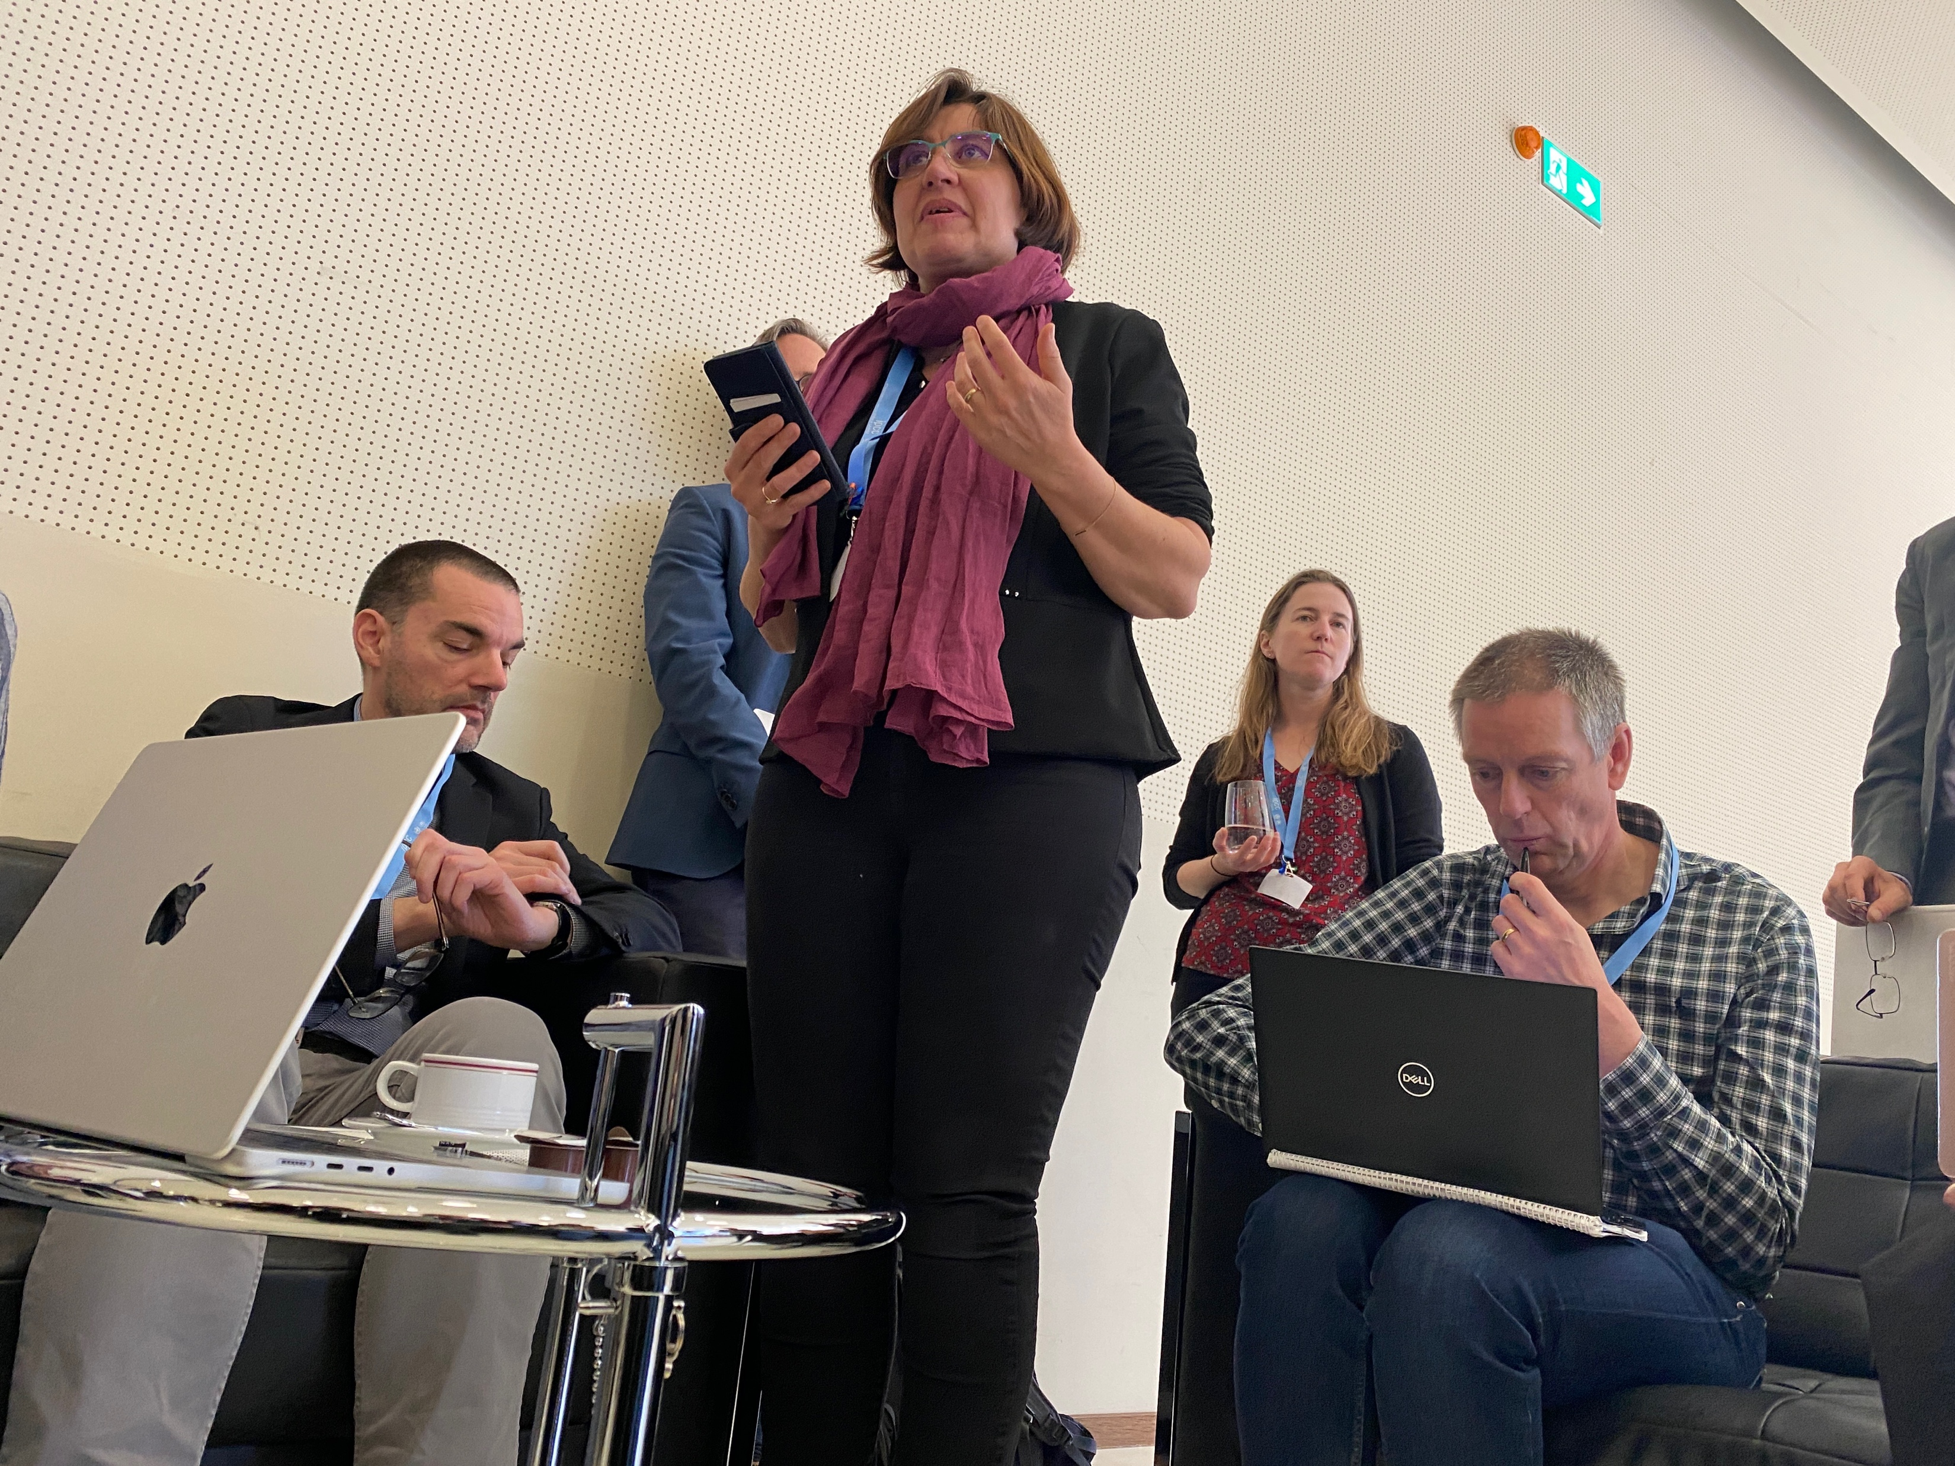

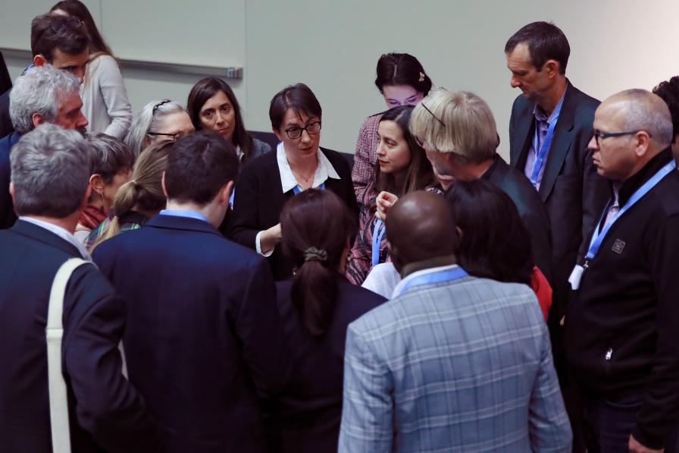
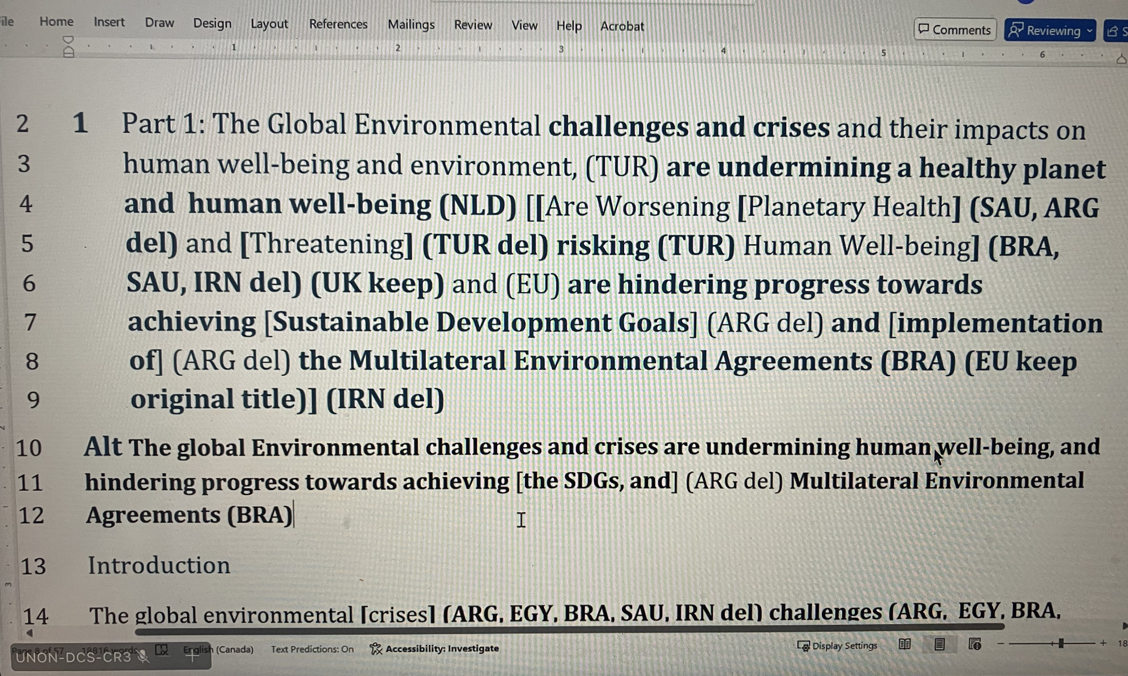
Notes:
An important document in these reports are the technical summaries which results from distillatin of all the chapters and which are written only by authors contrary to the SPM which is short and approved line by line by the delegates and scientists.
On one hand it means that it has a particular force, this is what is recognized as robust by everyone around the table. It now serves not only as a basis for governement when they discuss climate policies in COP but also NGO to push for climate actions and as been used by court of justice. Thus obvously some countries with specific vested interests do their best to limit the impact or readability of the sentence.

Slide 8
Traduced from DE PRYCK Kari, « Négocier la science du climat. Le rôle des États membres dans le Groupe d’experts intergouvernemental sur l’évolution du climat », Critique internationale, 2022/2 (N° 95), p. 132-153. DOI : 10.3917/crii.095.0134.
The IPCC represents a unique case of “multilateral science diplomacy”
[About the summary for policy makers]
The declared consensus does not reflect a convergence towards a single position of truth or point of view, but a compromise between multiple, and in some cases, conflicting perspectives, achieved through techniques of argumentation, persuasion and, in some cases of haggling between Member States (and the authors who must validate their scientific content).
While the IPCC has undeniably contributed to keeping the issue of global warming on the agenda, partly thanks to the political legitimacy that the participation of the Member States confers on it, the depoliticized and nuanced nature of its summaries risks, paradoxically, less and less impactful and increasingly unsuited to the growing demand for a socio-economic and political assessment of the climate problem.
D’autres institutions ont toutefois pris le relais pour analyser de manière plus critique l’action climatique, et associent acteurs scientifiques, think tanks et ONG. Le rapport Emission Gap produit par le Programme des Nations unies pour l’environnement permet par exemple de mettre en perspective les objectifs de réduction des émissions de GES définis par la communauté internationale et les actions des États pour y parvenir. Ce document et d’autres du même type analysent, bien plus clairement que les rapports du GIEC, le manque d’ambition des États dans la lutte contre le changement climatique.
Notes:
As pointed by external observers analysing the process, it also means that its sometimes a compromise rather than a consensus.
This is clearly an example of multilateral science diplomacy, with all the codes of diplomacy which to my opinion can be very destabilizing for scientists.
Is IPCC an extreme left organisation? We work under the auspice of the Uited nations whose role is to promote the human rights for all. The aim of the report is thus implicitely to find the solution protecting a mawimum of people and we will see that social aspects are key for vulnerability and consequently the magnitude of the impacts resulting from climate chane, that’s why IPCC discusses the need of reducing poverty and and social exclusion.

Slide 9
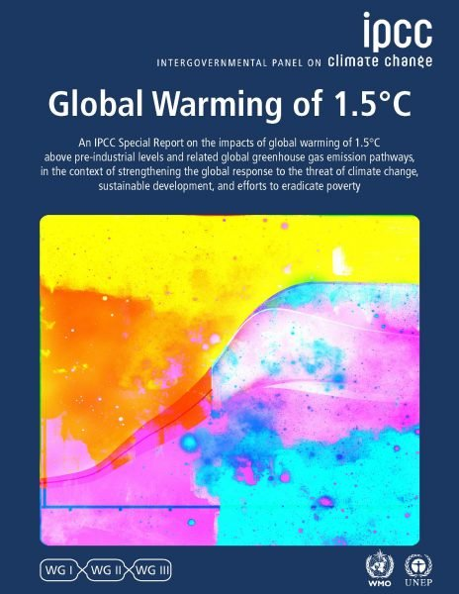
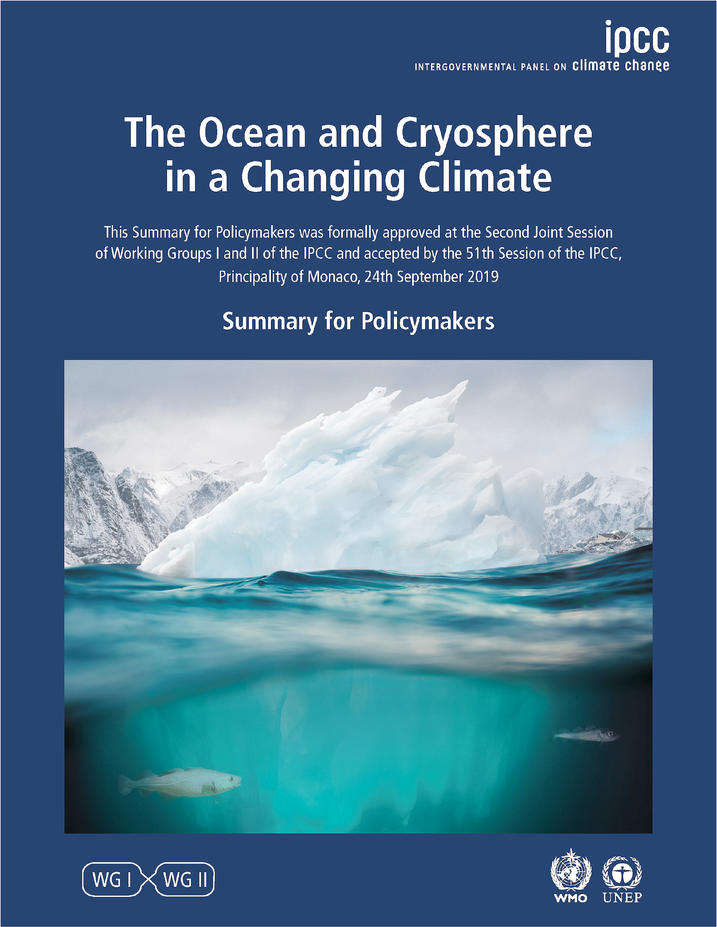
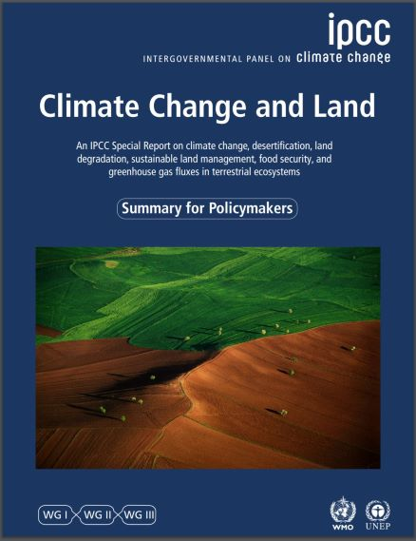
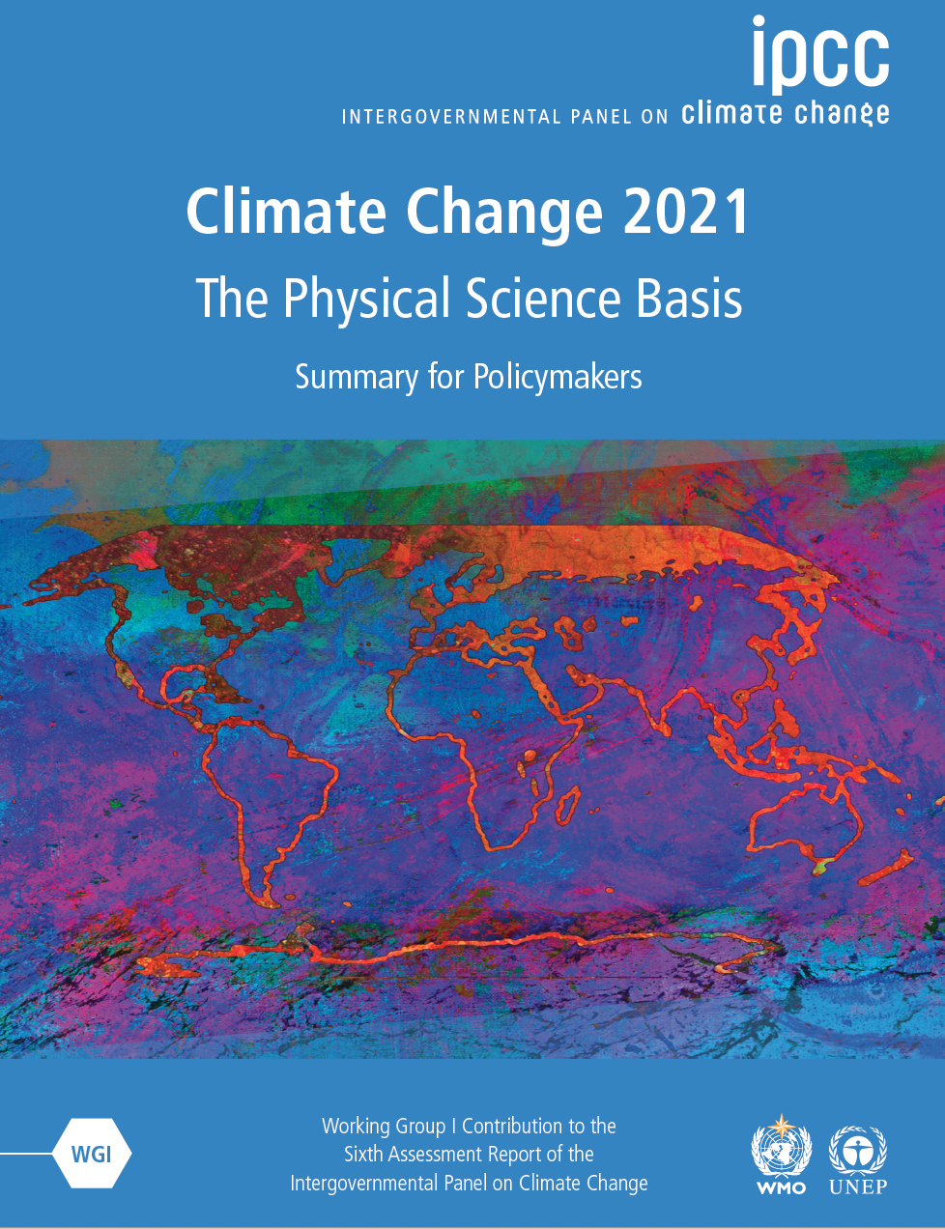
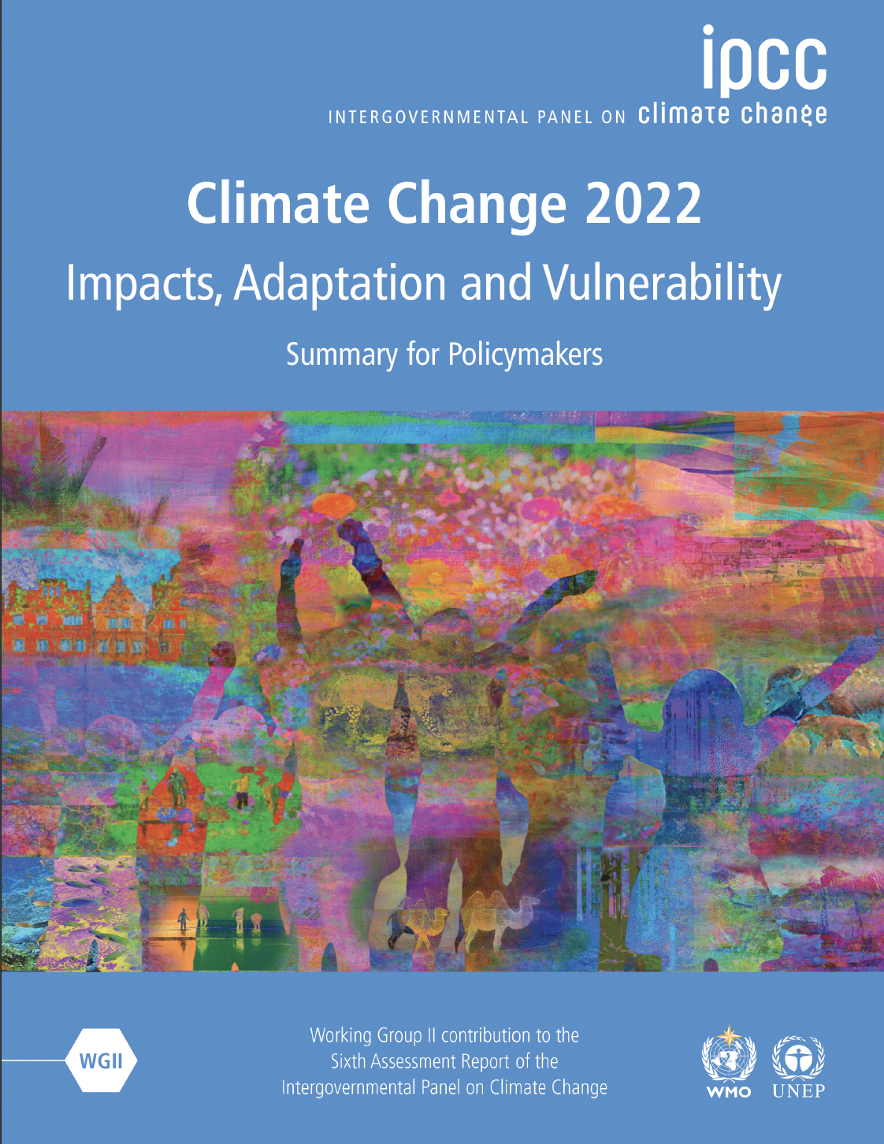
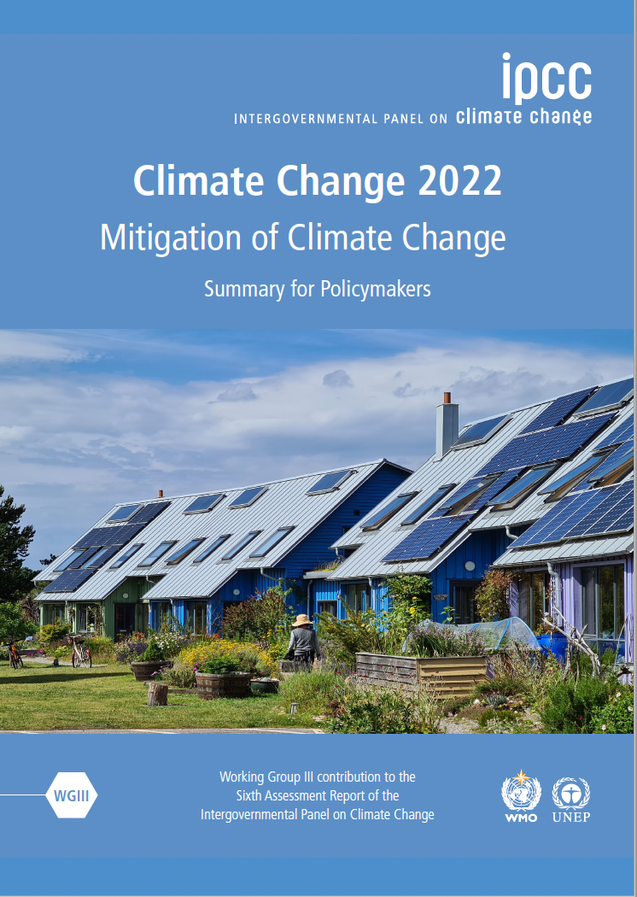
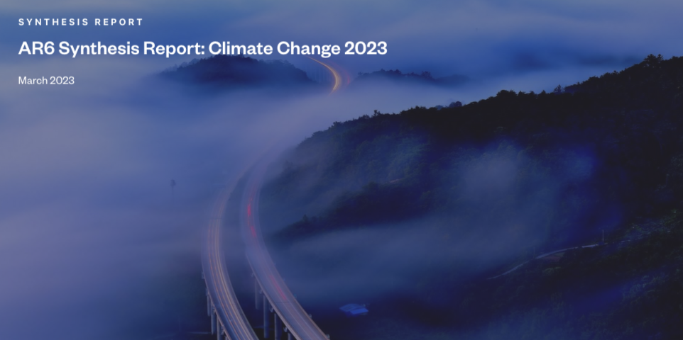
1000 lead authors, thousands contributors and reviewers
85 000 scientific publications
300 000 review comments
+ Atlas
+ Fact-sheets (by sectors and by regions)
+FAQs
www.ipcc.ch/report/ar6/syr/
Notes:
Now let’s see the key points gathered in the synthesis report that summarizes the most relevant element of knowldege assessed .
We received 300 000 comments on the successive drafts, which means a few thousands for each chapters. We have the reponsability to answer each of them and obvisouly consider them to improve the subsequent draft. So next time you receive a review of one of your paper, just think about it!.
This assessment is based on more than 80 000 scientific publications. It’s the most up-to-date overview of what’s happening due to climate change but also the solution to tackle it.
(15 MINUTES DE PASSE)

Slide 10
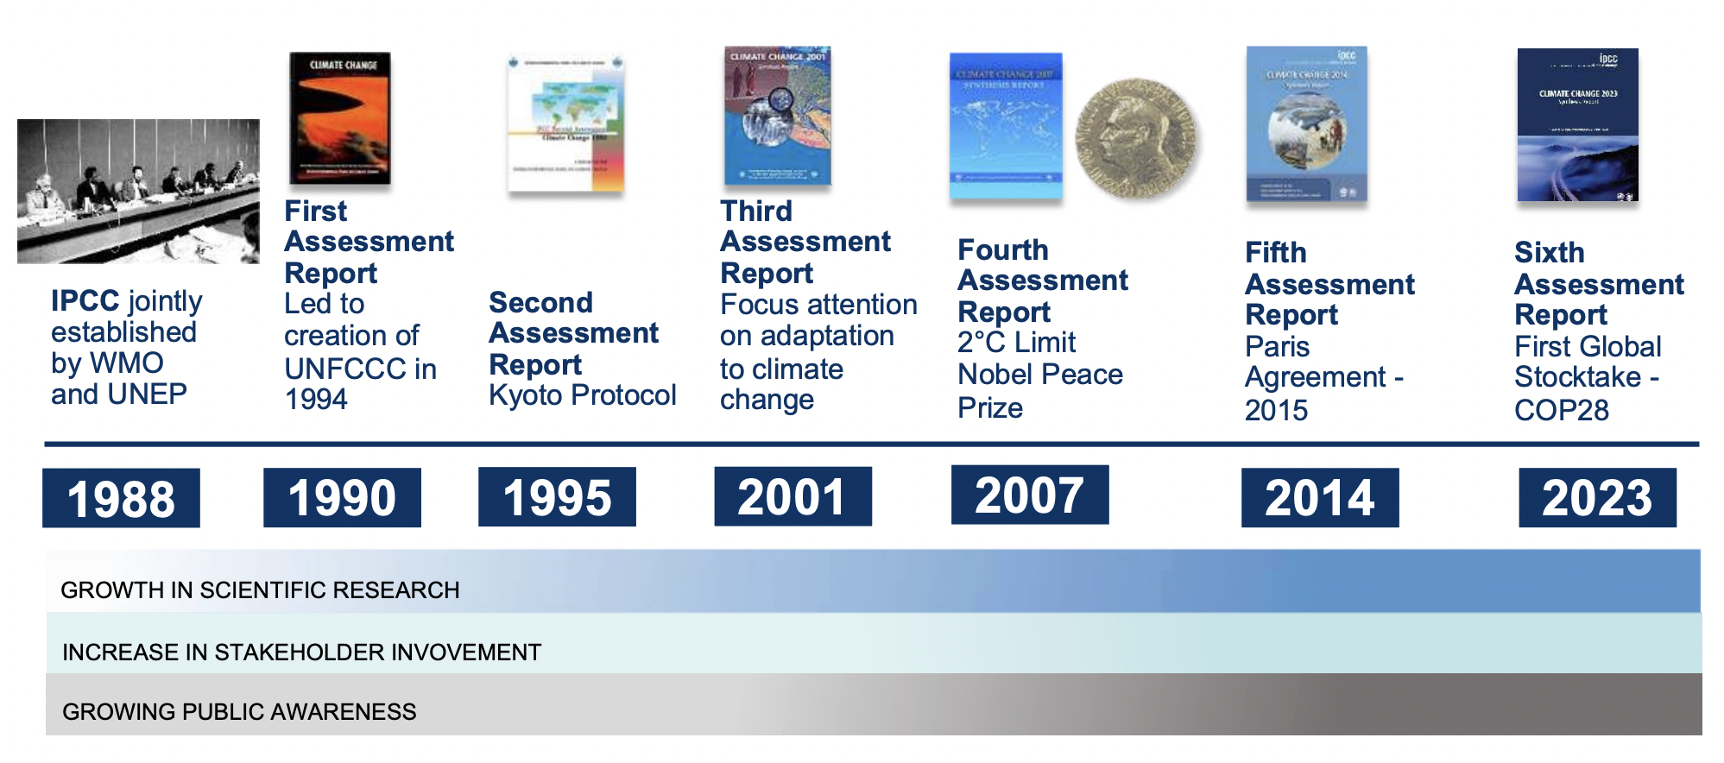
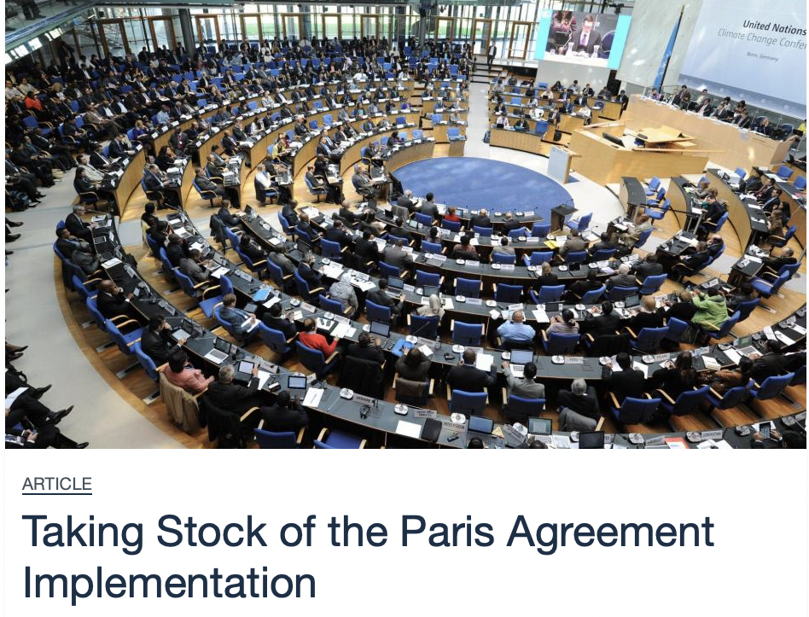
How IPCC reports informed successive climate policies?
(…) the IPCC aims to provide governments at all levels with scientific information they can use to develop climate policies. IPCC reports also constitute a vital contribution to international negotiations on climate change.
1970s
1980s
Notes:
And AR6 provides inputs for the STOCKTAKE which starts this week in Bonn and will last a few month and whose aim is to assess the comitemnts by the countries engaged in the paris agreement

Slide 11
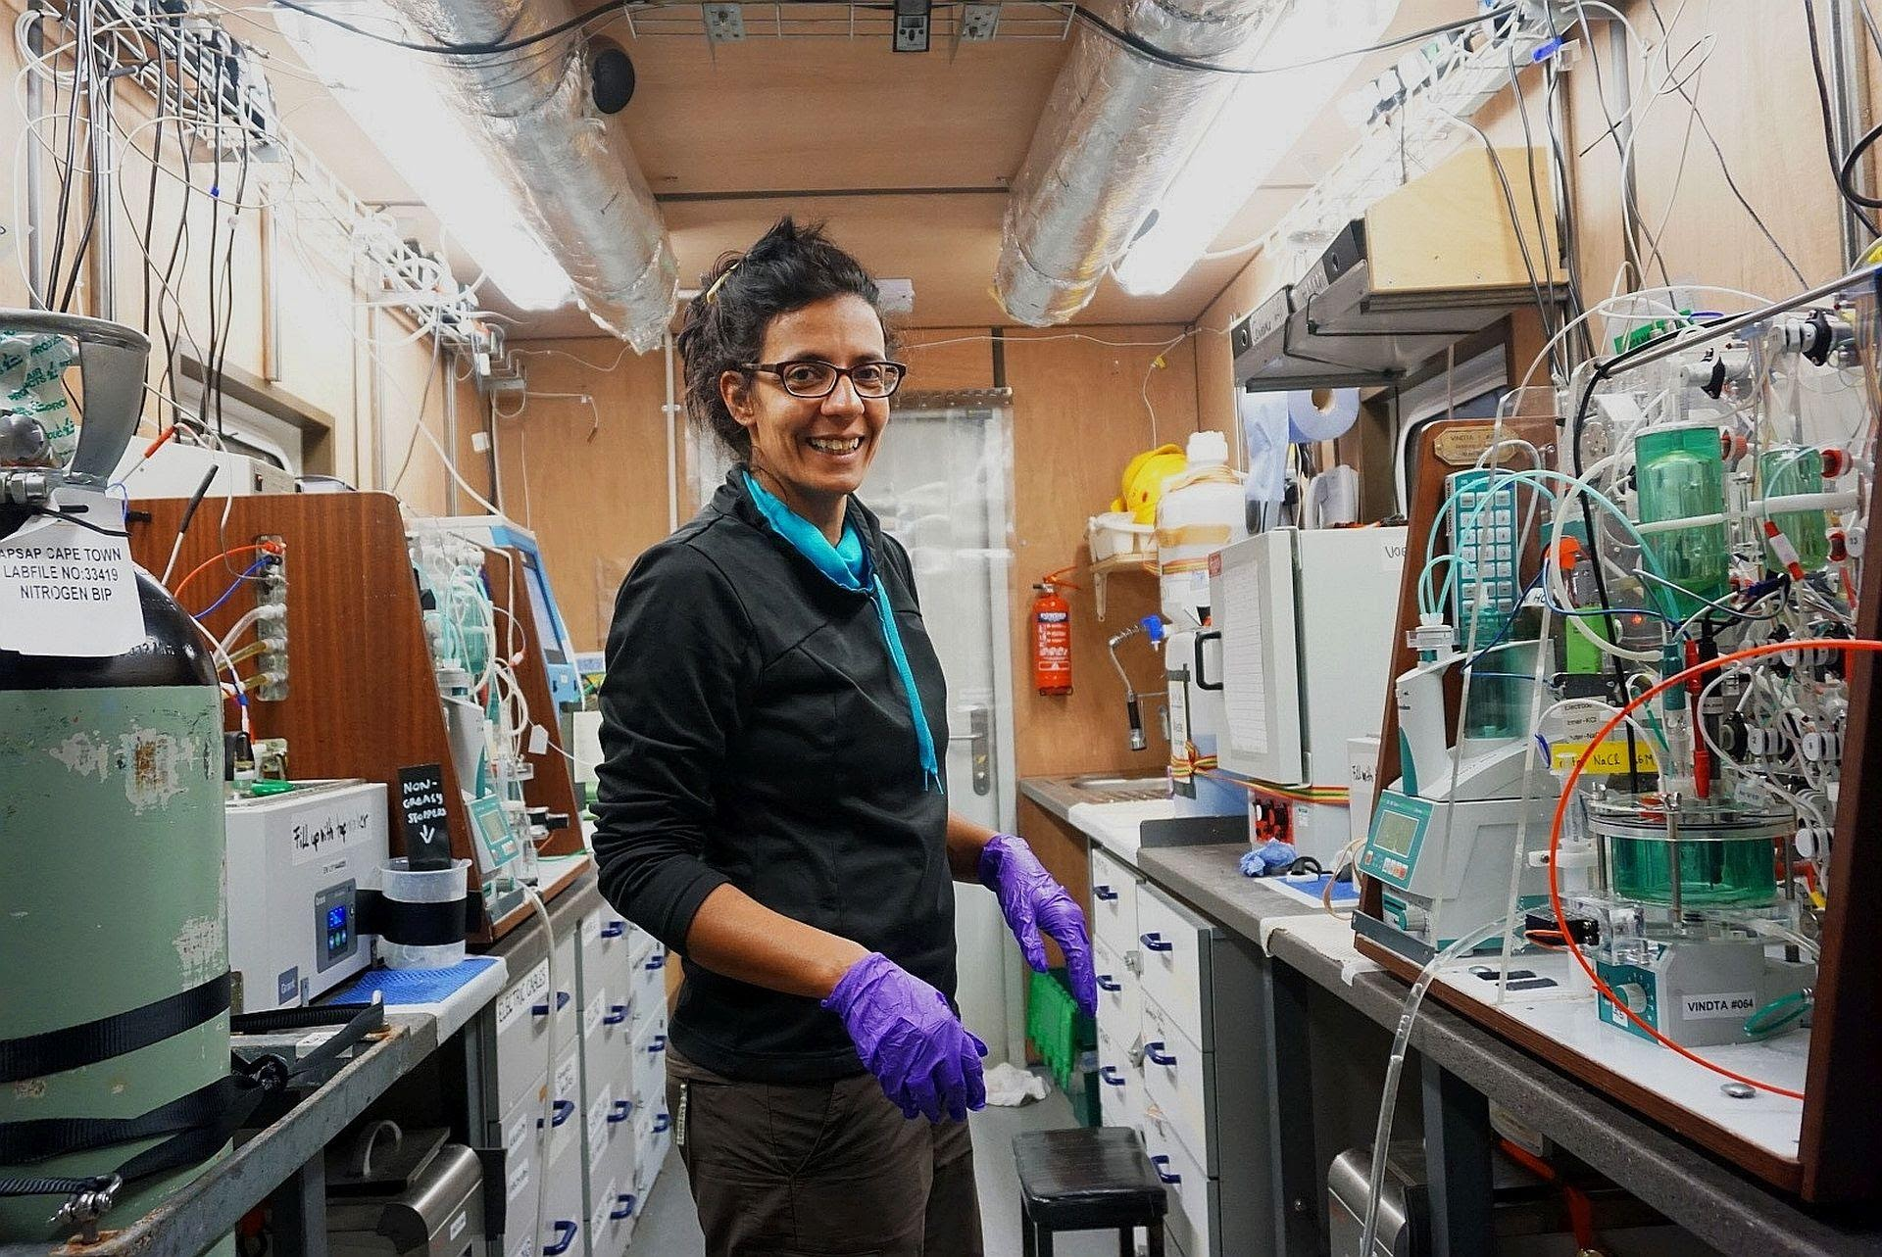
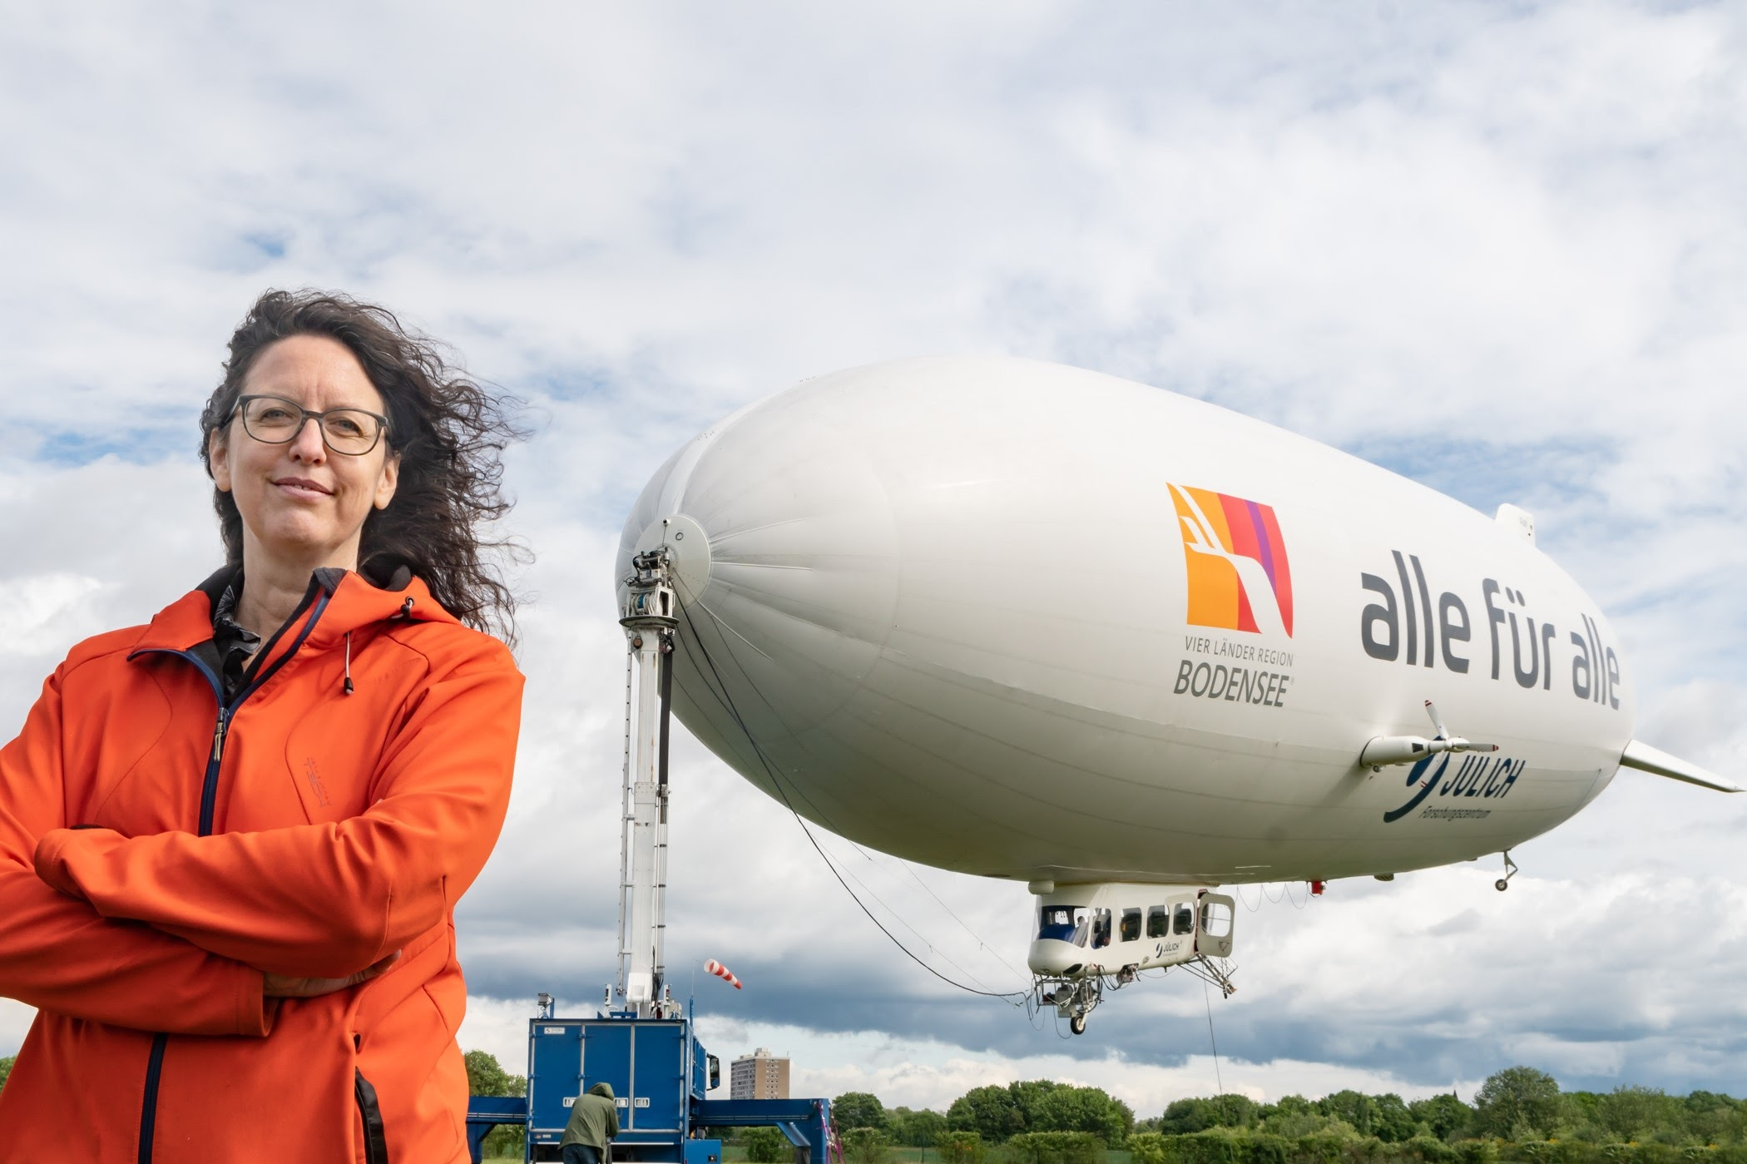
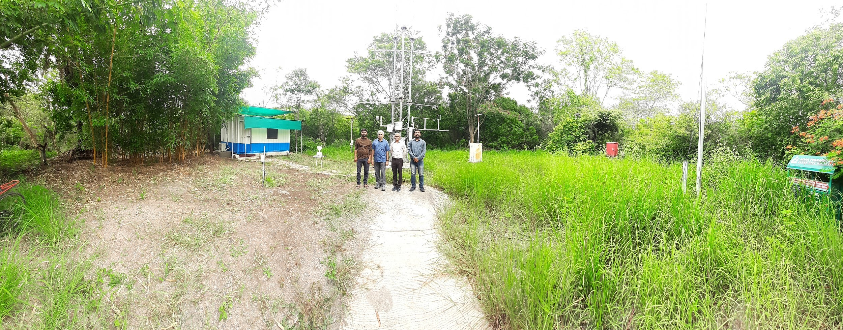
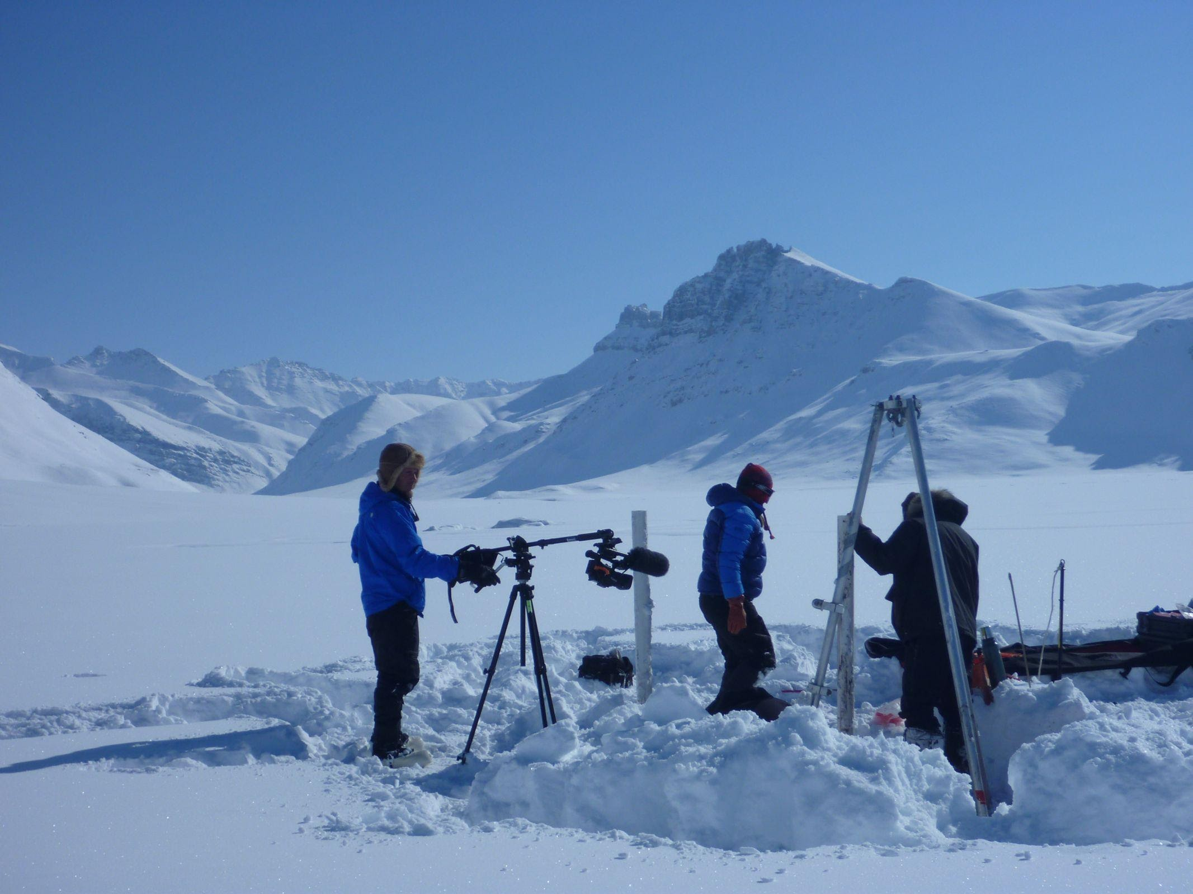
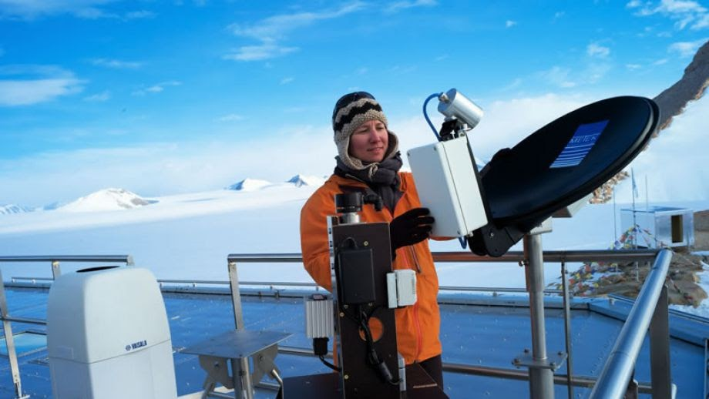
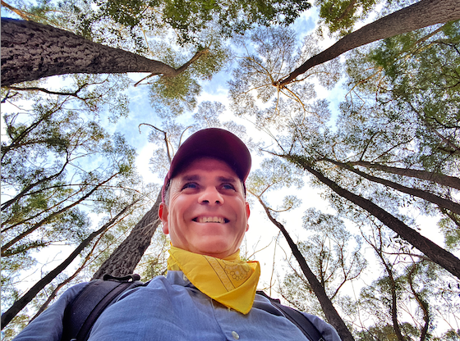
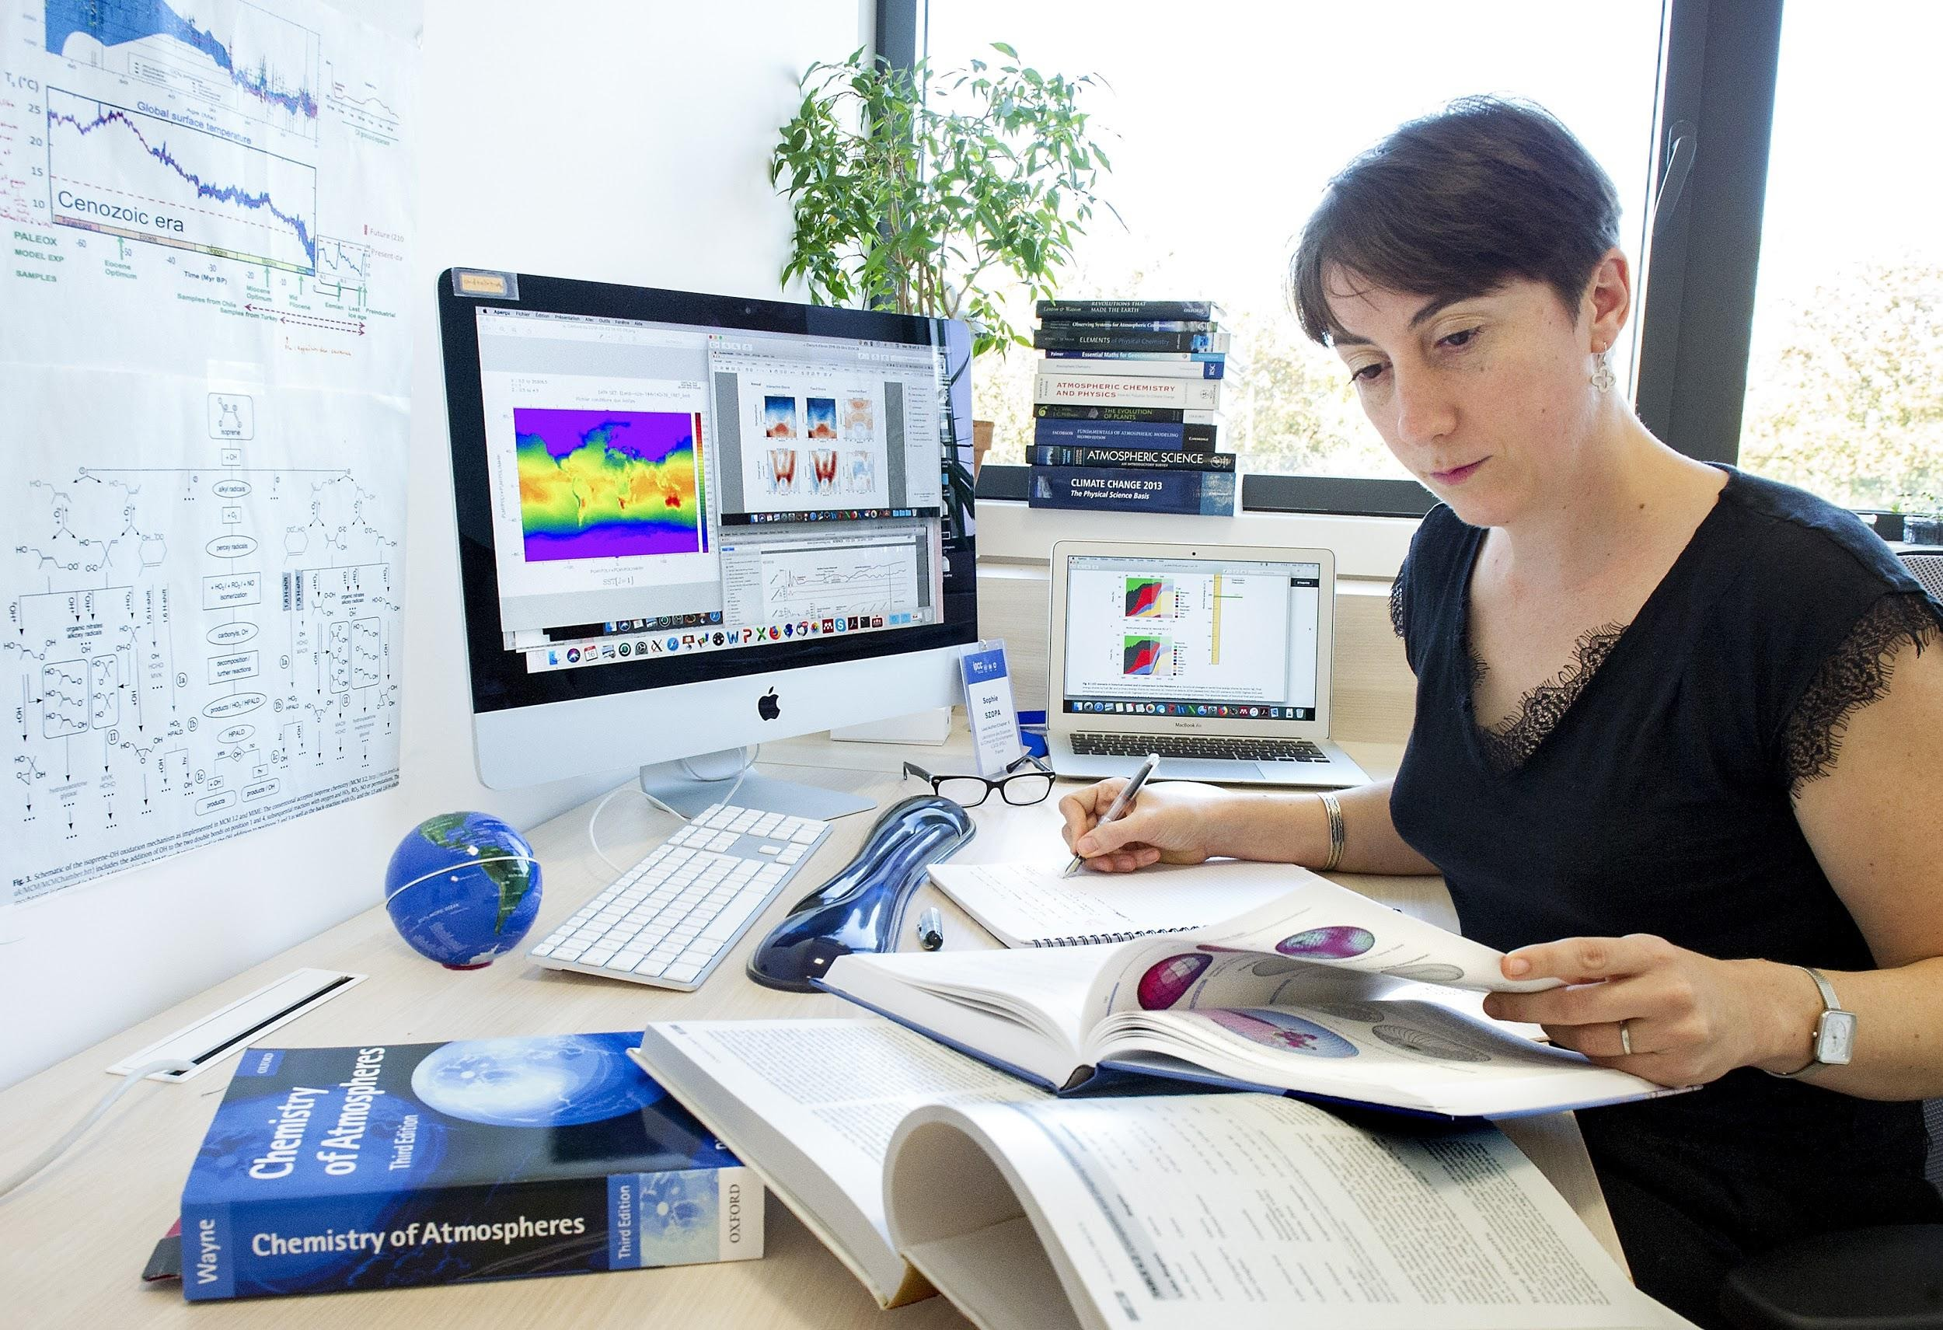
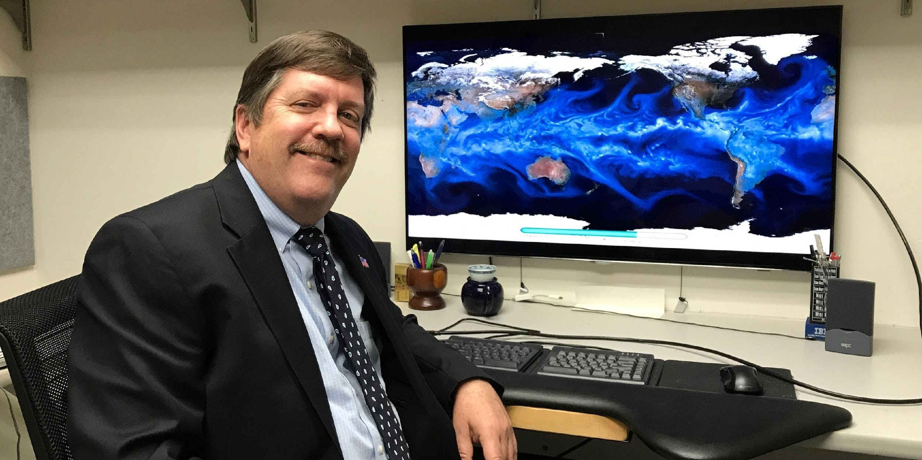
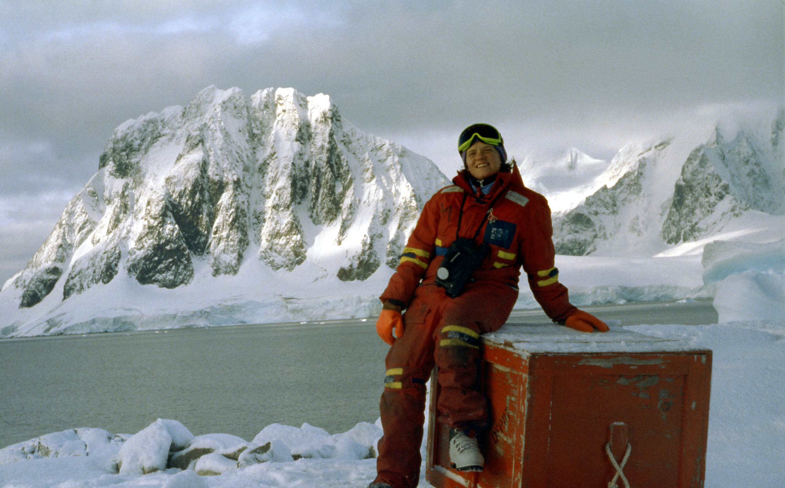
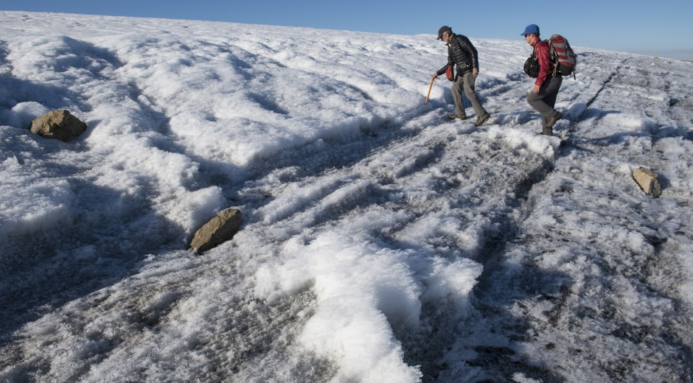
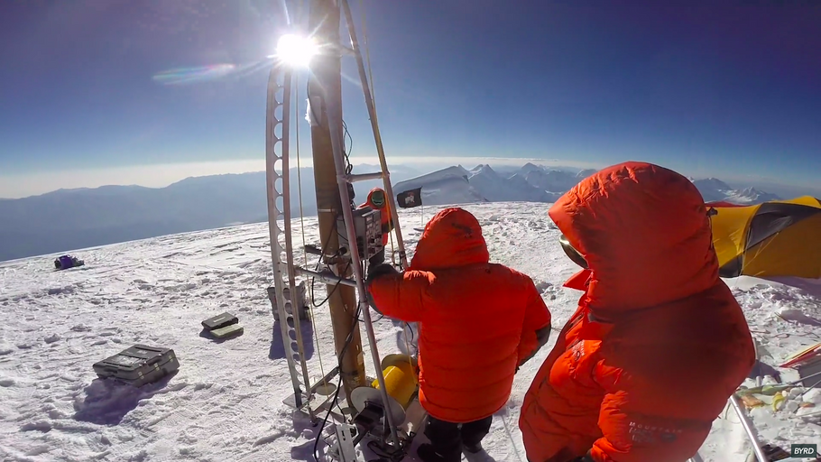
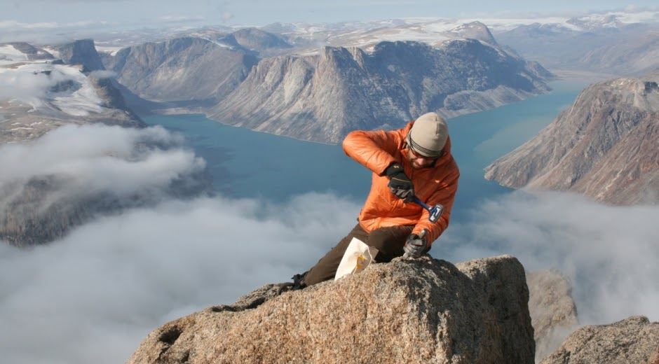
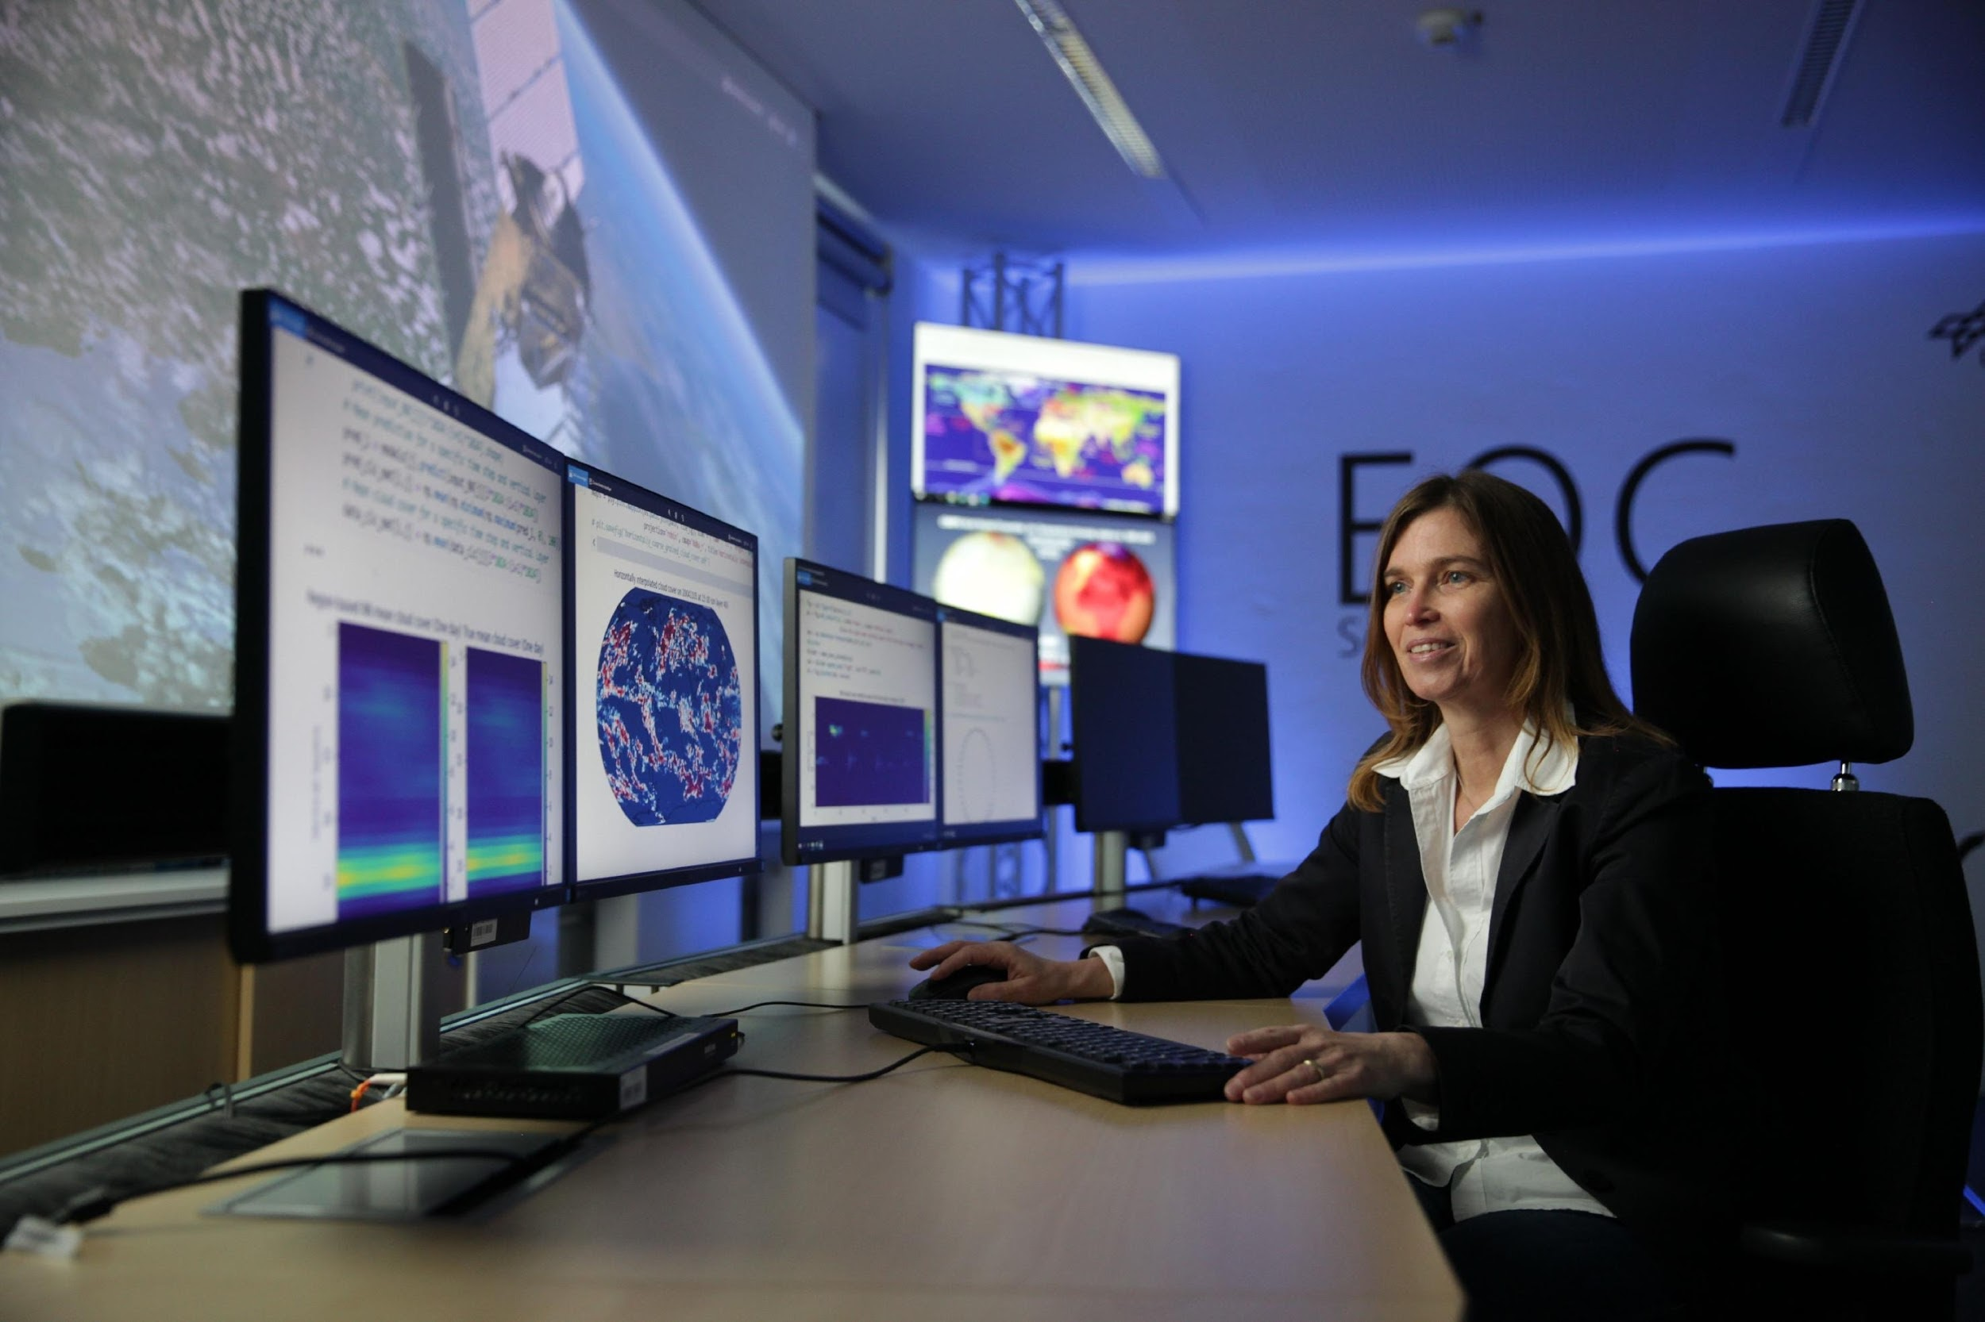
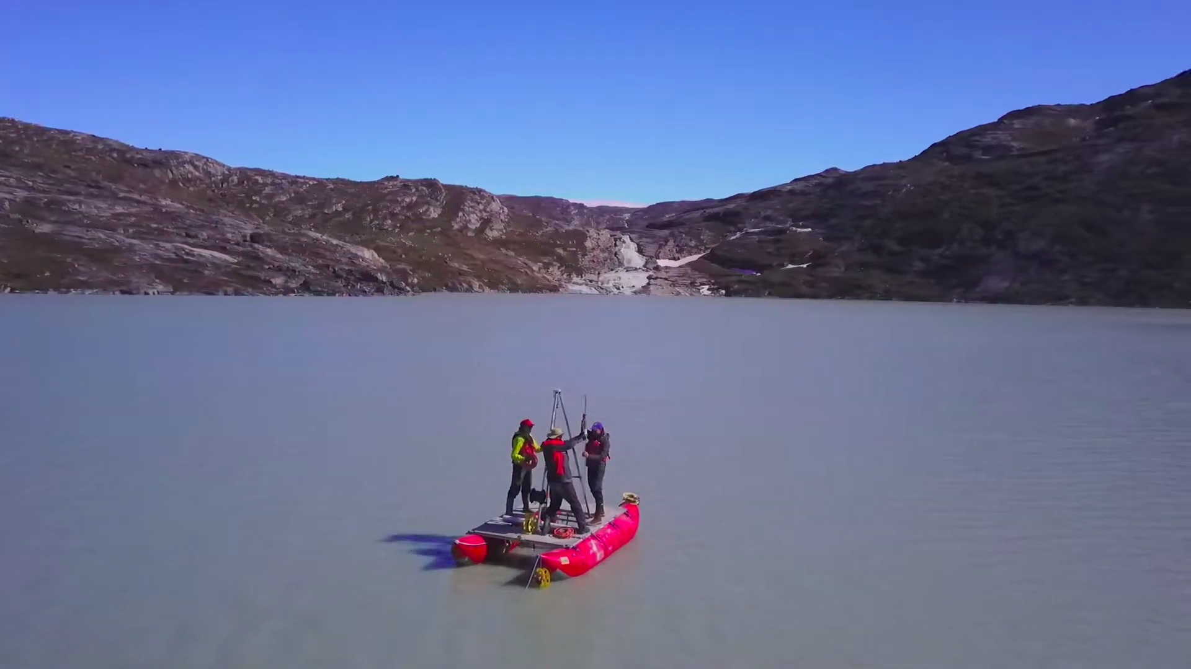
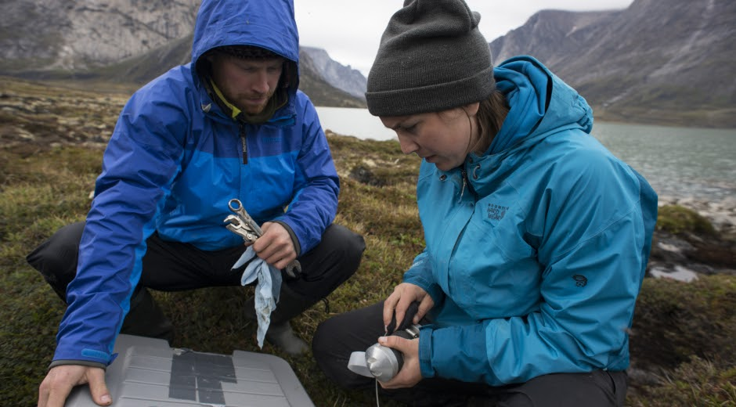

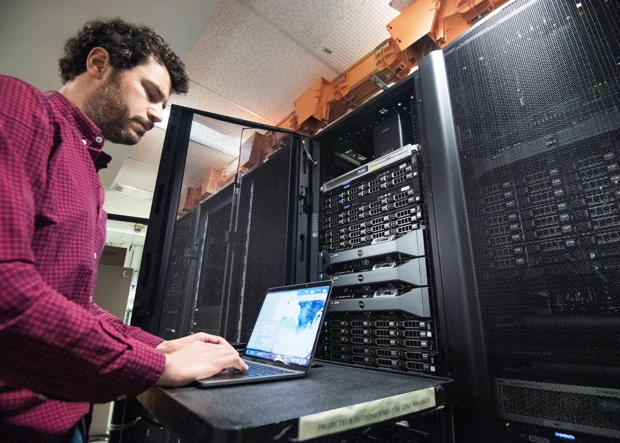
Notes:
You see here some scientists involved in WG1 in their daily researcher life and it illustrates the type of evidence supporting WG1 assessment wich are in situ observations in various environment, reconstruction of past climate thanks to various archives such as ice core, use of satellite data, of Earth system models based on physical relationsship in the Earth Système and mathematical tools to combine all these type of evidence.

Slide 12
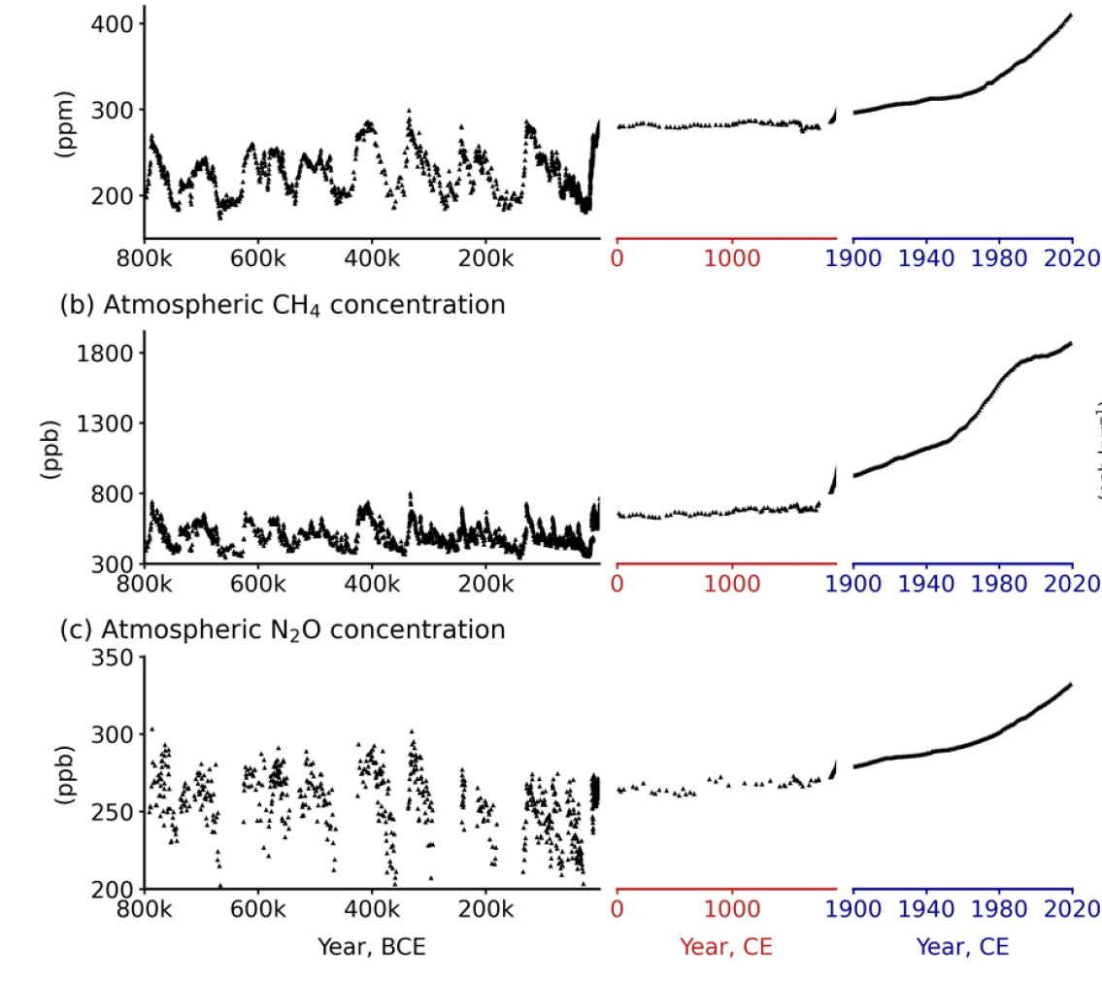
Human influence on climate is unequivocal
Atmospheric concentrations
CO₂
Observed increases in well-mixed greenhouse gas (GHG) concentrations since ~1750 are unequivocally caused by human activities
Emissions in the last decade reached the highest levels in human history
CH₄
N₂O
Figure 5.4
NB: since AR6 they all have continued to increase
thousands of years in the past
thousands of years in the past

Slide 13

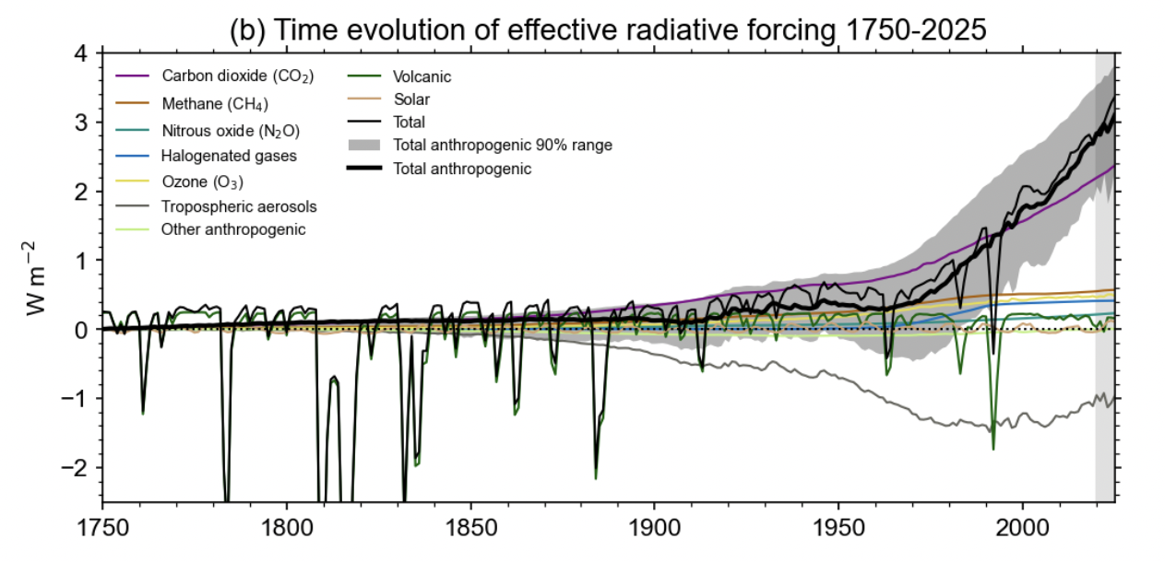
Human-caused radiative forcing is increasing
Figure 2.10 updated by Forster et al. 2026

Slide 14
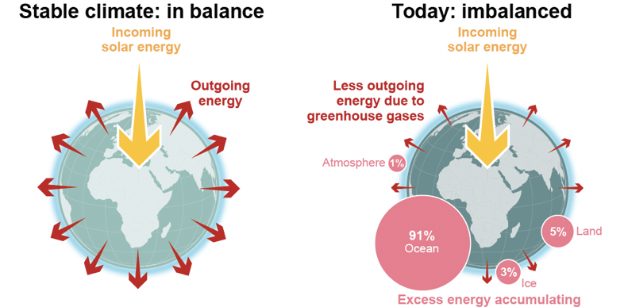
Human influence causes heating of the climate system
Figure FAQ7.1

Slide 15
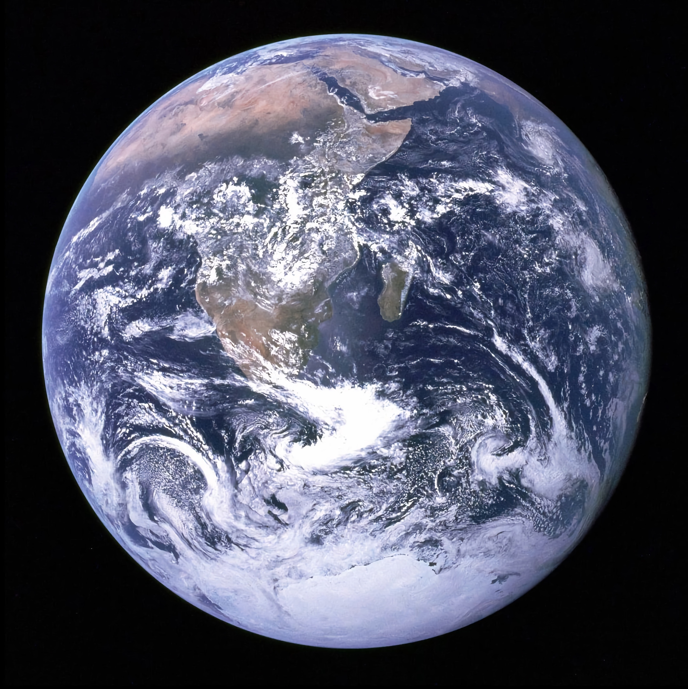
Recent changes in the climate are widespread, rapid, and intensifying, and unprecedented in thousands of years.
[Credit: NASA]

Slide 16
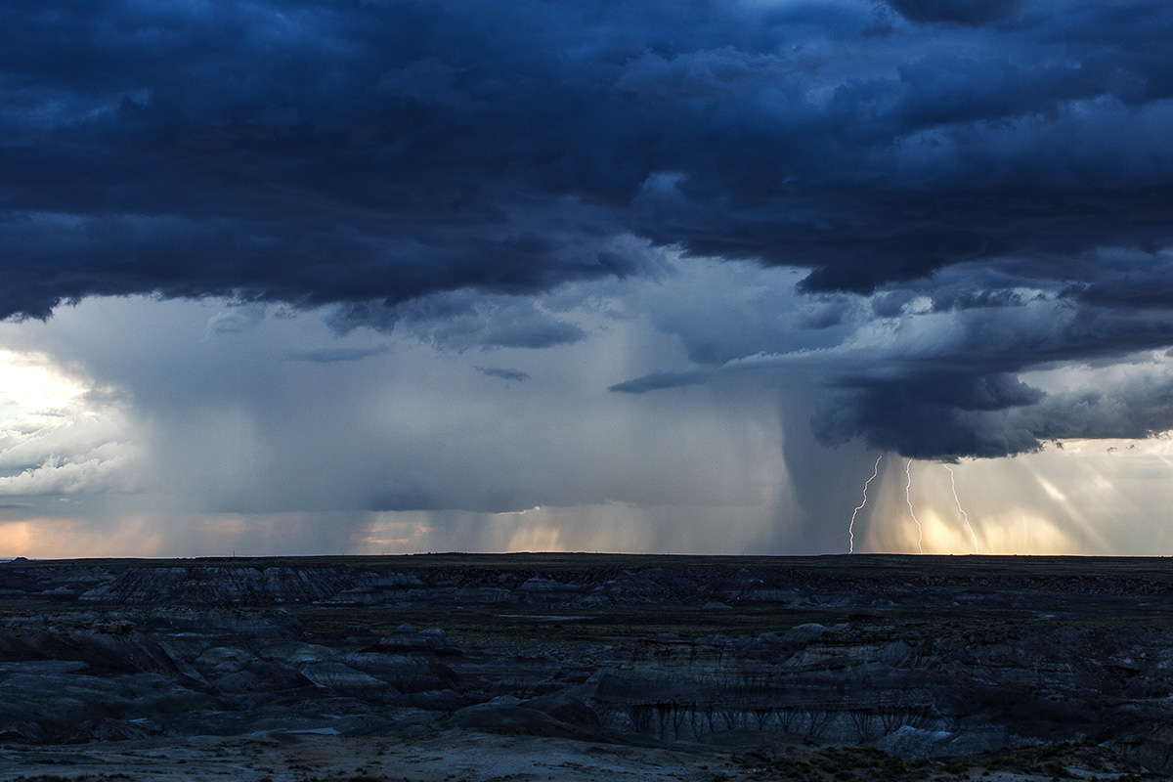
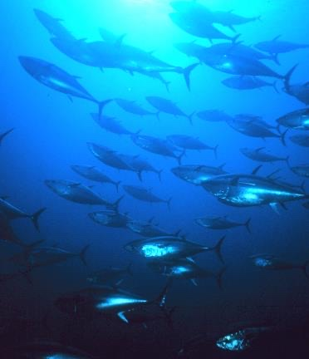
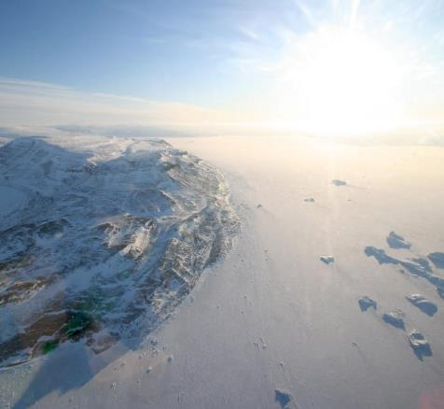
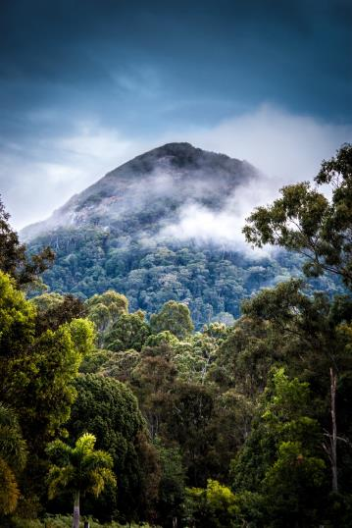

Slide 17
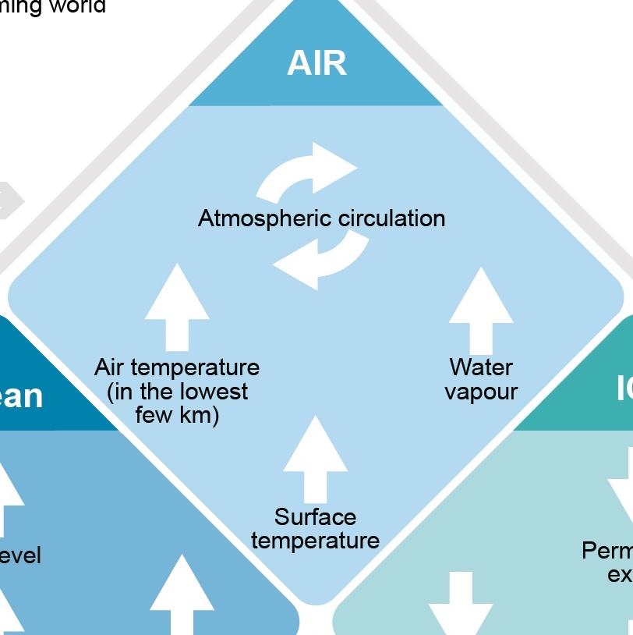

Slide 18
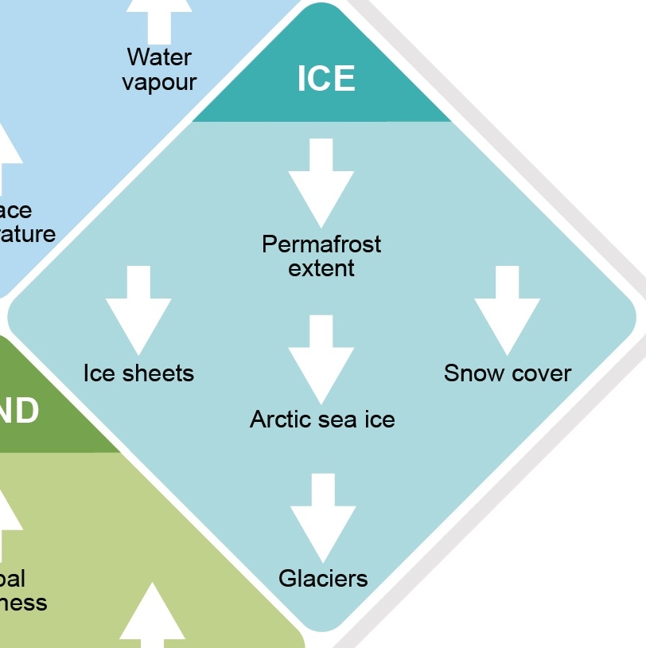
Notes:
Permafrost is thawing

Slide 19
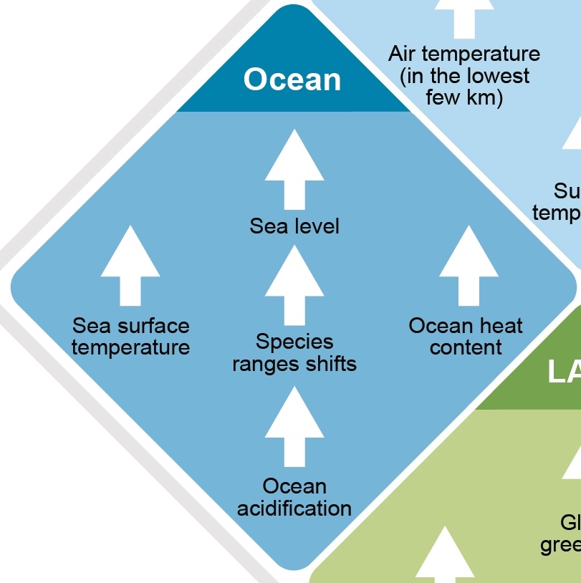
Notes:
SRL, increasing rate since 1970’
SST since

Slide 20

Notes:
Biosphere
Changes in the land biosphere since 1970 are consistent with global warming: climate zones have shifted poleward in both hemispheres, and the growing season has on average lengthened by up to two days per decade since the 1950s in the Northern Hemisphere extratropics (high confidence).

Slide 21

These changes are unprecedented
Fastest sea level rates
in at least 3000 years
Lowest Arctic sea ice level in at least
1000 years
Fastest sea surface temperature warming
in at least
11,000 years
Ocean acidification unusual
in at least 2 million years
Unprecedented glacier melt in at least
2000 years
Ocean heat content unprecedented
in at least
18,000 years
Figure FAQ2.2
Notes:
The scale of recent changes across the climate system as a whole and the present state of many aspects of the climate system are unprecedented over many centuries to many thousands of years.

Slide 22


The Earth has warmed by 1.36ºC
Warming is unprecedented in more than 2000 years
Changes in global surface temperature relative to 1850-1900
1.36° warmer
Observed warming is stronger over land than ocean and strongest in the Arctic
Adapted from Figure SPM.1 and updated by Forster et al. 2026

Slide 23




CO₂ concentration
Sea level rise
Arctic sea ice area
Glaciers retreat
Highest
In at least
2 millions years
Fastest rates
in at least
3000 years
Lowest level
In at least
1000 years
Unprecedented
In at least
2000 years

Slide 24

Human activities are causing climate change, making extreme climate events, including heat waves, heavy rainfall, and droughts, more frequent and severe
[Credit: Yoda Adaman | Unsplash]

Slide 25

Observed warming is driven by emissions from human activities, with greenhouse gas warming partly masked by aerosol cooling
Human Influence
Greenhouse gas warming
Aerosol cooling
Observed
Warming
1.36
Forster et al. 2026

Slide 26

CO₂ :
Fossil fuel (80-90%)
Landuse change
56% of the CO₂ emissions absorbed by ocean (acidification),
vegetation and soils
Cumulative effect, dominant forcing
CH₄ :
Fossil fuel
Agriculture (cattle)
Short lifetime (10 years)
Affect air quality (ozone production)
CO₂
CH₄
warming
cooling
Figure SPM2

Slide 27

Main driver of …
Contributes to …
Widespread changes are attributed to human influence
Adapted from Figure FAQ2.2
Notes:
Point on CO2 vs methane vs others

Slide 28



Human influence contributes to many observed changes in weather and climate extremes
Evidence of observed changes in extremes such as
heatwaves
heavy precipitation
droughts
tropical cyclones
and their attribution to human influence, has strengthened.
Hot extremes
Heavy Precipitations
Agricultural drought

Slide 29



Climate change is already affecting every inhabited region across the globe
Hot extremes
More frequent
More intense
Heavy rainfall
More frequent
More intense
Green: increase
Ecological Drought
Increase in some regions
Red: increase
Grey: limited data
level of confidence for attribution
Yellow: increase
Green: decrease

Slide 30
Green: increase
Grey: limited data
level of confidence for attribution
Heavy rainfall
More frequent
More intense

Slide 31
Ecological Drought
Increase in some regions
Yellow: increase
Green: decrease
Grey: limited data
level of confidence for attribution

Slide 32


Climate change is already affecting every inhabited region across the globe
Ocean
Warming Acidifying
Losing oxygen
Extreme heat
More frequent
More intense
Heavy rainfall
More frequent
More intense
Drought
Increase in some regions
Fire weather
More frequent
Photo Credits from left: 1. Luiz Guimaraes 2. Jonathan Ford 3. Peter Burdon 4. Ben Kuo 5. NOAA

Slide 33

Risk assessment (WG2)

Slide 34






SIXTH ASSESSMENT REPORT
WGII
Widespread and substantial impacts and related losses and damages attributed to climate change are observed on human and natural systems across the world
IPCC AR6 SYR Figure SPM.1a
IPCC AR6 SYR Figure SPM1a
Notes:
These changes have led to
"substantial impacts across on the naturel and human systems across the world”
• It leads to changes in all types of ecosystems both on land, fresh water and ocean
Half of them have shifted poleward or to higher altitudes due to climate modifications but some species unable to move, such as coral reef or trees, undergo high mortality
• CC impacts water availability and food production. Some regions can see positive effects in particular at high latitudes but the overall effect is mostly negative in particular for crops and fisheries
• C also impacts health through malnutrition bur also through increased diffusion of vector borne and waterborne diseases, hyperthermia, displacements and the resulting mental health problems through
Post traumatic stress of being displaced or loosing relatives or goods
• CC also causes damages to infrastructures and to economic sectors such as agriculture or tourism.
All these adverse impacts will continue to intensify with a warming climate.

Slide 35


Global warming has caused dangerous and widespread disruption in nature...
WG2
Switch to blue logo for contrast when necessary
Move/scale shape based on amount of text to maximize photo space
[Pacific Southwest Forest Service, USDA CC BY 2.0]
Notes:
Hans
Global warming has caused dangerous and widespread disruption in nature. The increased frequency, intensity and duration of extreme events on land and in the ocean is driving mass mortalities - for example in trees, as we show here in this drought-stressed forest in California, USA.

Slide 36


Observed impacts of climate change on ecosystems
WG2
Climate change has caused substantial damages, and increasingly irreversible losses, in terrestrial, freshwater and coastal and open ocean marine ecosystems.
Widespread deterioration of ecosystem structure and function, resilience and natural adaptive capacity, as well as shifts in seasonal timing have occurred due to climate change, with adverse socioeconomic consequences.
Approximately half of the species assessed globally have shifted polewards or, on land, also to higher elevations.
Notes:
Climate change has caused substantial damages, and increasingly irreversible losses, in terrestrial, freshwater and coastal and open ocean marine ecosystems (high confidence). The extent and magnitude of climate change impacts are larger than estimated in previous assessments (high confidence). Widespread deterioration of ecosystem structure and function, resilience and natural adaptive capacity, as well as shifts in seasonal timing have occurred due to climate change (high confidence), with adverse socioeconomic consequences (high confidence). Approximately half of the species assessed globally have shifted polewards or, on land, also to higher elevations (very high confidence). Hundreds of local losses of species have been driven by increases in the magnitude of heat extremes (high confidence), as well as mass mortality events on land and in the ocean (very high confidence) and loss of kelp forests (high confidence). Some losses are already irreversible, such as the first species extinctions driven by climate change (medium confidence). Other impacts are approaching irreversibility such as the impacts of hydrological changes resulting from the retreat of glaciers, or the changes in some mountain (medium confidence) and Arctic ecosystems driven by permafrost thaw (high confidence).

Slide 37

…and climate change is affecting the lives of billions of people, despite efforts to adapt.
……and climate change is affecting the lives of billions of people, despite efforts to adapt.
WG2
Switch to blue logo for contrast when necessary
WG2
Move/scale shape based on amount of text to maximize photo space
[NLRC via IFRC CC BY-NC 2.0]
Notes:
Hans
And climate change is affecting the lives and livelihoods of billions of people. The impacts from human-induced intensification of tropical cyclones, sea level rise and heavy rainfall have resulted in increased losses and damages.

Slide 38




WG2
Observed impacts of climate change on human systems
WG2
Global
Europe
Over Europe, crop losses x3 over the last 50 years
Climate change have reduced food and water security
Although overall agricultural productivity has increased, climate change has slowed this growth over the past 50 years globally,
impacts were mainly in mid- and low latitude regions
+ impacts occurred in some high latitude regions.
Ocean warming and ocean acidification have adversely affected food production from shellfish aquaculture and fisheries in some oceanic regions.
Increasing weather and climate extreme events have exposed millions of people to acute food insecurity and reduced water security, with the largest impacts observed in many locations and/or communities in Africa, Asia, Central and South America, Small Islands and the Arctic.
Notes:
Climate change including increases in frequency and intensity of extremes have reduced food and water security, hindering efforts to meet Sustainable Development Goals (high confidence). Although overall agricultural productivity has increased, climate change has slowed this growth over the past 50 years globally (medium confidence), related negative impacts were mainly in mid- and low latitude regions but positive impacts occurred in some high latitude regions (high confidence). Ocean warming and ocean acidification have adversely affected food production from shellfish aquaculture and fisheries in some oceanic regions (high confidence). Increasing weather and climate extreme events have exposed millions of people to acute food insecurity30 and reduced water security, with the largest impacts observed in many locations and/or communities in Africa, Asia, Central and South America, Small Islands and the Arctic (high confidence). Jointly, sudden losses of food production and access to food compounded by decreased diet diversity have increased malnutrition in many communities (high confidence), especially for Indigenous Peoples, small-scale food producers and low-income households (high confidence), with children, elderly people and pregnant women particularly impacted (high confidence). Roughly half of the world’s population currently experience severe water scarcity for at least some part of the year due to climatic and non-climatic drivers (medium confidence).

Slide 39

Observed impacts of climate change on human systems
WG2
Global
Europe
Notes:
Climate change including increases in frequency and intensity of extremes have reduced food and water security, hindering efforts to meet Sustainable Development Goals (high confidence). Although overall agricultural productivity has increased, climate change has slowed this growth over the past 50 years globally (medium confidence), related negative impacts were mainly in mid- and low latitude regions but positive impacts occurred in some high latitude regions (high confidence). Ocean warming and ocean acidification have adversely affected food production from shellfish aquaculture and fisheries in some oceanic regions (high confidence). Increasing weather and climate extreme events have exposed millions of people to acute food insecurity30 and reduced water security, with the largest impacts observed in many locations and/or communities in Africa, Asia, Central and South America, Small Islands and the Arctic (high confidence). Jointly, sudden losses of food production and access to food compounded by decreased diet diversity have increased malnutrition in many communities (high confidence), especially for Indigenous Peoples, small-scale food producers and low-income households (high confidence), with children, elderly people and pregnant women particularly impacted (high confidence). Roughly half of the world’s population currently experience severe water scarcity for at least some part of the year due to climatic and non-climatic drivers (medium confidence).

Slide 40

Observed impacts of climate change on human systems
WG2
Global
Europe
Notes:
Climate change including increases in frequency and intensity of extremes have reduced food and water security, hindering efforts to meet Sustainable Development Goals (high confidence). Although overall agricultural productivity has increased, climate change has slowed this growth over the past 50 years globally (medium confidence), related negative impacts were mainly in mid- and low latitude regions but positive impacts occurred in some high latitude regions (high confidence). Ocean warming and ocean acidification have adversely affected food production from shellfish aquaculture and fisheries in some oceanic regions (high confidence). Increasing weather and climate extreme events have exposed millions of people to acute food insecurity30 and reduced water security, with the largest impacts observed in many locations and/or communities in Africa, Asia, Central and South America, Small Islands and the Arctic (high confidence). Jointly, sudden losses of food production and access to food compounded by decreased diet diversity have increased malnutrition in many communities (high confidence), especially for Indigenous Peoples, small-scale food producers and low-income households (high confidence), with children, elderly people and pregnant women particularly impacted (high confidence). Roughly half of the world’s population currently experience severe water scarcity for at least some part of the year due to climatic and non-climatic drivers (medium confidence).

Slide 41


Impacts are magnified in cities where more than half the world’s population lives
WG2
Switch to blue logo for contrast when necessary
Move/scale shape based on amount of text to maximize photo space
[Peter Nguyen / Unsplash]

Slide 42

Global warming, could be stabilized by:
-reaching net zero CO₂ emissions
-strongly reducing other GHGs emissions
[Credit: GAP production report]

Slide 43

Every tonne of CO₂ emissions adds to global warming
Remaining carbon budget
Global Temperature
More CO₂
CO₂ emitted from 1850 to 2019 [2390 Gt CO₂]
500
Remaining CO₂ before reaching 1.5°C (with 50% probability)
1350 Gt CO₂
Remaining CO₂ before reaching 2°C (with 50% probability)
NB Updated to 130 (RCB for 1.5°C) and 1050 (for 2°C) from 1st Jan 2026 by Forster et al. 2026
Variations de réduction des
émissions non-CO₂

Slide 44

Use of illustrative scenarios to determine the range of possible futures
Shared Socioeconomic Pathway (SSP) Scenarios
Carbon dioxide (GtCO₂/yr)
Very high
High
Intermediate CO₂ emission pathway
Low
Very low
CO₂ emission pathways without any climate change mitigation
Net zero CO₂
CO₂ emission pathways in which CO₂ emissions decline to net zero around or after 2050
Box SPM.1, Figure SPM.4

Slide 45

Equilibrium Climate Sensitivity in IPCC reports
Broad agreement across multiple lines of evidence, supporting a best estimate of equilibrium climate sensitivity of 3°C, with a likely range of 2.5°C to 4°C
AR6
Figure TS.16

Slide 46

Global warming will worsen in the near term and 1.5°C and 2°C will be exceeded unless deep reductions in CO₂ and other greenhouse gas emissions occur in the coming decades
Global surface temperature change relative to 1850–1900
CO₂ emissions
Very high
High
Intermediate
1.5°C
Low
Very low
Near-term
Figure SPM.8

Slide 47

Unless there are immediate, rapid, and large-scale reductions in greenhouse gas emissions, limiting warming to 1.5°C will be beyond reach
[Credit: Peter John Maridable | Unsplash]

Slide 48

Projections in the context of the Earth’s climate history
Global surface temperature change (relative to 1850-1900)
Dinosaure Extinction
Future
Homo habilis
Neanderthalensis
Sapiens sapiens
+2.5ºC
2100
Figure TS.1
Figure TS.1

Slide 49

Many projected changes worsen with every additionnal increment of global warming
[Credit: Andy Mahoney | NSIDC]

Slide 50

With every increment of global warming, changes get larger in regional mean temperature, precipitation and soil moisture
Annual mean temperature change (°C) relative to 1850-1900
1.5°C
2°C
at 4°C
Figure SPM.5

Slide 51



With every increment of global warming, changes get larger in regional mean temperature, precipitation and soil moisture
Change in annual precipitation (%) relative to 1850-1900
1.5°C
2°C
4°C
drier
wetter
Change in soil moisture (sd)
wetter
Figure SPM.5
drier
wetter
drier

Slide 52


Atmosphere
Continued global warming is projected to further intensify
the global water cycle, including its variability, global monsoon precipitation and the severity of wet and dry events
Land
Ocean
Frozen regions

Slide 53

Rainfall and monsoons
Annual rainfall on land
Increasing
Monsoons
Changing in complex ways
Photos: Left: Arek Socha, Pixabay: Right: James Martin Phelps

Slide 54

Projected changes in extremes are larger in frequency and intensity with every additionnal increment of global warming
Hot temperature
extremes over land

Slide 55


There’s no going back from some changes in the climate system…
[Credit: Jenn Caselle | UCSB]

Slide 56


Human activities affect all the major climate system components, with some responding over decades and others over centuries
2050 :
+ 15 cm to 23 cm
Emissions
very high
high
intermediate
low
very low
2100 :
+ 28 cm to + 102 cm
… 2300 …

Slide 57



Ocean and ice sheets
Ocean temperature
Increasing
Greenland Ice Sheet
Melting
Sea level
Rising
Photo Credits from left: NOAA; Konrad Steffen; Allan Grinberg

Slide 58

Many changes in the climate system become larger in direct relation to increasing global warming
CO₂ emissions
Very low
Low
Intermediate
High
Very high
Very low
Low
Intermediate
High
Very high
Figure SPM.8

Slide 59



Regional climate assessment

Slide 60









C
Heat
&
cold
Rain
&
drought
Snow
&
ice
Wind
Coastal
&
oceanic
Other
Open ocean
A climatic impact-driver is a physical climate system conditions (e.g., means, events, extremes) that affect an element of society or ecosystems
Larger magnitude
Increased frequency
New locations
Different timing
New combinations

Slide 61


Example of regional synthesis in the Interactive Atlas
Dry climatic impact-drivers

Slide 62


Changes in several climatic impact-drivers would be more widespread at 2°C compared to 1.5°C global warming and even more widespread and/or pronounced for
higher warming levels
Heat warning index
Relative to 1995-2014
https://interactive-atlas.ipcc.ch/
Change in number of days per years
-40
0
40

Slide 63

Projected changes in extremes are larger in frequency and intensity with every additionnal increment of global warming
Hot temperature
extremes over land

Slide 64

Many projected changes worsen with every additionnal increment of global warming
WG2:
1.5°C, natural adaptation faces hard limits, driving high risks of biodiversity decline, mortality, species extinction
1.6°C, >10% of species become endangered,
2.1°C, >20% representing severe biodiversity risk
3°C, >80% of marine species across large parts of the tropical Indian and Pacific Ocean experience potentially dangerous climate conditions
> 4°C, ~50% of tropical marine species and biome shifts across 35% of global land area.
The percentage of terrestrial species at high risk of extinction:
at 1.5°C : 9% (maximum 14%),
at 2°C, 10% (max 18%)
at 3.0°C 12% (max 29%)
at 4°C 13% (max 39%).
Extinction risks are higher for species in biodiversity hotspots,
reaching 24% of species at very high extinction risk above 1.5°C, with yet higher proportions for endemic species of 84% in mountains and 100% on islands.

Slide 65


Projected changes in extremes are larger in frequency and intensity with every additionnal increment of global warming
Agricultural & ecological droughts
in drying regions
Heavy precipitation over land
Figure SPM.6

Slide 66

Many changes in the climate system become larger in direct relation to increasing global warming.
↑ frequency and ↑ intensity
Hot extremes,
Marine heatwaves
Heavy precipitation +7% par °C
Agricultural and ecological drought in some regions
proportion of intense tropical cyclones
↓ arctic sea ice, snow cover, permafrost
Larger magnitude
Increased frequency
New locations
Different timing
↑ Compounds events: concurrent and multiple changes in climatic impact-drivers
New combinations

Slide 67

Simultaneous extreme events compound risks
WG2
And are more difficult to manage
Notes:
DEBRA
When multiple extreme events happen at the same time, they compound the overall risk and are more difficult to manage.
What we see here is an example of how heat and drought combine to cause reductions in crop yields, made worse by reduced productivity because of heat stress among farm workers. Reduced yields lead to reductions in household incomes, increased food prices locally and, potentially, globally.
Climate risks do not respect national boundaries and weather-related extremes are creating shocks to global trade.

Slide 68
Low Likelihood High Impact events
The probability of occurrence is low but potential impacts on society and ecosystems could be high
They can occur at the global and regional scale
Their chance of occurrence increases with higher global warming
See Table 4.10

Slide 69




Climatic impact-drivers
Climate Information for Risk Assessment and Regional Adaptation
Snow & Ice
Heat & Cold
Wet & Dry
Coastal
Thresholdss
Wind
Open Ocean

Slide 70




Future global climate risks
WG2
Heat stress
Exposure to heat waves will continue to increase with additional warming.
Water scarcity
At 2°C, regions relying on snowmelt could experience 20% decline in water availability for agriculture after 2050.
Food security
Climate change will increasingly undermine food security.
At 2°C warming by 2050 people in sub-Saharan Africa, South Asia, Central and South America and on small islands are likely to experience food shortages, leading to malnutrition.
Flood risk
About a billion people in low-lying cities by the sea and on Small Islands at risk from sea level rise by mid-century.
[Well Bred Kannan - WBK Photography CC BY-NC-ND 2.0; Jay Huang CC BY 2.0; Cristina Anne Costello, Marcus Woodbridge / Unsplash]
Notes:
Globally, population exposure due to heatwaves will continue to increase with additional warming.
At approximately 2°C, regions that are highly dependent on snowmelt could experience a 20% decline in water availability for agriculture beyond 2050.
And we know that climate change will undermine food security. At 2C warming by 2050 people in sub-Saharan Africa, South Asia, Central and South America and on small islands are likely to experience food shortages, leading to malnutrition.
About a billion people living in low-lying cities and other settlements on the coast are projected to be at risk from sea level rise and other climate hazards by mid-century.

Slide 71
Regional sea level rise contributes to increases in the frequency and severity of coastal flooding in low-lying areas and to coastal erosion along most sandy coasts
Extreme sea levels that occurred once per century in the recent past will occur
    by 2050: 20 to 30 times more frequently,
    annually or more frequently at about 19–31% of tide gauges
    by 2100 : at least 160 times more frequently
    annually or more frequently at 60% (<2°C) to 80% (4°C) of tide gauges

Slide 72



Differences in trends in global surface temperature would begin to emerge from natural variability within around the next 20 years
CO₂ emissions (billion tonnes of CO2 per year)
CO₂ concentration in the atmposphere (ppm)
Global surface temperature (ºC)
High
High
High
CO₂ emissions scenario
Low
Low
Low
But decrease of air pollution (ozone, PM) induced by climate mitigation would bring benefit shortly after emission decrease
FAQ4.2, Figure 1

Slide 73

Climate change is already affecting every region on Earth, in multiple ways.
The changes we experience will increase with further warming.
[Credit: Hong Nguyen | Unsplash]

Slide 74

The climate we experience in the future depends on our decision now.

Slide 75





Understanding global changes remains a challenge:
• Recent changes
• Energy imbalance and role of aerosols, albedo, (low level) clouds, feedbacks
Anomaly of global surface T (relative to 1850-1900)
As assessed by IPCC AR6
Forster et al. 2024, 2026

Slide 76



Feasibility and Consequences of an ‘Overshoot’
(= T peak and decline)
We’re crossing the political threshold of 1.5°C warming:
• Maintaining the 1.5°C target = temperature return after a temporary overshoot with negative emissions
• Consequences and risks compared to a world that does not exceed 1.5°C? What elements are (ir)reversible? On what time scales?
• Consequences and risks compared to a world stabilized with greater warming?
• Feasibility and scalability of negative emissions through CDRs; feedback loops?
• Consequences and risks of negative emissions?
Abrupt, high-impact events and tipping points
• Reducing uncertainty about critical thresholds
• Understanding impacts and their timescales
• Risk cascades to understand and quantify up to the regional level
• Early warning indicators
Courtesy
R. Vautard,
Y. Silvy
Common framework for studying peak and decline scenarios

Slide 77

Better inform on risk
More regional information, better caracterisation of the changing physical parameters triggering impacts
More emulators able to investigate a larger range of scenario and caracterize regional changes
Need to understand record breaking extremes (which far exceed regional model projection)
Courtesy
R. Vautard,
Y. Silvy

Slide 78

A few challenges for the AR7
+ Technical challenges: more and more papers, emergence of paper mills, AI, increasing number of comments but still limited team of authors
+ Contextual: geopolitical tension/polarization, disinformation, instrumentalisation of science

