Slide 1
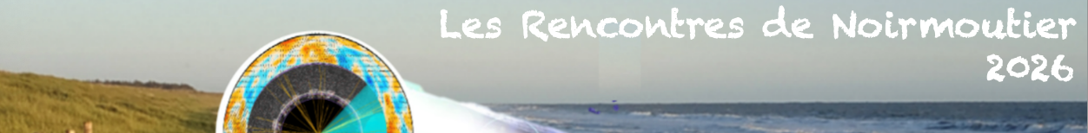
Aerosol particles and clouds across scales
Prof. (em.) Dr. Andrea I. Flossmann
Université Clermont Auvergne
andrea.flossmann@uca.fr

Slide 2
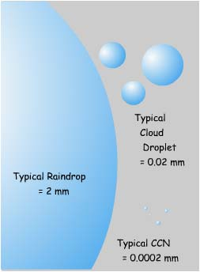
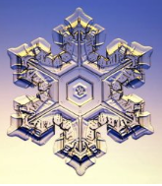
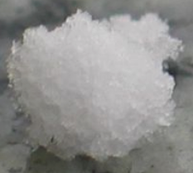
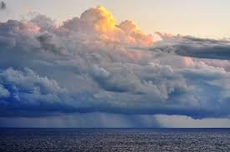
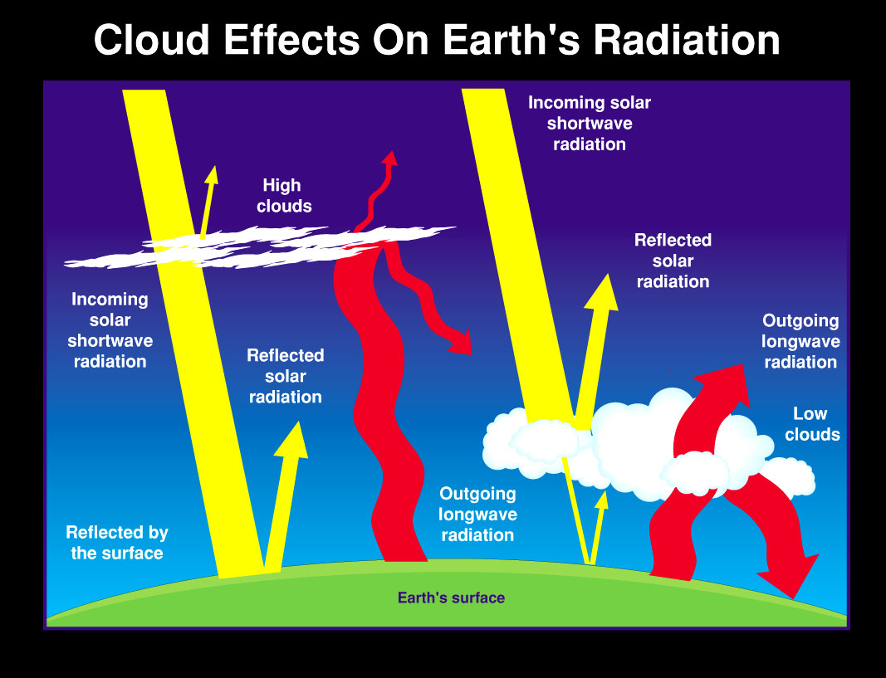
clouds across scales
Clouds
are composed of drops or ice crystals with sizes between some μm and several mm
determine our weather
Contribute to our climate

Slide 3
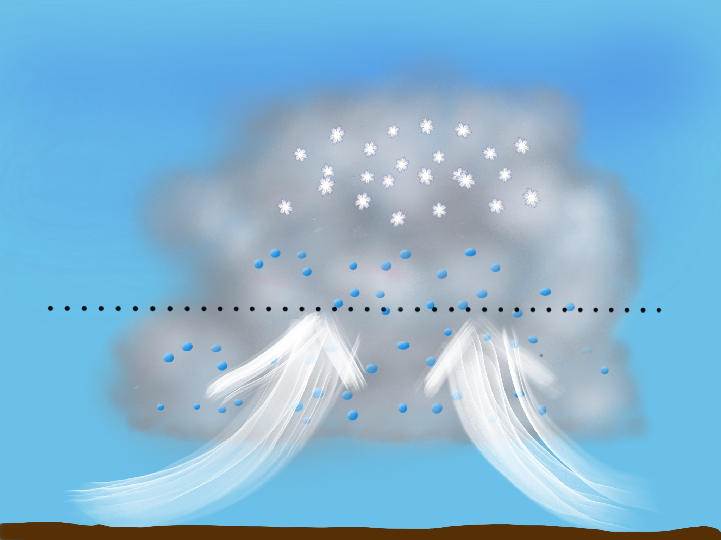
How do clouds form?
water vapour is rising, cooling and condensing
In « clean » air 20*100% rel hum is necessary to stabilize a drop of 9 molecules
A pre-existing support is mandatory
=> Aerosol particles serve as cloud condensation nuclei or ice nucleating particles
O°C
Notes:
Saturation vapor pressure too high

Slide 4
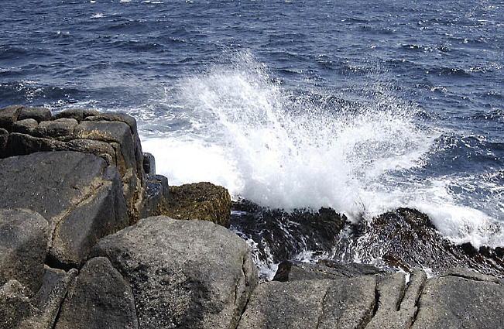
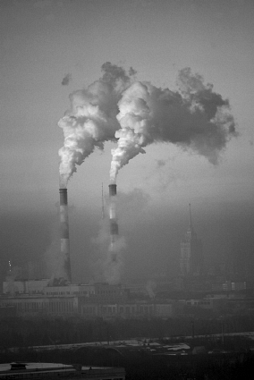
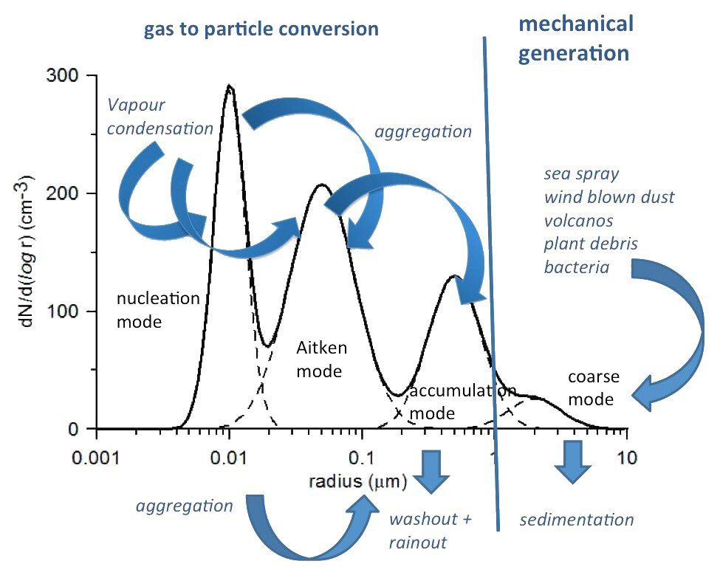
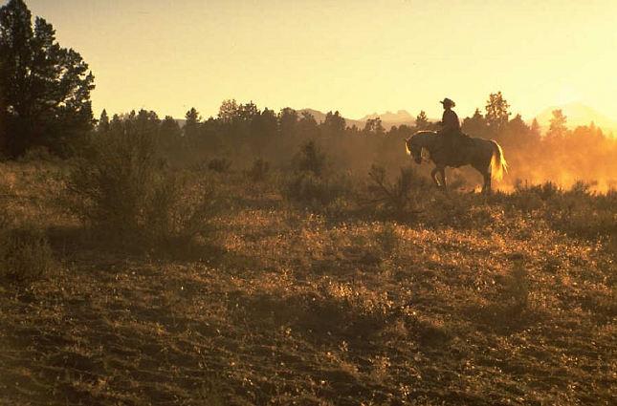
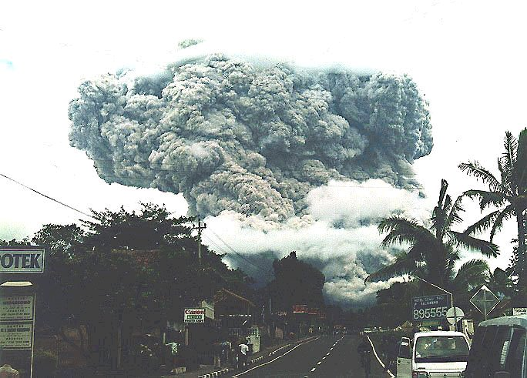
Aerosol particles
sizes between some nm and several μm

Slide 5
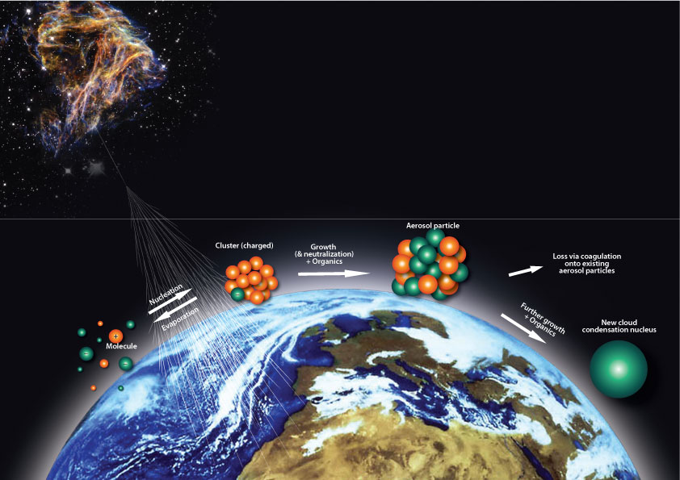
Aerosol particles formed by galactic cosmic rays
(CLOUD/CERN)
the Proton Synchrotron provides an artificial source of “cosmic rays”;
controlled temperature + additional trace gases
Notes:
Interesting for pre-industrial scenarios

Slide 6
Aerosol particles
Conditions for serving as cloud condensation nucleus (CCN) or ice nucleating particles (INP):
Size: 0.3 μm – 3 μm
CCN: soluble
INP: insoluble
Notes:
Goldilocks problem: size must be just right (not to small and not too big)

Slide 7
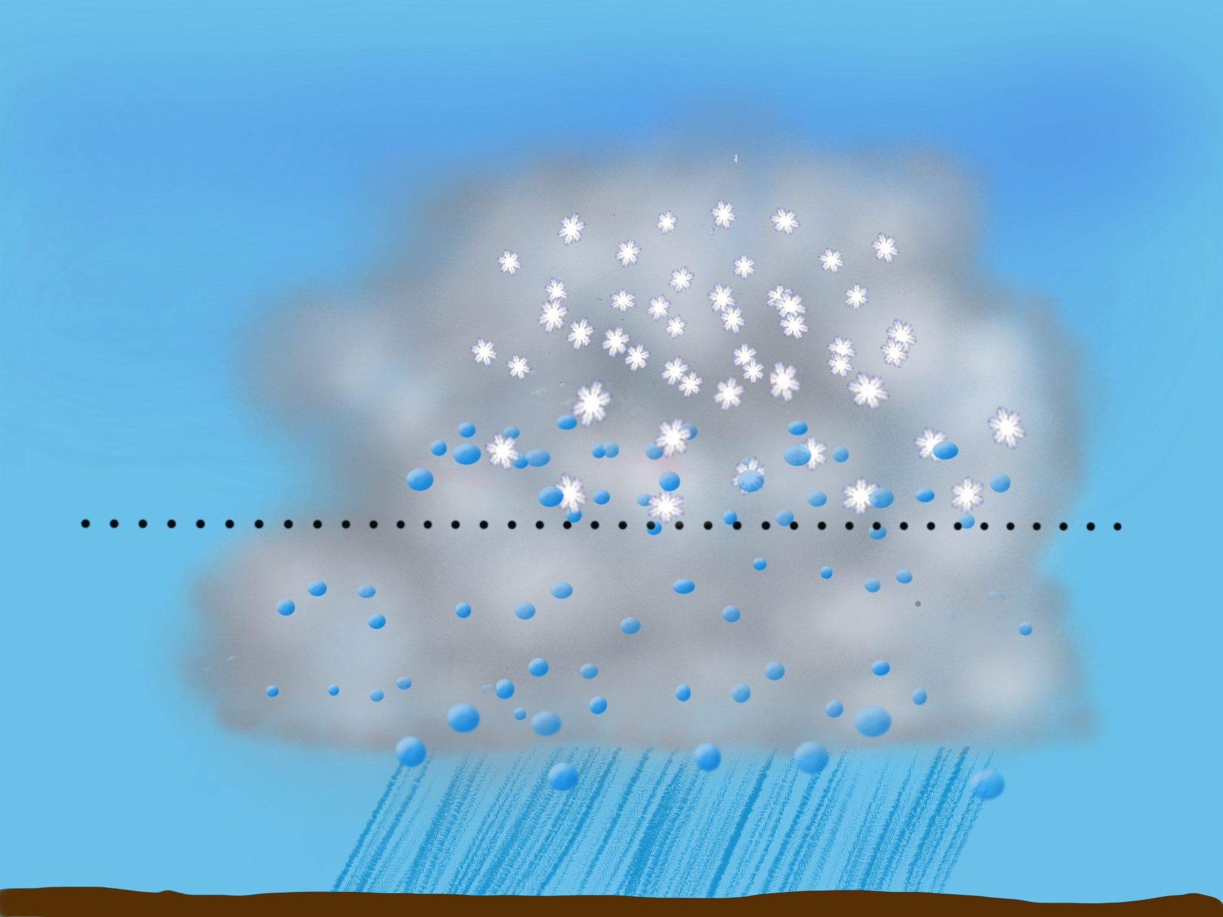
How precipitation is formed?
Growth of drops and crystals to millimeter - sizes
by collision:
drop – drop = raindrop,
crystal - crystal = snowflake,
drop - crystal = graupel/hail
O°C
only efficient if enough hydrometeors with different sizes (significant terminal velocities)
ca 1 million drops (of 10 μm) form a raindrop (of 1 mm)

Slide 8
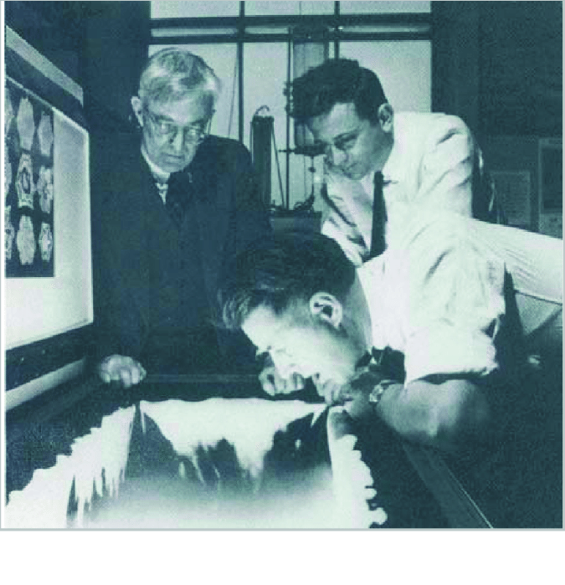
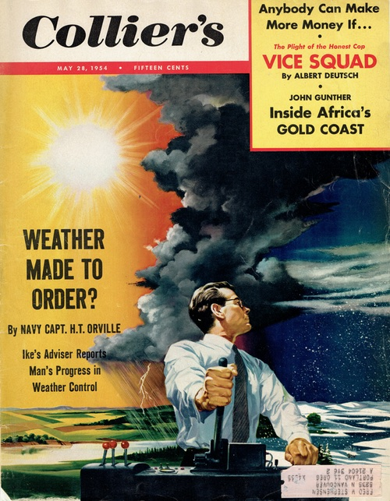
Early 1950 : idea to seed clouds with “appropriate particles” to boost precip formation
Problem: large natural variability of clouds
1946: Langmuir, Vonnegut
and Schaefer
https://www.novakarchive.com/vintage-magazine-covers/colliers-may-28-1954
Notes:
Discoveri of siveriodide AgI

Slide 9
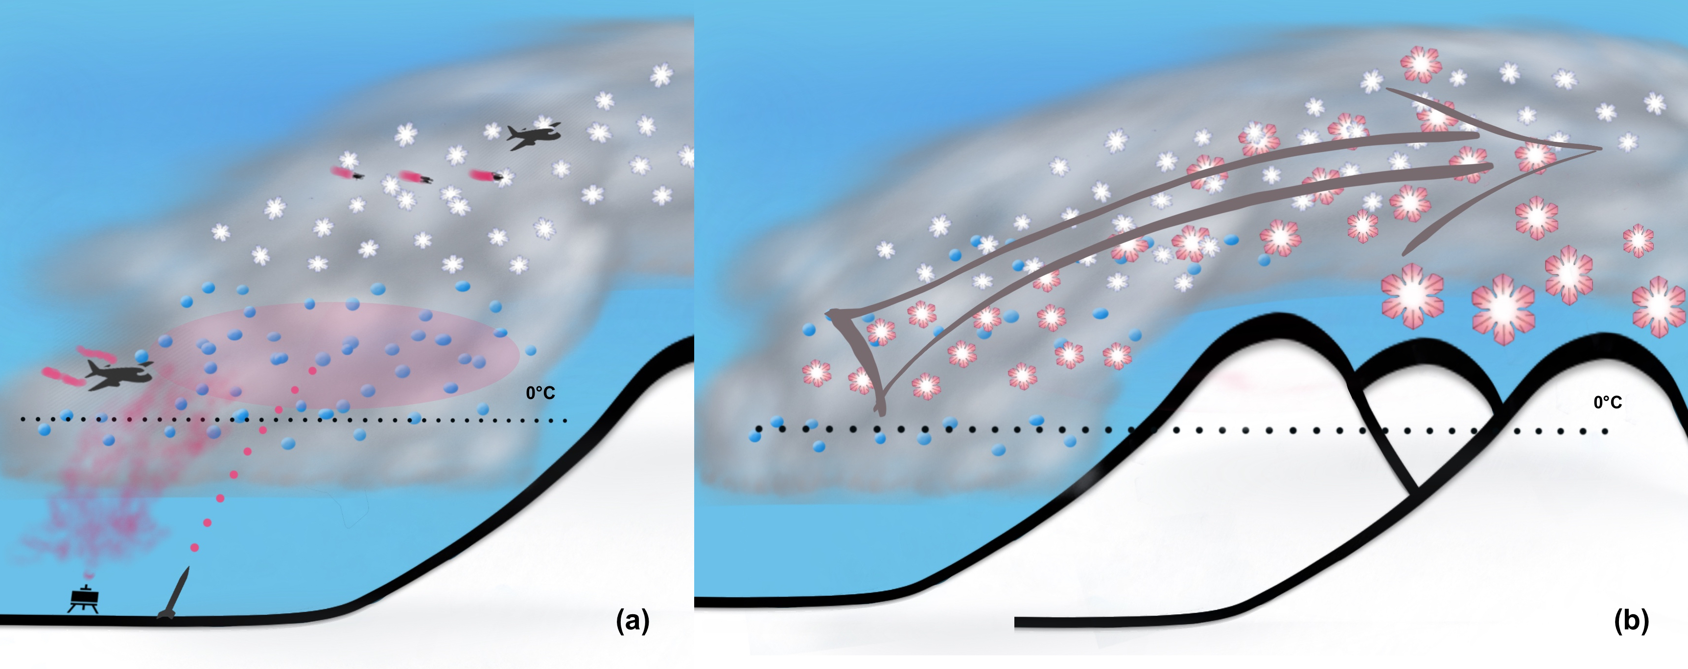
Concept of glaciogenic seeding of wintertime orographic clouds
add INP to form crystals that grow via vapor deposition and riming; the additional release of latent heat may invigorate the cloud; ex: the Snowy Precipitation Enhancement Research Projects (SPERP-1 and 2) in the Snowy Mountains of south eastern Australia; the Wyoming Weather Modification Pilot Project (WWMPP); to increase snow pack in catchment basins feeding water reservoirs

Slide 10
Difference in normalised frequency-altitude display (FAD) of aircraft-based radar reflectivity between seeded and unseeded conditions downwind of ground-based AgI generators in Wyoming, USA (taken from Geerts et al. 2010); there is a substantial increase in reflectivity within the boundary layer, especially near the ground; the mean seeded and unseeded difference is shown by the solid and dashed black lines. The inset shows the matching 37 aircraft passes in seeded and unseeded aircraft legs, based on 5 geographically-fixed cross-wind tracks.

Slide 11
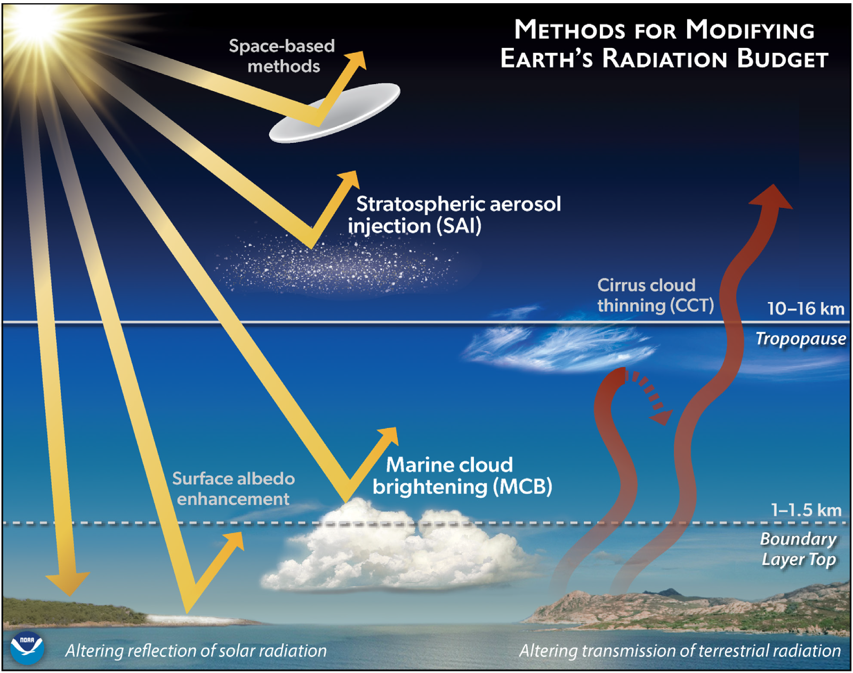
Discussion: seeding for geoengineering
(solar radiation management)

Slide 12
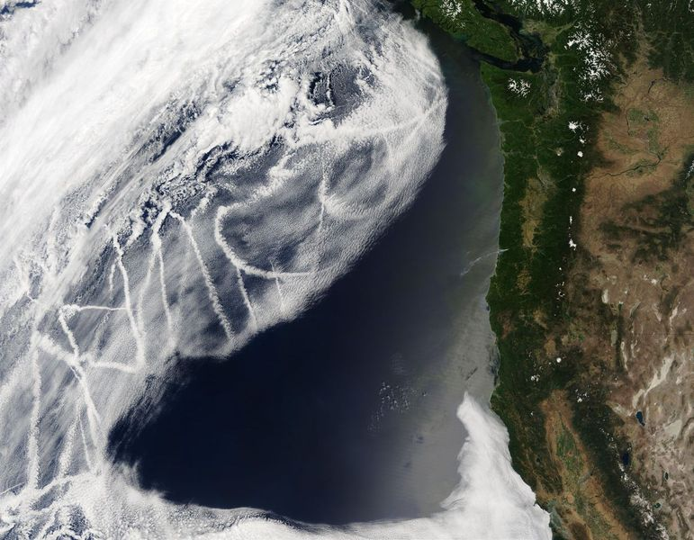
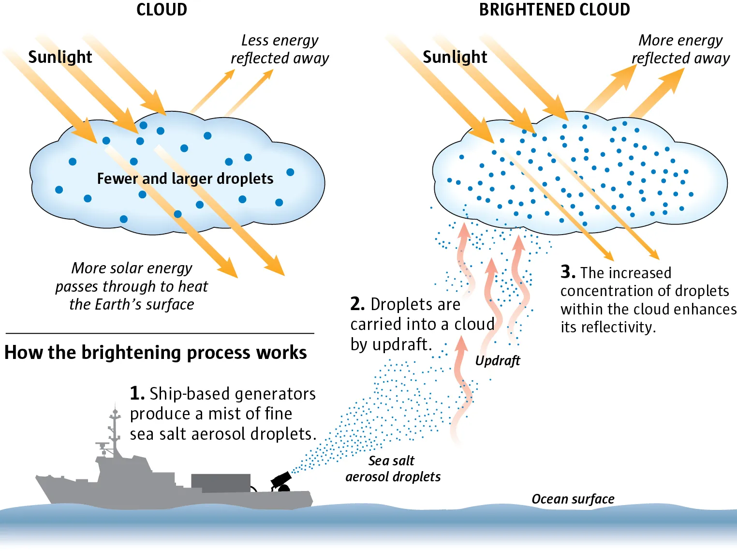
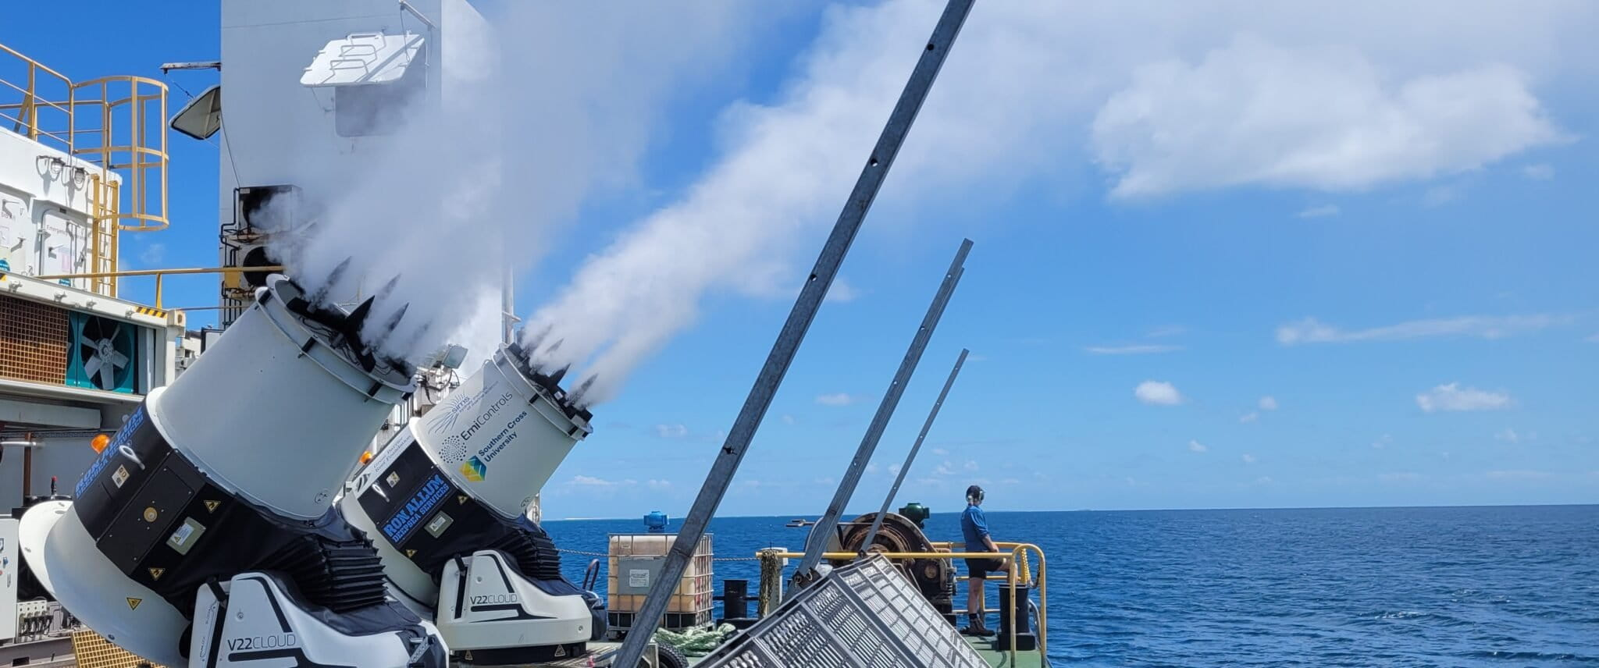
Principe of marine cloud brightening
ship tracks
2023 Great Barrier Reef (Australia)

Slide 13
Questions?
Effect of APs from galactic cosmic rays?
Debate wrt role for past, present and future climate change still ongoing
Pre-industrial role?

