Slide 1
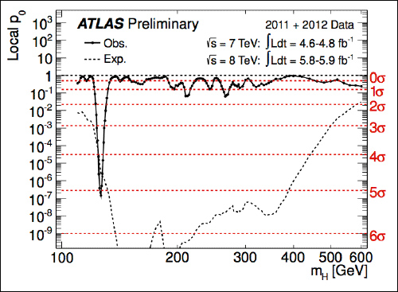
Climate Change
Higgs Boson
Noise trends
Signal trend ?
5-sigma : Is Climate Change More Detectable than the Higgs Boson ?
Laurent Terray, CNRS/Cerfacs/IRD
Thanks to: Ben Santer (LLNL)
Rencontres de Noirmoutier
June 1st –5th, 2026

Slide 2
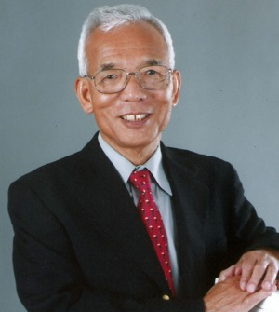
Climate change fingerprint: Prediction and Detection
Stratospheric cooling
Thermal Equilibrium of the Atmosphere with a Given Distribution of Relative Humidity
40
SYUKURO MANABE AND RICHARD T. WETHERALD
Geophysical Fluid Dynamics Laboratory, ESSA, Washington, D.C.
(Manuscript received 2 November1966)
30
150 ppm CO₂
300 ppm CO₂
600 ppm CO₂
Altitude (km)
Stratosphere
20
Tropospheric warming
10
Troposphere
0
-80
-60
-40
-20
0
20
Temperature (°C)
Notes:
Manabe prediction image is from: https://scx2.b-cdn.net/gfx/news/2021/the-most-influential-c.jpg. 1-D model of the atmosphere, simple radiative-convective model to simulate the effect of CO2 onto the vertical temperature profile.

Slide 3
Manabe’s ”Climate change fingerprint” is in the satellite temperature data
Stratosphere
Temperature trend over
1986 to 2025
Troposphere
°C/decade
Source: Santer et al., PNAS (2023; updated)
Notes:
Satellite observations (Santa Rosa, CA and University of Maryland). No causality here just pattern similarity, does not prove anything. Note that the stratospheric cooling strengthens with altitude and the Arctic amplification within the troposphere. The stratosphere is governed by a delicate balance between two key processes: absorption of UV radiation by ozone and emission of infrared radiation to space by CO2 molecules. New effect: the narrowing of the carbon dioxide absorption spectrum in the stratosphere that explains the magnitude and shape of the stratospheric cooling.
When CO2 concentration rises, atmospheric emissivity increases such that a lower temperature is needed to achieve the same longwave emission by CO2. Assuming that heating by O3 remains fixed, the stratosphere cools to remain in radiative equilibrium.

Slide 4
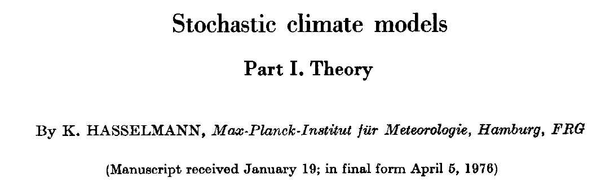
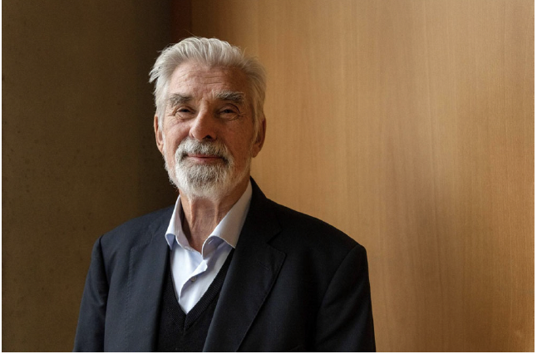
Not so easy … Climate system varies at all time scales !
Stratosphere
« Short-term weather variability leads to long-term climate variability »
« The slow components (e.g the Ocean) integrate weather variability on daily to monthly time scales into climate variability on annual to multidecadal time scales »
Note: The 2021 Nobel prize was awarded to both Suki Manabe and Klaus Hasselmann
"for the physical modelling of Earth’s climate, quantifying variability and reliably predicting global warming"
Notes:
Even without external forcing, the climate system has variability at annual to multi-decadal time scales (El Niño) and AMV/PDV

Slide 5
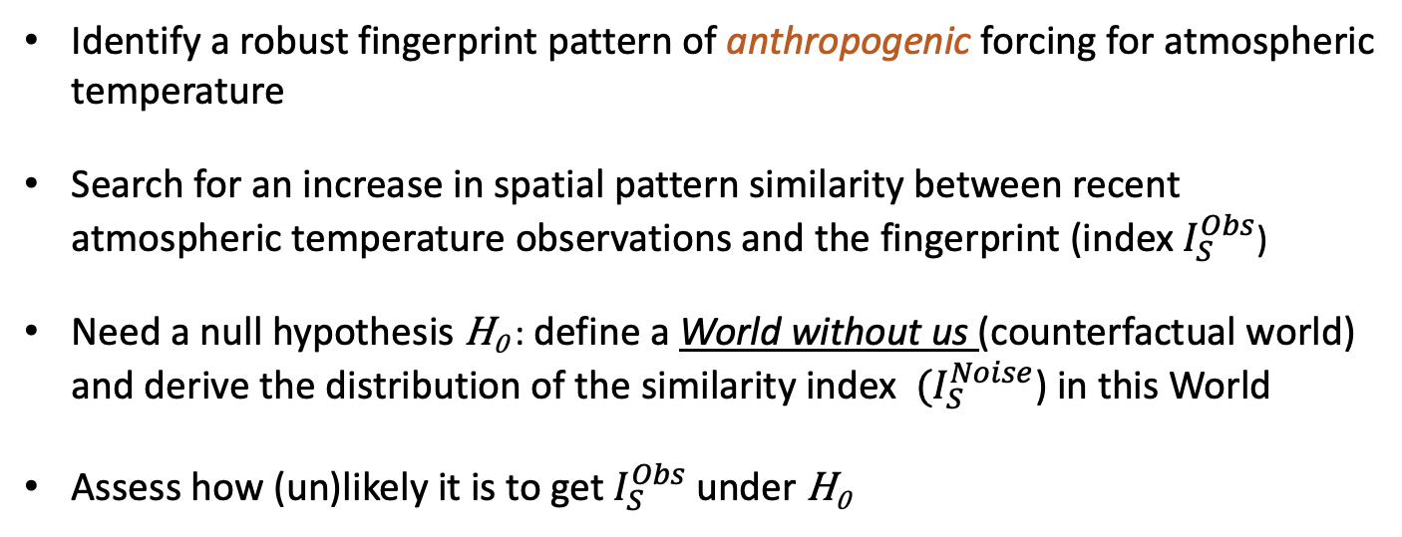
Detection of climate change due to human influence ?
Identify a robust fingerprint pattern of anthropogenic forcing for atmospheric temperature
Search for an increase in spatial pattern similarity between recent atmospheric temperature observations and the fingerprint (index $I_{S}^{Obs}$)
Need a null hypothesis H₀ : define a World without us (counterfactual world) and derive the distribution of the similarity index ${ (I}_{S}^{Noise}$) in this World
Assess how (un)likely it is to get $I_{S}^{Obs}$ under H₀
Stratosphere
Notes:
Point out that this is one (and a simple one) method of D&A out of many but in essence they have much in common.
How then can we be sure that the observed signal is mostly the response to the CO2 increase ? That is where the D&A approach becomes relevant and necessary. Note here that we are doing detection of an effect due to a given cause (standard detection only proves that there has been a change without mentioning the cause).

Slide 6
Detection ingredients
Observations: annual zonal mean atmospheric temperature T(θ, z, t) with t = 1986,..., 2025
Model-based:
  Anthropogenic temperature fingerprint F(θ, z) : derived from historical simulations
  The World without us: simulated temperature from long control simulations T_{c} (θ, z, t)
Notes:
Zonal average: the aim is to reduce the number of degrees of freedom. Repeat the definitions of historical simulations: same forcing as observed but different chronology due to chaos (introduce the notion of members and models)

Slide 7
How to get the “vertical fingerprint” F(θ, z) ?
Model 1
Model 2
Model 3
Model 4
Model 5
Model 6
Model 7
Model 8
Model 9
Trend, °C/decade, 1986-2025
−0.8
−0.6
−0.4
−0.2
0.0
0.2
0.4
0.6
0.8
Cooling
Warming
Notes:
The vertical fingerprint: the multimodel mean trend. Mention here that it is in fact a double average: 1. Over members (initial conditions) and over models (structural uncertainty)

Slide 8
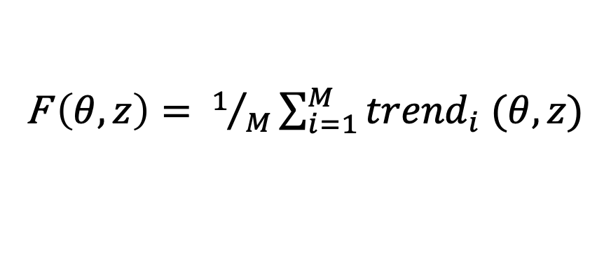
F(θ, z) : Multimodel Mean Trend
F $\left(θ,z\right)= 1/M\sum_{i=1}^{M}{{trend}_{i} (θ, z)}$
°C/decade, 1986-2025
−0.8
−0.6
−0.4
−0.2
0.0
0.2
0.4
0.6
0.8
Cooling
Warming
Notes:
Zonal average: the aim is to reduce the number of degrees of freedom. Repeat the definitions of historical simulations: same forcing as observed but different chronology due to chaos.

Slide 9
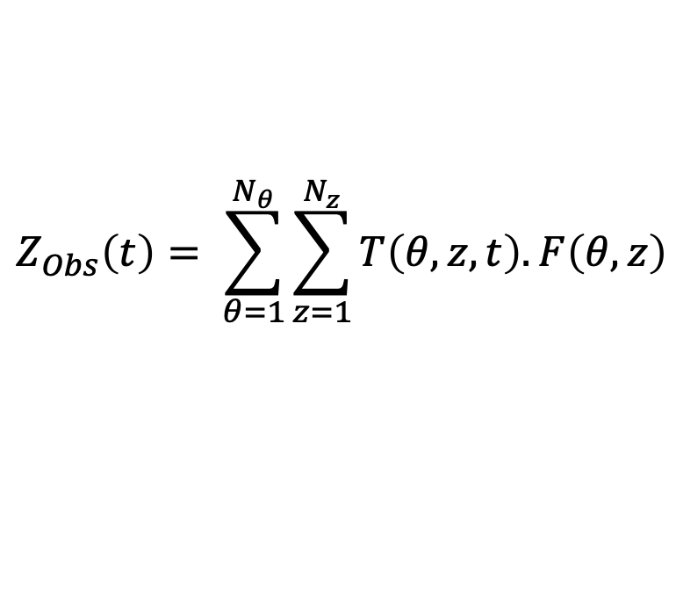

Detection algorithm
Project temperature observations T on the fingerprint F
Fit a linear trend to Z_{Obs}(t)
$$Z_{Obs}\left(t\right)= \sum_{θ=1}^{N_{θ}}{\sum_{z=1}^{N_{z}}{T\left(θ, z, t\right).F\left(θ,z\right)}}$$
t = 1986,...,2025
Index $I_{S}^{Obs}$ = trend@slope
Notes:
Zobs (t) provides information on the evolution of the fingerprint strength in observations

Slide 10
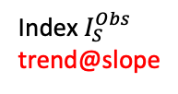
1986
Temperature observations
1989
1992
1995
Satellite data
(anomaly fields relative to 1986-2025 mean)
1998
2001
2004
2007
2010
2013
Index $I_{S}^{Obs}$
trend@slope
2016
2019
2022
2025
Human fingerprint
Generate pattern similarity time series Z_{Obs}(t)
Project onto fingerprint
9
Notes:
Pinatubo in June 15 1991, SO2 sulfur dioxide emitted up to 25 kms (total of a cube of 10³ km of matter). Emission of sulfur dioxide then oxidation (by interacting with hydroxyl radical OH-) of sulfur dioxide into sulfuric acid molecules then these molecules condense and nucleate (also collision with other particles) into sulfate aerosols that persist for a long time in the stratosphere due to the fact that the stratosphere is very dry and has low mixing (meaning that the aerosols are not washed out like in the troposphere).
Note the large interannual variability and 1992 due to Pinatubo eruption in 1991.

Slide 11
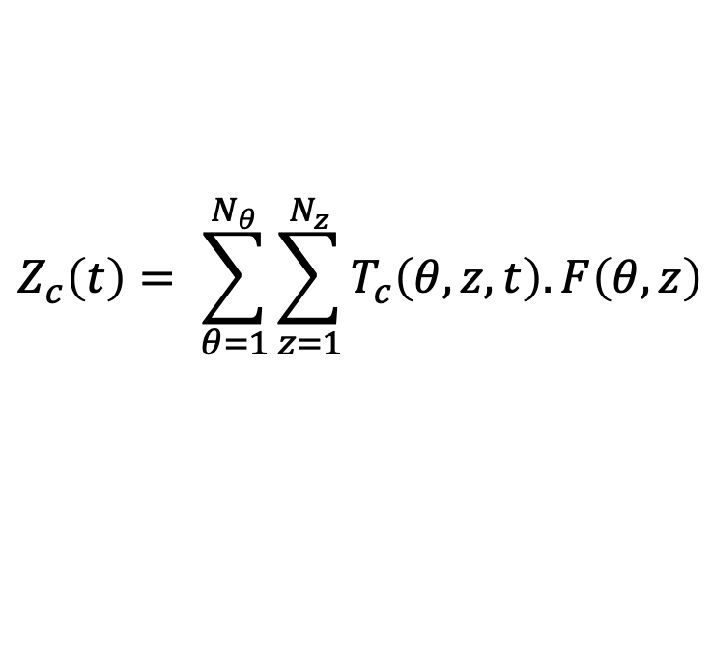
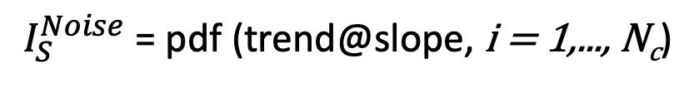
Detection algorithm
Project World without us temperature on the fingerprint
Fit linear trends to the N_{c} non-overlapping 40-year chunks ofZ_{c}(t)
$$Z_{c}\left(t\right)= \sum_{θ=1}^{N_{θ}}{\sum_{z=1}^{N_{z}}{T_{c}\left(θ, z, t\right).F\left(θ,z\right)}}$$
t = 1,...,O(1000s)
$I_{S}^{Noise}$ = pdf (trend@slope, i = 1,..., N_{c})
Notes:
Zc (t) provides information on the fingerprint strength in the World without us temperature

Slide 12

1
World without us temperature
301
601
901
Model Control Simulations
(anomaly fields relative to control run averages)
1201
1501
1801
2101
2401
2701
3001
PDF ${ I}_{S}^{Noise}$
3301
3601
3901
Human fingerprint
Generate pattern similarity time series
Project onto fingerprint
11

Slide 13

“Vertical fingerprint” results
Noise trend PDF ${ I}_{S}^{Noise}$
Density
40-year trend in pattern similarity

Slide 14


“Vertical fingerprint” results
Signal trend${ I}_{S}^{Obs}$
Noise trend PDF ${ I}_{S}^{Noise}$
Density
Virtually impossible to obtain fingerprint match with satellite data by internal variability
40-year trend in pattern similarity

Slide 15
When was the signal first detectable ? Early detection was possible in 1995 !
Signal to Noise ratio
Notes:
Models slightly overestimate the stratospheric cooling. The main factor is forcing uncertainty but also different phasing in internal variability, residual errors in observations. Note that noise estimate is derived from the gaussian approximation for the noise pdf (and is taken as the standard deviation of the gaussian).

Slide 16
Summary
Changes in the vertical structure of atmospheric temperature are a key piece of evidence for human effects on global climate
Upper stratosphere cooling is key to robust detection (40-sigma !)
The Higgs boson and climate change are two nice examples of predictive science
Two different detection problems !
Higgs: Low SNR problem, direct sampling of the counterfactual world (no Higgs)
Climate change: the one-Earth problem Structural model uncertainty
Notes:
The key difference from collider physics: you cannot compute the background/noise from first principles alone
In particle physics, the theory (Standard Model) predicts the signal before you look. Attribution is essentially a verification that the observation matches the prediction. Detection and attribution are performed simultaneously ! the background is measured from real data sidebands.
The Higgs boson is identified by its decay products and their invariant mass. You're not just seeing an excess of events — you're seeing an excess at exactly the predicted mass (~125 GeV), in exactly the predicted decay channels (γγ, ZZ*, WW*), with exactly the predicted spin-0 signature.
The Standard Model makes extraordinarily precise, quantitative predictions. The "background" (non-Higgs processes) is itself calculated to high precision using QFT.
So when you see the signal, there is essentially no plausible alternative explanation — the fingerprint is unique by construction. Attribution follows almost automatically from detection.
In particle physics, the Higgs Boson was announced as "discovered" in 2012 when the signal reached 5 sigma (5σ) — meaning the observed excess of events was 5 standard deviations above the background noise. This corresponds to a p-value of about 1 in 3.5 million (0.00003%).
The Higgs boson
At CERN, physicists were looking for a tiny excess of events buried in huge background noise. The signal:
occurs in rare particle collisions
must be inferred from decay products
competes against many similar-looking processes

Slide 17
Additional slides
Notes:
The key difference from collider physics: you cannot compute the background/noise from first principles alone
In particle physics, the theory (Standard Model) predicts the signal before you look. Attribution is essentially a verification that the observation matches the prediction. Detection and attribution are performed simultaneously ! the background is measured from real data sidebands.
The Higgs boson is identified by its decay products and their invariant mass. You're not just seeing an excess of events — you're seeing an excess at exactly the predicted mass (~125 GeV), in exactly the predicted decay channels (γγ, ZZ*, WW*), with exactly the predicted spin-0 signature.
The Standard Model makes extraordinarily precise, quantitative predictions. The "background" (non-Higgs processes) is itself calculated to high precision using QFT.
So when you see the signal, there is essentially no plausible alternative explanation — the fingerprint is unique by construction. Attribution follows almost automatically from detection.
In particle physics, the Higgs Boson was announced as "discovered" in 2012 when the signal reached 5 sigma (5σ) — meaning the observed excess of events was 5 standard deviations above the background noise. This corresponds to a p-value of about 1 in 3.5 million (0.00003%).
The Higgs boson
At CERN, physicists were looking for a tiny excess of events buried in huge background noise. The signal:
occurs in rare particle collisions
must be inferred from decay products
competes against many similar-looking processes

Slide 18
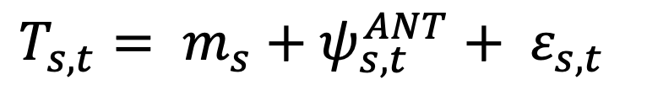
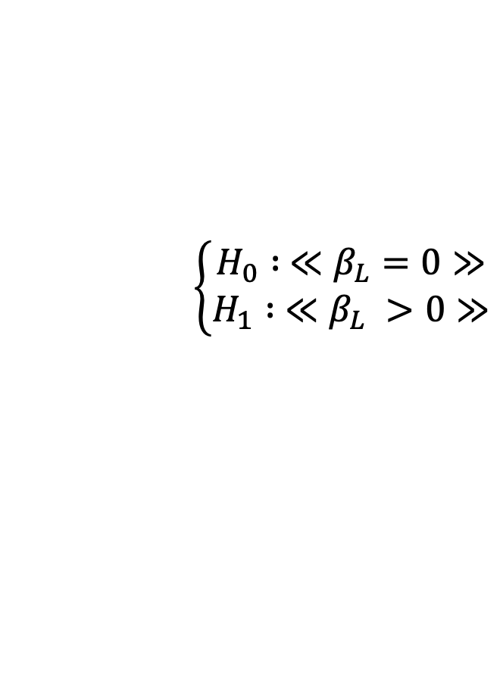
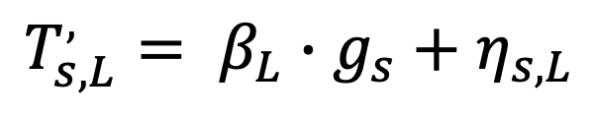
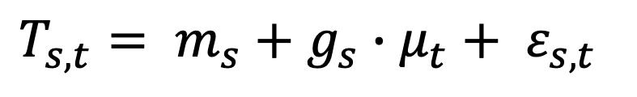
Summary of the Statistical Model:
T: temperature observations, function of space(s) and time(t)
$T_{s,t}= m_{s}+ψ_{s,t}^{ANT}+ ε_{s,t}$
Separability assumption of ANT forcing : ψ^{ANT} = g(s).μ(t)
$T_{s,t}= m_{s}+g_{s}∙μ_{t}+ ε_{s,t}$
Time filter: linear trend over a L-year period:
$$\left\{\begin{aligned}H_{0} : ≪β_{L}=0≫ \\ H_{1} : ≪β_{L} >0≫\end{aligned}\right.$$
$$T_{s,L}^{,}= β_{L}∙g_{s}+η_{s,L}$$
Test:

Slide 19
When was the signal first detectable ?
Signal
Noise

Slide 20
Why is fingerprint detection so clear?
Human fingerprint
Natural variability pattern 1
Natural variability pattern 2
(Dimensionless)
Cooling
Warming
Source: Santer et al., PNAS (2023)

