Slide 1






Tensions in Cosmology
Ali Rida Khalife
Les Rencontres de Noirmoutier 2026

Slide 2
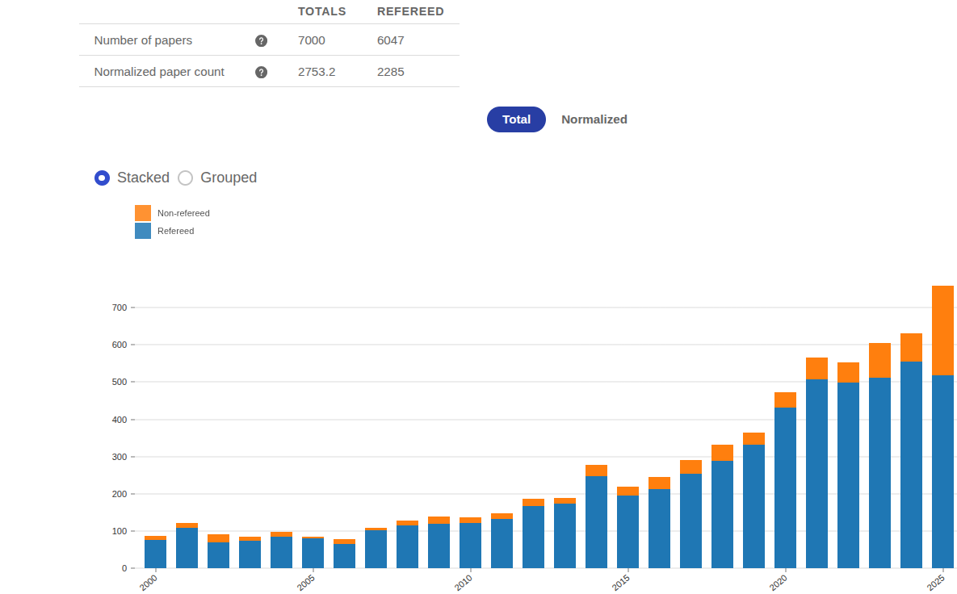
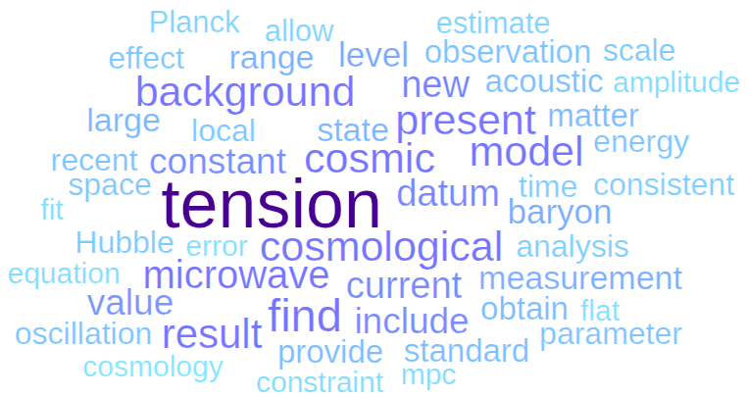
The Evolution of Tension with the years
Credit: Astrophysics Data System (ADS)

Slide 3
Cosmology: a Precise Science
Several milestones transformed Cosmology from a discipline of approximations to a precise, data rich science.

Slide 4
Cosmology: a Precise Science
Several milestones transformed Cosmology from a discipline of approximations to a precise, data rich science.
These milestones include:
  Better theoretical description

Slide 5
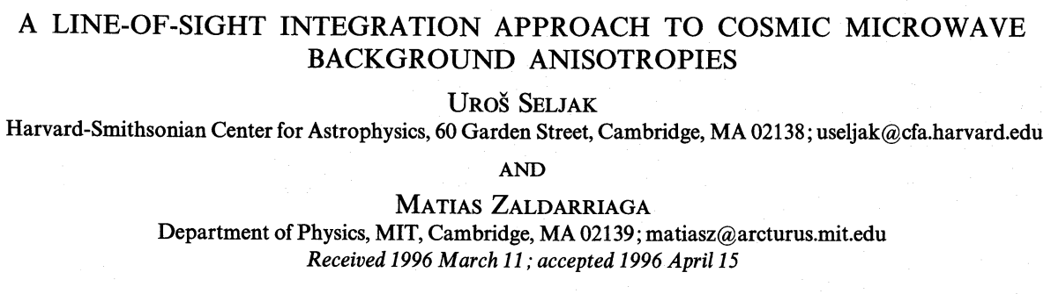
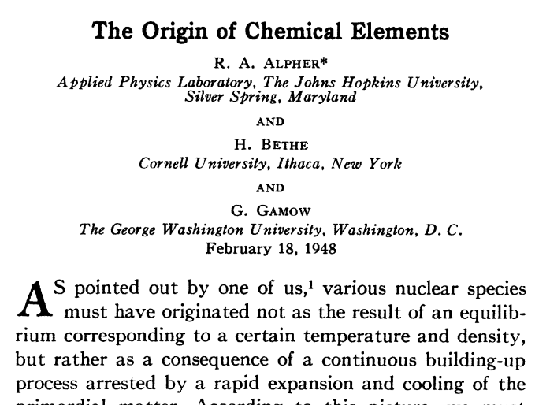
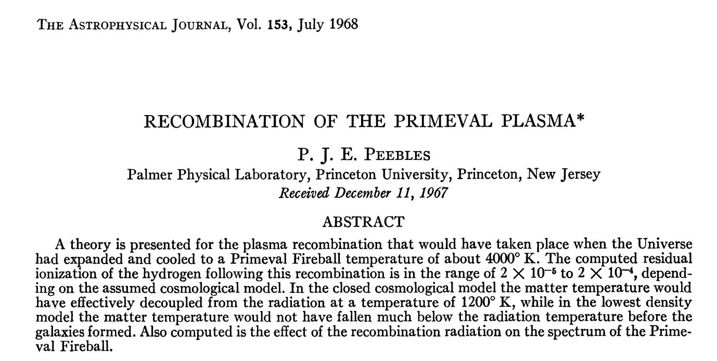
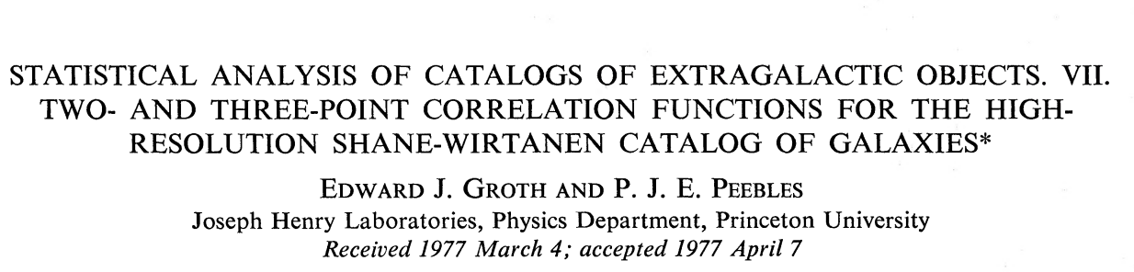
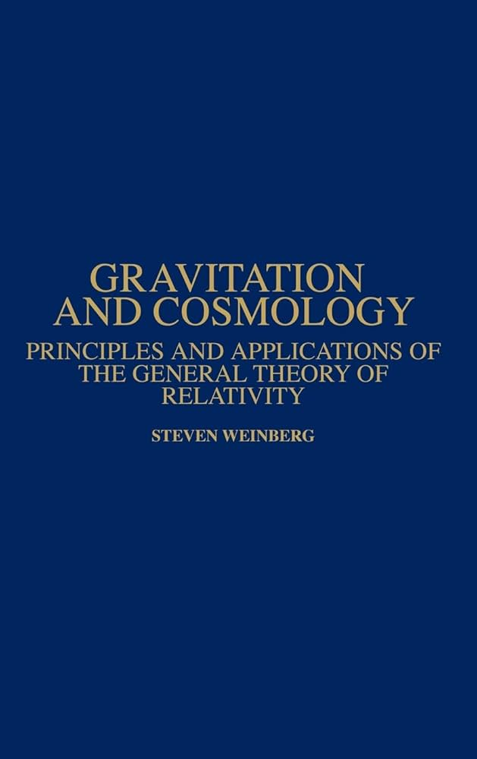
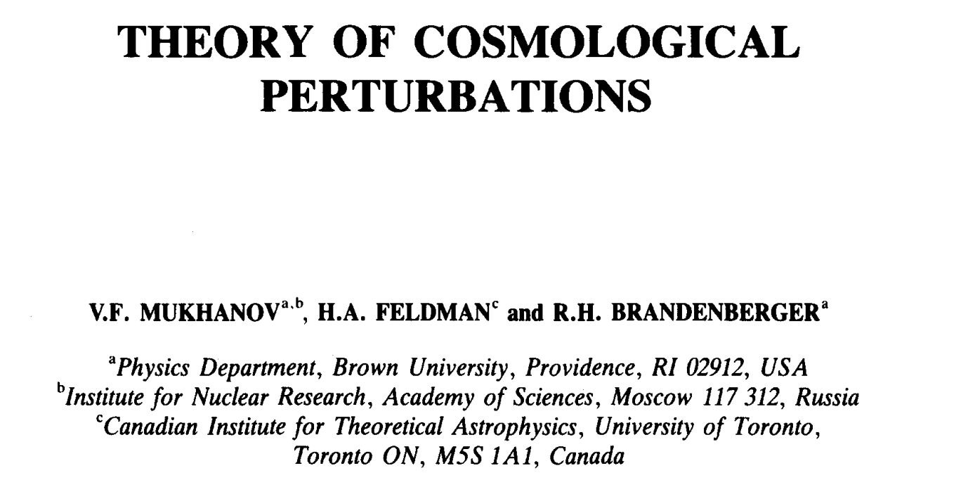
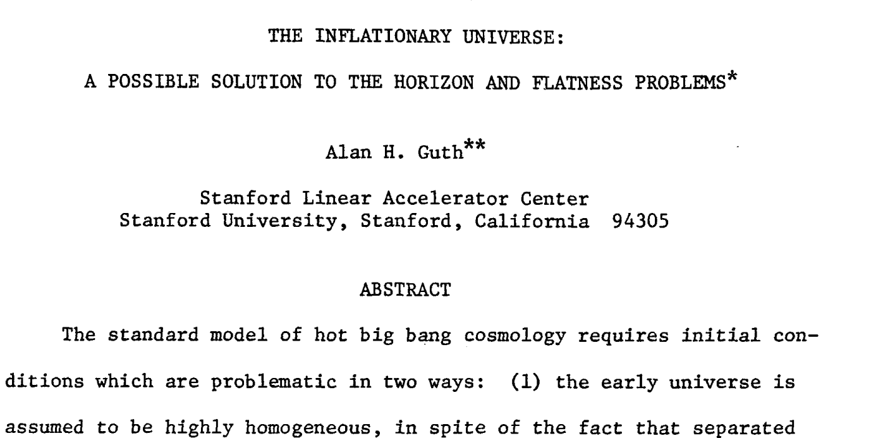

Slide 6
Cosmology: a Precise Science
Several milestones transformed Cosmology from a discipline of approximations to a precise, data rich science.
These milestones include:
  Better theoretical description
  Improved numerical techniques

Slide 7
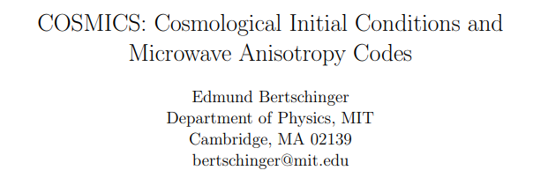

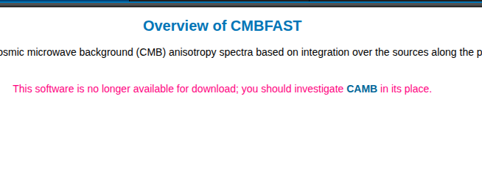

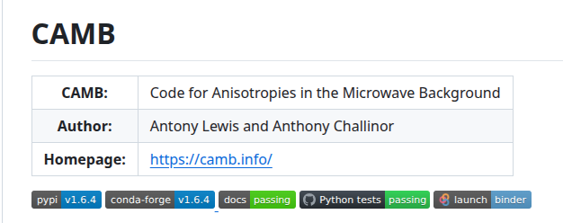

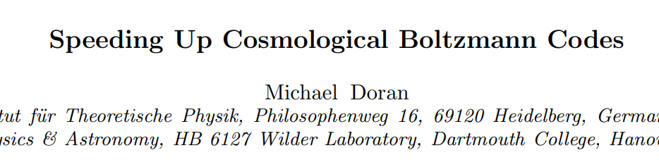
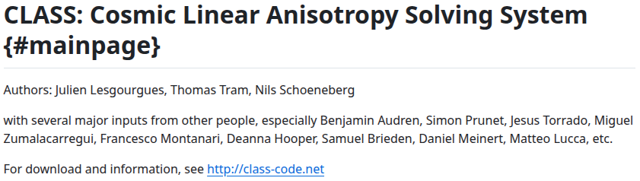

S.Günther,...,ARK et al.; 2025
(CMBEASY)

Slide 8
Cosmology: a Precise Science
Several milestones transformed Cosmology from a discipline of approximations to a precise, data rich science.
These milestones include:
  Better theoretical description
  Improved numerical techniques
  Technological advancements to ameliorate observations.

Slide 9
Cosmology: a Precise Science
Several milestones transformed Cosmology from a discipline of approximations to a precise, data rich science.
These milestones include:
  Better theoretical description
  Improved numerical techniques
  Technological advancements to ameliorate observations.
The birth of precision cosmology came with the discovery of the CMB

Slide 10
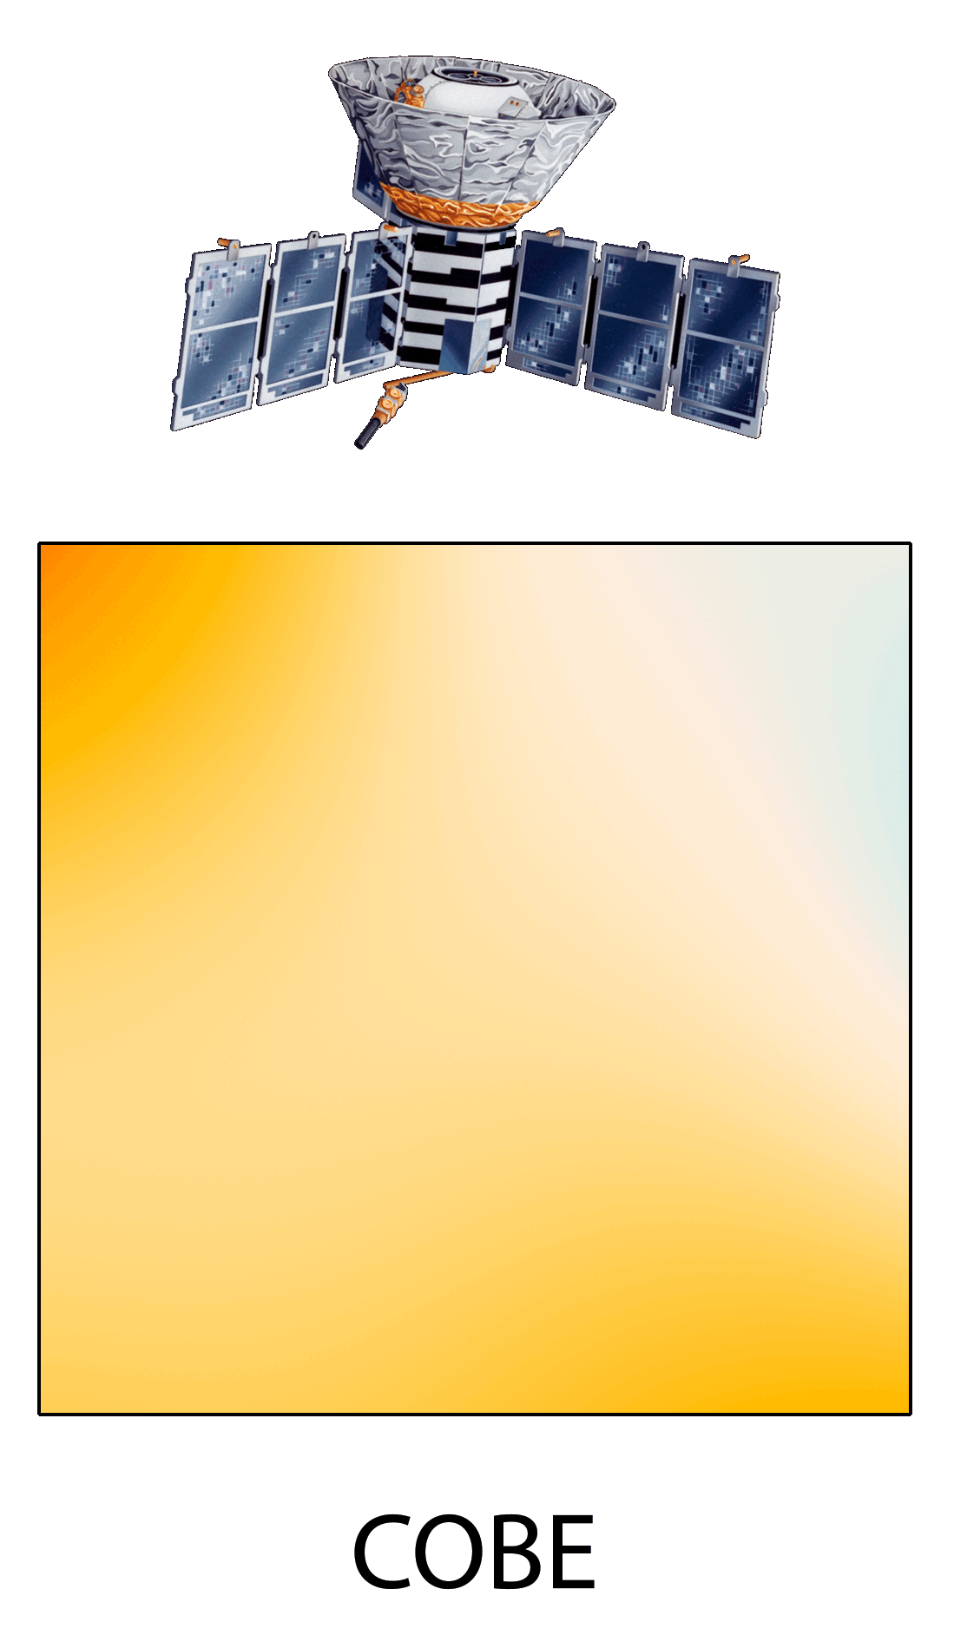
CMB Temperature Maps
Better detectors increased the resolution of CMB maps, uncovering the CMB temperature and polarizations fluctuations.
Credit: NASA/JPL-Caltech/ESA

Slide 11
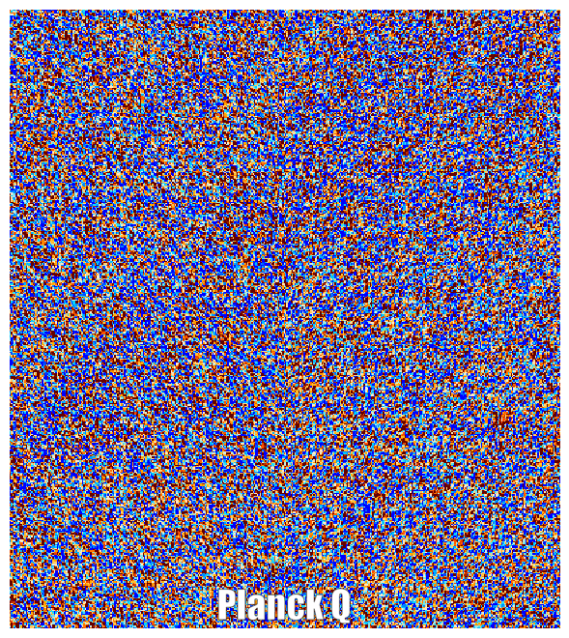
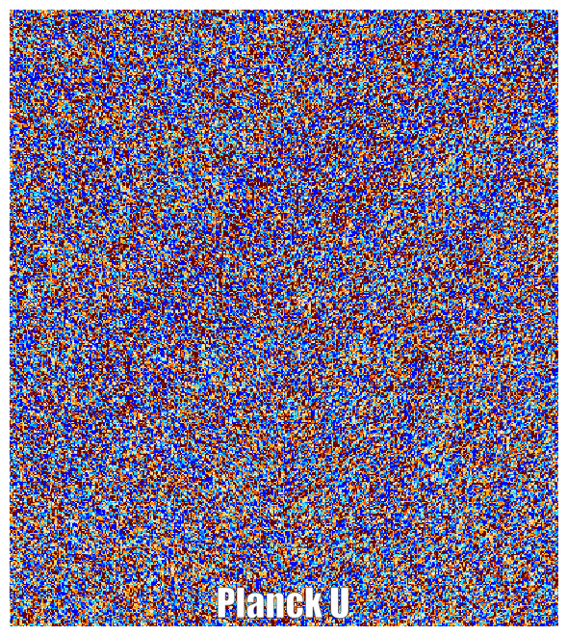
CMB Polarization Maps
Credit: Wei Quan & Cail Daley, SPT-3G Collaboration

Slide 12
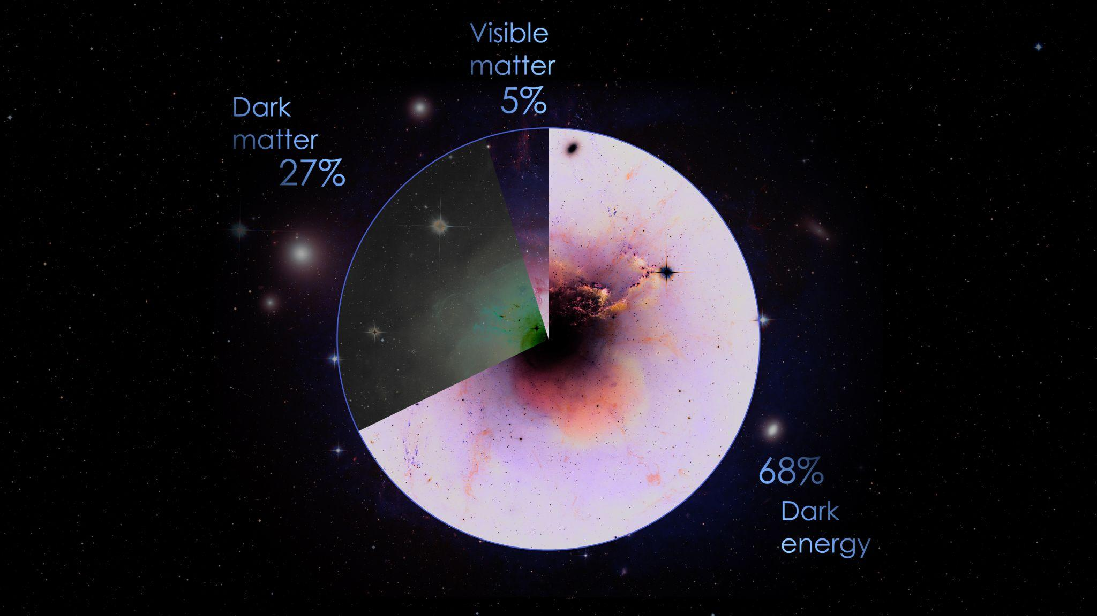
We have a Model: ΛCDM
Credit: NASA

Slide 13
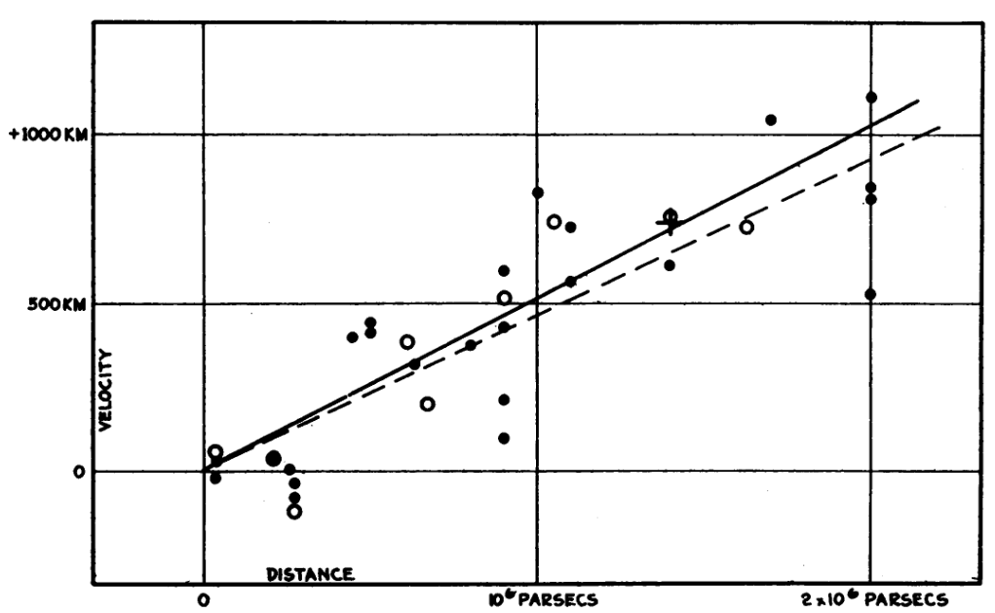
Evolution of Expansion rate measurements
Velocity-distance relation made by Hubble from ~30-50 Nebulae in 1929.
Credit: E. Hubble 1929

Slide 14
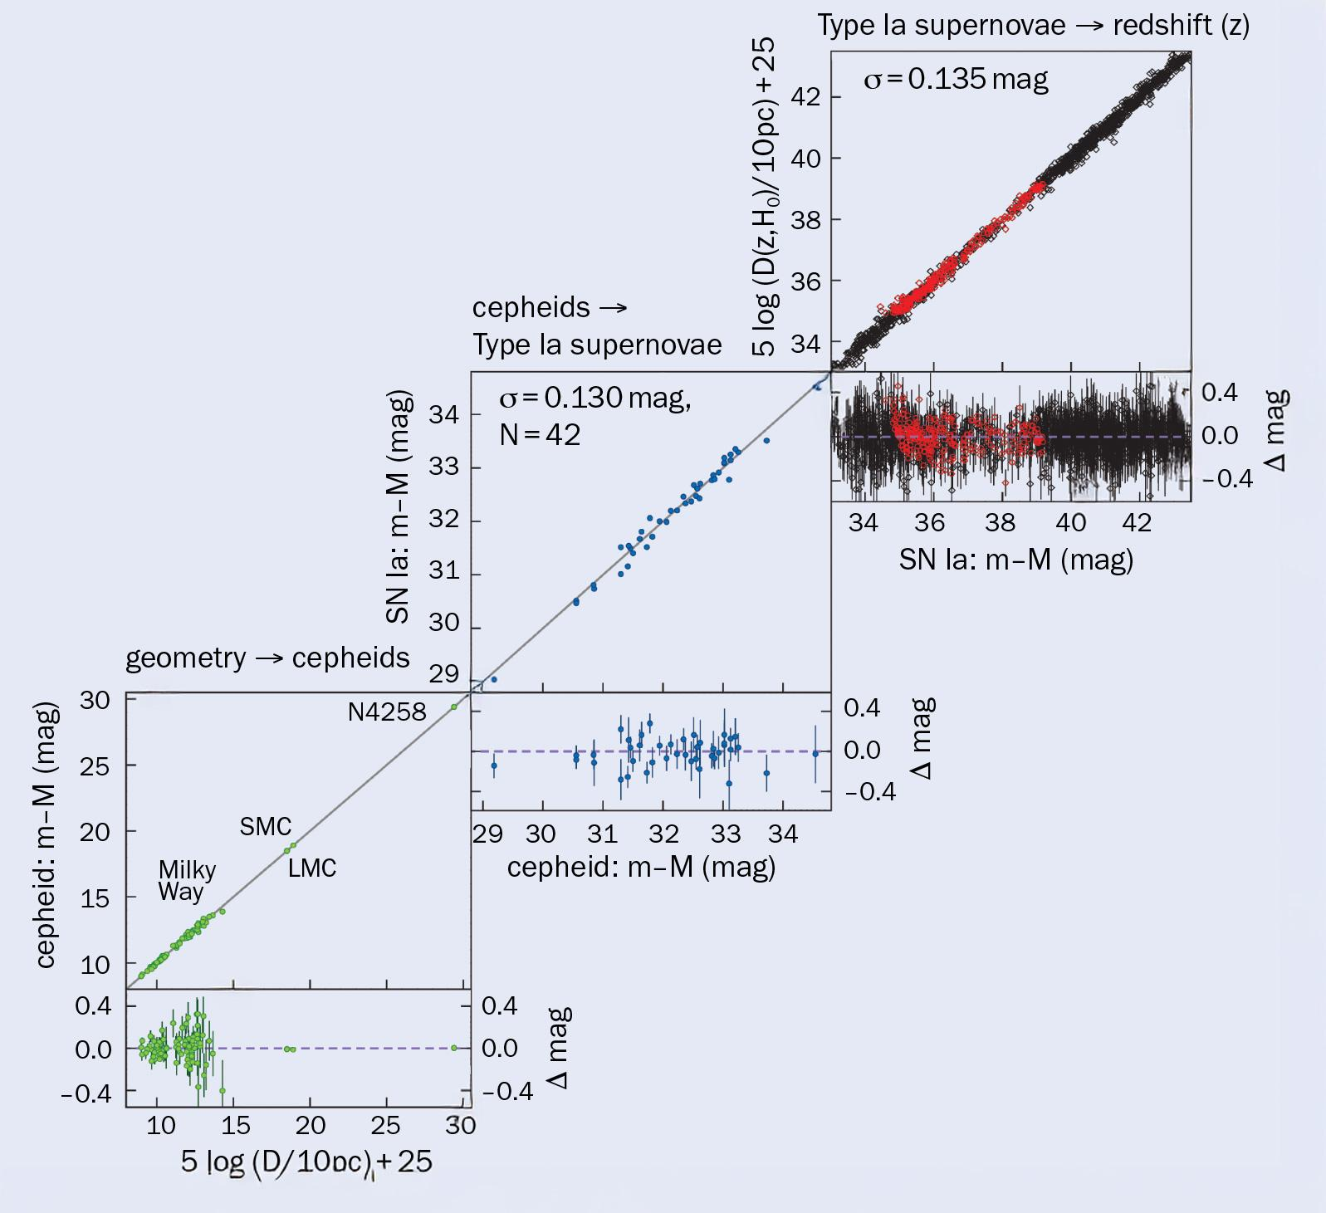
Evolution of Expansion rate measurements
State of the art telescopes (e.g. HST previously and JWST now) allowed the detection of many more SN Ia, substantially improving the inferred H₀
CERN Courier, March 2025
Adapted from
Riess et al; 2024

Slide 15
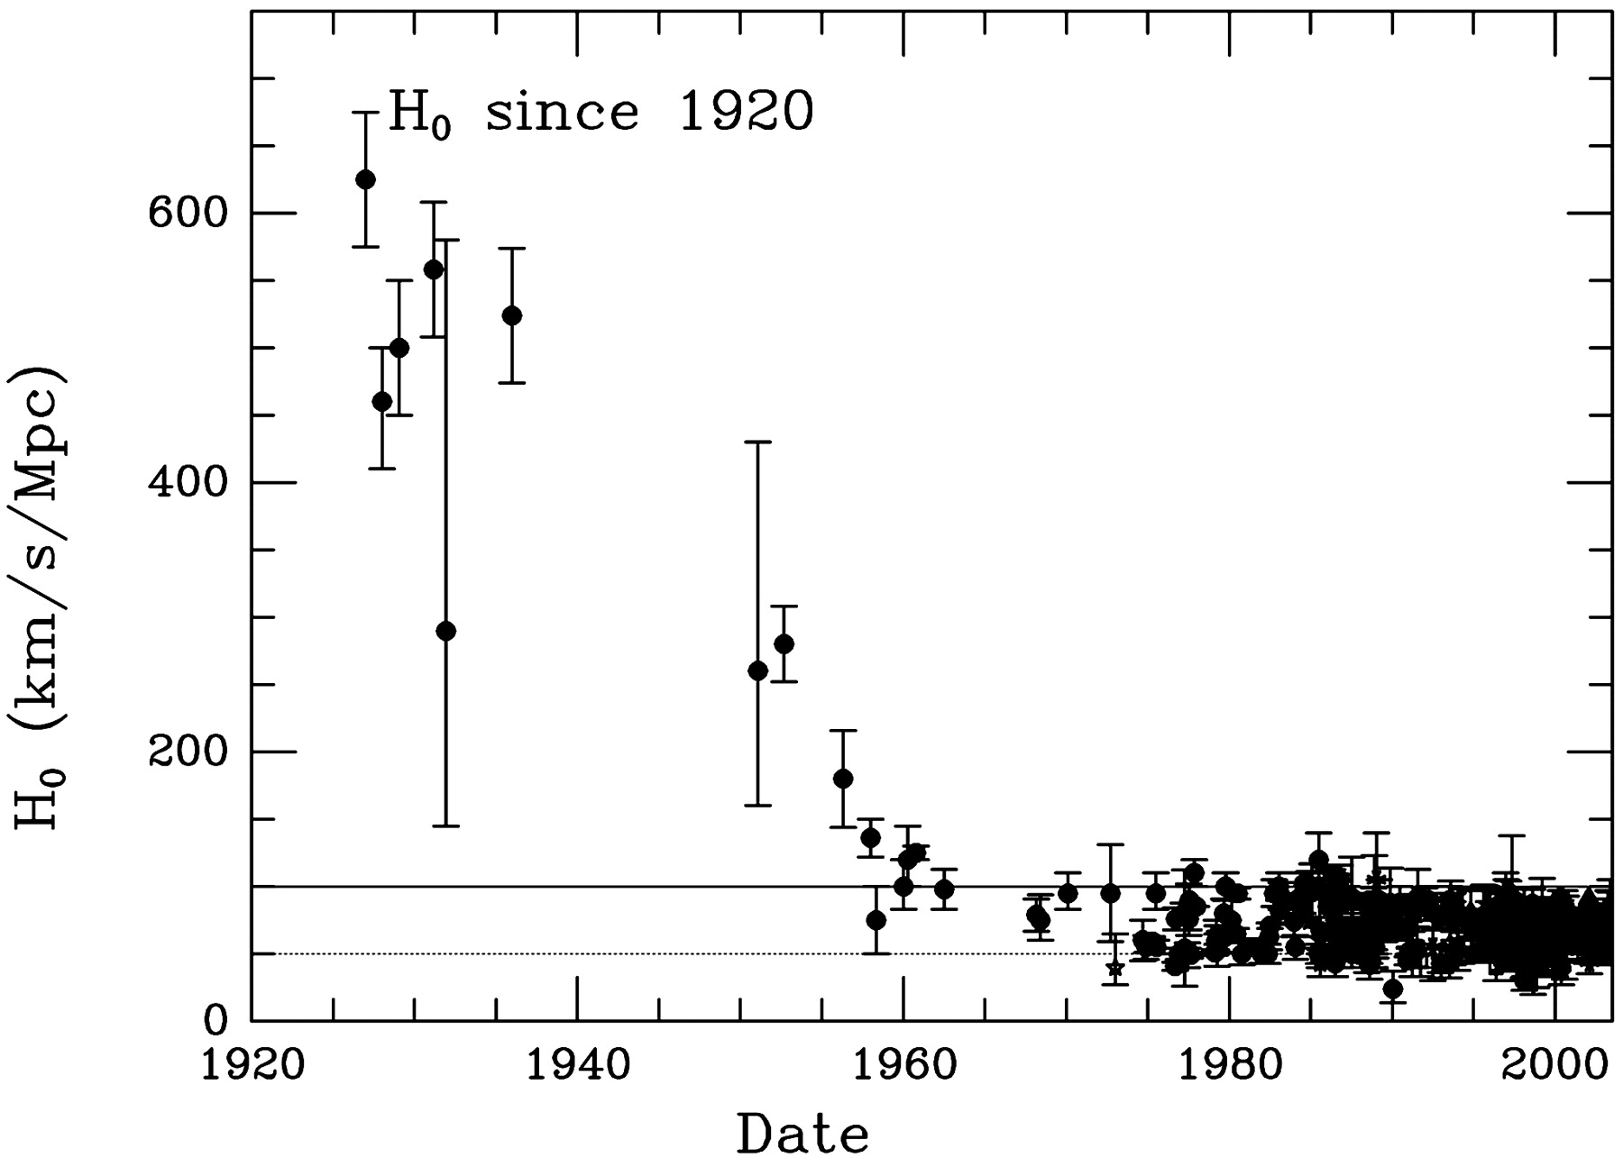
Evolution of Expansion rate measurements
First point made by Lemaître in 1927
Credit: Turner; 2022

Slide 16
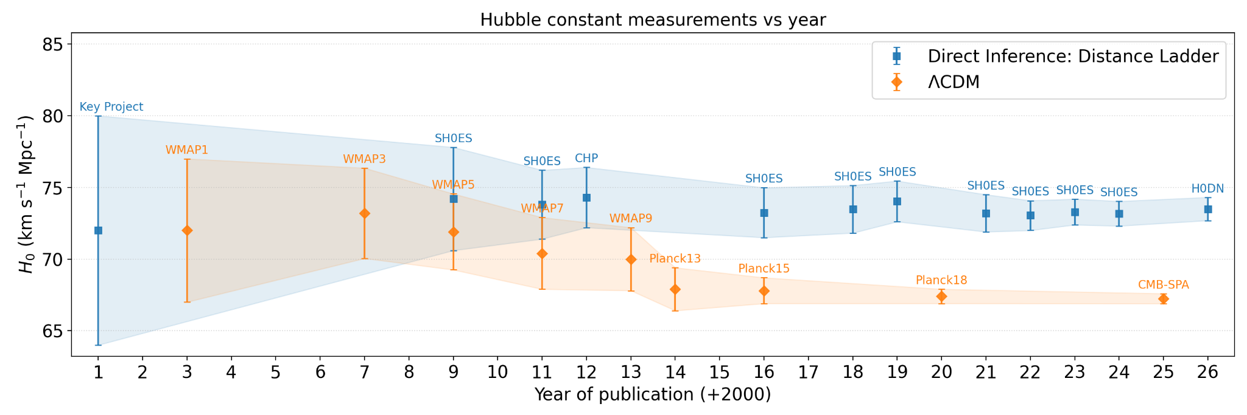
Rise of the First Tension: H₀ Tension
Tension = difference between two values > 3σ.
H₀ values from Perivolaropoulos & Skara; 2022 , Camphuis et al.;2025, Breuval et al.;2024 and H0DN Collaboration; 2026

Slide 17
Rise of the First Tension: H₀ Tension
From SPT-3G+Planck+ACTDR6 (CMB-SPA): 7.1σ (6.4 σ compared to Breuval et al.;2024)

Slide 18
The greatest tension of them all:
The Hubble Tension

Slide 19
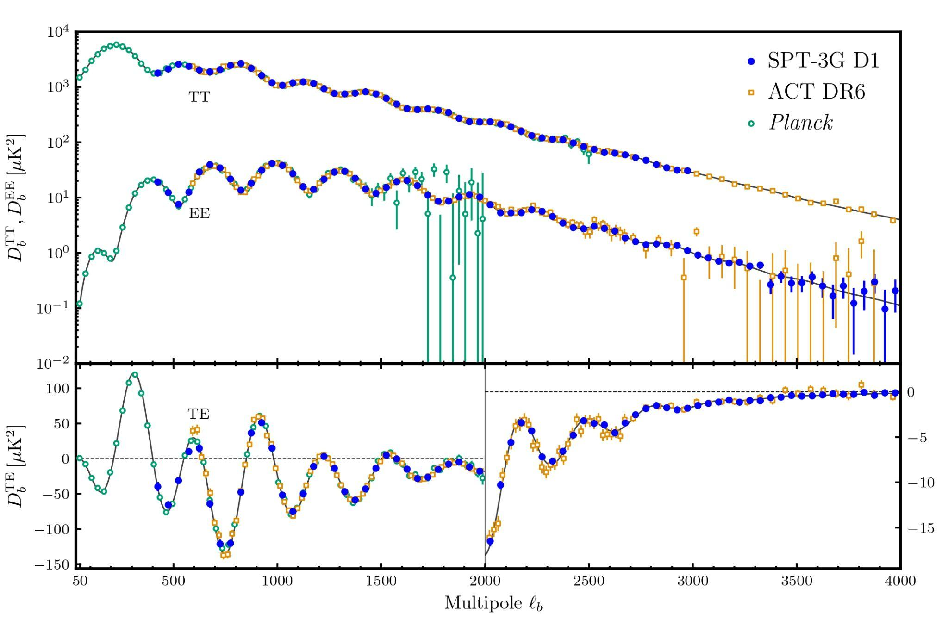
H₀ Tension Elaborated
ΛCDM is an excellent fit to CMB data.
Three different CMB experiments agree with the predictions of ΛCDM.
D_{b}^{XY} = ⟨𝛿X𝛿Y⟩
Credit: Camphuis et al; 2025

Slide 20
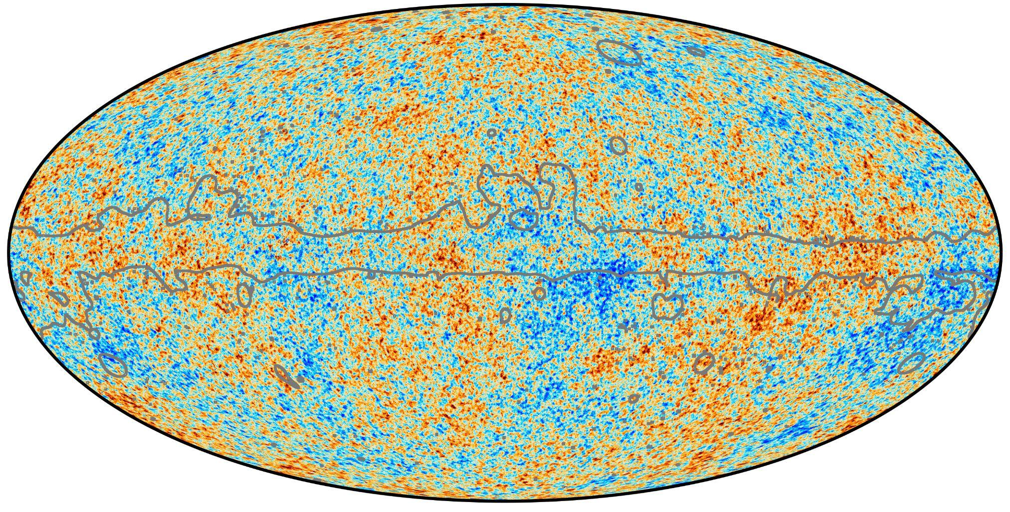
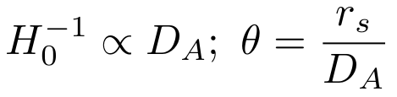

H₀ Tension Elaborated
Determining H₀ purely from the CMB requires a model.
r_{s} = sound horizon at the last scattering surface.
D_{A} = angular diameter distance to the last scattering surface.
Credit: ESA
r_{s}
D_{A}

Slide 21
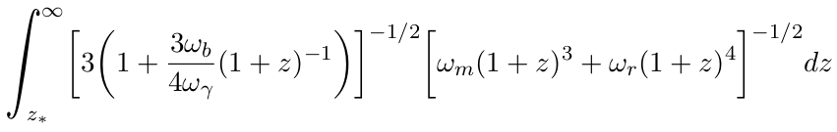
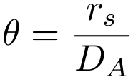
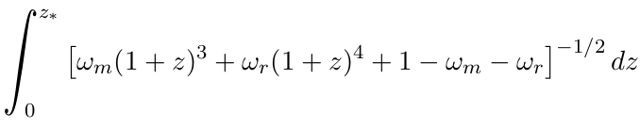
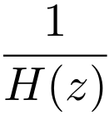
H₀ Tension Elaborated
The photon ( ꞷ_{𝛄} ), and thereby neutrino ( ꞷ_{𝜈} ) densities are fixed by the CMB temperature (Fixsen et al; 1996).
The baryon density ( ꞷ_{b} ) is mostly fixed by measurements from metal-poor galaxies (Aver et al.; 2020).
The matter (CDM) density ( ꞷ_{m} ), is the only free parameter we can use to change H₀

Slide 22
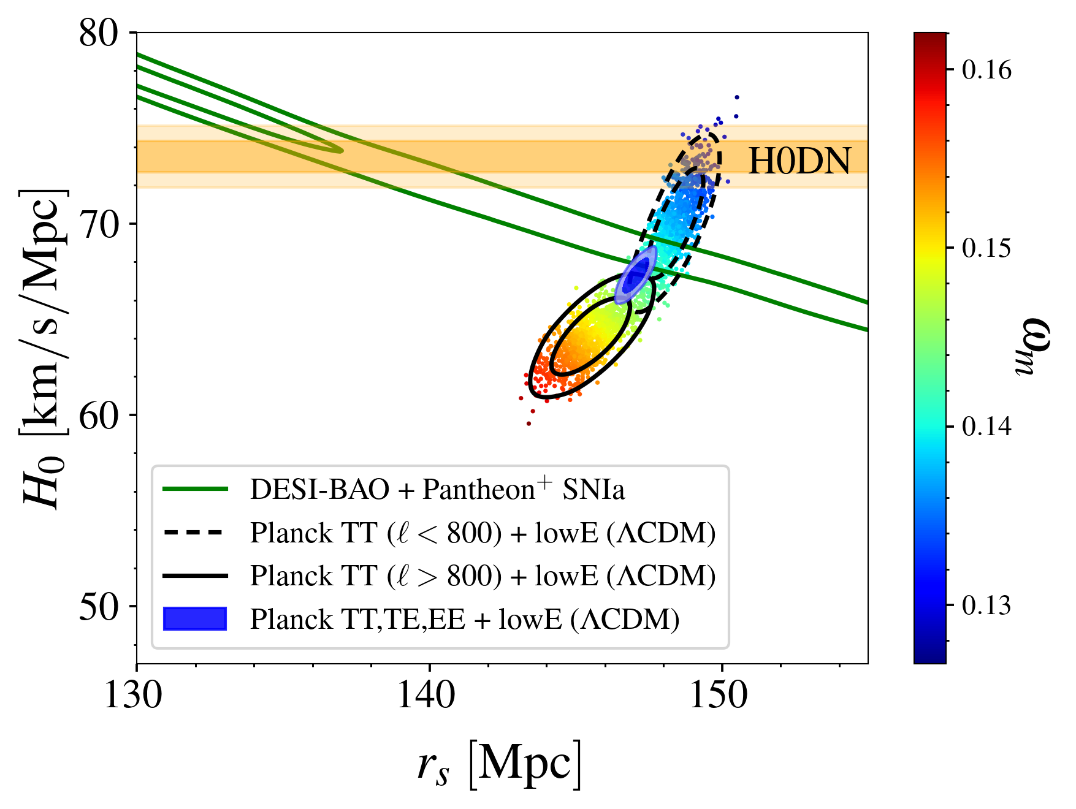
H₀ Tension Elaborated
Changes in the matter density are almost perpendicular to BAO+SN-Ia.
Decreasing the matter density to solve the Hubble tension creates an r_{s} tension.
We need to go beyond ΛCDM.
Update of Fig.1 from Knox & Millea; 2019
MCMC chains made by Marius Millea and Srinivasan Raghunathan

Slide 23
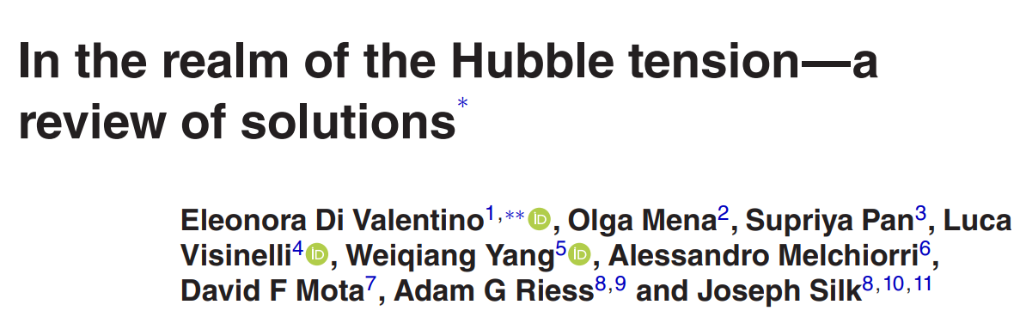
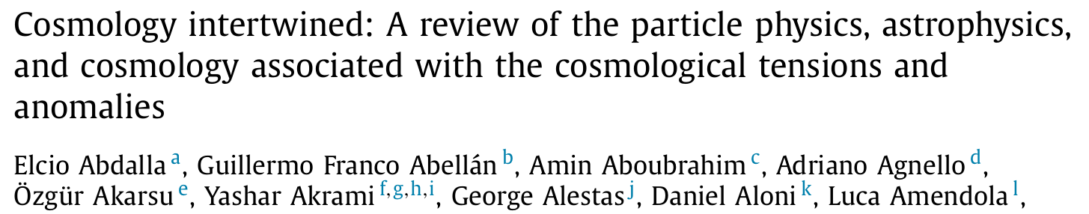
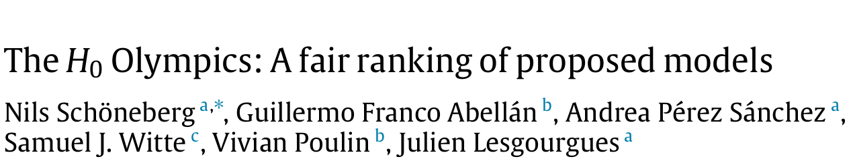
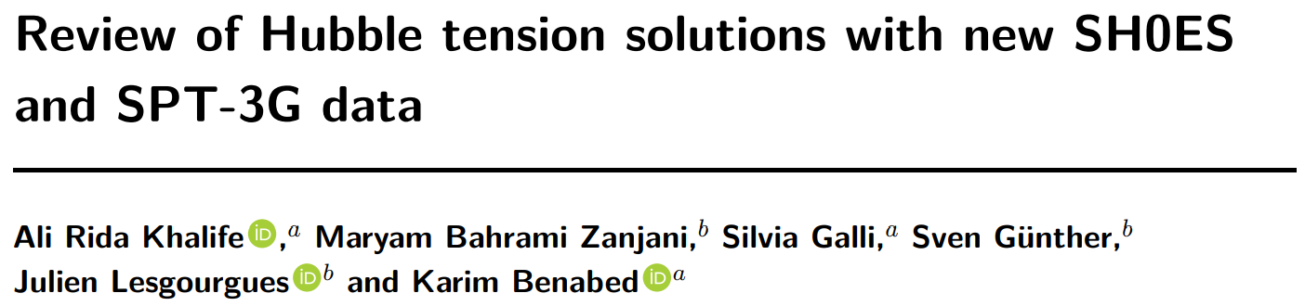
Hubble Tension Solutions
Numerous models, with a wide range of phenomena, have been proposed to solve the tension.
Di Valentino et al; 2021
Abdalla et al.; 2022
Schöneberg et al.; 2021
ARK et al.; 2023

Slide 24
Hubble Tension Solutions
Numerous models, with a wide range of phenomena, have been proposed to solve the tension.
Guiding principle: keep 𝜃 fixed
10⁴𝜃 = 104.161 ± 0.023 (Camphuis et al; 2025)
Pre-recombination solution
Post-recombination solution

Slide 25
Hubble Tension Solutions
Numerous models, with a wide range of phenomena, have been proposed to solve the tension.
Guiding principle: keep 𝜃 fixed
10⁴𝜃 = 104.161 ± 0.023 (Camphuis et al; 2025)
Post-recombination solutions:
  ΛCDM + 𝛀_{K} (Camphuis et al; 2025)
  Modified gravity (Desmond et al.; 2019)
  ……
These proposals don’t really solve the tension. The least unlikely solution is a pre-recombination one.

Slide 26
Pre-Recombination Solutions

Slide 27
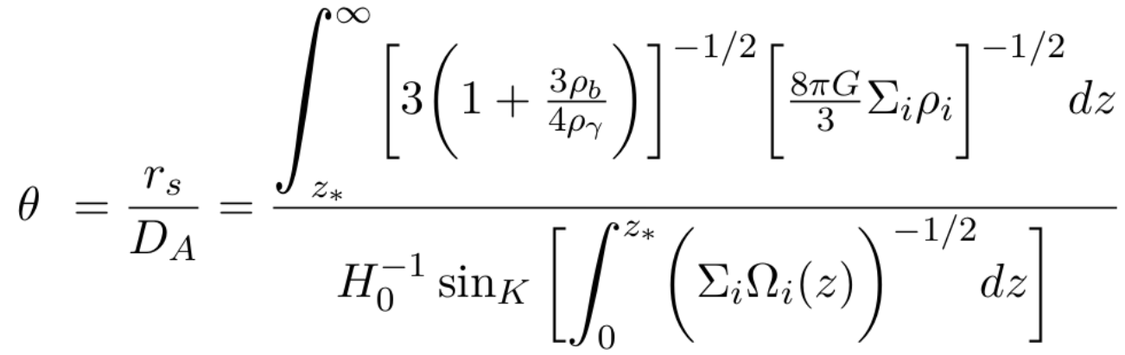
Pre-recombination Solutions
Main idea: Change the physics prior to recombination, reducing the sound horizon to increase H₀ while keeping 𝜃 fixed.

Slide 28
Pre-recombination Solutions
Main idea: Change the physics prior to recombination, reducing the sound horizon to increase H₀ while keeping 𝜃 fixed.
Possible mechanism:
  Additional light relics
  Primordial Magnetic fields
  Modified recombination
  Modified Gravity
  Varying electron mass with curvature (m_{e}+𝛀_{K})
  Early Dark Energy (EDE)
  ….

Slide 29
Pre-recombination Solutions
Main idea: Change the physics prior to recombination, reducing the sound horizon to increase H₀ while keeping 𝜃 fixed.
Possible mechanism:
  Additional light relics
  Primordial Magnetic fields
  Modified recombination
  Modified Gravity
  Varying electron mass with curvature (m_{e}+𝛀_{K})
  Early Dark Energy (EDE)
  ….

Slide 30
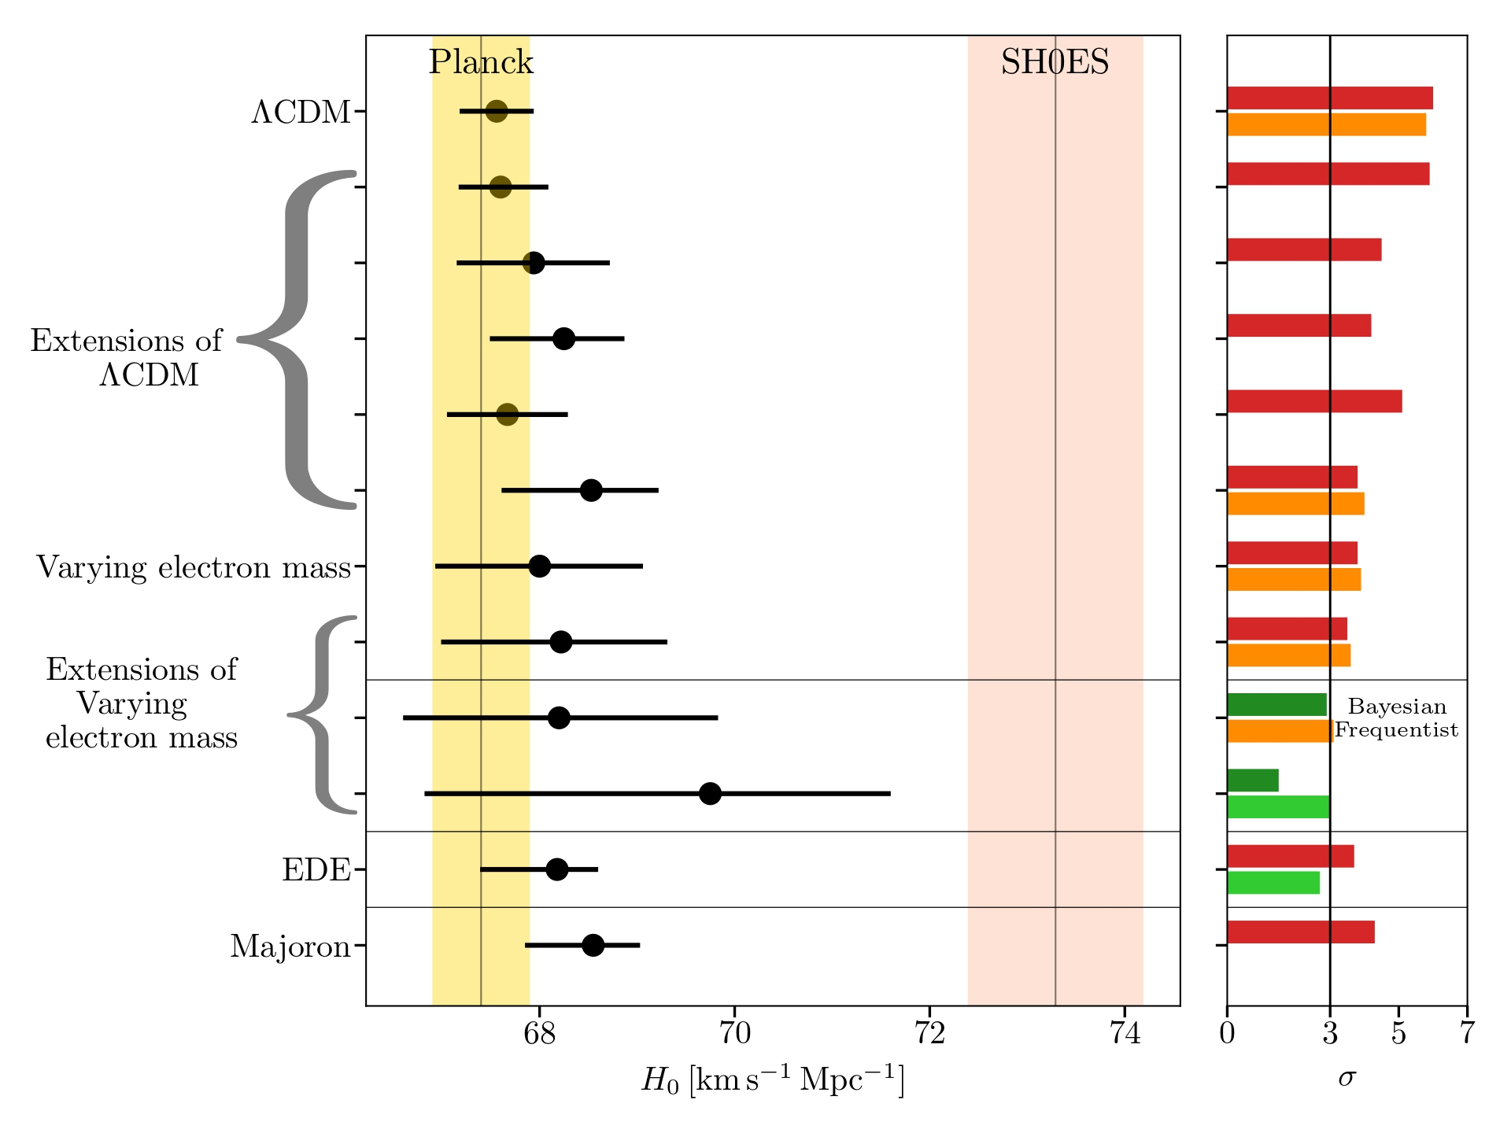
Pre-recombination Solutions
Main idea: Change the physics prior to recombination, reducing the sound horizon to increase H₀ while keeping 𝜃 fixed.
m_{e}+𝛀_{K} and EDE are the most effective in reducing the tension (under either Bayesian or frequentist statistics).
Modified Fig.1 of ARK et al.; 2023

Slide 31
m_{e} + 𝛀_{K}
Higher-dimensional theories (e.g. String theory) create couplings between fundamental fields, specifically electrons, that can alter their mass.
(Uzan J.-P.; 2011, Hart & Chulba; 2017 )
Changing m_{e}(relative to lab measurements) ⇒ changing Hydrogen recombination ⇒ changing time of recombination.
Freeing 𝛀_{K} allows for a better fit of late-time data.

Slide 32
m_{e} + 𝛀_{K}
Higher-dimensional theories (e.g. String theory) create couplings between fundamental fields, specifically electrons, that can alter their mass.
(Uzan J.-P.; 2011, Hart & Chulba; 2017 )
Changing m_{e}(relative to lab measurements) ⇒ changing Hydrogen recombination ⇒ changing time of recombination.
Freeing 𝛀_{K} allows for a better fit of late-time data.
In practice, the change in m_{e} is a step-function at z ~ 50.

Slide 33
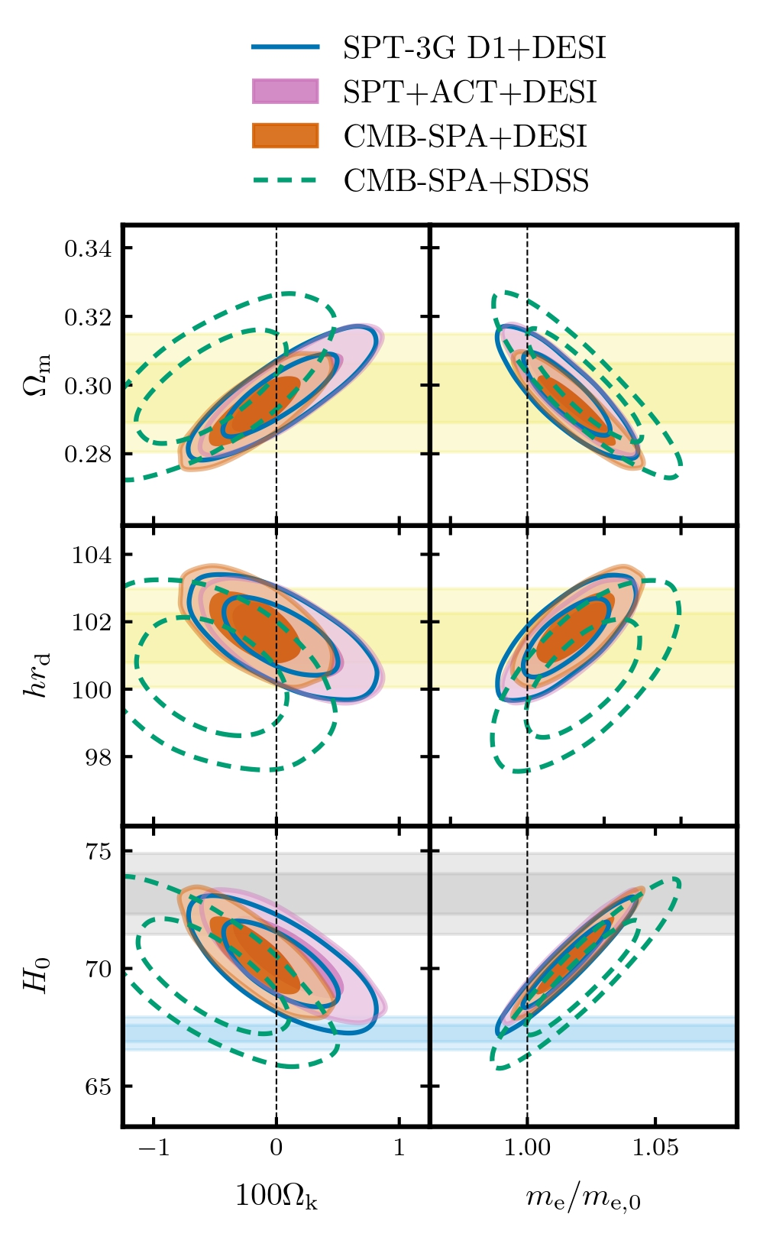
m_{e} + 𝛀_{K}
For CMB-SPA + DESI, tension reduces from 5.9σ to 2.1σ (using Bayesian statistics).
However, error bars are still large (x5 that of ΛCDM) and only 2.1σ preference over ΛCDM.
More data is needed to better assess the model.
DESI-DR2
SH0ES
CMB-SPA
Credit: Camphuis et al; 2025

Slide 34
Early Dark Energy
Higher-dimensional theories postulate the presence of scalar fields that can cause a brief period of accelerated expansion near matter-radiation equality.
(Kamionkowski et al.; 2014, Karwal & Kamionkowski; 2016)
This causes a decrease in the sound horizon that compensates the increase in H₀ needed to solve the tension.
EDE contribution

Slide 35
Early Dark Energy
Higher-dimensional theories postulate the presence of scalar fields that can cause a brief period of accelerated expansion near matter-radiation equality.
(Kamionkowski et al.; 2014, Karwal & Kamionkowski; 2016)
This causes a decrease in the sound horizon that compensates the increase in H₀ needed to solve the tension.
Several models have been proposed, with varying levels of complexity
(Smith & Poulin, 2023; Poulin et al, 2023).

Slide 36

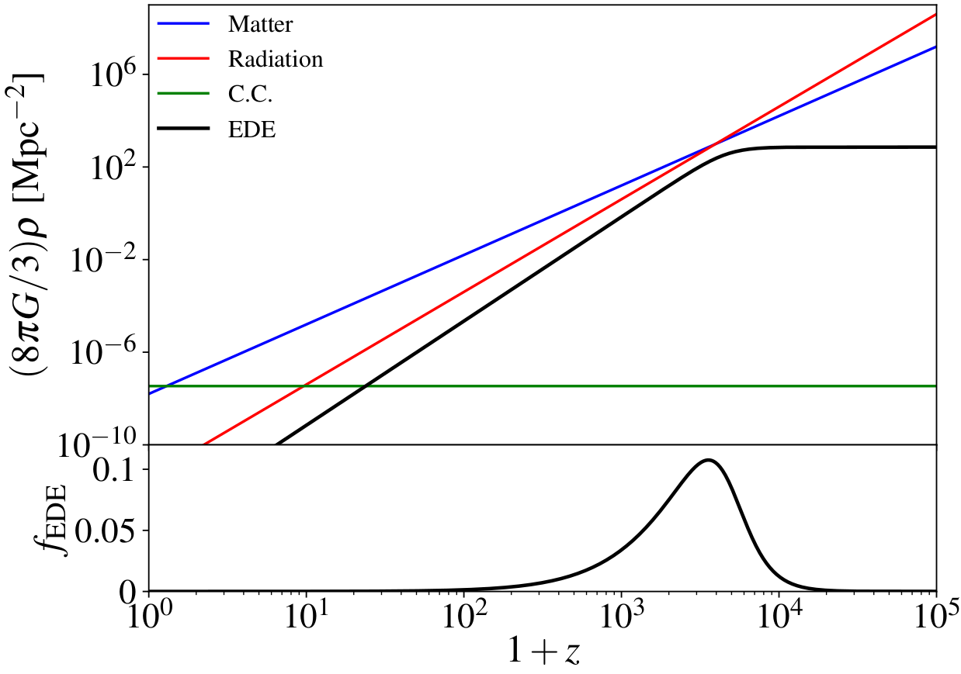
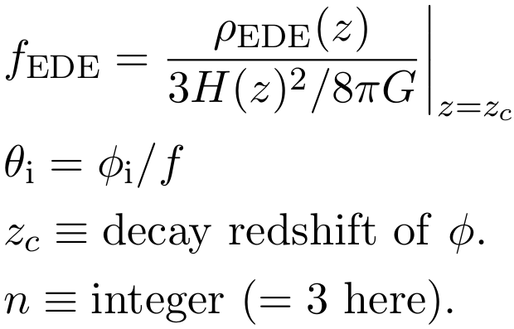
Early Dark Energy
The simplest model is Axion EDE:
Free parameters:
Credit: Poulin et al, 2023

Slide 37
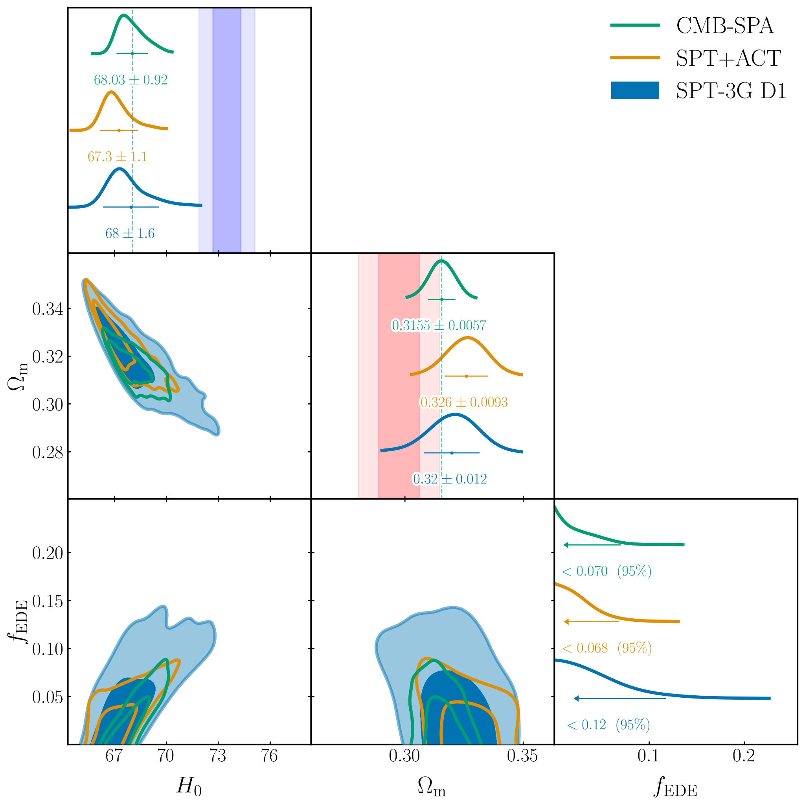
Early Dark Energy
H0DN
From the CMB, EDE does not reduce the tension below 3σ and does not provide a better fit than ΛCDM.
DESI DR2
Modified Fig.1 of ARK et al.; 2025

Slide 38
Pre-recombination solutions vs ΛCDM

Slide 39
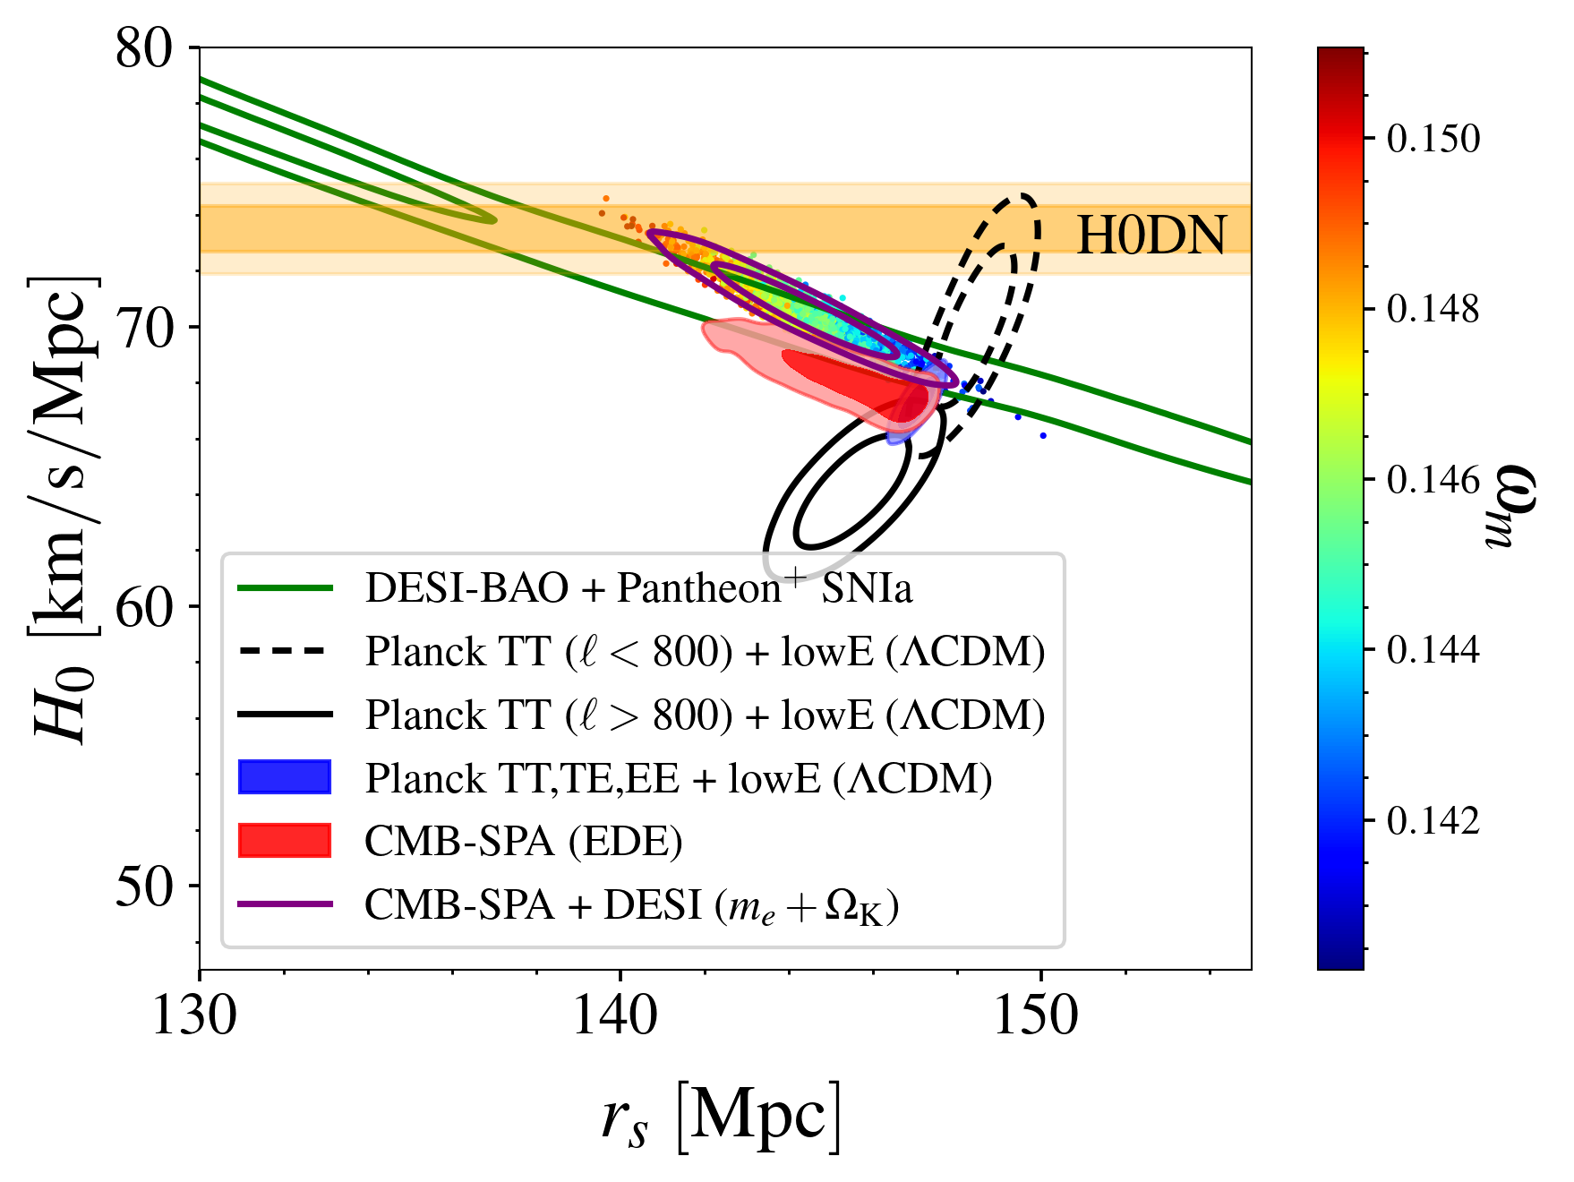
Pre-recombination solutions vs ΛCDM
Pre-recombination solutions change the degeneracy directions in a way that can reduce the tension.
Still, statistical preference for these models over ΛCDM is weak.
More data is needed.

Slide 40
Rise & Fall of a tension:
S₈/ σ₈ Tension

Slide 41
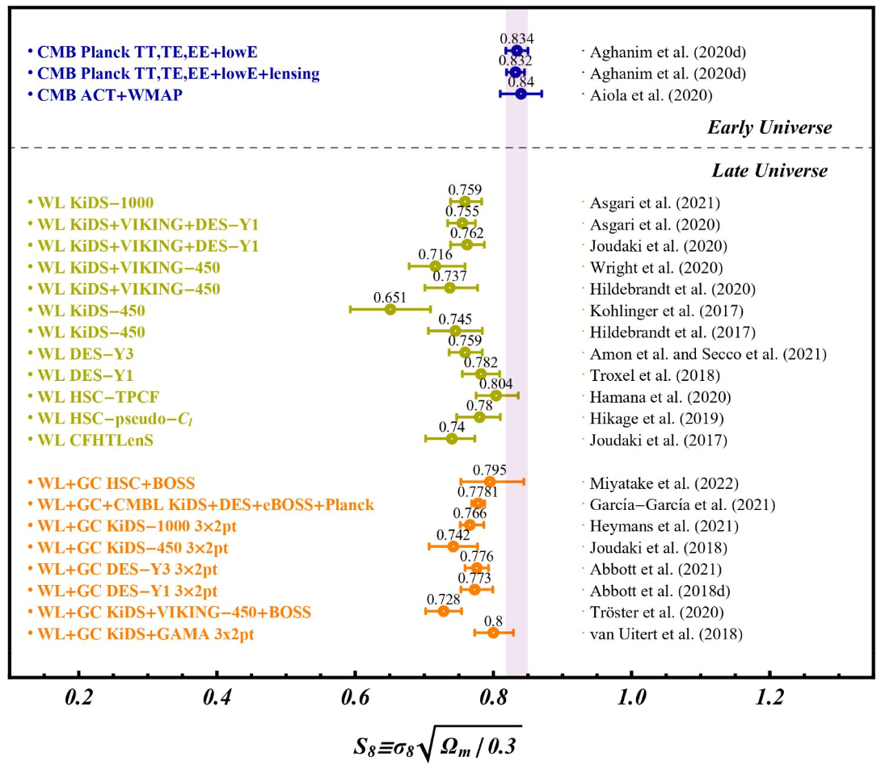
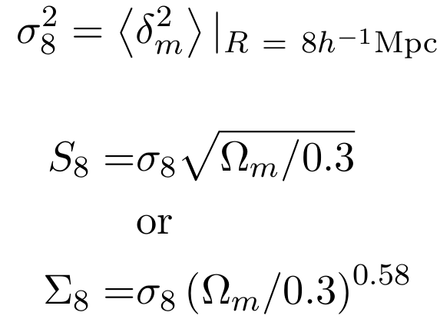
S₈/ σ₈ tension
Clustering of matter parameters inferred with the CMB were found to be in 2-3 σ tension with late universe probes, specially cosmic shear/weak lensing.
Modified Fig.4 of Abdalla et al.; 2022

Slide 42
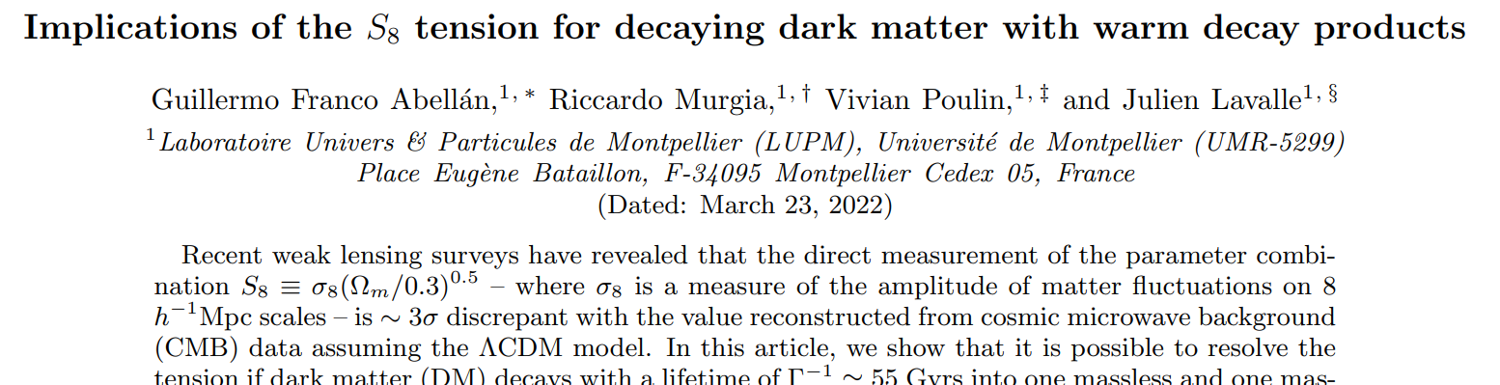
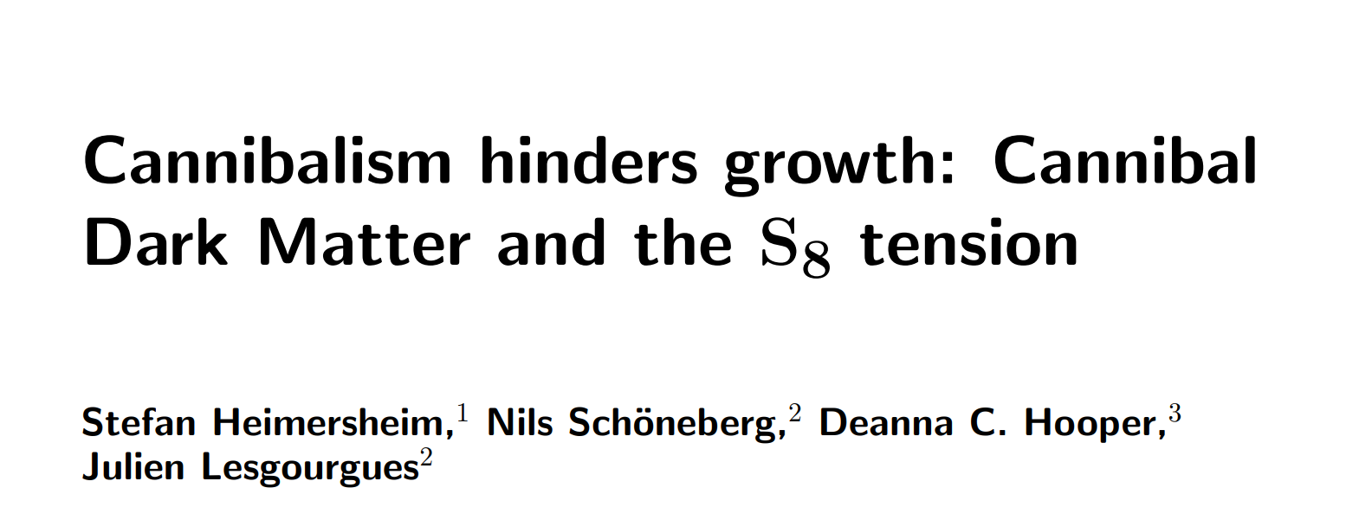
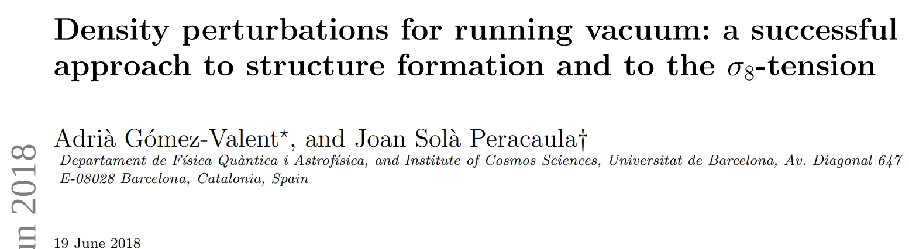
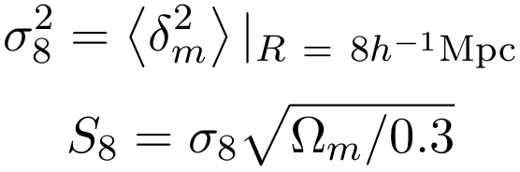
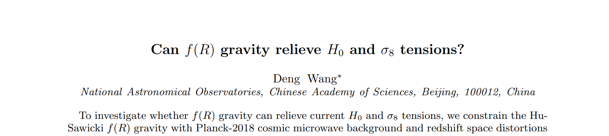
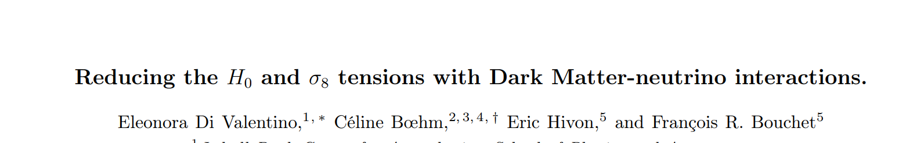
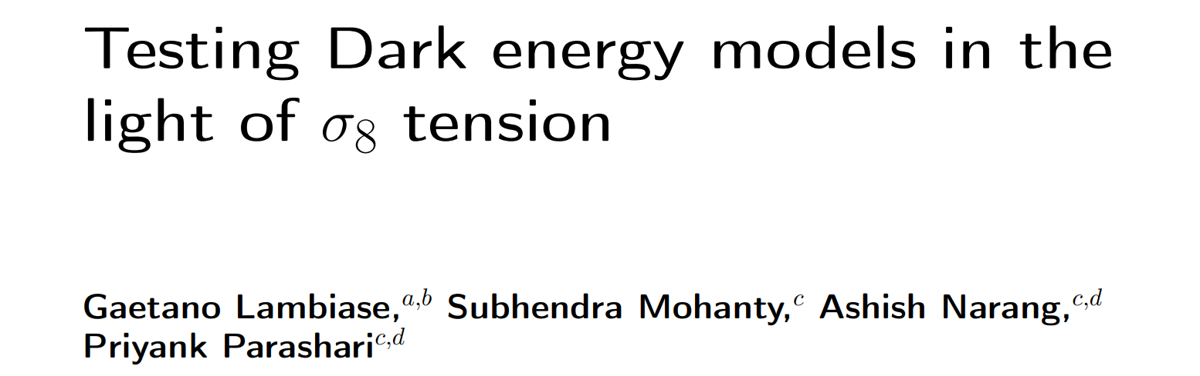
S₈/ σ₈ tension
Clustering of matter parameters inferred with the CMB were found to be in 2.1-3.8σ tension with late universe probes, specially cosmic shear/weak lensing.
Modification of Fig.4 of Abdalla et al.; 2022

Slide 43

S₈/ σ₈ tension Solved
Improved data modeling by the KiDS collaboration eliminated the tension.
Credit: Wright et al.; 2025 (KiDS-Legacy)

Slide 44
New tension on the horizon:
CMB vs. BAO

Slide 45

CMB vs BAO
CMB and BAO data were always consistent at the 1-2σ level in ΛCDM.
Credit: Adame et al.; 2024 (DESI-DR1)

Slide 46

CMB vs BAO
CMB and BAO data were always consistent at the 1-2σ level in ΛCDM.
However, a discrepancy started appearing between CMB and DESI-DR2 data.
The level of discrepancy varies depending on the CMB data.
Credit: Lennart Balkenhol

Slide 47

Differences between CMB and DESI in the Ω_{m}-hr_{d} plane can accommodate 2-3σ deviations from ΛCDM
Credit: Camphuis et al; 2025; ARK et al.; 2025

Slide 48
Back to EDE
H0DN
DESI DR2

Slide 49

Back to EDE
H0DN
Adding DESI DR2 data allows for larger f_{ede} values, which reduces the tension to 2.6σ
DESI DR2

Slide 50

Back to EDE
Increasing f_{ede} results in a smaller 𝛺_{m}, as preferred by DESI DR2.

Slide 51
Back to m_{e} + 𝛀_{K}

Slide 52

Back to m_{e} + 𝛀_{K}
Substituting DESI with Pantheon⁺ , m_{e} + 𝛀_{K} no longer reduces the tension below 3σ

Slide 53
Summary & Questions
The level of precision Cosmology reached allowed to uncover hidden tensions.
The Hubble tension is the most serious one (now at 7.1σ) without a clear candidate for a solution
  Do we need more data?
  Should we seek different data?
  What is needed from the theory side?
  More statistical tools?
The improved modeling of KiDS data resulted in the end of the S₈/σ₈ tension.
A new tension (2-3.7σ) emerged between recent BAO measurements from DESI and the CMB in ΛCDM.
  This discrepancy projects onto deviation of ΛCDM.
  More data is needed for more concrete conclusions.

Slide 54
Back-up

Slide 55


Slide 56

CMB Polarization Maps
Credit: Wei Quan, SPT-3G Collaboration

Slide 57
Post-Recombination Solutions

Slide 58
Post-recombination example I: Spatial Curvature
Allow H₀ to increase to the SH0ES value with the additional freedom in the curvature contribution to the energy content, 𝛀_{K}

Slide 59

Post-recombination example 1: Spatial Curvature
Current data does not allow enough change in 𝛀_{K} to solve the tension
(5 - 5.5σ)
Chains from results of Camphuis et al; 2025

Slide 60
Post-recombination example II: Modified Gravity (Desmond et al.; 2019)
Distance-ladder determination of H₀ assumes the physics is the same at every step/rung.

Slide 61
Post-recombination example II: Modified Gravity (Desmond et al.; 2019)
Distance-ladder determination of H₀ assumes the physics is the same at every step/rung.
Modifications of gravity create a fifth force that alters the Period-Luminosity relation (PLR) of distant Cepheids but not to calibration ones, for e.g (screening mechanisms).
Fifth Force
ΔG = G_{new}- G_{N}
Δlog(P)∝- log(1+ΔG/G_{N})
Δlog(L)∝ log(1+ΔG/G_{N})

Slide 62
Post-recombination example II: Modified Gravity (Desmond et al.; 2019)
Distance-ladder determination of H₀ assumes the physics is the same at every step/rung.
Modifications of gravity create a fifth force that alters the Period-Luminosity relation (PLR) of distant Cepheids but not to calibration ones, for e.g (screening mechanisms).
Changing the PLR ⇒ changing the distance to SNIa ⇒ changing inferred H0
(need 7-9% increase in G to solve the tension)
Δlog(L)∝ log(1+ΔG/G_{N})
D_{new} = (1+ΔG/G_{N})^{𝜶} D_{old}
H_{new} = (1+ΔG/G_{N})^{-𝜶} H₀^{SH0ES}

Slide 63

Post-recombination example II: Modified Gravity (Desmond et al.; 2019)
Results show a few models that are able to reduce the tension below 3σ.
From Table IV of Desmond et al.; 2019

Slide 64

Post-recombination example II: Modified Gravity (Desmond et al.; 2019)
Results show a few models that are able to reduce the tension below 3σ.
Caveats:
  Tension increases with CMB-SPA.
  Optimized to avoid tension with TRGB.
  Large error bars. Need more data
  Does not solve the tension between ΛCDM-inferred values and other probes (e.g. gravitational lensing time delay; Wong et al.; 2020)
Least unlikely solution: pre-recombination modification to ΛCDM
From Table IV of Desmond et al.; 2019

Slide 65
Pre-Recombination Solutions

Slide 66


Slide 67


Slide 68


Slide 69
Model Class | Preference over ΛCDM
Lensing Amplitude | 3.1σ
Modified Recombination | 2.0σ
Spatial Curvature | 2.5σ
Neutrino Mass | 2.8σ
CPL Dark Energy (w₀,w_{a}) | 3.2σ
Varying electron mass in a non-flat Universe | 2.1σ
Axion Early Dark Energy | 2.5σ

