Slide 1


  Quantum Correlations in Neutrino Oscillations: From Flat to Curved Spacetime
  Speaker: Abhishek Kumar Jha
  Department of Physics, Indian Institute of Science (IISc), India
  PRD 112, 036007 (2025), PRD 112, 043045 (2025)
  June 1 – 5, 2026
  Noirmoutier, France

Slide 2

Outline
Motivation
Bipartite entanglement
Quantum correlations (QC): entanglement entropy and capacity of entanglement
Quantum speed limit (QSL) for entanglement entropy
Effective Hamiltonian for the two- and three-flavor neutrino system in matter
QC and QSL for entanglement entropy in the two- and three-flavor neutrino oscillations
Dirac Lagrangian in curved spacetime
Gravitational potential around a spinning blackhole
Neutrino equation and effective mass matrix in curved spacetime
Two-flavor oscillations of the neutrino-antineutrino system and QC in curved spacetime
Summary

Slide 3
Motivation
Quantum correlations (QC) is a prominent example of entanglement, which are fundamental aspects of quantum information theory and exhibit intriguing features that have no classical counter parts.
During entanglement, two or more particles become so deeply correlated that the state of one cannot be described independently of the others, even across vast distances.
Although much research has been focused on optical and electronic systems, recent advances in neutrino oscillation experiments in flat space-time offer new avenues for exploring various quantum correlations in oscillating neutrinos.
Neutrino oscillations are a unique system capable of maintaining coherent quantum behavior over long distances and time.
Occupation numbers are defined within a multi-qubit space, allowing a single particle neutrino flavor state to be interpreted as a multipartite (bipartite or tripartite) mode-entangled state [Blasone et al. (2008, 2013, 2015)].
Fundamental questions arises:
How fast bipartite entanglement changes during neutrino oscillations in vacuum, matter with a CP-violating phase, and under neutrino mass ordering scenarios, specifically, in flat spacetime- Quantum speed limit for the entanglement entropy.
How transition probabilities and QC such as entanglement entropy behaves when neutrinos oscillates in curved spacetime.

Slide 4
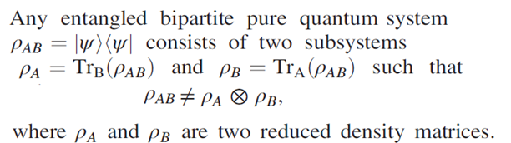

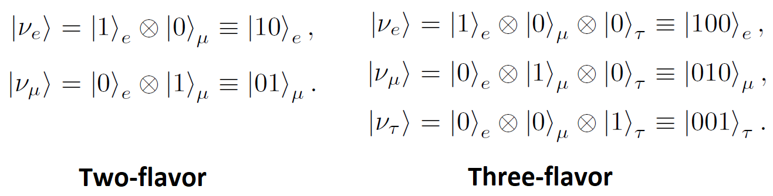

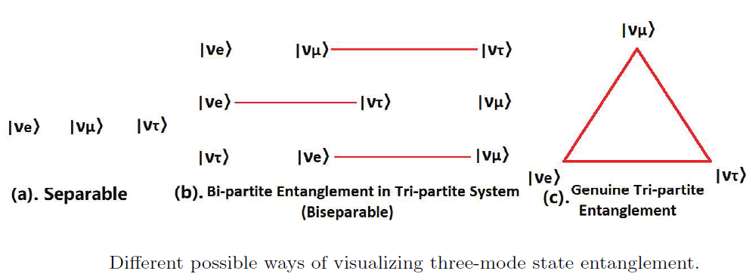

Bipartite entanglement
In quantum mechanics, the time
evolution of the initial state obey
The initial and final states can be
represented in the density matrix form
as and respectively.
In a bipartite pure quantum system, a state
of the quantum system can be represented
as the tensor product of minimum two-qubit
Hilbert spaces:
For example, Bell’s state

Slide 5


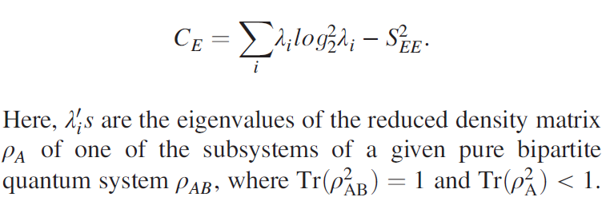
QC: Entanglement entropy and Capacity of Entanglement
Entanglement entropy serves as an important entanglement measure to assess the degree of quantum entanglement between the subsystems of a bipartite quantum system.
It determines the von Neumann entropy on the reduced matrix of one of the subsystems.
The entanglement entropy (SEE) for is defined as
The variance in entanglement entropy is defined as the capacity of entanglement (CE) of the reduced state of any of the subsystems:

Slide 6
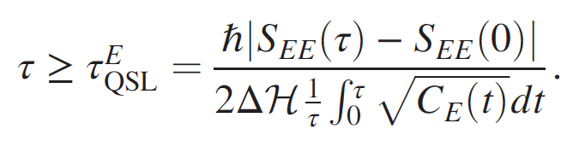
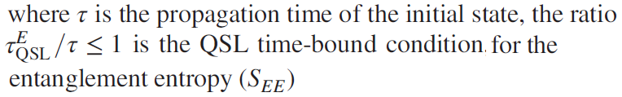
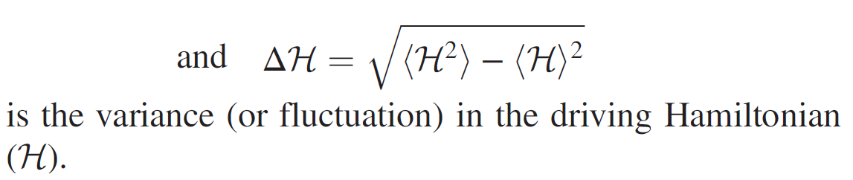



Quantum Speed Limit for the Entanglement entropy
If the dynamics of the system is unitary and the driving Hamiltonian remains time independent, the quantum speed limit for the entanglement entropy (SEE) adheres to the following bound
This equation establishes a quantum speed limit on the production and decay of entanglement in the case of pure bipartite states.
Physical significance:
If : the bipartite entanglement in the time-evolved state can not be speed up. In other words, the bipartite entanglement is already at its maximum speed for the given time-evolved state.
If : the bipartite entanglement in the time-evolved state could be speedup. Furthermore, the smaller is, the larger is the potential for bipartite entanglement to further speed up in the time-evolved state.

Slide 7
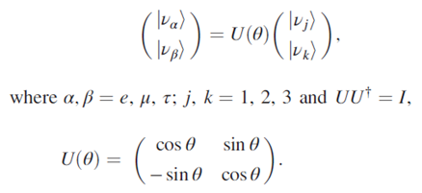
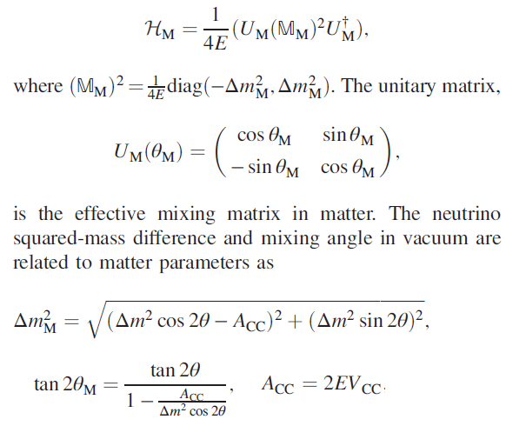
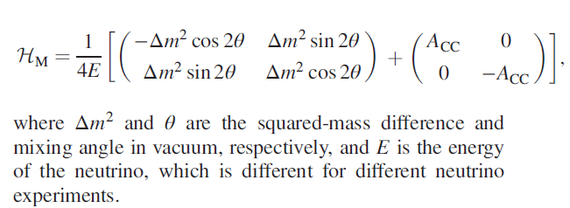
Effective Hamiltonian For the Two-Flavor neutrino system in matter
At time t =0, the neutrino flavor state can be written as
In matter, effective Hamiltonian is

Slide 8

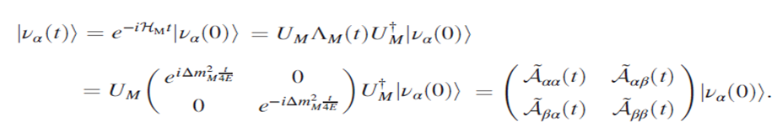



Two-Flavor Neutrino transition Probabilities in matter
In the plane-wave approximation, the time evolved neutrino flavor state in the presence of matter is
The time-evolved flavor neutrino state in matter is
In the ultra-relativistic limit (L=t), the survival and oscillation probabilities are, respectively

Slide 9
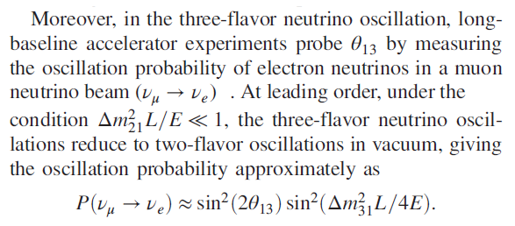
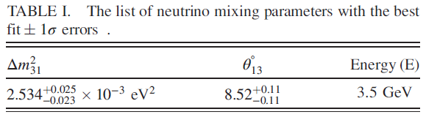
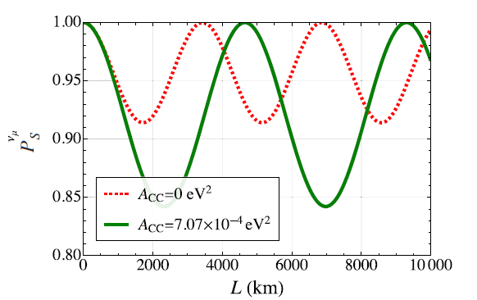
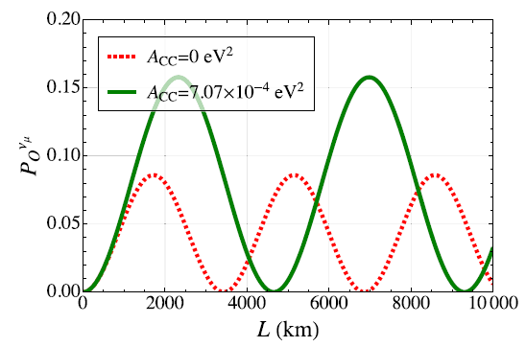
Two-Flavor Neutrino Oscillations Probabilities in matter for the initial muon-flavor neutrino state

Slide 10
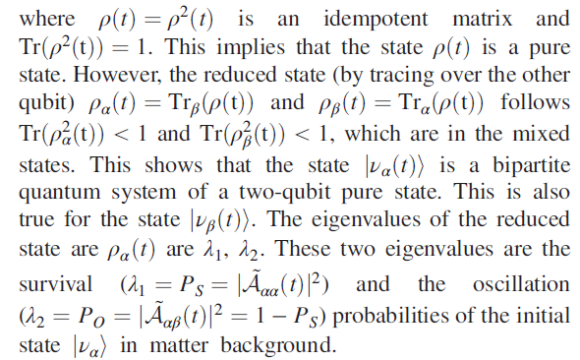

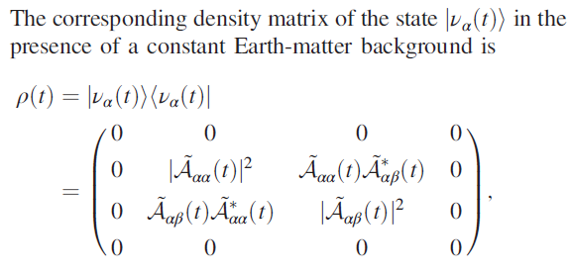
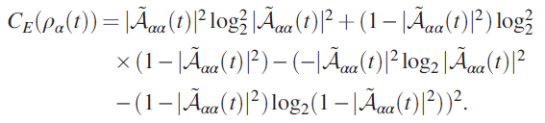

QC in terms of two-flavor neutrino transition probabilities in matter

Slide 11
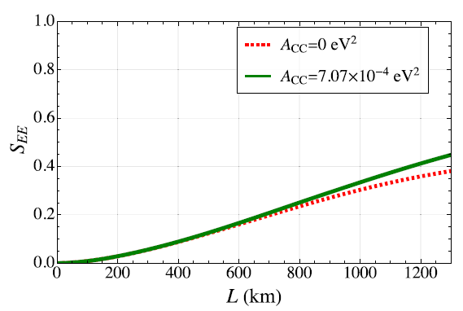
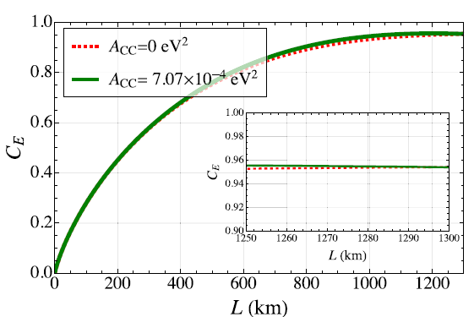
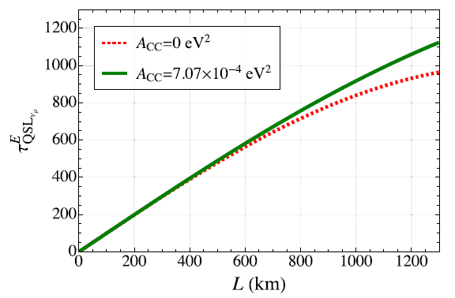
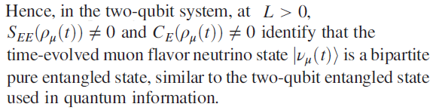
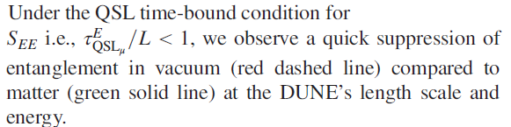
QSL for Entanglement entropy in Two-Flavor neutrino oscillations for the initial muon-flavor neutrino state

Slide 12
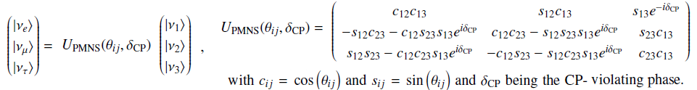

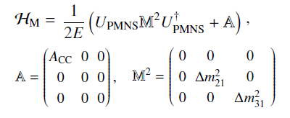
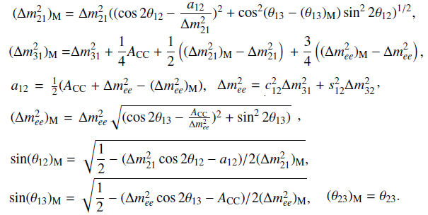
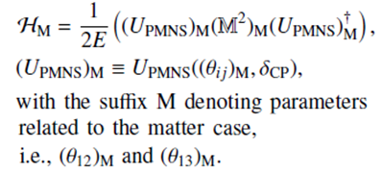
effective Hamiltonian for the three-flavor neutrino system in Matter

Slide 13
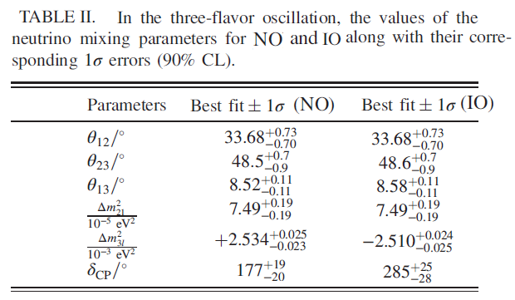



Three-Flavor Neutrino Oscillations Probabilities in matter for the initial muon-flavor neutrino state
The time-evolved muon-flavor neutrino state in the presence of matter can be expressed as
The transition probabilities in matter are
Neutrino mass-ordering scenarios

Slide 14
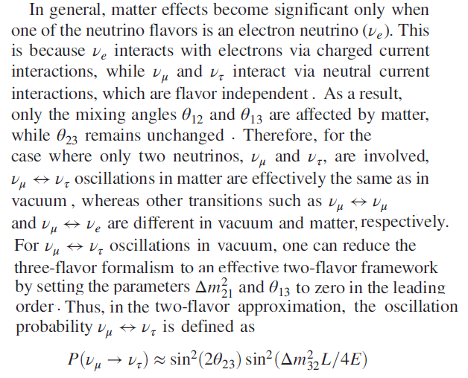
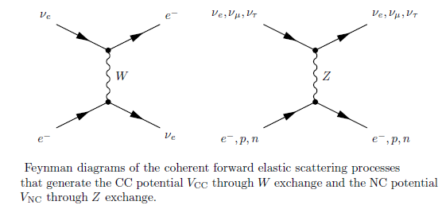
Two-Flavor Approximation of three flavor Oscillations in matter for the initial muon-flavor neutrino state
a

Slide 15
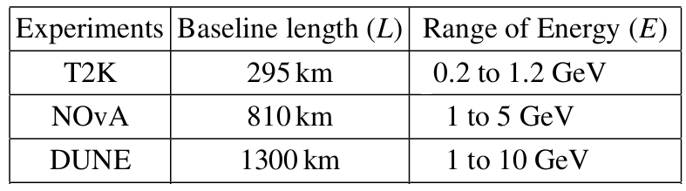
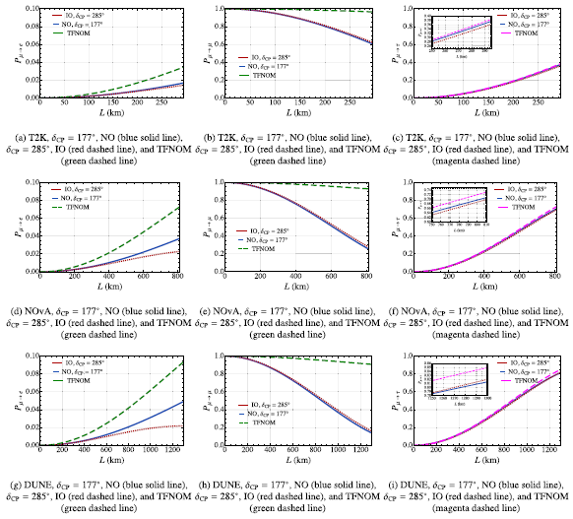
Two- and Three-Flavor Transition probabilities in matter for t2k, NOvA, and DUNE
The three-flavor probabilities in matter
are different for NO and IO across all
experiments.
These results are compared with
those obtained from two-flavor
neutrino oscillations in matter (TFNOM).
Noticeable differences
arise between the two- and
three-flavor results in matter,
primarily due to the additional
mixing angles, mass-squared
differences, and CP-violating phases
included in the three-flavor framework,
which are absent in the two-flavor
approximation.

Slide 16
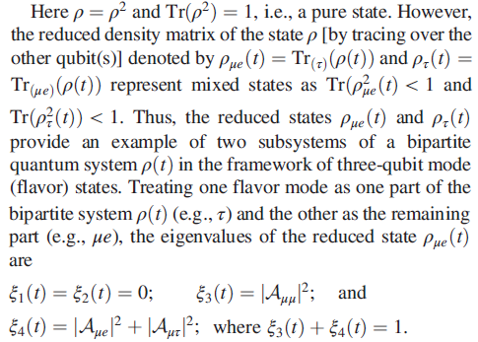
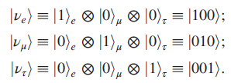

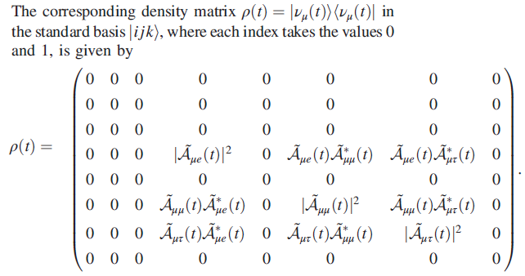
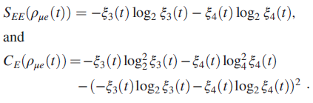
QC in terms of three-flavor neutrino transition probabilities in matter
in

Slide 17

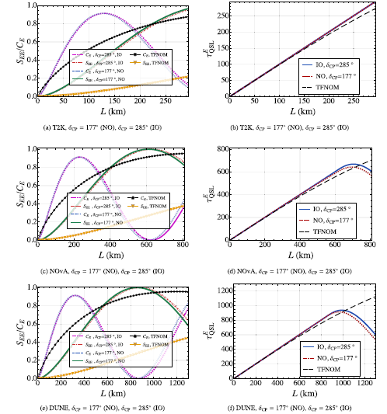

QSL for Entanglement entropy in Three-Flavor neutrino oscillations in matter for the initial muon-flavor neutrino state
Compared to two-flavor, in the
three-flavor exhibits a maximally
bipartite pure entangled state.
In three-flavor, no significant discrepancies
in the SEE & CE found for the best-fit CP
phases in both NO and IO using the length
scale and energy of T2K, discrepancies are
observed when we use NOvA and DUNE.
A greater decrease in SEE has been
observed at DUNE’s length scale and
energy for in NO.
Under the bound condition,
except for T2K, results showed that
entanglement suppression occurred
more rapidly near the ends of the NOvA
and DUNE baselines in NO for three-
flavor neutrino oscillations in matter,
compared to the TFNOM.

Slide 18
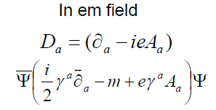



Dirac Lagrangian in curved spacetime
Neutrino physics plays a crucial role in various astrophysical and cosmological problems, such as nucleosynthesis in supernova explosions and the underlying accretion disks around black holes, leptogenesis-baryogenesis, dark matter, etc.
These studies necessitate the consideration of neutrinos in curved spacetime.
Dirac Lagrangian in curved spacetime for spin-1/2 particle
where, is the covariant derivative. The Lagrangian is valid for global coordinates (Greek indices) as well as local coordinates (Roman indices). We connect global coordinates to local coordinates via tetrads:

Slide 19


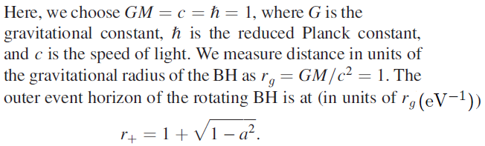
Gravitational Potential Around A spinning Black hole
The Lagrangian in curved spacetime can be simplified as
is the four-vector gravitational potential.
In the Kerr-Schild polar coordinates, the Kerr metric is
where,
M is the mass of black hole (BH),
is the dimension less specific
angular momentum per unit mass
and is the angle
of the position vector of the spinor
(neutrino) with respect to the spin axis
of the BH.

Slide 20
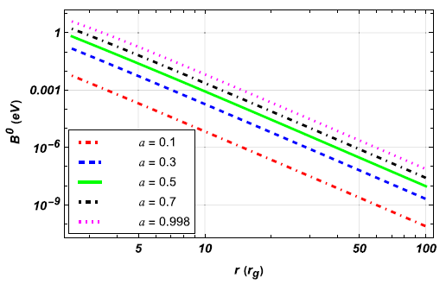



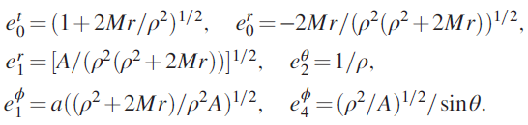
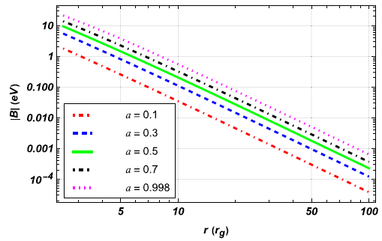




Gravitational Potential Around A spinning Primordial Black hole (PBH)
Effect of gravity is dominated in the quantum regime
for neutrinos when the gravitational radius of BH
is comparable with the Compton wavelength
of neutrinos
We take the mass of the neutrino in the order of
which essentially sets the mass of PBH:
Using the non-zero tetrads:
the four-vector gravitational potential
can be calculated as in the unit of gravitational
radius as, (where )
When the spin parameter
the components of vanishes.

Slide 21





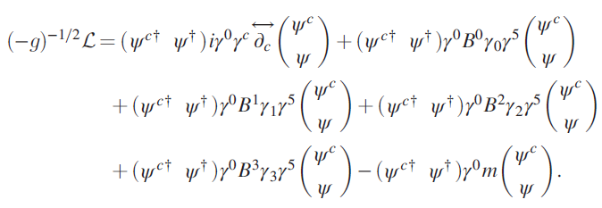
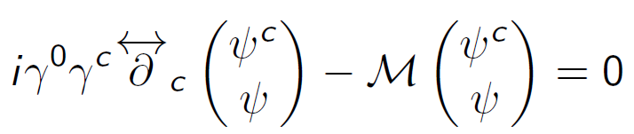

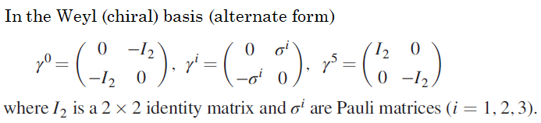
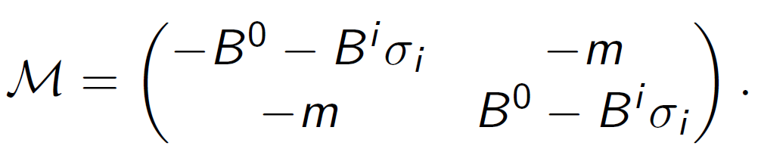
Neutrino equation and Effective Mass Matrix in curved spacetime
We consider neutrino to be a left-handed particle. For Majorana neutrinos, neutrino spinor in the Weyl representation is
where and denote antineutrino and neutrino spinors, respectively.

Slide 22
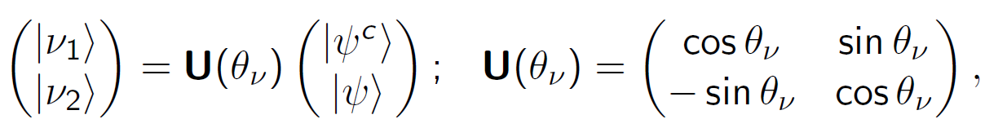
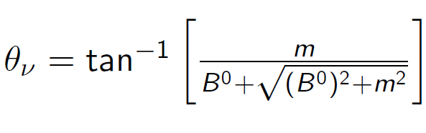
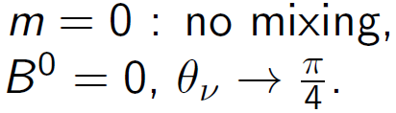
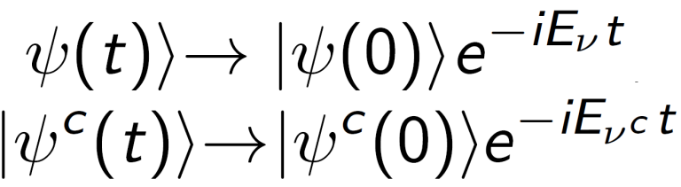



Oscillation in the neutrino-antineutrino system
We define two mass eigenstates as:
with mixing angle:
The time evolution of particle and antiparticle:
Neutrino-antineutrino states couple together with modified energy:
Due to the difference in energy (effective mass), their time evolution is different: Results in possible oscillation
Survival Probability:
Oscillation Probability:

Slide 23











Neutrino Trajectories, Mixing angle, and survival probability from the pbh
To deduce the relation between neutrino
propagation time t to the radial distance r,
we consider neutrinos moving along radial
trajectories. We find the relation between
t and r by setting with and
. Consequently, we obtain
In the ultrarelatvistic limit,
(in natural units )

Slide 24











In the background gravitational field: Euler lagrangian equation, effective mass matrix, and time evolution states in two flavor scenario
N

Slide 25



Survival probability and entanglement entropy in the two-flavor oscillations of the neutrino-antineutrino system in curved spacetime
1

Slide 26

Summary
We investigated CP violation and the neutrino mass-ordering problem in matter using various quantum correlations, including entanglement entropy, the capacity of entanglement, and the quantum speed limit associated with entanglement entropy, as key analytical tools.
Using the plane wave approach, these quantum correlations are quantified in terms of neutrino transition probabilities , which are measurable quantities in neutrino experiments.
Results illustrated using the length scales and energies of ongoing long-baseline accelerator neutrino experiments such as T2K, NOvA, and the upcoming DUNE experiment.
The time-evolved muon-flavor neutrino state in the three-flavor framework exhibits a maximally bipartite pure entangled state.
Quick suppression of entanglement, for the initial muon flavor neutrino state evolution in matter, has been observed in NO, in the presence of a best-fit CP-violation phase, at NOvA and DUNE length scale and energy.
Furthermore, we have shown that the spin-curvature coupling of the neutrino with the background spacetime leads to significant changes in its dynamics.
Oscillatory properties of its various quantum parameters are suppressed in the high coupling regime.
This effect reduces as the particle propagates away from the PBH, due to reduced coupling.

