Slide 1
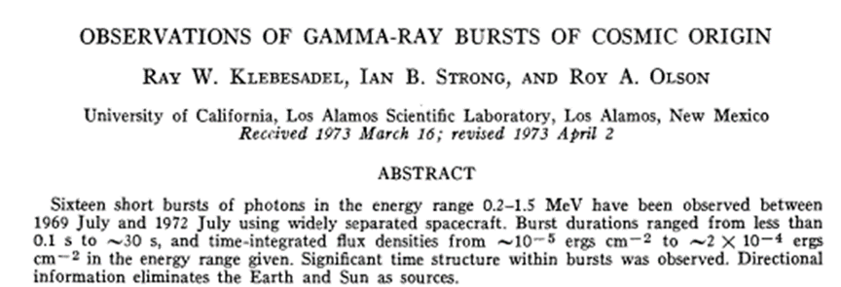
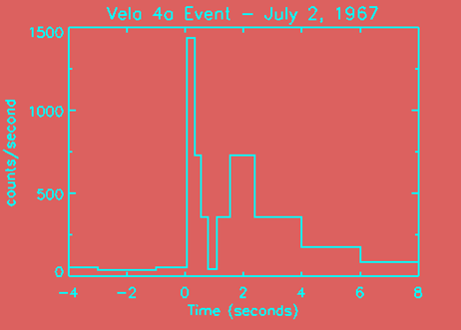
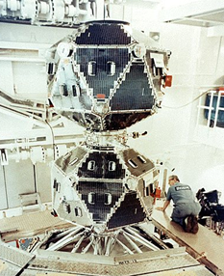
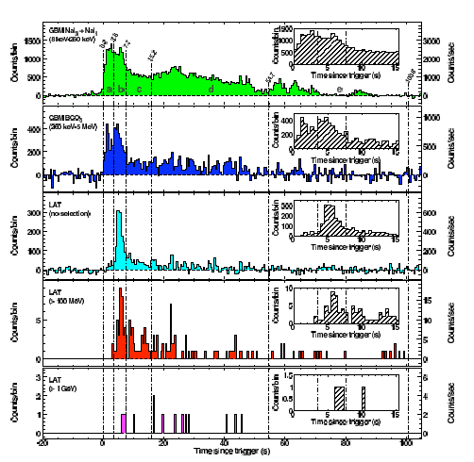
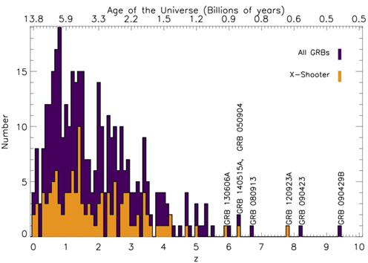
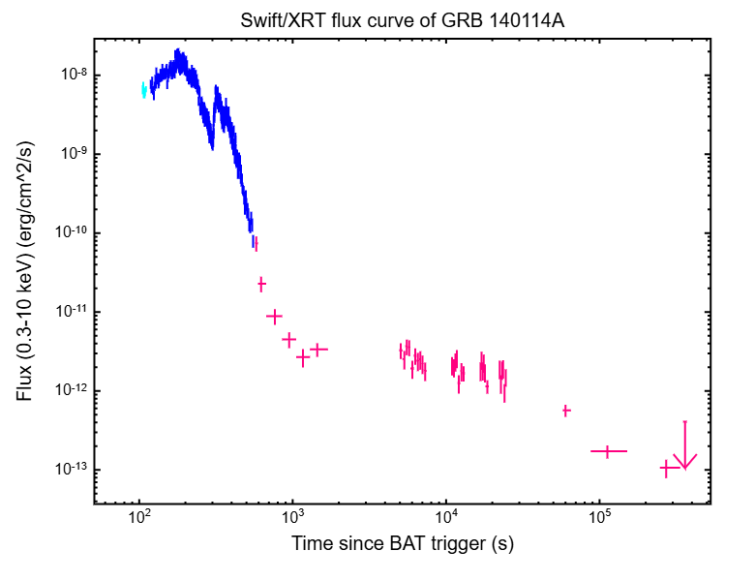
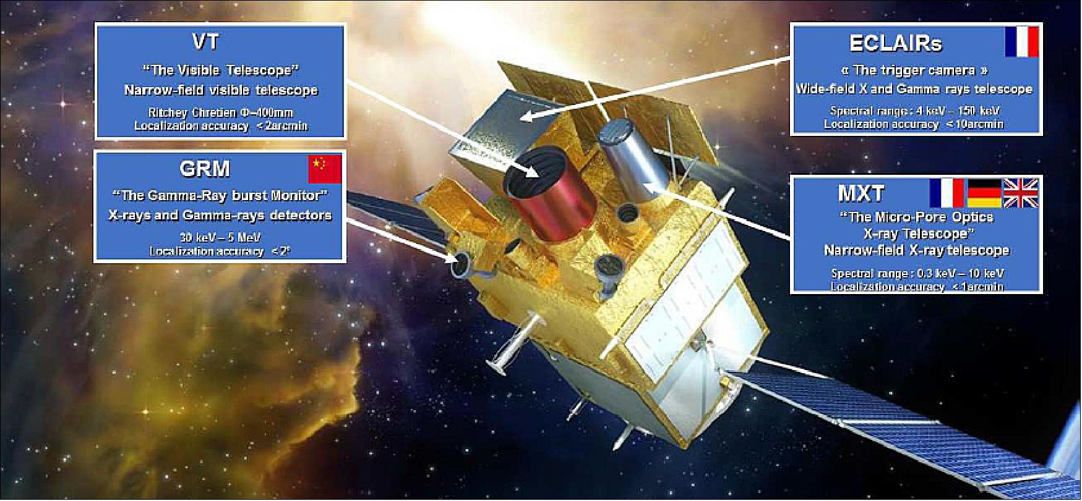
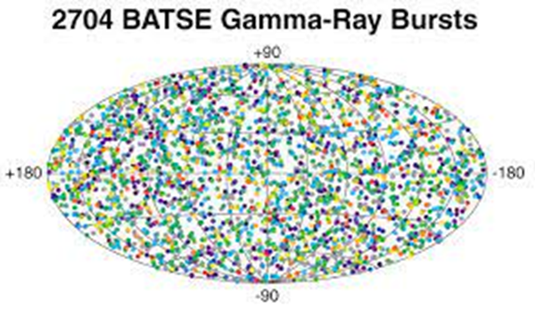
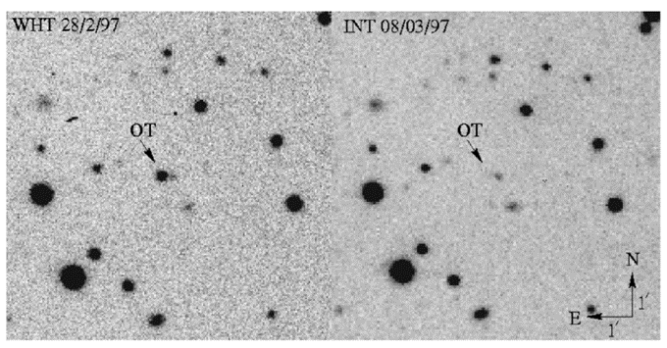
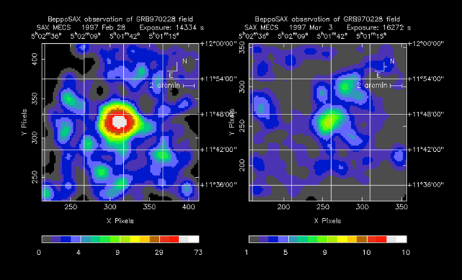
Where Does the Prompt Emission of Gamma Ray Bursts Come From?
Robert Mochkovitch (Institut d’Astrophysique de Paris)
A pity that we still don’t know, more than 50 years after the discovery paper was published!
Major GRB missions:
1991: BATSE (CGRO): duration; uniform distribution on the sky
1997: BeppoSAX: first redshifts; afterglows
2004: Swift: many redshifts; afterglows: plateaus, flares
2008: Fermi: high energy emission (0.1 – 10 GeV)
2024: SVOM (F. Daigne talk)

Slide 2
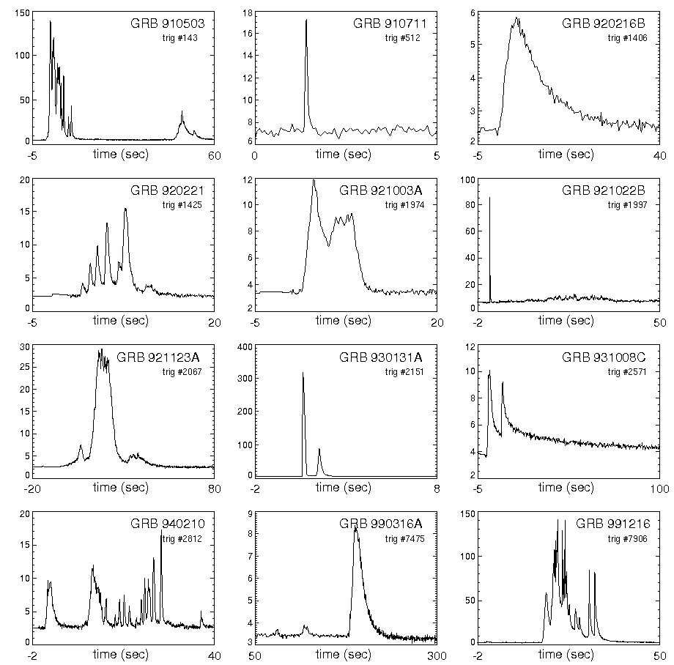
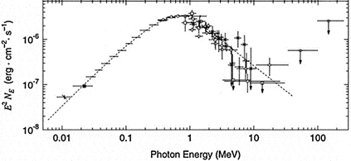
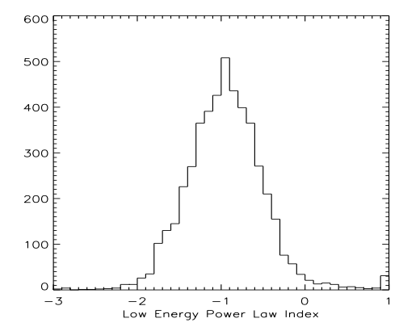
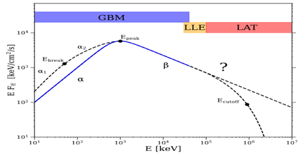
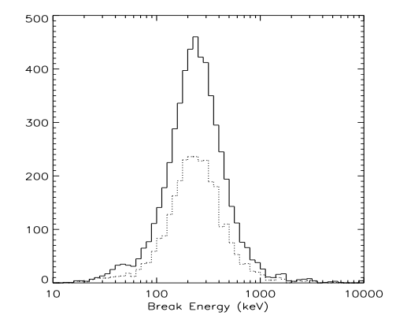
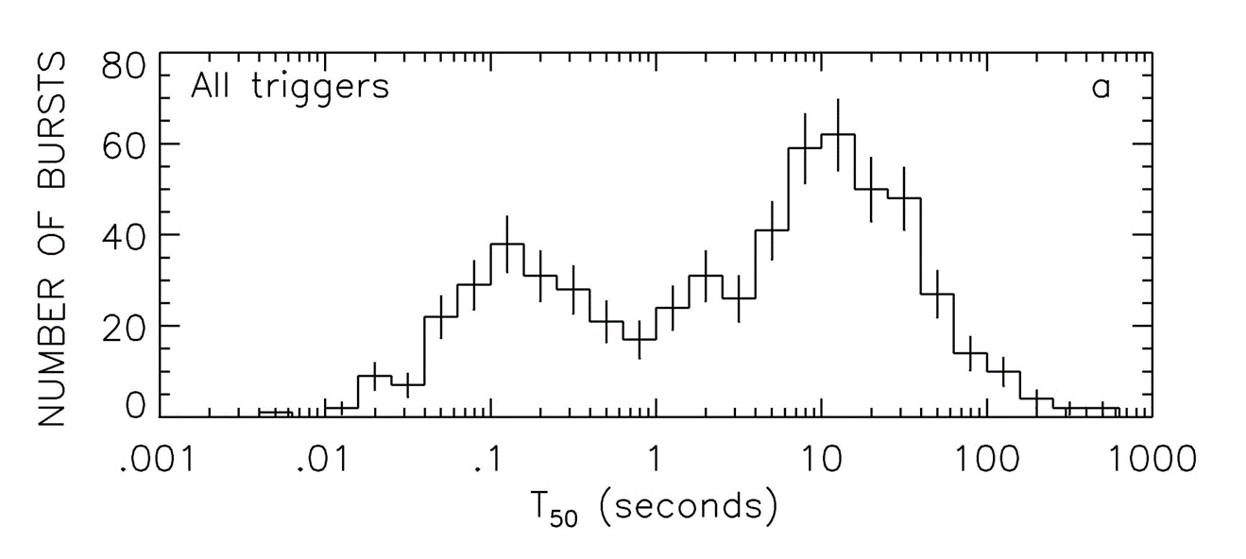
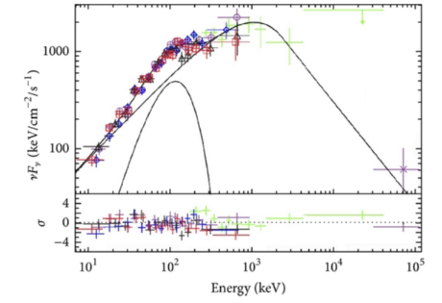
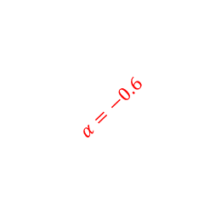
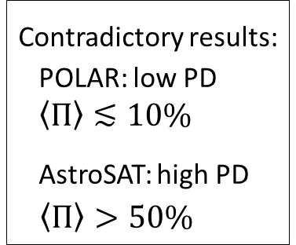


Temporal and spectral properties
Light curves:
Spectra:
Polarization:
α
Contradictory results:
POLAR: low PD
$\left\langle Π\right\rangle ≲10\%$
AstroSAT: high PD
$$\left\langle Π\right\rangle >50\%$$
$$α=−0.6$$
$$E_{p}=700 keV$$
E_{p}
$$E_{p}$$
- broken power-law(s) (Band spectrum)
- a sub-dominant thermal component?
- an additional power-law
- duration from a few ms to several hundred s
- great diversity
- precursors
- periods of quiescence
GRB 110721A (Iyyani et al, 2013)

Slide 3

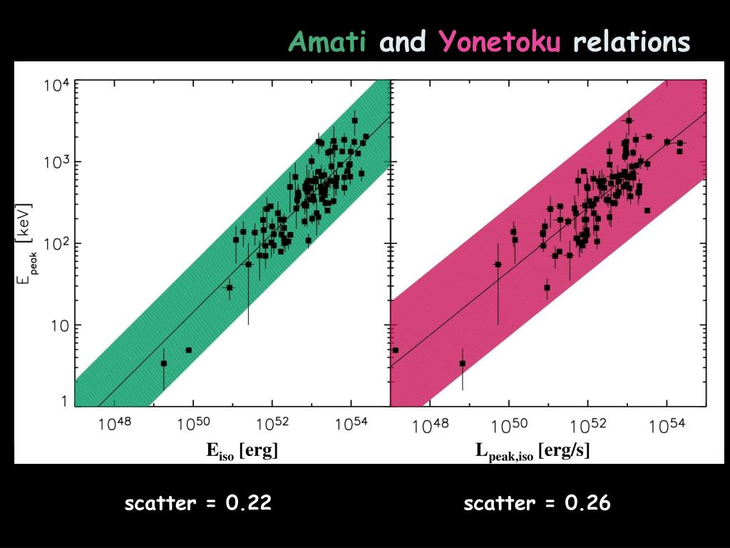
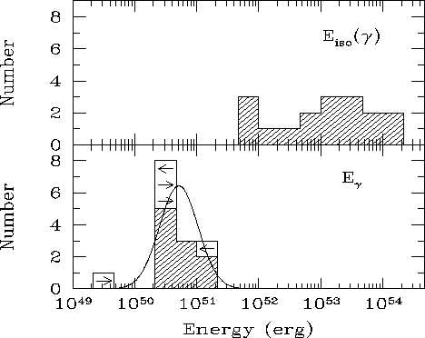
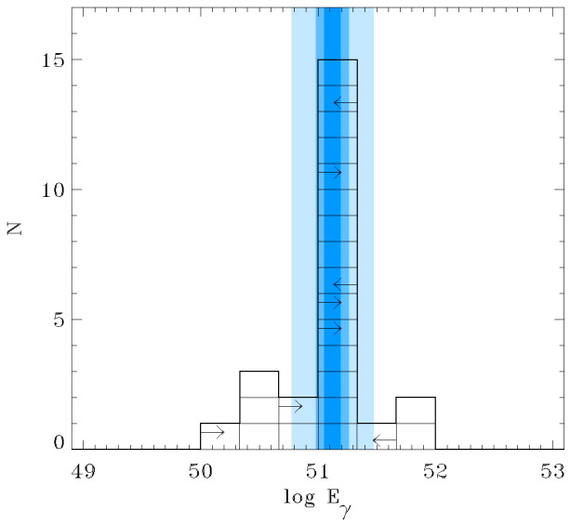
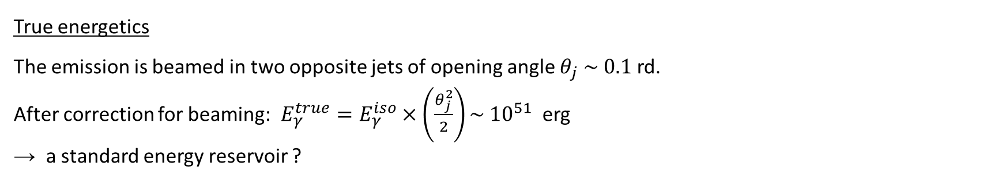

Energetics
From the redshift and observed flux and fluence → $L_{γ }^{iso}{, E}_{γ}^{iso}$ ( isotropic value)
(luminosities of short and long GRBs are comparable) - GRBs are the brightest sources in the Universe !
$E_{p}∝E_{γ,iso}^{1/2}$ , $L_{γ,iso}^{1/2}$
short
γ
γ
True energetics
The emission is beamed in two opposite jets of opening angle $θ_{j} \sim 0.1$ rd.
After correction for beaming: $E_{γ}^{true}=E_{γ}^{iso}×\left(\frac{θ_{j}^{2}}{2}\right)\sim { 10}^{51}$ erg
→ a standard energy reservoir ?
Differences in jet opening angle are the main cause of the diversity in $E_{γ}^{iso}$

Slide 4
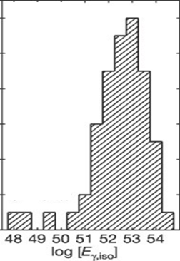
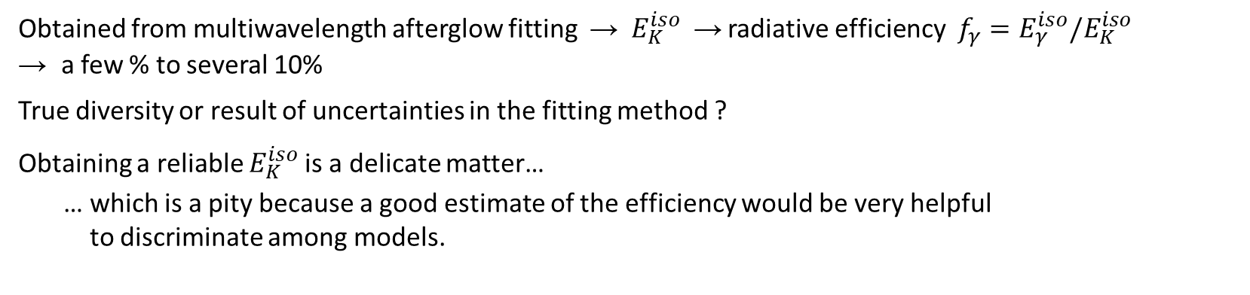
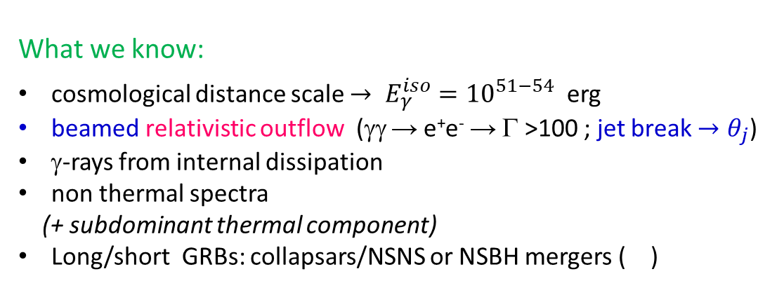
Total isotropic kinetic energy
Obtained from multiwavelength afterglow fitting → $E_{K}^{iso}$ → radiative efficiency ${f_{γ}=E}_{γ}^{iso}/E_{K}^{iso}$
→ a few % to several 10%
True diversity or result of uncertainties in the fitting method ?
Obtaining a reliable $E_{K}^{iso}$is a delicate matter…
… which is a pity because a good estimate of the efficiency would be very helpful
to discriminate among models.
What we know:
cosmological distance scale $→ E_{γ}^{iso}={10}^{51−54}$ erg
beamed relativistic outflow (γγ → e⁺e⁻ → Γ >100 ; jet break $→θ_{j}$)
γ-rays from internal dissipation
non thermal spectra
(+ subdominant thermal component)
Long/short GRBs: collapsars/NSNS or NSBH mergers ( )
What we would like to know:
dominant dissipation and radiation mechanism(s)
what? shocks ? magnetic reconnection
where? below or above the photosphere
how? synchrotron ? comptonization ?

Slide 5
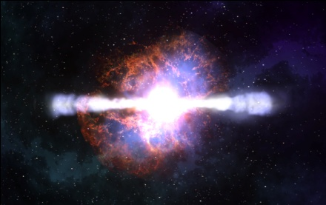

“top hat” jet
relativistic jet
10¹⁶⁻¹⁷ cm
10¹⁴⁻¹⁵ cm
10¹²⁻¹³ cm
Γ > 100
central engine
core collapse WR star
NSNS, NSBH coalescence
prompt
photosphere
afterglow
Origin of the prompt emission: three main contenders:
Sub-photospheric dissipation (shocks, reconnection) + comptonization
Above the photosphere:
internal shocks + synchrotron
reconnection + synchrotron
All three with pros and cons

Slide 6
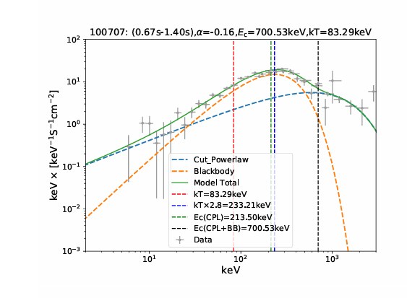
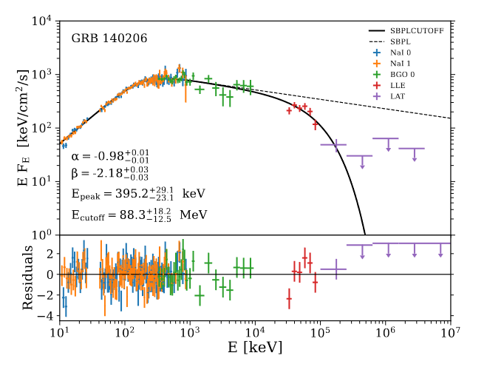
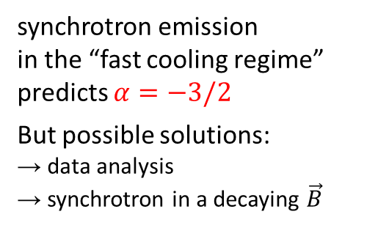
Possible clues? (spectral)
Low-energy spectral index
2. Extension of high-energy branch
3. Thermal component
100 MeV
synchrotron emission
in the “fast cooling regime”
predicts $α=−3/2$
But possible solutions:
→ data analysis
→ synchrotron in a decaying $\vec{B}$
thermal emission from the photosphere
expected in IS and reconnection models
In photospheric models, the thermal
emission is reprocessed to produce
the broken power-law spectrum
photospheric emission does not
easily produce a high-energy tail
in the spectrum
(Daigne Bosnjak, 2025)

Slide 7
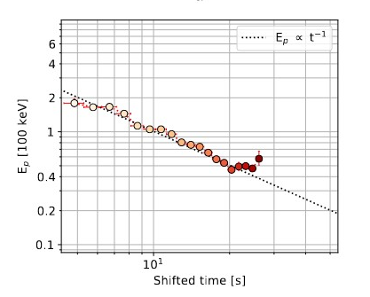
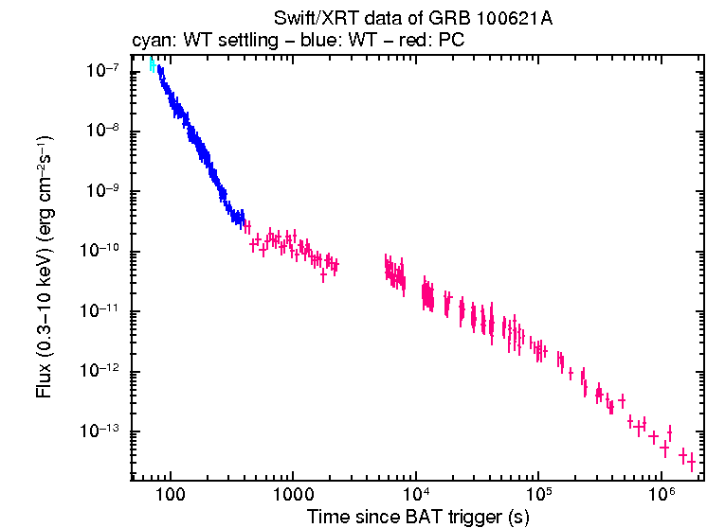
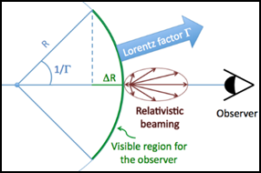
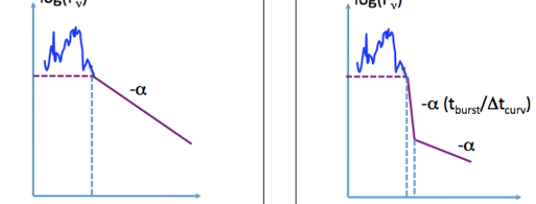


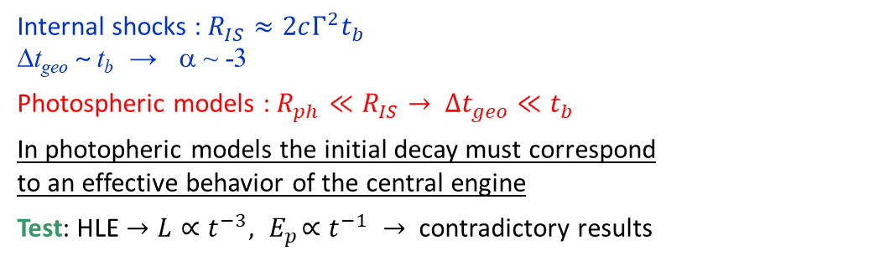

Possible clues? (spectro-temporal)
4. Early Steep Decay (ESD) when the prompt phase ends
High-Latitude Emission (HLE) or not?
ESD
HLE: , with and t_{b} , end time of the prompt burst
$$L(t)∼\frac{1}{{\left(1+\frac{t−t_{b}}{Δt_{geo}}\right)}^{3}}$$
$$E_{p}(t)∼\frac{1}{\left(1+\frac{t−t_{b}}{Δt_{geo}}\right)}$$
Internal shocks : $R_{IS}≈2cΓ^{2}t_{b}$
Δt_{geo} ~ t_{b} → α ~ -3
Photospheric models : $R_{ph}≪R_{IS}→ Δt_{geo}≪t_{b}$
In photopheric models the initial decay must correspond
to an effective behavior of the central engine
Test: HLE $→L∝t^{−3},{ E}_{p}∝t^{−1} →$ contradictory results
-3
initial decay slope:
(Alamaa et al, 2023)
(Hascoët et al, 2012, 2014)
t_{b}

Slide 8
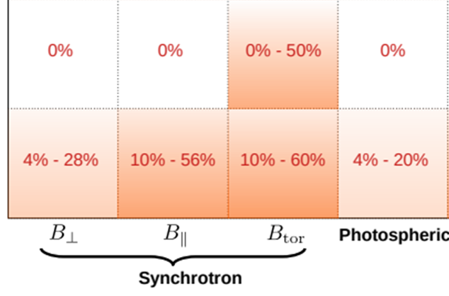
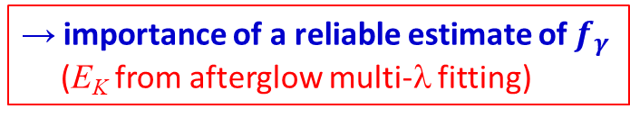

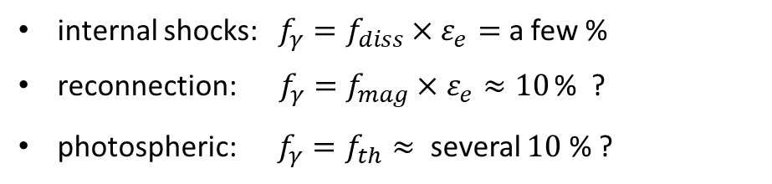
Possible clues?
5. Polarization during the prompt phase
${f_{γ}=E}_{γ}^{iso}/E_{K}^{iso}$
6. Efficiency :
Polarization depends on:
the radiative process
the viewing angle
the jet geometry
internal shocks: $f_{γ}=f_{diss}×ε_{e}=$ a few %
reconnection:$f_{γ}=f_{mag}×ε_{e}≈10$ % ?
photospheric: $f_{γ}=f_{th}≈$ several $10$ % ?
(synch.)
(Gill et al. 2021)
→ importance of a reliable estimate of $f_{γ}$
(E_{K} from afterglow multi-λ fitting)
$$θ_{obs}≈θ_{j}{ θ}_{obs}<θ_{j}$$
Promising diagnostic with the expected arrival
of POLAR-2 in 2028 !

Slide 9
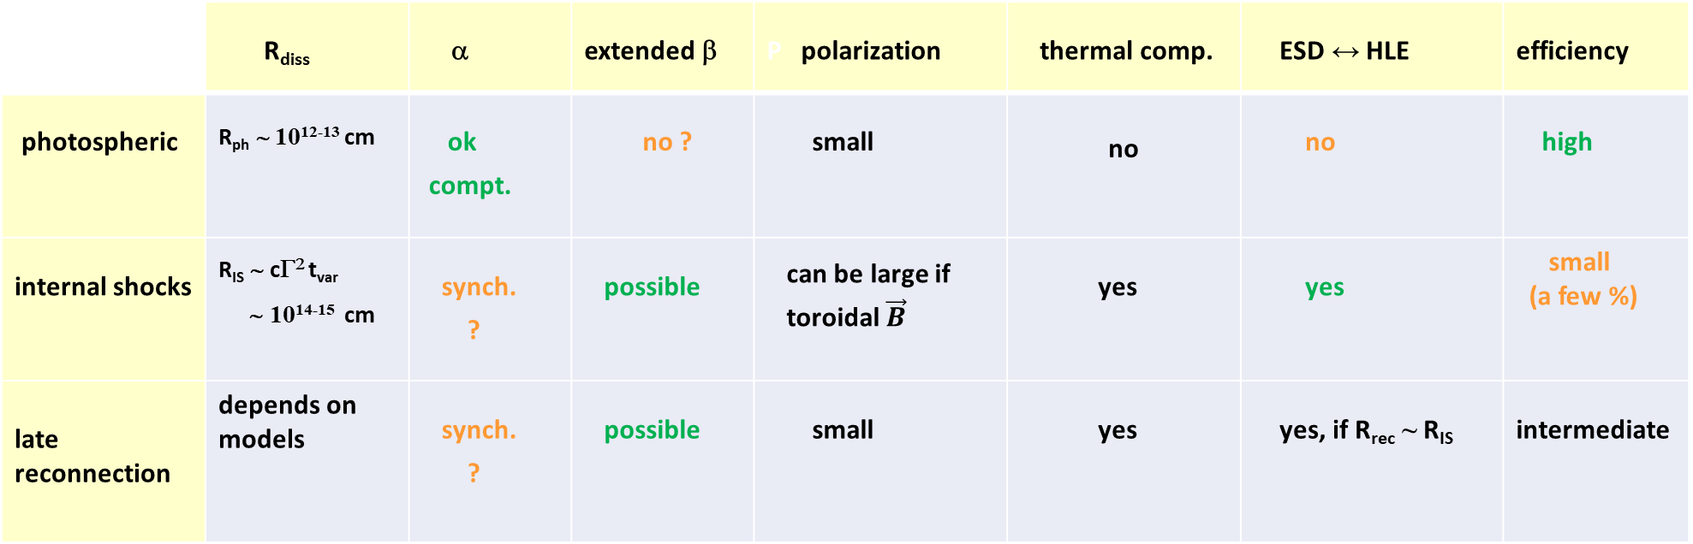
Synthetic summary
 | R_{diss} | α | extended β | P polarization | thermal comp. | ESD ↔ HLE | efficiency
photospheric | R_{ph} ∼ 10¹²⁻¹³ cm | ok compt. | no ? | small | no | no | high
internal shocks | R_{IS} ∼ cΓ² t_{var} ∼ 10¹⁴⁻¹⁵ cm | synch. ? | possible | can be large if toroidal $\vec{B}$ | yes | yes | small (a few %)
late reconnection | depends on models | synch. ? | possible | small | yes | yes, if R_{rec} ~ R_{IS} | intermediate
Some green and some orange in reach line…

Slide 10
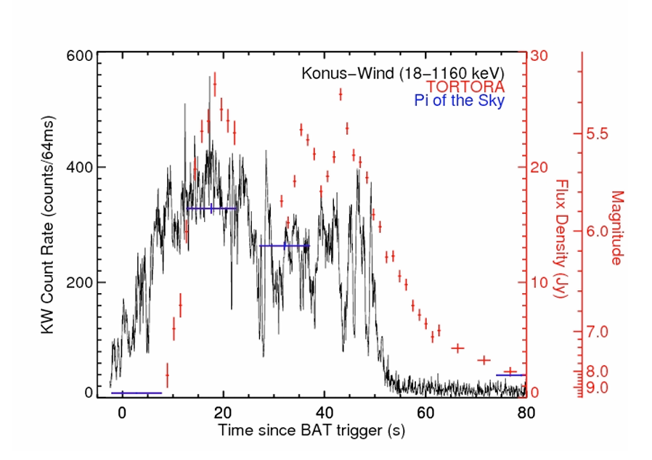
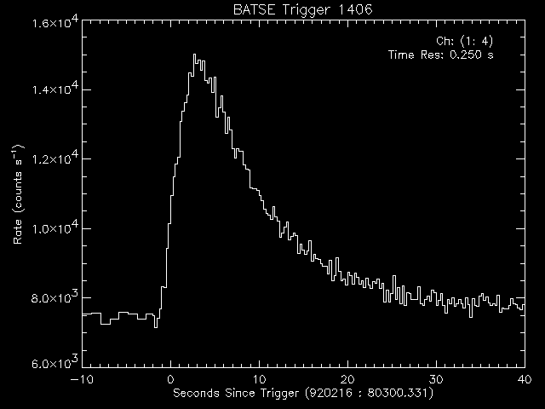
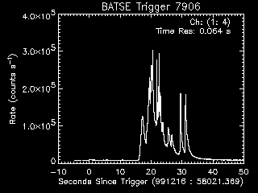
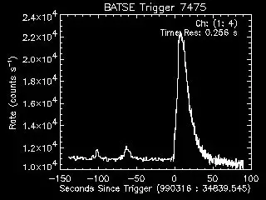
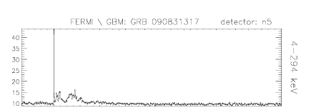

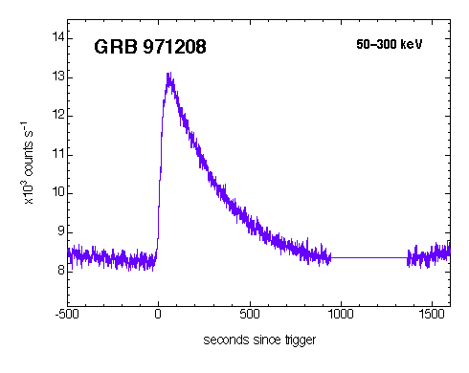
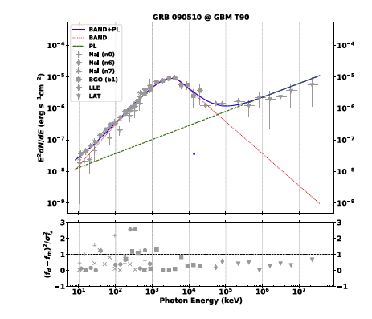
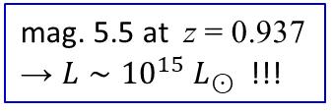
A few additional questions and mysteries
Smooth/spiky light curves 4. Prompt optical emission – « naked-eye burst »
Precursors
3. Ultra-long, single-pulse GRBs
variability from CE
or propagation ?
mag. 5.5 at z = 0.937
→ $L∼{10}^{15} L_{⊙}$ !!!
5. Short GRBs with extended emission
6. Additional power-law spectrum
only three cases
10 mn
(Alamaa et al, 2023)

Slide 11


Summary and perspectives
Not easy to choose among the three presented scenarios:
- each of them has strong points and weak points
- unfortunately none of the clues that could help to choose appears to be fully conclusive
What could be decisive?
A reliable estimate of the efficiency $E_{γ}/E_{K}$ : but (very) difficult
A reliable polarization measure: some hope with POLAR-2
→ launch to the Chinese space station in 2028
100 detection modules
Compton scattering (30 – 800 keV)
→ PD and PA

