Slide 1
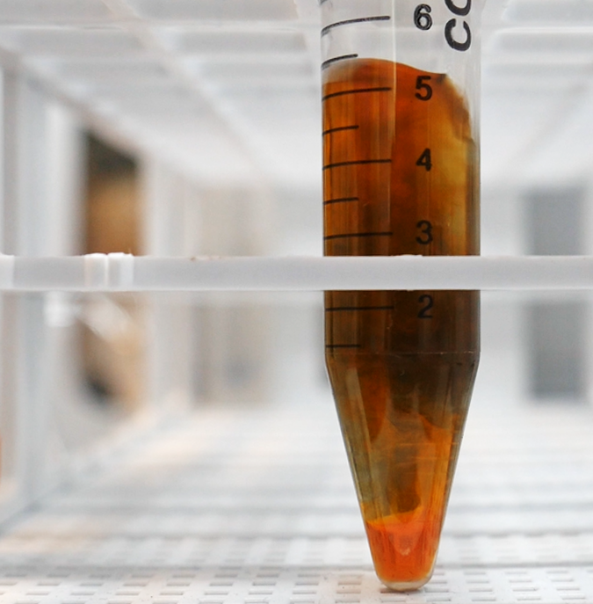


Ruthenium speciation during acidification of alkaline solution using a UV-Visible fast detector and an in-situ probe
Mathis Leblanc¹, Sarah Baghdadi¹, Alexandre Quemet¹, Jean Aupiais²
¹CEA, DES, ISEC, DMRC, Univ Montpellier, Marcoule, France.
²CEA, DAM, DIF, 91297 Arpajon, France.

Slide 2
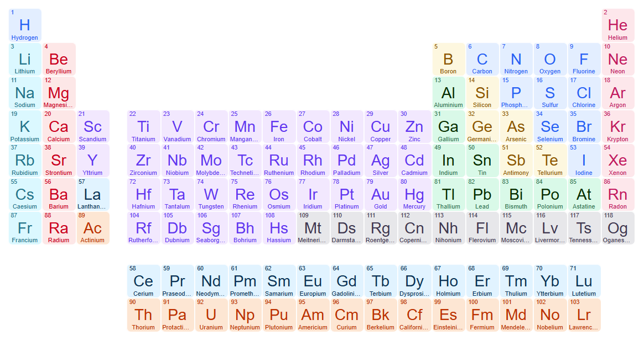
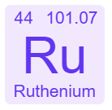
Context: What is it like to work with ruthenium?

Slide 3
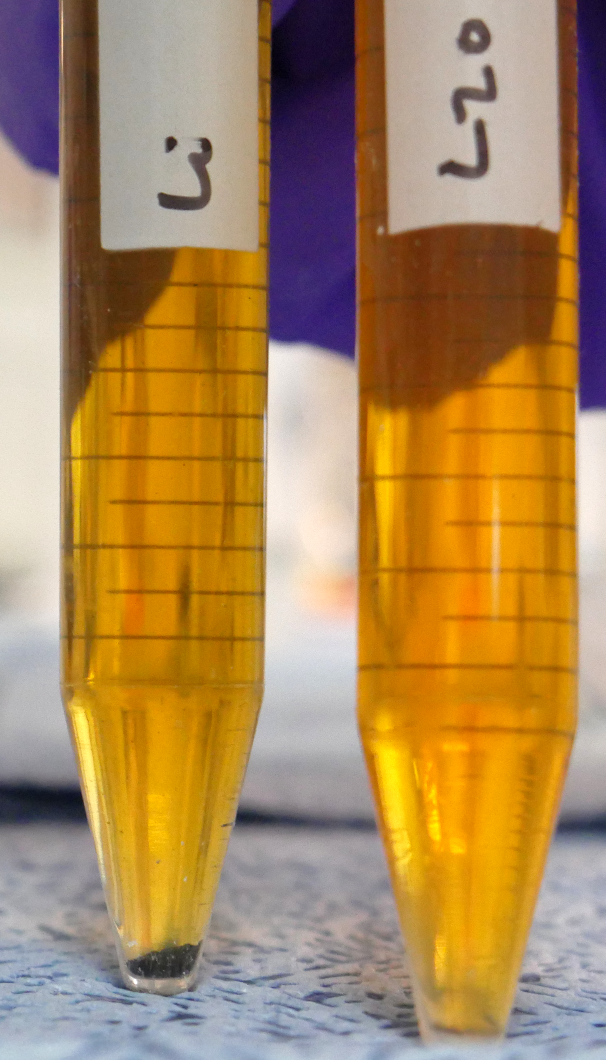
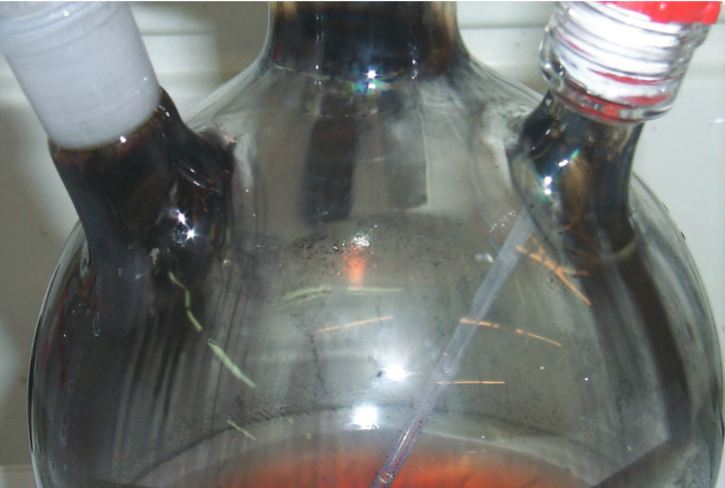
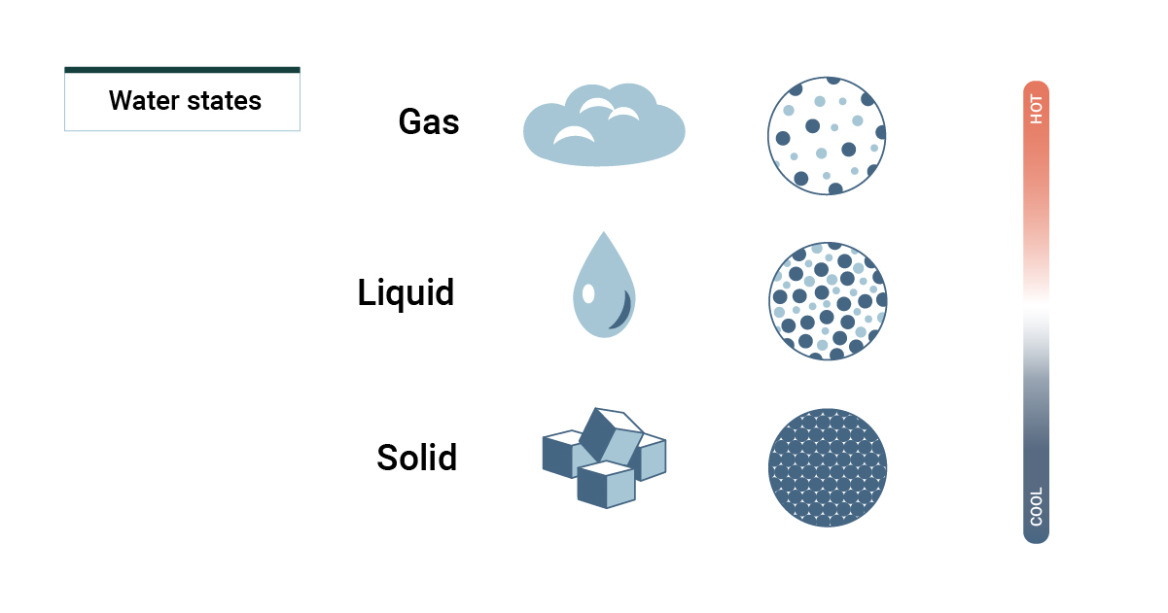


Context: What is it like to work with ruthenium?
-II
0
+I
+II
+III
+IV
+V
+VI
+VII
+VIII
Solid
Ex: RuO₂
Aqueous
Ex: RuO₄²⁻
Experimental results
Mousset, F. Ph.D. Thesis, Université Paris VI, 2004.
Gas
Ex: RuO₄
298 K – 100 kPa (20 °C – 1 bar)
To keep in mind

Slide 4



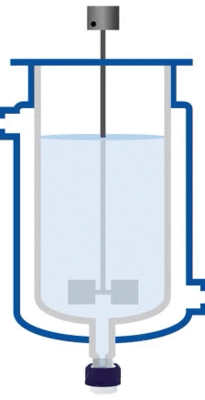



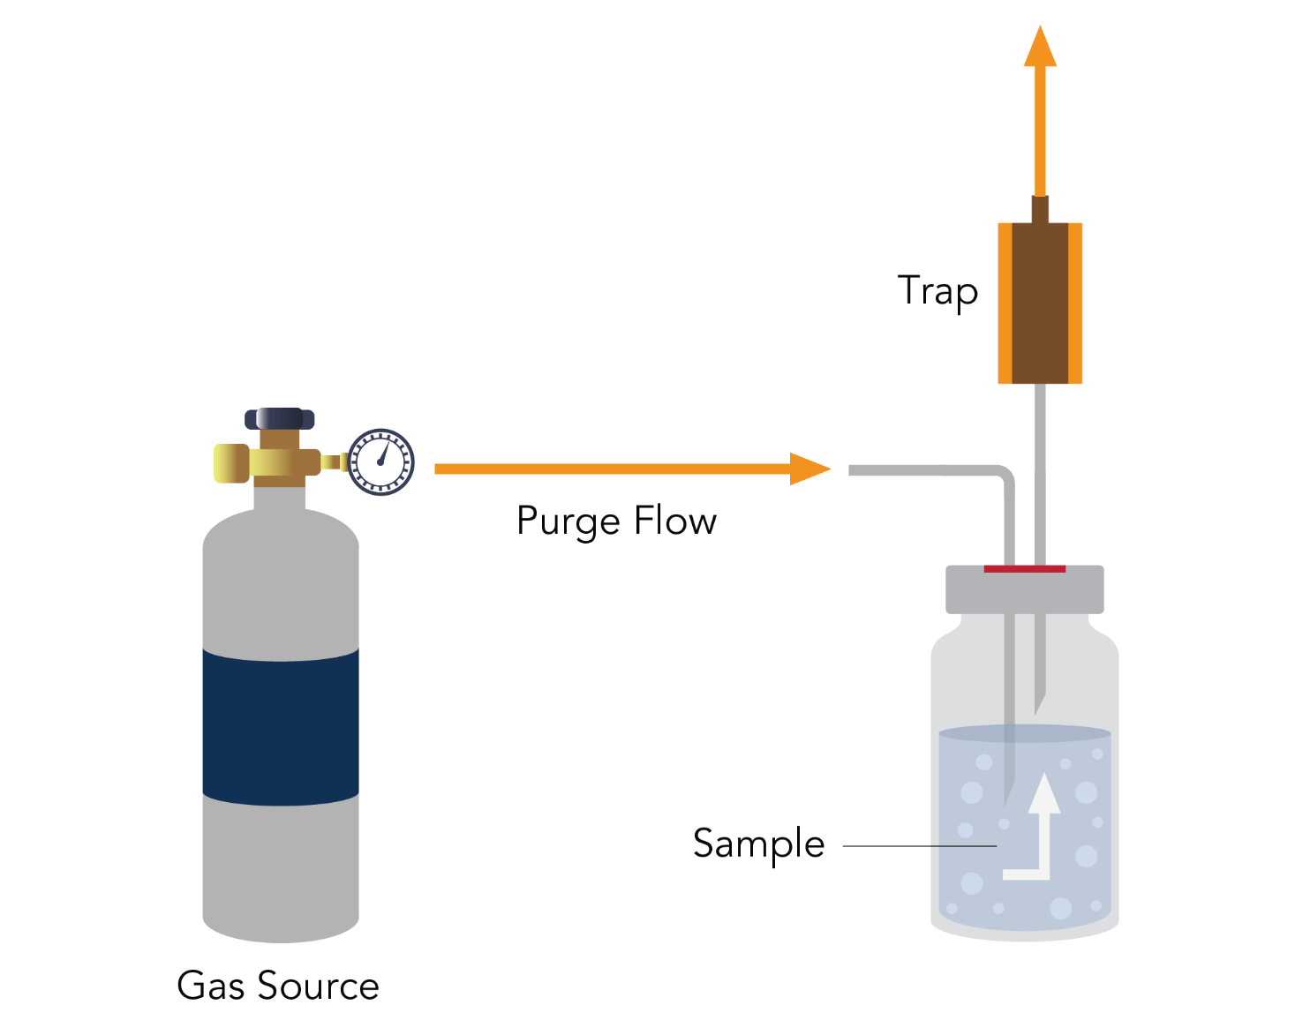


Context: Why are we interested in ruthenium?
Fission product
RuO₄ _{(g)}
NaOH
Ru - NaOH

Slide 5
Context: Why are we interested in ruthenium?
Ru - NaOH
Ru - NaOH
Ru – HNO₃
Low concentration
Low concentration
Difficult to quantify
ICP-MS
Low sensitivity
No alkaline standard
High Na⁺ level

Slide 6
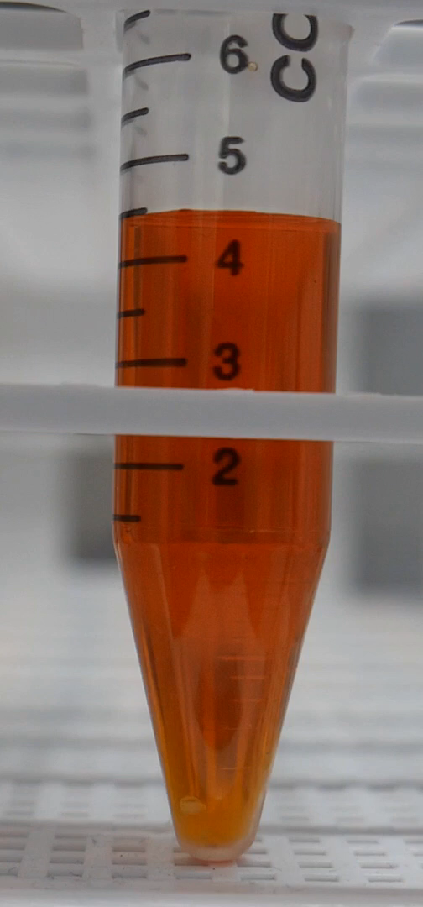
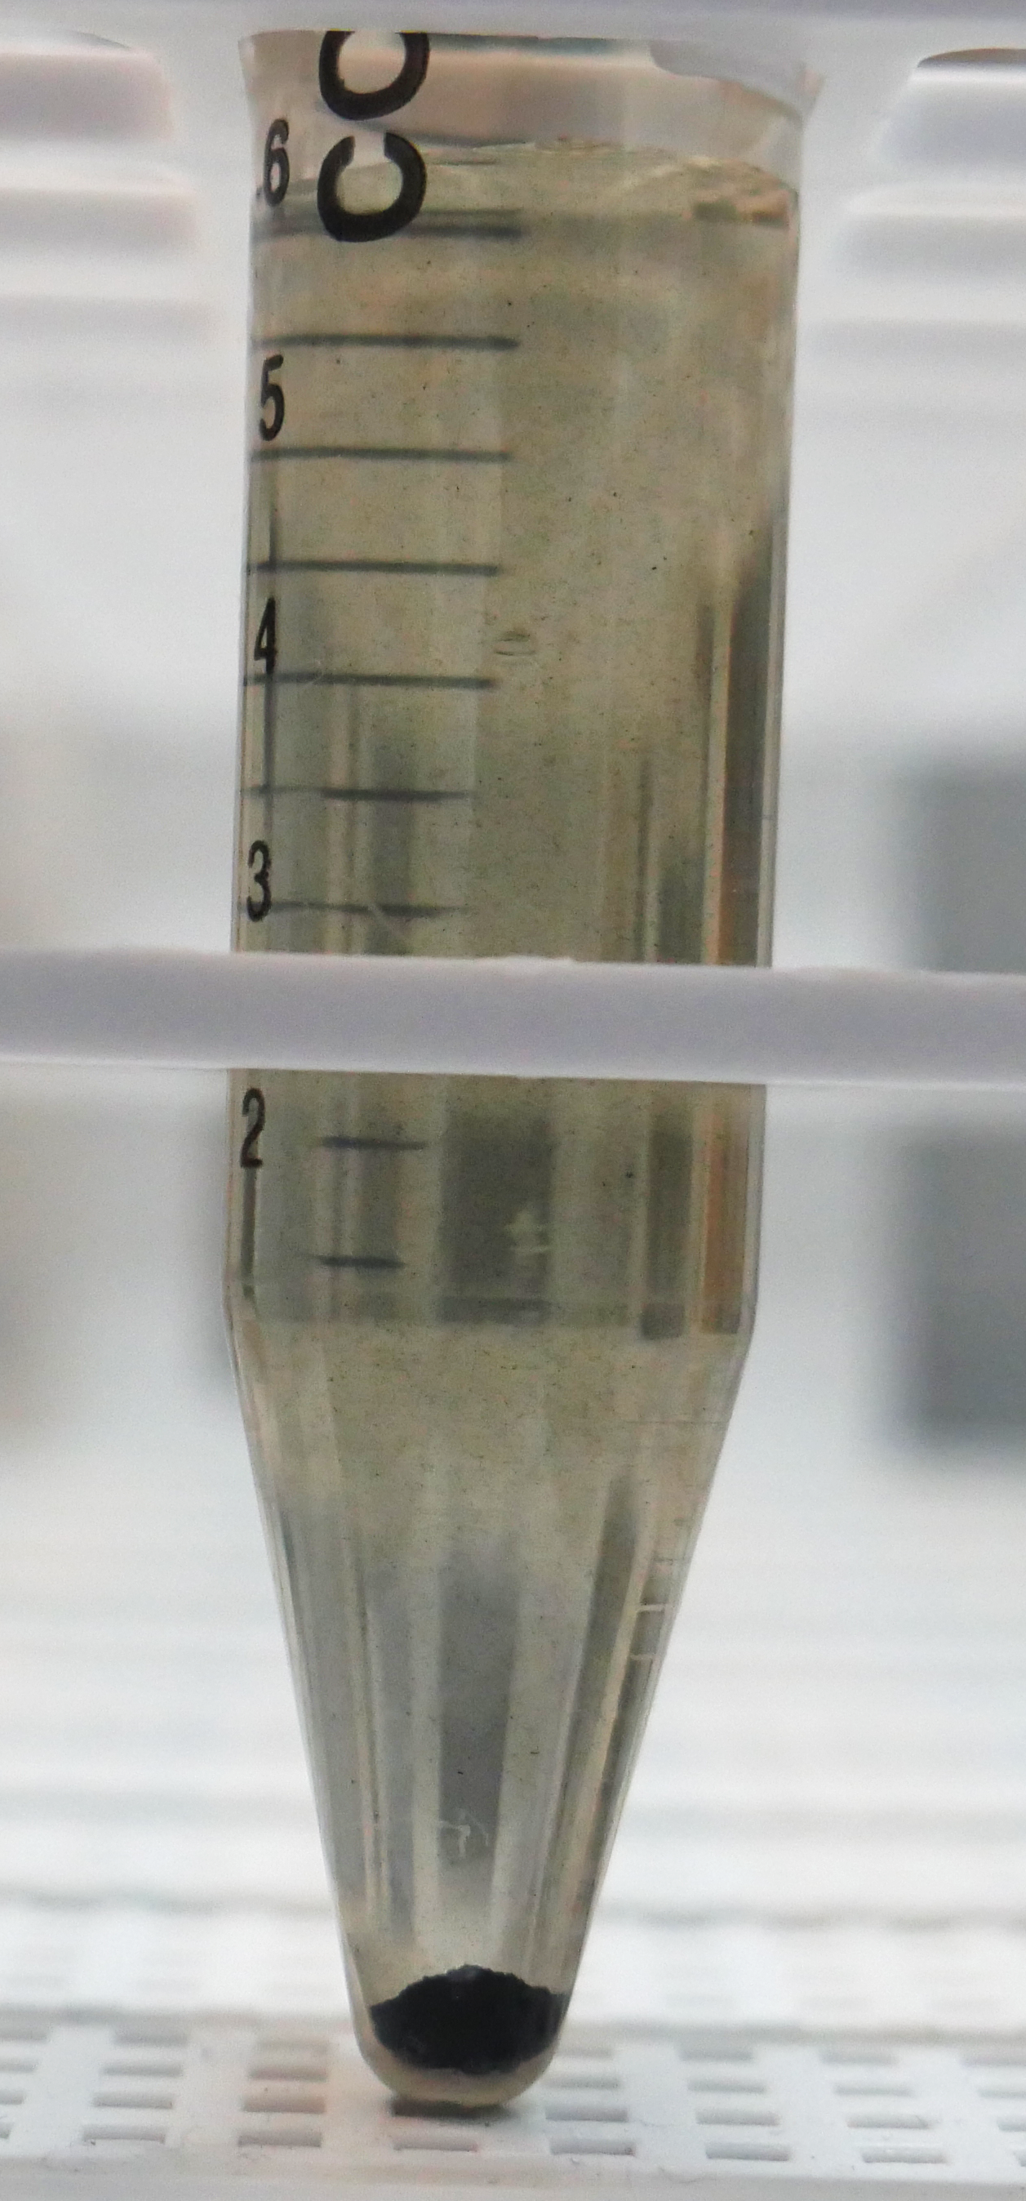
Context: Why are we interested in ruthenium?
Ru - NaOH
Ru – HNO₃
HNO₃
ICP-MS
Ru - NaOH
Black precipitate

Slide 7
Context: Why are we interested in ruthenium?
Identify and quantify the acidifications byproducts
HNO₃
Understand their formation mechanisms
Precipitate
Control their formations during the analysis
Ru - NaOH
Ru – HNO₃
Objectives:
ICP-MS?
0 – 30% of total Ru
Quantification not reproducible
1
2
3
Perform a reliable ICP-MS analysis of ruthenium from an initial alkaline medium

Slide 8
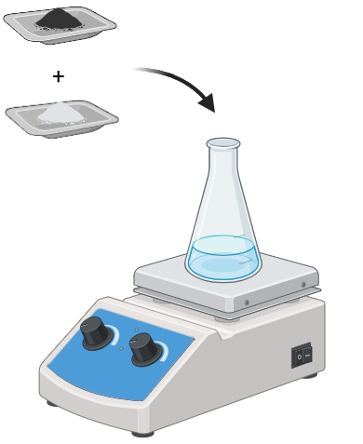
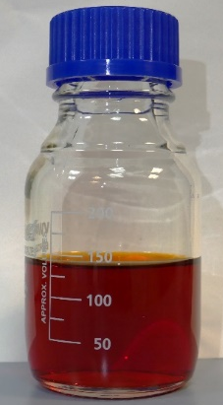
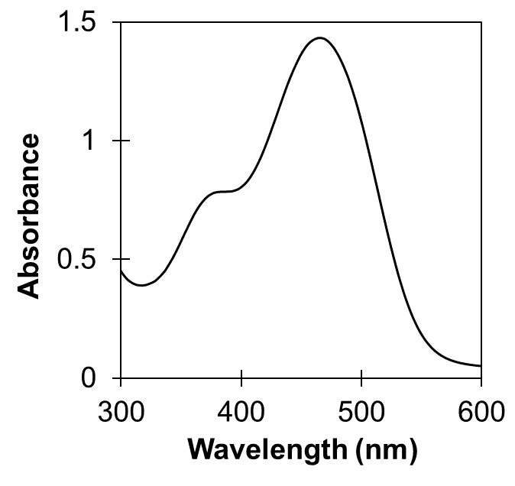
Methods: Synthesis of a Ru solution in NaOH at a known concentration
But how to confirm the concentration?
Ru metal
in NaOH 5.0 mol·L⁻¹
K₂S₂O₈
UV-Visible quantification
.
Boil, 1h
.
RuO₄²⁻
Ru – NaOH Stock solution
[Ru] = 850 mg·L⁻¹
[NaOH] = 5.0 mol·L⁻¹
High concentration

Slide 9



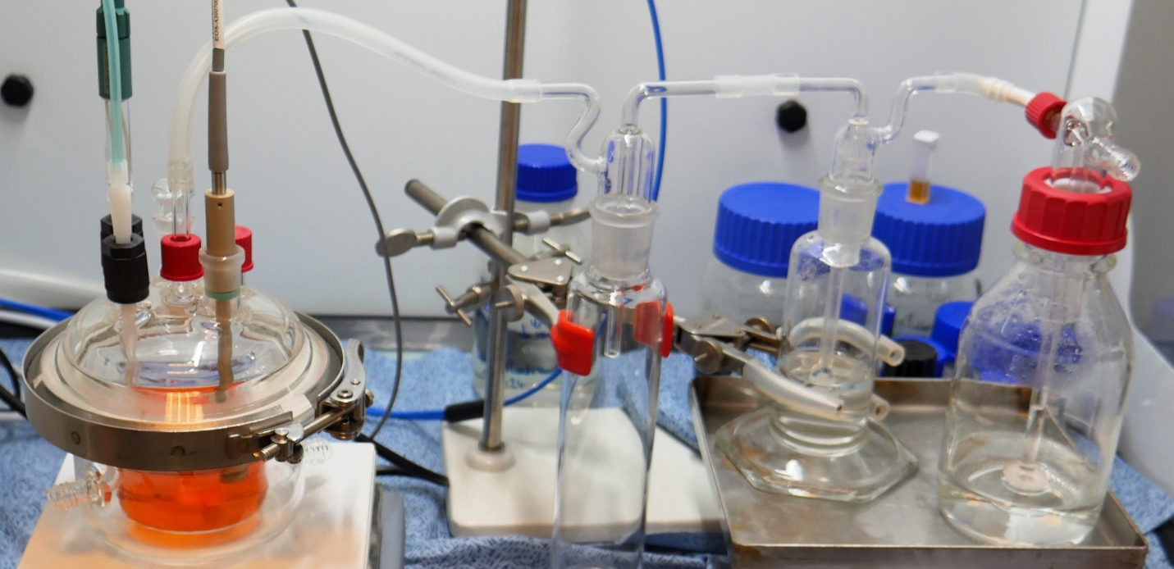


Methods: Experimental set-up for acidification
Fast detector – up to 160 spectra/s
Controlled acid addition
In-situ and real-time monitoring
Massive data acquisition
Deconvolution needed to resolve species
UV-Visible in-situ probe
Gas outlet
Closed reactor

Slide 10


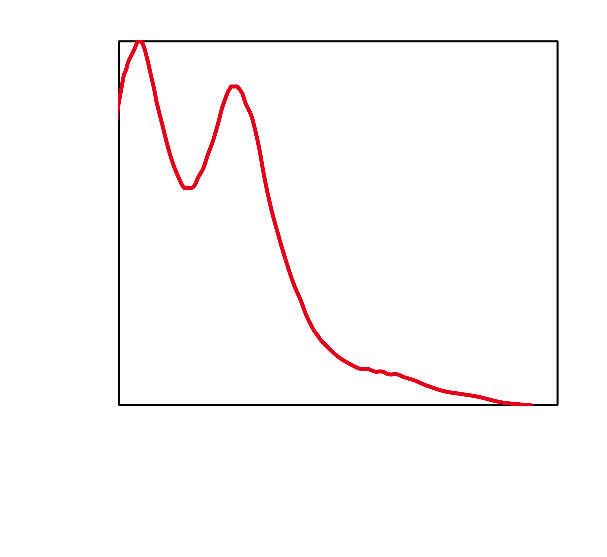
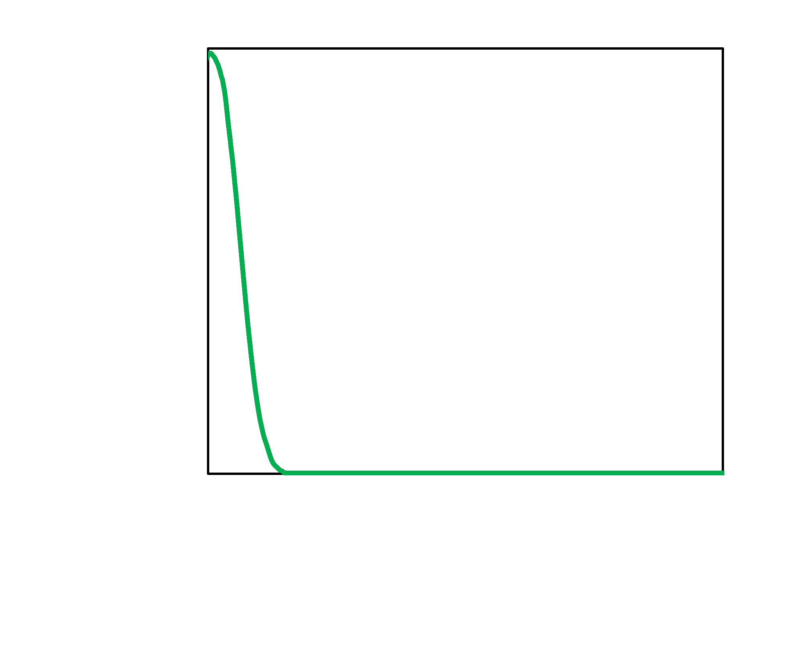
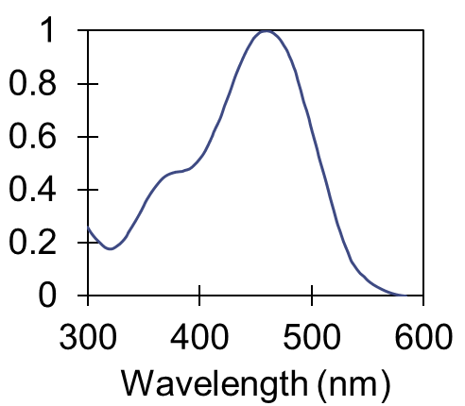
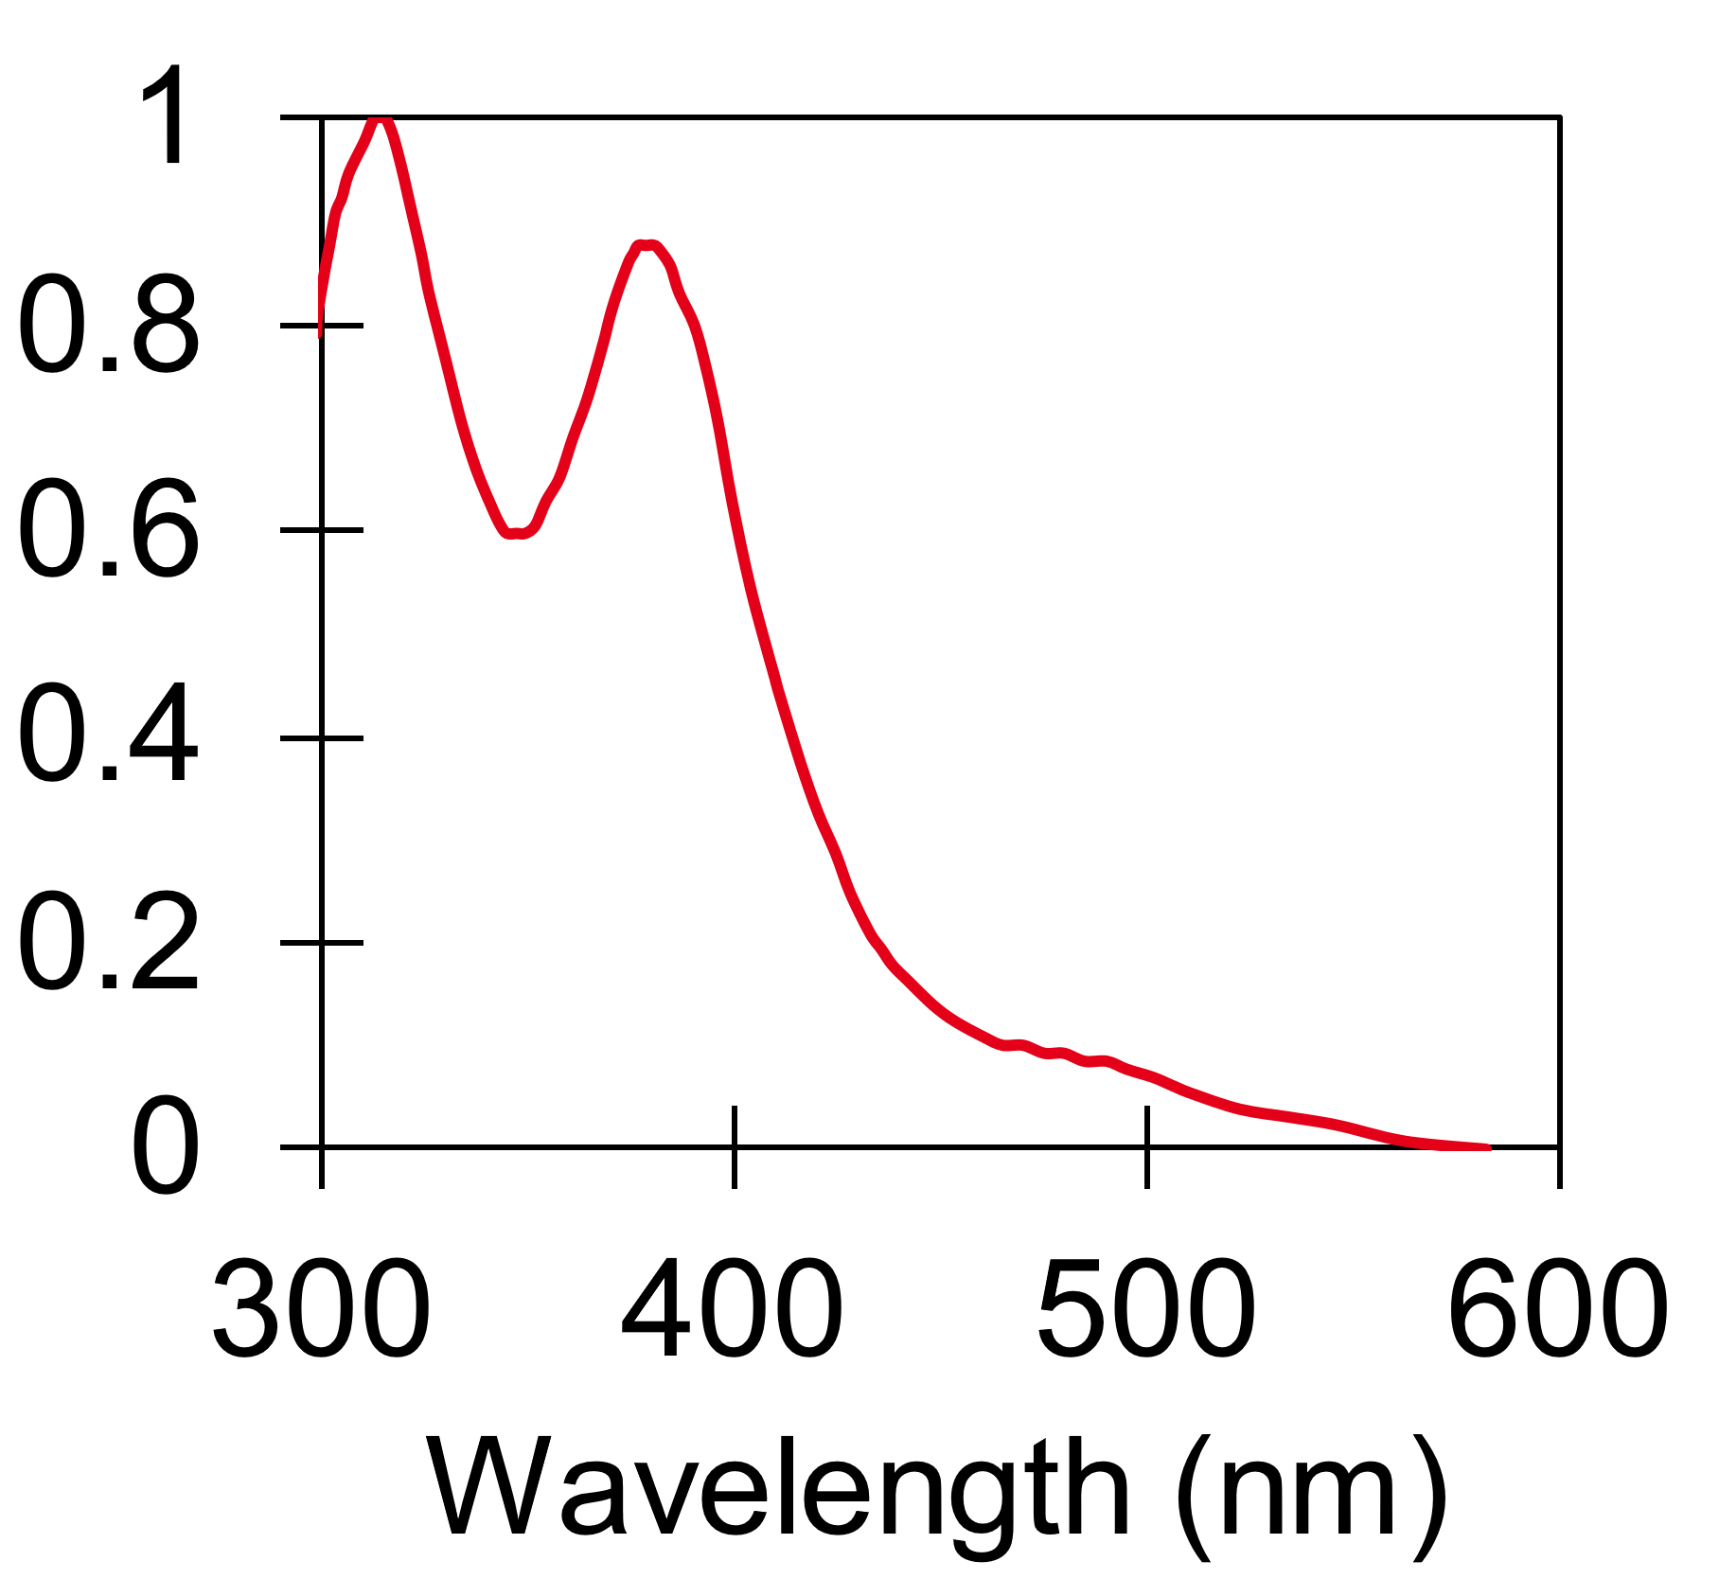
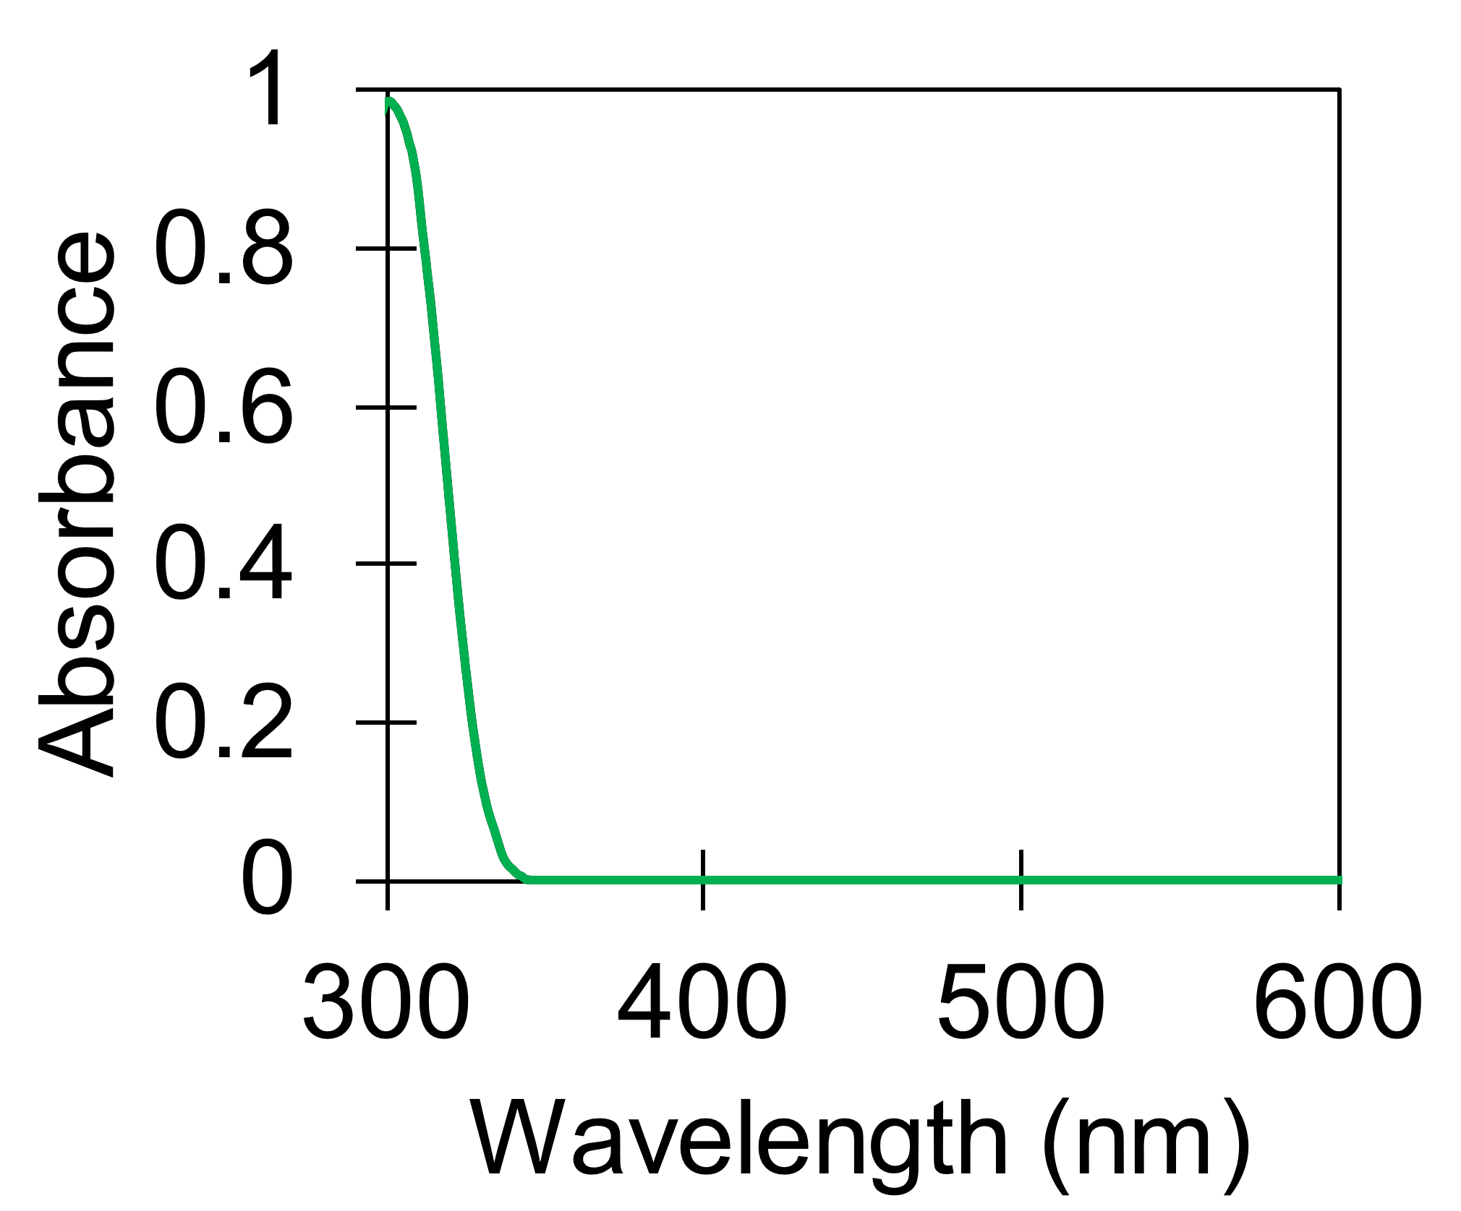
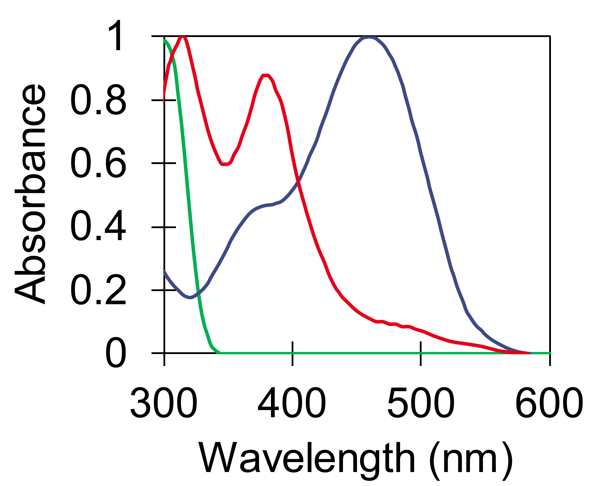
Methods: Data treatment
Python automation for large-scale data handling
MCR-ALS algorithm:
Multivariate Curve Resolution Alternating Least Squares
Chemical constraint
Nitrate: NO₃⁻
Ruthenate: RuO₄²⁻
Perruthenate: RuO₄⁻
Fed with estimated spectra of pure species:

Slide 11
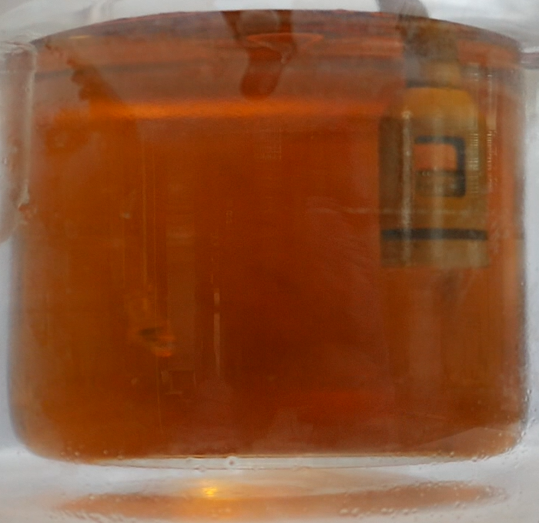
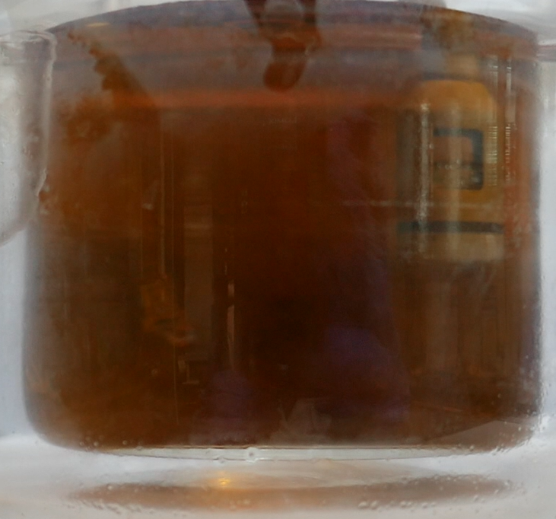
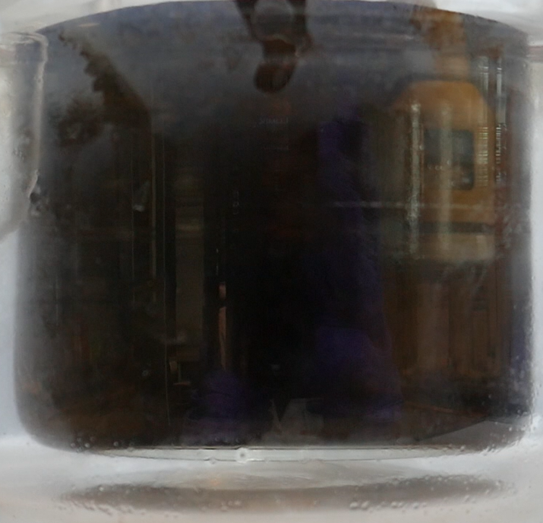
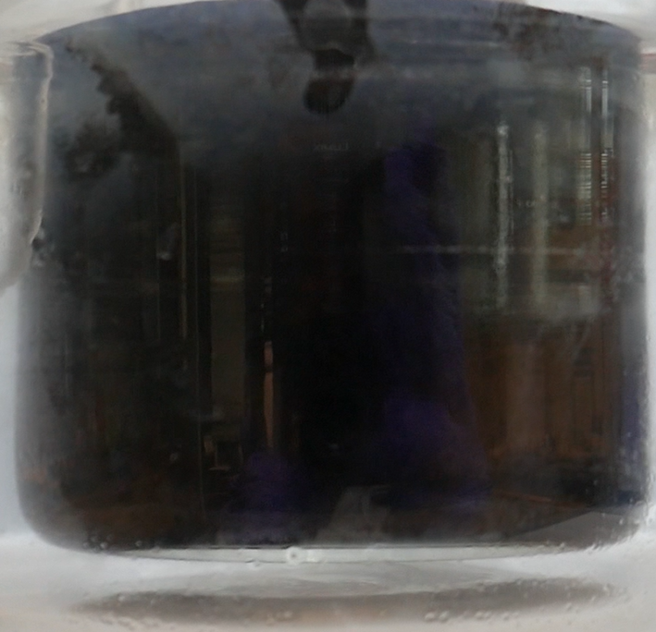
Results: Reactor during acidification
Time
Nitric acid

Slide 12
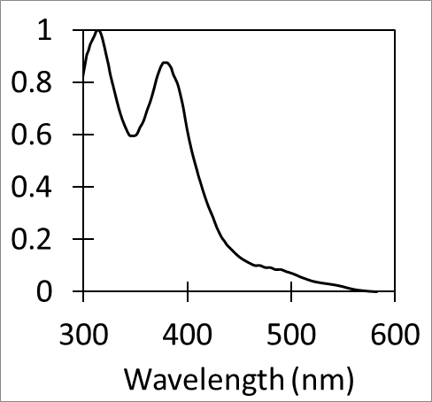
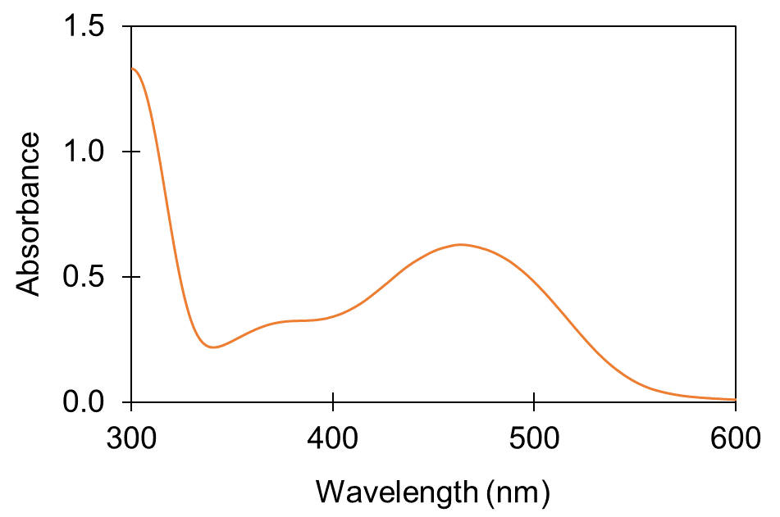
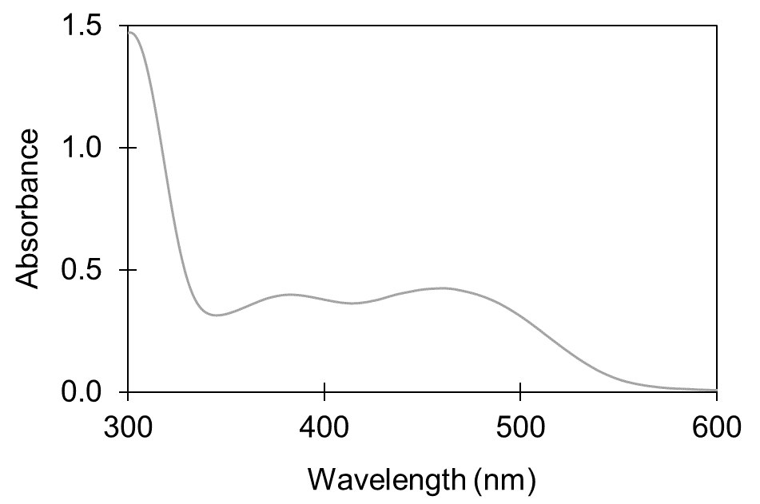
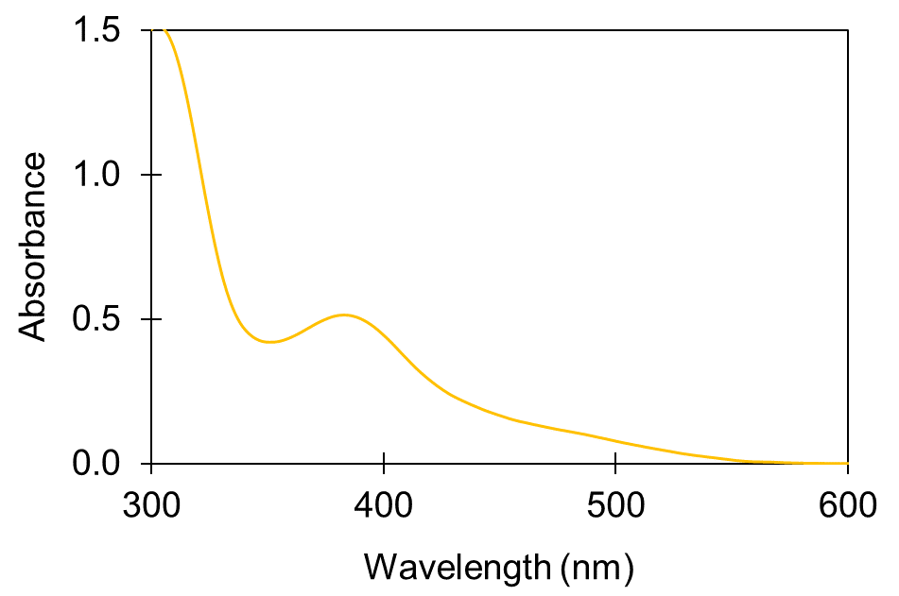
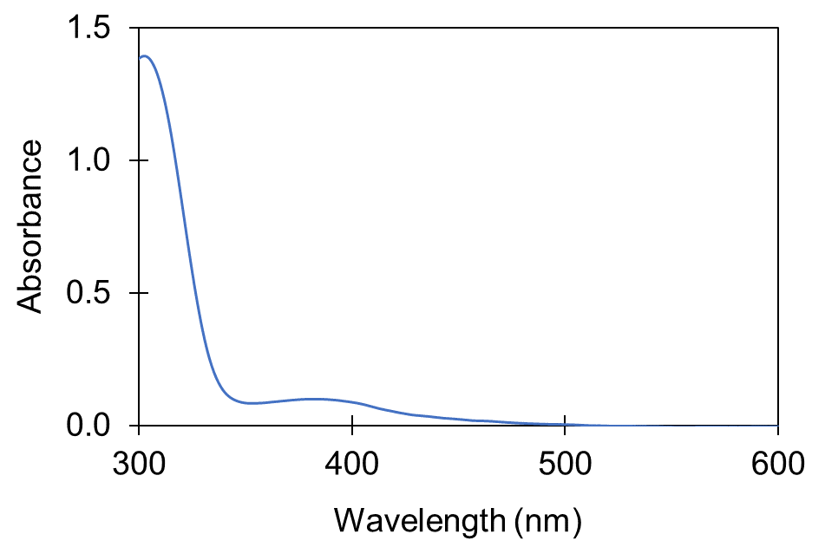
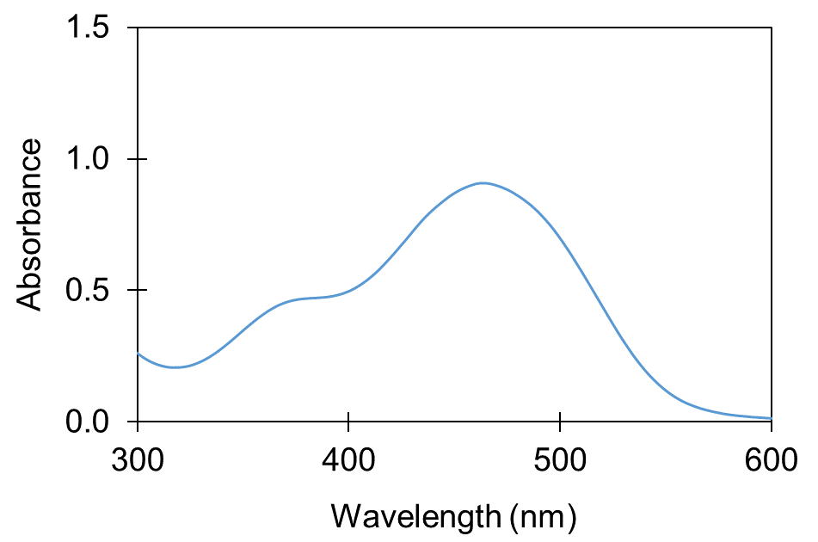
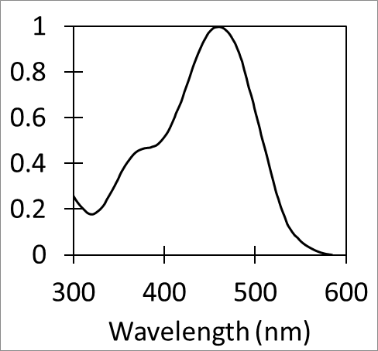
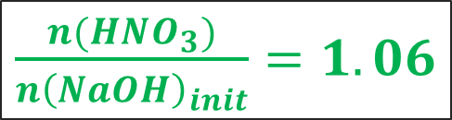
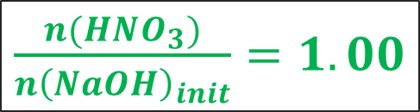
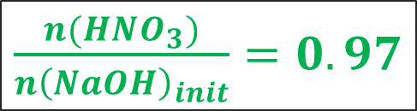
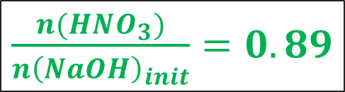
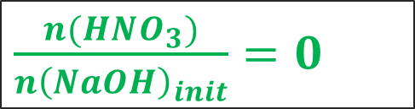
Results: Raw UV-Visible Spectra
Perruthenate
$\frac{n(HNO_{3})}{n{\left(NaOH\right)}_{init}}=0$
$\frac{n(HNO_{3})}{n{\left(NaOH\right)}_{init}}=0.89$
$\frac{n(HNO_{3})}{n{\left(NaOH\right)}_{init}}=0.97$
$\frac{n(HNO_{3})}{n{\left(NaOH\right)}_{init}}=1.00$
$\frac{n(HNO_{3})}{n{\left(NaOH\right)}_{init}}=1.06$
Ruthenate

Slide 13
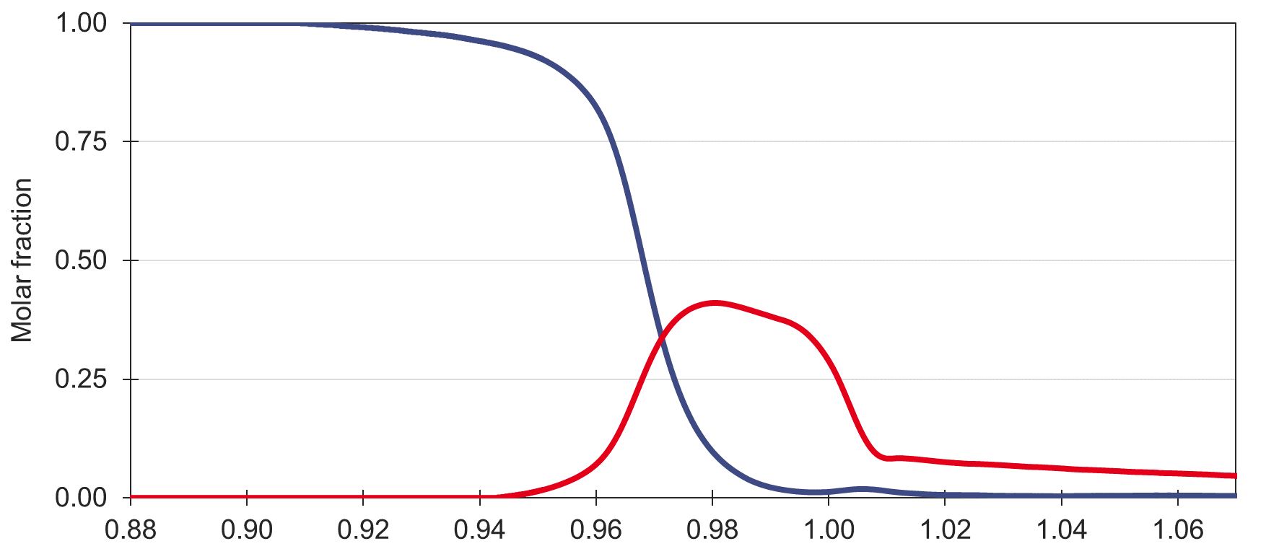
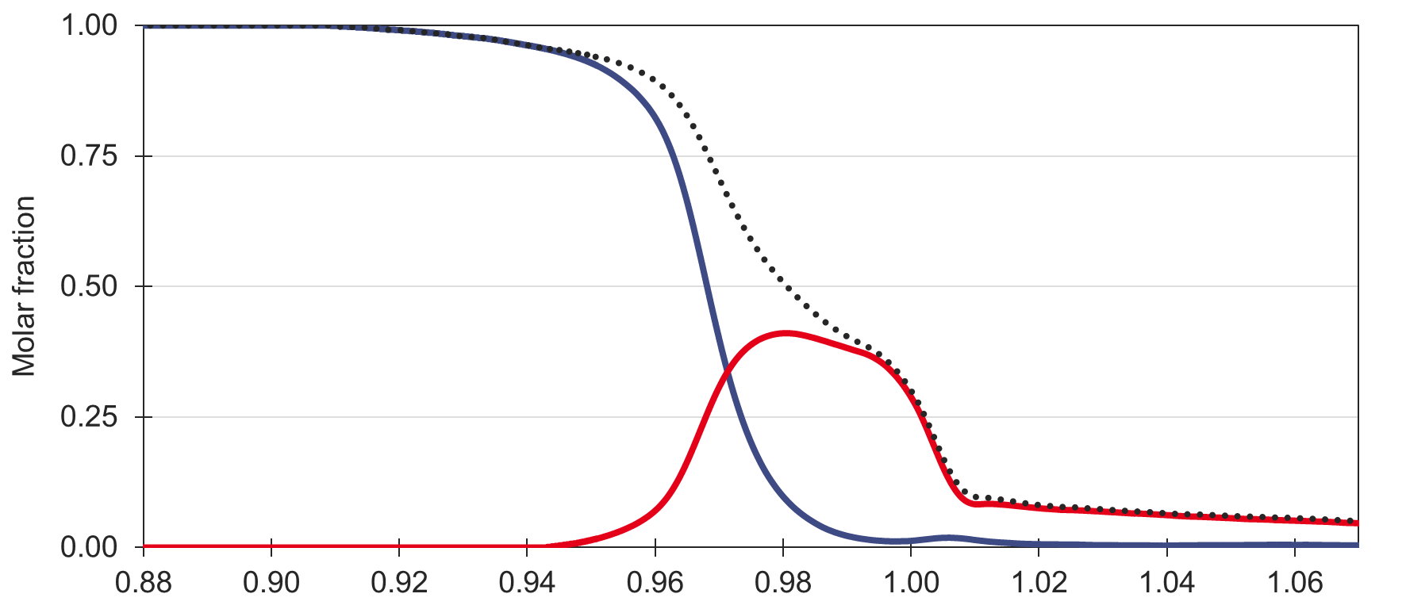

Results: Speciation during acidification
RuO₄²⁻
RuO₄⁻
Sum
Ratio $\frac{n(HNO_{3})}{n{(NaOH)}_{init}}$

Slide 14

Results: Speciation during acidification
a RuO₄²⁻ + b H⁺ → c RuO₄⁻ + d Ru_{(?)}
RuO₄²⁻
2 RuO₄²⁻ + b H⁺ → 1 RuO₄⁻ + 1 Ru_{(?)}
RuO₄⁻
2 Ru(VI) + b H⁺ → 1 Ru(VII) + 1 Ru_{(?)}
Sum
2 Ru(VI) + b H⁺ → 1 Ru(VII) + 1 Ru(V)
2 Ru(VI) + b H⁺ → 1 Ru(VII) + 1 RuO_{2.5}
4 RuO₄²⁻ + b H⁺ → 2 RuO₄⁻+ 1 Ru₂O₅
Ratio $\frac{n(HNO_{3})}{n{(NaOH)}_{init}}$

Slide 15
Results: Speciation during acidification
a RuO₄⁻ + b H⁺ → c Ru_{(?)}
1 RuO₄⁻ + b H⁺ → 1 Ru_{(?)}
Ratio $\frac{n(HNO_{3})}{n{(NaOH)}_{init}}$

Slide 16
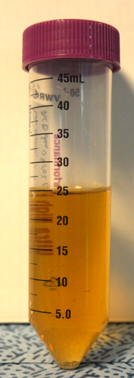
Results: Speciation during acidification
4 RuO₄²⁻ + b H⁺ → 2 RuO₄⁻ + 1 Ru₂O_{5 (s)}
2 RuO₄⁻ + b H⁺ → 2 Ru_{(?)}
4 RuO₄²⁻ + b H⁺ → 1 Ru₂O_{5 (s)} + 2 Ru_{(?)}
Solid quantification:
Ru solid
UV-Visible quantification:
K₂S₂O₈
The precipitate contains 66% of the initial Ru inventory
in 25mL NaOH
Where is the remaining 33%?

Slide 17
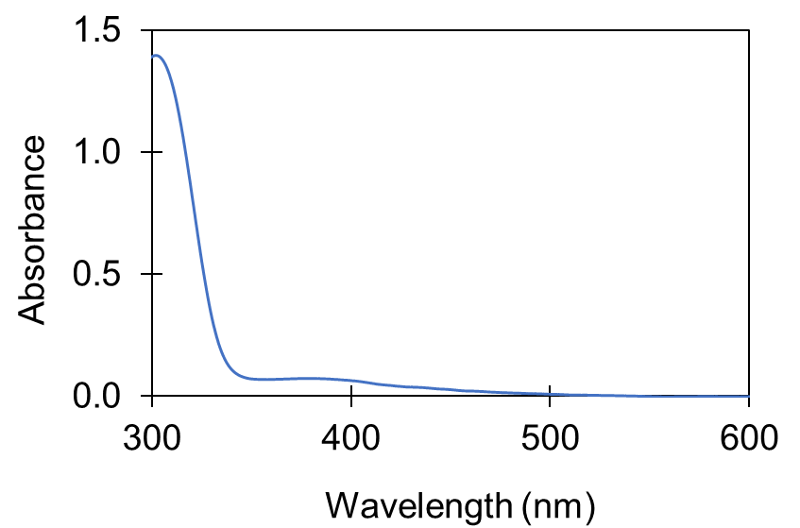
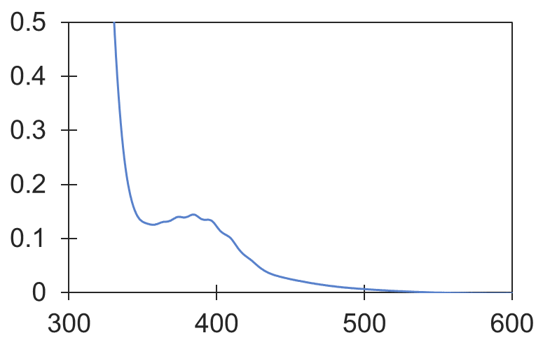
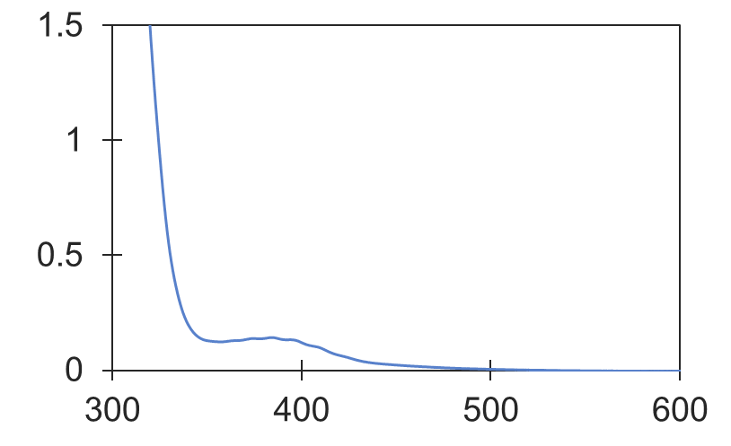
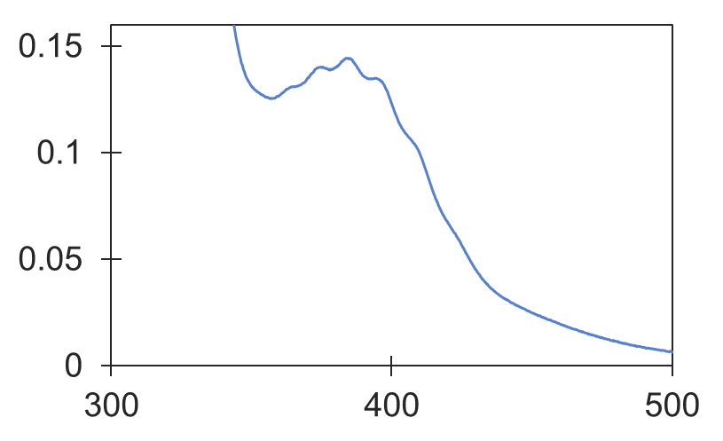
Results:
Where is the remaining 33%?
RuO₄ _{(aq)}
RuO₄ _{(g)}
Contains 33% of the initial Ru inventory
Increasing Ru concentration reveals the low-epsilon ruthenium tetroxyde
Increasing Ru concentration reveals the low-epsilon ruthenium tetroxyde
Increasing Ru concentration

Slide 18
Results: Final reaction equations
3 Ru_{(aq)} + b H⁺ → 2 Solid + 1 Gas_{(dissolved)}
66%
33%
Reaction 1:
4 RuO₄²⁻ + b H⁺ → 2 RuO₄⁻ + 1 Ru₂O_{5 (s)}
2 RuO₄⁻ + b H⁺ → 1 Solid + 1 RuO₄ _{(aq)}
Reaction 2:
2 RuO₄⁻ + b H⁺ → 2 Ru_{(?)}
2 Ru(VII) + b H⁺ → 1 Solid + 1 Ru(VIII) _{(aq)}
2 Ru(VII) + b H⁺ → 1 Ru(V) + 1 Ru(VIII) _{(aq)}
2 RuO₄⁻ + b H⁺ → 1 RuO_{2.5} + 1 RuO₄ _{(aq)}
4 RuO₄⁻ + b H⁺ → 1 Ru₂O_{5 (s)} + 2 RuO₄ _{(aq)}

Slide 19
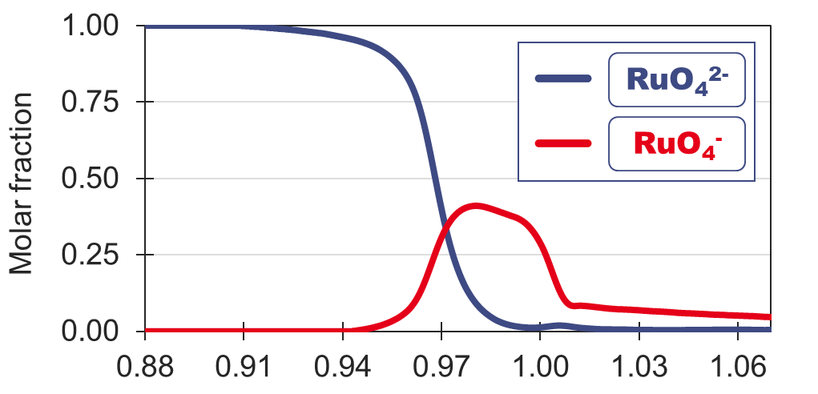

Results: Final reaction equations
Reaction 1:
4 RuO₄²⁻ + b H⁺ → 2 RuO₄⁻ + 1 Ru₂O₅
Reaction 2:
4 RuO₄⁻ + b H⁺ → 1 Ru₂O₅ + 2 RuO₄ _{(aq)}
4 RuO₄²⁻ + 6 H⁺ → 2 RuO₄⁻ + 1 Ru₂O₅ + 3 H₂O
6 RuO₄⁻ + 6 H⁺ → 1 Ru₂O₅ + 4 RuO₄ _{(aq)} + 3 H₂O
Ratio $\frac{n(HNO_{3})}{n{(NaOH)}_{init}}$

Slide 20
Results: Final reaction equations
3
Reaction 1:
4 RuO₄²⁻ + 6 H⁺ → 2 RuO₄⁻ + 1 Ru₂O₅ + 3 H₂O
Reaction 2:
6 RuO₄⁻ + 6 H⁺ → 1 Ru₂O₅ + 4 RuO₄ _{(aq)} + 3 H₂O
12 RuO₄²⁻ + 24 H⁺ → 4 Ru₂O₅ + 4 RuO₄ _{(aq)} + 12 H₂O
3 RuO₄²⁻ + 6 H⁺ → 1 Ru₂O₅ + 1 RuO₄ _{(aq)} + 3 H₂O
3 Ru_{(aq)} + 6 H⁺ → 2 Solid + 1 Gas _{(dissolved)}
66%
33%

Slide 21
Results: Back to the Ruthenium Analysis
HNO₃
Ru₂O_{5 (s)}
Ru - NaOH
RuO₄ _{(aq)}
ICP-MS?
0 – 30% of total Ru
Quantification not reproducible

Slide 22
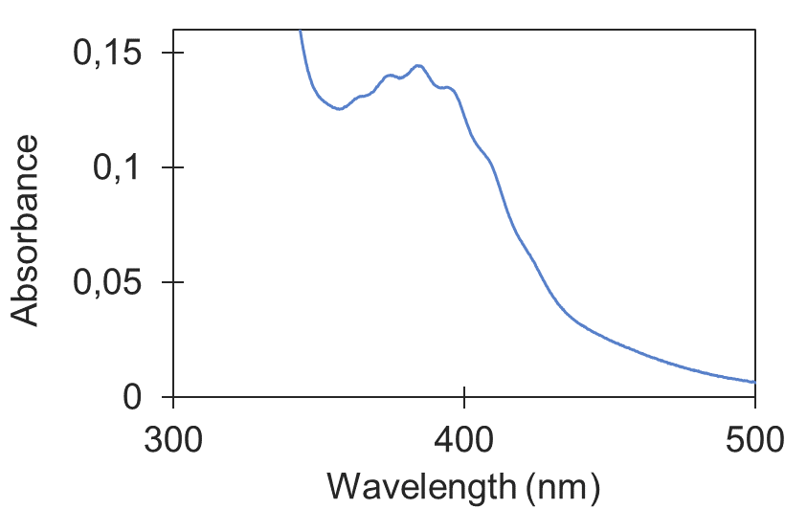
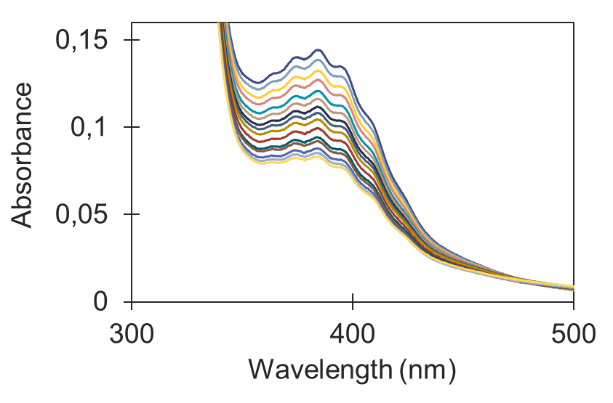
Results: Back to the Ruthenium Analysis
0 – 30% of total Ru
Quantification not reproducible
3 Ru_{(aq)} + 6 H⁺ → 2 Solid + 1 Gas _{(dissolved)}
66%
33%
.
.
RuO₄ _{(aq)}
Time
.
.
.
.
Variable amount of Ru over time

Slide 23
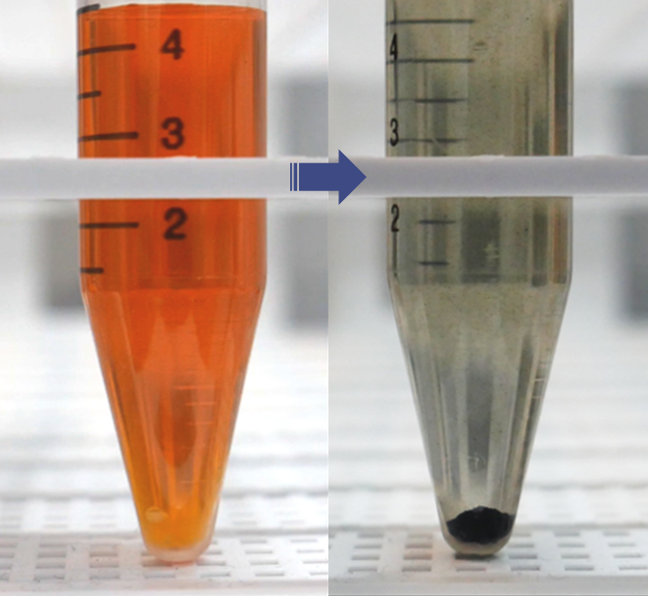


Conclusion and Outlooks
Identify and quantify the acidifications byproducts
Understand their formation mechanisms
1
Acidification of alkaline Ru sample leads to ⅔ of solid Ru₂O₅
⅓ RuO_{4(aq)}
Another ⅓ react into the highly volatile RuO₄ (partially dissolved)
Control their formations during the analysis
⅔ Ru₂O₅
2
Two-steps reaction involving a RuO₄⁻ intermediate
The two reactions are total and fast
Kinetic constants determination in progress
3
Ru - NaOH
HCl
?
Acidification with hydrochloric acid to form more stable species

Slide 24
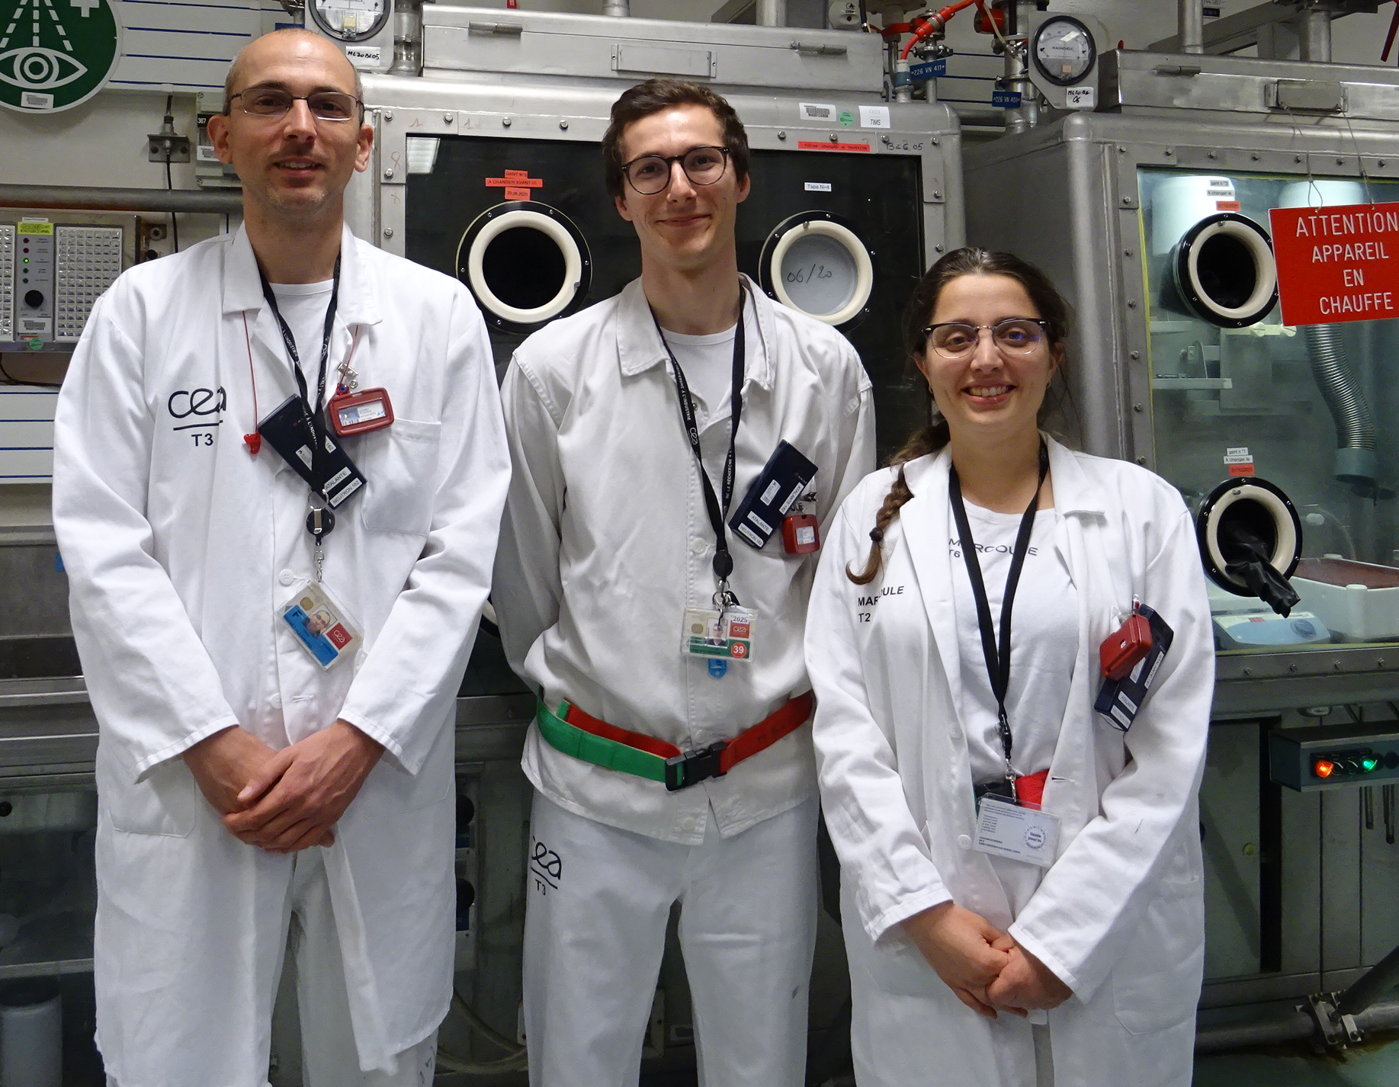
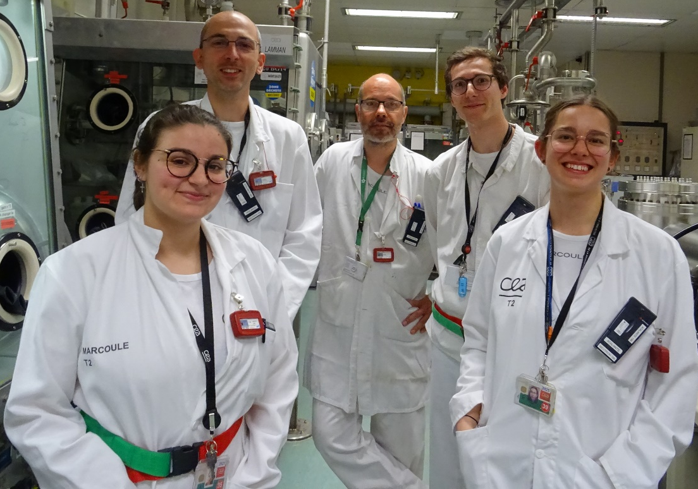
Thank you
Mathis LEBLANC
Marcoule Center – France
mathis.leblanc@cea.fr
PhD supervisors:
Sarah BAGHDADI – sarah.baghdadi@cea.fr
Alexandre QUEMET – alexandre.quemet@cea.fr
Jean AUPIAIS – jean.aupiais@cea.fr

