Slide 1
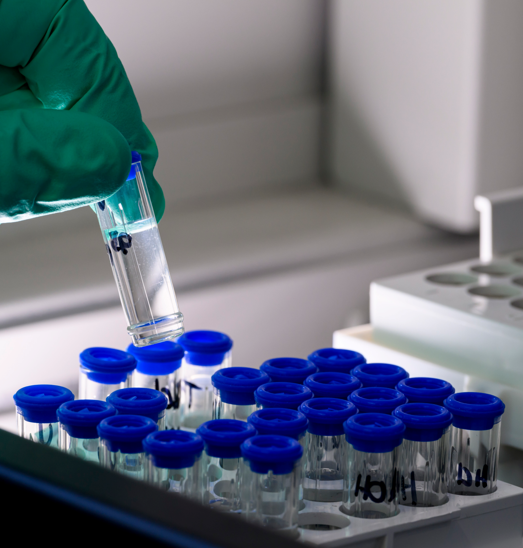


Impact of alkalis on the plutonium (V) hydrolysis
LASNIER Guillaume¹
AUPIAIS Jean¹
SIBERCHICOT Bruno^{1,2}
¹CEA, DAM, DIF, F-91297, Arpajon, France
²Université Paris-Saclay, CEA, Laboratoire Matière en Conditions Extrêmes,
F-91680 Bruyères-Le-Châtel, France
An experimental and theoretical study

Slide 2
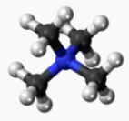
Context
Tetramethylammonium cation
Aquatic plutonium chemistry is poorly understood
Predominant form in aerated aquatic systems : PuO₂⁺ ( Pu V)
Disproportionation at high concentration → hard to study
Utilisation of the data of stable (at high concentration) analogous : Np V
Hydrolysis complicated to study due to
  Solubility limit
  Competion with carbonato species
Neptunium data in the literature are not in agreement between NaClO₄ medium and TMACl medium
  NaClO₄ : V. Neck et al., Radiochim. Acta, 56, 25−30, 1994
  TMACl : L. Rao et al., Cosmochim. Acta, 68, 4821-4830, 2004
Medium | NaClO₄ | TMACl
Log*β₁⁰ | -11.3 (0.7) | -8.98 (0.09)
Log*β₂⁰ | -23.6 (0.5) | -19.22 (0.11)
  What is the impact of different alkalis on the hydrolysis of plutonium V ?

Slide 3
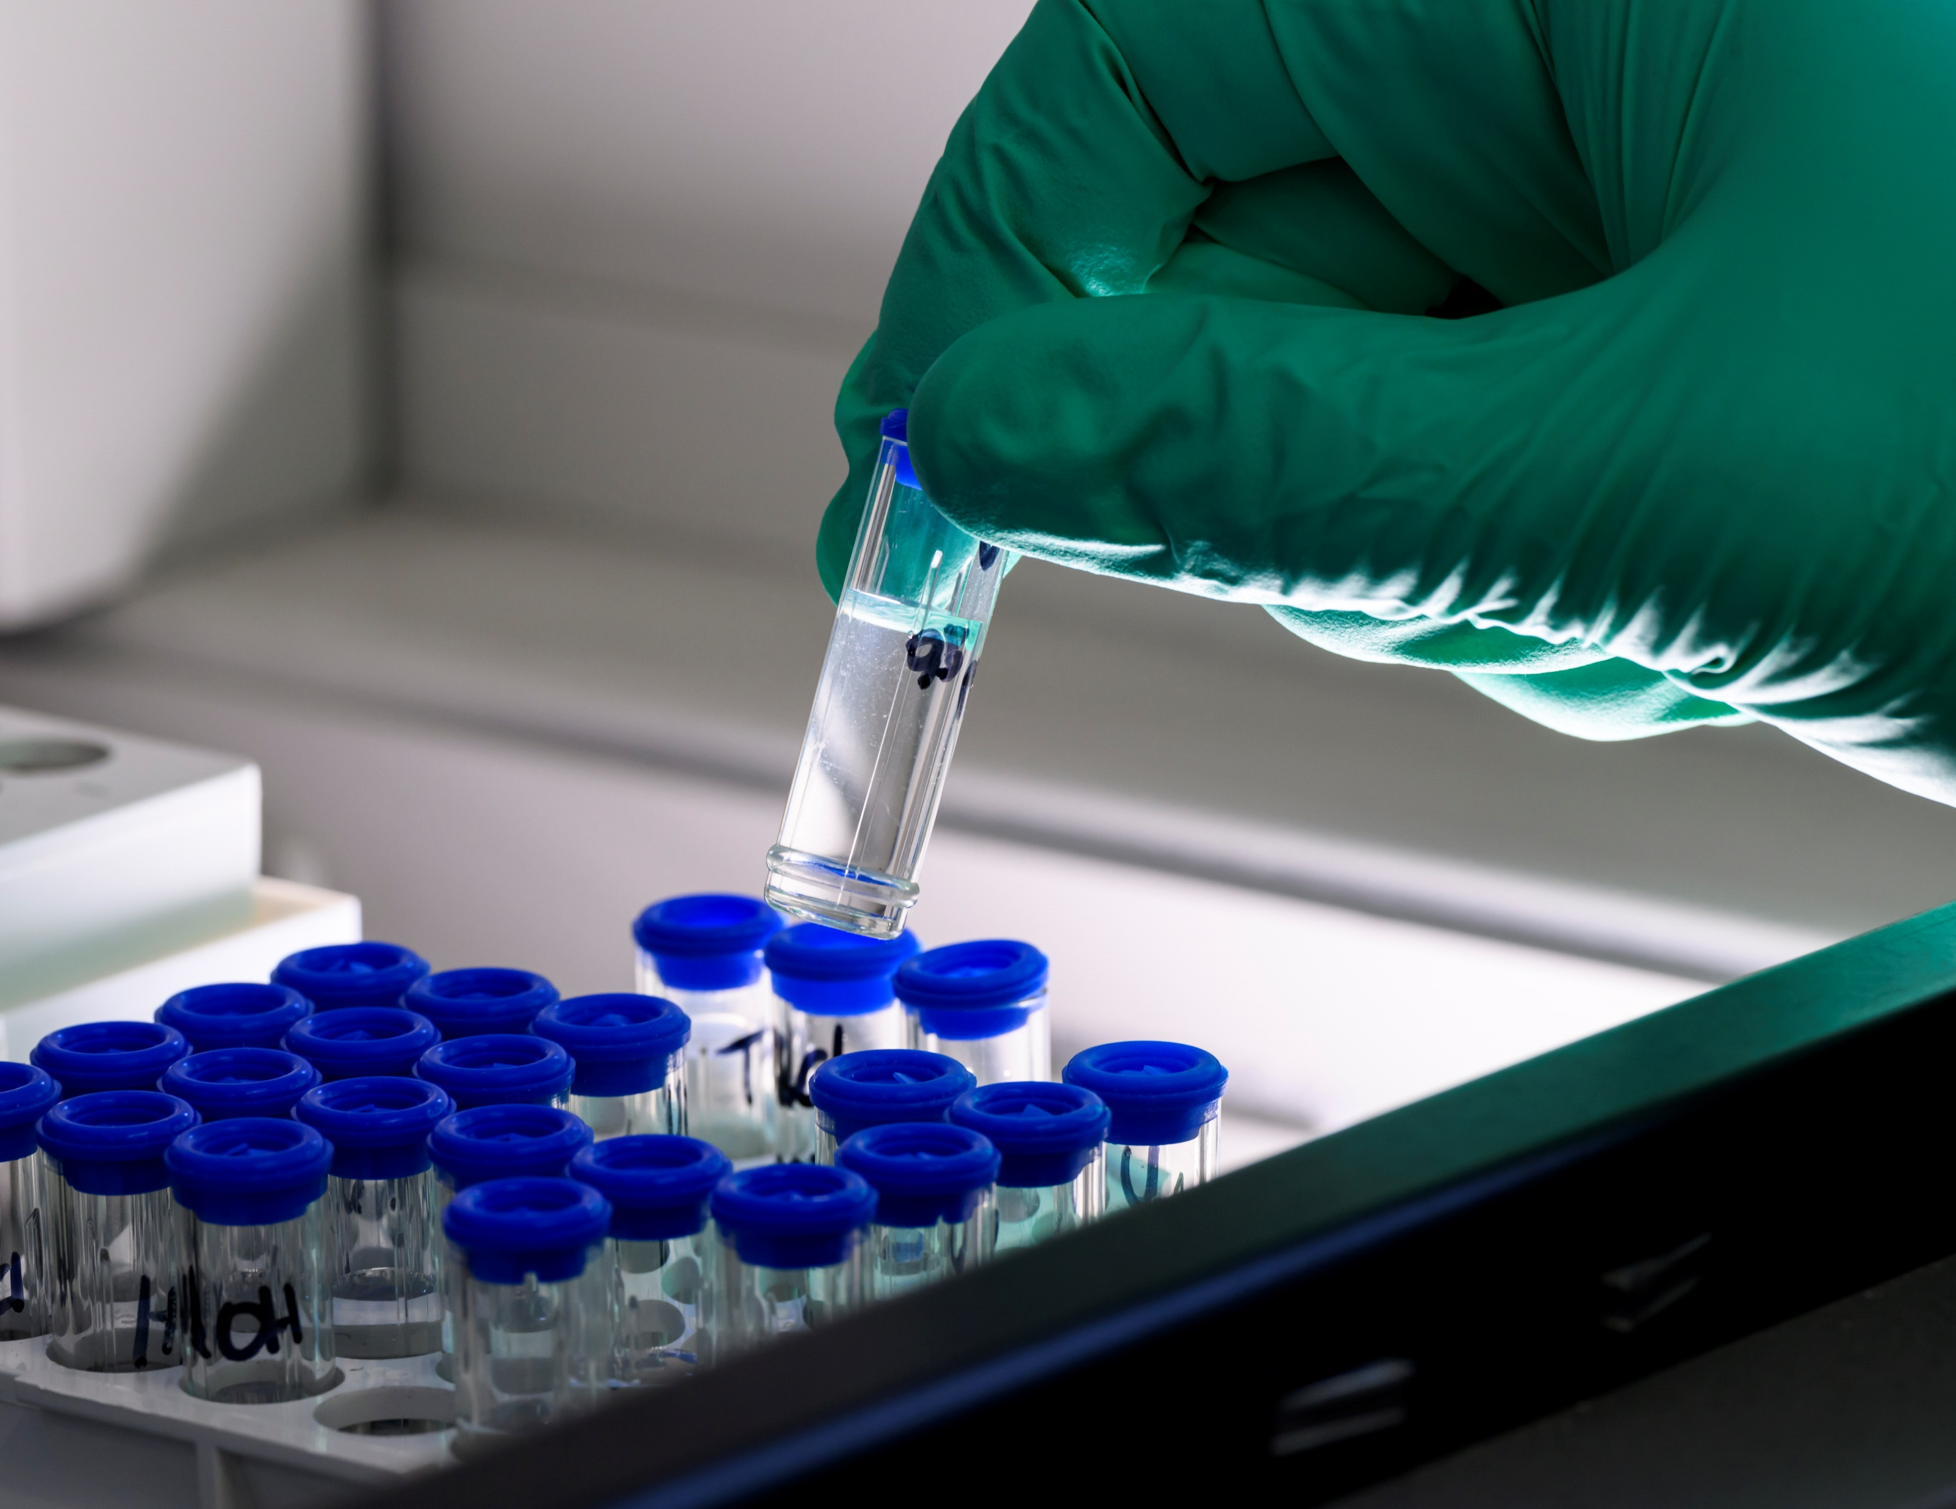
Part 1:
Experimental study

Slide 4
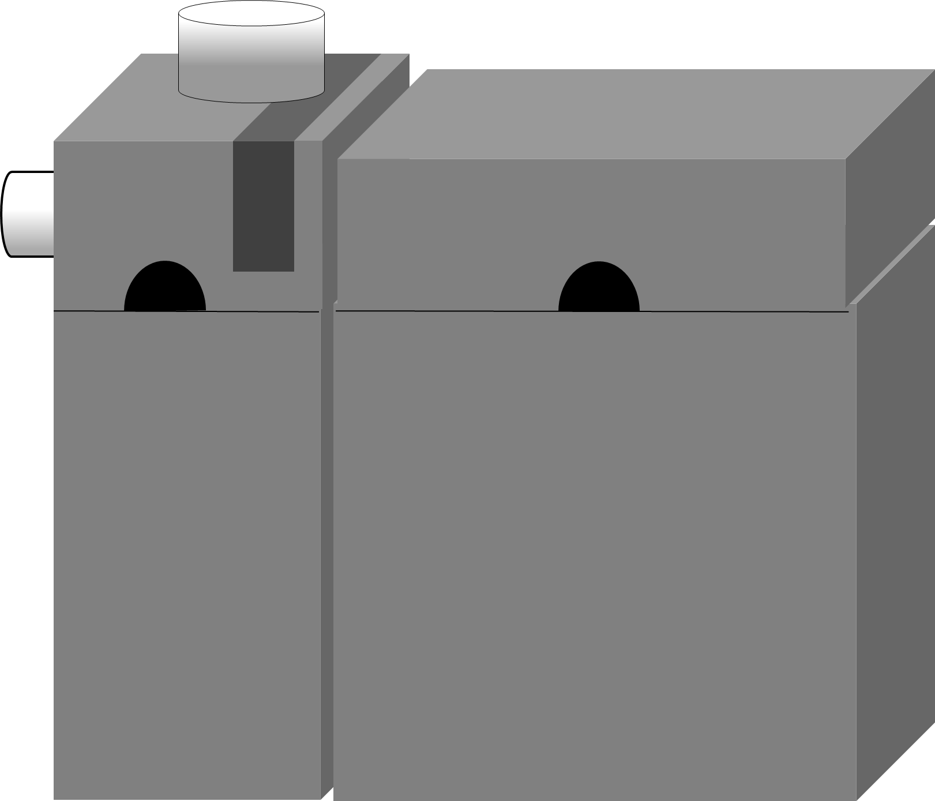
Principle of capillary electrophoresis
Capillary electrophoresis
ICP-MS
Visualisation of changes in charge and volume of hydration of a species according to the composition of the medium
Based on two phenomena :
  Electroosmotic flow : Non negligeable force moving all the species homogeneous
  Electrophoretic migration : Force depending of the charge and hydrated volume of the species
With rapid kinetics, the mobility measured is a lineary combinaison of the mobility of the species present
n
-
+
Medium

Slide 5
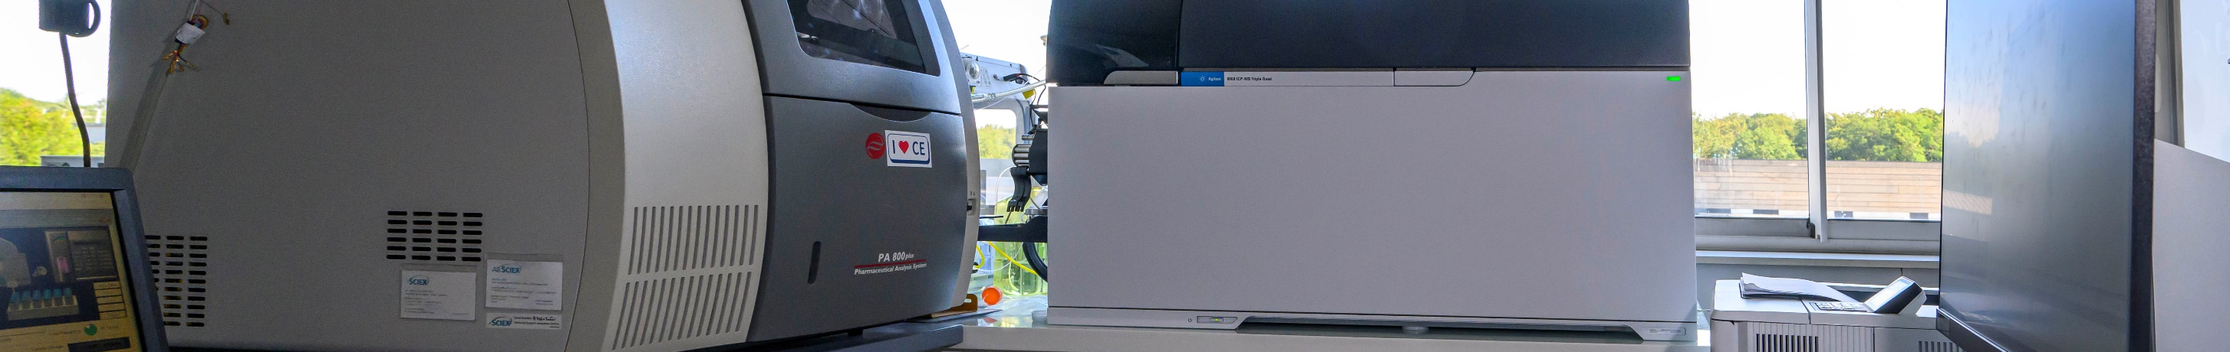
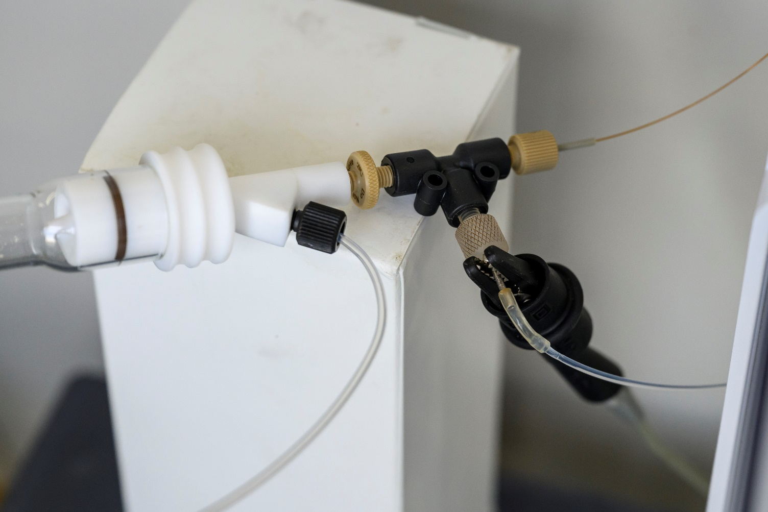
Analytical set-up
Capillary electrophoresis (Sciex PA 800+)
  75 µm silica capillaries
  Applied voltage : 3000 V
Use of a specific nebuliser (Mira mistTM)
  Suppression of the suction effect of a classic nebuliser
  Adapting the flow rates for the requirement of ICP-MS
Use of a desolvator (APEX)
  Increase of the sensibility by a factor 10
Using an ICP-MS as a detector (Agilent 8900 QQQ)
Capillary
Nebuliser
Compensation liquid
Nebulizer chamber
or desolvator
Electrode

Slide 6
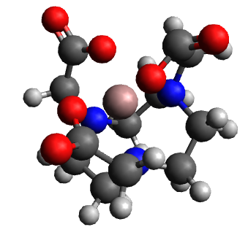


Electrophoretic mobility
Utilisation of a neutral marker [Ga(Nota)] and transformation of times into electrophoretic mobility
$$μ=\frac{L^{2}}{U}\left(\frac{1}{t_{An}}−\frac{1}{t_{[GaNOTA]}}\right)$$
$μ$ : Electrophoretic mobility (m²·V⁻¹·s⁻¹)
L : Capillary length (m)
U : Voltage applied (V)
$t_{An}$: Migration time of the actinide (s)
$t_{[GaNOTA]}$: Migration time of [GaNOTA] (s)
  Reduce experimental fluctuations
The evolution of mobility as a function of ligand concentration can be used to determine the formation constants
  $μ=\frac{μ_{{{AnO}_{2}}^{+}}+\sum_{1≤n≤2}{\left(μ_{{{{[AnO}_{2}\left(OH\right)}_{n}]}^{1−n}}×β_{{{{[AnO}_{2}\left(OH\right)}_{n}]}^{1−n}}×{\left[{OH}^{−}\right]}^{n}\right)}}{1+\sum_{1≤n≤2}{\left(β_{{{{[AnO}_{2}\left(OH\right)}_{n}]}^{1−n}}×{\left[{OH}^{−}\right]}^{n}\right)}}$
  Determination by mathematical adjustment with Origin 8TM
Gallium
[Ga(Nota)]

Slide 7
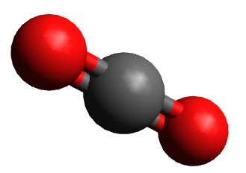
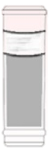

Study characteristics
Experimental parameters
  Concentration of Pu: 1 x 10⁻⁸ mol L⁻¹
  Utilisation of non-complexing buffer
  Ionic strength adjusted at 0.1 mol L⁻¹
  Temperature: 25°C
  Analysis at different pH
  Degassing of demineralised water with argon
  Use of fresh alkali hydroxide (carbonate free)
  Protection by a fine layer of paraffin oil to limit carbonatation during analysis
Correction of formation constants at zero ionic strength with the Davis equation
  $−\log\left(γ\right)=0,5009 ×z^{2}×\left(\frac{\sqrt{I}}{1+\sqrt{I}}−0,30×I\right)$
  $β_{0}=β_{IS=0.1}×\frac{γ_{{[AcO_{2}{\left(OH\right)}_{n}]}^{1−n}}}{γ_{{{[AcO}_{2}}^{+}]}×{γ_{[{OH}^{−}]}}^{n}}$
Paraffine oil
Sample (CO₂ free)

Slide 8
Results: Electrophoretic mobility versus pH
Three types of behavior depending on the medium
  LiCl
    Fall of mobility at pH = 8
    Plateau at a negative mobility at pH = 10.5
  NaCl
    Fall of mobility at pH = 10.5
    Plateau at a negative mobility at pH > 12.5
  KCl, RbCl, CsCl
    Fall of mobility at pH = 8
    Plateau at a negative mobility at pH = 12
LiCl
NaCl
KCl
RbCl
CsCl

Slide 9


Results: Formation constants
$${[PuO_{2}(OH)]}^{ }$$
LiCl
KCl
RbCl
TMACl
First hydrolysis constant
  Similar constants for LiCl, KCl, RbCl, CsCl media
    And similar to the TMACl medium
  Constant lower in NaCl medium
    And similar to the NaClO₄ medium
Second hydrolysis constant
  Higher constant in LiCl medium
  Lower constant in NaCl medium
    Lower than in the NaClO₄ medium → Cl effect
  Similar constants for KCl, RbCl, CsCl media
    And similar to the TMACl media
CsCl
NaCl
LiCl
$${[PuO_{2}{(OH)}_{2}]}^{−}$$
TMACl
KCl
CsCl
RbCl
NaCl

Slide 10

Part 2:
Simulation study

Slide 11

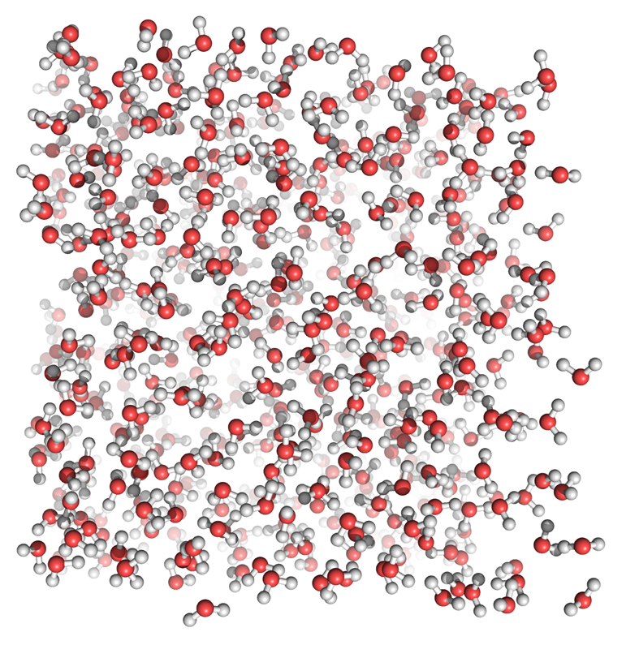
Simulations characteristics
Simulation ab initio with the software Abinit
  Using the dahlke functional
  Pseudopotentials generated by the Atompaw code
  Formalism GGA+U for 5f electrons with U = 5.85 eV and J = 0.61 eV*
  Temperature: 25°C (langevin thermostat)
  Pressure: 1 bar
  Time step : 0,48 fs
  Simulated times: few picoseconds
  Simulated element : Neptunium (analogous of Pu)
Simulated species:
  1 Hydroxoneptunyl or dihydroxoneptunyl
  1 alkali
  1 chloride
  128 water molecules
*N. A. Holzwarth, M. Torrent, F. Jollet. http://pwpaw.wfu.edu

Slide 12
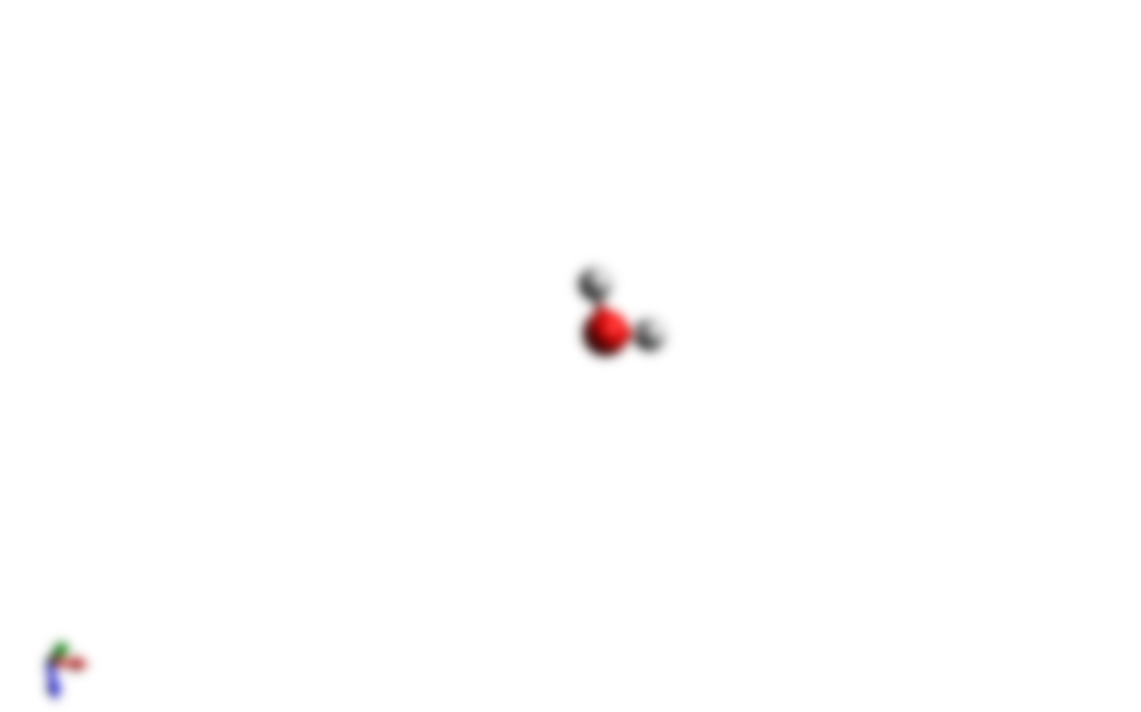
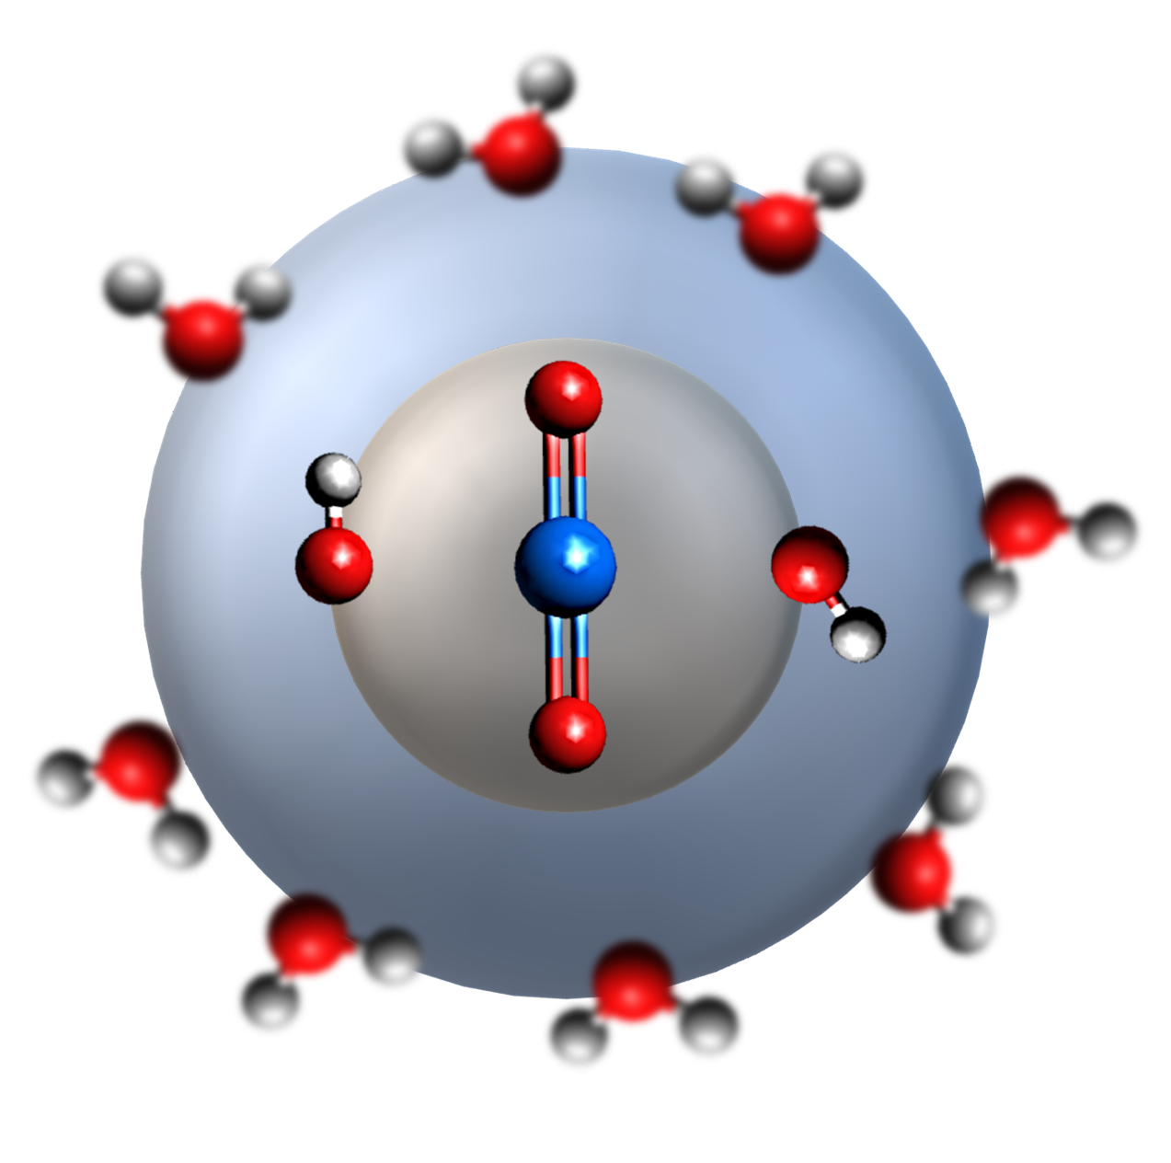
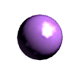
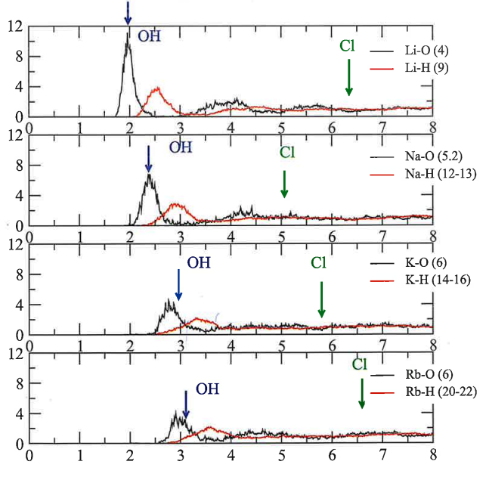
Spatial geometry of complexes
O=Np=O
Na⁺
OH⁻
K⁺
Rb⁺
No change in the geometry of the hydroxo complexes
Stabilisation of alkalis near the complex (except cesium)
The alkaline environment is different
  Li et Na : 1 OH⁻ in their first sphere
  K, Rb, Cs : Only water molecule in their first sphere
Li⁺
Cs⁺
Np
Cs
K,Rb
Distance Np – O (Å)
Na
Alk
Li
Lithium
Sodium
Potassium
Rubidium
Distance Alkali – O (Å)
Distance Alkali – H (Å)

Slide 13
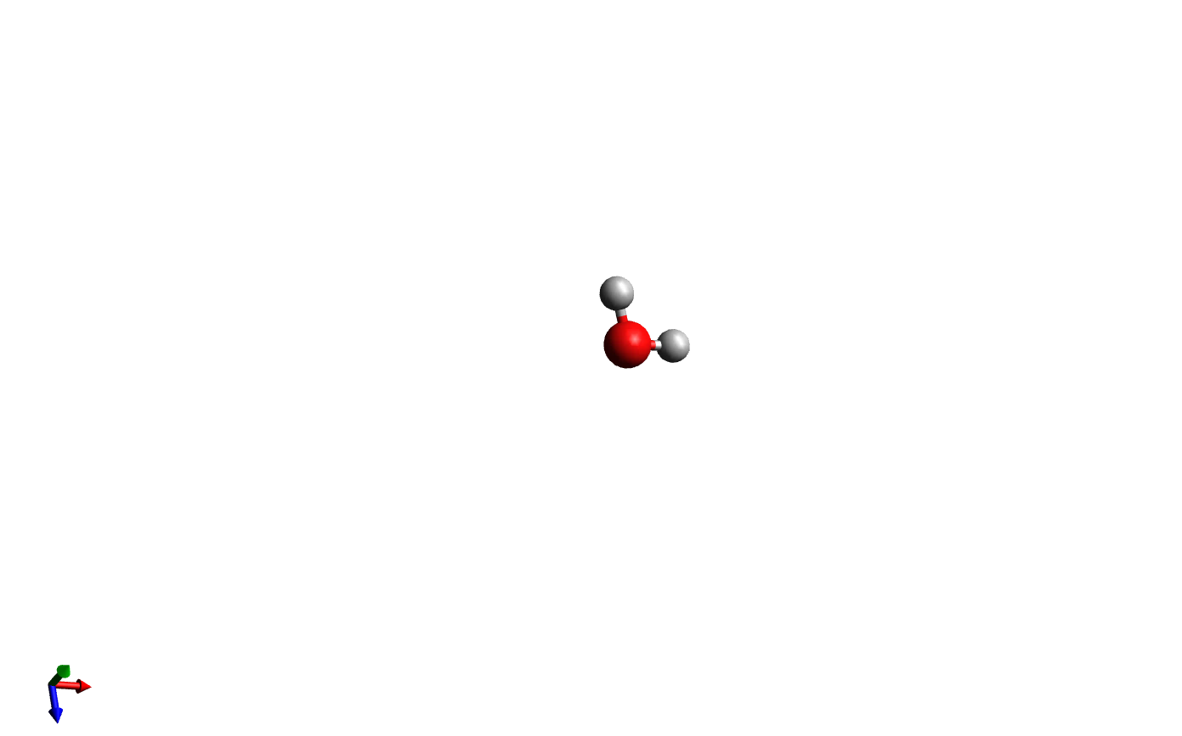


Samoilov’s theory
Two categories of ions
  Positive hydration ions (Li)
    Water molecules in the first hydration sphere are less mobile than in the bulk (t_{residence} long)
  Negative hydration ions (Na, K, Rb, Cs)
    Water molecules in the first hydration sphere are more mobile than in the bulk (t_{residence} short)
Li stabilises one hydroxide of the complex
  β 
  Unchanged charge
Na destabilises one hydroxide of the complex
  β 
  Unchanged charge
K, Rb are in the vicinity of the complex (too far)
  β ⇨
  Unchanged charge
Cs is not present in the vicinity of the complex
Samoilov, O. Ya. Structure of aqueous electrolyte solutions and the hydration of ions ; New York, Consultants Bureau, 1965.
New type of ternary complex
Interaction of a third species with ligands without change of charge
Ion pairing

Slide 14
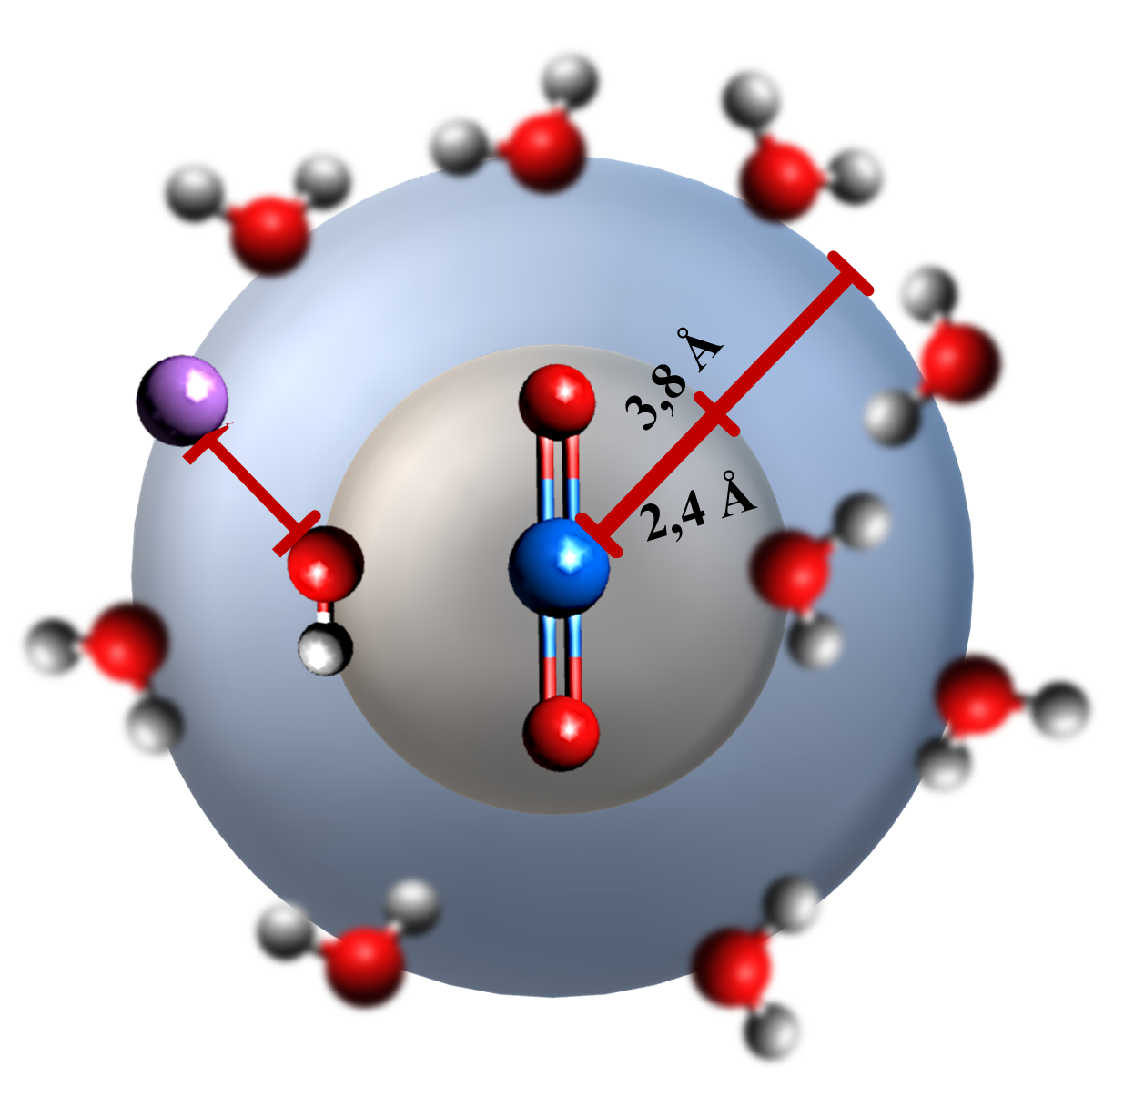
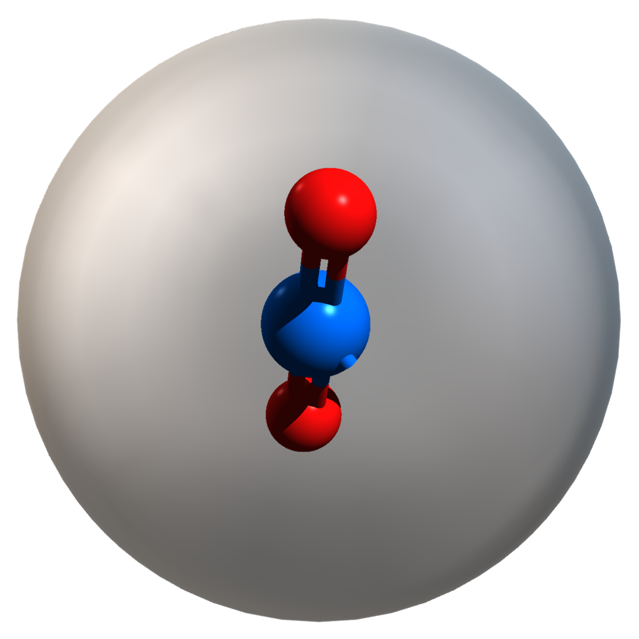


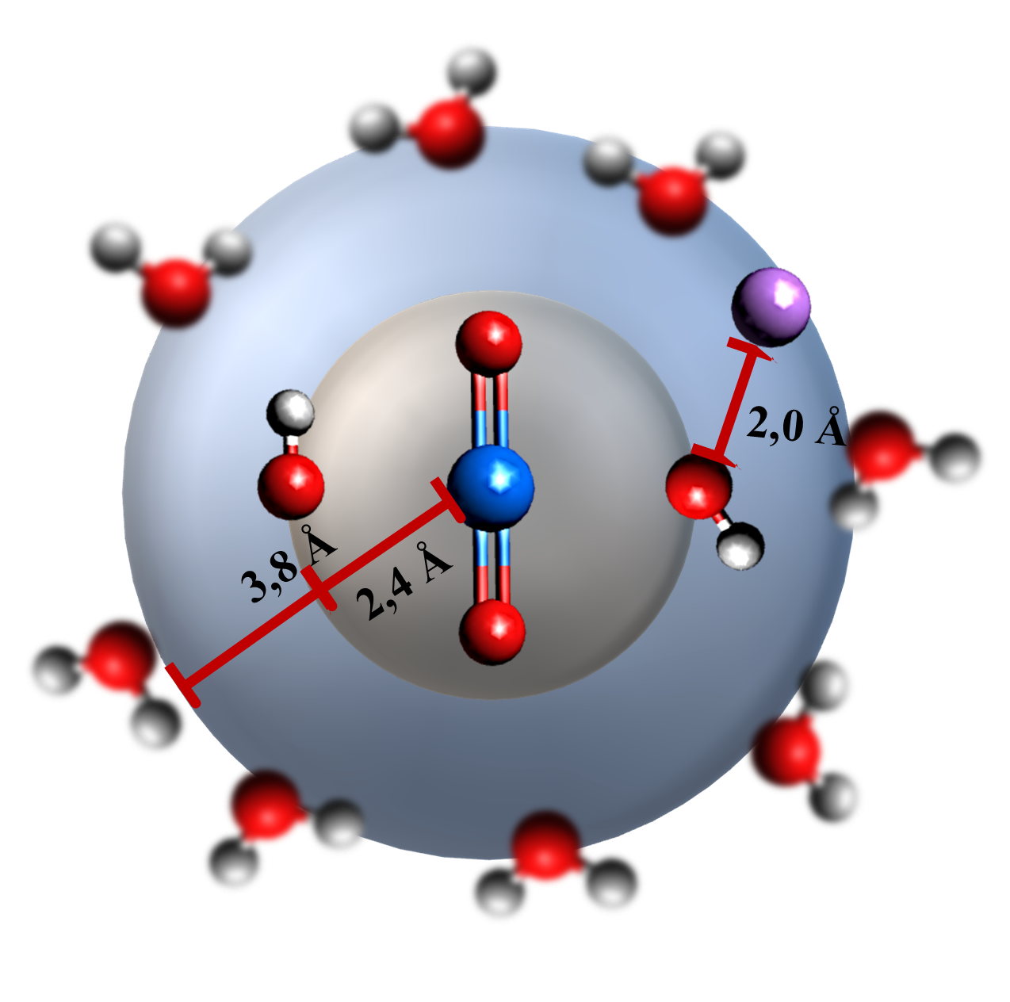


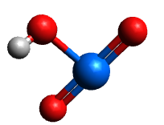
Conclusion
Alkalis have a significant effects on the hydrolysis of plutonium (V)
A new type of ternary complex has been identified:
  Proximity of a metal cation
  Effect on speciation
  No effect on the complexe charge
The results on this study are currently in the process of being published in the journal Inorganic Chemistry
!
There is certainly a change of the solubility

Slide 15
Thank you for your attention
LASNIER Guillaume¹
AUPIAIS Jean¹
SIBERCHICOT Bruno^{1,2}
¹CEA, DAM, DIF, F-91297, Arpajon, France
²Université Paris-Saclay, CEA, Laboratoire Matière en Conditions Extrêmes,
F-91680 Bruyères-Le-Châtel, France

