Slide 1
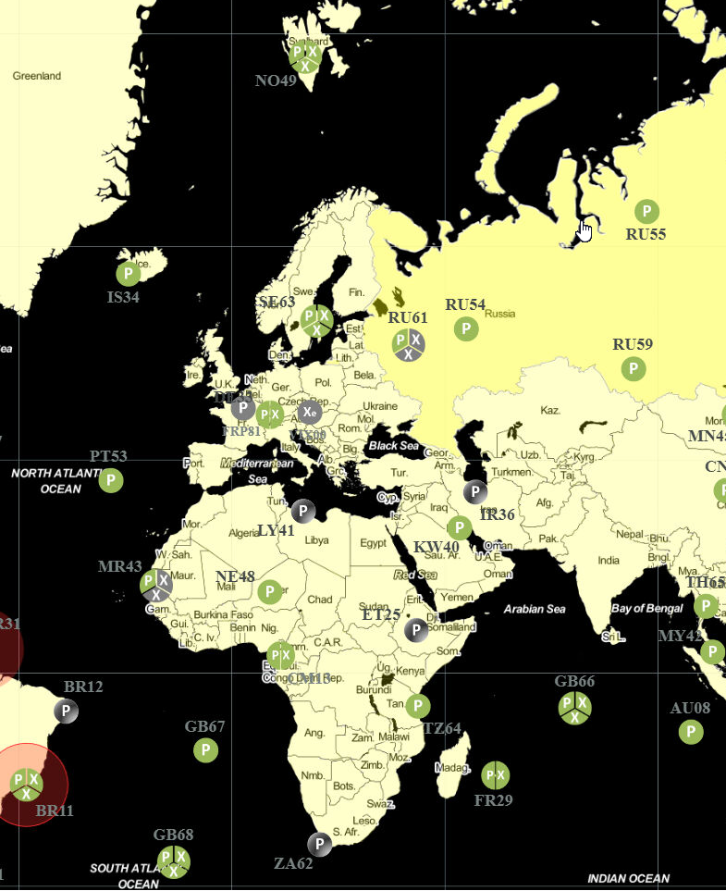

Overcoming challenges in coincidence matrix analysis
H.-D. Lenouvel¹, P. Gross¹ , A. De-Vismes Ott¹ , M. Morin¹ , S. Topin^{1,2} , J. Aupiais¹, H. Paradis¹
¹ CEA, DAM, DIF, F-91297 Arpajon, France
² CNAM, Analyse Chimique et Bioanalyse, EPN-7, 292 rue Saint Martin, 75003 Paris, France
Corresponding author : hugues.paradis@cea.fr

Slide 2
Introduction
1

Slide 3
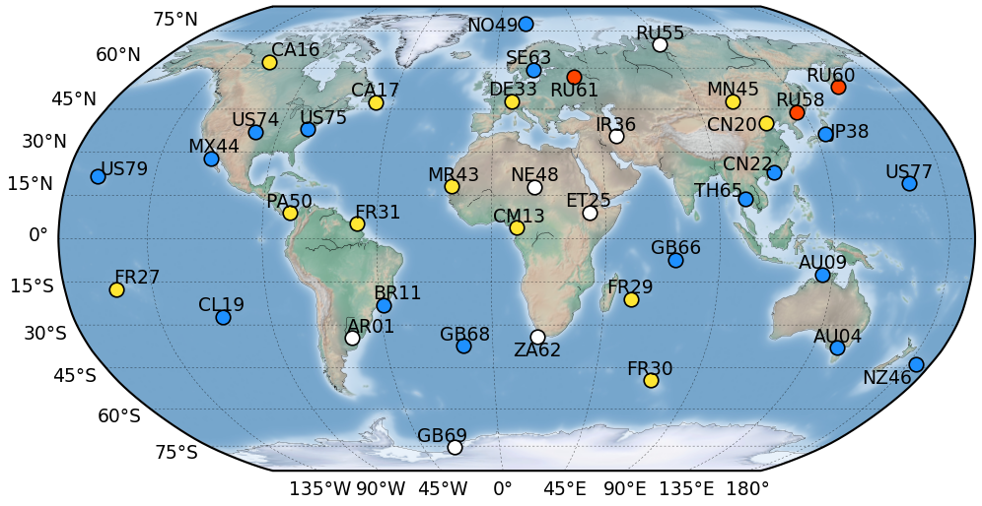
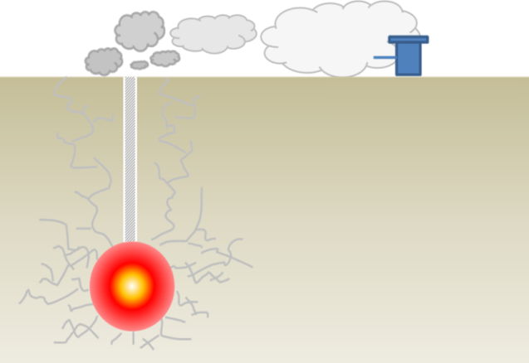
Comprehensive Nuclear-Test-Ban Treaty (CTBT)
Many nuclear test campaigns ➔ Comprehensive Nuclear-Test-Ban Treaty (1996) [1]
States :
Signature : 187
Ratification : 178
High atmospheric dilution ➔ Low radioactivity
XENON (1–4 samples/d)
IMS status (Dec 2023)
( : non-op. station)
321 stations and 16 laboratories:
4 types:
Seismic
Radionuclides
80 particles
40 noble gases
Hydroacoustic
Infrasound
SPALAX
SAUNA
ARIX
Fig 1. Xenon stations Map of the IMS
Atmospheric transport
~10⁻³ Bq/m³
Detection
Migration
Fig 2. Example for an underground nuclear explosion of 1 kt eq. TNT [2]
[1] United Nations, The Comprehensive Nuclear-Test-Ban Treaty, Resolution CTBT/MSS/RES/1, 1996.
¹³³Xe ∼ 10¹² Bq
Cavity
[2] Boxue Liu et al., Characterization of CTBT-Relevant Radioxenon Detections at IMS Stations Using Isotopic Activity Ratio Analysis, Pure Appl. Geophys. 180 (2023), 1521-1540
Thousands of km
➔ Radionuclide technology allows to qualify the nuclear nature of an event

Slide 4
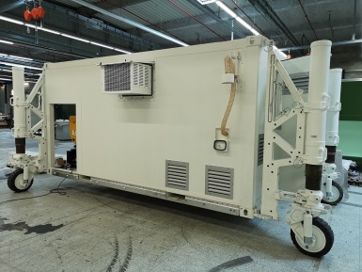
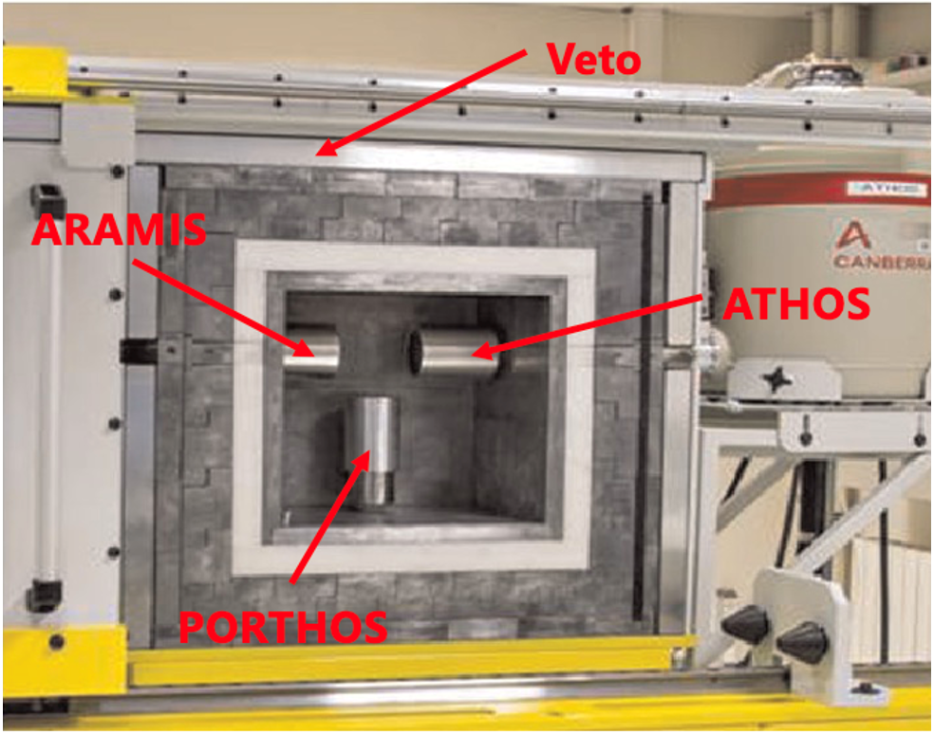
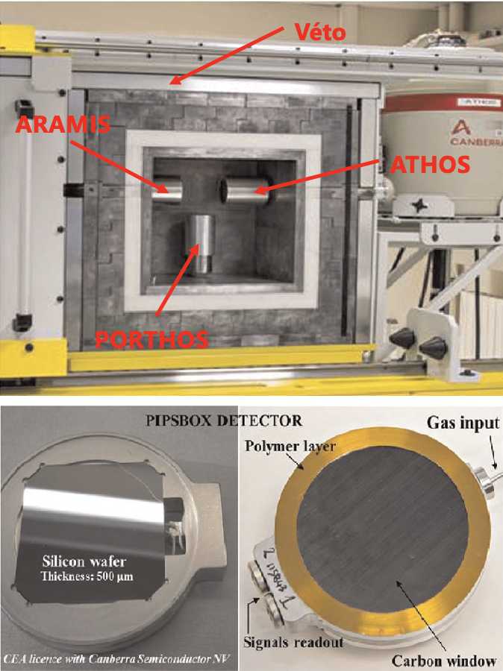
Radionuclide technology : context and stakes
Resources deployed by the CEA as part of the CTBT framework:
Stations : SPALAX and SPALAX-NG [3]
National Data Center (NDC)
Certified Laboratory : FRL08 (Gamma³) [4]
Research for radionuclide measurements :
Coincidence measurements (with the Gamma³)
Data analysis
Fig 3. SPALAX-NG
[3] S. Topin, et al. 6 months of radioxenon detection in western Europe with the SPALAX-New generation system - Part1: Metrological capabilities, J. Environ. Radioact. 225 (2020) 106442
[4] A. Cagniant, et al., An introduction to γ³ a new versatile ultralow background gamma spectrometer. Background description and analysis, Applied Radiation and Isotopes 98 (2015)
Fig 4. Gamma³ (left) & PIPSBox (right)
Notes:
Desired characteristics :
Nuclear weapons involves fission reactions ➔ Detection of fission products and activation products

Slide 5
Construction of the digital model
2

Slide 6
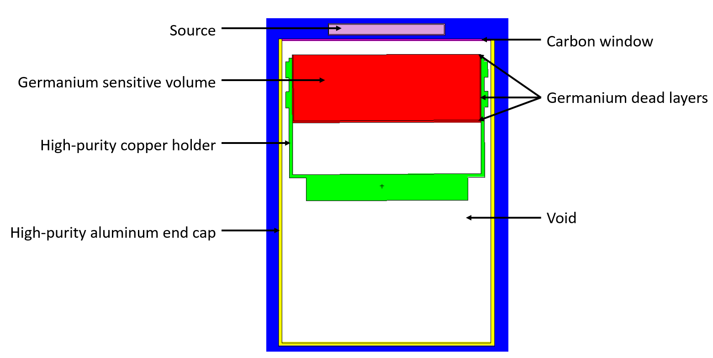
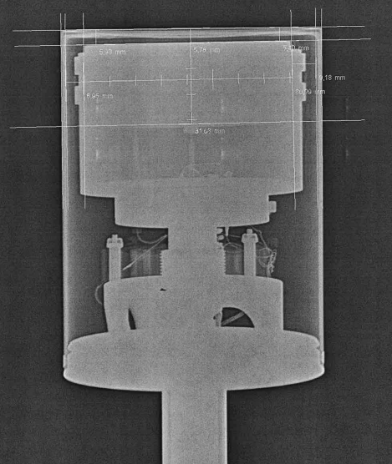
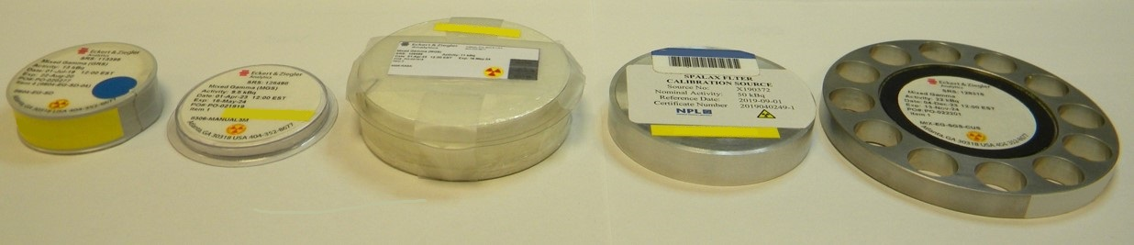
Model creation with MCNP
Modeling from :
Technical drawings provided by the manufacturer
Radiography of detectors
Fig 6. Display of a cross-sectional view of a detector modeled under MCNP.
Fig 5. Radiography of a HPGe detector (BEGe5030P)
Standard sources :
Energy range covered : [22 - 2505 keV]
Geometries :
compressed or uncompressed particle filters (diameter of 110 mm)
volumetric geometries (from 20 mL to 500 mL)
BP20
3M
RASA
PIPSBox geometry
Double Face
Fig 7. Common sources geometry used by the laboratory
➔ Use of sources of different sizes and compositions to provide a general calibration

Slide 7
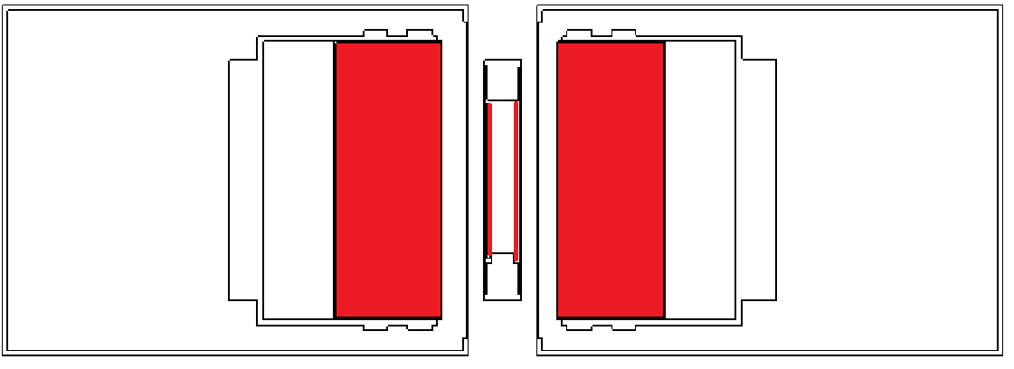

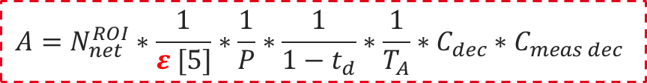
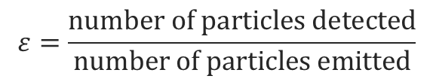
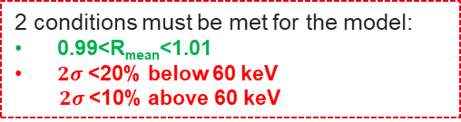
Optimization of detector models
Detection efficiency :
$$ε=\frac{number of particles detected}{number of particles emitted}$$
Validation of the digital model :
3° Validation of models
1° Modeling of detectors
separation at 60 keV
2° Optimization :
Mean ratio = $\left(\frac{ε_{EXP}}{ε_{MCNP}}\right)$ $≈1$
Fig 8. Modeling of the configuration (ATHOS + ARAMIS) & PIPSBox
2 conditions must be met for the model:
0.99<R_{mean}<1.01
$2σ$ <20% below 60 keV
$2σ$<10% above 60 keV
Parameters to optimize:
Thickness of materials (dead layers, carbon window…)
Position of the source relative to the crystal detector
Crystal size
Fig 9. Detection efficiency ratio (EXP/MCNP) versus energy
$$A=N_{net}^{ROI}∗\frac{1}{ε [5]}∗\frac{1}{P}∗\frac{1}{1−t_{d}}∗\frac{1}{T_{A}}∗C_{dec}∗C_{meas dec}$$
➔ Model validation enables simulation for calculating new detection efficiencies
[5] A. Berlizov, A correlated particle source extension of a general purpose Monte Carlo N-Particle transport code, MCNP-CP Upgrade Patch Version 3.2, Institute for Nuclear Research National Academy of Sciences of Ukraine, 2012

Slide 8

Radioxenon isotopes measurement
3
$β/γ$ coincidences

Slide 9
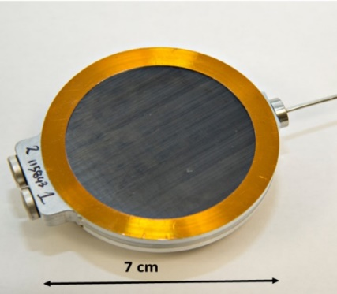
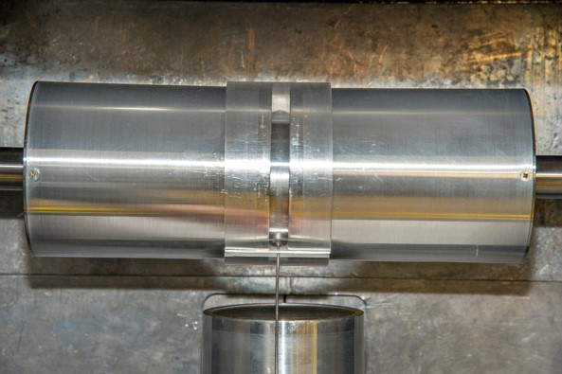
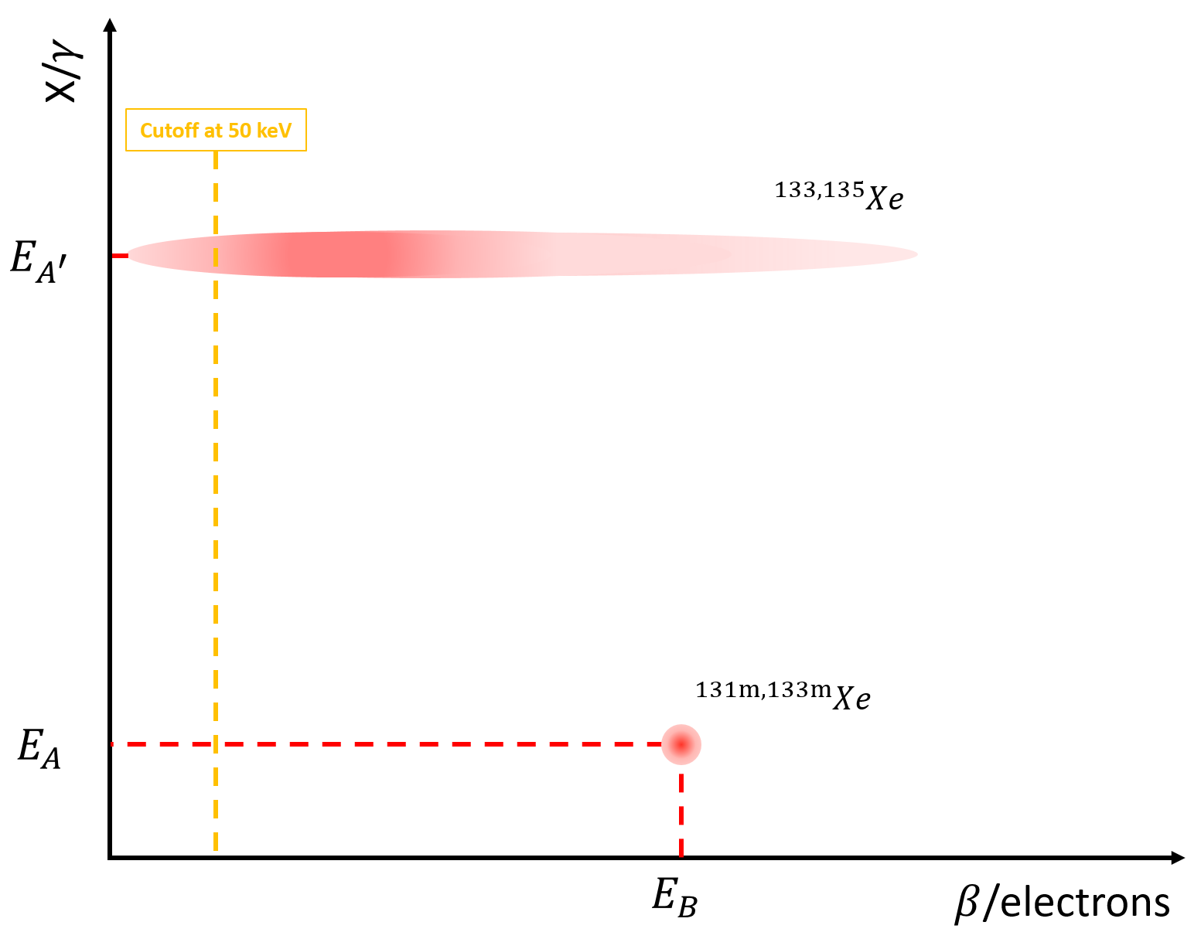
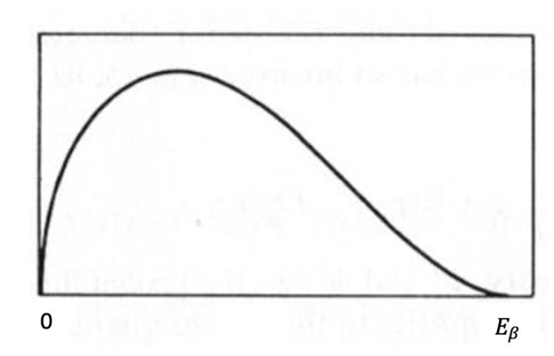
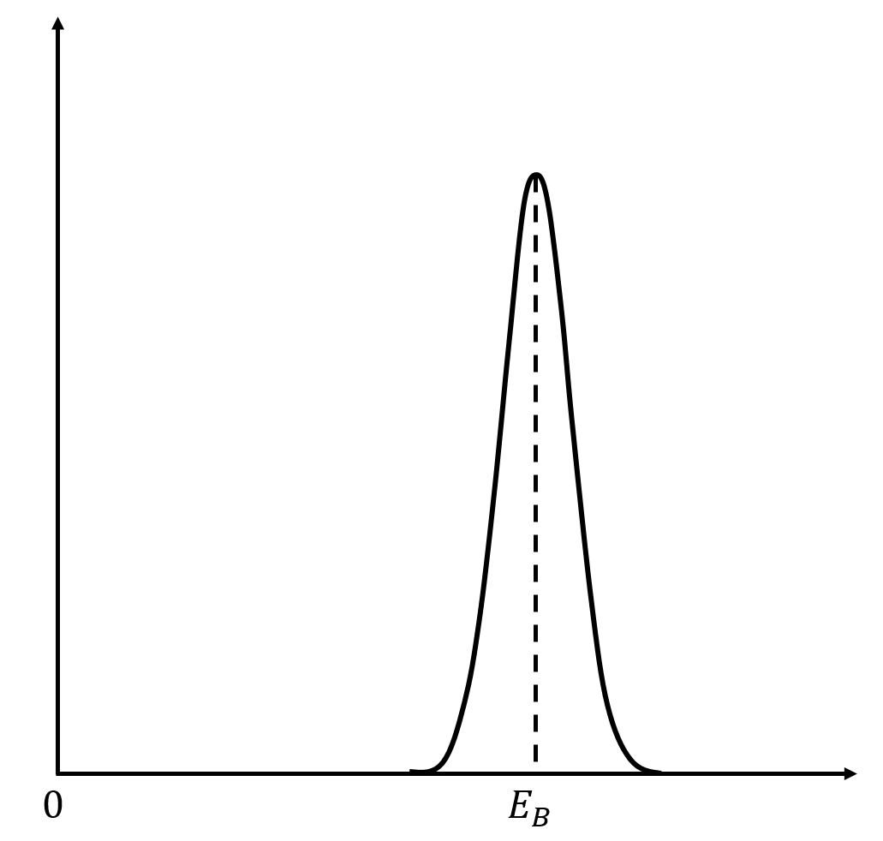

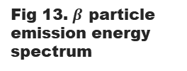
Gamma³ : configuration for the measurement of gaseous samples
Configuration :
2 HPGe : detection of photons
2 PIPS : detection of electrons
The PIPSBoxTM is placed between ATHOS and ARAMIS detectors
Fig 10. (ATHOS+ARAMIS)&PIPSBox configuration
$β/γ$ coincidences :
Fig 13. $β$ particle emission energy spectrum
Fig 12. Energy spectrum of the electron emitted by internal conversion
Fig 11. Depiction of the shape of the fingerprints

Slide 10
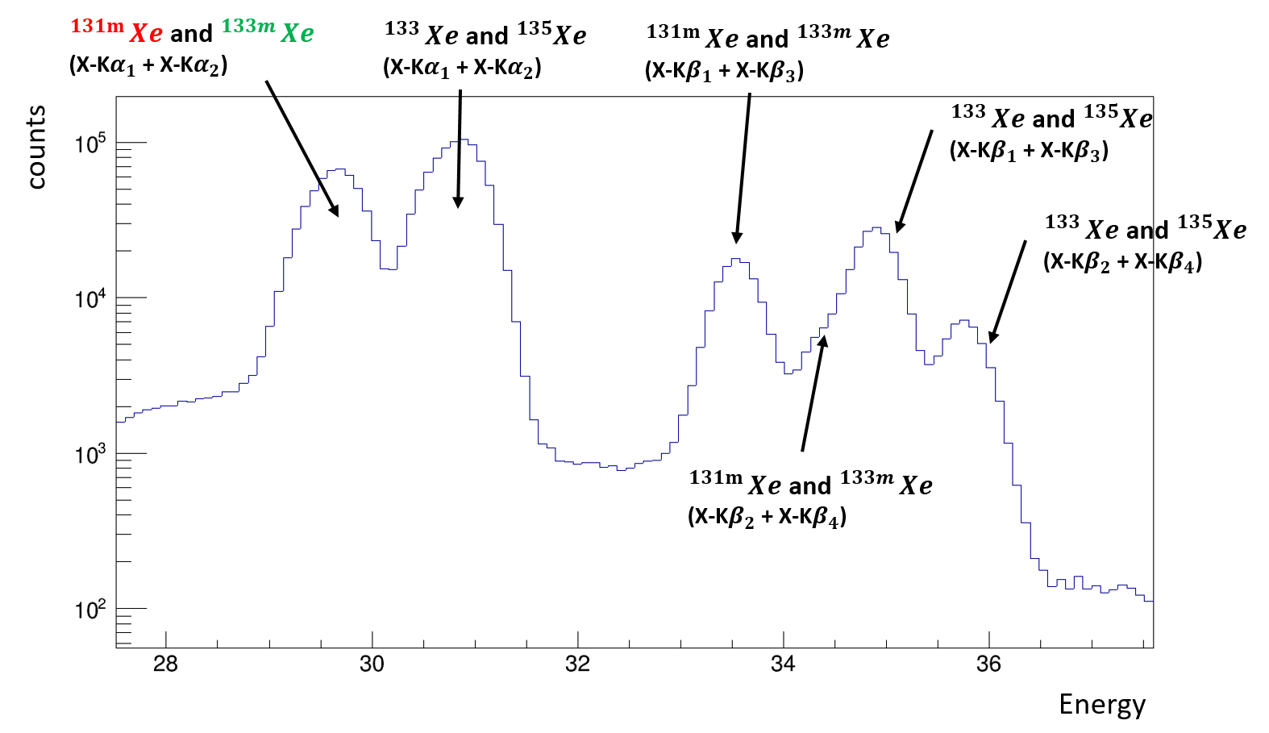
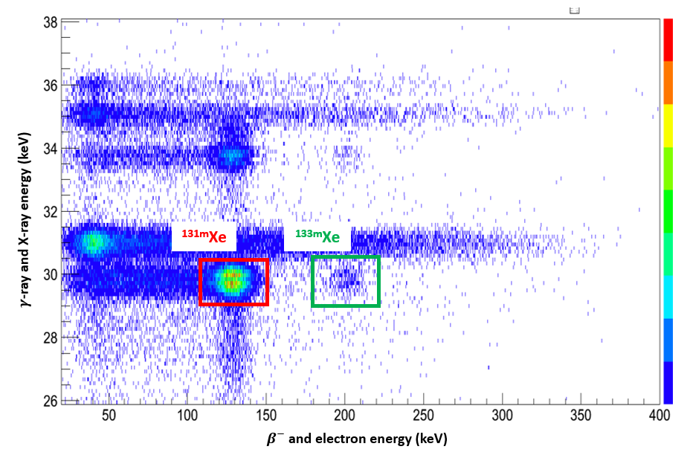
Benefit of using $β/γ$ coincidence detection
The benefit of using coincidences in the X-ray region:
Impossibility of using the X-rays due to peak overlaps
Fig 14. Separation of the signatures of metastable radioxenon isotopes
Fig 15. $γ$-ray spectrum with a zoom on the X-ray region
Characteristic signatures of radionuclide (very low background)

Slide 11
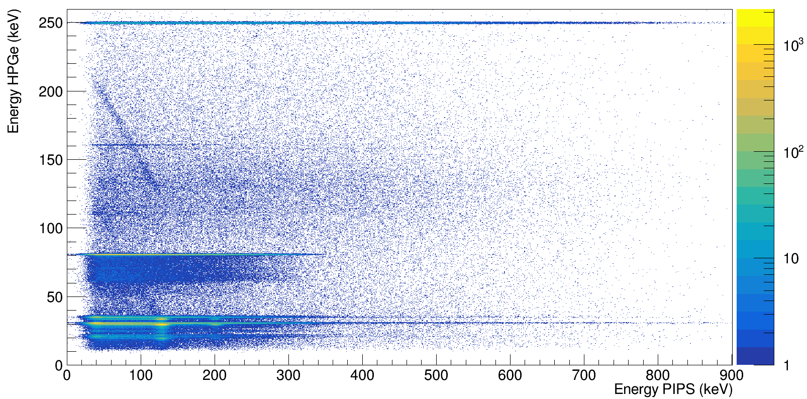
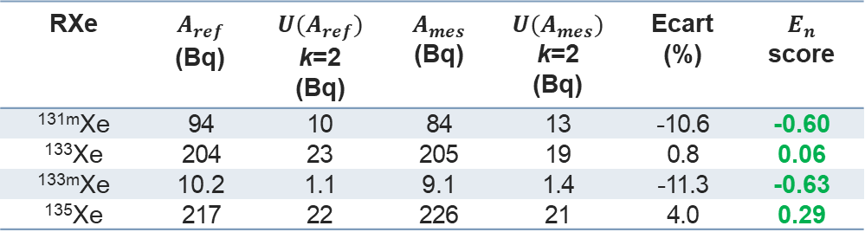

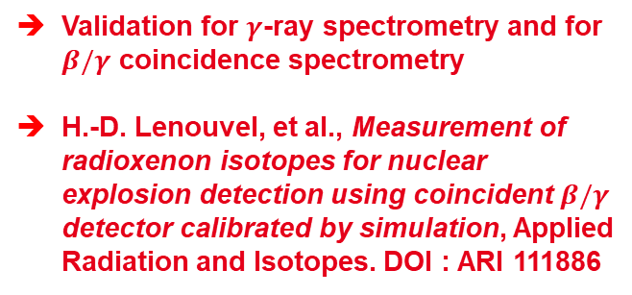

Validation of the method on a gaseous sample
Standard gaseous sample of radioxenon isotopes:
Measurement :
(ATHOS+ARAMIS)&PIPSBox
Duration : 57600 s
Efficiency calculation :
Calculated with MCNP-CP
Radioxenon isotope | β/γ coincidence spectrometry
^{131m}Xe | 0.16 ± 0.02
¹³³Xe | 0.20 ± 0.02
^{133m}Xe | 0.147 ± 0.023
¹³⁵Xe | 0.176 ± 0.016
Fig 16. $β/γ$ matrix obtained from the measurement
Tab 1. $β/γ$ detection efficiencies for the 4 radioxenon isotopes
Analysis :
RXe | $$A_{ref}$$ (Bq) | $$U(A_{ref})$$ k=2 (Bq) | $$A_{mes}$$ (Bq) | $$U(A_{mes})$$ k=2 (Bq) | Ecart (%) | $E_{n}$ score
^{131m}Xe | 94 | 10 | 84 | 13 | -10.6 | -0.60
¹³³Xe | 204 | 23 | 205 | 19 | 0.8 | 0.06
^{133m}Xe | 10.2 | 1.1 | 9.1 | 1.4 | -11.3 | -0.63
¹³⁵Xe | 217 | 22 | 226 | 21 | 4.0 | 0.29
Validation for $γ$-ray spectrometry and for $β/γ$ coincidence spectrometry
H.-D. Lenouvel, et al., Measurement of radioxenon isotopes for nuclear explosion detection using coincident $β/γ$ detector calibrated by simulation, Applied Radiation and Isotopes. DOI : ARI 111886
Tab 2. Comparison between reference activities and measured activities
Notes:
*Validation with $E_{n}$ score according to the ISO 13528 standard
$$E_{N}=\frac{A_{i}−A_{ref}}{\sqrt{U^{2}\left(A_{i}\right)+U^{2}\left(A_{ref}\right)}}$$

Slide 12

Particulate fission products
4
$γ/γ$ coincidences

Slide 13
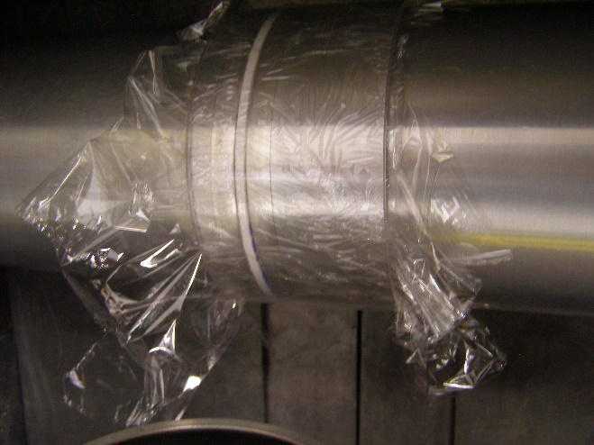
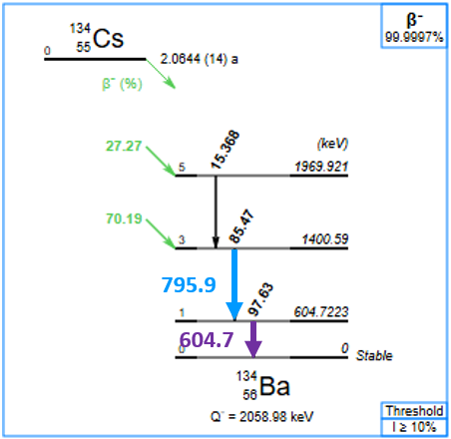
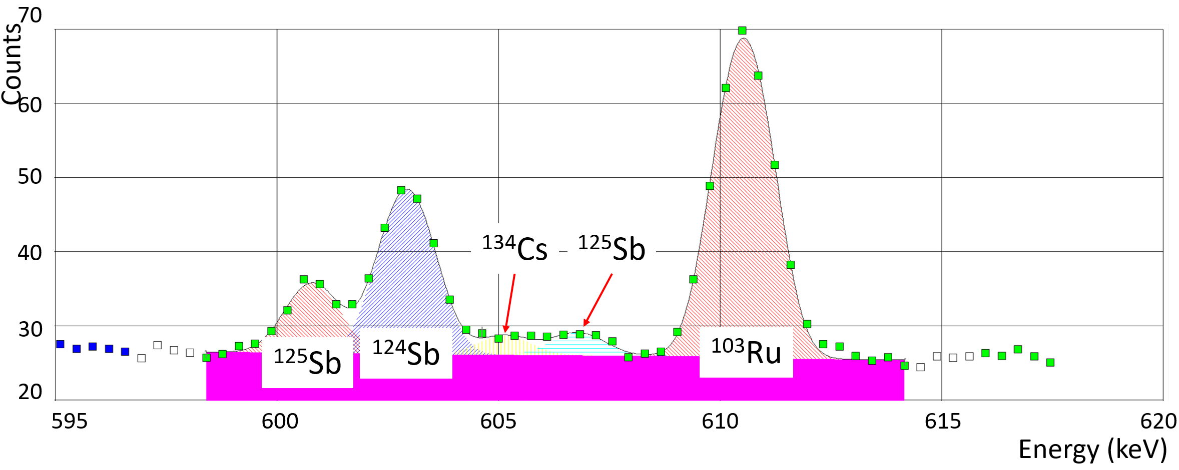
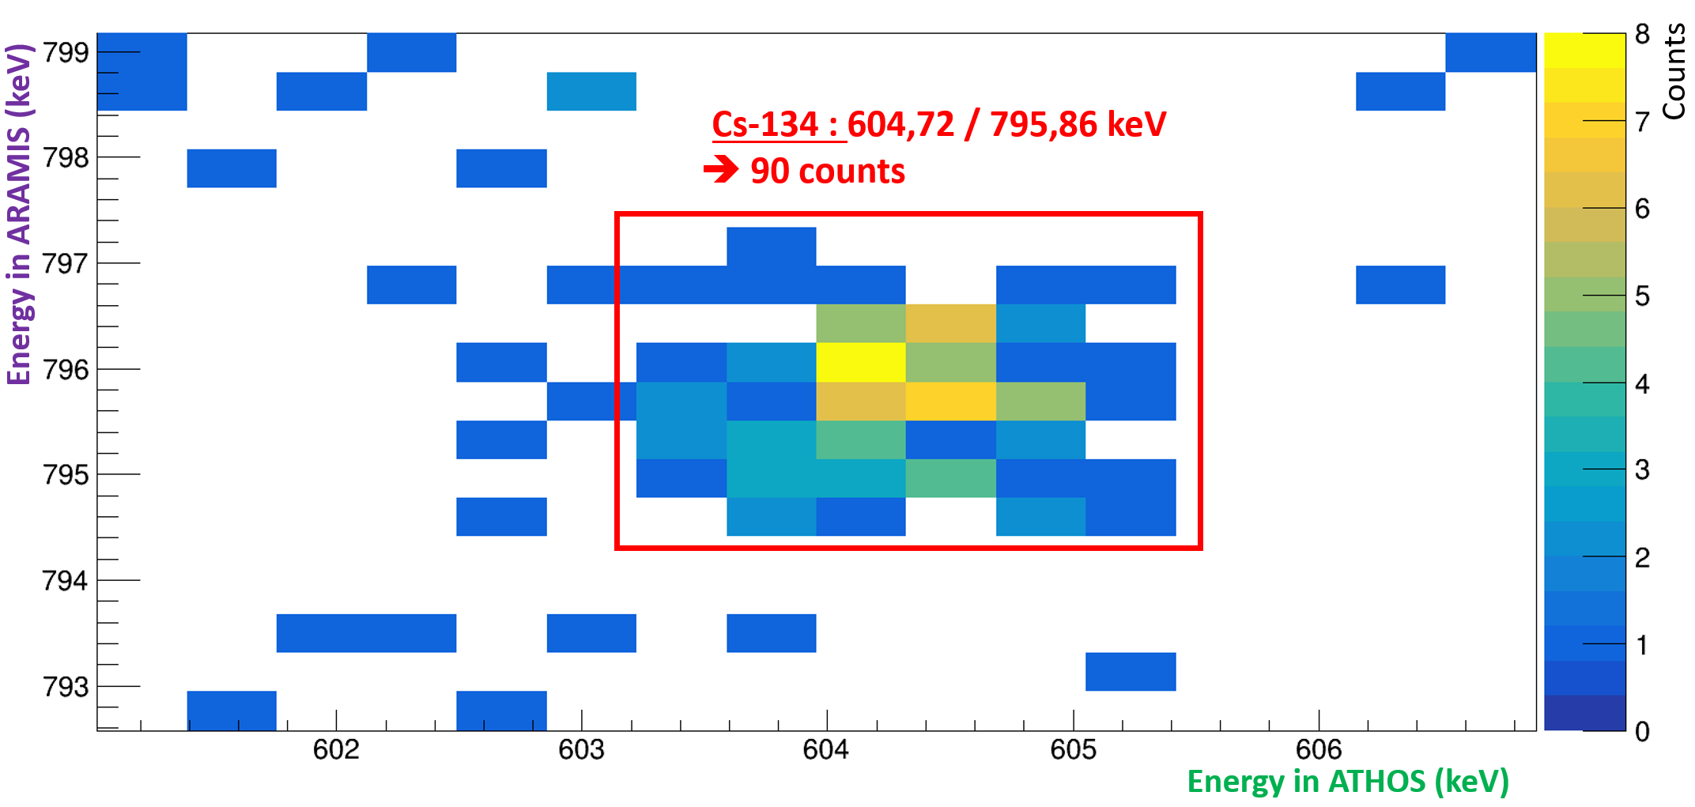



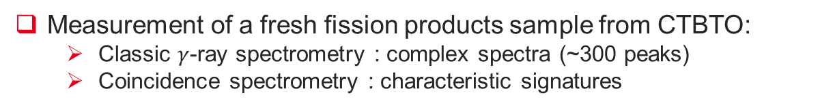

Benefits of using $γ/γ$ coincidence detection (example with ¹³⁴Cs)
Identification of ¹³⁴Cs using coincidences:
Fig 17. Decay scheme of ¹³⁴Cs
Fig 18. Aerosol filter placed between two HPGe detectors with expected coincidence matrix signatures
Measurement of a fresh fission products sample from CTBTO:
Classic $γ$-ray spectrometry : complex spectra (~300 peaks)
Coincidence spectrometry : characteristic signatures
$SNR$ : Signal-to-Noise Ratio
$$SNR≪1$$
Fig 19. Classic 𝛾-ray with zoom around 605 keV
Fig 20. Coincidence matrix with a zoom on the ¹³⁴Cs
$$SNR\sim 10$$
High SNR values make it easier to qualify and quantify certain radionuclides
Notes:
Ruthenium-103 -> 610
Antimoine-124 -> 602
Antimoine-127 -> 603

Slide 14
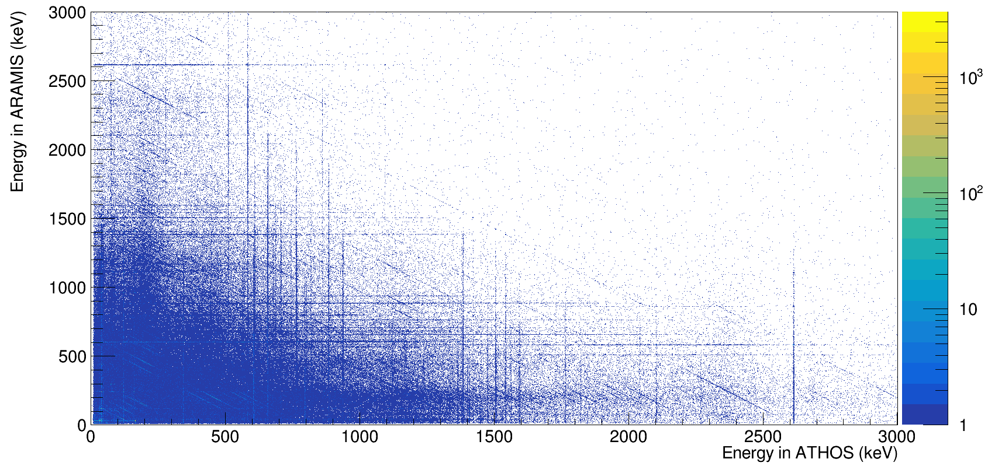
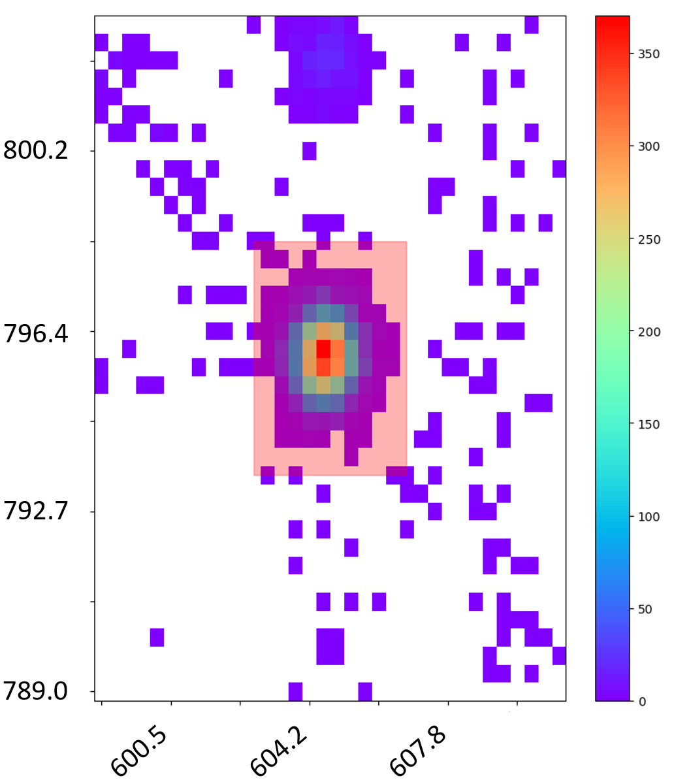
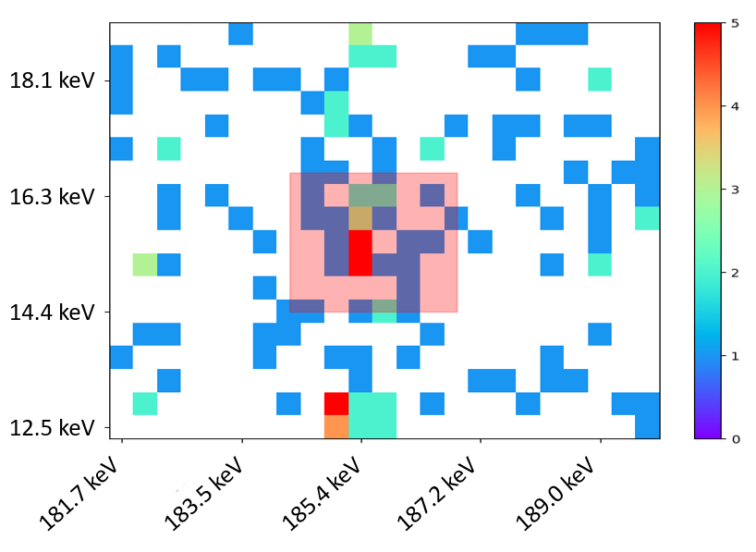
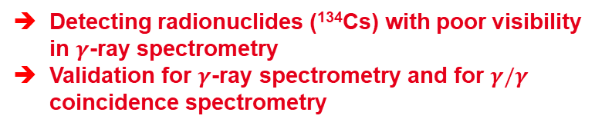
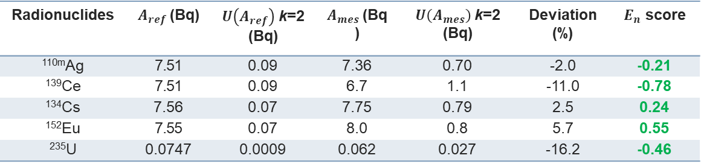
Validation of the method on a IAEA sample
Standard IAEA swipe sample
Bckg
Measurement :
ATHOS&ARAMIS
Duration : 316800 s
ROI
Efficiency calculation :
Calculated with MCNP-CP
Fig 21. $γ/γ$ matrix obtained from the measurement with a zoom on the ¹³⁴Cs
Analysis :
Radionuclides | $A_{ref}$(Bq) | $U\left(A_{ref}\right)$k=2 (Bq) | $A_{mes}$(Bq) | $U\left(A_{mes}\right)$k=2 (Bq) | Deviation (%) | $E_{n}$ score
^{110m}Ag | 7.51 | 0.09 | 7.36 | 0.70 | -2.0 | -0.21
¹³⁹Ce | 7.51 | 0.09 | 6.7 | 1.1 | -11.0 | -0.78
¹³⁴Cs | 7.56 | 0.07 | 7.75 | 0.79 | 2.5 | 0.24
¹⁵²Eu | 7.55 | 0.07 | 8.0 | 0.8 | 5.7 | 0.55
²³⁵U | 0.0747 | 0.0009 | 0.062 | 0.027 | -16.2 | -0.46
Fig 22. Zoom on a region where ²³⁵U coincidences may occur
Tab 3. Comparison between reference activities and measured activities
Detecting radionuclides (¹³⁴Cs) with poor visibility in $γ$-ray spectrometry
Validation for $γ$-ray spectrometry and for $γ/γ$ coincidence spectrometry

Slide 15
Conclusions
5

Slide 16
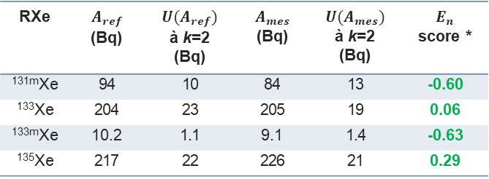
Conclusion and perspectives
Metrological connection of the digital models of detectors
Determination of detection efficiencies through simulation
Validation of a new method using simulation to qualify and quantify samples with coincidence measurements
Gaseous samples
Particle filters
RXe | $$A_{ref}$$ (Bq) | $$U(A_{ref})$$ à k=2 (Bq) | $$A_{mes}$$ (Bq) | $$U(A_{mes})$$ à k=2 (Bq) | $E_{n}$ score *
^{131m}Xe | 94 | 10 | 84 | 13 | -0.60
¹³³Xe | 204 | 23 | 205 | 19 | 0.06
^{133m}Xe | 10.2 | 1.1 | 9.1 | 1.4 | -0.63
¹³⁵Xe | 217 | 22 | 226 | 21 | 0.29

Slide 17
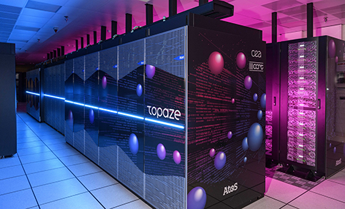
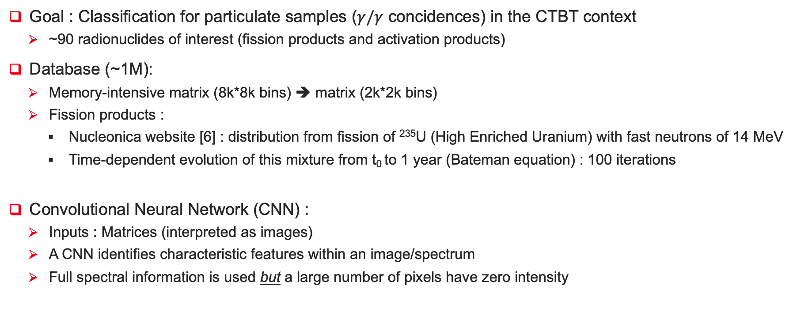
Outlook : AI tool
Goal : Classification for particulate samples ($γ/γ$ concidences) in the CTBT context
~90 radionuclides of interest (fission products and activation products)
Database (~1M):
Memory-intensive matrix (8k*8k bins) ➔ matrix (2k*2k bins)
Fission products :
Nucleonica website [6] : distribution from fission of ²³⁵U (High Enriched Uranium) with fast neutrons of 14 MeV
Time-dependent evolution of this mixture from t₀ to 1 year (Bateman equation) : 100 iterations
Convolutional Neural Network (CNN) :
Inputs : Matrices (interpreted as images)
A CNN identifies characteristic features within an image/spectrum
Full spectral information is used but a large number of pixels have zero intensity
Fig 23. Topaze High-Performance Computing (HPC) system (CEA)
Thank you.
[6] Nucleonica website, www.nucleonica.com
Notes:
Simulation of $γ/γ$ coincidences of each radionuclide by MCNP-CP
Reduction of input matrix size (~2000*2000) with resolution binning (1 bin = 1*FWHM)

Slide 18
Annexes
3

Slide 19
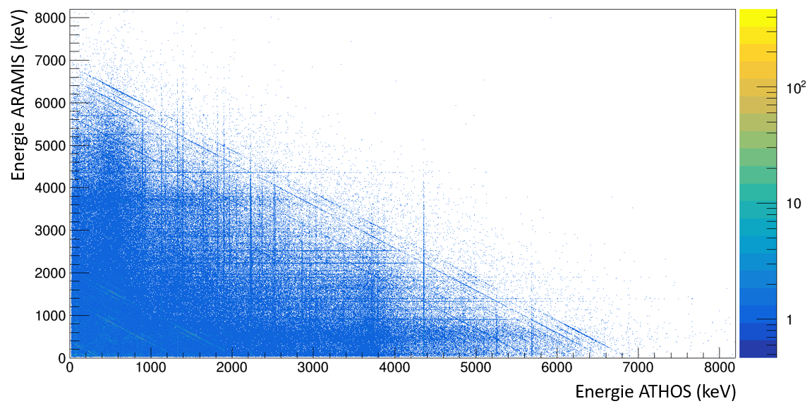
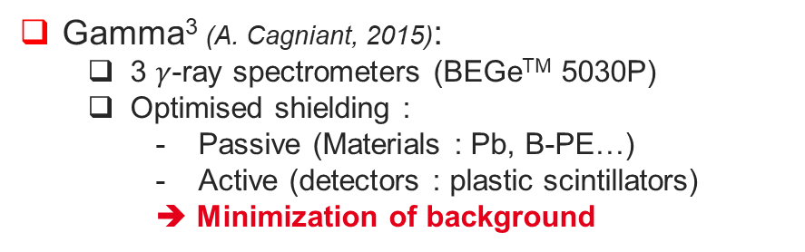

Gamma³ : detection device for radionuclides present at trace levels in the environment
Gamma³ (A. Cagniant, 2015):
3 $γ$-ray spectrometers (BEGeTM 5030P)
Optimised shielding :
Passive (Materials : Pb, B-PE…)
Active (detectors : plastic scintillators)
➔ Minimization of background
Fig 5. Gamma³ (left) & PIPSBox (right)
Multi-detector spectrometer:
Increase detection efficiencies
Multi-channel acquisition electronics ➔coincidence measurements
➔Characteristic signatures of radionuclides
➔Ultra low background
$γ/γ$
Fig 5. $γ/γ$ coincidence matrix

Slide 20
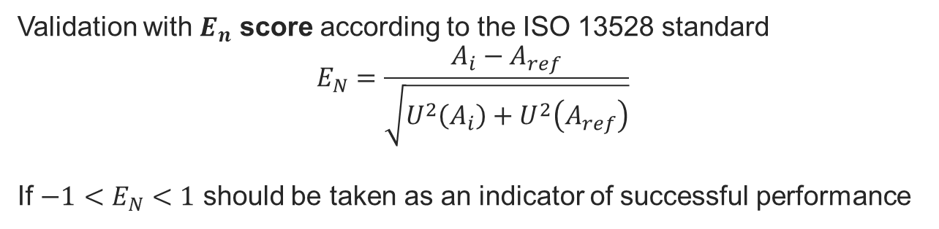
$E_{N}$ score calculation
Validation with $E_{n}$ score according to the ISO 13528 standard
$$E_{N}=\frac{A_{i}−A_{ref}}{\sqrt{U^{2}\left(A_{i}\right)+U^{2}\left(A_{ref}\right)}}$$
If $−1<E_{N}<1$ should be taken as an indicator of successful performance

Slide 21
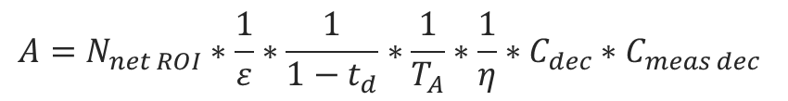
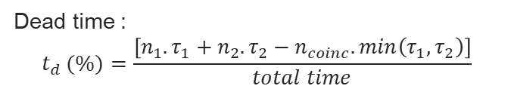
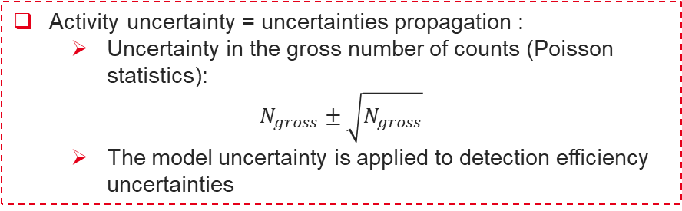
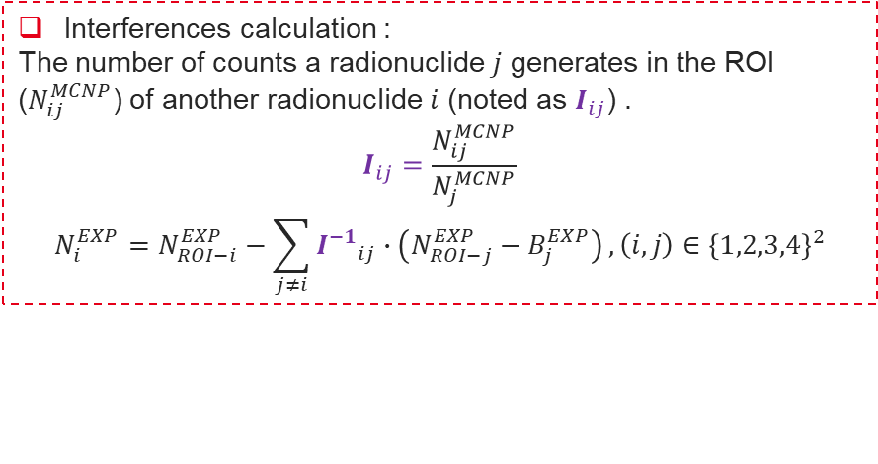
Activity calculation and uncertainties for radioxenon isotopes measurements
Decay correction factors :
Decay between the reference time and the beginning of the measurement
Decay during the measurement
Background contribution :
Radiological blank (6 days) : < 0,01 counts per bin (negligible)
Interference matrix that examines the contribution of each radionuclide in each ROI
Active time
$$A=N_{net ROI}∗\frac{1}{ε}∗\frac{1}{1−t_{d}}∗\frac{1}{T_{A}}∗\frac{1}{η}∗C_{dec}∗C_{meas dec}$$
Detection efficiencies are calculated with MCNP-CP
Gas transfer yield
Dead time :
$$t_{d} (\%)=\frac{\left[n_{1}.τ_{1}+n_{2}.τ_{2}−n_{coinc}.min\left(τ_{1},τ_{2}\right)\right]}{total time}$$
Activity uncertainty = uncertainties propagation :
Uncertainty in the gross number of counts (Poisson statistics):
$$N_{gross}±\sqrt{N_{gross}}$$
The model uncertainty is applied to detection efficiency uncertainties
Interferences calculation :
The number of counts a radionuclide $j$ generates in the ROI ($N_{ij}^{MCNP}$) of another radionuclide $i$ (noted as $I_{ij}$) .
$$I_{ij}=\frac{N_{ij}^{MCNP}}{N_{j}^{MCNP}}$$
$$N_{i}^{EXP}=N_{ROI−i}^{EXP}−\sum_{j≠i}{{I^{−1}}_{ij}∙\left(N_{ROI−j}^{EXP}−B_{j}^{EXP}\right)}, \left(i,j\right)∈{\left\{1,2,3,4\right\}}^{2}$$

Slide 22

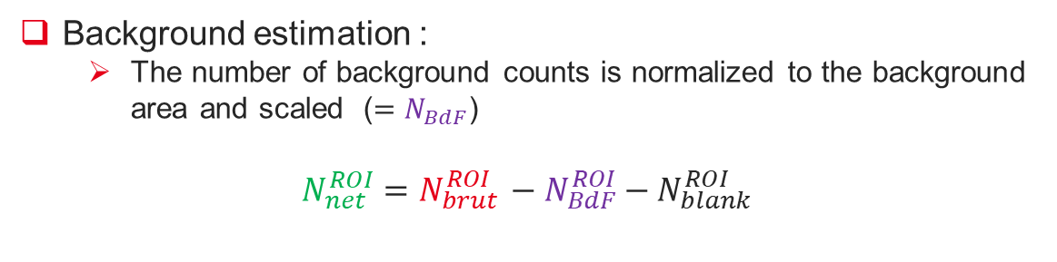


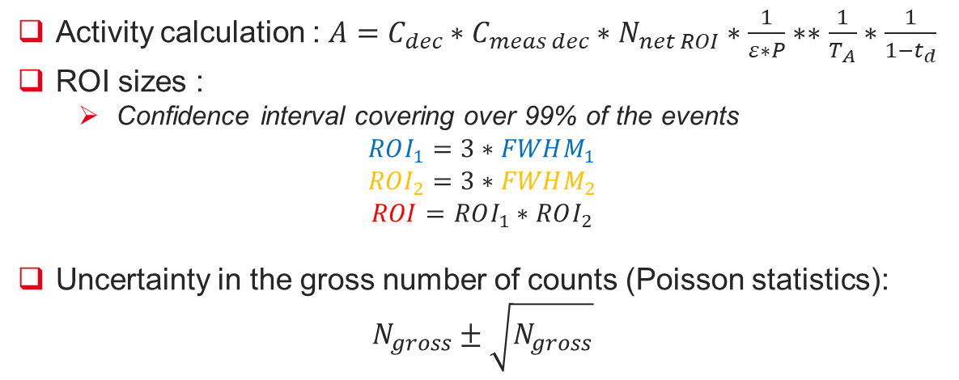
Activity calculation and uncertainties for aerosol filters
Activity calculation : $A=C_{dec}∗C_{meas dec}∗N_{net ROI}∗\frac{1}{ε∗P}∗∗\frac{1}{T_{A}}∗\frac{1}{1−t_{d}}$
ROI sizes :
Confidence interval covering over 99% of the events
$$ROI_{1}=3∗FWHM_{1}$$
$$ROI_{2}=3∗FWHM_{2}$$
$$ROI=ROI_{1}∗ROI_{2}$$
Uncertainty in the gross number of counts (Poisson statistics):
$$N_{gross}±\sqrt{N_{gross}}$$
$$t_{d}=\frac{\left[n_{1}.τ_{1}+n_{2}.τ_{2}−n_{coinc}.min\left(τ_{1},τ_{2}\right)\right]}{total time}$$
Bckg
Energy in ARAMIS
ROI
$$FWHM_{2}$$
$$FWHM_{1}$$
Background estimation :
The number of background counts is normalized to the background area and scaled ($=N_{BdF}$)
$$N_{net}^{ROI}=N_{brut }^{ROI}−N_{BdF}^{ROI}−N_{blank}^{ROI}$$
Energy in ATHOS
Drawing of an ROI on a coincidence matrix

Slide 23
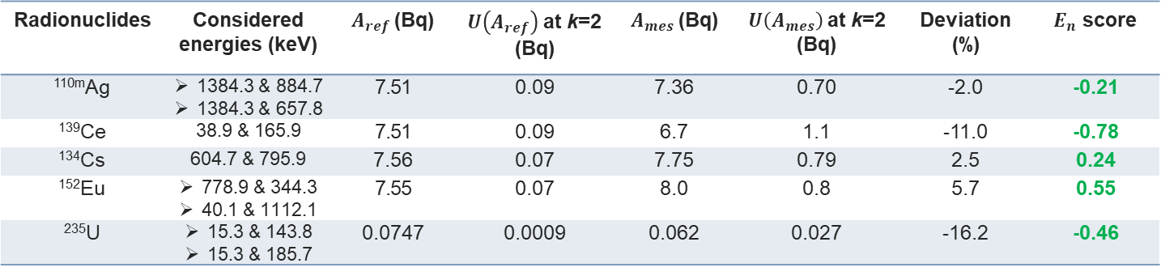
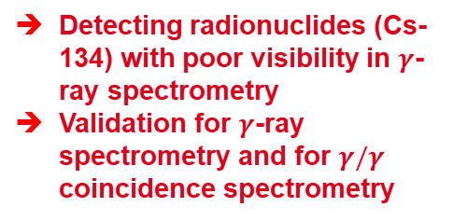
Validation of the method on a IAEA sample
Low-level radiological swipe performed to detect fission and activation products, and assess nuclear material lineage :
Bckg
ROI
Measurement :
ATHOS&ARAMIS
Time : 316800 s
Efficiency calculation :
Calculated with MCNP-CP
Analysis :
Fig 21. $γ/γ$ matrix obtained from the measurement with a zoom on the Cs-134
Radionuclides | Considered energies (keV) | $A_{ref}$(Bq) | $U\left(A_{ref}\right)$at k=2 (Bq) | $A_{mes}$(Bq) | $U\left(A_{mes}\right)$at k=2 (Bq) | Deviation (%) | $E_{n}$ score
^{110m}Ag | 1384.3 & 884.7 1384.3 & 657.8 | 7.51 | 0.09 | 7.36 | 0.70 | -2.0 | -0.21
¹³⁹Ce | 38.9 & 165.9 | 7.51 | 0.09 | 6.7 | 1.1 | -11.0 | -0.78
¹³⁴Cs | 604.7 & 795.9 | 7.56 | 0.07 | 7.75 | 0.79 | 2.5 | 0.24
¹⁵²Eu | 778.9 & 344.3 40.1 & 1112.1 | 7.55 | 0.07 | 8.0 | 0.8 | 5.7 | 0.55
²³⁵U | 15.3 & 143.8 15.3 & 185.7 | 0.0747 | 0.0009 | 0.062 | 0.027 | -16.2 | -0.46
Detecting radionuclides (Cs-134) with poor visibility in $γ$-ray spectrometry
Validation for $γ$-ray spectrometry and for $γ/γ$ coincidence spectrometry
Tab 3. Comparison between reference activities and measured activities

Slide 24
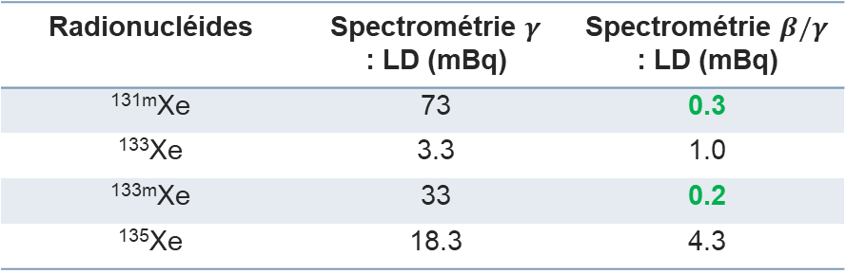
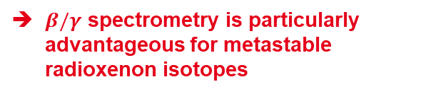




Detection limits
Calculation of decision thresholds (SD) and detection limits (LD) on a blank measurement :
ISO 11929 standard
Comparison between the classical spectrometry and the coincidence spectrometry
Particulate samples :
Radionucléides | Spectrométrie $γ$ : SD / LD (mBq) | Spectrométrie en $γ/γ$ : SD / LD (mBq)
^{108m}Ag | 2.03 / 4.2 | 0.39 / 2.9
^{110m}Ag | 2.44 / 5.0 | 3.67 / 26.4
⁶⁰Co | 1.81 / 3.8 | 0.60 / 4.3
¹²⁵Sb | 5.31 / 10.9 | 5.39 / 19.0
¹³⁴Cs | 1.75 / 3.6 | 0.71 / 3.2
For certain radionuclides :
$P∗ε$ very low → $LD_{γγ}>LD_{γ}$
➔ $SD_{γγ}$ is particularly advantageous → a more sensitive qualification
Tab 4. Comparison of SD and LD between classical $γ$ spectrometry and $γ/γ$ spectrometry for particulate measurements
Noble gas samples :
Radionucléides | Spectrométrie $γ$ : LD (mBq) | Spectrométrie $β/γ$ : LD (mBq)
^{131m}Xe | 73 | 0.3
¹³³Xe | 3.3 | 1.0
^{133m}Xe | 33 | 0.2
¹³⁵Xe | 18.3 | 4.3
Tab 5. Comparison of SD and LD between classical $γ$ spectrometry and $β/γ$ spectrometry for particulate measurements
$β/γ$ spectrometry is particularly advantageous for metastable radioxenon isotopes

