Slide 1
ADVANCED NUMERICAL TECHNIQUES AND AI TO MITIGATE IMPERFECTIONS IN FUTURE CIRCULAR COLLIDER
Doctorant:
Quentin BRUANT
Sous la supervision de:
Barbara DALENA (Dir), Francesca BUGIOTTI, Valérie GAUTARD

Slide 2
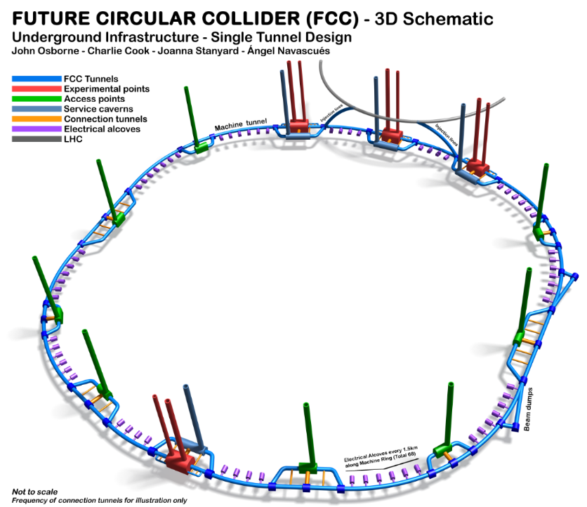
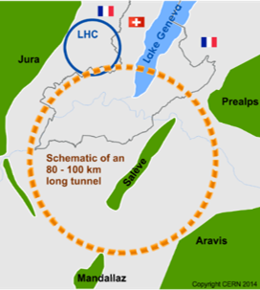
Context
International FCC collaboration (CERN as host lab) to study:
pp-collider (FCC-hh) → main emphasis, defining infrastructure requirements
~100 km tunnel infrastructure in Geneva area, site specific
e⁺e⁻ collider (FCC-ee), as potential first step
HE-LHC with FCC-hh technology
p-e (FCC-he) option, IP integration, e⁻ from ERL
CDRs published in European Physical Journal C (Vol 1) and ST (Vol 2 – 4)
Summary documents provided to EPPSU SG
FCC-integral, FCC-ee, FCC-hh, HE-LHC
Accessible on http://fcc-cdr.web.cern.ch/

Slide 3
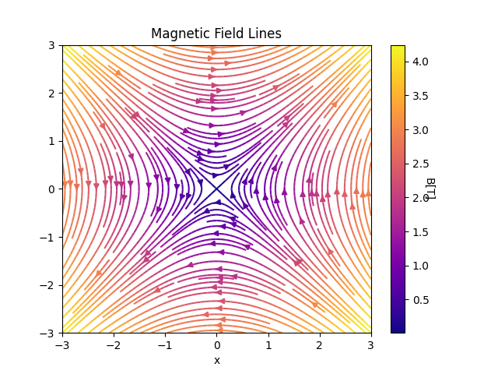
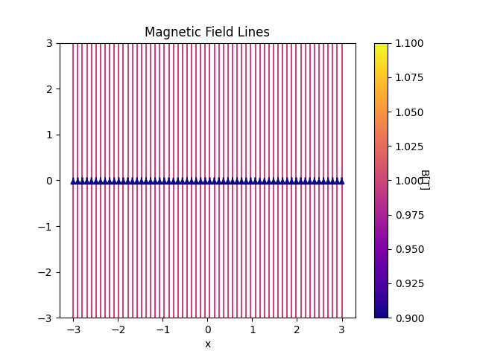
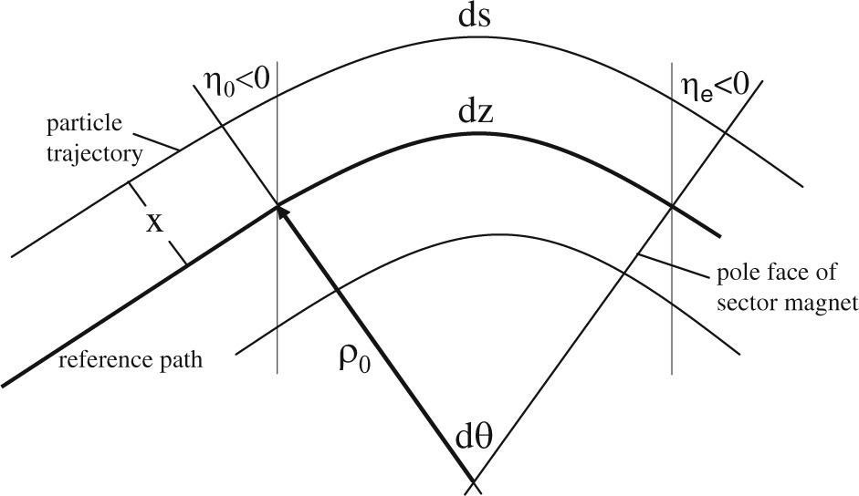
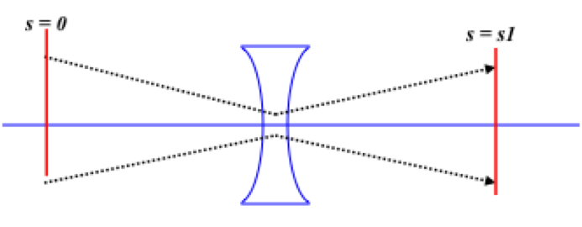
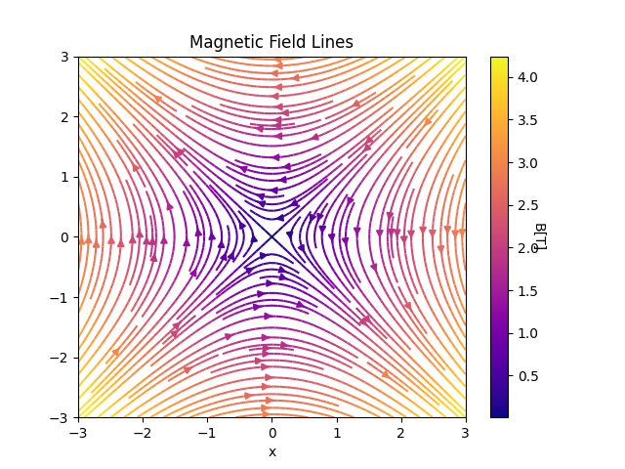
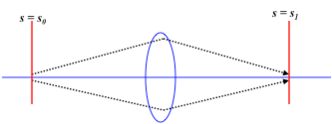
Few key principles

Slide 4
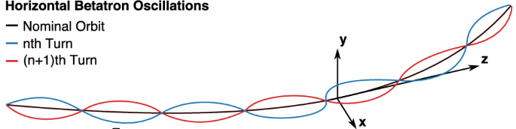
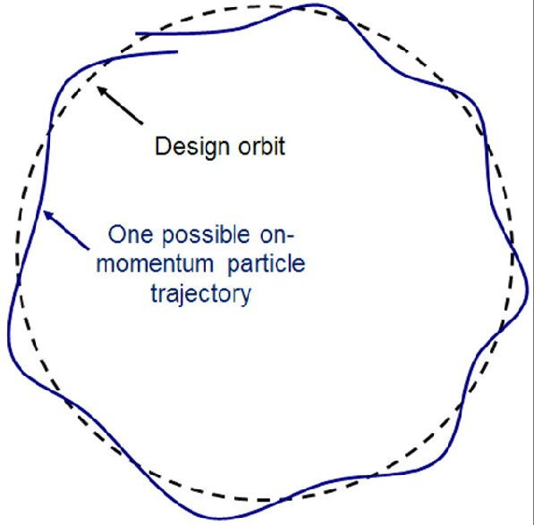

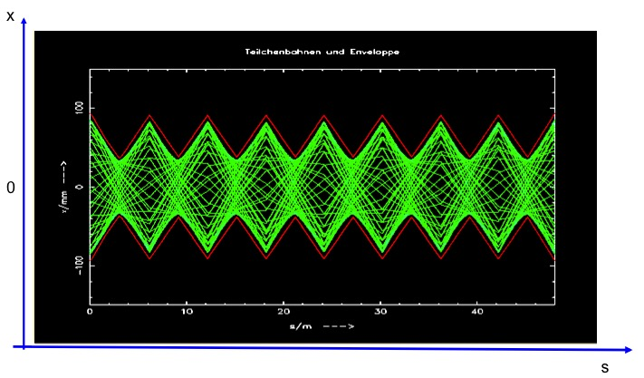



Betatron oscillations and Twiss parameters

Slide 5
FCCee High Energy Booster (FCCee-HEB)
1

Slide 6

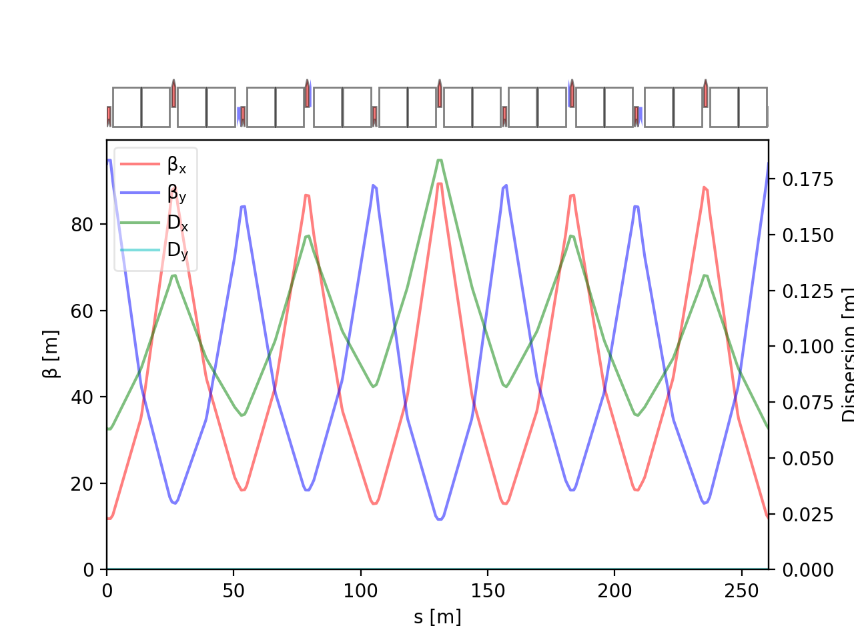
Errors and Correctors
D1
F1
D2
F2
D3
F3
D3
F1
Error type | σ value
Dipole relative field error | 10⁻³
Quadrupole relative field error | 2 x 10⁻⁴
Sextupole relative field error | 2 x 10⁻⁴
Main dipole roll error | 300 μrad
Offset quadrupoles | 200 µm (girder) + 50 µm
Main Quadrupoles roll | 300 μrad
Offset BPMs | 200 µm (girder) + 50 µm
Offset sextupoles | 200 µm (girder) + 50 µm
F2
D2
MQ
BPM
MS
MS
MQ
BPM
Errors are randomly distributed in arcs
(PDF=Truncated gaussian @3σ).
= skew quad corrector
(568)
= normal quad corrector
(560)
= orbit corrector
(~2800)

Slide 7
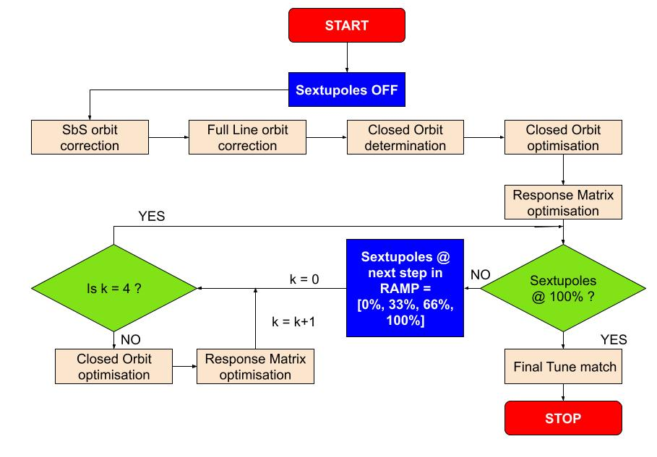
Correction Strategy
Sextupole RAMP ensure limited effect due to interplay between sextupole strength and imperfections
100 seeds simulated

Slide 8
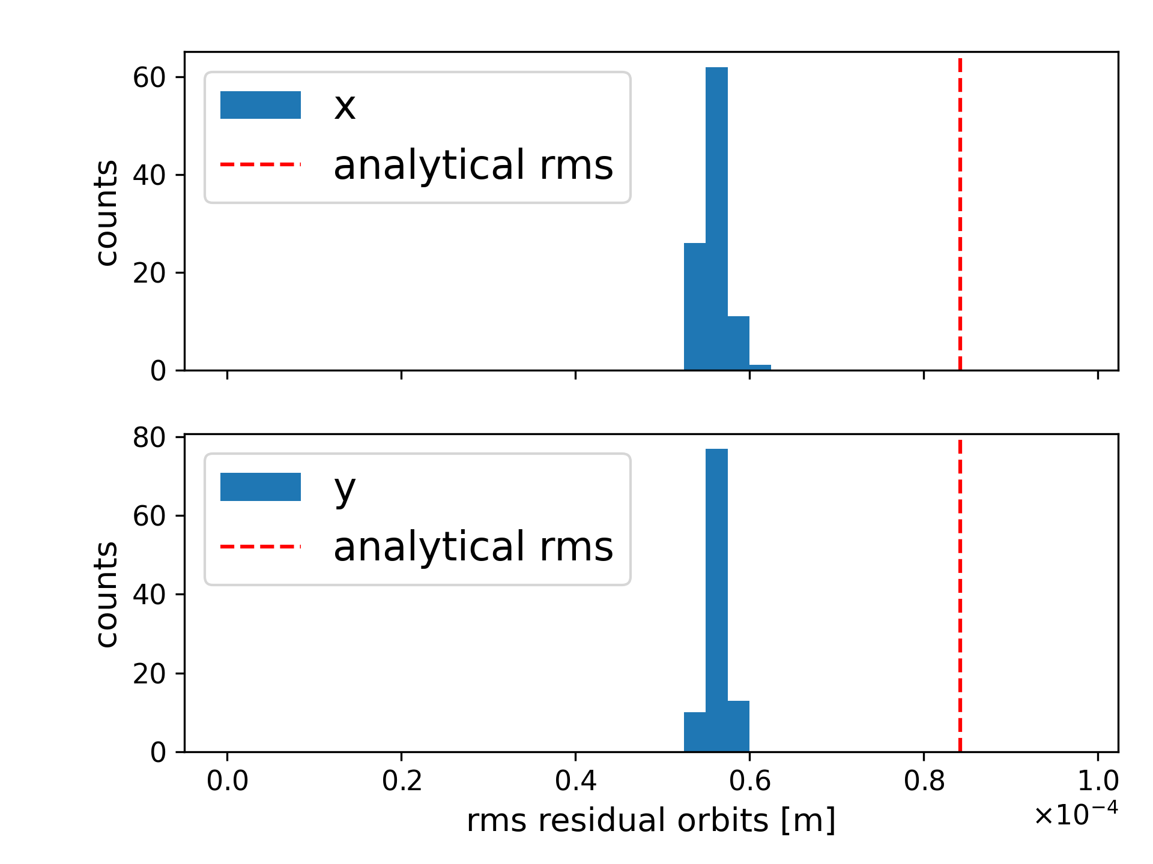
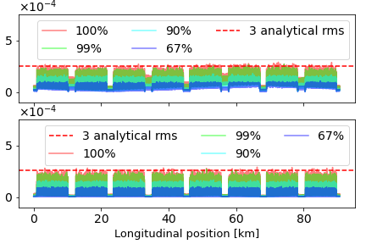
Residual Orbit
|x| [m]
|y| [m]
RMS residual orbits below analytical value
Absolute orbit excursion below .3mm
100 successful seeds

Slide 9
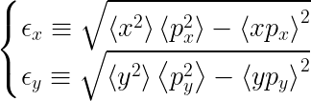
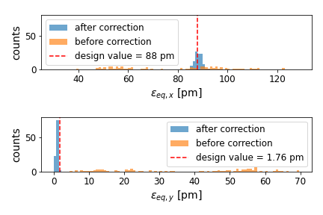


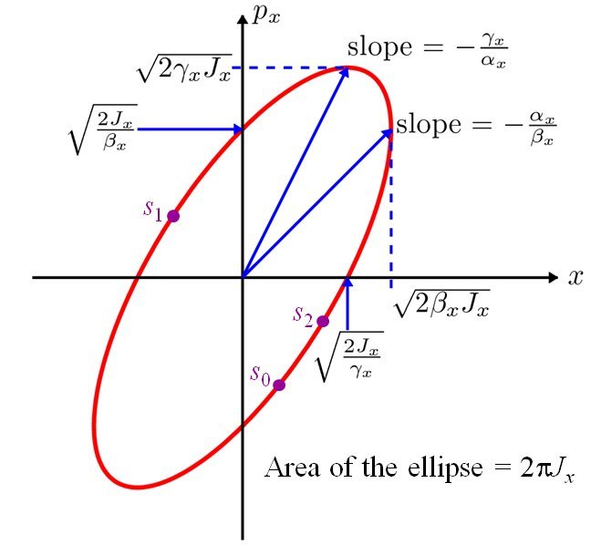
Emittance

Slide 10
Anomaly detection and denoising of SuperKEKB Turn-by-turn BPMs
2

Slide 11


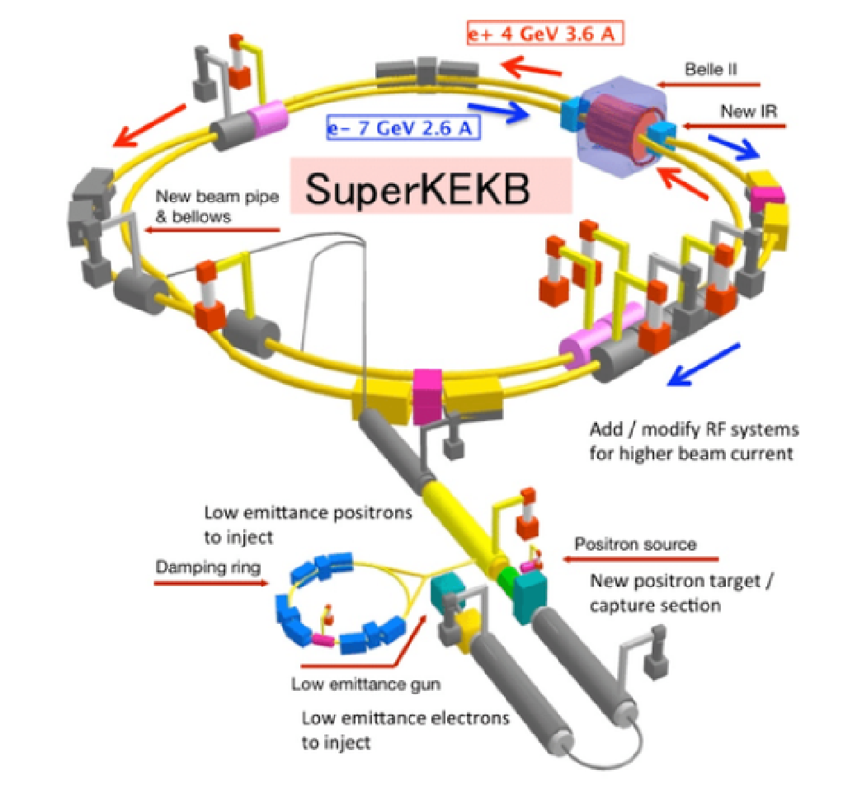
SuperKEKB
Largest existing e+/e- collider
~3km long
small-scale FCCee
Provides proof of principle of several concepts and design choices.

Slide 12
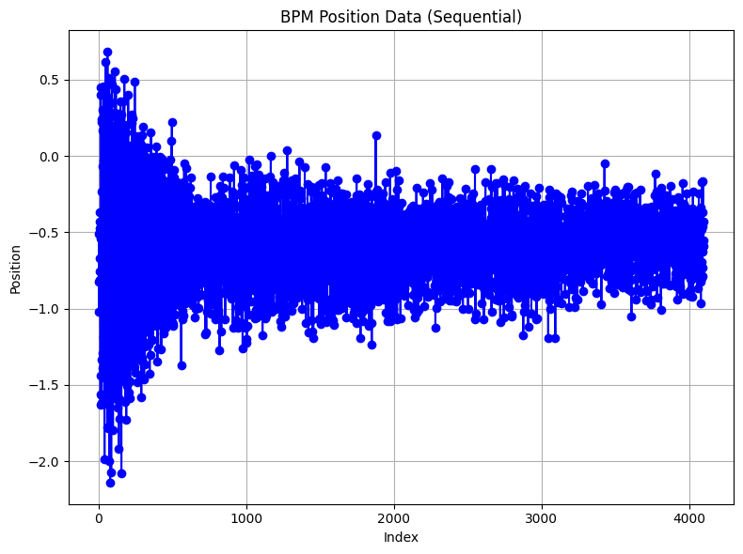
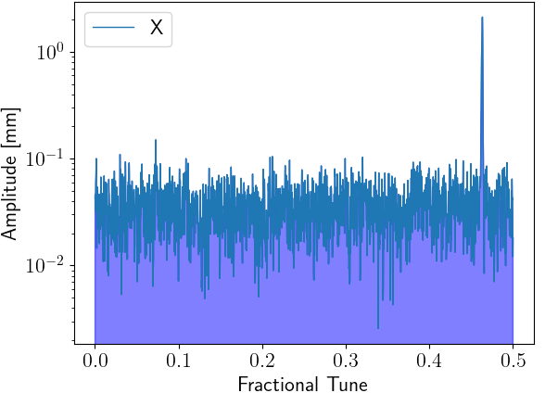
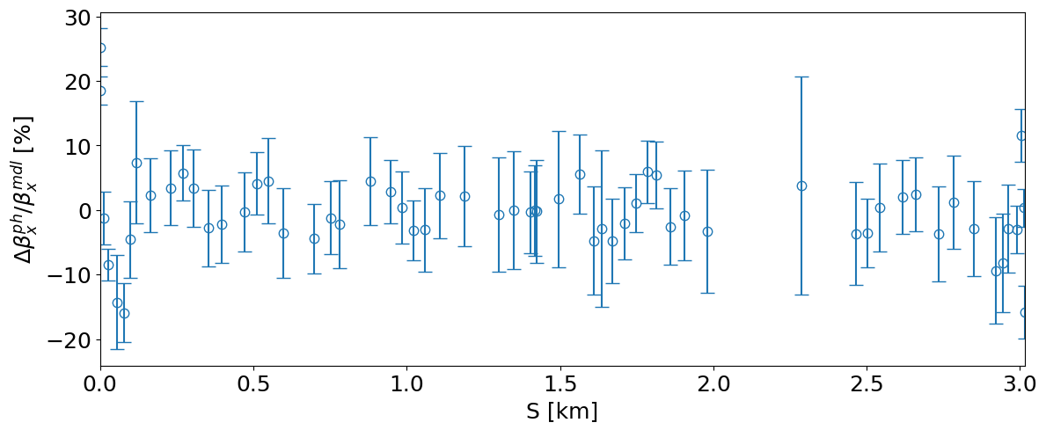
TbT BPM data
BPM data (gen. sdds format)
BPM data
Synchronization
SVD cleaning
If high singular
intrinsic errors
Else
Position [mm]
ACCELERATOR
BPM cuts
Optics parameters reconstruction
Harmonic analysis
Turn number

Slide 13
Anomaly detection
Clustering algorithm : DBSCAN
Hyperspace of the statistical features from Multivariate Time Series (MTS)
1 vs All approach
ɛ distance based algorithm
: outlier out of ε range from other points
ε
Main approach:
One measurement, all tracks
: first point considered in the cluster
Feature 2
: point in the cluster
Selection of features by Time2Feat library.
: point in the cluster w/ no neighbour
Feature 1
For HER: standard deviation, median, autocorrelation, FFT components, location of max, …
Features kept: 37/201
For LER: percentage of recurring values, FFT components, variance, …
Features kept: 31/201

Slide 14
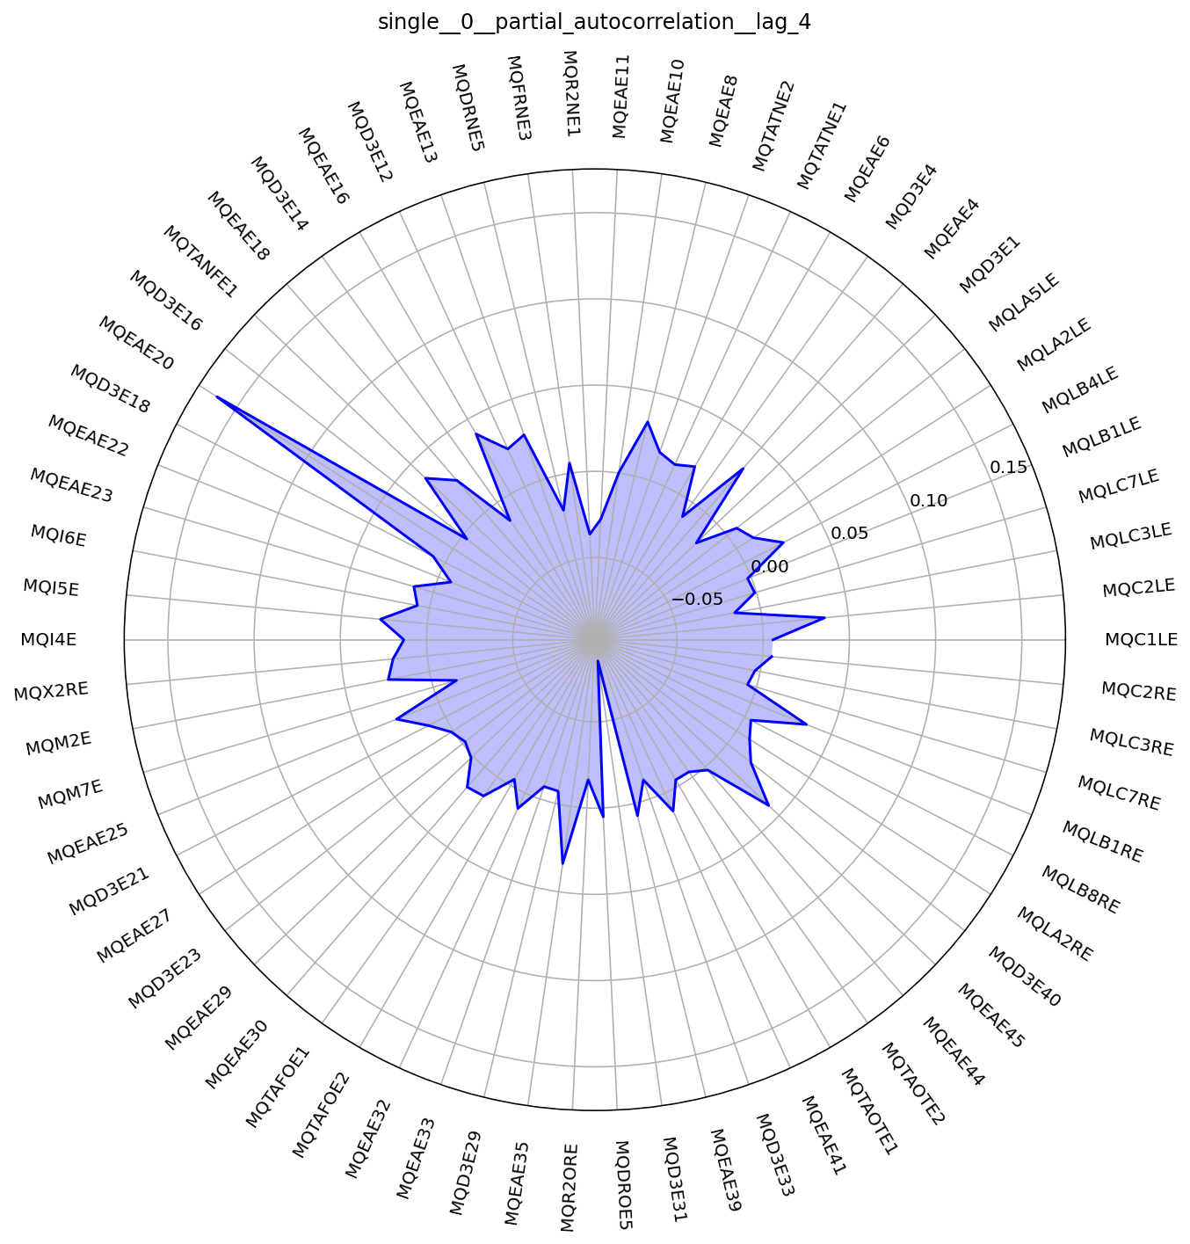
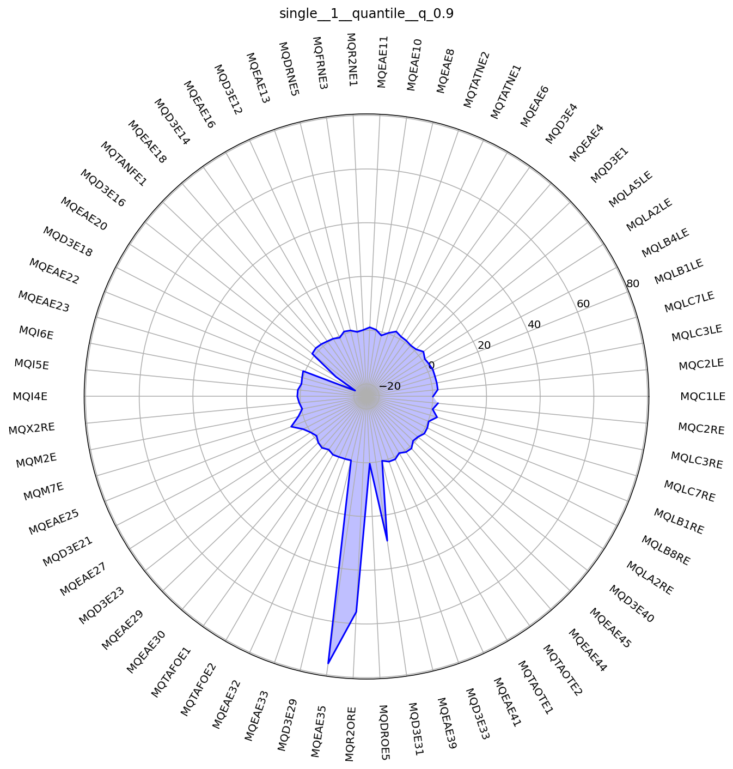
Examples of features

Slide 15
Main results
Faulty BPM HER (DBSCAN) | Expected faulty BPM HER | Faulty BPM LER (DBSCAN) | Expected faulty BPM LER
MQEAE35 | MQEAE35 |  | MQD3P23
MQD3E18 | MQD3E18 | MQEAP29 | MQEAP29
MQR2ORE | MQR2ORE |  | MQD3P8
MQEAE20 | MQEAE20 |  | MQEAP10
MQEAE33 |  | MQEAP35 | MQEAP35
MQD3E29 |  | MQW2ORP | MQW2ORP
 | MQD3E23 | MQEAP32
MQEAE25 |  | MQEAP33
 | MQD3E8 | MQEAP44
 |  | MQD3P29
 |  | MQI6P
 |  | MQEAP38
Faulty BPM HER (DBSCAN) | Expected faulty BPM HER | Faulty BPM LER (DBSCAN) | Expected faulty BPM LER
MQEAE35 | MQEAE35 | MQD3P23 | MQD3P23
MQD3E18 | MQD3E18 | MQEAP29 | MQEAP29
MQR2ORE | MQR2ORE |  | MQD3P8
 | MQD3E8 |  | MQEAP10
MQD3E23 | MQD3E23 | MQEAP35 | MQEAP35
 | MQEAE20 | MQW2ORP | MQW2ORP
MQC2RE
MQLB1LE
Results of an SVD & Isolation Forest algorithm built by CentraleSupelec students co-supervised by B.Dalena and F.Bugiotti (CentraleSupélec)
Résultats DBSCAN

Slide 16
Conclusion & perspectives

Slide 17
Conclusion
Design FCCee-HEB:
Large number of quite realistic errors taken into account.
Full correction of the imperfections taken into account with achieving target emittances
Anomaly detection and denoising of TbT-BPMs :
Implementation of the DBSCAN algorithm to apply in the case of BPMs and accelerators
Formatting the dataset for the use of librairies.
Detection of at least 50% main known faulty BPMs

Slide 18
Perspectives
Design FCCee-HEB:
Study to lower the number of correctors (autocorrelation, NN-based methods, …)
Implement a method considering tapering for ttbar operation (@182GeV)
Compute the Dynamic Aperture with the errors implemented
Anomaly detection and denoising of TbT-BPMs :
Building a truth table for the algorithm DBSCAN
Understand the feature selection process
Building and Comparison of other methods

Slide 19
Merci

Slide 20
Annexes
A

Slide 21
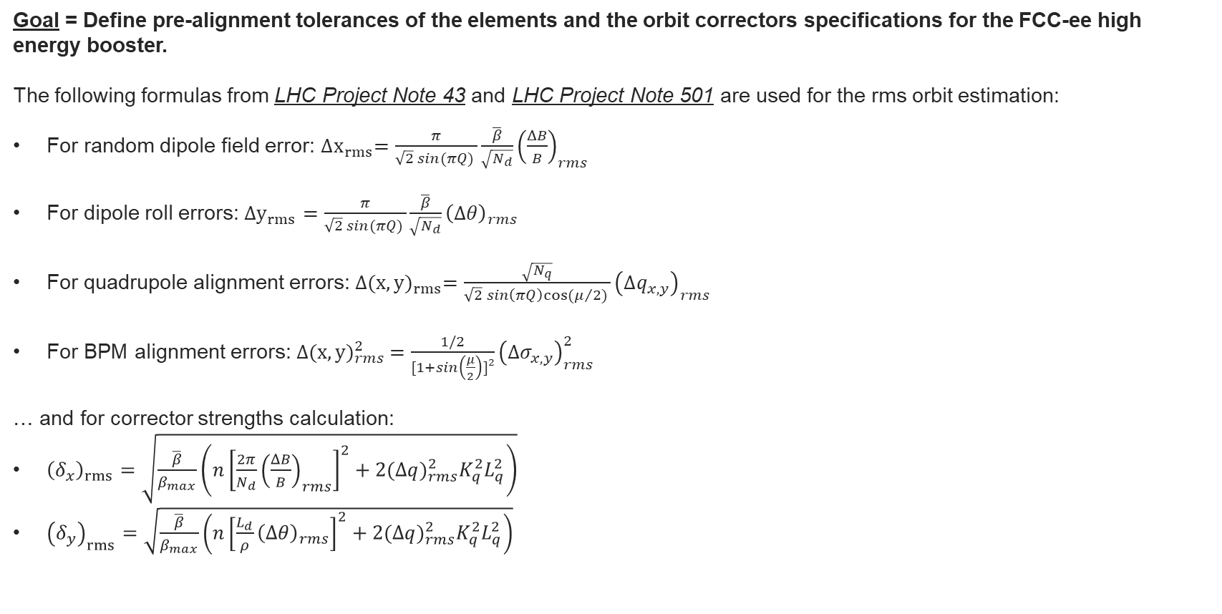
MOTIVATION

Slide 22

FCC-ee booster advancement
Equilibrium Emittance computation:​
To cross check the computation, use of EMIT package of the MAD-X algorithm. It computes the emittance with the method explained in A.Chao method [1].
It is based on the eigenvalues and eigenvectors studies of the single-turn transfer matrix
The final formula for the emittance is given by:
where:
E is the matrix built by the concatenation of the eigenvectors,
Alpha is the damping constant of the k^th mode
C_L is a constant related to C_q

Slide 23



FCC-ee booster advancement
Vertical Equilibrium Emittance computation with errors:
For the vertical transverse emittance, we used a formula, assuming that the vertical error are completely random in the ring (not related to the curvature), and that the coupling between the tranverse planes is low:

Slide 24







FCC-ee booster advancement
Equilibrium Emittance computation:
To compute it in the booster, we used another equation that allow us to compute the natural (without the alignement errors) and the real emittance for the horizontal transverse emittance:
where C_q is a constant, I_x are synchrotron integrals

Slide 25




FCC-ee booster advancement
A.Franchi, S.M.Liuzzo, Z.Martí. "Analytic formulas for the rapid evaluation of the orbit response matrix and chromatic functions from lattice parameters in circular accelerators"
[arXiv:1711.06589v4 [physics.acc-ph] 4 Apr 2023]
Residual Orbit Response Matrix:

Slide 26

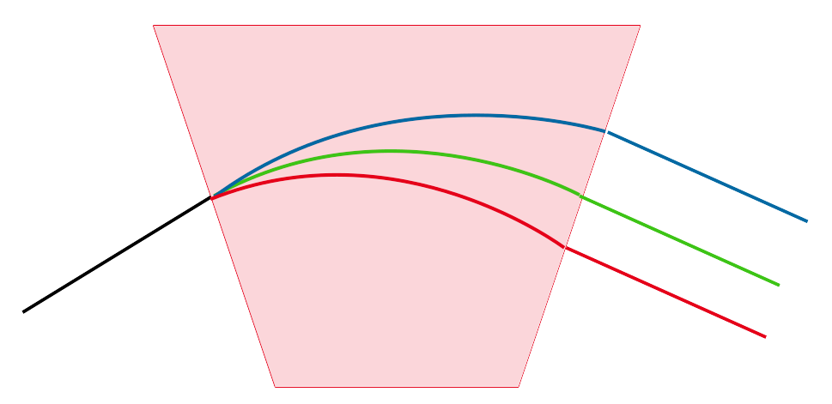




FCC-ee booster advancement
Dispersion at any position s considering m magnetic contributions:
Residual dispersion :
Phase advance

Slide 27
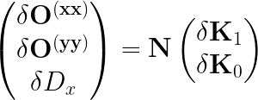
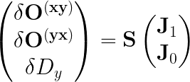
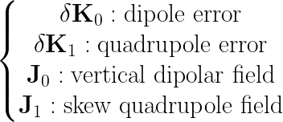


FCC-ee booster advancement

Slide 28
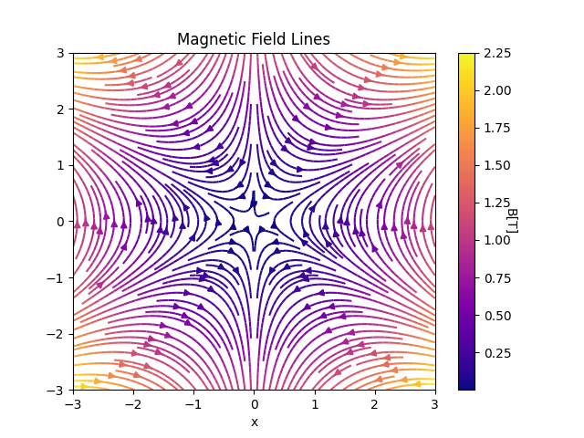
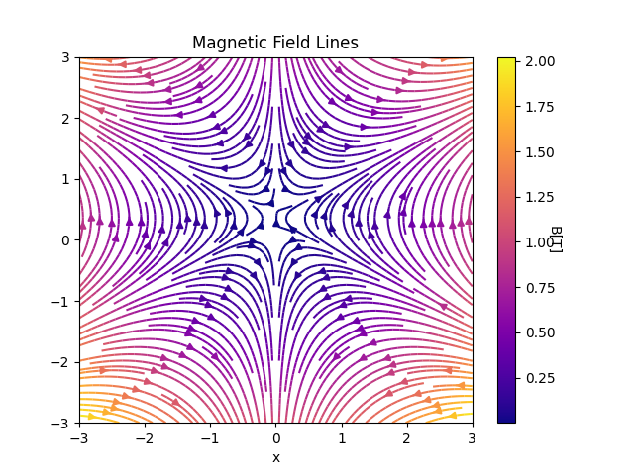
FCC-ee booster advancement
Perfect sextupole field
Misaligned sextupole field computed with feed-down fields
Skew quadrupolar fields and vertical dipole fields can be produced by misalignement of sextupole

Slide 29
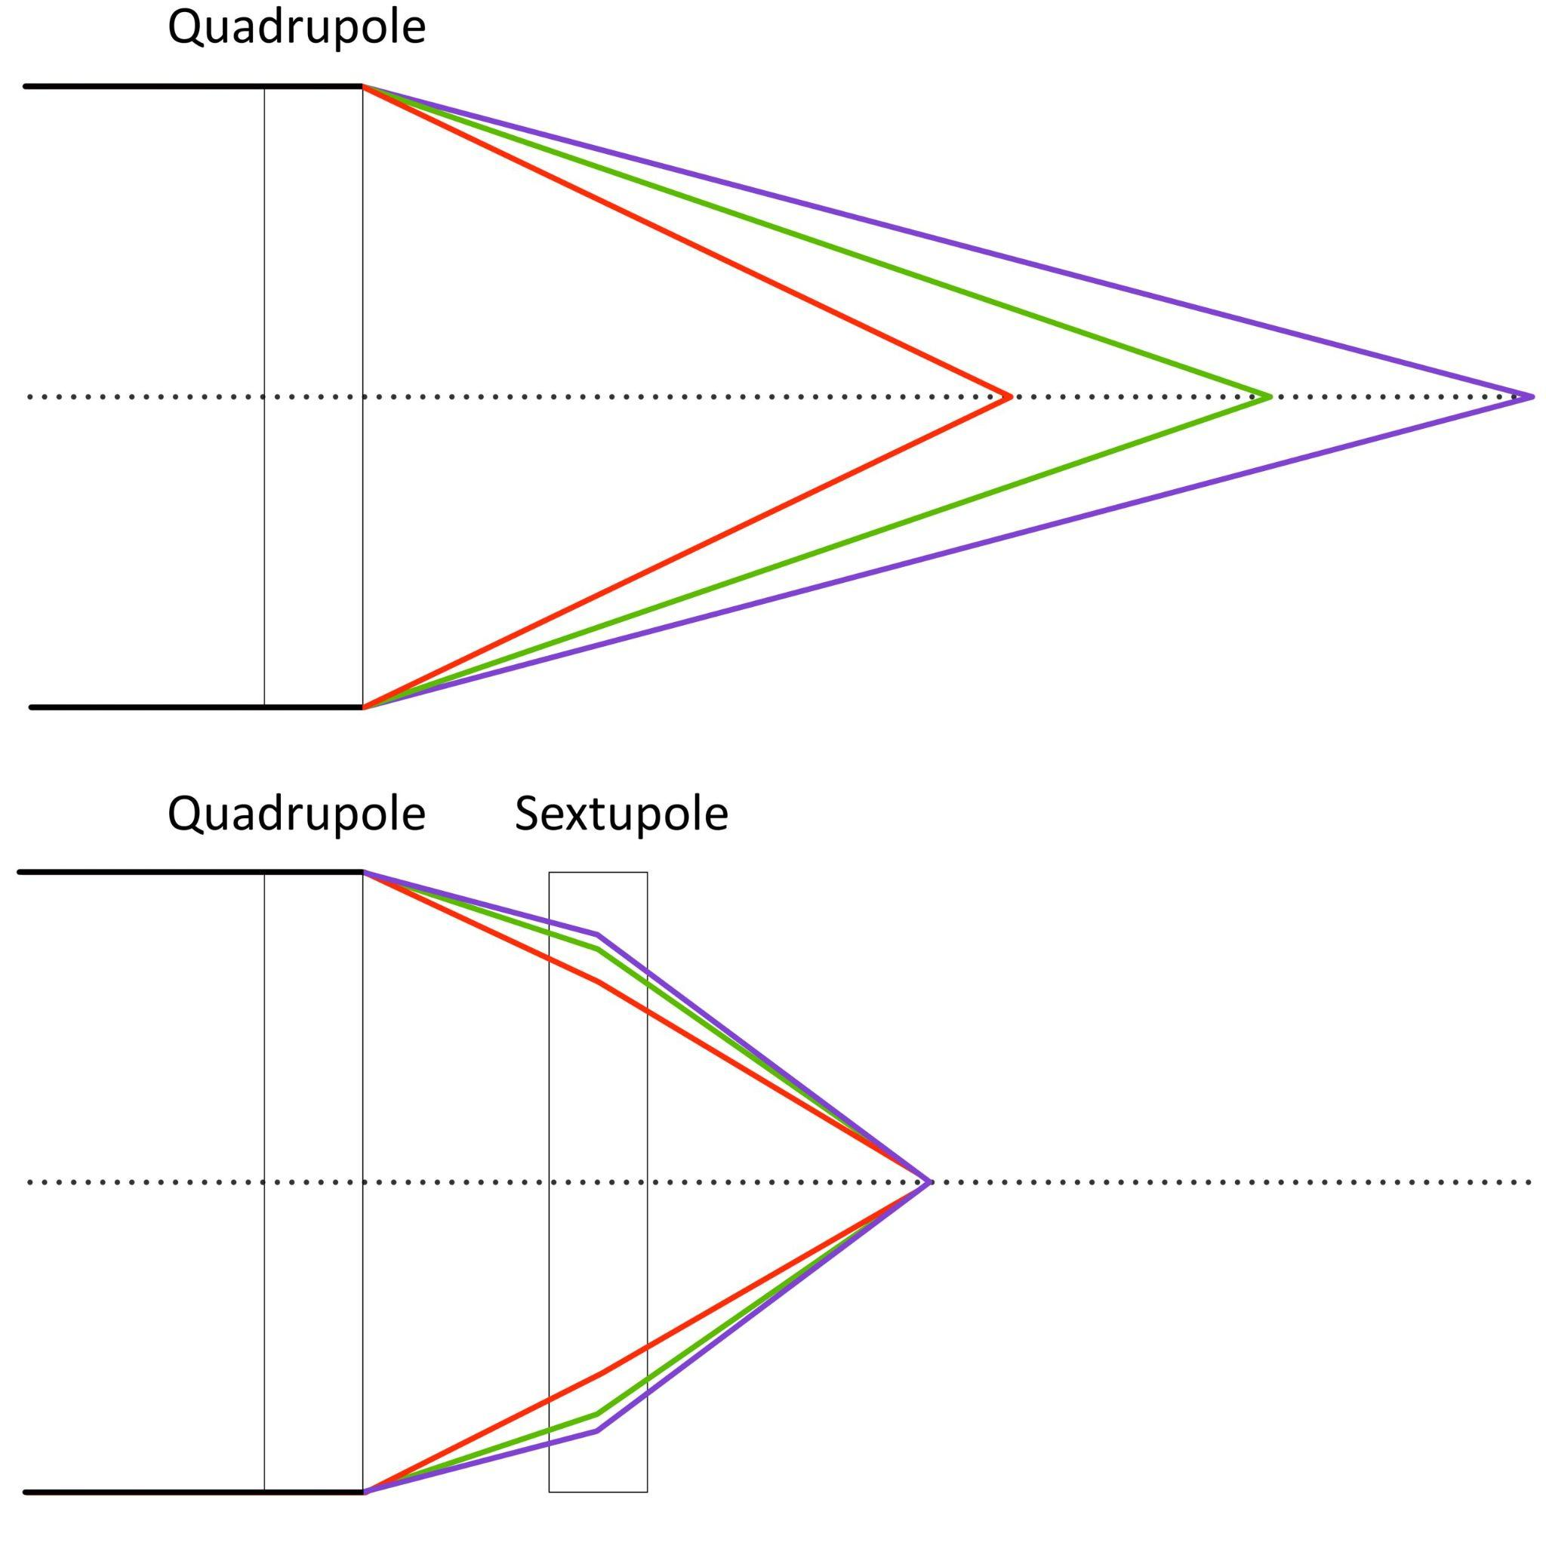

Sextupole and chromaticity

Slide 30
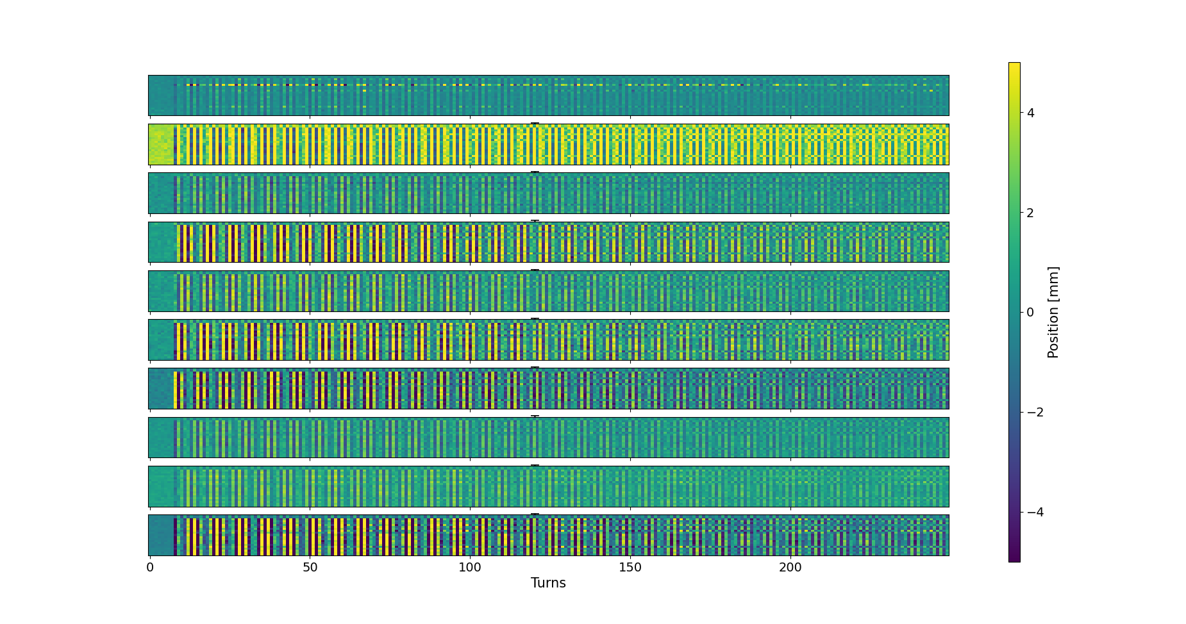
SuperKEKB data
BPMs
Shifted BPM

Slide 31
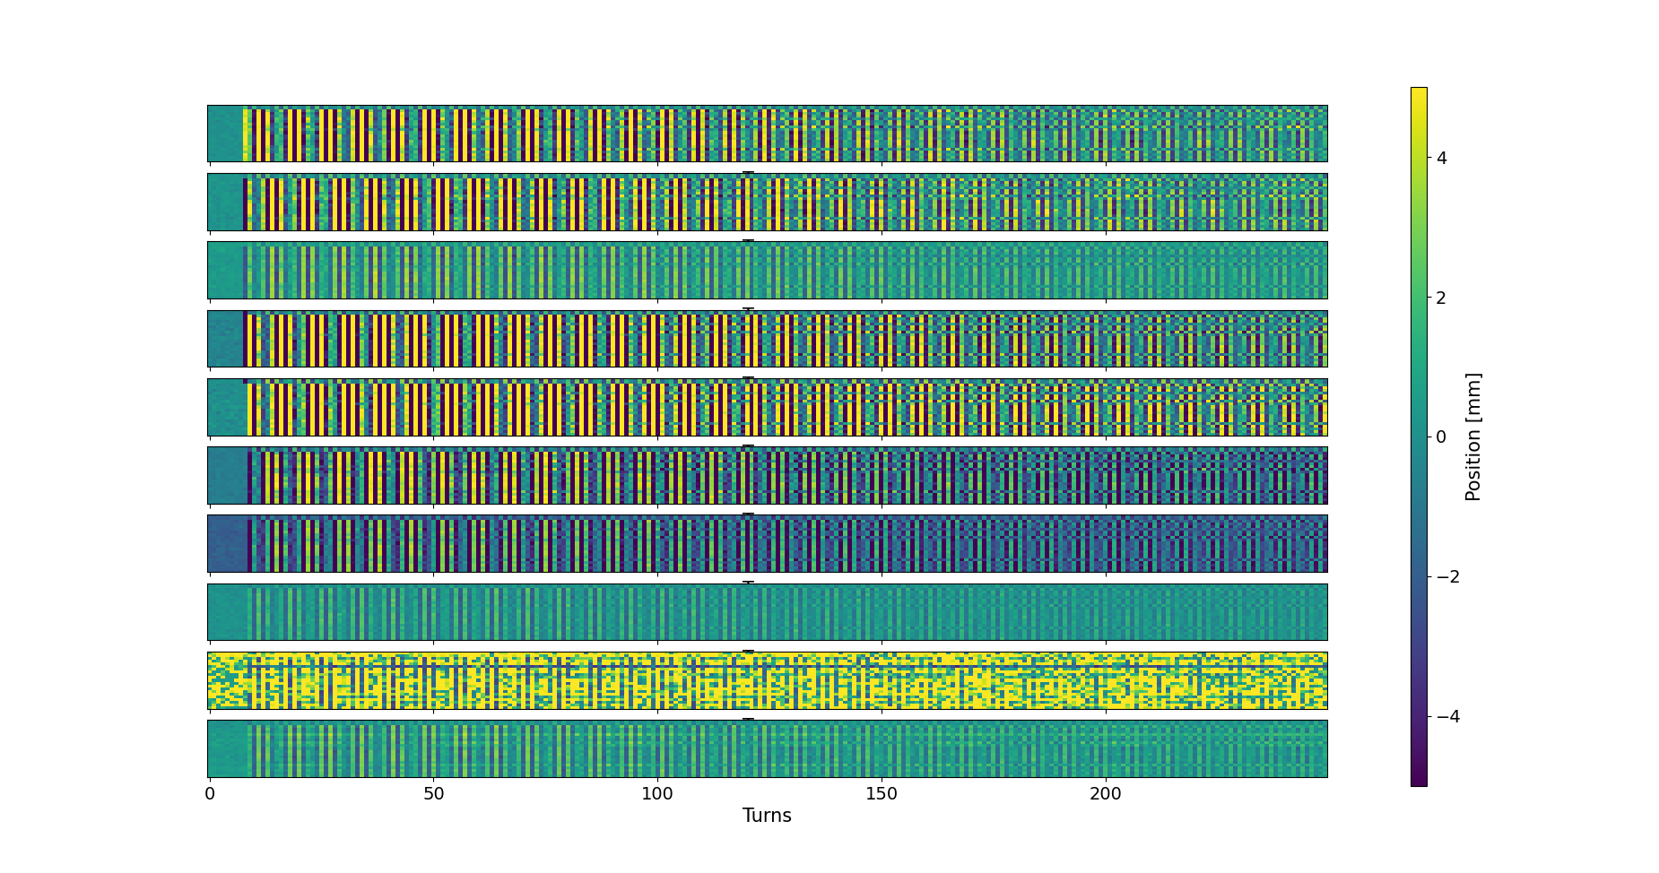
SuperKEKB data
Faulty BPMs

Slide 32
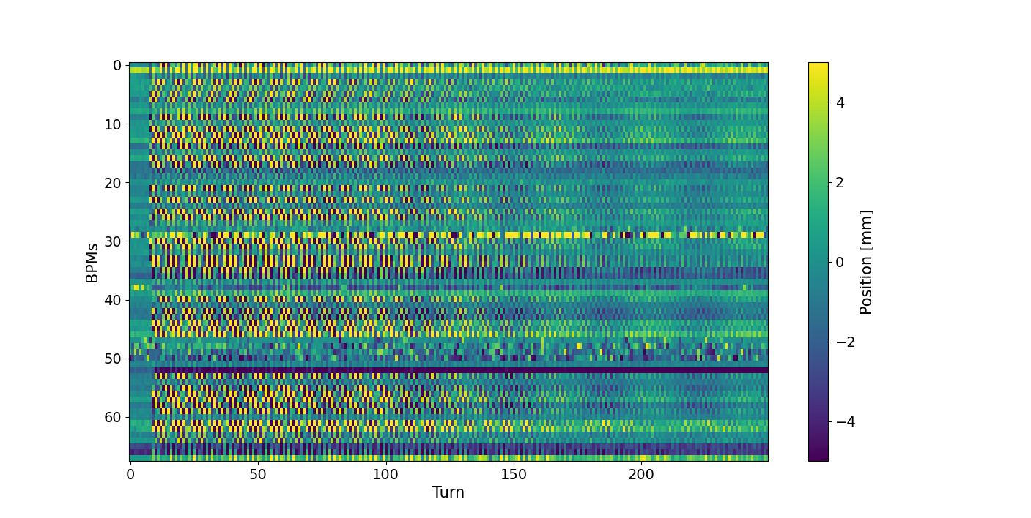
SuperKEKB data
Faulty BPMs

