Slide 1

Design of pulsed synchrotrons for the high-energy acceleration chain for a muon collider.
Lisa Soubirou – CEA Saclay / IRFU / DACM / LEDA

Slide 2
Why a muon collider ?
1

Slide 3
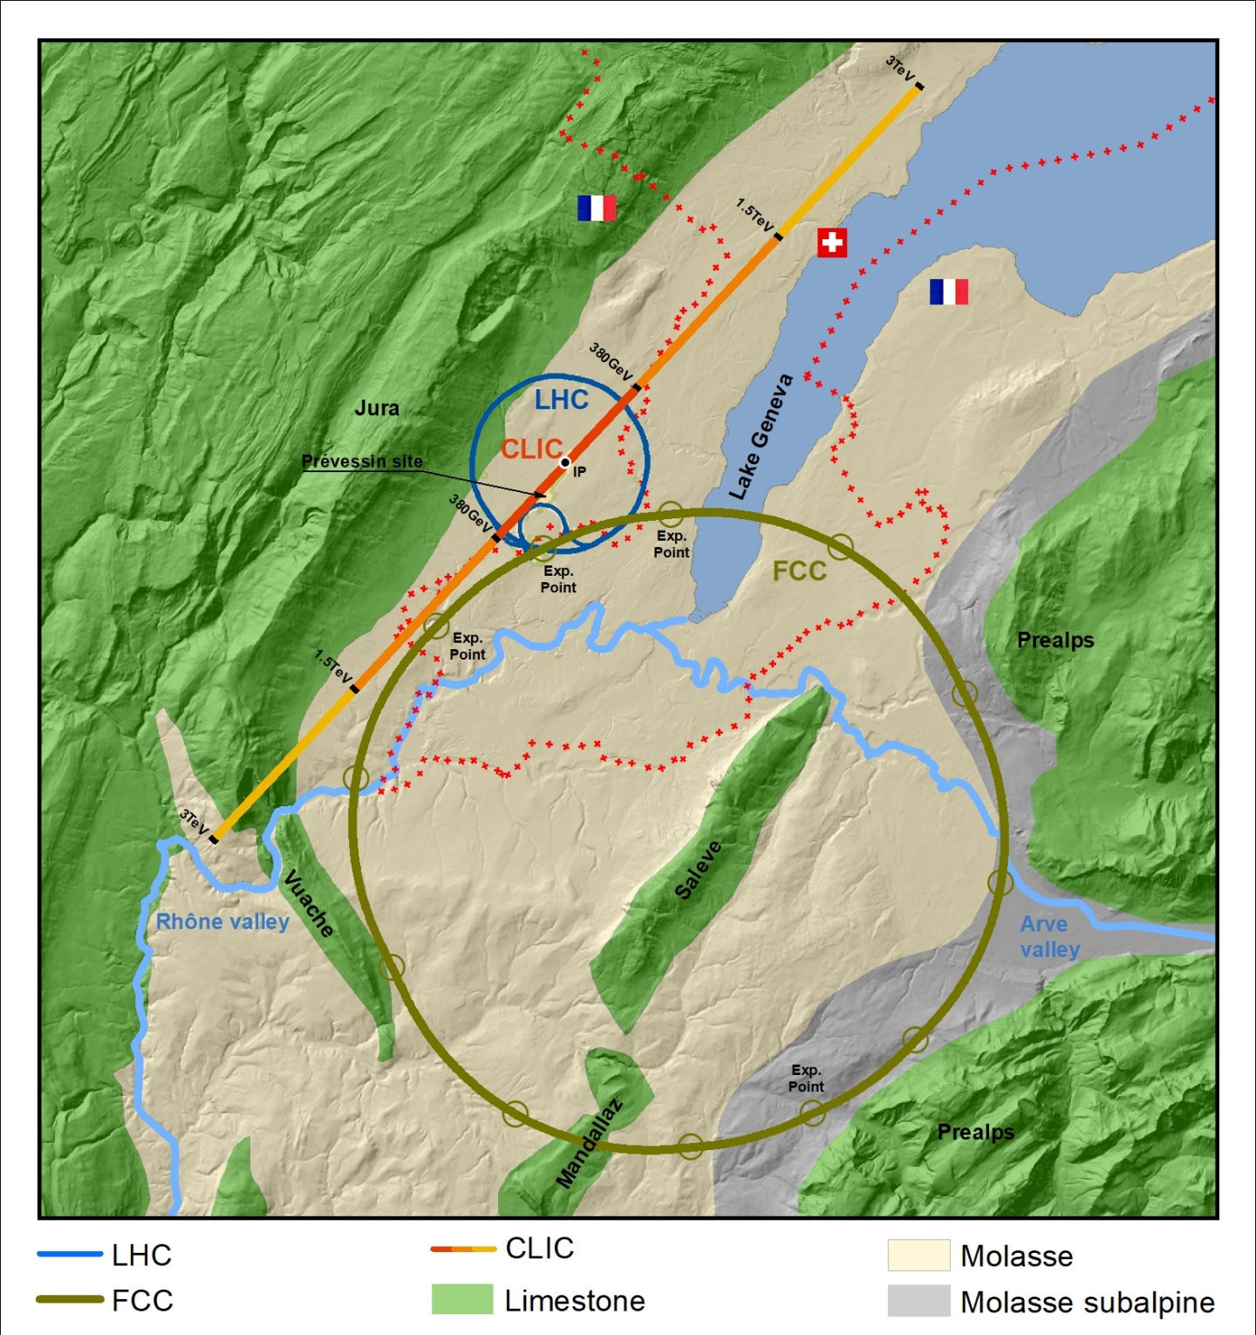
What will the next collider look like ?
Collider proposals:
Circular lepton and hadron rings : FCC (Future Circular Collider, CERN) & CepC (Circular Electron Positron Collider, China)
  90-100 km circumference
  90 – 350 GeV e⁺e⁻
  100 TeV p⁺-p⁺
Linear colliders :
  ILC (International Linear Collider, Japan) : 500 GeV e⁺e⁻ , 31 km.
  CLIC (Compact Linear Collider, CERN) : 380 GeV e⁺e⁻ , 11 km.

Slide 4
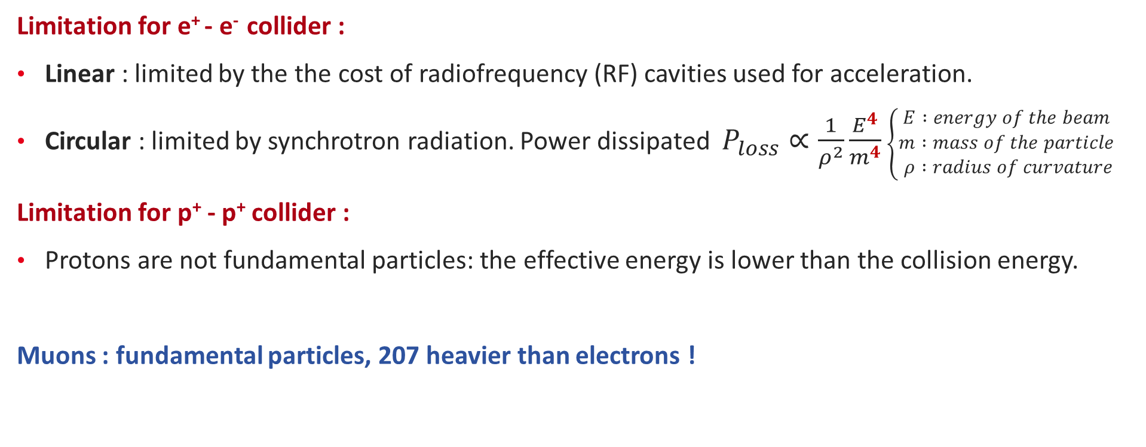
Motivation for a Muon Collider
Limitation for e⁺ - e⁻ collider :
Linear : limited by the the cost of radiofrequency (RF) cavities used for acceleration.
Circular : limited by synchrotron radiation. Power dissipated $P_{loss}∝\frac{1}{ρ^{2}}\frac{E^{4}}{m^{4}}$ $\left\{\begin{aligned}E :energy of the beam \\ m :mass of the particle \\ ρ :radius of curvature\end{aligned}\right.$
Limitation for p⁺ - p⁺ collider :
Protons are not fundamental particles: the effective energy is lower than the collision energy.
Muons : fundamental particles, 207 heavier than electrons !
UNSTABLE : half-life of 2.2 µs at rest.

Slide 5
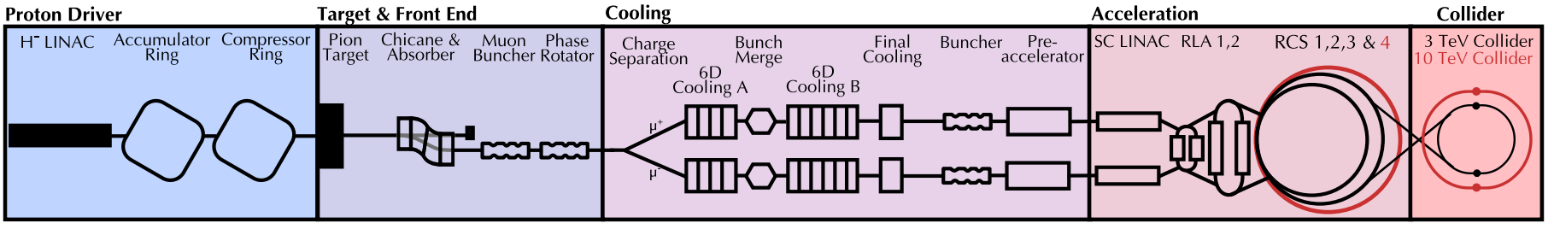
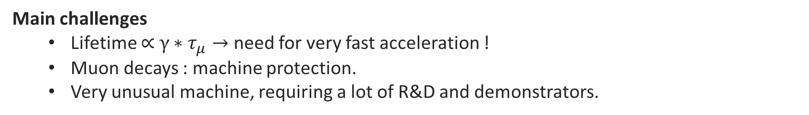
Muon Collider : reaching 10 TeV collisions
Acceleration
Low energy: Supraconducting linear accelerator (linac) + recirculation linac.
High energy: Pulsed synchrotrons.
Proton Driver
Short and intense bunches of protons are produced and sent onto a target.
Target and Capture
Pion production at the target.
Pions decay into muons. Muon capture.
Ionisation cooling of the muon bunches decreases emittance.
Collider
Main challenges
  Lifetime $\text{∝} γ∗τ_{μ}→$ need for very fast acceleration !
  Muon decays : machine protection.
  Very unusual machine, requiring a lot of R&D and demonstrators.

Slide 6
High-energy accelerator complex
2

Slide 7
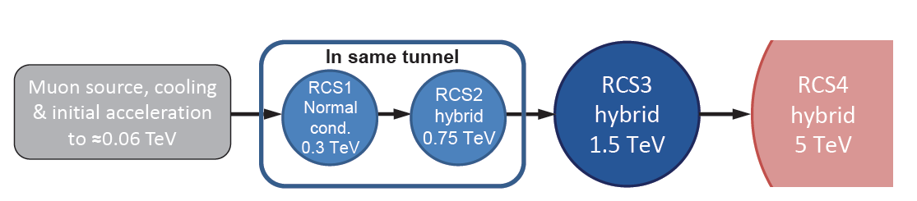
High-energy acceleration chain
Design goals: fast acceleration (total survival rate of 70%), cost efficient and power efficient !
Layout for the high-energy acceleration chain: chain of Rapid Cycling Synchrotrons (RCS), spanning an energy range from 63 GeV to 5 TeV.
Conventional RCS : the magnetic field B of the dipoles is ramped to keep up with the energy increase to keep a constant bending radius.
The baseline for the chain features both conventional and hybrid RCS.
Circumference :
C=5990m
C=10700m
C=35000m

Slide 8
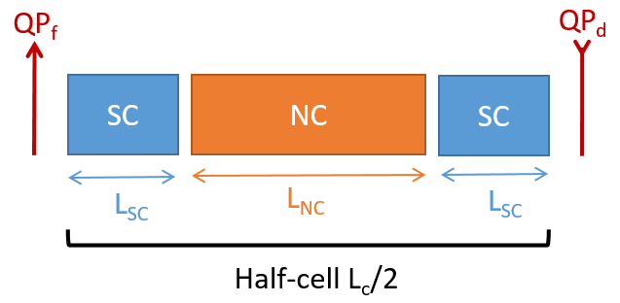
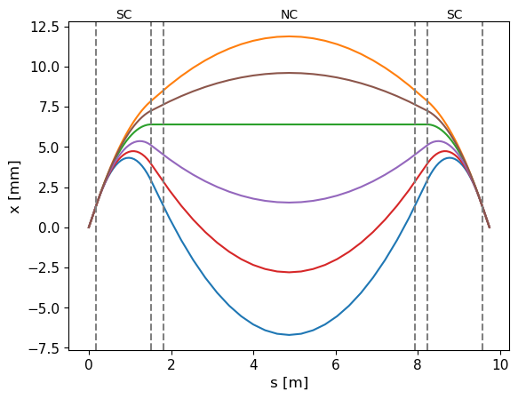
Hybrid RCS
To minimize the total RF voltage (and therefore the cost), we need to work with the smaller ring possible.
Hybrid synchrotron (never operated configuration) features two types of dipoles:
Fixed-field superconducting (SC) dipoles (10 T) : provides high average bending field → compact ring.
Pulsed normal-conducting (NC) dipoles (-1.8 T to 1.8 T) : keep up with the fast acceleration.
The two types of dipole result in a local change in trajectory during acceleration, which also causes a variation in path length.
RCS 2
Extraction
Injection

Slide 9
Optics design
3

Slide 10
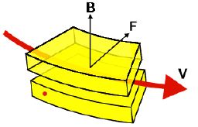
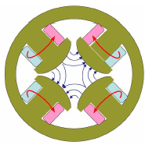
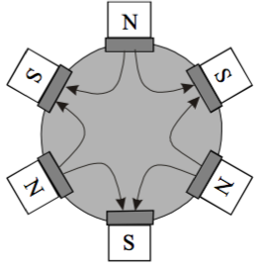
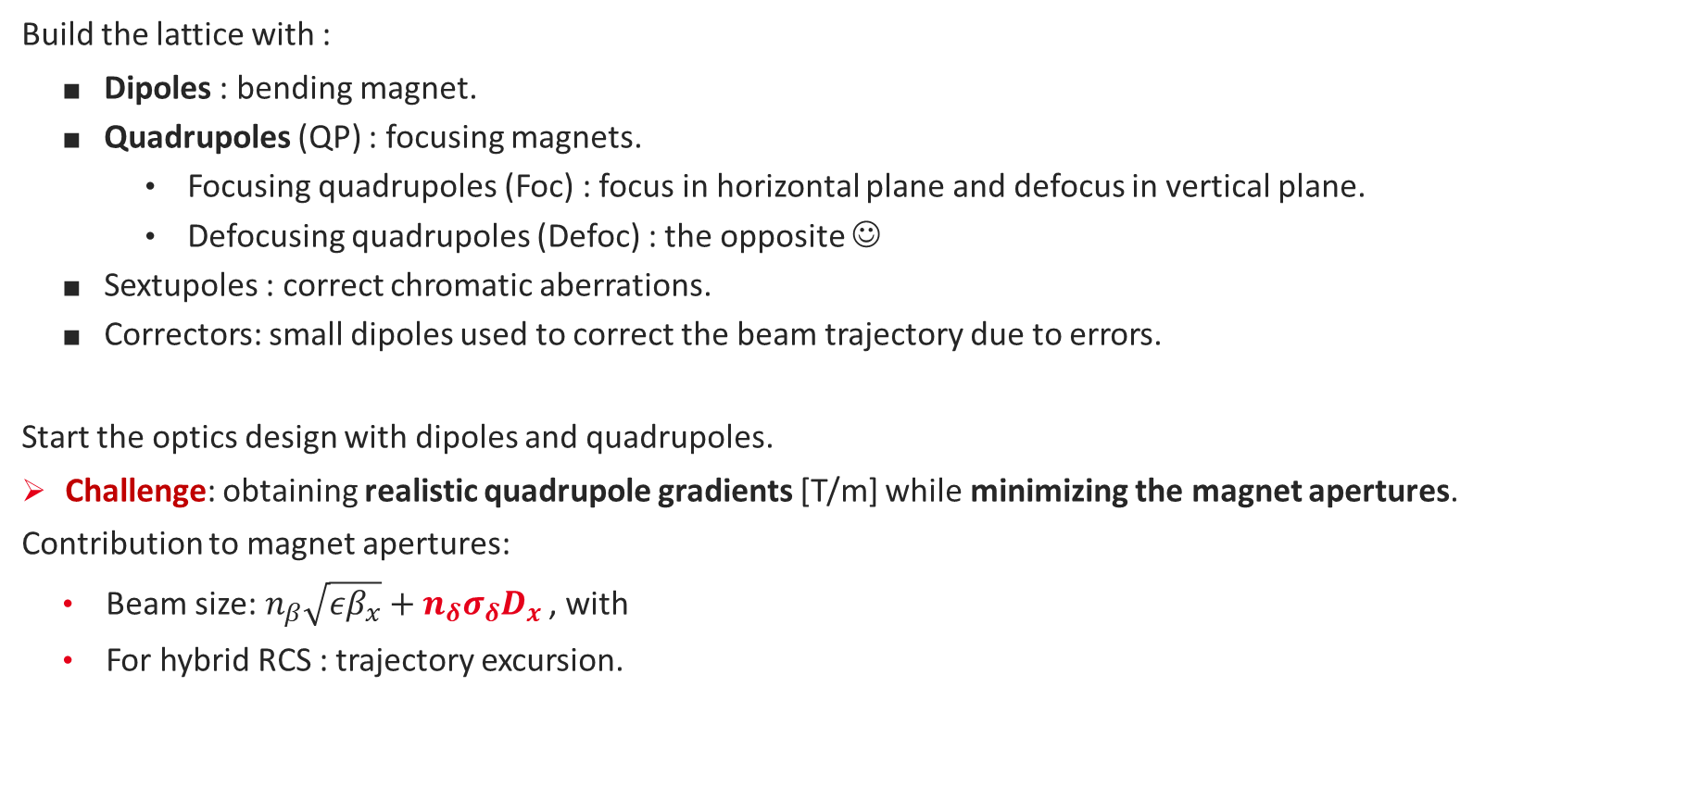
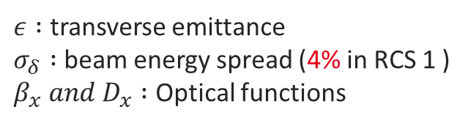
Building a ring from its component parts.
Dipole
Quadrupole
Build the lattice with :
    Dipoles : bending magnet.
    Quadrupoles (QP) : focusing magnets.
      Focusing quadrupoles (Foc) : focus in horizontal plane and defocus in vertical plane.
      Defocusing quadrupoles (Defoc) : the opposite ☺
    Sextupoles : correct chromatic aberrations.
    Correctors: small dipoles used to correct the beam trajectory due to errors.
Start the optics design with dipoles and quadrupoles.
Challenge: obtaining realistic quadrupole gradients [T/m] while minimizing the magnet apertures.
Contribution to magnet apertures:
  Beam size:${ n}_{β}\sqrt{εβ_{x}}+{n_{δ}σ_{δ}D}_{x}$ , with
  For hybrid RCS : trajectory excursion.
Sextupole
$ε :$ transverse emittance
$σ_{δ} :$beam energy spread (4% in RCS 1 )
$β_{x} and D_{x} :$ Optical functions

Slide 11
Three types of cells
« Conventional » FODO (FODO)
Pulsed QP.
DIPOLES
DIPOLES
QP NC Foc
QP NC Defoc
Interconnexion length
L_{c}
QP SC
Foc
QP SC
Defoc
« Hybrid » FODO (HFODO)
Strong steady and pulsed QP.
DIPOLES
DIPOLES
QP NC Foc
QP NC Defoc
Combined Functions (CF)
No QP. Focusing added into the dipoles.
DIPOLES
+ focusing
DIPOLES
+ defocusing
Insertion
Insertion
QP : quadrupole
SC : superconducting
NC : normal-conducting

Slide 12
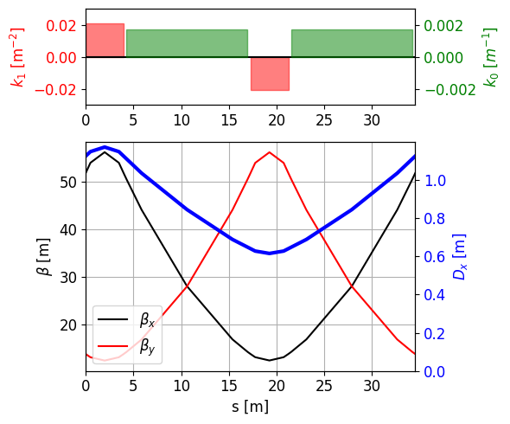
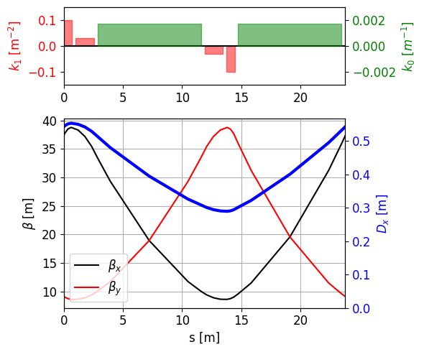
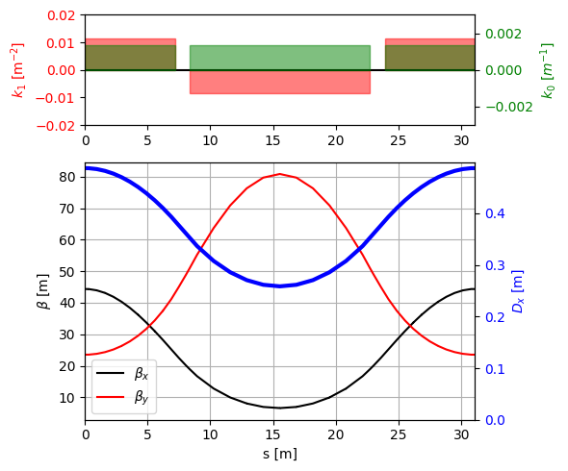
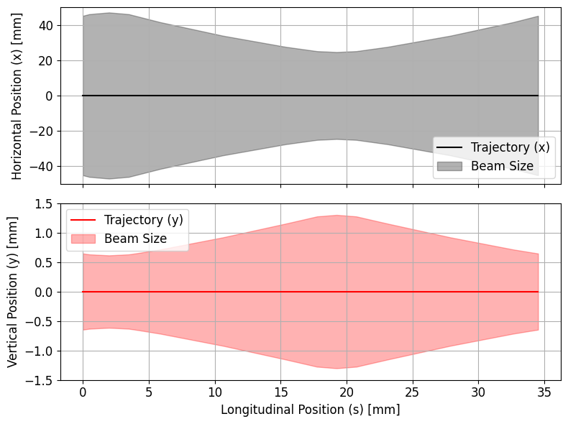
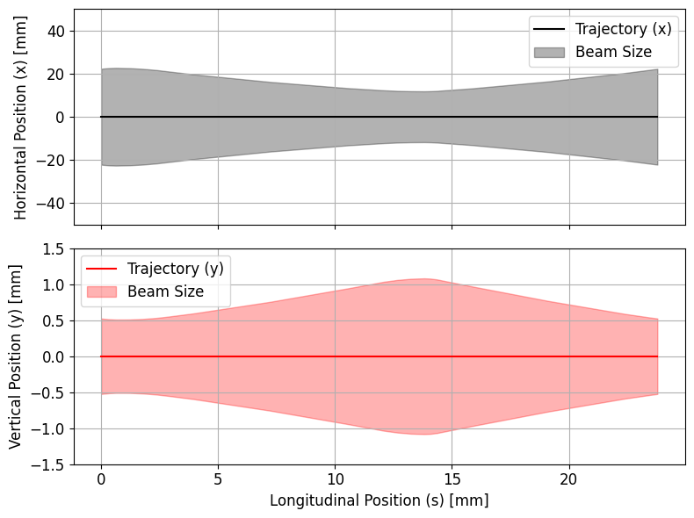
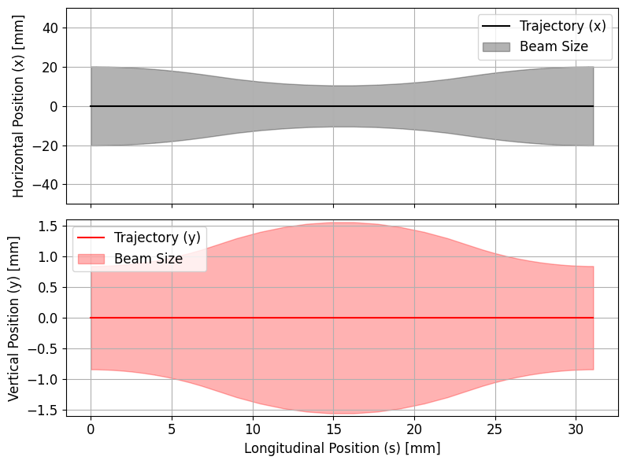
Cell optimization for RCS1
« Conventional » FODO
« Hybrid » FODO
Combined Functions

Slide 13
We accelerate so fast...
4

Slide 14
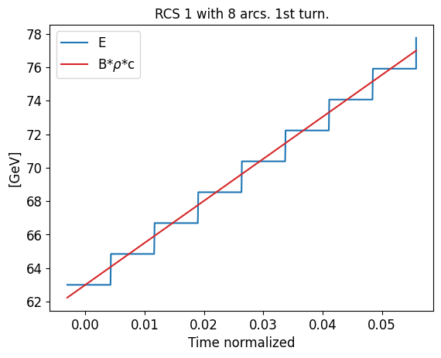
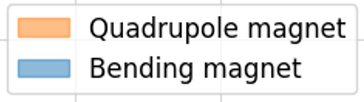
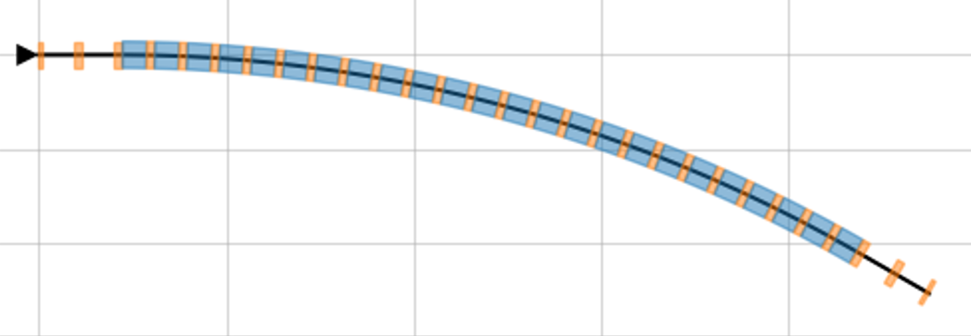
Difference between beam energy and magnetic field
Acceleration is done in less than 10 ms (LHC : 20 min).
For a conventional machine, the variation of B(t) in the arc is negligeable.
Not the case for the RCS of a muon collider ! For 8 arcs, error on the bending up to 3% for RCS 1 in the first arc.
Layout of an arc
Energy increase
Energy increase
Magnetic field increase B(s)
s

Slide 15
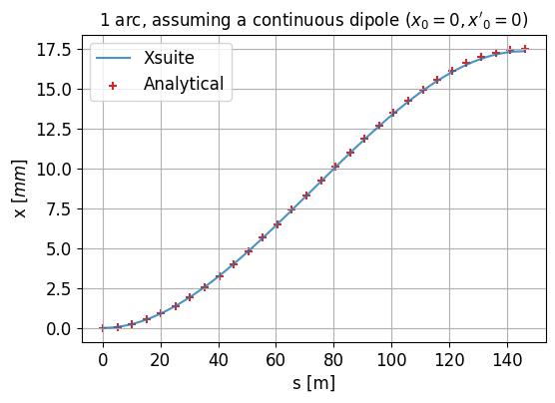
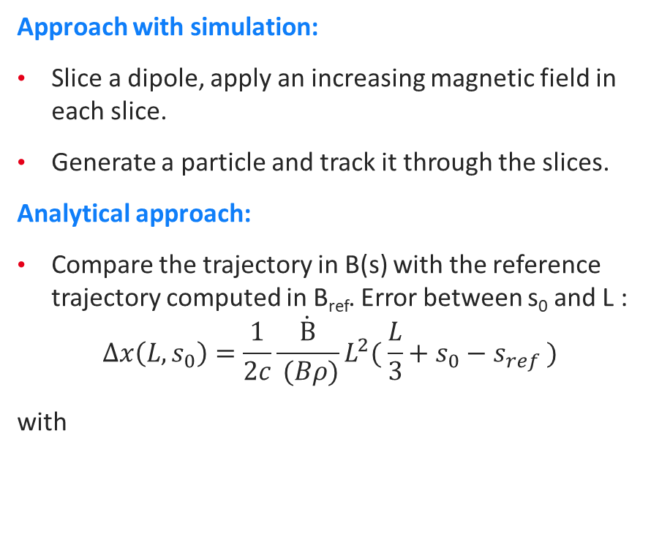
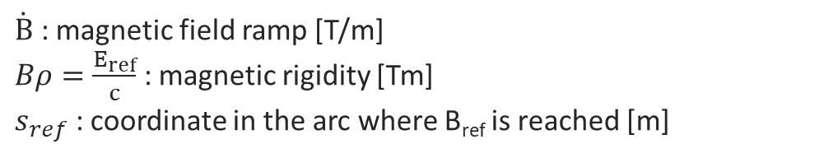
Analytical model and simulation
Approach with simulation:
Slice a dipole, apply an increasing magnetic field in each slice.
Generate a particle and track it through the slices.
Analytical approach:
Compare the trajectory in B(s) with the reference trajectory computed in B_{ref}. Error between s₀ and L :
$$Δx\left(L, s_{0}\right)=\frac{1}{2c}\frac{\dot{B}}{ (Bρ)}L^{2}( \frac{L}{3}+s_{0}−s_{ref} )$$
with
Preliminary results:
work in progress !
$\dot{B}$ : magnetic field ramp [T/m]
$Bρ=\frac{E_{ref}}{c}$ : magnetic rigidity [Tm]
$s_{ref}$ : coordinate in the arc where B_{ref} is reached [m]

Slide 16

Conclusion and perspectives
First optics design for the chain of RCS.
First tracking studies done in the chain.
An analytical model has been developed to study the difference in beam energy and magnetic field.
  Need for more refined simulation studies on a realistic arc.
  Study the effect on the optics.
Future work will involve adding errors (magnet misalignments, field errors and jitters from the alimentation) and developing a correction scheme.

Slide 17

Thank you!
CEA SACLAY
91191 Gif-sur-Yvette Cedex
France
lisa.soubirou@cea.fr
* Artwork from Gaia Fontana @qftoons

