Slide 1



The DeLLight Experiment:
Reaching the Ultimate Sensitivity Toward Observing the Optical Nonlinearity of Vacuum
Ali Aras¹, Adrien Kraych¹, Francois Couchot¹, Xavier Sarazin¹
1. IJCLab, Université Paris-Saclay, CNRS/IN2P3, 91405 Orsay, France
PHENIICS FEST 2025, IJCLab, Orsay
4 July 2025

Slide 2
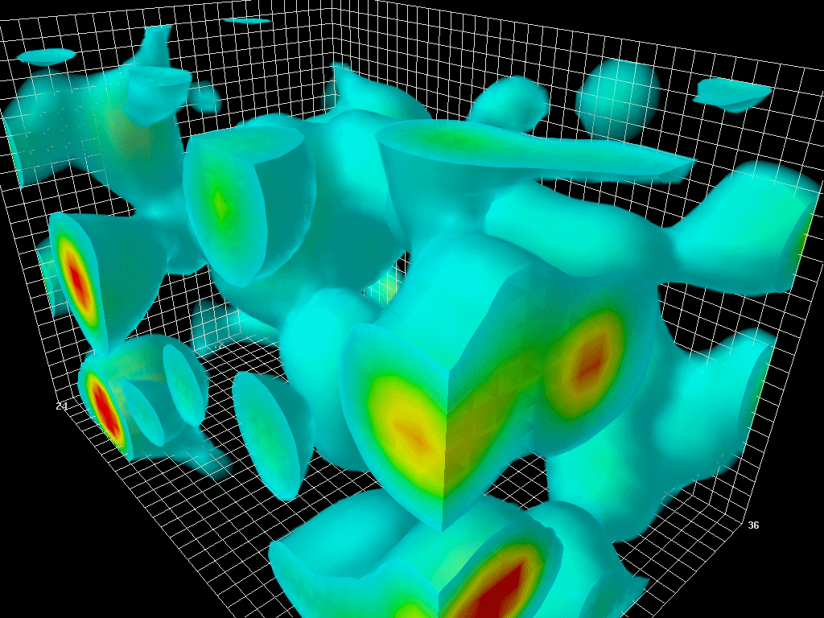



Introduction - From Classical to Quantum Vacuum
Classical Electrodynamics: Vacuum is empty → Maxwell’s equations are linear
D = $ε$₀E
B = $μ$₀H
$$c=\frac{1}{\sqrt{ε_{0}μ_{0}}}$$
${c, ε}_{0}$and $μ_{0}$ are UNIVERSAL CONSTANTS
Quantum Electrodynamics: Vacuum is dynamic → Virtual pairs exist → Nonlinear interaction between the electromagnetic fields via $e^{−}/e^{+}$ pairs
D = ε₀E + P(E,B) = ε (E,B).E
B = μ₀H + μ₀M(E,B) = μ (E,B).H
$$v=\frac{1}{\sqrt{ε(E,B)μ(E,B) }}$$
Maxwell’s equations become nonlinear
Optical index depends on external fields E,B ⇒ n(E,B)
When the vacuum is stressed by ultra-intense electromagnetic fields, the speed of light could be reduced in vacuum, in macroscopic scale.
Ali Aras (IJCLab - U. Paris Saclay)
2/12
July 4, 2025 – PHENIICS Fest 2025, IJCLab

Slide 3
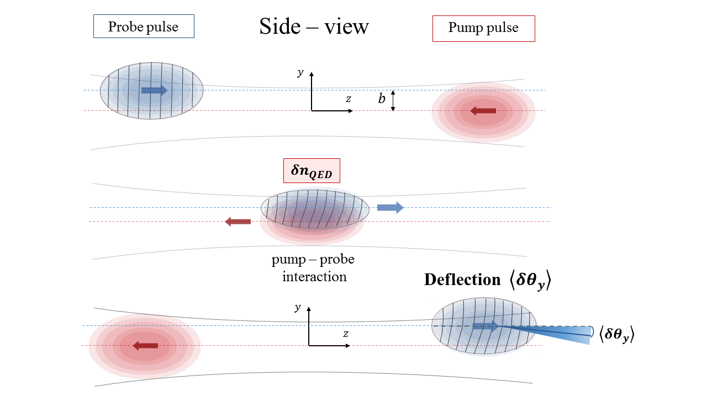
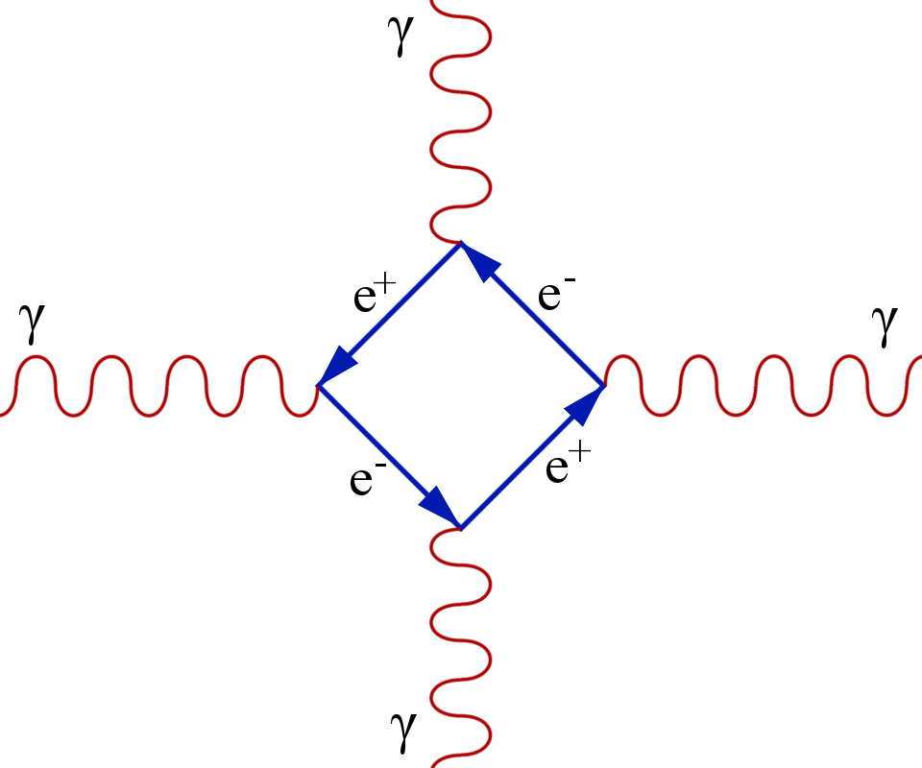






DeLLight Experiment – Pump-Probe Interaction
$$y$$
$$e$$
Pump specifications (LASERIX)
Energy ≈ 2.5 Joules
Duration ≈ 50 fs
Waist @ focus ≈ 5 μm
⇒ I_{pump} ∼ 2 × 10²⁰ W/cm²
$$b$$
$$x$$
E₀
k₁
B₀
k₂
$${δn}_{QED} \text{∼} 3×{10}^{−13}$$
$$〈δθ_{y}〉 \text{∼} 0.13 prad$$
Ali Aras (IJCLab - U. Paris Saclay)
3/12
July 4, 2025 – PHENIICS Fest 2025, IJCLab

Slide 4
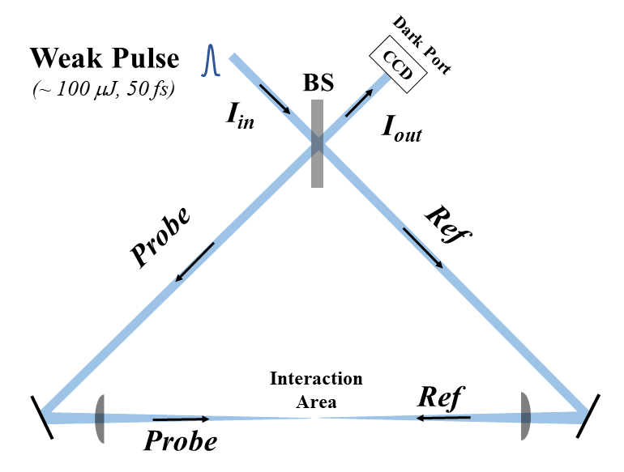
DeLLight Experiment - Amplification by Sagnac Interferometer
Direct amplification of the signal via Sagnac interferometer
10 Hz
BR1
Interference
BR2
Ali Aras (IJCLab - U. Paris Saclay)
4/12
July 4, 2025 – PHENIICS Fest 2025, IJCLab

Slide 5
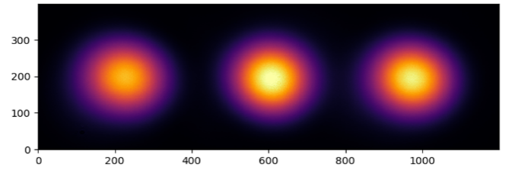
DeLLight Experiment - Amplification by Sagnac Interferometer
Direct amplification of the signal via Sagnac interferometer
10 Hz
BR1
Interference
BR2
Ali Aras (IJCLab - U. Paris Saclay)
4/12
July 4, 2025 – PHENIICS Fest 2025, IJCLab

Slide 6
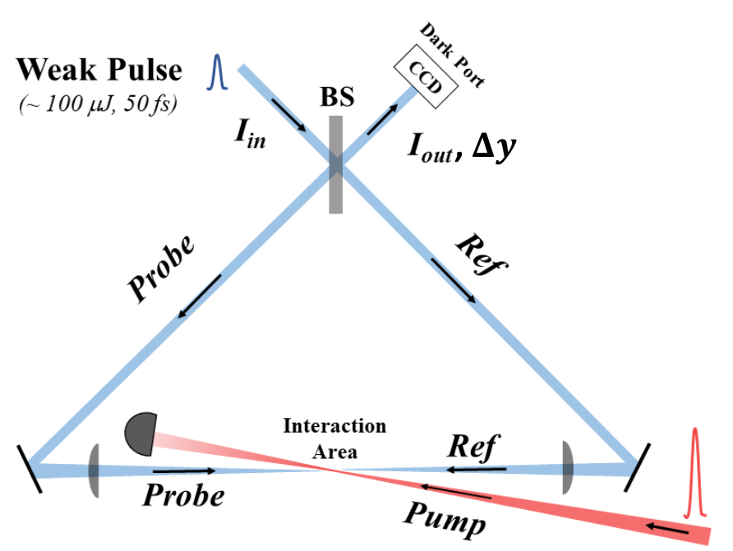


DeLLight Experiment - Amplification by Sagnac Interferometer
Direct amplification of the signal via Sagnac interferometer
10 Hz
BR1
Interference
BR2
Deflection $δθ_{y}$
→ Direct vertical shift $δy$ inside the Sagnac
5 Hz
$$δy=f×δθ$$
Ali Aras (IJCLab - U. Paris Saclay)
4/12
July 4, 2025 – PHENIICS Fest 2025, IJCLab

Slide 7



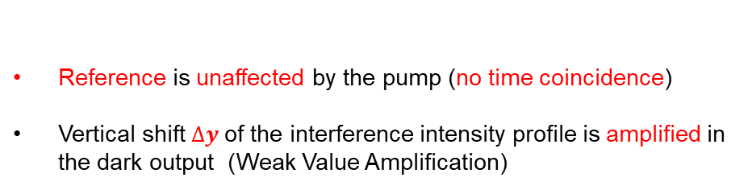

DeLLight Experiment - Amplification by Sagnac Interferometer
Direct amplification of the signal via Sagnac interferometer
10 Hz
BR1
Interference
BR2
→ Direct vertical shift $δy$ inside the Sagnac
Reference is unaffected by the pump (no time coincidence)
Vertical shift$Δy$ of the interference intensity profile is amplified in the dark output (Weak Value Amplification)
Deflection $δθ_{y}$
⇒
$$∆y=𝒜×δy$$
5 Hz
Amplification factor $𝒜$:
$$δy=f×δθ$$
$$𝒜≈±\frac{1}{2\sqrt{ℱ}}$$
$$ℱ ≈\frac{I_{out}}{I_{in}}$$
⇒
Ali Aras (IJCLab - U. Paris Saclay)
4/12
July 4, 2025 – PHENIICS Fest 2025, IJCLab

Slide 8
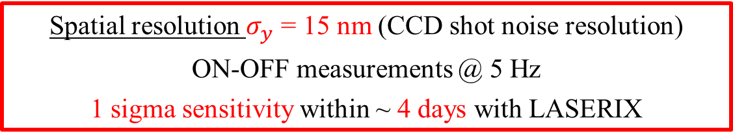
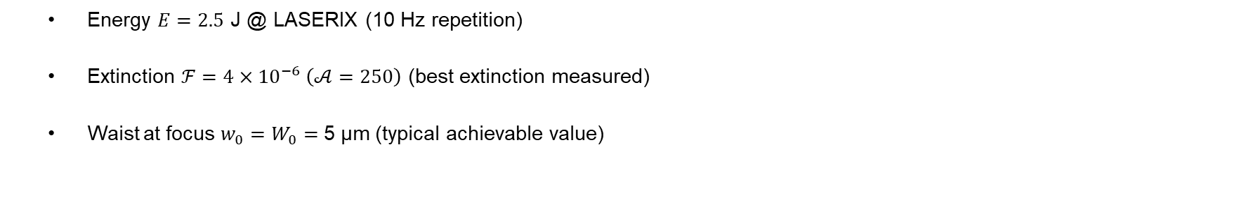

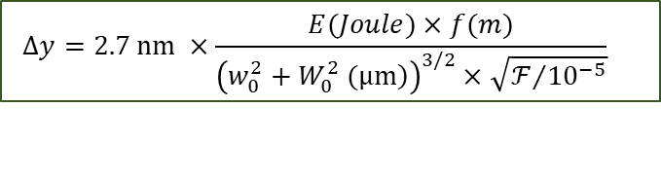
DeLLight Experiment - Amplification by Sagnac Interferometer
Expected signal:
$$Δy=2.7 nm ×\frac{E(Joule)×f(m)}{{\left(\left.w_{0}^{2}+W_{0}^{2} (μm\right)\right)}^{3/2}×\sqrt{ℱ/{{10}^{−5}}}}$$
  Energy $E=2.5$ J @ LASERIX (10 Hz repetition)
  Extinction $ℱ=4×{10}^{−6} \left(𝒜=250\right)$ (best extinction measured)
  Waist at focus $w_{0}=W_{0}=$ 5 µm (typical achievable value)
$$∆y \sim 15 pm$$
ROI
Spatial resolution $σ_{y}$ = 15 nm (CCD shot noise resolution)
ON-OFF measurements @ 5 Hz
1 sigma sensitivity within ~ 4 days with LASERIX
Ali Aras (IJCLab - U. Paris Saclay)
5/12
July 4, 2025 – PHENIICS Fest 2025, IJCLab

Slide 9
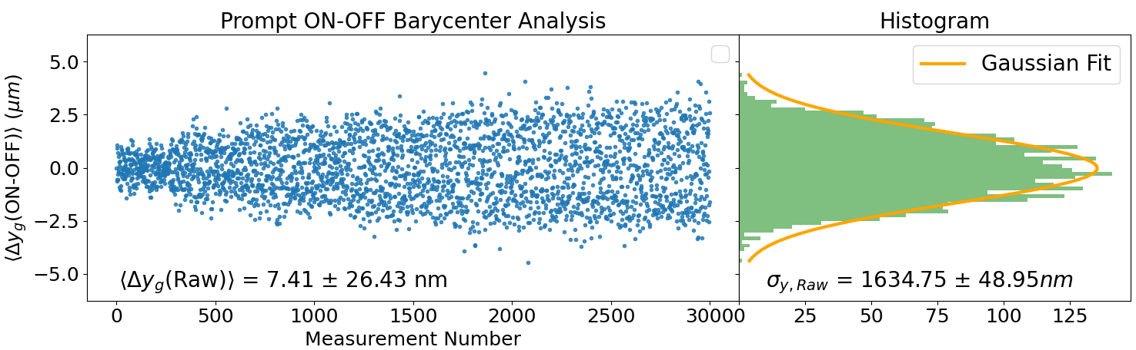
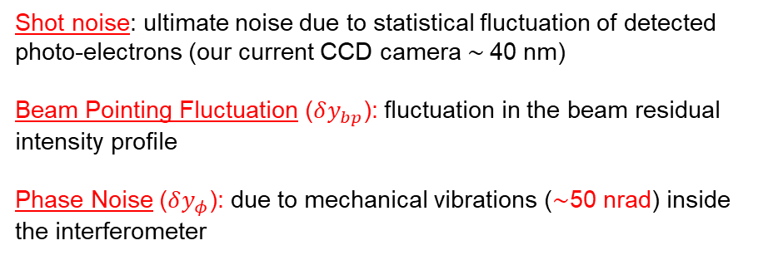



DeLLight Experiment – Reaching the ultimate shot noise sensitivity
Reaching the spatial resolution of the ultimate shot noise level of CCD camera is crucial
Shot noise: ultimate noise due to statistical fluctuation of detected photo-electrons (our current CCD camera ∼ 40 nm)
Beam Pointing Fluctuation ($δy_{bp}$): fluctuation in the beam residual intensity profile
Phase Noise ($δy_{φ}$): due to mechanical vibrations (∼50 nrad) inside the interferometer
$$I_{Ref}$$
$$I_{sig}$$
ROI
We are dominated by the strong phase noise amplified by the interferometer
!
Phase noise must be reduced by about a factor 40
$$σ_{y} \sim 40×σ_{shot noise}$$
High Frequency Phase Noise Suppression (HFPNS) Method
Ali Aras (IJCLab - U. Paris Saclay)
6/12
July 4, 2025 – PHENIICS Fest 2025, IJCLab

Slide 10
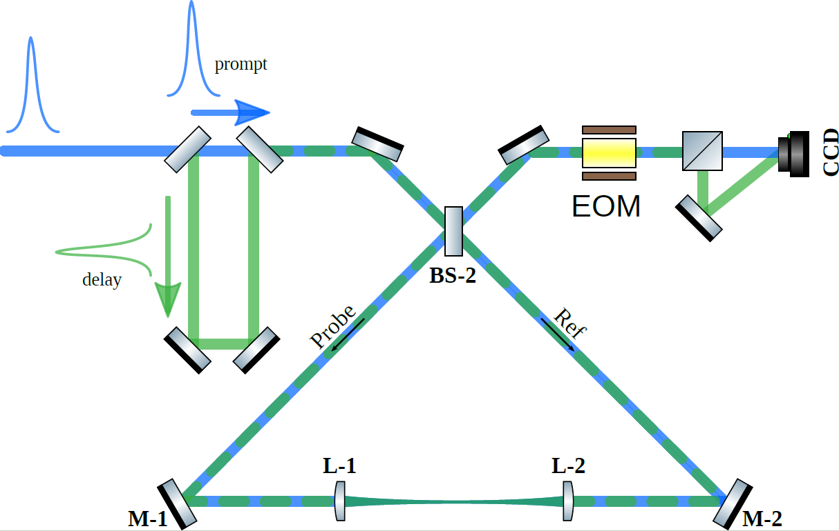
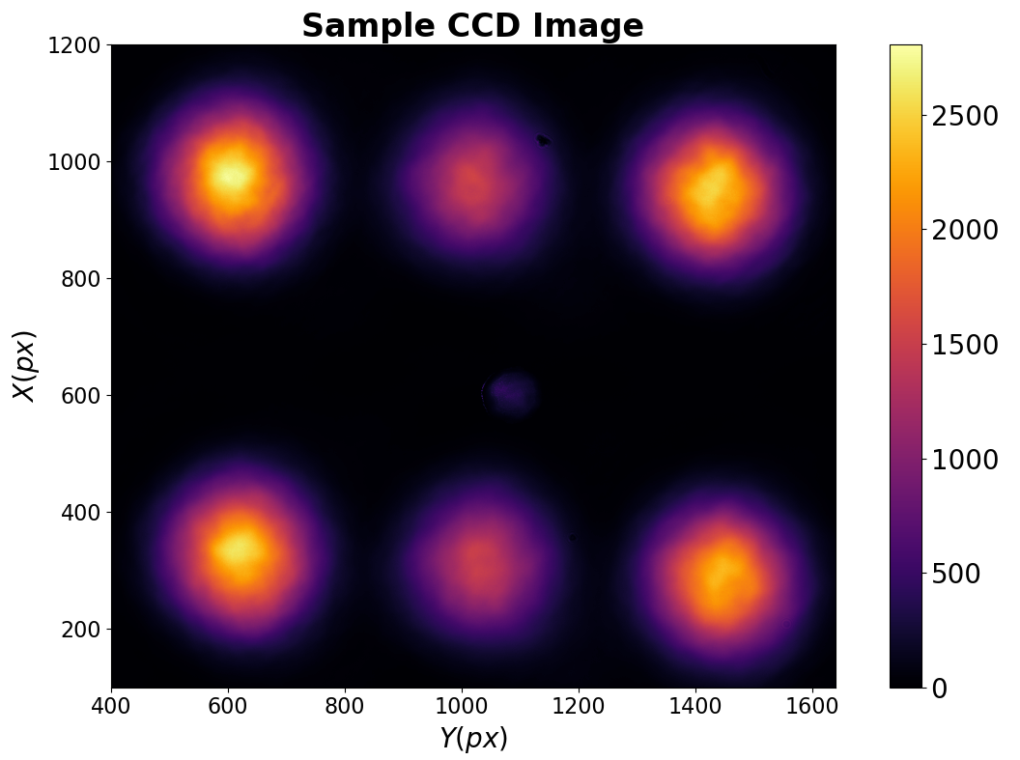
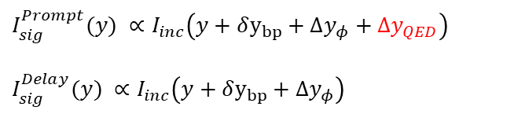
HFPNS Method
Generation of a new delayed pulse (∼ 5ns delay time) affected by the same phase noise
They both carry the same phase noise considering the small delay time
Delay is not affected by the pump pulse due to time offset
Spatial splitting is done by using a Pockels cell
Prompt
$$I_{sig}^{Prompt}(y) ∝I_{inc}\left(y+δy_{bp}+Δy_{φ}+Δy_{QED}\right)$$
$$I_{sig}^{Delay}(y) ∝I_{inc}\left(y+δy_{bp}+Δy_{φ}\right)$$
Delay
Off-line
Data Analysis
Correlation
Correction
First results for a long dataset taken by a CCD with $σ_{SN}∼40 nm$ without the pump beam
Ali Aras (IJCLab - U. Paris Saclay)
7/12
July 4, 2025 – PHENIICS Fest 2025, IJCLab

Slide 11




Data Analysis – Prompt/Delay Signal Correction
Prompt
$$I_{sig}^{P}$$
$$〈y_{Sig}^{P}〉$$
Delay
ON-OFF
$$I_{sig}^{D}$$
$〈y_{Sig}^{PD}\left(OFF\right)〉=〈y_{Sig}^{P}\left(OFF\right)〉$ - FIT(OFF)
$〈y_{Sig}^{PD}\left(ON\right)〉=〈y_{Sig}^{P}\left(ON\right)〉$ - FIT(OFF)
$$〈y_{Sig}^{D}〉$$
Ali Aras (IJCLab - U. Paris Saclay)
8/12
July 4, 2025 – PHENIICS Fest 2025, IJCLab

Slide 12
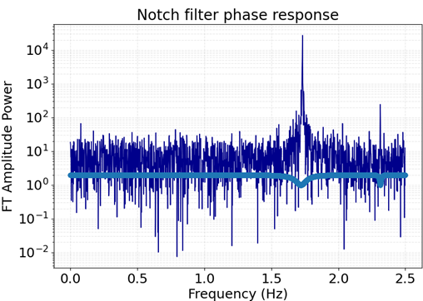
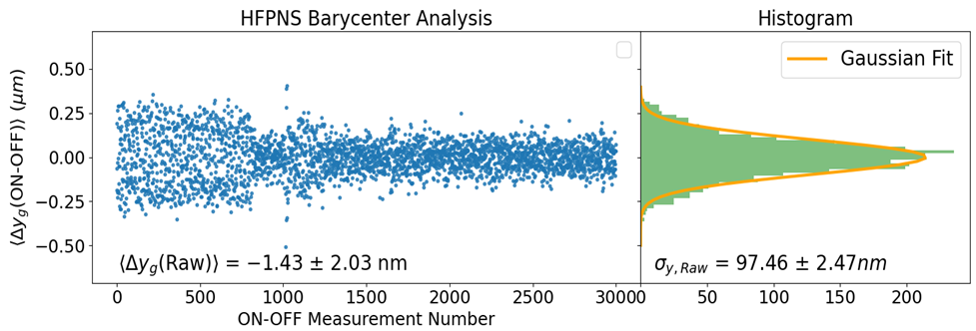
Data Analysis – Prompt/Delay Signal Correction
Generation of a new delayed pulse (∼ 5ns delay time) at high frequency affected by the same phase noise
We improved our measurement sensitivity by a factor of ~20
It is still ~2 times higher than the expected spatial resolution (40nm)
Fourier analysis is made to further investigate
Ali Aras (IJCLab - U. Paris Saclay)
9/12
July 4, 2025 – PHENIICS Fest 2025, IJCLab

Slide 13
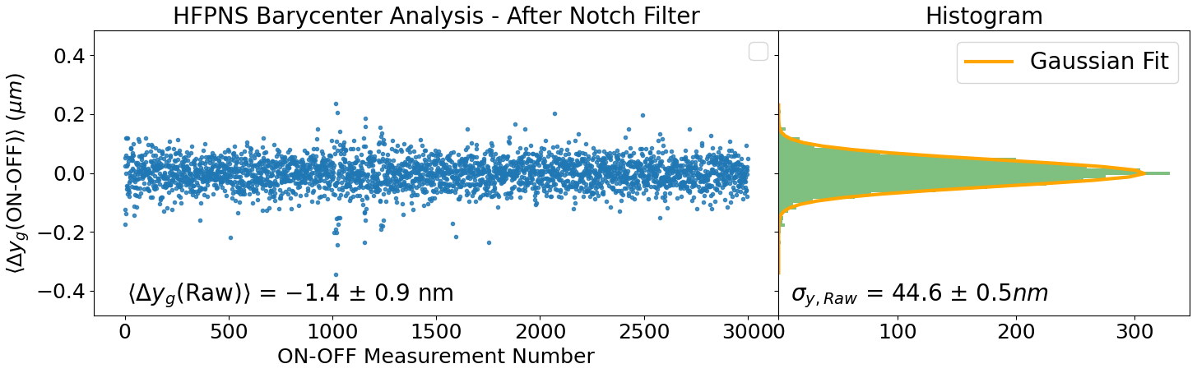
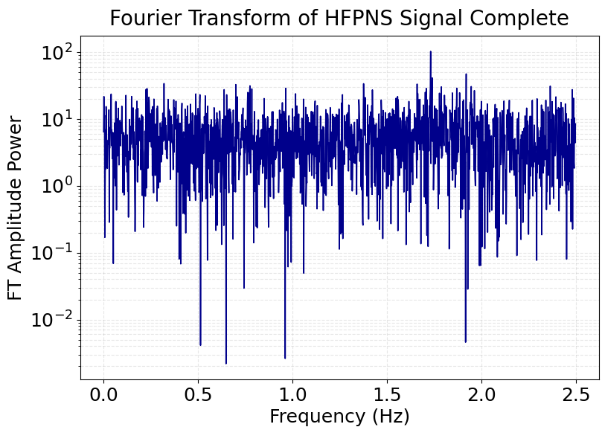
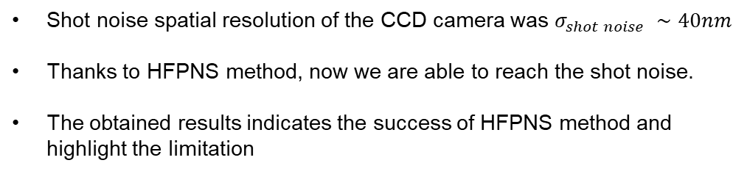
Data Analysis – Prompt/Delay Signal Correction
Generation of a new delayed pulse (∼ 5ns delay time) at high frequency affected by the same phase noise
Shot noise spatial resolution of the CCD camera was $σ_{shot noise} ∼40nm$
Thanks to HFPNS method, now we are able to reach the shot noise.
The obtained results indicates the success of HFPNS method and highlight the limitation
Ali Aras (IJCLab - U. Paris Saclay)
10/12
July 4, 2025 – PHENIICS Fest 2025, IJCLab

Slide 14
Data Analysis – Final Result
Compared with standard direct measurement, we have successfully suppressed both the beam pointing fluctuation and the phase noise by using the HFPNS method, and we have reached the ultimate shot noise resolution.
Ali Aras (IJCLab - U. Paris Saclay)
11/12
July 4, 2025 – PHENIICS Fest 2025, IJCLab

Slide 15

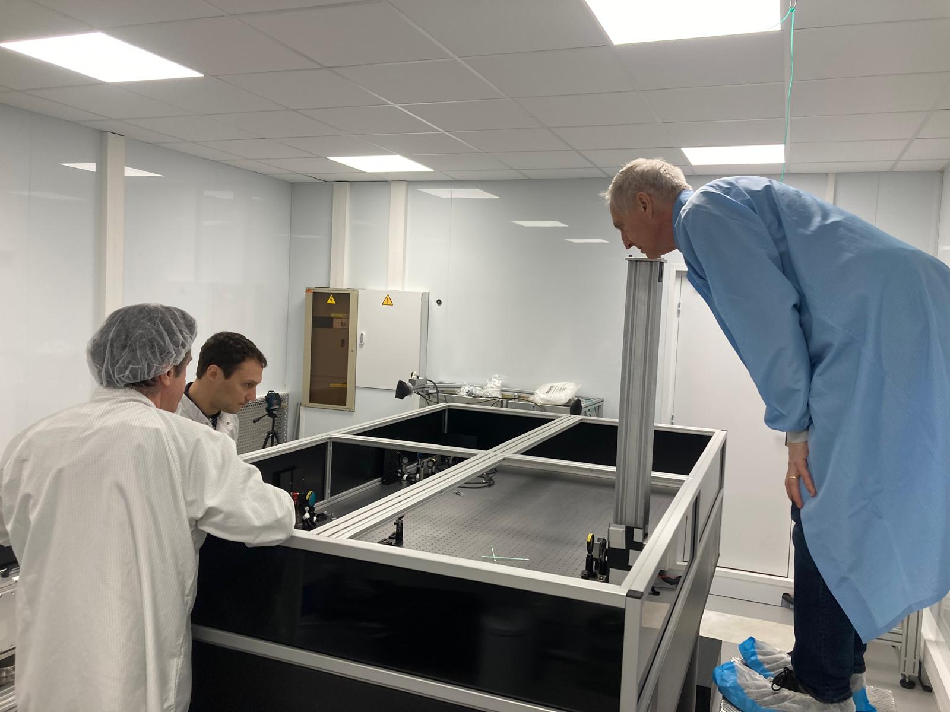
Conclusion and Outlook
The HFPNS method works to suppress the phase noise which is amplified inside the interferometer
A paper is being written to publish the initial results
Implementation of the HFPNS setup on the final DeLLight experiment table in a new room
Long run, with higher amplification and a CCD camera of spatial resolution 15 nm (goal value)
First tests of HFPNS method to measure the optical nonlinearity of vacuum for the first time
The first measurement in vacuum with a high-intensity beam is foreseen in 2026
Thank you!
&
Questions?
Ali Aras (IJCLab - U. Paris Saclay)
12/12
July 4, 2025 – PHENIICS Fest 2025, IJCLab

Slide 16
Backup Slides
Ali Aras (IJCLab - U. Paris Saclay)
July 4, 2025 – PHENIICS Fest 2025, IJCLab

Slide 17
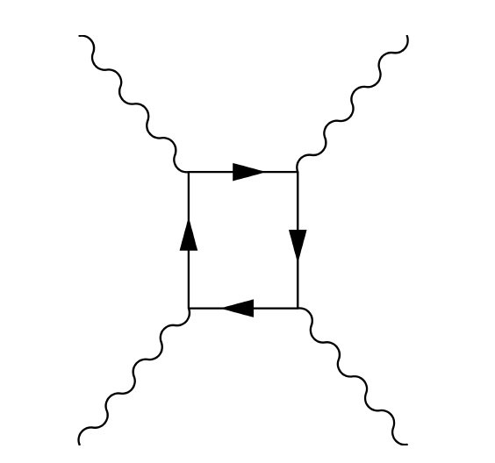
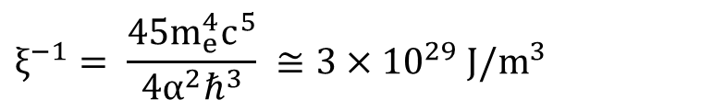
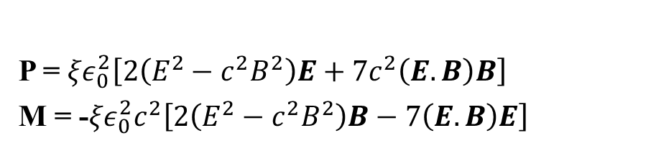
Euler-Heisenberg Lagrangian Formulation
Nonlinear interaction between electromagnetic fields
D = ε₀E + P(E,B) = ε (E,B).E
B = μ₀H + μ₀M(E,B) = μ (E,B).H
Electromagnetic field coupling through $e^{−}/e^{+}$ virtual pairs in vacuum
P = 𝜉$ε_{0}^{2}\left[2\left(E^{2}−c^{2}B^{2}\right)E+7c^{2}\left(E.B\right)B\right]$
M = -𝜉$ε_{0}^{2}c^{2}\left[2\left(E^{2}−c^{2}B^{2}\right)B−7\left(E.B\right)E\right]$
$$ξ^{−1}= \frac{45m_{e}^{4}c^{5}}{4α^{2}ℏ^{3}} ≅3×10^{29} J/m^{3}$$
Ali Aras (IJCLab - U. Paris Saclay)
July 4, 2025 – PHENIICS Fest 2025, IJCLab

Slide 18
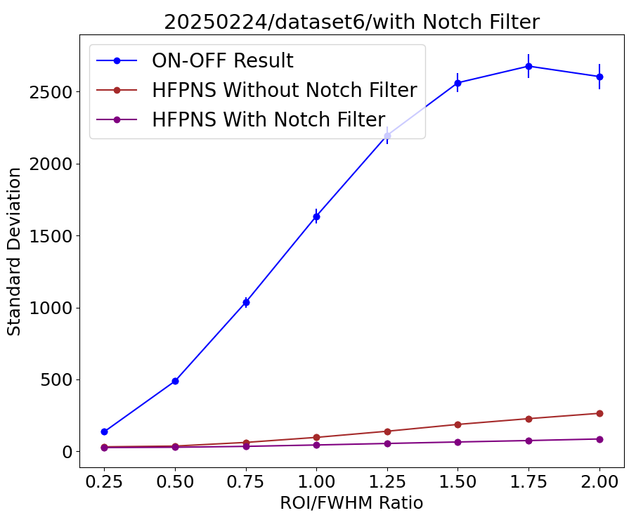
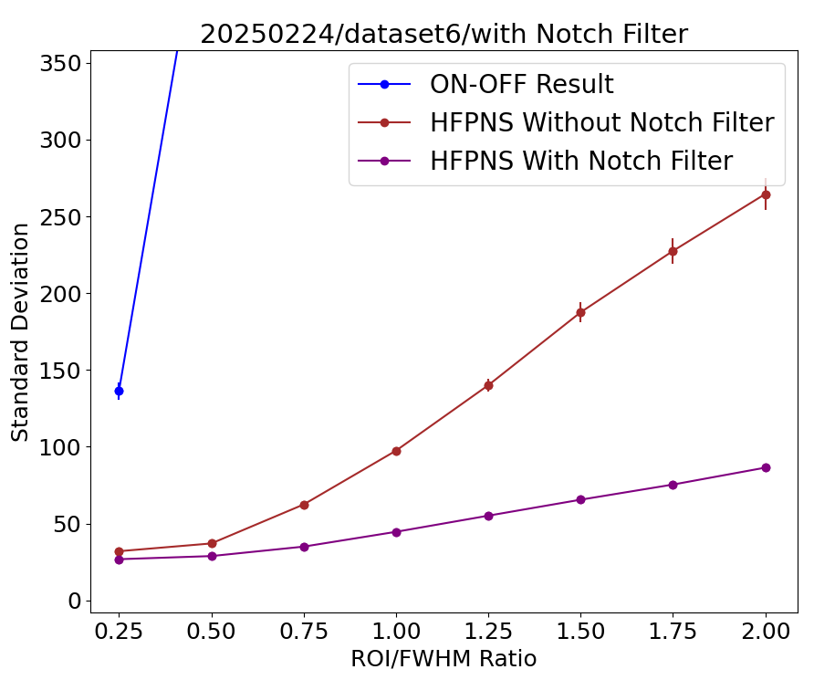
Results for Different ROI Sizes
Ali Aras (IJCLab - U. Paris Saclay)
July 4, 2025 – PHENIICS Fest 2025, IJCLab

Slide 19
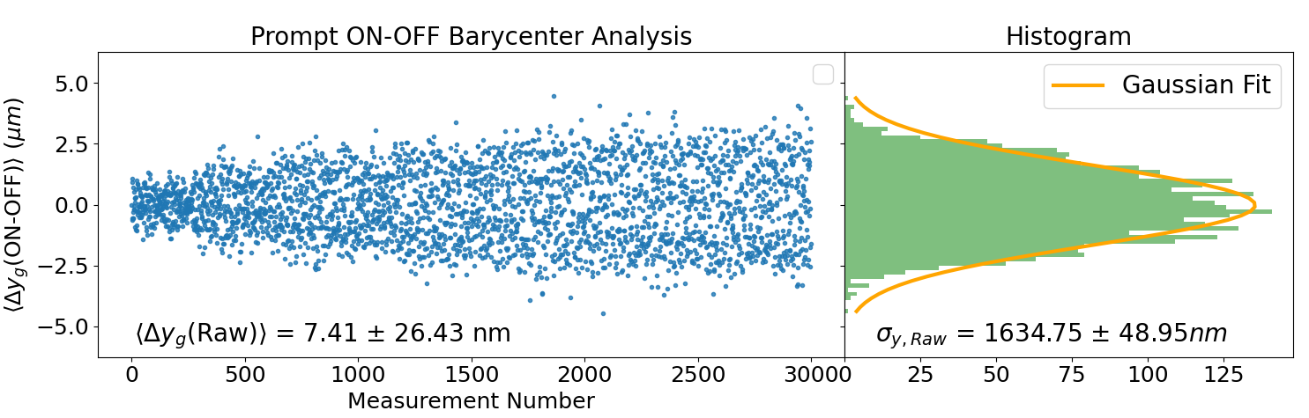
Direct ON-OFF Result
Ali Aras (IJCLab - U. Paris Saclay)
July 4, 2025 – PHENIICS Fest 2025, IJCLab

Slide 20
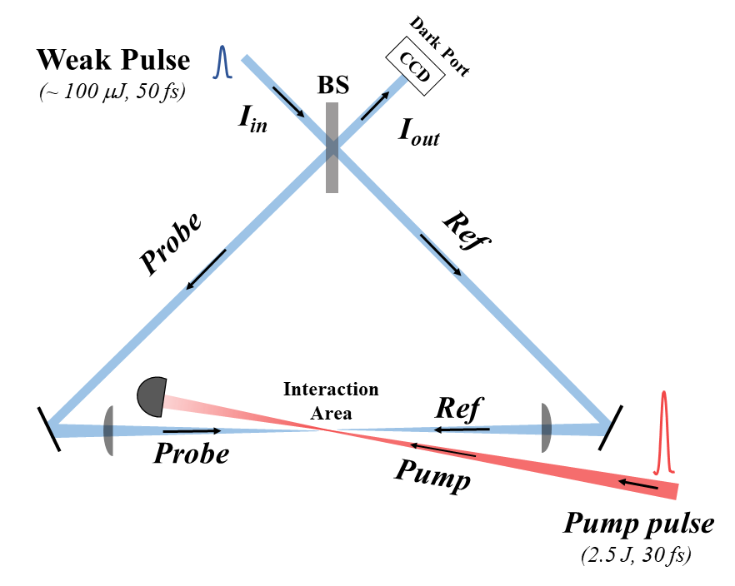
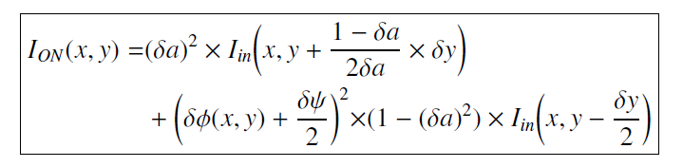
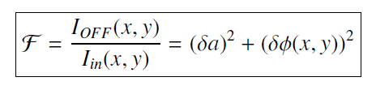
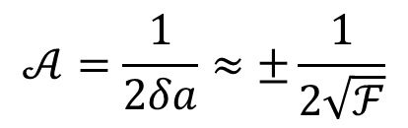
Backup – How does amplification really works?
$$𝒜=\frac{1}{2δa}≈±\frac{1}{2\sqrt{ℱ}}$$
⇒
Ali Aras (IJCLab - U. Paris Saclay)
July 4, 2025 – PHENIICS Fest 2025, IJCLab

Slide 21
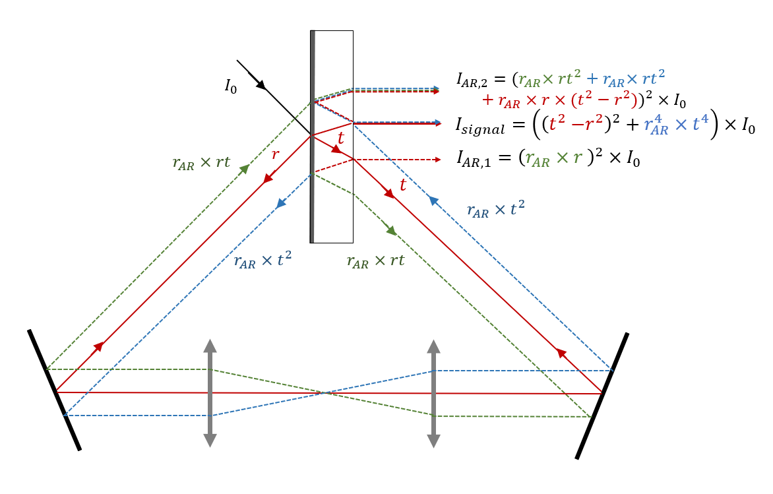



Backup – Back Reflections
$$I_{AR,1}$$
$$I_{signal}$$
$$I_{AR,2}$$
Ali Aras (IJCLab - U. Paris Saclay)
July 4, 2025 – PHENIICS Fest 2025, IJCLab

Slide 22
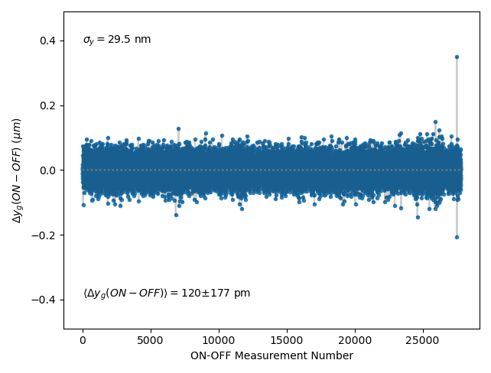
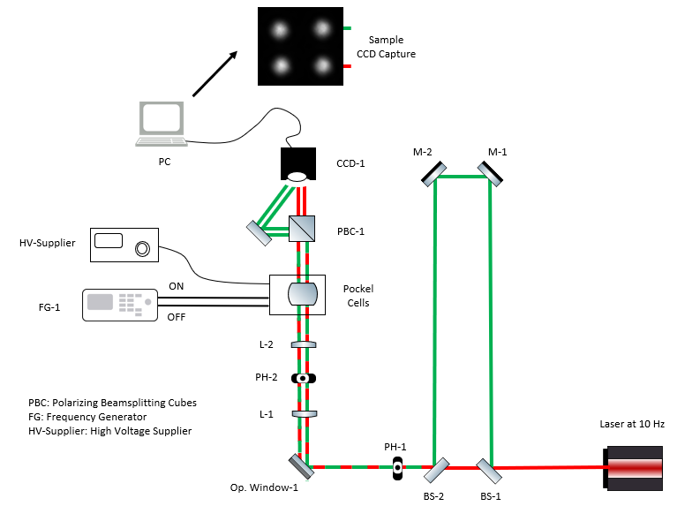
Backup – Results With Window
Ali Aras (IJCLab - U. Paris Saclay)
July 4, 2025 – PHENIICS Fest 2025, IJCLab

Slide 23
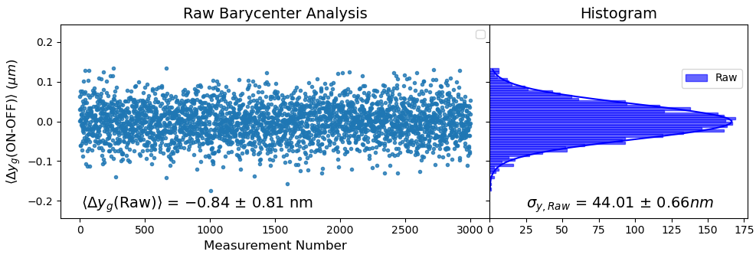
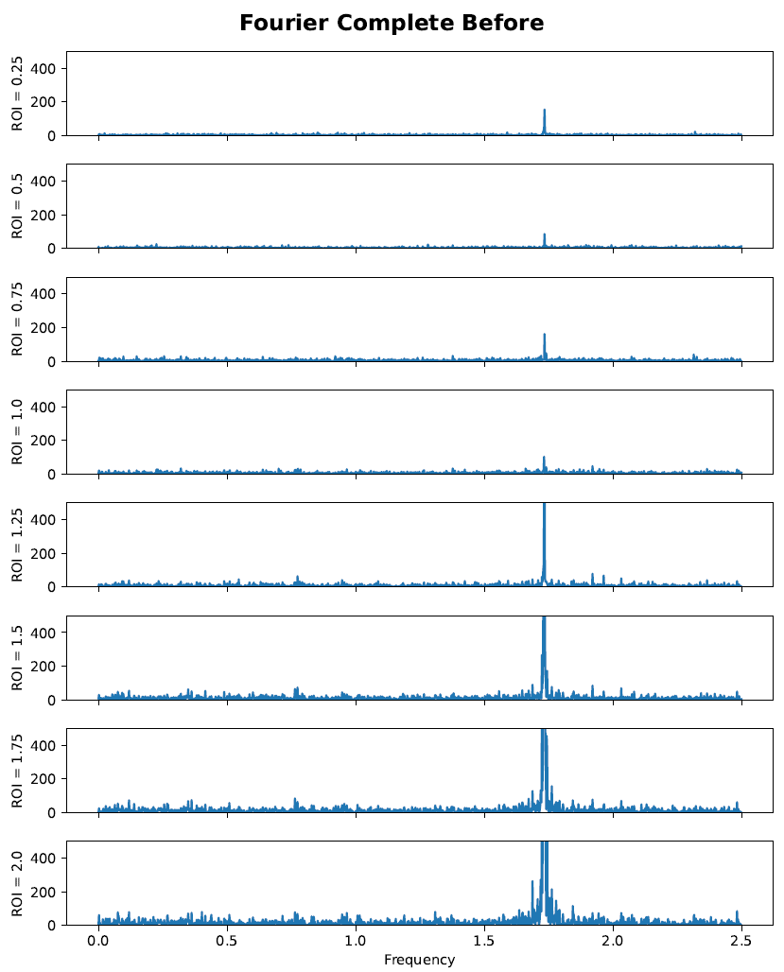
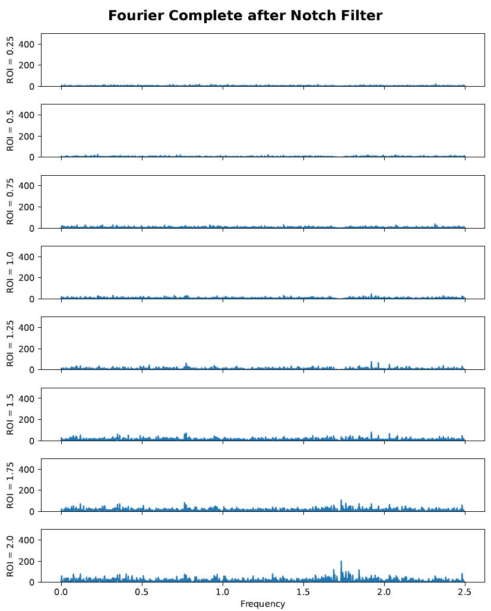
Backup – Fourier Analysis
Ali Aras (IJCLab - U. Paris Saclay)
July 4, 2025 – PHENIICS Fest 2025, IJCLab

Slide 24
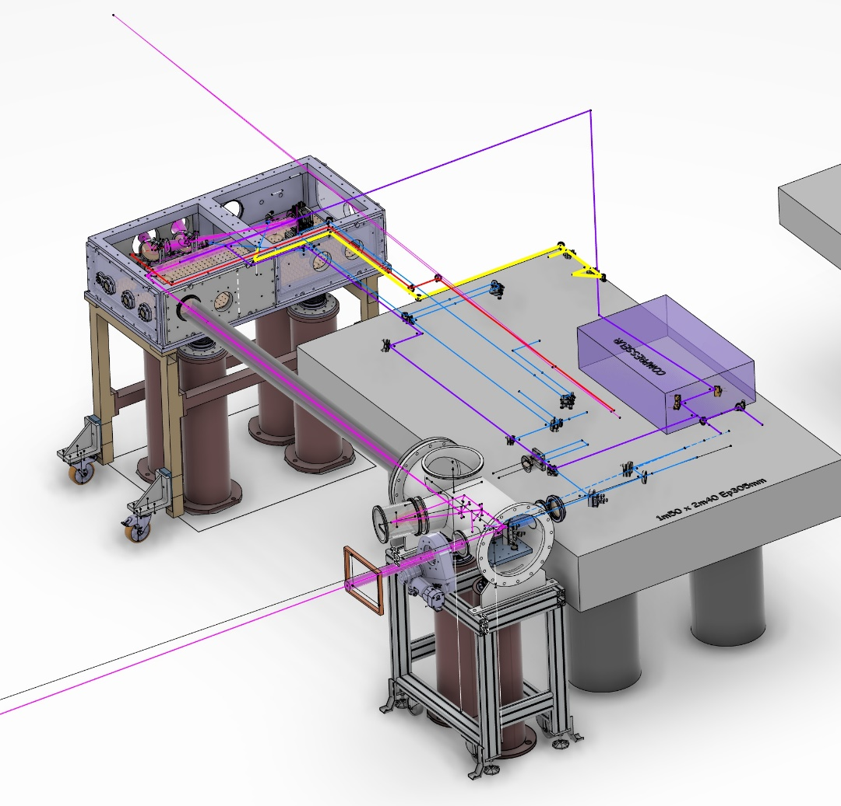
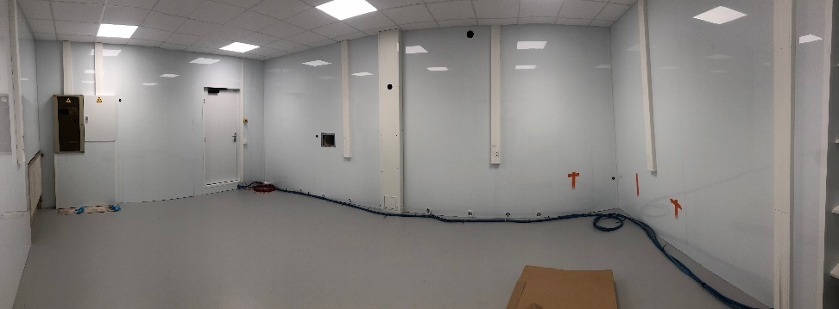
Backup – New isolated room
Start the experiment in a vacuum:
Installation of the FINAL DeLLight experiment in the new room funded by IJCLab
Ali Aras (IJCLab - U. Paris Saclay)
July 4, 2025 – PHENIICS Fest 2025, IJCLab

Slide 25
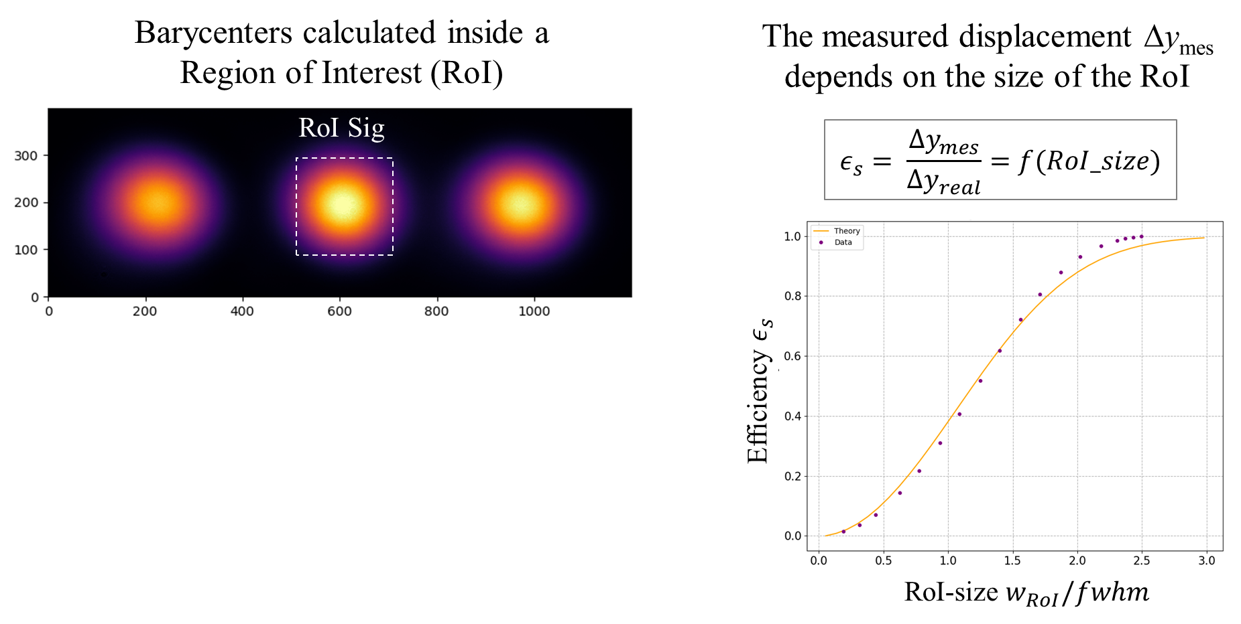

Backup – Barycenter Calculation
$$<y> = \frac{\int_{ROI}{{y I}_{sig}\left(y\right)dy}}{\int_{ROI}{I_{sig}\left(y\right)dy}}$$
Ali Aras (IJCLab - U. Paris Saclay)
July 4, 2025 – PHENIICS Fest 2025, IJCLab

Slide 26
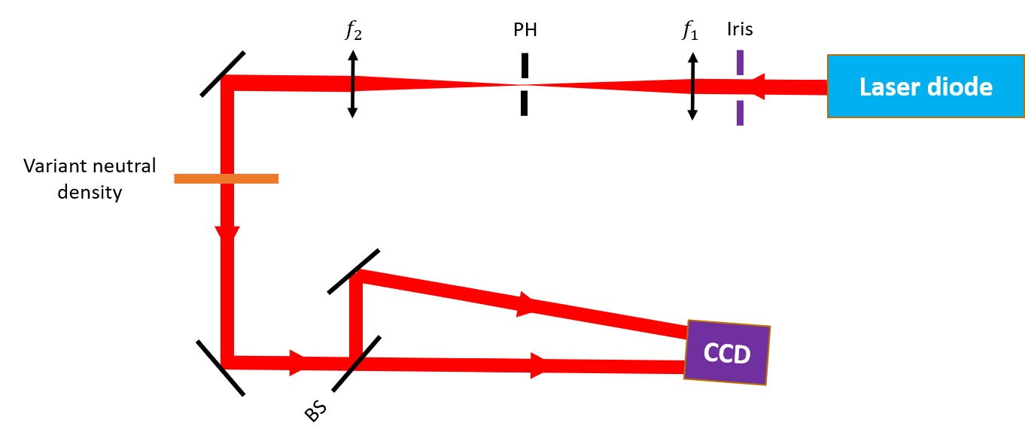
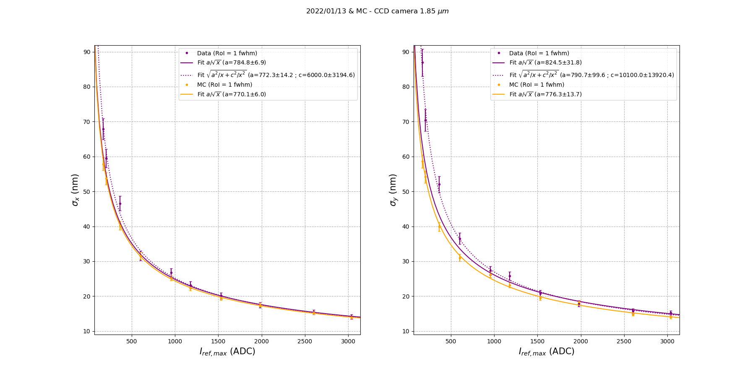
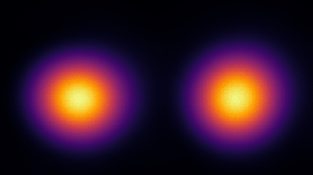

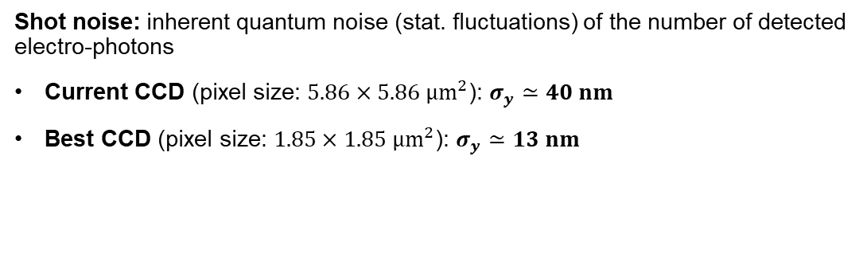
Backup – Barycenter Calculation
Pixel size: $1,85×1,85 μm^{2}$ (goal CCD)
Ref
Sig
Shot noise: inherent quantum noise (stat. fluctuations) of the number of detected electro-photons
Current CCD (pixel size: $5.86×5.86 μm^{2}$): $σ_{y}≃40 nm$
Best CCD (pixel size: $1.85×1.85 μm^{2}$): $σ_{y}≃13 nm$
Ali Aras (IJCLab - U. Paris Saclay)
July 4, 2025 – PHENIICS Fest 2025, IJCLab

Slide 27
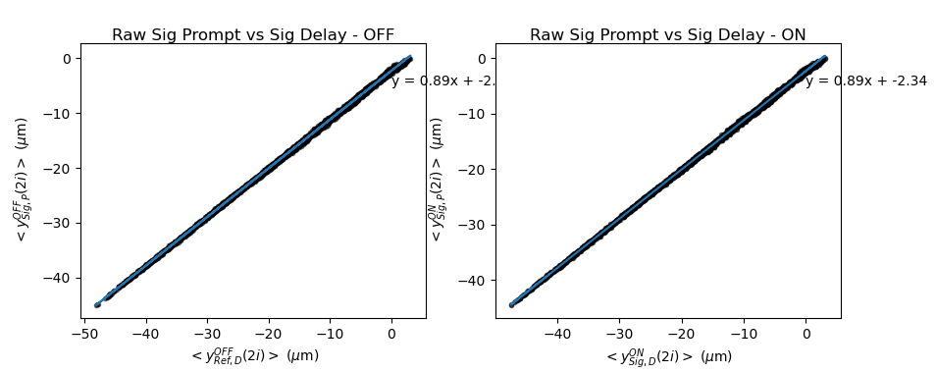


Data Analysis
$$I_{Ref}$$
$$I_{sig}$$
$$I_{Ref}$$
$$I_{sig}$$
ROI
Ali Aras (IJCLab - U. Paris Saclay)
July 4, 2025 – PHENIICS Fest 2025, IJCLab

Slide 28
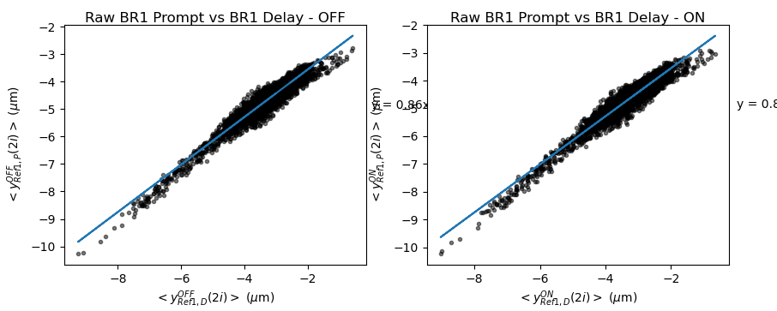
Data Analysis
$$I_{Ref}$$
$$I_{sig}$$
$$I_{Ref}$$
$$I_{sig}$$
ROI
Ali Aras (IJCLab - U. Paris Saclay)
July 4, 2025 – PHENIICS Fest 2025, IJCLab

Slide 29
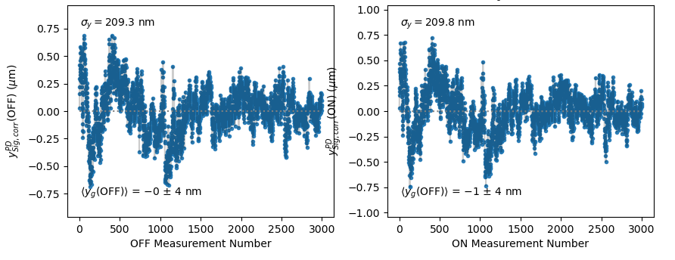
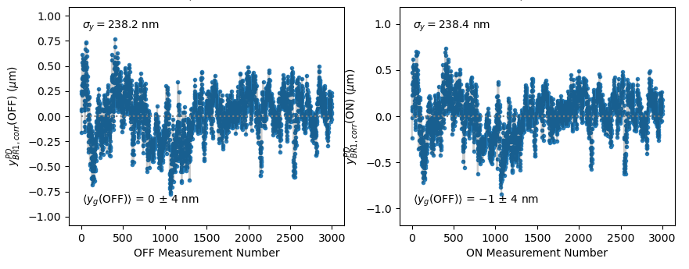
Data Analysis
$$I_{Ref}$$
$$I_{sig}$$
$$I_{Ref}$$
$$I_{sig}$$
ROI
Ali Aras (IJCLab - U. Paris Saclay)
July 4, 2025 – PHENIICS Fest 2025, IJCLab

Slide 30


Data Analysis
$$I_{Ref}$$
$$I_{sig}$$
$$I_{Ref}$$
$$I_{sig}$$
ROI
Ali Aras (IJCLab - U. Paris Saclay)
July 4, 2025 – PHENIICS Fest 2025, IJCLab

Slide 31

Data Analysis
$$I_{Ref}$$
$$I_{sig}$$
$$I_{Ref}$$
$$I_{sig}$$
ROI
Ali Aras (IJCLab - U. Paris Saclay)
July 4, 2025 – PHENIICS Fest 2025, IJCLab

Slide 32



Introduction - From Classical to Quantum Vacuum
Photon-photon scattering has already been observed in corpuscular perspective:
  SLAC, LHC
No optical modification of quantum vacuum has not yet observed
PVLAS: Search for vacuum birefringence induced by an external continuous rotating magnetic field (2.5 T, rotation rate = 5Hz)
Expected birefringence : 𝛿𝑛𝑃𝑉𝐿𝐴𝑆≃2.5×10−23
Current best limit : 𝛿𝑛𝑃𝑉𝐿𝐴𝑆≃12±17×10−23after about 100 days of collected data
Sensitivity must be improved by a factor ~ 50 in order to measure a signal at 5 sigma in 100 days
Limitations: magnetic field (B ~ 2.5 T) and birefringence of the mirrors
Ali Aras (IJCLab - U. Paris Saclay)
2/12
July 4, 2025 – PHENIICS Fest 2025, IJCLab

Slide 33

Data Analysis – Prompt/Delay Signal Correction
Generation of a new delayed pulse (∼ 5ns delay time) at high frequency affected by the same phase noise
We improved our measurement sensitivity by a factor of ~20
It is still ~2 times higher than the expected spatial resolution (40nm)
Fourier analysis is made to further investigate
Ali Aras (IJCLab - U. Paris Saclay)
9/12
July 4, 2025 – PHENIICS Fest 2025, IJCLab

Slide 34
Data Analysis – Prompt/Delay Signal Correction
Generation of a new delayed pulse (∼ 5ns delay time) at high frequency affected by the same phase noise
We improved our measurement sensitivity by a factor of ~20
It is still ~2 times higher than the expected spatial resolution (40nm)
Fourier analysis is made to further investigate
Ali Aras (IJCLab - U. Paris Saclay)
9/12
July 4, 2025 – PHENIICS Fest 2025, IJCLab

Slide 35


Data Analysis – Prompt/Delay Signal Correction
Generation of a new delayed pulse (∼ 5ns delay time) at high frequency affected by the same phase noise
Prompt
$$I_{sig}^{Prompt}(y) ∝I_{inc}\left(y+δy_{bp}^{P}+Δy_{φ}+Δy_{QED}\right)$$
$$I_{sig}^{Delay}(y) ∝I_{inc}\left(y+δy_{bp}^{D}+Δy_{φ}\right)$$
Delay
$$I_{ref}^{Prompt}\left(y\right)∝I_{inc}\left(y+δy_{bp}^{P}\right)$$
$$I_{ref}^{Delay}\left(y\right)∝I_{inc}\left(y+δy_{bp}^{D}\right)$$
!
Delay line instability might deteriorate the result
→ Back reflection correlation
Ali Aras (IJCLab - U. Paris Saclay)
9/12
July 4, 2025 – PHENIICS Fest 2025, IJCLab

Slide 36






Data Analysis – Prompt/Delay Ref Correction
$$I_{Ref}^{P}$$
$$I_{sig}^{P}$$
$$〈y_{BR1}^{PD}〉$$
$$〈y_{BR1}^{PD}〉$$
$$〈y_{Sig}^{PD}〉$$
$$I_{Ref}^{D}$$
$$I_{sig}^{D}$$
Ali Aras (IJCLab - U. Paris Saclay)
10/12
July 4, 2025 – PHENIICS Fest 2025, IJCLab

Slide 37

Data Analysis – Prompt/Delay Ref Correction
$$I_{Ref}^{P}$$
$$I_{sig}^{P}$$
$$〈y_{BR1}^{PD}〉$$
$$〈y_{BR1}^{PD}〉$$
$$〈y_{Sig}^{PD}〉$$
$$I_{Ref}^{D}$$
$$I_{sig}^{D}$$
Shot noise spatial resolution of the CCD camera was $σ_{shot noise} ∼40nm$
Thanks to HFPNS method, now we are able to reach the shot noise.
Ali Aras (IJCLab - U. Paris Saclay)
10/12

Slide 38

Data Analysis – Prompt/Delay Ref Correction
Instead of using back-reflection spots, a numerical filtering can be applied to the signal
In the analysis phase, we used Notch filter at two frequencies at which the delay line fluctuates
The obtained results indicates the success of HFPNS method and highlight the limitation (delay line stability)
Ali Aras (IJCLab - U. Paris Saclay)
10/12
July 4, 2025 – PHENIICS Fest 2025, IJCLab

Slide 39



DeLLight Experiment – Reaching the ultimate shot noise sensitivity
Reaching the spatial resolution of the ultimate shot noise level of CCD camera is crucial
Shot noise: ultimate noise due to statistical fluctuation of detected photo-electrons (our current CCD camera ∼ 40 nm)
Beam Pointing Fluctuation ($δy_{bp}$): fluctuation in the beam residual intensity profile
Phase Noise ($δy_{φ}$): due to mechanical vibrations (∼50 nrad) inside the interferometer
$$I_{Ref}$$
$$I_{sig}$$
ROI
$I_{sig}^{ON}(y) ∝I_{inc}\left(y+{δy}_{bp}+{Δy}_{φ}+{Δy}_{QED}\right)$
$I_{sig}^{OFF}(y) ∝I_{inc}\left(y+{δy}_{bp}+{Δy}_{φ}\right)$
$I_{ref}\left(y\right)∝I_{inc}\left(y+δy_{bp}\right)$
!
Phase noise must be reduced by about a factor 40
High Frequency Phase Noise Suppression (HFPNS) Method
We are dominated by the strong phase noise amplified by the interferometer
$$σ_{y} \sim 40×σ_{shot noise}$$
Ali Aras (IJCLab - U. Paris Saclay)
6/12
July 4, 2025 – PHENIICS Fest 2025, IJCLab

