Slide 1




HiggsML Uncertainty Challenge
Ragansu Chakkappai,
Director of Thesis : David Rousseau
PHENIICS FEST 2025

Slide 2
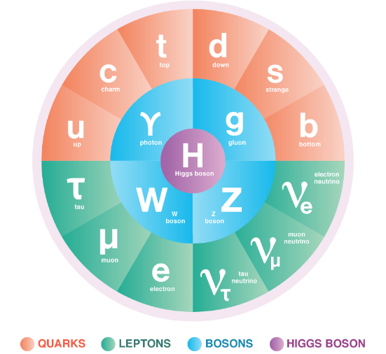
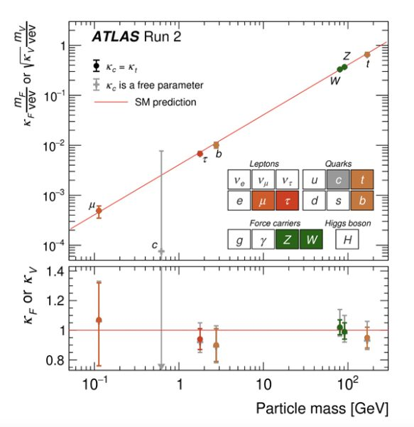
Introduction - Higgs Boson
Discovery of Higgs boson completed the Standard model
Higgs mechanism gives mass to particles
Study of higgs boson could reveal us more interesting things of our universe

Slide 3
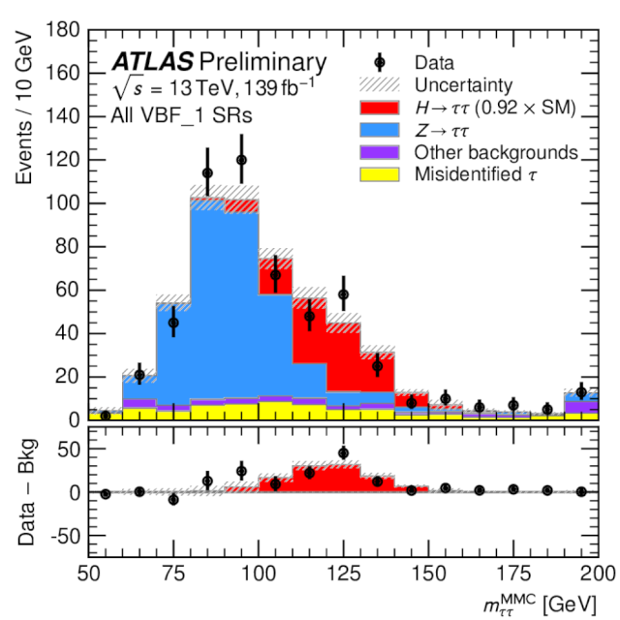
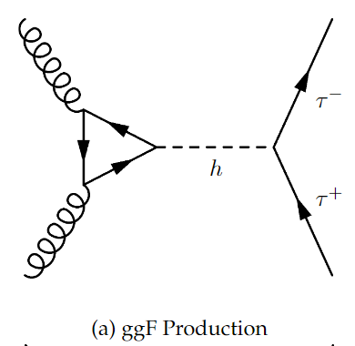
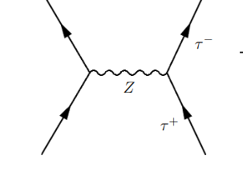
Introduction - H → ττ
Measures higgs coupling to leptons
Ztautau background very similar to signal
Tau lepton is unstable => decays to produce neutrinos

Slide 4
Introduction - ML in HEP
MET
Neutrinos can’t be measured in ATLAS
Classification of Signal and background is difficult
Use of ML help us improve signal significance
τ_{had}
τ_{lep}
Sub-leading jet
Leading jet

Slide 5
Bias and uncertainty in Higgs Physics
At the LHC we analyse proton collision with specific final state e.g. evidence for the Higgs boson
τ_{had}
MET
MET
τ_{had}
τ_{lep}
τ_{lep}
Simulations
Reality
Sub-leading jet
Sub-leading jet
Leading jet
Leading jet
There are possible biases
Eg. In calibration of particle energy

Slide 6
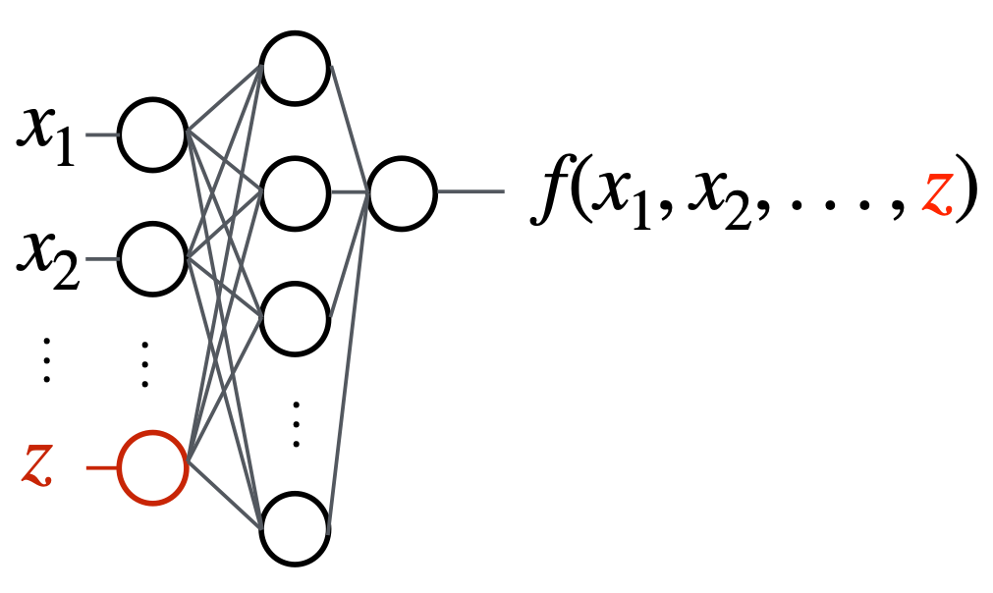
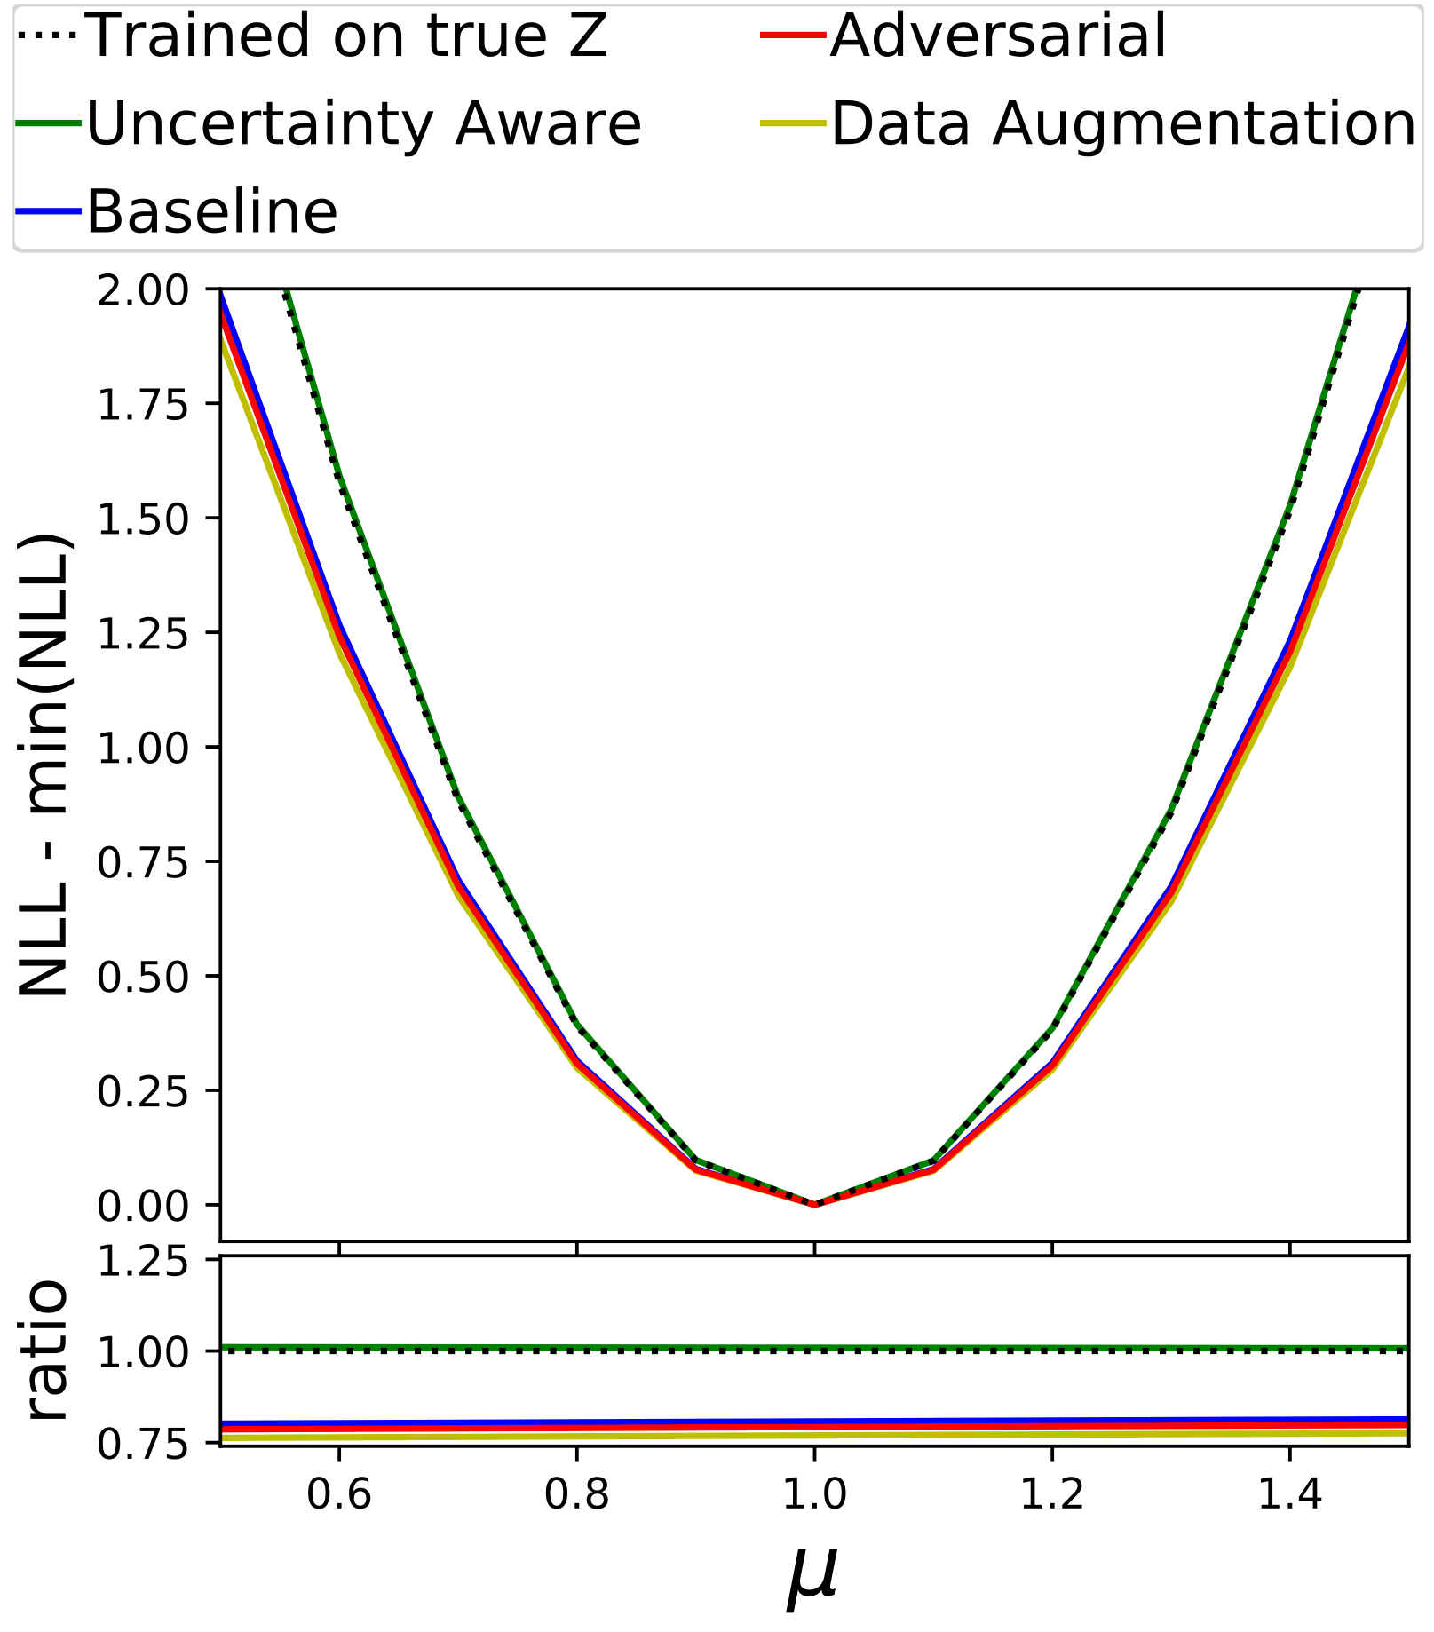
Landscape of Uncertainty Aware Learning
“pivot” Louppe, Kagan, Cranmer : arXiv:1611.01046
“Uncertainty-aware” approach of Ghosh, Nachman, Whiteson PhysRevD.104.056026
  Parameterize classifier using Z
  Measured on “Toy” 2D Gaussian Dataset and dataset from HiggsML Challenge modified to include systematic on tau-energy scale
  Performs as well as classifier trained on true Z
Other novel approaches e.g. (not comprehensive)
  Inferno: arxiv:1806.04743
  Direct profile-likelihood: e.g. arxiv:2203.13079
  (Neuro) Simulation Based Inference has to include Z: arXiv:1911.01429
Many Methods Developed But No Common BenchMark
Narrower is better
(Signal Strength)

Slide 7
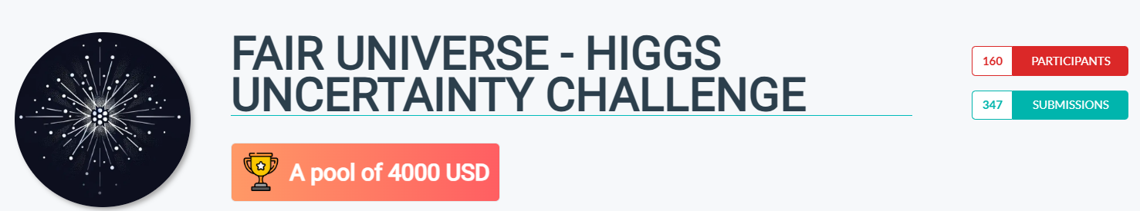
Fair Universe: HiggsML Uncertainty Challenge
Full HiggsML Uncertainty Challenge Ran from September 12 to March 14th
Accepted as NeurIPS competition 2024
Dedicated workshop at NeurIPS (most important ML conference) - 2024 at December 14th
Final results presented in May at CERN(satellite event of IML - 2025)

Slide 8


Fair Universe: HiggsML Uncertainty Challenge
 | 2014 | 2024
Data Source | ATLAS Open Data (Sample of real data) | New simulated dataset
Data Quantity | 800,000 | 340,000,000
Parameterized systematics | ❌ | 6 Systematics
Inference | Classification accuracy | Signal strength (𝜇) CI (Confidence Interval) with pseudo-experiment
Metric | Z - Classification Significance | New metric aimed at CI Coverage

Slide 9

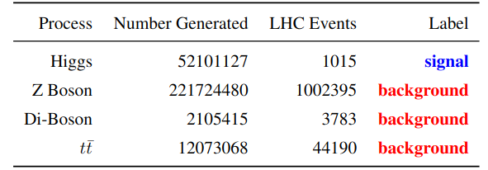
Challenge Dataset
Generated data with fast approximate simulation
Using the updated Delphes ATLAS card
Generated ~280 Million Events after initial cuts equivalent to 220 X 10fb-1 + Higgs
Data Organised into tabular form with 28 features per event.
@10fb⁻¹
Dataset permanently released on Zenodo in May 2025 for Future Benchmarks
https://zenodo.org/records/15131565

Slide 10
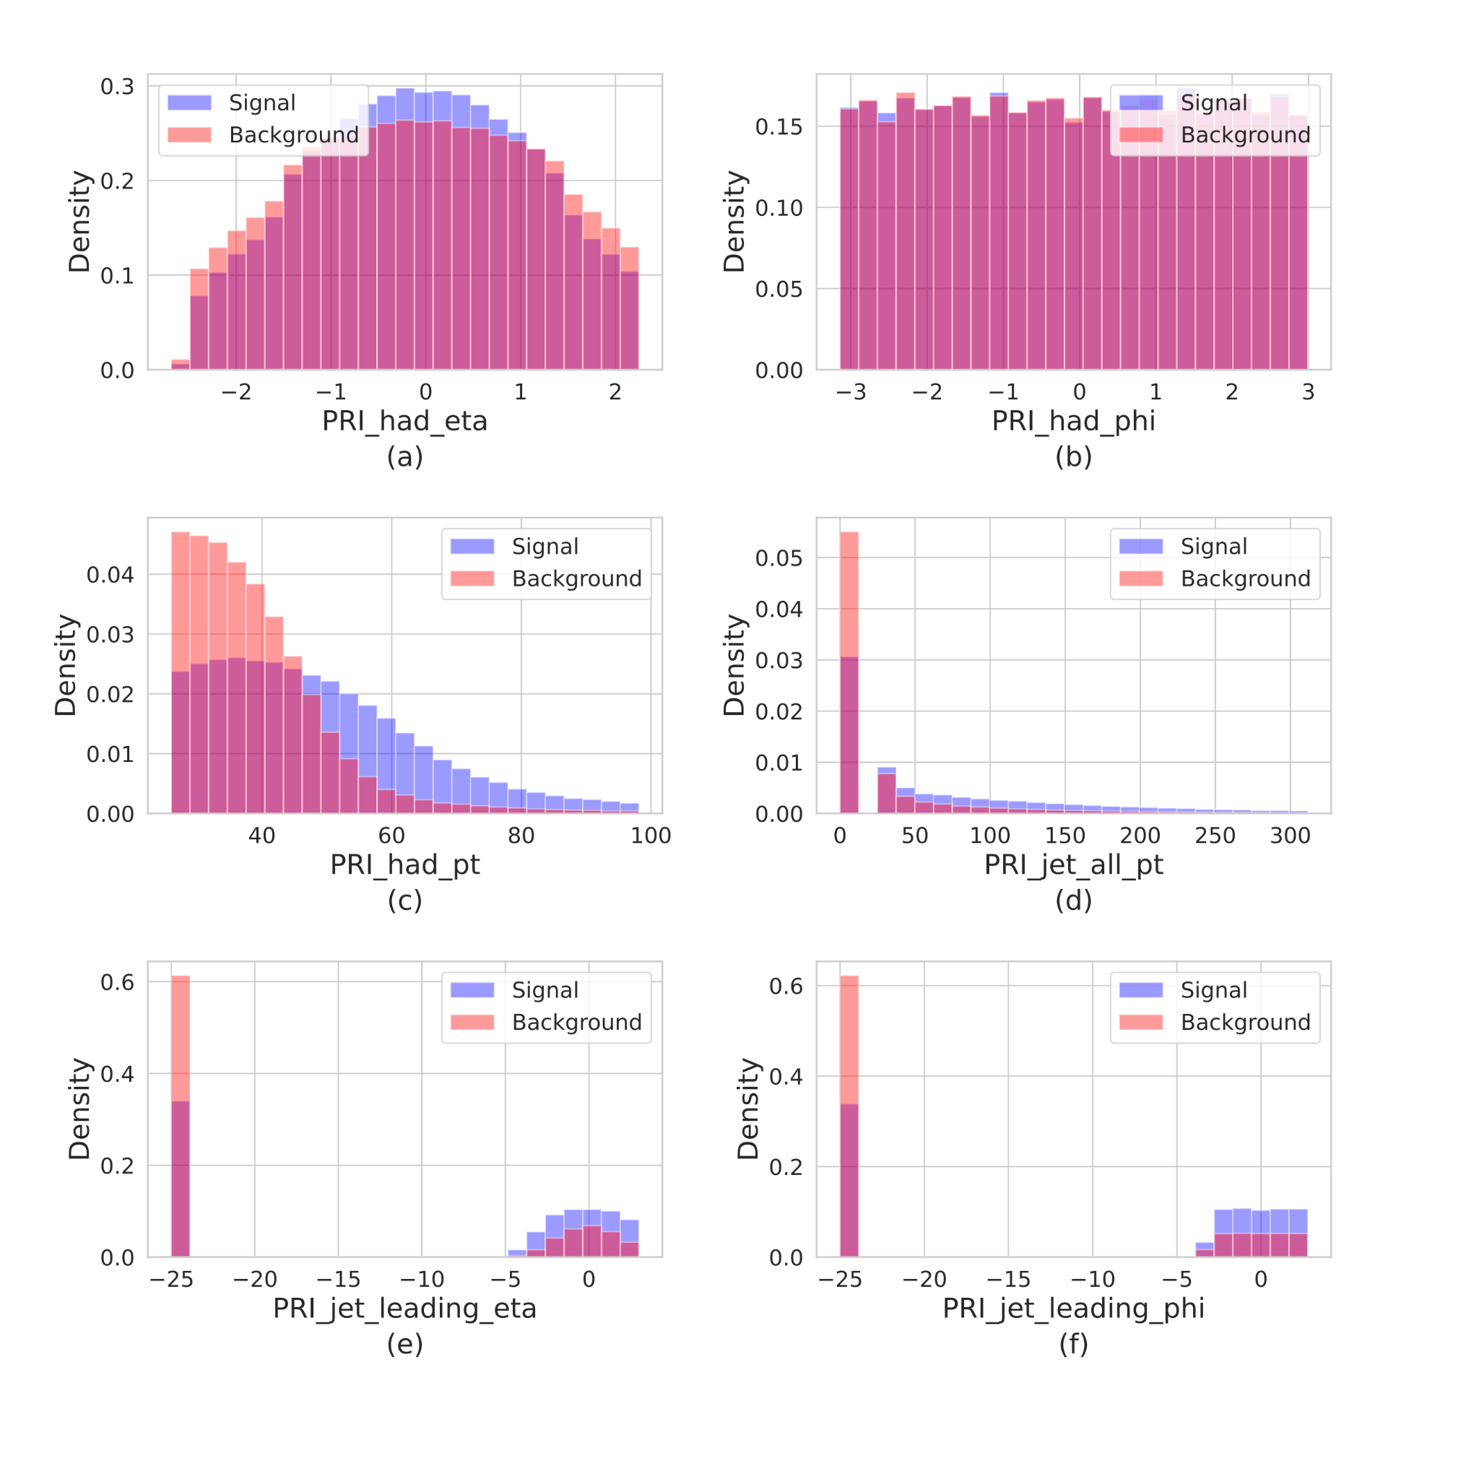
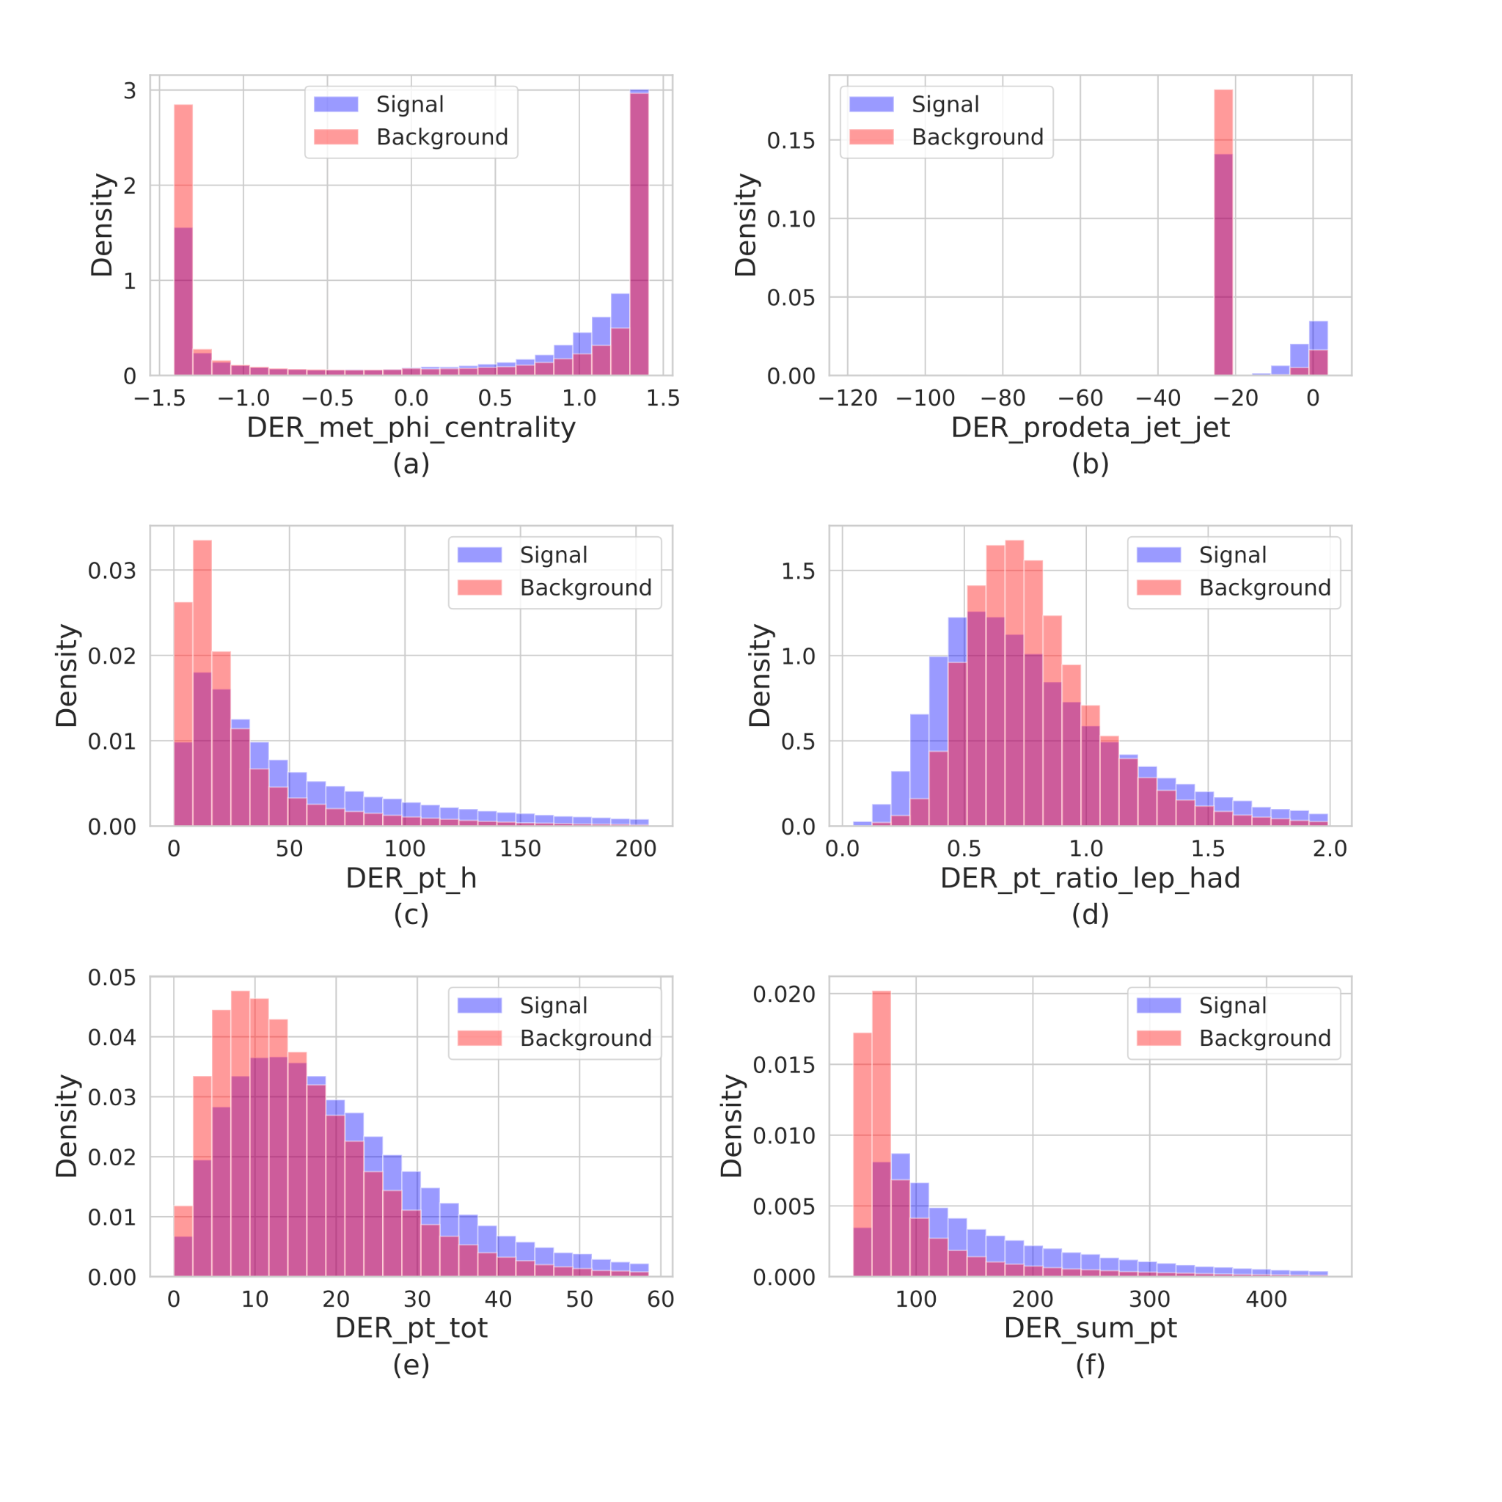
Dataset : some feature examples

Slide 11
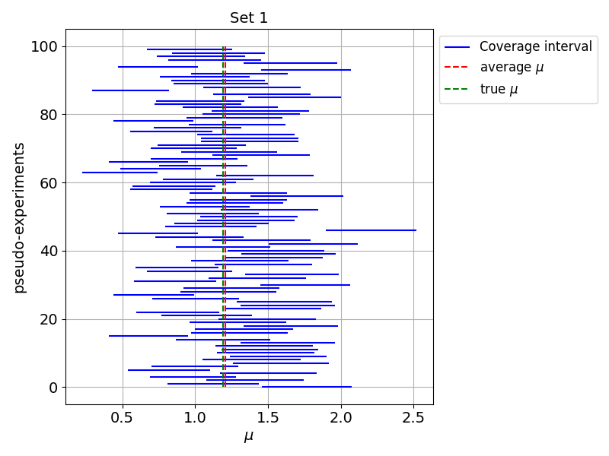
Coverage Evaluation
Form multiple pseudo-experiment test sets: different signal strengths (𝝁) and systematics
  100𝝁 times 100 pseudo-experiments
Task: predict uncertainty interval [𝝁₁₆, 𝝁₈₄]
  E.g. 68% quantile of likelihood or assume 1σ
100 pseudo experiments
Each with different systematics
100 sets each with different values of 𝜇
Notes:
Interval can also be used for cosmology basian setting

Slide 12
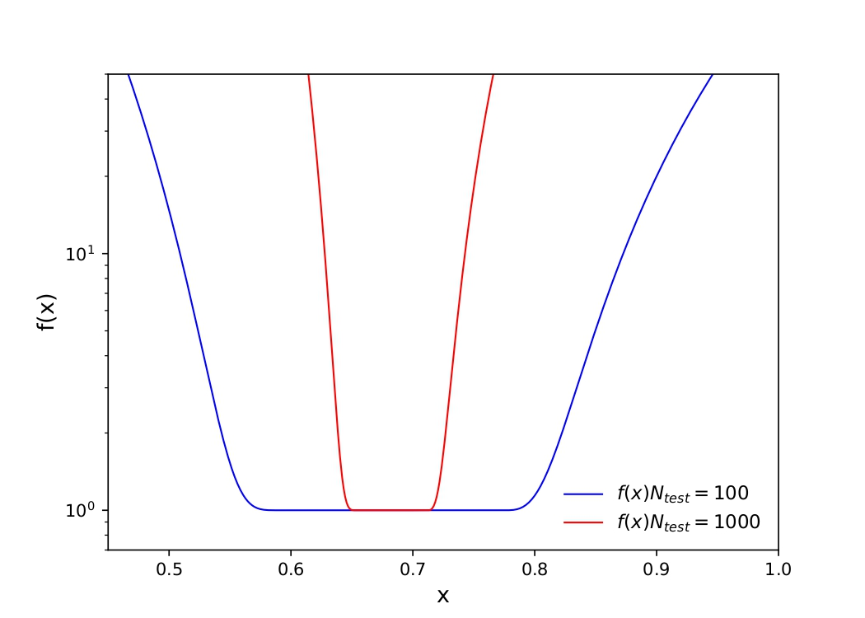
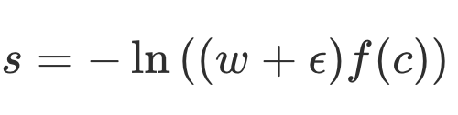
Coverage Evaluation
Form multiple pseudo-experiment test sets: different signal strengths (𝝁) and systematics
  100𝝁 times 100 pseudo-experiments
Task: predict uncertainty interval [𝝁₁₆, 𝝁₈₄]
  E.g. 68% quantile of likelihood or assume 1σ
Scoring formula
Mean width
Coverage penalty
Notes:
Interval can also be used for cosmology basian setting

Slide 13
Results

Slide 14

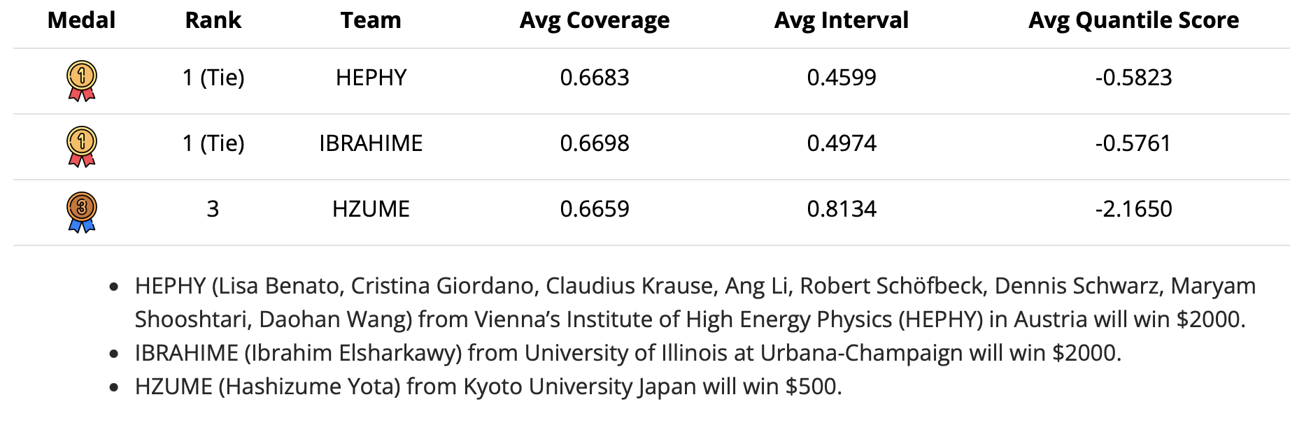
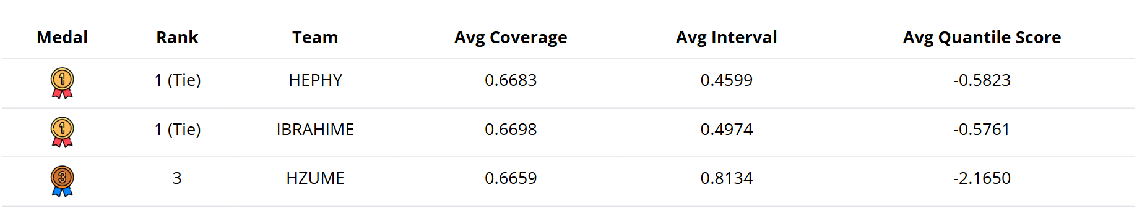
Winners
Notes:
Interval can also be used for cosmology basian setting

Slide 15
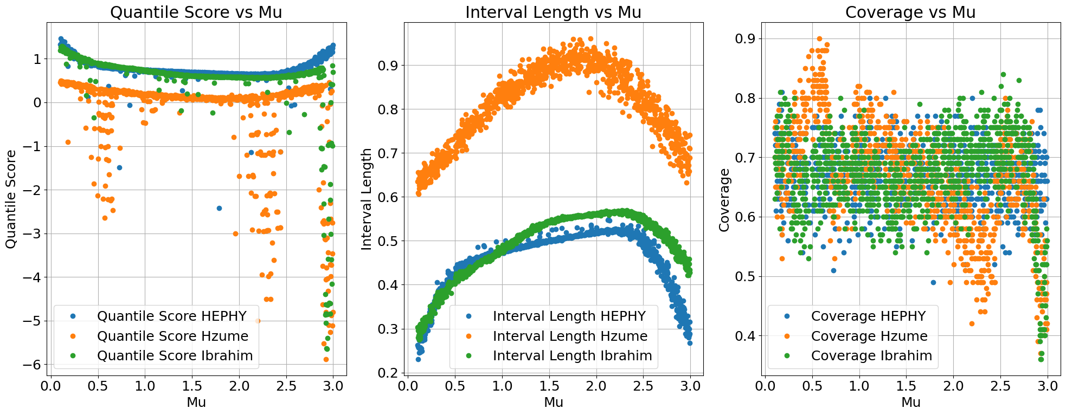
Final evaluation on 1000 x 100 p-e

Slide 16









CONTRASTIVE NORMALIZING FLOWS
FOR UNCERTAINTY-AWARE PARAMETER ESTIMATION
IBRAHIM ELSHARKAWY
UNDER THE GUIDANCE OF PROF. YONI KAHN

Slide 17
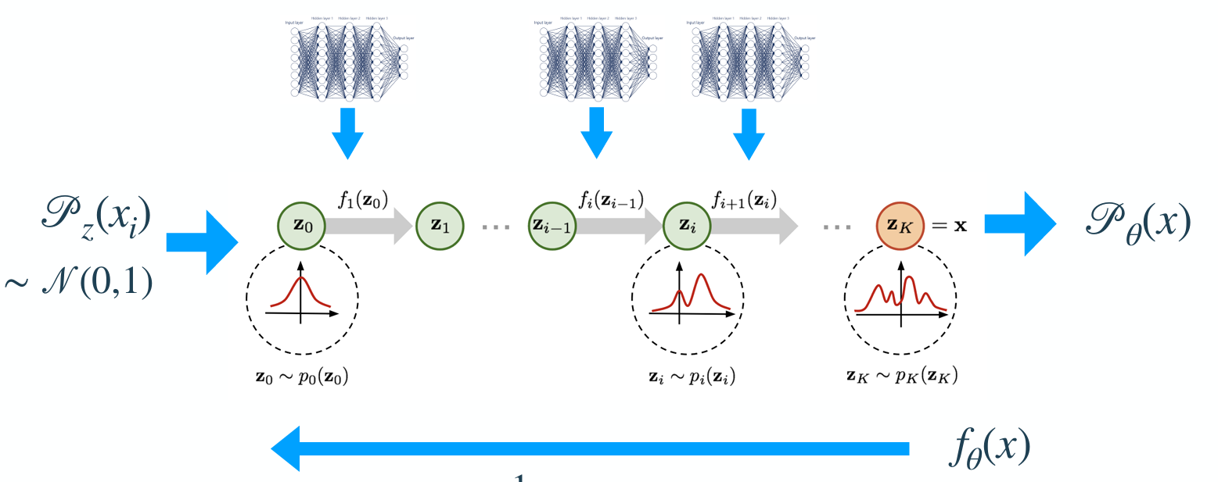
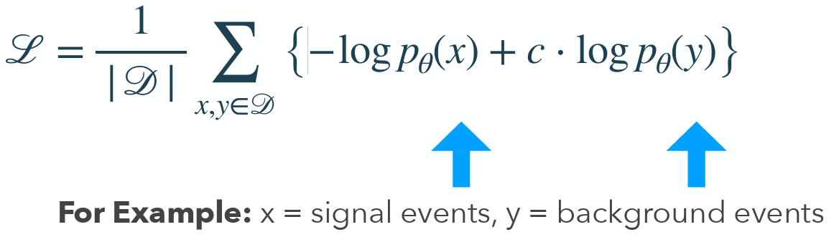
Contrastive Normalizing Flows
Hyper parameter
For tuning signal like vs Background like

Slide 18
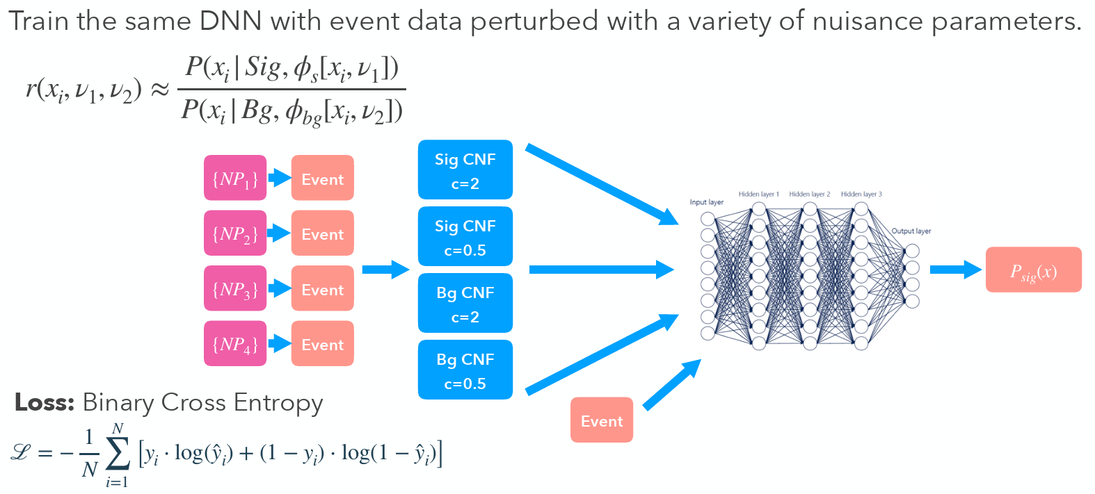
DNN Training with CNF
Score Histogram
and MLE
and 1-sigma Error Bars
Inverse Neyman Construction
Learn more at: https://arxiv.org/abs/2505.08709

Slide 19
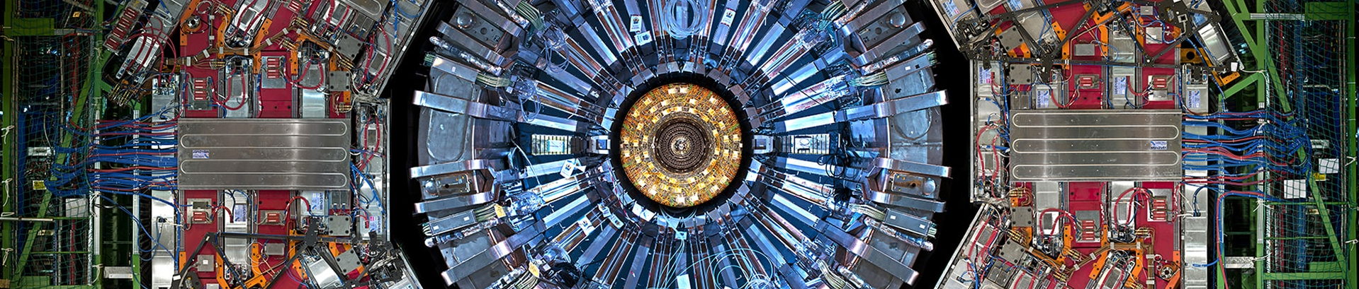

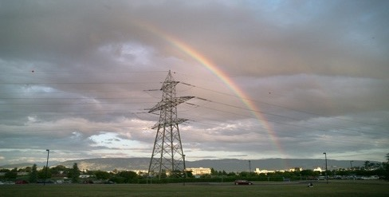
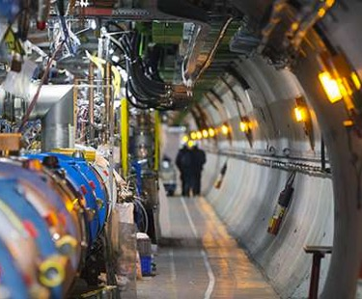
Unbinned measurements with refinable systematics
Lisa Benato, Cristina Giordano, Claudius Krause, Ang Li, Robert Schöfbeck, Dennis Schwarz, Maryam Shooshtari, Daohan Wang HEPHY Vienna

Slide 20
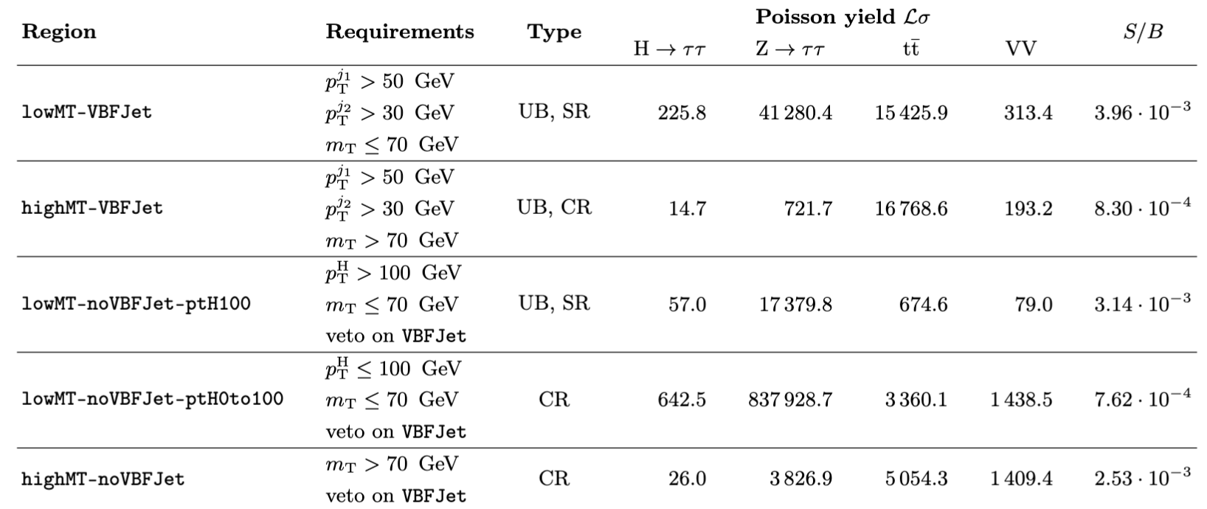
analysis regions
We split into five regions: two signal regions and three control regions
  lowMT-VBFJet vector boson fusion (VBF) with about 90% of sensitivity
  lowMT-noVBFJet-ptH100 ggH (no label for production mode)
Main SR for VBF (90% sensitivity)
Unbinned CR
SR for ggH
90% of data → One bin for bkg norm
Split off tt and VV CR (2 bins)

Slide 21
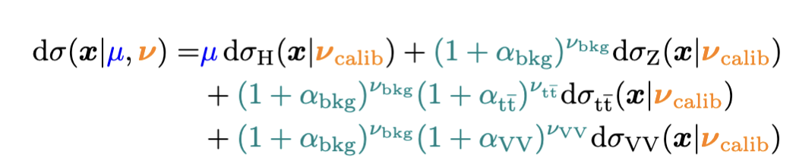
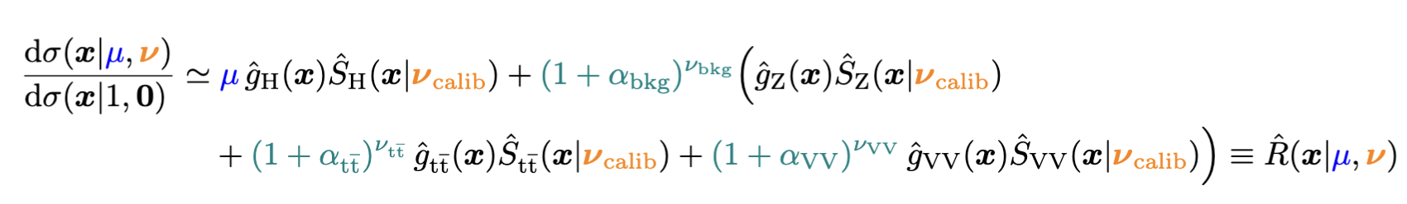
There and back again …
Additive expansion with analytic dependence for normalization uncertainties
Relate to reference model and factorize the calibration-type systematics
Repeat for Z, tt, VV & put it together:
NB1: Still avalid measure
NB2: The additive ansatz
facilitates to refinable modeling.
Form ratio wrt total
nominal (a choice)
model systematics per-process
(another choice)
ML surrogate
for systematics
Likelihood-ratio
trick
DCR =
= surrogate

Slide 22
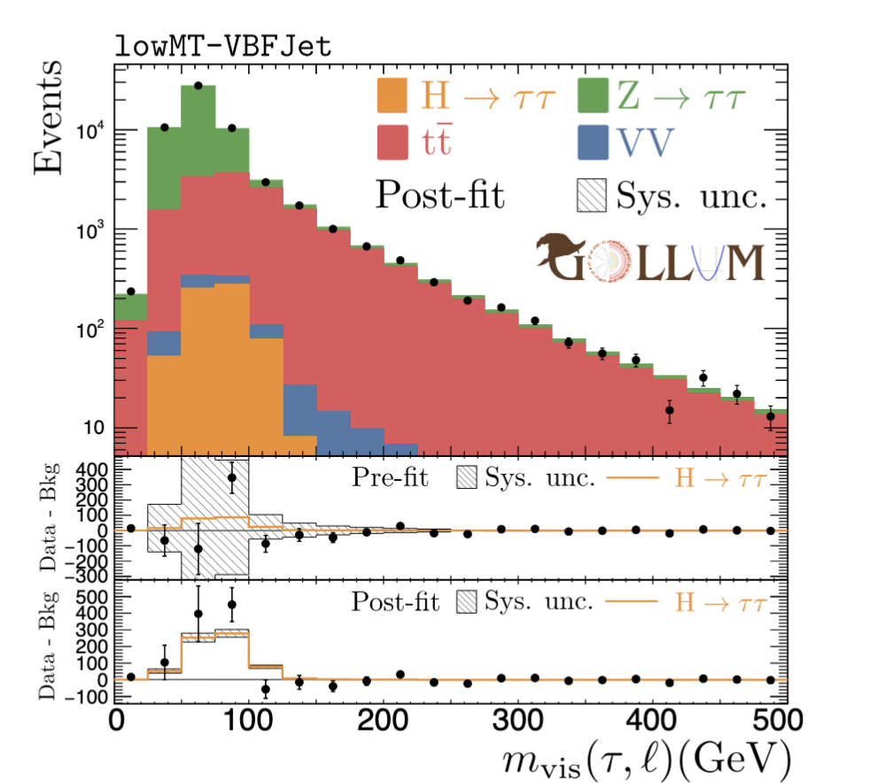
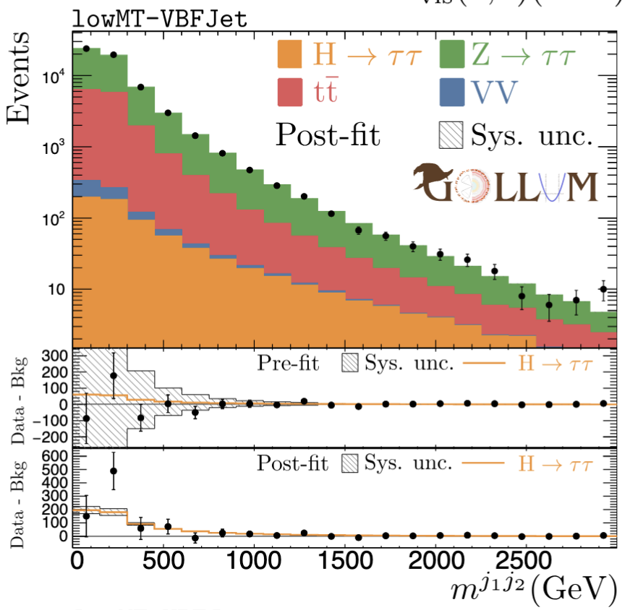
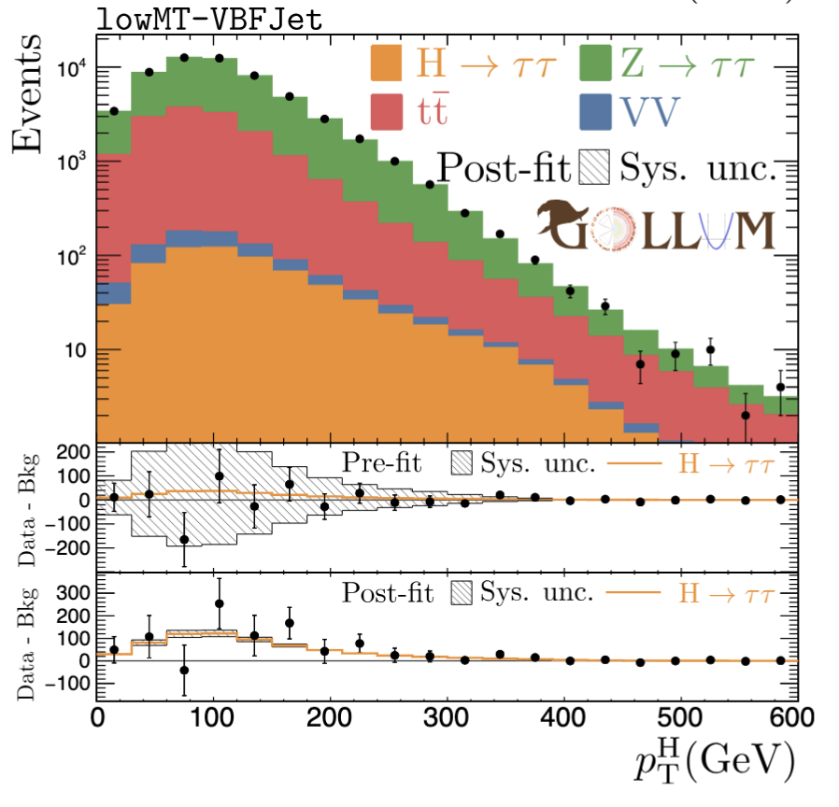
Postfit distributions
μ ^{true} = 3, μ^{MLE} = 3.24
Learn more at : https://arxiv.org/abs/2505.05544

Slide 23
Conclusion
AI challenge which addresses Systematic Uncertainty in HEP problem.
Large Public dataset in Zenodo with ~ 280M Events (signal + background)
New scoring to take Coverage and Confidence interval into account.
Exciting submissions which could be applied to future HEP analysis
New long term permanent benchmark will be launched Soon.
Questions and feedback: #higgsml-uncertainty-challenge channel on the Fair Universe Slack
Ongoing information Google Group: Fair-Universe-Announcements
Collaborations, questions, comments: fair-universe@lbl.gov

Slide 24
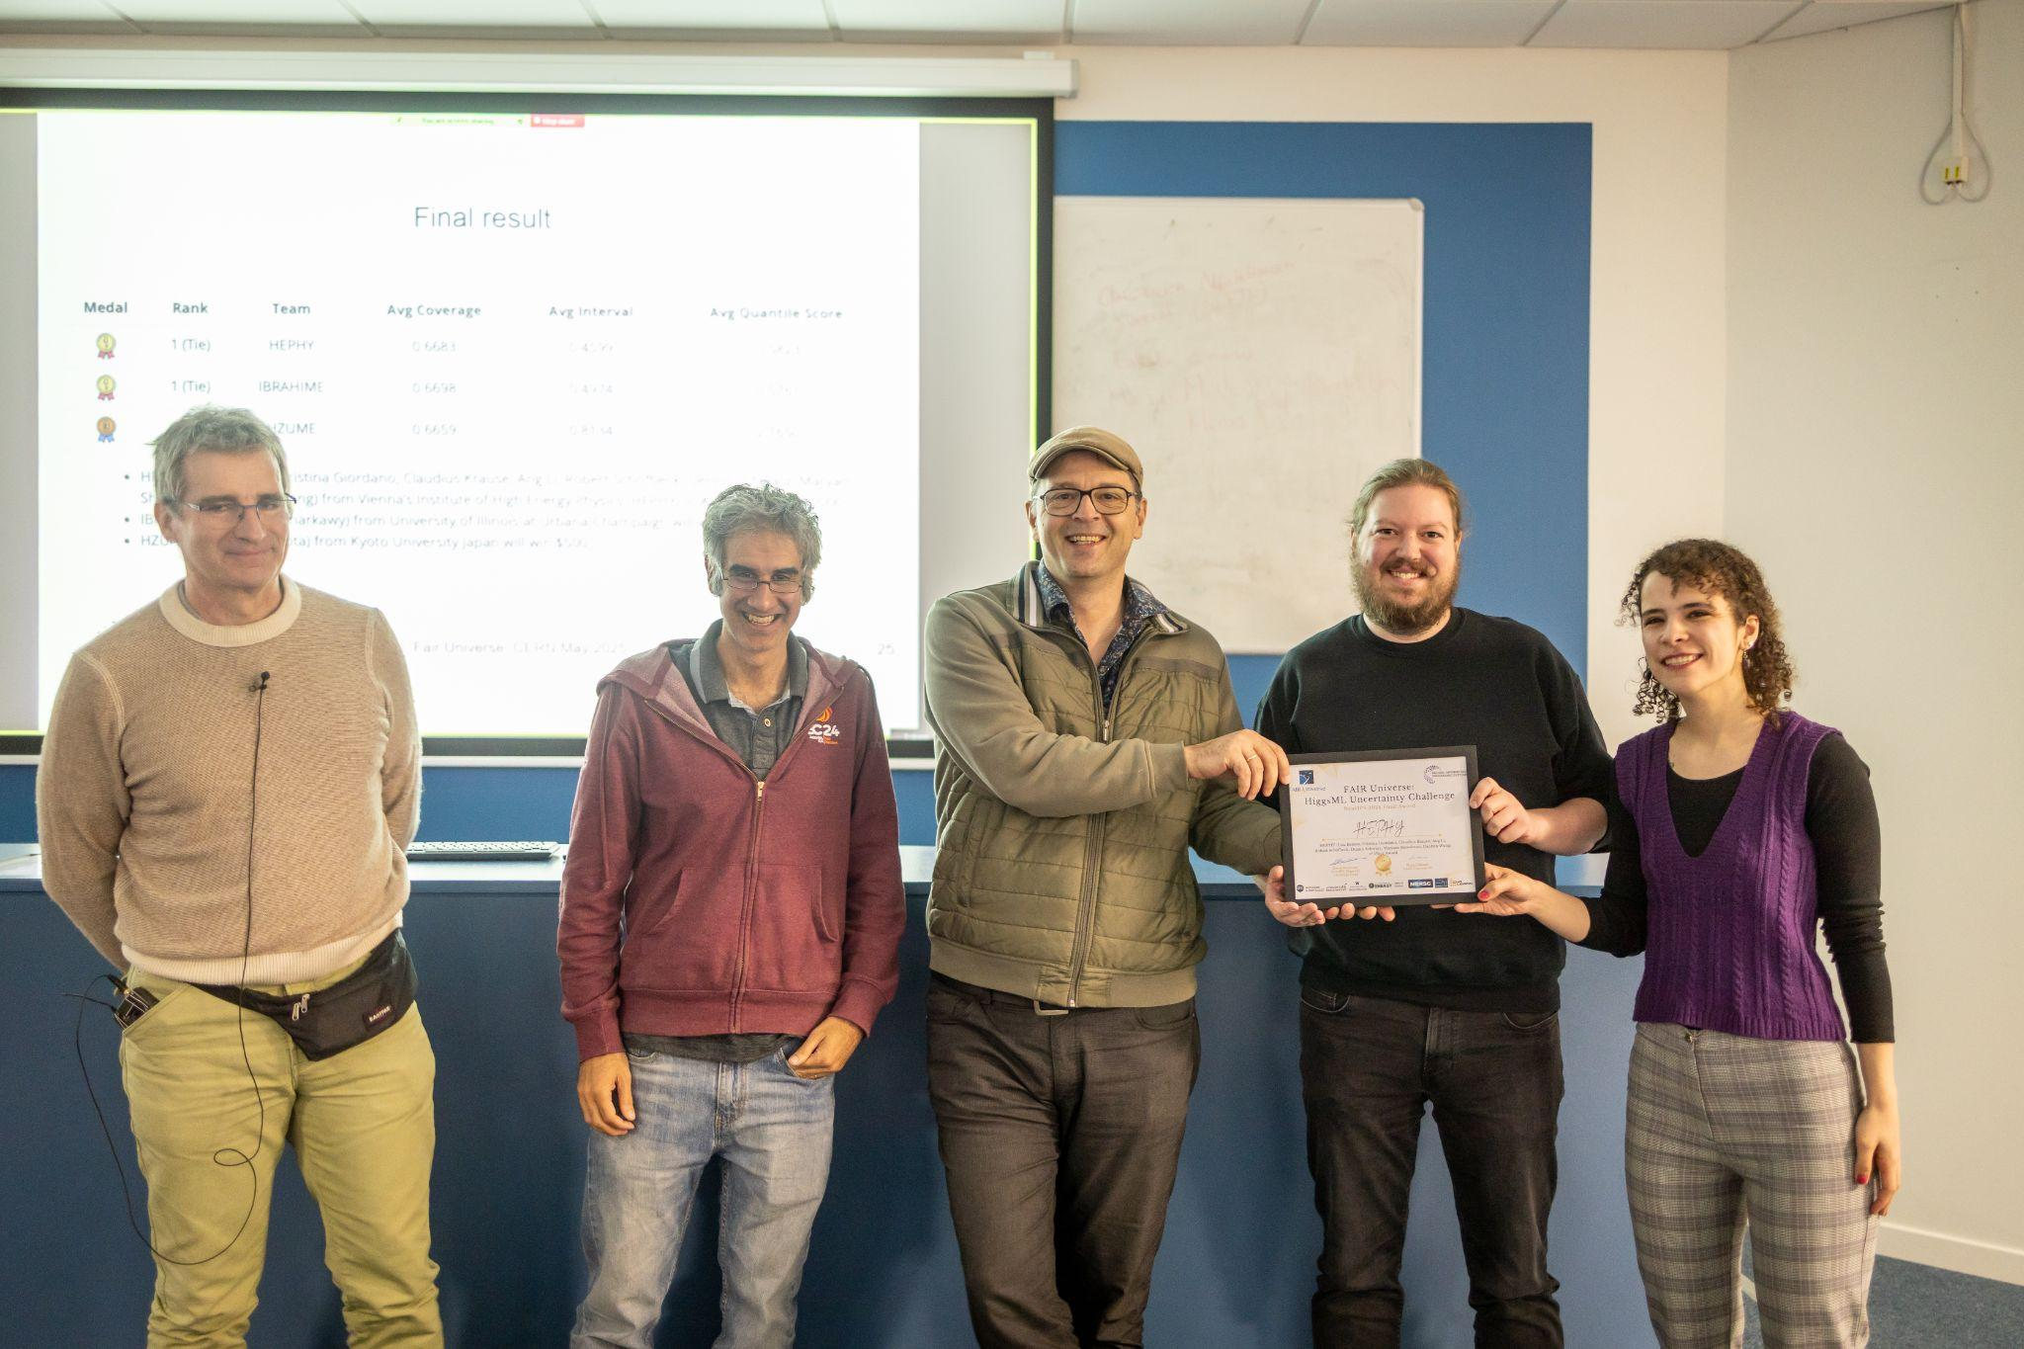
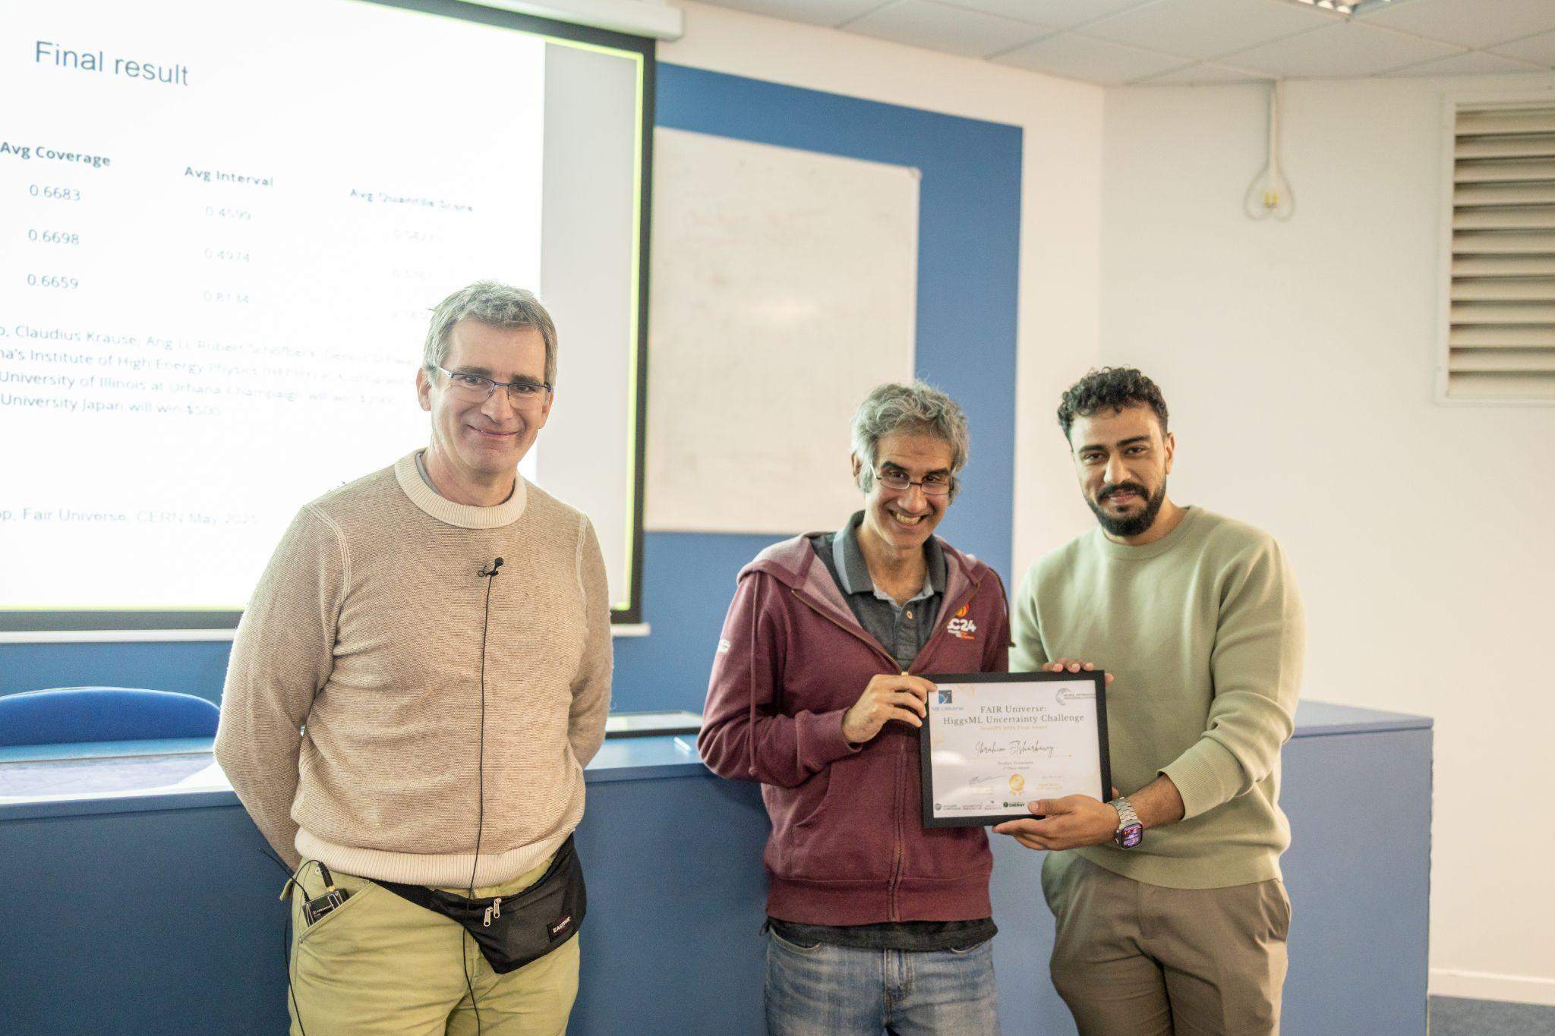
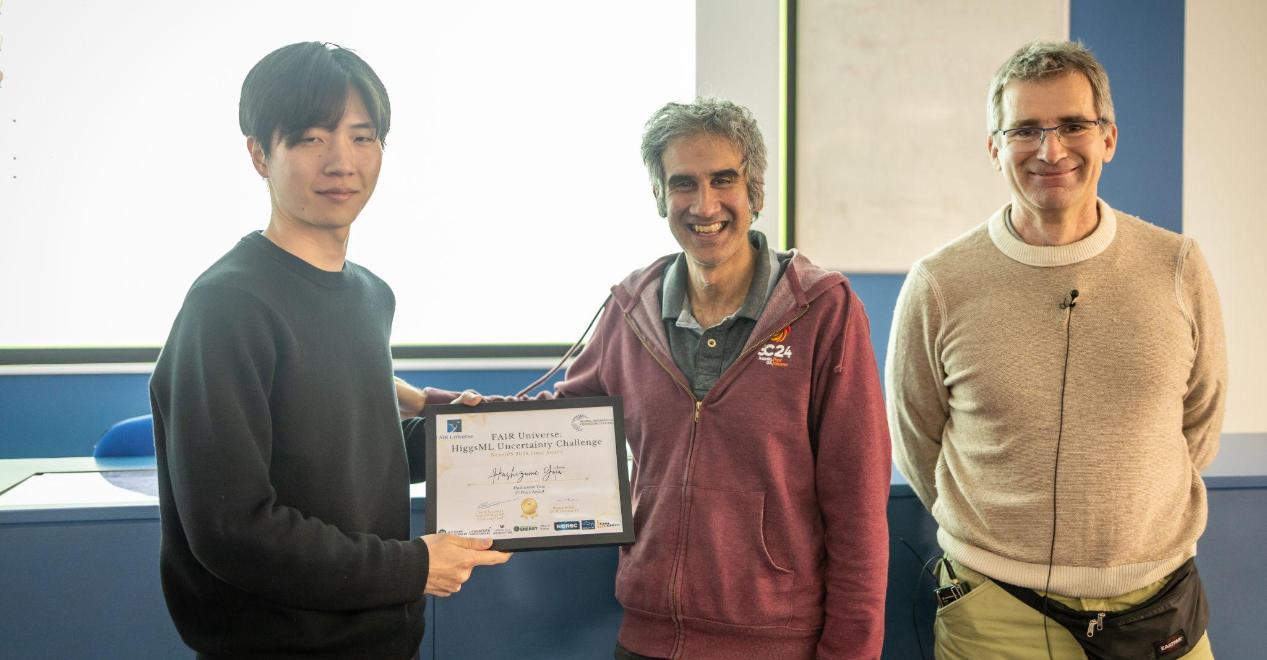
Thank you for your attention!

Slide 25
Back-up

Slide 26
Background on Fair Universe Project
3 year US Dept. of Energy, AI for HEP project. Aims to:
  Provide an open, large-compute-scale AI ecosystem for sharing datasets, training large models, fine-tuning those models, and hosting challenges and benchmarks.
  Organize a challenge series, progressively rolling in tasks of increasing difficulty, based on novel datasets.
  Tasks will focus on measuring and minimizing the effects of systematic uncertainties in HEP (particle physics and cosmology).
This funding went to LBL, NERSC, U Washington, and Chalearn (Isabelle Guyon's Non-Profit US Organisation).

Slide 27
Challenge Datasets - Systematics
MET
Apply parameterized systematics (Nuisance Parameters) :
Feature distortions:
  Tau Energy Scale (and correlated MET)
  Jet Energy Scale (and correlated MET impact)
  Additional randomised Soft MET
Event category normalisation
  Background overall normalisation
  Di-boson background normalisation
  ttbar background normalisation
τ_{had}
l
Sub-leading jet
Leading jet

Slide 28
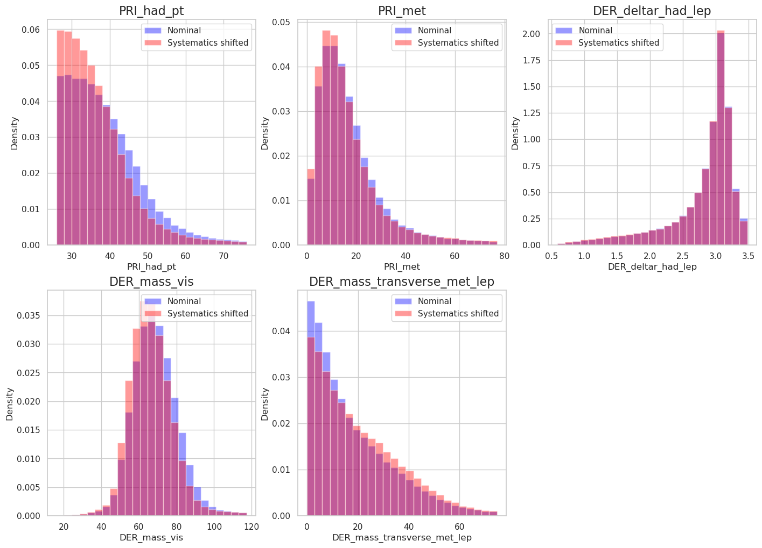
Tau Energy Scale Systematics Applied
Histogram between nominal (TES = 1) and shifted (TES = 0.9)
TES = 0.9, is an exaggeration, in practice it is sampled with a gaussian of 1 +/- 0.01

Slide 29






Competition Flow
Phase 1
Phase 2
Get Public Data
Train model
Compete with other best submissions and win the competition
Make sure to not re-train in fit function
Prepare zip with model.py and pre-trained model
Submit your model to the competition website
Leaderboard is updated once a day
Best submission is taken to Phase 2
Repeat till phase ends

Slide 30
Large-compute-scale AI ecosystem … hosting challenges and benchmarks.

Slide 31
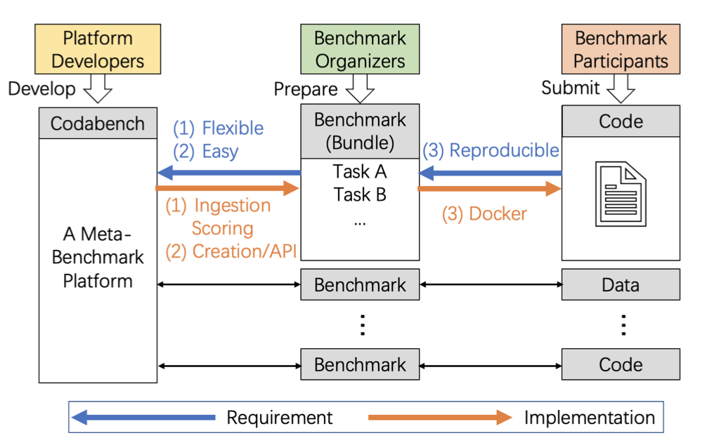

Codabench Platform
Codabench - open source platform for AI benchmarks and challenges
Originally (CodaLab) Microsoft/Stanford now a Paris-Saclay/LISN led community
> 600 challenges since 2013
Completely open-ended competition design.
Allows code submission as well as results e.g. for evaluation timing or reproducibility
Also data-centric AI “inverted competitions”
Queues for evaluation can run on diverse compute resources
Platform itself can be deployed on different compute resources
Ranked best challenge platform for ML by ML contests
Notes:
Also easy data-centric AI “inverted competitions” for running of AI models on different datasets

Slide 32
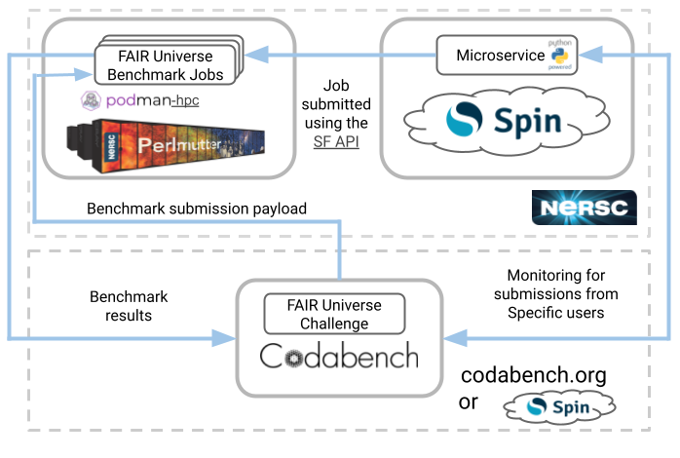
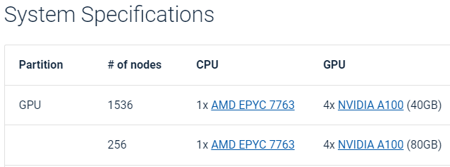
Fair Universe Platform:
Codabench-NERSC integration

Slide 33
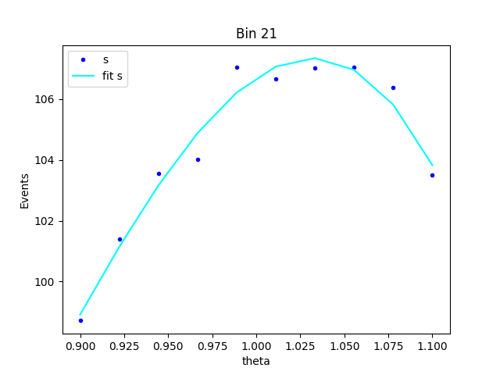
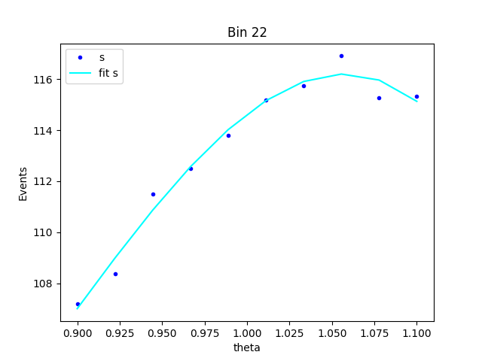
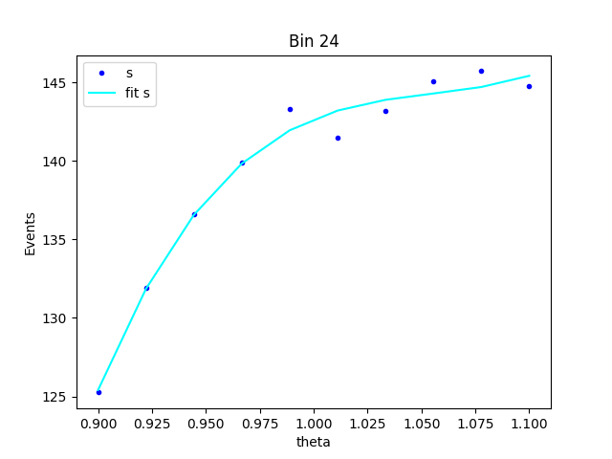
Parameterisation of S(𝛼)
With the help of the holdout_set for we get values of S and B for each NP in each bin.
A polynomial function is used to fit them. This function is later used in the NLL formalism

Slide 34

3rd Place Solution
Decision-Tree Aggregated Features
and Hybrid Bin-Classifier/Quantile-Regressor
Yota Hashizume (hzume)

Slide 35
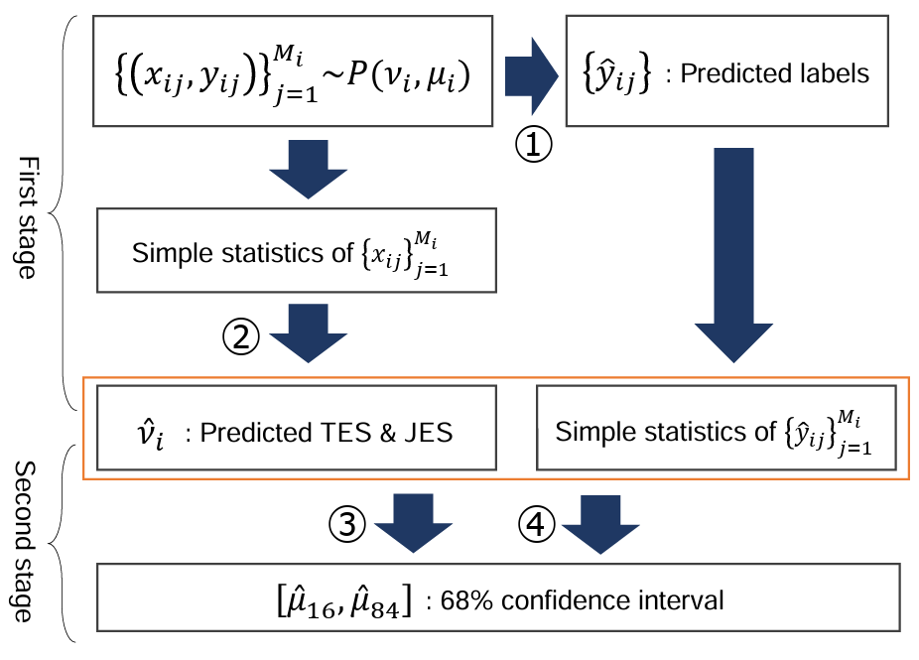
Overview
2-stage, GPU-free GBDT-based model
First stage
  Aggregated features
  Used 2 models (①,②)
Second stage
  Estimate 68% confidence interval by using aggregated features
  Used 2 models (③,④) and merged their outputs
https://indico.cern.ch/event/1523250/contributions/6456344/attachments/3070079/5431138/higgsml-3rd-place.pdf

