Slide 1





Dosimetry in Mammography
PHENICS FEST
3-4 Juillet 2025
M. DJAROUM, J. LEFEVRE, J. PLAGNARD, J.M. BORDY, I. FITTON et C. VAN NGOC TY

Slide 2
CONTEXT
1

Slide 3
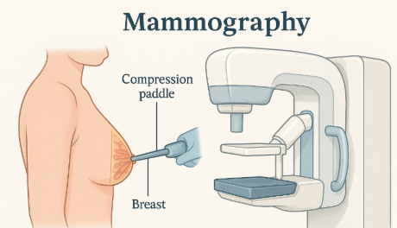
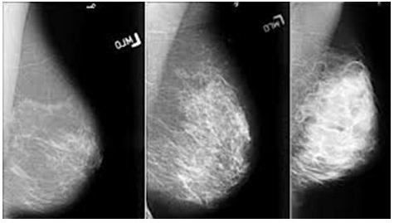
Definitions
Mammography: a key breast examination
Low-energy X-ray imaging technique (20–50 kV) used for screening and detecting cancer in women
Mammography Procedure
Positioning
The breast is positioned on the imaging device
Compression
A compression paddle is used to gently compress the breast, enhancing the visibility of the breast tissue
Mammography images

Slide 4

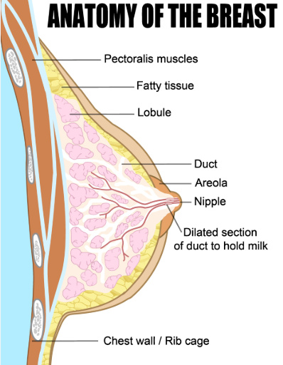

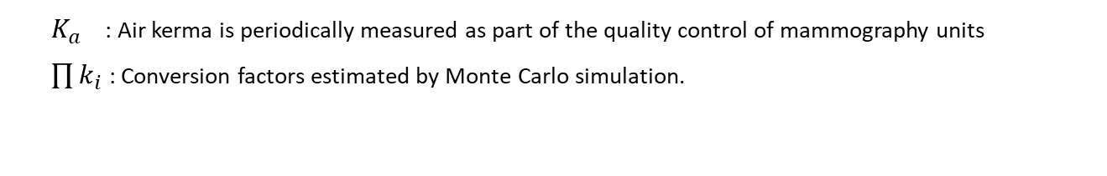

Dosimetry in mammography
ICRP Recommendation, 1987: Use of the Mean Glandular Dose (MGD) [mGy] for breast dosimetry.
MGD$=K_{a}.\prod_{i}{k_{i}}$
$$[mGy]$$
$K_{a}$ : Air kerma is periodically measured as part of the quality control of mammography units
$\prod{k_{i}}$: Conversion factors estimated by Monte Carlo simulation.
The ALARA Principle
Parameters influencing dose measurement in mammography
Breast geometry: thickness and composition
X-ray beams used (kVp, anode, filtration)
To minimize radiation exposure while maintaining diagnostic quality.
PHENICS FEST, M. DJAROUM
04/07/2025 4

Slide 5
PROBLEM& OBJECTIVE
2

Slide 6
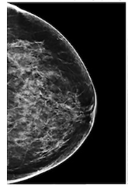
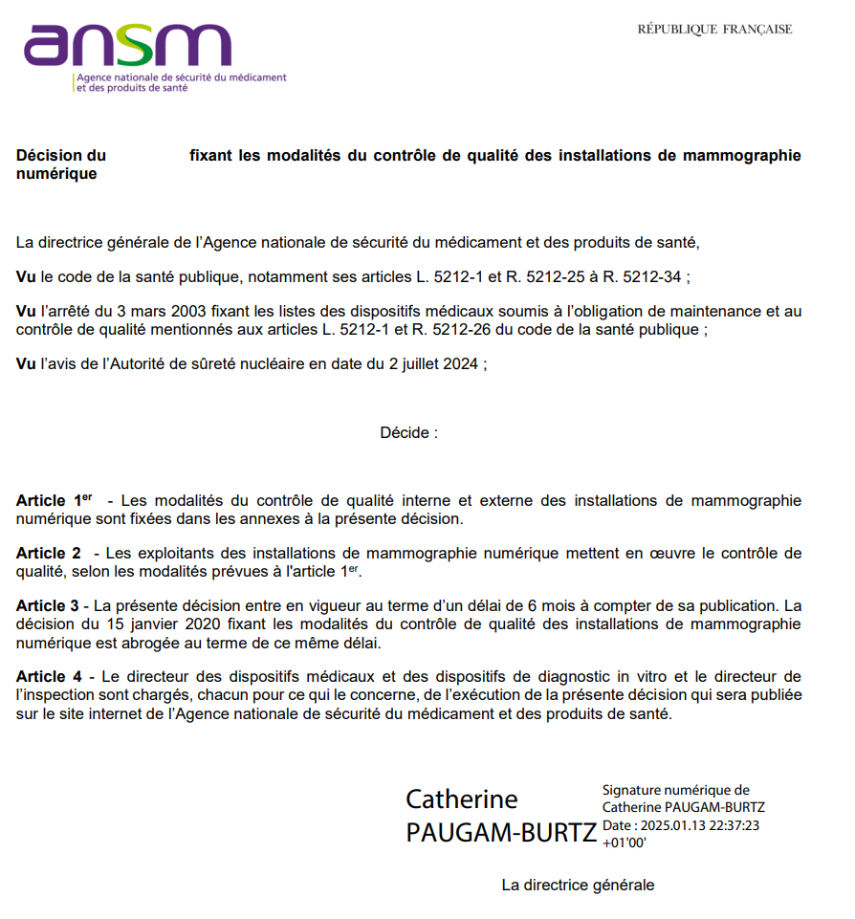


During Exam
Focal spot
Foyer
MGD= f(THT; mAs; anode/filter ...)
?
Plaque de compression
Sein
receptor
MGD_{exam}
Compression paddle
Breast
MGD$=K_{a}.c.g.s$
Quality Controls ( ANSM.2025)
Comparison MGD_{calc} Vs MGD_{exam}
acceptability criterion :

Slide 7
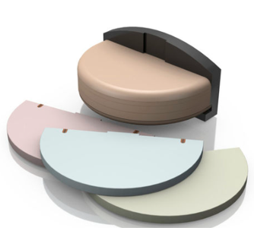


OBJECTIVE
Focal spot
$$MGD=K_{a}.g.c.s.$$
Foyer
Plaque de compression
Système de mesure actif
receptor
$$MGD$$
Compression paddle
measurement system
Develop a measurement system that allows direct measurement of MGD

Slide 8
METHODOLOGY
3

Slide 9
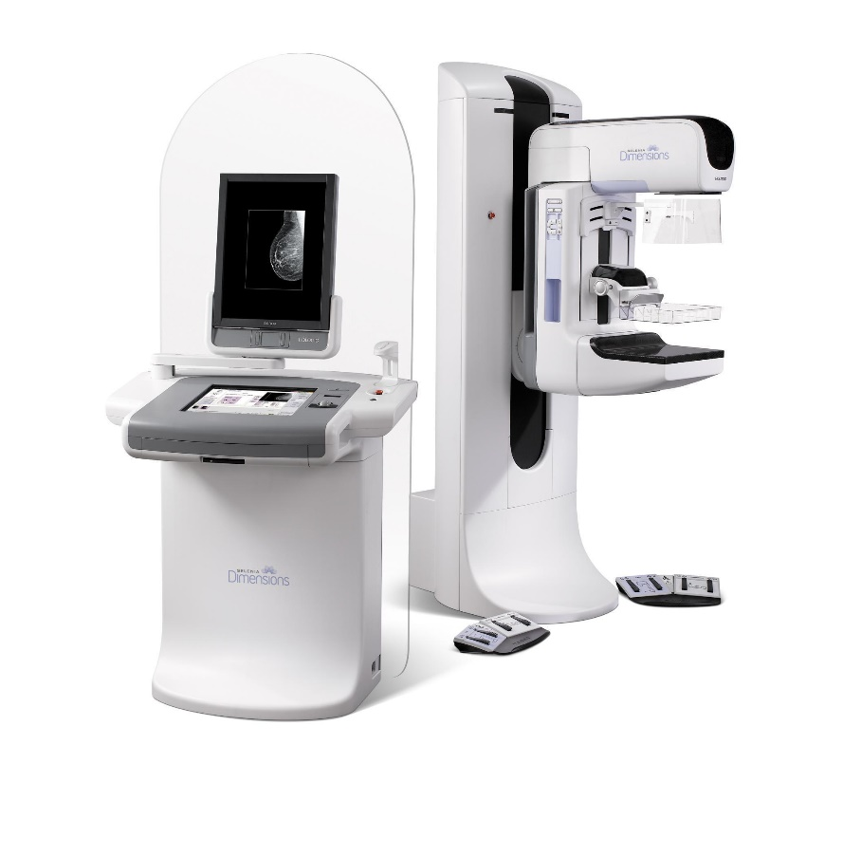
1. PHYSICAL MEASURMENTS
1.1 Selection of reference clinical beams
► 15 mammography beams Hologic Selenia® Dimensions® de l’HEGP
1.2 Caracterisation of x-ray beams at HEGP
► spectrometric measurments + HVLs measurments
1.3 x-ray beams reproduction at LNHB
► spectrometric measurments + HVLs measurments
1.4 Calibration of a transfer chamber (Radcal 10X6-6M) on LNHB beams ► Measurement of calibration coefficients (Nk) of the transfer chamber in terms of air kerma (Ka) using the LNHB air-kerma chamber WK07 (primary reference standard for low-energy X-ray dosimetry).
1.5 Measurements of air kerma (Ka) under quality control conditions and conversion to mean glandular dose (MGD) using the c, g, and s factors from the Dance model.
1.6 Dose profile measurements using GAFCHROMIC films
Digital mammography model used at HEGP.
W/Ag | W/Al | W/Rh
22 kV | 25 kV | 22 kV
28 kV | 30 kV | 25 kV
32 kV | 35 kV | 28 kV
36 kV | 40 kV | 33 kV
39 kV | 49 kV | 39 kV
Radiation qualities (anode/filtration) selected for this study

Slide 10
1. PHYSICAL MEASURMENTS
1.1 Selection of reference clinical beams
► 15 mammography beams Hologic Selenia® Dimensions® de l’HEGP
1.2 Caracterisation of x-ray beams at HEGP
► spectrometric measurments + HVLs measurments
1.3 x-ray beams reproduction at LNHB
► spectrometric measurments + HVLs measurments
1.4 Calibration of a transfer chamber (Radcal 10X6-6M) on LNHB beams ► Measurement of calibration coefficients (Nk) of the transfer chamber in terms of air kerma (Ka) using the LNHB air-kerma chamber WK07 (primary reference standard for low-energy X-ray dosimetry).
1.5 Measurements of air kerma (Ka) under quality control conditions and conversion to mean glandular dose (MGD) using the c, g, and s factors from the Dance model.
1.6 Dose profile measurements using GAFCHROMIC films
Devices used at HEGP for X-ray emission spectrometry measurements (top) and for HVL measurements (bottom).
Titable support for Al screen and PTW23342 detector

Slide 11
1. PHYSICAL MEASURMENTS
1.1 Selection of reference clinical beams
► 15 mammography beams Hologic Selenia® Dimensions® de l’HEGP
1.2 Caracterisation of x-ray beams at HEGP
► spectrometric measurments + HVLs measurments
1.3 x-ray beams reproduction at LNHB
► spectrometric measurments + HVLs measurments
1.4 Calibration of a transfer chamber (Radcal 10X6-6M) on LNHB beams ► Measurement of calibration coefficients (Nk) of the transfer chamber in terms of air kerma (Ka) using the LNHB air-kerma chamber WK07 (primary reference standard for low-energy X-ray dosimetry).
1.5 Measurements of air kerma (Ka) under quality control conditions and conversion to mean glandular dose (MGD) using the c, g, and s factors from the Dance model.
1.6 Dose profile measurements using GAFCHROMIC films
PMMA cap simulating the imaging block of the HEGP mammograph
Devices used at LNHB for X-ray emission spectrometry measurements (top) and HVL measurements (bottom).

Slide 12

1. PHYSICAL MEASURMENTS
1.1 Selection of reference clinical beams
► 15 mammography beams Hologic Selenia® Dimensions® de l’HEGP
1.2 Caracterisation of x-ray beams at HEGP
► spectrometric measurments + HVLs measurments
1.3 x-ray beams reproduction at LNHB
► spectrometric measurments + HVLs measurments
1.4 Calibration of a transfer chamber (Radcal 10X6-6M) on LNHB beams ► Measurement of calibration coefficients (Nk) of the transfer chamber in terms of air kerma (Ka) using the LNHB air-kerma chamber WK07 (primary reference standard for low-energy X-ray dosimetry).
1.5 Measurements of air kerma (Ka) under quality control conditions and conversion to mean glandular dose (MGD) using the c, g, and s factors from the Dance model.
1.6 Dose profile measurements using GAFCHROMIC films
RX BE Generator
RadCal detector ( 10X6-6M
Reference chamber (WK07)

Slide 13
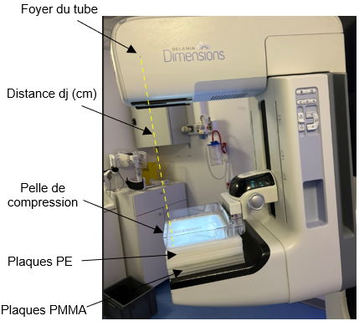
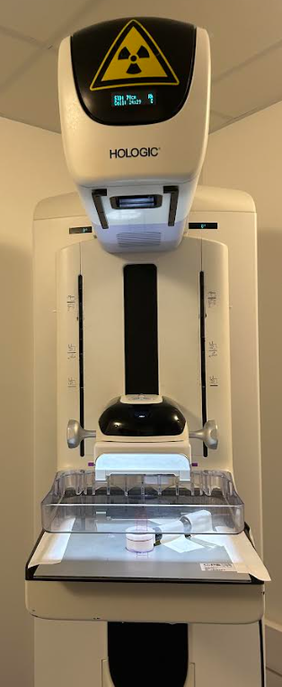
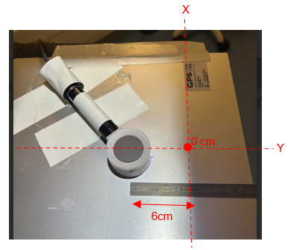
1. PHYSICAL MEASURMENTS
Focal spot
1.1 Selection of reference clinical beams
► 15 mammography beams Hologic Selenia® Dimensions® de l’HEGP
1.2 Caracterisation of x-ray beams at HEGP
► spectrometric measurments + HVLs measurments
1.3 x-ray beams reproduction at LNHB
► spectrometric measurments + HVLs measurments
1.4 Calibration of a transfer chamber (Radcal 10X6-6M) on LNHB beams ► Measurement of calibration coefficients (Nk) of the transfer chamber in terms of air kerma (Ka) using the LNHB air-kerma chamber WK07 (primary reference standard for low-energy X-ray dosimetry).
1.5 Measurements of air kerma (Ka) under quality control conditions and conversion to mean glandular dose (MGD) using the c, g, and s factors from the Dance model.
1.6 Dose profile measurements using GAFCHROMIC films
Compression paddle
Compression paddle
RadCal chamber 10X6-6M Placed at y= 6cm from the bloc image and centered laterally at x=0cm

Slide 14
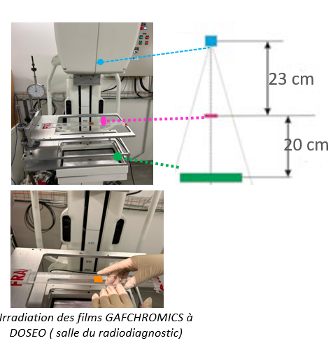
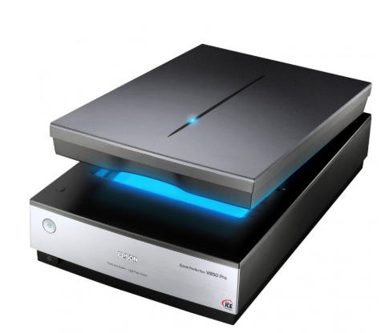
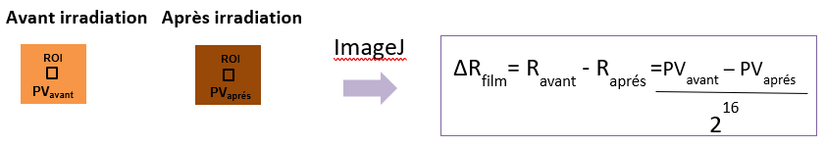
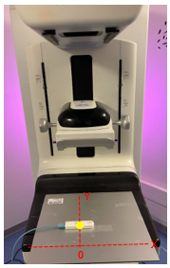
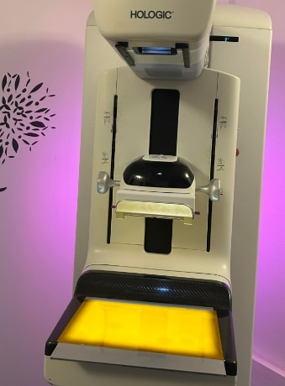
1. PHYSICAL MEASURMENTS
RX source
1.1 Selection of reference clinical beams
► 15 mammography beams Hologic Selenia® Dimensions® de l’HEGP
1.2 Caracterisation of x-ray beams at HEGP
► spectrometric measurments + HVLs measurments
1.3 x-ray beams reproduction at LNHB
► spectrometric measurments + HVLs measurments
1.4 Calibration of a transfer chamber (Radcal 10X6-6M) on LNHB beams ► Measurement of calibration coefficients (Nk) of the transfer chamber in terms of air kerma (Ka) using the LNHB air-kerma chamber WK07 (primary reference standard for low-energy X-ray dosimetry).
1.5 Measurements of air kerma (Ka) under quality control conditions and conversion to mean glandular dose (MGD) using the c, g, and s factors from the Dance model.
1.6 Dose profile measurements using GAFCHROMIC films
Radiochromic film sample
Imaging bloc
Radiochromic film sample
Scanner EPSON
Before irradiation after irradiation
Beam | Nomber of mAs | Nomber of exposure | Dose for one exposure (mGy) | Dose for all exposures (mGy)
Ag-36 kV | 300 | 4 | 30.47 | 120
Al-40 kV | 120 | 4 | 25.28 | 100
Rh-33 kV | 300 | 12 | 18.61 | 223.32
Radiopaque shield
Radiochromic
film
Raysafe Xi MAM
Placed 6 cm from the edge along the y-axis.

Slide 15
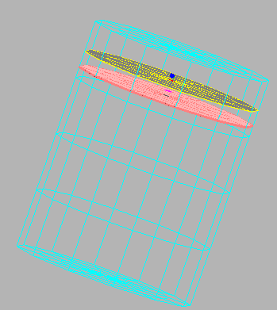
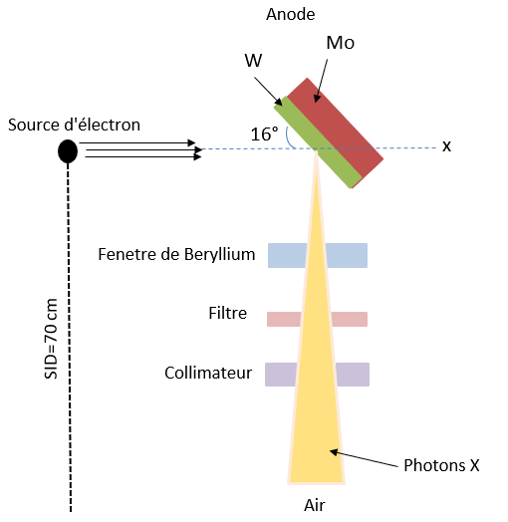
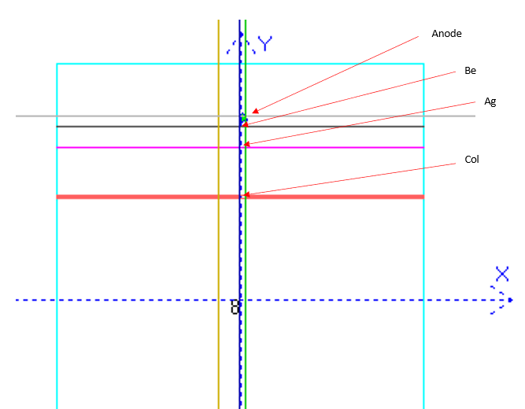
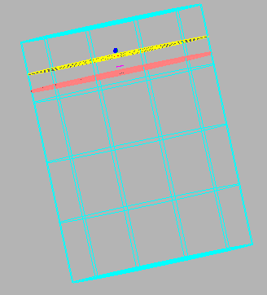
2. MONTE CARLO SIMULATIONS (MCNP Code)
2.1 MCNP numerical modeling of the X-ray tube of the HEGP mammography unit
► Comparison of simulated spectra with measured spectra for validation of the numerical model.
► Analysis of the spatial distribution of the radiation field
Electron source
Beryllium window
Filter
Collimator
X photons

Slide 16
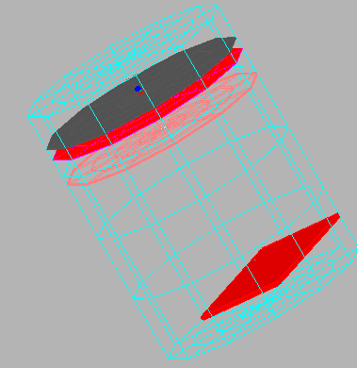
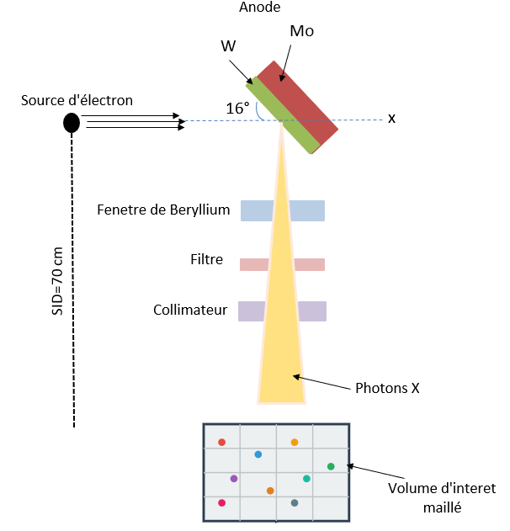
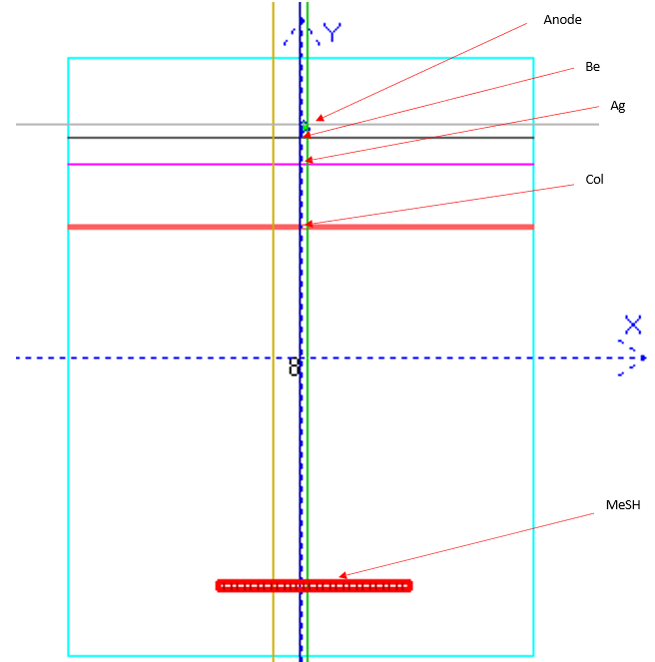
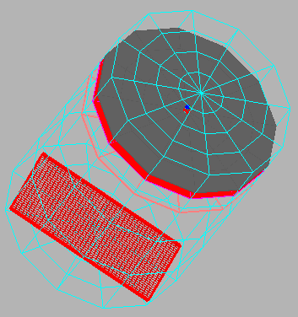
2. MONTE CARLO SIMULATIONS ( MCNP Code)
2.1 MCNP numerical modeling of the X-ray tube of the HEGP mammography unit
► Comparison of simulated spectra with measured spectra for validation of the numerical model.
► Analysis of the spatial distribution of the radiation field
Electron source
Beryllium window
Filter
Collimator
X photons
Meshed volume of interest
Measurment points
Points de mesure

Slide 17
RESULTS
4

Slide 18
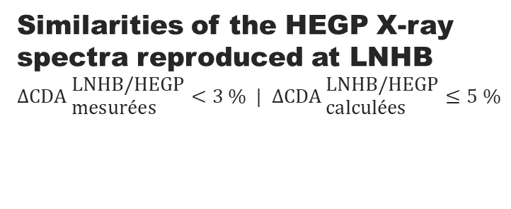
(1.2-1.3) Characterization and reproduction of the X-ray beams from HEGP
MCNP
Results presented obtained in 2024. The LNHB has access to the beam qualities of the HEGP mammography unit :
Similarities of the HEGP X-ray spectra reproduced at LNHB
$$Δ{\text{CDA} }_{\text{mesur}\text{é}\text{es}}^{\text{LNHB}\text{/}\text{HEGP}}<3 \% | Δ{\text{CDA} }_{\text{calcul}\text{é}\text{es}}^{\text{LNHB}\text{/}\text{HEGP}}≤5 \%$$
Measurements performed with a PTW 23342 ionization chamber and the LNHB air-kerma chamber WK07 (national reference for Ka measurements in the 10–100 keV range)
CDA [mm Al]
CDA [mm Al] -
THT [kV]
THT [kV]
17

Slide 19
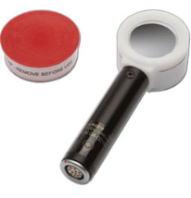

(1.4) Calibration of the Radcal 10X6-6M transfer chamber at LNHB
The calibration coefficient (Nk) shows a slight gradual increase, with an overall variation of about 2% across the entire HVL range.
Low dependence of Nk on the type of filtration: relative differences ≤ 0.5% for equivalent voltages
Good measurement precision: standard uncertainties ranging between 0.3% and 0.5%.
Stability of Nk with respect to HVL: a 5% bias in HVL results in a 0.4% variation in Nk
$$N_{k}=\frac{{\dot{K}}_{a}^{}}{\left(L−L_{MP}\right)}.\frac{1}{k_{T}{.k}_{P}}$$
HVL [mmAl]
Nk = f(HVL) measured for the different studied beams using the Radcal 10X6-6M chamber calibrated at LNHB

Slide 20





(1.5) Comparison of measured vs. displayed mean glandular dose (MGD) (HEGP console) – Quality Control setup
Systematic underestimation of the mean glandular dose displayed by the mammography console: from -4% to -12%.
No influence of the stacking order of PMMA and PEHD plates on the displayed mean glandular dose.
Foyer
Foyer
dp
d
Mesure CQE
Radcal 10X6-6M
X
Plaque de compression (PC)
PMMA+PEHD
Récepteur
PC
Récepteur
$${K_{a}=K}_{a}^{\text{Rad}.}\frac{{mAs}_{\text{auto}}}{{\text{mAs}}_{\text{man}}}{\left(\frac{d}{d_{p}}\right)}^{2}$$
$$\left\{\begin{aligned}{mAs}_{auto} \\ THT\end{aligned}\right\}$$
$$\left\{\begin{aligned}{mAs}_{man} \\ THT\end{aligned}\right\}$$
PMMA+PEHD thikness [mm]
Comparison of mean glandular dose (MGD) values measured using the Radcal 10X6-6M transfer chamber with those displayed by the mammography software
$$D_{\text{G}}^{\text{aff}.}$$
$$D_{\text{G}}^{\text{mes}.}$$

Slide 21
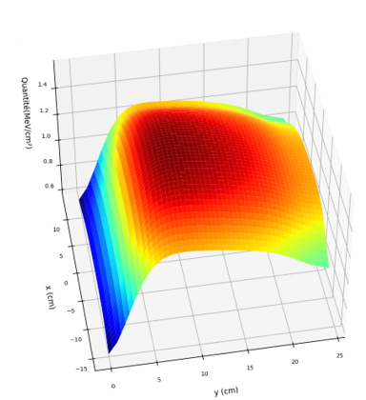
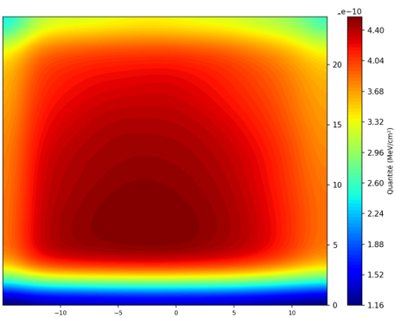
( 1.6) Measurements of the spatial dose distribution delivered by the HEGP digital mammography unit
W/Ag (36 kV)
W/Al (40 kV)
W/Rh (33 kV)
24
+10
0
-10
-20
-30
-40
-50
-60
-70
-80
18
Différentiel de dose (%) par rapport au centre du film
[cm]
12
6
6 cm
0
Spatial dose distribution on Gafchromic LD-V1 film. (In yellow) Projection of a standard breast according to the Dance model (disk with an 8 cm radius) proximal to the Potter (cross).
24
1
0,8
0,6
0,4
0,2
0
Profil 1D
18
12
[cm]
Bord proximal du Potter
6
0 8 16 24
6 cm
2
Dose profile at the center of the film from the proximal edge of the Potter (on the left).
0

Slide 22
Conclusions & perspectives
5

Slide 23
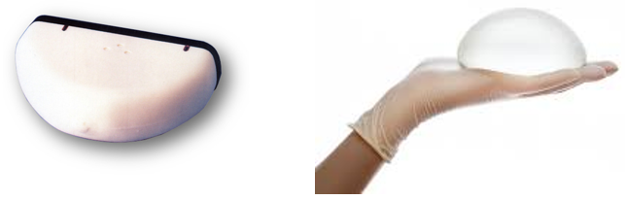
Conclusions & Perspectives
The LNHB was able to reproduce X-ray beams equivalent to those used clinically for breast cancer screening. These beams offer significant advantages, such as the ability to calibrate dosimeters and to study X-ray attenuation through breast implants.

Slide 24
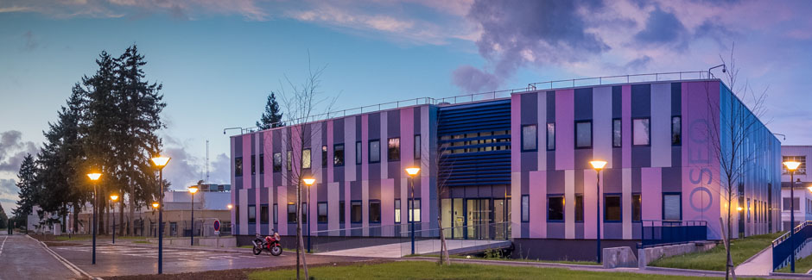
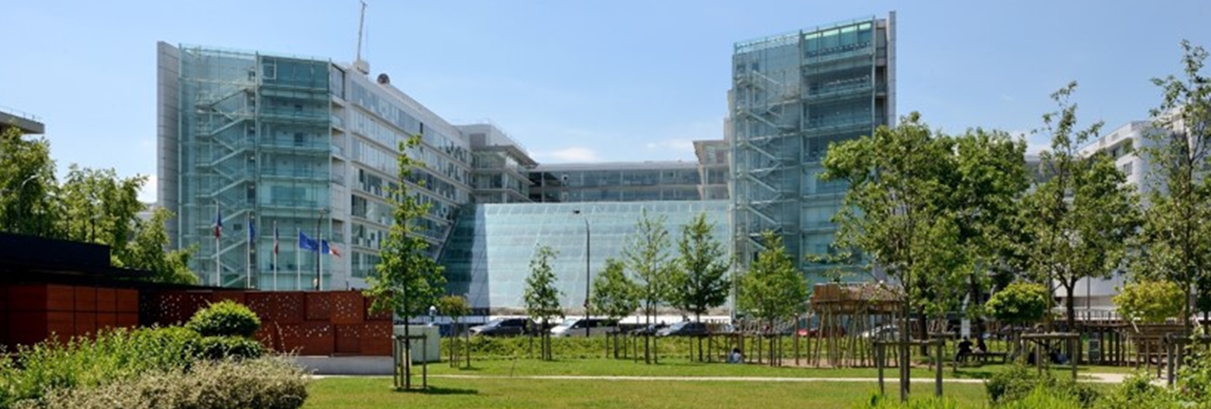
Thank you for your attention

