Slide 1
PERLE Collaboration Board Meeting
Project Advancements and Collaboration Matters
Maud Baylac, Achille Stocchi & Walid Kaabi
Wednesday, May 28th 2025

Slide 2
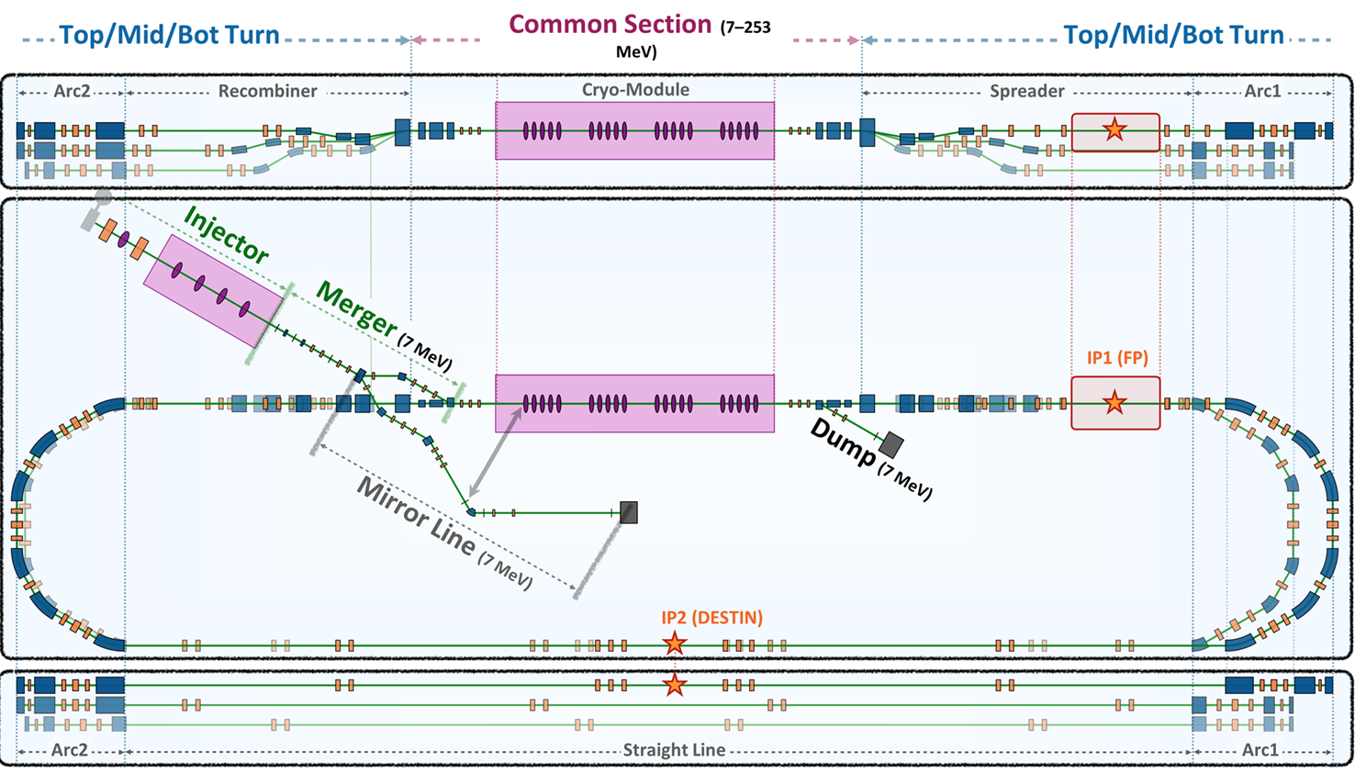
Lattice design and beam dynamics
PERLE 250 MeV lattice with diagnostic line, taking into account the requirements on IPs (Fabry-Perot cavity in IP1 and ion trap for e- scattering with RIB in IP2).

Slide 3
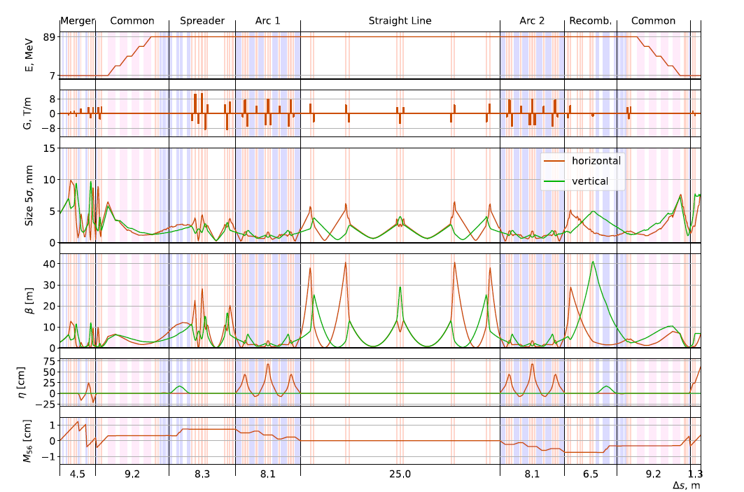
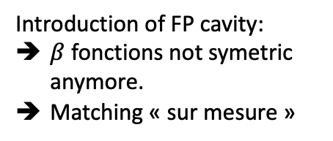
Lattice design and beam dynamics
Introduction of FP cavity:
$β$ fonctions not symetric anymore.
Matching « sur mesure »

Slide 4
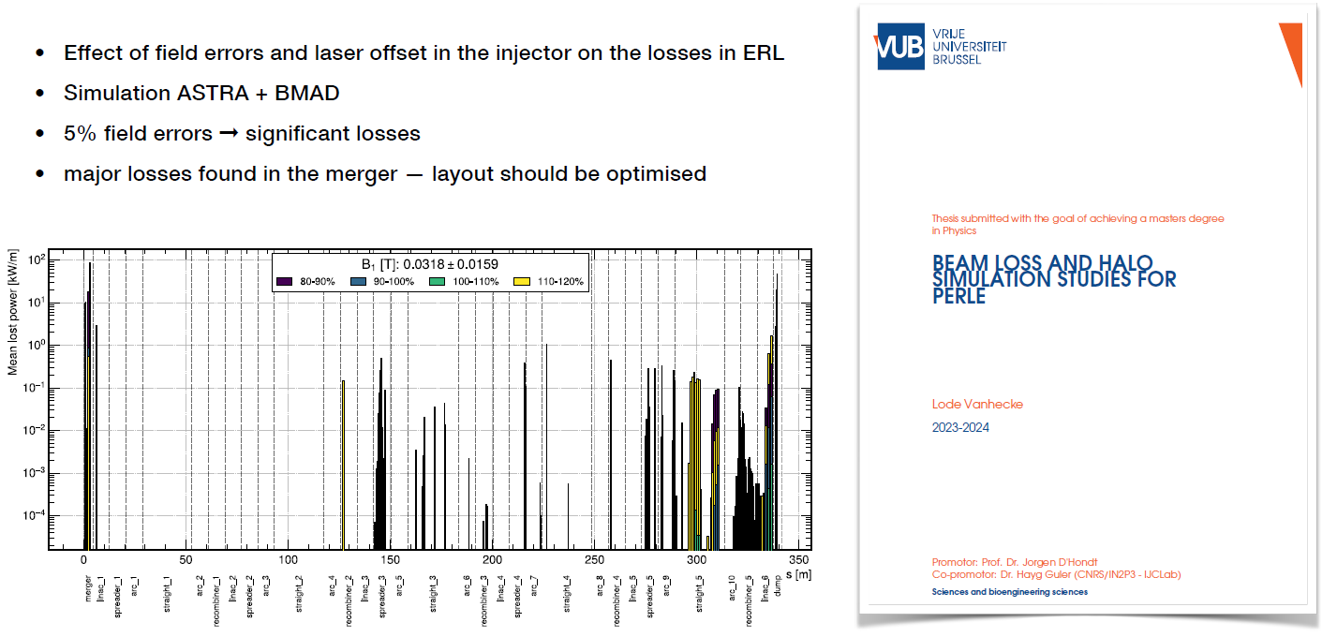
Lattice design and beam dynamics
IJCLab- ULB
Beam loss more important in deceleration phase (already observed in other ERLs)
Important beam loss in the merger (« bad particles » are lost very early → Collimation needed)
Spreaders/recombiners are identified as hotspots
Important field errors and laser offset were introduced to generate losses

Slide 5
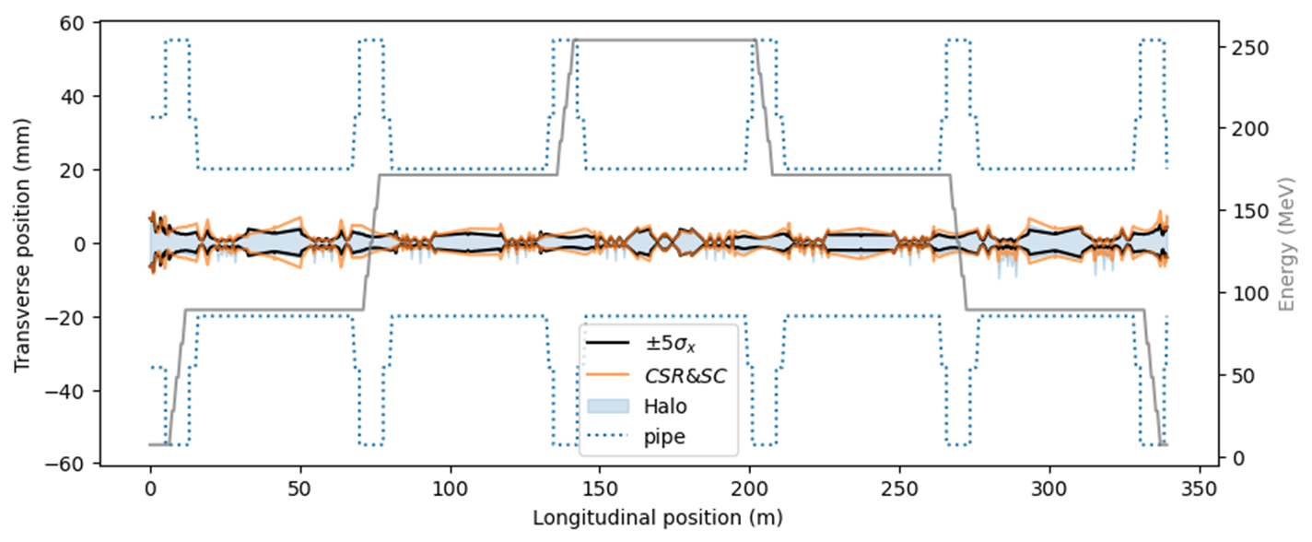
Lattice design and beam dynamics
Evolution of the beam transverse envelop along the 250 MeV machine:
  The beam 5𝜎 envelop is tracked through start-to-end tracking
  Realistic beam pipes are taken into account with :
    40mm diameter apertures in the recovery arcs and spreaders/recombiners
    60mm diameter apertures in the merger/dump and common sections
    110mm diameter aperture in the cryomodule

Slide 6
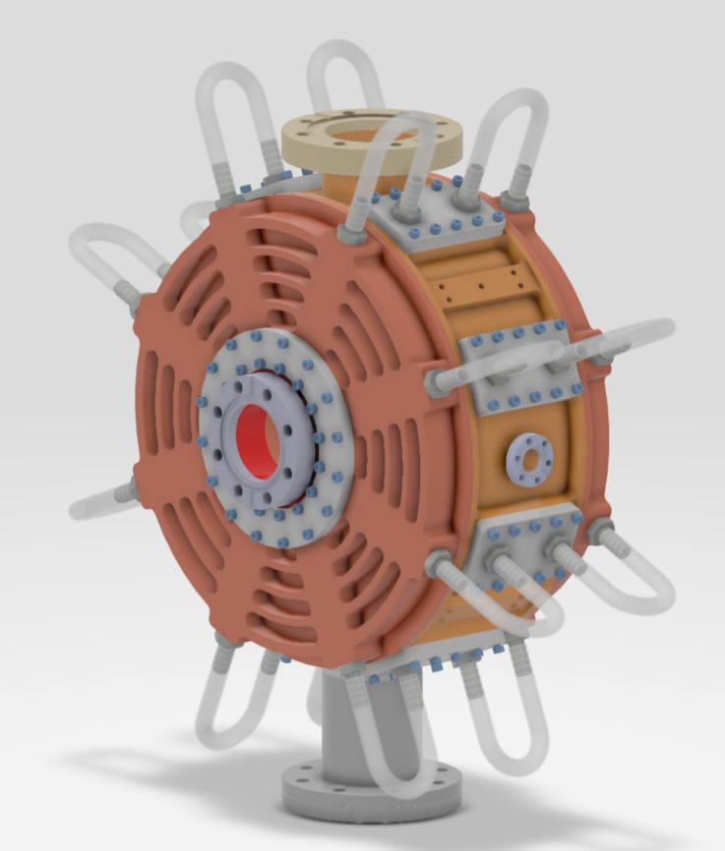
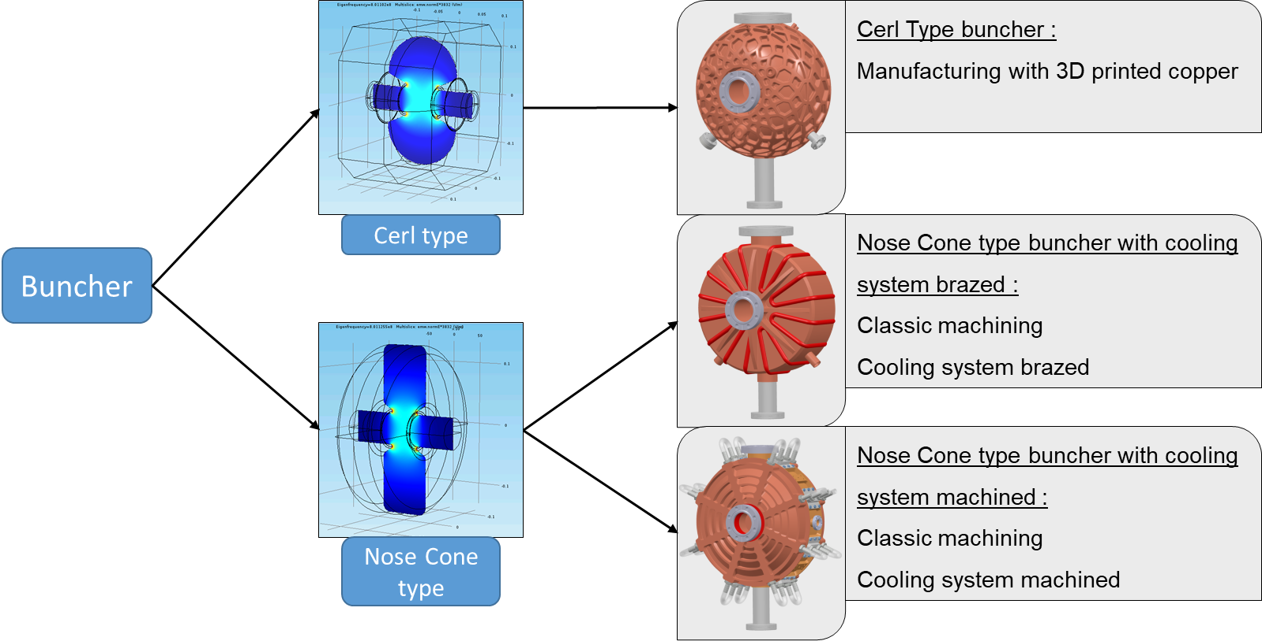
Buncher design:
ESS-Bilbao & IJCLab
2 different RF design cavities were studied and 3 mechanical design investigated:

Slide 7
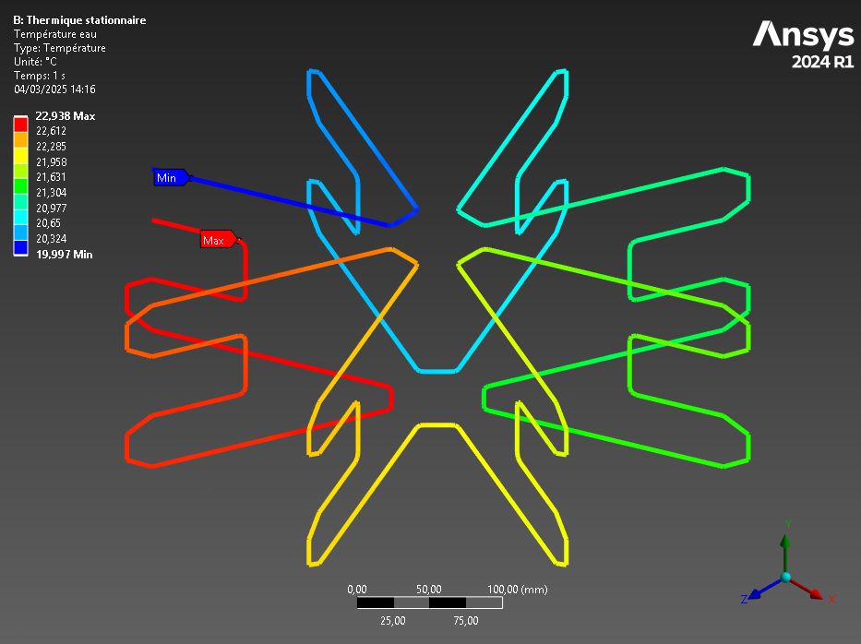
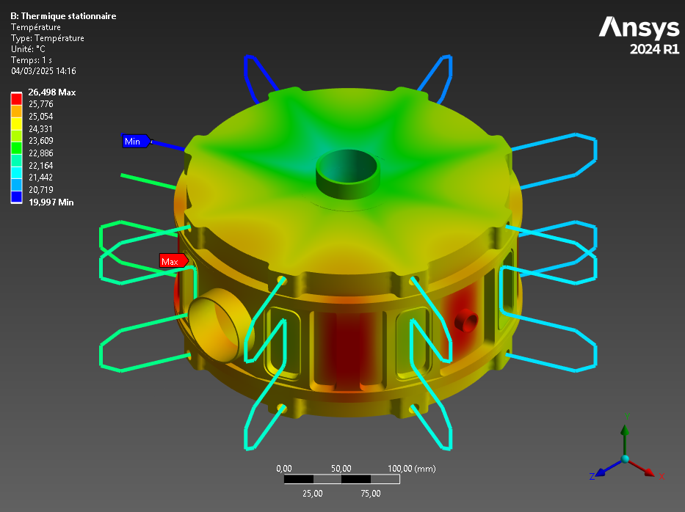
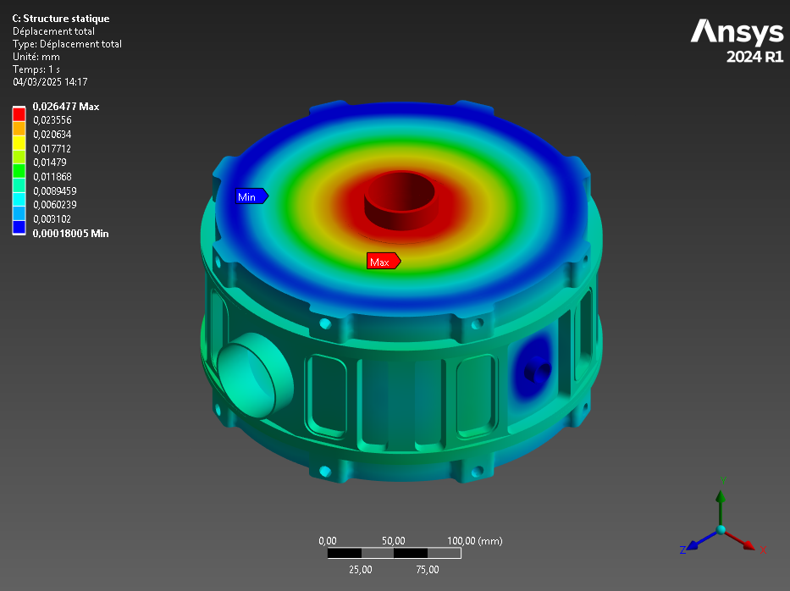
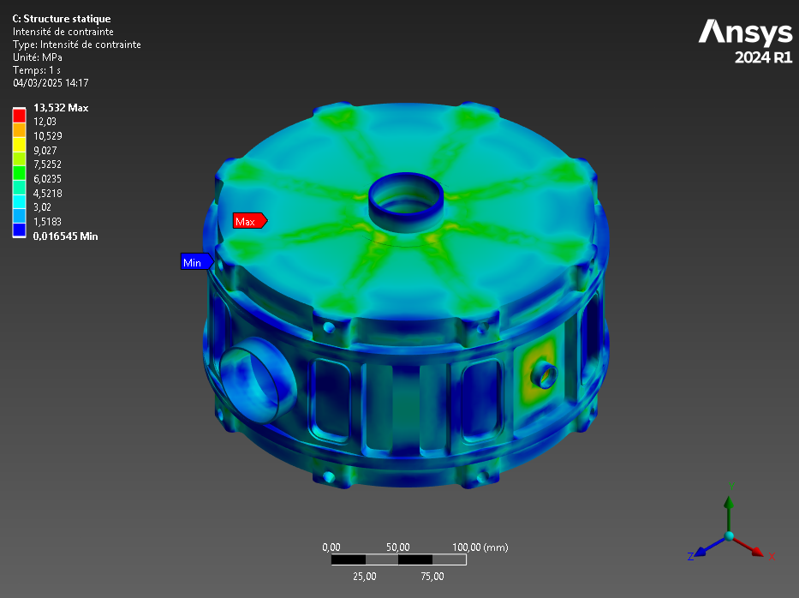
Buncher design:
ESS-Bilbao & IJCLab
Input :
Absorbed power of 1,6 kW
Inlet water temperature at 20°C and a flow of 0,1 L/s
Thermal
Results :
T max < 26°C
T max water < 22°C
Mechanical plans folder under preparation.
Order for fabrication foreseen on October 2025
Input :
Intern pressure : 0,10132 MPa
Thermal dilatation based on thermal simulation
Gravity
Pipes pressure : 1MPa
Pump weight : 50 N
Mechanical
Results :
Y Deformation (Beam axes) : 0,02 mm
X Deformation : 0,01 mm
Constraint < 14 MPa

Slide 8
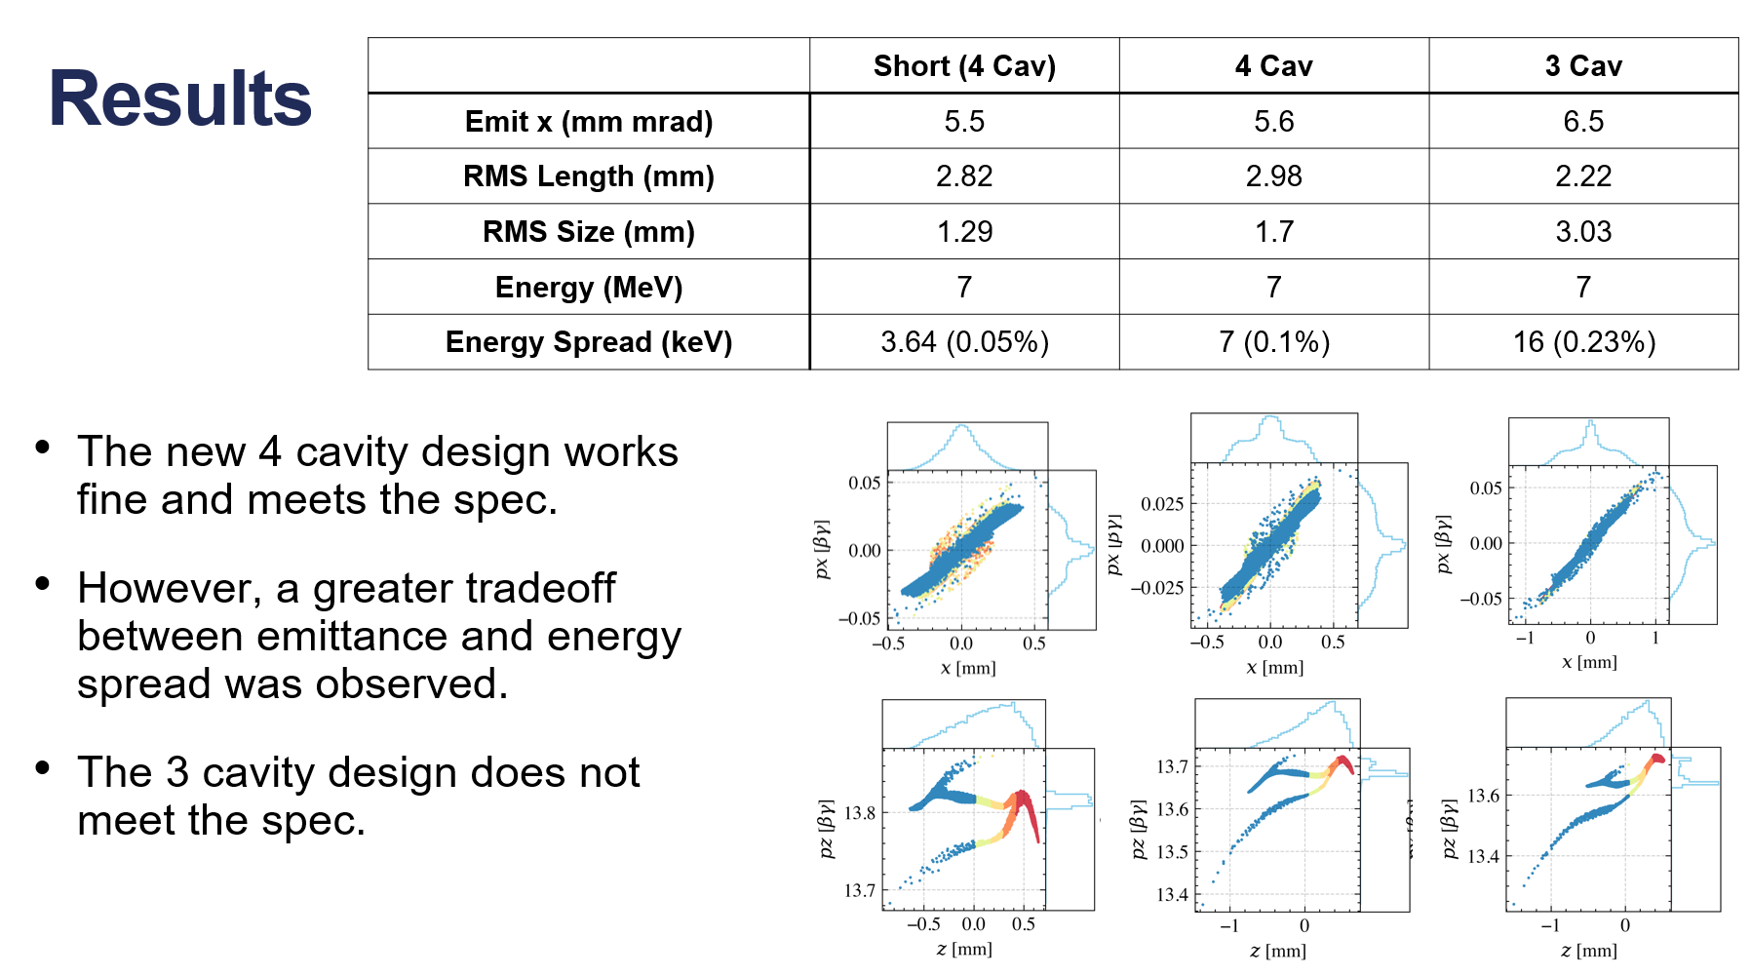
Booster design:
  Several booster configurations studied recently: 3 and 4 single-cavities

Slide 9
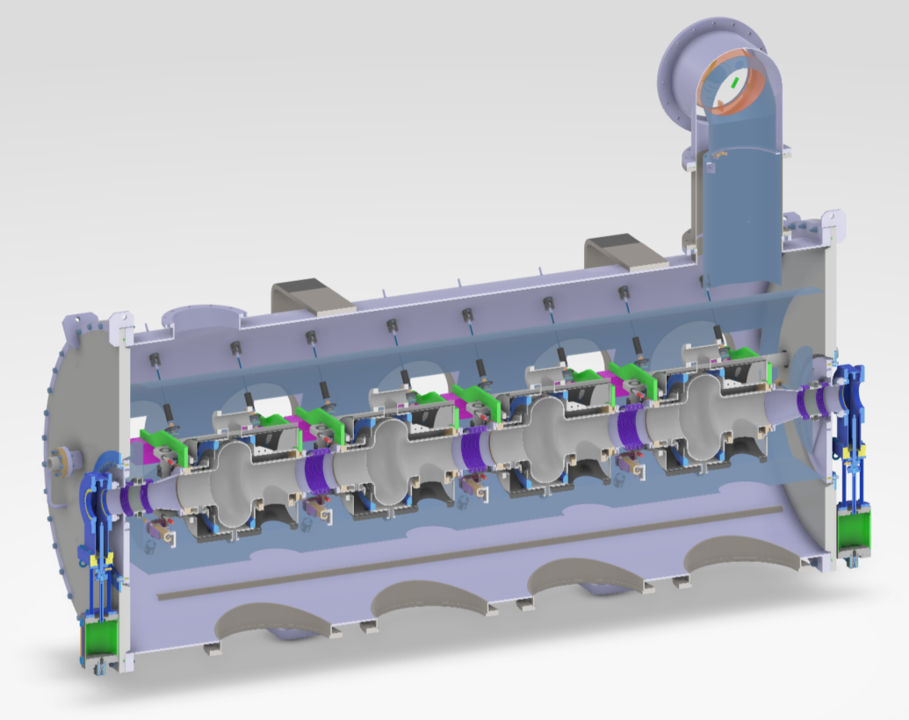
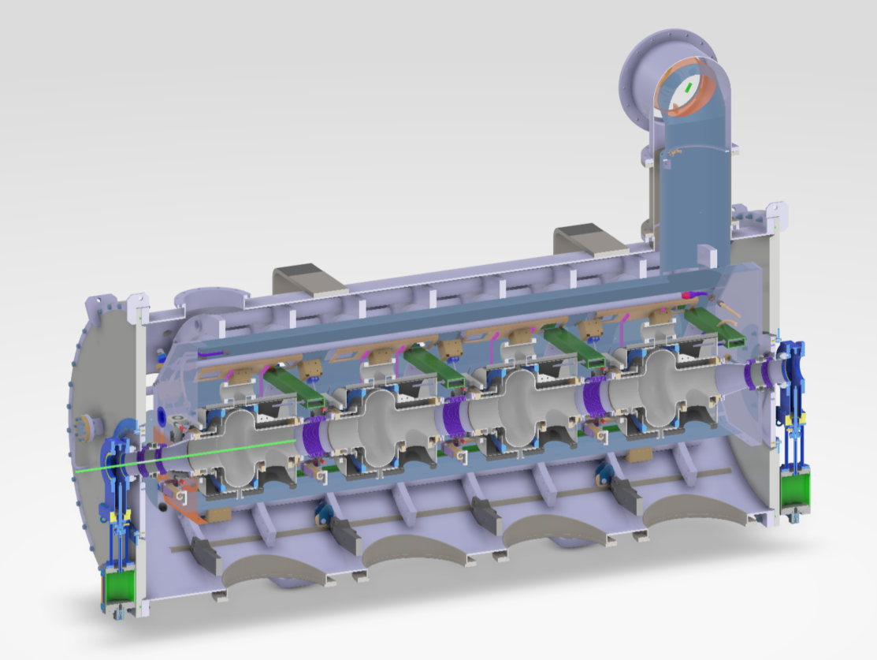
Booster design:
  A 4 cavities booster 200 mm longer than the baseline design was validated to ease the mechanical integration
  2 mechanical designs under investigation currently:
Design with antagonistic rods
Design with spaceframe
Advantage:
Easy assembly of the cavity string and its integration into the cryomodule
Constrains:
Massive spaceframe that could disturb cryogenics
No lateral adjustment allowed.
Advantages:
Less tooling
Possibility to adjust the position of the cavities in the vessel
Constrains:
More difficult access

Slide 10
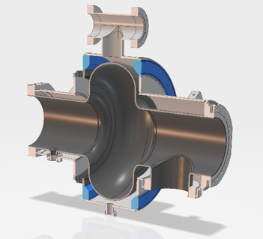
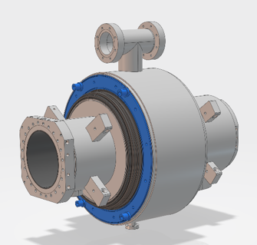
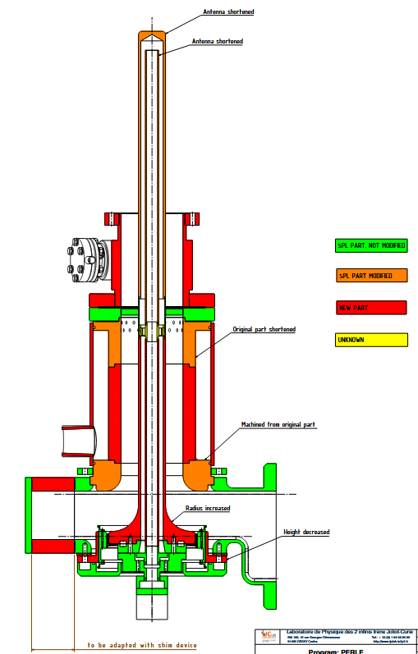
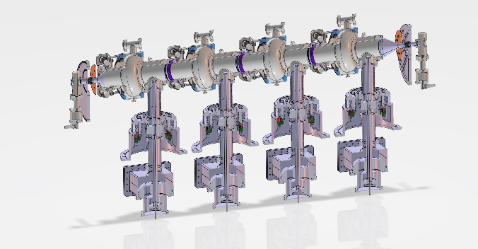
Booster design:
Eléments du booster:
  Cavité accélératrice supraconductrice:
  RF Power coupleur (20 kW):
Design of the mono-cell cavity of the booster finalised and interfaces standardised with The 5-cell cavity
To be compatible with cryostat insert for the VT à IJCLab.
Ready to order cavity fabrication.
Coupler design almost finished within iSAS European program (WP3): same design of booster and ERL cryomodule FPC.

Slide 11
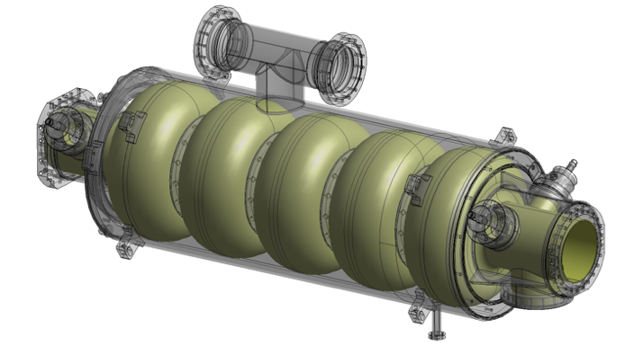
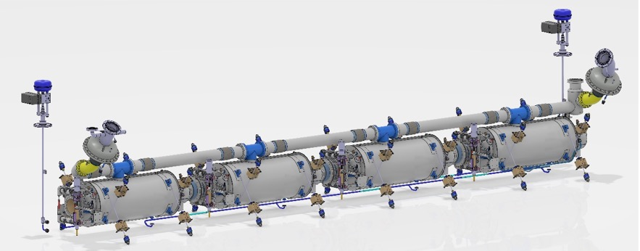
5-Cell Cavity design:
Cavity design completed with:
  Titanium Helium tank
  4 HOM coupler ports + 1 FPC port in end groups
The cavity string completed with
  A « classical » tuning as the one developped for ESS spoke cavities
  Beam line Absorbers BLAs (preliminary design) between cavities
  A cold magnetic shielding.
Technical review meetings were organised to discuss cavity post-production receipies (EP, BCP, Diffusion, infusion, Mid-T baking…) with international experts.
→ An R&D program underway to exchange experience and define an optimised receipe (Coll. IJCLab, Jlab, Fermilab, CERN and KEK)
Within the European program iSAS:
Procurement of the Nb (for single-cell & 5-cell cavities).
Call for tender for fabrication of 4 5-Cell cavities before summer break.

Slide 12
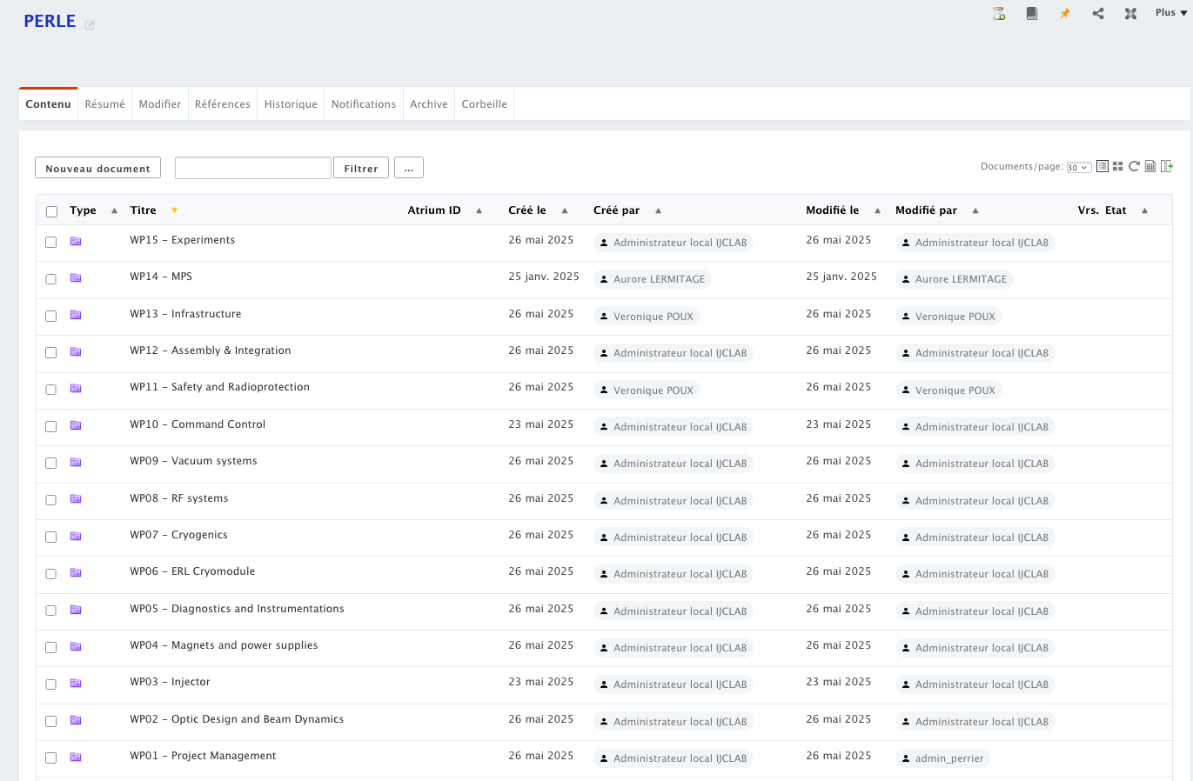
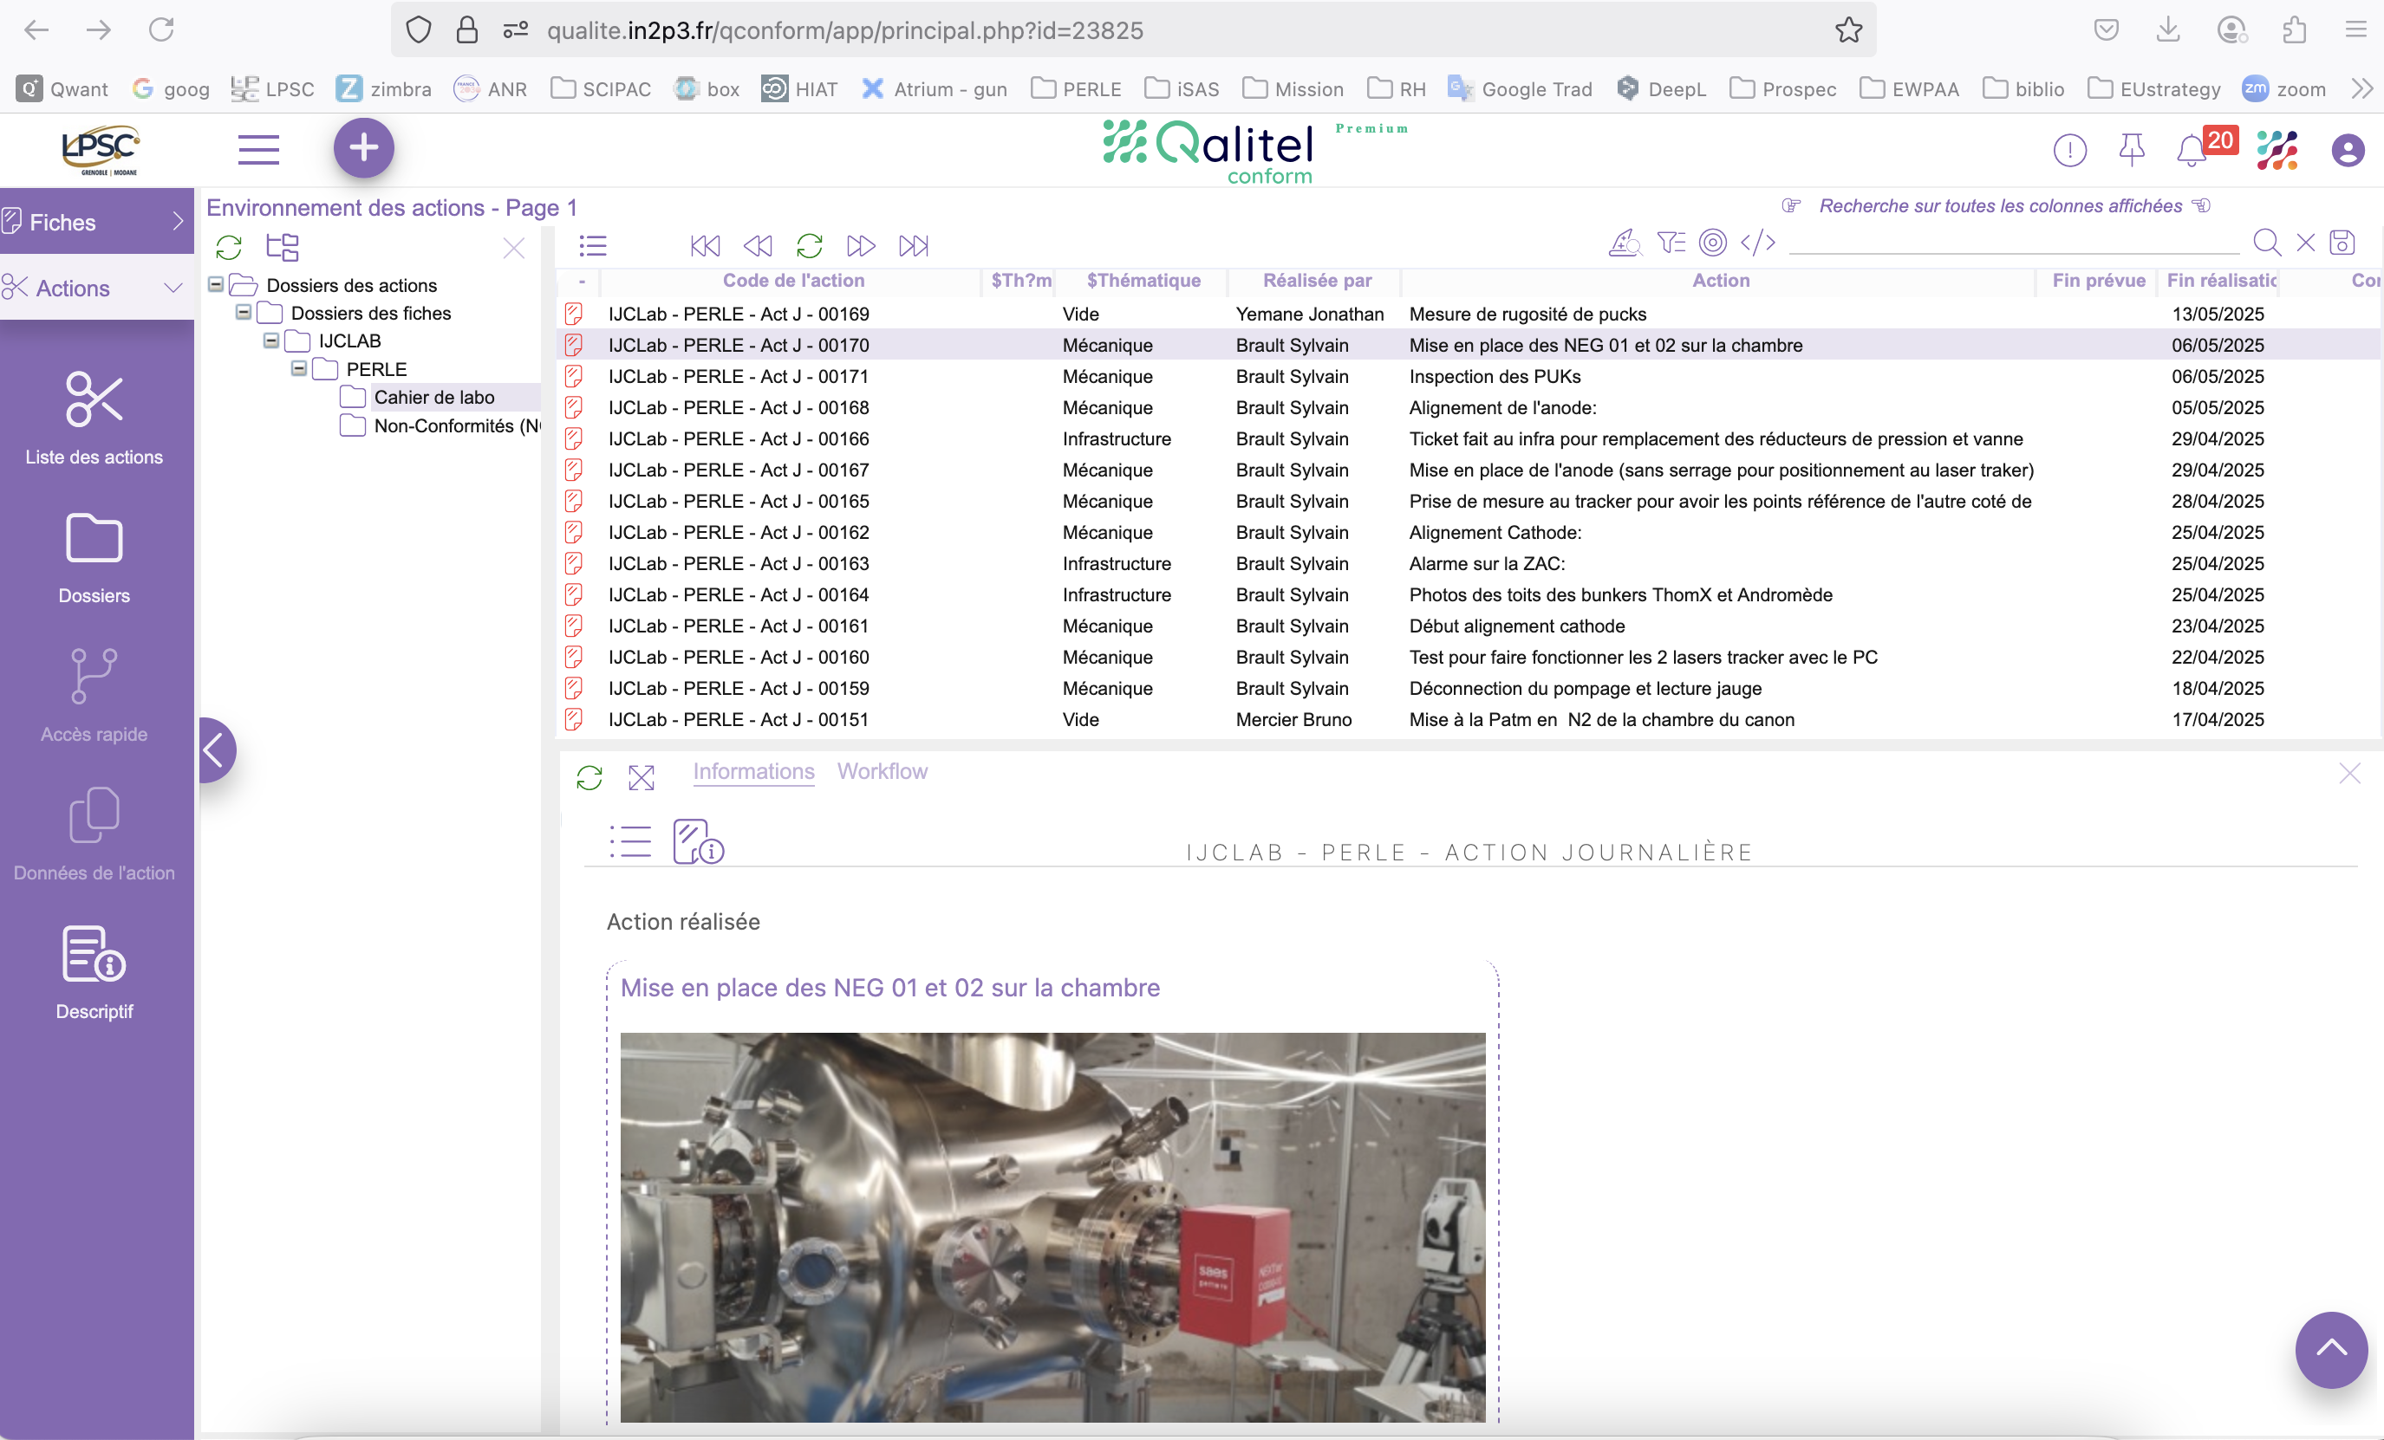
Documentation Management:
Atrium: Management of technical report, minutes, Specs, supplier documentations…
Qalitel Conform: Logbook (Monitoring of technical actions)+ Non-conformity management
Diffusion are accessible for international collaborators

Slide 13
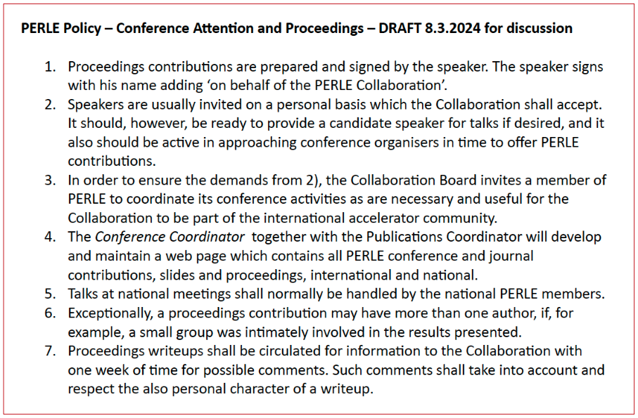
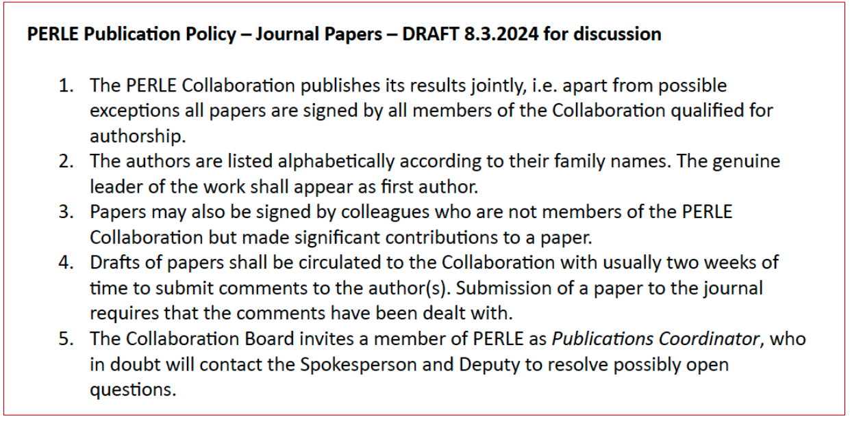
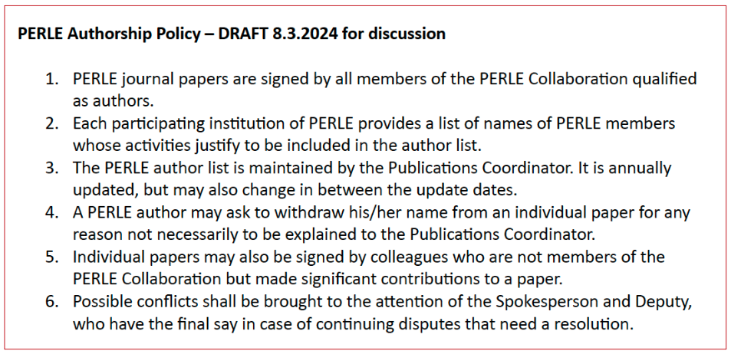
Collaboration Matters:
Reminder of the publication and authorship rules:
Achille asked for the list of perle members per institution→ Received!

Slide 14
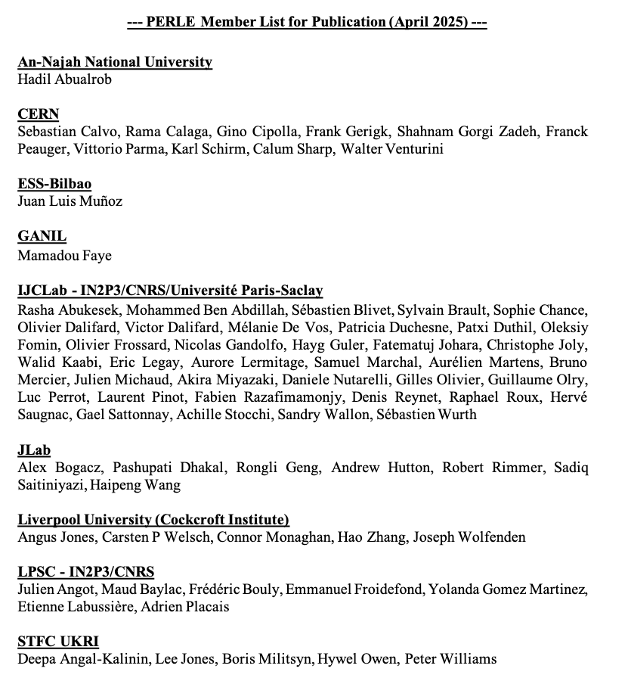
Collaboration Matters:
New members will join the collaboration: discussion ongoing with:
Manchester University
Lancaster university
HZB-Berlin
IFJ-PAN- Cracow
ESS-Lund

Slide 15
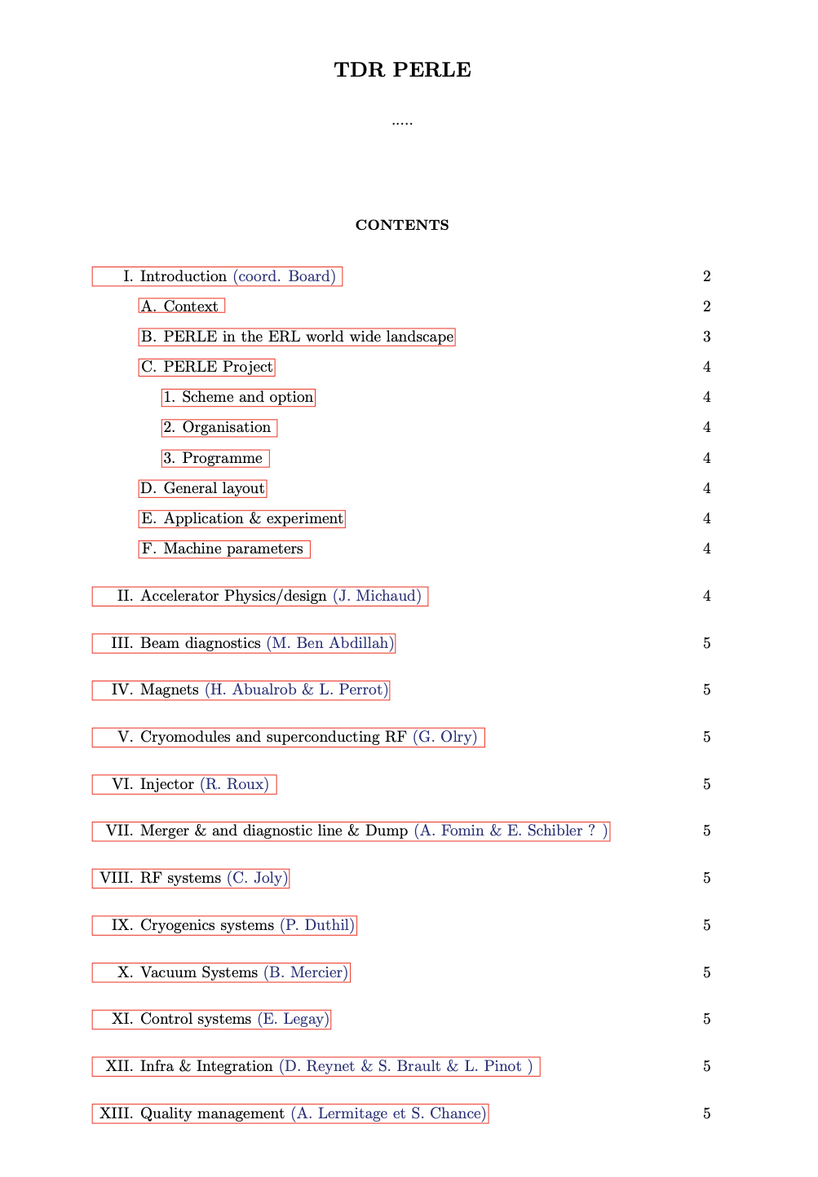
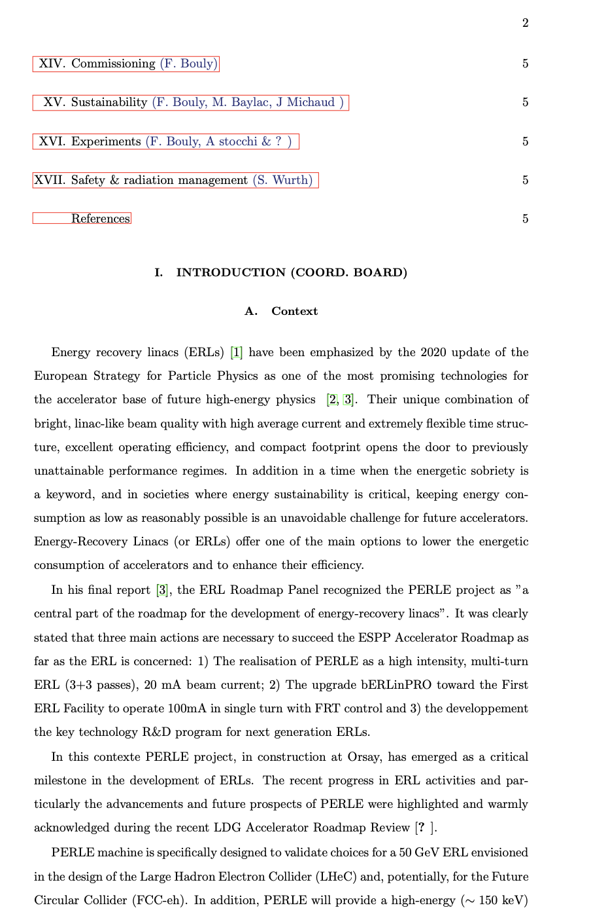
Collaboration Matters:
PERLE TRD:

Slide 16
Other news:
Creation of PERLE Website:
https://perle-web.ijclab.in2p3.fr/
New PhD thesis:
Since March 2025: Innovative LLRF system development for PERLE- Nawal Belouchrani
October 2025: Study of the longitudinal matching in PERLE 250 MeV- Janine Issa (Currently in Master internship)
October 2025: Study of beam line Absorbers for PERLE- Alex Perez Ruiz
October 2025: Beam halo studies for PERLE- Arnaud Cieplak (Currently in Master internship)
Contributions to IPAC’25- Taiwan:
MOPS041: “ Status of the beam dynamics studies for the PERLE Energy Recovery Linac ” by Julien Michaud
SUPM042 & MOPB049: “Characterisation of beam dynamics sensitivity to misalignments in PERLE injector” by Connor Monaghan
MOPS042: “Orbit correction for PERLE accelerator” by Rasha Abukeshek
Next PERLE Collaboration Meeting:
The next Collaboration Meeting will be held on October 13 to 15, 2025 at CERN

