Slide 1



Transverse Beam Dynamics
Julien Michaud
Accelerator physicist at IJCLab, Orsay (Paris)
jmichaud@ijclab.in2p3.fr

Slide 2
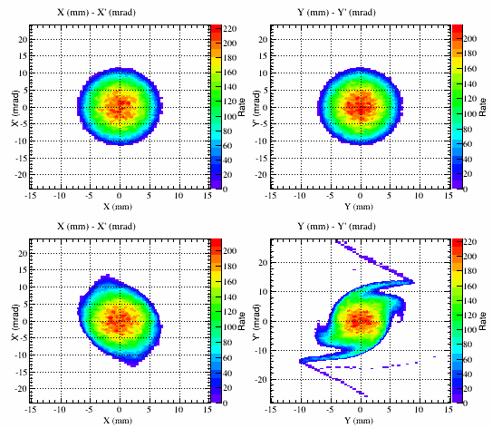
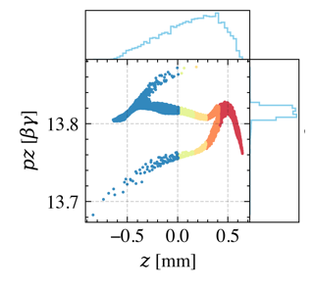
Particles dynamics specificity
Particles dynamics in an accelerator is usually treated in 2 specific formalisms :
  Transverse beam dynamics
    Associated velocities are relatively small
    Beam visible « shape »
    Beam guidance
    Necessary to avoid losses in the walls
  Longitudinal beam dynamics
    Very high velocities
    Acceleration
First course
Second course

Slide 3
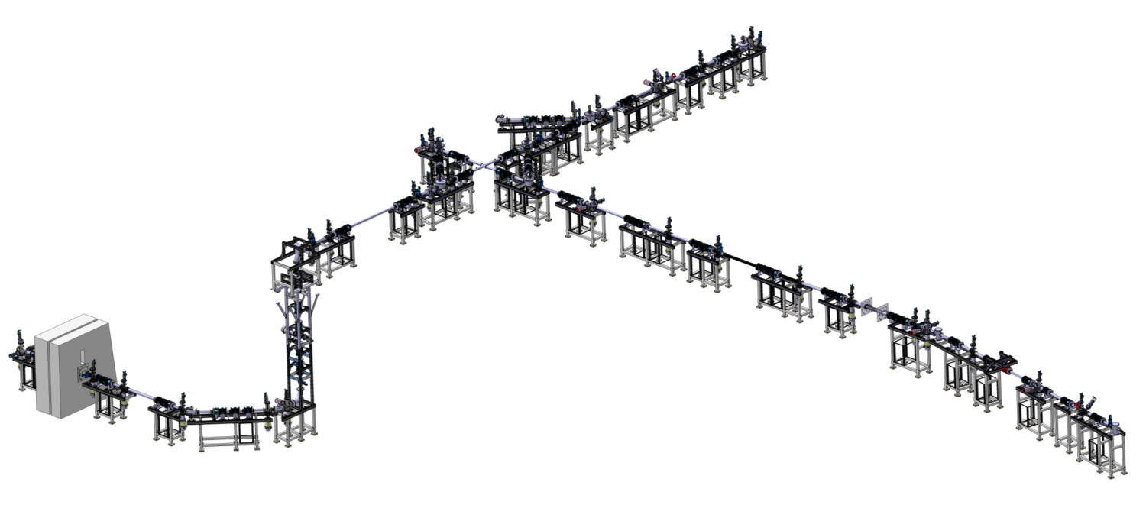
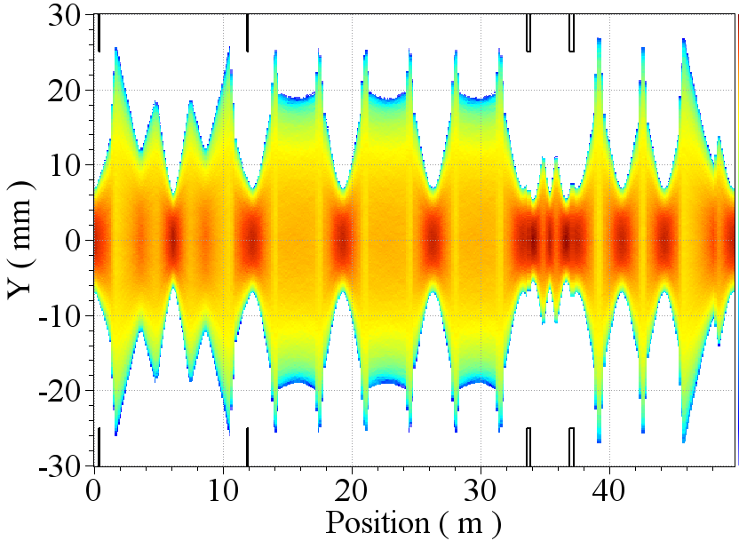
First course : content
  Charged particle in electromagnetic field
    Around Lorentz equation :
  Guided and focalization magnets : dipoles, quadrupoles, multi-poles
  General development of magnetic field around the reference trajectory:
  The magnetic field equation :
  Particles motion around the reference trajectory :
  Beam envelop and emittance

Slide 4
References
  CERN accelerator School: http://cas.web.cern.ch/cas
  CERN Joint Universities Accelerator School (JUAS) : https://indico.cern.ch/event/356897/contributions, https://indico.cern.ch/event/286275/contributions
  K.L. Brown, D.C. Carey, Ch. Iselin and F. Rothacker, Transport, a computer program for designing charged beam transport systems, CERN 80-04
  F. Dupont, Cours élémentaire sur les transports de faisceau et les accélérateurs de particules, janvier 1988
  Bernhard Holzer, CERN-LHC, Introduction to accelerator Physics
  Marc Muñoz, CELLS-ALBA, Introduction to charged particle optics, Jan 2010
  Stanley Humphries, Principles of Charged Particle Acceleration, Wiley-Interscience, 1986
  A.P. Banford, The Transport of Charged Particle Beams, Spon, 1966
  http://bc1.lbl.gov/CBP_pages/educational/WoB/home.htm
  P.J. Bryant, A Brief History and review of accelerators, CERN, Geneva, Switzerland
  E. Baron, Panorama des accélérateurs et de leurs utilisations, HAL Id: cel-0012288
  A. R. Steere, A Timeline of Major Particle Accelerators, Michigan State University, Department of Physics and Astronomy, 2005
  M. Sands, The Physics of Electron Storage Rings, an Introduction, SLAC-121, UC-28 (ACC), 1970

Slide 5





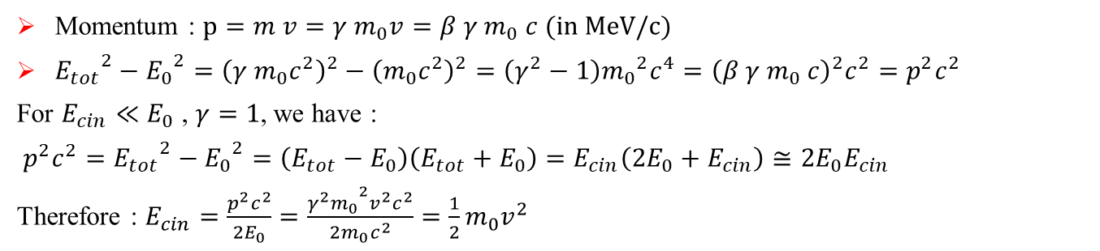

I – Charged particles in electromagnetic fields
First let us define some important values :
Einstein's mass-energy
Total energy
$$E_{0}=m_{0}×c^{2}$$
$$E_{tot}=γ m_{0}c^{2}$$
Kinetic energy
  With: particle mass $m_{0}$
  speed of light $c=2.99.{10}^{8} m/s$
  With: $γ=\frac{E_{tot}}{E_{0}}=\frac{m}{m_{0}}=\frac{1}{\sqrt{1−β^{2}}}$
  $β=\frac{v}{c}$
$E_{kin}=E_{tot}−E_{0}$ $= \left(γ−1\right)m_{0}c^{2}$
  Typical masses : 511keV for e-
  938.3MeV for protons
  For a rest particle :
  For a non relativist particle :
  For a ultra-relativist particle (close to speed light) :
  $$β=0, γ=1$$
  $$β≪1,γ≈1$$
$$β→1,γ→∞$$
  Momentum : $p=m v=γ m_{0}v=β γ{ m}_{0} c (in MeV/c)$
  ${E_{tot}}^{2}−{E_{0}}^{2}={\left(γ m_{0}c^{2}\right)}^{2}−{\left(m_{0}c^{2}\right)}^{2}=\left(γ^{2}−1\right){m_{0}}^{2}c^{4}={\left(β γ{ m}_{0} c\right)}^{2}c^{2}=p^{2}c^{2}$
  For $E_{cin}≪E_{0}$ , $γ=1$, we have :
  $p^{2}c^{2}={E_{tot}}^{2}−{E_{0}}^{2}=\left(E_{tot}−E_{0}\right)\left(E_{tot}+E_{0}\right)=E_{cin}\left({2E}_{0}+E_{cin}\right)≅2E_{0}E_{cin}$
  Therefore : $E_{cin}=\frac{p^{2}c^{2}}{2E_{0}}=\frac{{{γ^{2}m}_{0}}^{2}v^{2}c^{2}}{2m_{0}c^{2}}=\frac{1}{2}m_{0}v^{2}$

Slide 6
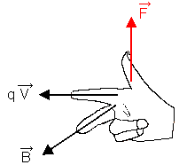
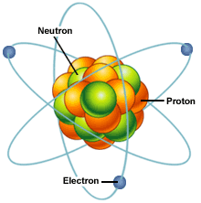
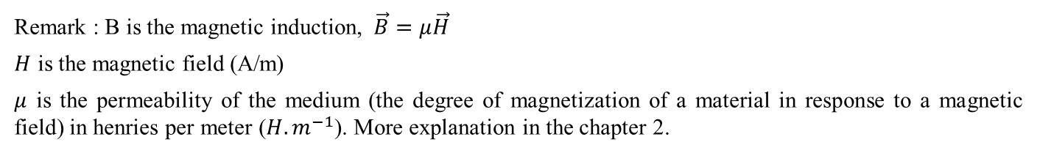
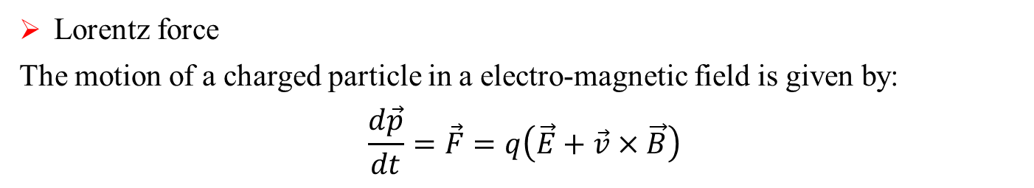
I – Charged particles in electromagnetic fields
  Lorentz force
  The motion of a charged particle in a electro-magnetic field is given by:
  $$\frac{d\vec{p}}{dt}=\vec{F}=q\left(\vec{E}+\vec{v}×\vec{B}\right)$$
                F : lorentz force in Newton
                p : momentum in kg.m/s
                q : particle charge (±Ze) in Coulomb
                E, B : electric and magnetic induction (resp. V/m and T)
                Remark : B is the magnetic induction, $\vec{B}=μ\vec{H}$
                $H$ is the magnetic field (A/m)
                $μ$ is the permeability of the medium (the degree of magnetization of a material in response to a magnetic field) in henries per meter ($H.m^{−1}$). More explanation in the chapter 2.
y
B
E
z
v
x
q<0

Slide 7
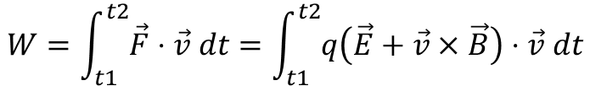
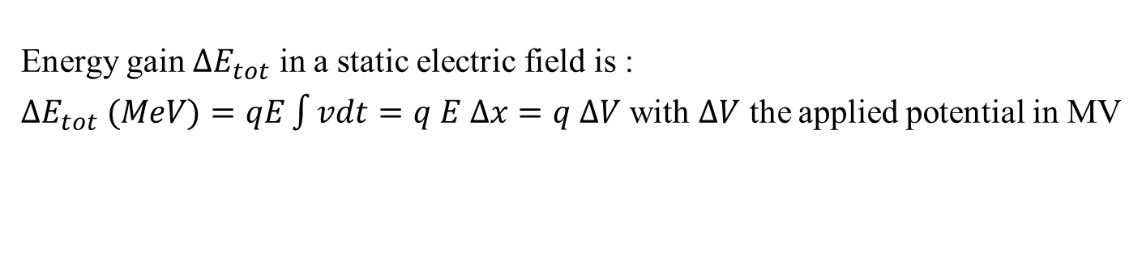
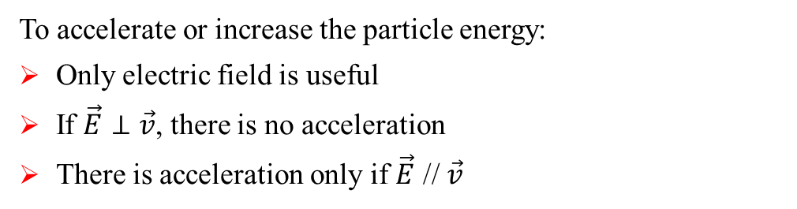
I – Charged particles in electromagnetic fields
Important remark : variation of energy in EM fields :
$$W=\int_{t1}^{t2}{\vec{F}⋅\vec{v} dt}=\int_{t1}^{t2}{q\left(\vec{E}+\vec{v}×\vec{B}\right)⋅\vec{v} dt}$$
  $⇒\frac{dE_{tot}}{dt}=q \vec{v} .\vec{E}$ $⇒$ No acceleration with magnetic fields !!
E
  To accelerate or increase the particle energy:
  Only electric field is useful
  If $\vec{E}⊥\vec{v}$, there is no acceleration
  There is acceleration only if $\vec{E}$ // $\vec{v}$
z
v
x
q<0
  Energy gain ${∆E}_{tot}$ in a static electric field is :
  ${∆E}_{tot} (MeV)=qE\int{vdt}=q E ∆x=q ∆V$ with $∆V$ the applied potential in MV
An eV is the energy gained by an electron under 1V of potential difference

Slide 8
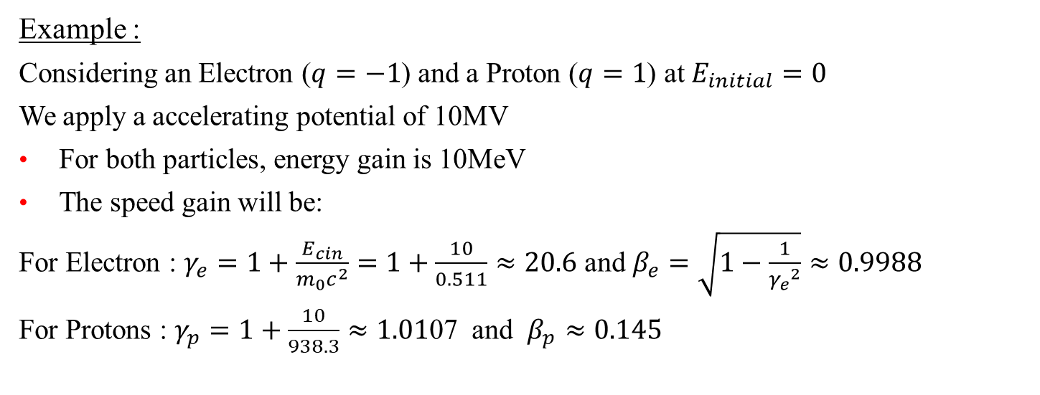
I – Charged particles in electromagnetic fields
  Example :
  Considering an Electron ($q=−1$) and a Proton ($q=1$) at $E_{initial}=0$
  We apply a accelerating potential of 10MV
  For both particles, energy gain is 10MeV
  The speed gain will be:
  For Electron : $γ_{e}=1+\frac{E_{cin}}{m_{0}c^{2}}=1+\frac{10}{0.511}≈20.6$ and $β_{e}=\sqrt{1−\frac{1}{{γ_{e}}^{2}}}≈0.9988$
  For Protons : $γ_{p}=1+\frac{10}{938.3}≈1.01$07 and $β_{p}≈0.145$
  Accelerator and structures must be design according to particle characteristics

Slide 9

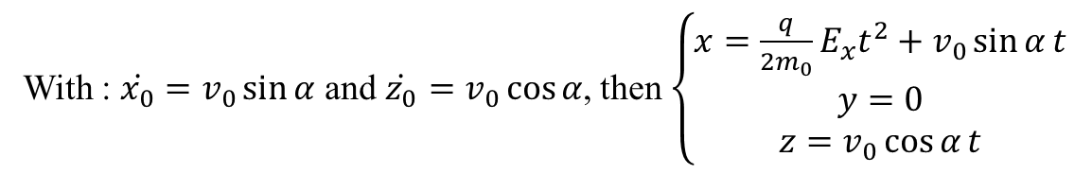

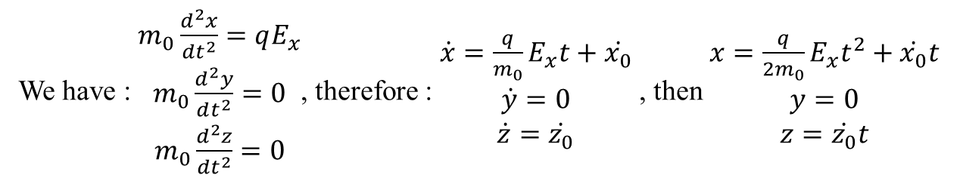
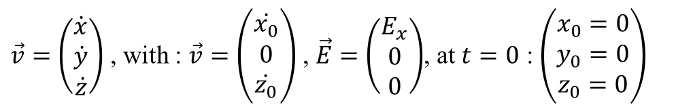
I – Charged particles in electromagnetic fields
  Particle motion in a transverse electric field : $\vec{F}=\frac{d\vec{p}}{dt}=q\vec{E}$
x
$$\vec{E}$$
$$\vec{v_{0}}$$
α
0
$\vec{v}=\left(\begin{matrix}\dot{x} \\ \dot{y} \\ \dot{z}\end{matrix}\right)$ , with : $\vec{v}=\left(\begin{matrix}\dot{x_{0}} \\ 0 \\ \dot{z_{0}}\end{matrix}\right)$ , $\vec{E}=\left(\begin{matrix}E_{x} \\ 0 \\ 0\end{matrix}\right)$, at $t=0$ : $\left(\begin{matrix}x_{0}=0 \\ y_{0}=0 \\ z_{0}=0\end{matrix}\right)$
z
q>0
y
We have : $\begin{matrix}m_{0}\frac{d^{2}x}{dt^{2}}=qE_{x} \\ m_{0}\frac{d^{2}y}{dt^{2}}=0 \\ m_{0}\frac{d^{2}z}{dt^{2}}=0\end{matrix}$, therefore : $\begin{matrix}\dot{x}=\frac{q}{m_{0}}E_{x}t+\dot{x_{0}} \\ \dot{y}=0 \\ \dot{z}=\dot{z_{0}}\end{matrix}$ , then $\begin{matrix}x=\frac{q}{{2m}_{0}}E_{x}t^{2}+\dot{x_{0}}t \\ y=0 \\ z=\dot{z_{0}}t\end{matrix}$
With : $\dot{x_{0}}=v_{0}\sin{α}$ and $\dot{z_{0}}=v_{0}\cos{α}$, then $\left\{\begin{matrix}x=\frac{q}{{2m}_{0}}E_{x}t^{2}+v_{0}\sin{α}t \\ y=0 \\ z=v_{0}\cos{α}t\end{matrix}\right.$
Particle trajectory is parabolic : $x=\frac{qE_{x}}{{2m}_{0}}\frac{z^{2}}{\left(v_{0}\cos{α}\right)}+z\tan{α}$

Slide 10
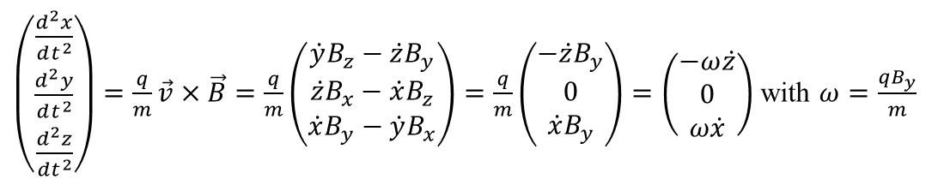
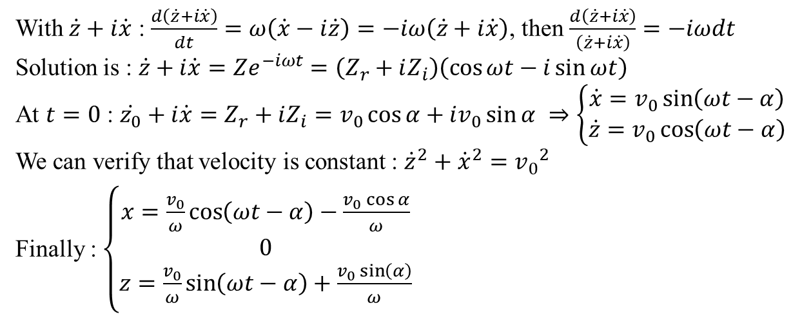
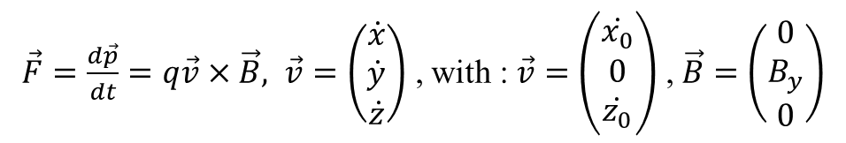

I – Charged particles in electromagnetic fields
  Particle motion in a transverse magnetic field :
x
  $\vec{F}=\frac{d\vec{p}}{dt}=q\vec{v}×\vec{B}, \vec{v}=\left(\begin{matrix}\dot{x} \\ \dot{y} \\ \dot{z}\end{matrix}\right)$ , with : $\vec{v}=\left(\begin{matrix}\dot{x_{0}} \\ 0 \\ \dot{z_{0}}\end{matrix}\right)$ , $\vec{B}=\left(\begin{matrix}0 \\ B_{y} \\ 0\end{matrix}\right)$
q>0
$$\vec{v_{0}}$$
α
0
z
  $\left(\begin{matrix}\frac{d^{2}x}{dt^{2}} \\ \frac{d^{2}y}{dt^{2}} \\ \frac{d^{2}z}{dt^{2}}\end{matrix}\right)=\frac{q}{m}\vec{v}×\vec{B}=\frac{q}{m}\left(\begin{matrix}\dot{y}B_{z}−\dot{z}B_{y} \\ \dot{z}B_{x}−\dot{x}B_{z} \\ \dot{x}B_{y}−\dot{y}B_{x}\end{matrix}\right)=\frac{q}{m}\left(\begin{matrix}−\dot{z}B_{y} \\ 0 \\ \dot{x}B_{y}\end{matrix}\right)=\left(\begin{matrix}−ω\dot{z} \\ 0 \\ ω\dot{x}\end{matrix}\right)$ with $ω=\frac{qB_{y}}{m}$
$$\vec{B}$$
y
With $\dot{z}+i\dot{x}$ : $\frac{d\left(\dot{z}+i\dot{x}\right)}{dt}=ω\left(\dot{x}−i\dot{z}\right)=−iω\left(\dot{z}+i\dot{x}\right)$, then $\frac{d\left(\dot{z}+i\dot{x}\right)}{\left(\dot{z}+i\dot{x}\right)}=−iωdt$
Solution is : $\dot{z}+i\dot{x}=Ze^{−iωt}=\left(Z_{r}+iZ_{i}\right)\left(\cos{ωt}−i\sin{ωt}\right)$
At $t=0$ : $\dot{z_{0}}+i\dot{x}=Z_{r}+iZ_{i}=v_{0}\cos{α}+iv_{0}\sin{α}$ $⇒\left\{\begin{matrix}\dot{x}=v_{0}\sin\left(ωt−α\right) \\ \dot{z}=v_{0}\cos\left(ωt−α\right)\end{matrix}\right.$
We can verify that velocity is constant : ${\dot{z}}^{2}+{\dot{x}}^{2}={v_{0}}^{2}$
Finally : $\left\{\begin{matrix}x=\frac{v_{0}}{ω}\cos\left(ωt−α\right)−\frac{v_{0}\cos{α}}{ω} \\ 0 \\ z=\frac{v_{0}}{ω}\sin\left(ωt−α\right)+\frac{v_{0}\sin\left(α\right)}{ω}\end{matrix}\right.$

Slide 11
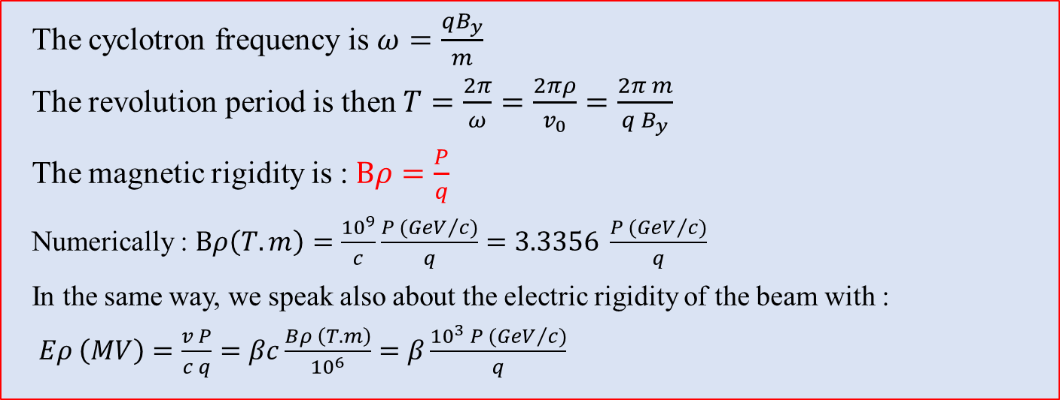
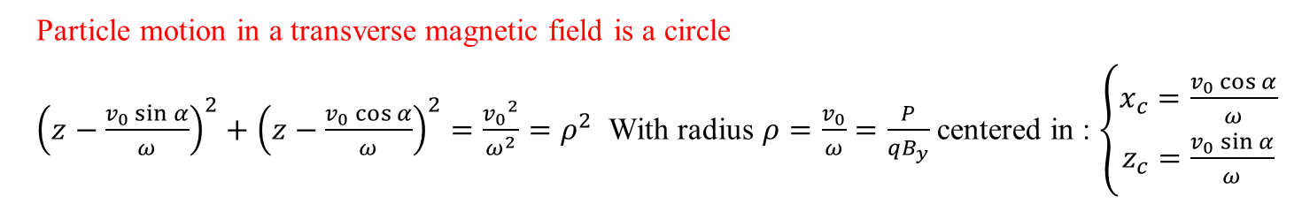
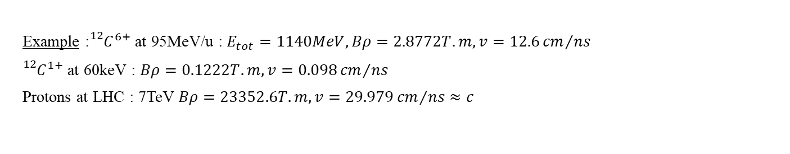
I – Charged particles in electromagnetic fields
  Particle motion in a transverse magnetic field is a circle
  ${\left(z−\frac{v_{0}\sin{α}}{ω}\right)}^{2}+{\left(z−\frac{v_{0}\cos{α}}{ω}\right)}^{2}=\frac{{v_{0}}^{2}}{ω^{2}}=ρ^{2}$ With radius $ρ=\frac{v_{0}}{ω}=\frac{P}{qB_{y}}$ centered in : $\left\{\begin{matrix}x_{c}=\frac{v_{0}\cos{α}}{ω} \\ z_{c}=\frac{v_{0}\sin{α}}{ω}\end{matrix}\right.$
  The cyclotron frequency is $ω=\frac{qB_{y}}{m}$
  The revolution period is then $T=\frac{2π}{ω}=\frac{2πρ}{v_{0}}=\frac{2π m}{{q B}_{y}}$
  The magnetic rigidity is : $Bρ=\frac{P}{q}$
  Numerically : $Bρ\left(T.m\right)=\frac{{10}^{9}}{c}\frac{P ({GeV}/c)}{q}=3.3356 \frac{P ({GeV}/c)}{q}$
  In the same way, we speak also about the electric rigidity of the beam with :
  $Eρ \left(MV\right)=\frac{v P}{c q}=βc\frac{Bρ \left(T.m\right)}{{10}^{6}}=β\frac{{10}^{3} P ({GeV}/c)}{q}$
  Example :${{}_{}^{12}C}^{6+}$ at 95MeV/u : $E_{tot}=1140MeV, Bρ=2.8772T.m, v=12.6{cm}/{ns}$
  ${{}_{}^{12}C}^{1+}$ at 60keV : $Bρ=0.1222T.m, v=0.098{cm}/{ns}$
  Protons at LHC : 7TeV $Bρ=23352.6T.m, v=29.979{cm}/{ns}≈c$

Slide 12






Parenthesis : mass separation, spectrometers
(Non-relativistic approx.)
$$Bρ=\frac{mv}{q}=\frac{p}{q}$$
$$Bρ=\frac{\sqrt{2 m E}}{q}$$
$$E_{k}=\frac{1}{2}mv^{2}⇒v^{2}=2\frac{E_{k}}{m}$$
$$Eρ=\frac{γmv^{2}}{q}$$
$$Eρ=\frac{2E_{k}}{q}$$
No mass dependance on electric fields !
$$E_{k}=\frac{1}{2}mv^{2}⇒v^{2}=2\frac{E_{k}}{m}$$
Particle mass separators (or spectrometers) need a magnetic field !

Slide 13
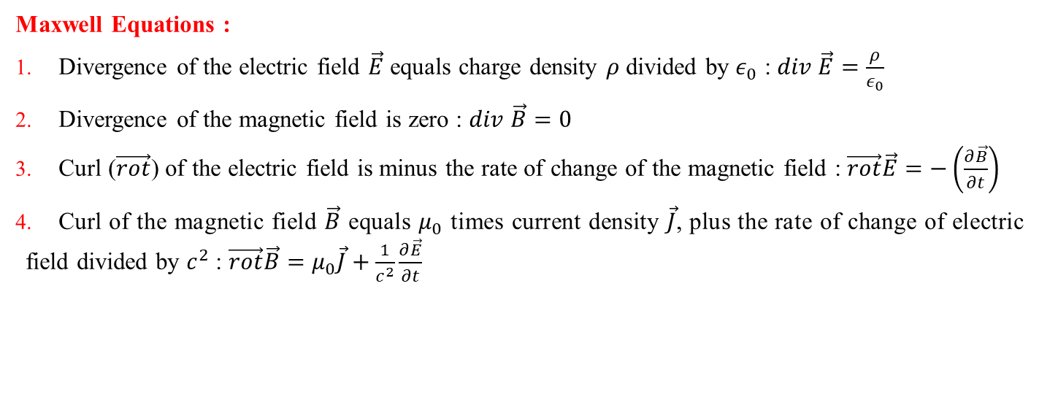
I – Charged particles in electromagnetic fields
In a more general approach, electric and magnetic fields are described by the Maxwell equations
Maxwell Equations :
Divergence of the electric field $\vec{E}$ equals charge density $ρ$ divided by $ε_{0}$ : $div \vec{E}=\frac{ρ}{ε_{0}}$
Divergence of the magnetic field is zero : $div \vec{B}=0$
Curl ($\vec{rot}$) of the electric field is minus the rate of change of the magnetic field : $\vec{rot}\vec{E}=−\left(\frac{∂\vec{B}}{∂t}\right)$
Curl of the magnetic field $\vec{B}$ equals $μ_{0}$ times current density $\vec{J}$, plus the rate of change of electric field divided by $c^{2}$ : $\vec{rot}\vec{B}=μ_{0}\vec{J}+\frac{1}{c^{2}}\frac{∂\vec{E}}{∂t}$

Slide 14
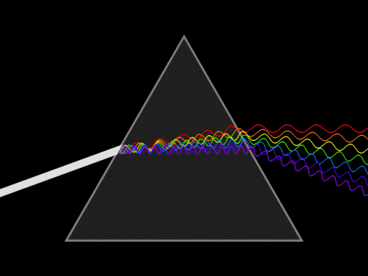
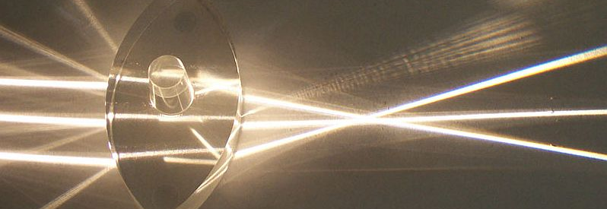
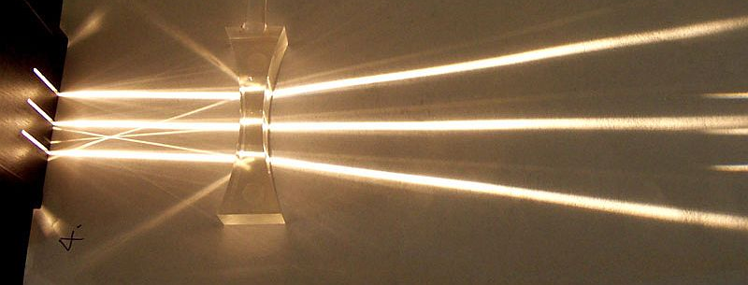
I – Guiding and focalizing magnets : dipoles, quadrupoles and multipoles
  Generalities
  In beam optic, we apply a analogy with the geometrical optic where light beams are deflected by prisms and focus by using focusing or defocusing lenses.
  Same approach is applied in corpuscular optic.
  Optic structures are designed in order to induce bending and focalization of the charged particles.
  Bending and focalization can be separated or combined.
  Systems with electric and/or magnetic fields around a central trajectory are realized.
  Systems ensure the transverse dimensions of the beam (transverse = orthogonal plane of the beam direction)

Slide 15
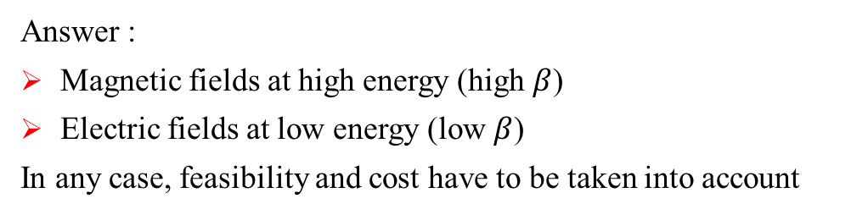
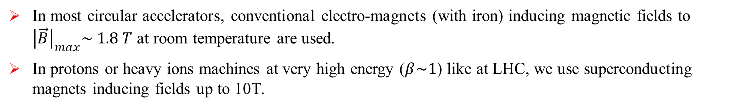
I – Guiding and focalizing magnets : dipoles, quadrupoles and multipoles
Use of magnetic and electric fields :
  Acceleration is only possible with electric fields
  Bending/manipulations can be done with both electric or magnetic fields
  From Lorentz equation, we can deduce : $\left|\frac{F_{E}}{F_{B}}\right|=\left|\frac{q \vec{E}}{q \vec{v}×\vec{B}}\right|=\frac{{\left|\vec{E}\right|}_{V/m}}{β c_{m/s} {\left|\vec{B}\right|}_{T}}$
Q : In which case do we use electric or magnetic fields for bending ?
  Answer :
  Magnetic fields at high energy (high $β$)
  Electric fields at low energy (low $β$)
  In any case, feasibility and cost have to be taken into account
Ex : A Tin beam 122Sn50, 1+ of energy 60keV has a magnetic rigidity of 0.3894Tm, electrostatic is more interesting. For 1GeV protons, Brho=5.65838Tm, magnetic is more interesting.
  In most circular accelerators, conventional electro-magnets (with iron) inducing magnetic fields to ${\left|\vec{B}\right|}_{max}\sim 1.8 T$ at room temperature are used.
  In protons or heavy ions machines at very high energy ($β\sim 1$) like at LHC, we use superconducting magnets inducing fields up to 10T.

Slide 16
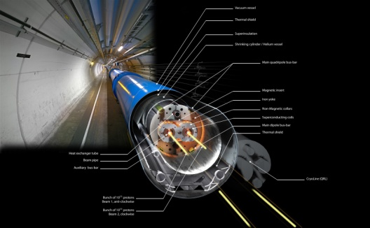
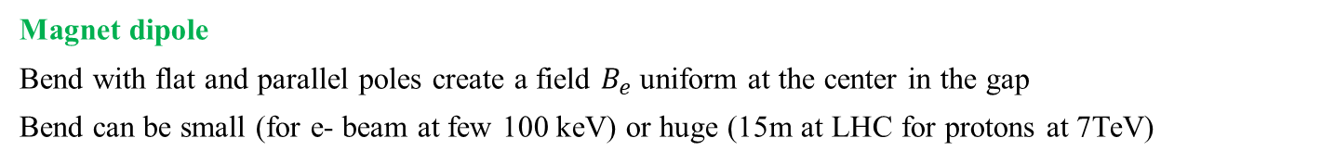
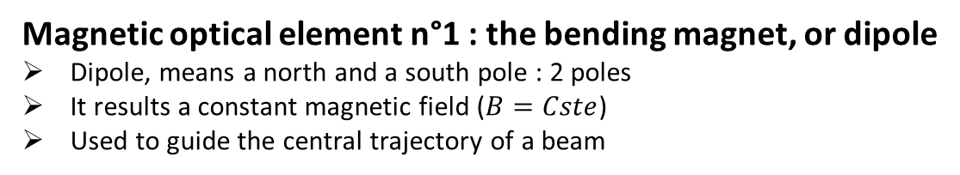
I – Guiding and focalizing magnets : dipoles
Magnetic optical element n°1 : the bending magnet, or dipole
Dipole, means a north and a south pole : 2 poles
It results a constant magnetic field ($B=Cste$)
Used to guide the central trajectory of a beam
  Magnet dipole
  Bend with flat and parallel poles create a field $B_{e}$ uniform at the center in the gap
  Bend can be small (for e- beam at few 100 keV) or huge (15m at LHC for protons at 7TeV)
LHC Bending magnet
ρ=2804m, L=15m
N=1232
Bρ=23352.6Tm
B=8.33T
Iron yoke
Coil (I)
C-shape
H-shape
Window shape
  Structure of the yoke
  give the name of bends

Slide 17
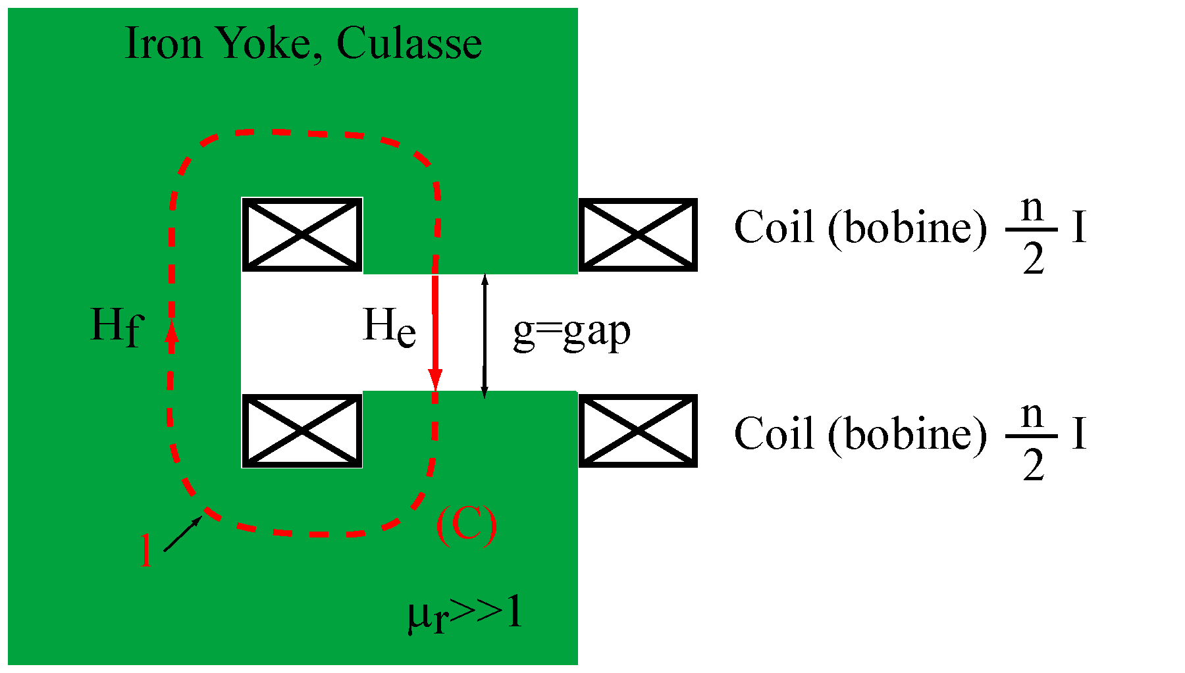
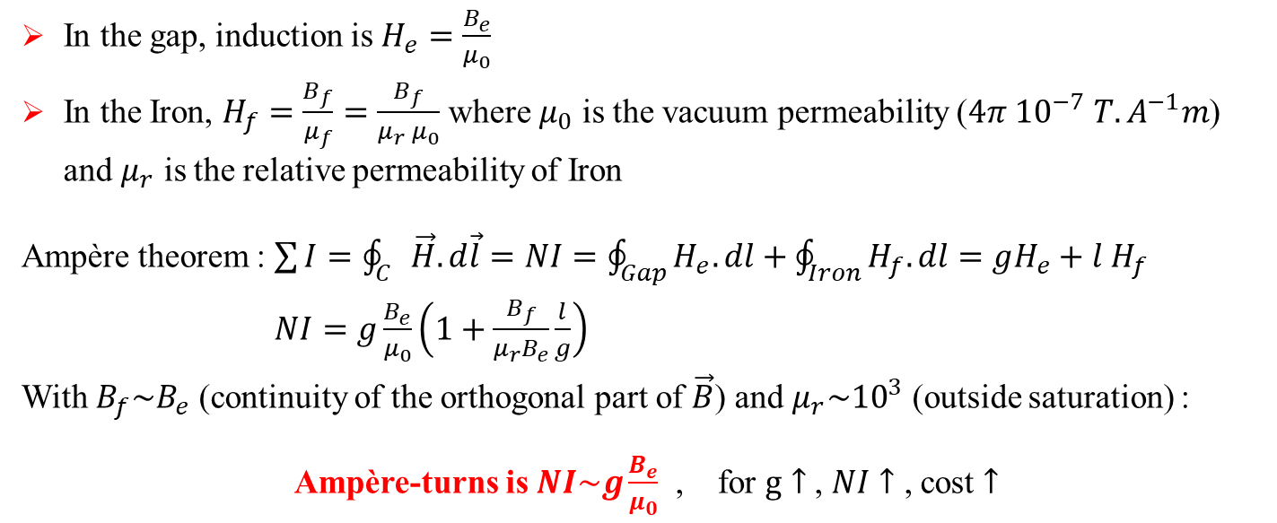
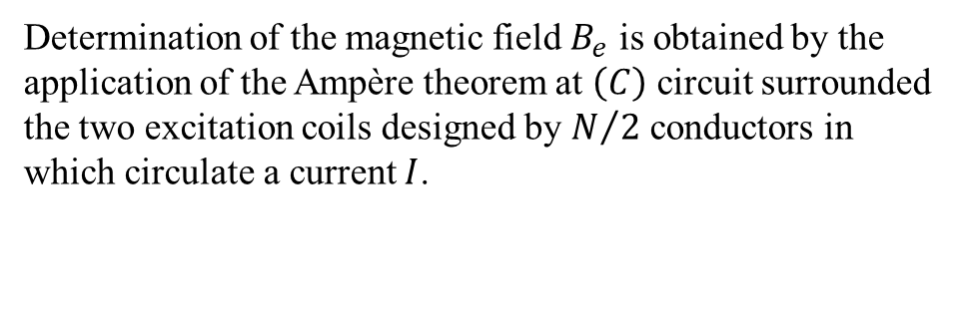
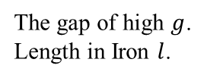
I – Guiding and focalizing magnets : dipoles
  Determination of the magnetic field $B_{e}$ is obtained by the application of the Ampère theorem at $\left(C\right)$ circuit surrounded the two excitation coils designed by $N/2$ conductors in which circulate a current $I$.
  The gap of high $g$.
  Length in Iron $l$.
  In the gap, induction is $H_{e}=\frac{B_{e}}{μ_{0}}$
  In the Iron, $H_{f}=\frac{B_{f}}{μ_{f}}=\frac{B_{f}}{μ_{r} μ_{0}}$ where $μ_{0}$ is the vacuum permeability ($4π {10}^{−7} T.A^{−1}m$) and $μ_{r}$ is the relative permeability of Iron
  Ampère theorem : $\sum{I}=\oint_{C}{\vec{H}.d\vec{l}}=NI=\oint_{Gap}{H_{e}.dl}+\oint_{Iron}{H_{f}.dl}=gH_{e}+l H_{f}$
  $NI=g\frac{B_{e}}{μ_{0}}\left(1+\frac{B_{f}}{μ_{r}B_{e}}\frac{l}{g}\right)$
  With $B_{f}\sim B_{e}$ (continuity of the orthogonal part of $\vec{B}$) and $μ_{r}\sim {10}^{3}$ (outside saturation) :
  Ampère-turns is $NI\sim g\frac{B_{e}}{μ_{0}}$ , for $g↑$ , $NI↑$ , cost $↑$
  Ex: LISE spectrometer at GANIL: $NI=0.1×\frac{1.7}{μ_{0}}\sim 1.35 {10}^{5} A.t$ for $B_{max}=1.7T$ with $N=160 spires$, $I_{max}\sim 850A$

Slide 18
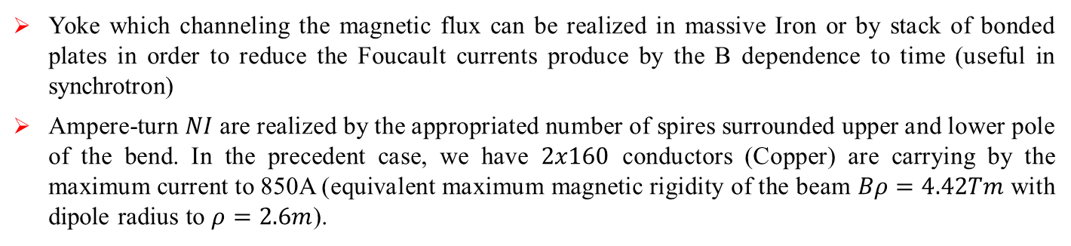

I – Guiding and focalizing magnets : dipoles
At room temperature, $B_{e}=f\left(NI\right)$ is not linear due to circulation of $H$ in Iron.
Relative permeability $μ_{r}$ of Iron is a function to $B_{f}$ ($μ_{r}→1$ when $B_{f}↑$).
Permeability dependence to induction for various steel types
Hysteresis curve
$\left|B_{max}\right|$ level depend to $μ_{r}$
Yoke which channeling the magnetic flux can be realized in massive Iron or by stack of bonded plates in order to reduce the Foucault currents produce by the B dependence to time (useful in synchrotron)
Ampere-turn $NI$ are realized by the appropriated number of spires surrounded upper and lower pole of the bend. In the precedent case, we have $2x160$ conductors (Copper) are carrying by the maximum current to 850A (equivalent maximum magnetic rigidity of the beam $Bρ=4.42Tm$ with dipole radius to $ρ=2.6m$).

Slide 19
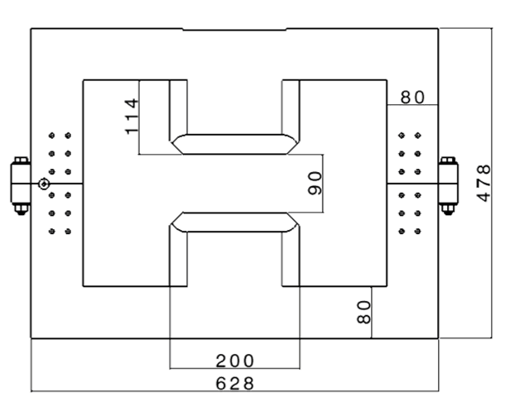
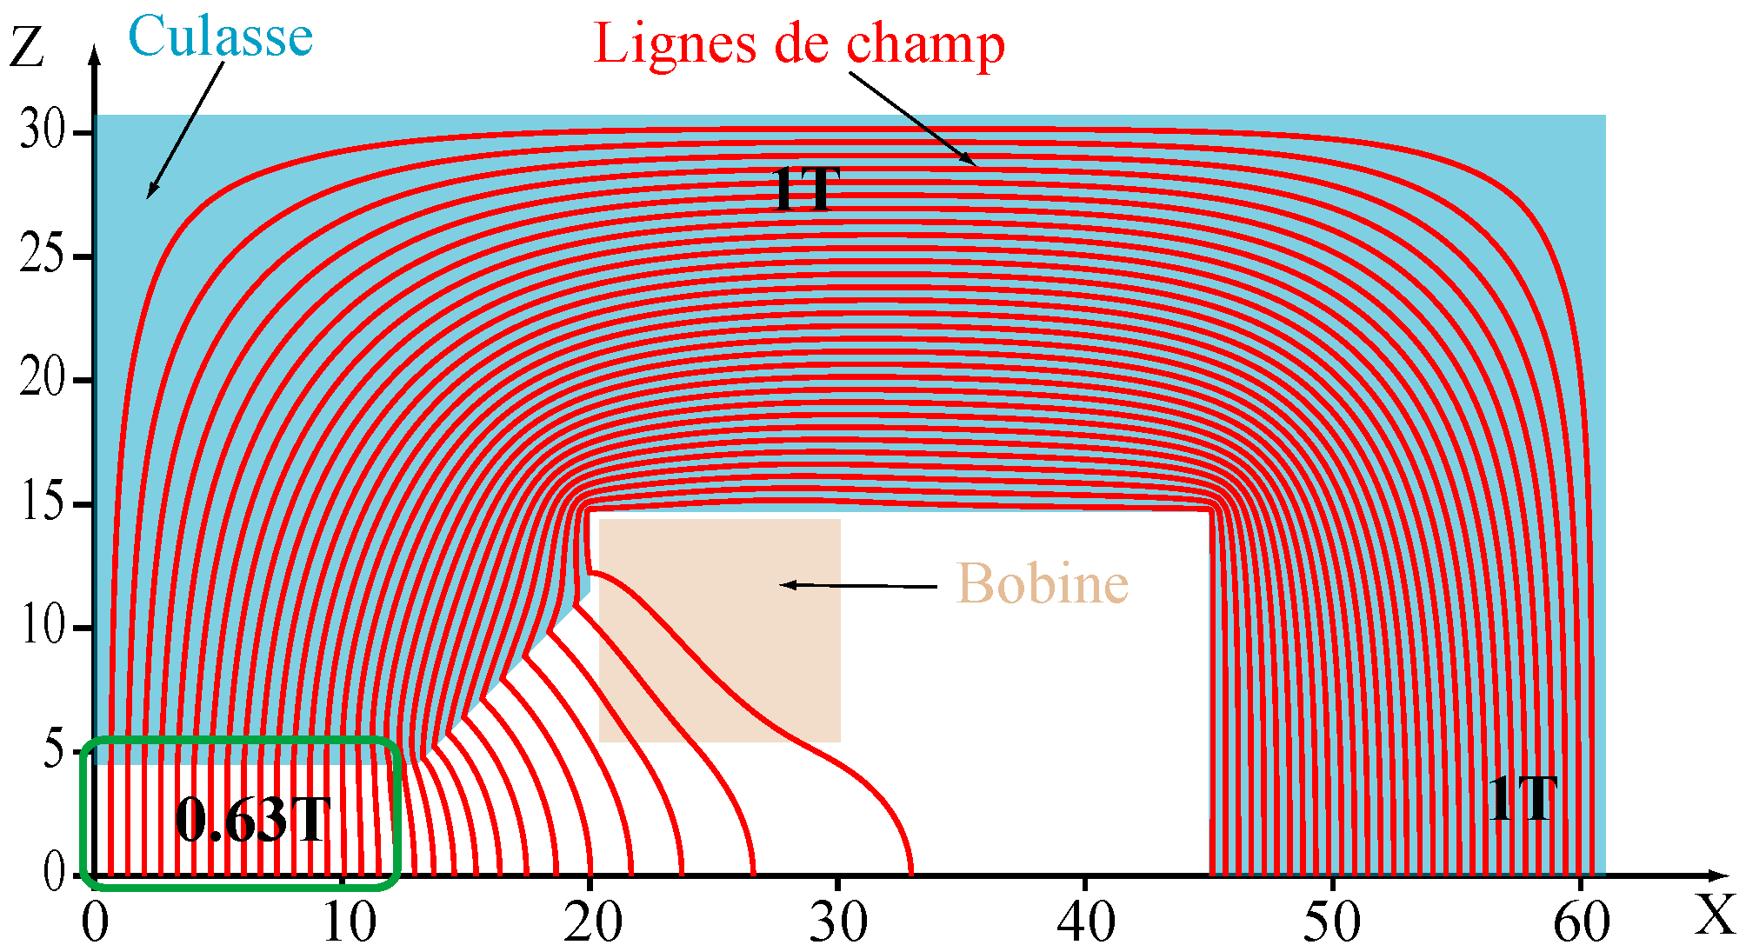
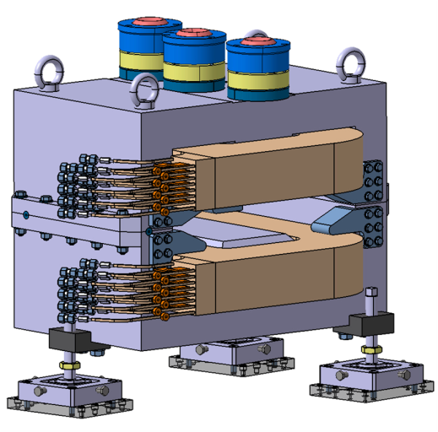
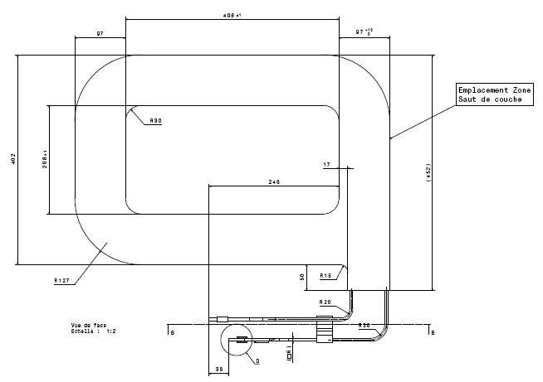
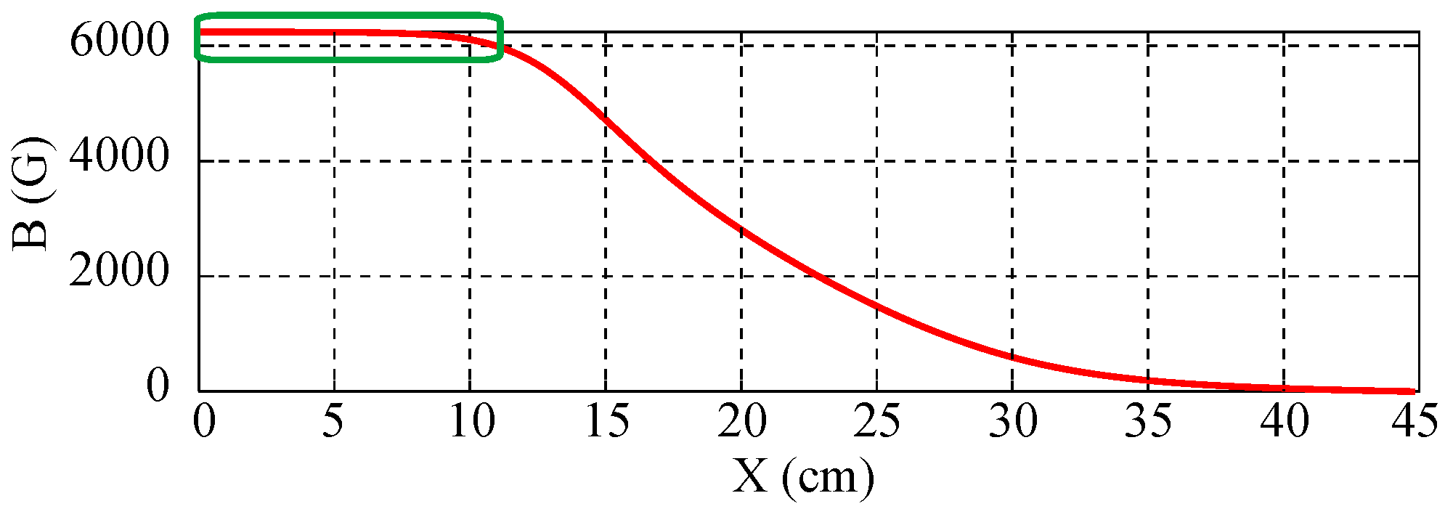
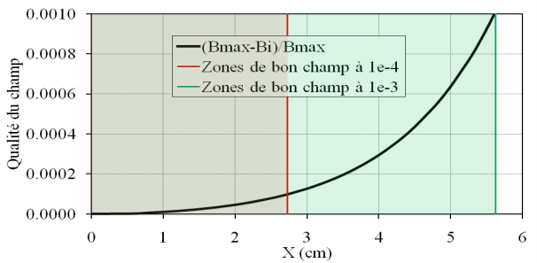
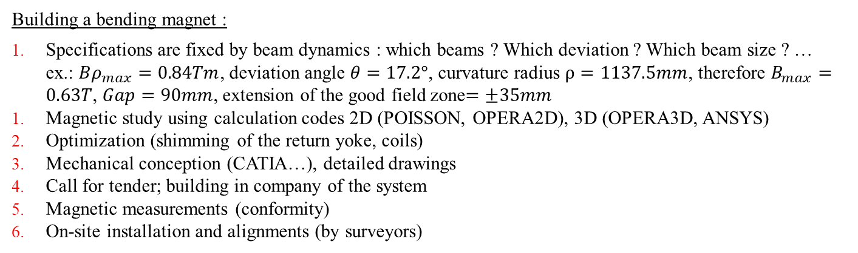
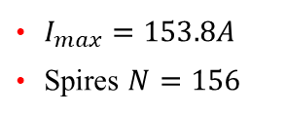
I – Guiding and focalizing magnets : dipoles
Building a bending magnet :
Specifications are fixed by beam dynamics : which beams ? Which deviation ? Which beam size ? …
ex.: $Bρ_{max}=0.84Tm$, deviation angle $θ=17.2°$, curvature radius $ρ=1137.5mm$, therefore $B_{max}=0.63T$, $Gap=90mm$, extension of the good field zone$=±35mm$
Magnetic study using calculation codes 2D (POISSON, OPERA2D), 3D (OPERA3D, ANSYS)
Optimization (shimming of the return yoke, coils)
Mechanical conception (CATIA…), detailed drawings
Call for tender; building in company of the system
Magnetic measurements (conformity)
On-site installation and alignments (by surveyors)
Yokes : 560kG of Iron
2 coils : 105kG of Copper
$I_{max}=153.8A$
Spires $N=156$

Slide 20
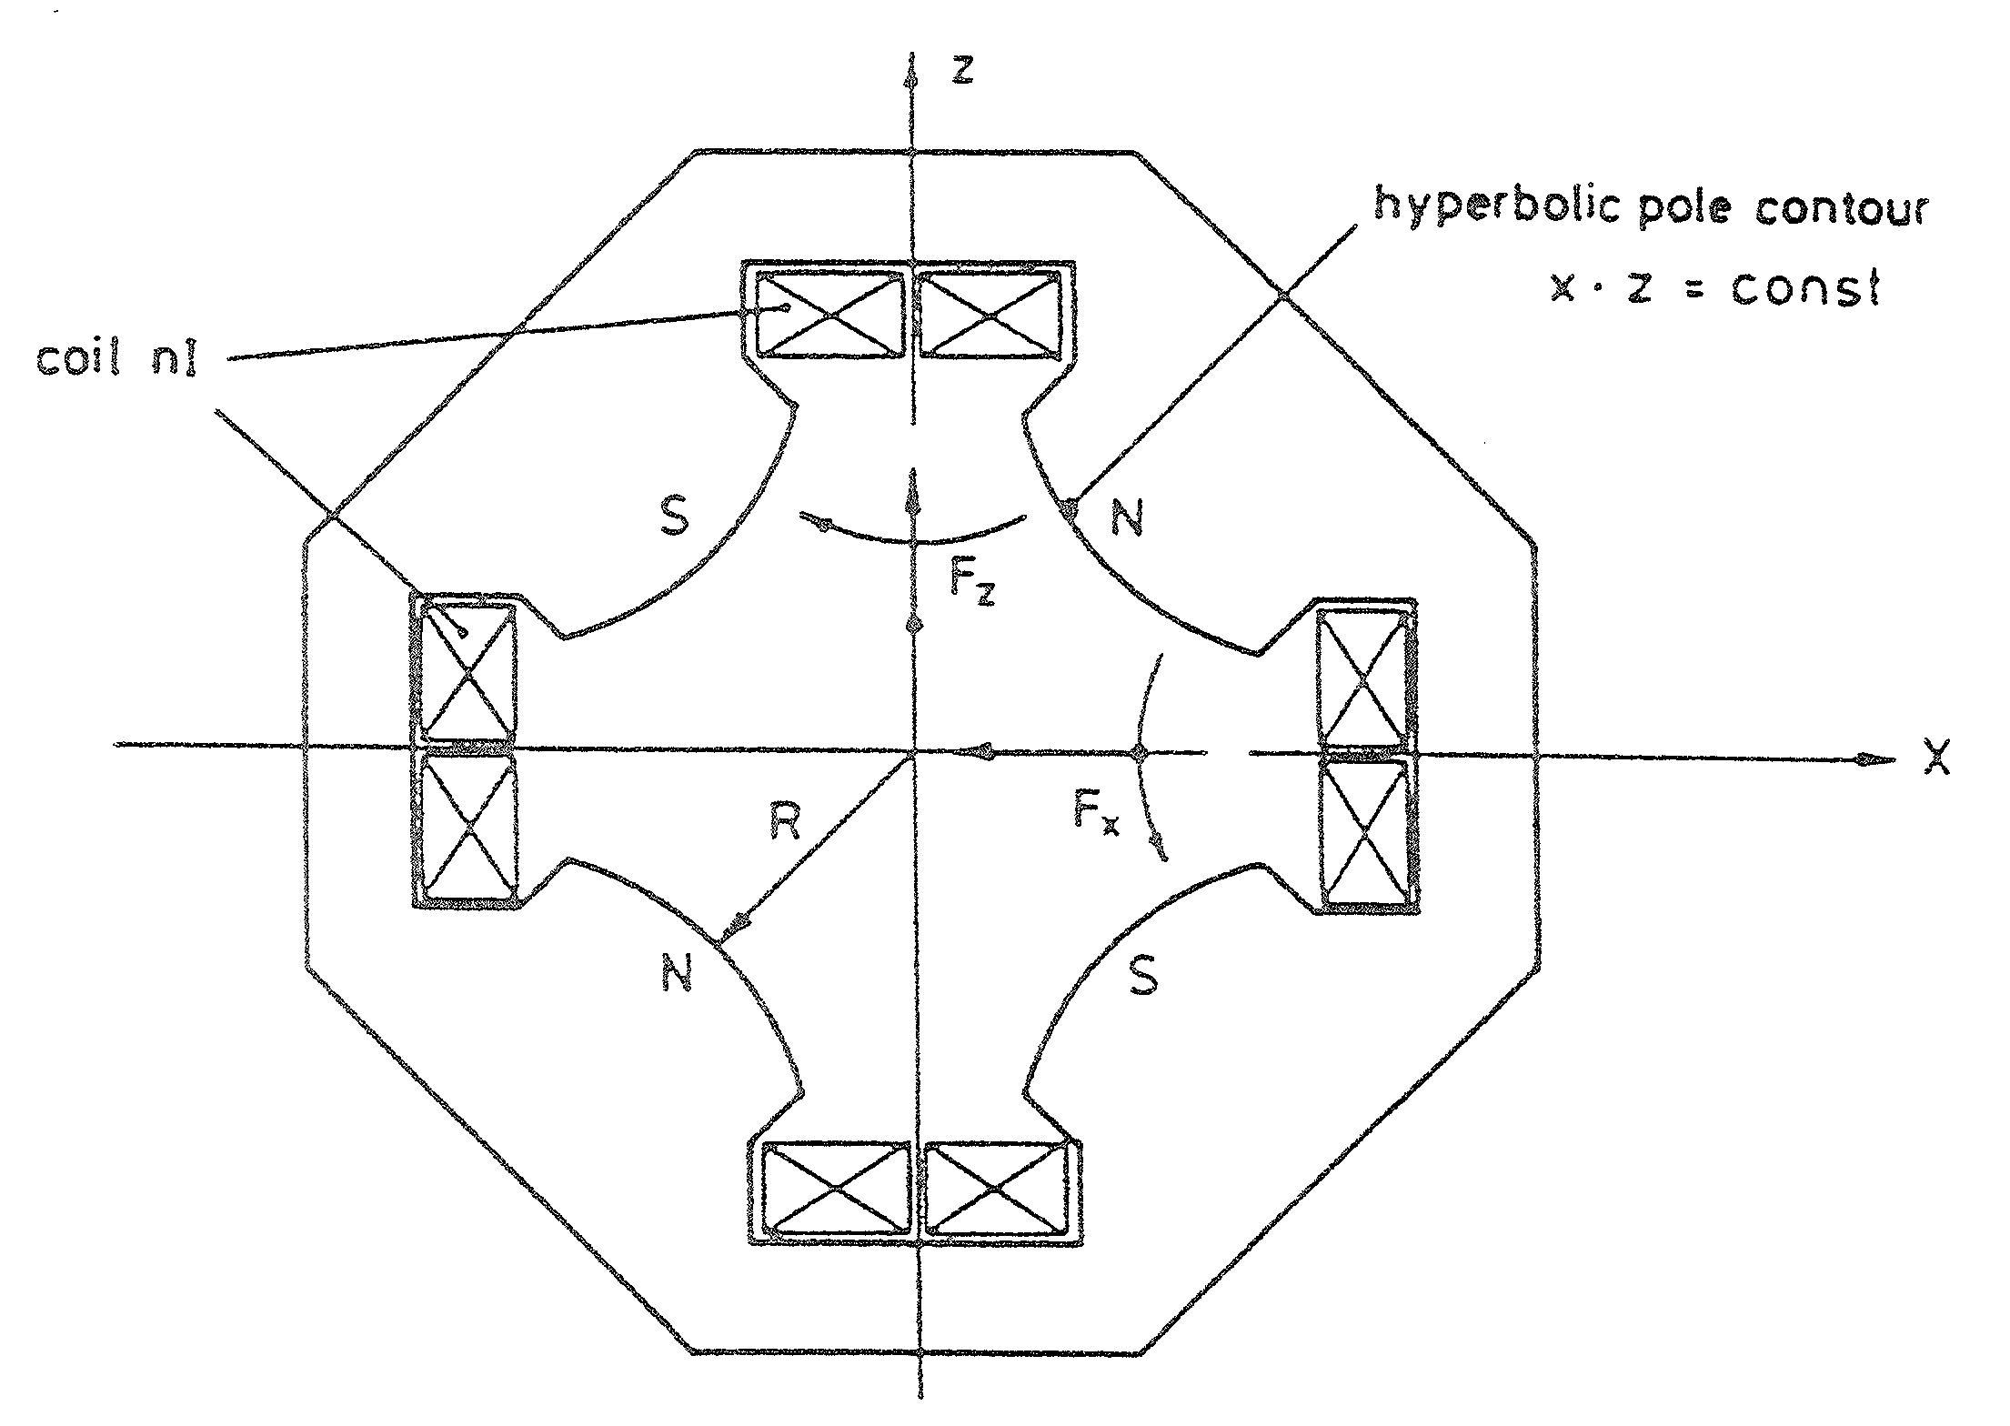
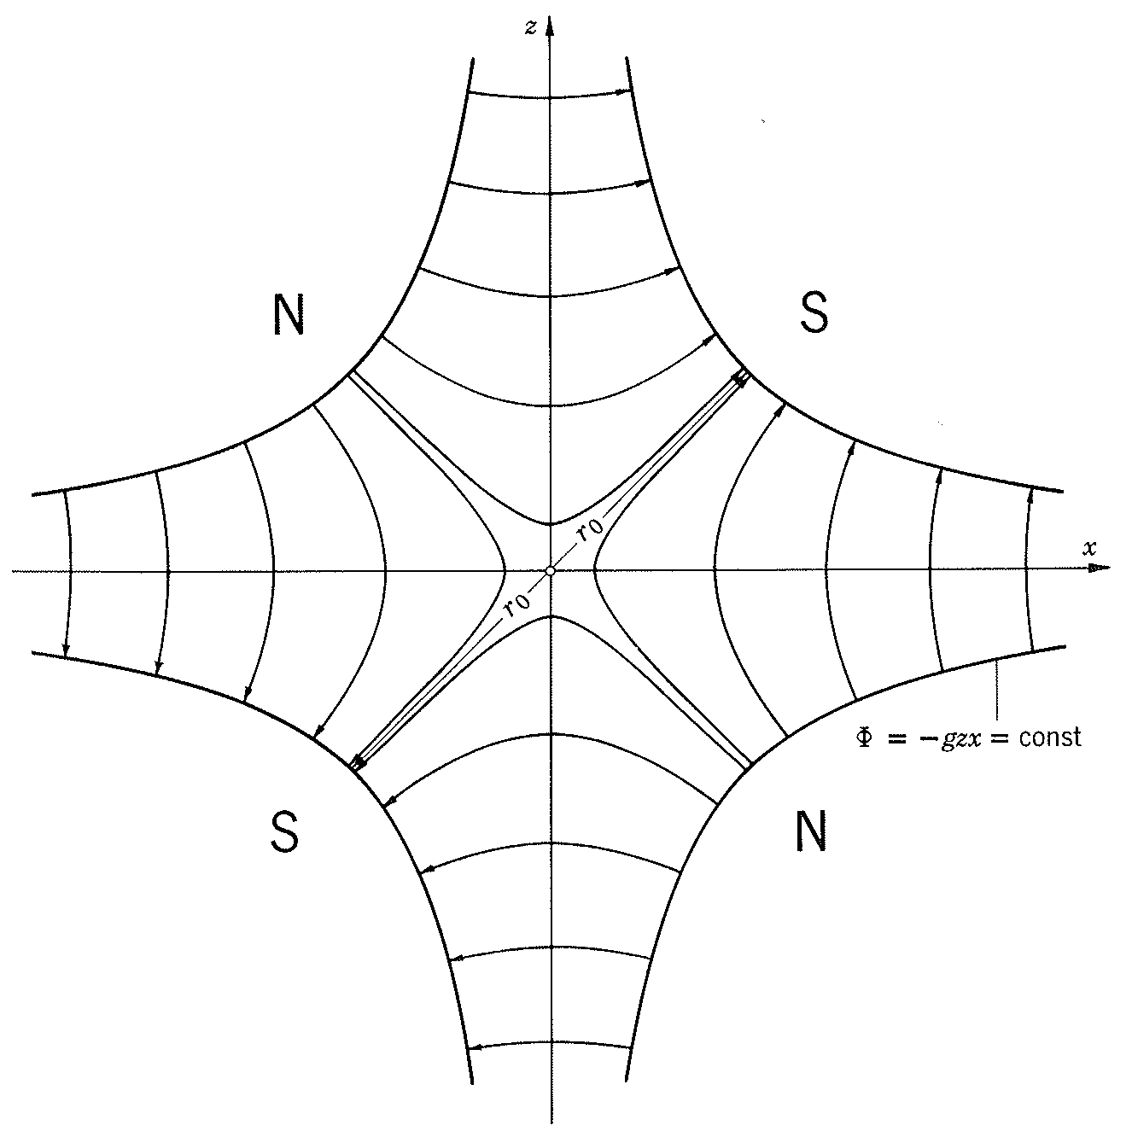
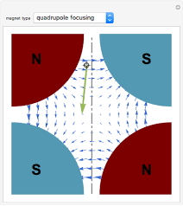

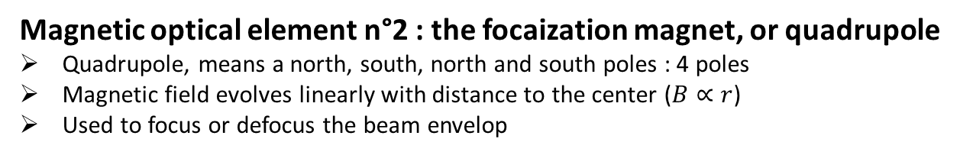


I – Guiding and focalizing magnets : quadrupoles
Magnetic optical element n°2 : the focaization magnet, or quadrupole
Quadrupole, means a north, south, north and south poles : 4 poles
Magnetic field evolves linearly with distance to the center ($B∝r$)
Used to focus or defocus the beam envelop
  y
  Equipotential : $=±gyx=cte$
  Hyperbolic pole
  $$x×y=const$$
  Field line : $B=cte$
  x
  z
Q : What is the effect of this quad on the beam ?

Slide 21
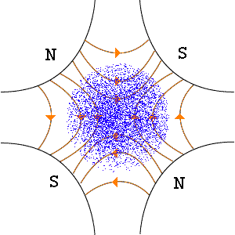
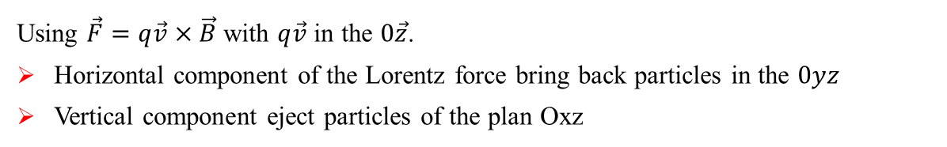














I – Guiding and focalizing magnets : quadrupoles
Magnetic optical element n°2 : the focaization magnet, or quadrupole
Quadrupole, means a north, south, north and south poles : 4 poles
Magnetic field evolves linearly with distance to the center ($B∝r$)
Used to focus or defocus the beam envelop
  y
  Equipotential : $=±gyx=cte$
  Hyperbolic pole
  $$x×y=const$$
  Field line : $B=cte$
  x
  z
  Using $\vec{F}=q\vec{v}×\vec{B}$ with $q\vec{v}$ in the $0\vec{z}$.
  Horizontal component of the Lorentz force bring back particles in the $0yz$
  Vertical component eject particles of the plan Oxz
  on $OX>0$
  on $OX<0$
  on $OY>0$
  on $OY<0$
  $$q\vec{v}$$
  $$\vec{B}$$
  $$\vec{B}$$
  $$\vec{B}$$
  $$\vec{B}$$
  $$\vec{F}$$
  $$\vec{F}$$
  $$\vec{F}$$
  $$\vec{F}$$

Slide 22



I – Guiding and focalizing magnets : quadrupoles
Electrostatic quadrupole :
  Q1 : where are the poles ?
  Q2 : what voltage sign on the poles ?
  y
  Hyperbolic pole
  $$x×y=const$$
  x
  z

Slide 23


I – Guiding and focalizing magnets : quadrupoles
  Quad is focusing in the horizontal plane and de-focusing in the vertical plane.
  If the quadrupole is rotated by 90° or if the polarities are inverted, the opposite effect is obtained.
  y
  For mechanical and electromagnetic symmetry reasons :
  B_{y}( x, -y) = B_{y}(x,y)
  B_{y}( -x, y) = -B_{y}(x,y)
  B_{x}( x, -y) = -B_{x}(x,y)
  B_{x}( -x, y) = B_{x}(x,y)
  Hyperbolic pole
  $$x×y=const$$
  Or B_{y} even in y, odd in x
  x
  Or B_{x} odd in y, even in x
  z
  Therefore $By=Bx=0$ at $x=y=0$. A centered beam on the $Oz$ axis is not deflected.
  We can develop the transverse $By$ and $Bx$ magnetic field (see Taylor expansions) :
  $$B_{y}\left(x,y\right)=0+\frac{∂B_{y}}{∂x}x+\text{higher} \text{orders}$$
  $$B_{x}\left(x,y\right)=0+\frac{∂B_{x}}{∂y}y+\text{higher} \text{orders}$$
Field increase linearly with distance to the center

Slide 24




I – Guiding and focalizing magnets : quadrupoles
  Field gradient G as a function of Ampere-turns (the current) in the quadrupole coils is determined by using the Ampère theorem to $𝒞$.
  $\sum{I}=\oint_{𝒞}{\vec{H}.d\vec{l}}$
  $$NI=\oint_{0 to 1 (R)}{H\left(r\right).dr}+\oint_{1 to 2 (Iron)}{{\vec{H}}_{I}.d\vec{l}}+\int_{2 to 0}{\vec{H}.d\vec{l}}$$
  From 0 to 1 : $H\left(r\right)=\frac{B\left(r\right)}{μ_{0}}=\frac{\sqrt{B_{x}^{2}+B_{y}^{2}}}{μ_{0}}=\frac{G}{μ_{0}}\sqrt{x^{2}+y^{2}}=\frac{Gr}{μ_{0}}$
  From 1 to 2 : $H_{I}=\frac{B_{I}}{μ_{0}μ_{r}}\sim 0$ because $μ_{r}≫1$
  From 2 to 0 : $\vec{H}⊥d\vec{l}$, therefore $\vec{H}.d\vec{l}=0$
  $NI\sim \frac{G}{μ_{0}}\int_{0}^{R}{r dr}\sim \frac{G R^{2}}{2 μ_{0}}$ and the gradient $G=\frac{{2 μ}_{0} NI}{R^{2}}$ with R the quadrupole radius.
  Particle travelling into a magnetic quadrupole of length $L$ at a distance $x_{0}$ from the central axis is deflected by :
  $∆θ=\frac{1}{P/q}\int{B dl}=\frac{1}{Bρ}\int{B dl}=\frac{G L x_{0}}{Bρ}$
  The quadrupole focal length is : $\frac{1}{f}=\frac{x_{0}}{\tan{θ}}=\frac{x_{0}}{∆θ}=\frac{G L}{Bρ}$ with $\tan{θ}\sim ∆θ$

Slide 25






I – Guiding and focalizing magnets : dipoles, quadrupoles and multipoles
  Summarize : HEBT quadrupoles at SPIRAL2 Caen :
  $Gmax=13T/m$, $Lm=330mm$, aperture radius$=64mm$
  4 coils to 25160A.turn.
  Yoke Iron weight : 750kg, 4 Coils Copper weight : 132kg.
  $Imax=370A$, $Pmax=16.3kW$ (need water cooling)
  68 turns (Copper length 1.1m for One turn), water cooled along 75m circuit.
  690mm
  Few examples :
  Calculation using Poisson code of the magnetic field in a warm quadrupole.
  Field lines
  Vacuum pile for the beam
  Pole / Yoke

Slide 26








I – Guiding and focalizing magnets : multipoles
  Bend with combined function
  Used in synchrotron with strong focusing
  Combination of deflection and focalization using hyperbolic poles
  $Y$
  $z$
  Ex.: PS at CERN
  $y$
  $$X,x$$
  Such bend can be considered like a quadrupole at a distance $d$ from the center.
  We can deduce $BX$ and $BY$ component of the field :
  Using the new reference $\left(x,y\right)$ to $\left(X,Y\right)$ : $Y=y$ and $X=x+d$
  $B_{X}=GY=Gy=B_{x}$
  $B_{Y}=GX=G \left(x+d\right)=B_{0}+gx=B_{0}+B_{y}$ with $B_{0}=Gd$
  $y$
  $x$

Slide 27



I – Guiding and focalizing magnets : multipoles
Magnetic optical element n°3 : the sextupole
Sexupole, means 6 poles (alternate south and north)
Magnetic field evolves quadratically with distance to the center ($B∝r²$)
Used to correct higher order effects (chromatic aberrations)
  N
  Using Ampère-theorem, the turn-numbers $NI$ are function to the $S$ force by :
  $$NI=\oint{\vec{H}.d\vec{l}}=\int_{0}^{R}{H_{r} dr}=\int_{0}^{R}{\frac{B_{r}}{μ_{0}}dr}=\int_{0}^{R}{\frac{1}{μ_{0}}Sr^{2}dr}$$
  $NI=\frac{SR^{3}}{3μ_{0}}$ with R the sextuple aperture radius
  S
  S
  N
  N
  S

Slide 28



I – Guiding and focalizing magnets : multipoles
  Multipolar lenses $\left(2×n \text{poles}\right)$
  Strictly, expressions of the magnetic field components already seen are valid only close to the center of the gap in a bend. Higher order of the Taylor expansion of the field $B$ have been neglected and transverses position of particles were small.
  Therefore, it exist high order (non linear terms) terms due to finite dimensions of the pole surface :
  Extension of the poles in the transverse plane (section of hyperbole in quadrupole)
  Finite length of bend which induce a leakage field
Plateau
Leakage field
  According amplitudes of non linearity (effects on the beam), the compensation of these defects can justify the use of multipolar lenses. These lens create non linear fields at a given order.
  These elements correct induce aberrations.
  The much common lens use is the sextuple (or hexapoles).

Slide 29


I – Guiding and focalizing magnets : multipoles
A magnetic dipole, is meant to apply a… dipolar field on the beam
A perfect dipole would, but reality hits sometimes :
Can be corrected with higher order multipole :
Harmonic content of a magnetic dipole (for illustration)
Example of a 48 poles electric multipole
dipole
quadrupole
sextupole
(or hexapole)
octupole
Hecatonicosapentacontapole
Higher-order fields will affect the shape of the beam : this is called optical aberrations

Slide 30




I – Guiding and focalizing magnets : dipoles, quadrupoles and multipoles
Hexapolar aberration ($2^{nd}$ order)
is dominant
Octupolar aberration ($3^{rd}$ order)
Hexapolar corrected
Higher order aberration (${>3}^{rd}$ order)
Octupolar corrected
Typically « C-shaped »
Typically « S-shaped »
Optical aberrations tend to increase the beam size and need to be corrected

Slide 31











II – Guiding and focalizing magnets : dipoles, quadrupoles and multipoles
  LHC at CERN

Slide 32





II – Guiding and focalizing magnets : dipoles, quadrupoles and multipoles
  LHC at CERN

Slide 33



III – Magnetic field around the reference trajectory
  III.1 Coordinate systems
  Accelerators are structured by a succession of bending magnets and multipolar lenses (quadrupoles, sextupoles …).
  In practice, we try to put these elements in the same horizontal plane which is call mid-plane.
  For the calculation of the beam (a set of particles) motion, we describe the system in the single referential.
  By convention, we use the system (x, y, z) with a reference trajectory (C) associated to a particle (impulsion p₀)
  We use also (x,y,s) system instead of (x, y, z).
Beam vector is described in 3D by :
$$\left\{x,x^{′},y,y^{′},z,δ=\frac{ΔE}{E_{0}}\right\}$$
Transverse
horizontal
Transverse
vertical
Longitudinal
It can be extended to mass and charge:
$$\left\{x,x^{′},y,y^{′},z,\frac{ΔE}{E_{0}},\frac{Δm}{m_{0}},\frac{Δq}{q_{0}}\right\}$$
but not often used

Slide 34

II – Guiding and focalizing magnets : dipoles, quadrupoles and multipoles
  III.2 Field Development
The (magnetic) fields can be developed with a taylor expansion :
$$\text{In} \text{plane} y=0\text{ : }B_{y}(y=0)=a_{00}+a_{01}x+a_{02}x^{2}+…=B_{y0}\left(1+\frac{1}{B_{y0}}{\left(\frac{∂B_{y}}{∂x}\right)}_{0}x+\frac{1}{2B_{y0}}{\left(\frac{∂^{2}B_{y}}{∂x^{2}}\right)}_{0}x^{2}+…\right)$$
$$B_{y}(y=0)=B_{y0}\left(1−nhx+βh^{2}x^{2}+…\right)$$
$$\text{Field} \text{index}\text{ : }n=−\frac{1}{hB_{y0}}{\left(\frac{∂B_{y}}{∂x}\right)}_{0}, \text{sextupolar} \text{terme}\text{ : }β=\frac{1}{2h^{2}B_{y0}}{\left(\frac{∂^{2}B_{y}}{∂x^{2}}\right)}_{0}$$
$$\text{and} h=h\left(s\right)=\frac{1}{ρ\left(s\right)}=−\frac{q}{P_{0}}B_{y0}\left(s\right) \text{(}\text{from} {\text{B}}_{0}ρ=\frac{P_{0}}{q})$$
  From this taylor expansion we can deduce dipole, quadrupole, sextupole… terms

Slide 35




IV – Particles motion around the reference trajectory
Particle dynamics is calculated using the « Newton-Lorentz » equation :
$$\frac{d}{dt}\left[mγv\right]=q⋅(E+v×B)$$
B field expression injected here
$$\text{In} \text{the} \text{horizontal} \text{plane} \text{x}\text{ : }\text{equation} \text{is}\text{ : }x^{″}+K_{x}\left(s\right)x=x^{″}+\left(1−n\right)h^{2}x=h\left(s\right)δ=f\left(s\right) \\ \text{The} \text{complete} \text{solution} \text{is}\text{ :} \\ x\left(s\right)=x_{0}C_{x}\left(s\right)+{x_{0}}^{′}S_{x}\left(s\right)+δ\left[S_{x}\left(s\right)\int_{0}^{s}{\frac{C_{x}\left(s\right)}{ρ\left(s\right)}ds}−C_{x}\left(s\right)\int_{0}^{s}{\frac{S_{x}\left(s\right)}{ρ\left(s\right)}ds}\right]=x_{0}C_{x}\left(s\right)+{x_{0}}^{′}S_{x}\left(s\right)+D_{x}\left(s\right)δ \\ x^{′}\left(s\right)=x_{0}{C_{x}}^{′}\left(s\right)+{x_{0}}^{′}{S_{x}}^{′}\left(s\right)+{D_{x}}^{′}\left(s\right)δ$$
Finally we have a simple equation for $x_{1}\left(x_{0},x_{0}^{′},δ\right)$
Where x : position, x’ : angle, $δ$ : energy
$$\text{In} \text{the} \text{vertical} \text{plane} \text{y}\text{ : }\text{motion} \text{equation} \text{is}\text{ : }{\text{y}}^{″}+K_{y}\left(s\right)y=y^{″}+nh^{2}y=0 \\ \text{The} \text{complete} \text{solution} \text{is}\text{ :} \\ y\left(s\right)=y_{0}C_{y}\left(s\right)+{y_{0}}^{′}S_{y}\left(s\right) \\ y^{′}\left(s\right)=y_{0}{C_{y}}^{′}\left(s\right)+{y_{0}}^{′}{S_{y}}^{′}\left(s\right)$$
$$x_{0}\text{, }{x_{0}}^{′}\text{, }y_{0}\text{, }{y_{0}}^{′} \text{and} δ \text{are} \text{initial} \text{particles} \text{characteristics} \text{in} s=0. \\ \text{Functions} C\left(s\right)\text{, }S\left(s\right) \text{and} D\left(s\right) \text{are} \text{called} \text{principal} \text{trajectories}\text{.} \\ D\left(s\right) \text{function} \text{characterise} \text{chromatic} \text{properties} \text{of} \text{the} \text{system} (\text{dispersion} \text{function}).$$

Slide 36


IV – Particles motion around the reference trajectory
Particle dynamics is calculated using the « Newton-Lorentz » equation :
$$\frac{d}{dt}\left[mγv\right]=q⋅(E+v×B)$$
B field expression injected here
It is usually sufficient to describe beam dynamics at 1st order.
Development of equations along reference path at 1st order, as a function of the 3D(+) phase space.
This can be expressed under the form of matrix transport :
$$\left\{x,x^{′},y,y^{′},z,\frac{ΔE}{E_{0}},\frac{Δm}{m_{0}},\frac{Δq}{q_{0}}\right\}$$
$${\left[\begin{matrix}\begin{matrix}x \\ x^{′} \\ y\end{matrix} \\ \begin{matrix}y^{′} \\ z \\ δ\end{matrix}\end{matrix}\right]}_{final}=\left[\begin{matrix}\begin{matrix}R_{11} & R_{12} & R_{13}\end{matrix} & \begin{matrix}R_{14} & R_{15} & R_{16}\end{matrix} \\ \begin{matrix}\begin{matrix}R_{21} \\ \begin{matrix}R_{31} \\ \begin{matrix}R_{41} \\ \begin{matrix}R_{51} \\ R_{61}\end{matrix}\end{matrix}\end{matrix}\end{matrix} & \begin{matrix}R_{22} \\ \begin{matrix}R_{32} \\ \begin{matrix}R_{42} \\ \begin{matrix}R_{52} \\ R_{62}\end{matrix}\end{matrix}\end{matrix}\end{matrix} & \begin{matrix}R_{23} \\ \begin{matrix}R_{33} \\ \begin{matrix}R_{43} \\ \begin{matrix}R_{53} \\ R_{63}\end{matrix}\end{matrix}\end{matrix}\end{matrix}\end{matrix} & \begin{matrix}\begin{matrix}R_{24} \\ \begin{matrix}R_{34} \\ \begin{matrix}R_{44} \\ \begin{matrix}R_{54} \\ R_{64}\end{matrix}\end{matrix}\end{matrix}\end{matrix} & \begin{matrix}R_{25} \\ \begin{matrix}R_{35} \\ \begin{matrix}R_{45} \\ \begin{matrix}R_{55} \\ R_{65}\end{matrix}\end{matrix}\end{matrix}\end{matrix} & \begin{matrix}R_{26} \\ \begin{matrix}R_{36} \\ \begin{matrix}R_{46} \\ \begin{matrix}R_{56} \\ R_{66}\end{matrix}\end{matrix}\end{matrix}\end{matrix}\end{matrix}\end{matrix}\right]⋅{\left[\begin{matrix}\begin{matrix}x \\ x^{′} \\ y\end{matrix} \\ \begin{matrix}y^{′} \\ z \\ δ\end{matrix}\end{matrix}\right]}_{init}$$
General transport matrix :

Slide 37
IV – Particles motion around the reference trajectory
Particle dynamics is calculated using the « Newton-Lorentz » equation :
$$\frac{d}{dt}\left[mγv\right]=q⋅(E+v×B)$$
B field expression injected here
It is usually sufficient to describe beam dynamics at 1st order.
Development of equations along reference path at 1st order, as a function of the 3D(+) phase space.
This can be expressed under the form of matrix transport :
$$\left\{x,x^{′},y,y^{′},z,\frac{ΔE}{E_{0}},\frac{Δm}{m_{0}},\frac{Δq}{q_{0}}\right\}$$
horizontal
$${\left[\begin{matrix}\begin{matrix}x \\ x^{′} \\ y\end{matrix} \\ \begin{matrix}y^{′} \\ z \\ δ\end{matrix}\end{matrix}\right]}_{final}=\left[\begin{matrix}\begin{matrix}R_{11} & R_{12} & R_{13}\end{matrix} & \begin{matrix}R_{14} & R_{15} & R_{16}\end{matrix} \\ \begin{matrix}\begin{matrix}R_{21} \\ \begin{matrix}R_{31} \\ \begin{matrix}R_{41} \\ \begin{matrix}R_{51} \\ R_{61}\end{matrix}\end{matrix}\end{matrix}\end{matrix} & \begin{matrix}R_{22} \\ \begin{matrix}R_{32} \\ \begin{matrix}R_{42} \\ \begin{matrix}R_{52} \\ R_{62}\end{matrix}\end{matrix}\end{matrix}\end{matrix} & \begin{matrix}R_{23} \\ \begin{matrix}R_{33} \\ \begin{matrix}R_{43} \\ \begin{matrix}R_{53} \\ R_{63}\end{matrix}\end{matrix}\end{matrix}\end{matrix}\end{matrix} & \begin{matrix}\begin{matrix}R_{24} \\ \begin{matrix}R_{34} \\ \begin{matrix}R_{44} \\ \begin{matrix}R_{54} \\ R_{64}\end{matrix}\end{matrix}\end{matrix}\end{matrix} & \begin{matrix}R_{25} \\ \begin{matrix}R_{35} \\ \begin{matrix}R_{45} \\ \begin{matrix}R_{55} \\ R_{65}\end{matrix}\end{matrix}\end{matrix}\end{matrix} & \begin{matrix}R_{26} \\ \begin{matrix}R_{36} \\ \begin{matrix}R_{46} \\ \begin{matrix}R_{56} \\ R_{66}\end{matrix}\end{matrix}\end{matrix}\end{matrix}\end{matrix}\end{matrix}\right]⋅{\left[\begin{matrix}\begin{matrix}x \\ x^{′} \\ y\end{matrix} \\ \begin{matrix}y^{′} \\ z \\ δ\end{matrix}\end{matrix}\right]}_{init}$$
vertical
General transport matrix :
But at first order, horizontal and vertical motions are generally independant

Slide 38


IV – Particles motion around the reference trajectory
$$\text{At} \text{first} \text{order}\text{, }\text{horizontal} \text{and} \text{vertical} \text{motions} \text{are} \text{decoupled} \text{and} \text{independant}\text{ :}$$
$$x^{″}+K_{x}\left(s\right)x=hδ=f\left(s\right) \\ {\text{y}}^{″}+K_{y}\left(s\right)y=0$$
$$\text{Expression} \text{of} K_{x}\left(s\right) \text{and} K_{y}\left(s\right) \text{depend} \text{to} \text{the} \text{crossing} \text{structures}\text{ :} \\ ∗ \text{Bending} \text{magnet} \text{with} \text{index}\text{ : }K_{x}\left(s\right)=\left(1−n\right)h^{2} \text{and} K_{y}\left(s\right)=nh^{2} \text{where} n=−\frac{1}{hB_{y0}}{\left(\frac{∂B_{y}}{∂x}\right)}_{0} \\ ∗ \text{Dipolar} \text{bending} \text{magnet} (n=0)\text{ : }K_{x}\left(s\right)=h^{2} \text{and} K_{y}\left(s\right)=0 \\ ∗ \text{Pure} \text{quadrupole}\text{ : }K_{x}\left(s\right)=\frac{G}{Bρ} \text{and} K_{y}\left(s\right)=−\frac{G}{Bρ} \text{with} \text{G}\text{=}−nh^{2}Bρ \text{and} \left[G\right]=\left[−nh^{2}Bρ\right]=m^{−2}Tm=T/m \\ ∗ \text{In} \text{a} \text{drift} (\text{no} \text{field} \text{section})\text{ : }K_{x}\left(s\right)=K_{y}\left(s\right)=0 \text{and} x^{″}=y^{″}=0$$
The motion equations are also called Hill’s equations
K is also part of the general expression of the Hamiltonian function in accelerator physics

Slide 39




IV – Particles motion around the reference trajectory
  IV.2 General solution of the linear equation – Transfer matrixes
$$\text{In} \text{the} \text{horizontal} \text{plane} \text{x}\text{ : }\text{equation} \text{is}\text{ : }x^{″}+K_{x}\left(s\right)x=x^{″}+\left(1−n\right)h^{2}x=h\left(s\right)δ=f\left(s\right) \\ \text{The} \text{complete} \text{solution} \text{is}\text{ :} \\ x\left(s\right)=x_{0}C_{x}\left(s\right)+{x_{0}}^{′}S_{x}\left(s\right)+δ\left[S_{x}\left(s\right)\int_{0}^{s}{\frac{C_{x}\left(s\right)}{ρ\left(s\right)}ds}−C_{x}\left(s\right)\int_{0}^{s}{\frac{S_{x}\left(s\right)}{ρ\left(s\right)}ds}\right]=x_{0}C_{x}\left(s\right)+{x_{0}}^{′}S_{x}\left(s\right)+D_{x}\left(s\right)δ \\ x^{′}\left(s\right)=x_{0}{C_{x}}^{′}\left(s\right)+{x_{0}}^{′}{S_{x}}^{′}\left(s\right)+{D_{x}}^{′}\left(s\right)δ$$
Finally we have a simple equation for $x_{1}\left(x_{0},x_{0}^{′},δ\right)$
Where x : position, x’ : angle, $δ$ : energy
$$\text{In} \text{the} \text{vertical} \text{plane} \text{y}\text{ : }\text{motion} \text{equation} \text{is}\text{ : }{\text{y}}^{″}+K_{y}\left(s\right)y=y^{″}+nh^{2}y=0 \\ \text{The} \text{complete} \text{solution} \text{is}\text{ :} \\ y\left(s\right)=y_{0}C_{y}\left(s\right)+{y_{0}}^{′}S_{y}\left(s\right) \\ y^{′}\left(s\right)=y_{0}{C_{y}}^{′}\left(s\right)+{y_{0}}^{′}{S_{y}}^{′}\left(s\right)$$
$$x_{0}\text{, }{x_{0}}^{′}\text{, }y_{0}\text{, }{y_{0}}^{′} \text{and} δ \text{are} \text{initial} \text{particles} \text{characteristics} \text{in} s=0. \\ \text{Functions} C\left(s\right)\text{, }S\left(s\right) \text{and} D\left(s\right) \text{are} \text{called} \text{principal} \text{trajectories}\text{.} \\ D\left(s\right) \text{function} \text{characterise} \text{chromatic} \text{properties} \text{of} \text{the} \text{system} (\text{dispersion} \text{function}).$$

Slide 40

IV – Particles motion around the reference trajectory
Matrix formalism :
$$\text{We} \text{can} \text{write} \text{these} \text{equations} \text{in} \text{a} \text{matrix} \text{system}\text{ :}$$
$$\underline{x \text{axis}\text{ :}} \left(\begin{aligned}&x\left(s\right) \\ &x^{′}\left(s\right) \\ &δ\end{aligned}\right)=\left(\begin{matrix}C_{x}\left(s\right) & S_{x}\left(s\right) & D_{x}\left(s\right) \\ {C_{x}}^{′}\left(s\right) & {S_{x}}^{′}\left(s\right) & D_{x}\left(s\right) \\ 0 & 0 & 1\end{matrix}\right)\left(\begin{aligned}&x_{0}\left(s\right) \\ &{x_{0}}^{′}\left(s\right) \\ &δ\end{aligned}\right)=T_{x}\left(\begin{aligned}&x_{0}\left(s\right) \\ &{x_{0}}^{′}\left(s\right) \\ &δ\end{aligned}\right) \\ \underline{y \text{axis}\text{ :}} \left(\begin{aligned}&y\left(s\right) \\ &y^{′}\left(s\right)\end{aligned}\right)=\left(\begin{matrix}C_{y}\left(s\right) & S_{y}\left(s\right) \\ {C_{y}}^{′}\left(s\right) & {S_{y}}^{′}\left(s\right)\end{matrix}\right)\left(\begin{aligned}y_{0}\left(s\right) \\ &{y_{0}}^{′}\left(s\right)\end{aligned}\right)=T_{y}\left(\begin{aligned}&y_{0}\left(s\right) \\ &{y_{0}}^{′}\left(s\right)\end{aligned}\right) \\ \text{With} \det{T_{x}}=\det{T_{y}=1}$$
$$T_{x} \text{and} T_{y} \text{are} \text{called} \text{matrix} \text{transfer} \text{between} \text{two} \text{plane}\text{.}$$
  In practice, beam lines are structured by various optical elements (dipoles, quadruples, drift, …).
  We calculate the transfer matrix T_{x}, T_{z} of each single elements.
  Total matrix transfer M_{x}, M_{z} is the product of each single matrix T_{x,z}.

Slide 41


IV – Particles motion around the reference trajectory
$$\text{The} \text{full} \text{system} \text{matrix} \text{with}\text{ 5 }\text{elements} \text{is} M_{x,y}=T_{5/x,y}T_{4/x,y}T_{3/x,y}T_{2/x,y}T_{1/x,y} \\ \left\{\begin{aligned}&x\left(s\right)=x_{\text{final}}=T_{x11}x_{0}+T_{x12}{x_{0}}^{′}+T_{x13}δ \\ &x^{′}\left(s\right)=x_{\text{final}}=T_{x21}x_{0}+T_{x22}{x_{0}}^{′}+T_{x23}δ \\ &y\left(s\right)=y_{\text{final}}=T_{y11}y_{0}+T_{y12}{y_{0}}^{′} \\ &y^{′}\left(s\right)=y_{\text{final}}=T_{y11}y_{0}+T_{y12}{y_{0}}^{′}\end{aligned}\right.$$

Slide 42



IV – Particles motion around the reference trajectory
Particle dynamics is calculated using the « Newton-Lorentz » equation :
$$\frac{d}{dt}\left[mγv\right]=q⋅(E+v×B)$$
It is usually sufficient to describe beam dynamics at 1st order.
Development of equations along reference path at 1st order, as a function of the 3D phase space.
This can be expressed under the form of matrix transport :
$${\left[\begin{matrix}\begin{matrix}x \\ x^{′} \\ y\end{matrix} \\ \begin{matrix}y^{′} \\ z \\ δ\end{matrix}\end{matrix}\right]}_{final}=\left[\begin{matrix}\begin{matrix}R_{11} & R_{12} & R_{13}\end{matrix} & \begin{matrix}R_{14} & R_{15} & R_{16}\end{matrix} \\ \begin{matrix}\begin{matrix}R_{21} \\ \begin{matrix}R_{31} \\ \begin{matrix}R_{41} \\ \begin{matrix}R_{51} \\ R_{61}\end{matrix}\end{matrix}\end{matrix}\end{matrix} & \begin{matrix}R_{22} \\ \begin{matrix}R_{32} \\ \begin{matrix}R_{42} \\ \begin{matrix}R_{52} \\ R_{62}\end{matrix}\end{matrix}\end{matrix}\end{matrix} & \begin{matrix}R_{23} \\ \begin{matrix}R_{33} \\ \begin{matrix}R_{43} \\ \begin{matrix}R_{53} \\ R_{63}\end{matrix}\end{matrix}\end{matrix}\end{matrix}\end{matrix} & \begin{matrix}\begin{matrix}R_{24} \\ \begin{matrix}R_{34} \\ \begin{matrix}R_{44} \\ \begin{matrix}R_{54} \\ R_{64}\end{matrix}\end{matrix}\end{matrix}\end{matrix} & \begin{matrix}R_{25} \\ \begin{matrix}R_{35} \\ \begin{matrix}R_{45} \\ \begin{matrix}R_{55} \\ R_{65}\end{matrix}\end{matrix}\end{matrix}\end{matrix} & \begin{matrix}R_{26} \\ \begin{matrix}R_{36} \\ \begin{matrix}R_{46} \\ \begin{matrix}R_{56} \\ R_{66}\end{matrix}\end{matrix}\end{matrix}\end{matrix}\end{matrix}\end{matrix}\right]⋅{\left[\begin{matrix}\begin{matrix}x \\ x^{′} \\ y\end{matrix} \\ \begin{matrix}y^{′} \\ z \\ δ\end{matrix}\end{matrix}\right]}_{init}$$
General transport matrix :

Slide 43


IV – Particles motion around the reference trajectory
$${\left[\begin{matrix}\begin{matrix}x \\ x^{′} \\ y\end{matrix} \\ \begin{matrix}y^{′} \\ z \\ δ\end{matrix}\end{matrix}\right]}_{final}=\left[\begin{matrix}\begin{matrix}R_{11} & 0 & 0\end{matrix} & \begin{matrix}0 & 0 & R_{16}\end{matrix} \\ \begin{matrix}\begin{matrix}{ R}_{21} \\ \begin{matrix}0 \\ \begin{matrix}0 \\ \begin{matrix}0 \\ 0\end{matrix}\end{matrix}\end{matrix}\end{matrix} & \begin{matrix}R_{22} \\ \begin{matrix}0 \\ \begin{matrix}0 \\ \begin{matrix}0 \\ 0\end{matrix}\end{matrix}\end{matrix}\end{matrix} & \begin{matrix}0 \\ \begin{matrix}R_{33} \\ \begin{matrix}R_{43} \\ \begin{matrix}0 \\ 0\end{matrix}\end{matrix}\end{matrix}\end{matrix}\end{matrix} & \begin{matrix}\begin{matrix}0 \\ \begin{matrix}0 \\ \begin{matrix}R_{44} \\ \begin{matrix}0 \\ 0\end{matrix}\end{matrix}\end{matrix}\end{matrix} & \begin{matrix}0 \\ \begin{matrix}0 \\ \begin{matrix}0 \\ \begin{matrix}1 \\ 0\end{matrix}\end{matrix}\end{matrix}\end{matrix} & \begin{matrix}R_{26} \\ \begin{matrix}0 \\ \begin{matrix}0 \\ \begin{matrix}L/γ^{2} \\ 1\end{matrix}\end{matrix}\end{matrix}\end{matrix}\end{matrix}\end{matrix}\right]⋅{\left[\begin{matrix}\begin{matrix}x \\ x^{′} \\ y\end{matrix} \\ \begin{matrix}y^{′} \\ z \\ δ\end{matrix}\end{matrix}\right]}_{init}$$
Dispersion (sometimes expressed in cm/%)
Point-to-point focusing
For spectrometers :
Magnification (minimize if possible)
Time of fligth (bunched beams)
No energy change
$$⇒ x_{1}=R_{11}⋅x_{0}+R_{16}⋅δ_{0}$$
The final position of a particle depends on the magnification and the dispersion

Slide 44


IV – Particles motion around the reference trajectory
  a - Magnetic length
Magnetic length
Iron length
  b- Sector dipole magnet

Slide 45
IV – Particles motion around the reference trajectory
  c- Bend with combined functions

Slide 46

IV – Particles motion around the reference trajectory
  d- Contribution of the dipole with entrance and exit face angle
2nd order effects can be added by using parabolic faces

Slide 47
IV – Particles motion around the reference trajectory
  e- Transfer matrix of the quadruple
For $G>0$ quadruple is beam focusing on horizontal plane and defocusing in vertical plane.
For $G<0$ quadruple is beam defocusing on horizontal plane and focusing in vertical plane.

Slide 48



IV – Particles motion around the reference trajectory
  f- Thin lens
  Thin lenses are use at the very beginning of a project.
  A quadruple (length L) is a thin lens with 2 drift space to length.
  focusing
  defocusing

Slide 49

IV – Particles motion around the reference trajectory
  g- Matrix of the drift space to length L
Q : transfer matrix of a drift ?

Slide 50

IV – Particles motion around the reference trajectory
  g- Matrix of the drift space to length L
$$\text{Motion} \text{equations} \text{in} \text{a} \text{drift} \text{are}\text{ :} \\ x^{″}\left(s\right)=0 \text{and} {\text{y}}^{″}\left(s\right)=0 \\ \text{with} K_{x}\left(s\right)=K_{y}\left(s\right)=0 \text{and} hδ=0 \text{because} ρ=1/h→∞$$
$$T_{x}=\left(\begin{matrix}1 & L & 0 \\ 0 & 1 & 0 \\ 0 & 0 & 1\end{matrix}\right) \text{and} T_{y}=\left(\begin{matrix}1 & L \\ 0 & 1\end{matrix}\right)$$

Slide 51
IV – Particles motion around the reference trajectory
  h- Some keys words
  Dispersion :
  Achromatic system :
  System resolution :

Slide 52



V – Beam envelop and emittance
  V.0 Introduction
  A beam is a set of particles with different initials conditions values (x₀, x’₀, y₀, y’₀ ,z and δ). What happened to this set of particles along a line in terms of trajectories. We take about beam envelope.
  At first order, horizontal and vertical motion are decoupled.

Slide 53


V – Beam envelop and emittance
  V.1 Phase space and emittance ellipse
  For each particle of the beam, we give a point in the phase space (x,x’) et (y,y’).
  In each plane, the surface occupied by all particles define the phase extension or beam emittance.
  In the general case, complete phase space is 6 dimensions x, x’, y, y’, z, δ where l is the trajectory length difference of the beam particles.
x’ or y’
Γ_{x} or Γ_{y}
x or y
The ellipse area, called the (RMS) beam emittance, is a quantity which is constant along the beam trajectory

Slide 54

V – Beam envelop and emittance

Slide 55



V – Beam envelop and emittance
  1 – Ellipse transformation in a drift space to length L :
  2 – Ellipse transformation in a focusing lens (same for quadrupole) :
  3 – Ellipse transformation in a defocusing lens (same for quadrupole) :

Slide 56




V – Beam envelop and emittance
Front view: tantal mask
Side view:
MCP + Phosphore screen
Front view:
CCD camera
Pepperpot
Emittance-meter
18/06/2025

Slide 57

V – Beam envelop and emittance
  V.3 Effect of the dispersion energy
  For 2 individual particles

Slide 58


V – Beam envelop and emittance
  V.3 Effect of the dispersion energy

Slide 59

V – Beam envelop and emittance
  Resolving power

Slide 60


V – Beam envelop and emittance
  Example with the dispersion section of the LISE (Ligne d’Ions Super Epluchés) spectrometer at GANIL in Caen.
  Section length : 7.46m
  Full spectrometer length : 43m
  1st Transfer matrix of the section (units : cm, mrad, %):
  -0.73928 0.00017 0.00000 0.00000 0.00000 -1.65347
  8.65925 -1.35471 0.00000 0.00000 0.00000 -3.59935
  0.00000 0.00000 -3.73131 -0.00203 0.00000 0.00000
  0.00000 0.00000 -6.96975 -0.27180 0.00000 0.00000
  -1.69788 0.22406 0.00000 0.00000 1.00000 -0.20355
  0.00000 0.00000 0.00000 0.00000 0.00000 1.00000
  D en cm/%
  Primary Beam
  Target (object)
  2 quads
  45° bend
  2 quads
  Dispersive plane (image)

Slide 61





V – Beam envelop and emittance
  Example with the dispersion section of the LISE (Ligne d’Ions Super Epluchés) spectrometer at GANIL in Caen.
  2 quads
  Each spot can be secondary beam produce in target with $δ=1\%$
  2 quads
  45° bend
  Dispersive plan (image)
  Primary beam on Be target
  D=-16.5mm/%
  δ=-2%
  δ=2%
  δ=1%
  δ=-1%
  All secondary beam summed

Slide 62
Thank you for listening !

