Slide 1
Measurement of Laser Jitter
Alex Jentsch, on behalf of BNL AC-LGAD team
EICROC meeting
June 23rd, 2025

Slide 2
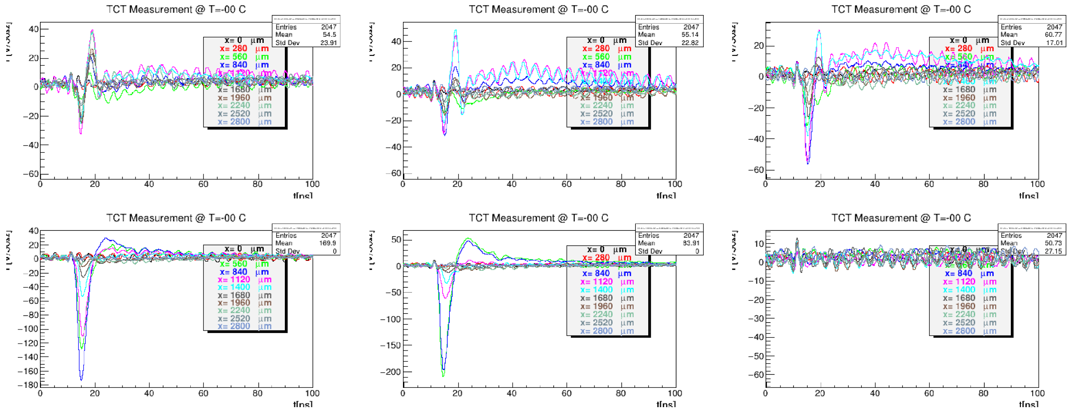
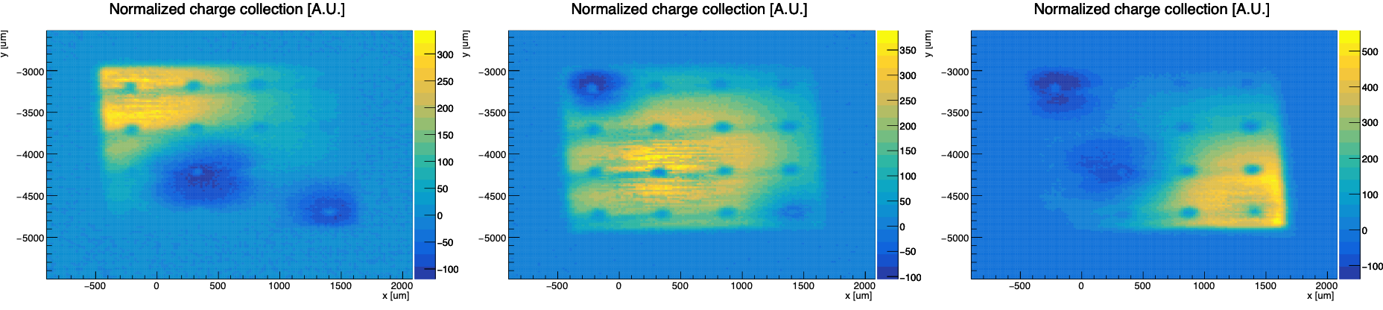
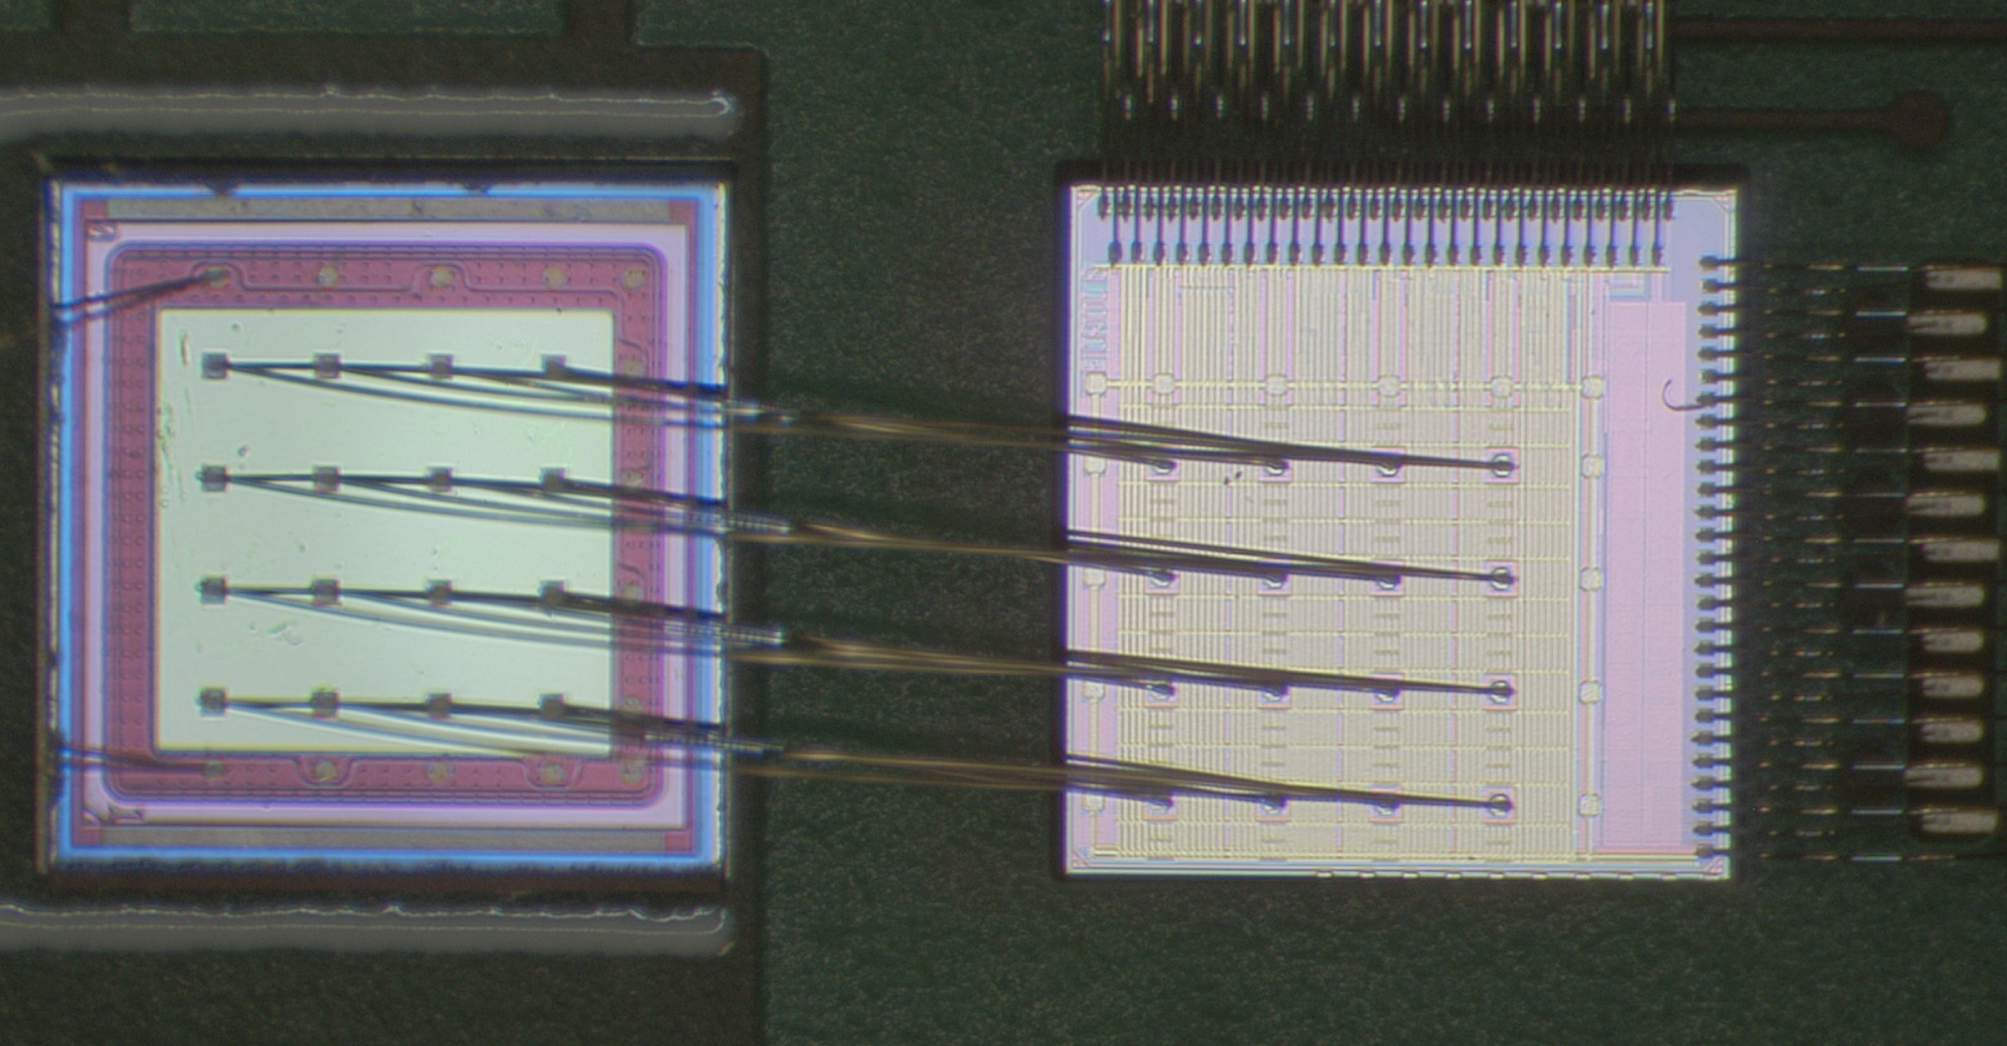
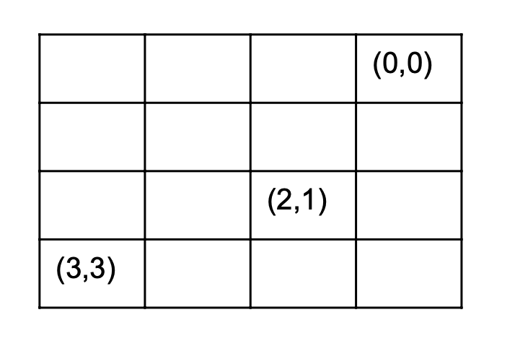
AC-LGAD Testing → AC-LGAD + EICROC0
“focused” laser
Each plot is a different region in y, and each curve is a step selection in x – not all steps are shown.
Plots are in units of current on the y-axis – integrating over the time window provide a charge measurement.
Significant amount of noise observed → likely due to wirebonds.
AC-LGAD
EICROC0
Pixel (0,0)
Pixel (2,1)
Pixel (3,3)

Slide 3
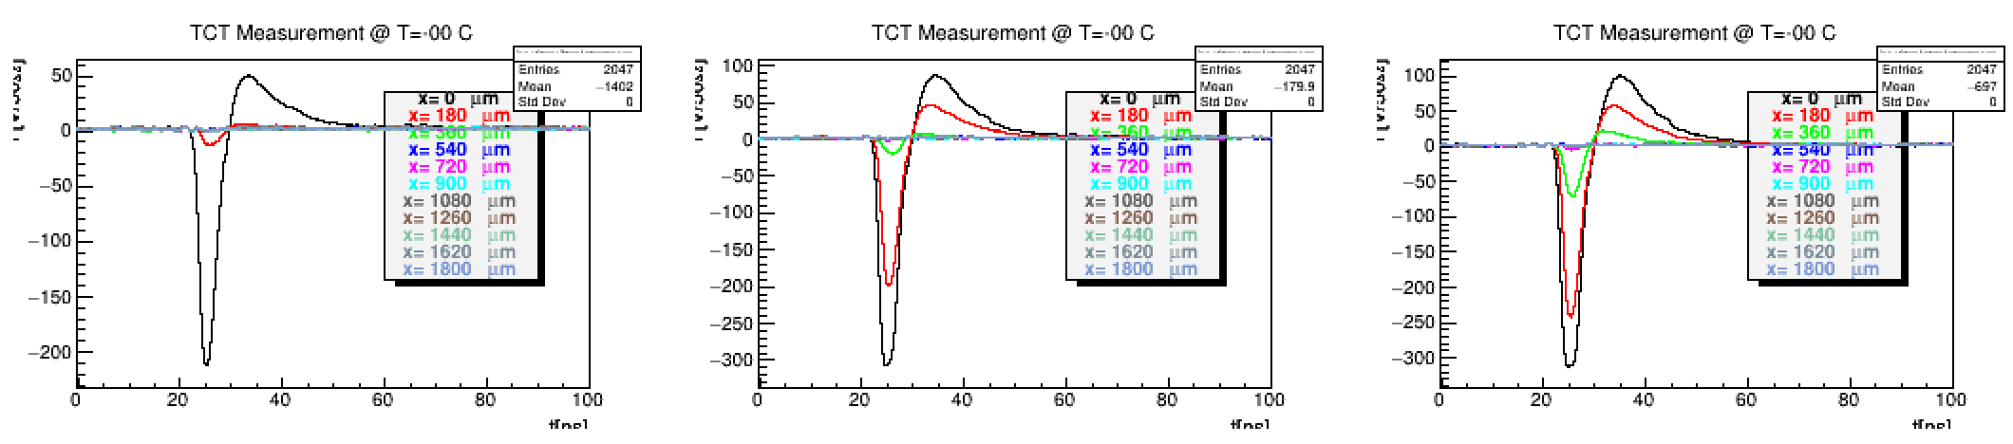
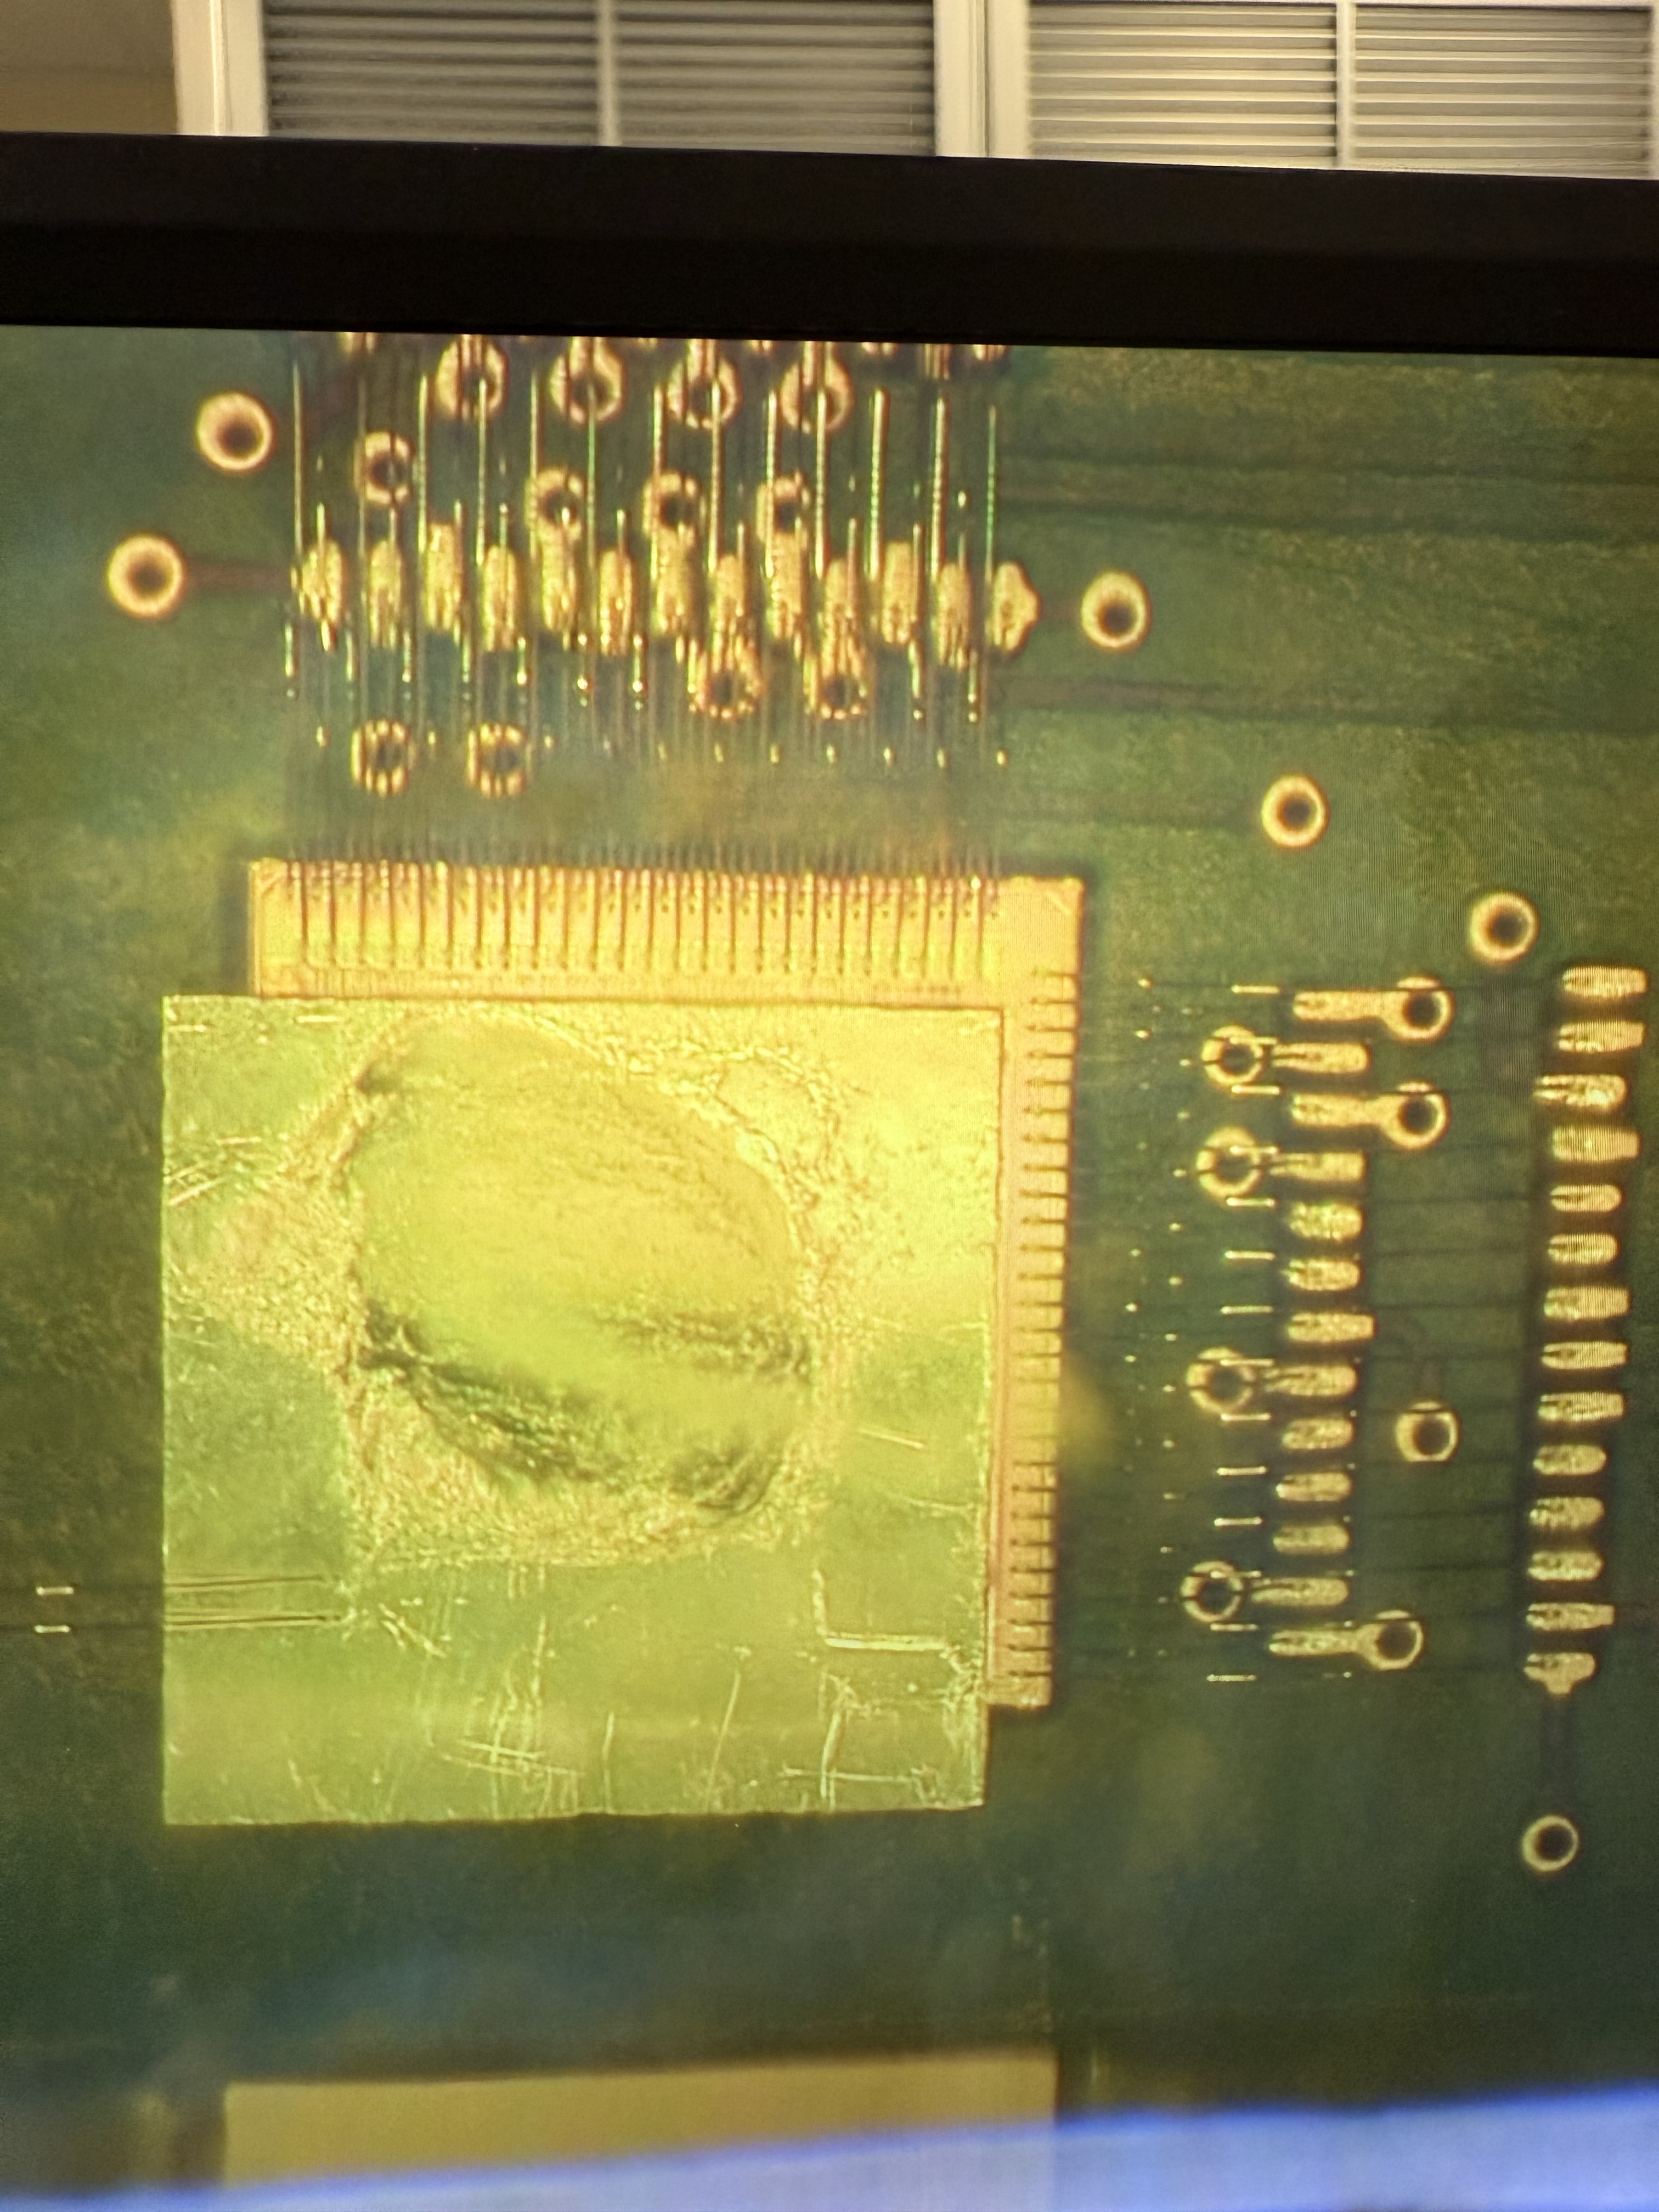
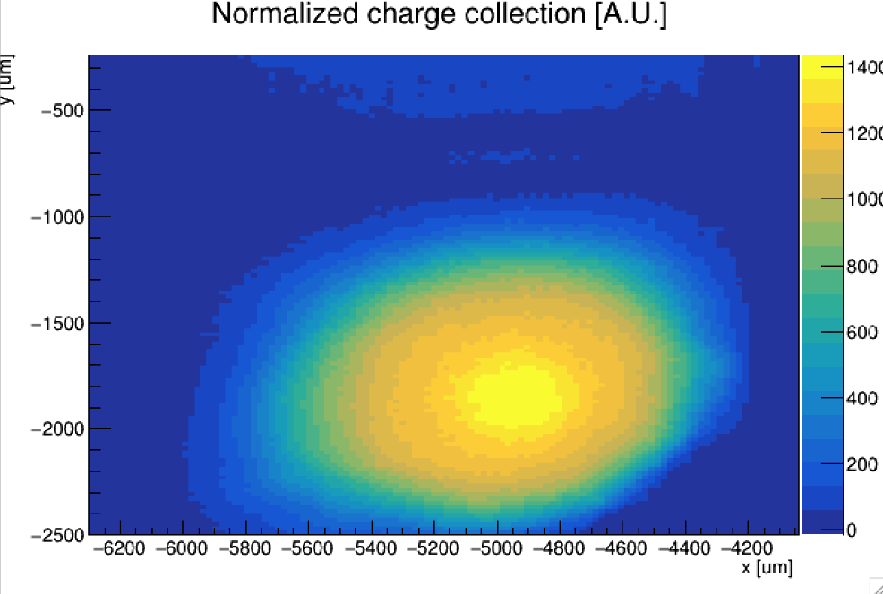
AC-LGAD Testing → AC-LGAD + EICROC0
“un-focused” laser
V [mV]
V [mV]
V [mV]
t[ns]
t[ns]
t[ns]
An AC-LGAD (HPK) was “etched” to remove portions of the backplane which normally block incident IR light from the laser in a bump-bonded assembly.
Etching by Simone Mazza from UCSC.
Initial tests show promising reduction in noise observed → should be able to make jitter measurements with this setup now.
Work in-progress.
Etched, bump-bonded assembly.
20um steps

Slide 4
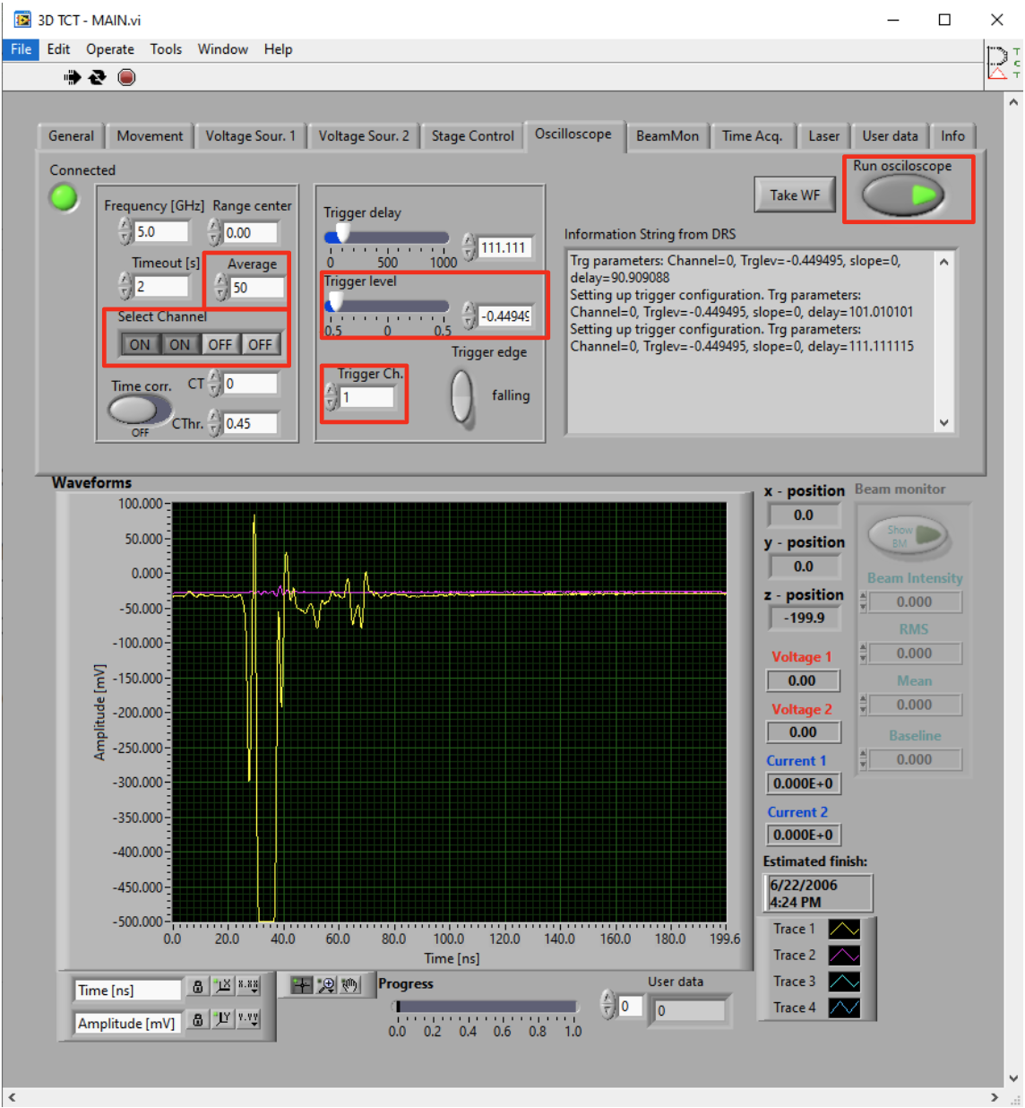
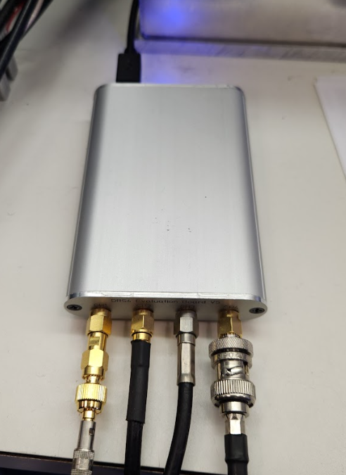
Setup
Using DRS4 board + the oscilloscope through LabView.
Set frequency to maximum of 6 GHz.
Laser set to 95% pulse width to avoid saturating the DRS4.
Not powerful enough to produce signal in LGAD.
Will need to switch to the normal oscilloscope to do this measurement properly (more later).
10k samples taken (just set the DAQ system to “scan” 1um steps 10k times, and just grab the laser waveforms).
Data extracted from DAT file using TCT Analyze, converted to ROOT format.

Slide 5
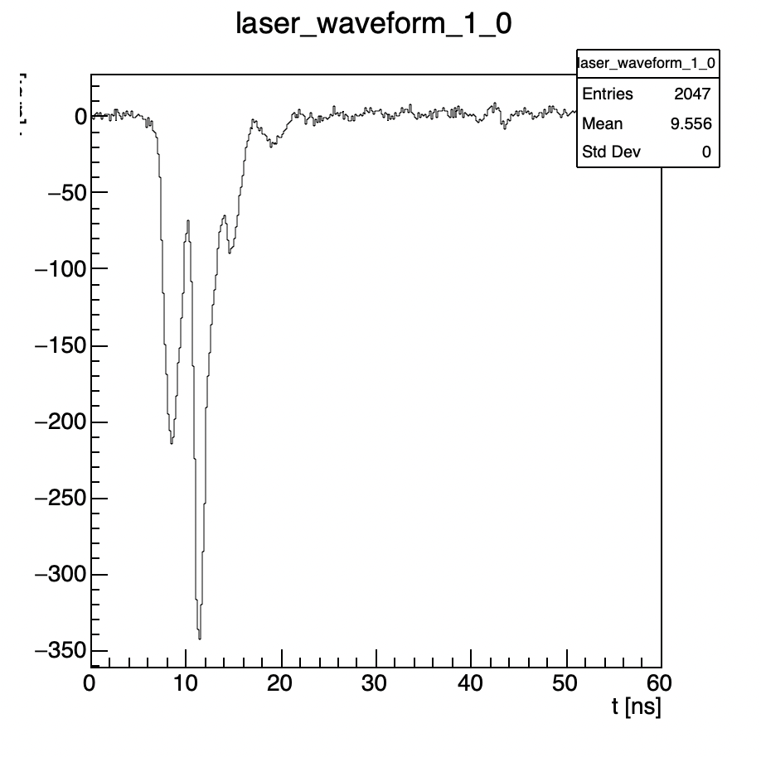
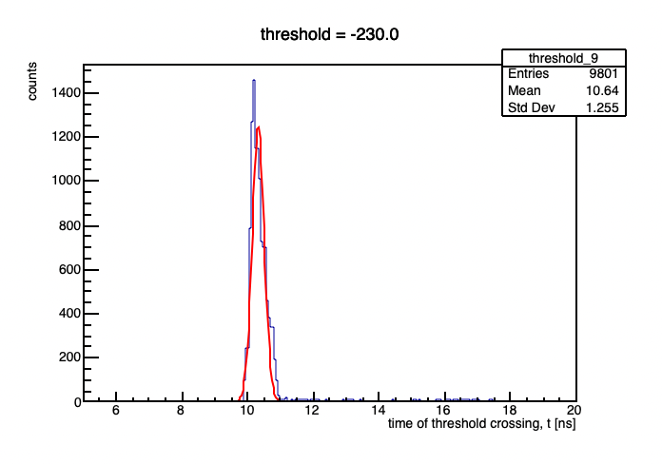
Procedure
For every waveform, set a “threshold” value.
For each threshold, find the time when the peak crosses the threshold → this is what would “fire” the trigger in a normal case.
For a particular threshold, fill a histogram with the time value at that threshold for all of the waveforms.
Fit the peak with a Gaussian, and extract the sigma → this will be the jitter.
Plot jitter as a function of threshold to obtain the best threshold to minimize the laser jitter.
Amplitude [mV]
Various thresholds
Laser pulse peak

Slide 6
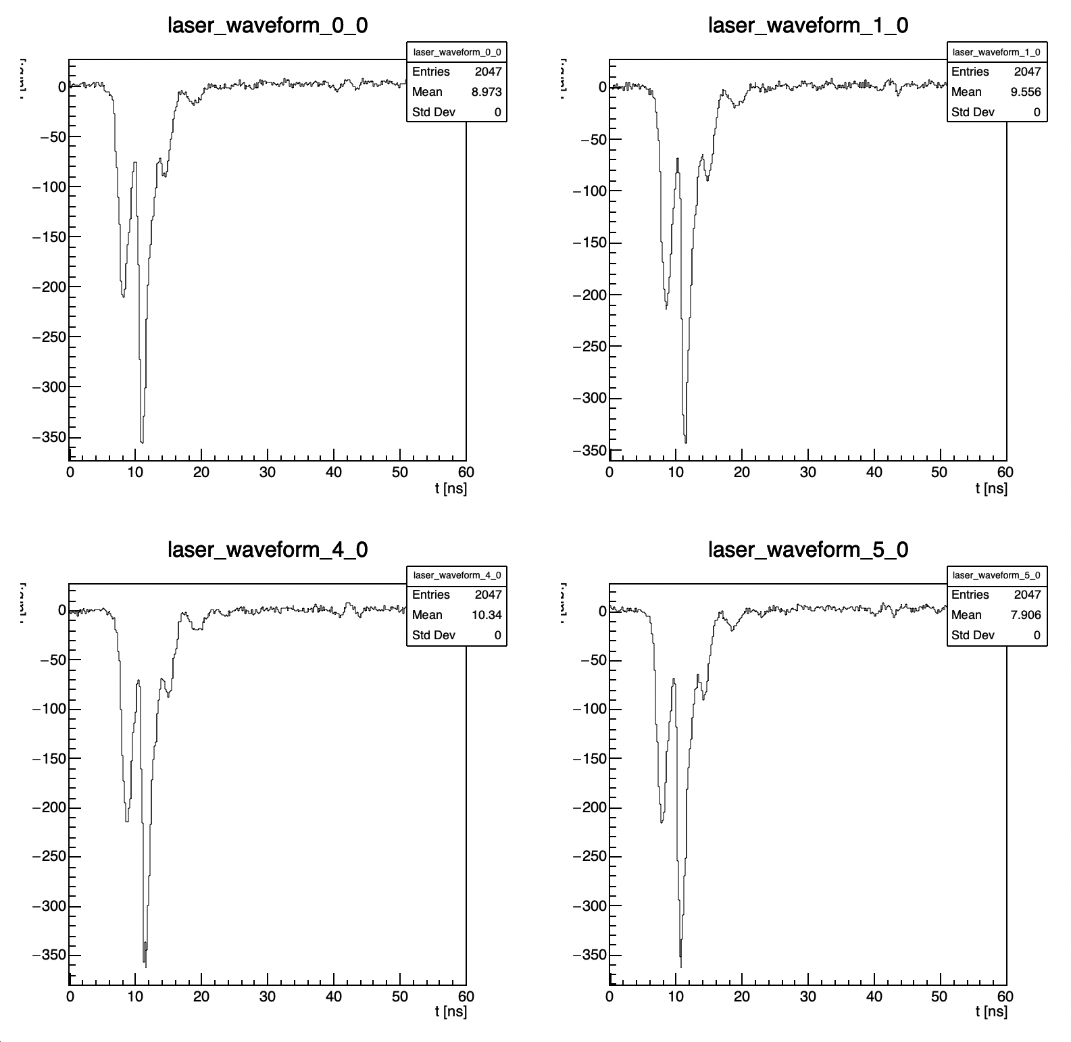
Laser pulses (subset)
Pulses look fairly similar by eye – this was just a sanity check to ensure our measurement approach was working okay, since the TCT software DAQ is used for scans, and we are just using it for the laser waveforms

Slide 7
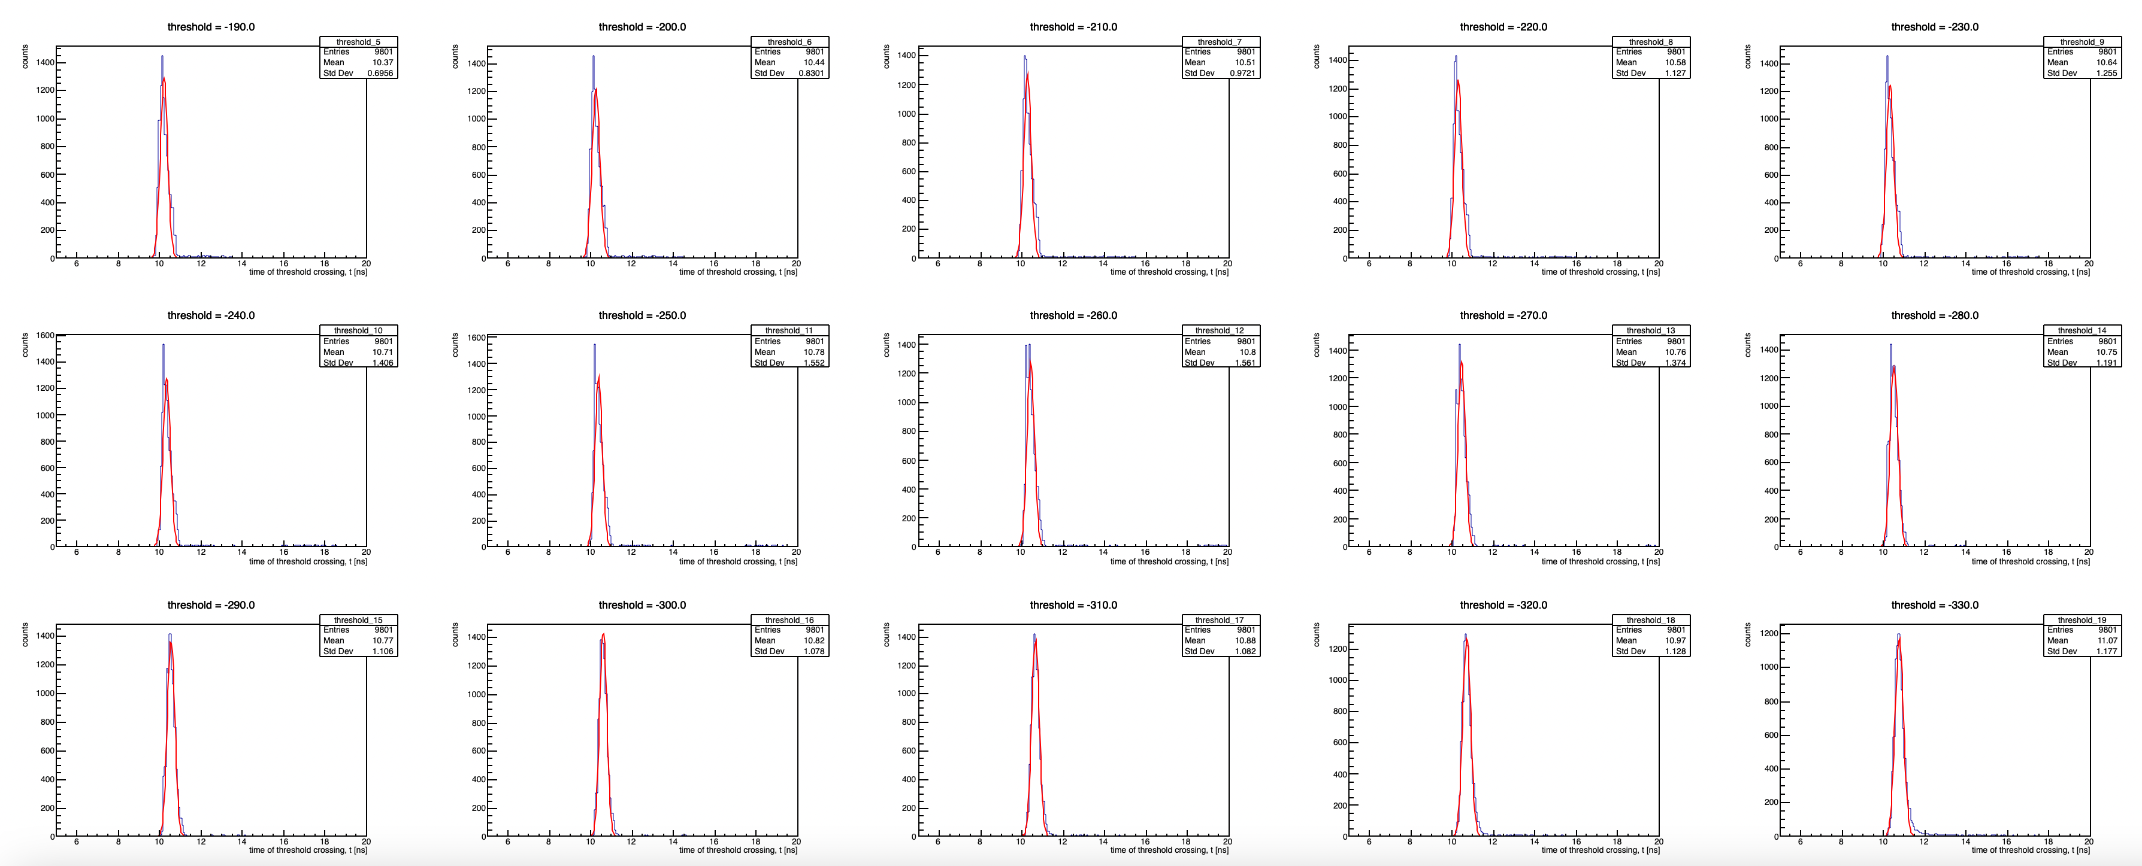
Time distributions for various thresholds
For each threshold value (individual plots), the time is recorded at the first crossing of the given threshold, and that value plotted for all 10k waveforms.
Resulting distribution fit with a Gaussian to extract width.

Slide 8
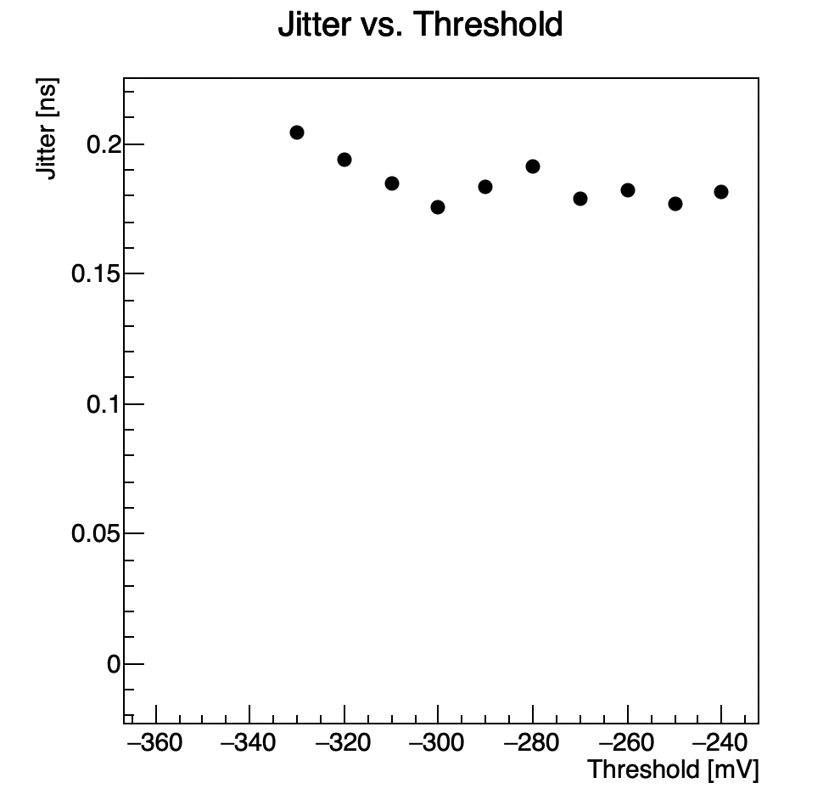
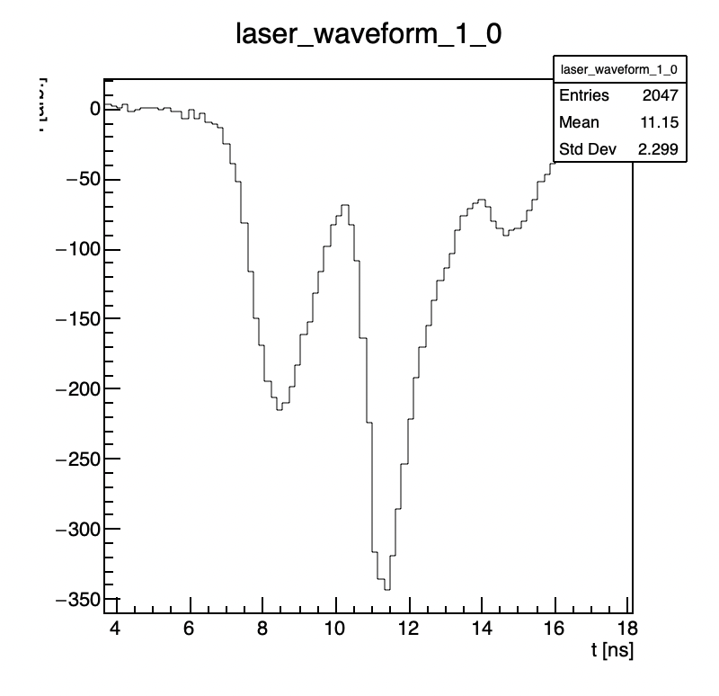
Jitter vs. Threshold
Laser jitter appears too large, ~ 180ps.
Problem could be the DRS4.
Laser power normally used for scans of the sensor much higher → better pulse shape for trigger, but saturates the DRS4.
Sampling rate of DRS4 seems too low* → reliance on interpolation between bins when measuring time of threshold crossing could smear the result enough to worsen the jitter measurement.
Very wide bins in time: ~ 120ps/bin

Slide 9
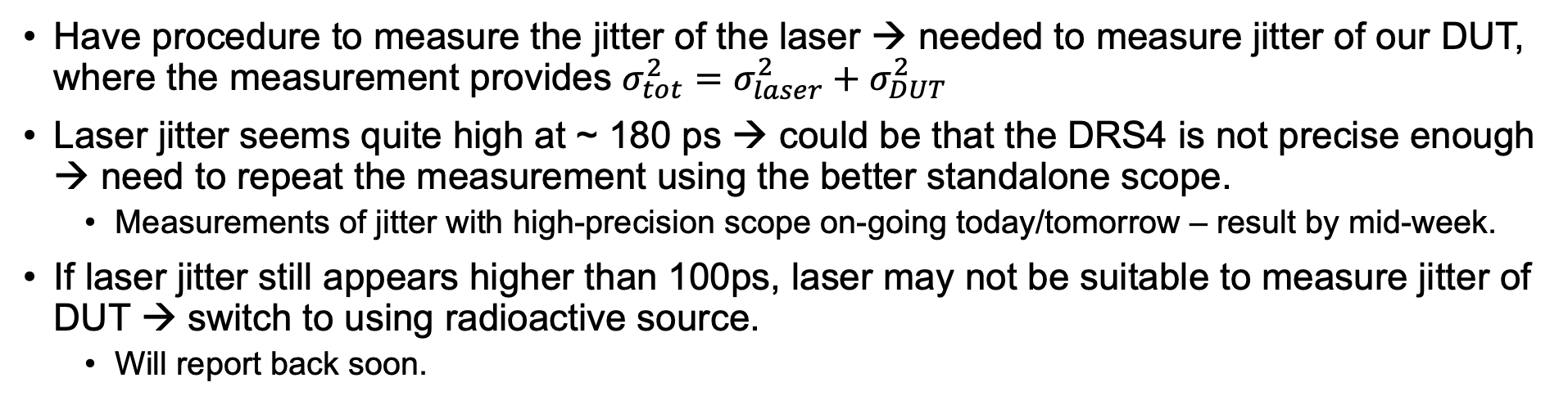
Short Summary
Have procedure to measure the jitter of the laser → needed to measure jitter of our DUT, where the measurement provides $σ_{tot}^{2}=σ_{laser}^{2}+σ_{DUT}^{2}$
Laser jitter seems quite high at ~ 180 ps → could be that the DRS4 is not precise enough → need to repeat the measurement using the better standalone scope.
Measurements of jitter with high-precision scope on-going today/tomorrow – result by mid-week.
If laser jitter still appears higher than 100ps, laser may not be suitable to measure jitter of DUT → switch to using radioactive source.
Will report back soon.

