Slide 1


WP2: LLRF Berlin meeting, April 23, 2025
All information contained in this presentation and any accompanying documents is for iSAS project only, and must be treated as strictly confidential.
Any dissemination, distribution or other use of this information without the consent of its owner is prohibited.
Funded by the European Union. Views and opinions expressed are however those of the authors only and do not necessarily reflect those of the European Union or the European Commission. Neither the European Union nor the granting authority can be held responsible for them.

Slide 2
WP2: Low Level RF controls 23.04.2026
DESY, HZB, CNRS
Convener & deputy: Julien Branlard (DESY) & Christian Schmidt (DESY)
Main contacts with other partners: Axel Neumann (HZB), Christophe Joly (CNRS)
WP02’s task with iSAS
Main goal:
Investigate and demonstrate techniques to achieve efficient field-control of narrow-bandwidth SRF cavities
through
improved algorithms to achieve RF field control
improved algorithms to achieve resonance control
improving efficiency of RF sources and their usage
investigation of what can be achieved with FE-FRT for resonance control
improving diagnostics (detuning measurement and fault detection) making use of AI / ML

Slide 3

WP2: Low Level RF controls 23.04.2026
DESY, HZB, CNRS
Convener & deputy: Julien Branlard (DESY) & Christian Schmidt (DESY)
Main contacts with other partners: Axel Neumann (HZB), Christophe Joly (CNRS)
Task 2.1: Coordination of R&D on LLRF – M1-M48
Candidate declined position → load on other members Milestone M24 coming up → risk analysis (contact Adèle regarding form of deliverable)
WP02 meeting next week for status update
Task 2.2: Efficient field control for high loaded-quality factor cavities – M1-M48
Test ongoing, publication pending – On-track for milestone M30
Task 2.3: Vibration analysis and detuning control of cavities – M1-M36
Measurement on-going, report this year
Task 2.4: Integrated LLRF control using Ferro-Electric Fast Reactive Tuners– M13-M48
Task 2.5: Energy efficient supervisory control and fault diagnosis– M1-M48
No recent progress. Next point of focus
2026 milestone M24
due/submitted Feb 2026
2026 milestone M30
due Nov. 2026
2026 milestone M33
due Aug. 2026

Slide 4

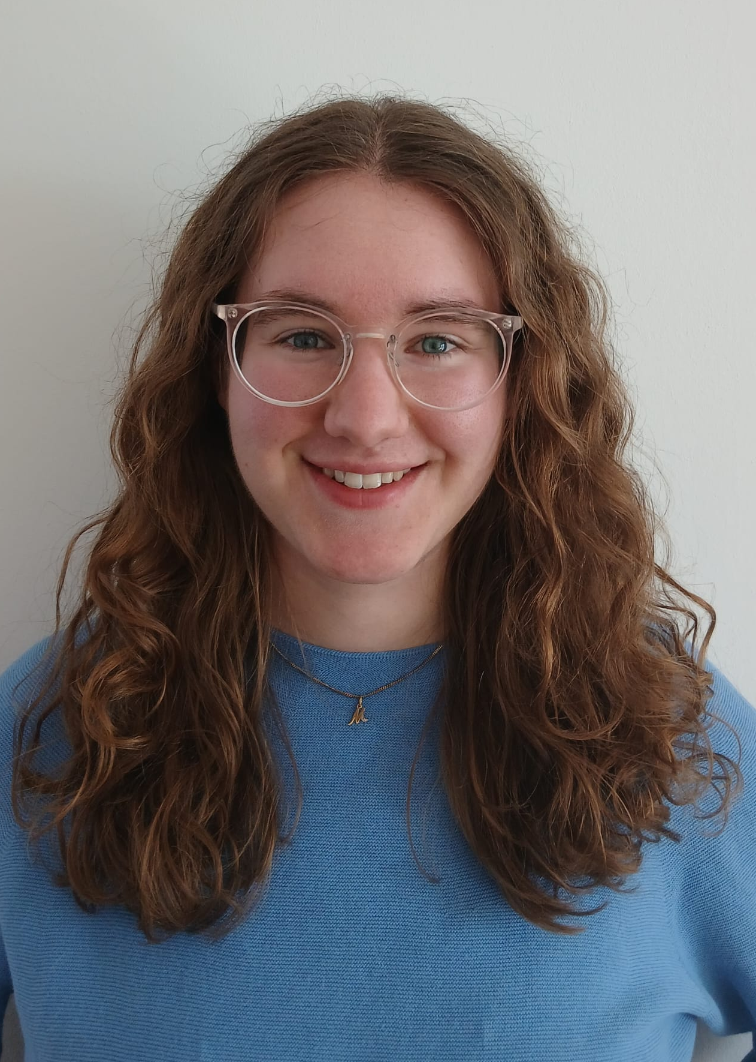
WP2 – LLRF: status/evolution of Task 2.1
Coordination of R&D on LLRF – M1-M48
Past developments
Organization of meetings, deliverables, document sharing structure, …
Current developments
Euclid Techlabs is WP2’s industrial partner
overlap with FE-FRT development
DESY iSAS hire
Mona, Bachelor student to support with iSAS related cryomodule tests and data analysis
Plans to follow up with a consulting position for a soon-to-be retired RF expert
Preparation for iSAS 1st reporting period review on June 1st
RP1 submitted
Mona Eberenz

Slide 5
WP2: Low Level RF controls 23.04.2026
DESY, HZB, CNRS
Convener & deputy: Julien Branlard (DESY) & Christian Schmidt (DESY)
Main contacts with other partners: Axel Neumann (HZB), Christophe Joly (CNRS)
Task 2.1: Coordination of R&D on LLRF – M1-M48
Candidate declined position → load on other members Milestone M24 coming up → risk analysis (contact Adèle regarding form of deliverable)
WP02 meeting next week for status update
Task 2.2: Efficient field control for high loaded-quality factor cavities – M1-M48
Test ongoing, publication pending – On-track for milestone M30
Task 2.3: Vibration analysis and detuning control of cavities – M1-M36
Measurement on-going, report this year
Task 2.4: Integrated LLRF control using Ferro-Electric Fast Reactive Tuners– M13-M48
Task 2.5: Energy efficient supervisory control and fault diagnosis– M1-M48
No recent progress. Next point of focus
2026 milestone M24
due/submitted Feb 2026
2026 milestone M30
due Nov. 2026
2026 milestone M33
due Aug. 2026

Slide 6
WP2 – LLRF: status/evolution of Task 2.2
Efficient field control for high loaded-quality factor cavities – M1-M48
Past developments
Developed prototypes to externally shift the Qext to higher range
Current developments
Tests with Q-corrector show factor 5 reduction in forward power for only 8% coupler temperature increase (slides 7-8)
Developed techniques to drive high loaded-quality factor (narrow bandwidth) cavities (not using self-excited loop or PLL), adapted to pulsed and vector sum operation (i.e. interesting for XFEL upgrade) (slides 9-10)

Slide 7
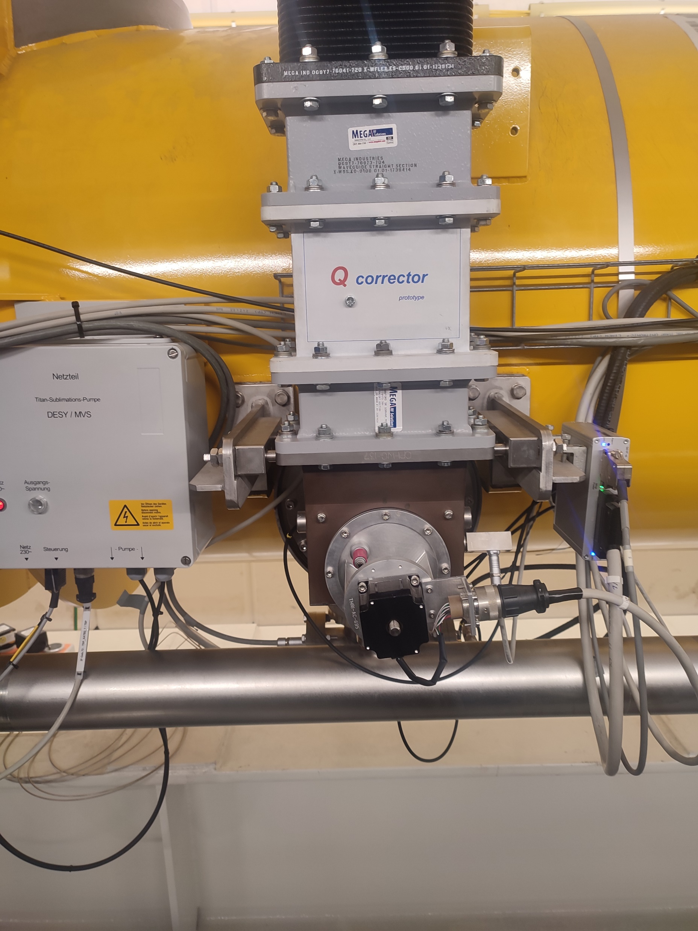
WP2 – LLRF: status/evolution of Task 2.2
Efficient field control for high loaded-quality factor cavities – M1-M48
Developed prototype to shift Q_{ext} to higher values (i.e. narrower cavity bandwidths)
The Q corrector can effectively shift the Qext range
For e.g. for a standard L3 cryomodule
Qext = [1e6 – 1e7]
Qext = [3e6 – 5e7]
Q corrector
Qext measurement during RF decay
coupler mover (standard)

Slide 8
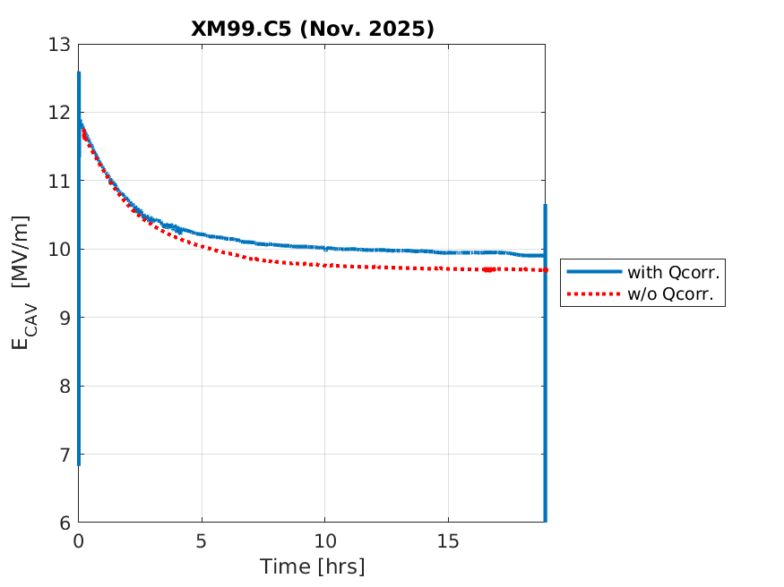
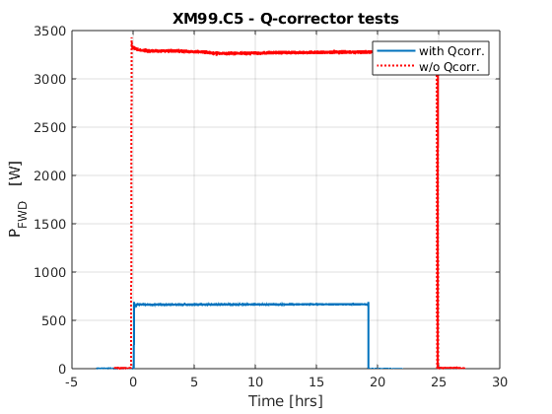
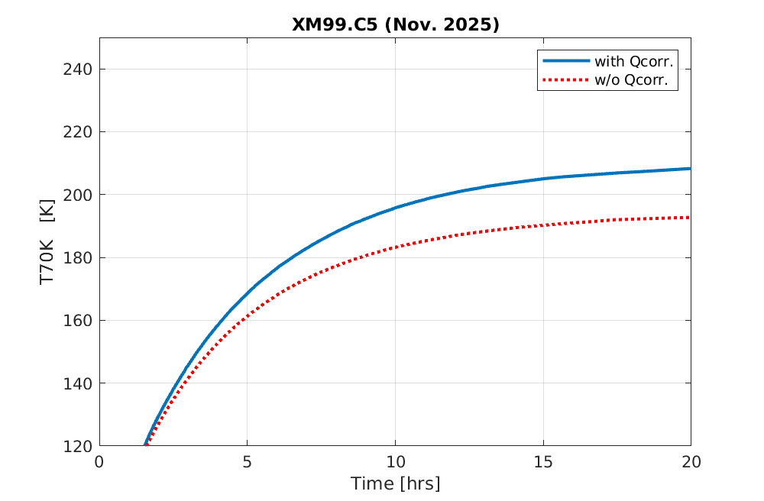
WP2 – LLRF: status/evolution of Task 2.2
Efficient field control for high loaded-quality factor cavities – M1-M48
Operating at higher Qext can potentially bring significant RF power savings
3.3 kW
Gradient drops due to coupler heating
(steady state reached after ~ 20h)
a fraction (1/5)
of the power is necessary with Q corrector
similar gradient with and without Q corrector
650 W
the price to pay is an increased heating of the coupler (16K, 8%)
Currently : investigate if coupler heating is safe for coupler ?

Slide 9
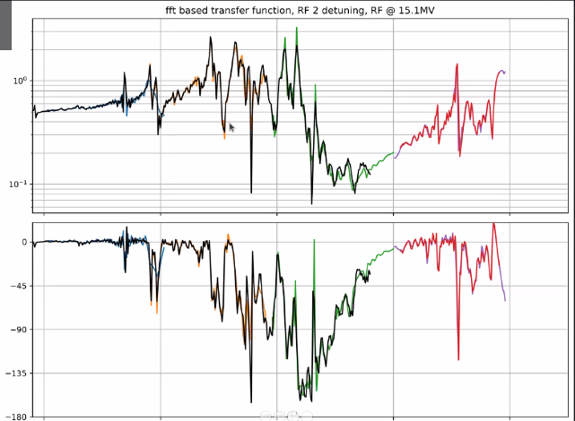
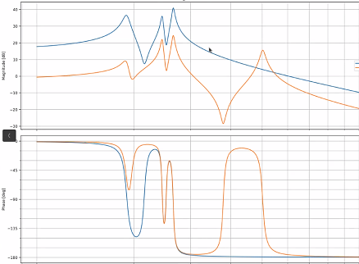
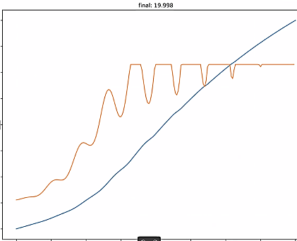
WP2 – LLRF: status/evolution of Task 2.2
Efficient field control for high loaded-quality factor cavities – M1-M48
Current developments
Resonance filling : model-based approach
Step 2: fit model to experimental transfer function
Step 3: compute piezo and RF drive (given power limit) to bring cavity to target setpoint in allocated time
Step 1: identify RF-to-detuning and piezo-to detuning transfer functions
40
piezo-to-detuning
RF-to-detuning
20
Cavity gradient ramp-up from 0 to 20 MV/m in 20 msec
E_{cav}
30
20
17.5
stay within available power (4kW)
Amplitude [a.u.]
10
Magnitude [dB]
15
0
unpublished
-10
unpublished
12.5
unpublished
-20
V_{forw}
-30
Cavity gradient E_{cav} [ MV/m]
0
10
-45
7.5
Phase [deg.]
-90
5
Q_{ext} = 6x10⁷
(i.e. f_{1/2} = 11 Hz)
-135
2.5
0
100
200
300
400
500
10²
Frequency [Hz]
10³
0
2.5
5
7.5
10
12.5
15
17.5
20
Frequency [ Hz ]
Time [msec]
Currently acquiring experimental data. Next publish !
Courtesy : Bozo Richter

Slide 10
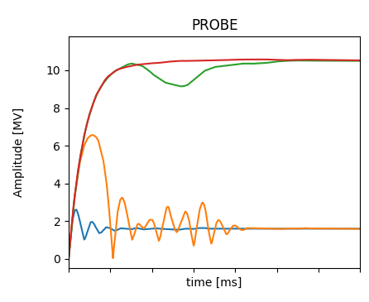
WP2 – LLRF: status/evolution of Task 2.2
Efficient field control for high loaded-quality factor cavities – M1-M48
Current developments
Adaptive resonance filling
Cavities with narrow bandwidth experience during field ramp-up a detuning induced by Lorentz forces equivalent to tens of bandwidths (i.e. several 100 Hz compared to BW ≈ 20 Hz)
The frequency of the RF must be modulated to always drive the cavity on resonance during the fill time (in pulsed mode): so called “resonance filling”
Use iterative learning techniques to learn this frequency modulation in a robust and reproducible way
4
3
Consecutive “learning” pulses
2
1
Demonstrated at DESY’s cryomodule test stand (paper in preparation)
Courtesy : Bozo Richter

Slide 11
WP2: Low Level RF controls 23.04.2026
DESY, HZB, CNRS
Convener & deputy: Julien Branlard (DESY) & Christian Schmidt (DESY)
Main contacts with other partners: Axel Neumann (HZB), Christophe Joly (CNRS)
Task 2.1: Coordination of R&D on LLRF – M1-M48
Candidate declined position → load on other members Milestone M24 coming up → risk analysis (contact Adèle regarding form of deliverable)
WP02 meeting next week for status update
Task 2.2: Efficient field control for high loaded-quality factor cavities – M1-M48
Test ongoing, publication pending – On-track for milestone M30
Task 2.3: Vibration analysis and detuning control of cavities – M1-M36
Measurement on-going, report this year
Task 2.4: Integrated LLRF control using Ferro-Electric Fast Reactive Tuners– M13-M48
Task 2.5: Energy efficient supervisory control and fault diagnosis– M1-M48
No recent progress. Next point of focus
2026 milestone M24
due/submitted Feb 2026
2026 milestone M30
due Nov. 2026
2026 milestone M33
due Aug. 2026

Slide 12
WP2 – LLRF: status/evolution of Task 2.3
Vibration analysis and detuning control of cavities – M1-M36
Past developments
Energy efficient Lorentz force detuning compensation at EuXFEL →presented at Padova 2025 + published at IPAC 2025
Developed an observer-based measurement of cavity detuning → accepted for publication at Phys Rev Accel & Beam
Current developments
Assessment of microphonics level at XFEL
relevant information for EuXFEL CW upgrade
(slides 13-15)
Exploring AI-based method to achieve detuning compensation
(slides 16-19)
Implemented an narrow bandwidth active noise compensation algorithm, tested in CW at LCLS-II (SLAC)
(slide 20)
See poster from J. Einstein Curtis
To be presented and published at IFAC 2026
To be presented and published at IPAC 2026

Slide 13
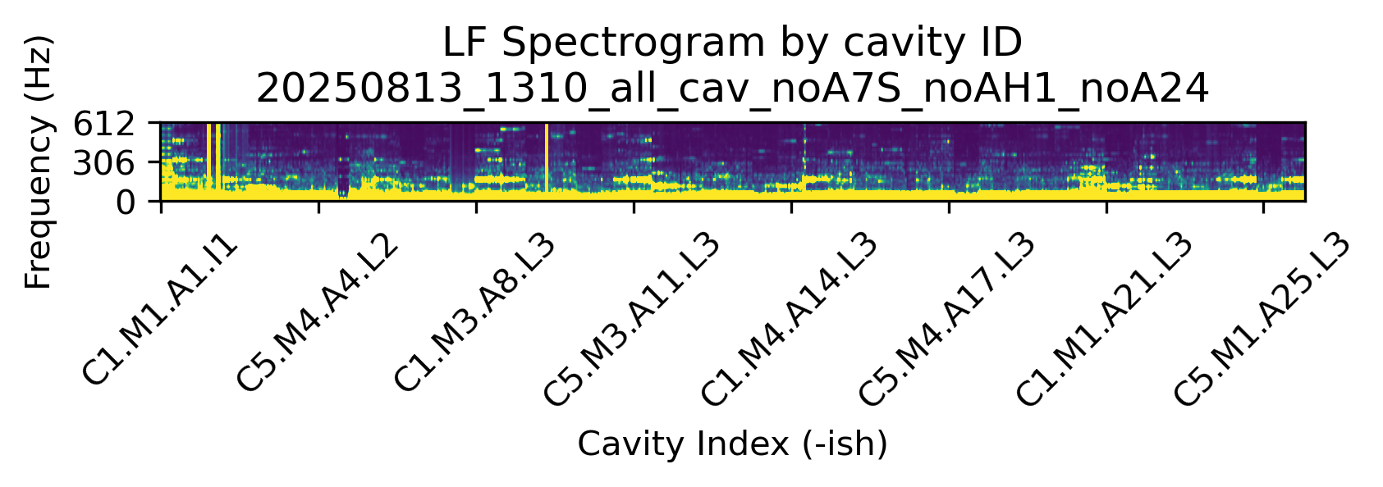
WP2 – LLRF: status/evolution of Task 2.3
Vibration analysis and detuning control of cavities – M1-M36
Current developments
Assessment of microphonics level at XFEL
Microphonics measured without RF, using installed piezos during last year summer shutdown
Identified vibration source at cryostring junction (propagating up-/down-stream) coming from flow sensor
2025-08-13 XFEL w.o. AH1, A7S, A24
CS# = CryoString#
612
A# Accelerating RF station (4 cryomod. = 32 cav.)
306
Frequency (Hz)
0
CS1
CS2
CS3
CS4
CS5
CS6
CS7
CS8
CS9
A1
A2
A3 – A4 – A5
A6 – A7 – A8
A9 – A10 – A11
A12 – A13 – A14
A15 – A16 – A17
A18 – A19 – A20
A21 – A22 – A23
A24 – A25
0
200m
400m
620m
760m
910m
1060m
1200m
1350m
tunnel
Courtesy Josh Einstein-Curtis

Slide 14
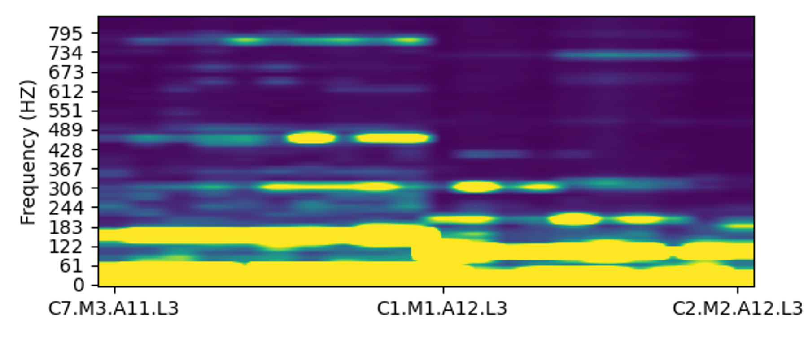
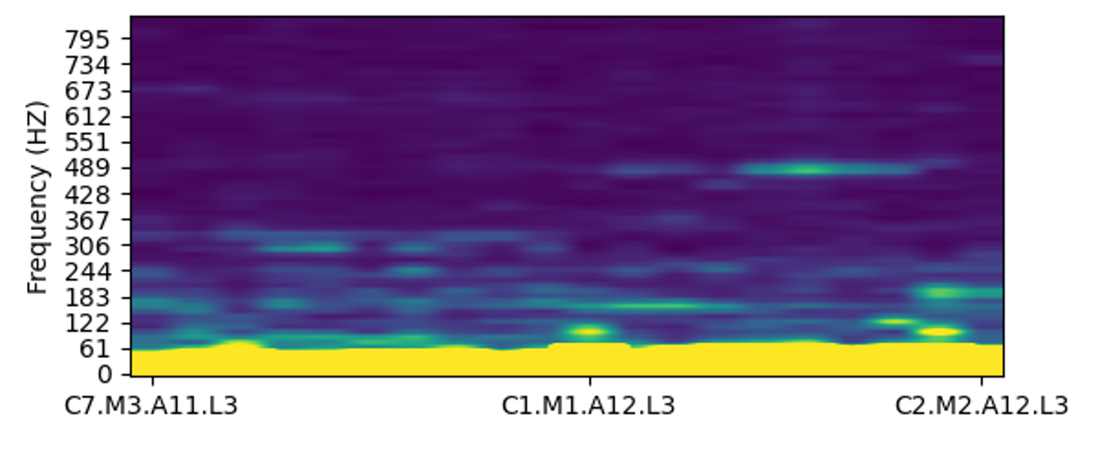
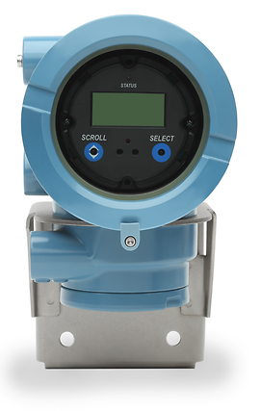
WP2 – LLRF: status/evolution of Task 2.3
Vibration analysis and detuning control of cavities – M1-M36
Current developments
Assessment of microphonics level at XFEL
Microphonics measured without RF, using installed piezos during last year summer shutdown
Identified vibration source at cryostring junction (propagating up-/down-stream) coming from flow sensor
No direct impact on current operation of the EuXFEL but valuable information for the upgrade.
See poster from J. Einstein Curtis
Flow sensor ON
Flow sensor OFF
Coriolis flow sensor
Courtesy Josh Einstein-Curtis

Slide 15
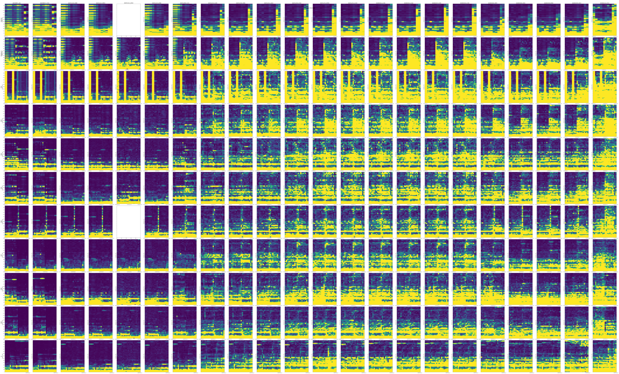
time
Along
tunnel

Slide 16
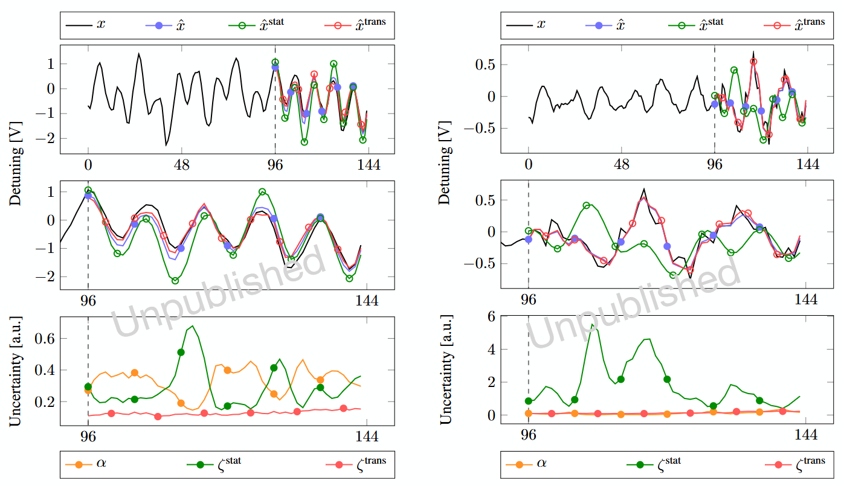
WP2 – LLRF: status/evolution of Task 2.3
Vibration analysis and detuning control of cavities – M1-M36
Current developments
Exploration of AI-based methods for RF detuning compensation
1. AI-based detuning compensation
Designed a hybrid dynamical model architecture
“KIND: a Kalman-inspired adaptive estimator for SRF cavity detuning” , accepted
Proved stability under recursive model rollout
“Stable multi-step rollouts via uncertainty guided hybrid dynamics”, under review
To be presented (+ proceeding) at IFAC 2026
Figure: Rollout behavior of a KIND model on measured SRF gun cavity data.
On nominal data: hybrid model parts - stationary and transient - track the ground truth.
On transient data: compared to transient model part, nominal part misses the right dynamics.
In both cases hybrid parts are correctly blended to produce the final prediction.
a)
b)
Courtesy A. Maalberg

Slide 17
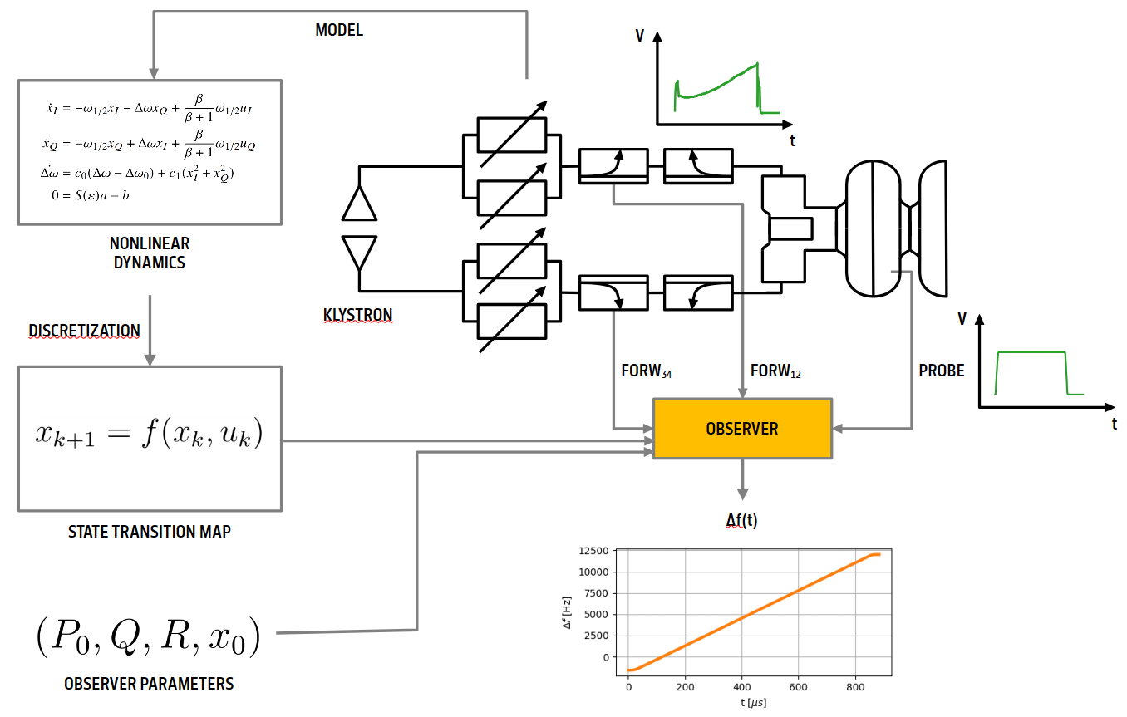
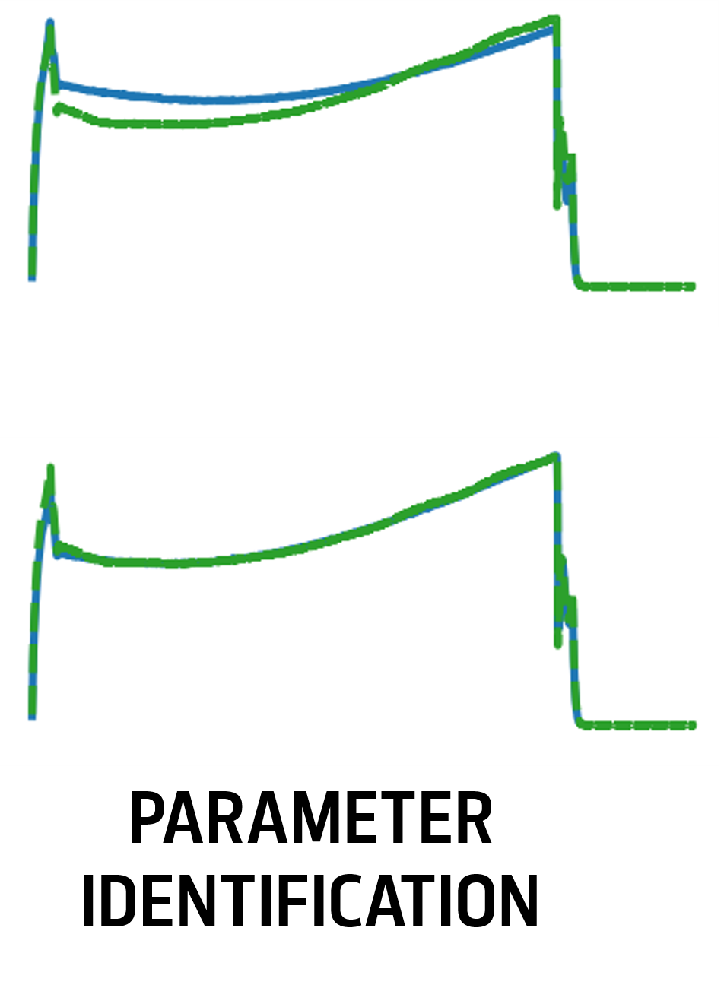
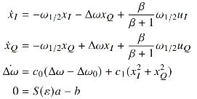

WP2 – LLRF: status/evolution of Task 2.3
Vibration analysis and detuning control of cavities – M1-M36
Current developments
Exploration of observer-based methods for RF detuning computation, at the EuXFEL NRF gun
One challenge comes from the double input coupler architecture of the NRF gun
After parameter identification, a model-based observer provides online detuning estimation
2. observer-based detuning estimation
Courtesy M. Herrmann
1
NORMAL CONDUCTING GUN
arm1
2
arm2
3
bi-direction couplers
DISCRETIZATION
KLYSTRON
4
phase shifters
Δf(t)
To be presented (+ proceeding) at IPAC 2026

Slide 18
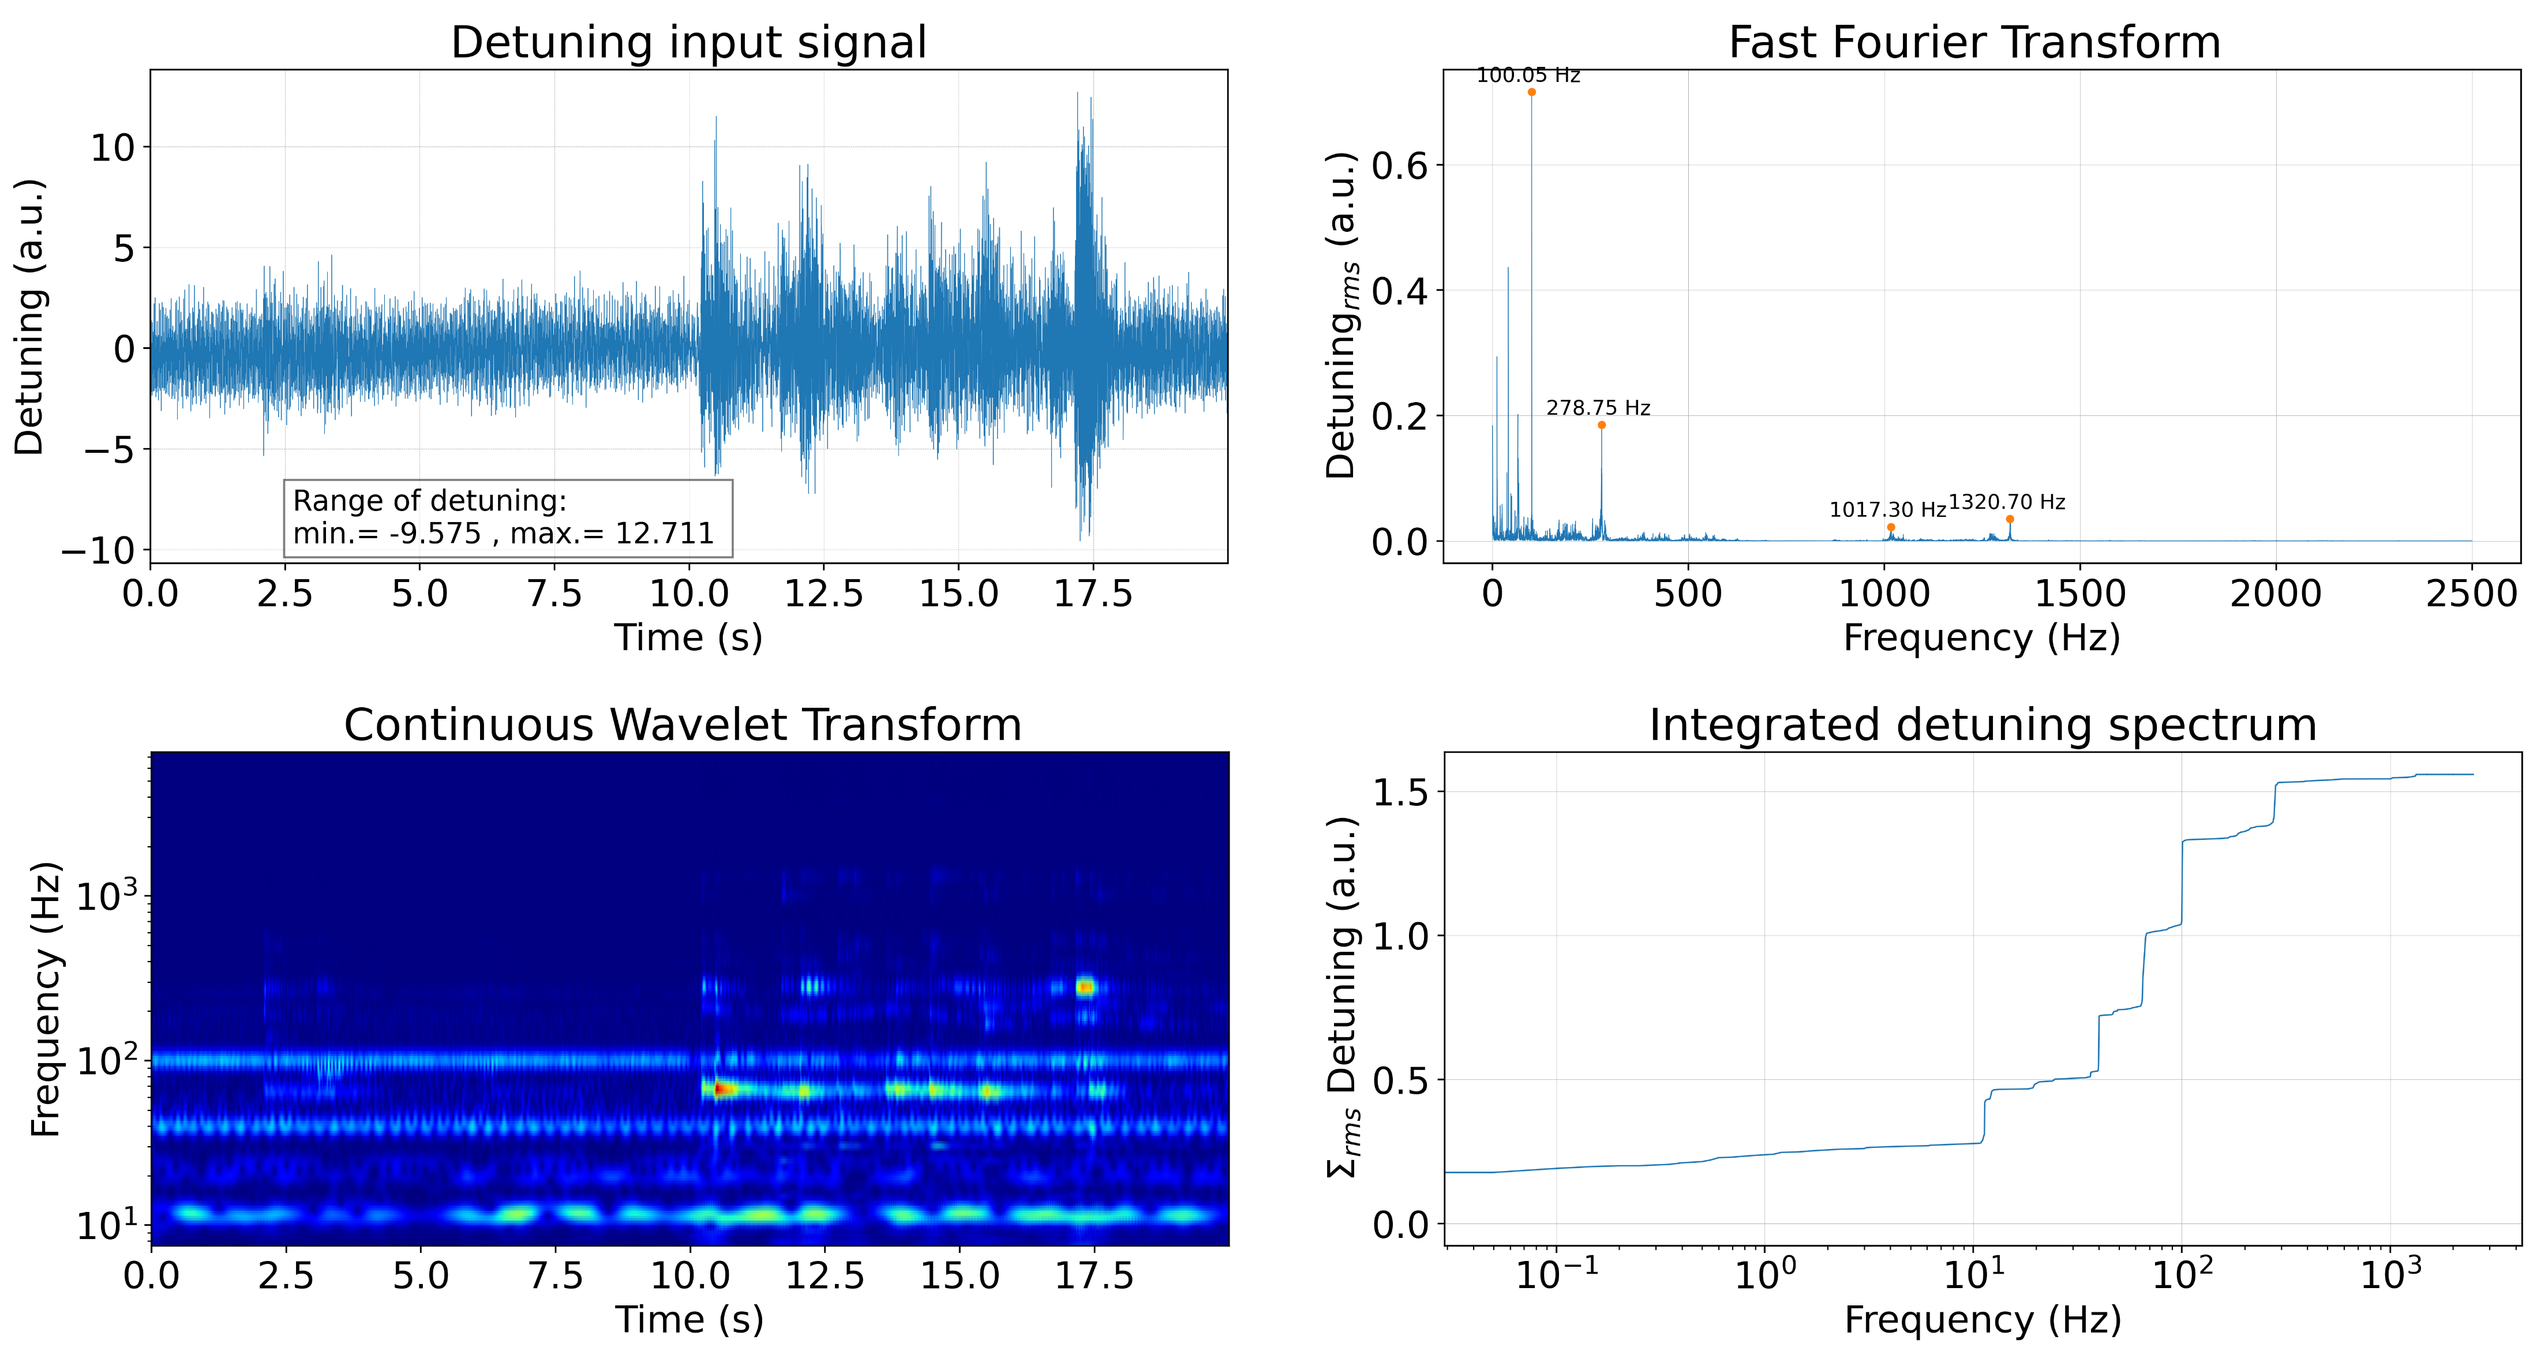
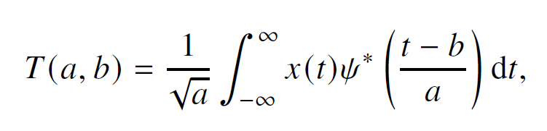
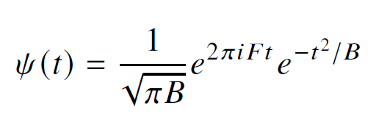
WP2 – LLRF: status/evolution of Task 2.3
Vibration analysis and detuning control of cavities – M1-M36
Current developments
Exploration of wavelets for RF detuning computation, at SeaLAB, HZB
Classical Fourier analysis provides a global description that does not retain temporal information.
Short-time Fourier transform (STFT) introduce time localization by applying the transform over sliding windows, but uses a fixed window length, leading to a trade-off between time and frequency resolution that remains constant across all frequencies.
Benefit of continuous wavelet transform (CWT): provides a time-frequency representation with adaptive resolution.
3. wavelets-based detuning estimation
Microphonics measured at SEALab‘s photoinjector
Morlet wavelet offers a well-defined central frequency and is particularly suitable for analyzing oscillatory signals
Courtesy P. Echevarria
To be presented (+ proceeding) at IPAC 2026

Slide 19
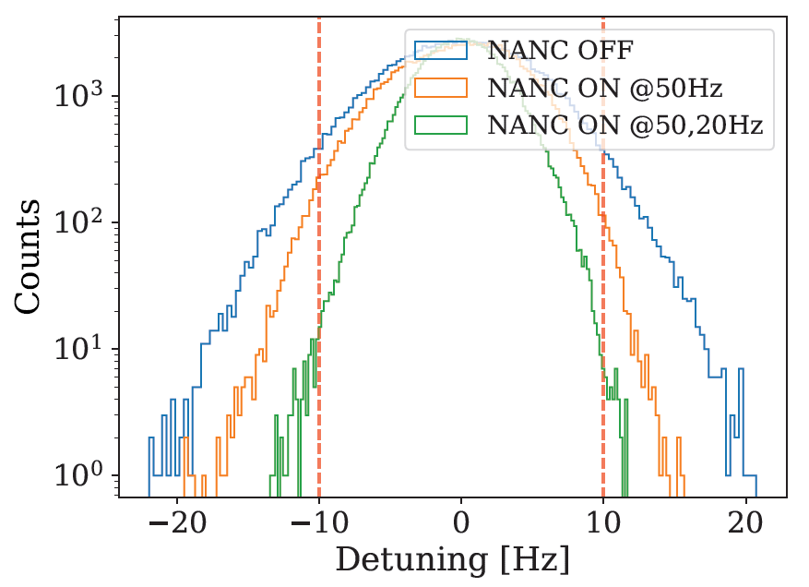
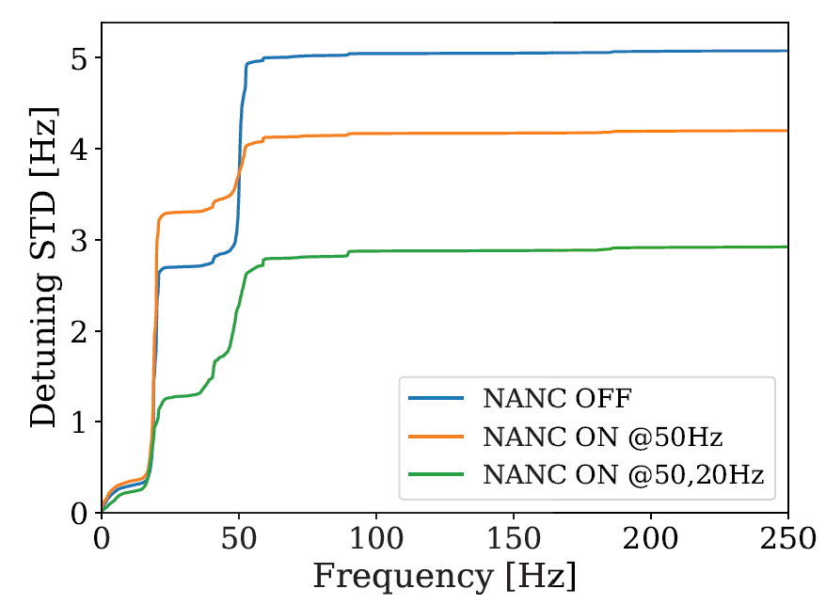
WP2 – LLRF: status/evolution of Task 2.3
2026 milestone M33
Vibration analysis and detuning control of cavities – M1-M36
Current developments
Microphonics suppression to allow higher gradient operation
Developed a Narrow Bandwidth Active Noise Cancellation (NANC) algorithm and demonstrated at SLAC (LCLS-II)
With NANC off, the cavity could operate at max 9 MV/m
With NANC ON, the cavity can be operated at 16 MV/m (78% improvement!)
Courtesy B. Richter, J. Diaz
UNPUBLISHED
To be presented (+ proceeding) at IPAC 2026
UNPUBLISHED

Slide 20
WP2: Low Level RF controls 23.04.2026
DESY, HZB, CNRS
Convener & deputy: Julien Branlard (DESY) & Christian Schmidt (DESY)
Main contacts with other partners: Axel Neumann (HZB), Christophe Joly (CNRS)
Task 2.1: Coordination of R&D on LLRF – M1-M48
Candidate declined position → load on other members Milestone M24 coming up → risk analysis (contact Adèle regarding form of deliverable)
WP02 meeting next week for status update
Task 2.2: Efficient field control for high loaded-quality factor cavities – M1-M48
Test ongoing, publication pending – On-track for milestone M30
Task 2.3: Vibration analysis and detuning control of cavities – M1-M36
Measurement on-going, report this year
Task 2.4: Integrated LLRF control using Ferro-Electric Fast Reactive Tuners– M13-M48
Task 2.5: Energy efficient supervisory control and fault diagnosis– M1-M48
No recent progress. Next point of focus
2026 milestone M24
due/submitted Feb 2026
2026 milestone M30
due Nov. 2026
2026 milestone M33
due Aug. 2026

Slide 21
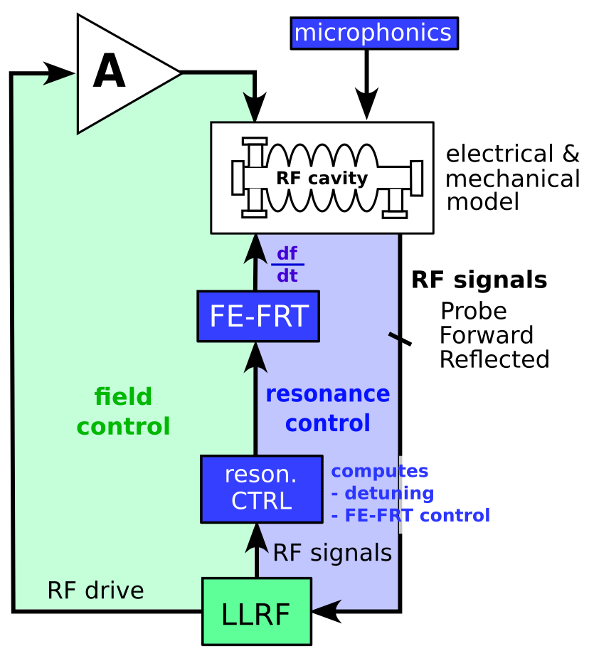
WP2 – LLRF: status/evolution of Task 2.4
Integrated LLRF control using Ferro-Electric Fast Reactive Tuners– M13-M48
Past developments
…
Current developments
Goal is to integrate a ferro-electric fast reactive tuner (FE-FRT) with a digital LLRF system
Hardware development 2026/27 within WP1
Measure FE-FRT voltage response and temperature dependence
Evaluation of existing MTCA hardware as potential FE-FRT driver
Development of Matlab/Simulink model of RF control loop to simulate resonance control
Using FE-FRT voltage response, include it in LLRF control simulation environment
Set back : joint-PhD program on this topic stopped
Work taken over by colleagues from IJCLab and LPSC
RF and resonance control using FE-FRT
High-voltage amplifier transfer function measurement using capacitive load (to emulate FE-FRT))
Controller development on RF SoC on going, HZB
First measurements at HoBicat, HZB
Roadmap toward milestone
Synergy with WP1

Slide 22
WP2: Low Level RF controls 23.04.2026
DESY, HZB, CNRS
Convener & deputy: Julien Branlard (DESY) & Christian Schmidt (DESY)
Main contacts with other partners: Axel Neumann (HZB), Christophe Joly (CNRS)
Task 2.1: Coordination of R&D on LLRF – M1-M48
Candidate declined position → load on other members Milestone M24 coming up → risk analysis (contact Adèle regarding form of deliverable)
WP02 meeting next week for status update
Task 2.2: Efficient field control for high loaded-quality factor cavities – M1-M48
Test ongoing, publication pending – On-track for milestone M30
Task 2.3: Vibration analysis and detuning control of cavities – M1-M36
Measurement on-going, report this year
Task 2.4: Integrated LLRF control using Ferro-Electric Fast Reactive Tuners– M13-M48
Task 2.5: Energy efficient supervisory control and fault diagnosis– M1-M48
No recent progress. Next point of focus
2026 milestone M24
due/submitted Feb 2026
2026 milestone M30
due Nov. 2026
2026 milestone M33
due Aug. 2026

Slide 23
WP2 – LLRF: status/evolution of Task 2.5
Energy efficient supervisory control and fault diagnosis– M1-M48
Past developments
1st milestone delivered and approved : (D35) ML implementation plan
Current developments
Development of SSPA test stand to investigate efficient operation depending on working point
Details next slide
AI-based diagnostic for LLRF (presented at IPAC last year, full article submitted for peer-review
Details next slide
2026 milestone M33
due Aug. 2026

Slide 24
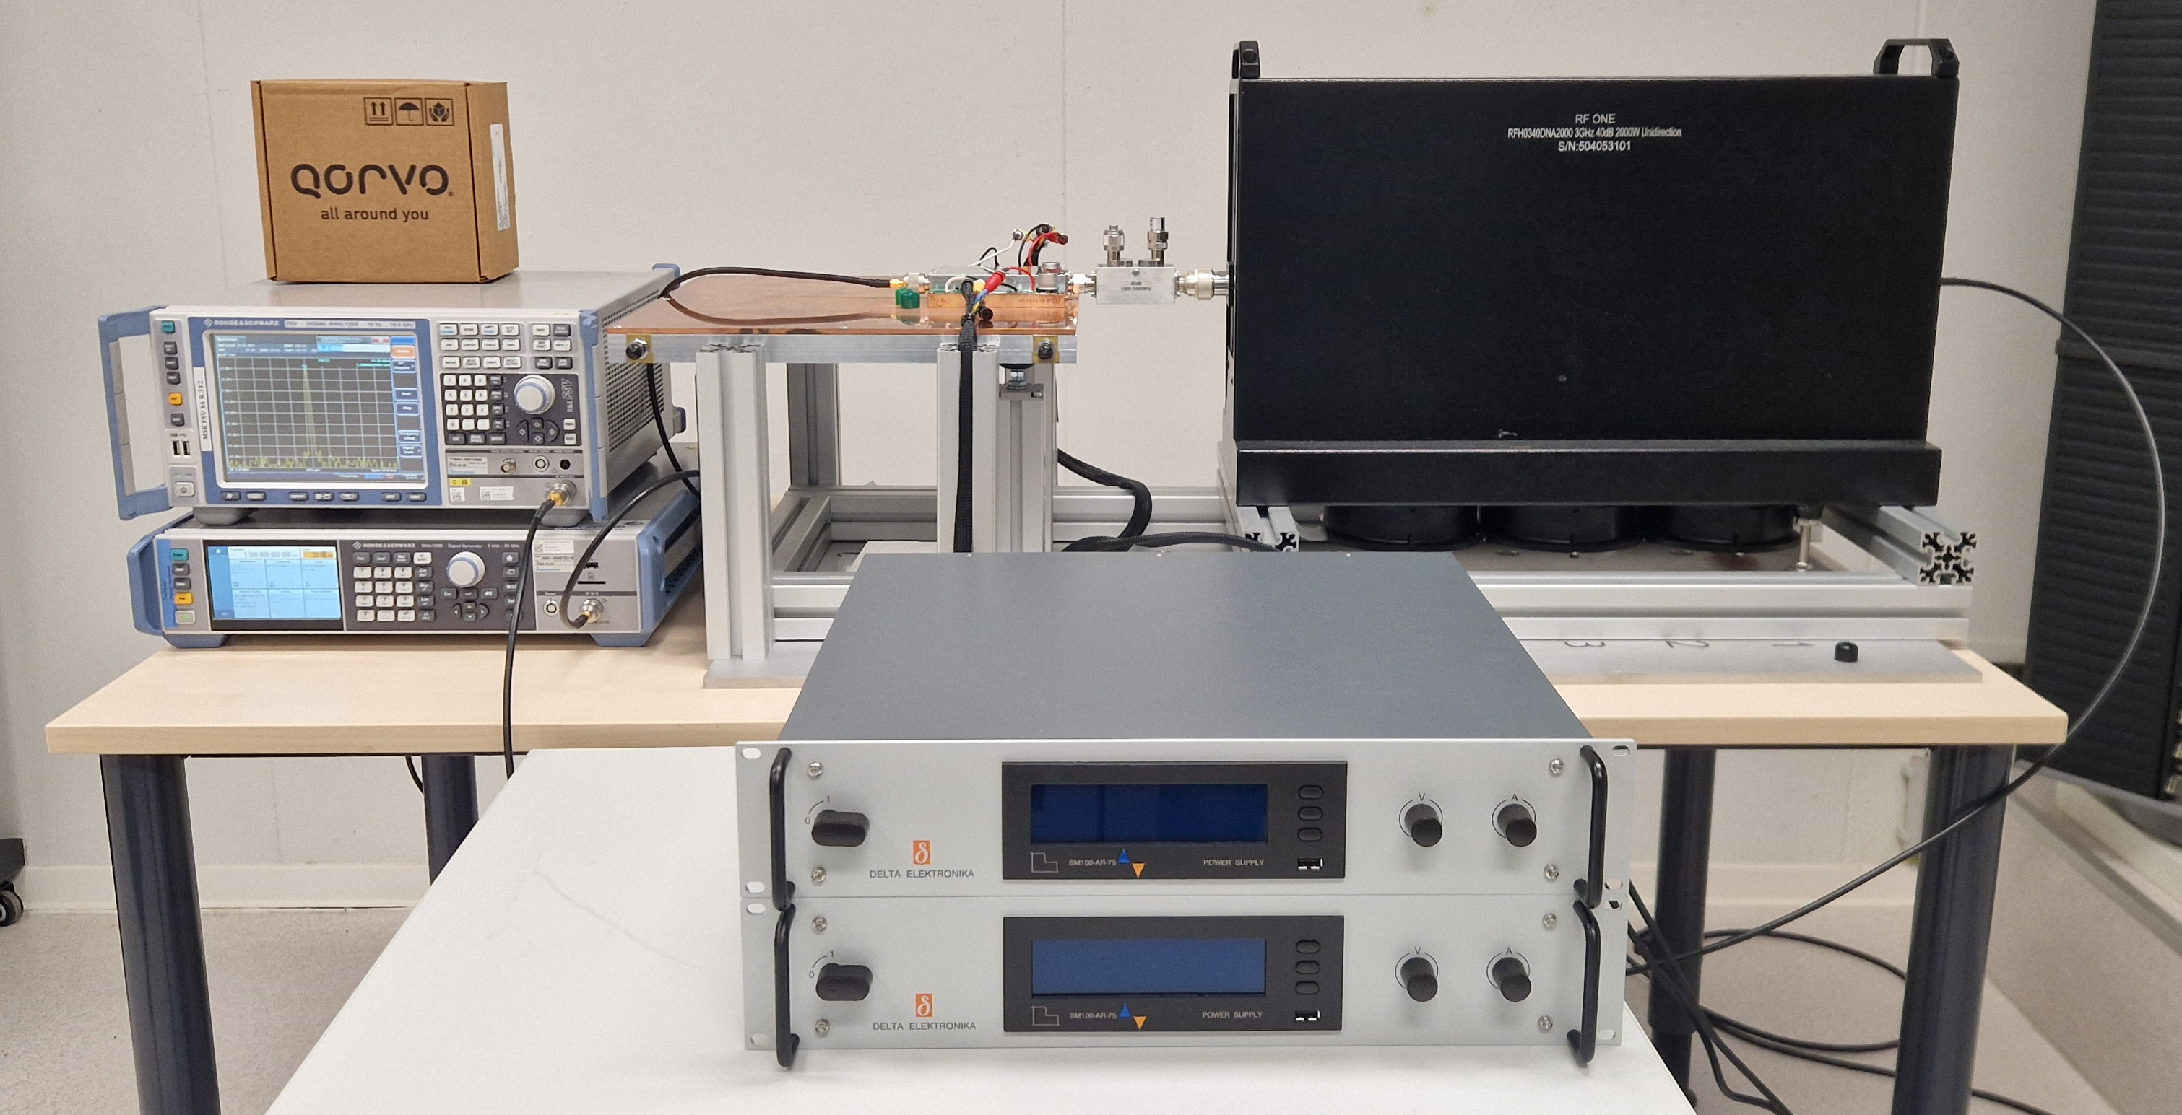
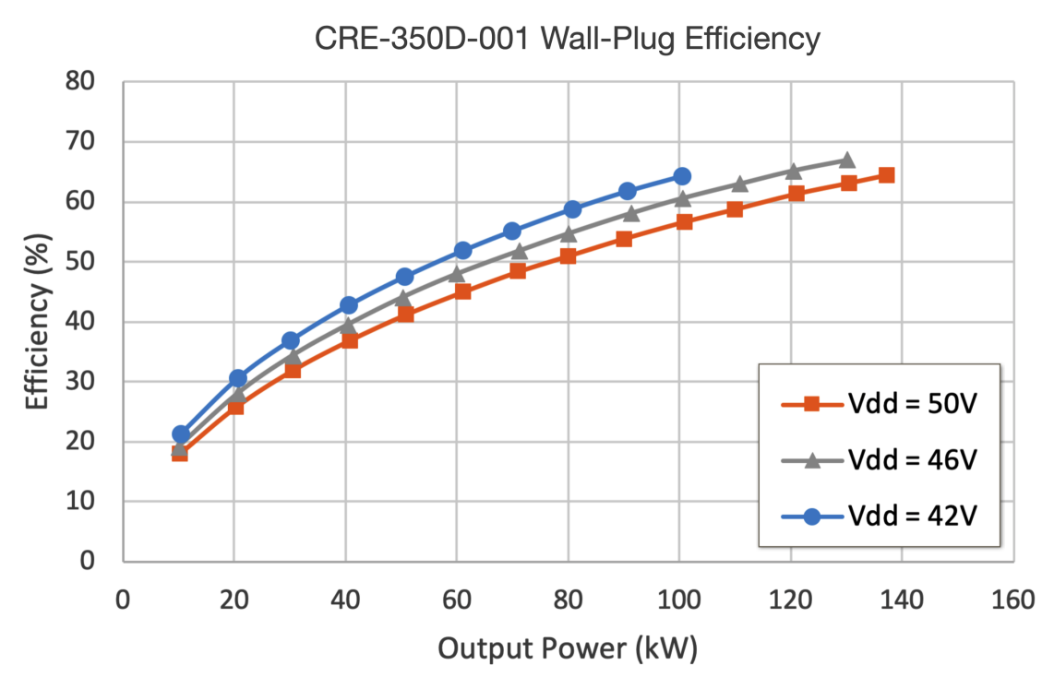
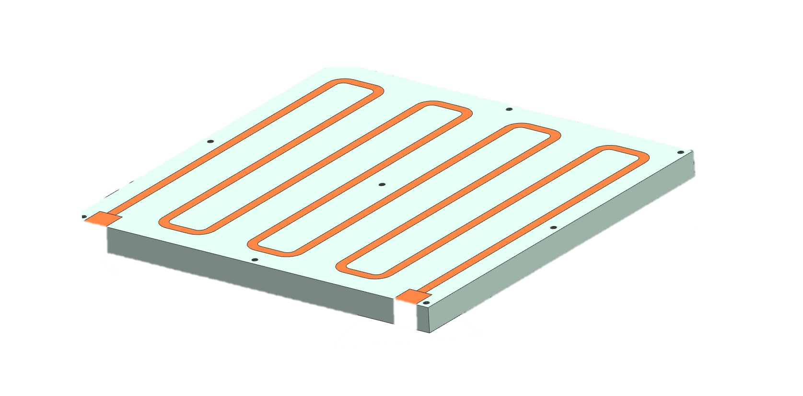
WP2 – LLRF: status/evolution of Task 2.5
Energy efficient supervisory control and fault diagnosis– M1-M48
Current developments
Development of SSPA test stand to investigate efficient operation depending on working point
high-power bi-directional coupler
Courtesy H. Pryschelski
1kW GaN amplifier
2 kW load
Preparation of a SSA test stand
GaN 1 kW prototype
Cooling / load / power supply
Experiment with pulsed/CW operation
Understand efficiency optimization with drain voltage adjustments
1.3 GHz source and instrumentation
Example
GaN technology
1.3 GHz
130 kW SSA
drain voltage (Vdd) adjustments
water-cooled plate
high-performance power supplies
Reference: “High-efficiency industrial 130 KW CW solid-state RF amplifier for 1.3 GHz”, M. Nedos, N. Pupeter et al. in proc. IPAC 2023

Slide 25
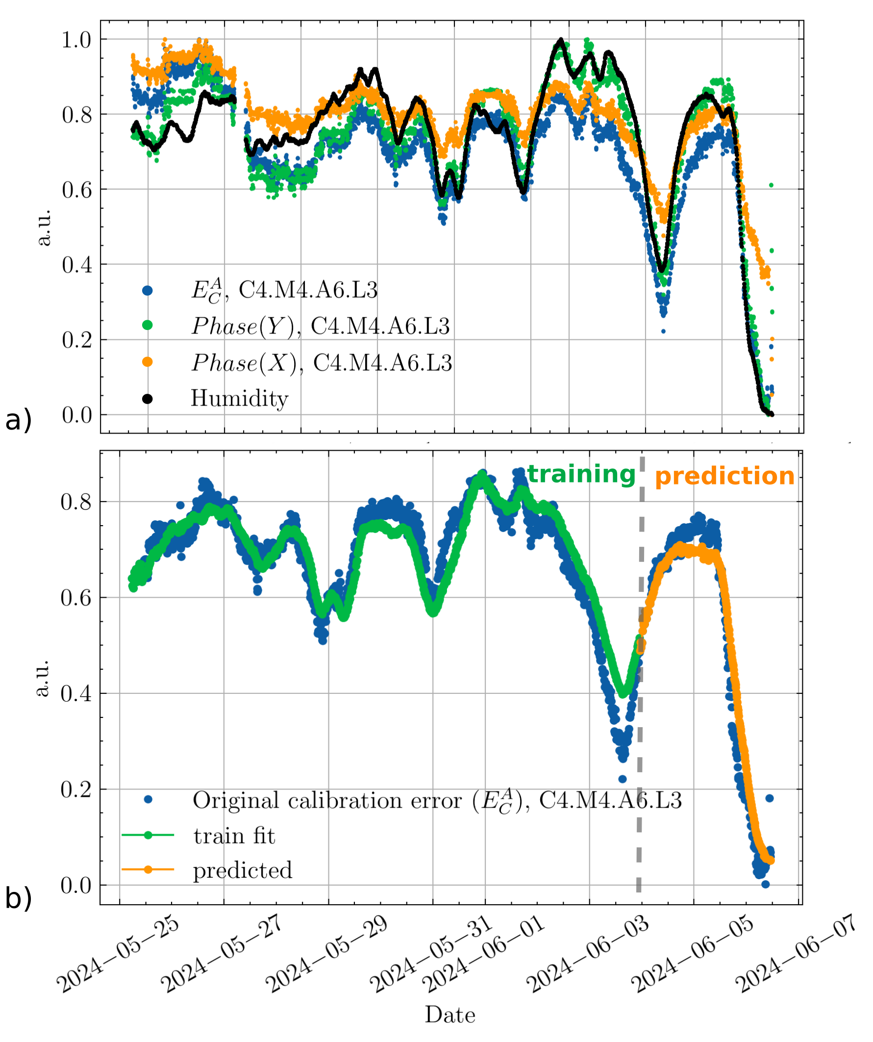
WP2 – LLRF: status/evolution of Task 2.5
Energy efficient supervisory control and fault diagnosis– M1-M48
Current developments
AI-based diagnostic for LLRF (presented at IPAC last year, full article submitted for peer-review
a) Strong correlation between RF waveform calibration coefficients and relative humidity
b) Using weather forecast, a trained model can predict 2 days in advance the calibration error!
First results presented at IPAC 2025, full article submitted for peer-review

Slide 26
WP2 – LLRF: points of attention
Points of attention
Discussions on future involvements for the call HORIZON-INFRA-2026-TECH01
Suggested topics with application for large scale accelerator operation
Cryoelectra / DESY : optimization of SSPA parameters for efficient pulsed operation (EuXFEL upgrade)
DESY / CERN framework development for anomaly detection (link to LLRF)
HZB topics related to AI, FE-FRT and RF sources
➔ All 3 have links to LLRF

Slide 27



WP2 – LLRF: plans to achieve milestones & deliverables
Milestones & deliverables on track? → yes
D35
ML implementation plan
D5 Report uphonics study and ML-based mitigation
D6 Report on
LLRF/SSA interface study
D7 Report on RF control studies
D9 Report on RF control studies
D8 Report on RF control studies
2024
2025
2026
2027
2028
Dx Deliverables
M40 Impact analysis WP2
M6 Energy-efficient SSA oper.
M7 Detuning control techniques
M8 Field control for high Qext cavs.
M9 demo
ML and anomaly detect.
M10 demo
uphonic FE-FRT
compensation
Mx Milestones
Accounted for

Slide 28
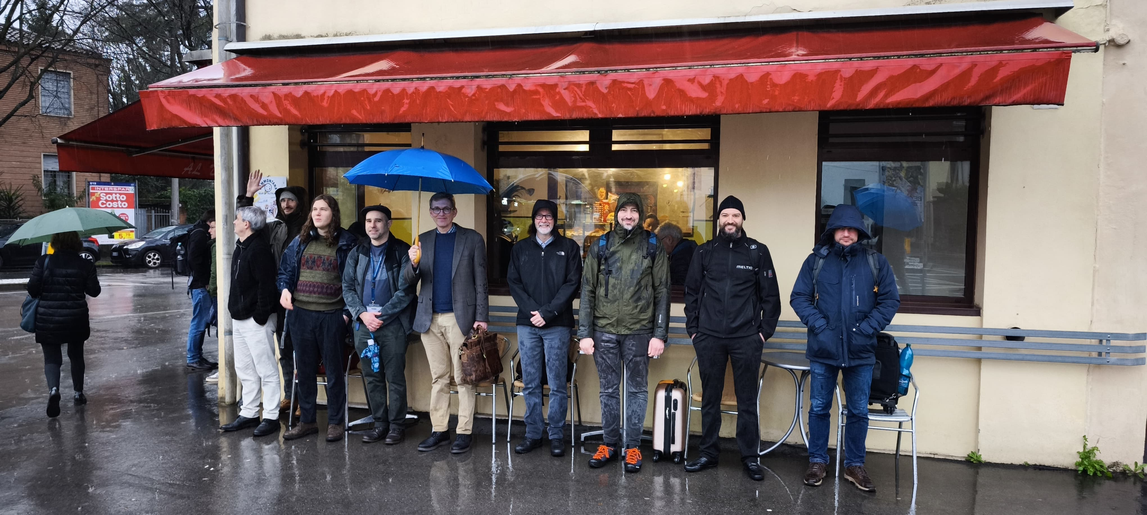
WP2 – LLRF: plans to achieve milestones & deliverables
Thank you for your attention !
2025 iSAS meeting in Padova, Italy

Slide 29
BACKUP

Slide 30
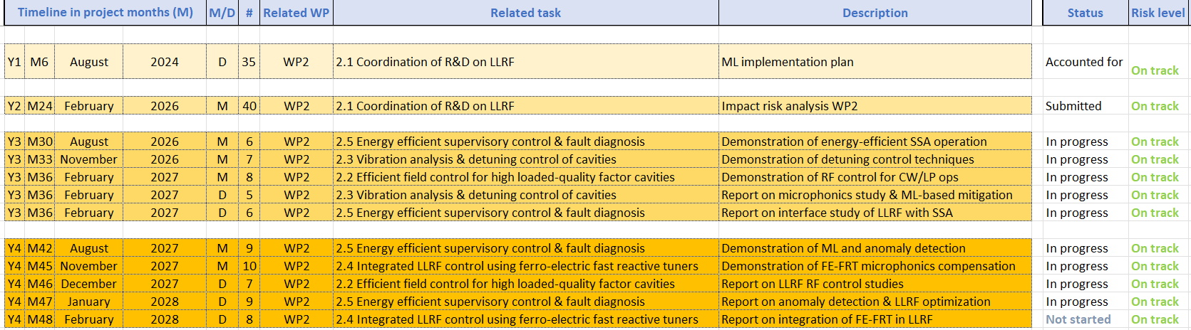
WP2 – LLRF: plans to achieve milestones & deliverables
Milestones & deliverables on track? → yes
Plans to achieve milestones & deliverables
Delay risks to be anticipated? → some unknowns but nothing critical. Plan B as back up
Cooperation with other WP(s) to be reactivated? → clearly potential to increase collaboration, not always easy in practice due to daily “emergency” in home institute + budget / travel restrictions
Risk mitigation measures to be implemented? → risks were identified and mitigations strategies presented in official impact risk analysis (milestone M40 submitted in Feb. 2026)

Slide 31
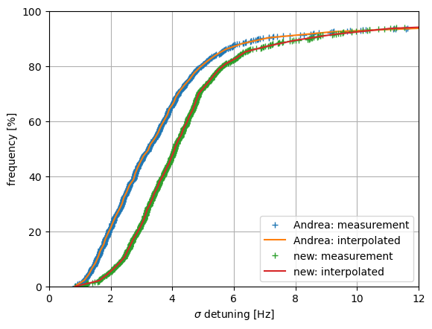
WP2 – LLRF: status/evolution of Task 2.3
Vibration analysis and detuning control of cavities – M1-M36
Past developments
…
Current developments
Assessment of microphonics level at XFEL
80% of cavities are below 6 Hz (rms)
Fraction of cavities [ % ]
+ 2025 meas.
+ 2026 meas.
Detuning standard deviation [ Hz]

Slide 32
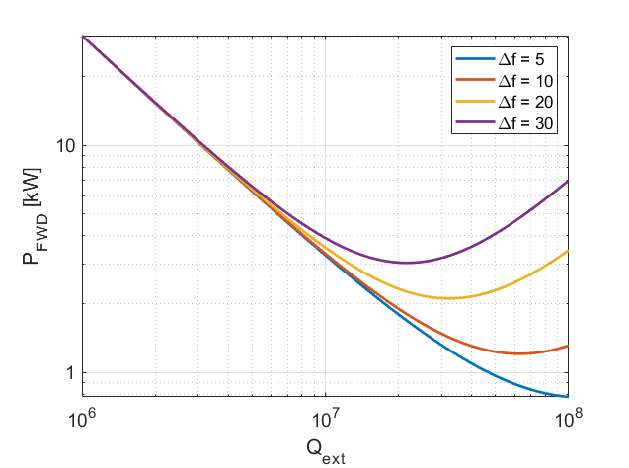
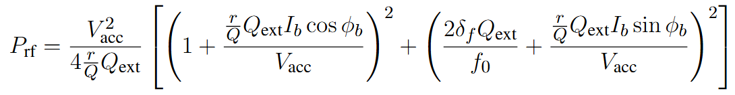
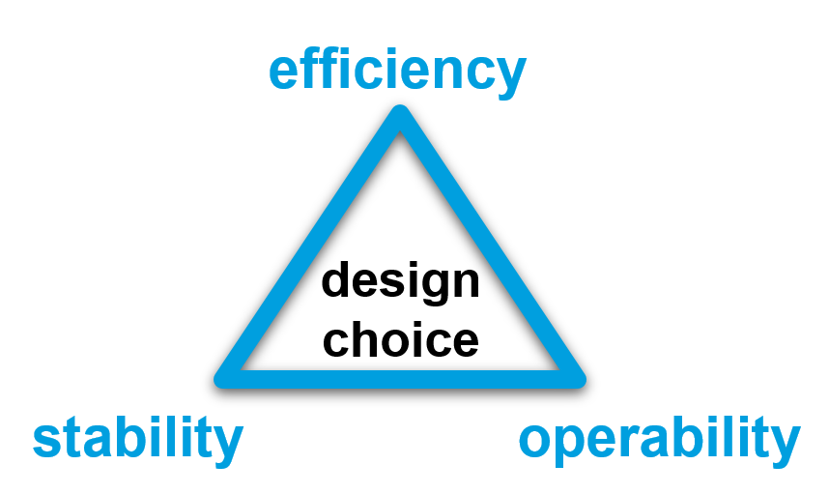
Why is bandwidth and resonance control crucial for efficiency
Bandwidth (Qext) and Resonance (Δf) control
Operating at higher Qext (narrower bandwidth)
reduces the power needs IF resonance control can be guaranteed
makes resonance control extremely challenging
Parameters for SRF gun
r/Q = 208 Ohm V_{acc} = 5 MV (energy gain from the gun at 50 MV/m -> 5 MeV) I_{b} = 100 uA (100 pC at 1 MHz)
φ_{b} = 0 deg.
4 kW
3.3 kW
2 kW
1.3 kW
The challenge is to find the highest Qext one can operate the cavity at while still meeting the resonance control goals and without compromising operability and reliability of the system.
1 kW
Q_{ext} = 1e7
Q_{ext} = 4e7

Slide 33
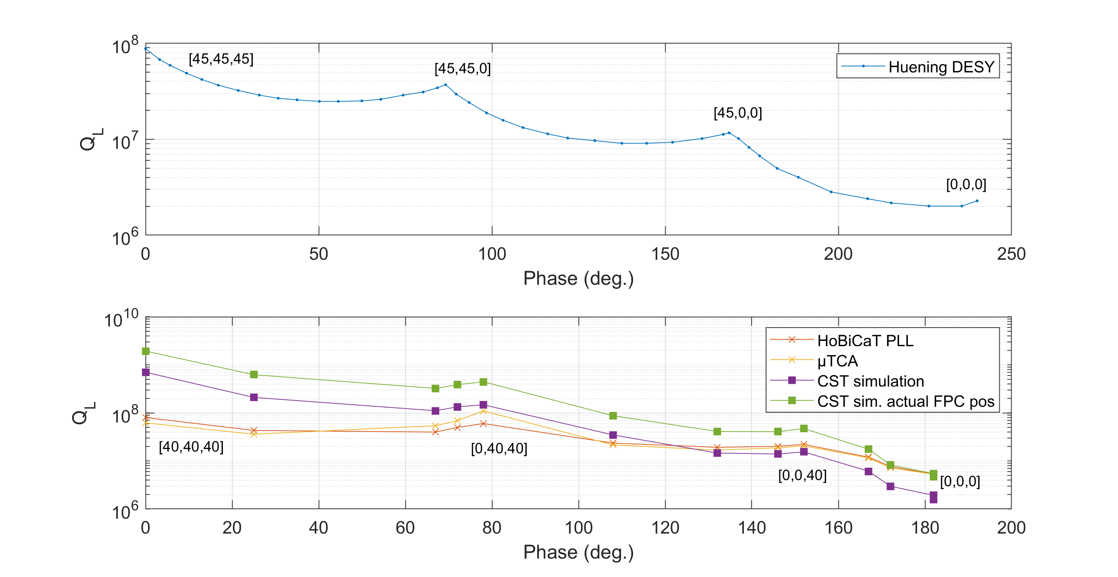
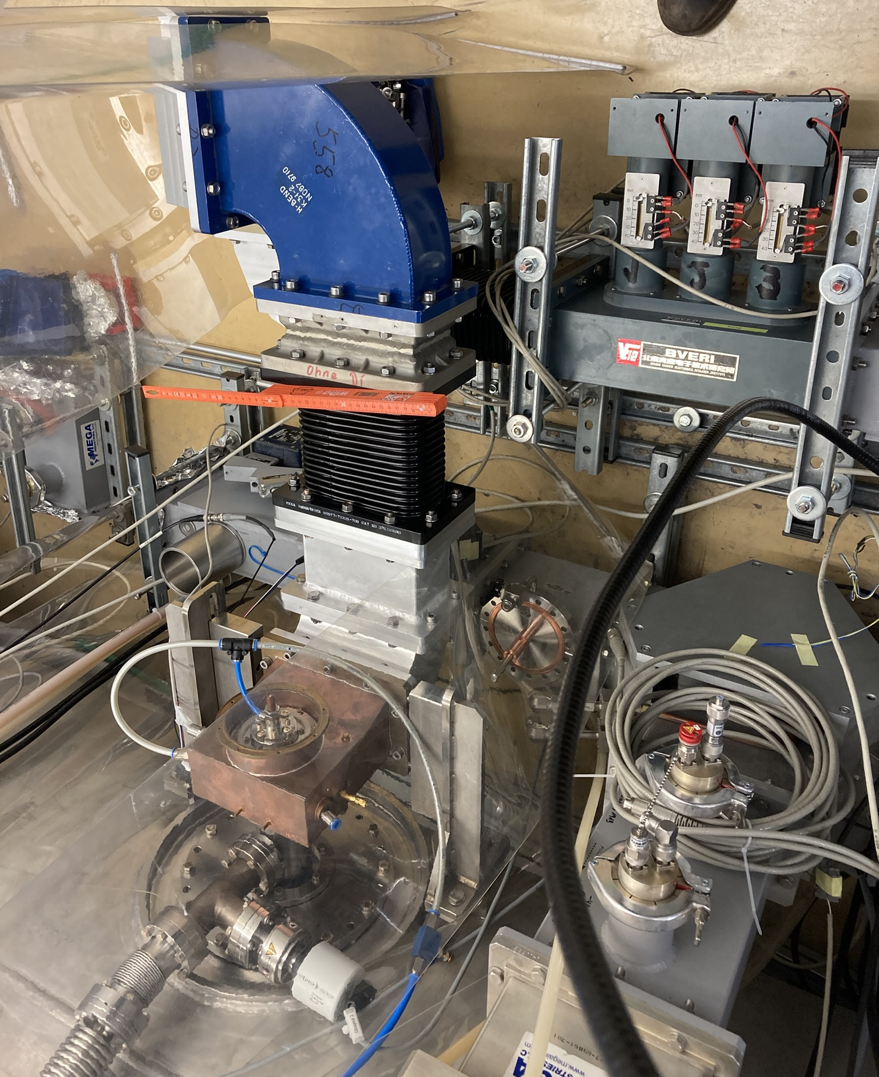
Extending the Qext range
First test with 3-stub tuner at HobiCat
(HZB) re-measured Qext change with 3-stub tuner at HobiCat (had already been done a long time ago…)
Cross checked results with CST simulations.
3-stub tuner
CST simulation
Courtesy A. Neumann

Slide 34
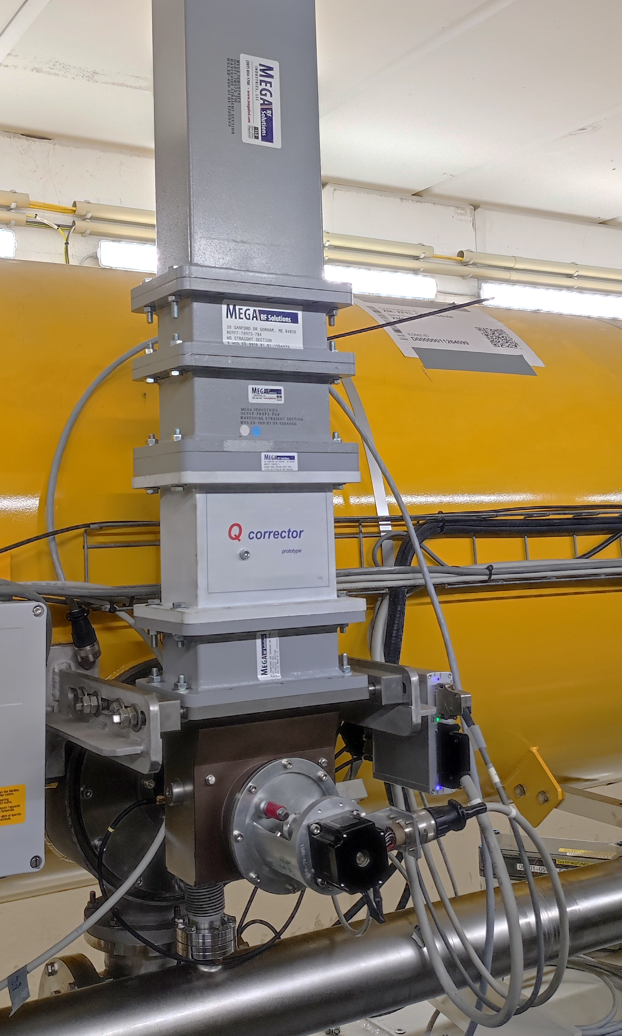
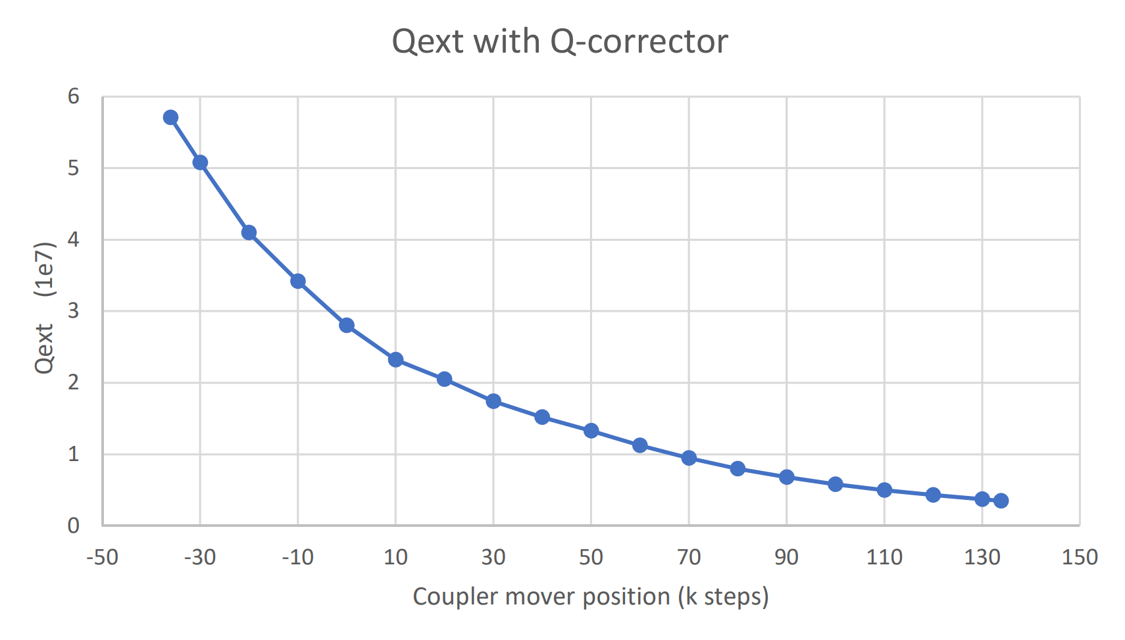
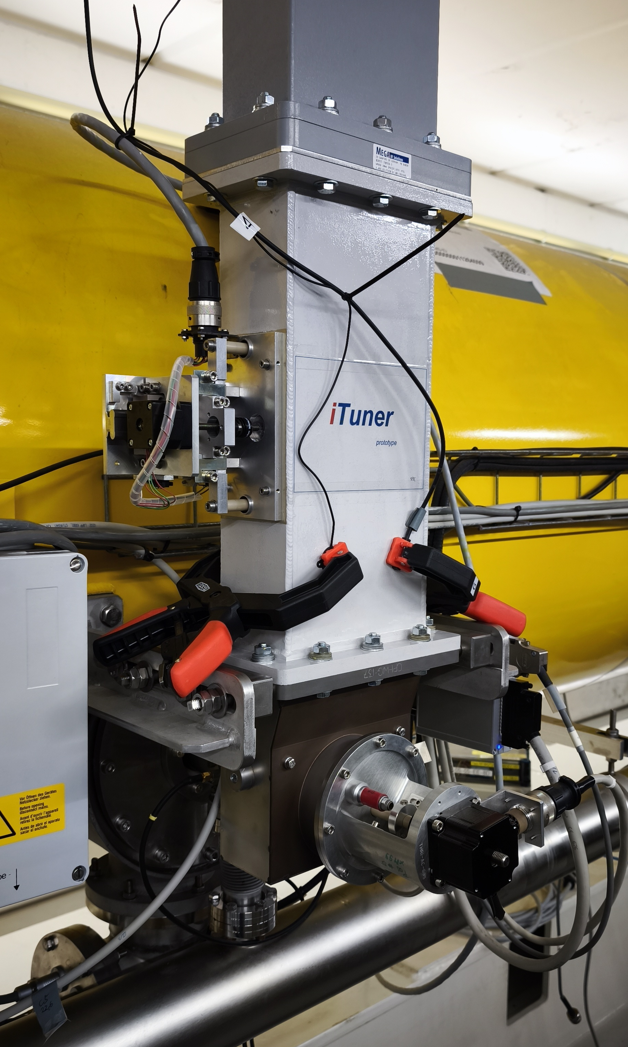
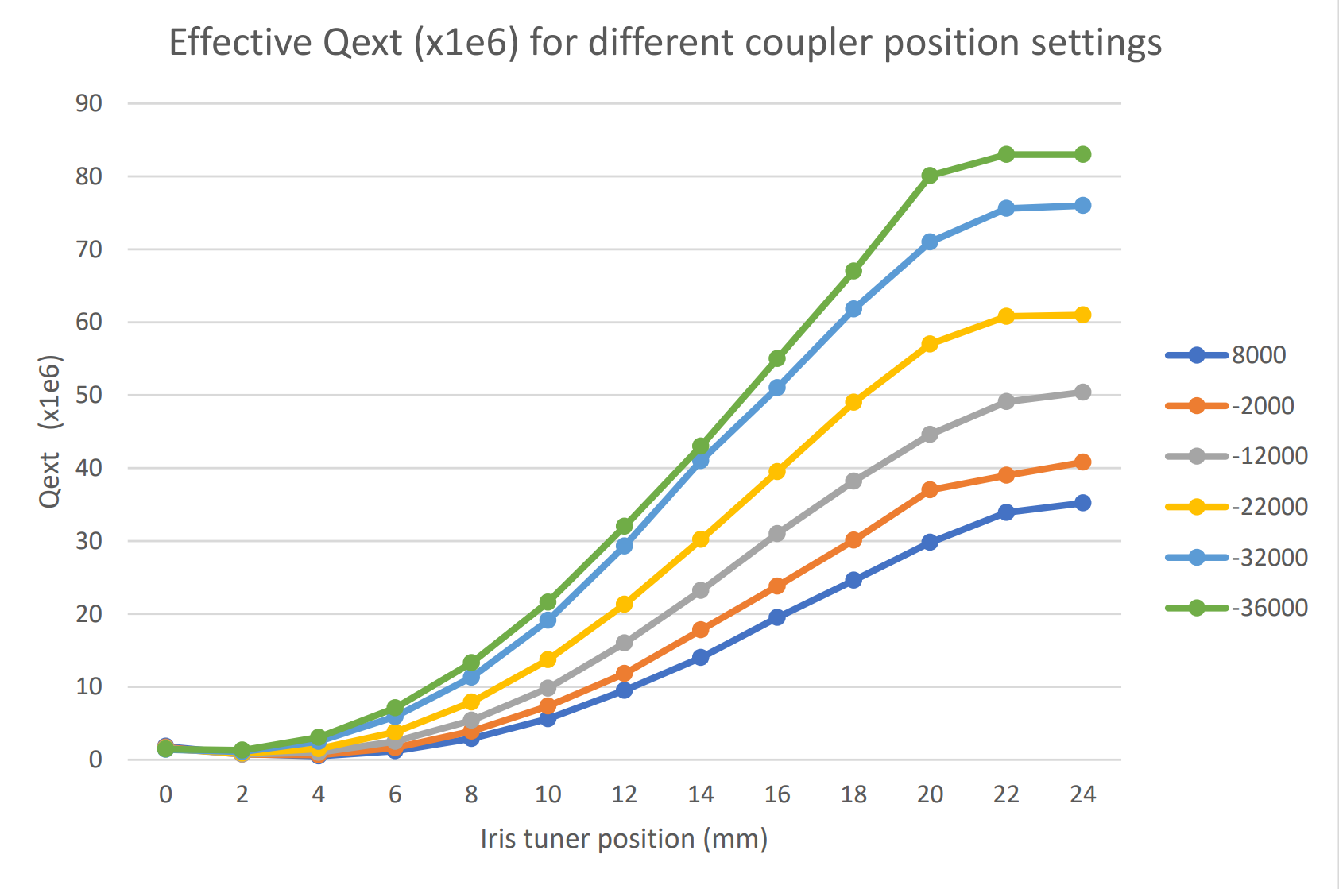
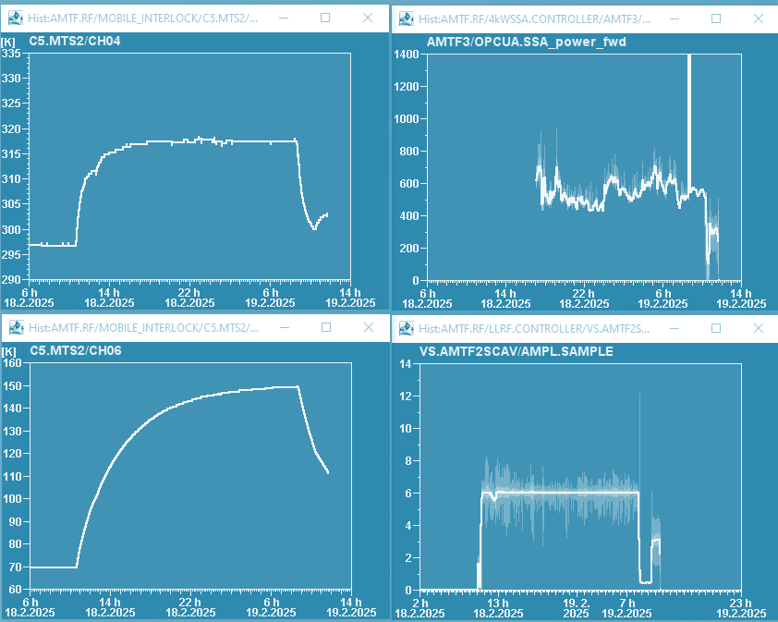
Developed 2 prototypes to extend the Qext range
Waveguide components to increase Qext range
Q-corrector (fixed)
Iris-tuner (variable)
I-tuner motor
coupler motor
fixed stud
coupler motor
coupler motor
Courtesy V. Katalev
Several devices are being developed to increase or shift the Qext tuning range
High-power test started
Currently investigating induced heating of coupler
T300K heating
T70K heating

Slide 35
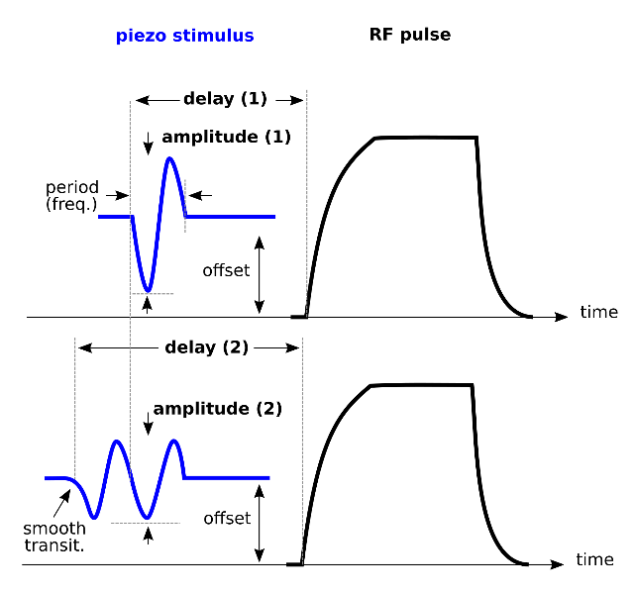
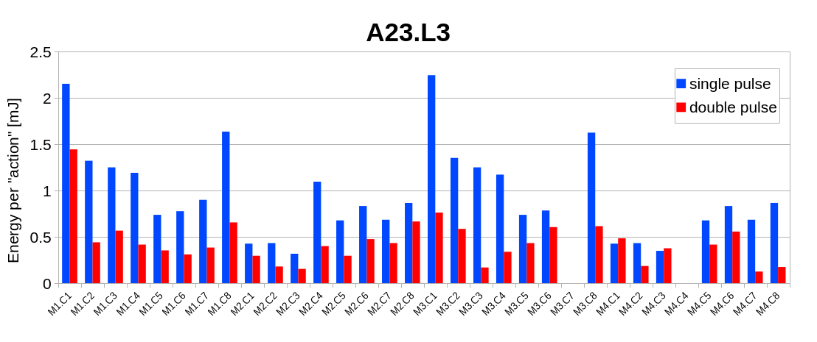
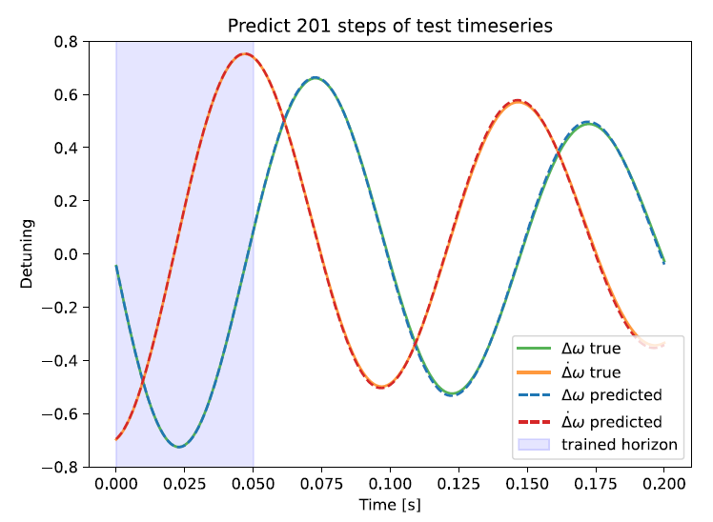
WP2 – LLRF: status update
Example 1: improving efficiency of resonance control algorithms (DESY)
Piezo stimulus used to compensate Lorentz force detuning in pulsed operation at EuXFEL.
Bayesian optimization of piezo stimulus parameters (delay, amplitude, offset)
Using a double sine excitation (instead of just 1)
Smoothing the leading edge (to minimize inrush current)
= net energy saving factor of 2
Presented at IPAC 2025: “Optimization of Piezo Operation for Superconducting TESLA Cavities at EuxXFEL”, M. Grecki et al.
Example 2: developing machine learning–based diagnostics for SRF cavities (HZB)
Deep learning of cavity detuning
Can one use machine learning (auto encoders) to predict detuning in CW
Use deep learning to adapt the cavity model to real-time variations
Use Koopman filter to make dynamics of the system appear linear
Simulated detuning data, then used to train and test model
iSAS WP2 LLRF | J. Branlard | WP2 status update

Slide 36
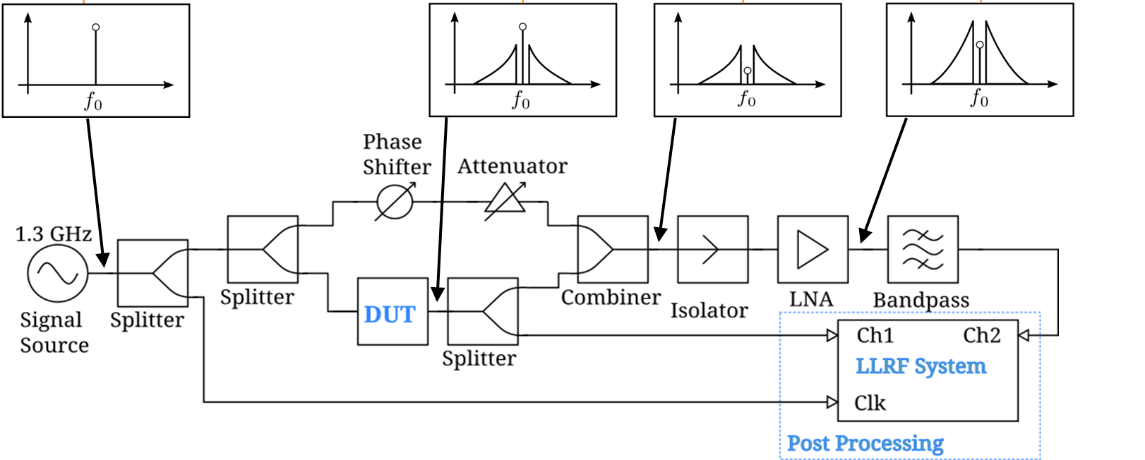
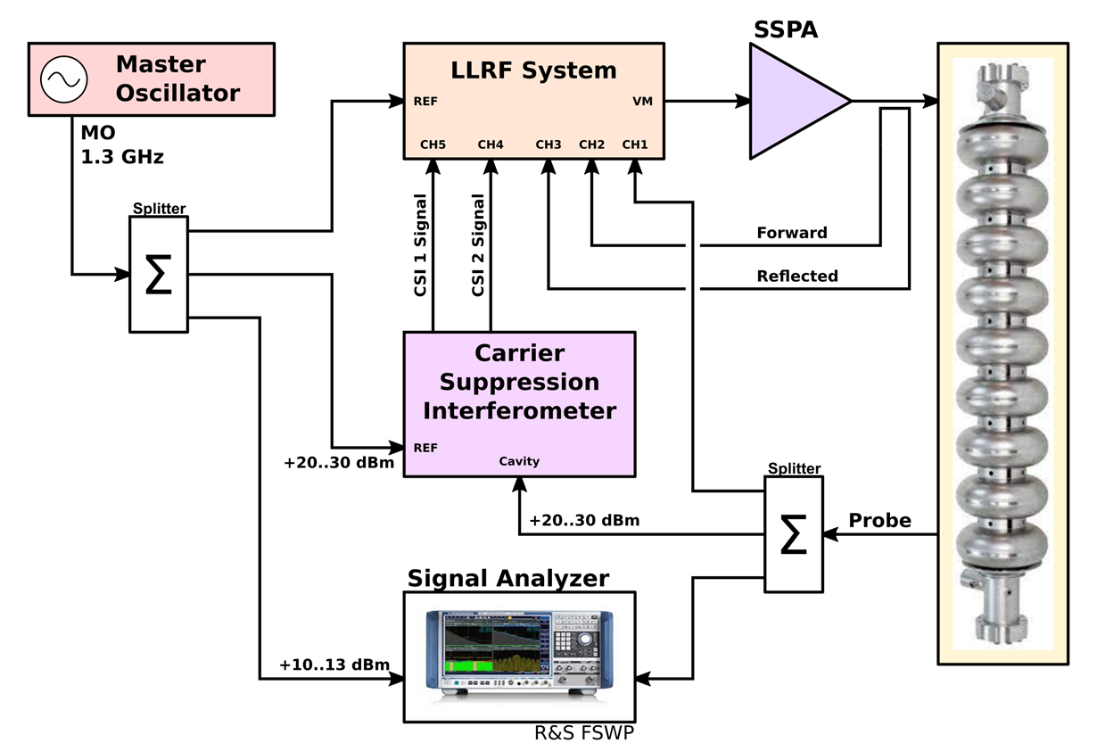
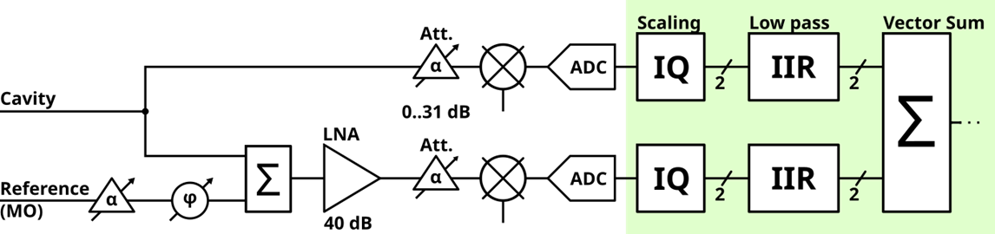
Carrier Suppression Interferometer
Courtesy: M. Hoffmann
Concept
Overcome noise limits of the post-IQ system
CSI performance scales with RF input power
Source → very low amplitude noise !
Replace the DUT with the LLRF system
CSI signal contains no carrier
no absolute information of amplitude and phase
CSI signal as amplified error signal
Combination of CSI and standard measurement as controller input

Slide 37
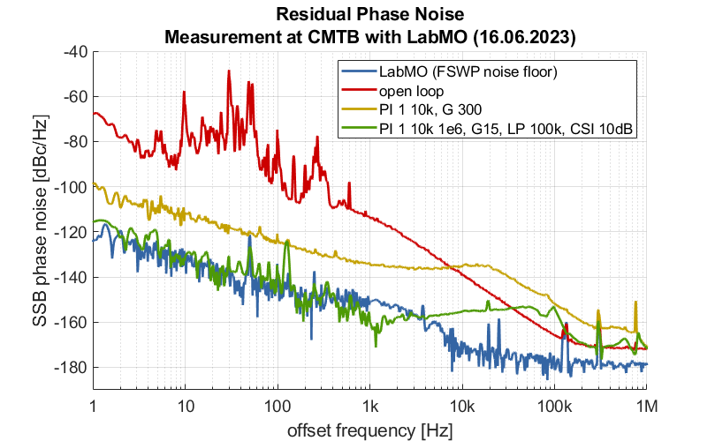
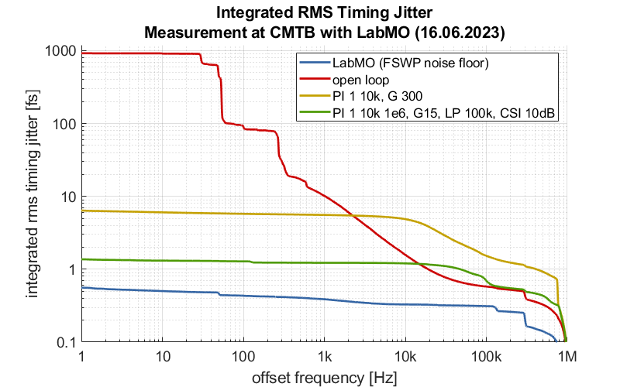
Measurement Results from CMTB
Lab MO as Reference (best results)
Cavity at Q_{L} ~ 10⁷ (f₁₂ = ~ 65 Hz)
Open loop vs. PI controller vs. CSI with PI
Reached noise floor of FSWP
Requires stable condition of the cavity (steady state CW)
Cavity tuning (PZT) to maintain operation at resonance
Courtesy: M. Hoffmann

Slide 38
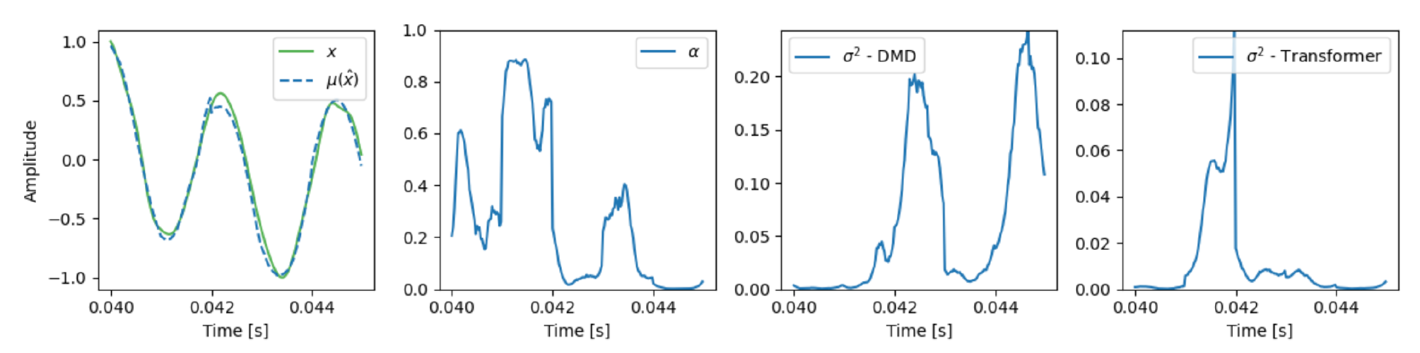
WP2 – LLRF: status/evolution of Task 2.3
Vibration analysis and detuning control of cavities – M1-M36
Current developments
Exploration of AI-based methods for RF detuning compensation
Designed a hybrid model that learns detuning dynamics from data (accepted for presentation at IFAC2026)
Derived a stability theorem (paper under review)
1. AI-based detuning compensation
Courtesy A. Maalberg
Demonstration of estimating “real-world” time series by blending Dynamic Mode Decomposition (DMD) and Transformer (deep-learning architectures) predictions with an adaptive alpha (similar to Kalman gain)
To be presented (+ proceeding) at IFAC 2026

