Slide 1


WP6: Integration into Accelerator and Collider Ris
Berlin meeting, April 23, 2025
Guillaume Olry on behalf of WP6 partners
All information contained in this presentation and any accompanying documents is for iSAS project only, and must be treated as strictly confidential.
Any dissemination, distribution or other use of this information without the consent of its owner is prohibited.
Funded by the European Union. Views and opinions expressed are however those of the authors only and do not necessarily reflect those of the European Union or the European Commission. Neither the European Union nor the granting authority can be held responsible for them.

Slide 2
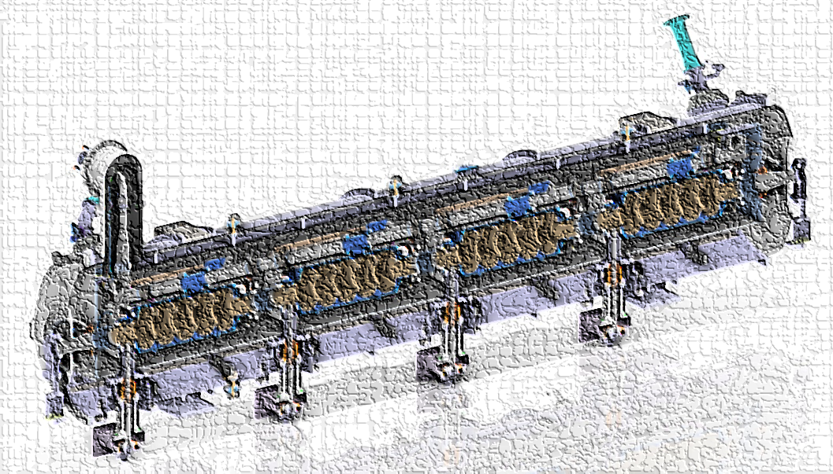
WP6: Integration into Acc&Collider RIs
Institutes participating: CNRS, CEA, ESS, INFN, Uni. Lancaster
Convener: G. Olry (CNRS/IJCLab) + S. Berry, deputy (CEA), N. Elias (ESS), D. Giove (INFN), G. Burt (UL)
Main contacts with other partners : in WP4: Y. Gomez Martinez (CNRS/LPSC) and V. Parma, K. Canderan (CERN)
Main objective of the WP6: “while various RIs envisage upgrades, the objective is to expedite the technical integration of energy-saving technologies by retrofitting existing accelerating systems. A cryomodule will be adapted, ready to demonstrate energy recovery of high-power recirculating beams in the PERLE research facility, paving the way for high-energy, high-intensity electron beams with minimal energy consumption.”
Welcome to our new players!
Main people involved
CNRS: Guillaume Olry, Gilles Olivier, Sébastien Blivet, Patricia Duchesne, Patxi Duthil, Christophe Joly, Akira Miyazaki, Nicolas Gandolfo, Hervé Saugnac, Damien Till
CEA: Stéphane Berry, Fabien Eozénou
ESS: Nuno Elias, Paolo Pierini, Cecilia Maiano, Henry Przybilski, Marek Skiba, Emma Simpson
INFN: Dario Giove, Maria Rosaria Masullo, Luigi Celona, Gino Sorbello, Paolo Spruzzola
Uni. Lancaster: Graeme Burt
Cryomodule design
...in progress
c/o S.Blivet

Slide 3
WP6: Integration into Acc&Collider RIs
Institutes participating: CNRS, CEA, ESS, INFN, Uni. Lancaster
Convener: G. Olry (CNRS/IJCLab) + S. Berry, deputy (CEA), N. Elias (ESS), D. Giove (INFN), G. Burt (UL)
Main contacts with other partners : in WP4: Y. Gomez Martinez (CNRS/LPSC) and V. Parma, K. Canderan (CERN)
Task 6.1 (CNRS): Coordination – M1-M48
  • General coordination in collaboration with WP4 on HOM and RF couplers and WP1 on FE-FRT development.
Task 6.2 (UL, CNRS): Retrofitting Fast Reactive Tuners into existing cryomodules HL-LHC oriented – M1-M24
  • Investigate if the existing cavity end group can be used with an FE-FRT by combining the FE-FRT and a HOM coupler into a single device.
Task 6.3 (CNRS, CEA, ESS): Adapt the existing ESS cryomodule – M1-M18
  • Adaptation of the existing ESS cryomodule into a new configuration which will integrate a completely new cavity string equipped with the optimized HOM and FPC couplers developed in WP4
Task 6.4 (INFN, CNRS, ESS, UL): Fabrication and validation of cryomodule components – M1-M30
  • Fabrication, preparation and test of the critical components (SRF cavity, tuning systems, HOM couplers, ...)
Task 6.5 (CEA CNRS, ESS): Assembly and test of adapted cryomodule – M30-M48
  • Assembly and cryogenic & RF test of the cryomodule.
→ Link with WP1
→ Link with WP4 and WP5
→ Link with WP4
→ Link with WP5

Slide 4
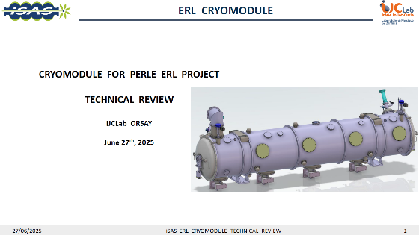
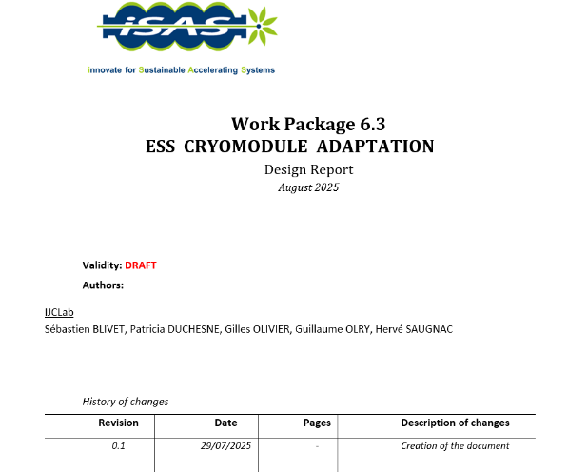
status of Task 6.1 – general coordination
Done
  Meetings on the first Wednesday of every month.
  Keep on participating to joint meetings with WP4 and WP5.
  27 June 2025: Technical review on ESS Cryomodule adaptation.
  29 August 2025, Milestone n°22 (engineering report): ESS cryomodule adaptation
  09 April 2026: Stéphane Berry took over Arnaud’s position as a deputy
  16 April 2026 : Risk analysis updated
On-going:
  Periodic report 1: almost complete...
  WP4 post-doc position, initially for HOM couplers dvpt but reallocated to beam line absorbers studies → important for WP6. Waiting for funds transfer from INFN to CNRS.
Short term:
  Deliverable D6.1 (design report). Conceptual design of a combined FE-FRT-HOM coupler → postponed to August 2026
Many thanks to:
CEA: S. BERRY, A. MADUR
CERN: K. CANDERAN, V. PARMA
ESS: N. ELIAS, H. PRZYBILSKI, M. SKIBA

Slide 5
status of Task 6.2 – retrofitting FRT
Past developments
  …
Current developments
  …
See Axel’s presentation (WP1)

Slide 6
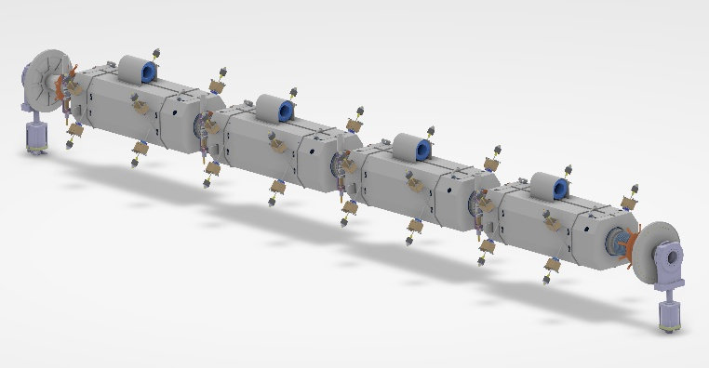
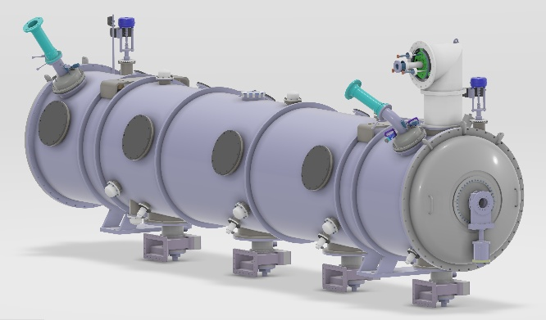
status of Task 6.3 – adapt the existing cryomodule
Past developments
New 5cell cavity design
Mechanical integration of HOM and power couplers (inputs from WP4)
New cold and warm magnetic shields designs
Adaptation of the ESS/MYRRHA cold tuning systems
First cold Beam line absorber mechanical design
New end-cap design including warm-to-cold transition
New cryo lines for HOM couplers and beam line absorbers
Definition of the P&ID (Piping and Instrumentation Diagram)
Current developments
Cold BLAs (WP4): characterization studies of several samples, thermal and RF calculations → cryo cooling
Finalization of the cryogenic circuit design to include fast cooling possibility and BLAs cooling.
Final configuration of the Instrumentation and cabling (temperature sensors, heaters)
c/o S.Blivet
Cavity string (with cold magnetic shield)
Spaceframe
c/o S.Blivet
Cryomodule (with new dished ends)

Slide 7
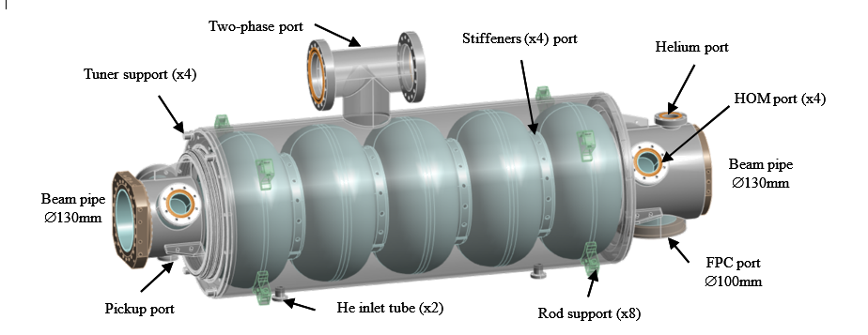
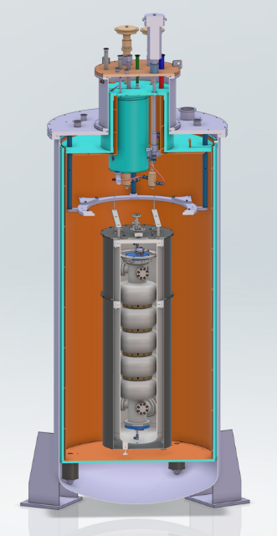
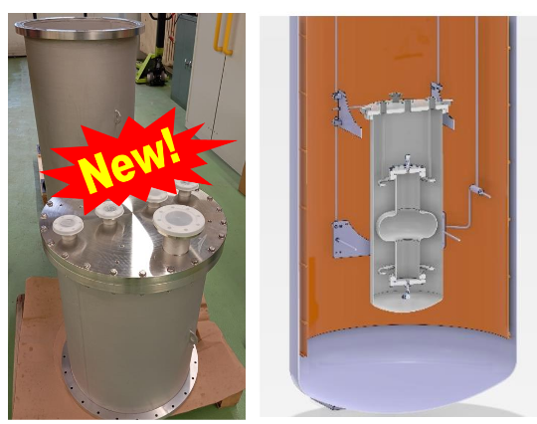
status of Task 6.3 – adapt the existing cryomodule
Main RF parameters of the cavity
Parameter | Value
Frequency @2K | 801.58 MHz
βopt | 1
Lacc = (n.β.λ/2) | 0.935 m
Iris aperture | 0.13 m
Eacc | 21.9 MV/m
G | 272 Ω
R/Q @β=1 | 523 Ω
Epk/Eacc | 2.35
Bpk/Eacc | 4.8 mT/(MV/m)
Epk @ 20.5 MeV | 51.5 MV/m
Bpk [mT] @ 20.5 MeV | 105 mT
Pcav (Qo 3.e10) | 27 W
Pcav (Qo 1.e10) | 81 W
5cell cavity
c/o P.Duchesne
Mechanical design of the 5-cell jacketed cavity
Past developments
Helium jacket optimized to vertical test configuration: adding a helium outlet port
Adjust the stiffening rings position to facilitate the fabrication.
Current developments
Commissioning of a new removable tank integrated to ICJLAB Vertical Cryostat to test bare single and multi cell cavities
Order of the cathode for Electro Polishing (at CEA)
new removable tank

Slide 8

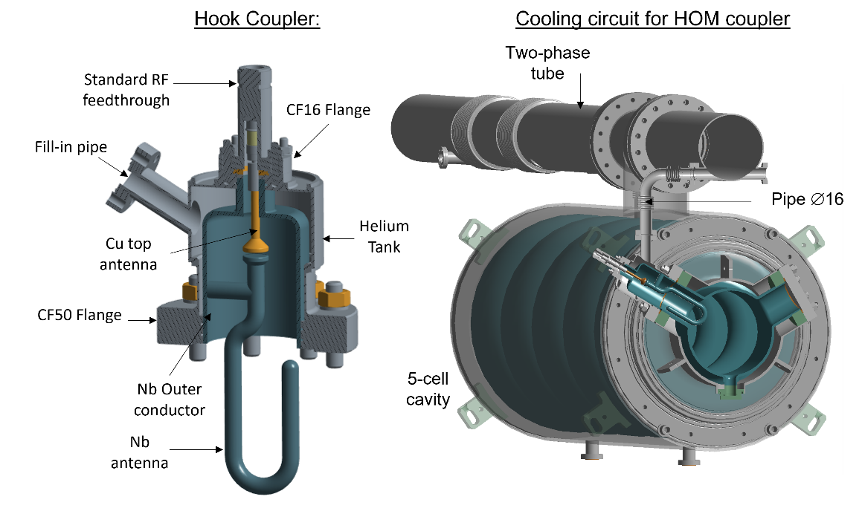
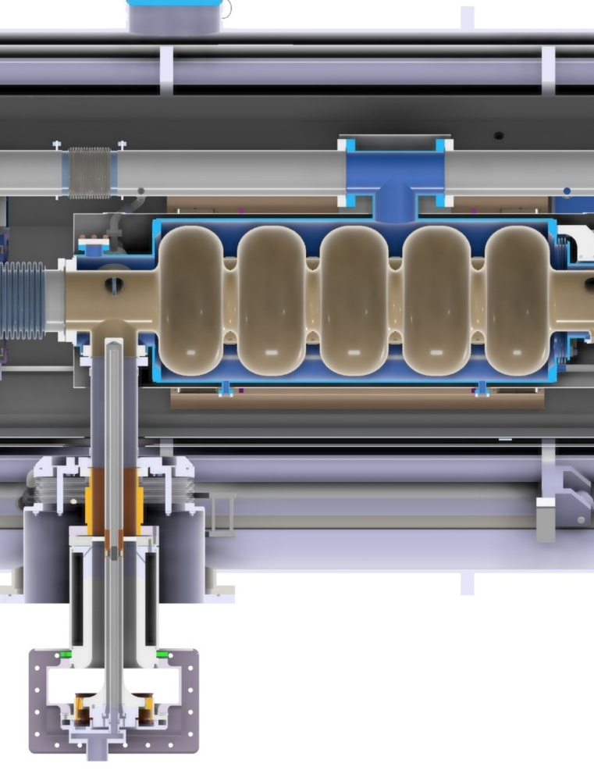
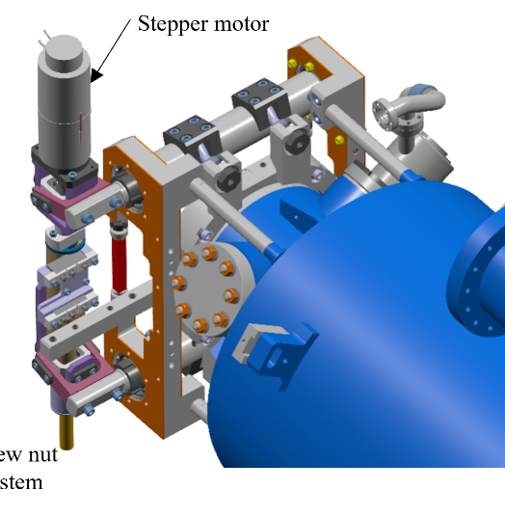
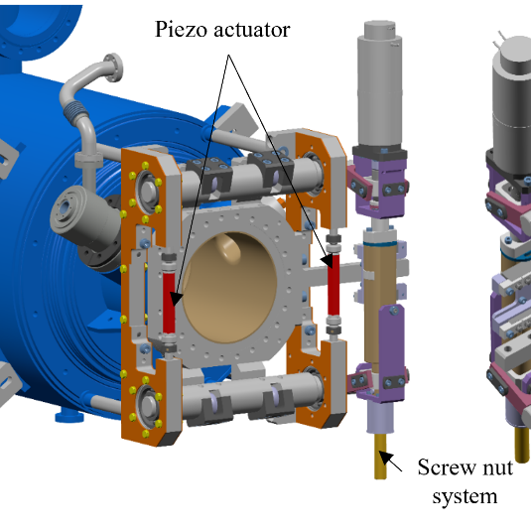

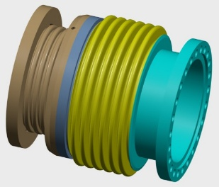
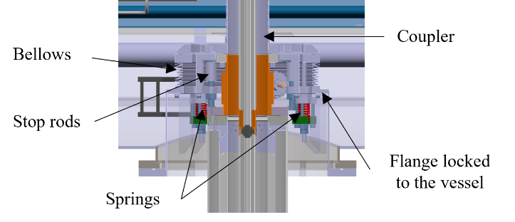
status of Task 6.3 – adapt the existing cryomodule
Mechanical integration of the HOM & FPCs and Cold Tuning Systems and cold BLAs
HOM coupler
FPC
Cold tuning system
c/o S.Blivet
c/o P.Duchesne
c/o G.Olivier
BLA
3D model of the BLA
c/o S.Blivet

Slide 9
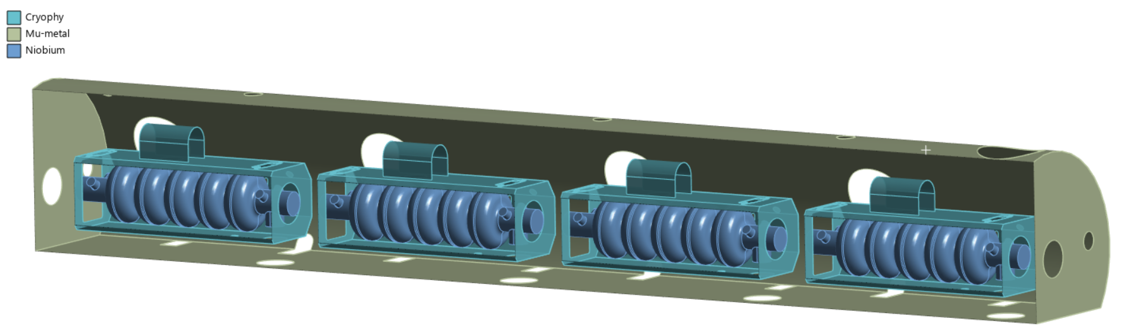
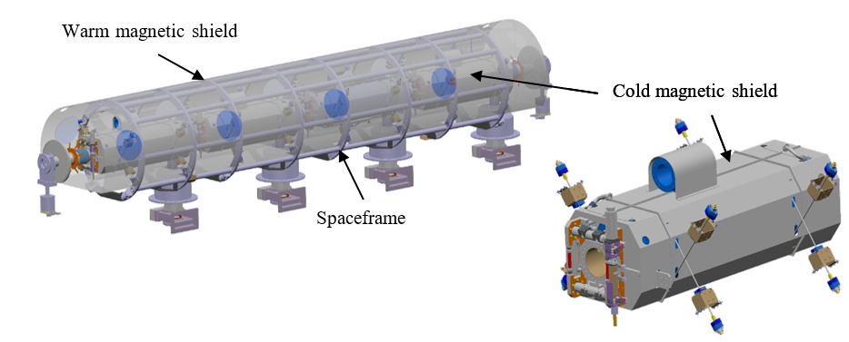
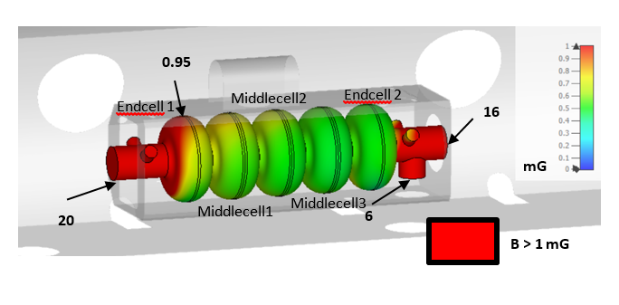
WP6 : status/evolution of Task 6.3 – adapt the existing cryomodule
Warm + Cold magnetic shields integration
Goal: residual B field < 1mG at the cavity surfaces (due to high sensitivity to trapped flux after mid-T bake) → double the magnetic shielding, consisting of a 2 mm-thick layer of µ-metal and a 2 mm-thick layer of Cryophy around the cavities
c/o P.Duchesne
c/o S.Blivet
CST simulations

Slide 10
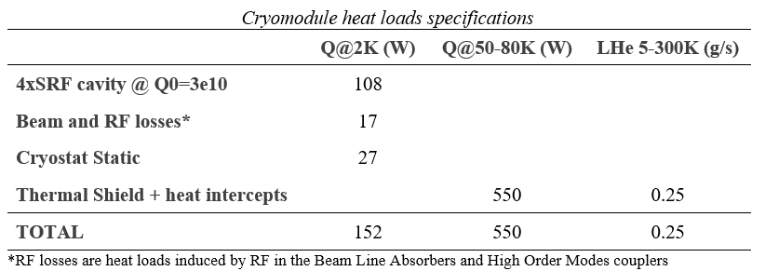
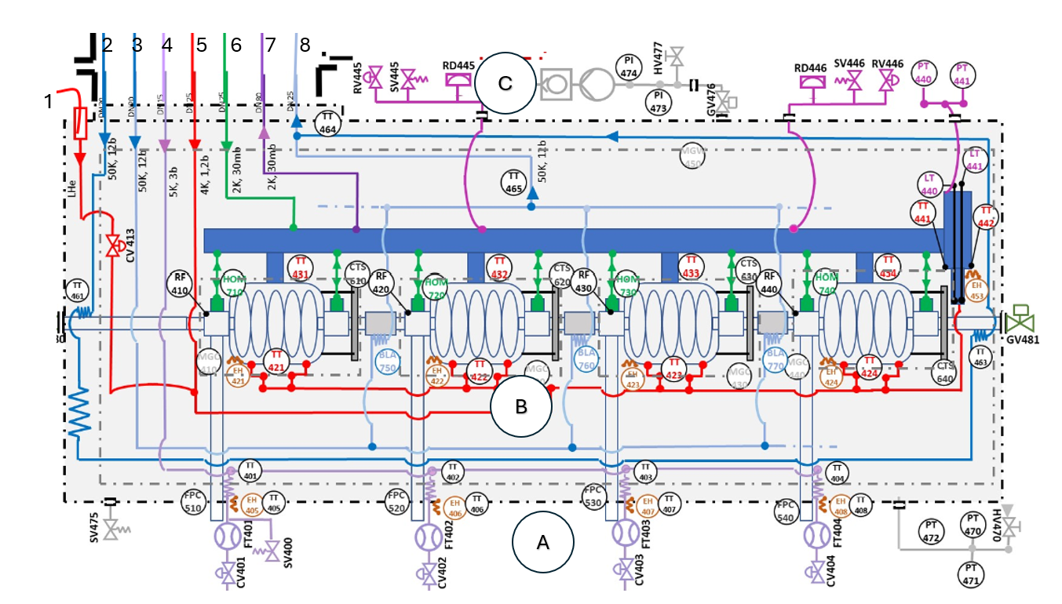
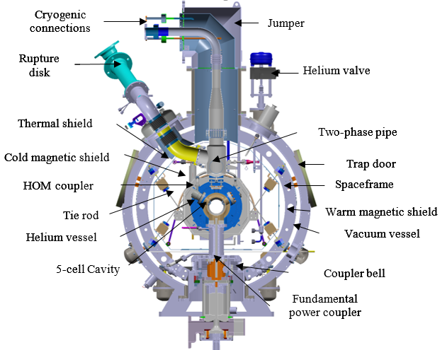
WP6 : evolution of Task 6.3 – adapt the existing cryomodule
Cryogenic circuits
No sub-cooling heat exchanger, nor JT valve into the cryomodule (main difference with ESS cryomodule)
New circuits: Cavities fast cooling down (red line #1),HOM couplers (green connexions to the bi-phase pipe), BLA cooling (ligth blue line #3)
Preliminary PID
c/o S.Blivet

Slide 11
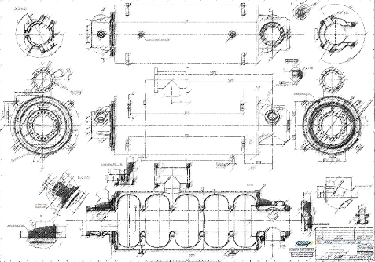
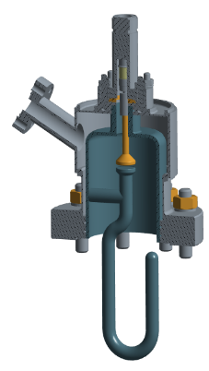
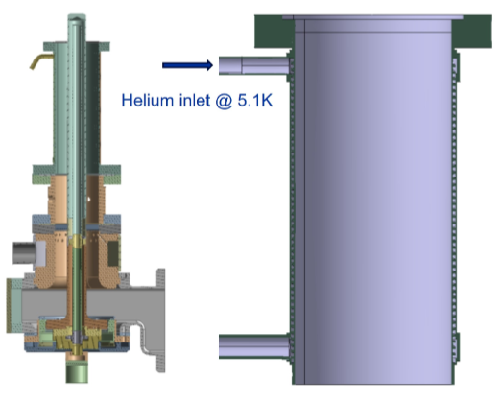

Status of Task 6.4 – Fabrication & validation of cryomodule components
Past developments
  Niobium material : delivered and shipped to Zanon.
  5-cell cavities : call for tender #2 in 2025. Zanon awarded. Kick-off meeting 16 January 2026. Manufacturing file is progressing well (technical drawings approved)...final approval soon then fabrication will start. First bare cavities expected in T1 2027.
  Magnetic shields: material (cryophy and µmetal) ordered. 6 month delay for 2mm thick µmetal...delivery in September 2026.
Current developments
  HOM couplers (+ 4 units w.r. to WP4): call for tender in preparation. Publication in May.
  Double-wall tubes (for FPC): call for tender in preparation. Publication in May.
  Cold tuning systems: all quotations received (~30k€/CTS). Ordering phase is about to start.
  All metal gate valves: quotation received. Super expensive! Ongoing discussion with another supplier (VSE Vakuumtechnik)
  Magnetic shields: call for tender postponed to October 2026
  Cryomodule dished-ends: technical drawings in progress...
5cell cavity drawing
Hook type HOM coupler
FPC & DWT

Slide 12
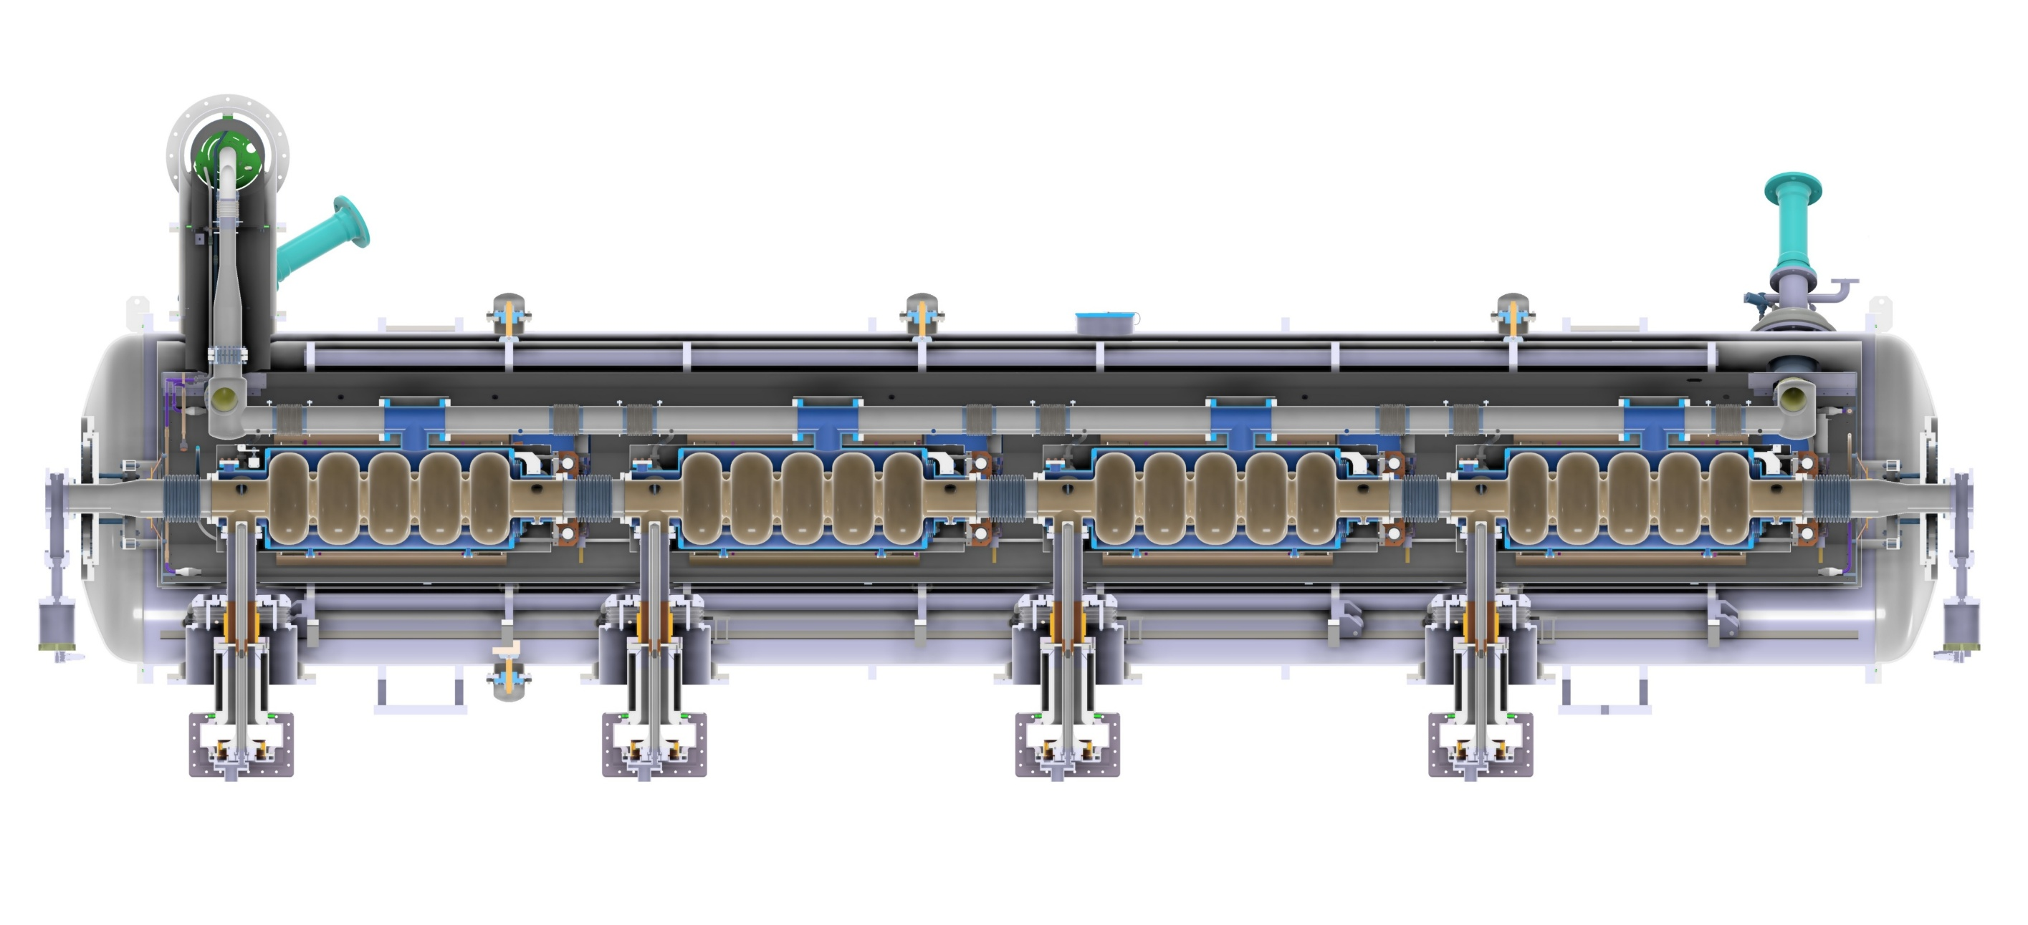
status of Task 6.5 – assembly and test of the cryomodule
Clean room assembly and cryostating phase.
Not started yet. Task 6.3 needs to be completed (expected this summer).
Cryomodule should look something like this...
c/o S.Blivet

Slide 13
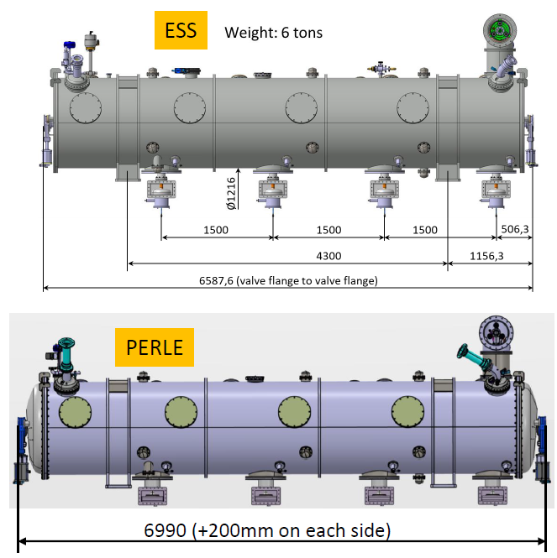

status of Task 6.5 – assembly and test of the cryomodule
Preparation of the test stand @ Lund.
Points of attention raised during the technical review in June 2025 and addressed:
Cryomodule footprint into the bunker (+40cm total w.r. to ESS Cryomodule)
Air cooling of the FPC (vs. water cooling for ESS couplers). Assembly before cryomodule installation into the bunker: checked and validated.
FPC doorknobs dimensions vs. ESS ones : checked and validated.
Cryogenic and RF test of the cryomodule.
Not started yet.

Slide 14
points of attention
Fabrication of 5-cell cavities already on critical path → action: carefully follow-up the fabrication
Cavity preparation (Vertical EP, annealing, mid-T bake) never done on multi-cell 800MHz cavity → action: recipe must be validated on single-cell cavities beforehand. Close collaboration already established with CERN and CEA to develop the right recipe. First single-cell cavity delivered to IJCLAB a week ago.
Linked to WP4 acitivity. HOM couplers & FPC fabrication → action: continue participating to the WP4 meetings and be flexible is adaptation is needed.
Additional cost of certain components. Gate valves for example (more than x2) → action: start technical discussion with another potential supplier (whenever it is possible of course).
No spare components → action: keep your fingers crossed!

Slide 15
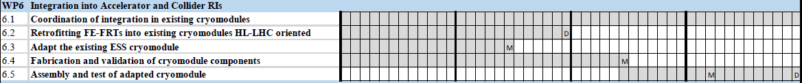
plans to achieve milestones & deliverables
Planning
Feb 2025
Feb 2026
Feb 2027
Feb 2028
Milestones
M6.1
OK
M6.2
August 2026 → Sept 2027
M6.3
May 2027 → May 2028
Deliverables
D6.1
Feb 2026 → Aug 2026
D6.2
Feb 2028 → Nov 2028
→ Extension of the contract needed

