Slide 1

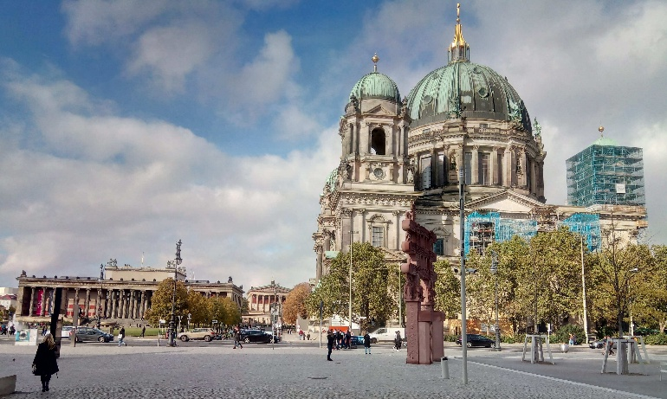




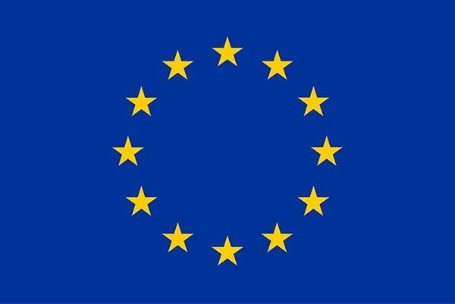
WP1: FE-FRT Berlin meeting, April 23, 2026
All information contained in this presentation and any accompanying documents is for iSAS project only and must be treated as strictly confidential.
Any dissemination, distribution or other use of this information without the consent of its owner is prohibited.
With material from Nick Shipman, Alick Macpherson, Graeme Burt, Sam Smith et al. Further Members: André Frahm, Maleesh Dissanayake, Hingpong Jiang, Alexei Kanareykin et al., Walid Kaabi
Funded by the European Union. Views and opinions expressed are however those of the authors only and do not necessarily reflect those of the European Union or the European Commission. Neither the European Union nor the granting authority can be held responsible for them.

Slide 2


Can we afford large scale accelerator driven science?
introduction
A different view on science (take these numbers with error bars):
LHC at CERN transforms electric power of 120 MW up to 200 MW
LHC run 2 had an estimated energy usage of 750 GWh per year
50 MW alone is cooling power to liquify helium (1.9K SC magnets) Note: w/o crab cavities there are only eight SRF cavities per beam
The standard LHC produced about 3M Higgs bosons per year
© IMAGO / ZUMA Wire / Fatima-Tuj Johora LMU München, https://www.lmu.de/de/newsroom/newsuebersicht/ news/forschung-zum-klimawandel.html
0.25 MWh per Higgs or 28.7 tons of CO₂ per Higgs boson
taking Switzerland's rather clean 115g CO₂ per kWh electricity
3 million Higgs bosons produce as much CO₂ as 12 million average German citizens as of 2023
or about 23 million Swiss citizens (2023)
https://www.home.cern/resources/faqs/facts-and-figures-about-lhc
Vol. 1 (2018): Proceedings of the CAS-CERN Accelerator School on Free Electron Lasers and Energy Recovery Linacs

Slide 3

What do we want to achieve within WP1
WP1 is part of task#1: Aim to lower the amount of required RF power
Develop novel fast tuning systems compensating detuning by mechanical vibrations or beam induced transients, which both are usually compensated by adding a significant power overhead → WP1 aka FE-FRT
Most effectively applied on CW driven SRF cavities, especially for low beam-loading FELs or ERLs (EU XFEL, LHeC (PERLE)), eventually FCC use cases and transient beam-loading (switching)
All this should of course not compromise the stability and reliability of operation, better even improve it beyond current state of the art. The savings in RF power should be significant, to justify any required modification to a cavity system → retro-fitting to existing systems would be pure gold

Slide 4
WP1: FE-FRT (Official overview)
HZB, CERN, CNRS, Uni.Lancaster
Convener: Axel Neumann (HZB), deputy Alick Macpherson (CERN)
Main contacts with other partners: Alick Macpherson (CERN), Walid Kaabi (CNRS), Graeme Burt (Uni.Lanc.), industry: Alexei Kanareykin (Euclid Techlabs)
Task 2.4 Integrated LLRF control using FE-FRT
Task 3.3 RF tunability, FE-FRT for Nb3SN coated cavities?
Task 1.1: Coordination of R&D on FE-FRT – M1-M48 (HZB)
• General coordination by HZB as described above.
Task 1.2: FE-FRT for Transient Beam Loading – M1-M40 (CERN)
• Design a full FE-FRT-based 400 MHz tuner, applicable to LHC transient detuning scenarios.
• Perform full RF, mechanical and cryogenic evaluation of the FE-FRT-equipped . LHC cryo-module.
• Use design lessons learned to design a tuner for transient detuning of FCC 800 MHz multi-cell cavities.
Task 1.3: FE-FRT for Microphonics – M1-M48 (HZB)
• Establish characteristics and performance of FE-FRT ferroelectric material at frequencies ≥1300 MHz.
• Design, fabricate and validate an FE-FRT for microphonics suppression on a single-cell 1.3 GHz cavity.
• Design, fabricate and validate an FE-FRT for multi-cell cavity at 1300 MHz, in a cryomodule-like setup.
Task 1.4: FE-FRT in Energy-Recovery LINAC (ERL) mode – M1-M48 (CNRS)
• End-group design study for integration into ERL-type cavity, study HOM+BBU properties.
• FE-FRT design study for RF and mechanical integration into upgraded ERL cavity.
Task 6.2: Retrofitting Fast Reactive Tuners into existing cryomodules HL-LHC oriented – M1-M24
Study of frequency domain multiplexor-based HOM coupler
Study the effect of HOMs on FE-FRT operation to define max leakage
Study the heating due to high fundamental power in the coupler
Strong link to Tasks 1.2-1.4

Slide 5

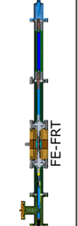
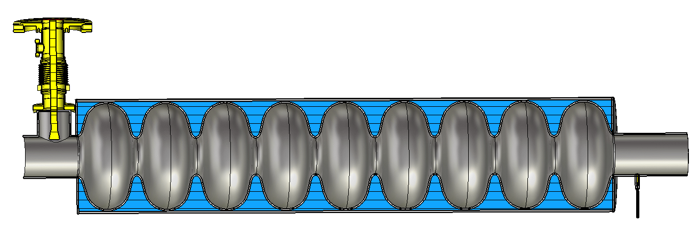
WP1 – FE-FRT: Collaboration
Ilan Ben-Zvi
New applications
FE-FRT
for microphonics detuning
1300 MHz
bERLinPro
FE-FRT for transient beam-loading compensation
400-800 MHz LHC HiLumi FCC use cases
Emerging non
iSAS partners…
WP6: Retrofitting fast reactive tuner, beam effects
FE-FRT for ERLs
1300 MHz, UK-XFEL
400-800 MHz, FCC use cases
800 MHz PERLE

Slide 6
WP1 – FE-FRT: status/evolution of Task 1.1
coordination
Past developments
Bi-weekly online meetings to discuss work progress, exchange information, review milestone progress
Hosted first FE-FRT workshop at HZB (Nick Shipman) including partners beyond iSAS: CERN, U Lancaster, UKRI Daresbury, JLab, U Mainz, Euclid, Vitave, DESY, Research Instruments, HZB
Published (CERN) two iSAS related articles:
S. Smith et al., ”Towards high power tests of an FE-FRT for transient detuning”, in Proc. SRF2025, Tokyo, Sep. 2025, pp. 516-521. doi:10.18429/JACoW-SRF2025-WEA03
Ben-Zvi, Ilan, Alick Macpherson, and Samuel Smith. ”Detailed design and optimization of ferroelectric tuners.” Physical Review Accelerators and Beams 28.9 (2025): 093502
Current developments
Submitted Milestone reports in time for MS1 (Task 1.3), MS41 (Task 1.1) and MS46 (Task 1.2)
Hired two students at HZB with the Basque University abroad program to work on FE-FRT material characterization (1300 MHz) and support the AI implementation on FPGA systems (WP2)
Report RP1 submitted for the iSAS 1st reporting period review on June 1st

Slide 7
iSAS timeline and milestones
FRT design and fabrication
Nov 2024 Design of TTD1
June 2025 Fabrication of TDD1
FE ceramics
Material characterized at 400 MHz
High voltage breakdown tests performed
Test of TDD1 (cold test with high power)
Dryrun at room temperature in Q3 2025
Cold test (low power) performed
July 2024 Design and fabrication of teststand
April 2025 LLRF control ready
Sample preparation established
High power test in Q2/3 2026
Integration study into LHC ¼ cryo-module
Not started
Task 1.2: FE-FRT for Transient Beam Loading – M1-M40 (CERN)
iSAS funds:
0.44 M€
FRT design and fabrication
May 2025 RF design ready
June 2025 Mechanical design
FE ceramics
Material characterized at 1300 MHz (FERMAT, Euclid)
Sample preparation: Cutting, grinding, lapping, polishing
Single cell test with prototype
2-cell cavity being prepared at RI
Critically coupled, but with blade tuner +piezos
Preparation of LLRF system started (RFSoC)
Tuner ready for Q1-2 2026
Sample analysis
Microphonics compensation proof of principle test
Multi-cell test (fully equipped cavity)
TESLA cavity in HoBiCaT with FPC and classic tuner
FE-FRT second version, e.g. optimized also for higher stored energy
Final LLRF + FE-FRT test
MS46/ Feb 26
400MHz cavity with
FE-FRT
Task 1.3: FE-FRT for Microphonics – M1-M48 (HZB)
MS3/ Feb 27
iSAS funds:
0.57 M€
MS41/ Feb 26 Risk analysis
MS1/ Feb 26
Material characterized
MS4/ Feb 27
MS5/ Oct 27

Slide 8
WP1 – FE-FRT: status/evolution of Task 1.2
FE-FRT for transient beam-loading

Slide 9
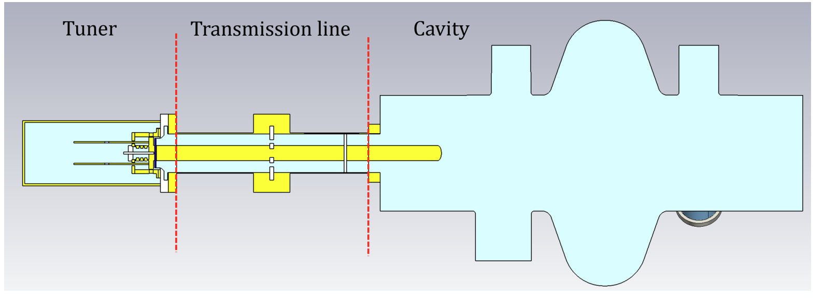
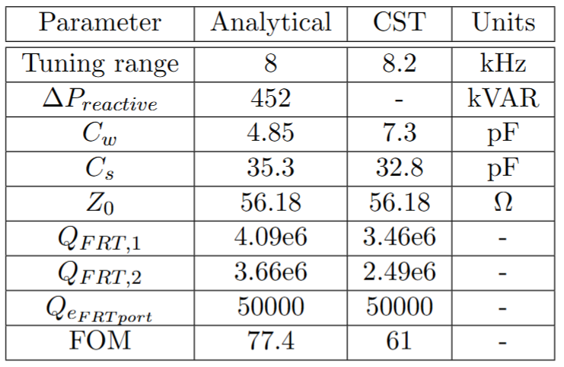
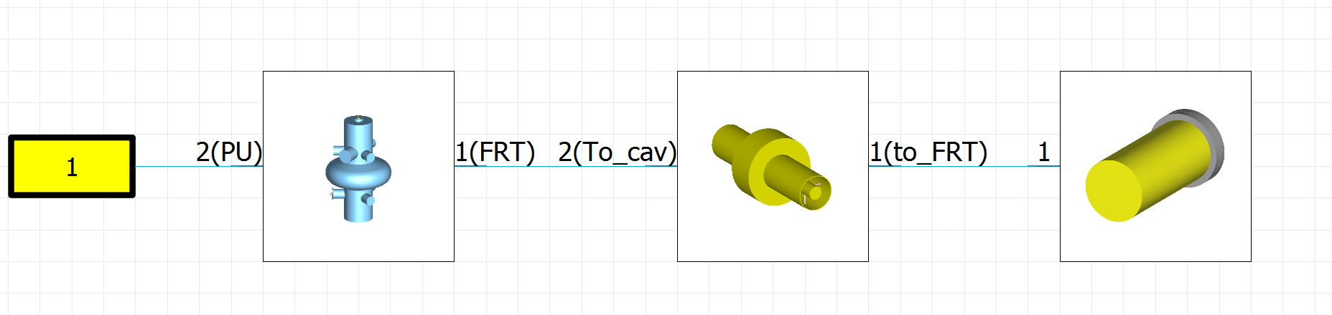
WP1 – FE-FRT: status/evolution of Task 1.2
Target: Develop, optimize and test an FE-FRT design for a 400 MHz LHC cavity with a tuning range of 8 KHz for 7.2 kV bias voltage and 100 ns switching time at up to 150 kHz switching rate → Prototype target
Method: Optimize RF design by analytical and numerical modelling, perform sensitivity studies due to fabrication tolerances, cooldown, operating temperature, variation of ceramics (ferroelectrica) performance
Response seen through cavity
0 – 7.2 kV bias
8.2 kHz
RF model
Tuner FoM 61: 3.8 kW P_{diss}

Slide 10
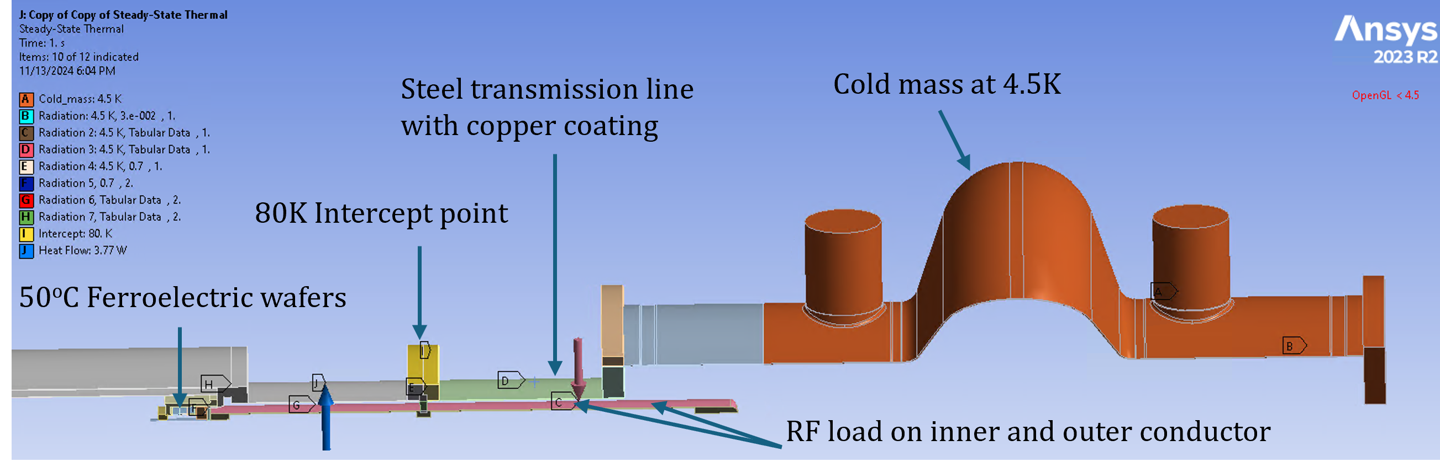
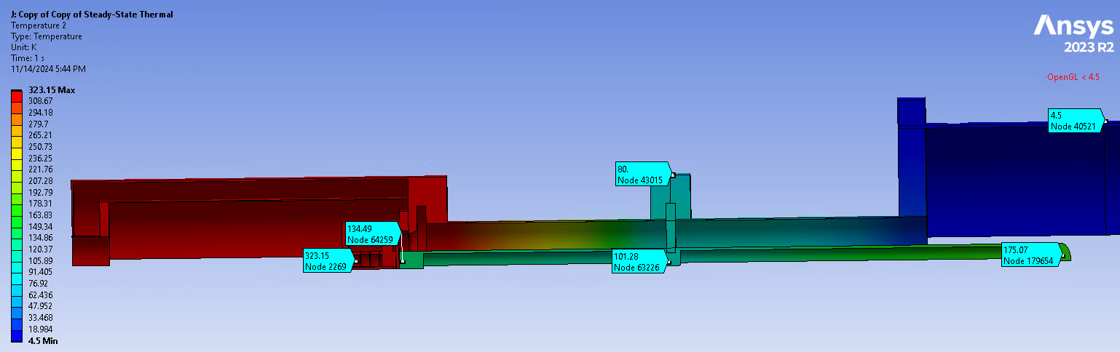
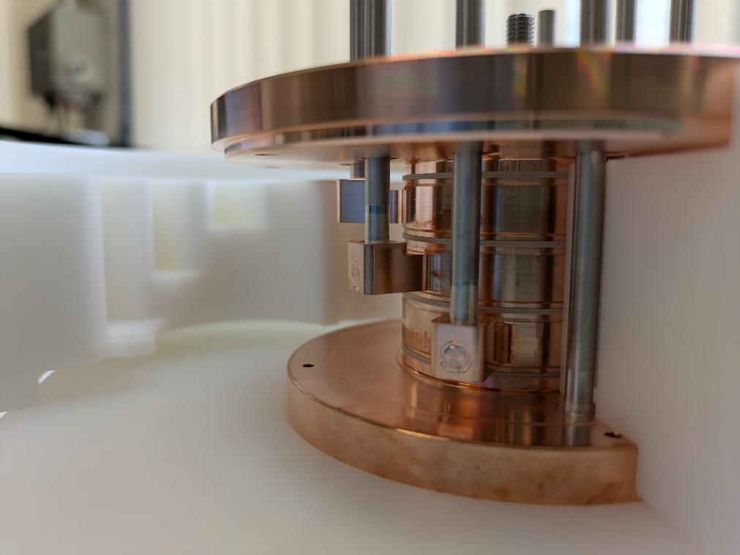
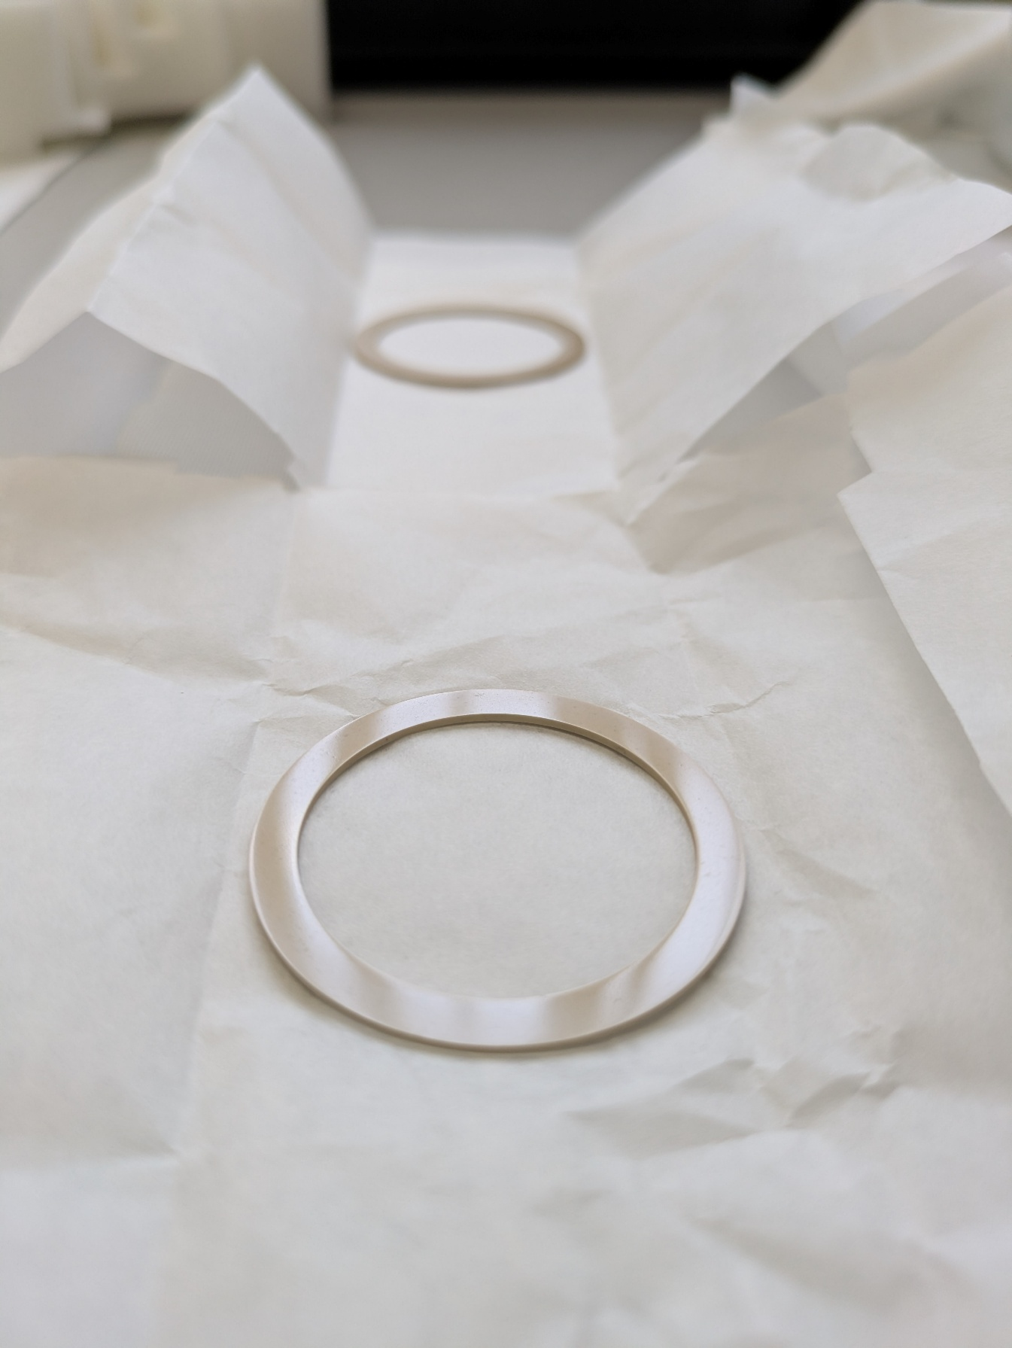
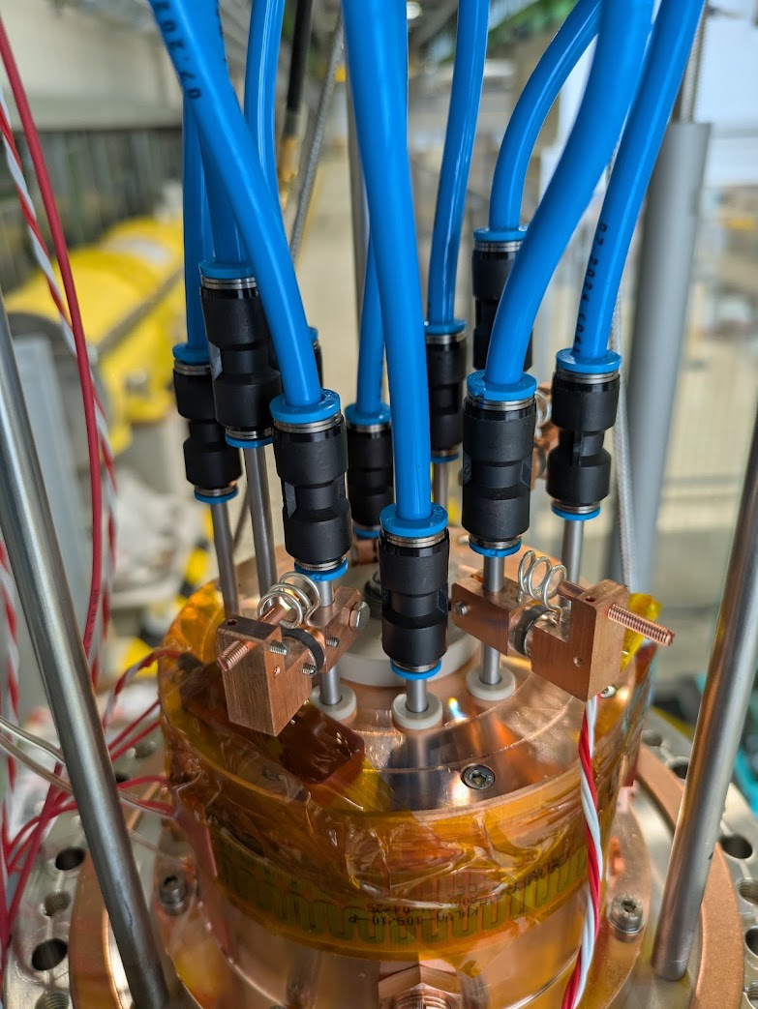
WP1 – FE-FRT: status/evolution of Task 1.2
Method: Thermal analysis of design, sensitivity analysis → Improved RF and mech. design
Losses and heating by dynamic RF load as well as static losses
Steel transmission line with Cu coating to minimize heat transport, 80K intercept
Ferroelectric wafer at 50°C ←→ Cavity at 4.5 K, heat management, guarantee the right operating temperature of FE material (ferroelectric vs. para- electric regime!)
Antenna length deformation due to cool-down and temperature distribution vs. power level, etc…..
Design features:
Wafer overhang to reduce breakdown prob.
Optically polished ceramic: Good contact
Integrated electrode cooling
Tuning screws to adjust capacitance
LC filters to isolate HV…..and more
FE Wafers

Slide 11
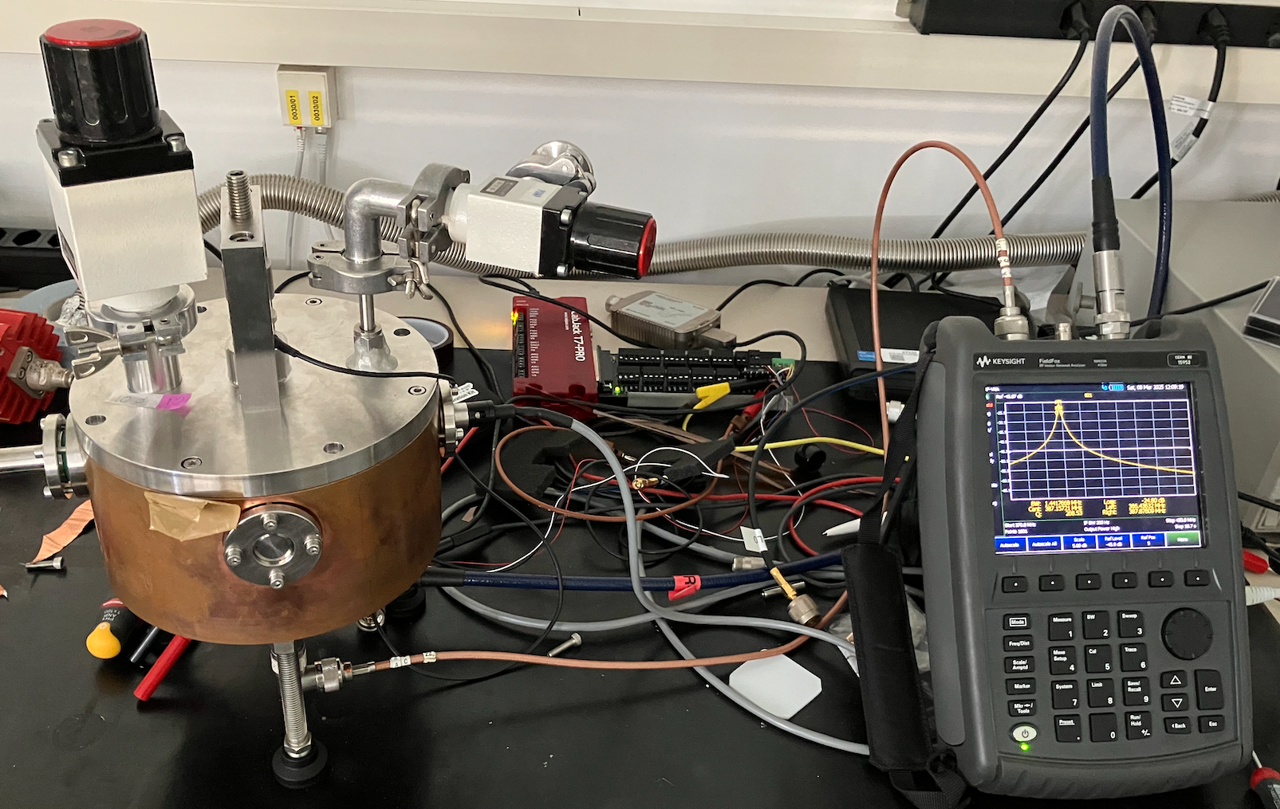
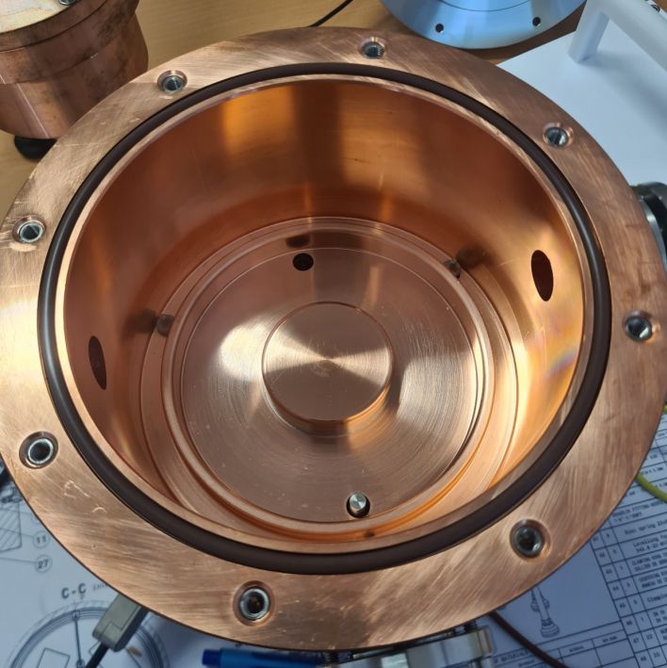
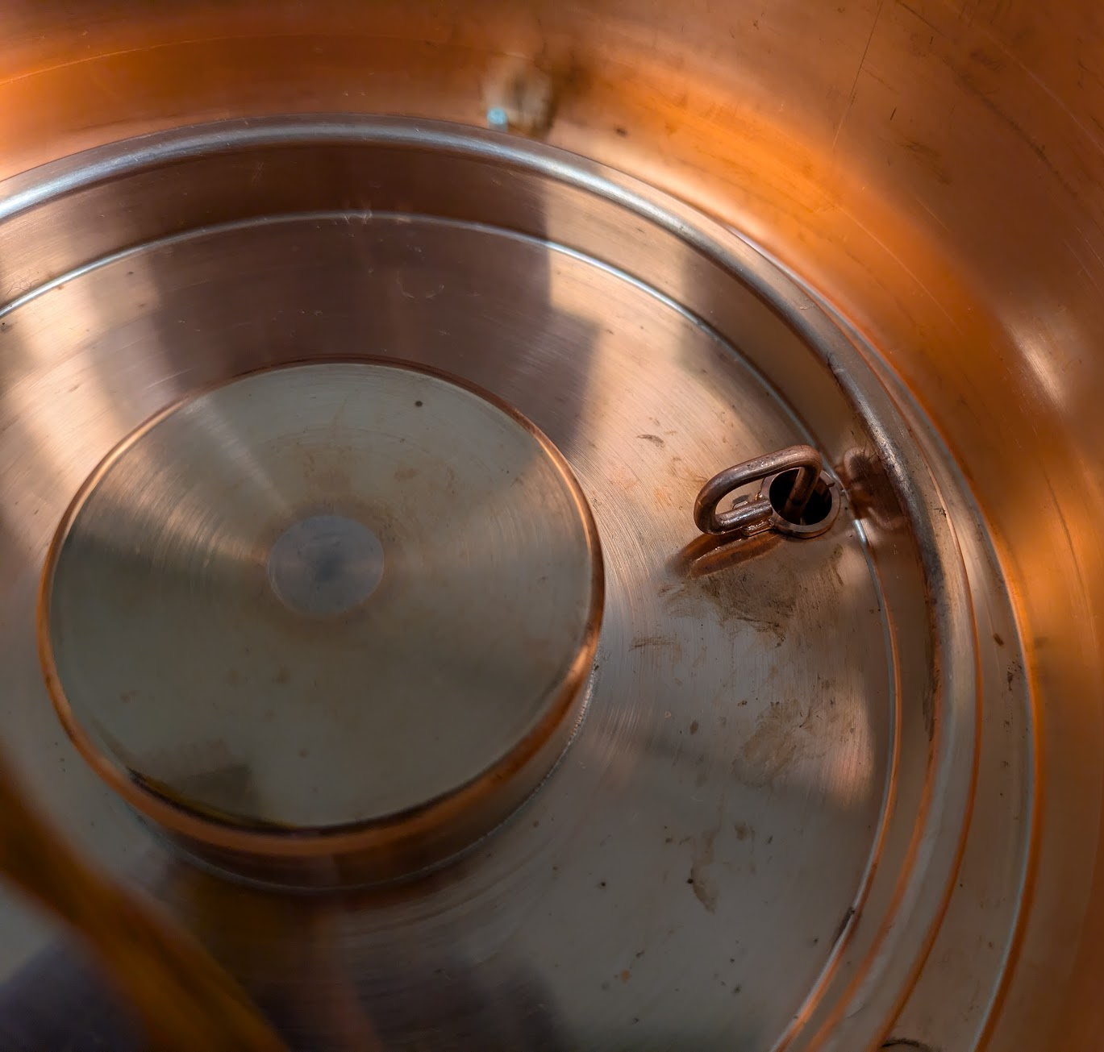
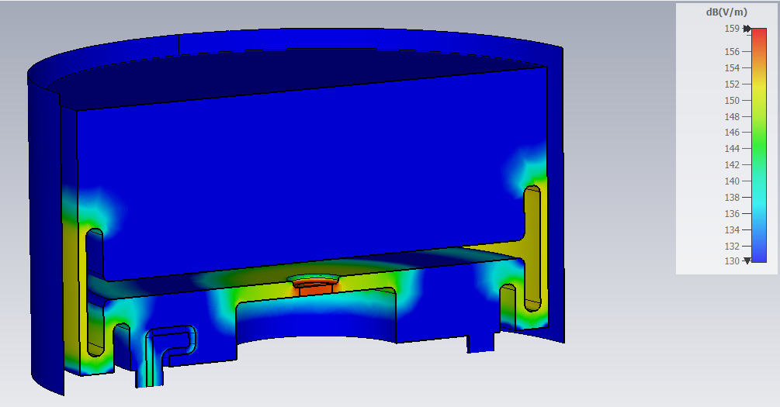
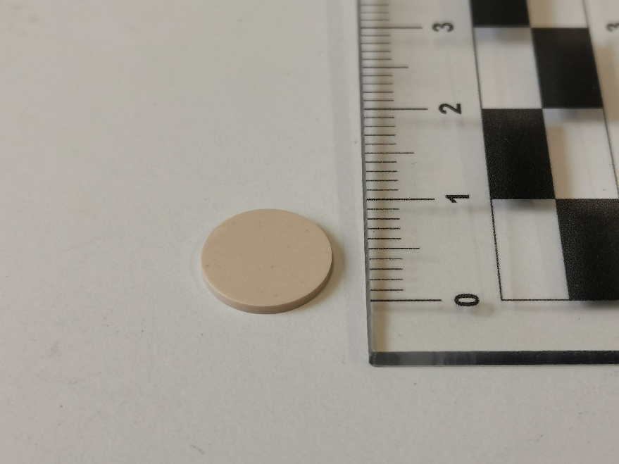
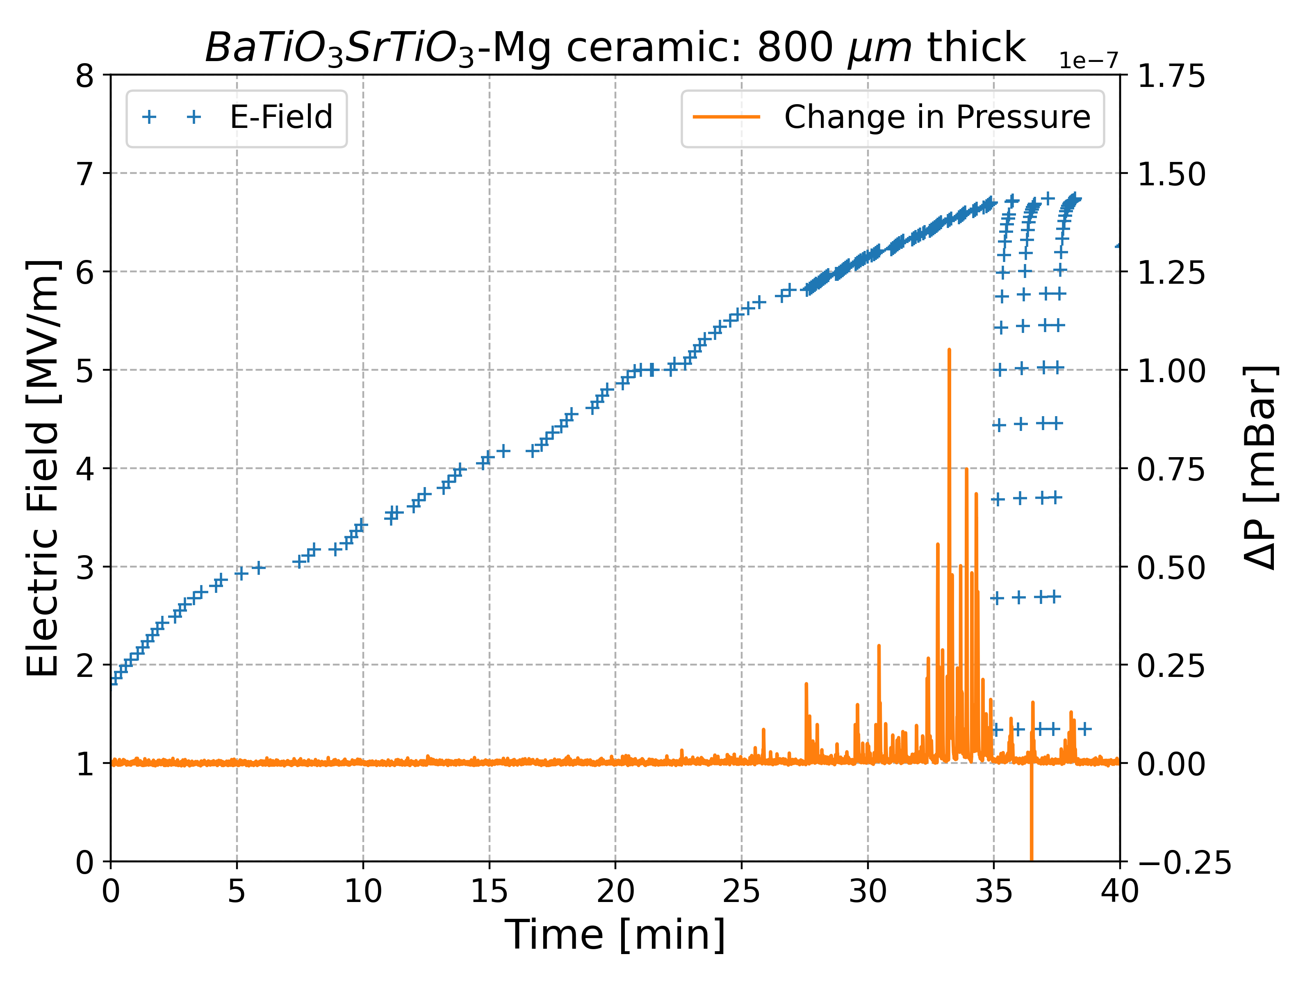
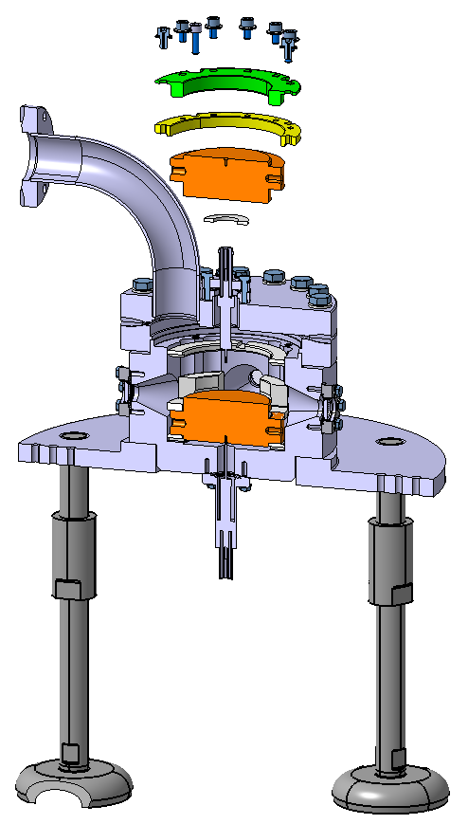
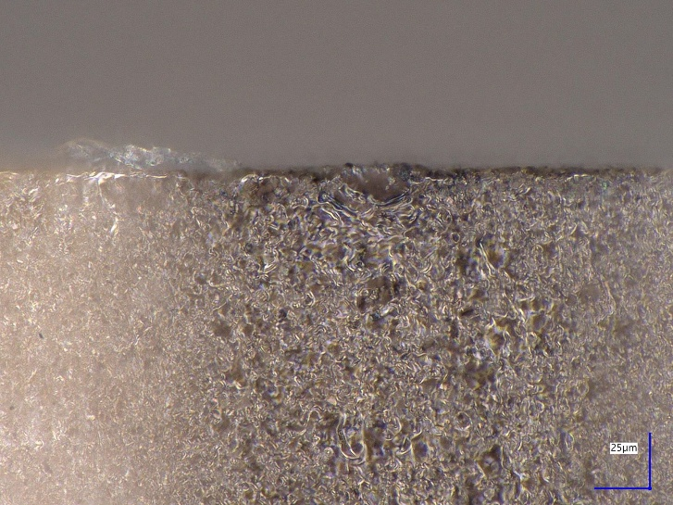
WP1 – FE-FRT: status/evolution of Task 1.2
Method: FE-FRT only as good as its BST ferroelectric ceramic!
Sample preparation:
Diamond saw cutting of slices
Grinding/polishing procedure for optical finish
Cleaning by US bath, alcohol wipe and 120°C bake
Provider: Industry partner Euclid Techlabs:
Water jet cutting → surface polish → vacuum bake
Compression w/o brazing with diamond machined copper parts
40mm
Surface quality
Impact on material performance with RF
f(ε_{r})
Test of high voltage breakdown: LES (W. Wuensch group)
Validation of FE machining, preparation and cleaning
Reached 7.2 V/µm
Detailed campaign with optimized geometry in Q3 2026

Slide 12
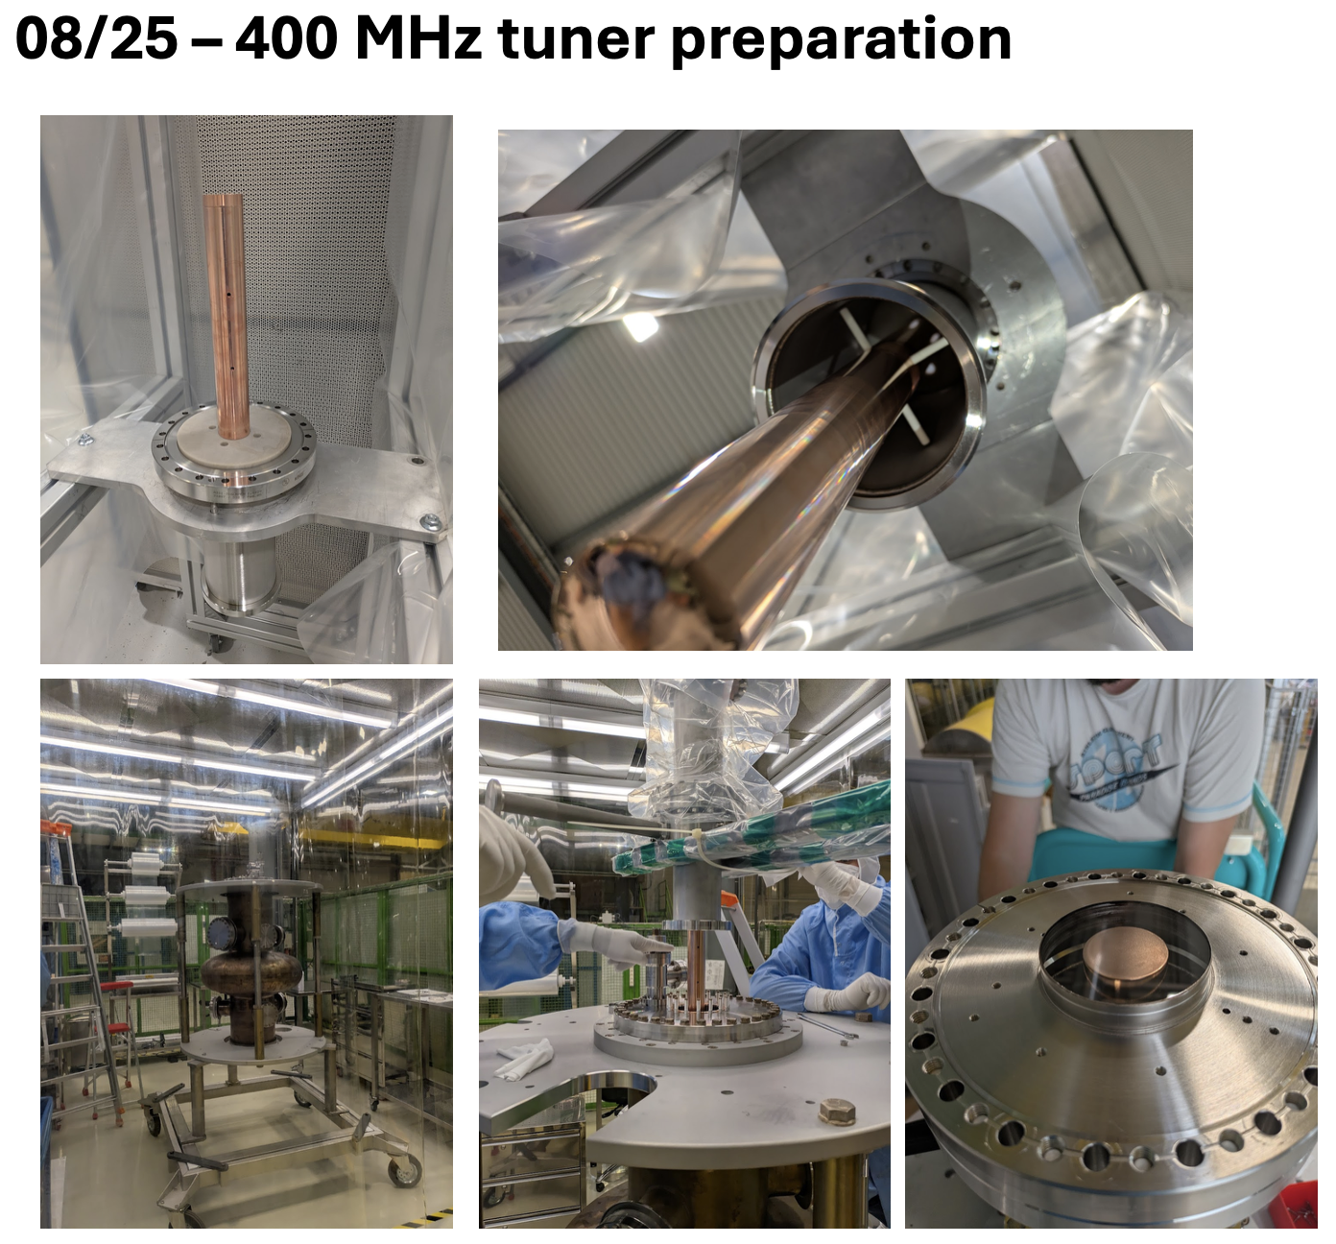
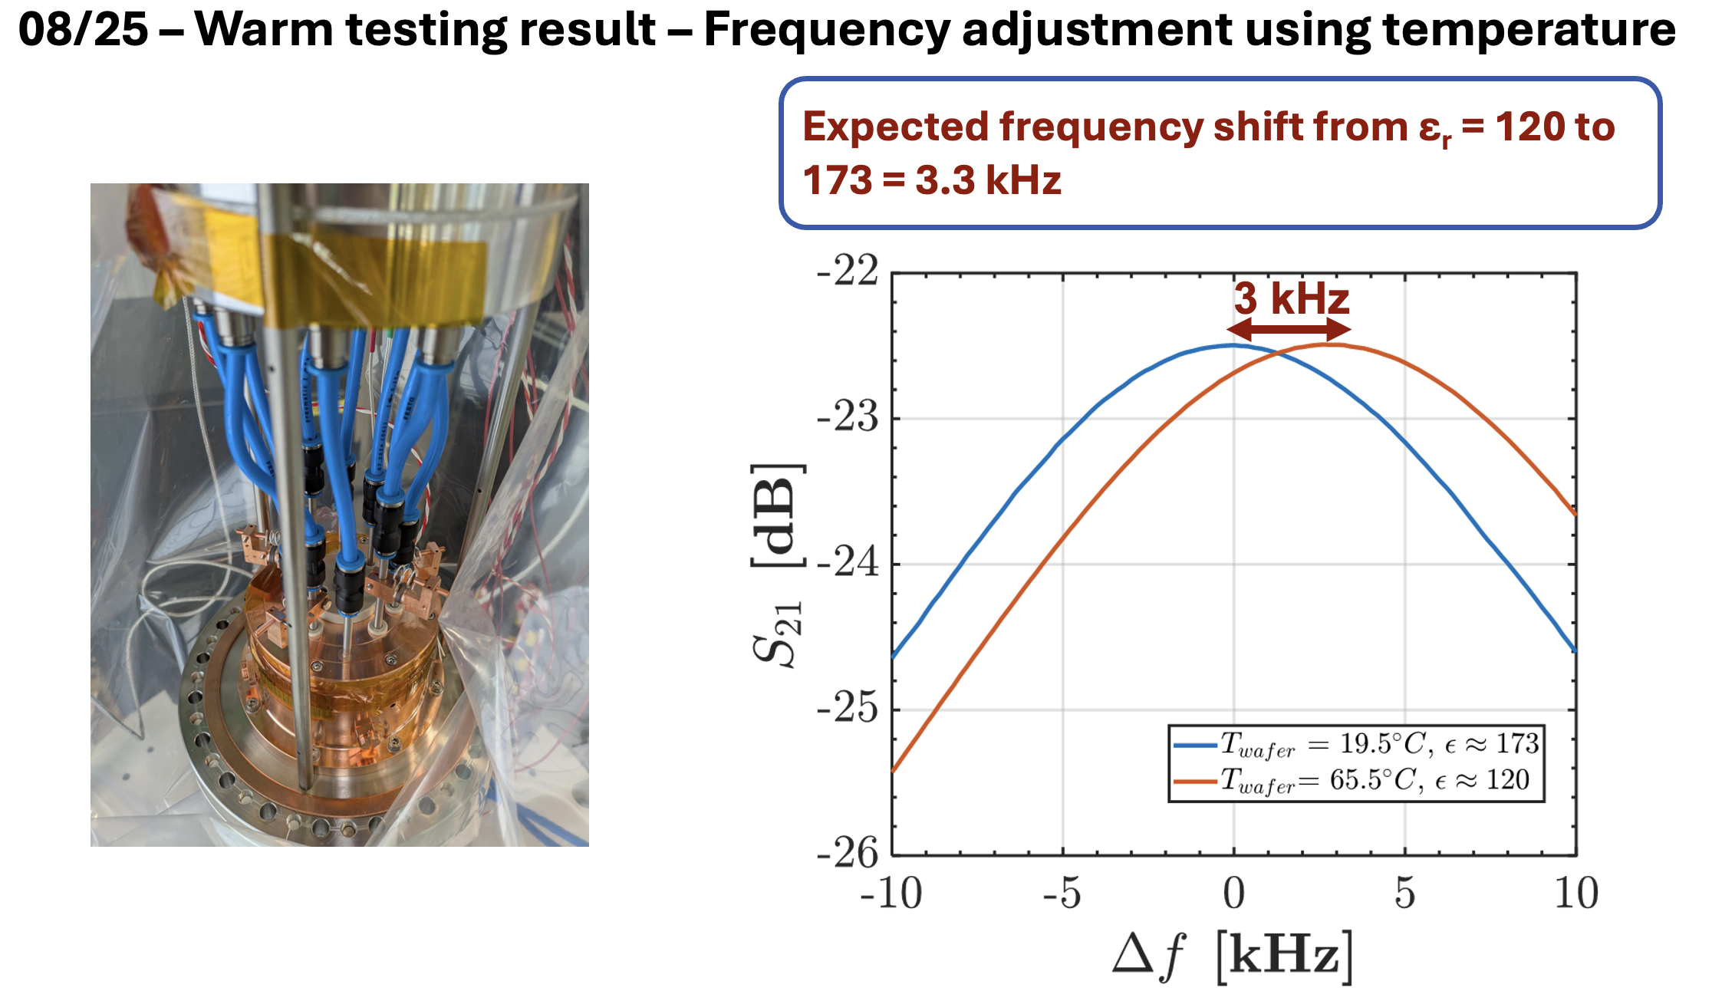
WP1 – FE-FRT: status/evolution of Task 1.2
Steps taken in 2025: Tuner assembly, warm test validation preparation of cold test:
Goal: Obtain results for MS3 (Due in Feb. 27, Cold test + high power tests D2 June 27)
By temperature change of FE material

Slide 13
WP1 – FE-FRT: status/evolution of Task 1.2
QFRT
First Cold measurement in Q4 2025:
Anti-cryostat in VTS setup validated
Tuner operated at 320 K inside cold cryostat
Measurement issues
Cooling circuit: Porosity under vacuum
RF leakage from tuner to notch filters
Frequency sensitivity to cryostat pressure variations
Δf0
Q1 2026:
Addressing RF and cryostat issues
Modifications ongoing: 4-week RF test in June 2026 → MS3 Test of 400 MHz cavity with FE-FRT
High power test for D3
Go as high as reasonable possible with cold test
High power (100 kW) demonstration with Spin-off developed FE phase shifter
Tuner @ 4.2 K: QFRT tuning
Sensitive to cryostat pressures

Slide 14
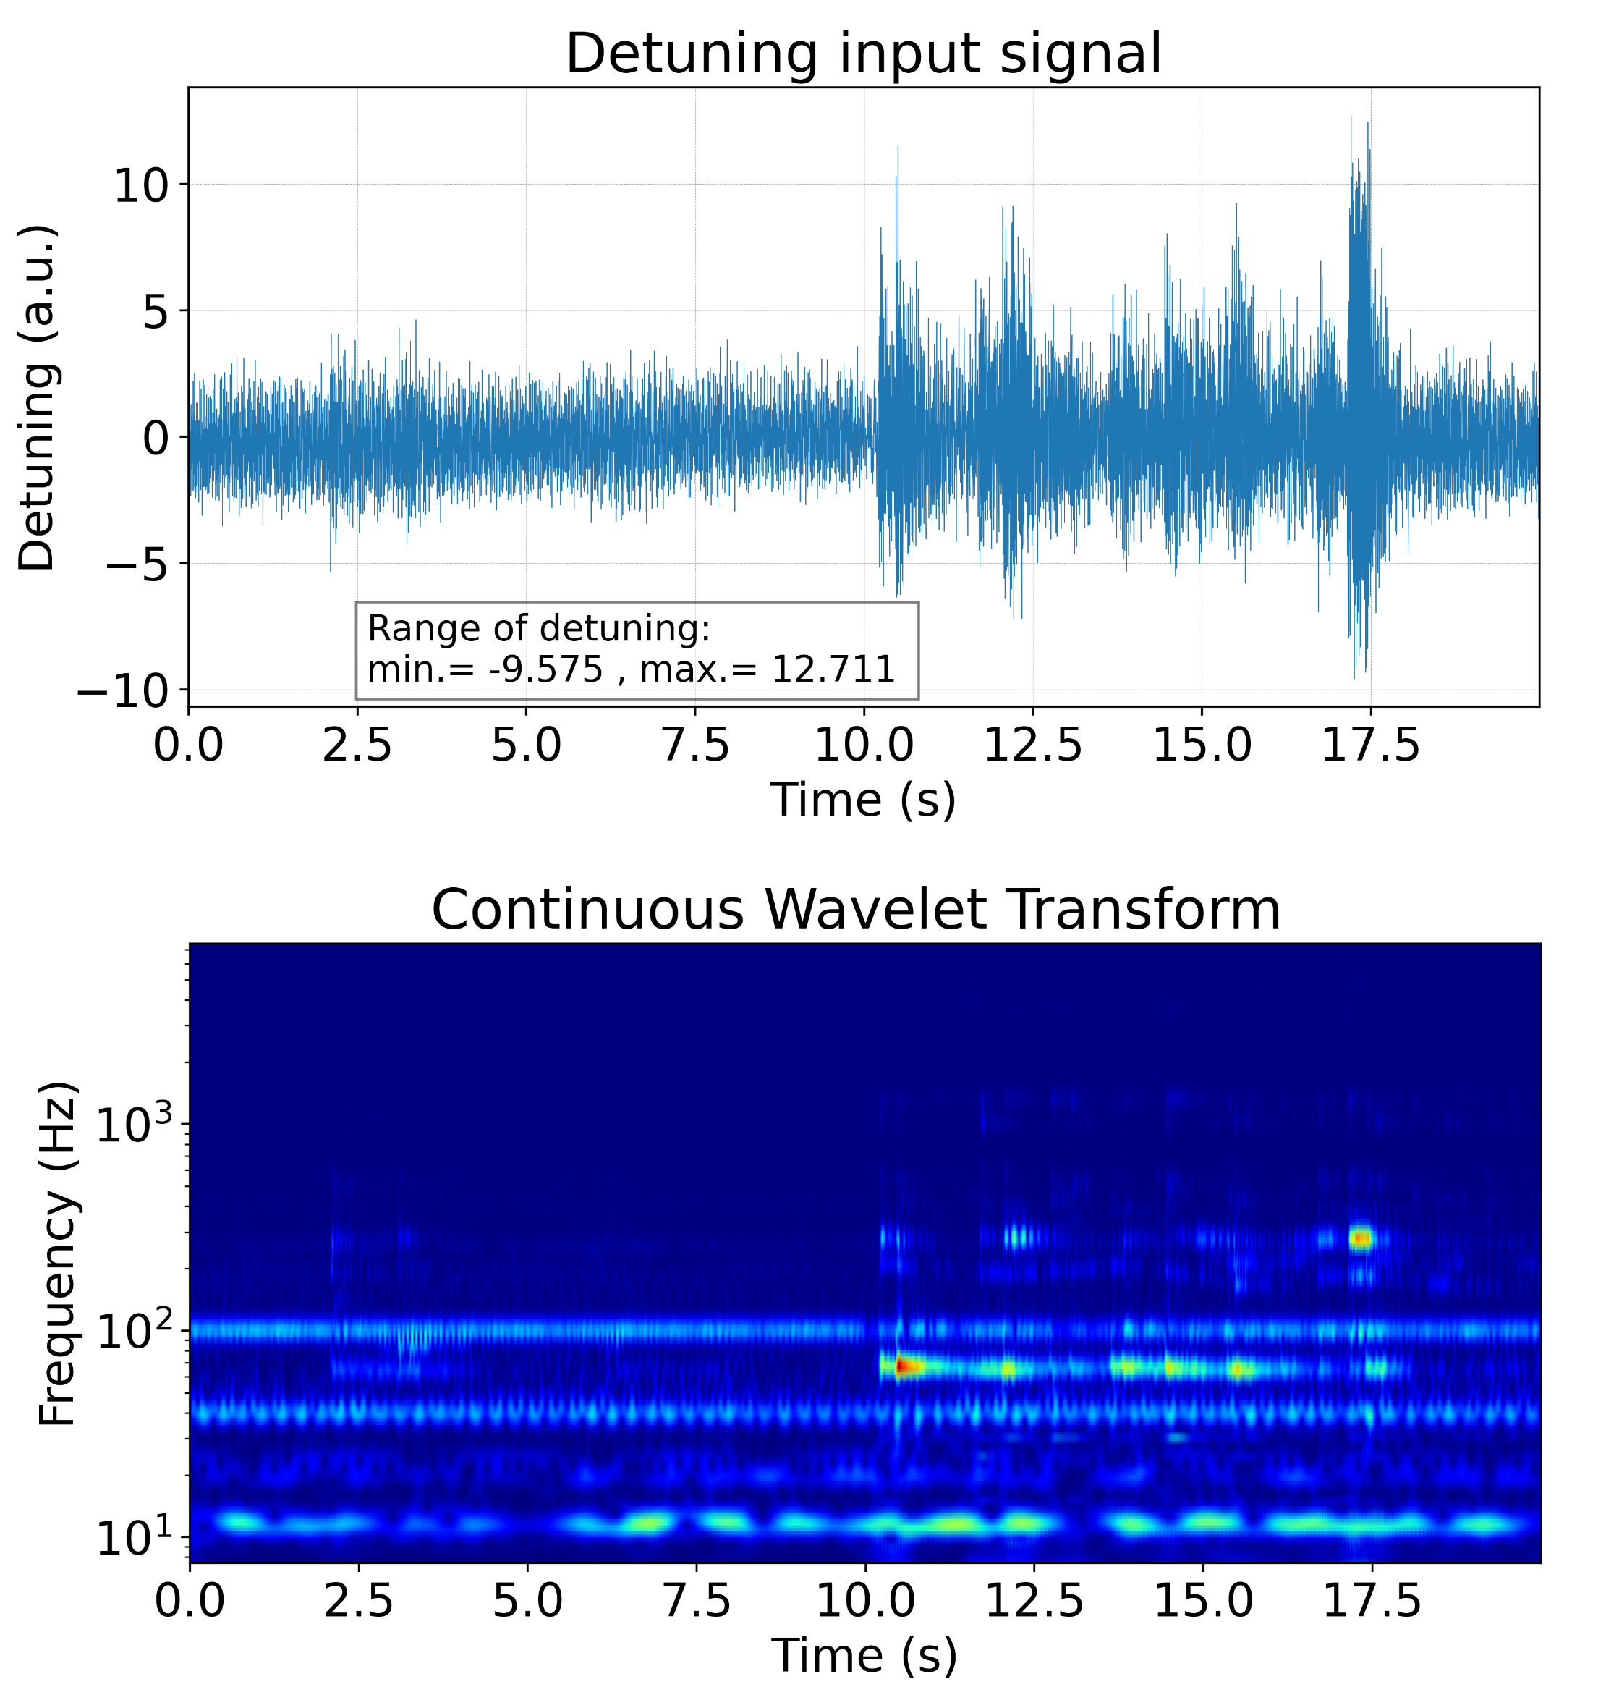
WP1 – FE-FRT: status/evolution of Task 1.3
FE-FRT for microphonics
J.S. Romero-Jiménez et al., IPAC 26

Slide 15
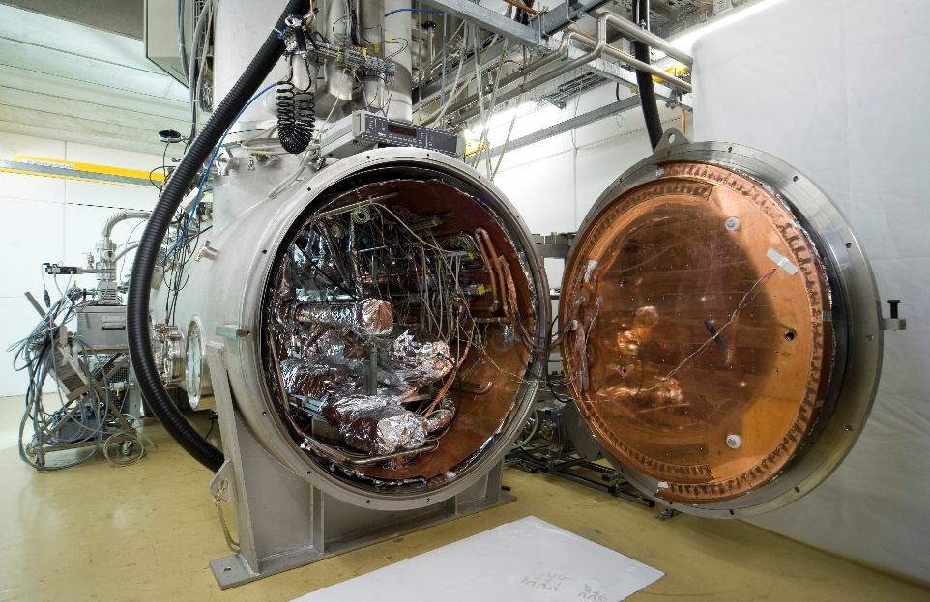
WP1 – FE-FRT: status/evolution of Task 1.3
Target: Develop and build an FE-FRT for microphonics compensation of a multi-cell SRF cavity at 1300 MHz → demonstrate a reduction of required RF power
Method: Start with design and construction of FE-FRT → RF bench test → Optimize → Test in HoBiCaT with 2-cell cavity (lower stored energy) MS4/Feb27
Improve design for a nine-cell TESLA cavity (ERL, FEL use case) → high power test with fully equipped cavity MS5/Oct27
Challenge: High FoM possible at rather high frequency, as peak/avg power reduced by FoM/2, FoM/4
Can we prepare the ceramics to required surface quality?

Slide 16
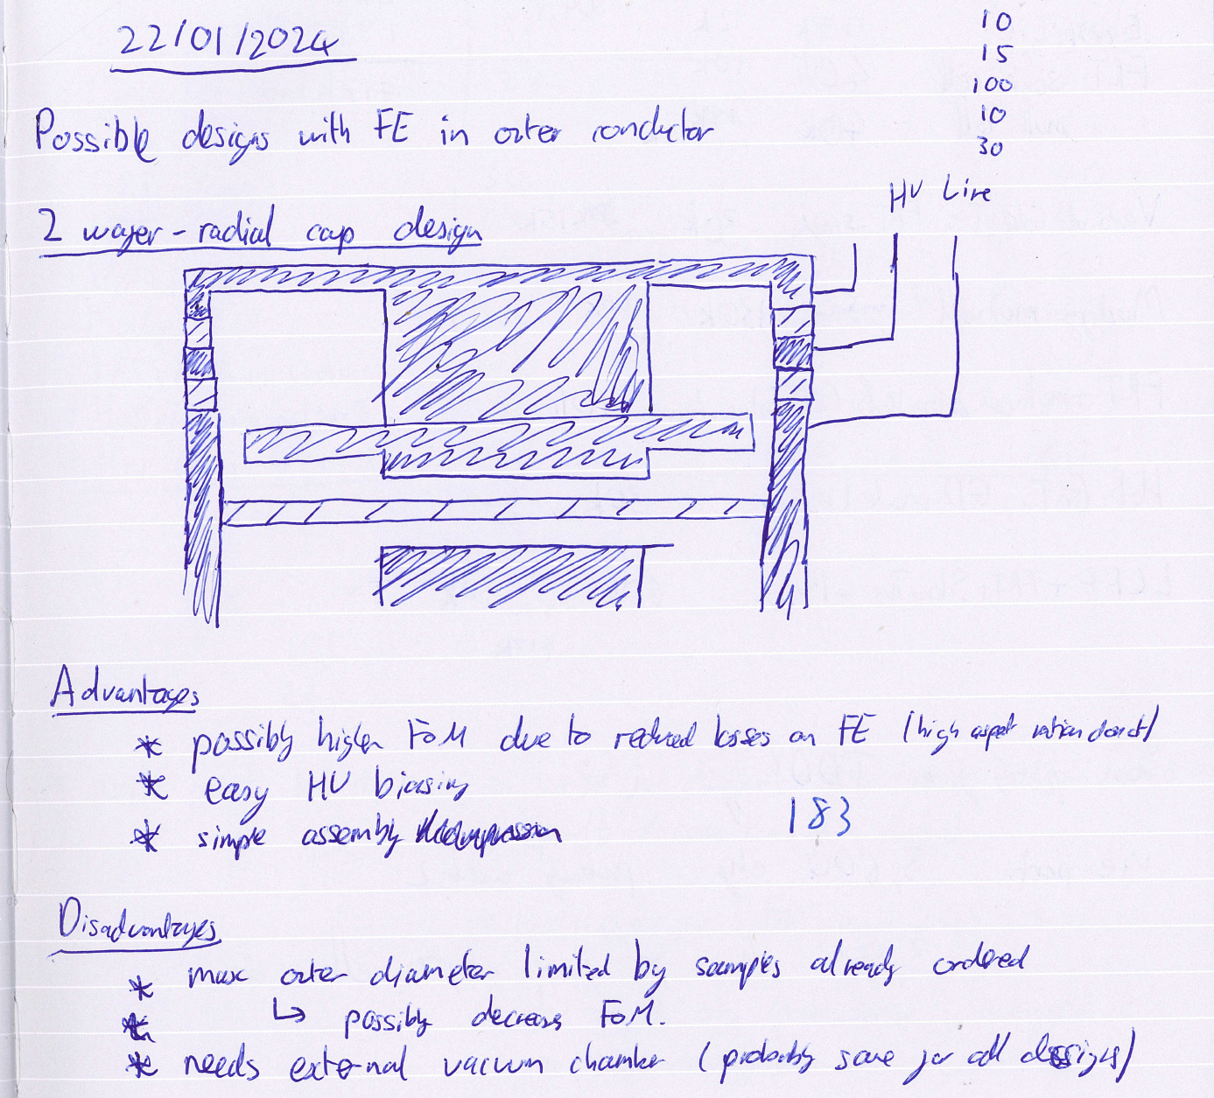
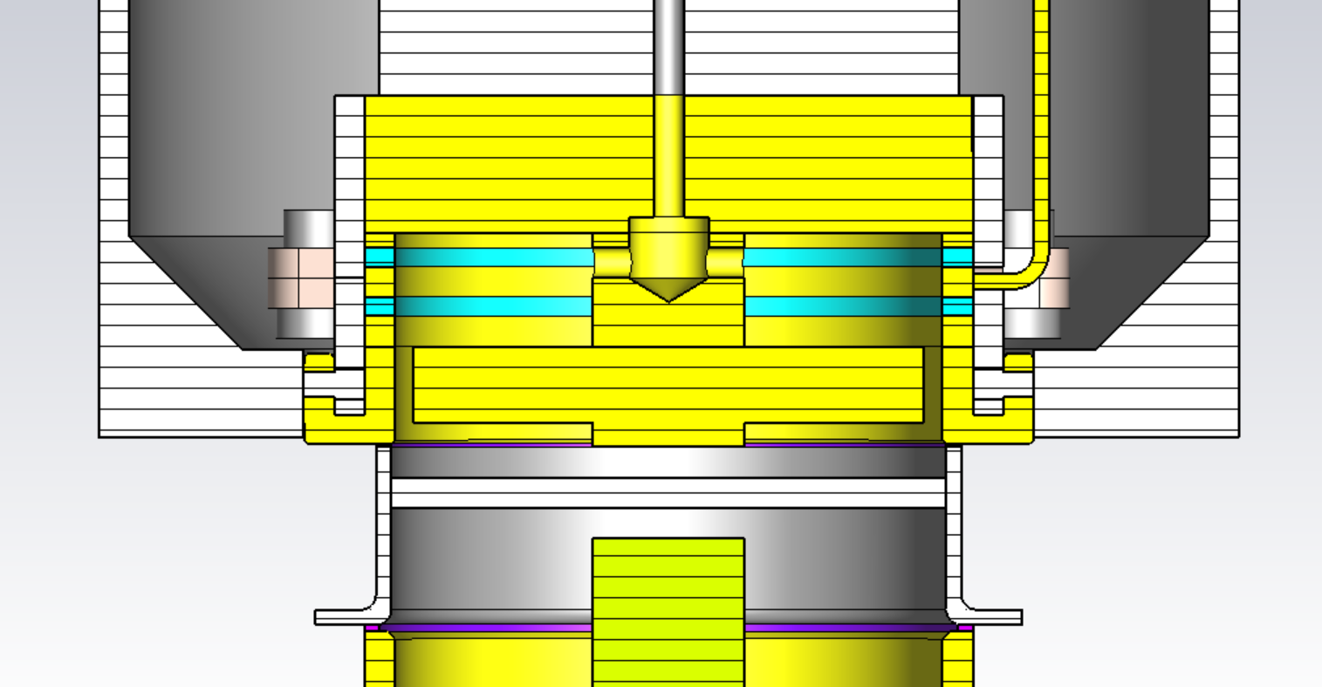
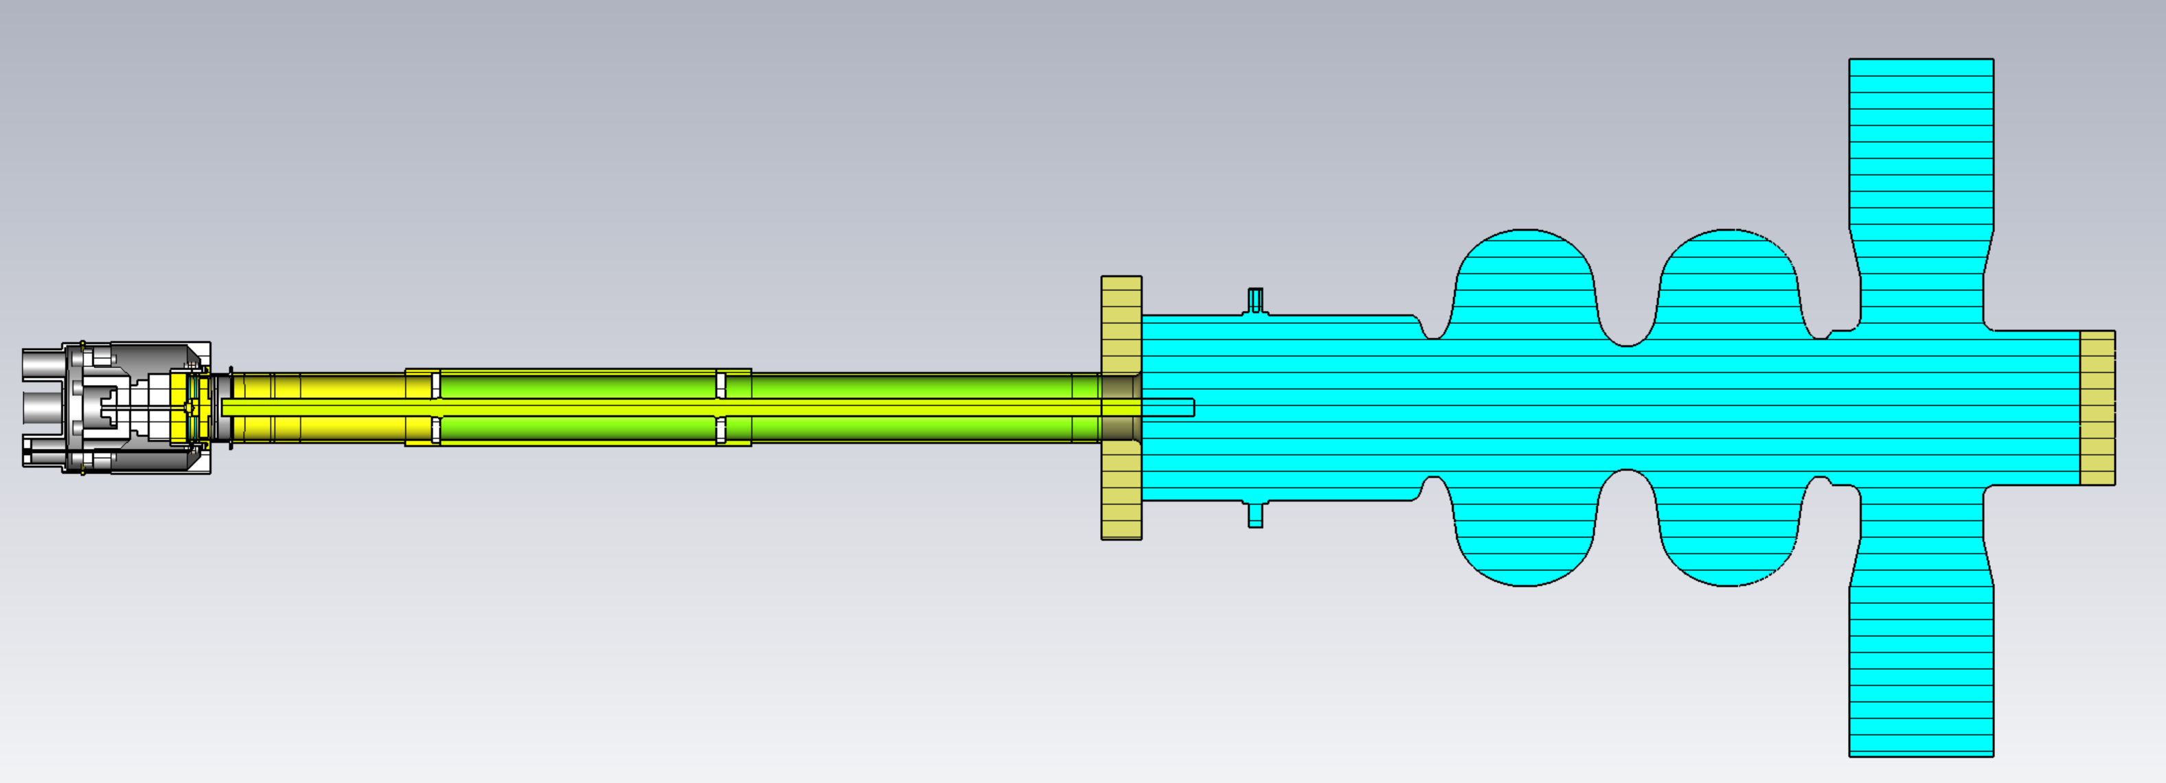
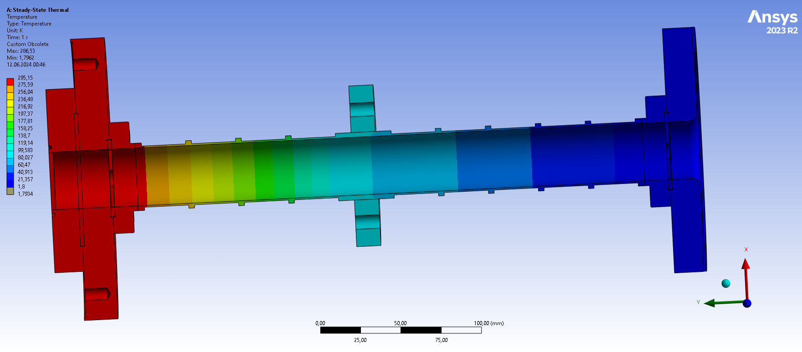
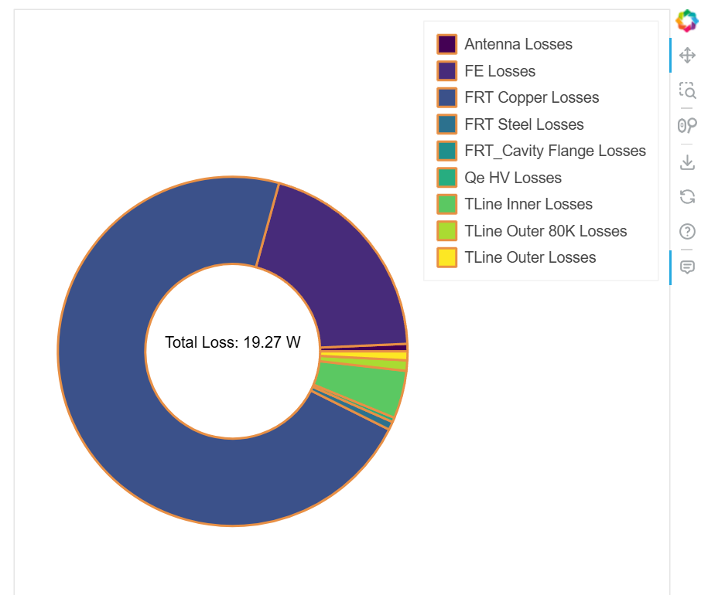
WP1 – FE-FRT: status/evolution of Task 1.3
Performed steps:
RF design finalized in May 25 (Bi-resonant design), mechanical design ready in June 25, thermal analysis, transmission line and antenna optimization
For HoBiCaT test we aim to limit heat transfer to cavity to ~2W
For eventual integration into a cryomodule we would aim to reduce this further
Use thin walled steel for transmission line
Ridges for mechanical strength
80K intercept to further reduce heat flow
Required additional cooling power ~270W
RF power saved:
2 cell Booster Cavity @ 2.1MV ~ 190W
7 cell LINAC cavity @ 15MV ~3.2kW
How it started……
Transmission line
FRT
2-cell Booster

Slide 17
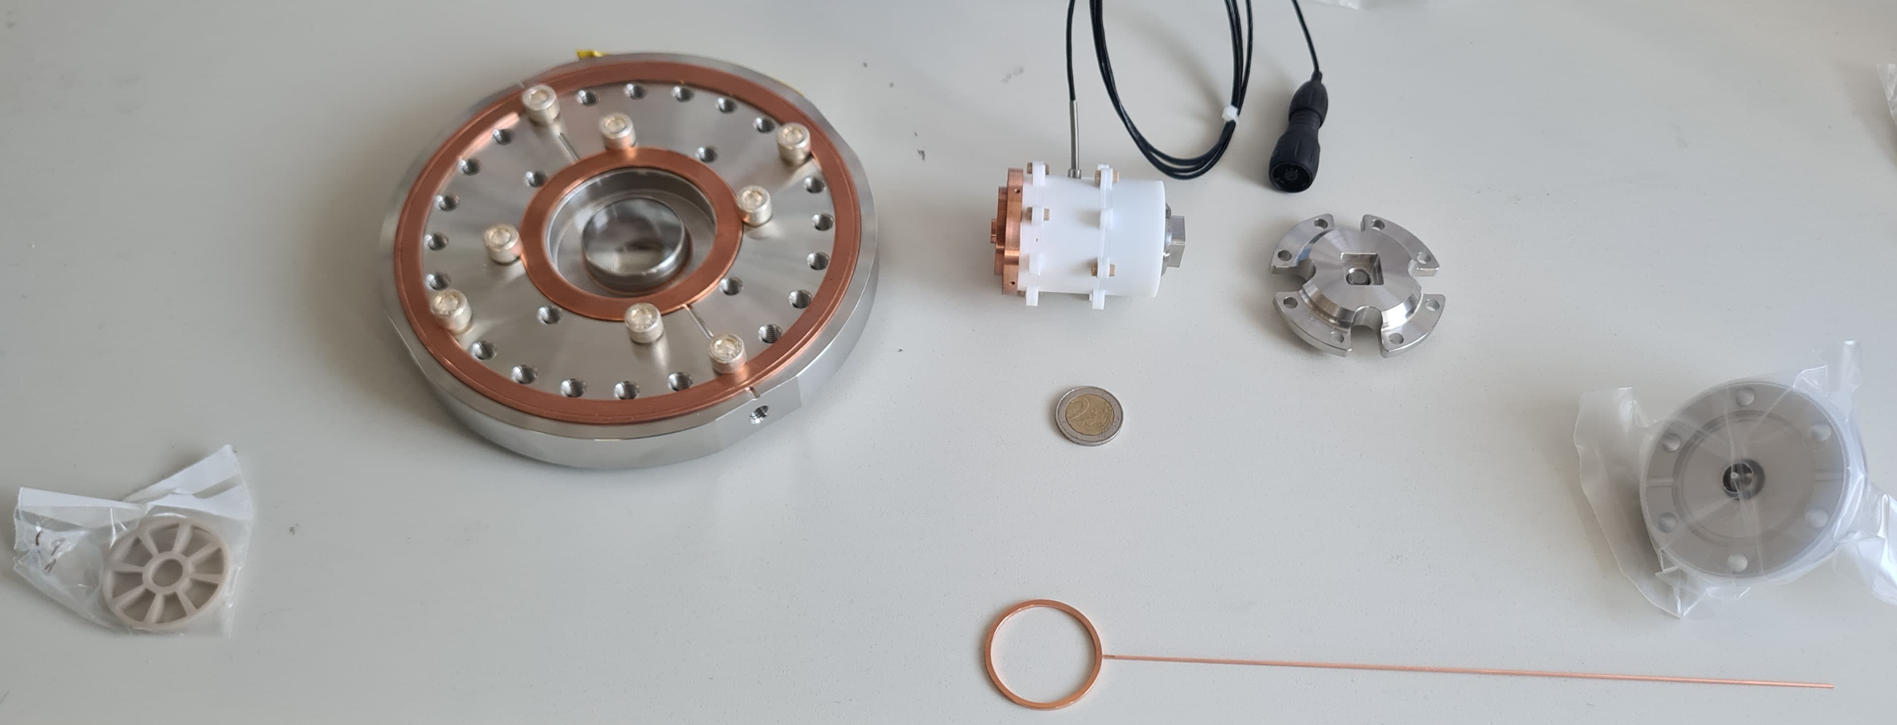
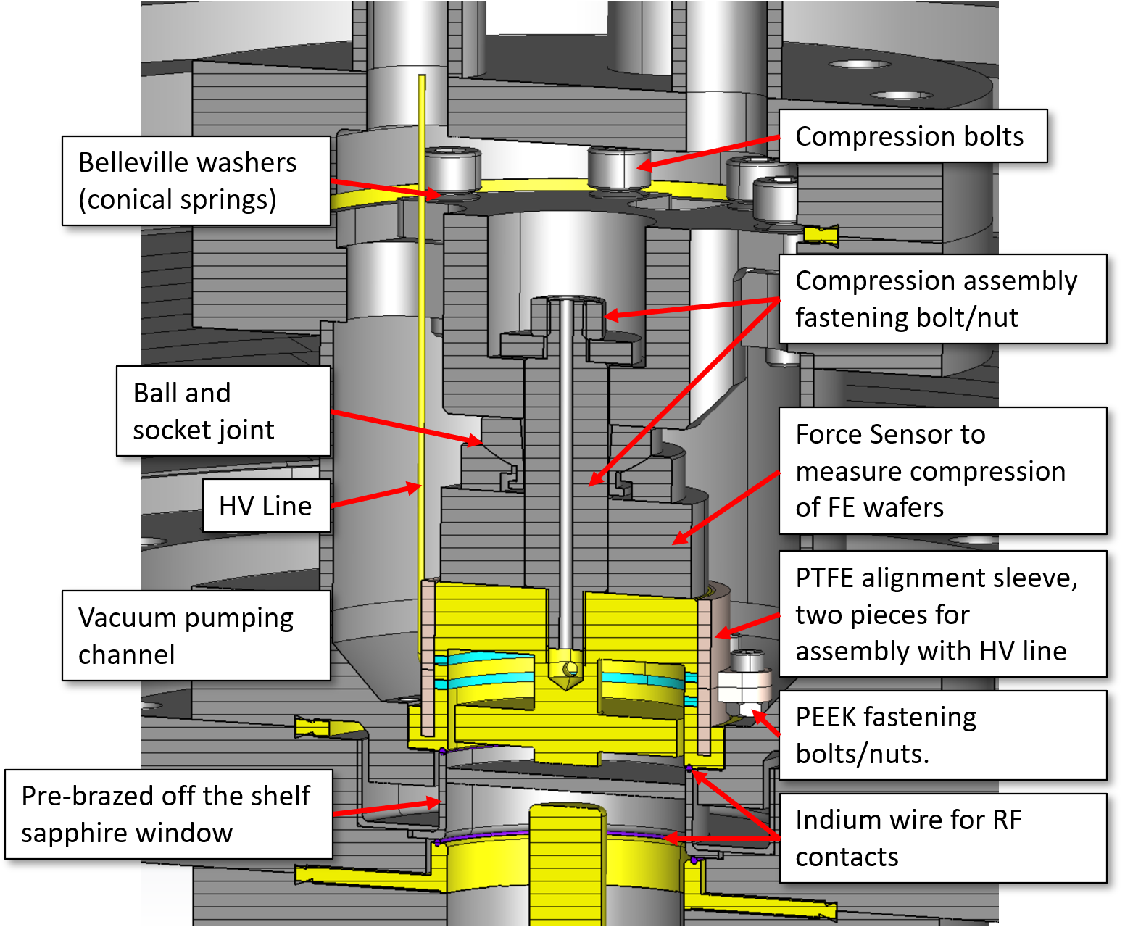
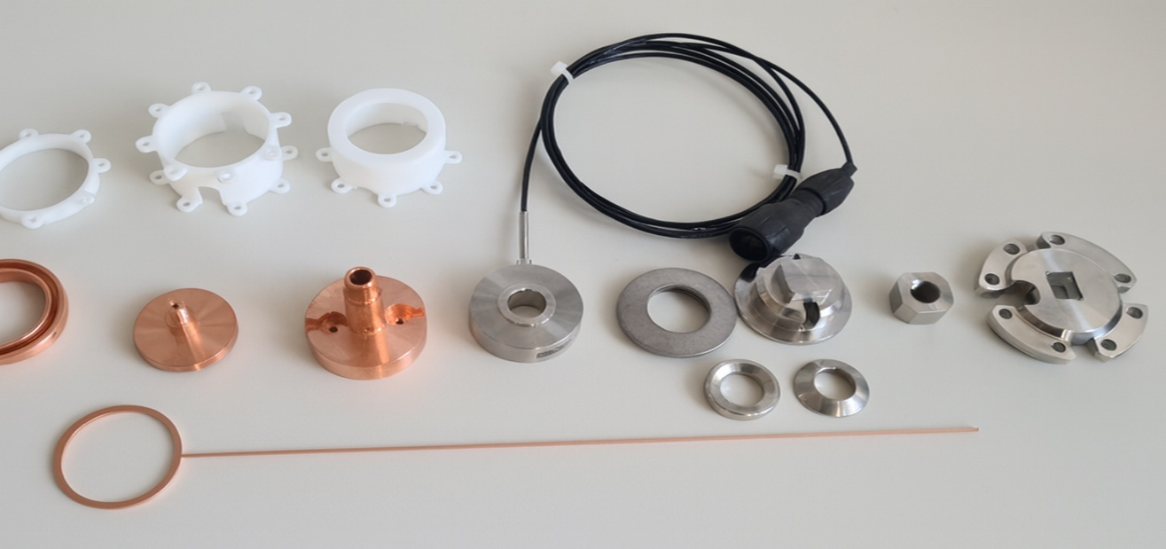
WP1 – FE-FRT: status/evolution of Task 1.3
2 euro coin
FE-FRT parts left to right: antenna holder, bottom flange with sapphire window, main stack, top of compression assembly, HV feedthrough. Bottom: HV electrode.
Thanks and acknowledgments to A. Frahm.
More info available on the tour on Friday!
Mechanical design: All parts done, but we need ferroelectrica…..
Disassembled stack. Top: PTFE sleeve. Middle left to right: Lower electrode, inner conductor, top electrode, compression sensor, belleville washers, ball and socket joint, top parts of compression assembly. Bottom: HV electrode. Not shown: heater catridge, FE wafers.

Slide 18
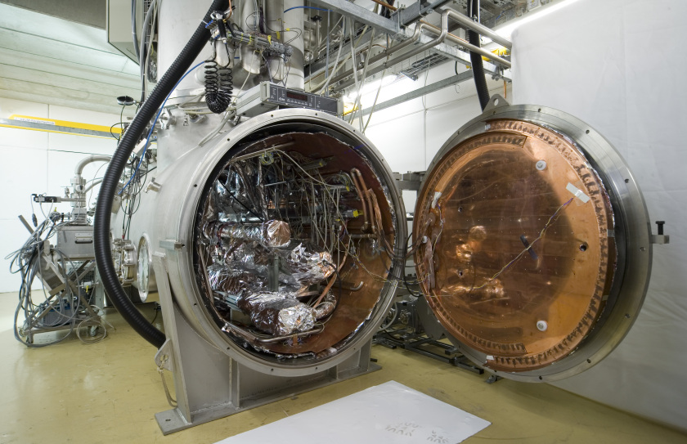
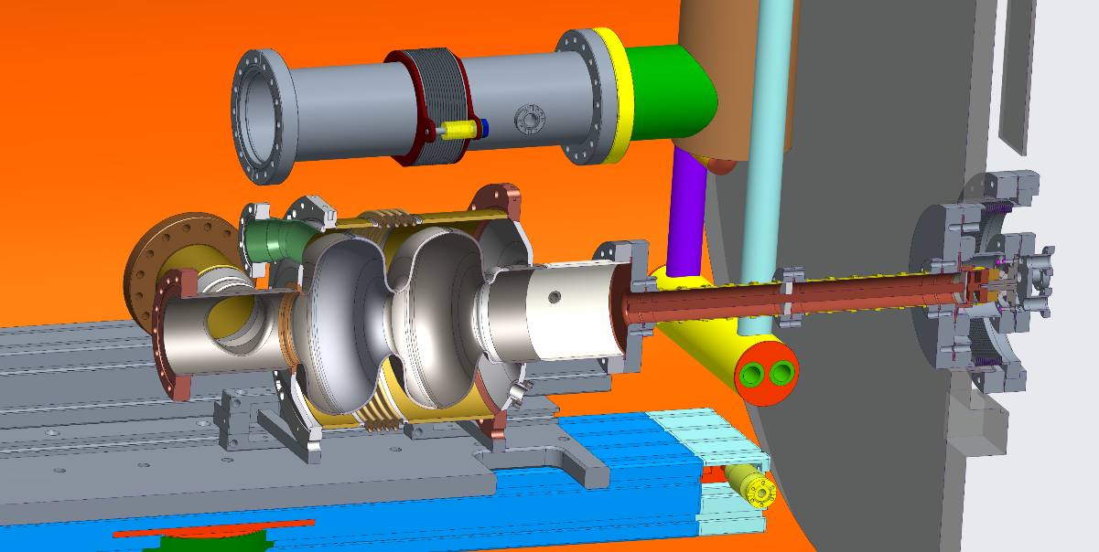
WP1 – FE-FRT: status/evolution of Task 1.3
Preparation of HoBiCaT cavity test:
FE-FRT was already tested for leaks and performed well
A test assembly with a second cavity will be performed, including cleanroom assembly
An RF bench test of the FE-FRT will be performed (Tuning via temperature) Q3 2026
Up to three available Booster cavities will be tested and the most suitable picked for the FE-FRT (baseline) Q3 2026
Understand loss mechanisms due to FE-FRT (ΔQ₀)
Are there new field emitters activated (cleanliness of assembly)
Cavity presumable equipped with magnetic shielding and classic blade tuner including piezos → eventually study interaction of both tuning systems (Lf-detuning, coarse tuning, switching at FE-FRT limits)
Assemble for 2-cell FE-FRT test, microphonics compensation using SEL and HV controller loop (A. Ushakov, WP2, task 2.4) Q4 2026

Slide 19
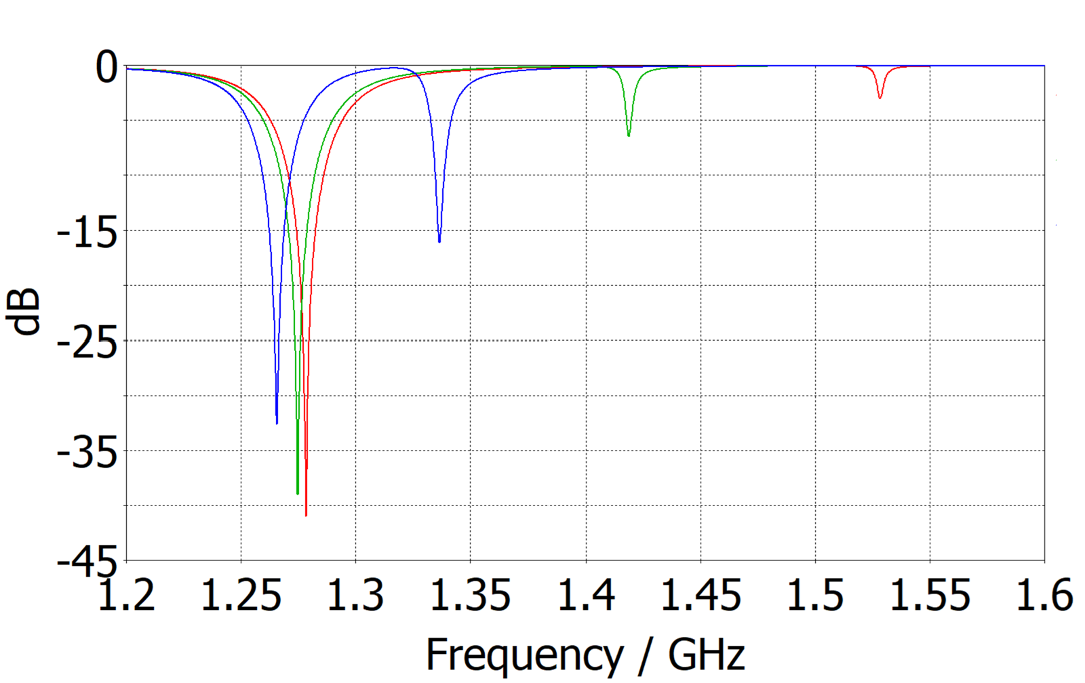
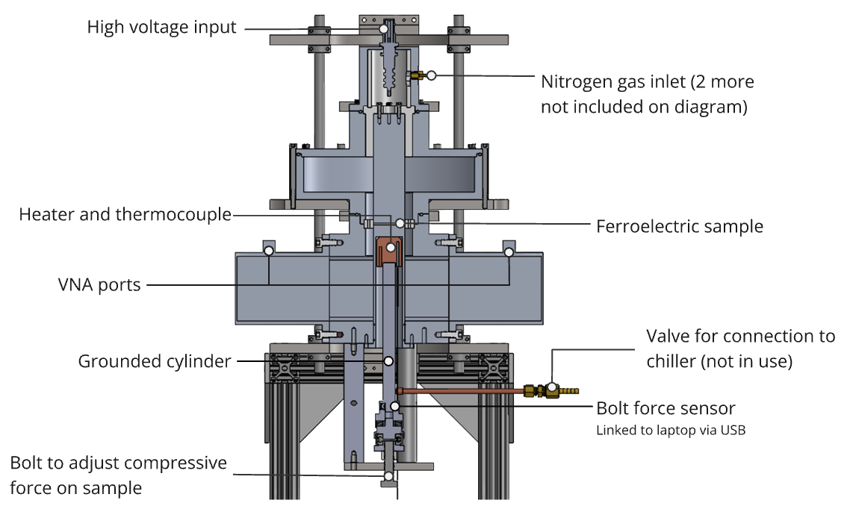
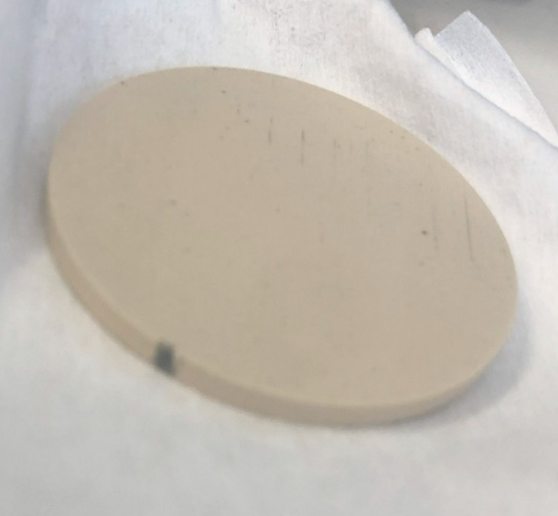
WP1 – FE-FRT: status/evolution of Task 1.3
Characterization of FE ceramics at 1300 MHz, sample preparation
Measure permittivity by variation of frequency of modes interacting with the ceramic
Relies on accurate simulations
Function of voltage, force, temperature, inert gas press.
ε=160, 140, 120
In short:
Permittivity versus voltage was measured
Results were not always consistent and lower as expected (not fully linear) → lower tuning range?
We assume more a problem of gaps between electrodes and samples (voltage drop across gap) → sample preparation, surface quality, electrical contact
All this improved after Euclid refurbished FERMAT, but still questions remain open → see hot topic
Still enough results to fulfill MS 1
FERMAT teststand by Euclid
Damage from breakdown in FERMAT at 9kV (3.6V/µm) in 2.3bar N₂ atmosphere.

Slide 20
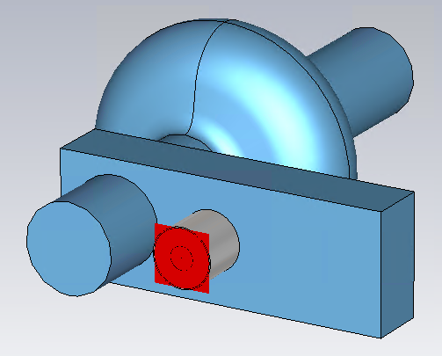
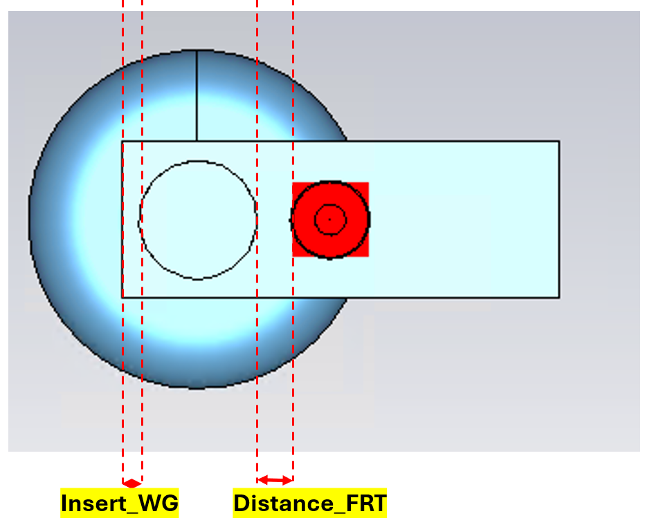
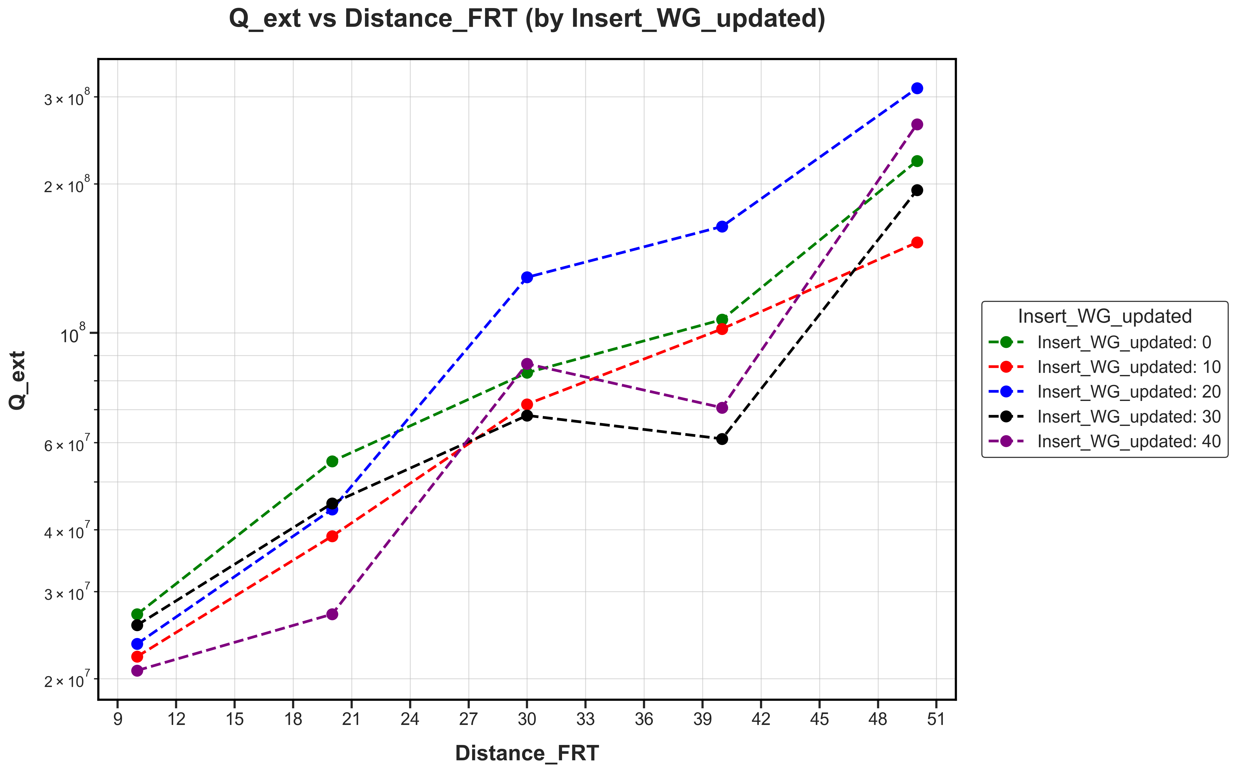
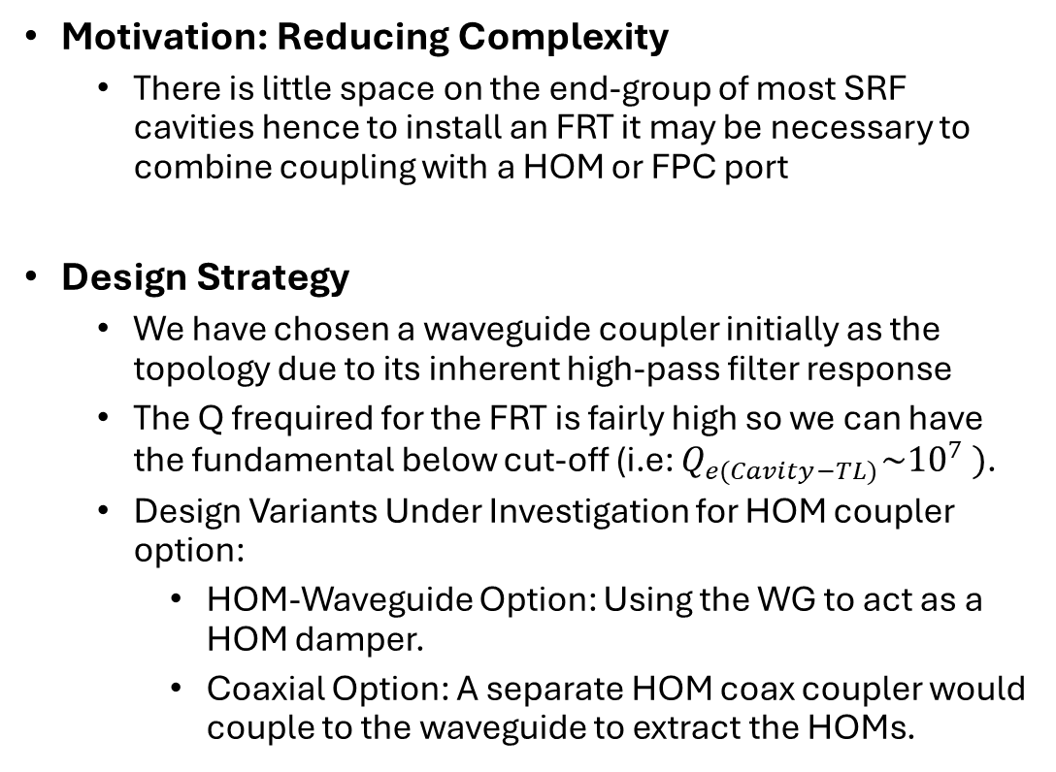
WP6 – Retrofitting FE-FRT : status/evolution of Task 6.2
Active exploration of the parameter space
Integrated FRT+HOM Waveguide Coupler Design
Motivation: Reducing Complexity
There is little space on the end-group of most SRF cavities hence to install an FRT it may be necessary to combine coupling with a HOM or FPC port
Design Strategy
We have chosen a waveguide coupler initially as the topology due to its inherent high-pass filter response
The Q frequired for the FRT is fairly high so we can have the fundamental below cut-off (i.e: ${Q_{e(Cavity−TL)}\sim 10}^{7} )$.
Design Variants Under Investigation for HOM coupler option:
HOM-Waveguide Option: Using the WG to act as a HOM damper.
Coaxial Option: A separate HOM coax coupler would couple to the waveguide to extract the HOMs.
[mm]

Slide 21
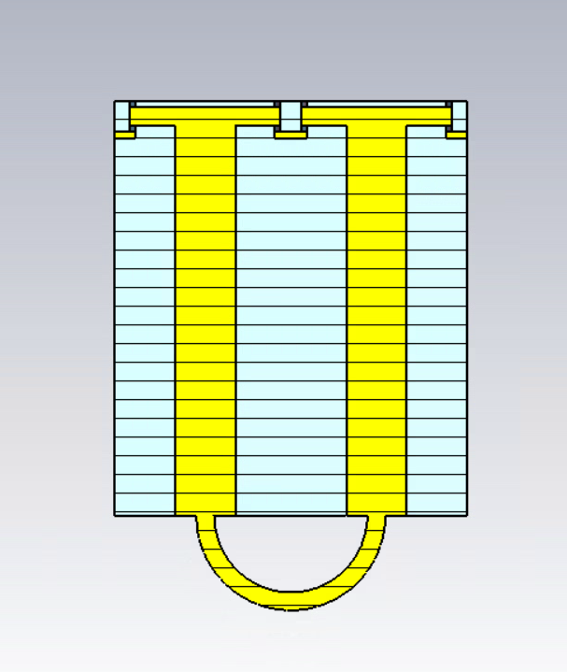
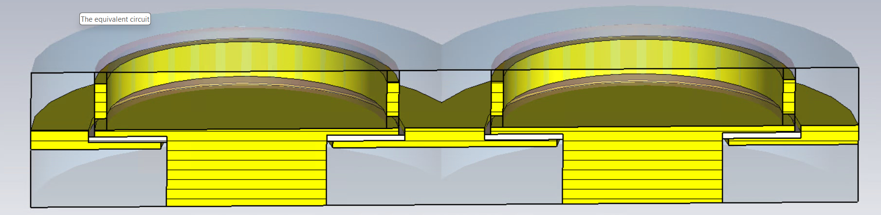
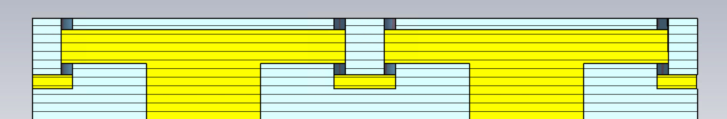
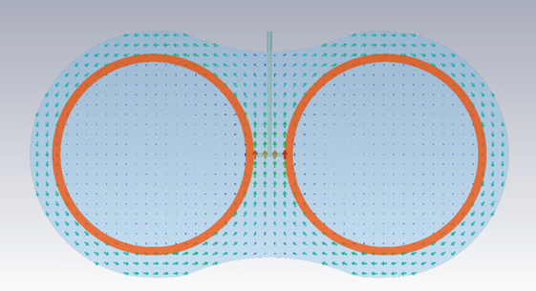
Twin-coaxial FRT
WP6 – Retrofitting FE-FRT : status/evolution of Task 6.2
The RF design
Power handling and cooling is a major constraint in FRTs due to their small size
We propose a dual FRT to split the power between to FRT resonators that are strongly coupled together, and connected to a twin-ax line
The bias high voltage and cooling system
The temperature rise of the twin-coaxial FE wafers with one side cooling is similar with single FE wafers with double sides cooling.
There is no cooling of the bias high voltage spacer.
The Qe of the bias high voltage port: 10e11. There is no RF leakage from the high voltage port as the bias is monopole and the RF is dipole

Slide 22
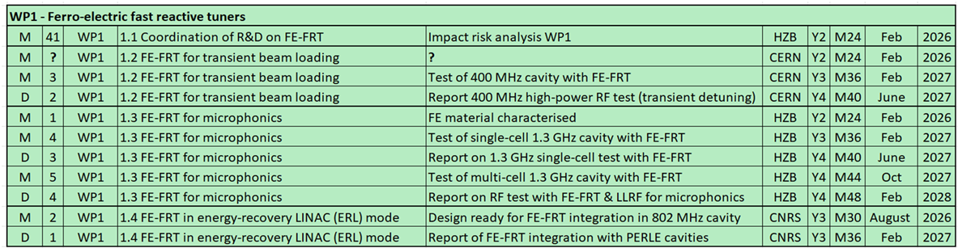
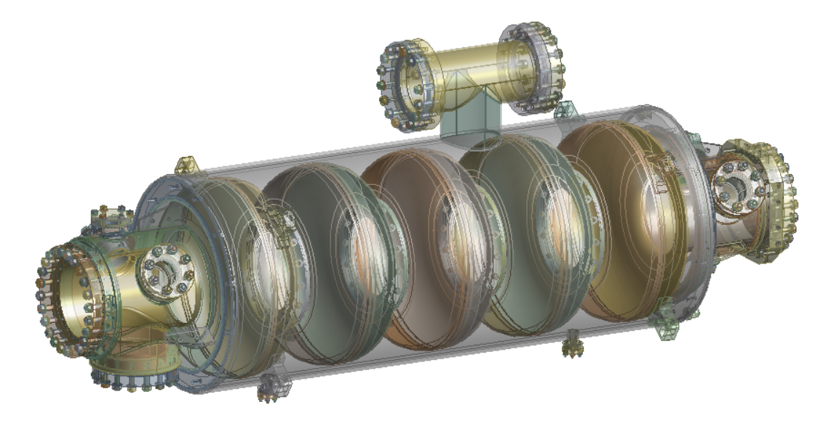
WP1 –FE-FRT in ERL : status/evolution of Task 1.4
MS 2 for design of FE-FRT ready to integrate in PERLE cavity due this summer
A PERLE cryo-module with cavities w/o FE-FRT is also a deliverable for iSAS
Personnel at PERLE is tight to design a cavity optimized for FE-FRT and fulfills ERL requirements
Decided to join forces between IJCLab, CERN, U Lancaster and HZB to work on a design, as:
PERLE cavity + tank
Similar 800 MHz use case for FCC Booster and PERLE (more relaxed than FCC)
A common 2-wafer coaxial design can be used
Study started with first analysis from HZB, RF designs by CERN and Lancaster, coordination, models etc. by IJCLab → MS 2 (back) on track
FRT on free HOM port
FPC
Studies on impact of FE-FRT used port on HOM spectrum, coupler kicks, port size dimensions suitable
Can Qext be reduced to achieve real power savings for RF or is multi-turn beam transient during ramp up the driver for choice of Qext (multi-turn ERL)

Slide 23
WP1 meeting hot topics
Treatment of ceramics, surface quality:
CERN achieved 7.8 V/µm, results seem sufficient (theoretical limit 20V/µm)
HZB achieves good quality, but still struggles for consistent results in teststand, surface quality an issue?:
Series of measurements, polishing, surface analysis (A.Prudnikava)
Started lapping tests with company, metallization tests with institute
Breakdown tests at CERN revealed first time breakdown in material, not edge only → analysis to check surface and bulk quality
Surface pits and viods, which were uncovered, were found at HZB, reason for breakdown?
Will start exchange of material scientists on CERN and HZB side, look for correlation between breakdown and pits/voids (use cutout of wafer rings)
A dedicated FE ceramics meeting will take place including Euclid Note: It is well known, that the material is porous by nature!
Damage from breakdown in FERMAT at 9kV (3.6V/µm) in 2.3bar N₂ atmosphere.

Slide 24
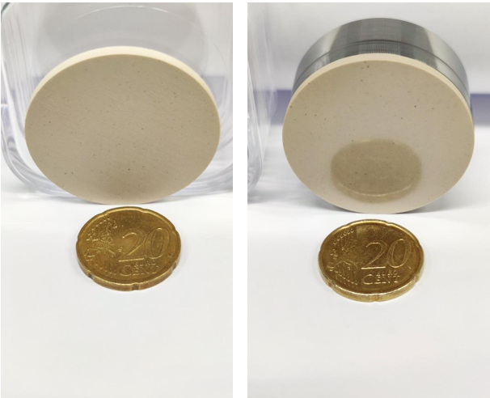
WP1 – FE-FRT: Thanks for listening
Thanks for your attention
Alick Macpherson, Sam Smith, Graeme Burt, Walid Kaabi, André Frahm, Nick Shipman, Alexei Kanareykin and Co., Jens Knobloch, Axel Neumann,
Maleesh Dissanayake, Hingpong Jiang, Victoria Almaraz
WP2 members, Ilan Ben-Zvi, Alena Prudnikava, Paul Schneider, Mickael Crouvizier and more involved co-workers at CERN, HZB, Lancaster and IJCLab

