Slide 1
iSAS Task 3.2: Flux trapping Progress at UKRI/STFC
O.B. Malyshev, D. Seal and L. Smith
R. Valizadeh and C. Benjamin

Slide 2
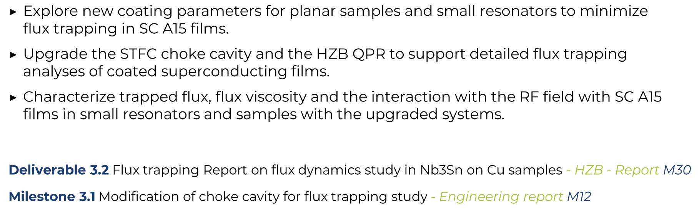
iSAS Task 3.2 objectives
completed

Slide 3
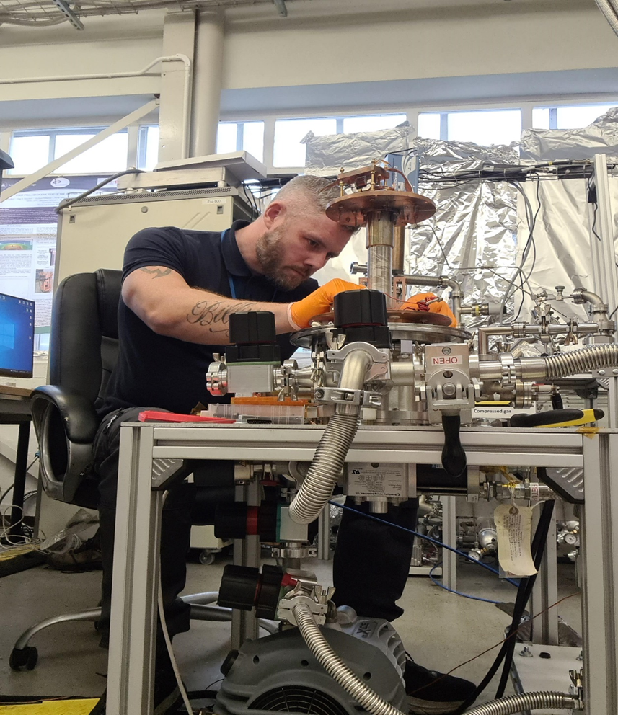
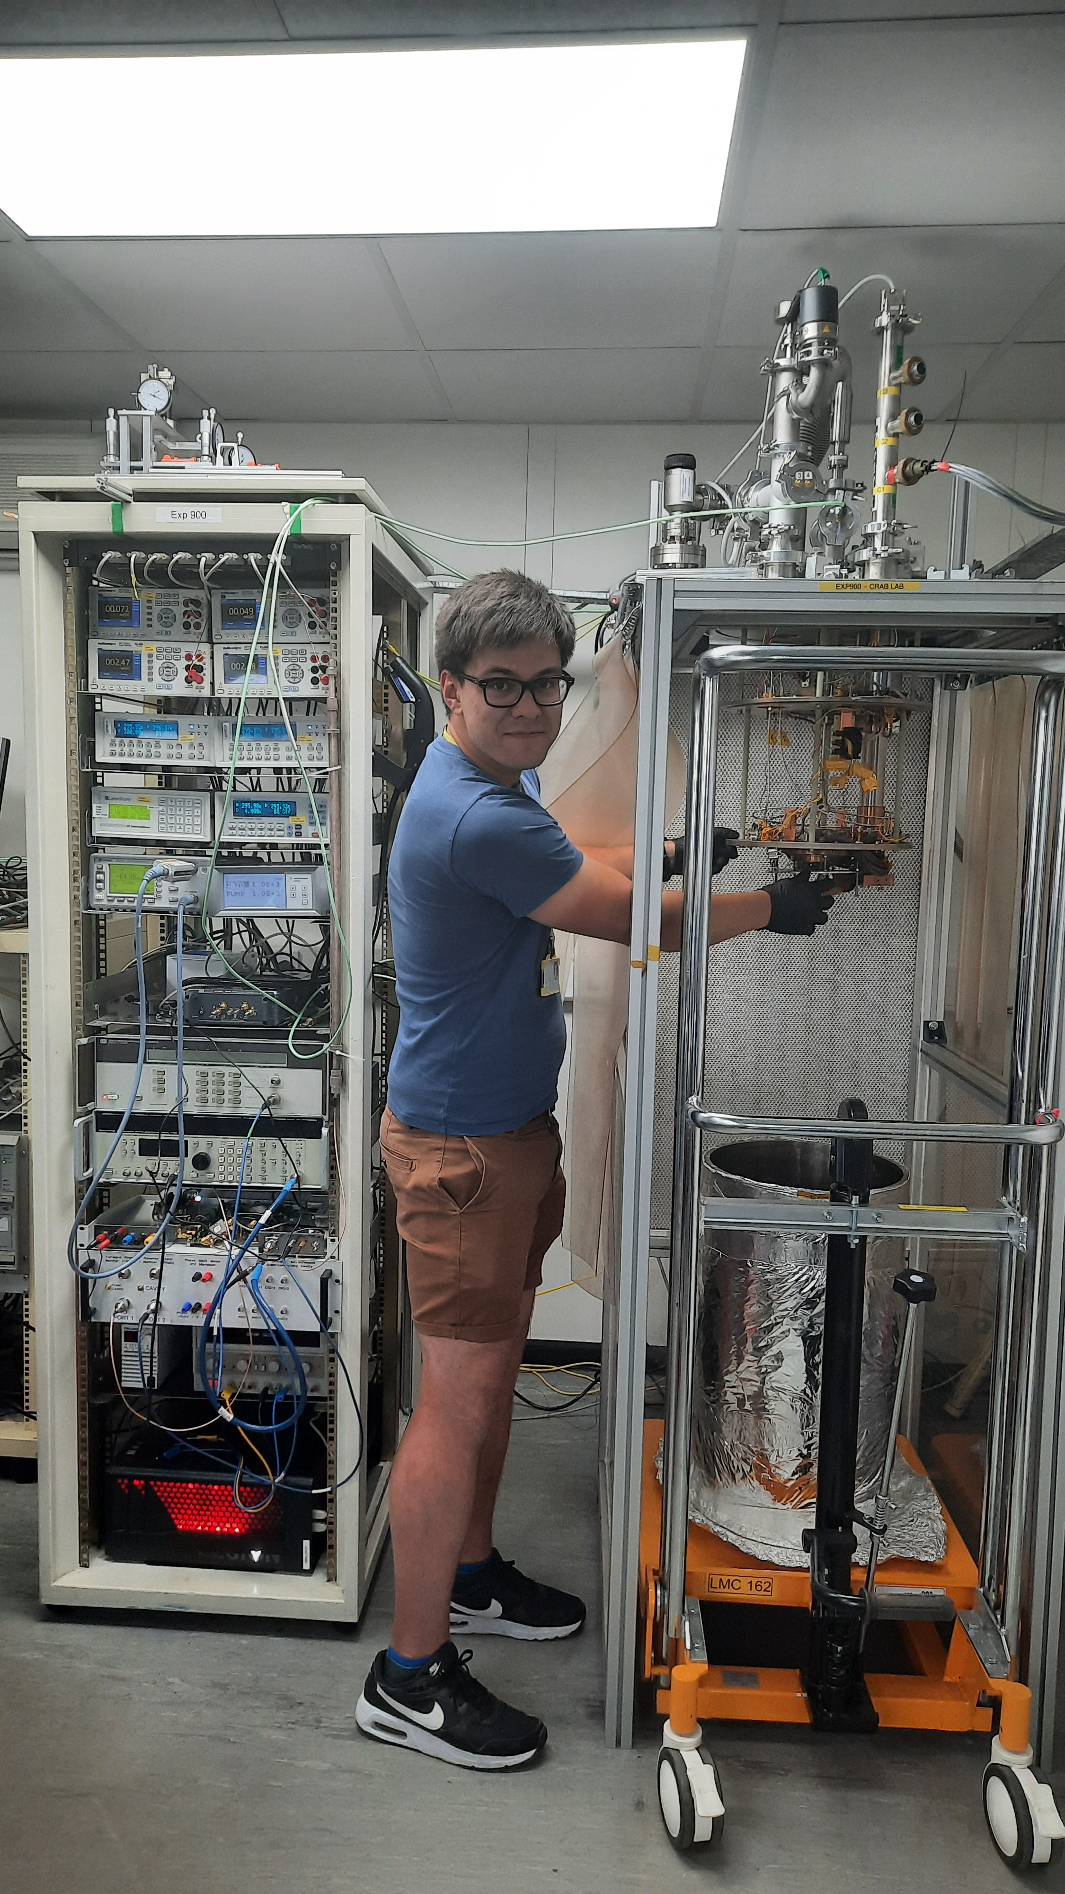
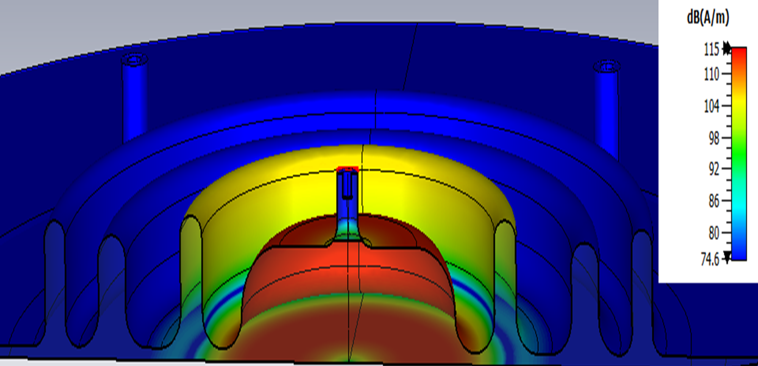
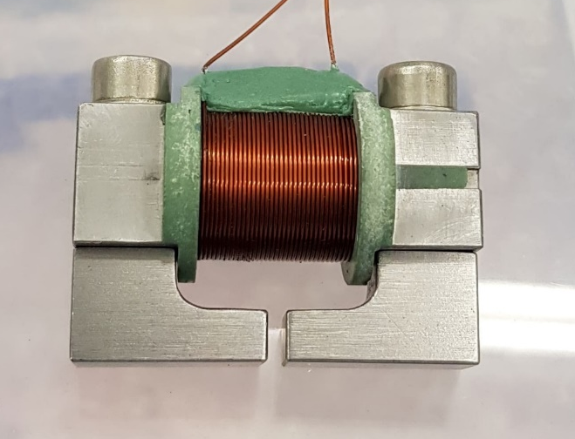
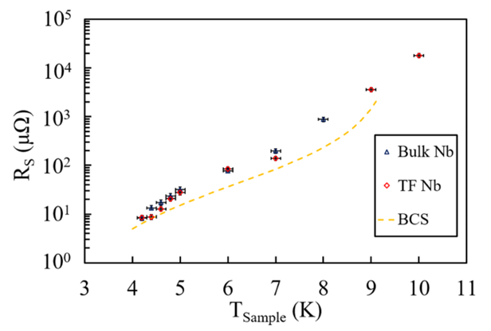
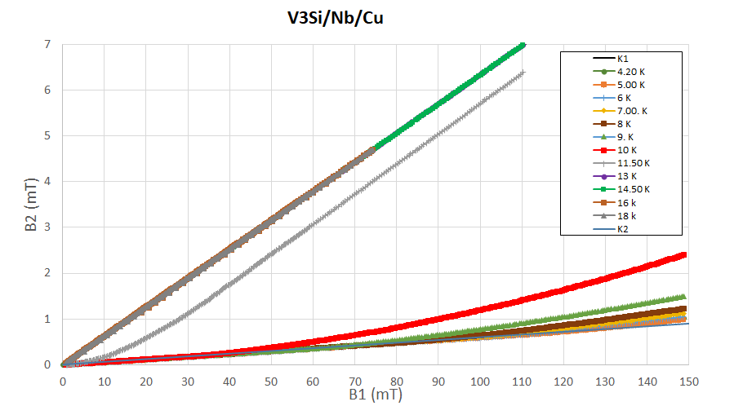
Facilities for Superconducting Properties Evaluation at UKRI/STFC/CI
HP1
HP2
EXP700: Magnetic field penetration facility (in-vacua)
EXP900: R_{S} measurements with 7.8 GHz cavity

Slide 4
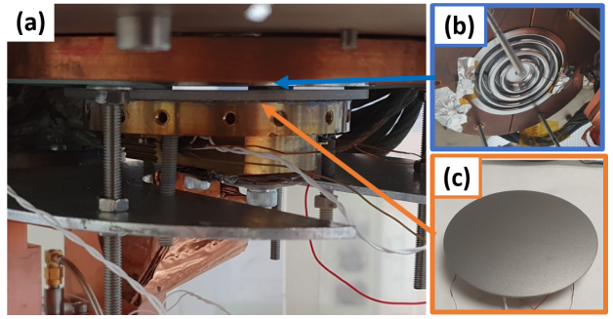
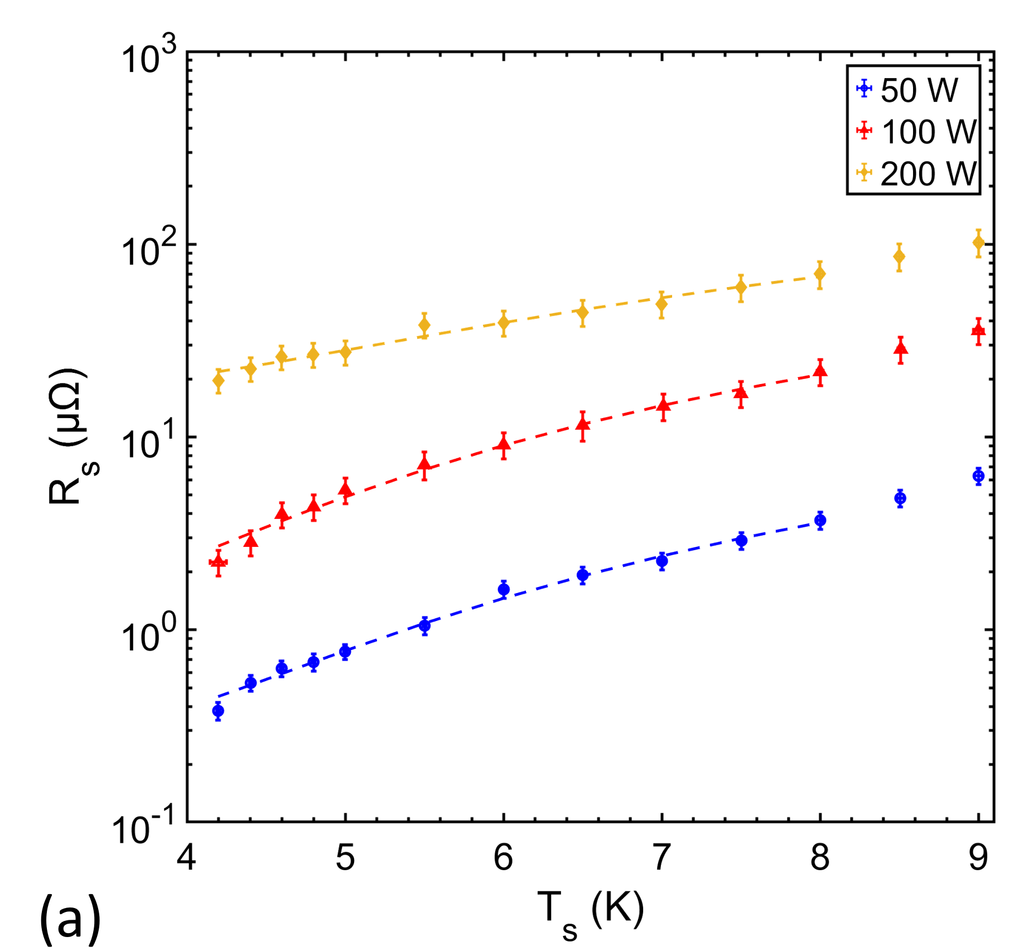
The Choke Cavity Facility (EXP-900)
Two-part test cavity in LHe-free cryostat:
Bulk Nb choke cavity
Sample:
planar disk ∅90 - 130 mm,
thickness w = 1 – 10 mm
RF-DC compensation → R_{S} (T, B)
VNA measurements → Δf → Δλ
Parameters:
f₀ = 7.8 GHz
T_{Sample} ≥ 4 K
RF power up to 1 W
B_{sample, pk} ≤ 2.5 mT
To be B_{sample, pk} ≤ 20 mT after moving to a new CI Bunker
Example of results:
effect of magnetron power
for depositing Nb₃Sn
1 sample test R_{s}(T) in 2 days

Slide 5
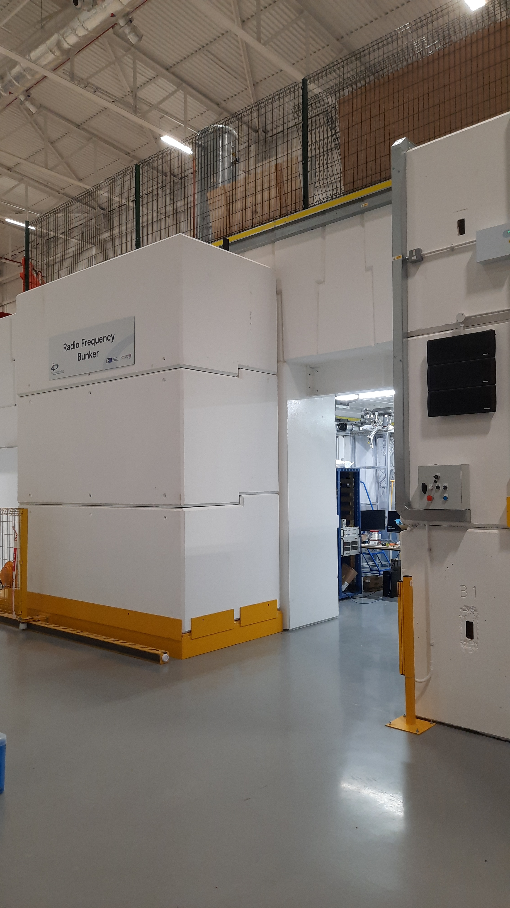
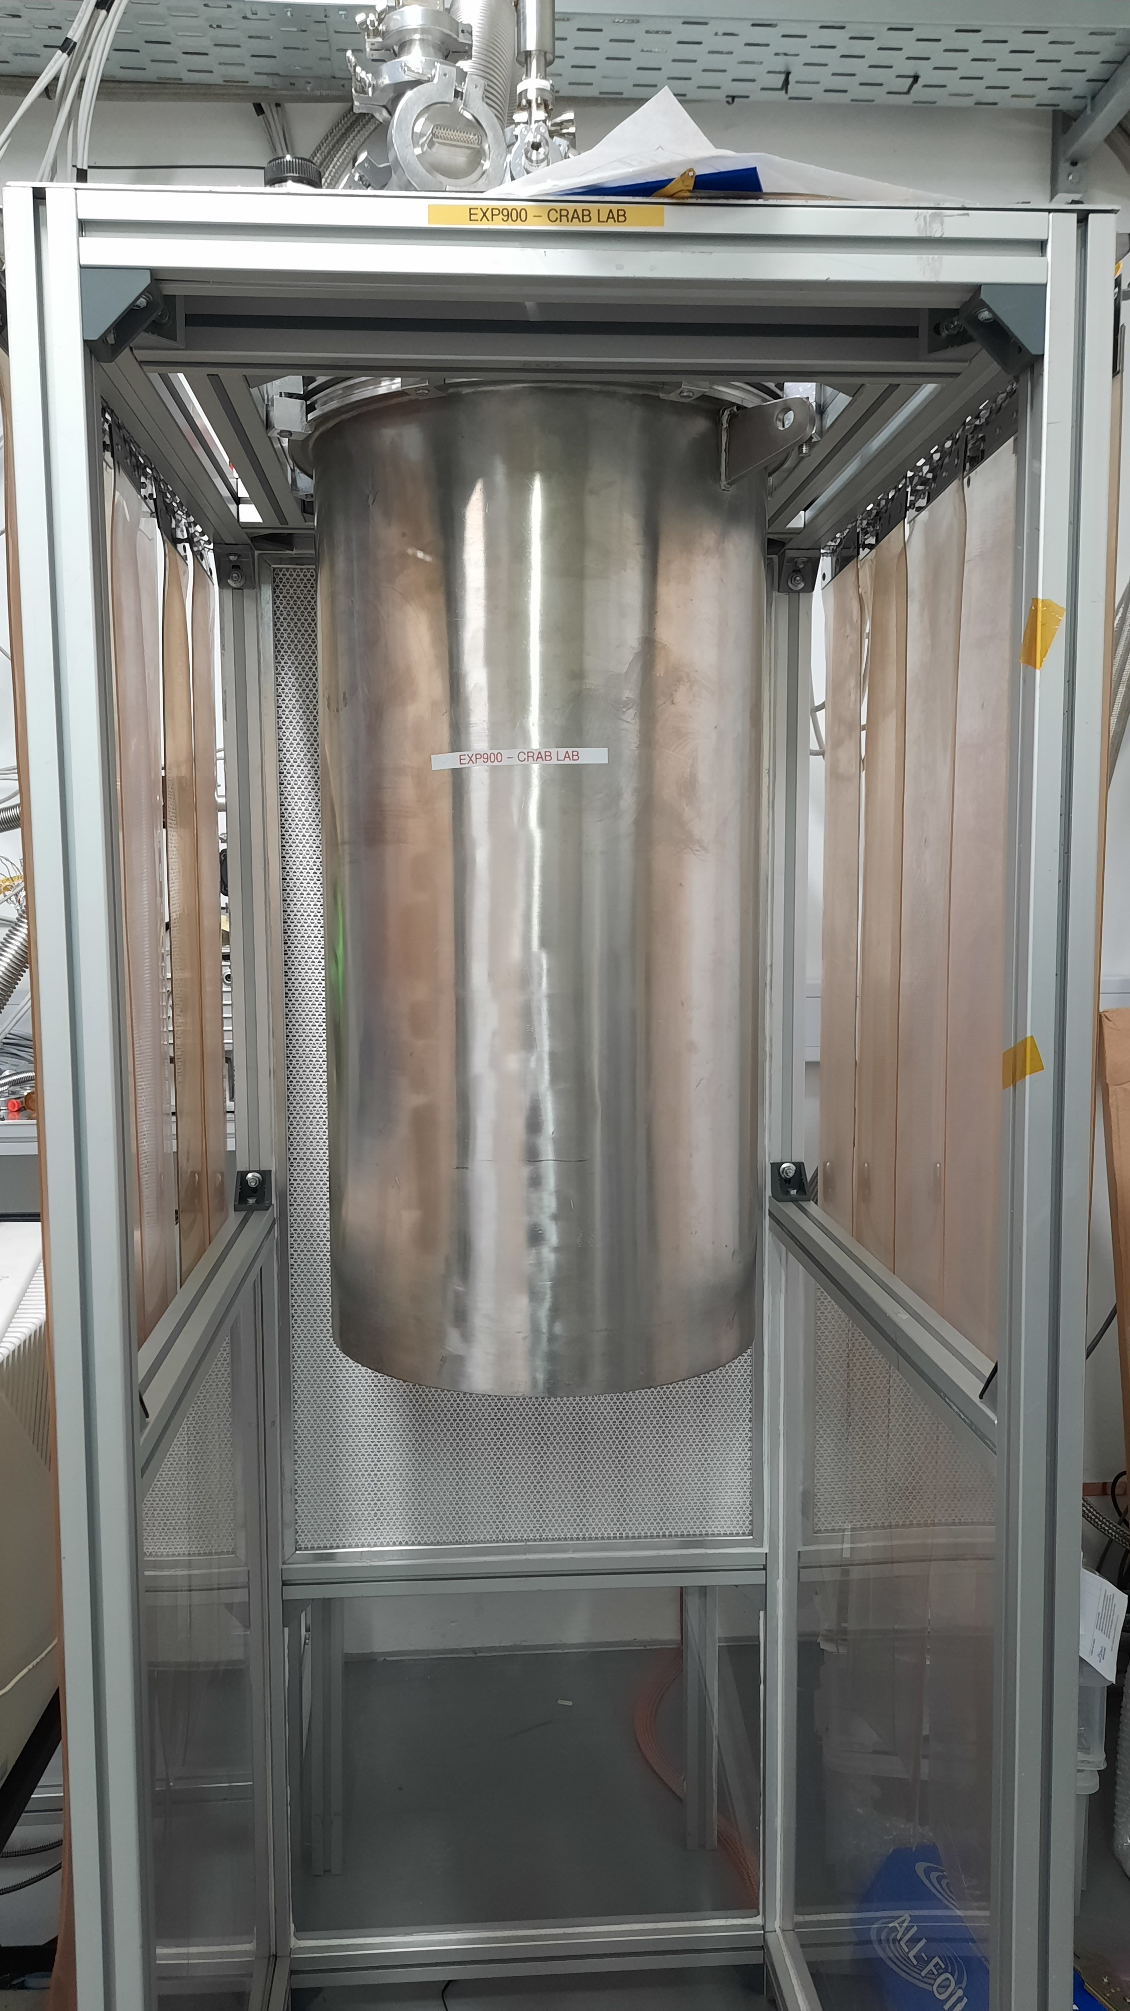
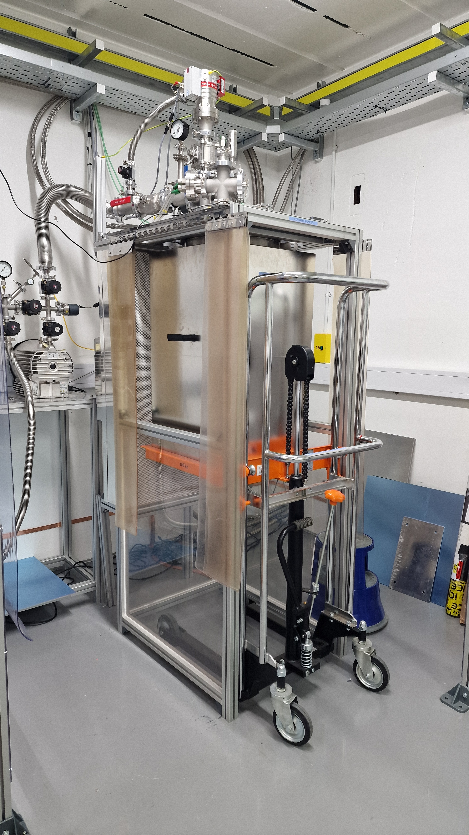
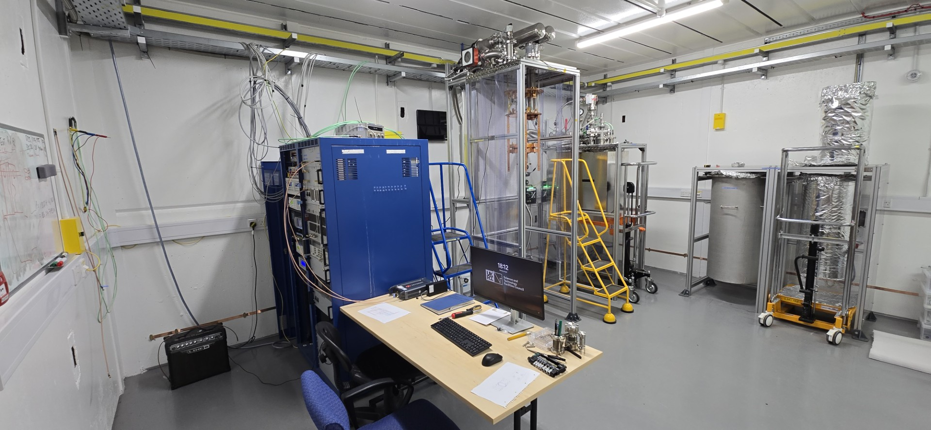
The Choke Cavity Facility updates
CI SRF bunker
Facility set into operation in a new CI Bunker
Cryogenics is operating
RF with VNA - OK
No radiation limit on RF power
after completing jobs for the gate closing (long delays due to outside contractor, but progress over last two weeks)
RF rack is being updated:
ongoing
f₀ = 7.8 GHz
T_{Sample} ≥ 4 K
RF power up to 1 W
B_{sample, pk} ≤ 20 mT in CW mode
Expected to be larger in pulsed mode
New Magnetic shield

Slide 6
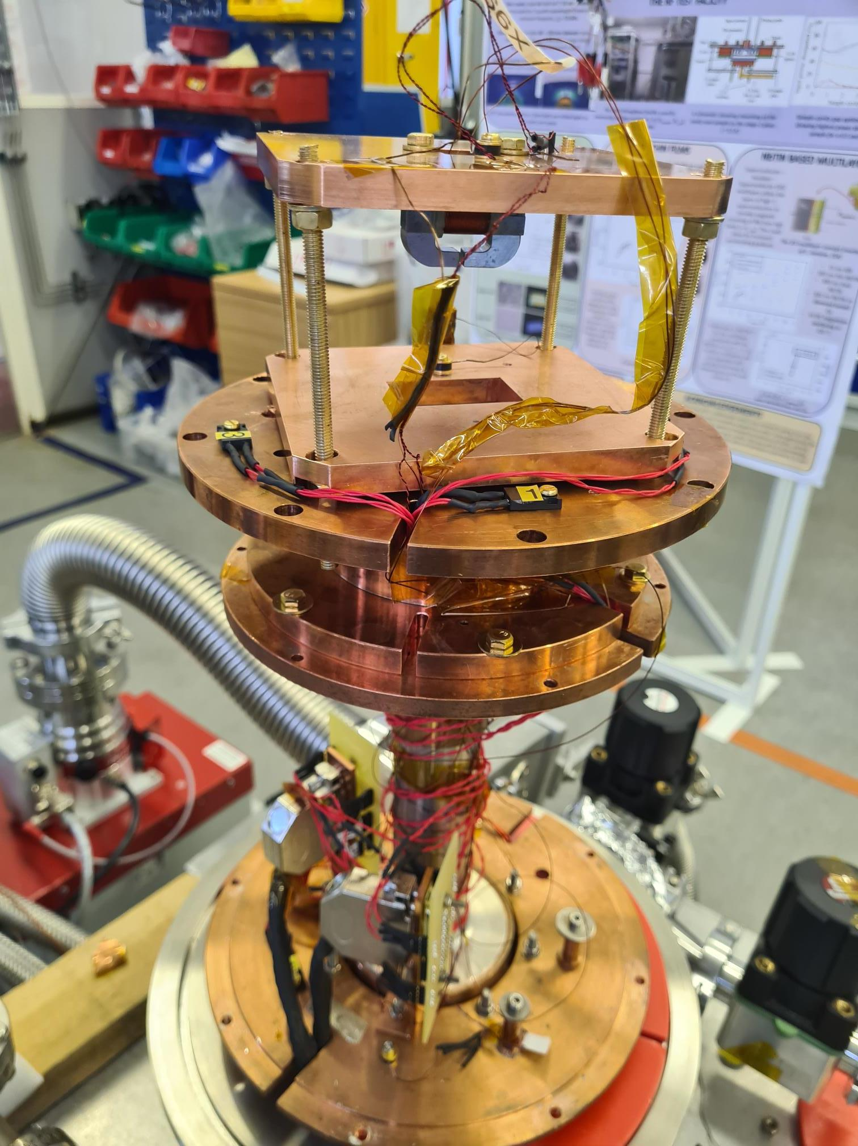
Magnetic Field Penetration Facility
Magnet Housing
SC coil
Sample Holder
Hall probe for applied field
Sample
HP1
Hall probe for penetrated field
HP2
Large Sample Plate
DC magnetic field
parallel to the surface
B ≤ 600 mT
Field local to the sample surface
2mm × 10 mm
To accommodate
samples ∅ = 30-100 mm
Split cavity
Parts of cavity up to 100 mm ×. 100 mm

Slide 7
The ongoing work
Samples:
Substrates:
100 mm diameter disks with thickness of 2-3 mm made of Cu or Nb
Coated with thin film of Nb and Nb₃Sn
Varying deposition parameters: temperature, duration, power, etc.
Varying Deposition method: DC or HIPIMS
Measuring R_{s} and T_{c-RF} of these samples with the choke cavity facility of samples
Testing the same samples with magnetic field penetration facility for full penetration magnetic field B_{fp}(T), residual magnetisation B_{res}(T) and T_{c-dc}
Choke cavity facility
Full magnetic field penetration facility

Slide 8
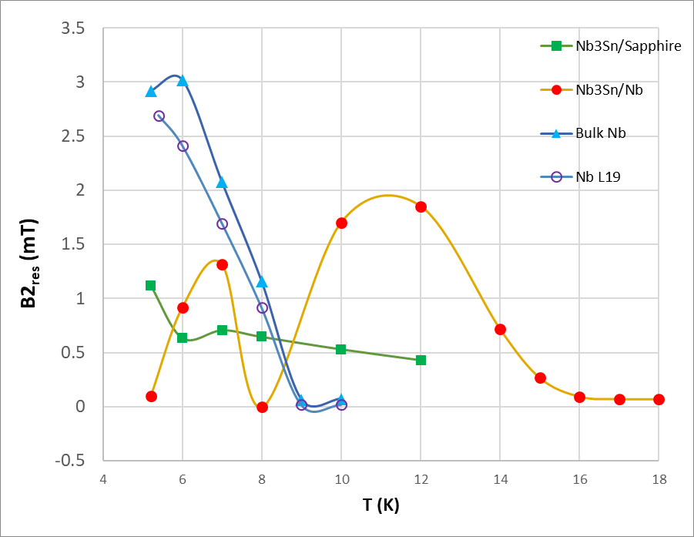
Residual magnetisation
Examples of residual magnetisation
Residual sample magnetisation can be measured as a function of
operation temperature, T
applied magnetic field, B1_{app}
Typical magnet residual magnetisation B1_{res}
stays in the range of B1_{res} = 4±1 mT and
does not change with T
Residual sample magnetisation B2_{res} :
varies from sample to sample and
depends on T

Slide 9
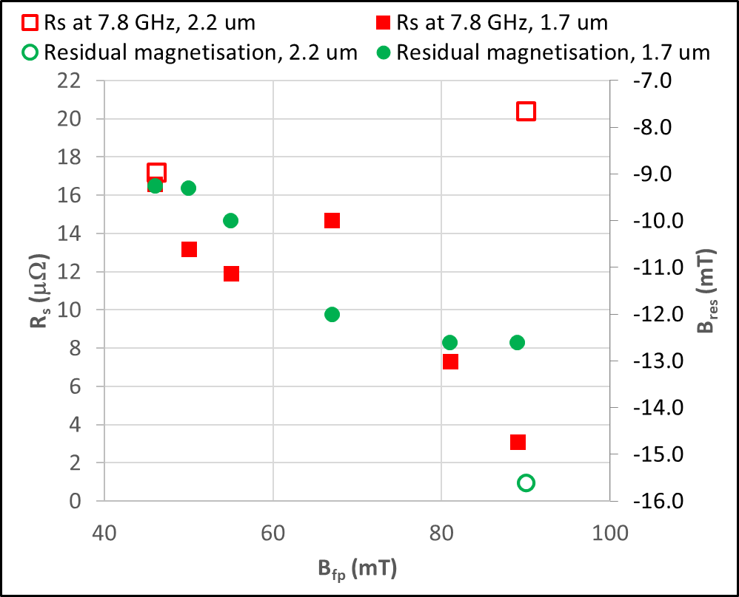
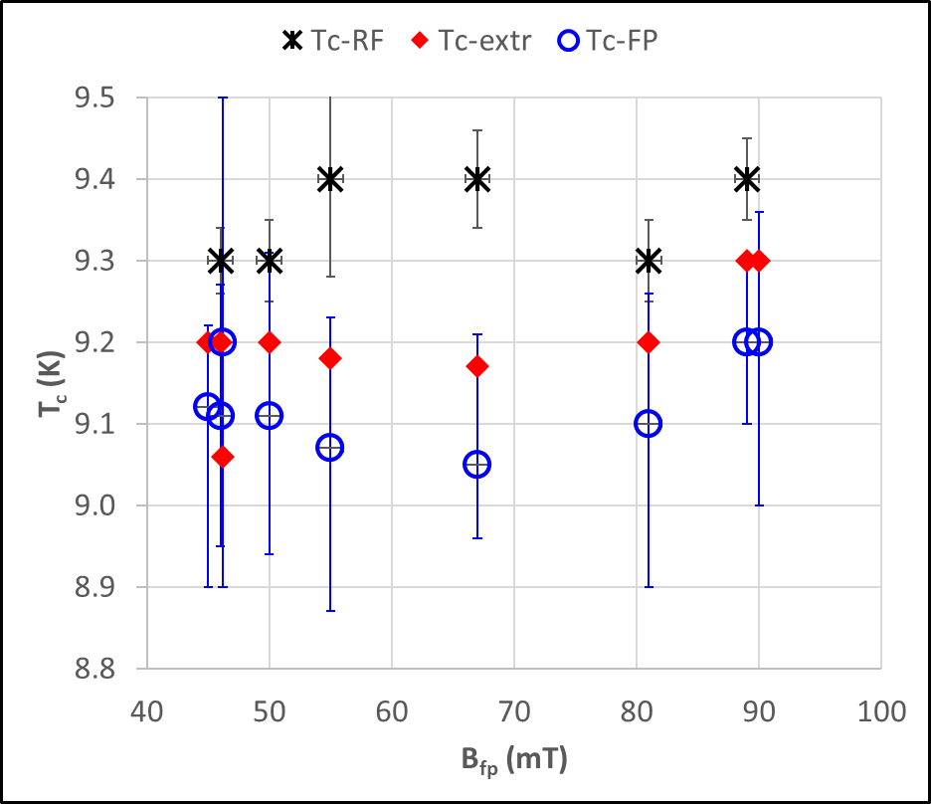
Main results for Nb on cupper substrate
Relation between R_{s}(7.8 GHz), B_{res} and B_{fp}
measured at 4.2 K
Corelation between T_{c} measured by different methods and B_{fp} measured at 4.2 K

Slide 10
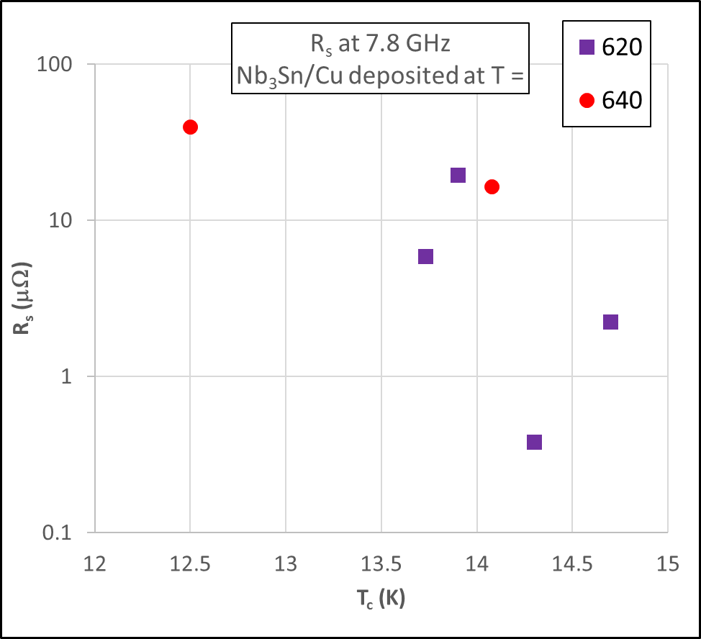
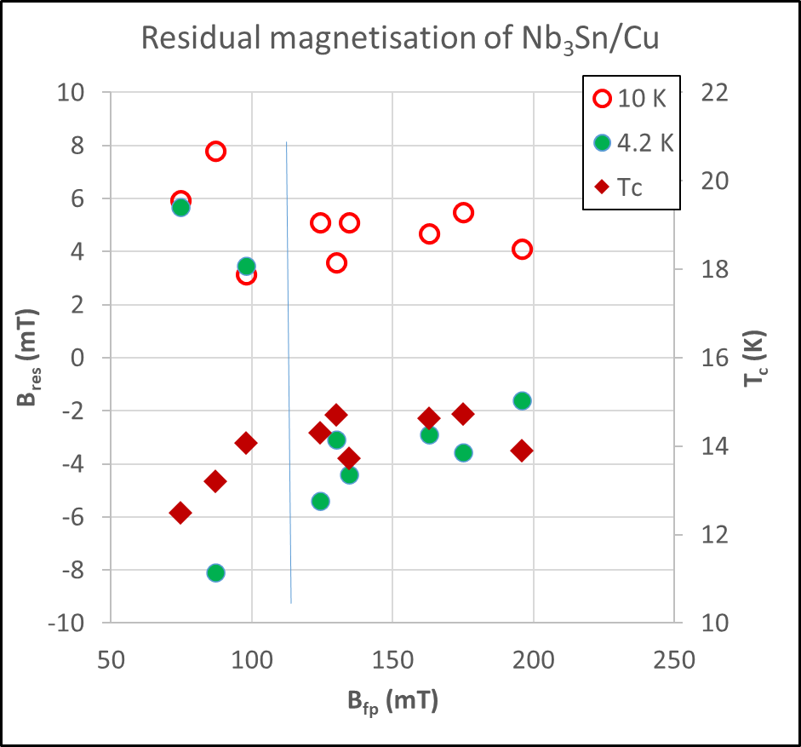
Main results for Nb₃Sn on cupper substrate
Relation between R_{s}(7.8 GHz) and B_{fp}
measured at 4.2 K
Corelation between T_{c}, B_{fp} measured at 4.2 K
and B_{res} measured at 4.2 and 10 K

Slide 11
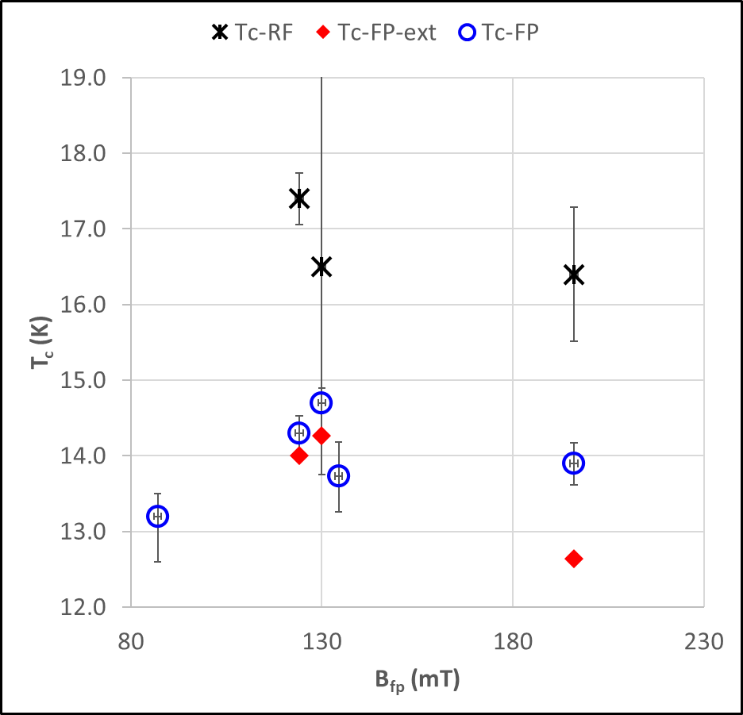
Main results for Nb₃Sn on cupper substrate
Corelation between T_{c} measured by different methods and
B_{fp} measured at 4.2 K

Slide 12
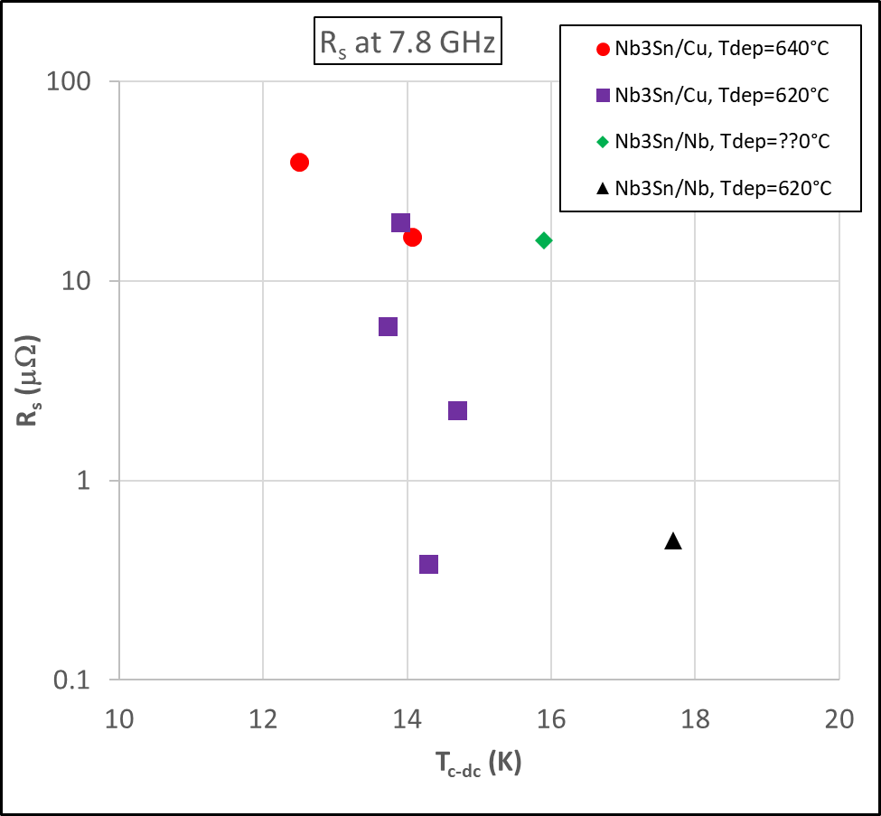
R_{s} for Nb₃Sn on Cu and Nb substrates
Relation between R_{s}(7.8 GHz) and T_{c-mag} measured at penetration rig

Slide 13
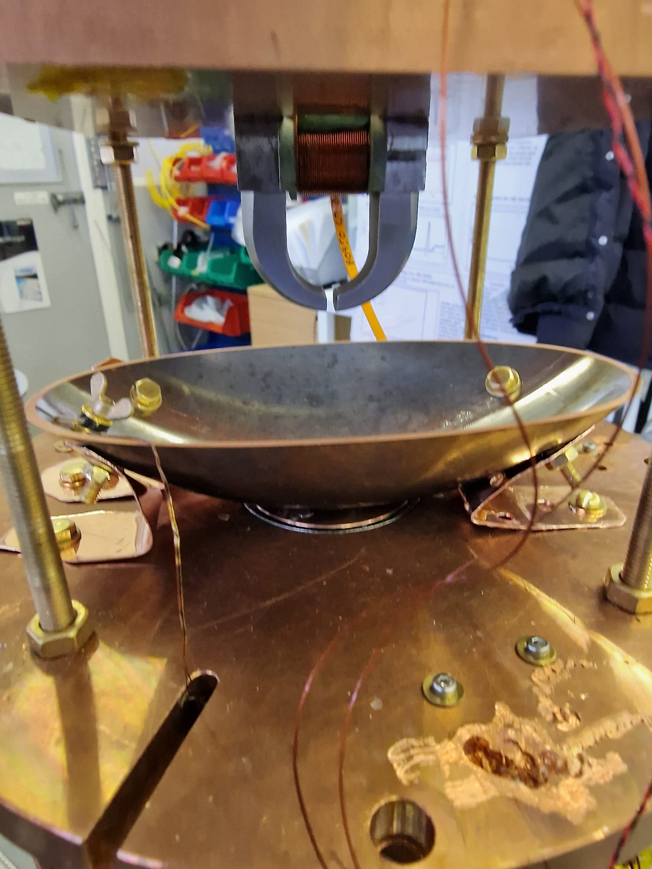
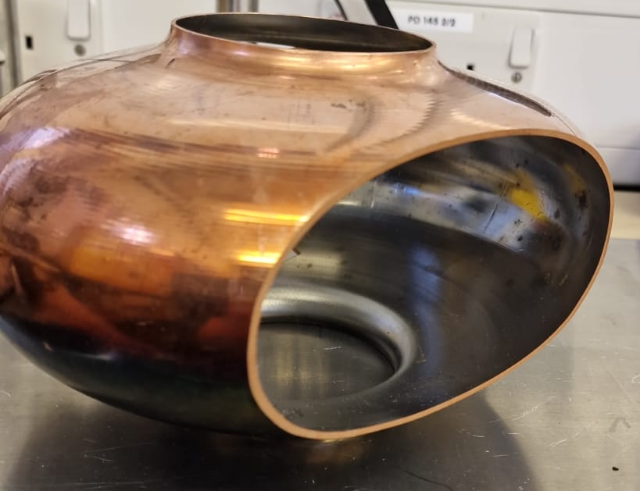
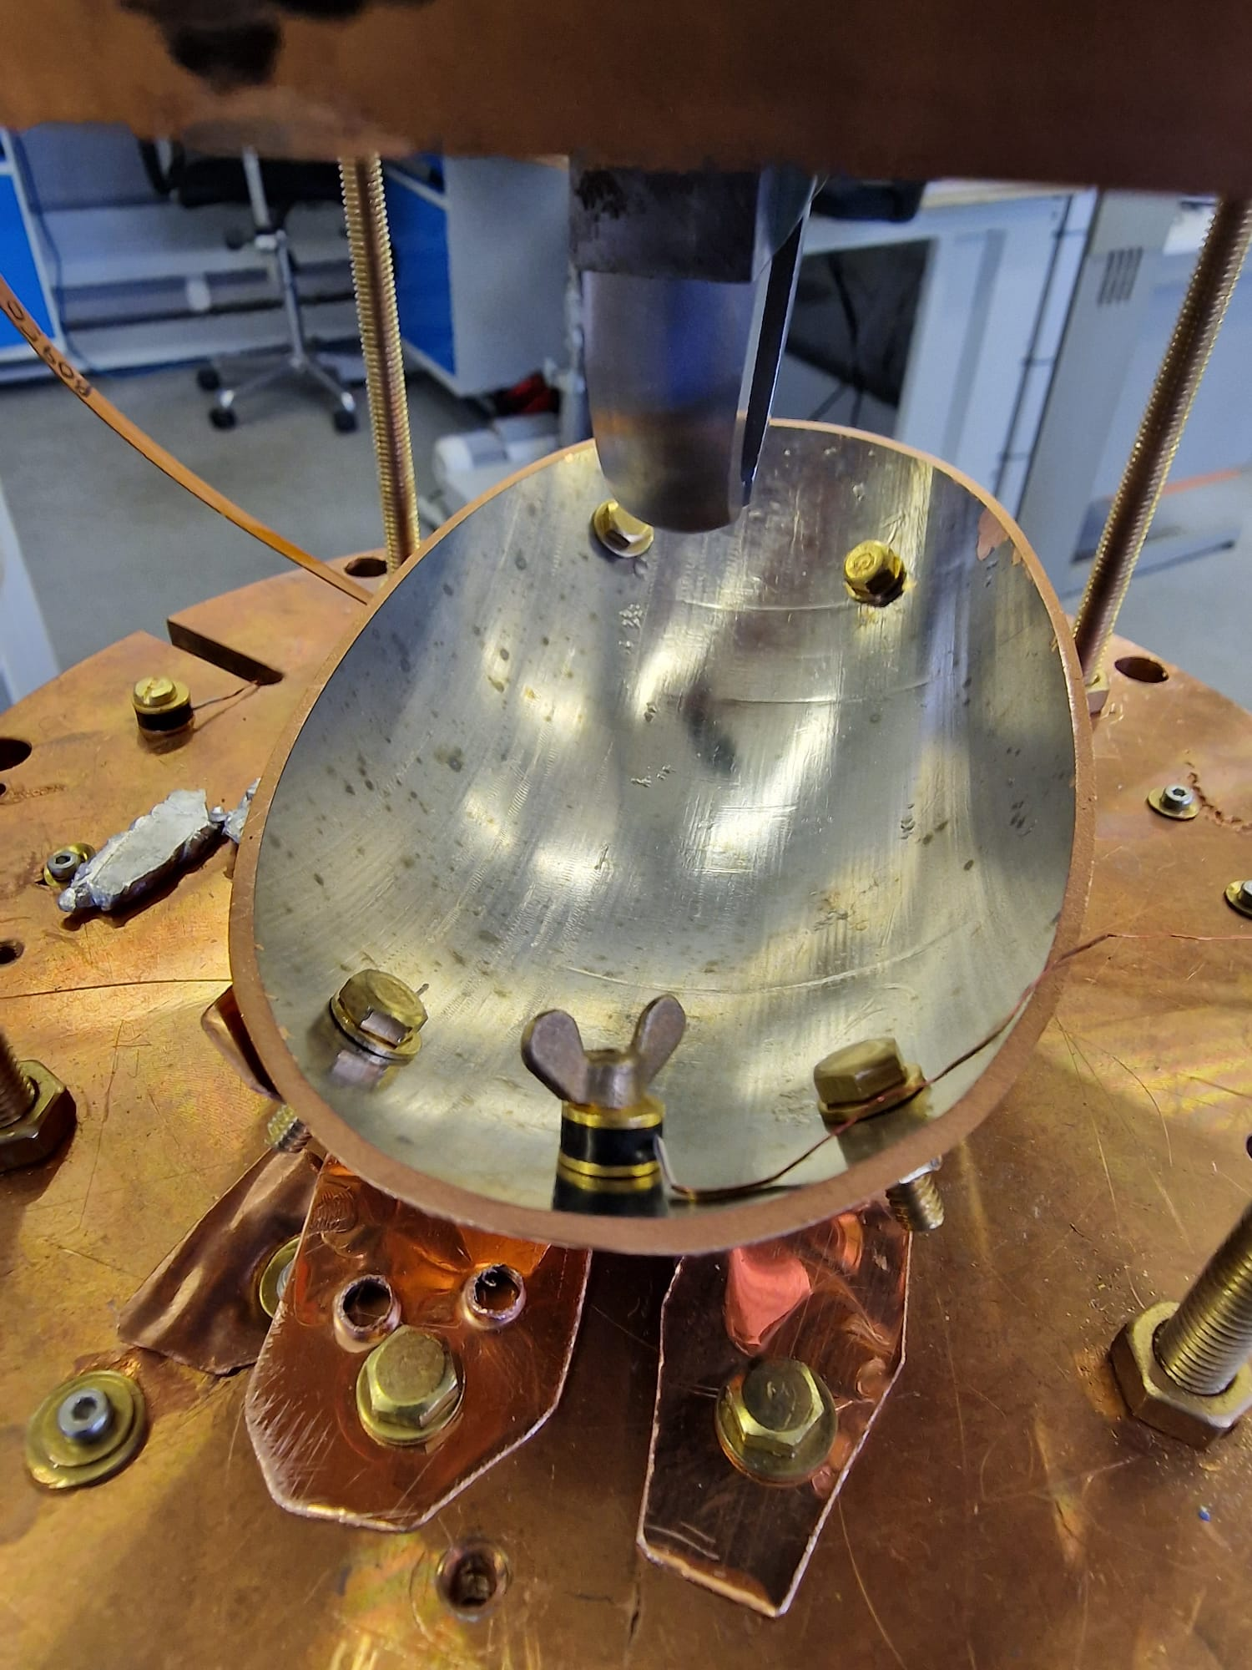
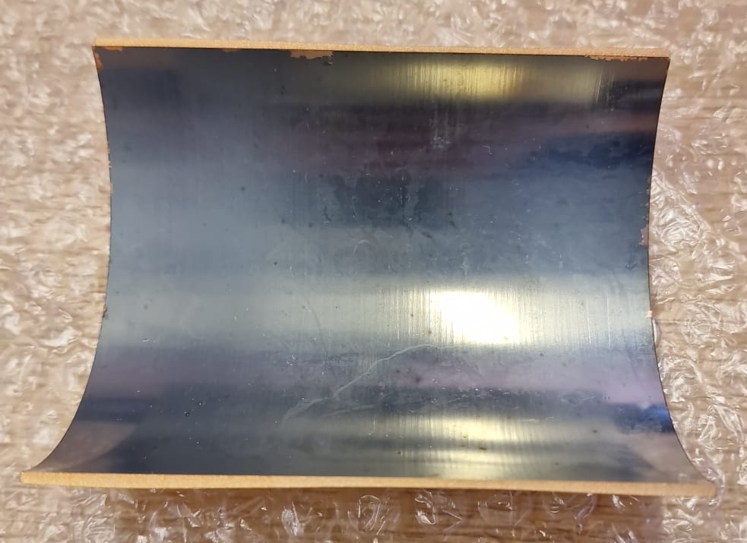
Magnetic Field Penetration Facility update - 1
New poles for a c-shaped magnet produced
New ability to test curved surfaces:
Cuts from 1.3 GHz cavity
Half of 6 GHz cavity
1.3 GHz cavity cut
from an equator zone
1.3 GHz mock cavity deposited Nb after cutting
Ability to relate performance of RF tested cavity to AC/DC characterisation such as
B_{fp}(T),
residual magnetisation
T_{c-dc}
Ability of AC/DC characterisation of cavity prototypes
Cavity cut from a tubular zone

Slide 14
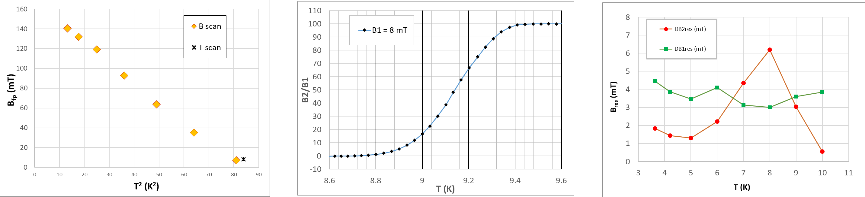
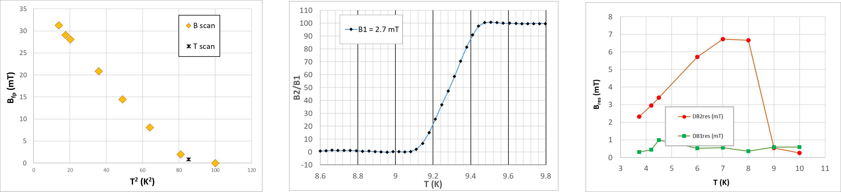


Results for 1.3 GHz cavity cuts
Equator
$Tc = {9.16}_{−0.26}^{+0.14}$K
B_{fp} (4.2 K) = 132 mT
Tube
$Tc = {9.24}_{−0.04}^{+0.06}$K
B_{fp} (4.2 K) =
= 29*4.1 = 119 mT

Slide 15
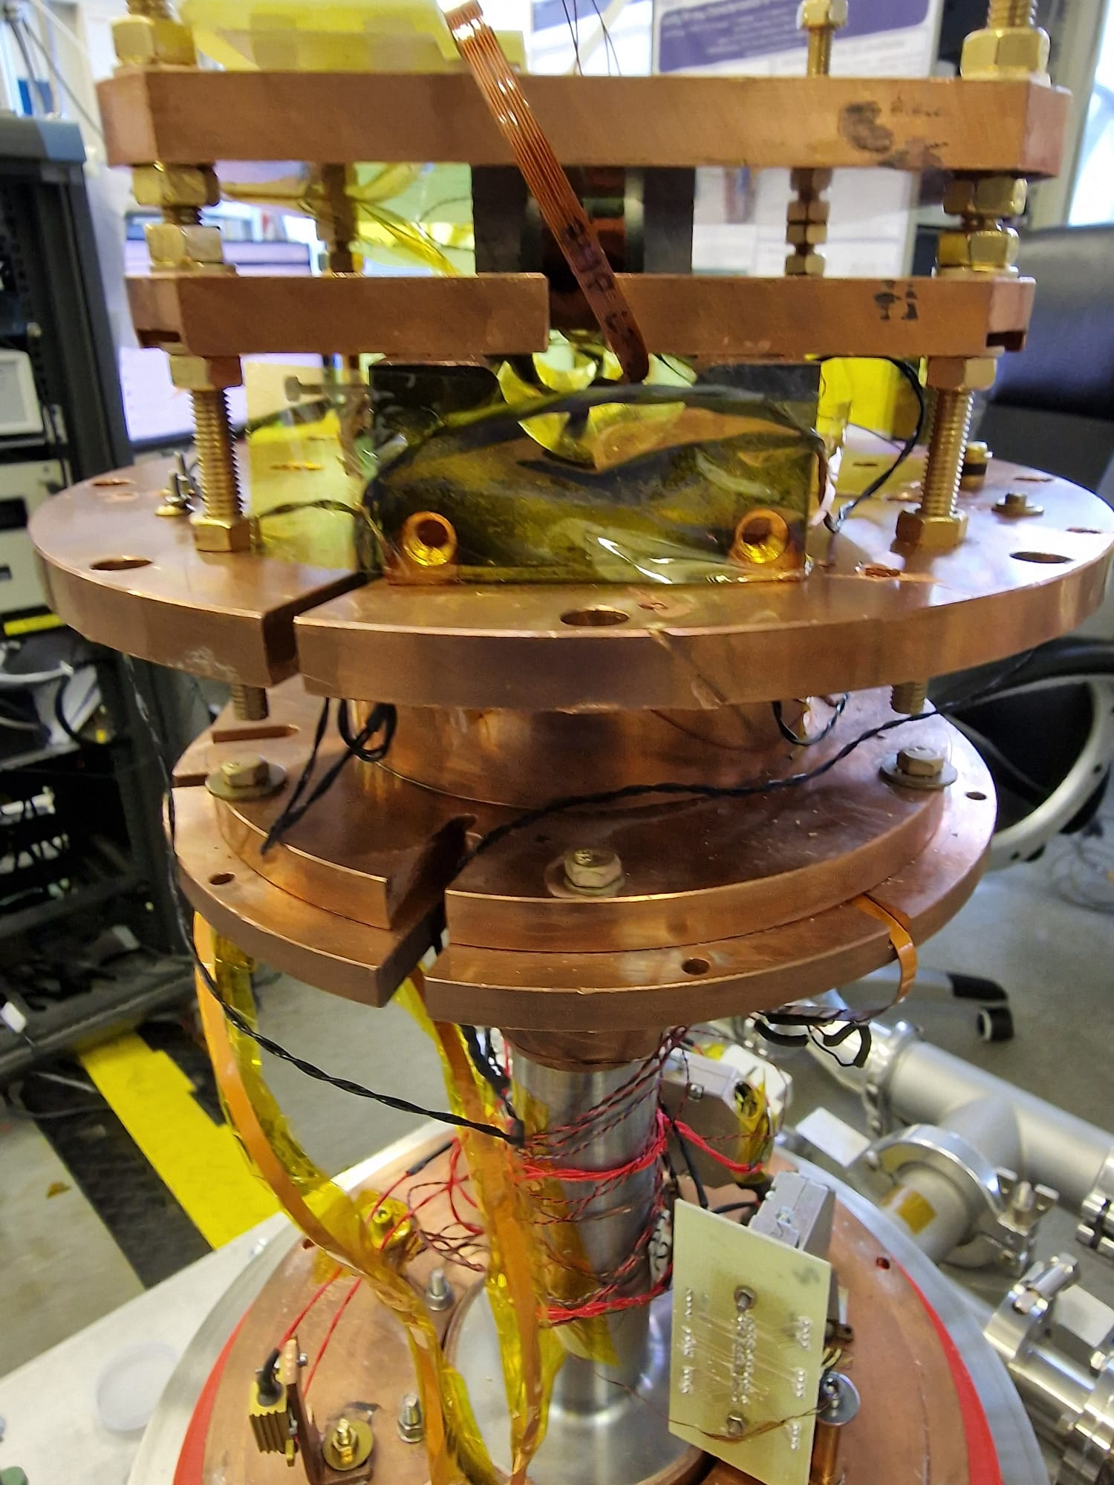
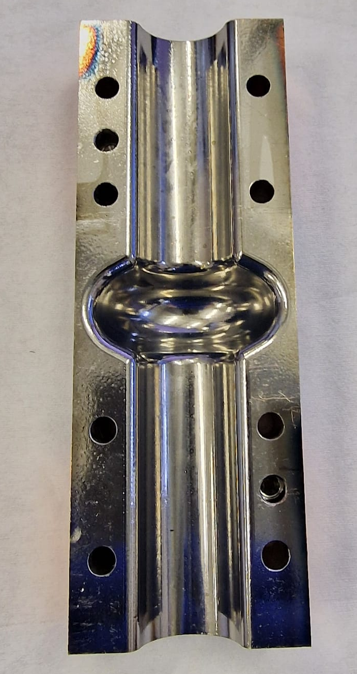
Magnetic Field Penetration Facility update - 2
New poles for a c-shaped magnet produced
New ability to test curved surfaces:
Half of 6 GHz split cavity
Half of a cut of 6 GHz cavity from INFN
Half of 6 GHz cavity installed for MFP measurements
No damage to 6 GHz split cavity
Non-destructive test, cavity can be used for future coatings and testings
Ability to relate performance of RF tested cavity to AC/DC characterisation such as
B_{fp}(T),
residual magnetisation
T_{c-dc}
Half of 6 GHz cavity deposited Nb

Slide 16
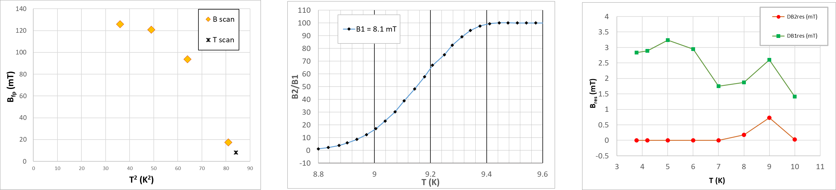
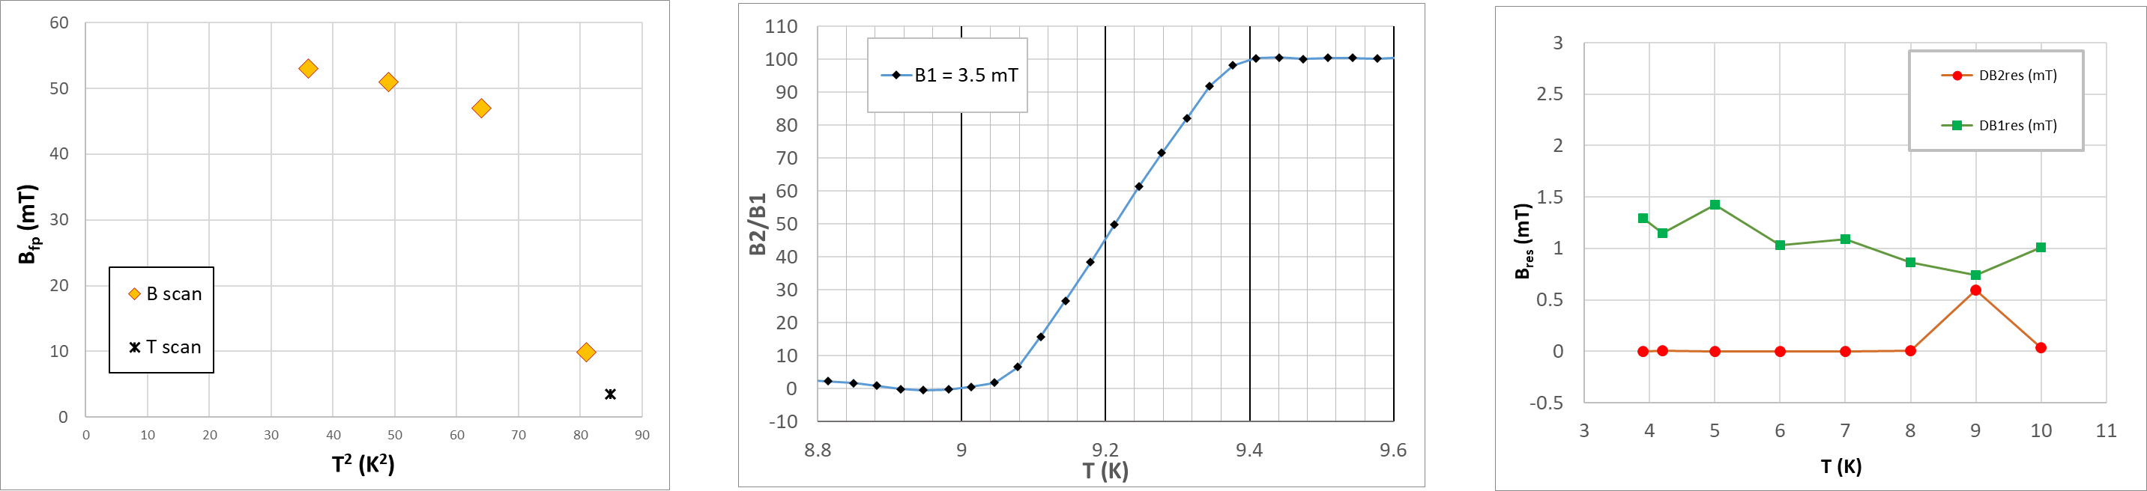


Results for half of 6 GHz split cavity
Side 1
$Tc = {9. 17}_{−0.27}^{+0.13}$K
B_{fp} (4.2 K) = 126 mT
Side 2
$Tc = {9.21}_{−0.13}^{+0.12}$K
B_{fp} (4.2 K) = 122 mT

Slide 17
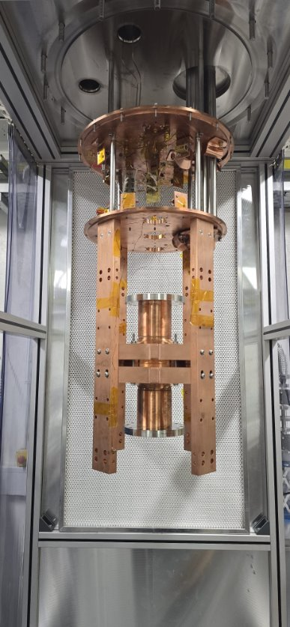
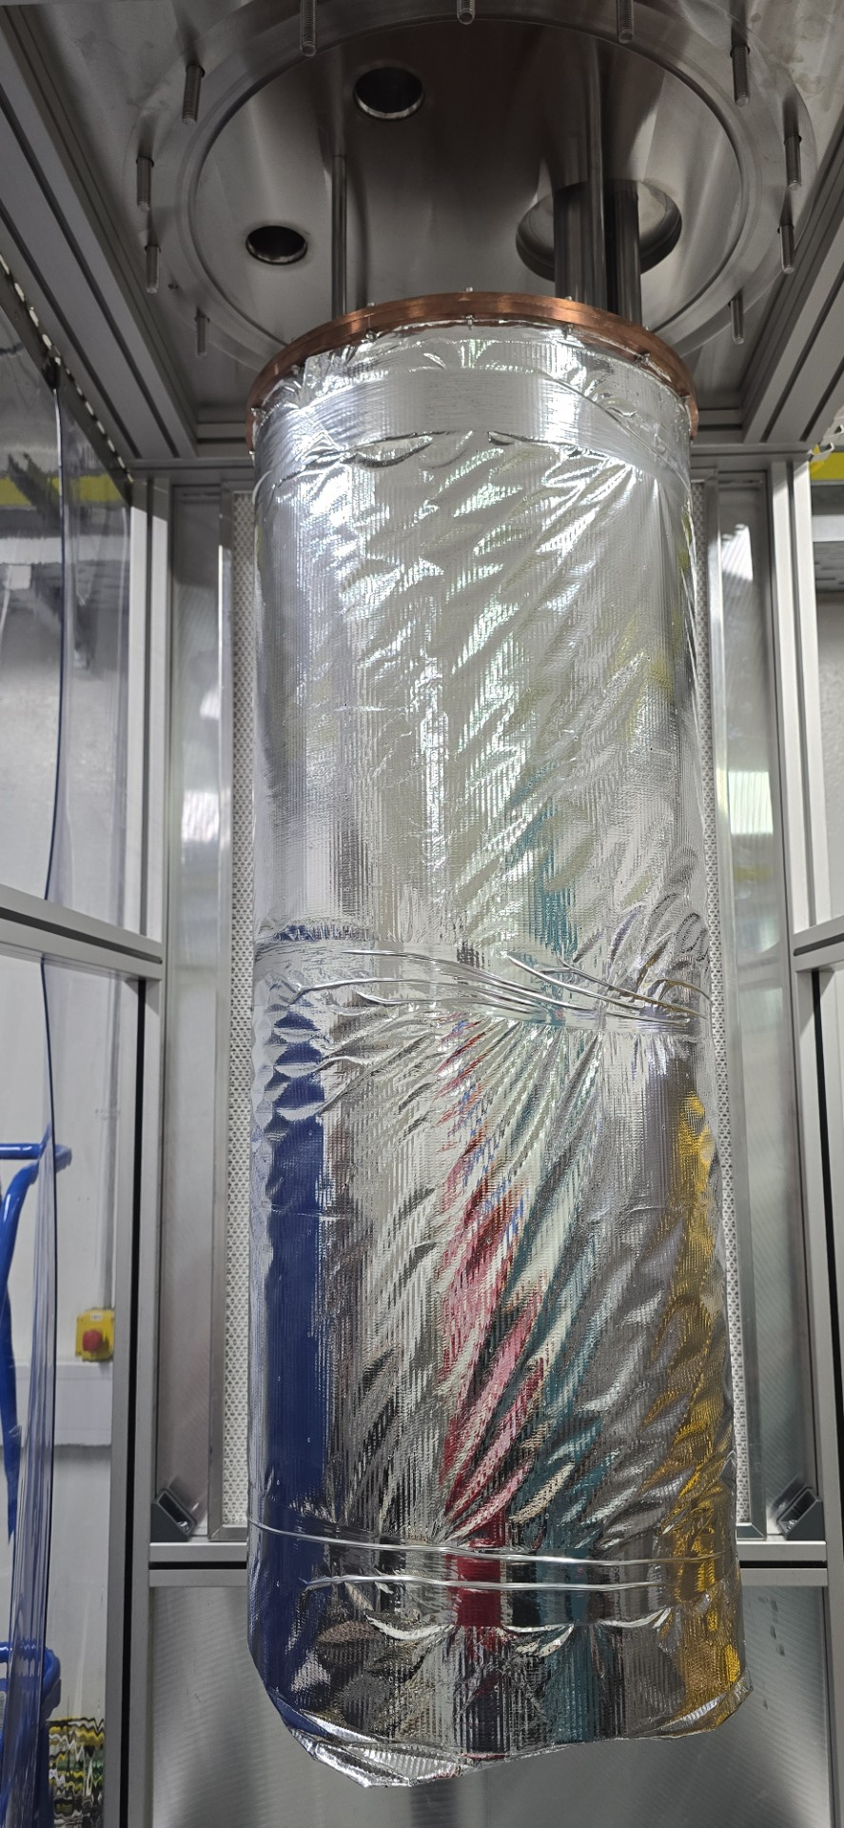
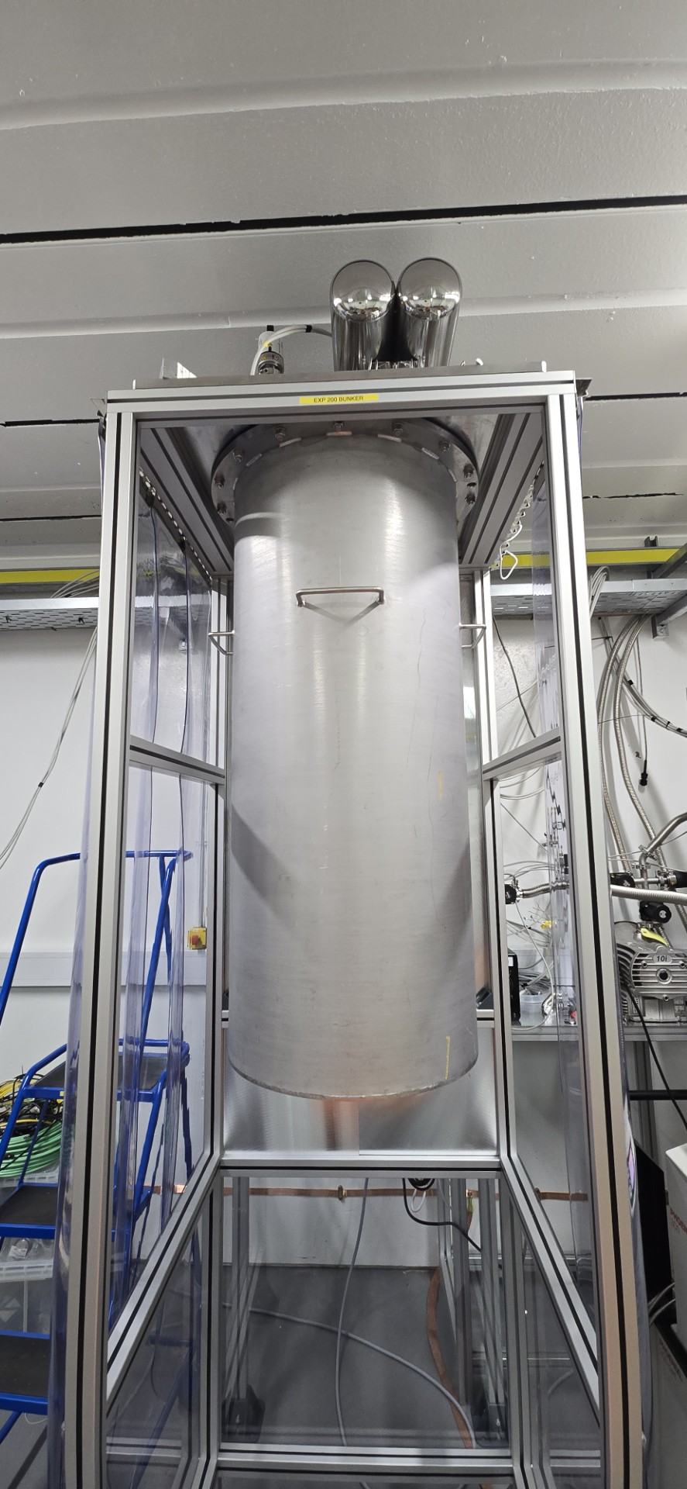
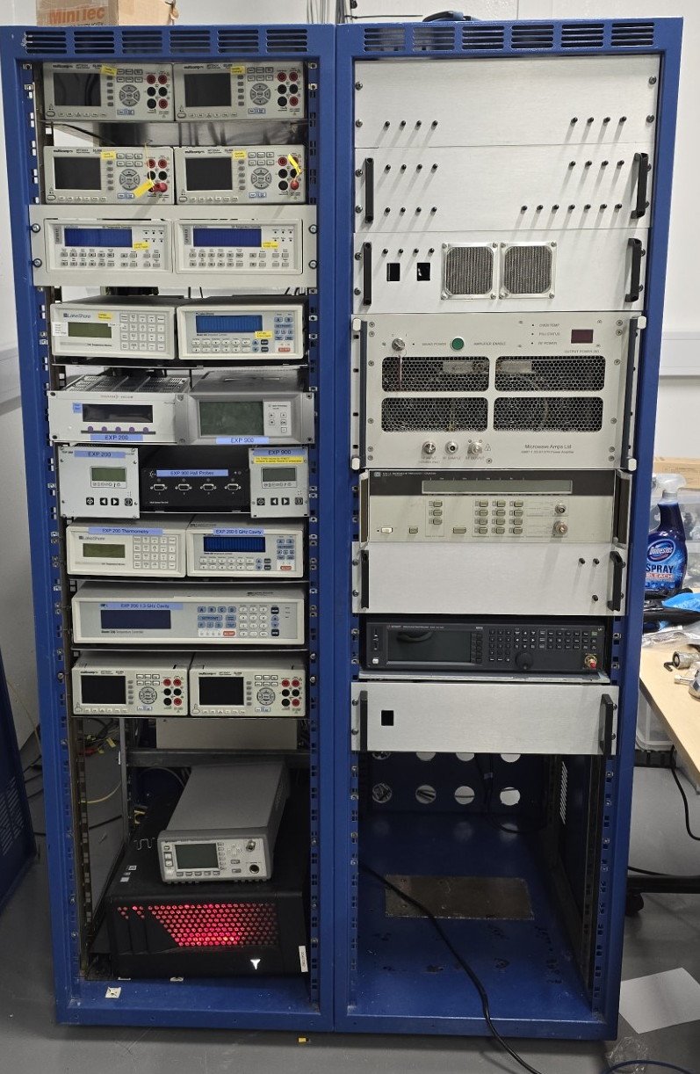
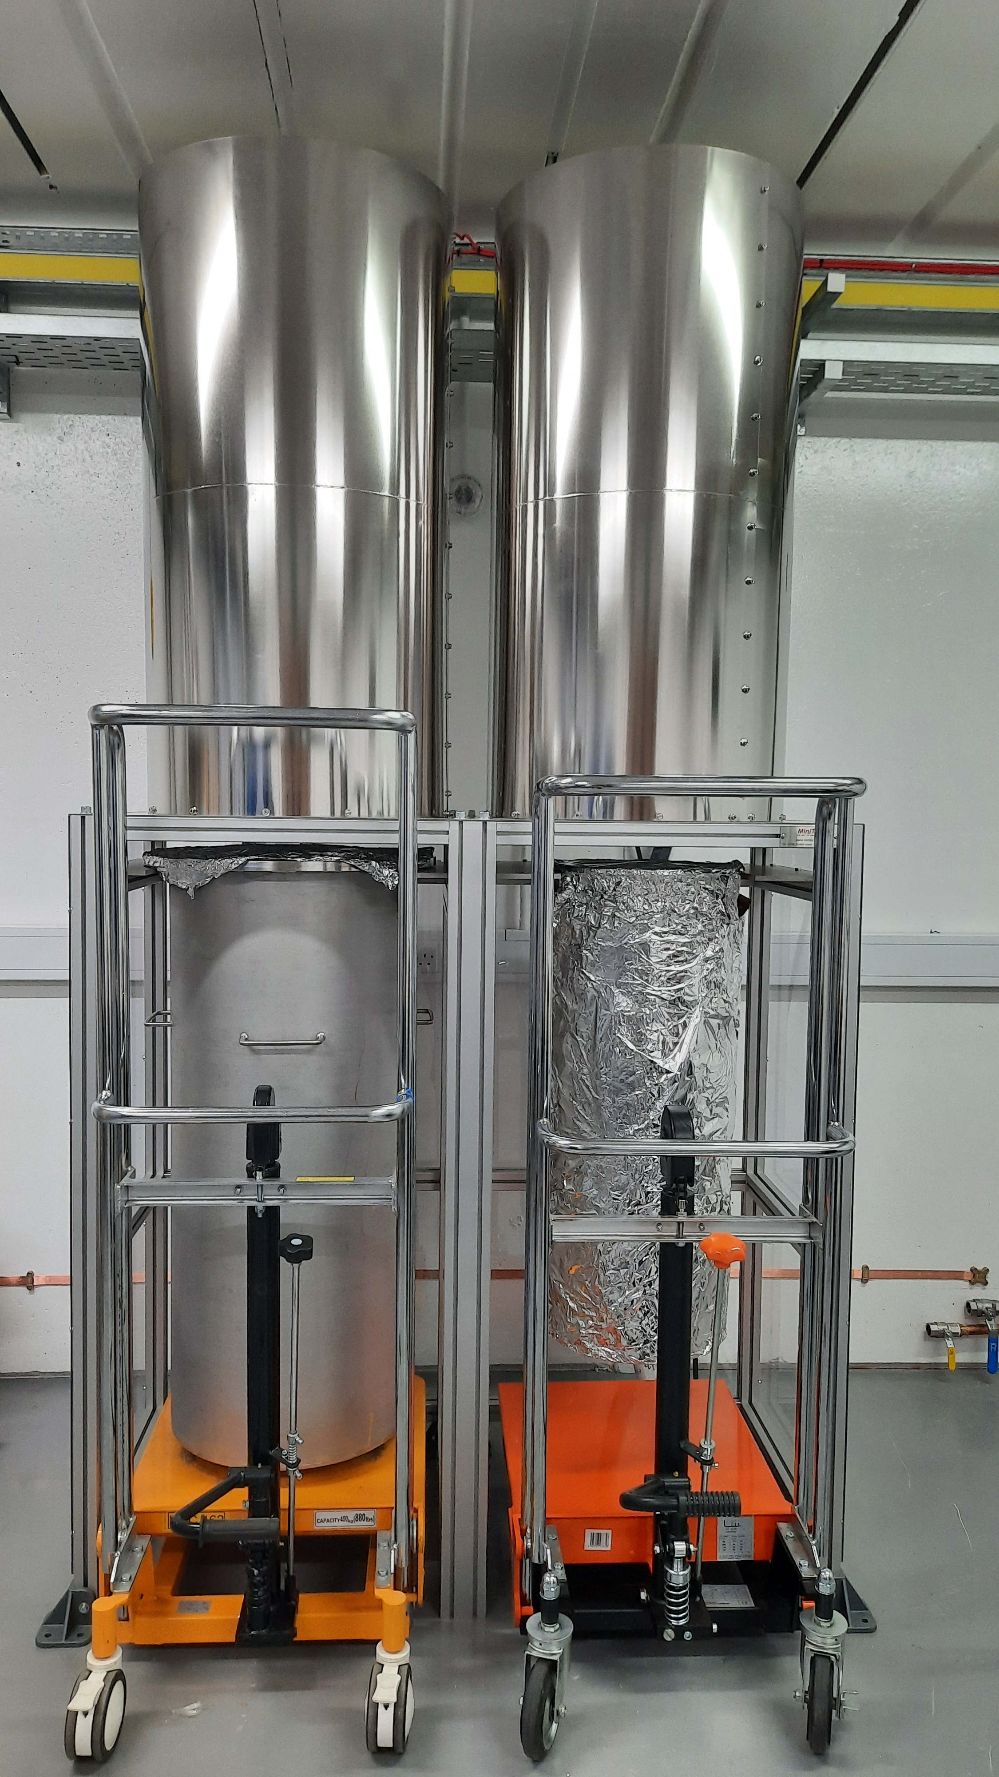
Low Power Cavity Test Facility
Mounted 1.3 GHz cavity & heat link
Heat shield & MLI
OVC
Magnetic shields
LLRF System

Slide 18

New low power RF testing facility (as a part of Task 3.4)
In CI RF bunker
Vacuum <10⁻⁷ mbar
Cryogenics: 3.0 K ≤ T_{cav} ≤ 20 K
Magnetic shield is produced and delivered
Next steps – focus on RF:
RF testing with VNA of uncoated cavity
flanges and RF cables will be added next week
RF testing with VNA of Nb coated cavity from IFAST (laser polished at RTU)
RF testing with VNA of bulk Nb cavity
After receiving after processing at CEA
RF testing with VNA of Nb₃Sn coated bulk Nb cavity
As a part of Task 3.4
Testing new RF system
Software is still underdevelopment

Slide 19
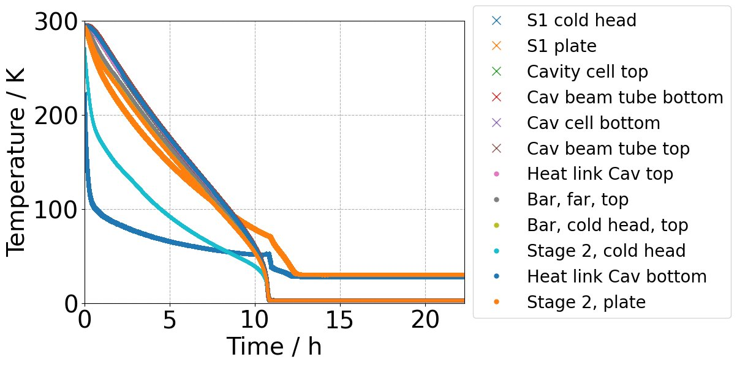
Facility Commissioning
Facility has undergone several cooldowns during cryogenic commissioning:
Base pressure ~ 10^-7 mbar
Base temperature ~ 2.7 K
Cooldown time ~ 14 hours
Successful cooling of a Cu cavity:
4 Cernoxes mounted to cavity
T_{ave} ~ 2.9 K
∆T < 2 mK
Next steps (May/June):
Commission RF facility
Test bulk Nb cavity

Slide 20
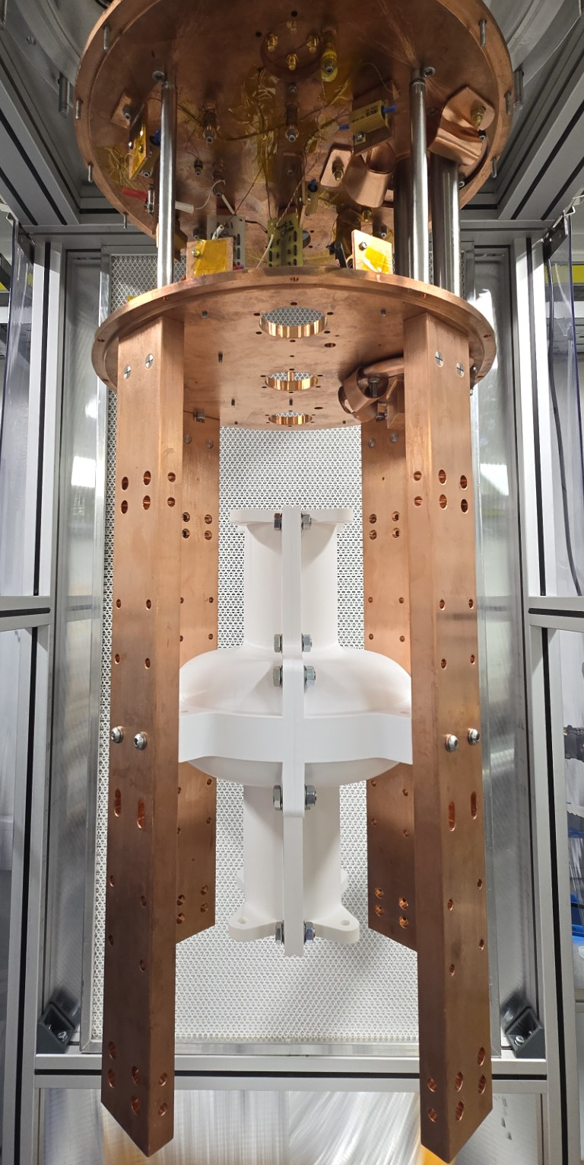
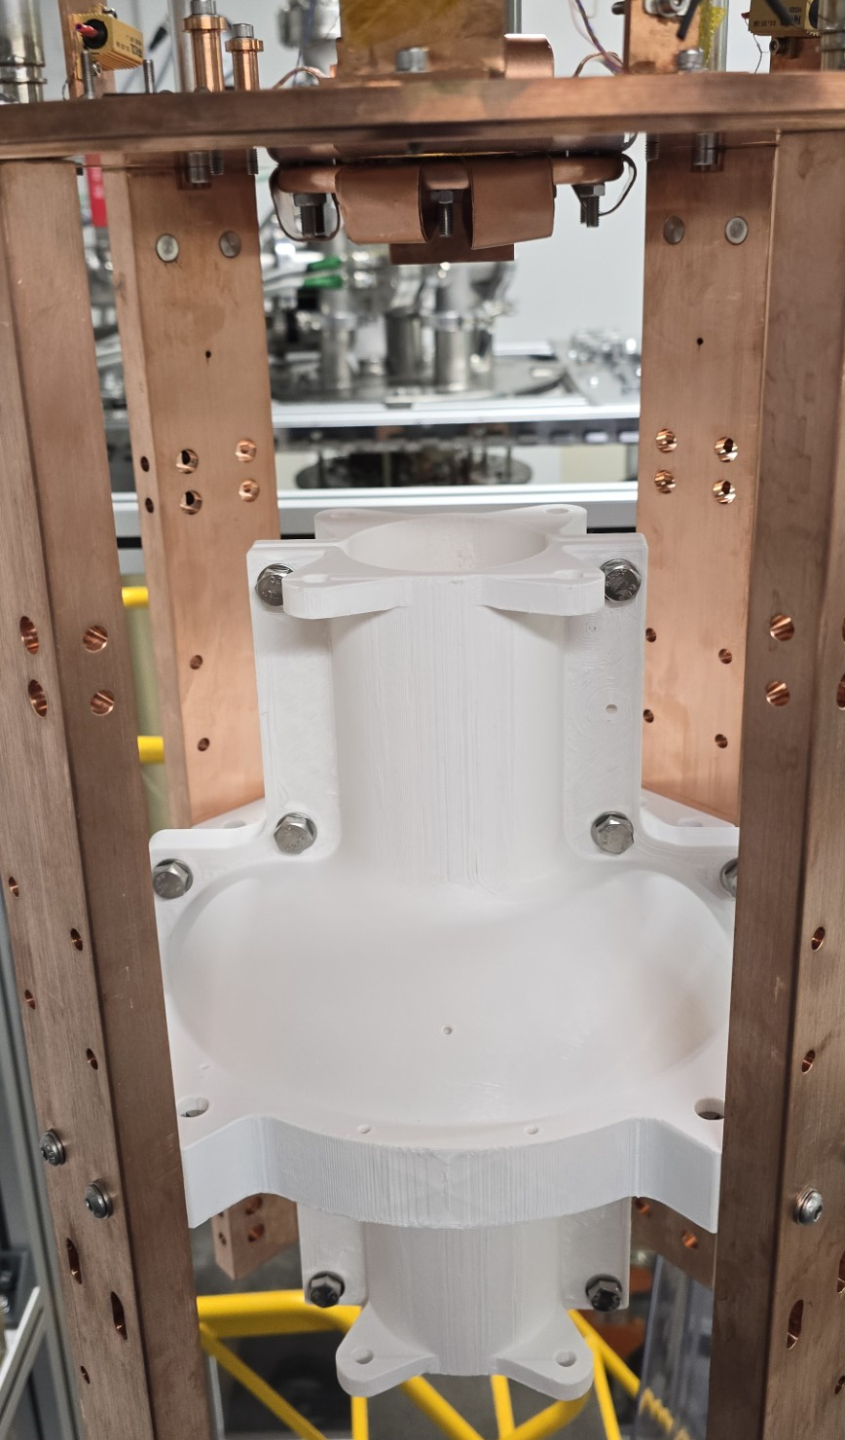
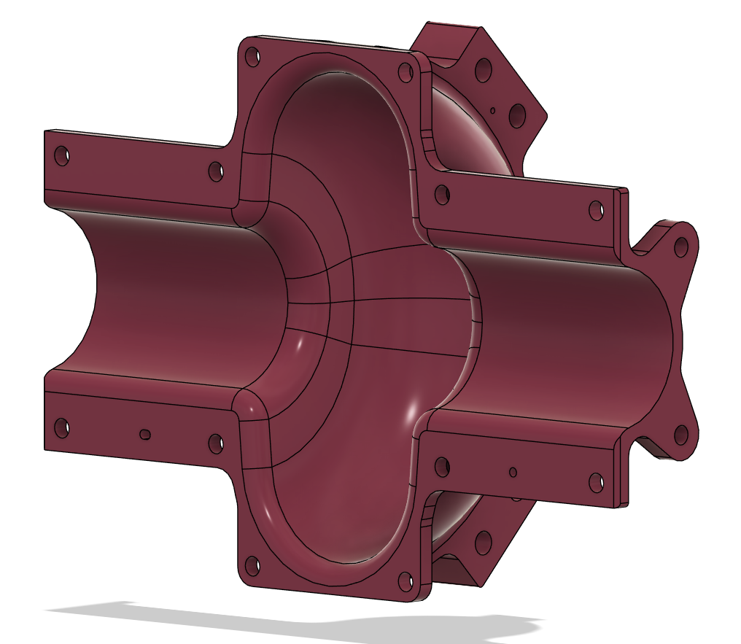
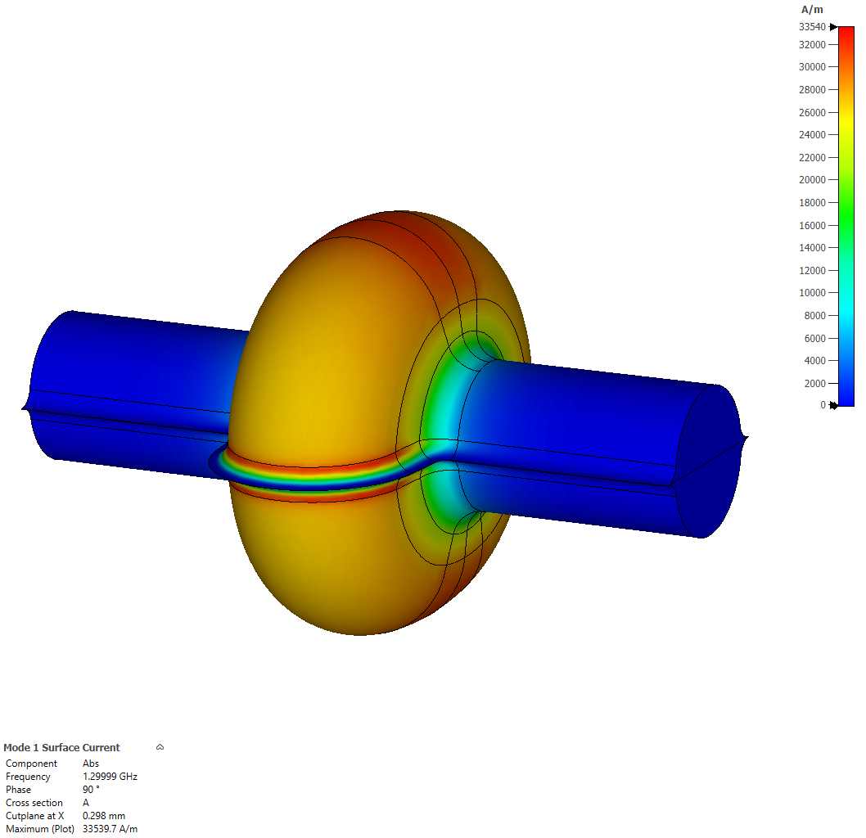
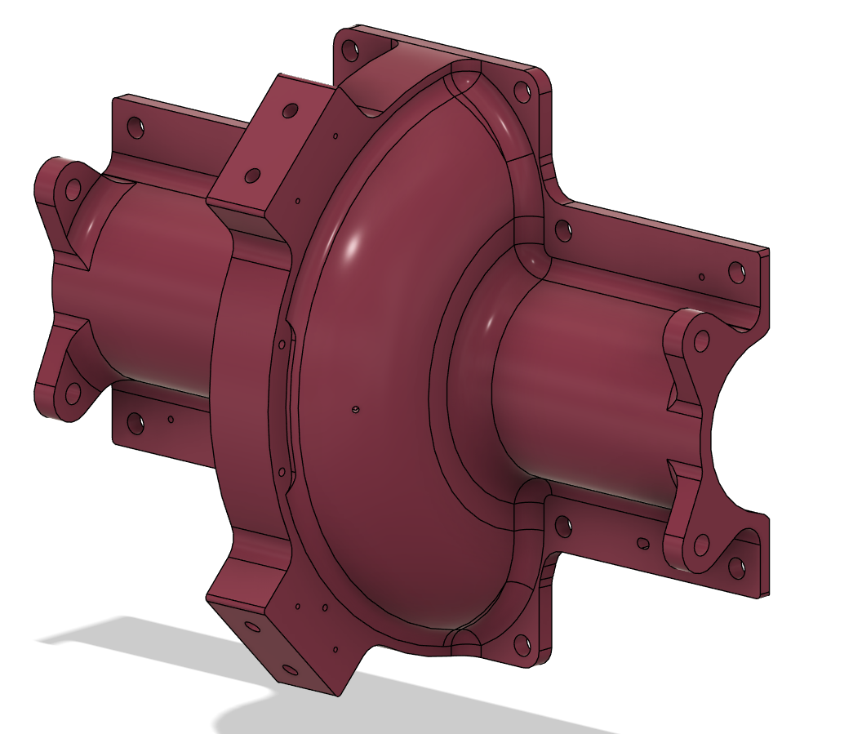
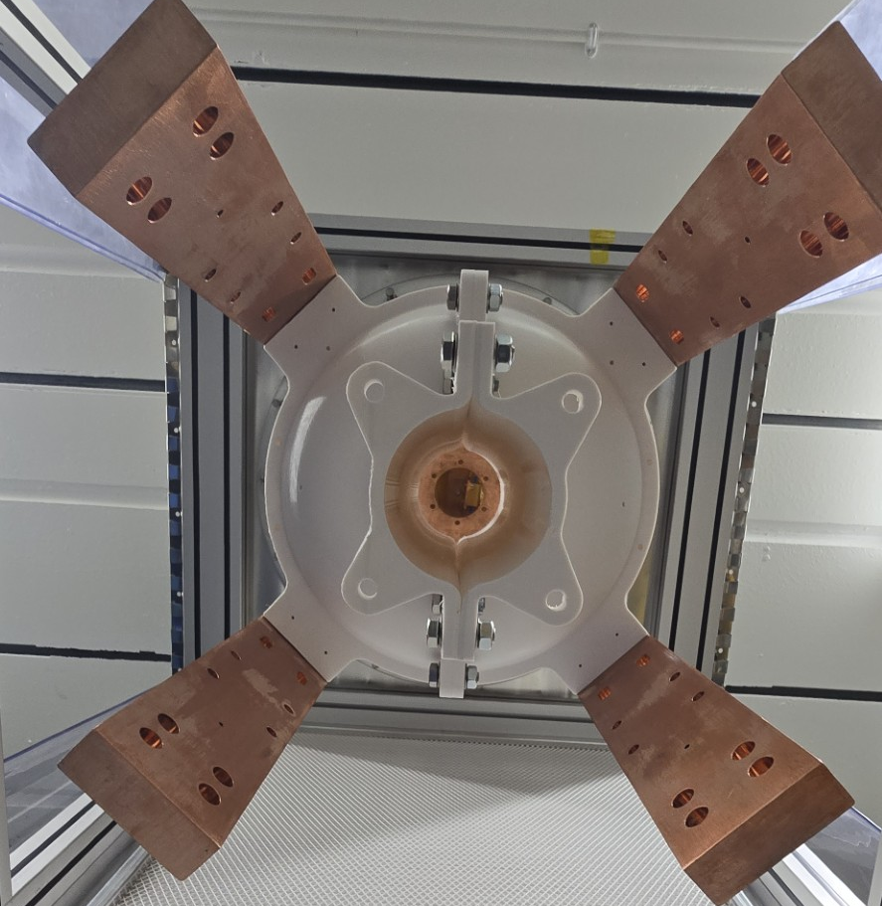
A new 1.3 GHz split cavity
RF design based on single-cell 1.3 GHz TESLA cavity split longitudinally
Al prototype currently being manufactured
Final Cu design ~ 15 kg
Cavity mounted to existing Cu supports

Slide 21
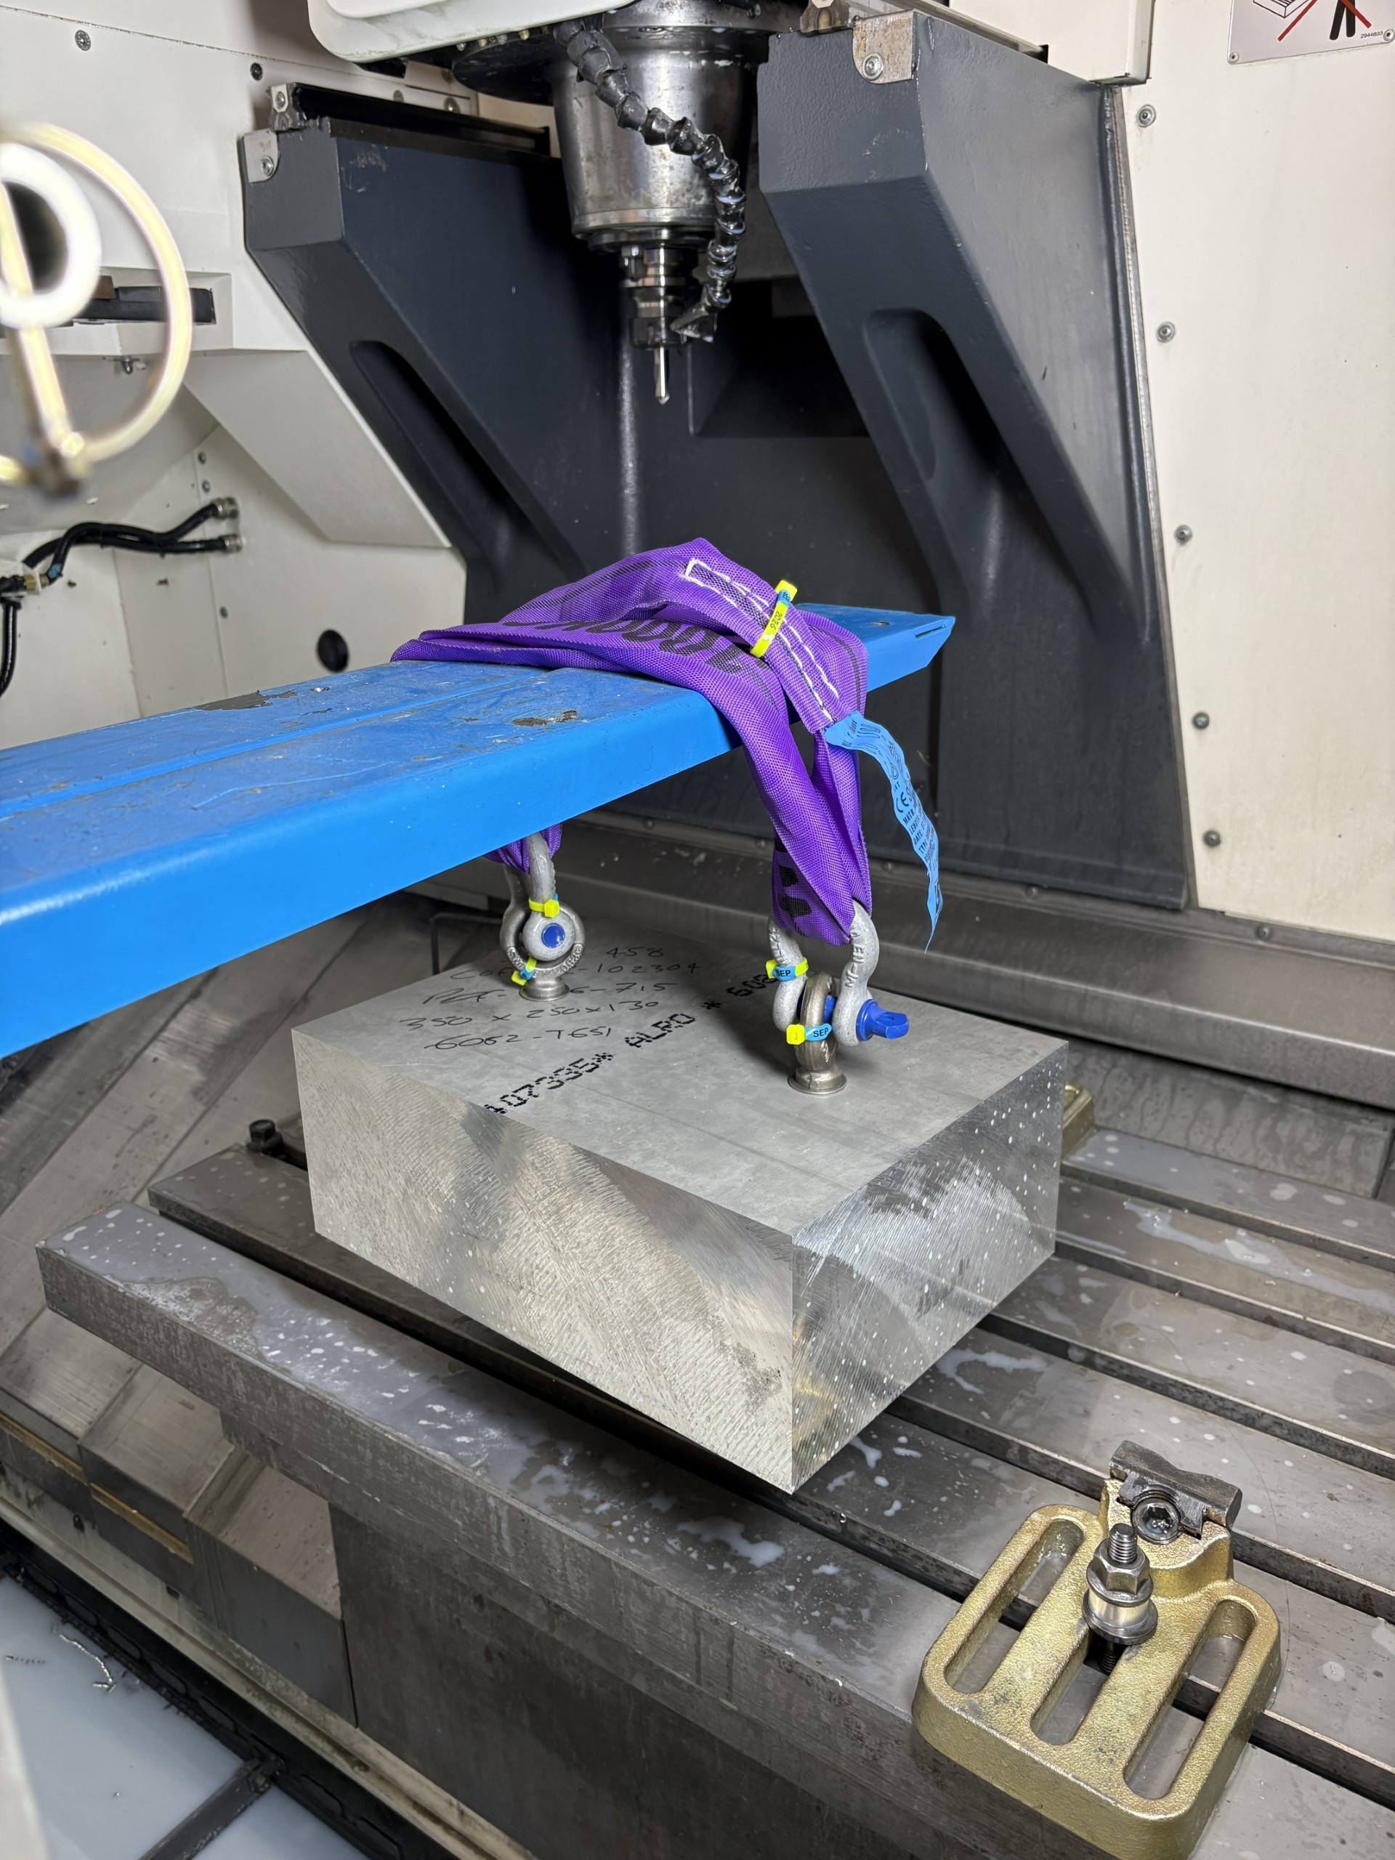
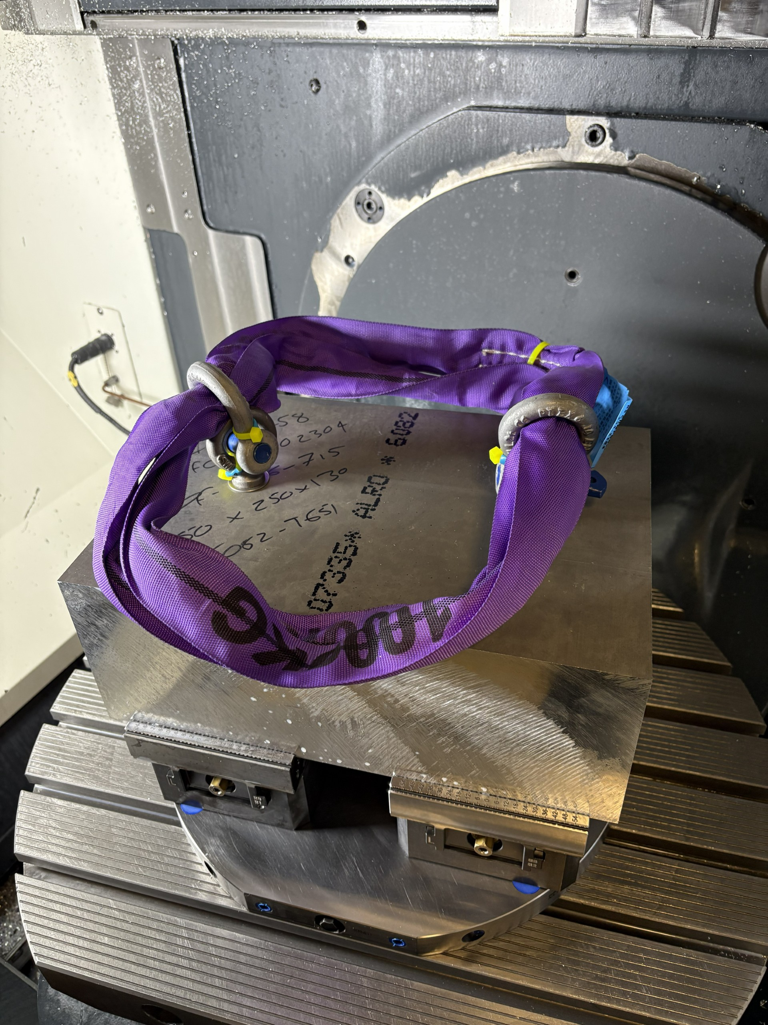
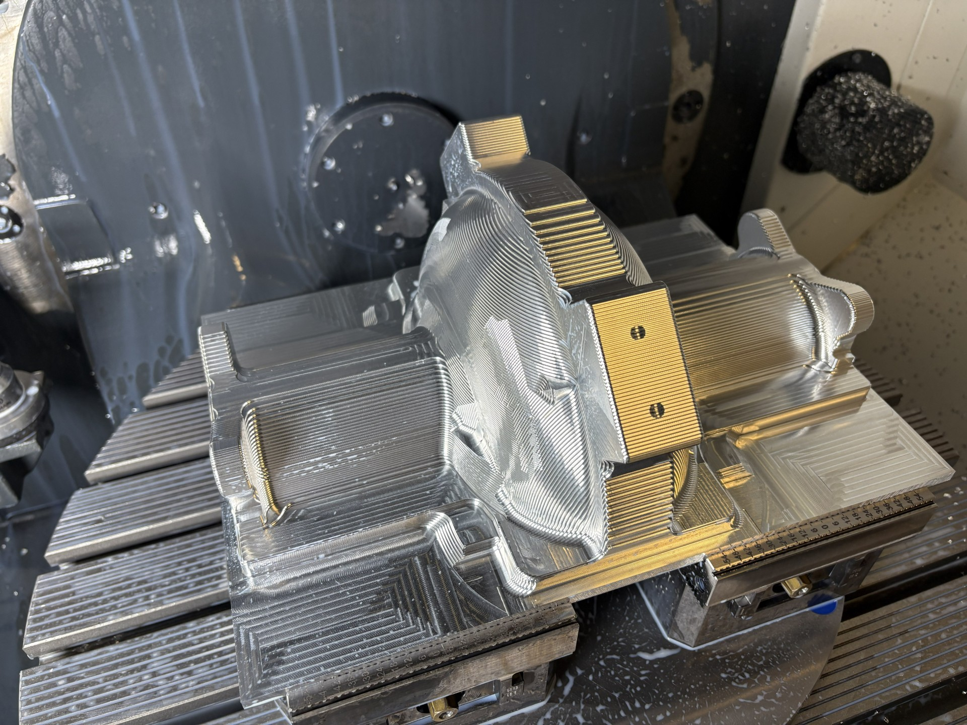
Current status
1. M16 holes machined on 3-axis machine (block mass ~ 31 kg)
2. Block lifted onto 5-axis machine
3. Rough machining outer profile with ~ 2 mm material on all faces

