Slide 1

D10: Q vs f tuning tool
Oliver Kugeler
20.03.2026
iSAS
WP3

Slide 2
Background
WP3 D10
Nb₃Sn-coated copper cavities must be mechanically tuned to adjust resonant frequency.
Tuning causes deformation that can damage the coating (e.g., cracks, delamination, ageing).
TESLA-type 1.3 GHz cavities require ~1 MHz tuning range, corresponding to ~2 mm length change.
Coarse tuning is slow (minutes) using a motor-driven lever system with high mechanical advantage.
Cavities also experience fast, small oscillations (0–300 Hz) from piezos for microphonics and compensation.
A prototype setup with a blade tuner and copper cavity is used to study coating stability under realistic conditions.

Slide 3
Impact on Nb₃Sn Coating
Nb₃Sn is brittle vs. ductile substrate
Strain induces:
Tensile + shear stress, Stress at interface
Real coatings:
Grain boundaries, defects → stress concentrators
Can lead to:
Microcracks, Delamination, Damage accumulation over cycles
Superconducting Consequences
Strain modifies:
Lattice spacing → electronic structure
Possible effects:
Shift in Tc, Change in critical current, Altered flux pinning
RF impact:
Increased surface resistance, Local hot spots at high fields
Mechanical Deformation & Strain
1.3 GHz cavity:
1 MHz shift → ~8 × 10⁻⁴ relative frequency change
Frequency scales with geometry → similar relative length change
For ~10 cm cavity:
Required deformation ≈ 80 µm
Induces strain in cavity walls:
10⁻⁴ – 10⁻³ (elastic regime)
Deformation is non-uniform:
Local bending
Stress concentrations (geometry, welds, tuner contact)
From Macroscopic to Atomic Scale
Strain translates to:
picometer-scale lattice changes
Affects both:
Substrate (Cu/Nb) & Nb₃Sn coating

Slide 4
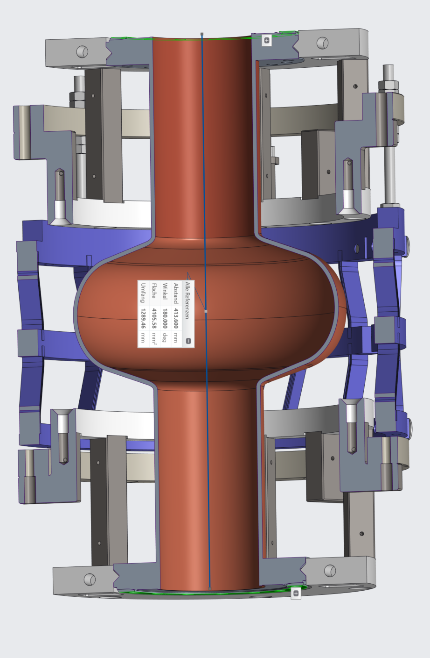
Experimental setup
Copper prototype cavities provided by INFN with TESLA-shaped geometry, formed by spinning
Ends equipped with horn-shaped „flanges“ → vacuum-tight via CF-100 adapters
Permanent vacuum connections (not removed after assembly)
Blade tuner design:
Three concentric rings along cavity axis
Middle ring split → connected via titanium blades (spring elements)
Lateral motion → converted into axial cavity deformation
Challenge: Standard tuners attach to LHe tank, not bare cavity, to be used in bath cryostat
Solution: Custom groove + adapters (HZB) to connect tuner directly to cavity

Slide 5
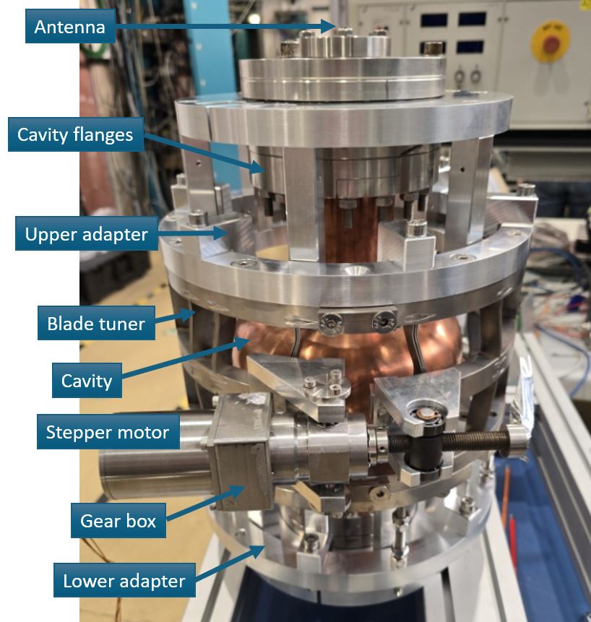
Actuation & RF Measurement
Stepper motor (Phytron) + harmonic drive → precise, reproducible cavity length control
Two antennas:
One strongly coupled
One weakly coupled
Vector Network Analyzer (VNA):
Measures S-parameters → resonance frequency & bandwidth
Automated via Python GUI (ChatGPT-assisted)

Slide 6
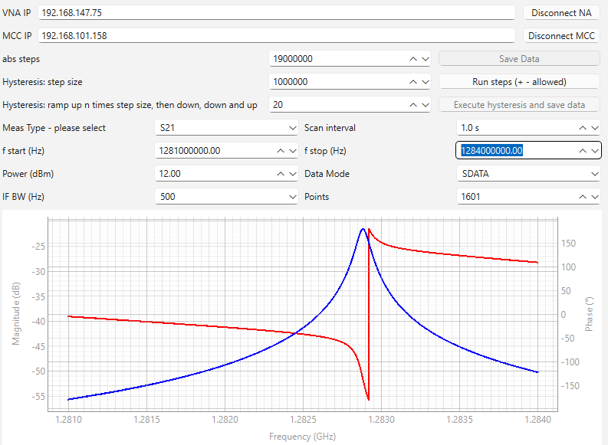
Prompt engineered DAQ tool
1000 lines of python code entirely generated by AI

Slide 7
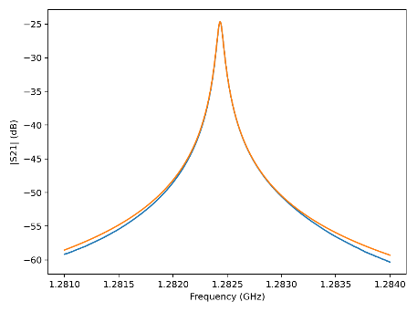
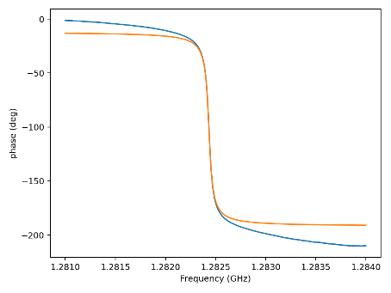
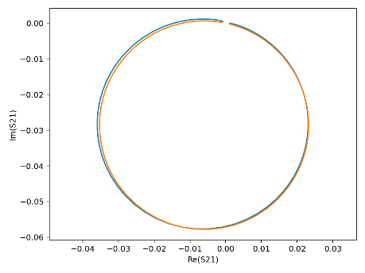
S21 measurements
Lorentz profile fit
Complex circle fit
Resonance frequency bandwidth

Slide 8
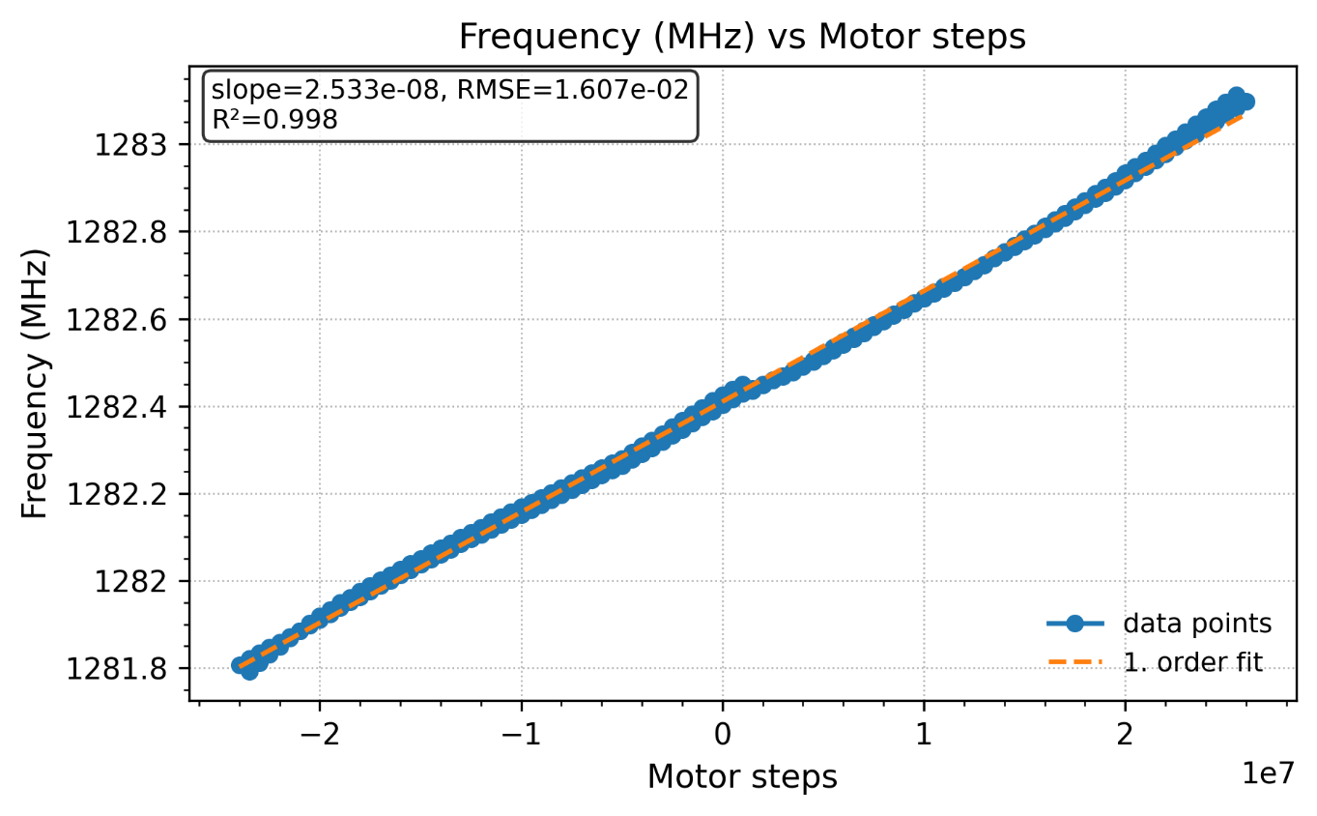
Commissioning results
Range ok
Linearity ok
Small hysteresis
Small plastic deformation at >1MHz elongation (can be healed)

Slide 9
Conclusion & outlook
Q vs f detuning tool successfully commissioned
ToDo
Confirm vacuum tightness upon tuning
Use better antenna
Operate with Nb₃Sn coated cavity in bath cryostat (above lambda point)
Optional: equip HRD (movable antenna tool)

