Slide 1
Trapped flux generated by thermoelectric currents
F. Kramer
22.04.2026
ISAS 2026
Berlin
Notes:
I will be sharing measurement data of trapped magnetic flux generated by thermo-electric currents in Nb3Sn samples.

Slide 2
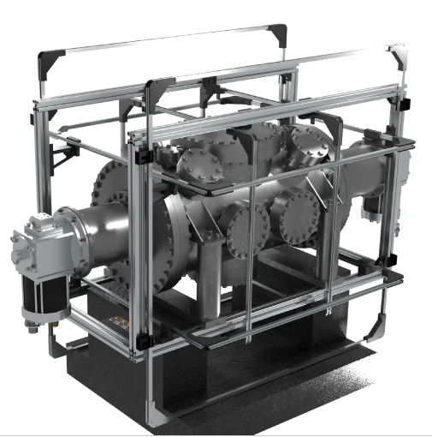
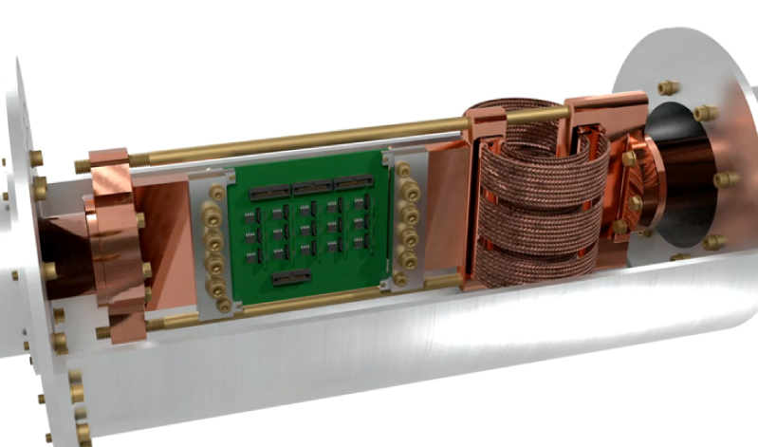
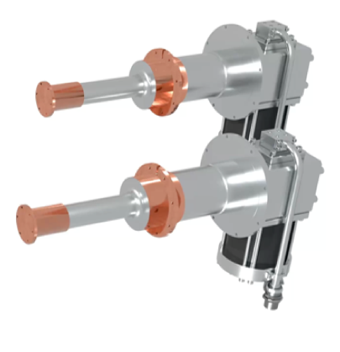
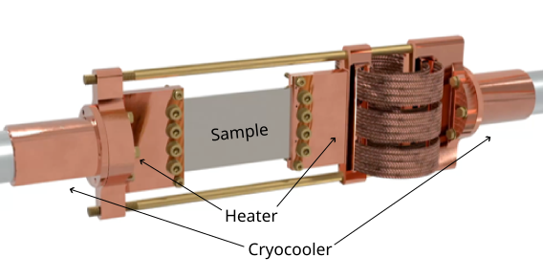
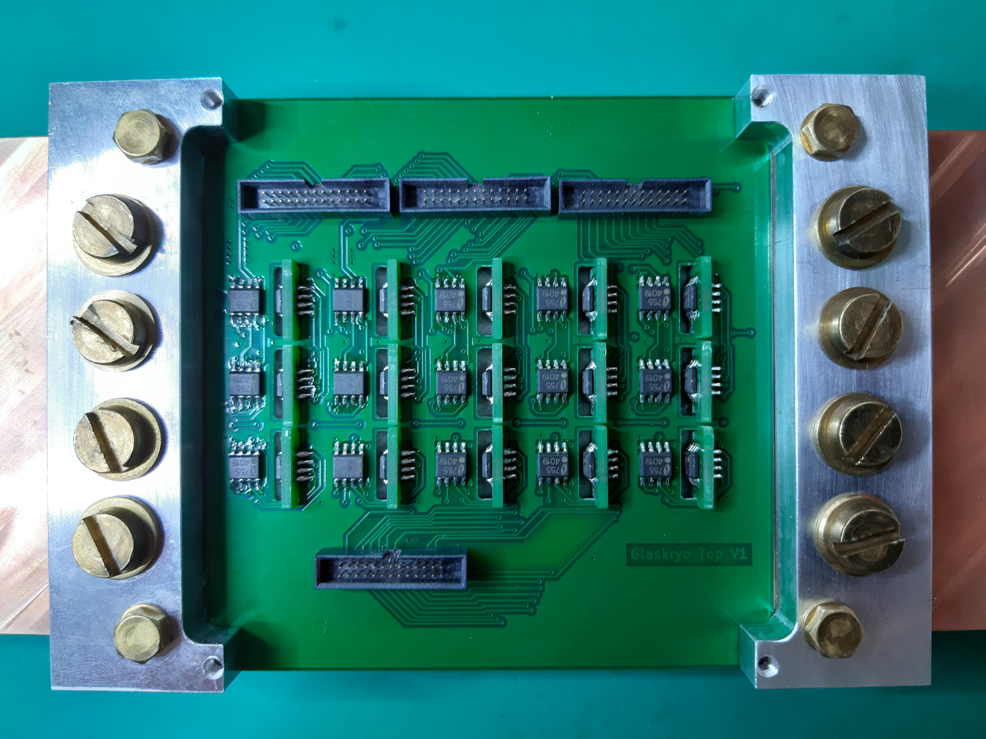
Experimental setup to measure trapped flux
Setup
2 cryocoolers to cool down sample
Sample (100x60x3)mm³, clamped in copper blocks at either end
Two heaters at the end of the blocks allow for precise control of temperature gradient and cooldown rate
Multiple AMR sensors for magnetic field measurements
grouping of 3 sensors to measure field vector in 3d
15 AMR sensor groups measure magnetic field just above the sample
2 Cernox sensors measure temperature gradient across sample
Active field compensation with three Helmholtz-coils
Minimum flux density at location of reference sensors < 30nT
Maximum flux density 220µT
Courtesy A. Cierpka

Slide 3
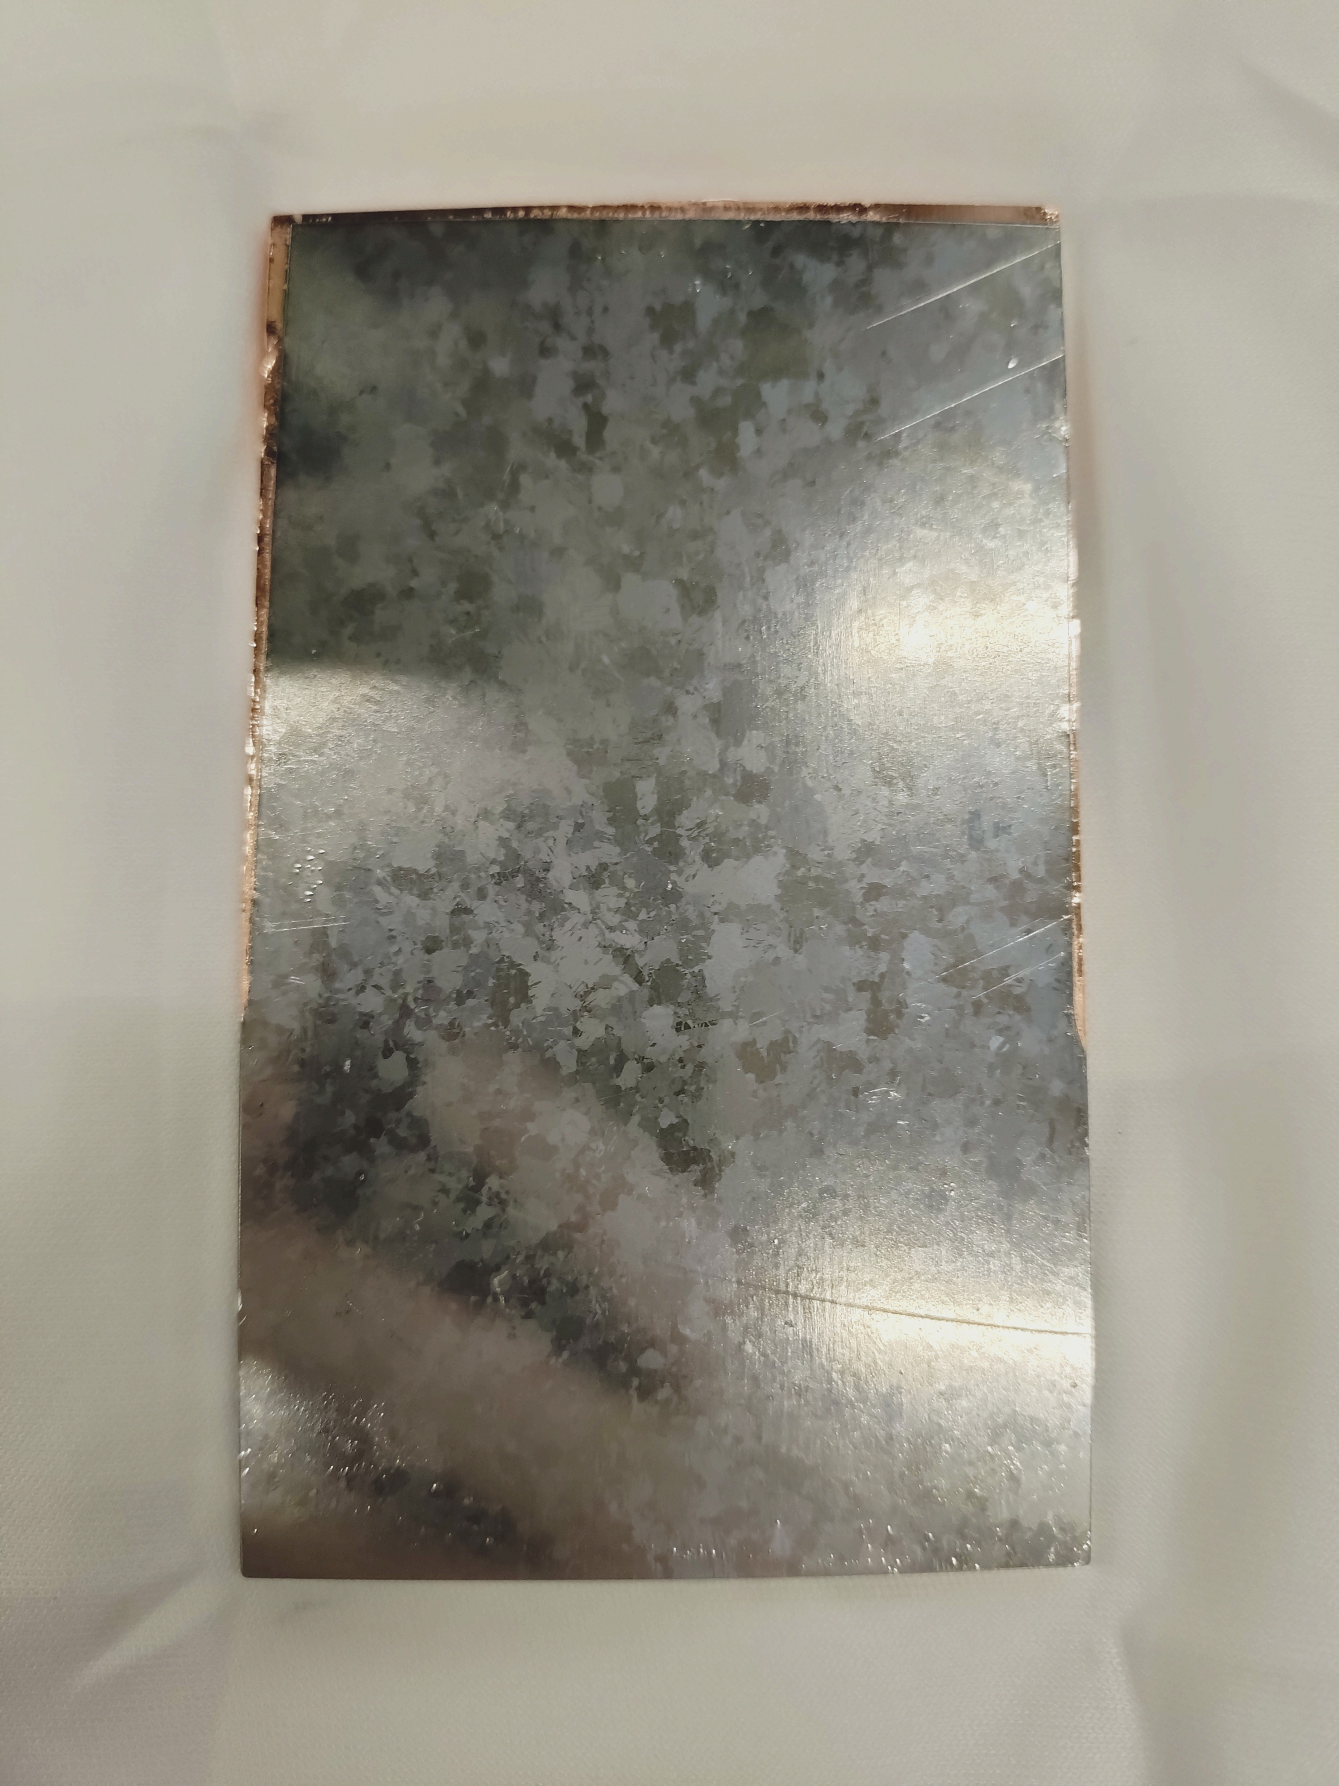
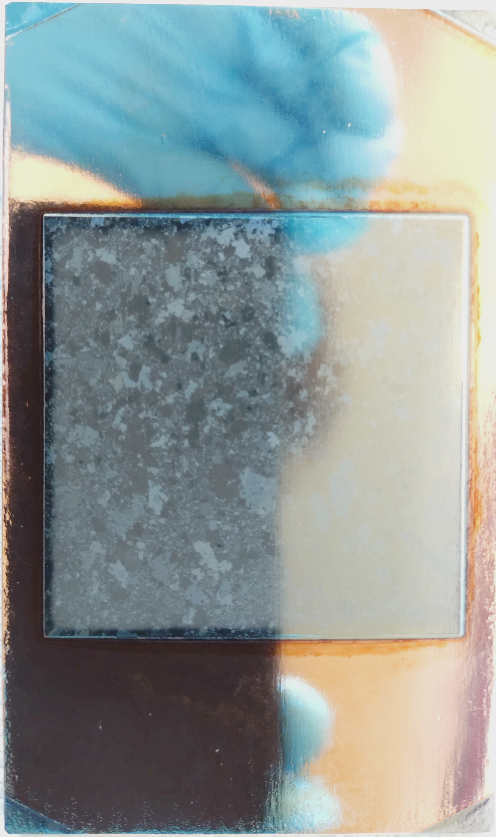


The samples
SampleS
Name | Substrate | Nb layer [µm] | Nb₃Sn layer [µm] | Method
Nb₃Sn BL (INFN) | Cu | 30 | 1 | Sputtered
Nb₃Sn (INFN) | Cu | - | 1 | Sputtered
Nb₃Sn BL (INFN) center | Cu | 30 | 1 | Sputtered
Nb₃Sn/Cu (HZB) | Cu | 10 | 1 | Sputtered / Bronze route
Nb₃Sn/Nb (HZB) | Nb | - | 1 | Bronze route
Nb/Cu (10µm) | Cu | 10 | - | Sputtered
Nb/Cu (4µm) | Cu | 4 | - | Sputtered
D. Fonnesu
D. Ford
M. Lu
A. Zubtsovskii

Slide 4
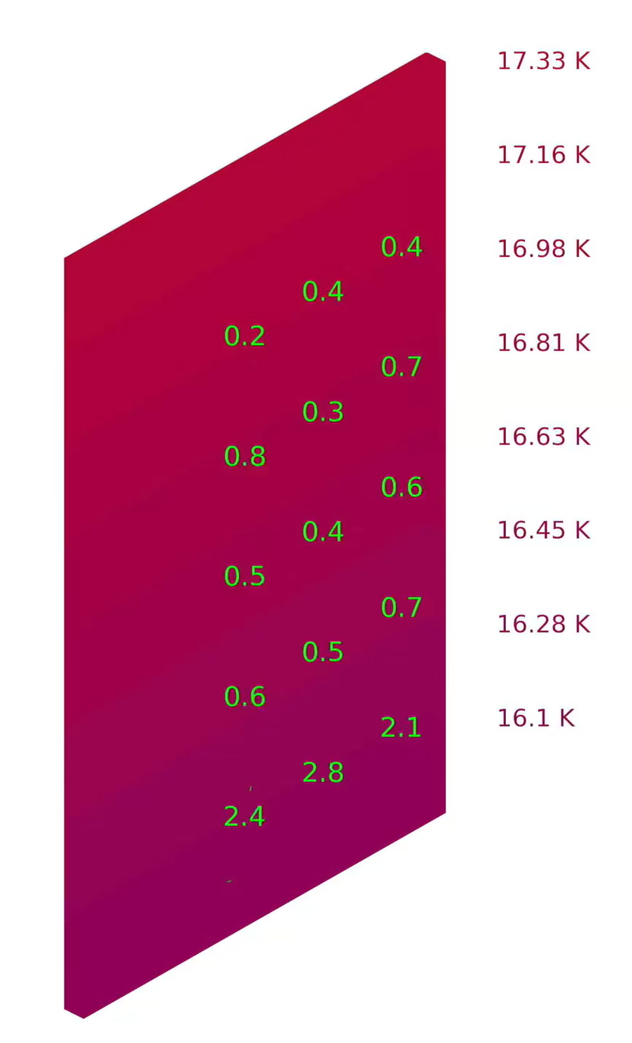
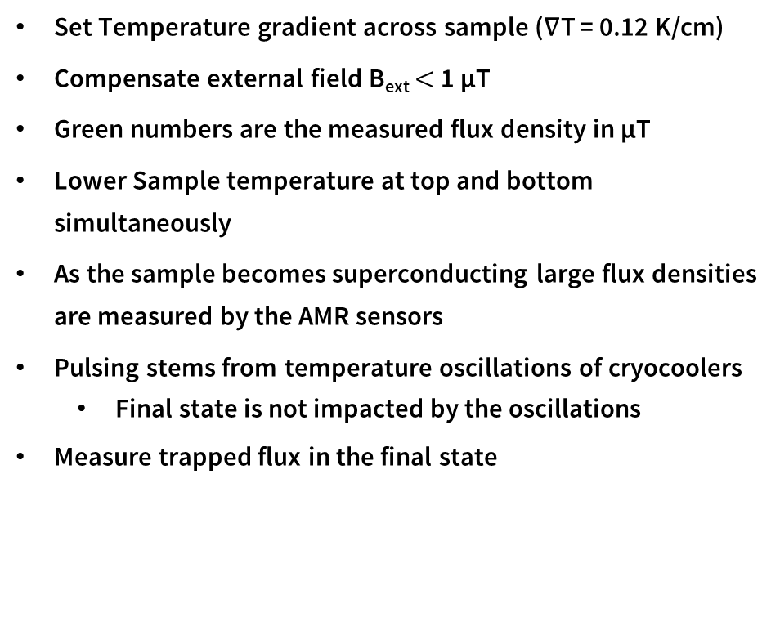
A typical Cooldown with “Nb₃Sn/Cu (HZB)”
Results
Set Temperature gradient across sample (∇T = 0.12 K/cm)
Compensate external field B_{ext} $<$ 1 µT
Green numbers are the measured flux density in µT
Lower Sample temperature at top and bottom simultaneously
As the sample becomes superconducting large flux densities are measured by the AMR sensors
Pulsing stems from temperature oscillations of cryocoolers
  Final state is not impacted by the oscillations
Measure trapped flux in the final state

Slide 5
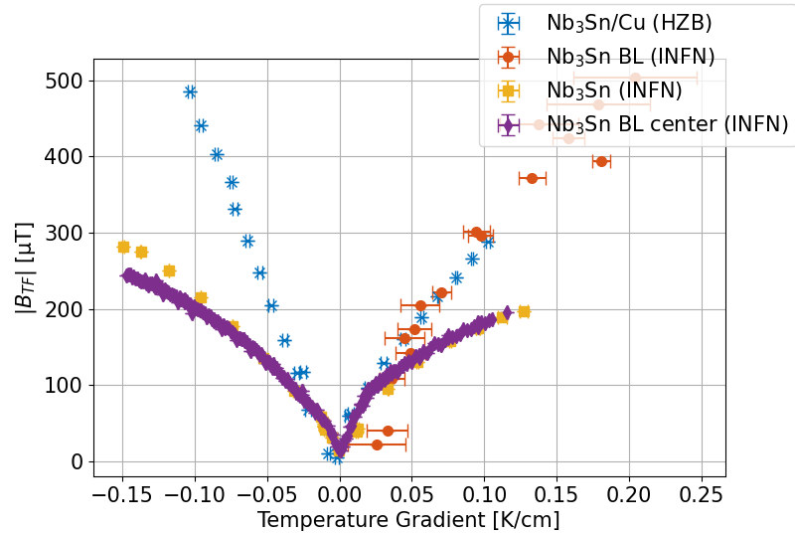
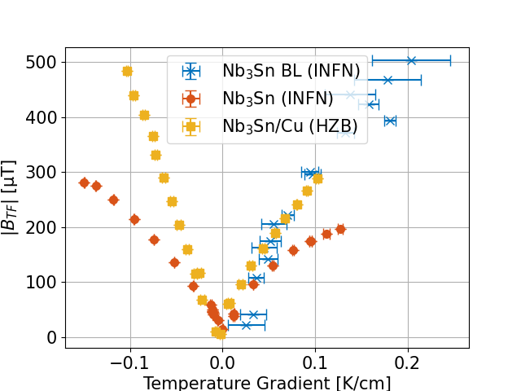
Nb₃Sn on copper substate
Results
Zero field cooled
Plot trapped flux magnitude of center sensor versus temperature gradient during cooldown
Increasing flux density with temperature gradient
All samples show large flux density magnitudes several times the earth’s magnetic field
To be published

Slide 6
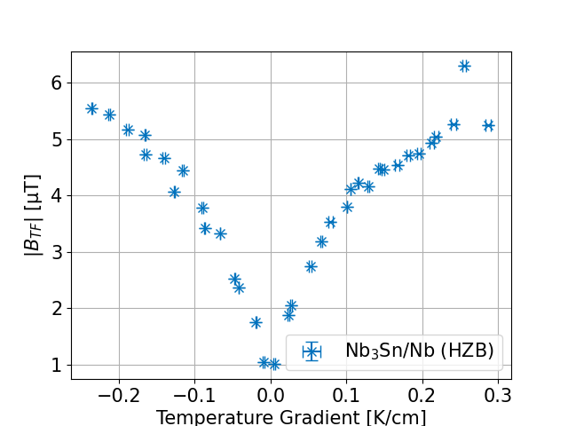
Nb₃Sn on niobium substrate
Results
Zero field cooled
Plot trapped flux magnitude of center sensor versus temperature gradient during cooldown
Increase with temperature gradient
Flux density 2 orders of magnitude smaller

Slide 7
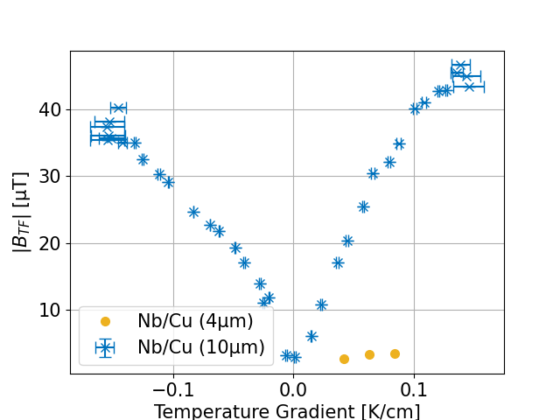
Niobium on copper
Results
Zero field cooled
Plot trapped flux magnitude of center sensor versus temperature gradient during cooldown
Trapped flux at 0.085 K/cm
  Nb/Cu (4µm): 3.5 µT
  Nb/Cu (10µm): 33 µT

Slide 8
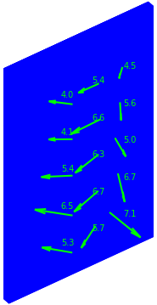
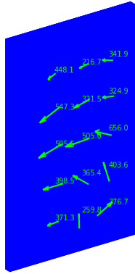
Trapped flux orientation
Results
Nb₃Sn/Nb (HZB)
Nb₃Sn/Cu (HZB)
The final state orientation of the trapped flux can be categorized in homogenous and inhomogeneous
All Nb₃Sn samples on copper substrate show an inhomogeneous final state
All other samples show a homogeneous final state

Slide 9
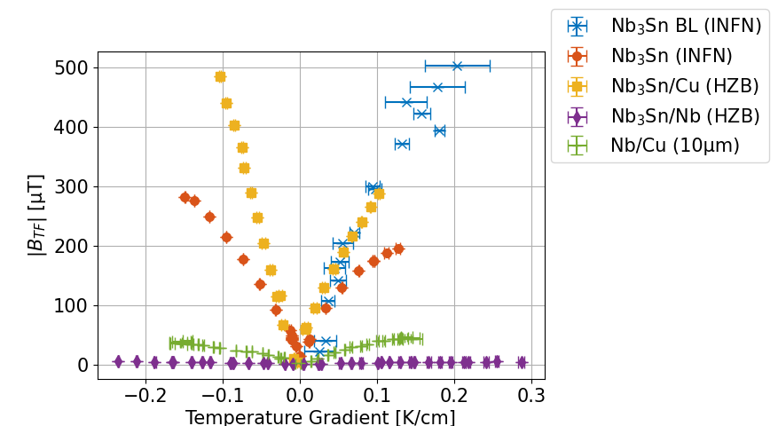
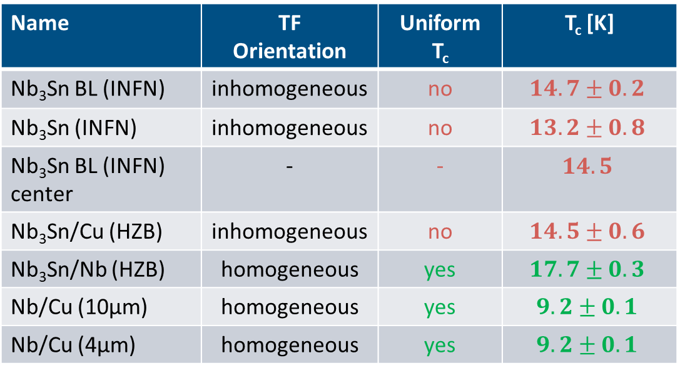
Overview
Results
Name | TF Orientation | Uniform T_{c} | T_{c} [K]
Nb₃Sn BL (INFN) | inhomogeneous | no | $$14.7±0.2$$
Nb₃Sn (INFN) | inhomogeneous | no | $$13.2±0.8$$
Nb₃Sn BL (INFN) center | - | - | $$14.5$$
Nb₃Sn/Cu (HZB) | inhomogeneous | no | $$14.5±0.6$$
Nb₃Sn/Nb (HZB) | homogeneous | yes | $$17.7±0.3$$
Nb/Cu (10µm) | homogeneous | yes | $$9.2±0.1$$
Nb/Cu (4µm) | homogeneous | yes | $$9.2±0.1$$

Slide 10
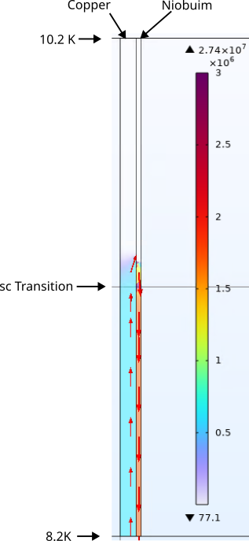
Simulation
Results
Simplified geometry to facilitate meshing:
  3mm copper
  1mm niobium
Seebeck coefficients:
  Nb: Temperature dependent
  Cu: Fixed -9 µV/K
Conductivity:
  Nb: RRR 10
  Cu: RRR 50
  Sc Nb: Increase by 5 orders of magnitude between 9.3 K and 9.2 K
Place transition in the middle of the sample
Compute current density
Currents are suppressed by low conductivity of normal conducting Nb

Slide 11
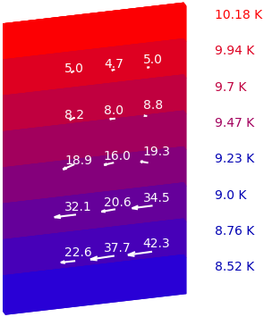
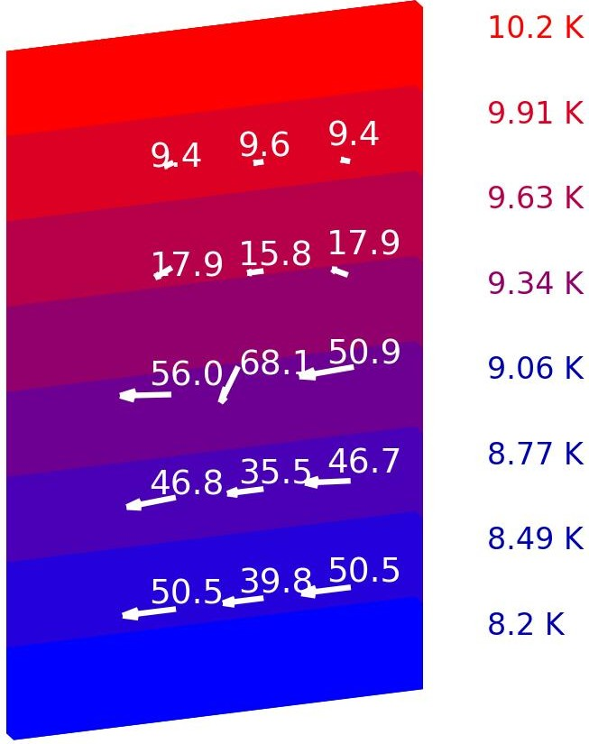
Simulation
Results
Measurement
Simulation
Simulate flux density generated by the current density
Extract flux density at sensor positions
Compare to measurement
  Nb/Cu (10 μm) Sample
  Partially superconducting
Good qualitatively agreement
Magnitude can change drastically by changing conductivity of the copper

Slide 12
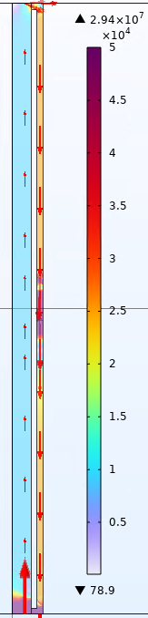
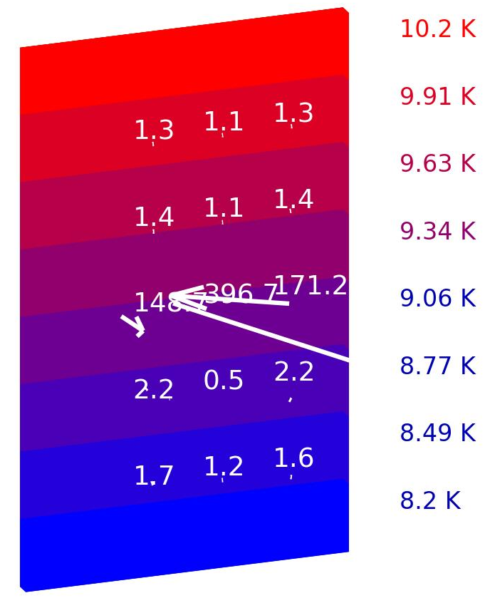
Barrier layer
Results
Introducing a barrier layer should increase the resistance on the path the thermoelectric currents take
Two samples:
  One fully coated: electric connection at ends
  One coated only in the center: floating Nb3Sn

Slide 13

Conclusion
Conclusion & Outlook
All Nb₃Sn samples on copper substrate created large fields during cooldown
Coating of only the center did not fix the low $T_{c}$
Simulation shows qualitative agreement with measurement
Electrical conductivity is crucial for thermoelectric currents
Outlook
outlook
Try different coatings
  Film thickness
  Coating area
  Higher Tc
  Insulating buffer layer
Different substrate materials
Adapt setup for smaller sample sizes (20x30 mm)

Slide 14
Backup Slides

Slide 15
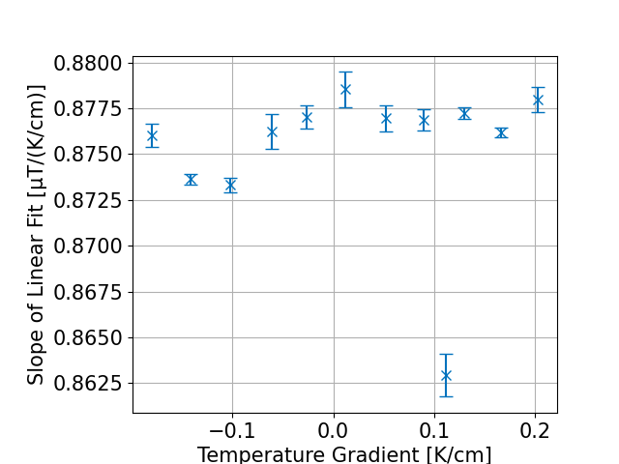
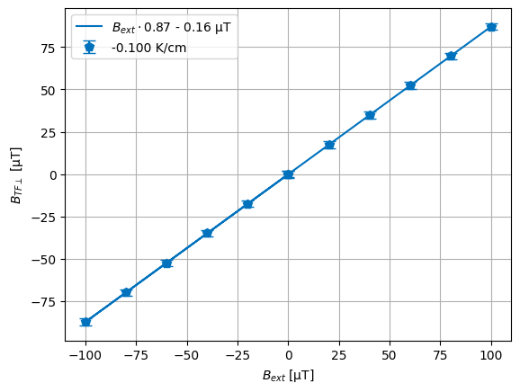
Trapping efficiency
Results
Nb₃Sn/Nb (HZB)
Cool down samples different external fields with constant temperature gradient
Plot trapped flux versus external field
Slope of linear fit is trapping efficiency
No dependency on temperature gradient
  This is in contrast with bulk samples where the trapping efficiency decreases with increasing temperature gradient
All coated samples show trapping efficiencies of 85-92 %

Slide 16
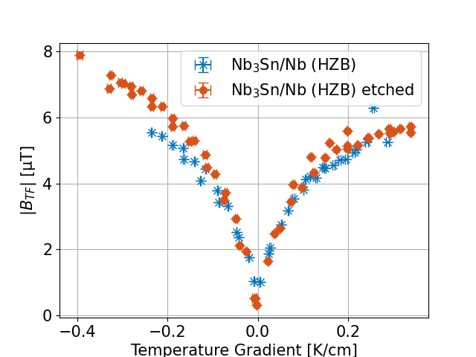
Nb₃Sn on niobium substrate
Results
Zero field cooled
Plot trapped flux magnitude of center sensor versus temperature gradient during cooldown
Flux density 2 orders of magnitude smaller than copper substrate samples
Increase with temperature gradient
Since this sample is coated only via bronze route it is coated from both sides
Remove coating on one side to make it comparable to others
No significant difference between the two
Two orders of magnitude less trapped flux

Slide 17
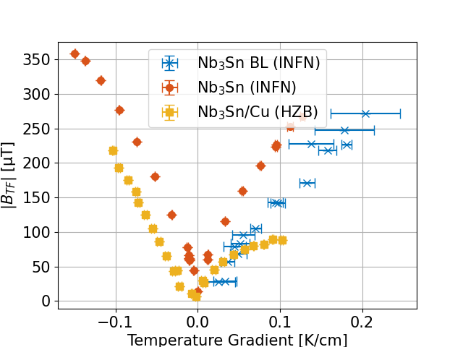
Nb₃Sn on copper substate
Results
Zero field cooled
Plot trapped flux magnitude of center sensor versus temperature gradient during cooldown
All samples show large flux density magnitudes several times the earth’s magnetic field
Increasing flux density with temperature gradient
Other sensors measures largest field with “Nb₃Sn (INFN)”
Flux densities 10 $×$ earths magnetic field generated

Slide 18
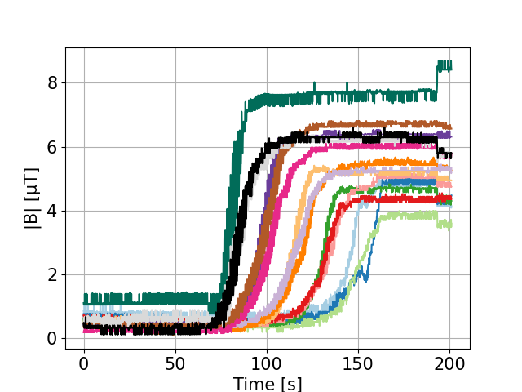

Cooldown dynamics and T_{c}
Results
Nb₃Sn/Nb (HZB)
Plot AMR raw data versus time
All 5 sensor rows are discernable
Uniform T_{c}
$T_{c}=(17.7±0.3)$ K
To be published

Slide 19
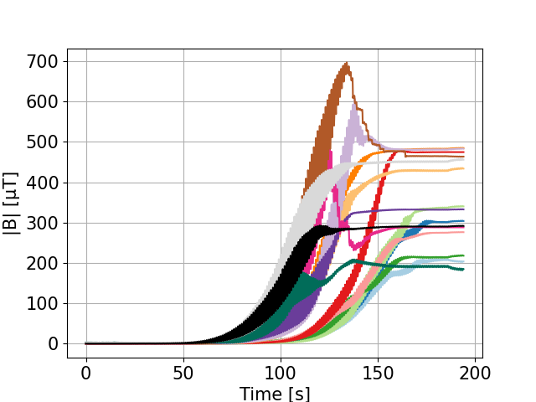

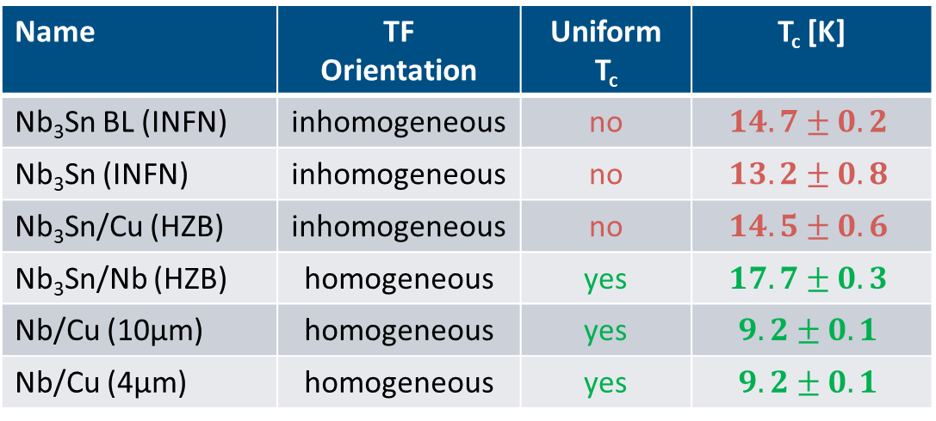
Cooldown dynamics and T_{c}
Results
Nb₃Sn/Cu (HZB)
Plot AMR raw data versus time
Sensor rows are not discernable
Non-uniform T_{c}
$T_{c}=(14.5±0.6)$ K
Name | TF Orientation | Uniform T_{c} | T_{c} [K]
Nb₃Sn BL (INFN) | inhomogeneous | no | $$14.7±0.2$$
Nb₃Sn (INFN) | inhomogeneous | no | $$13.2±0.8$$
Nb₃Sn/Cu (HZB) | inhomogeneous | no | $$14.5±0.6$$
Nb₃Sn/Nb (HZB) | homogeneous | yes | $$17.7±0.3$$
Nb/Cu (10µm) | homogeneous | yes | $$9.2±0.1$$
Nb/Cu (4µm) | homogeneous | yes | $$9.2±0.1$$

Slide 20
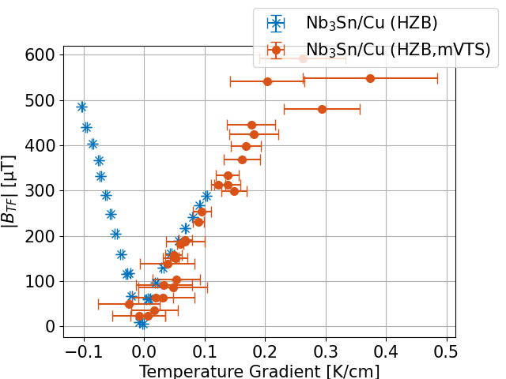
CRAFT vs. mVTS
Results

