Slide 1


Cristian Pira
LNL Status
innovate for Sustainable Accelerating Systems
WP3
Nb₃Sn on Cu films for 4.2K cavity operation
WP3 Meeting 09
22 April 2026

Slide 2

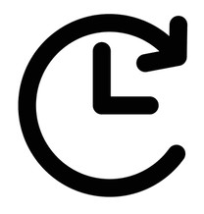
WP3 Nb₃Sn on Cu films for 4.2K cavity operation: Task 3.5
Working Cavity (INFN, CEA, HZB, UKRI) – Reza Valizadeh
Objectives
Improve I.FAST 1.3-GHz superconducting coating recipe based on Tasks 3.2-3.4 results.
Prepare 1.3-GHz thin film cavities with an optimized coating recipe.
Perform full cavity characterization @4.2 K (Q vs E, Q vs F, and flux trapping in the VTS@SupraLab vertical test stand).
Deliverable 3.4 4.5-K Cavity Report on 4.5-K Cavity performance & tunability tests - INFN - Report M46
Milestone 3.4 Characterization of Nb3Sn reference cavity - Test report M34

Slide 3
LNL SRF Group status
Over the past month, activities have slowed down due to a reduction in the group’s staff numbers
From May, two students will be joining the group and we will be back to our fully operational capacity

Slide 4
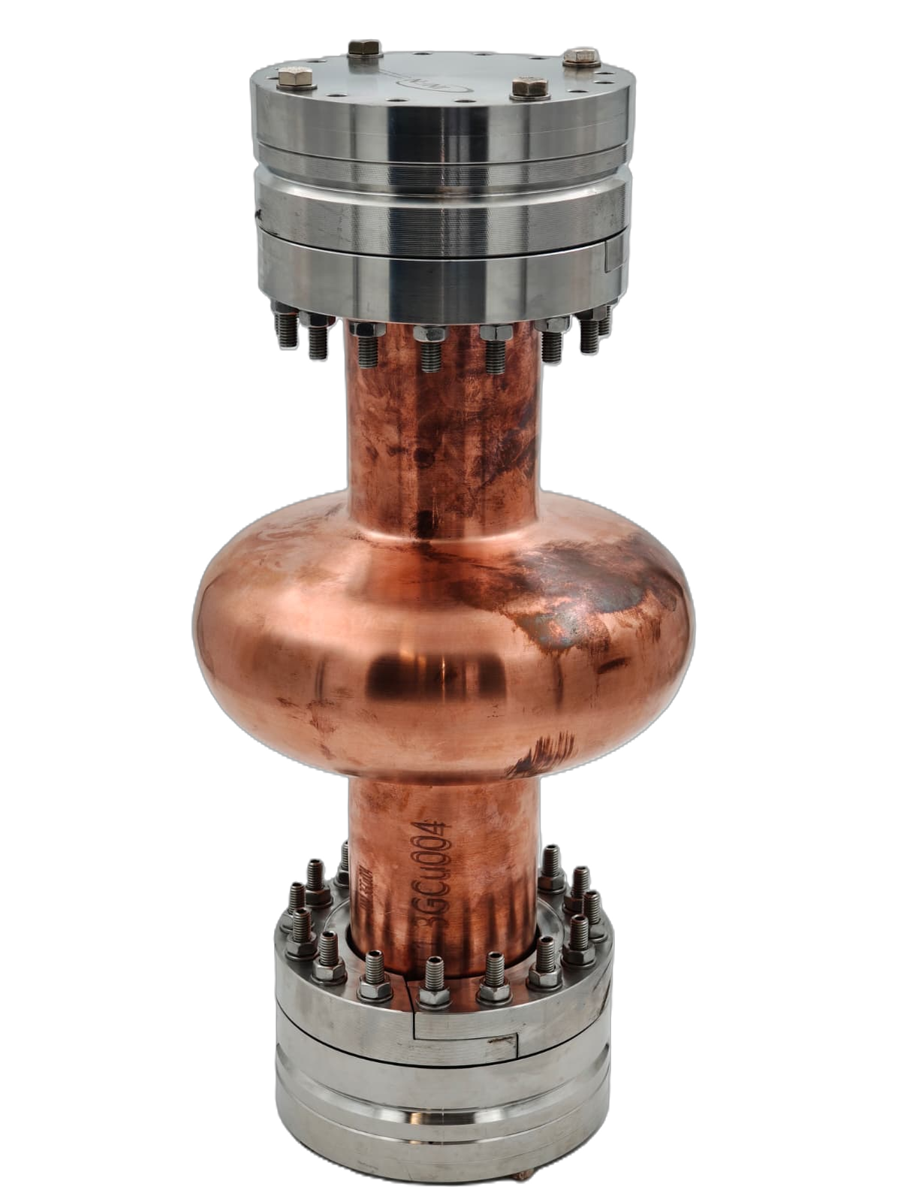
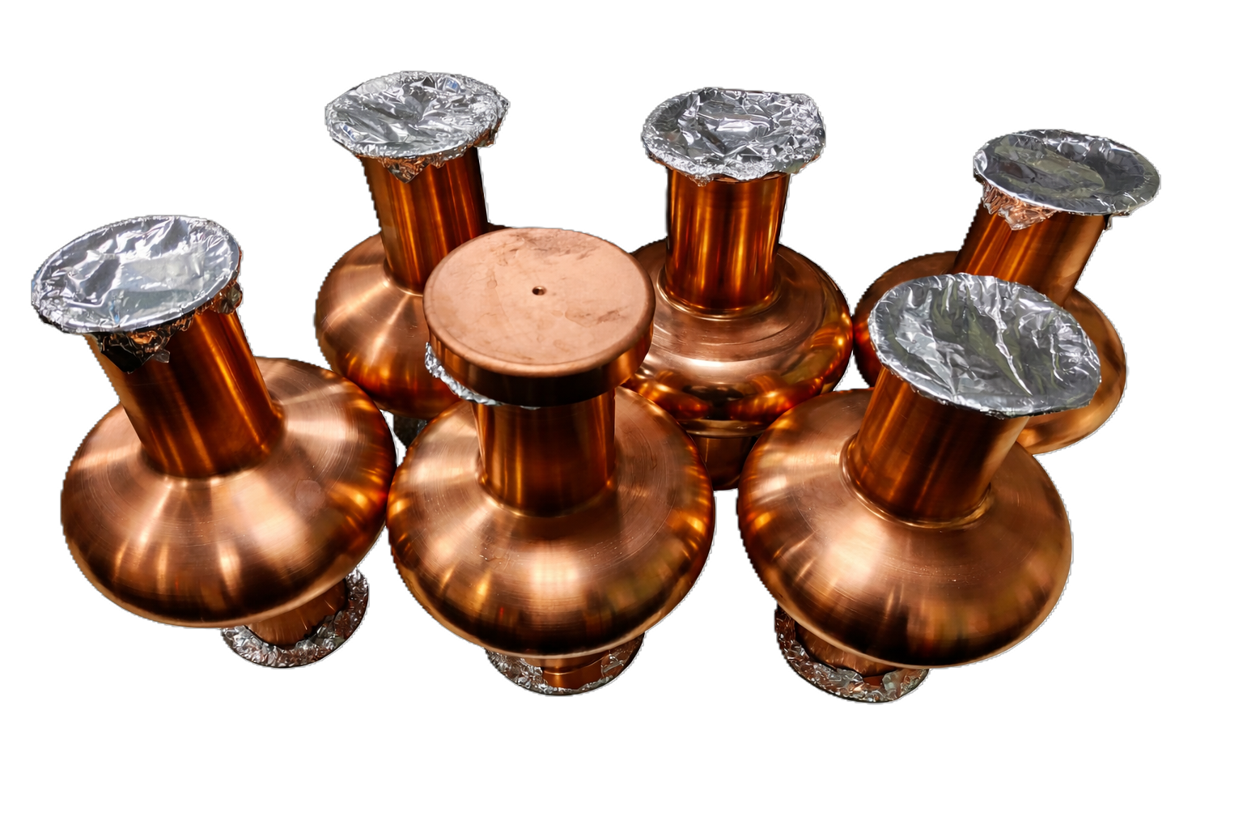
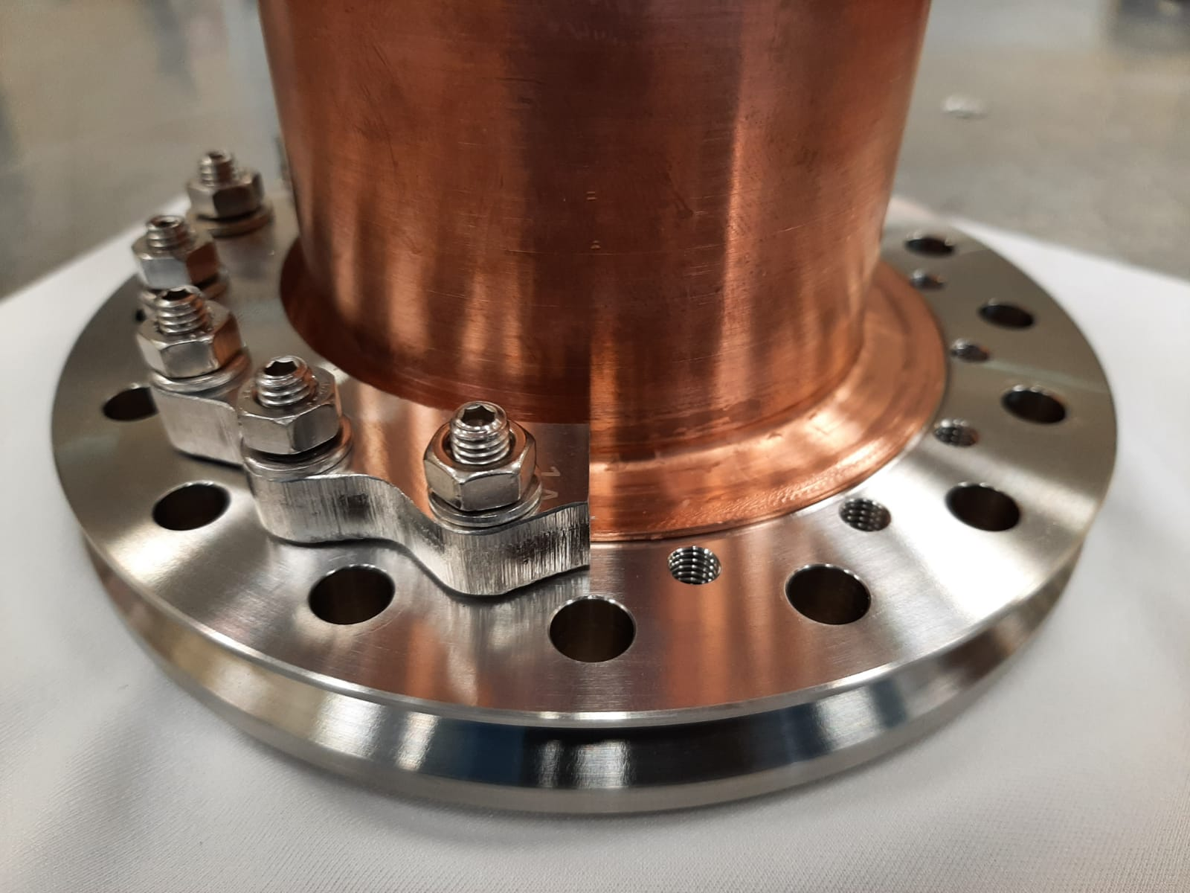
Cavity Production
Developed a new fully seamless design for 1.3 GHz elliptical cavities
Cavity sent to HZB for testing the new Tuning System (Milestone 3.1)
Leak of 10⁻¹⁰ mbar*L/s on one flange → Heat treatment necessary to release cold working
Further analysis required
Master Student thesis project will start on May
7 seamless cavities produced by Piccoli @LNL available
10 sets of flanges on production

Slide 5
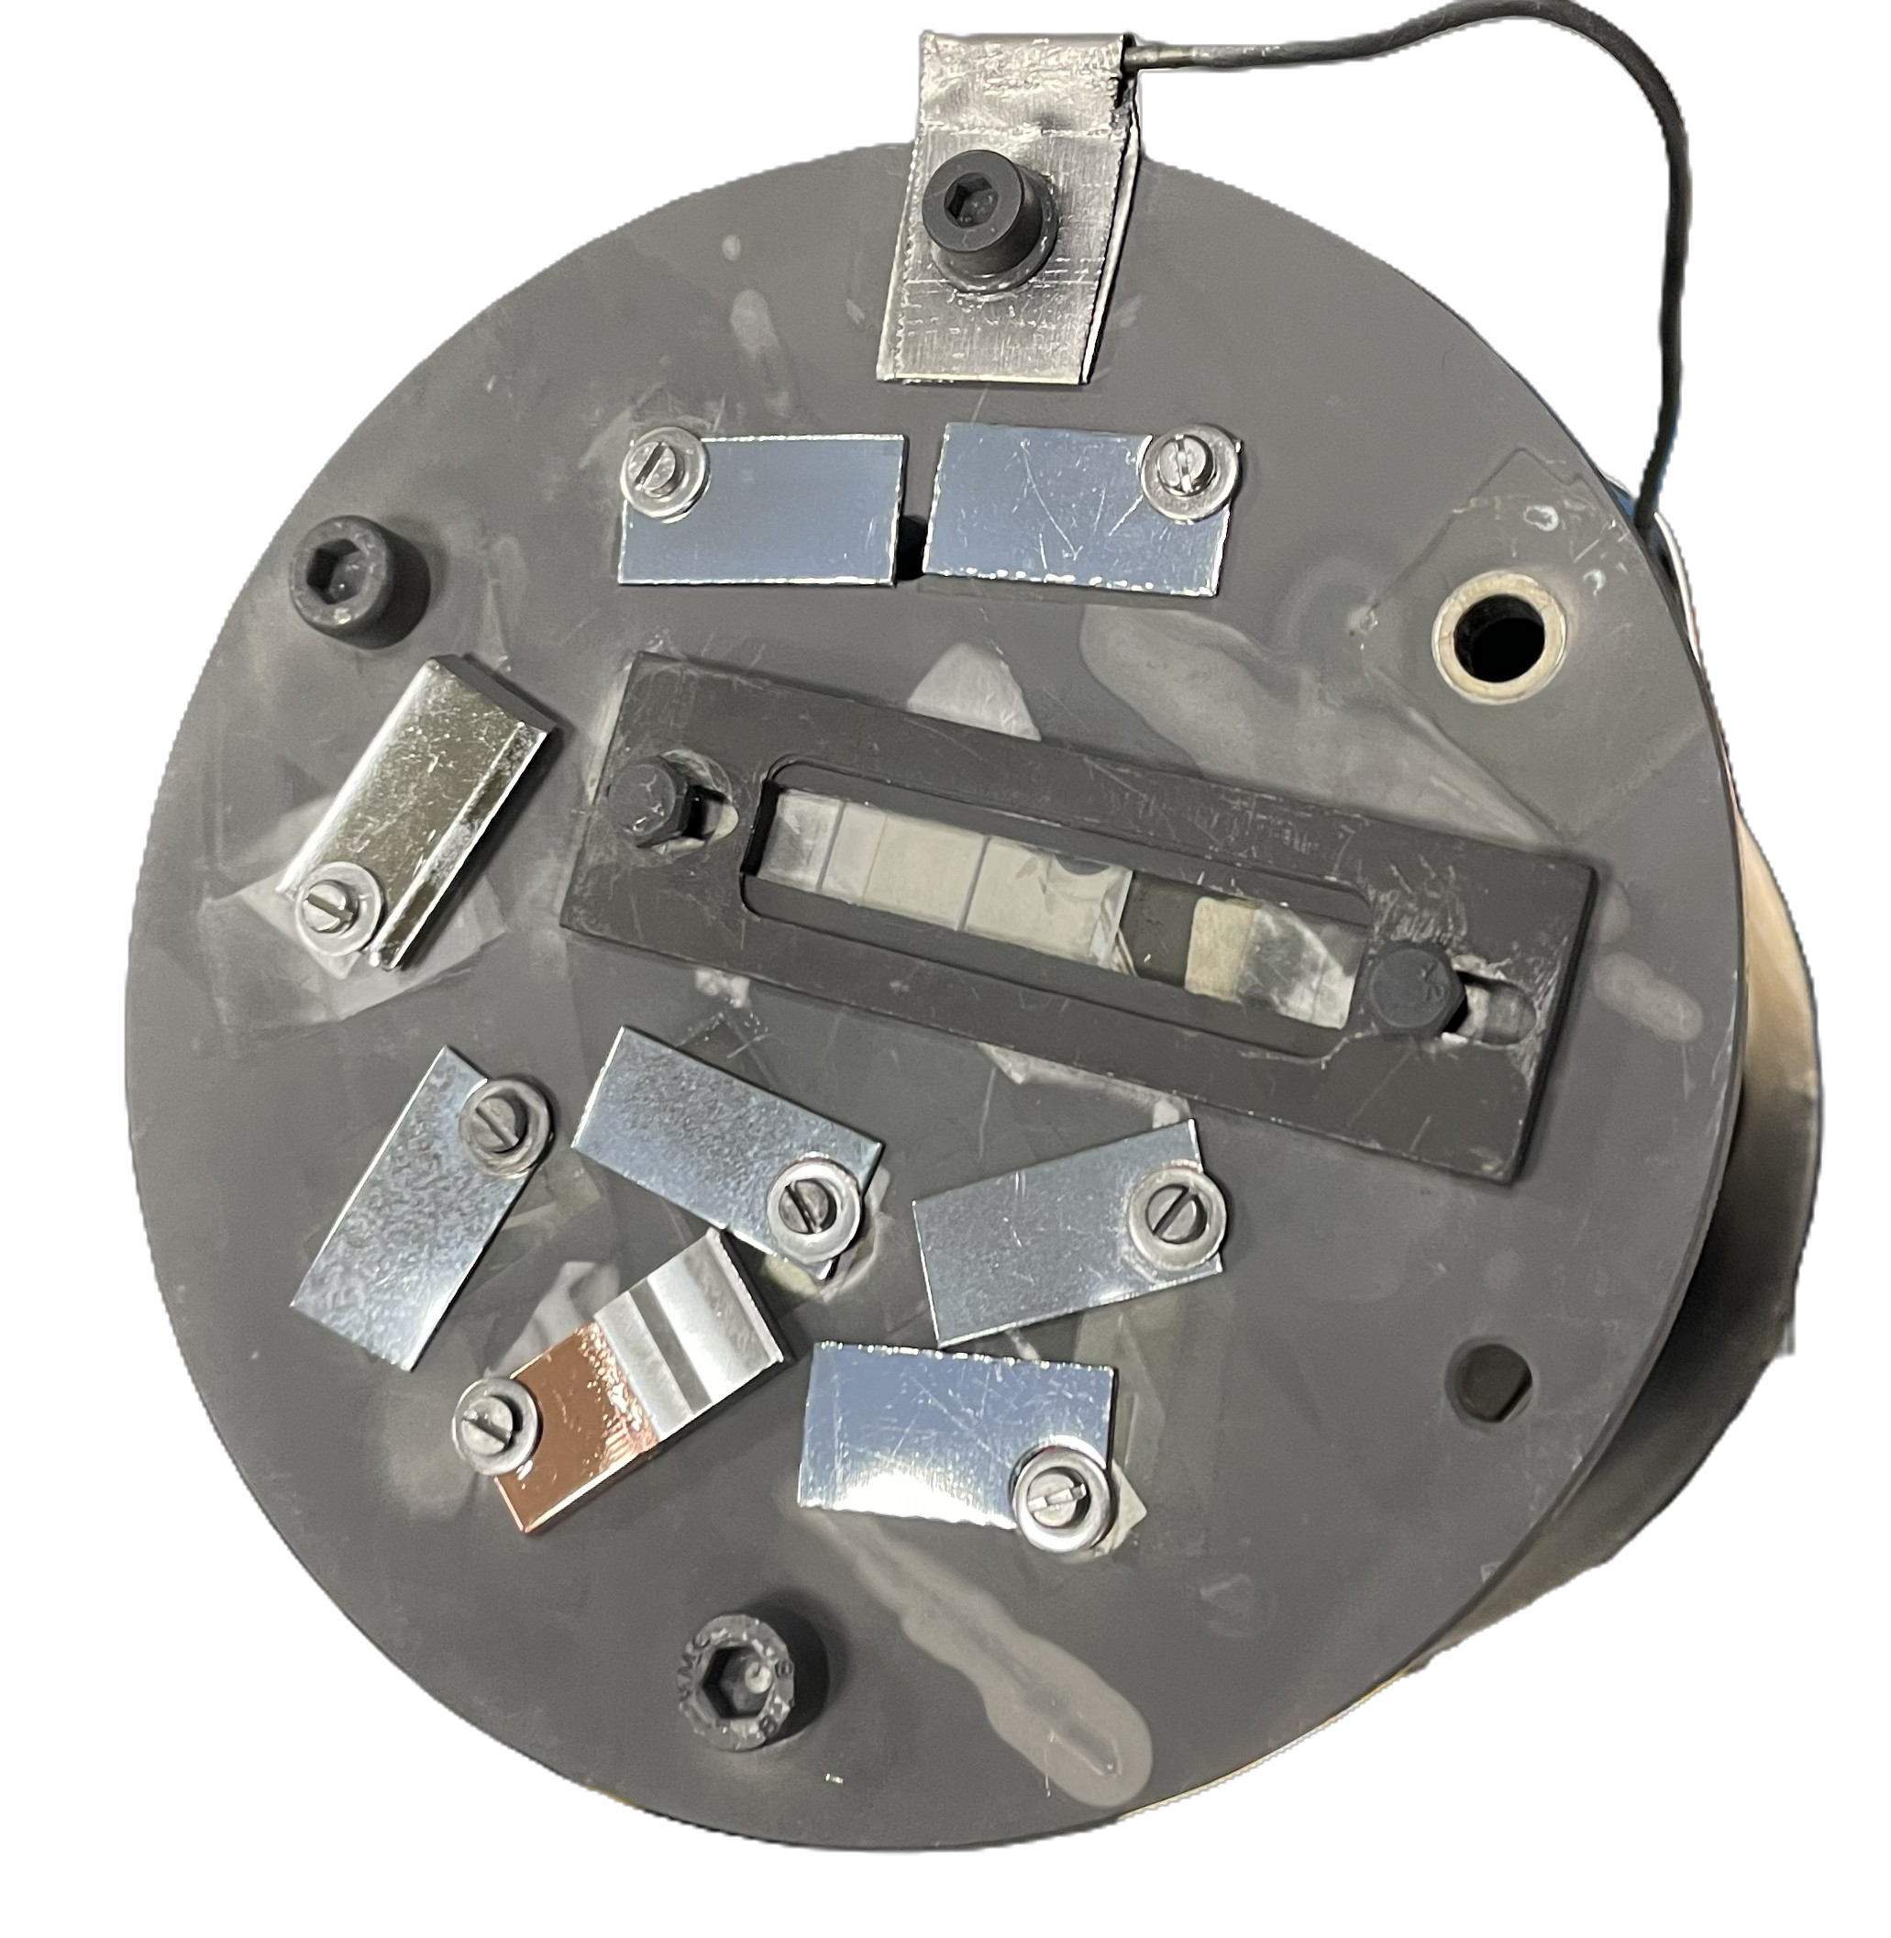
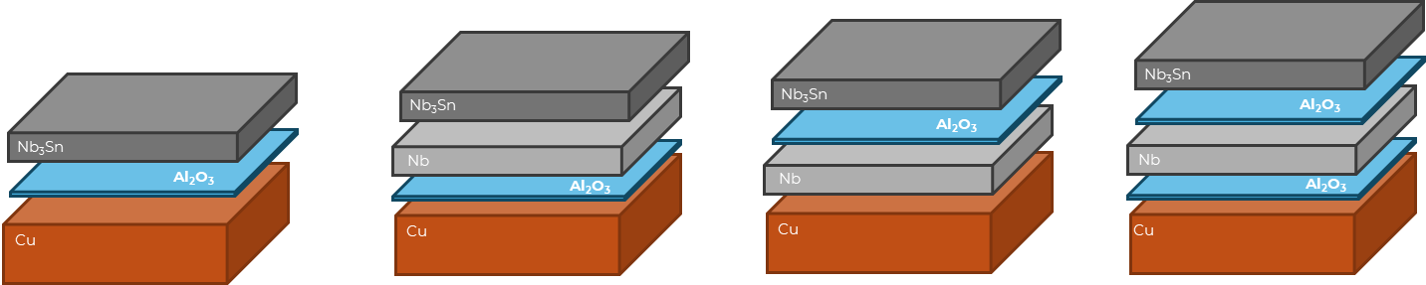
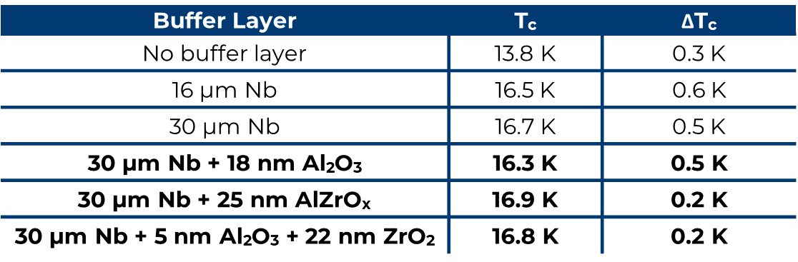
Task 3.4 Adaptive Layer
Tested CEA Adaptive Layer between Nb buffer layer and Cu substrate
Slightly enhancement of Tc
Low Tc
Tc ~ 17 K
Future Plans
Further analysis required on coatings
Test other ALD-Nb buffer layer-Nb3Sn coating schemes
→Master Student thesis project will start on May
→ 20 Cu coupons (20x10 mm) + 5 Cu + NbBL-16 coupons sent to CEA for ALD coatings

Slide 6
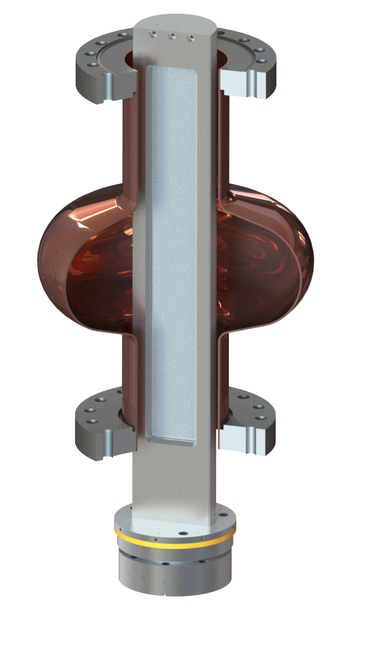
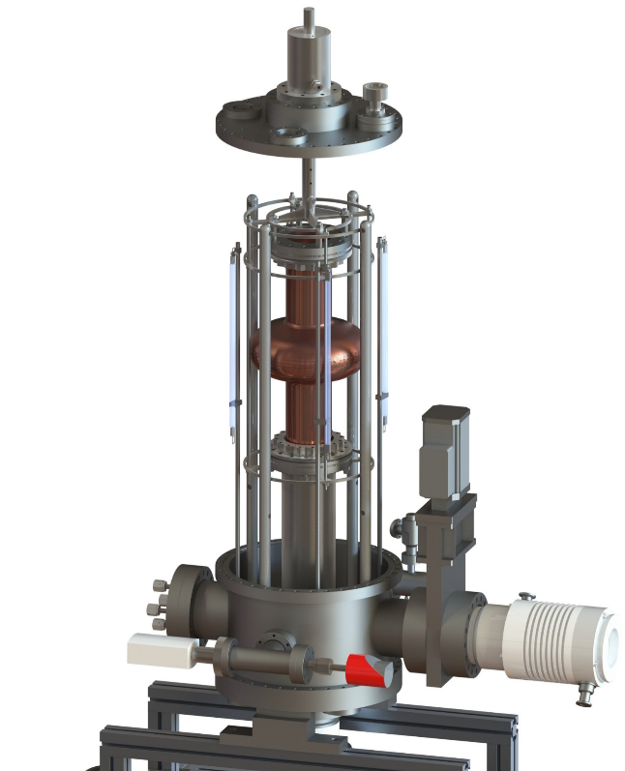
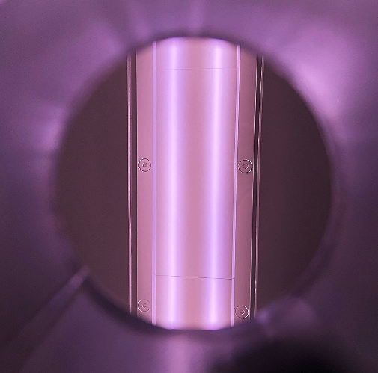
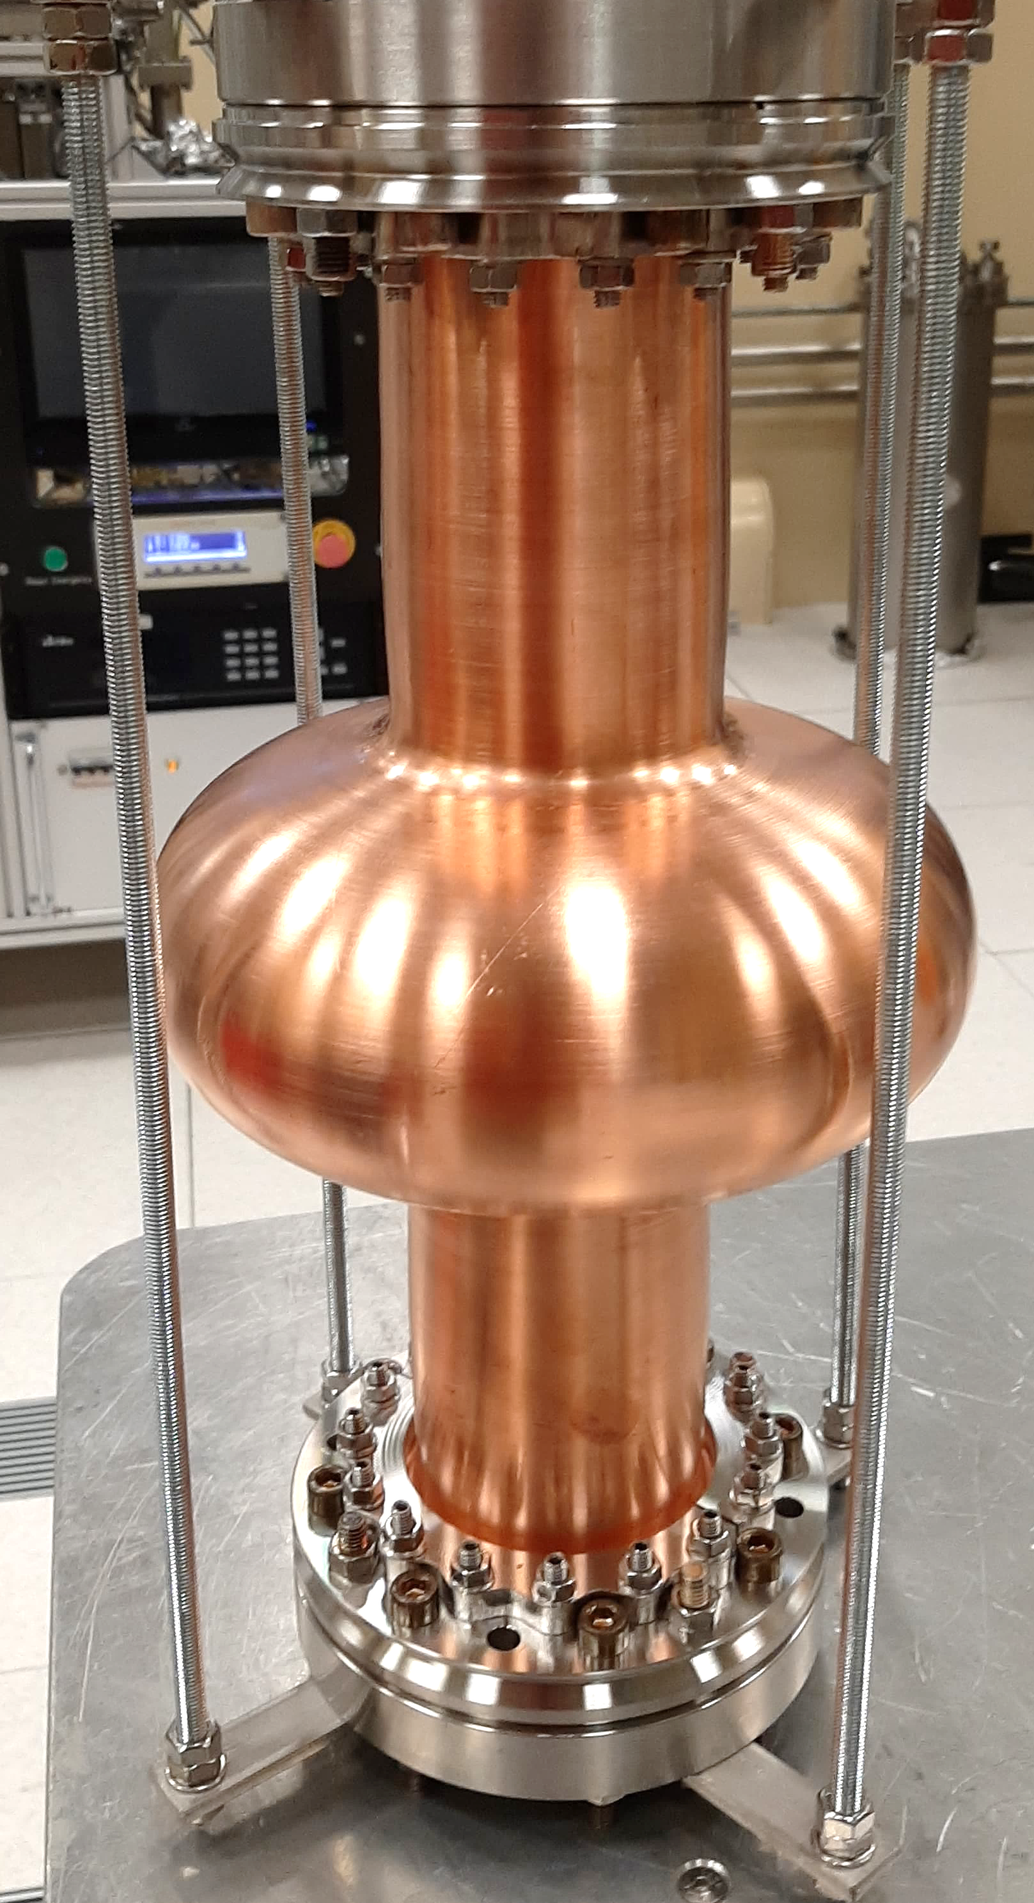
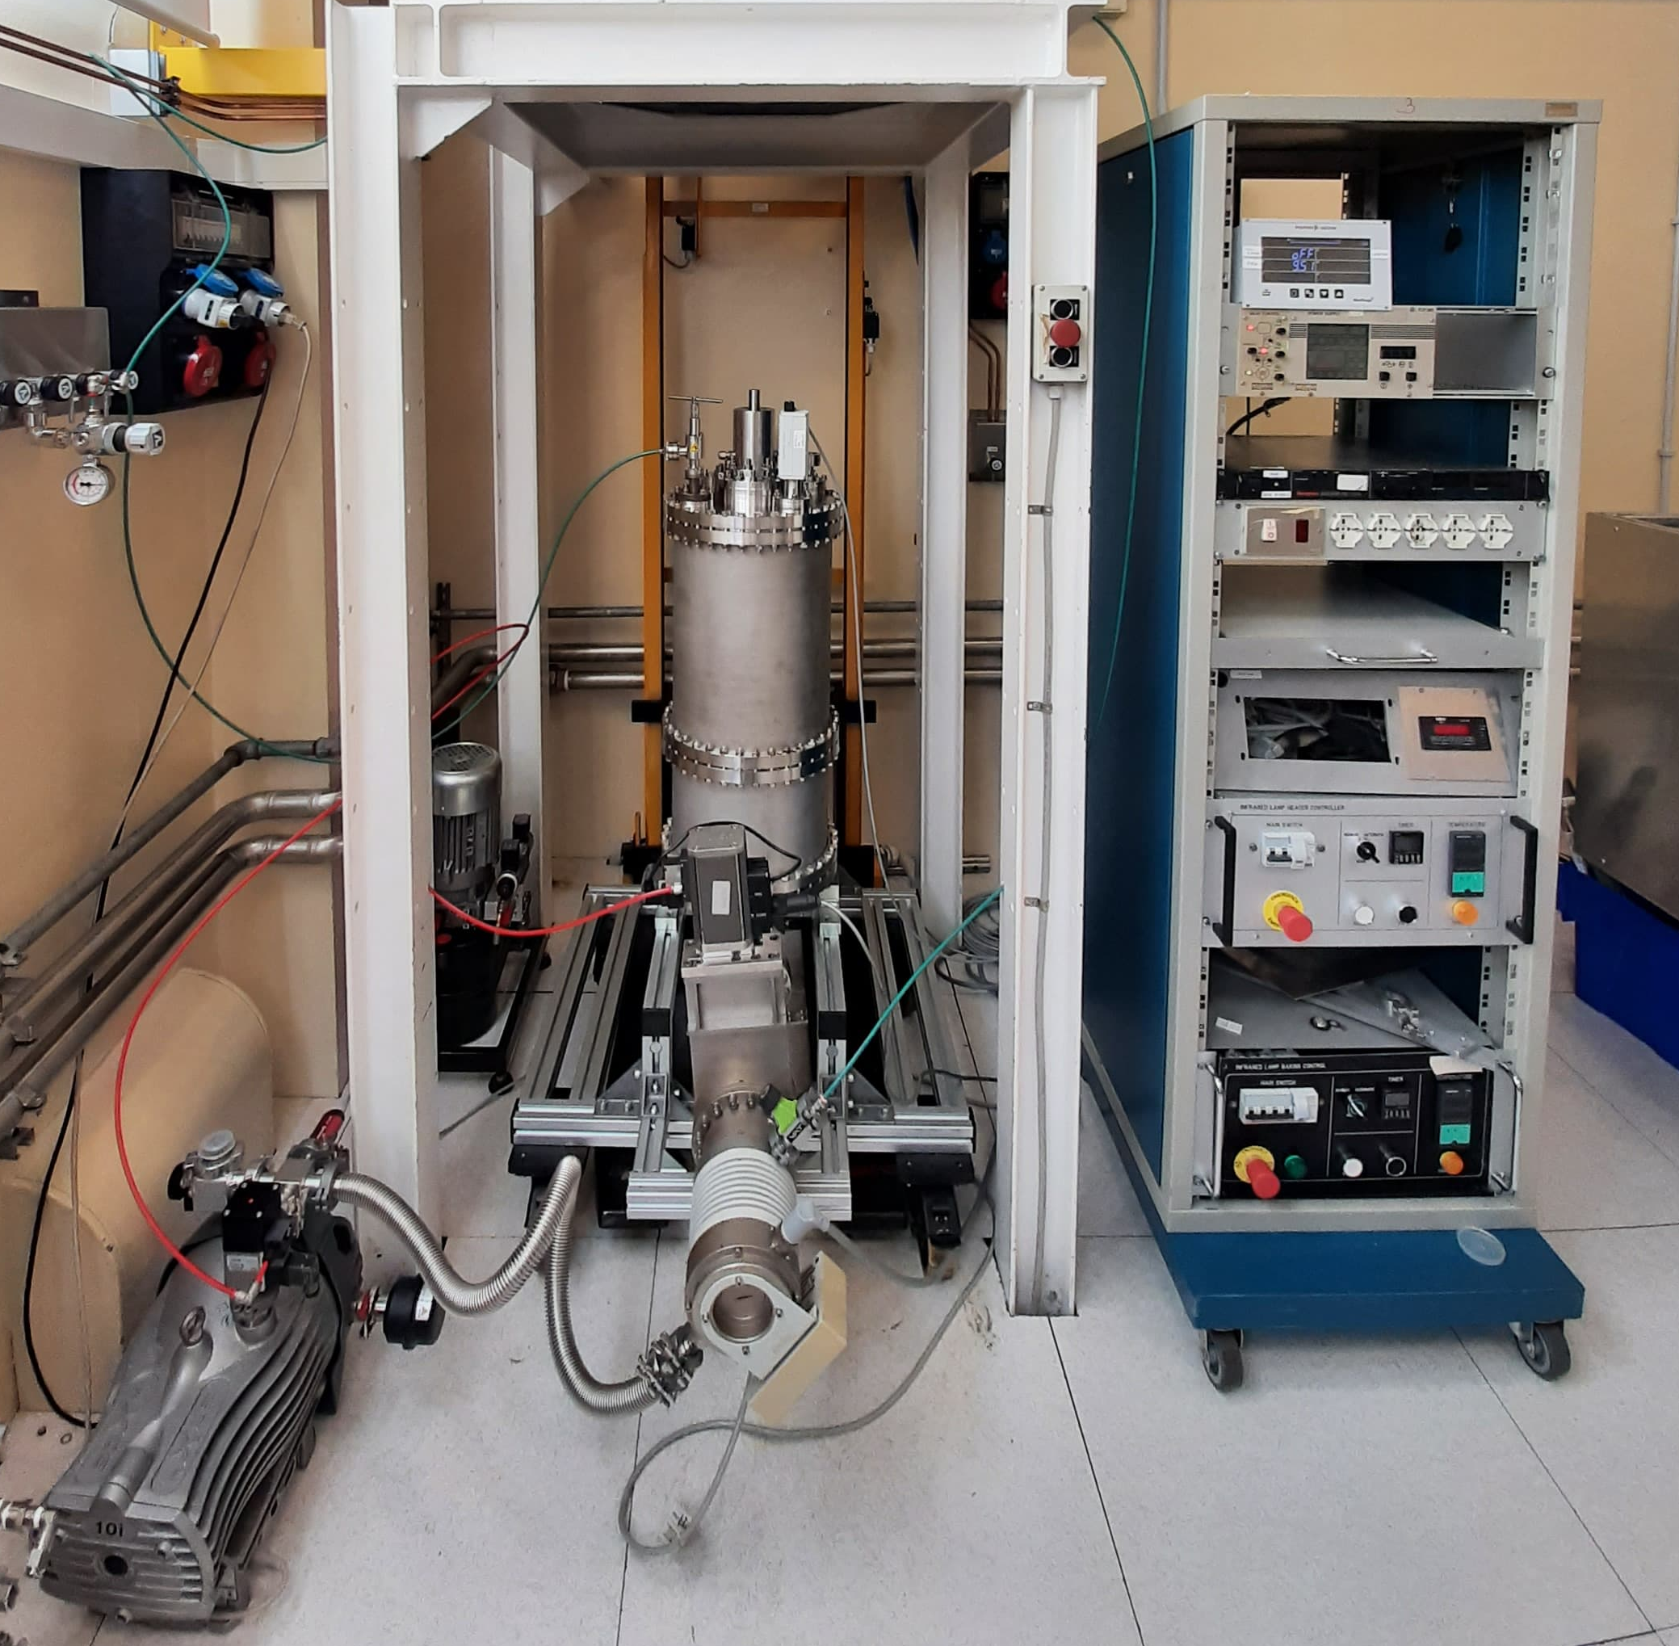

1.3 GHz coating system
Custom fixed rectangular planar magnetron with rotating cavity system
Current Status:
vacuum system assembled and tested
heating system completed and tested
magnetron test with first Nb target ignition completed
first Nb cavity coating planned for 2026
Coating on Cu cavity planned for 2027
1.3 GHz rotating cavity
fixed rectangular magnetron
ignited plasma

Slide 7
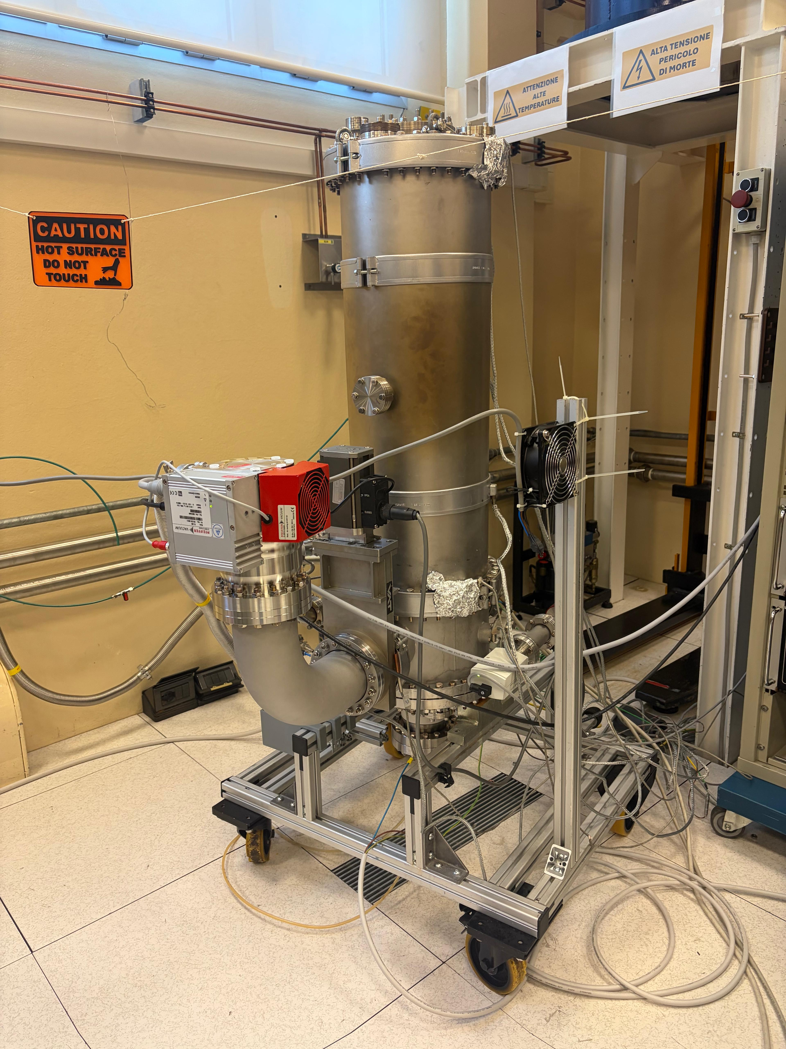
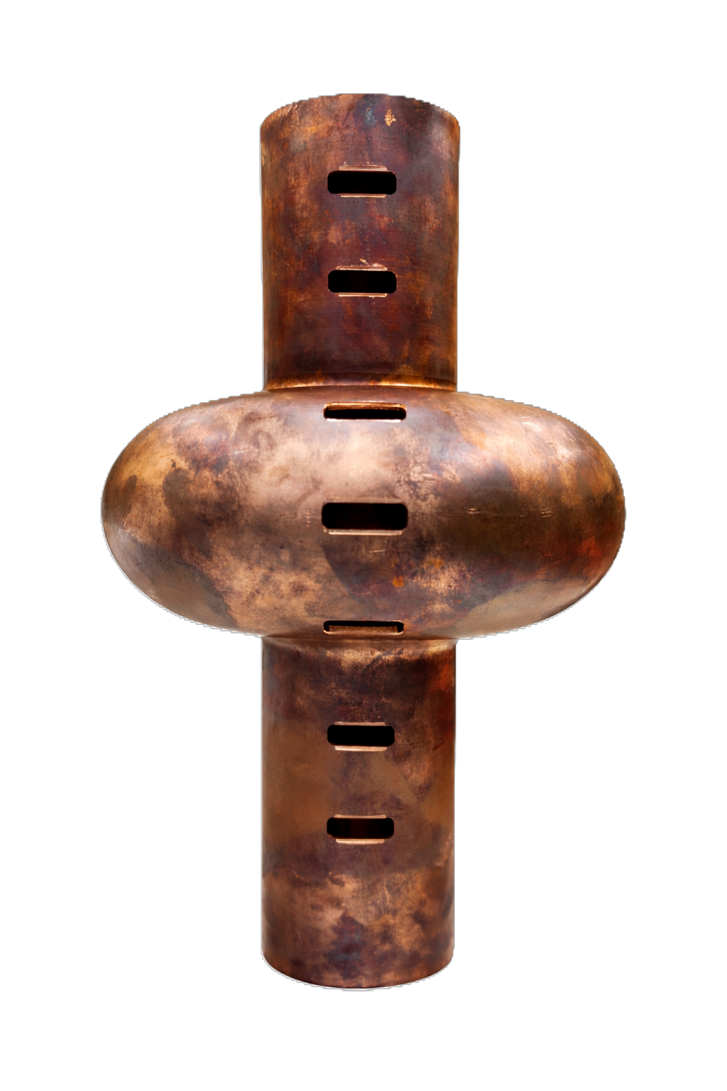
1.3 GHz coating system
Status and ongoing activity
Vacuum System
All metal system
New Turbo Pump
Ultimate Vacuum: 5*10⁻⁹ mbar, leak rate <10⁻¹² mbar*L/s
Mock up cavity designed and commisioned
7 window (3 samples each for a total of 21 samples for each run) to monitor morphology, deposition rate, Tc, composition

Slide 8
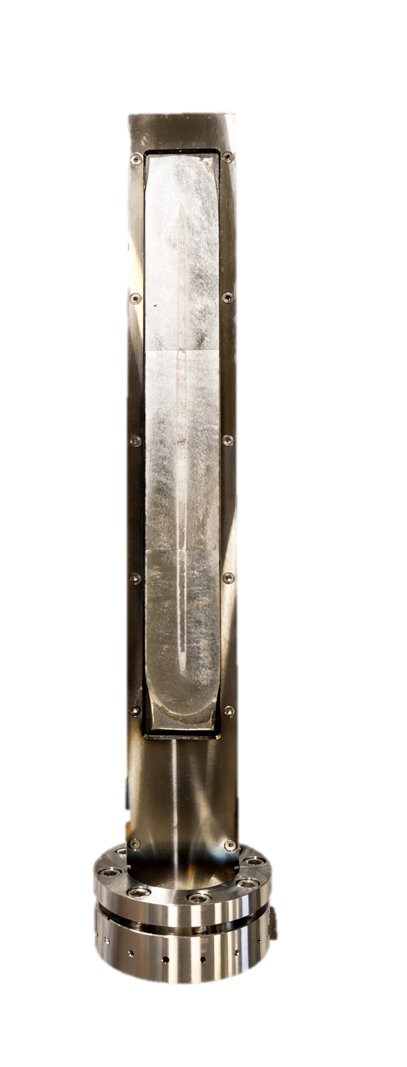
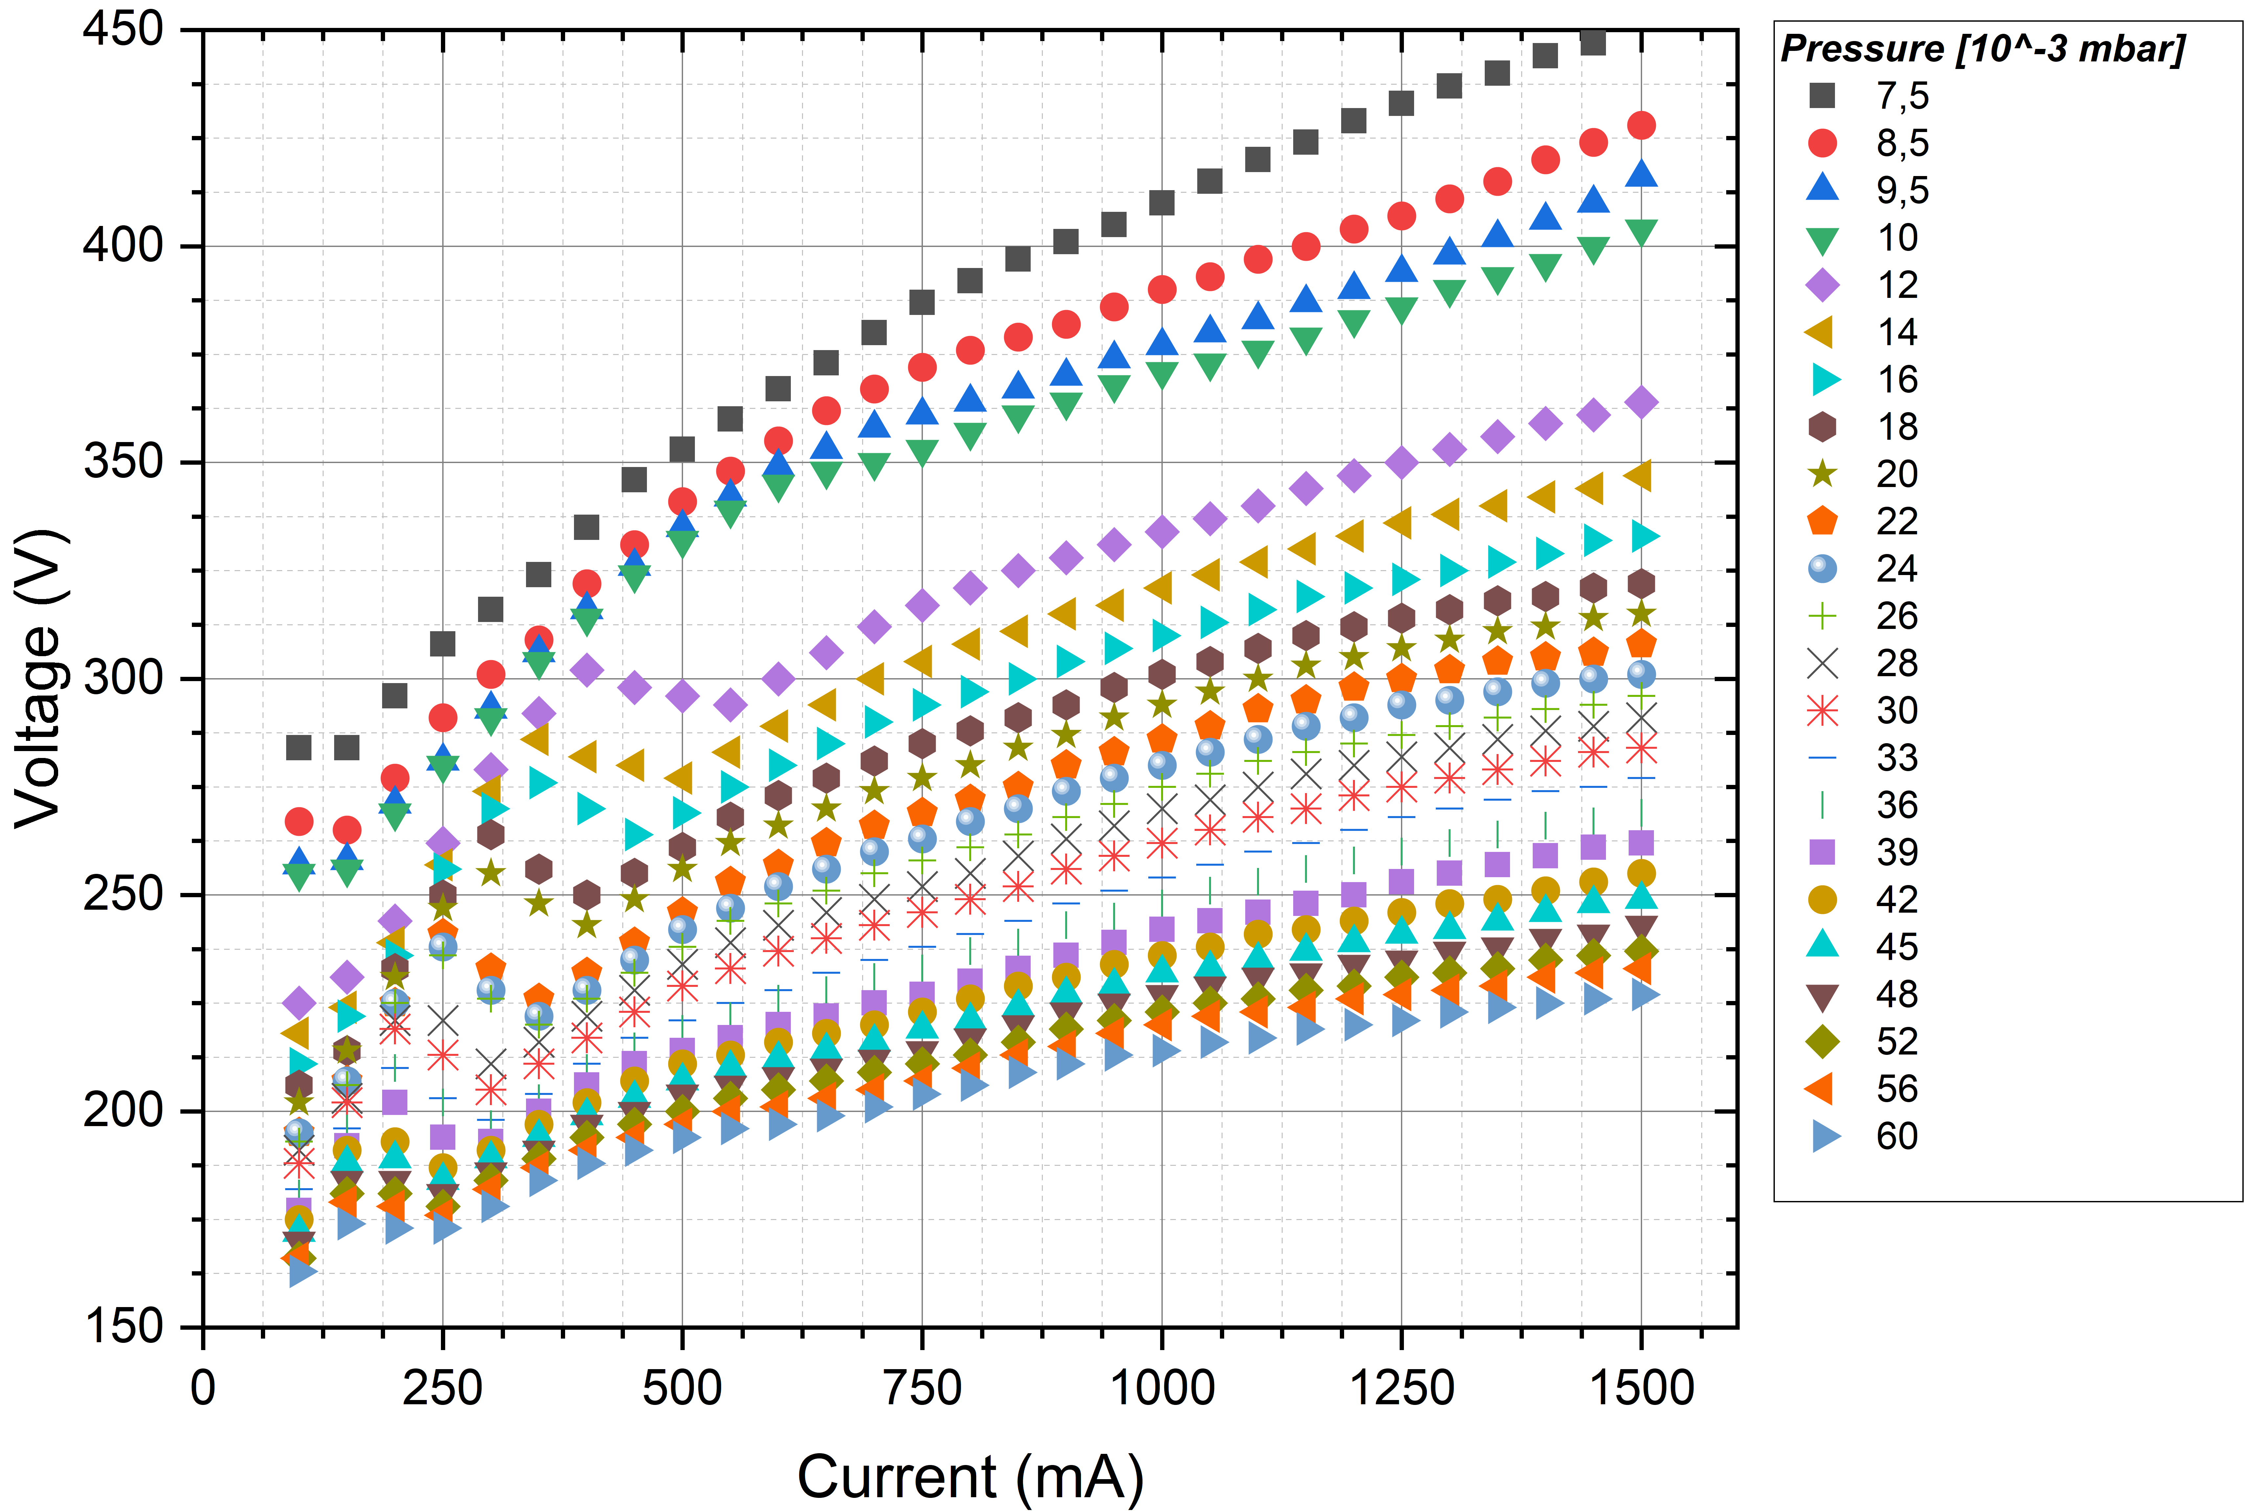

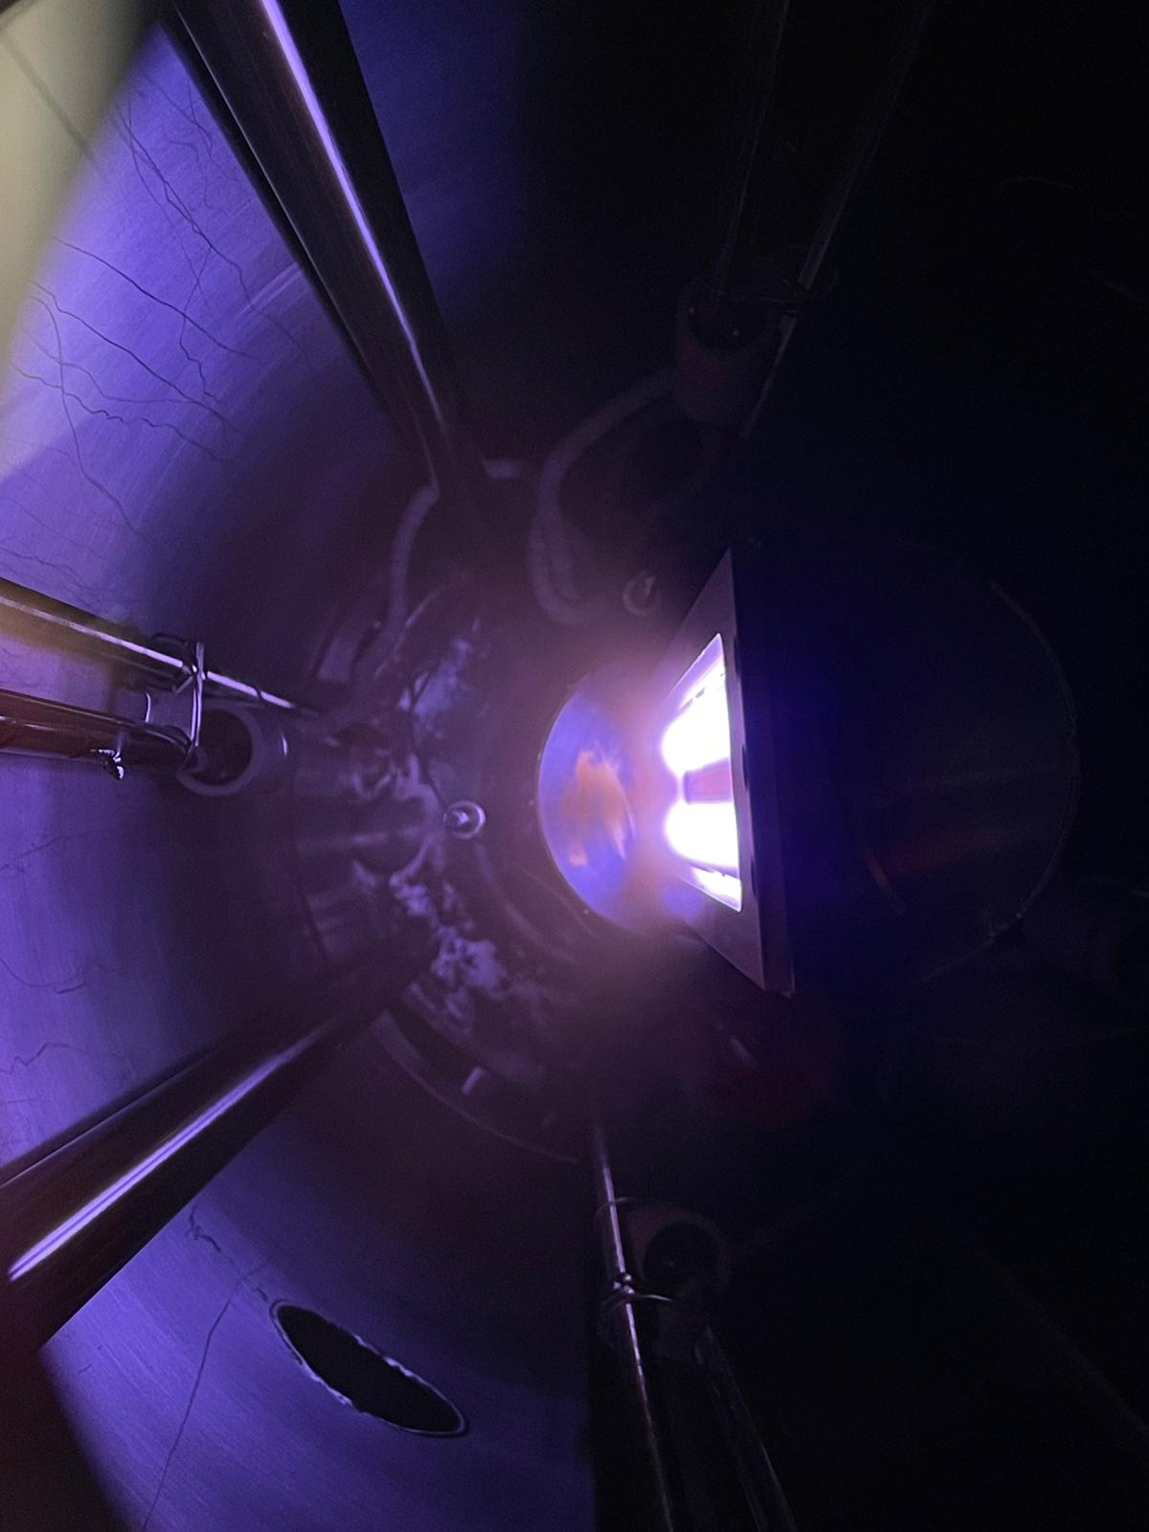
1.3 GHz coating system
Status and ongoing activity
Rectangular Magnetron
Test with Nb target
3 sets of magnets to be tested (0.68 T, 0.92 T, 1.02 T)
Tested 0,92T and 1.02 T configuration up to 1 A → classical power law obtained;
The race track seems open at the bottom
Shortcut at T>400 °C due to expansion of ground screen (new design currently in production)

Slide 9
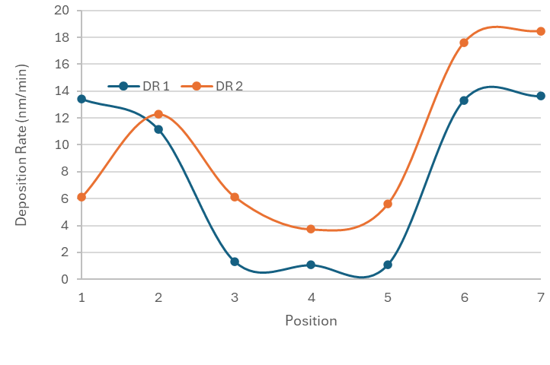
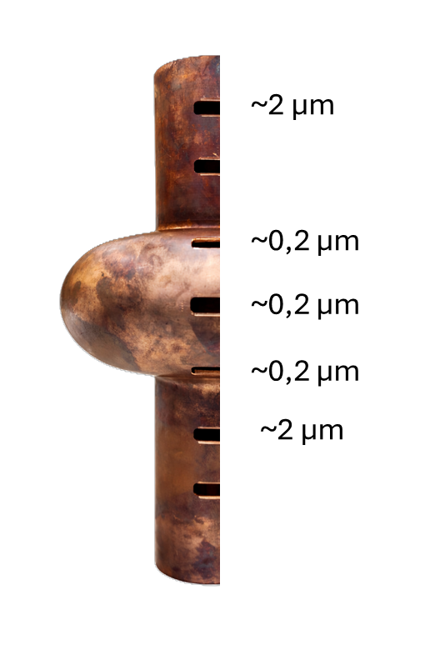
1.3 GHz coating system
Status and ongoing activity
Rectangular Magnetron – Deposition Rate
sets of magnets tested:
1 = 0.92 T
2 = 1.02 T
Nb target, I=0.5 A, P=5*10⁻³ mbar
DR2_{equator} ~ DR1_{equator}
DR1_{equator} / = DR1_{cut-off} ~ 13
DR2_{equator} / = DR2_{cut-off} ~ 5

Slide 10
1.3 GHz coating system
Activity Plan:
Optimize magnetron magnetic configuration (~ 1-2 weeks)
Optimize coating parameters in static position (~ 1 month)
Optimize coating parameters with rotating cavity (~ 2 months)
Coat the first Nb cavity (second half of 2026)

Slide 11
Thank You!

