Slide 1

Welcome @ Helmholtz-Zentrum Berlin
Andreas Jankowiak
Sustainable HZB
Second Annual Meeting, HZB 23.04.2026

Slide 2
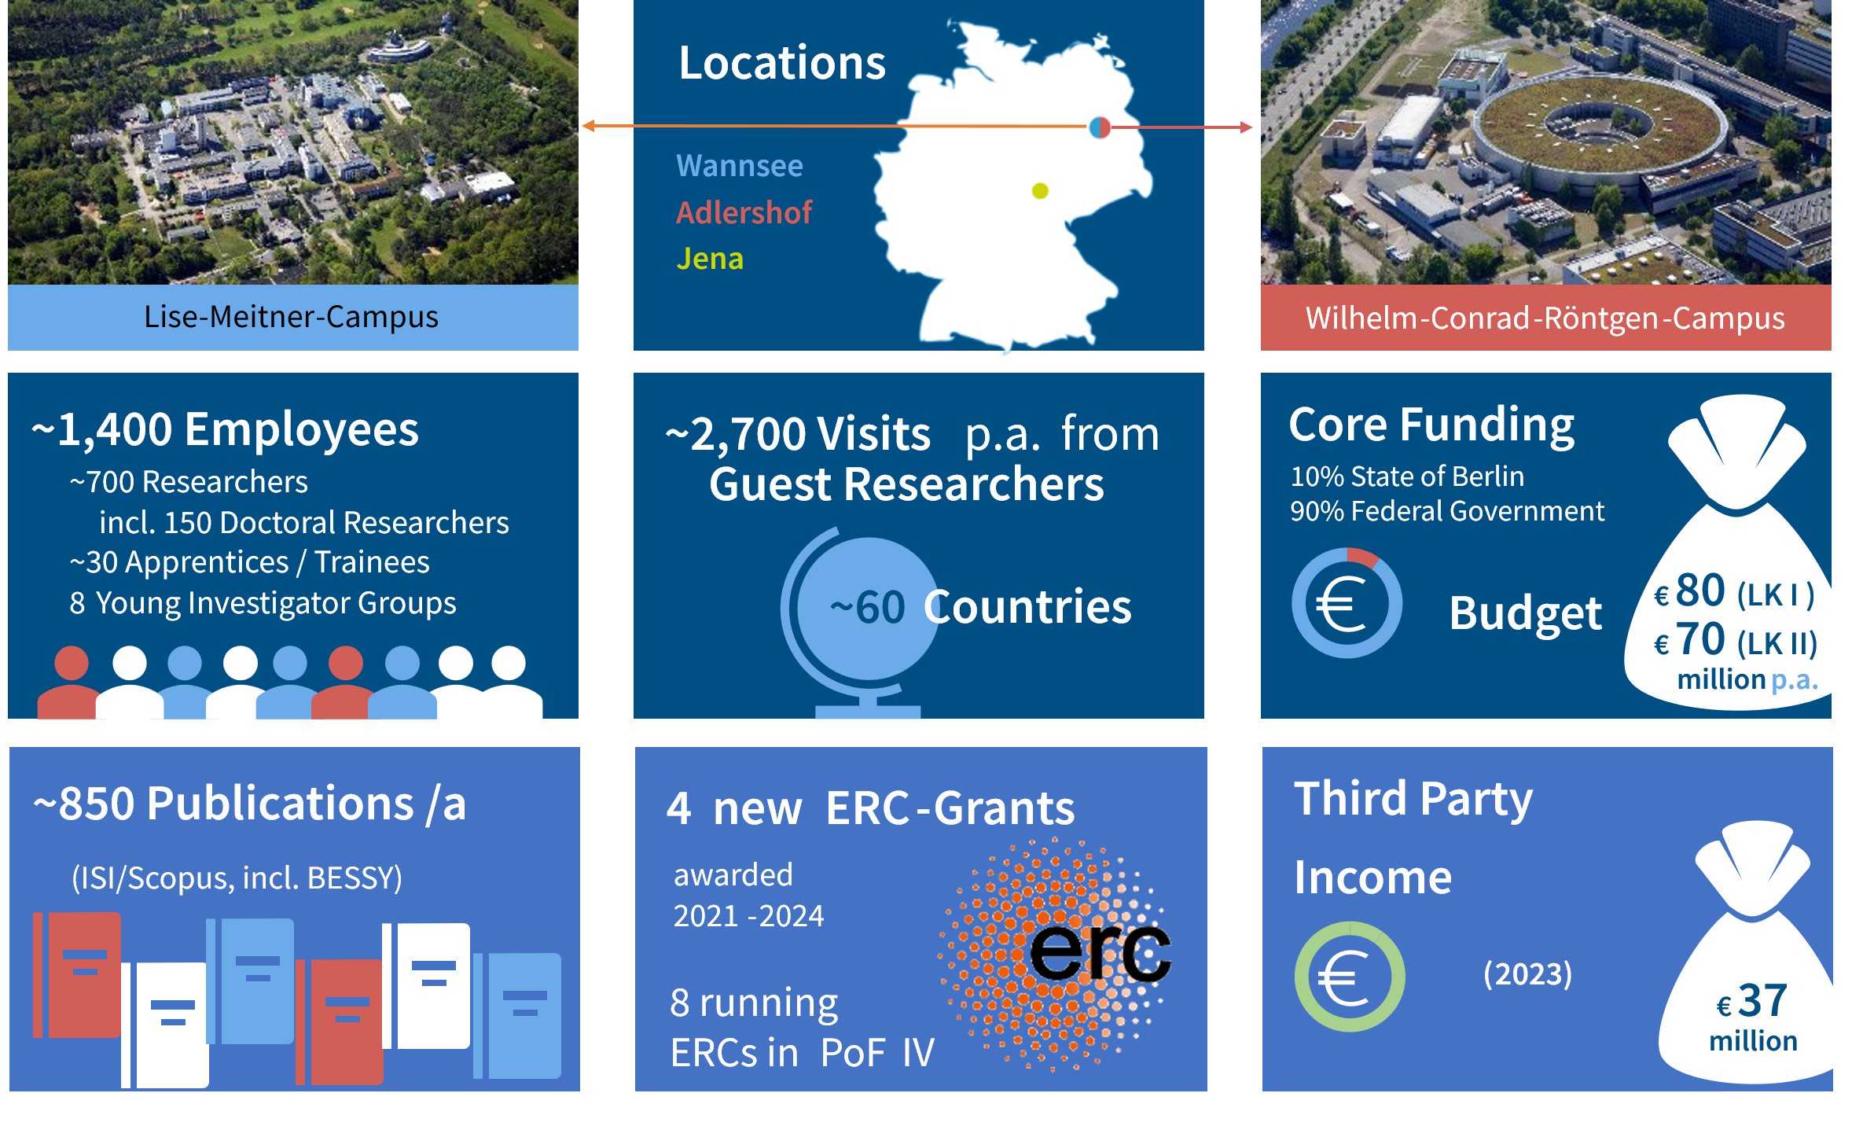
Three sites, one vision
HZB in a nutshell
+ ca. 40 Mio€ Third Party
OUR VISION: Shaping a sustainable future by developing technological solutions based on novel materials

Slide 3
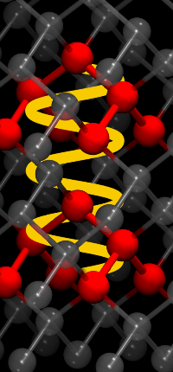
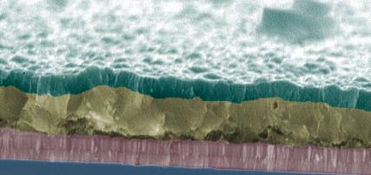
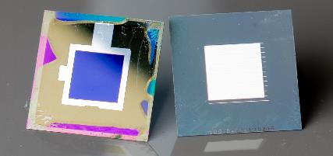
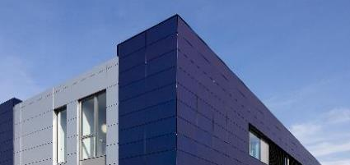
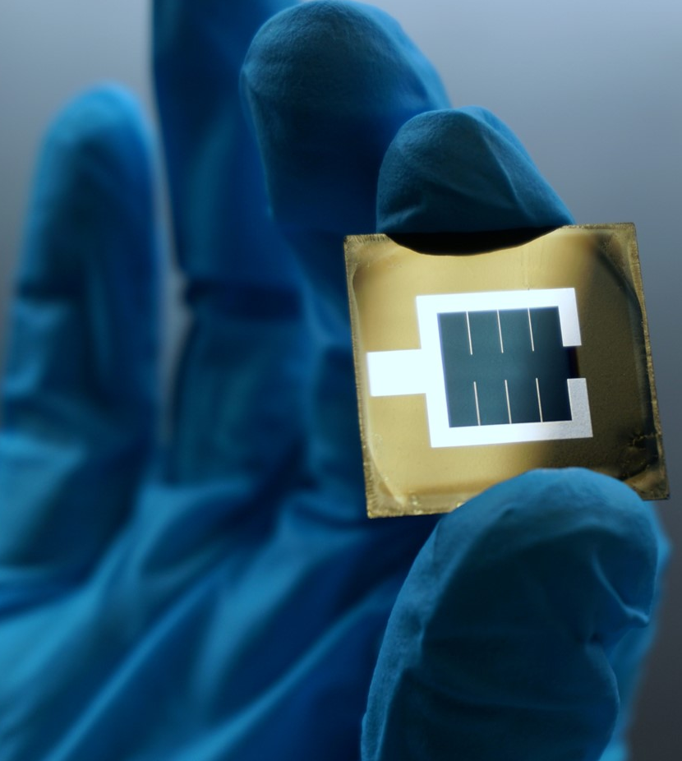
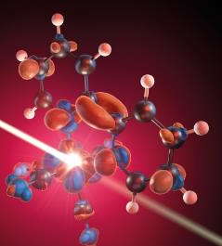

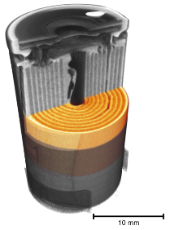
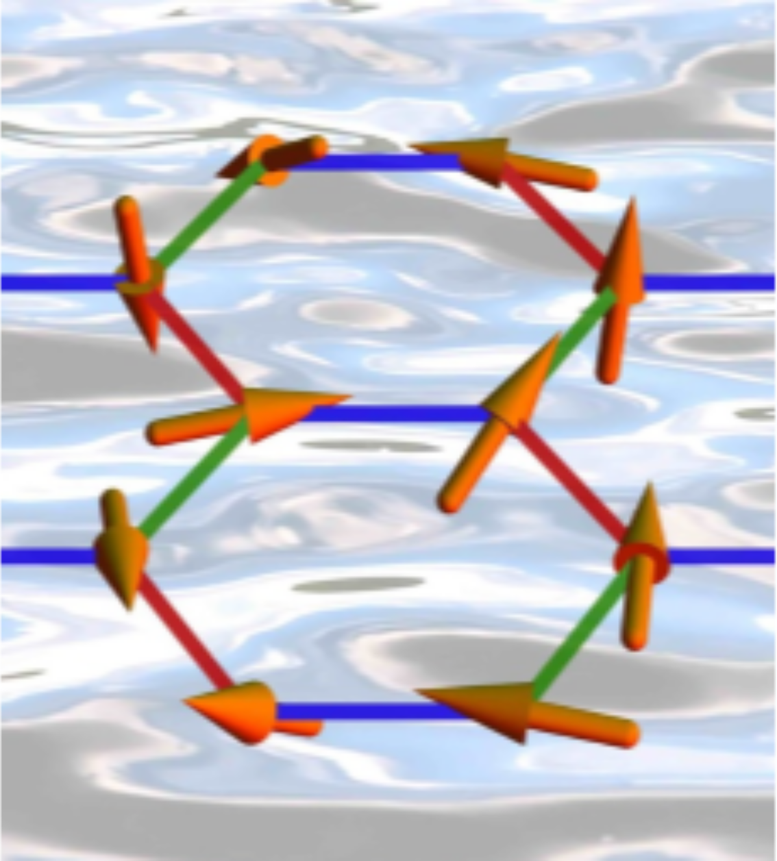
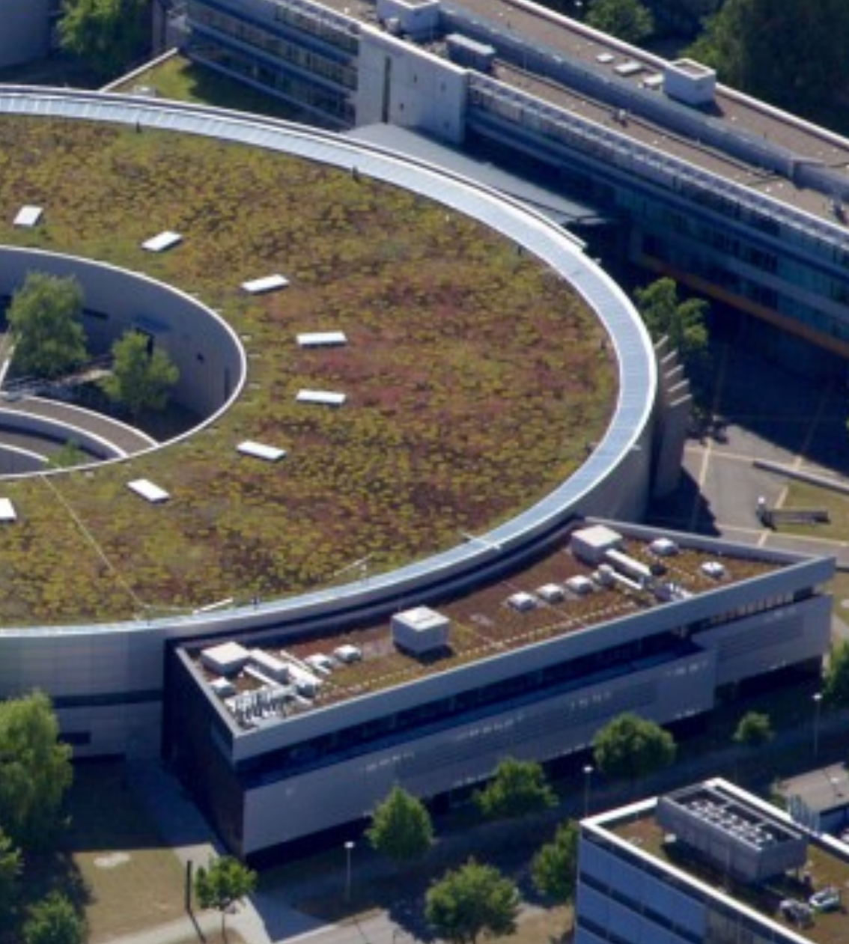
HZB in a nutshell
Helmholtz-Zentrum Berlin für Materialien und Energie
From materials to solutions
Atoms
Interfaces
Devices
System Integration
Increasing Technology Readiness Level
Highly efficient solar cells
Novel paradigms in heteregeneous catalysis
Dynamics and functionality of matter
Batteries & solar fuels
Quantum Materials / Spintronics
Accelerator research & development
Andreas Jankowiak, Welcome@HZB, iSAS 2nd Annual Meeting, HZB, 23.04.2026
Notes:
Bilder:
Atome - Quantenpunkte, die über Lichtpulse miteinander kommunizieren, © HZB aus Newseintrag: https://www.helmholtz-berlin.de/hzbin/news_seite?nid=22885;sprache=de;seitenid=74700
Grenzflächen - CIS-Solarzelle Schichtstrukturen im Raster-Elektronen-Mikroskop, © HZB
Geräte - nanotexturierte Frontseite (links) und eine Rückseite mit dielektrischem Reflektor der Perowskit-Silizium-Tandemsolarzellen mit Rekordwirkungsgrad von 29,80 % (Weltrekord am HZB bis Juni 2022), © A. Cruz /HZB
Systemintegration – Energiesystem
Blaupause für einen Wirkstoff gegen SARS-CoV-2. Das im Handel erhältliche Medikament Paxlovid von Pfizer wirkt als Inhibitor derselben Protease. https://www.helmholtz.de/newsroom/artikel/blaupause-fuer-einen-wirkstoff-gegen-das-neue-coronavirus/
https://en.wikipedia.org/wiki/3C-like_protease
3

Slide 4
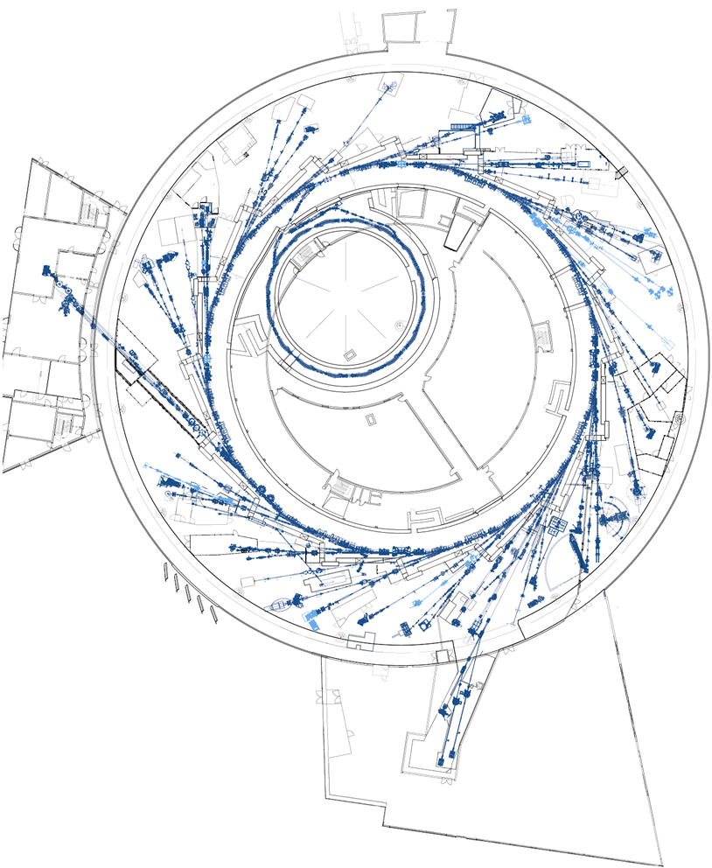
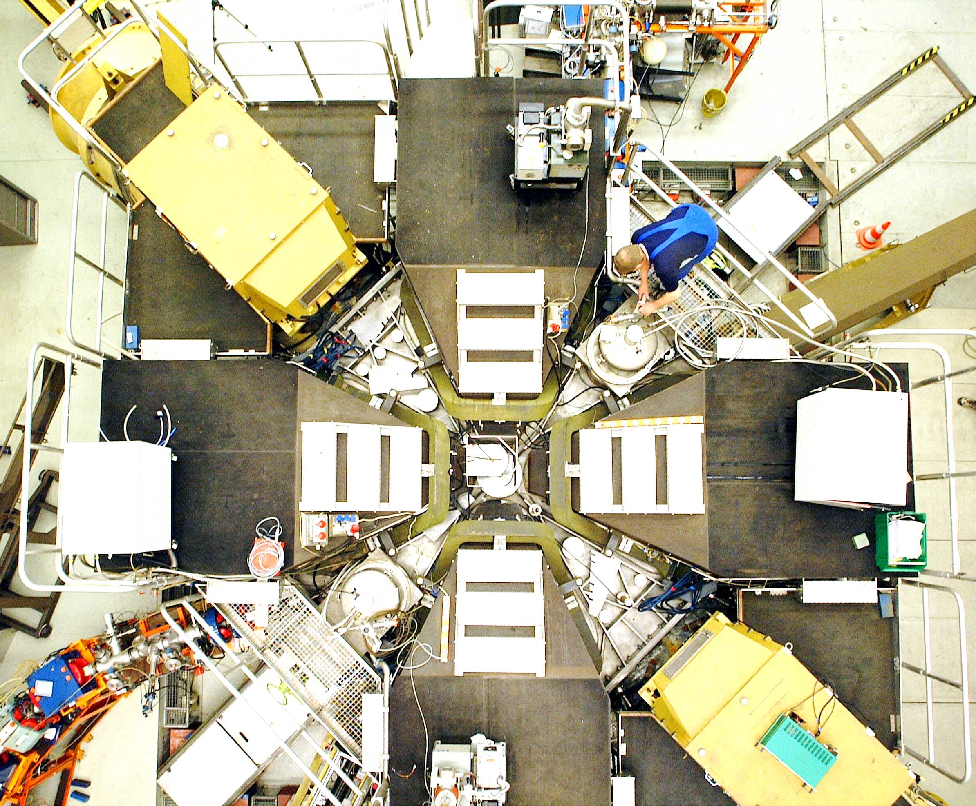

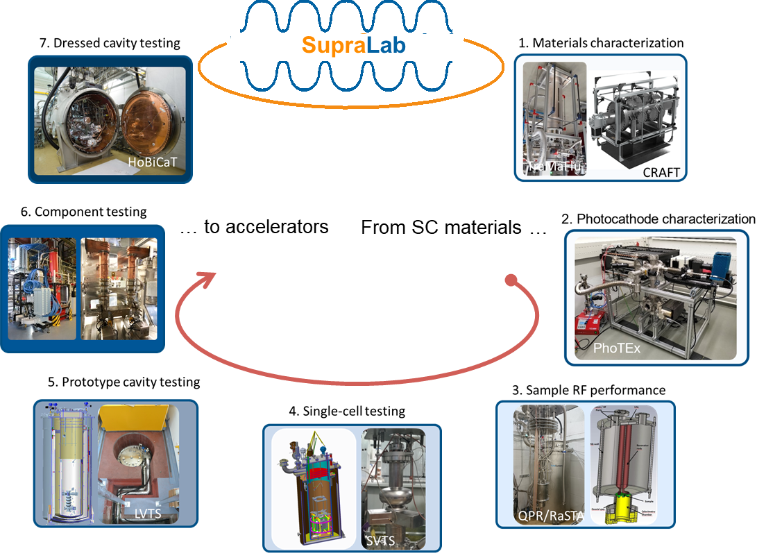
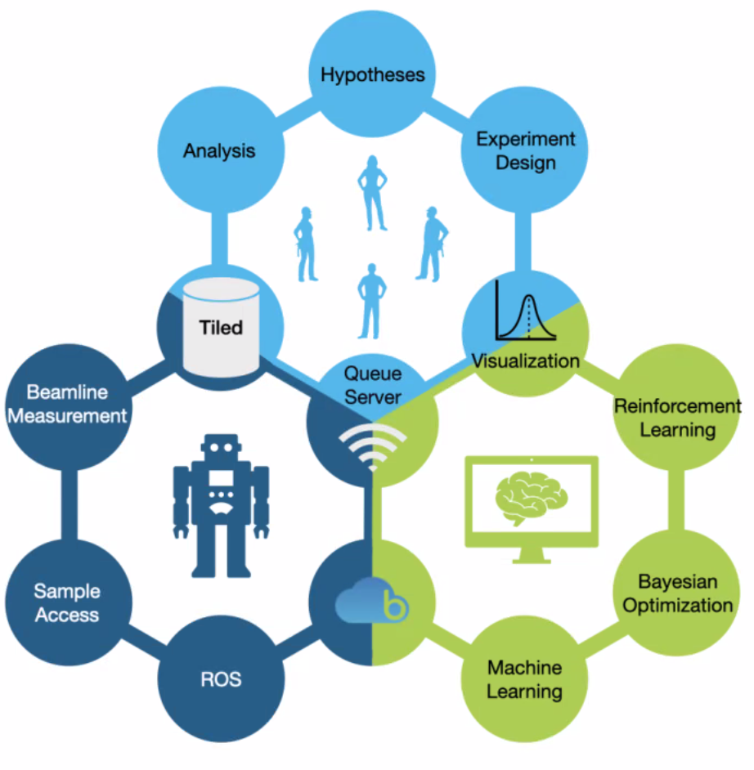
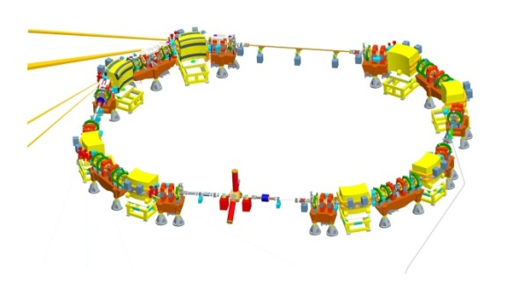
Accelerator Operation & Development @ HZB
68 MeV cyclotron
eye tumour therapy
(> 5000 patients, 10 % worl dwide)
development for FLASH therapy & micro beamlets
BESSY II & BESSY II+
Proton
Therapy
MLS & MLS+

Slide 5
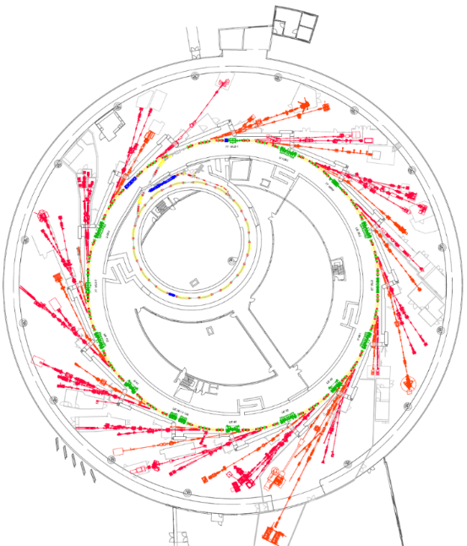
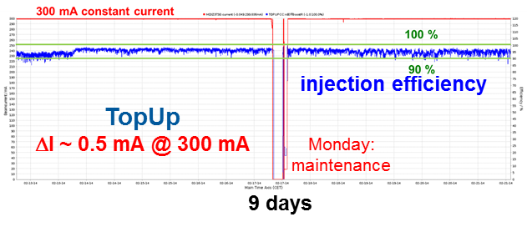
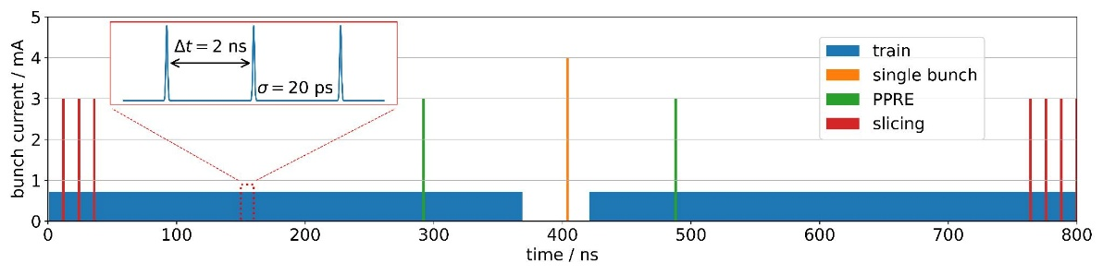
3rd Generation Source BESSY II – Multi-Mode / Multi-User operation
Successor of BESSY I, Germanys first dedicated light source (1981 – 1999)
Construction 1992 – 1998, in user operation since 1999
Energy/current 1.7 GeV / 300 mA
Emittance 7 nm rad
Pulse length 15 ps (rms)
Circumference 240 m
Straight sections 16
Undulators / WLS 13 / 2
Beamlines 36
end stations (fixed+var) 52
5000 h user operation, ~ 99 % availability
3000 user visits / a, > 500 papers /a
specialties
low-α operation
ps beams, CSR, THz
femto slicing
100 fs, polarised x-rays
6 kHz and variable
pump probe laser
standard mode = 4 in 1
excellent support of timing experiments
Andreas Jankowiak, Welcome@HZB, iSAS 2nd Annual Meeting, HZB, 23.04.2026

Slide 6
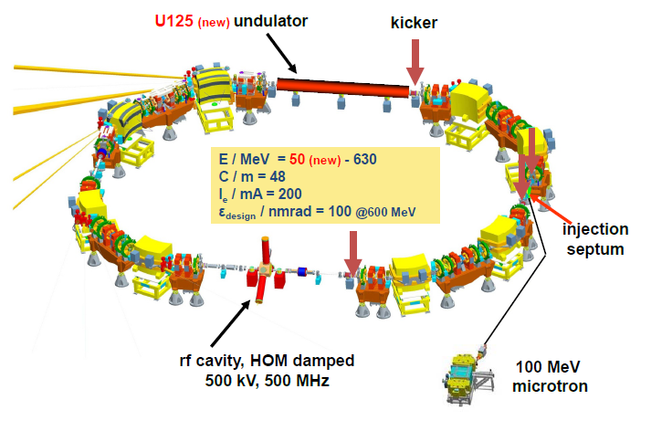



Metrology Light Source (MLS)
important test-bed for accelerator R&D
and education (Master, PhD Students)
owned by
developed and
operated by HZB
- metrology in the UV-EUV
- optimized for low-alpha operation (IR / THz generation) - EUV reflectometry (next generation EUV lithography – 13/6.5 nm process)
Andreas Jankowiak, Welcome@HZB, iSAS 2nd Annual Meeting, HZB, 23.04.2026

Slide 7
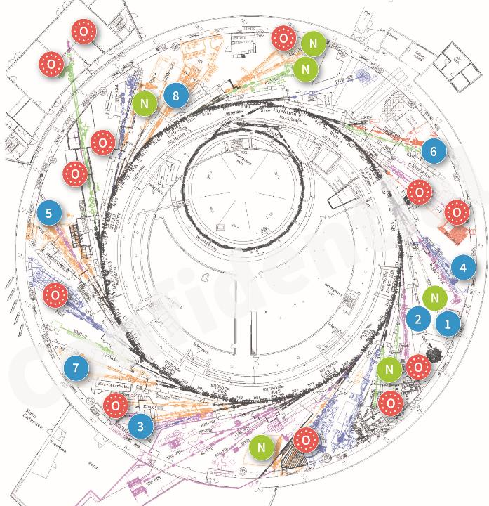

BESSY II+ – Operando Synchrotron for the Energy Transition
Operando
Scientific focus: Energy, catalysis and green IT
New instruments and sample environments
Modernisation
Stable & reliable accelerator performance
Improved digitalisation, automation & remote access
Lower barriers & higher instrument output
Sustainability
Increased self-sufficiency of energy supply
Reduced energy consumption
2023 – 2029
Total of 42 Mio€ of Invest
BESSY II+ Operando Capabilities for the Energy Transition
New instruments & sample environment
Expansion of digitalisation and support
Renovated / modernised accelerator and instruments
BESSY III A Materials Discovery Facility
Enhance capabilities compared to BESSY II+ with 4th generation source + integrated research infra.
Green field facility in Adlershof
User operation 2036+
Andreas Jankowiak, Welcome@HZB, iSAS 2nd Annual Meeting, HZB, 23.04.2026

Slide 8
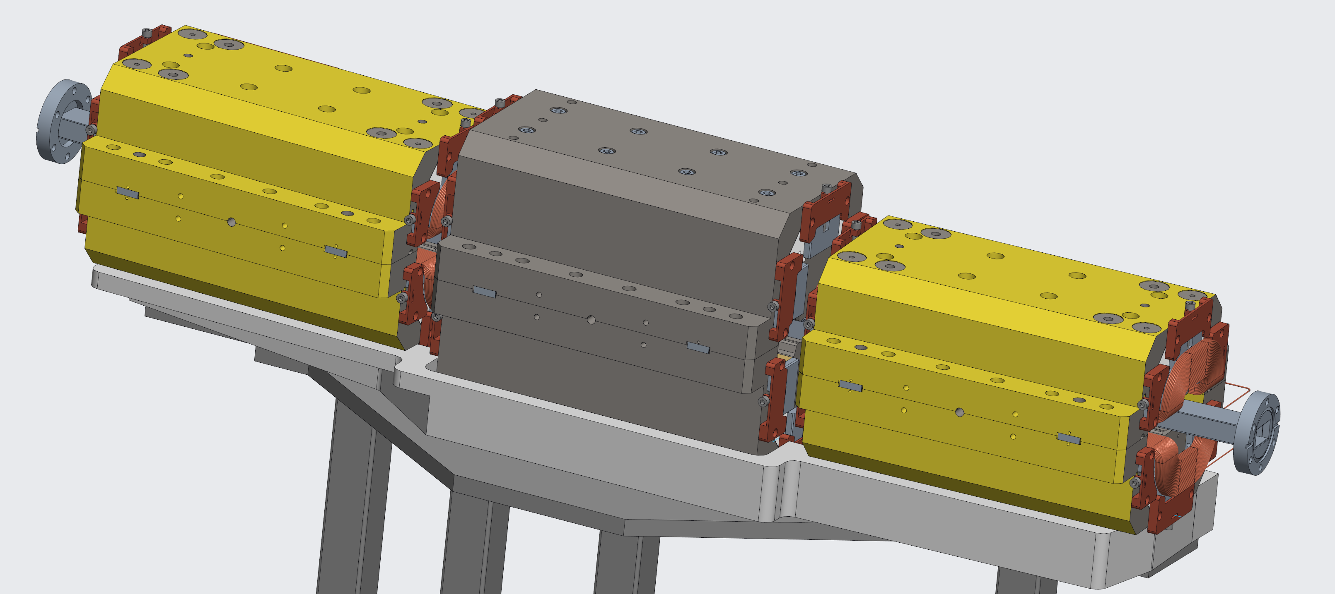
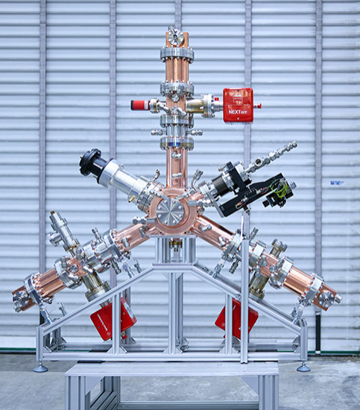
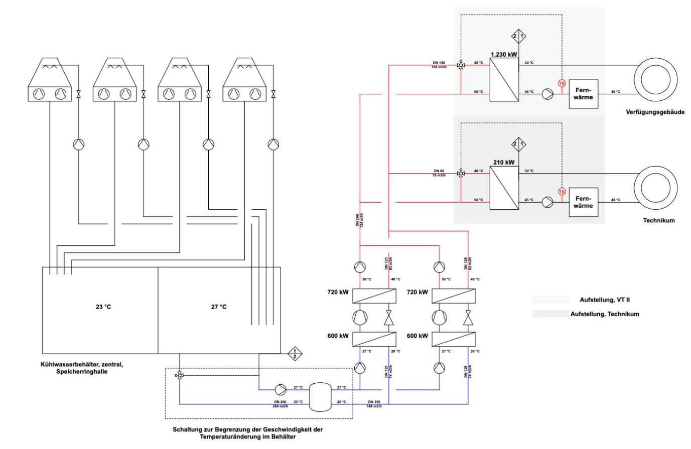
BESSY II+ – Accelerator & Sustainability Actions
Task 4: Modernisation and Upgrade Measures of the Accelerator Complex
CPMU20 fur SoTeXS
active NC Higher-Harmonic-Cavities
Permanent magnets(PM) for transfer lines
Replacements / spares for SC 7 T Wavelength Shifter
BESSY II Digital Twin
General preservation & modernisation measures
Task 6: Sustainable HZB
NetZero Emission Technicum
- Building integrated photovoltaics - Battery and hydrogen energy storage
BESSY II Building
- Roof refurbishment with significant PV
- Waste heat recovery from BESSY II with heat pumps
1.4 MW heating power @ 45°C with only 260 kW electrical power
not compromising BESSY II cooling water stability.
ca. 50% saving in heating costs and CO₂ (-130 tCO₂) per year
Andreas Jankowiak, Welcome@HZB, iSAS 2nd Annual Meeting, HZB, 23.04.2026

Slide 9
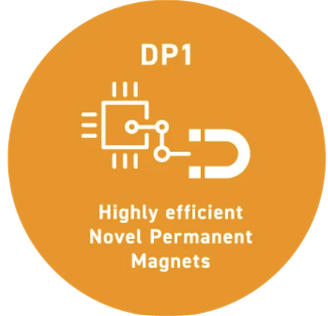



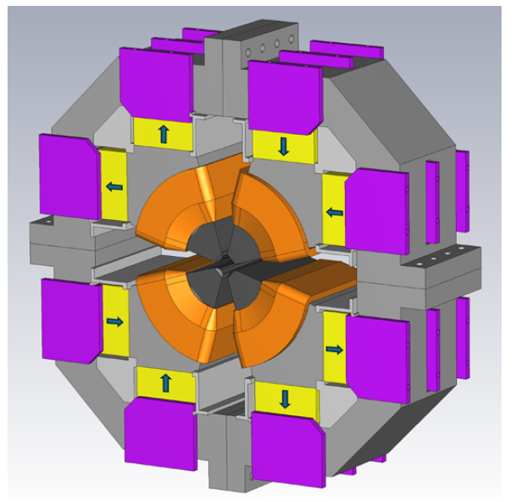
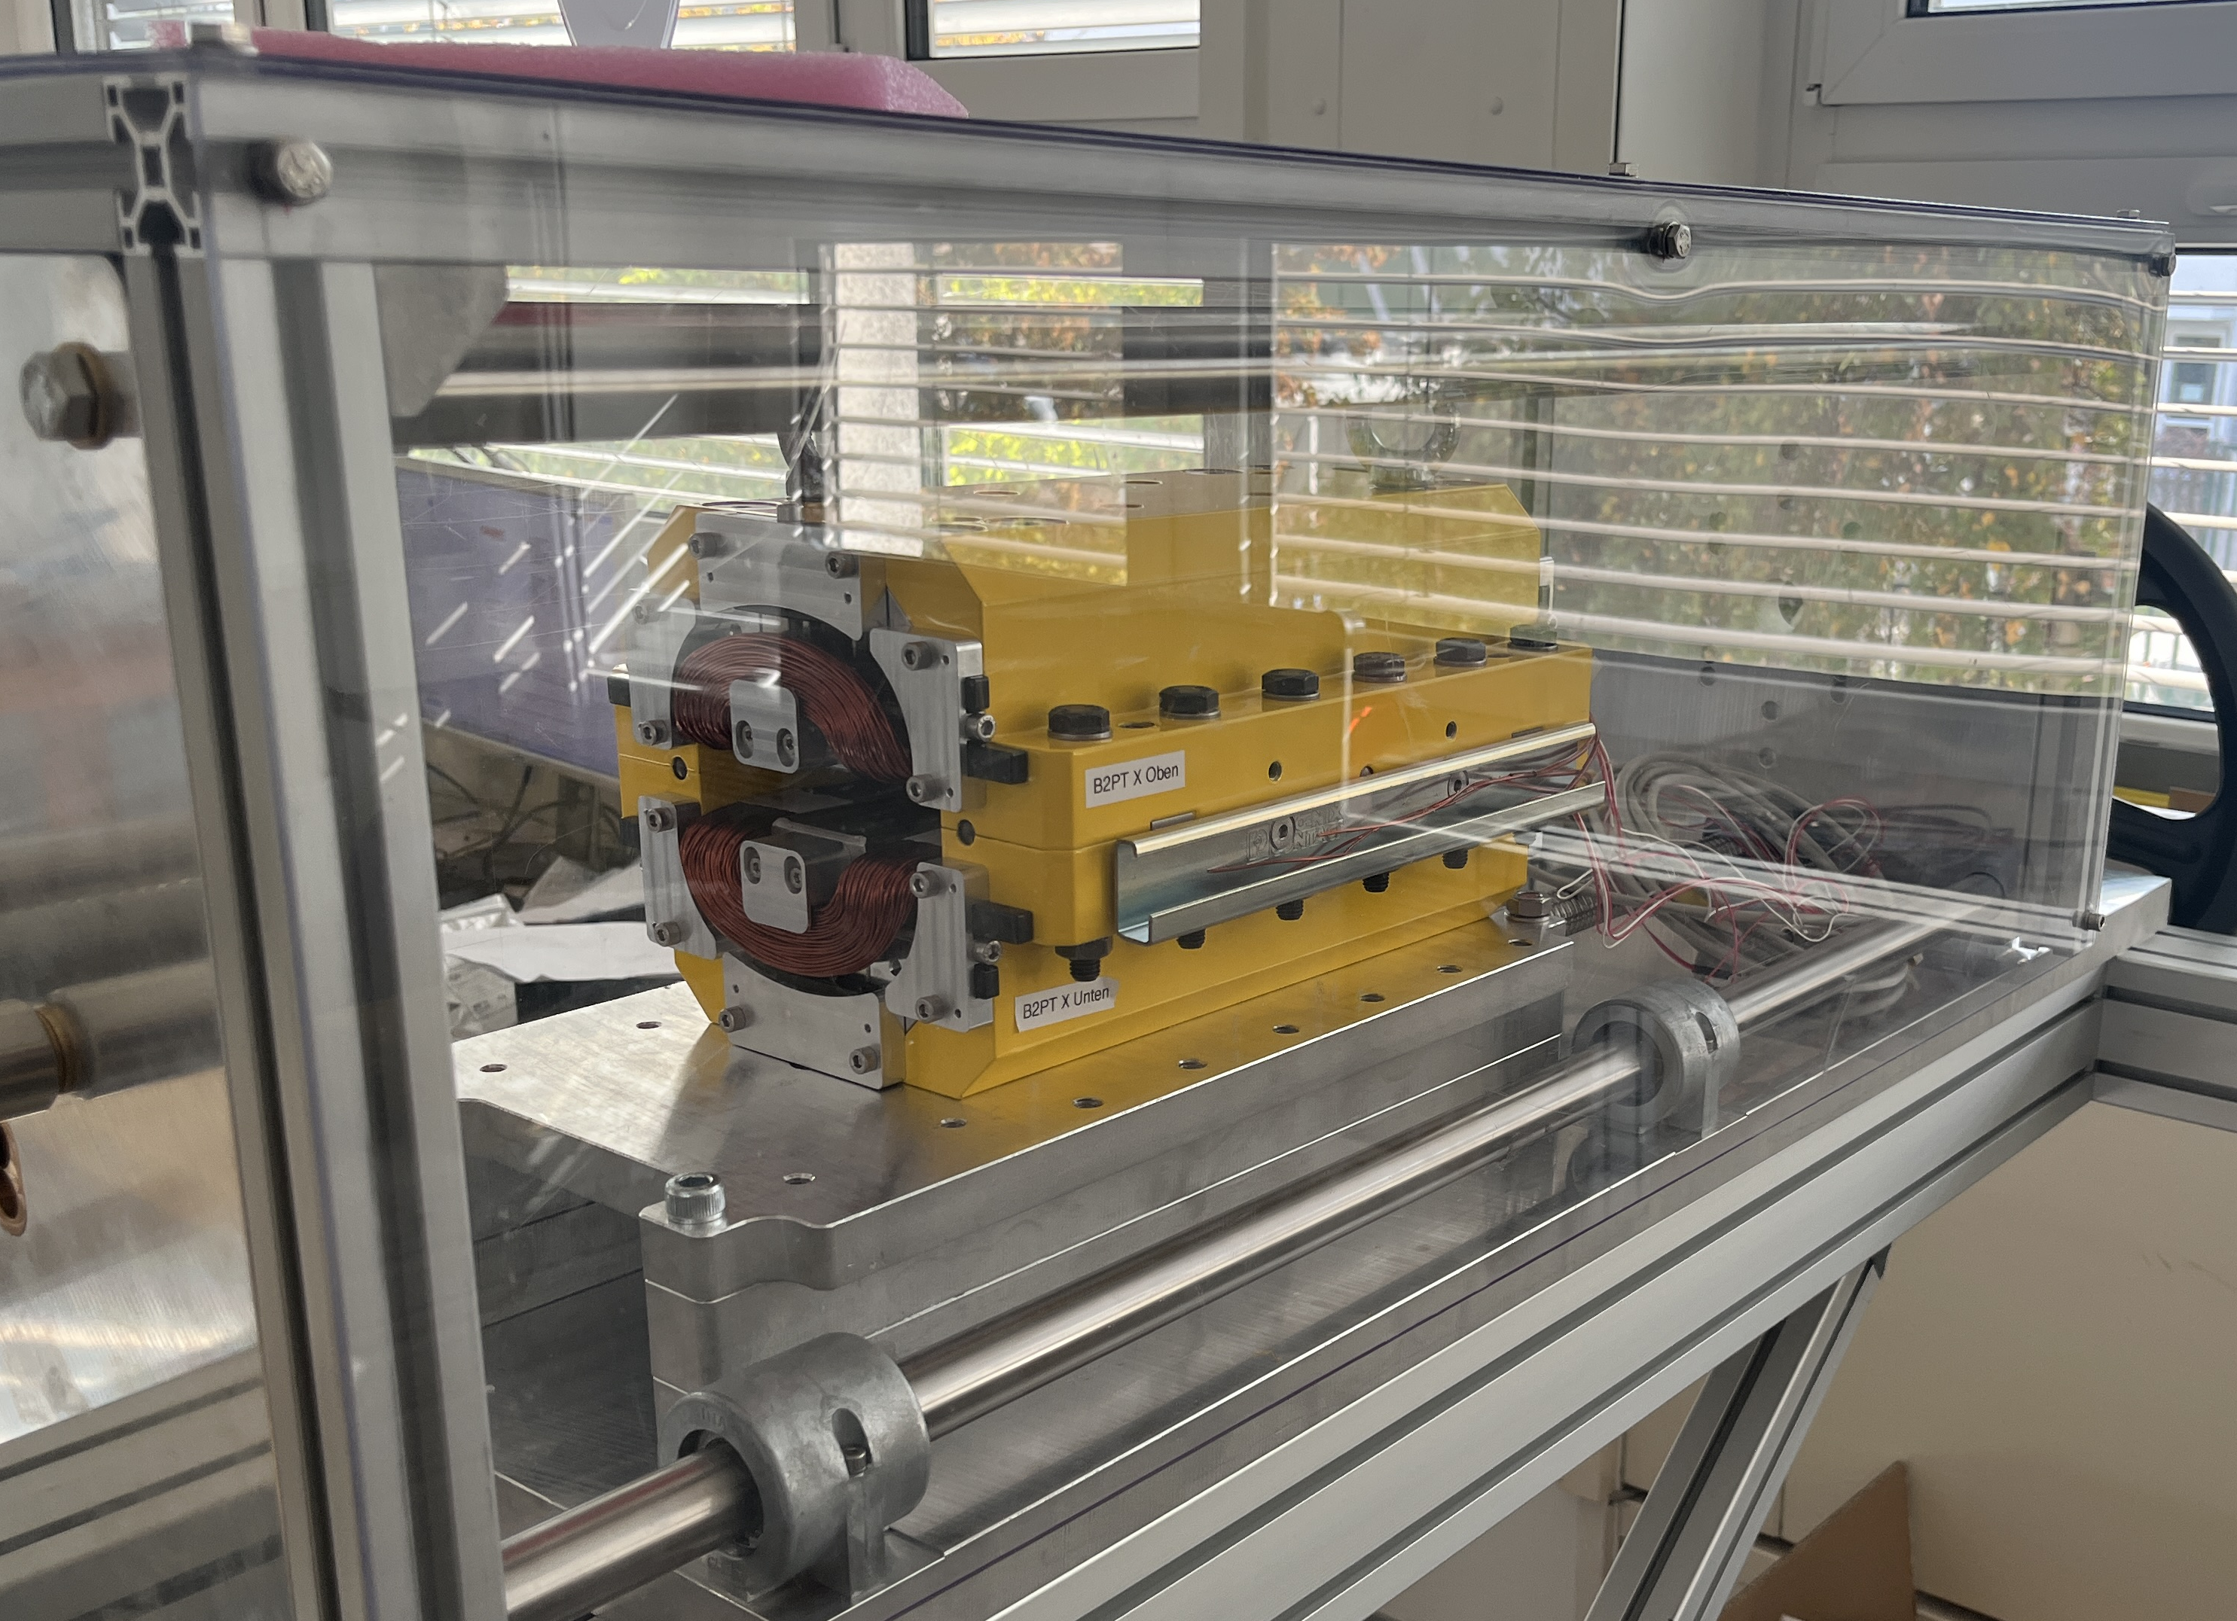
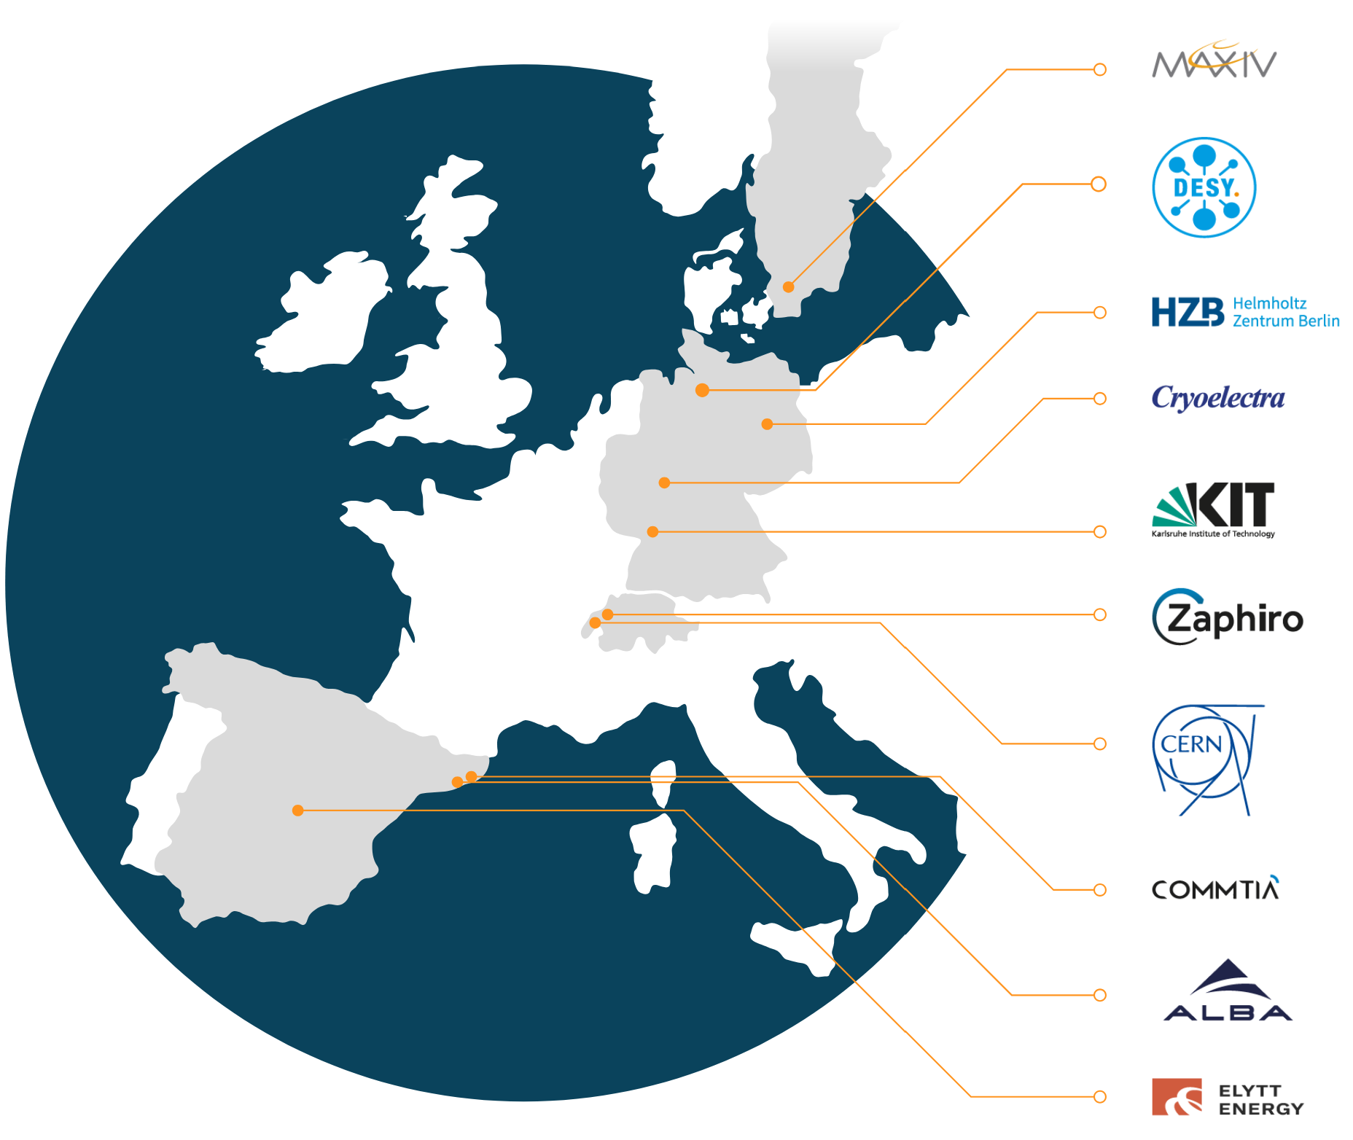

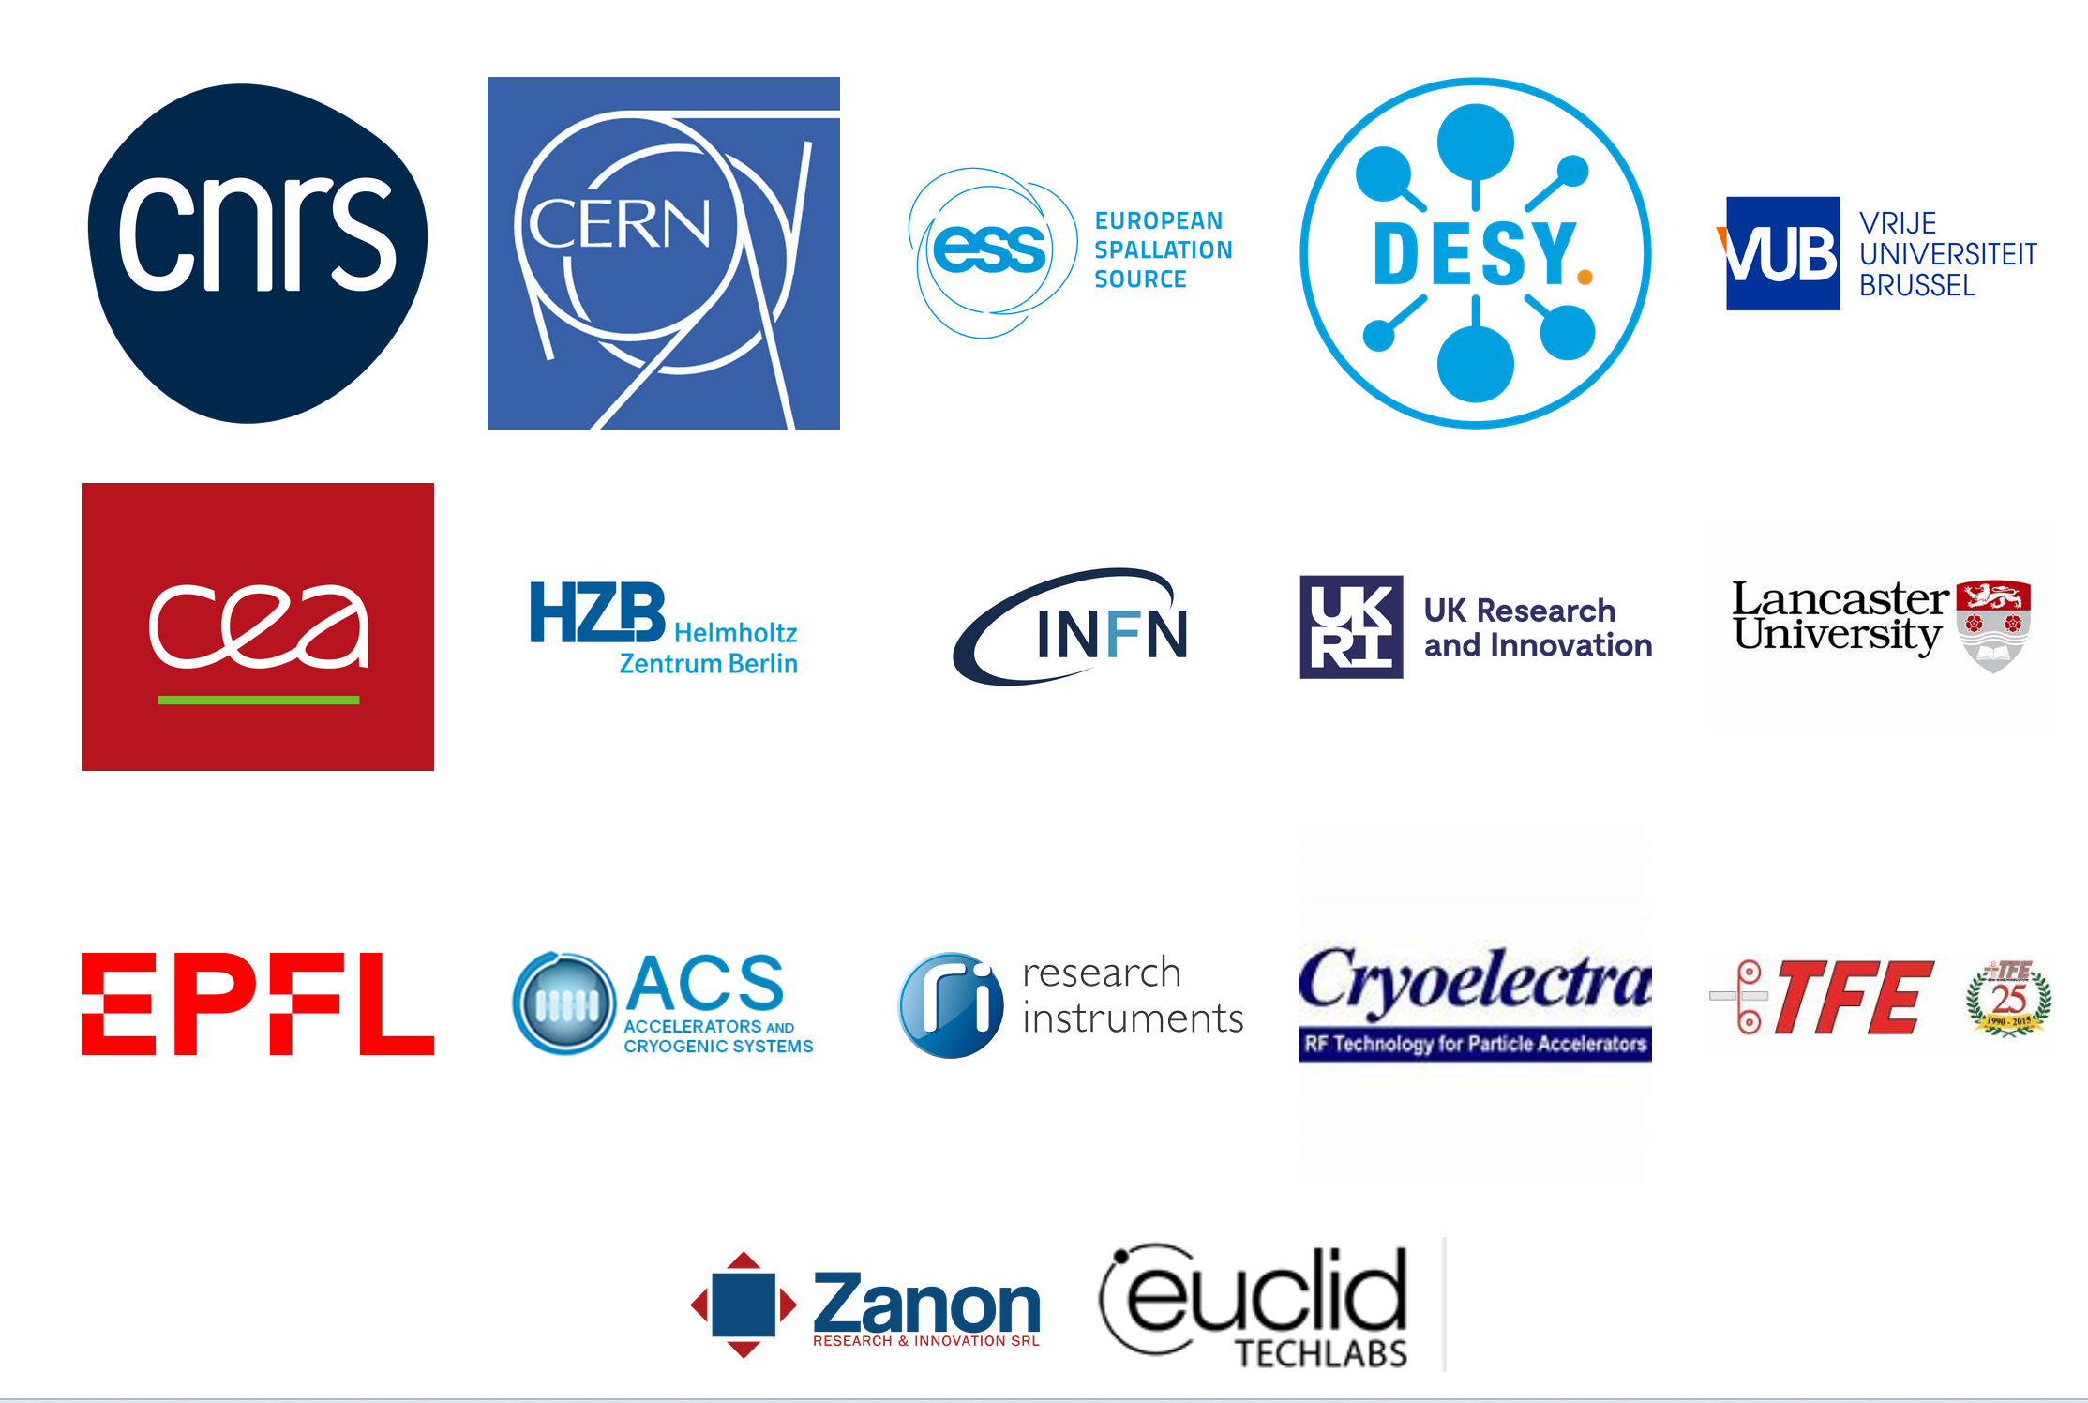

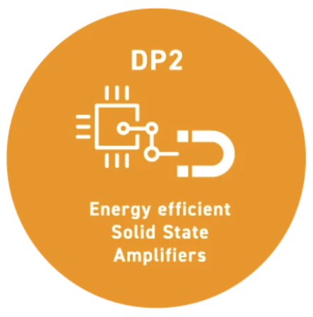
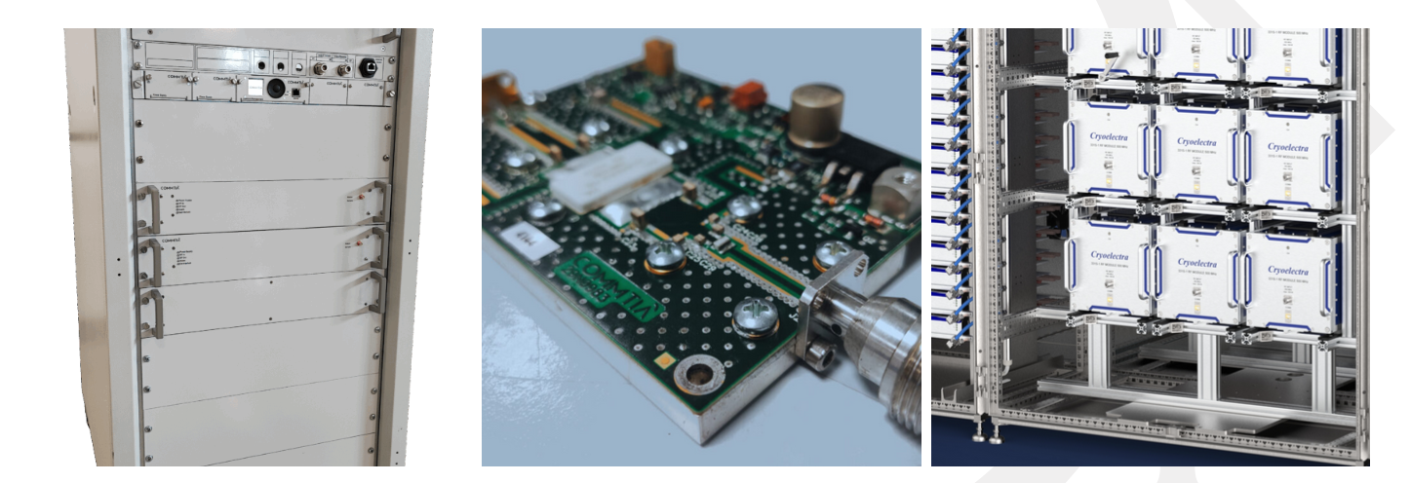
Research for sustainable accelerator technology
e.g.
Tunable PM Magnets for BESSY II+ & BESSY III
Tour
patent WO 2025/093072 A1
Tour
Perm. Magnets
Each 5 Mio€ funding! Activities @ HZB:
Energy Efficient SSA for BESSY III
PM tunable Quadrupoles
efficiency improved solid state amplifier
fast reactive tuner
Low-Level-RF systems
thin film superconductor
Adaptive adjustment of working point to improve load dependent efficiency.
Andreas Jankowiak, Welcome@HZB, iSAS 2nd Annual Meeting, HZB, 23.04.2026

Slide 10
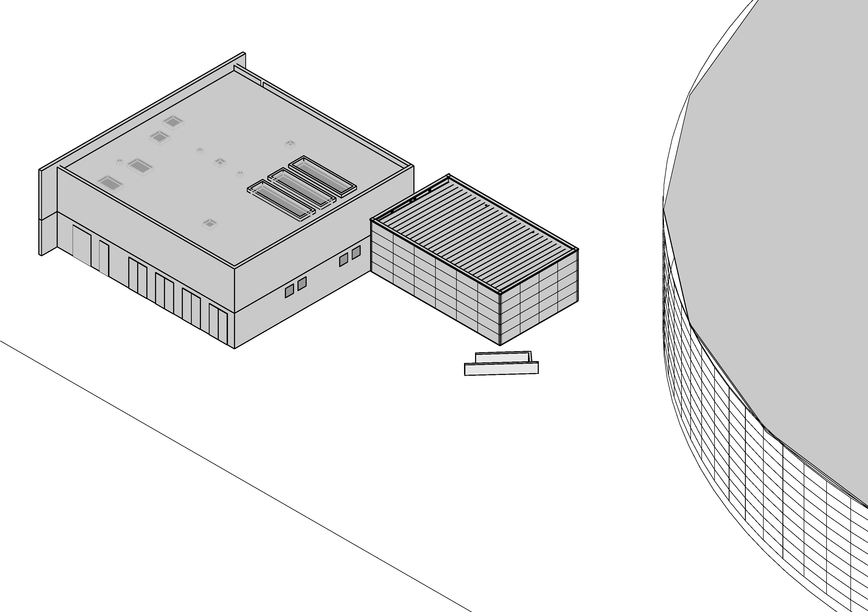
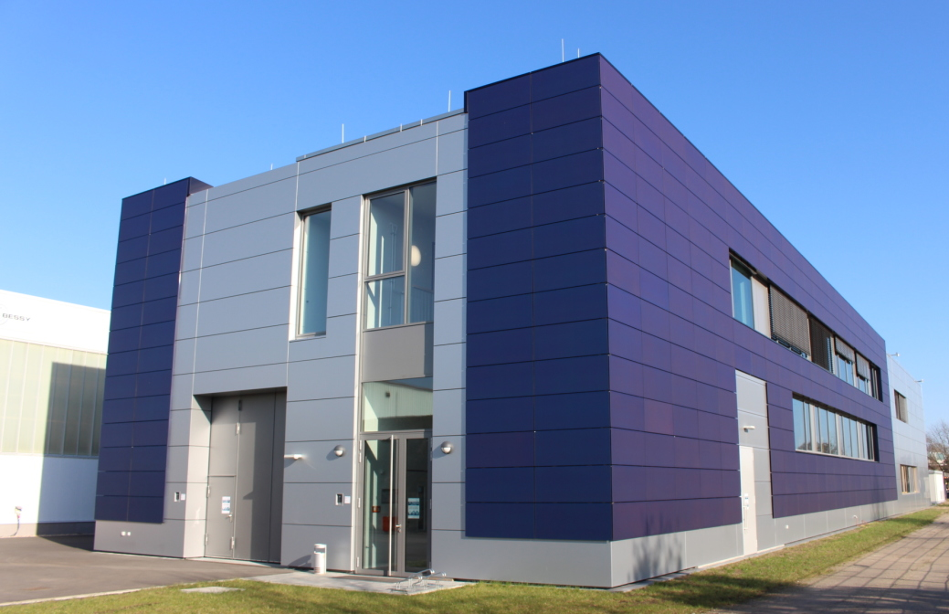

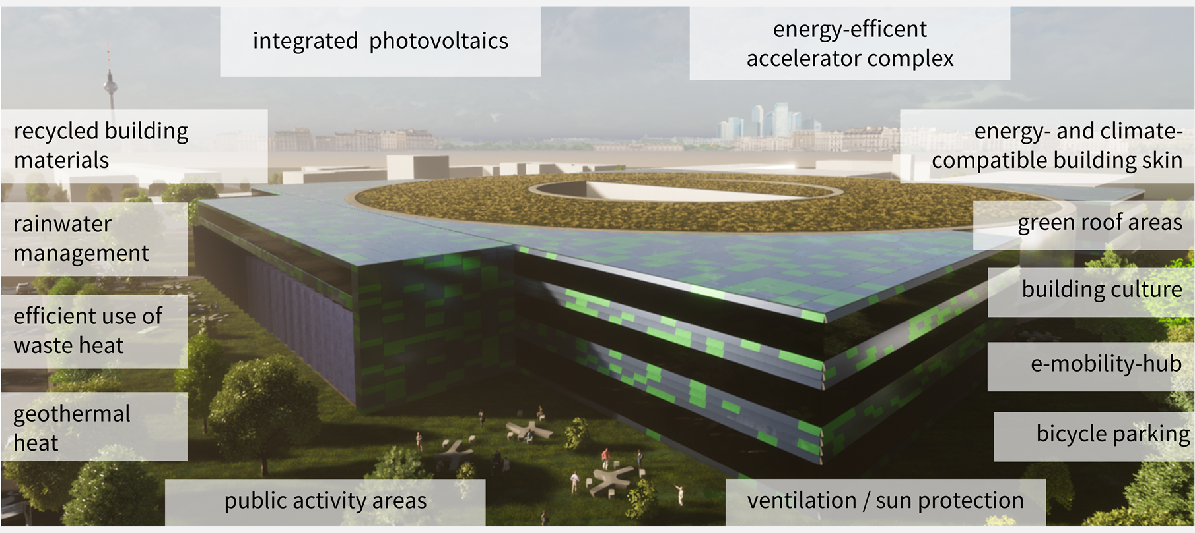






Overarching sustainability – HZB & BESSY
Living Lab BiPV
Towards Greenhouse Gas Neutrality in 2035
Heat Recovery BESSY II
Sustainable BESSY III
Green electricity
Heat recovery
PV
Components
GHG report

Slide 11

BESSY III
The materials discovery facility

Slide 12
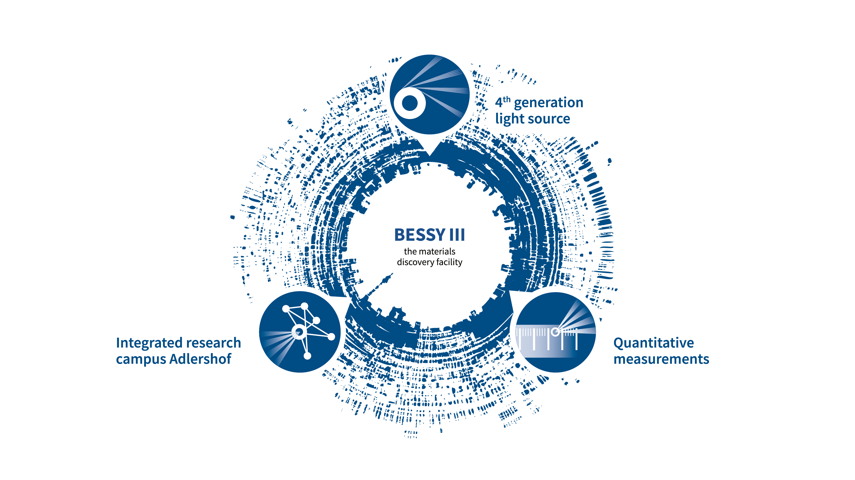
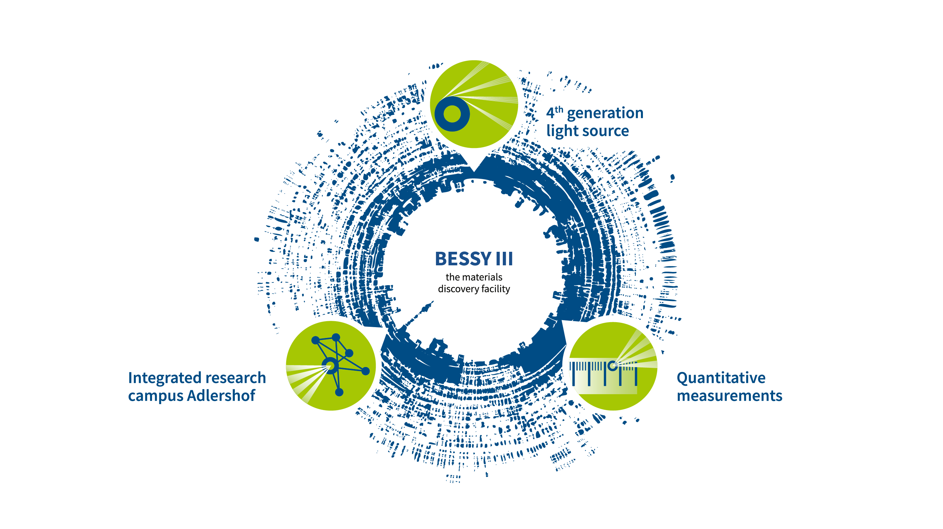
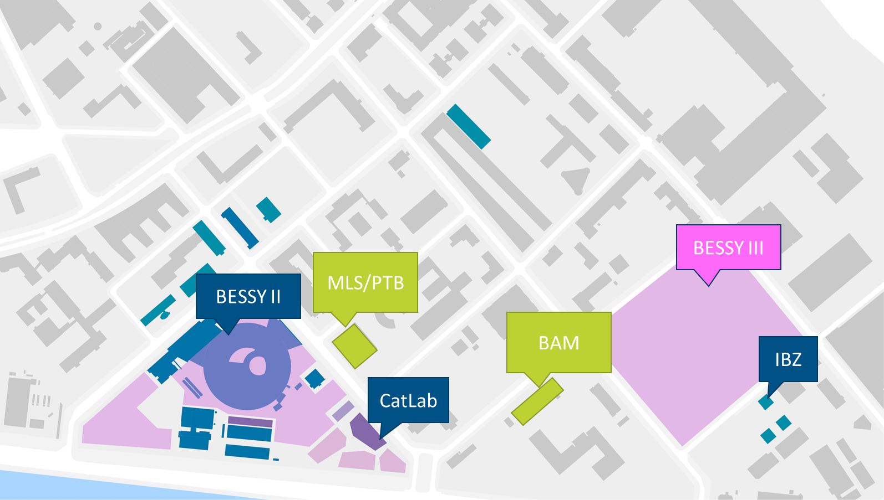

BESSY III – More than just another synchrotron
x100.000 brilliance on the sample
order of magnitude increase of coherent flux
#high-resolution spectroscopy
#high-resolution imaging
#dynamics and processes
soft to #tender X-rays
in-situ and #operando
#multimodal experiments
high-throughput / #automation
multi-modal measurements with
required labs on site / on campus
well defined uncertainties for all relevant parameters (“metrology”)
#quantitative materials science
Andreas Jankowiak, Welcome@HZB, iSAS 2nd Annual Meeting, HZB, 23.04.2026

Slide 13
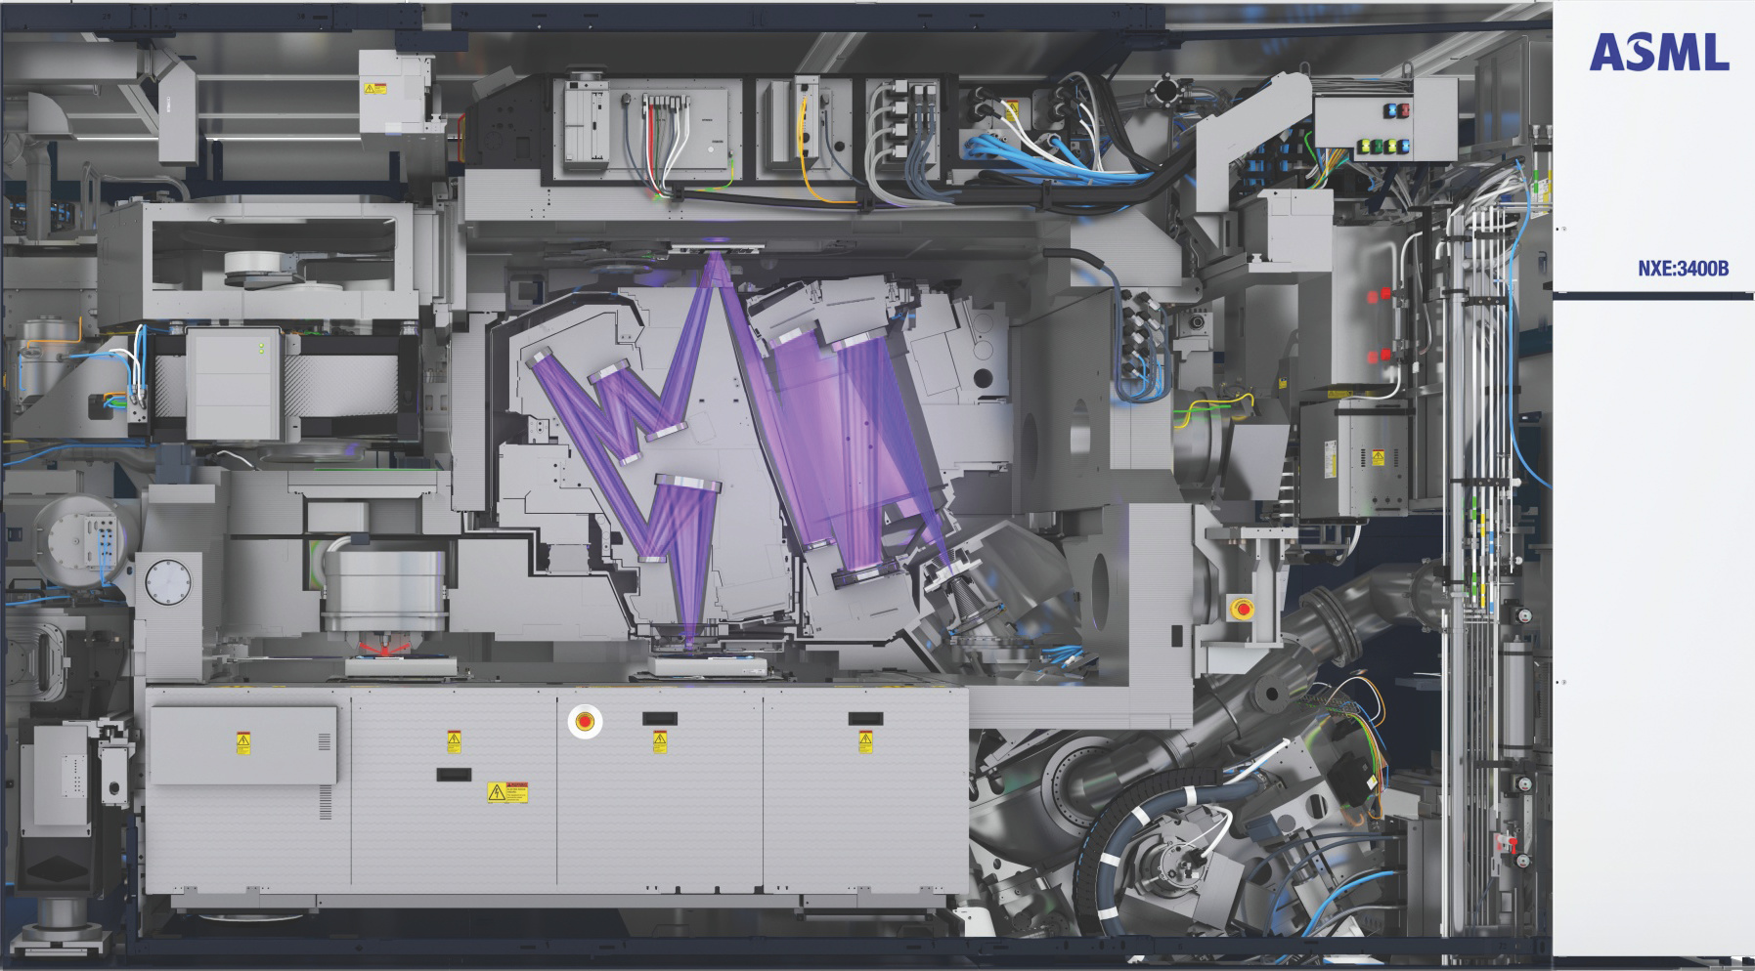



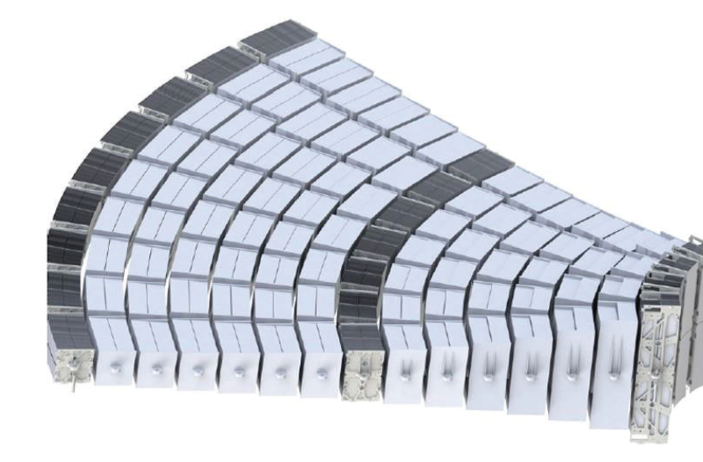









BESSY III – a 4th generation source as European Metrology Standard (as is BESSY II)
The Physikalisch-Technische Bundesanstalt
is the national metrology institute of the Federal Republic of Germany and the second largest metrology institute in the world.
holds (by law) the legally binding standards for units of measurements
uses BESSY II as (european) radiation standard for EUV, soft and soft X-rays and will use BESSY III the same way.
Develop competitive BESSY III lattice with homogenous bends
distinct from developments at other 4th generation facilities
satisfies PTB needs as important service provider for industry

Slide 14
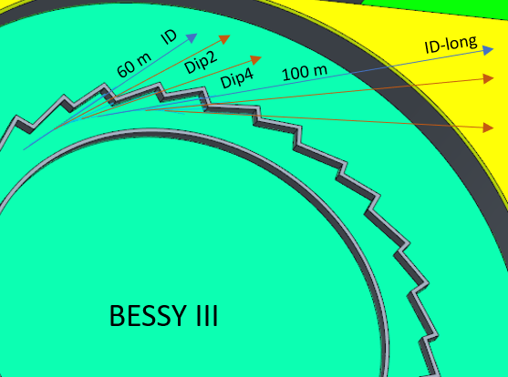
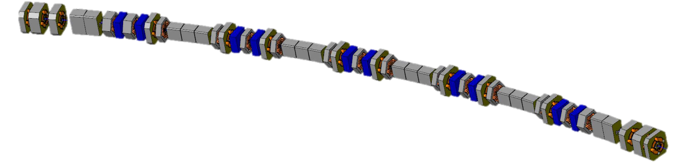
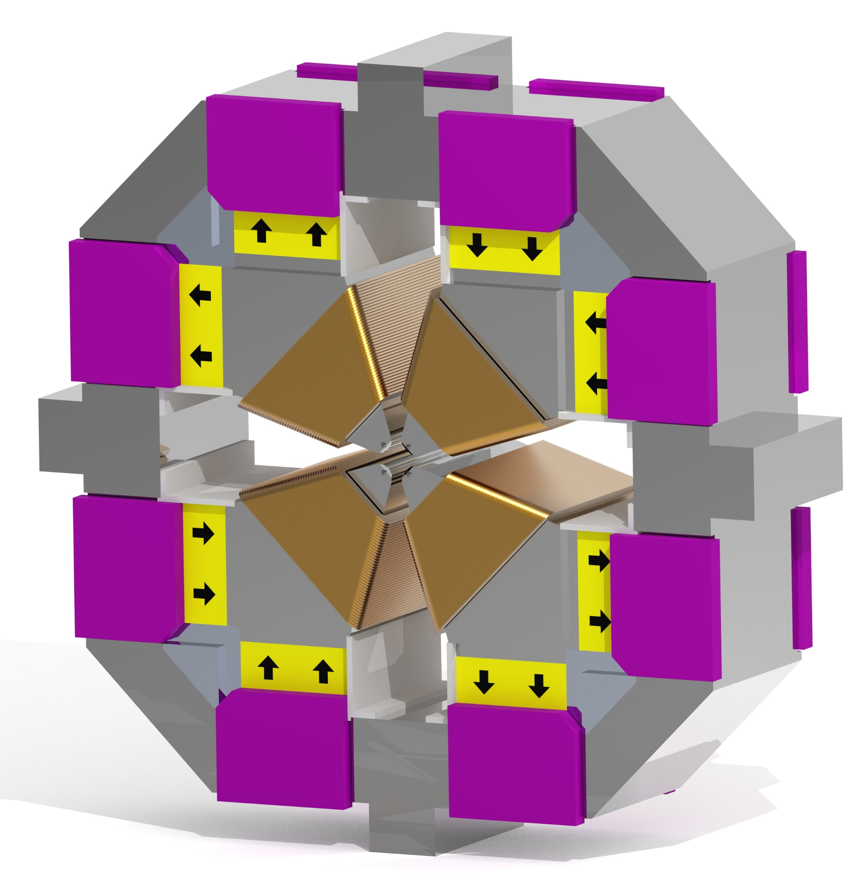
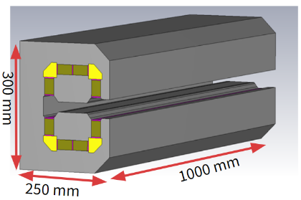
BESSY III – Baseline Lattice and main parameters / design choices
6-Bend-Higher-Order-Achromat
with homogenous bends for metrology
100 pm rad emittance @ 2.5 GeV
with 16 straights, each 5.6 m, on ca. 360 m circumference
15 µm source size, 10 ps bunch length, lifetime > 5 h
ID beamlines 60 m, up to 120 m (very limited number) possible
Dipole beamlines with 0.7 T / 1.5 T / 3 T / ? field at source point
dipoles and quadrupoles (tune able) mainly build as permanent magnets
power consumption reduce from 1,000 kW for electro magnets down to < 200 kW
Andreas Jankowiak, Welcome@HZB, iSAS 2nd Annual Meeting, HZB, 23.04.2026

Slide 15
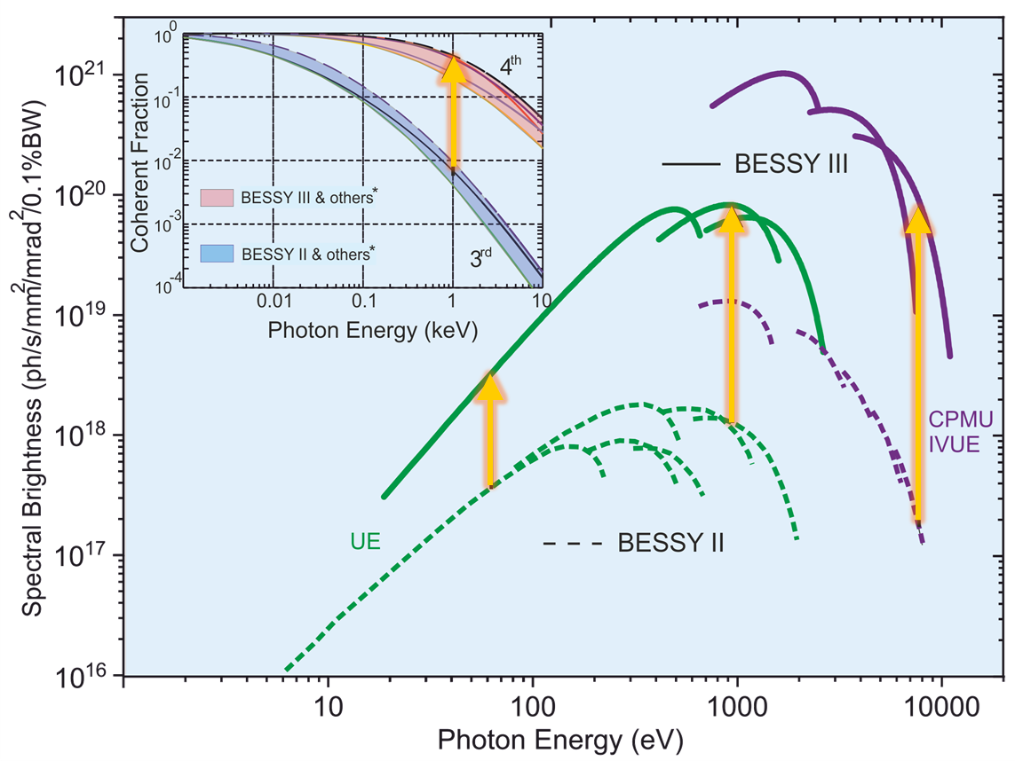
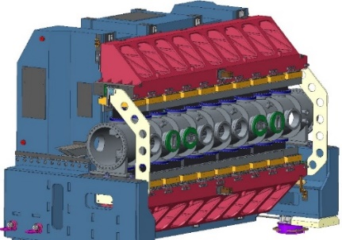
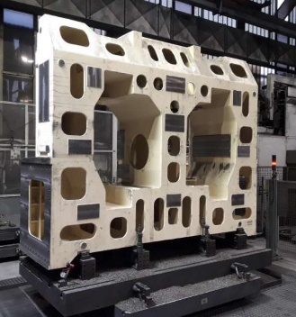
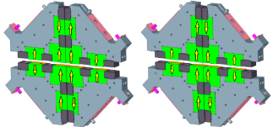
BESSY III – Highest brilliance and coherence
New IDs / first of its kind
Up to 3 orders brighter
IVUE32 for BESSY II
Magnetic length: 2.5m
Period length: 32mm
Minimum gap: 7mm
Force compensation: functional magnets at the center, compensation magnets at the sides and top / bottom
and additional boost x100 in the tender regime by highly efficient optics
Andreas Jankowiak, Welcome@HZB, iSAS 2nd Annual Meeting, HZB, 23.04.2026

Slide 16
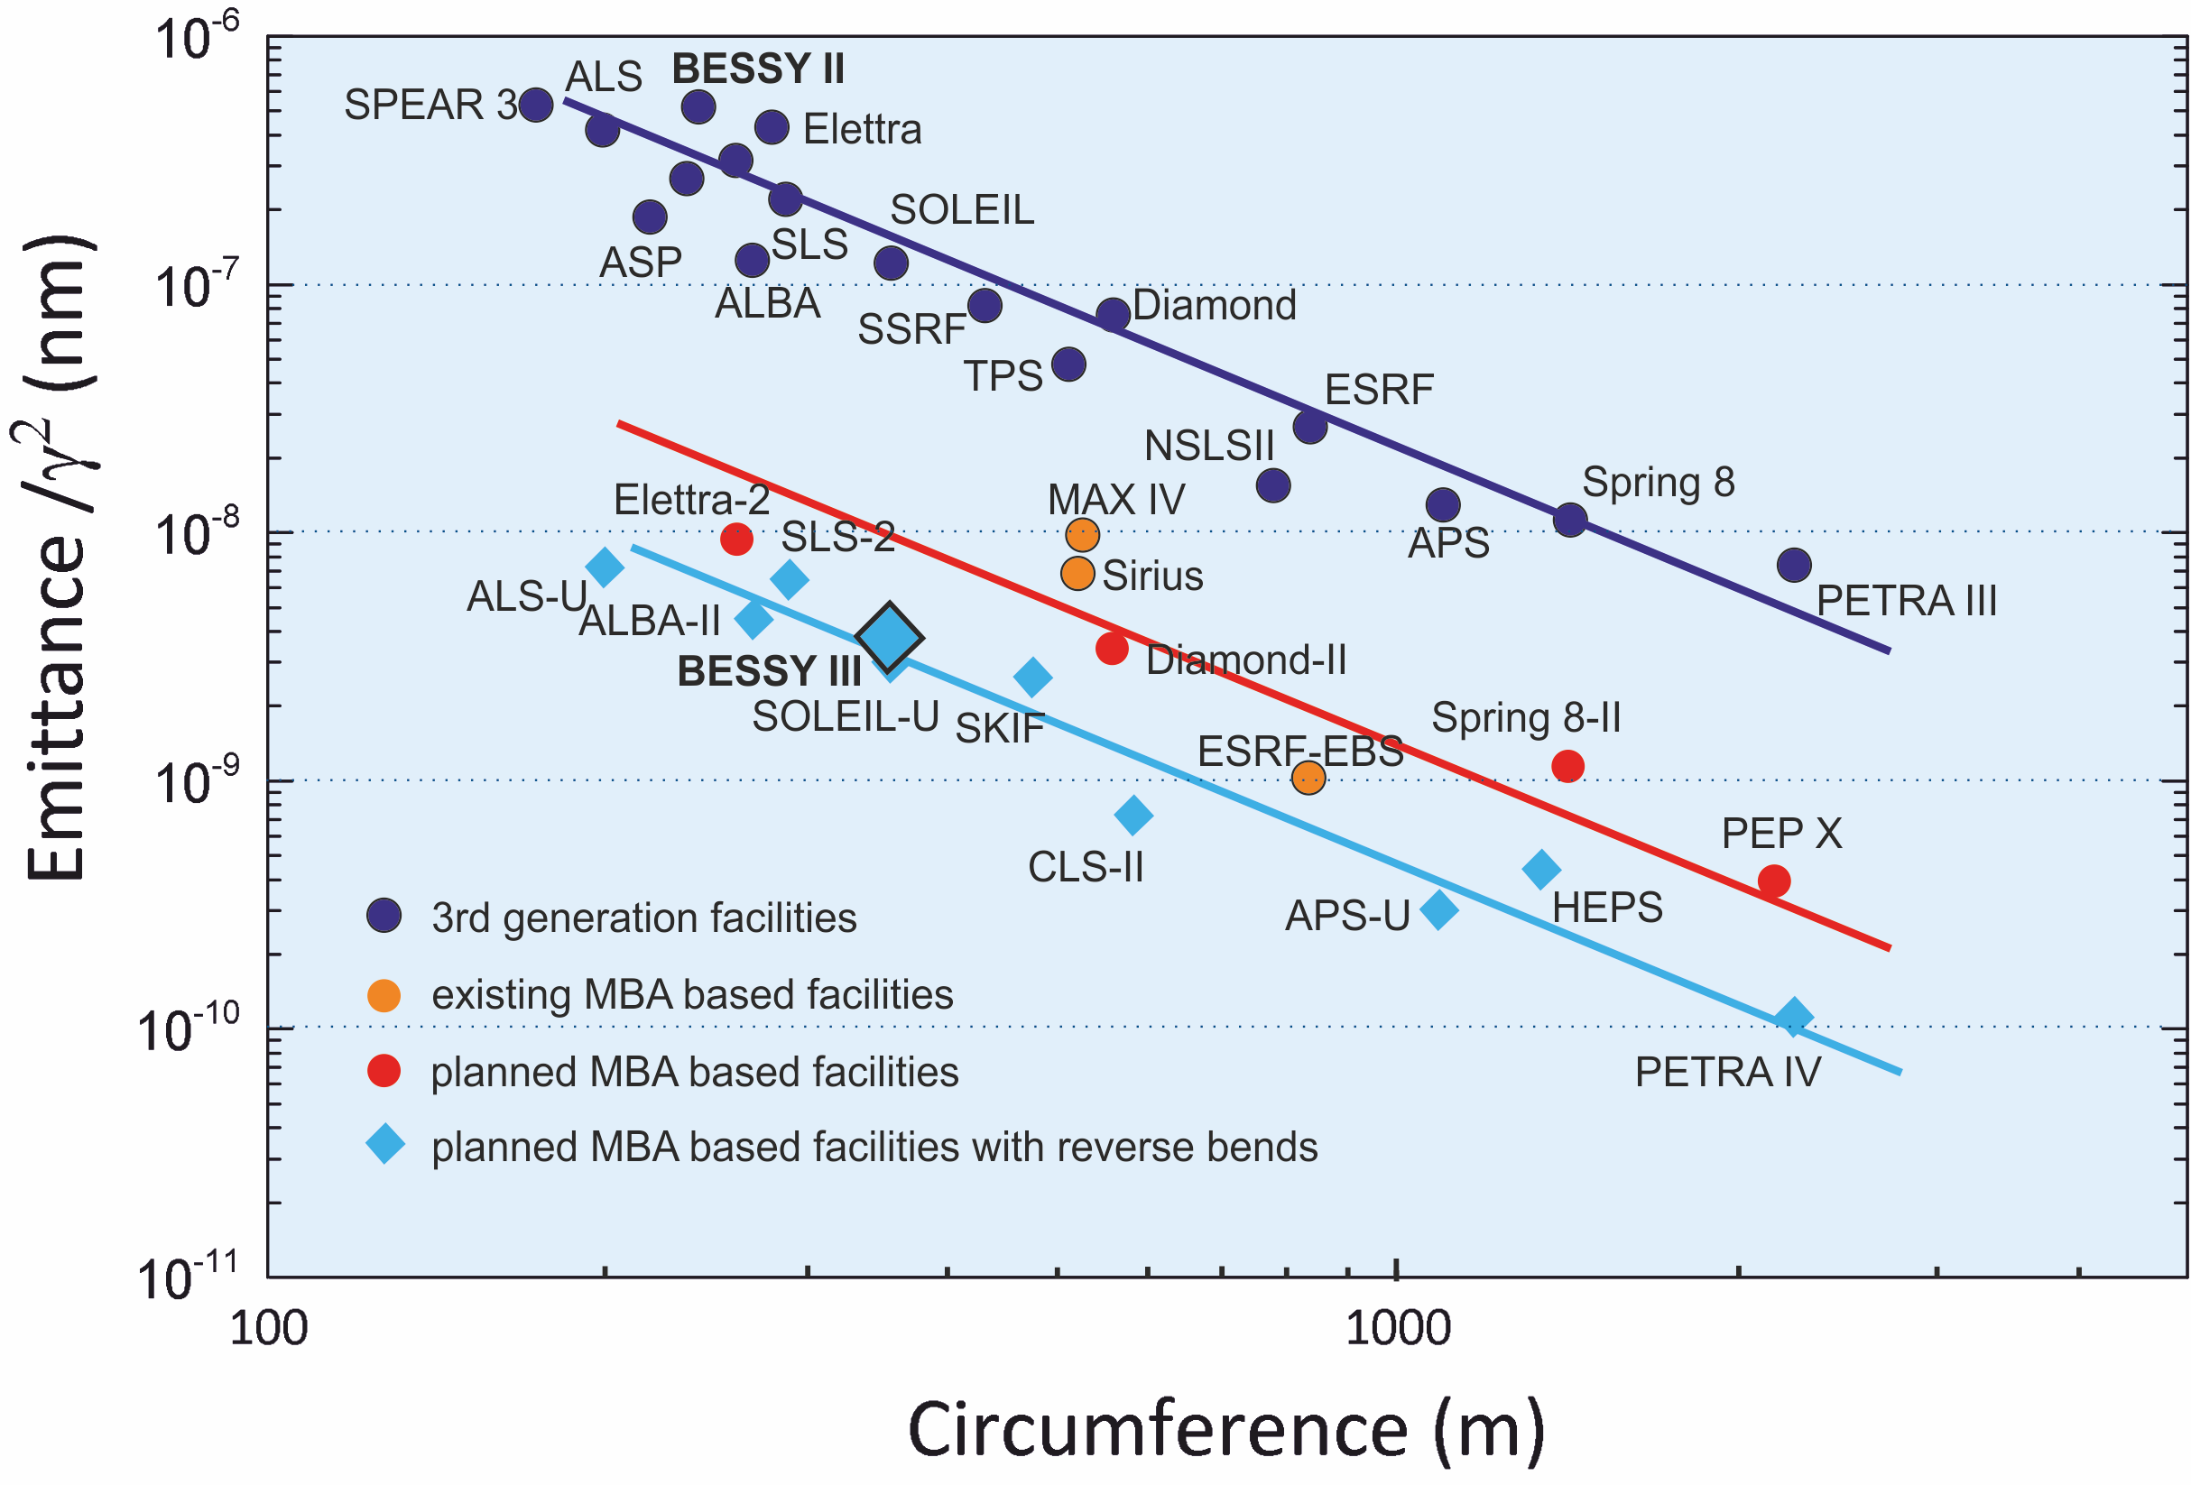
BESSY III lattice – Different, flexible but full in line with other advanced designs
better
Andreas Jankowiak, Welcome@HZB, iSAS 2nd Annual Meeting, HZB, 23.04.2026

Slide 17
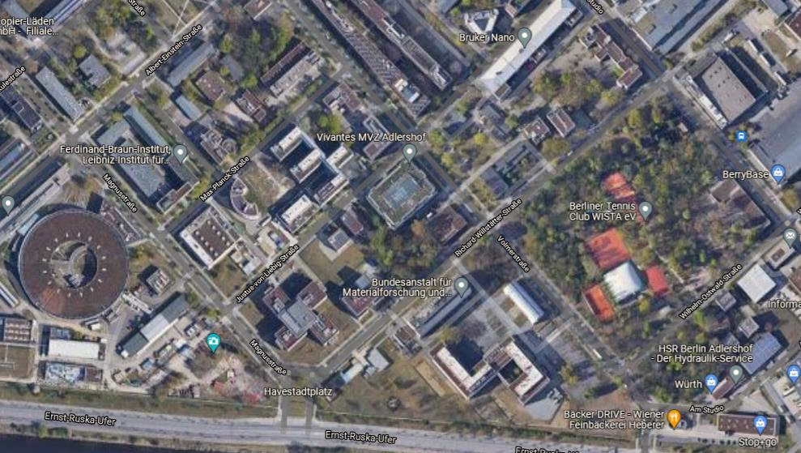
Envisioned construction site for BESSY III in Berlin-Adlershof – “on campus”
Berlin senate „Urban Development, Building and Housing”, district administration, WISTA and HZB ➔ joint endeavor to make this site accessible
Evaluation of five suggested sites in Adlershof
Only one (this) site meets the BESSY III's requirements
Application to initiate a project-related development plan procedure has been submitted.
HZB prepares for Urban Planning Competition
➔ Goal: Official release of modified development plan in 2029!
BESSY III
Andreas Jankowiak, Welcome@HZB, iSAS 2nd Annual Meeting, HZB, 23.04.2026

Slide 18

BESSY III – A Sustainable & Energy Efficient Research Facility in Berlin-Adlershof
ca. 1200 Mio€ (2024 prices) Invest Construction start 2030+ First users in 2036+
Andreas Jankowiak, Welcome@HZB, iSAS 2nd Annual Meeting, HZB, 23.04.2026

Slide 19

Thank you for your attention.
Have a great time @ HZB and in Berlin.

