Slide 1
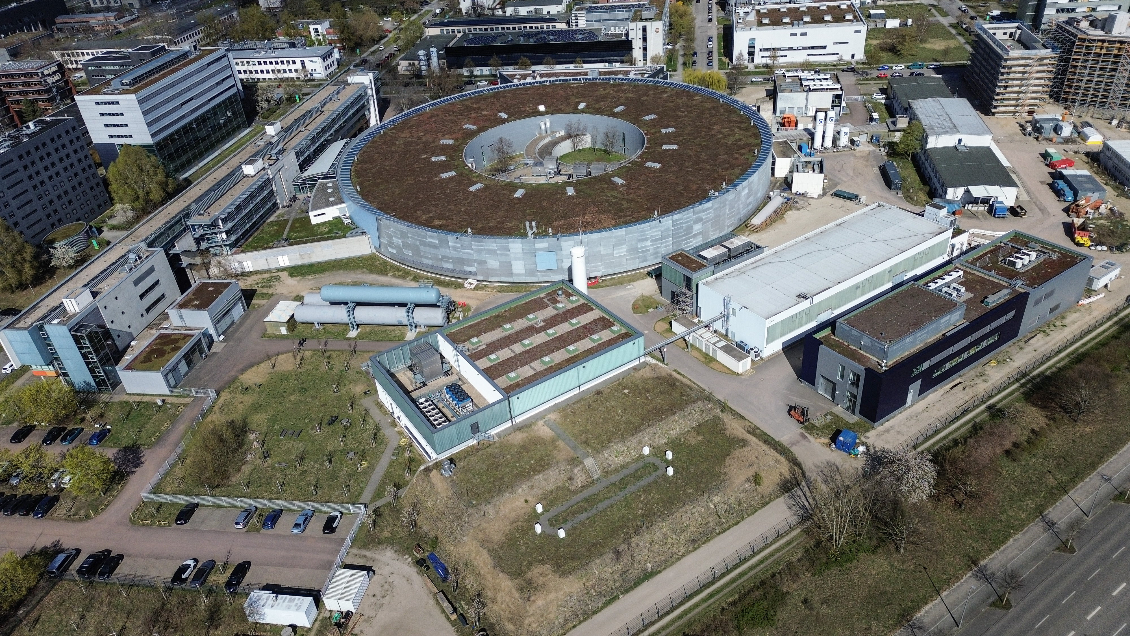

iSAS 2nd annual Meeting Workshop logistics
HZB, Berlin, Germany, 22nd-24th of April 2026
23rd of April, 2026 A. Neumann for the LOC
Welcome
to
HZB Berlin

Slide 2
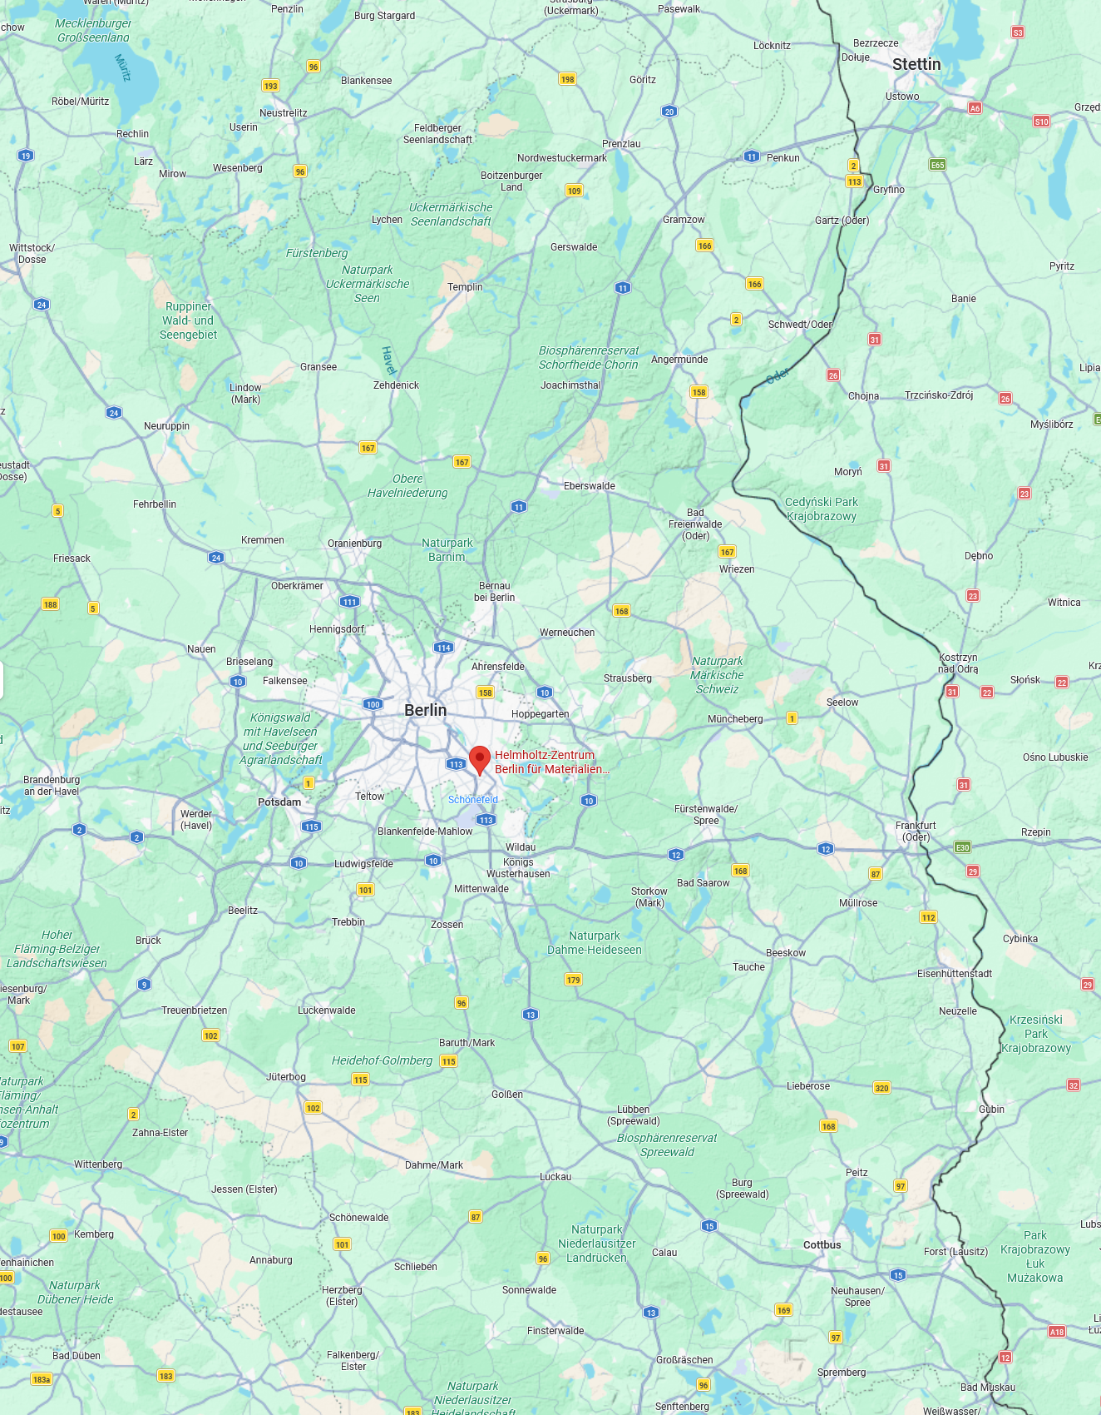
Where are we?
2nd annual meeting
You are here
13.10
BESSY II
N
Baltic Sea
14.51
Hamburg 300 km
Poland
bERLinPro
SEALAB
77 km
Dresden 175 km
Building 14.51 (main building) on the Adlershof Campus
of Helmholtz-Zentrum Berlin
Southeast of Berlin, Science park of Adlershof

Slide 3
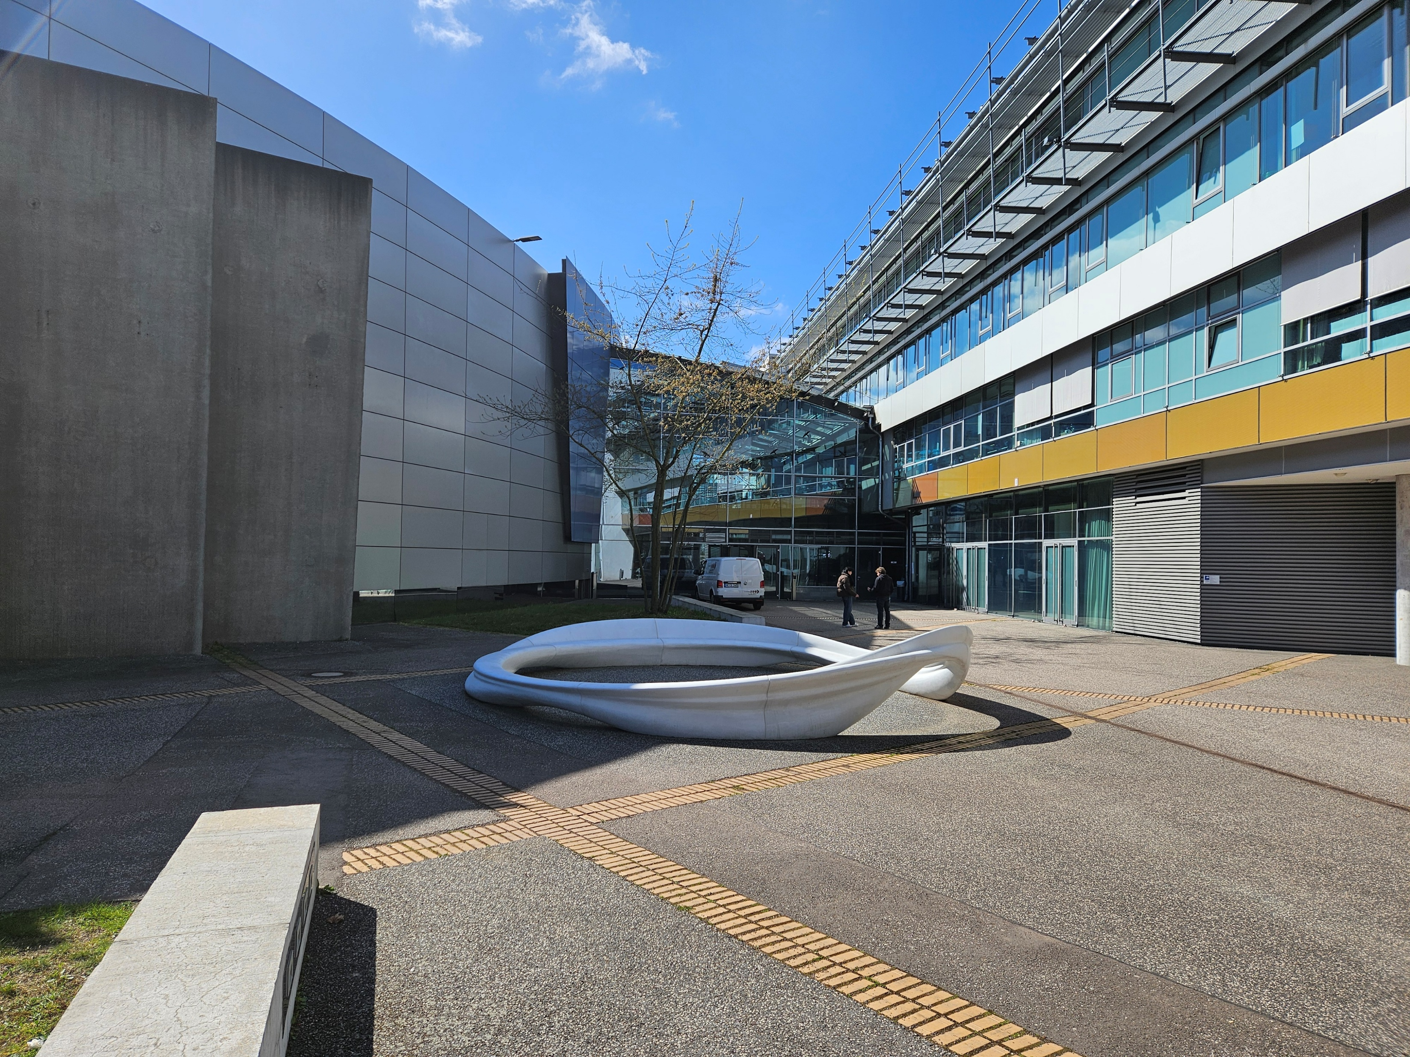
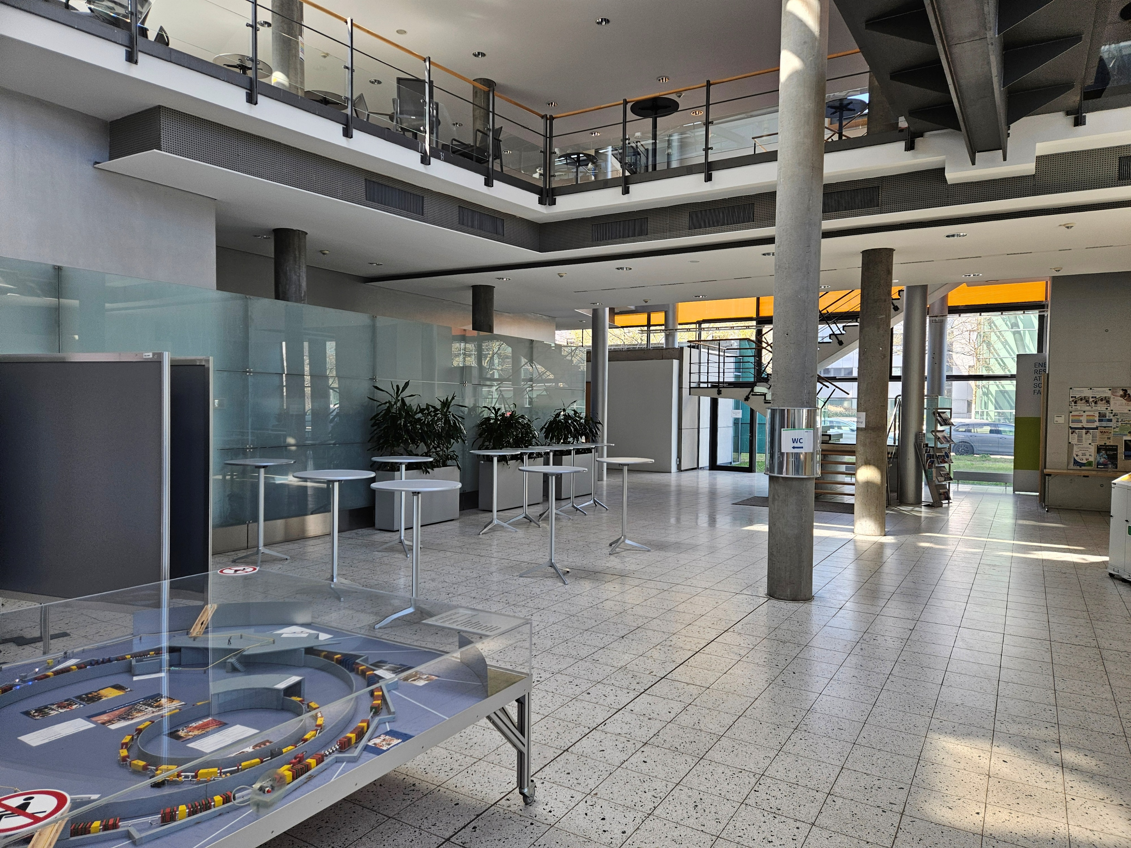

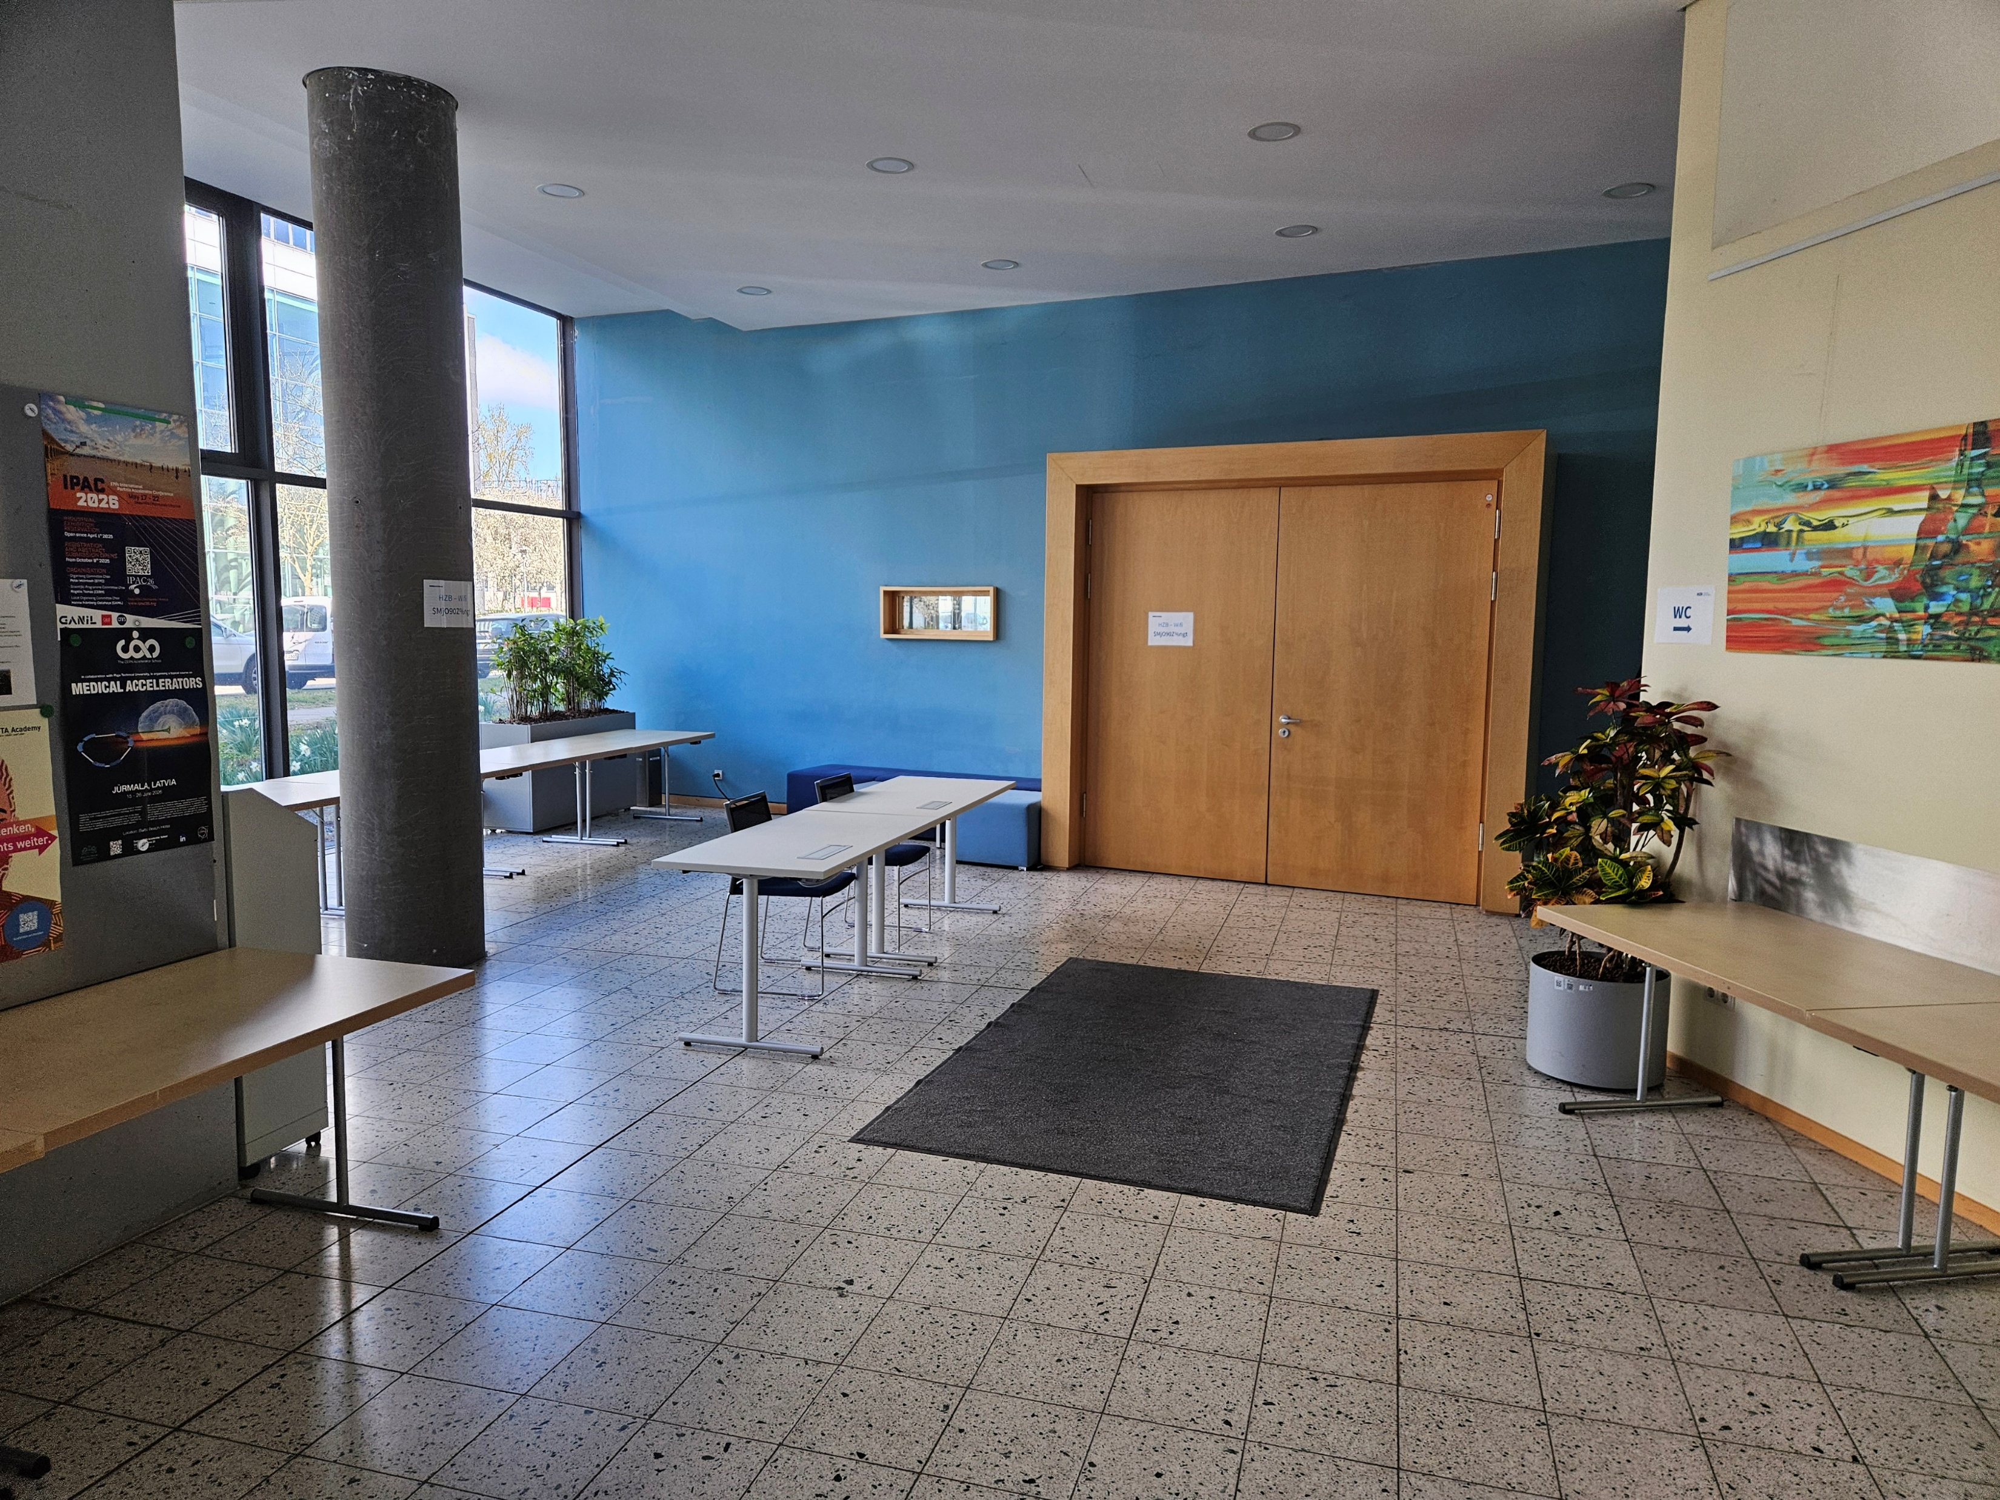

Cafeteria
Main Entrance
Main auditorium
BESSY II
WC
Entrance hall
Main auditorium
Albert-Einstein-Strasse
Magnustrasse
Venue: HZB Campus Adlershof (Wilhelm-Conrad-Röntgen Campus)

Slide 4





Organisation
2nd annual meeting
Wednesday, 22nd
Thursday, 23rd
Friday, 24th
Advisory Board led discussion
Welcome+invited talk
RF2.0&iSAS new project
WP 1-3
Industrial board
WP parallel meetings
Closing by Coordination Panel
Lab. tour
WP 4,5,6
WP 7, 8
Governing board (closed)

Slide 5
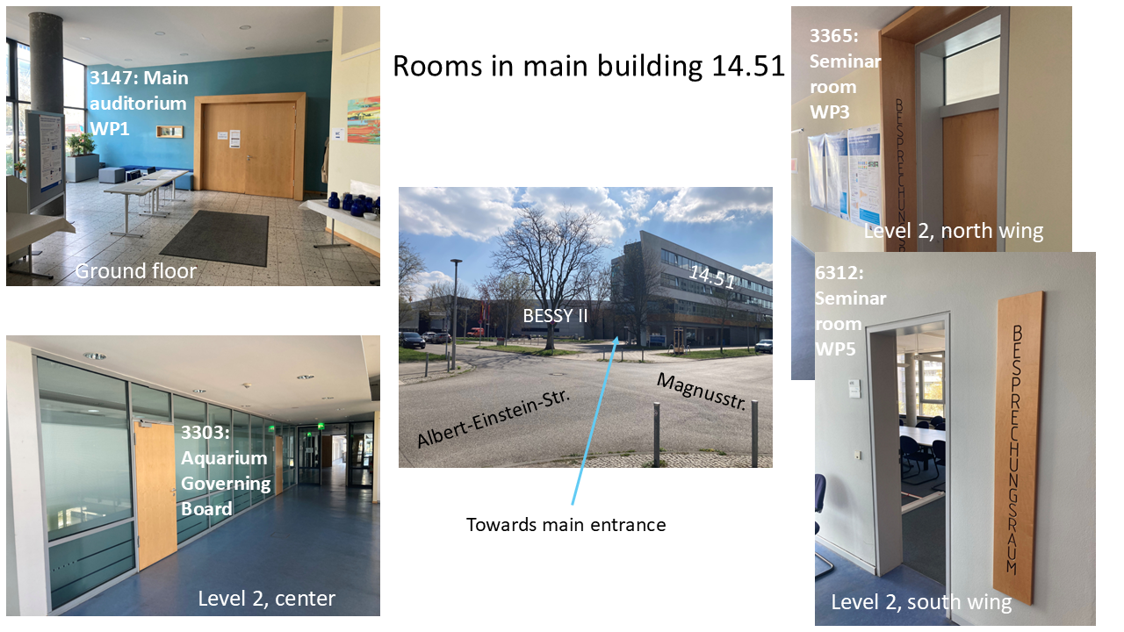
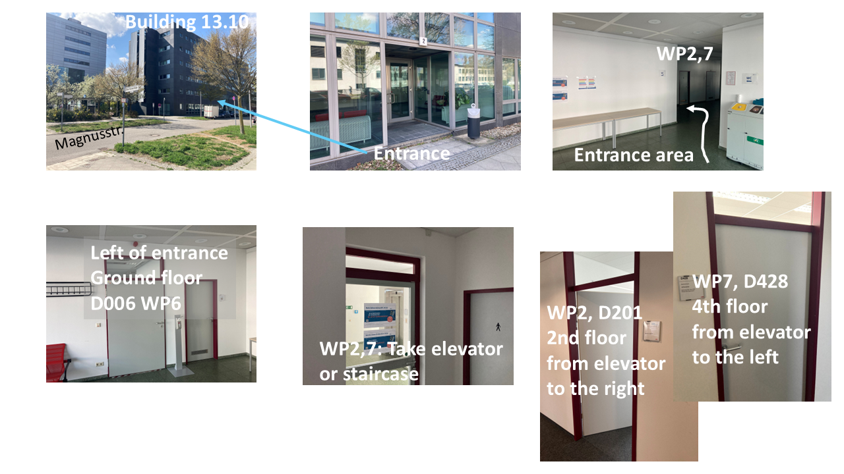
Meeting rooms
2nd Annual Meeting
Governing Board Meeting on Friday:
„Aquarium“, Level 2, just next to the main staircase
From today on, everything else will happen here in the auditorium and entrance area: Dinner, coffee breaks, posters on display, start and end of lab. tour

Slide 6
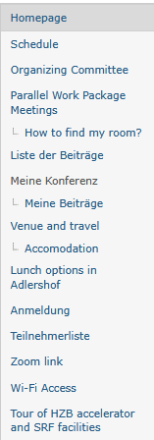
More info: Indico
2nd annual meeting
https://indico.ijclab.in2p3.fr/event/11960/overview
Timetable: Please upload your talks
Lunch: List online and printed version at registration or explore on your own
Zoom: Visible for all registered participants: Please forward, if needed
Wi-Fi: Eduroam does work in Adlershof, eventually not at HZB ☹ Please use „HZB“: Access code see printouts outside auditorium

Slide 7
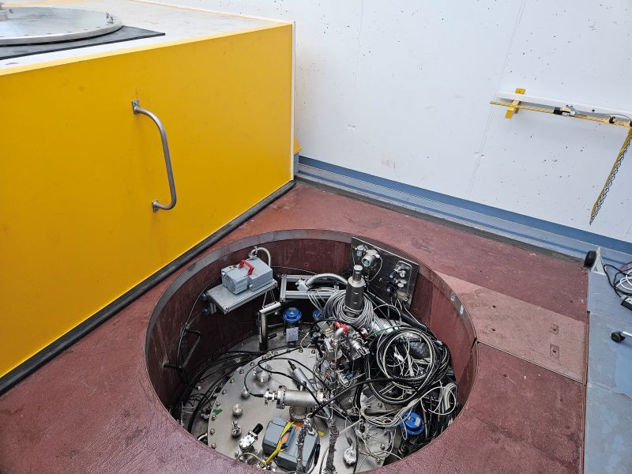
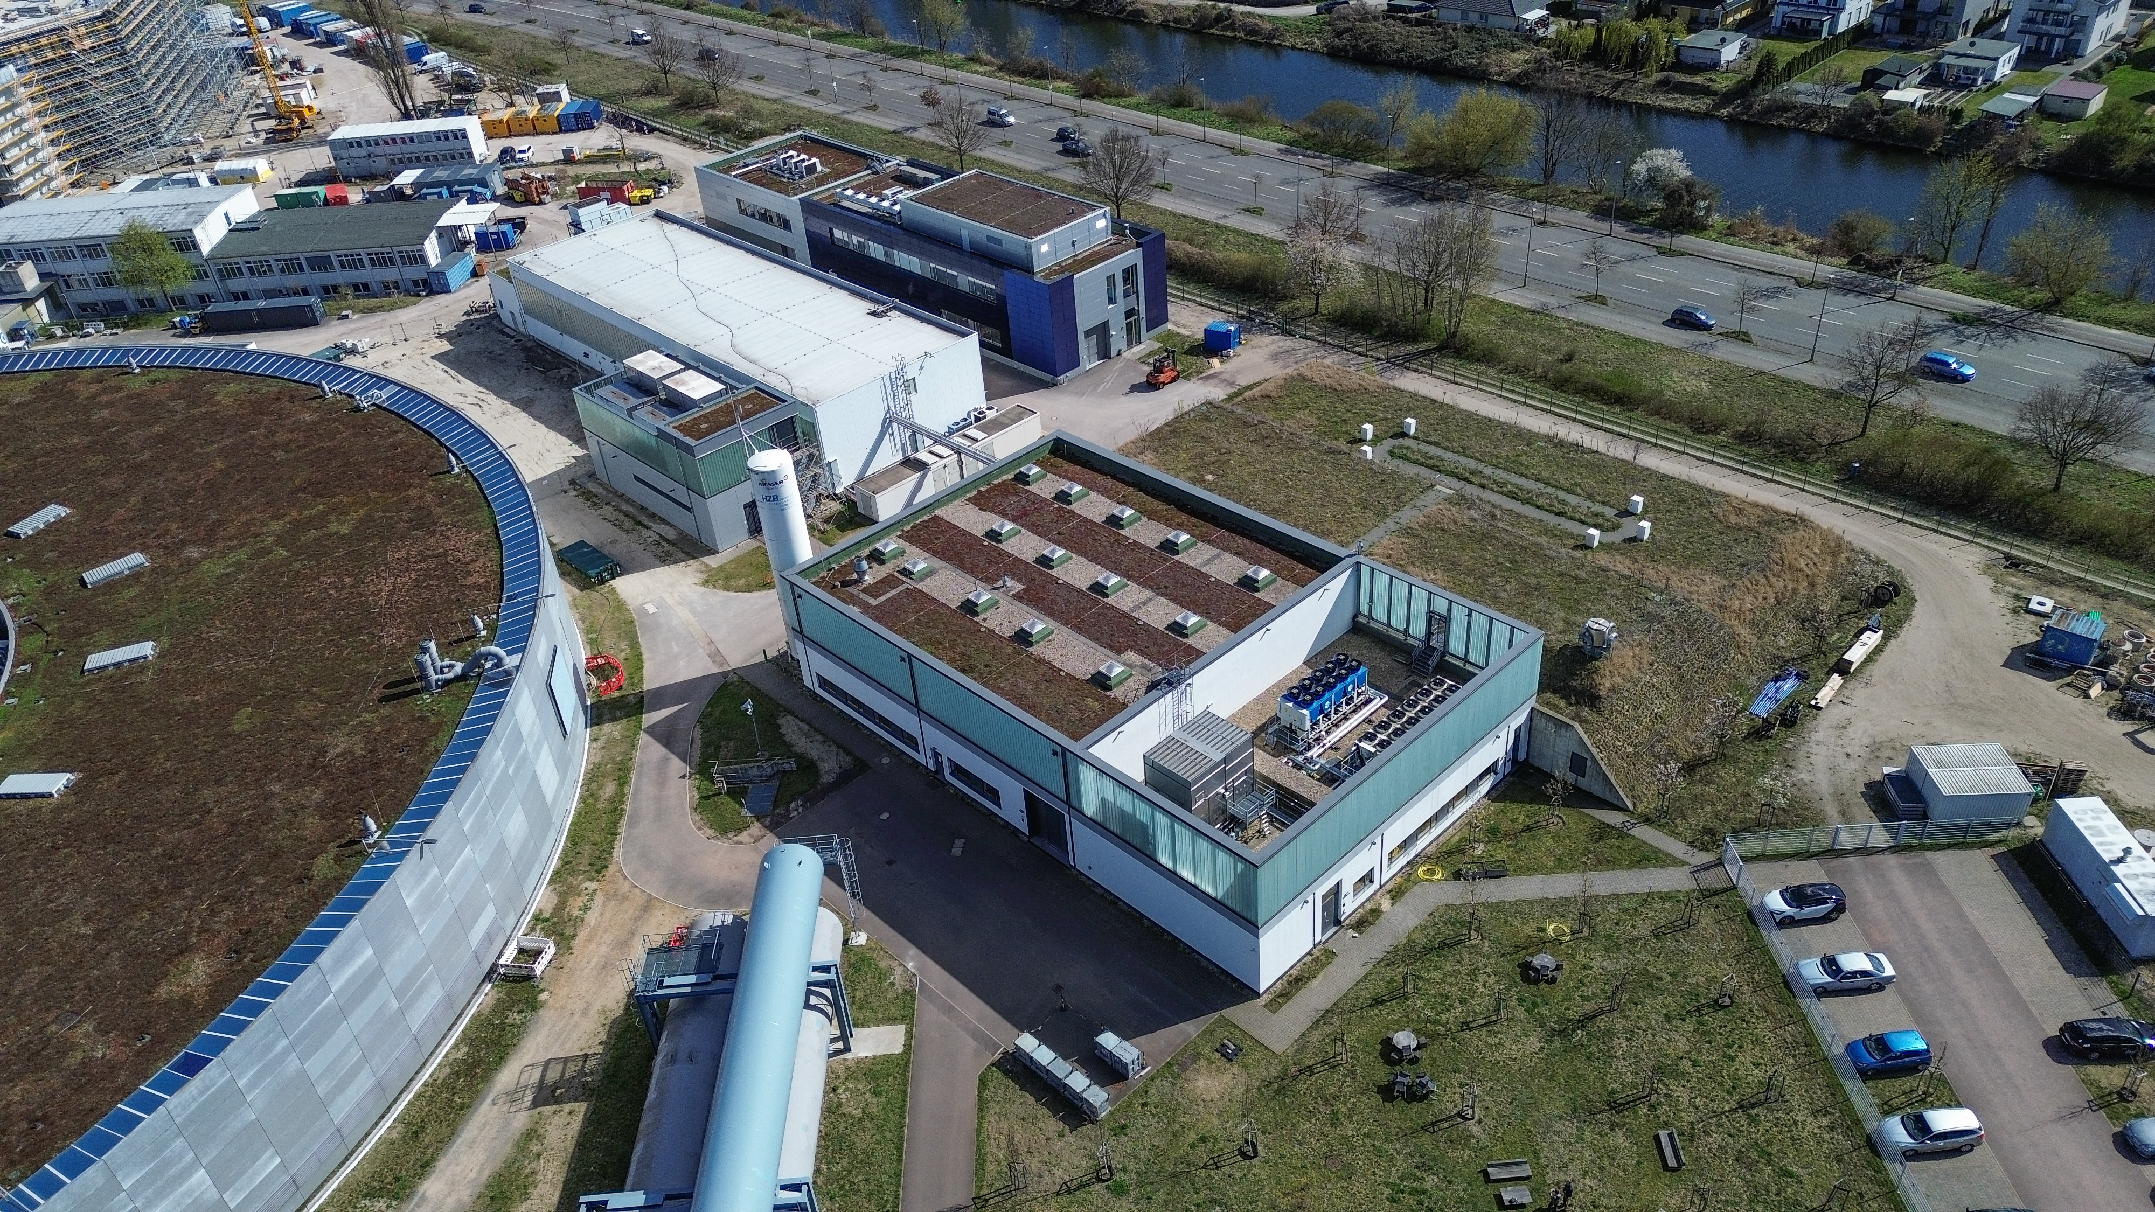
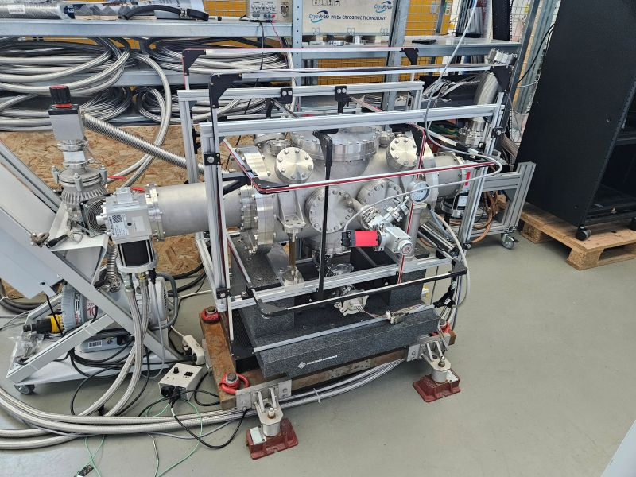
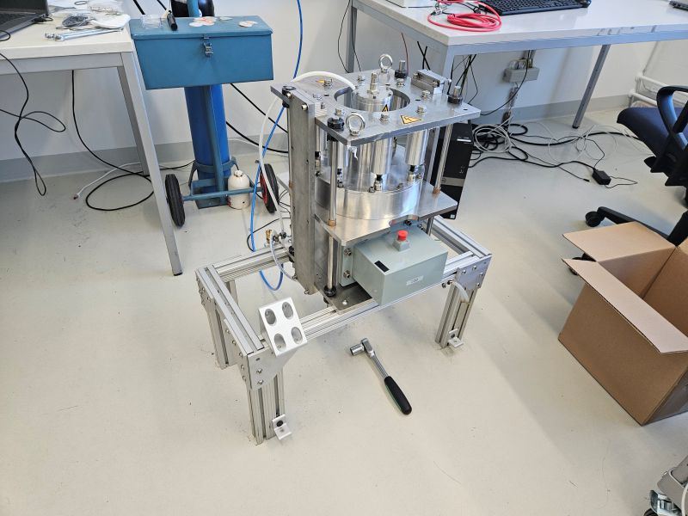
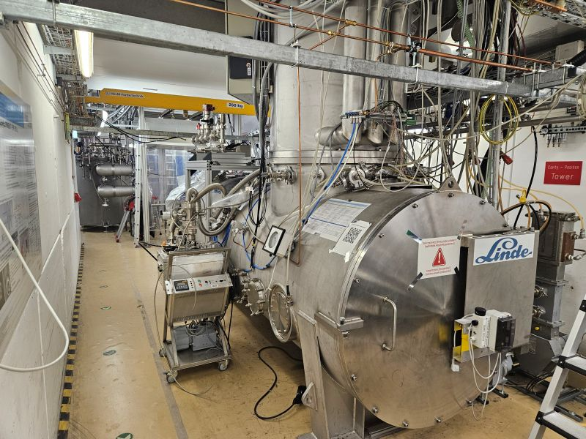
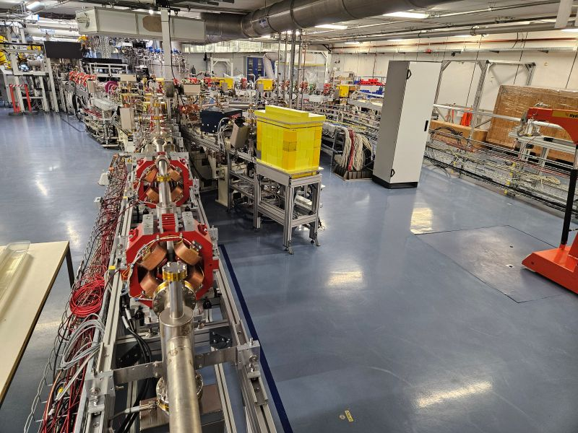
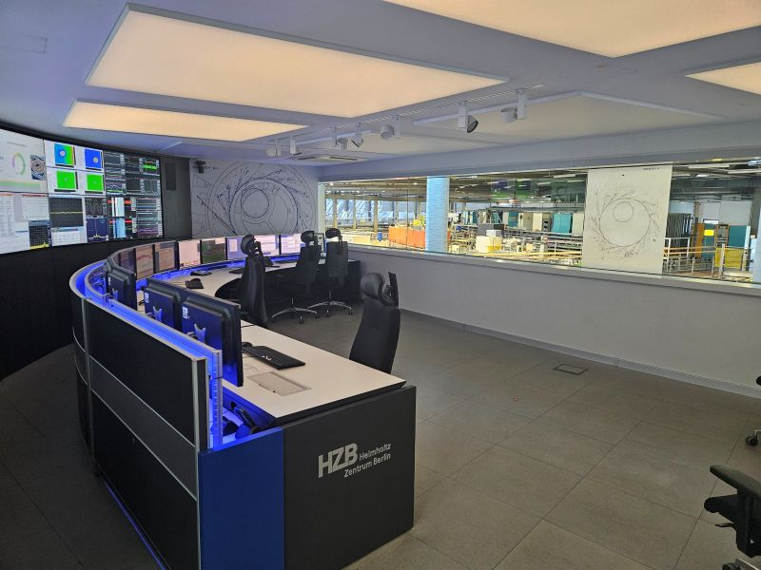
Laboratory Tour
2nd annual meeting
Five stations, 2 hours:
(five groups à six-seven persons
BESSY II (control room)
bERLinPro (SEALAB)
FE-FRT station
LVTS/Craft
HoBiCaT

Slide 8
Questions?
2nd annual meeting
In case of alarm (fire), please leave the building following the exit signs and meet at the assembly point outside the main entrance
In case of emergency, contact front desk or call +49 30 8062 1 5050 or 112 (especially outside HZB)
If you have any questions or request, please address Roswitha Schabardin, Axel Neumann, Oliver Kugeler or local HZB co-workers
Please, enjoy the workshop!

