Slide 1


Introductory talk iSAS Berlin meeting
23rd April, 2026
The iSAS Coordination Panel
Funded by the European Union. Views and opinions expressed are however those of the authors only and do not necessarily reflect those of the European Union or the European Commission. Neither the European Union nor the granting authority can be held responsible for them.

Slide 2
Consortium Agreement (CA), NDA, Amendment (AMD)
iSAS project outcomes at half-time
1st June Review meeting
Perspectives for the next 2 years and more
iSAS and beyond
Presentation(s) available on:
iSAS yearly meeting in Berlin Indico page

Slide 3
Consortium agreement, NDA, Amendment
Shared NDA for industrial partners done
Amendment (AMD) to the Grant Agreement done
Consortium Agreement (CA) done
Amendment (AMD) to the Grant Agreement request to be started ~first half of Y4
A 1 year project extension to expect (see discussion)

Slide 4
iSAS project outcomes at half-time
Kick-off
March 2024 project start date
April Kick-off meeting
2024
iSAS website, industrial section, data repository
Dissemination plan, internal communication plan, DMP
Y1
30th April RP1 report
1st June RP1 review meeting
1st yearly meeting at INFN in Padova
2025
WP9 Verifiable metric for energy-saving performances
2026
WP1 Characterisation of 400 MHz cavity with FE-FRT
Y2
2nd yearly meeting at HZB in Berlin
next
WP2 ML implementation plan
WP3 Modification of choke cavity for flux trapping study
WP4 Design of FPC & HOM coupler
WP5 Configure ESS CM
WP1 FE material characterised
WP3 Report on implementation of cavity Q vs F tuning tool
WP3 Developed ALD adaptive layers on Cu
WP5 Compilation of ESS CM, lesson learned & benchmarks
No significant delays
Delays were anticipated and treated in the AMD of the GA

Slide 5
Review meeting
RP1 report work expected for 30th April
WORK IN PROGRESS
To present the periodic report to the PO & external expert
Review meeting – June 1st 09:00 to 12:30 am
No objections raised to the nomination of the external exert
Bruno Miguel Soares GONÇALVES
European Fusion Development Agreement - Joint European torus (EFDA-JET)
Instituto de Plasmas e Fusão nuclear, Instituto Superior Técnico
Questions & comments expected from PO & external expert
It will examine
the degree to which the work plan has been carried out and whether all deliverables were completed
whether the objectives are still relevant and provide scientific or industrial breakthrough potential
the management procedures and methods of the project
the beneficiaries’ contributions and their integration within the project
the expected potential scientific, technological, economic, competitive and social impact, and plans for using and disseminating results
compliance with other grant agreement obligations

Slide 6
Perspectives for the next 2 years and more
Modifications to the work plan already validated via the previous AMD
Additions to WP4 to introduce BLA (Beam Line Absorber) (instead of a 1.3GHz HOM)
4 new milestones and the last (WP4.10 ) is in Sept 2027 (M43)
Delays due to cascading effects from WP4 to WP6 from components design
Shift the validation of all SRF components for adapted CM (WP6.4 ) to Sept 2027 (M43 )
A 1 year project extension needed (until M60 Feb 2029)
Delays because of procurement difficulties in WP6 (now solved !)
WP6.5 : “Assembly of adapted CM” May 2027 → May 2028 (M39→M51)
WP6.5 : “Report on test of adapted CM” Dec 2027 → Nov 2028 (M46 →M57)
It will also imply some probable cascading effect
WP5.3 : “Parametric design for a sustainable CM with iSAS technologies” → Dec 2028 (M58)
WP9.5 : “Report on energy saving performance of iSAS technologies” → Dec 2028 (M58)

Slide 7
iSAS and the European Strategies - ESPP2020
The iSAS project was conceived also in response to the recommendations of the ESPP2020 to address the energy efficiency of present and future accelerators.
The energy efficiency of present and future
accelerators […] is and should remain an area
requiring constant attention.
A detailed plan for the […] saving and re-use of
energy should be part of the approval process
for any major project.

Slide 8
iSAS and the European Strategies - ESPP2026
Strengthening the sustainability and energy efficiency of accelerators
has become a central theme in the recommendations of ESPP2026.
Technologies -Accelerator science and technology
Several technology approaches directly address the requirement of greater sustainability for future accelerator-based facilities. These include superconducting magnets and resonators operated at higher cryogenic temperature, superconducting current links, use of permanent magnets, and more efficient RF power sources, complemented by a more extensive use of robotics and artificial intelligence.
…R&D efforts to enhance the sustainability and energy efficiency of accelerators from design to operation and decommissioning should be supported.
Sustainability and environmental impact
For new proposed projects, a detailed life cycle assessment should be carried out at each stage, from concept to design and implementation, in order to quantify and minimise environmental impact.
The particle physics community should continue and intensify its efforts to develop and adopt sustainable solutions.

Slide 9
Very concise : Some already visible impact from iSAS
The design of a cryomodule integrating the innovations developed within iSAS (WP4,WP5,WP6) has made substantial advances and is on track to be adopted for the future 800 MHz cavity cryomodule for the FCC-ee booster, and subsequently for the higher-energy stage up to the top production threshold
Existing accelerators can already benefit from reduced energy consumption, if retrofitted with FE-FRT as well as with the digital RF control system with AI-optimization which have been developed in WP1 and WP2.
Thin-film-on-copper technologies for accelerating cavities were developed in WP3 collaboration with I-FAST. These technologies can be deployed in new accelerators/retrofitted into existing facilities, contributing to a reduced environmental impact
An Industry Board (IB), composed of WP leaders, company representatives (one for each WP) and Technology Transfer offices at research infrastructures, has been established to advise on maximizing the TRL of each R&D activity to foster direct industry involvement in future EU projects and support the industrialization of iSAS technologies.

Slide 10
The project has benefited from excellent synergies and is already opening new perspectives
The work done in WP3 is in excellent synergy/complementing with the European project iFAST. A natural continuation has recently emerged in the newly approved European project EPITA.
FE-FRT developments in WP1 got a great momentum with an extension of initial partners and inclusion in the EPITA project.
We established contacts with project RF 2.0 and will propose a new European project (RF 2.0+iSAS). The results already achieved across these projects demonstrate significant synergies and pave the way for a future integration project aimed at systematically optimizing energy usage, from the electrical grid all the way to the particle beam. (Presentation this evening)

Slide 11
Back up

Slide 12
Perspectives for the next 2 years and more
Modifications to the work plan already validated via the previous AMD
Additions to WP4 to introduce BLA
WP4.8 to WP4.10 Design to fabrication to test of ceramics
M27 May 2026 WP4.8 Design report of BLA
M30 August 2026 WP4.9 Engineering report of the fabrication of BLA
M37 March 2027 WP4.10 Test report of ceramics for BLA
M43 Sept 2027 WP4.10 Report qualification of ceramics for BLA test
Delays due to cascading effects from WP4 to WP6 from components design
Delays that could be included in 1st AMD because didn’t require a project extension
M30 August 2026 WP6.2 Concept. design of a combined FE-FRT-HOM coupler
M43 Sept 2027 WP6.4 Validation of all SRF components for adapted CM
More details

Slide 13
Perspectives for the next 2 years and more
A 1 year project extension to expect (until M60 Feb 2029)
Delays because of procurement difficulties in WP6
WP6.5 Assembly & test of adapted cryomodule
Assembly of adapted CM from M39 May 2027 to M51 May 2028
Report on test of adapted CM from M46 Dec 2027 to M57 Nov 2028
A new AMD will be needed to validate the project extension
To start towards the middle of RP2 (from ~M37-M43 to have a more precise & realistic viewpoint of the modifications to be made to the work plan)
To be finalised before the end of RP2 M48 Feb 2028 (still within GA’s time limits)
Probable cascading effect If project extension validated (to be included in new AMD)
Delays due to the closure purpose of the deliverables considered
M58 Dec 2028 WP5.3 Parametric design for a sustainable CM with iSAS techn.
M58 Dec 2028 WP9.5 Report on energy saving performance of iSAS techn.
M60 Feb 2028 WP9.2 Final reports of the achievement in the WPs
Addition that logically follows in a project management perspective
M59 Jan 2029 WP9.1 Organisation of 5th & final project meeting and report
More details

Slide 14
End of RP1
Milestones & deliverables
11 accounted for
2 pending, expected for 2nd week of March
No WP closure foreseen (iSAS not structured that way, all WPs end at the end of the project)
Next steps
RP2 opened since March 1st for next 2 project years (until Feb 2028)
Periodic report due April 30 & Review meeting June 1st to present it

Slide 15
Periodic report
End of RP1 report
Technical report (Part B) template shared by PO (not all sections relevant to this project)
Most notably:
1.2 Explanation of the work carried out per WP
1.3 Impact - progress of the project so far towards delivering scientific impact
Due 60 days after end of RP1 (end of April)
1st draft to be ready early enough to be reviewed carefully – at least by April 16

Slide 16
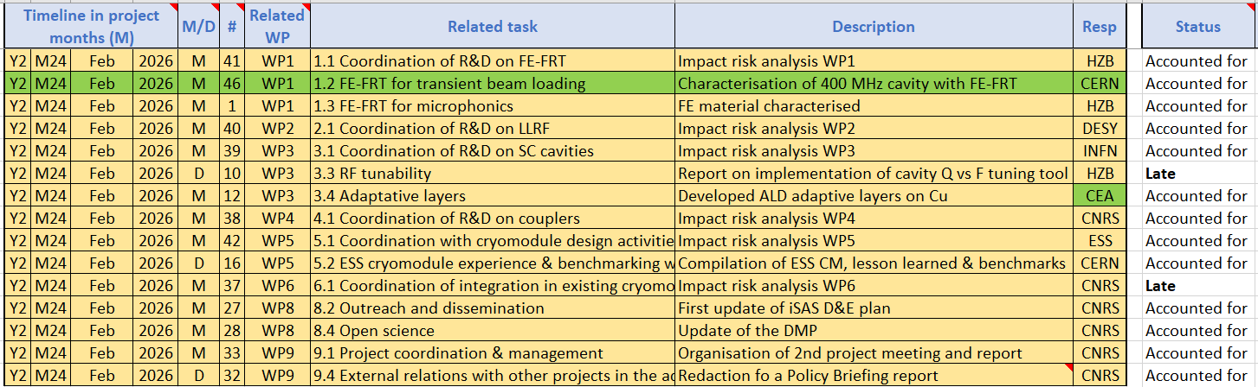
Work plan
Milestones & Deliverables status by timeline for the end of the 2nd project year

Slide 17
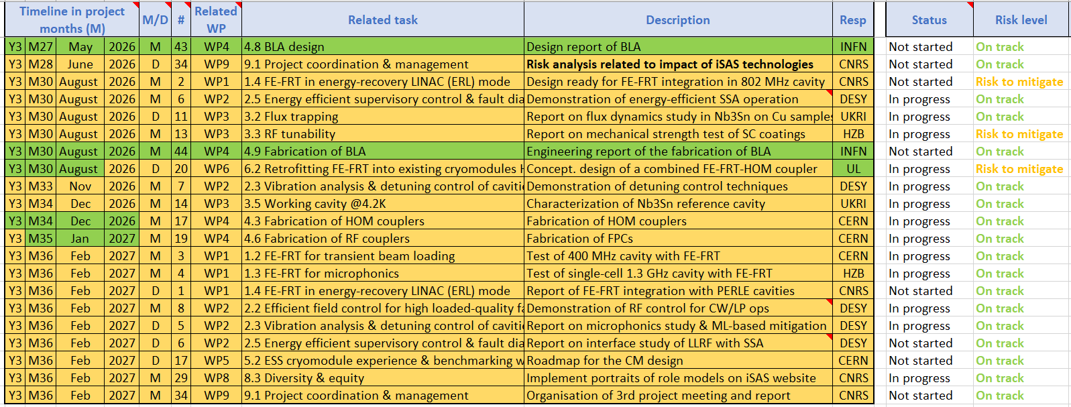
Work plan
Milestones & Deliverables status by timeline for the 3rd project year
2 milestones due August with risk to mitigate to look into

Slide 18
NEW PROJECT : RF 2.0 + iSAS
(see presentation this evening)

Slide 19
RF2.0 & iSAS project proposal update
Steps taken
Involvement of EU project managers to support the project development
RF2.0 + iSAS 1st concept paper prepared (iterative process)
Presentation of RF2.0 project last Steering committee by project coordinator
Ideas structured into WPs at Barcelona meeting Feb 26th-27th at RF2.0 annual meeting (ALBA)
Coordinator chosen: Giovanni De Carne, RF2.0 project coordinator from KIT
Draft cost evaluation from CERN on technologies
TIARA meeting March 18th for presentation & comments
Next steps
Core writing team set up
Proposal to submit to INFRATECH call by June 16

Slide 20


Inputs from RF2.0 & iSAS
Device level
Re-usable magnets
Magnetrons
Device-to-System
IoT
Cryomodule
SSA (Technology & System integration)
System level
UPFC @ CERN
Geothermal
Sustainable computing
Training, Transfer to industry
Strong Link/Hardware
System-to-Sustainability
Energy monitoring
LCA software
Strong Link/Hardware
Weak Link/Data
Demonstration stage: integrated system-level approach of the technologies
PERLE++
Single-site demonstrators

Slide 21
WP1 – Requirement analysis for future accelerators
WP12 – Training & Transfer
Device Level supported by previous research
RF tech
RF design
Magnet design
Pow. Elec. Analysis
AI-computing
WP 6
NEW
WP2 – Magnetrons
WP3 – Re-Usable Magnets
WP6b – System Level SSA (DC)
WP7 – UPFC @ CERN
WP8 - Geothermal
WP9 – Sustainable Computing
NEW
NEW
WP4 - IoT
WP5 - Cryomodule
WP6a – Converter Level SSA (800, 1.3)
Grid data
Materials
Power flexibility
Energy reduction
Energy reduction
WP10 – LCA Software
WP11 – Energy Monitoring
Energy potential
NEW
LCA assessment
LCA strategy
WP13a – PERLE++
WP13b – Single-site Demonstrators (DESY, HZB, CERN, Soleil, MAX IV, KARA)

Slide 22
