Slide 1
Accelerator R&D activities at CERN related to sustainable Accelerator Systems
Oliver Brüning
Director Accelerators and Technology Sector
iSAS Second Annual Meeting @ HZB, April 23, 2026

Slide 2
Content
Introduction
Energy Efficiency Efforts @ CERN
HL-LHC related activities
ESPP update and next steps for CERN
Superconducting Magnet R&D plans and Opportunities
SRF R&D plans and opportunities
April 23rd 2026
Notes:
Introducing myself

Slide 3
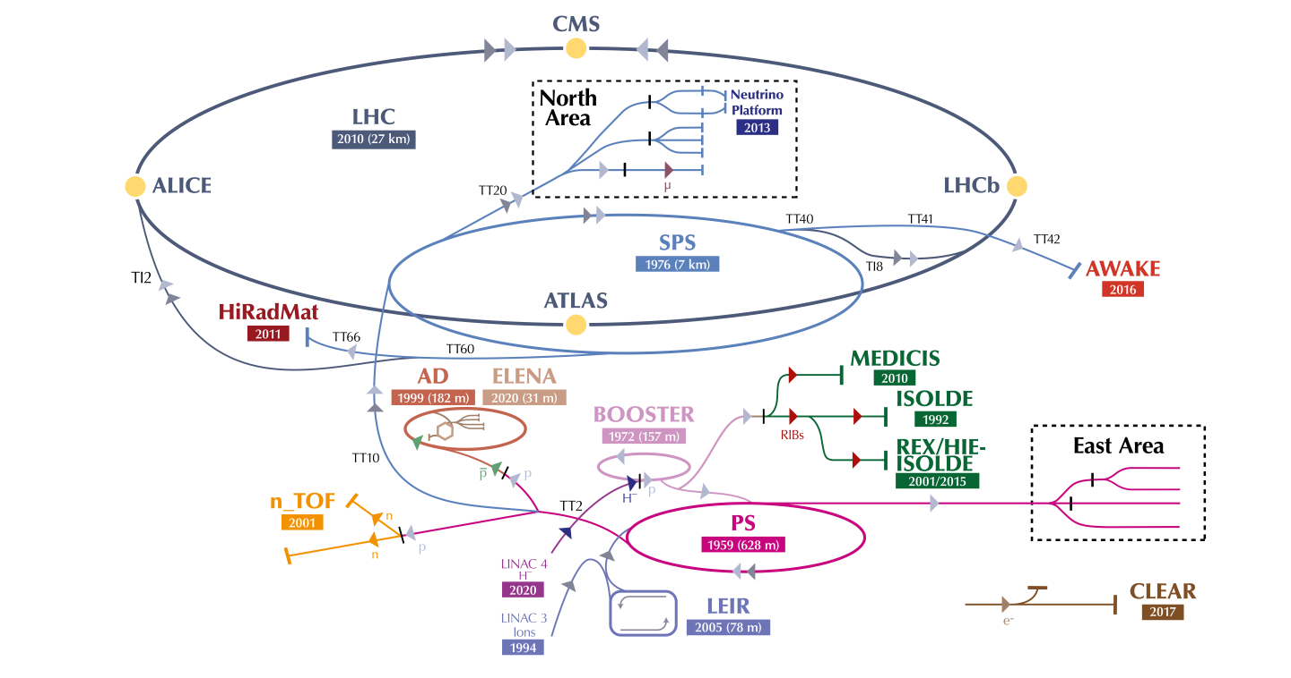
CERN Accelerator Complex
LHC : 2x(0.45 – 7) TeV
SPS : 26 – 450 GeV
[RF Power]
PS : 2 - 26 GeV
[RF and powering]
PSB : 0.16 -2 GeV
Linac 4: 0-160 MeV H⁻
Ca. 200MW peak power consumption during operation ➔ ca. 120MW LHC / 22MW detectors
➔ 750GWh per year for LHC
➔ ca. 18MW increase for HL-LHC
ca. 1.3TWh for total
CERN complex
April 23rd 2026
Notes:
https://home.cern/resources/faqs/facts-and-figures-about-lhc

Slide 4

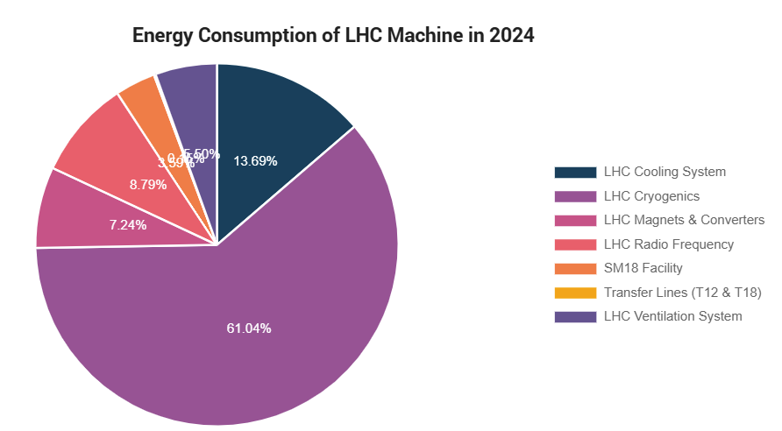
Making the case for Energy Efficiency
CERN Energy Efficiency Movement Day
14. April 2026 Nauman Latif
CERN’s Environmental commitment
CERN operates at the electricity scale of a mid-sized EU city
CERN Environment Report :2023–2024
Total Annual Energy Consumption of CERN ~1290 GWh (2024)
CERN
1,290
GWh
Lausanne
Switzerland
100k - 150k People
~1,000 GWh
5%
Maximum rise in electricity consumption
by the end of Run 3 vs 2018 baseline
while delivering significantly increased performance of its facilities
Energy Consumption of LHC machine ~473 GWh (2024 run period)
~90 GWh (~19%) for Cooling & Ventilation systems
Ventilation systems (26 GWh)
Cooling systems (65 GWh)
Cooling & Ventilation infrastructure at CERN >2,000 motors (Pumps and HVAC applications)
April 23rd 2026

Slide 5

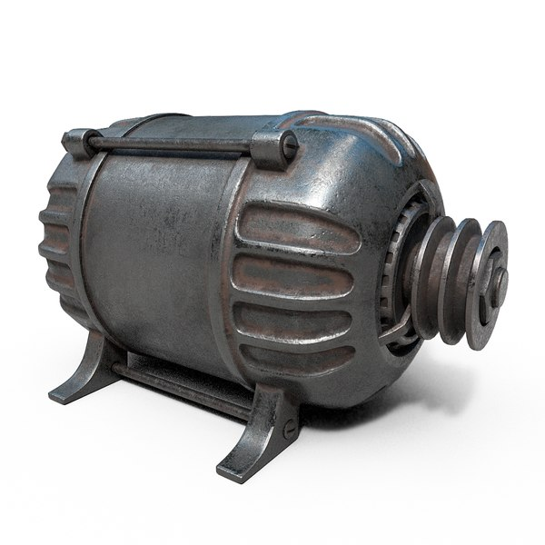
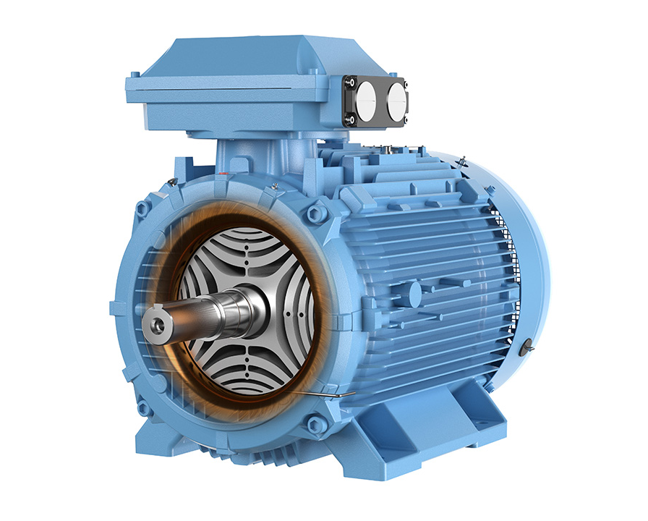
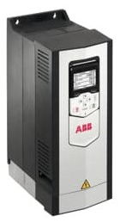
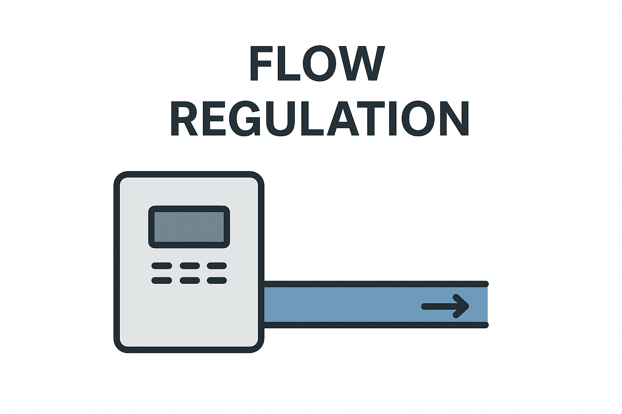
CERN Energy Efficiency Movement Day
motorSENSE Collaboration – Key Conclusions
POTENTIAL SAVINGS
POTENTIAL SAVINGS
17.4% across a fleet of 800 motors based on method A appraisal
*Based on method A appraisal
>50%
on networks suitable for variable-flow operation validated through detailed studies
+
+
=
O. Brüning iSAS 2nd annual meeting @ HZB
April 23rd 2026

Slide 6
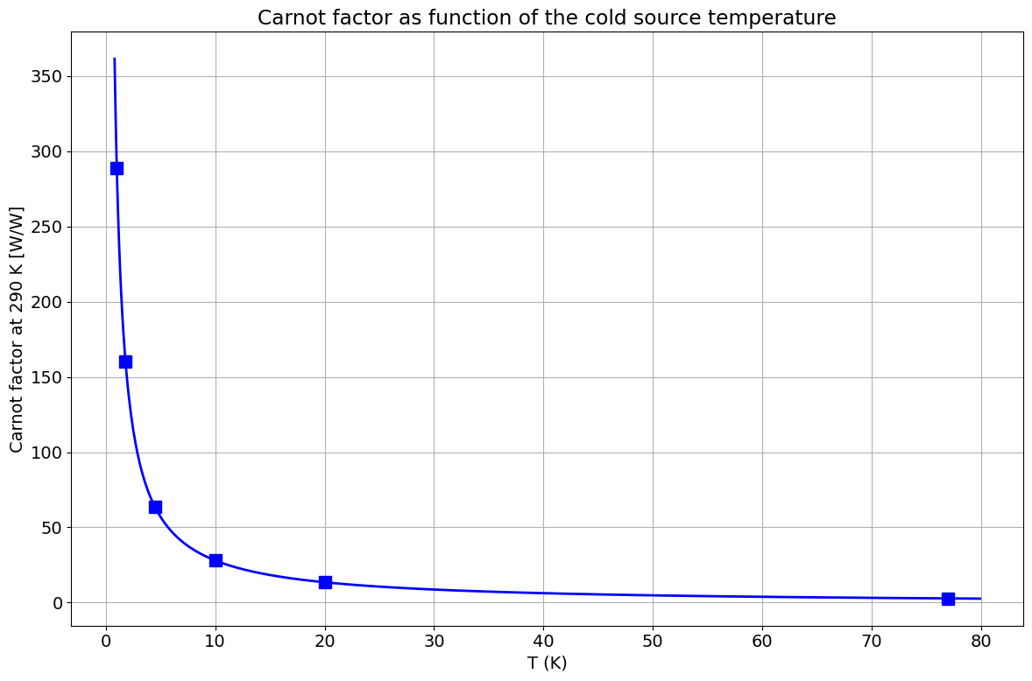
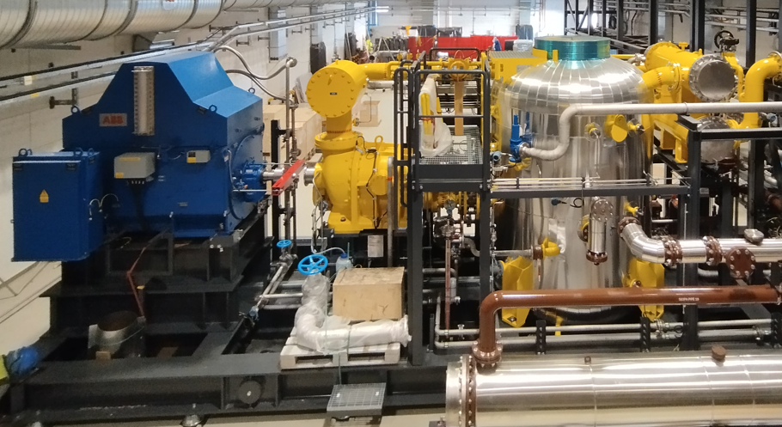
Energy optimization in cryogenic systems
What CERN is already doing:
Design phase:
Minimise the static heat loads on cryogenic equipment
Intercept all cryogenic heat loads at the maximum temperature
Tendering phase:
Impose a bonus/malus based on energy efficiency (ISO 50 001)
Operation phase:
Optimise cryogenic cooling power with accelerator heat loads to be removed through compressor regulation with appropriate hardware.
Organize the accelerator schedule along to concentrate the "high load periods" and the "low load periods" such that the cryogenic systems can be reconfigured efficiently for these different regimes.
Establish a yearly electrical consumption forecast with a regular monitoring/review of electrical consumptions (ISO 50 001)
R&D studies starting for the FCC-ee:
The development of centrifugal helium compressors
Initial study with industrial partners to evaluate potential energy savings
Objective: pass from a Carnot efficiency of ~30% ➔ 40%.
Carnot factor: the minimum electrical power needed in a perfect thermal machine to remove 1 W at a cold temperature
Today, we reach 28% of Carnot factor @ 4.5 K
➔ 225 We/W in helium cryogenic systems
Superfluid helium
at 1.8 K : 160 W/W
Liquid helium
at 4.5 K : 63 W/W
Liquid Nitrogen
at 77 K : 3 W/W
April 23rd 2026

Slide 7
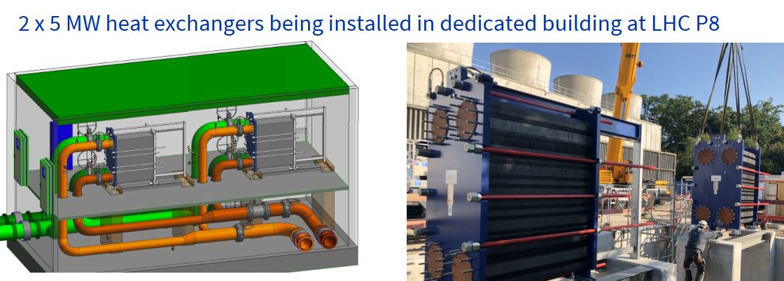
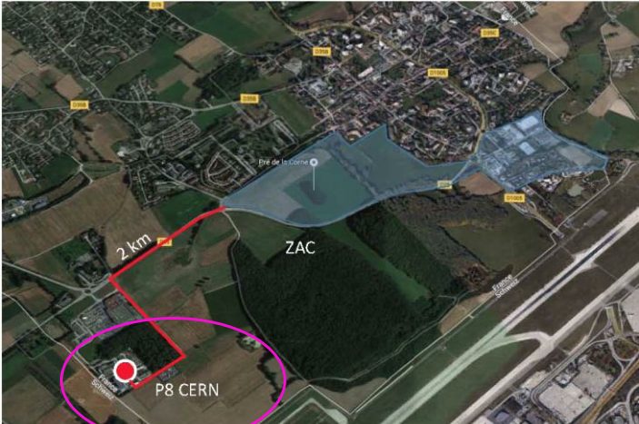
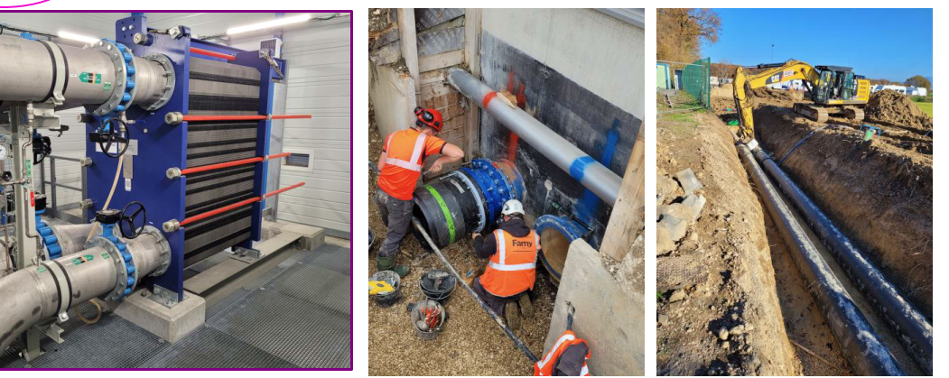
Heat recovery project at LHC-P8 – a societal impact
LHC Cryogenics is producing several MW of heat, removed by water-cooling systems around the LHC ring
The project will recover this heat by transferring it to the district heating system of the nearby city of Ferney-Voltaire
Water-cooling towers connected to 2 x 5 MW heat exchangers
Heat recovery system in service since last year
~15 GWh should be recovered each year
2xDN500 pipes over more than 1.6km
between P8 to Ferney district
Heat exchangers
Trenches with the water piping interconnection
O. Brüning iSAS 2nd annual meeting @ HZB
April 23rd 2026

Slide 8
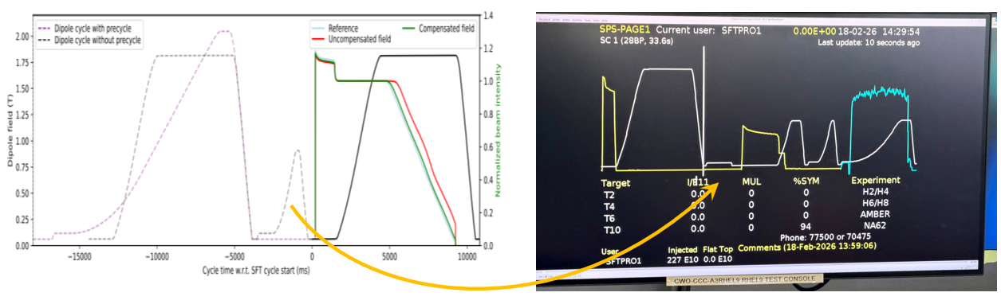
Powering resistive magnets only when needed: work part of the Efficiency Particle Accelerator project
Exploiting the combination of measurements and modelling of magnets in a digital twin framework
SPS implementation:
Savings:
Ca. 1000 households / a
4.6GWh / a ➔ ca 300kCHF /a
April 23rd 2026

Slide 9
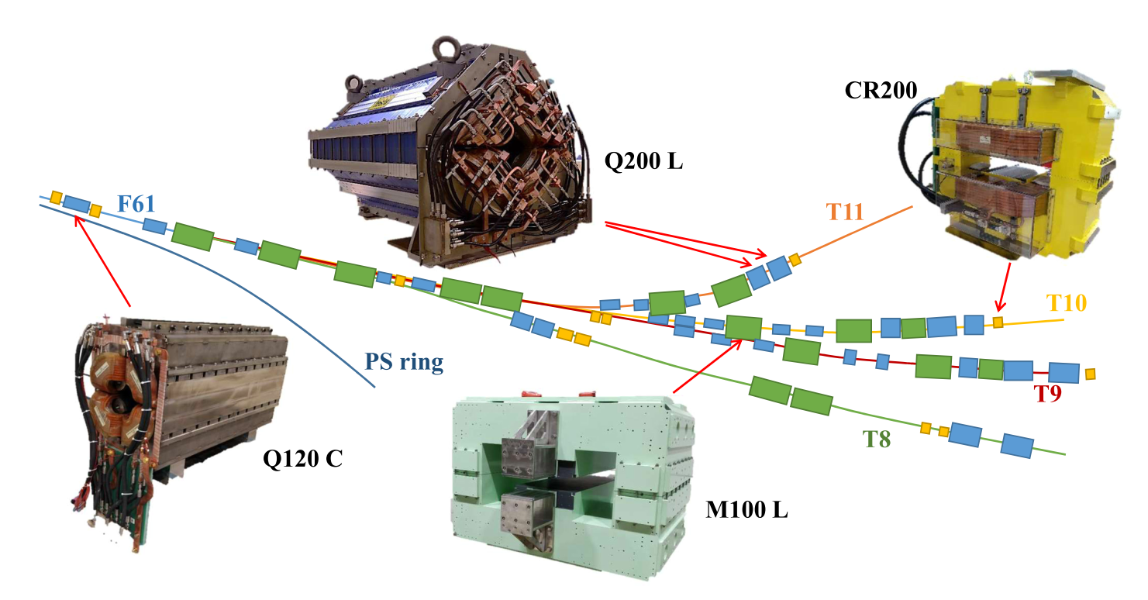
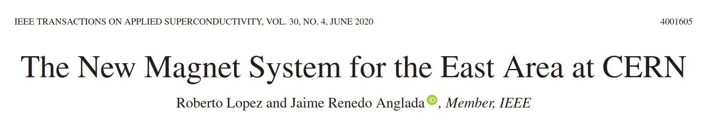
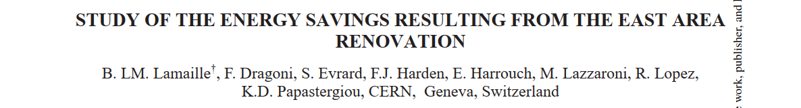
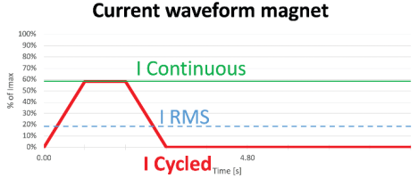
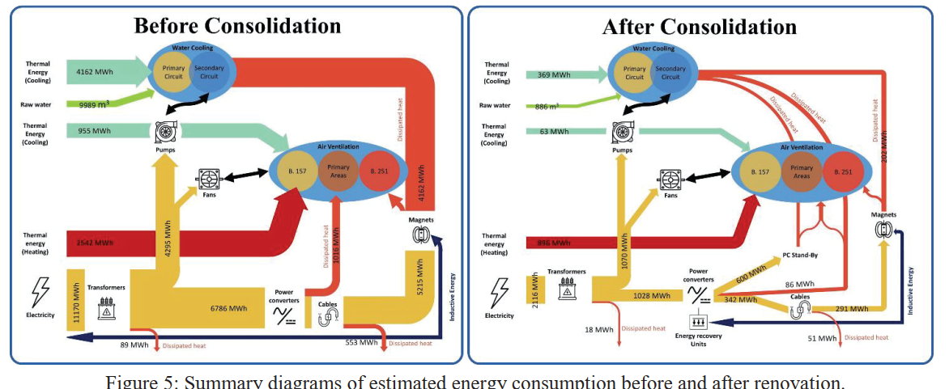
Powering resistive magnets only when needed: the case of the East Area renovation
Consolidation of power converters and replacement of magnets with solid yokes with laminated ones, to allow pulsing
Energy consumption decrease of 81% after renovation
April 23rd 2026

Slide 10
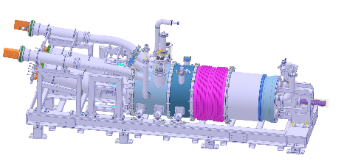
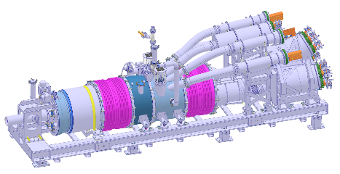
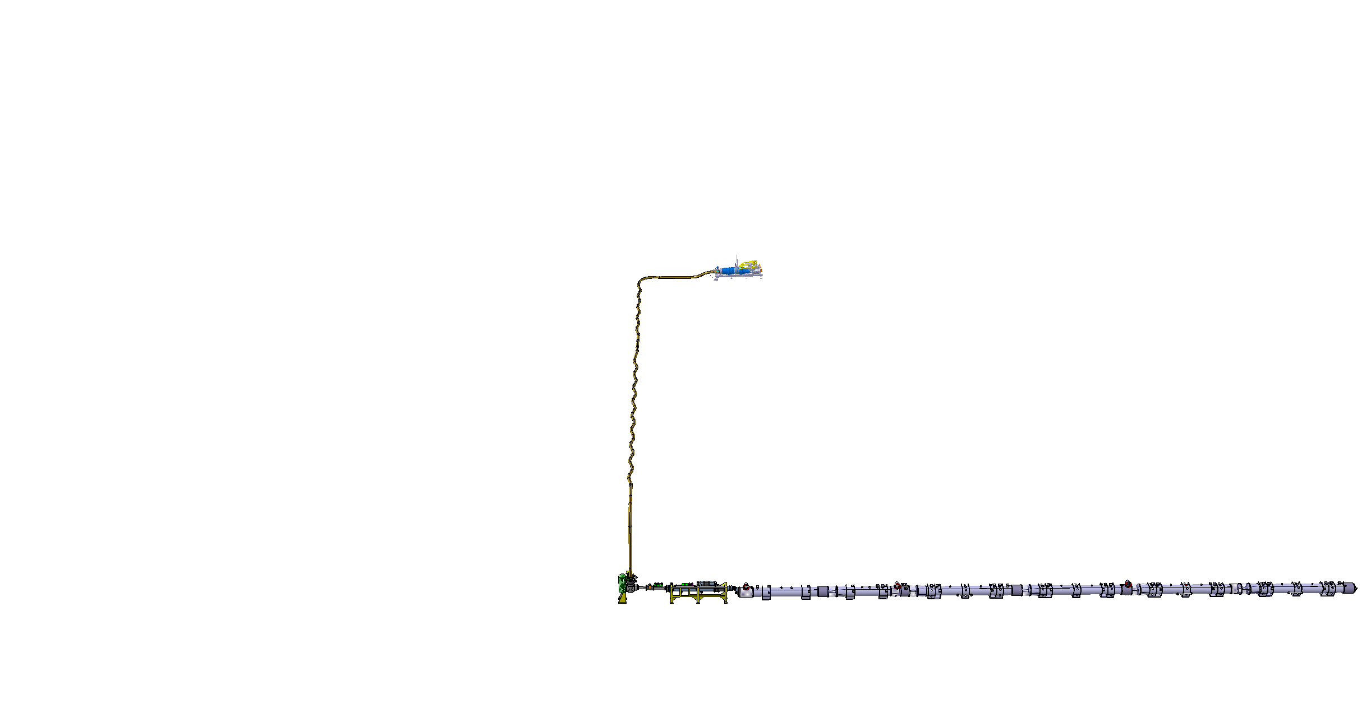
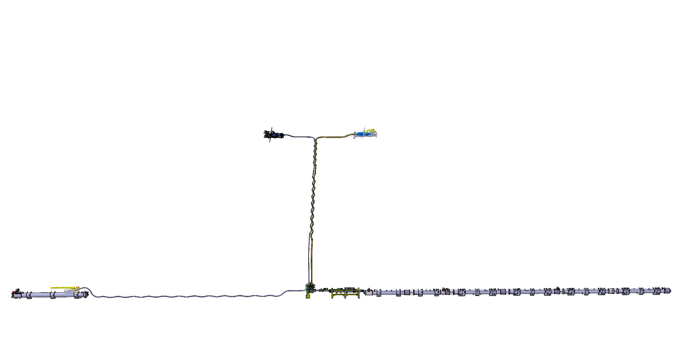
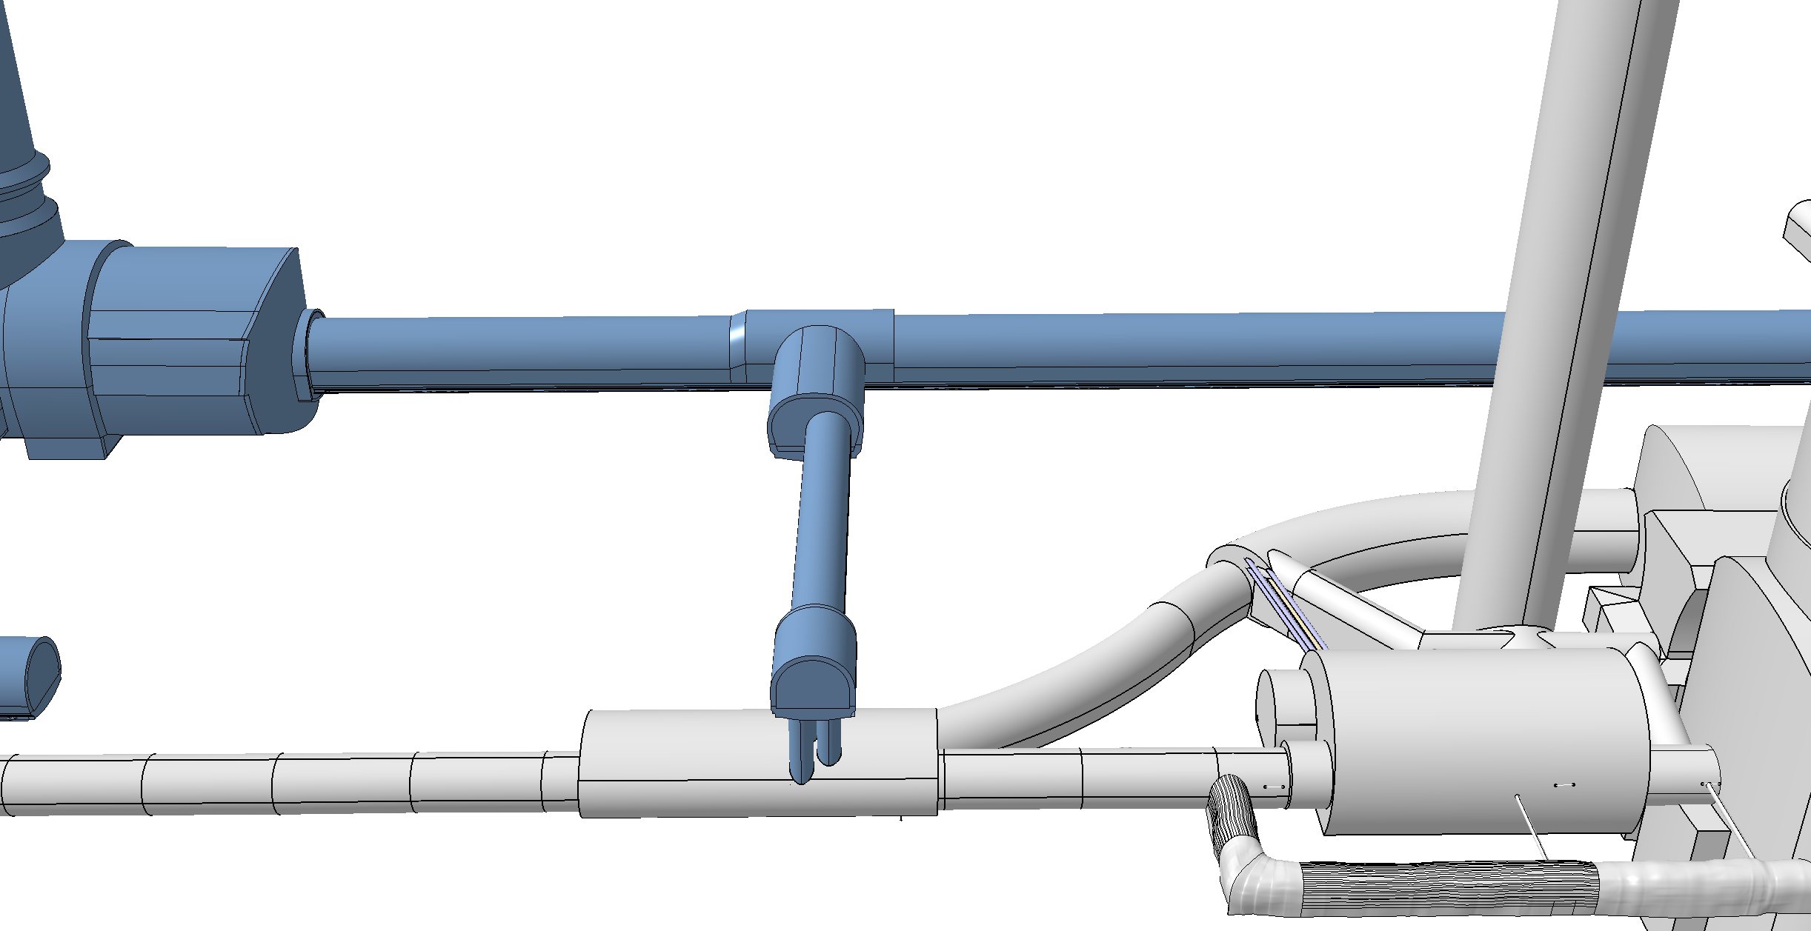
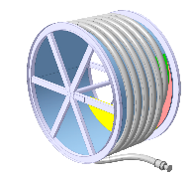
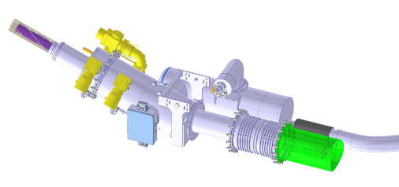
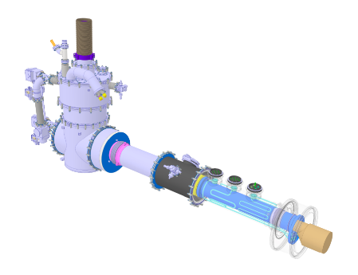
HL-LHC Cold Powering System
Superconducting link to minimize thermal losses when transporting over 100kA over 100m!
High Temperature Superconductor, MgB₂ operating at ca. 20K to 30K
Cooling with gaseous He from liquid He boil off
DFHM
DFHX
Power converters: (18, 0.6) kA
Power converters: (18, 7, 2) kA
DSHM
DSHX
140 m
89.5 m
Power converters: (60, 120, 200) A
D2
DCM
D1
CP
Q3
Q2B
Q2A
Q1
DFM
DFX
April 23rd 2026

Slide 11
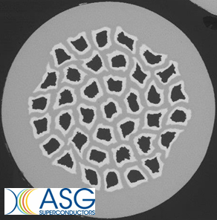
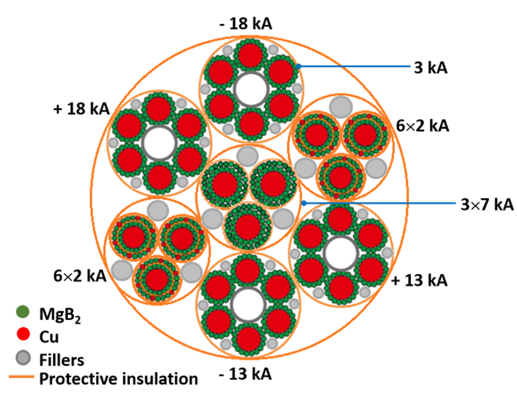

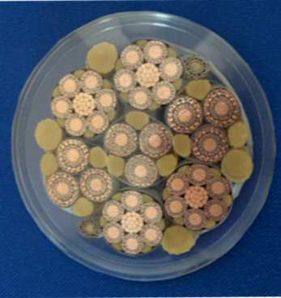

MgB₂ and REBCO for HL-LHC
MgB₂ from 4.5 K to 20 K, REBCO from 20 K to 60 K, up to ~ 130 m
Cooling with helium gas
Φ ∼ 90 mm
Φ ∼ 10 mm
A sustainable effort
∼ |120| kA DC @ 25 K
∼ 3 kA DC @ 60 K
April 23rd 2026

Slide 12
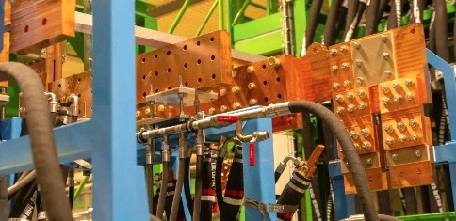
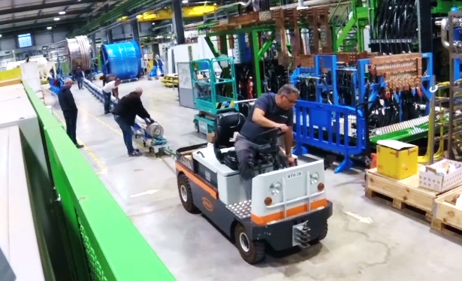
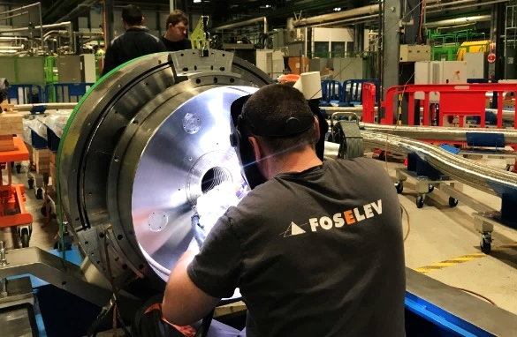
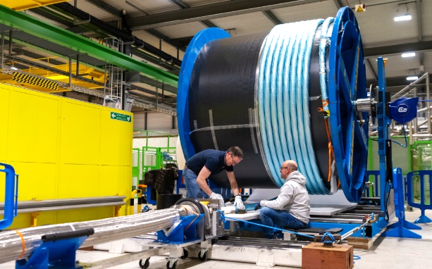
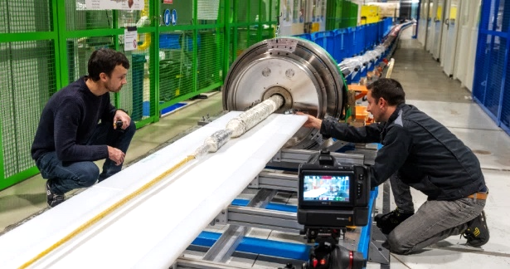
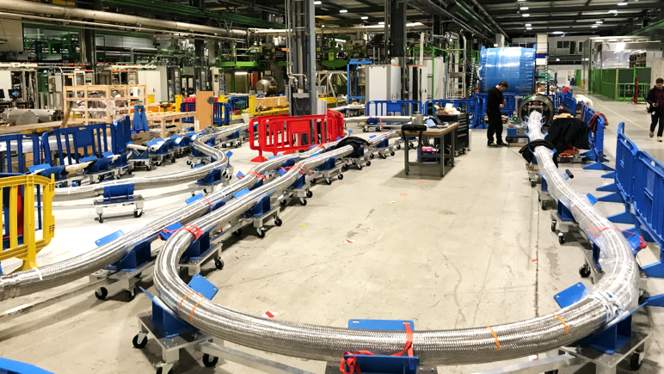
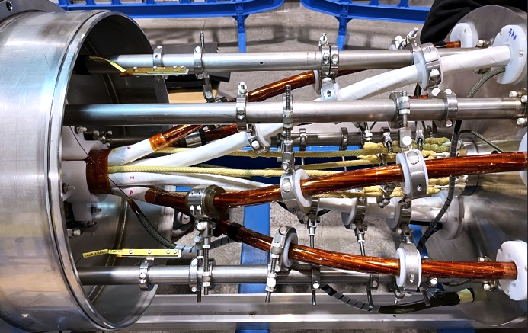
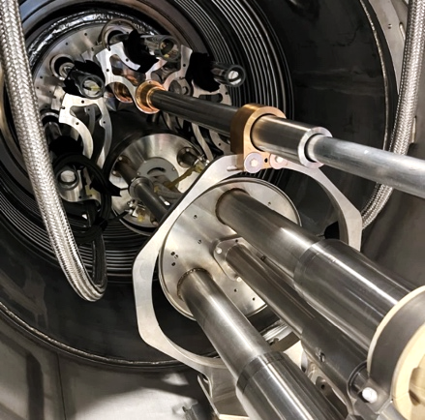
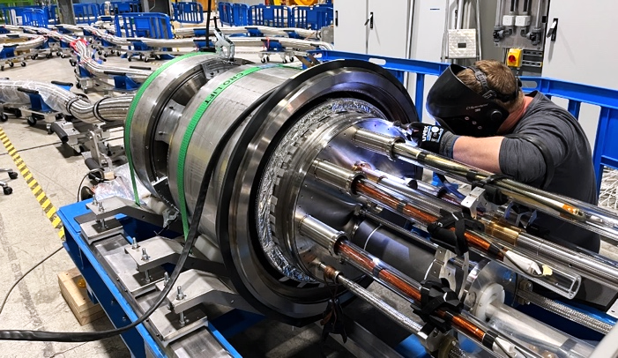
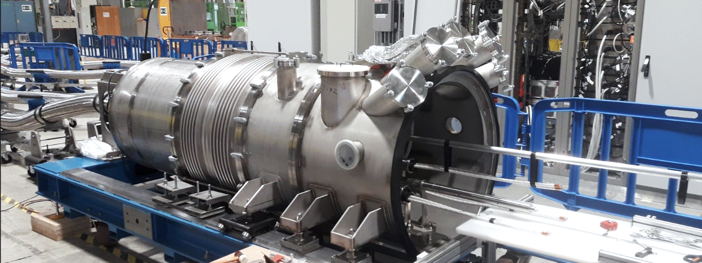
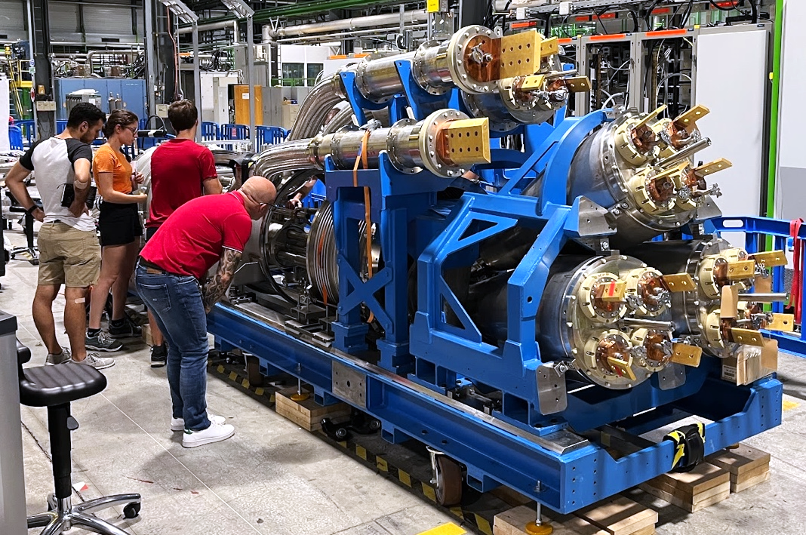
SC-Link-DFHX assembly in pictures
Complete system test of full SC link completed June’24!!!
April 23rd 2026

Slide 13
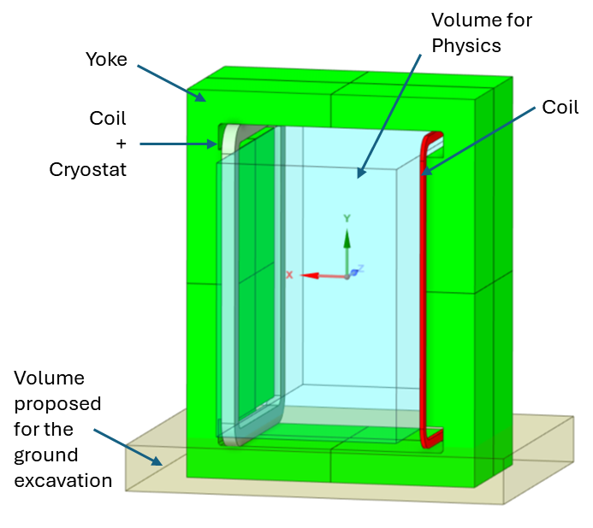
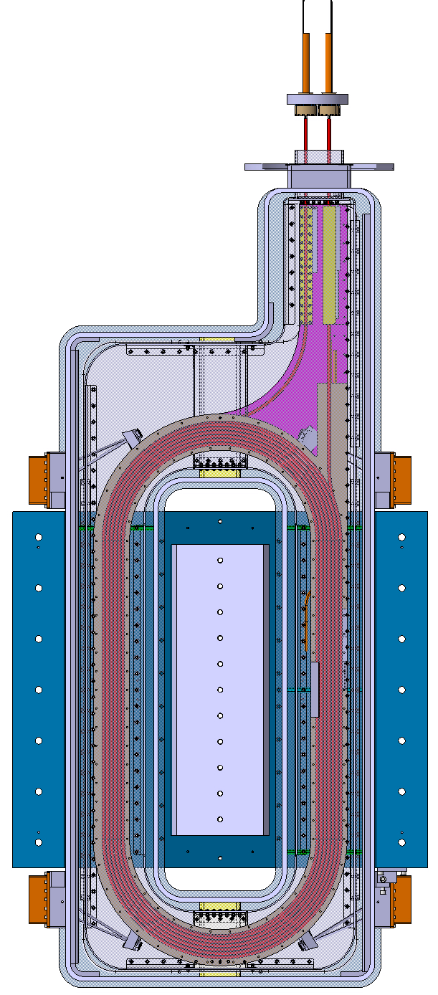
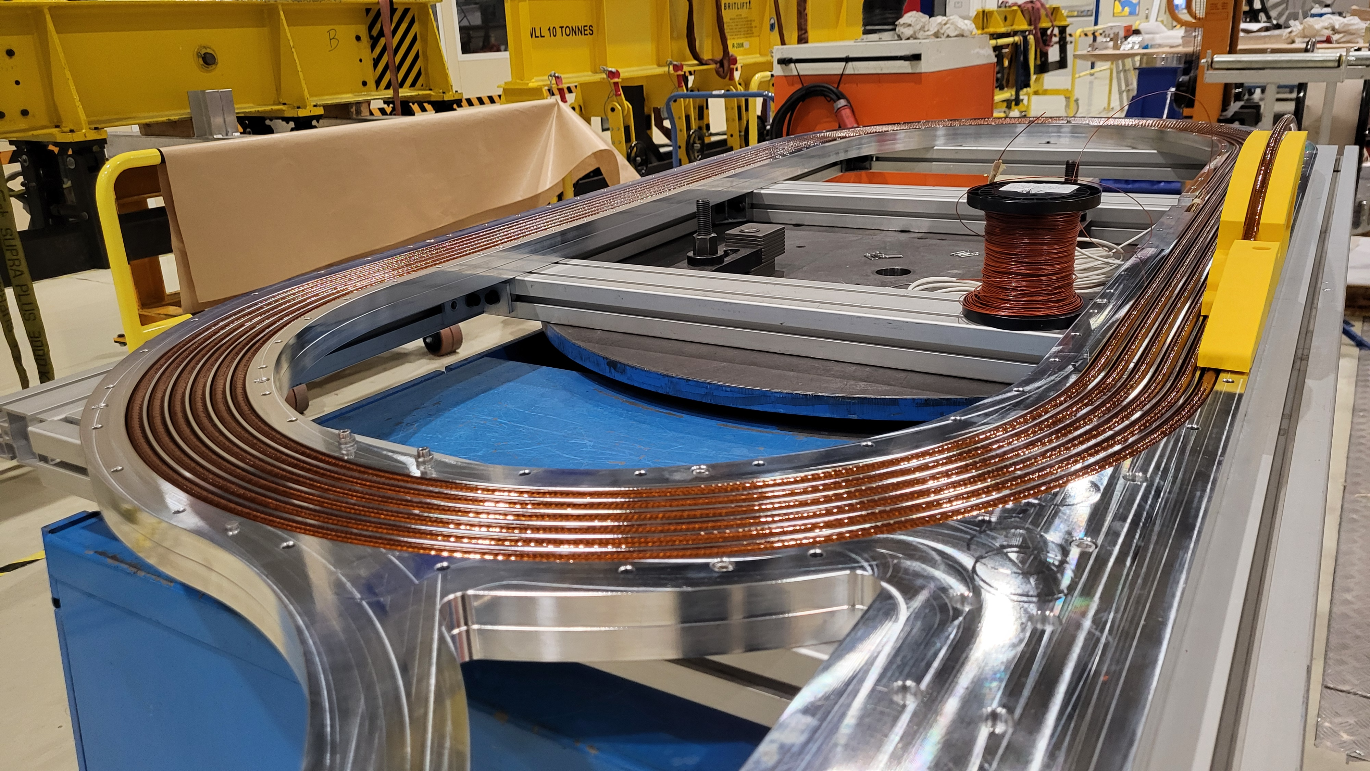
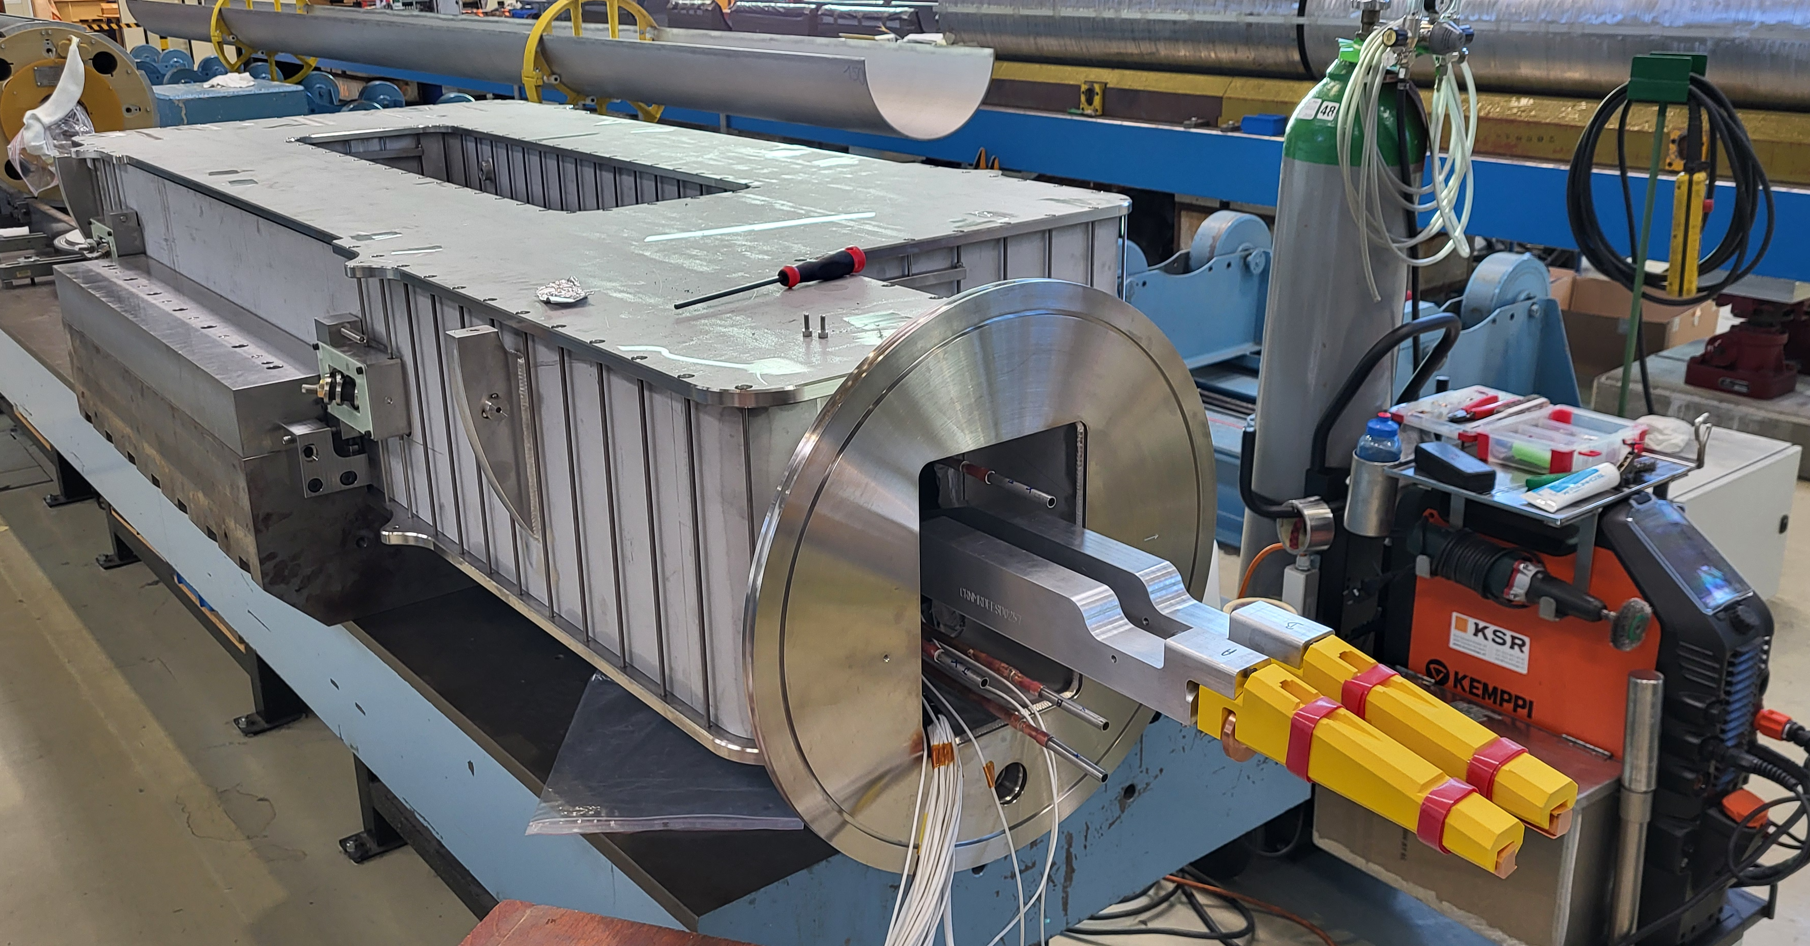


Potential application to the SHiP spectrometer magnet, with operation at 20 K – a resistive version would consume ~10 times more electrical power of order of 1 MW
$\sim$1m
$\sim$ 2m
6 m
4 m
Conceptual design of SHiP spectrometer magnet
April 23rd 2026

Slide 14
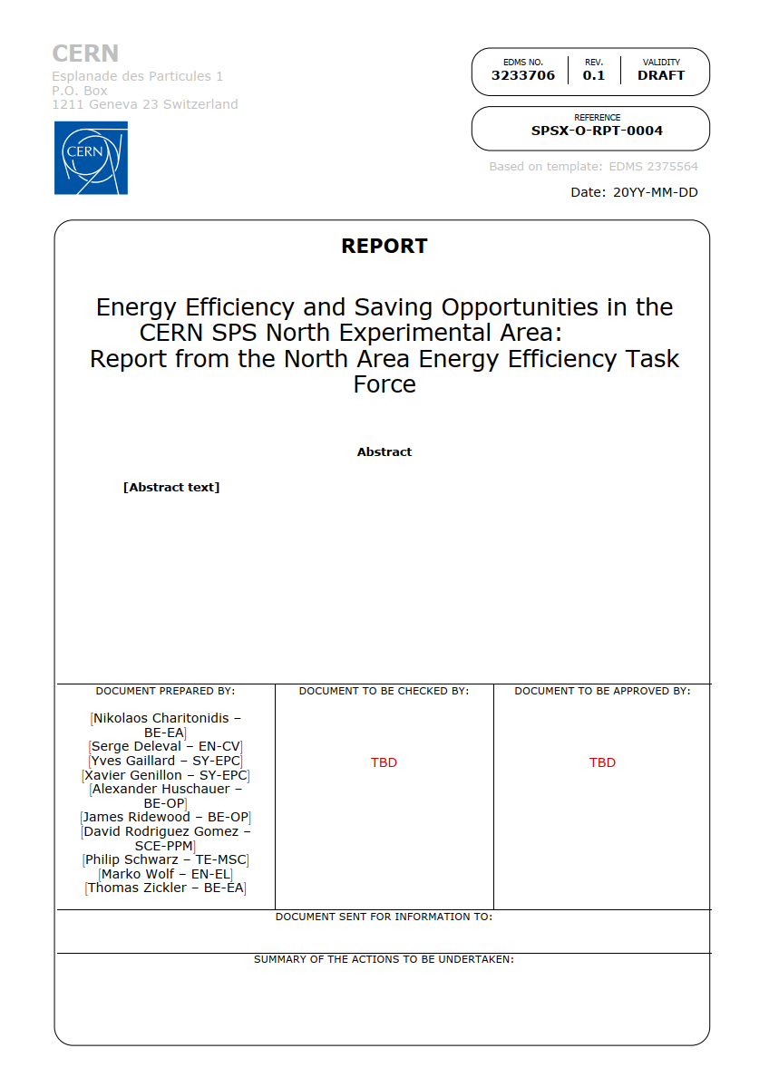
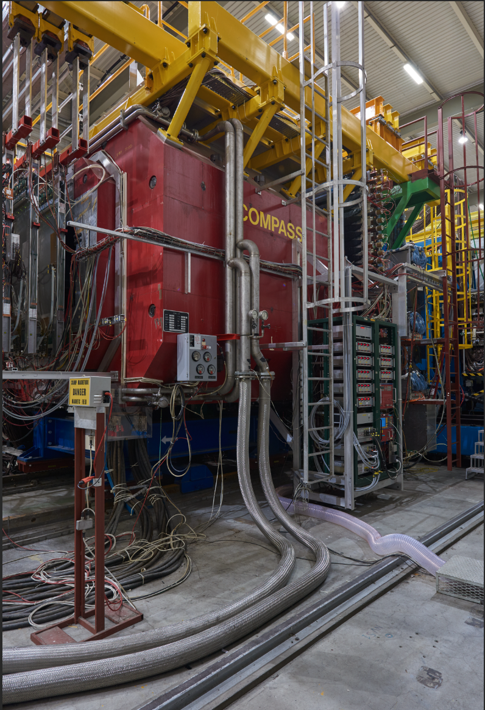
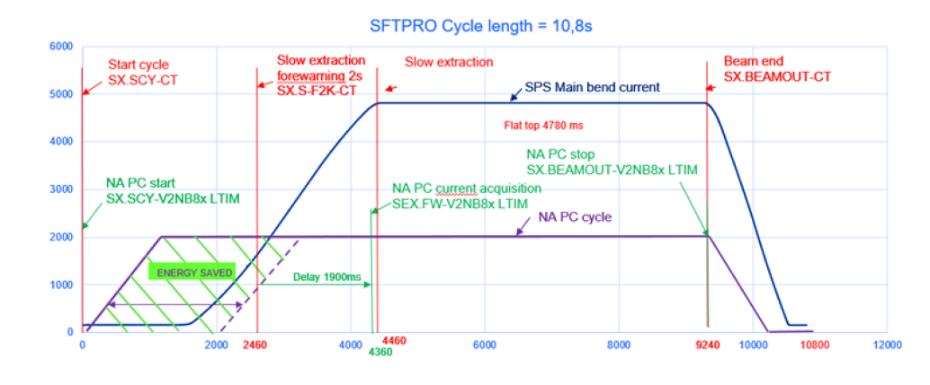
Energy efficient and saving opportunities are being considered in the North Experimental Area, including the possible conversion of resistive magnets to superferric ones
Possible optimization of powering cycle for proton spill
Large resistive magnet in the experimental area
April 23rd 2026

Slide 15
Extract ESPP 2026: Accelerator Science & Technologies:
Advanced accelerators rely on detailed beam physics models, powerful simulations and key technologies.
Several technology approaches directly address the requirement of greater sustainability for future accelerator-based facilities.
B. In order to realise the visionary plan presented, the highest priority must be the development and
industrialisation of key technologies: advanced superconducting and normal-conducting RF structures,
efficient RF power sources and accelerator-quality magnets in the 14–20 T range, including those based on
high-temperature superconductors.
SRF developments for ERLs are also highly relevant for the FCC-ee. ERLs offer intense lepton beams for diverse
applications, although the feasibility of high-current, high-power operation remains to be demonstrated.
The PERLE demonstrator at IJCLab will explore this regime while supporting sustainable SRF technology
development.
C. Demonstration of high-current multi-turn energy recovery in linacs constitutes an important step towards
power-efficient lepton accelerators for a broad range of applications and should be pursued.
D. The longer-term development of advanced technologies, such as high-gradient wakefield acceleration and
those underpinning bright muon beams, should be supported at an appropriate level. Synergies with the US
initiative on muon collider R&D should be exploited.
April 23rd 2026
Notes:
CERN Long term future

Slide 16
Important sentences conserving energy saving and sustainability
in the ESPP2026 document
Technologies -Accelerator science and technology
Several technology approaches directly address the requirement of greater sustainability for future accelerator-based facilities. These include superconducting magnets and resonators operated at higher cryogenic temperature, superconducting current links, use of permanent magnets, and more efficient RF power sources, complemented by a more extensive use of robotics and artificial intelligence.
…R&D efforts to enhance the sustainability and energy efficiency of accelerators from design to operation and decommissioning should be supported.
Sustainability and environmental impact
For new proposed projects, a detailed life cycle assessment should be carried out at each stage, from concept to design and implementation, in order to quantify and minimise environmental impact.
The particle physics community should continue and intensify its efforts to develop and adopt sustainable solutions.

Slide 17
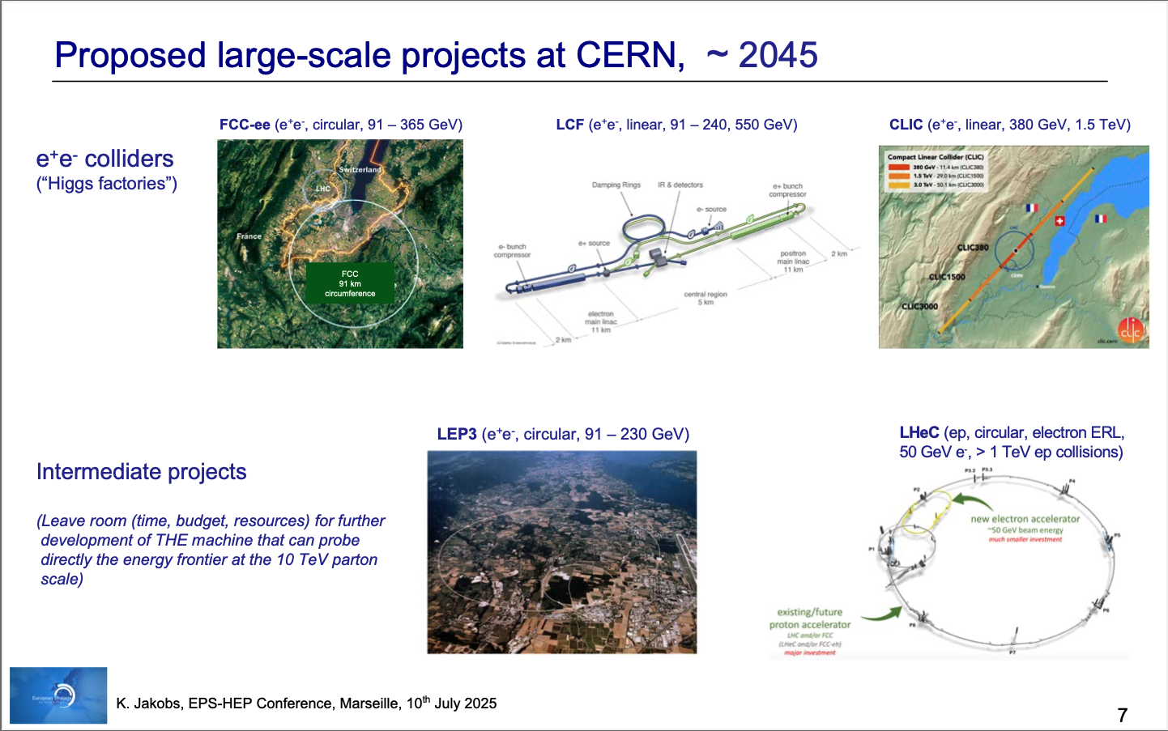
FCC-ee clearly identified as THE preferred option in the ESPP update process!
The focus is FCC, but some other projects should also be studied to prepare CERN for case that FCC timescale or cost turn
out to be challanging
April 23rd 2026
Notes:
CERN Long term future

Slide 18
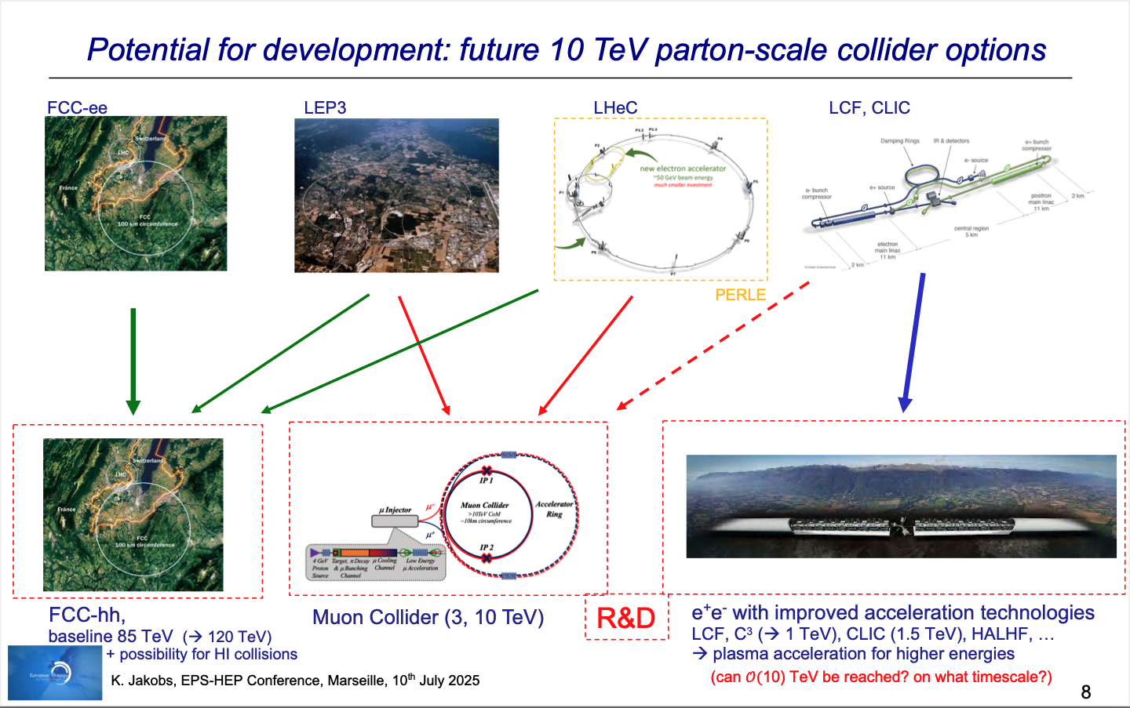
Next Steps:
Council meeting in Budapest in May 2026
18
April 23rd 2026
Notes:
CERN Long term future

Slide 19
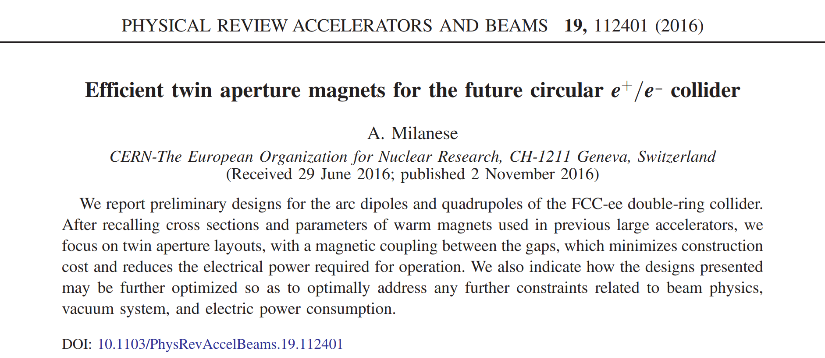
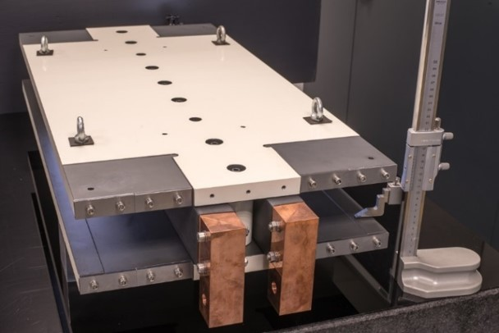

Sustainable main bending magnets are being proposed for FCC-ee, with a twin layout, a low current density and aluminum conductor
First paper on efficient resistive magnets for FCC-ee
First model of FCC-ee collider main dipole
Twin layout allows 50% energy (and material) reduction with respect to separate magnets, as the Ampere turns are recycled in the second aperture
Cross section of FCC-ee bending magnet as of May 2025
April 23rd 2026

Slide 20







HTS REBCO Studies for FCC ee (1/2)
High-gradient applications (performance-driven)
System-level energy-efficient lattice magnets
Machine Detector Interface
Collider Ring
Final Focus FCC-ee Quadrupoles
Baseline: Nb-Ti
Lattice combined function MQ/MS
Baseline: resistive iron dominated magnets
2900 quadrupoles and 4700 sextupoles in the 80 km arc cells
REBCO CCT at ~ 30 K
REBCO at ~ 20-50 K
Two opposed solenoid fields
Superconductor in a groove
Dodecapole structure allowing quadrupole, sextupole, and combined operation

Slide 21




HTS REBCO Studies for FCC ee (2/2)
HTS studies complementary to main lattice and final-focus systems
Positron capture solenoid
→ High-field REBCO (~15 T, ~15 K),
compact source region
Short Straight Sections (nested Q-S magnets) → Energy-efficient optics,
increased filling factor
REBCO matching/capture solenoid at the
target (one per positron source line).
Demonstration in the P³ experiment at PSI
REBCO (~2T, ~40 K)
Cooling < 11 MW
Resitive baseline:
~ 39 MW average power
HTS in FCC-ee spans both traditional high-field applications and
new energy-efficiency-driven concepts
April 23rd 2026
Notes:
Simplified schematic of positron production

Slide 23
SRF R&D
O. Brüning iSAS 2nd annual meeting @ HZB
April 23rd 2026
23

Slide 24







SRF R&D Ongoing collaborations
SRF Basic Research
Fundamental SRF research
Magnetic flux expulsion studies
Point contact Tunneling Spectroscopy
Nb coating on copper
Nb3Sn coating on copper
Nb3Sn coating on niobium
Atomic Layer Deposition
SRF thin films
High Q0 800 MHz cavities
Clean room process, chemistry, surface inspection & robotisation
SRF surface treatments
SRF process equipment for SA18 building
Low & high pressure ultra-pure water rinsing systems
Clean equipment (Lifters, gantries, assembly toolings)
Horizontal airflow cleanrooms
Hydroforming of copper cavity substrates
Dry cryogenics cooling
Cavity test methods and diagnostics
Ferro-electric Fast-Reactive tuner
SRF Technologies
O. Brüning iSAS 2nd annual meeting @ HZB
April 23rd 2026

Slide 25







Build 400 MHz Demo, an FCC 2-cell cavity full size cryomodule
Parameter (machine installed) | Value
No. cryomodules | 66
2-cell cavities per cryomodule | 4
CM length (GV flange to flange) | ~ 11 m
RF frequency (MHz) | 400.79
Cavity voltage (MV) | 7.95
Cavity gradient Eacc (MV/m) | 10.6
Qo | 2.7E+09
Dyn. HL (CW)/cavity at 4.5 K | 129 W
Stat. HL/CM | 197 W
Environ. Magnetic field | ≤ 5 mG
RF power (kW, CW) | 380
Q _{L} (optimum coupling) | 9.2E+05
HOM power per CM: Z (W/H/ttbar) | 62.3 kW (coax. Extractor for 15/20 kW peak!) (lower for W/H/ttbar)
Items to be designed, built and qualified (non exhaustive list!)
Cavity Nb sputtered
He tank
Tuning system
FPC
HOMs, RF extraction lines (LHC/Crab designs shown)
Derived from LHC SRF, but final designs will be considerably different !
April 23rd 2026

Slide 26





800 MHz with collaborations: FNAL, DESY, IJCLAB, CEA
Draft MOU
FNAL schedule: 2025-2031
High Qo studies (under FCC project funding):
5 single cell cavities in fabrication at CERN (MME), 3 to be supplied to FNAL (June ‘25)
FNAL improving EP process on a 5-cell cavity (cold testing now)
Mid T baking and retesting of same cavity to follow
Single cell processing to follow
800 MHz CM plan for assy & testing by 2031
Regular fruitful exchanges with FNAL (every 2 weeks)
But funding still pending (FNAL made a cost estimate)
FCC management agreed to fund 4 6-cell cavities through FCCee (but now funding is postponed)
We have limited funding under SRD-D project (1.4 MCHF) → purchase of Nb
CERN conceptual design
based on FNAL PIP –II features
April 23rd 2026

Slide 27





Tristron Gridded cathode
CST PIC simulations.
FCC_{ee} 400MHz, 0.5MW, CW MB Tristron
April 23rd 2026

Slide 29



Cavity manufacturing and coating technologies
Nb 800 MHz cavity repair (JLAB cavity)
Hydroforming of Cu cavities (achieved on 1.3 GHz)
Bulk machining of Cu cavities (achieved up to 400 MHz, 1-cell, 2-cell under preparation).
Laser welding & laser surface preparation of cavities.
Nb3Sn: exploring coating options on Cu and other materials: first results are encouraging. Recipies are being fine-tuned with sample test in the Cryolab.
April 23rd 2026

Slide 30


New cavity types for “quasi-dry” cooling: SWELL & embedded channels
Slotted Waveguide ELLiptical cavity
A mixture of highly damped CLIC structures and elliptical SC cavities, suitable for very high current applications (e.g. FCCee Z).
Successfully tested at 1.3 GHz with individually coated quadrants up to 13.7 MV/m.
Suitable for cooling via embedded Helium channels (drastic reduction of Helium volume).
Embedded cooling channels
Grooves machined into cavity walls,
Can be easily applied in bulk machined cavities
Protoyping onoing.
Proof-of-principle on flat plates was successful
April 23rd 2026

Slide 31
SA18: a new SRF facility
O. Brüning iSAS 2nd annual meeting @ HZB
April 23rd 2026
31

Slide 32



New SRF Facility SA18
Reasoning
Combining all of CERN’s SRF processes & teams under one roof.
Increased efficiency & quality control of SRF processes for bulk Nb and thin films.
Avoiding process repetition because of faults.
Status
CE engineering contractor is ready to start.
April 23rd 2026
Main entrance (Unanime Architects)

Slide 33

FCC Feasibility Study published in 2025
April 23rd 2026
Notes:
Acknowledgement of last years achievements: HL-LHC

Slide 34

Helium preservation in cryogenic systems
Helium is the only element to cooldown macroscopic equipment below 10 K
Generally, a by-product extracted from the natural gas: Limited and expensive resource !
Cryogenic system design must preserve helium as much as technically possible
Reduce the helium inventory as much as possible in the accelerators
Ensure that all helium is recovered during normal operations as well as during failures scenarios
Recover and purify helium during cryogenic circuit purges if possible
Install sufficient storage capacity
Helium losses is an important KPI for cryogenics
Online monitoring to detect losses as soon as possible
Perform regular leak test campaigns across cryo installations
Regular internal review/publication of the losses
Ongoing R&D towards less helium dependency in future
Superconducting material R&D for operation > 10 K
Develop new cooling schemes requiring less helium inventory
(forced flow cooling, dry cooling, etc.)
LHC annual helium
losses in the last 20 years
April 23rd 2026

Slide 35

Technology
Landmarks
Nb-Ti Technology
Separation / Recombination
dipole magnets: D1 & D2
Complete Prototype System validated in 2024
➔ Over 120kA transported over ca. 100M without resistivity
April 23rd 2026

Slide 36


HL-LHC Magnet Scope
Design, engineering, construction, test and installation the Insertion Region (IR) magnets of IR1 and IR5 for the HL-LHC upgrade.
Q1/Q3 cryomagnets: from AUP (US)
Q2: from CERN
MCBXF nested corrector magnets: from CIEMAT (Spain)
HO corrector magnets: from INFN-LASA (Italy) [completed]
D1 cold masses: from KEK (Japan)
D2 magnets: from INFN-Ge (Italy)
D2 corrector magnets: from IHEP (China)
DCM: from CERN
April 23rd 2026

Slide 37

EN-EL Web Energy: Energy Management System
CERN Energy Efficiency Movement Day
Proven Deployment at CERN: Enabling full-spectrum energy traceability across complex operations
Governance and Compliance: Supports ISO 50001 adherence, contractual commitments, and overarching sustainability objectives
Operational Visibility: Continuous monitoring of consumption, enhanced by automated anomaly detection
Predictive Capability: Anticipates energy demand through integrated data, scheduling, and advanced statistical modelling
Performance Management: Configurable KPIs underpinning executive-level efficiency dashboards
Scalable Framework: Adaptable to highly complex infrastructures and varied operational environments
Strategic Insight: Drives informed decision-making to reduce consumption, optimise costs and strengthen organisational performance
Energy Management for:
Research facilities
Airports and large transit hubs
Data centres and IT infrastructure
Smart cities and municipal utilities
Manufacturing plants and industrial sites
Office buildings and commercial real estate
April 23rd 2026

Slide 38



Reduction of CO₂ emissions
CERN Energy Efficiency Movement Day
ATLAS and CMS Detector Cooling
Systems using fluorinated gases will be dismantled at the end of RUN3 (mid-2026) and will be replaced by CO₂ cooling for start of RUN4 (2030)
Reduction of more than 40’000 tCO₂e/year
New surface and underground CO₂ cooling plants at ATLAS
April 23rd 2026

Slide 39
Helium preservation in cryogenic systems
Helium is the only element to cooldown macroscopic equipment below 10 K
Generally, a by-product extracted from the natural gas: Limited and expensive resource !
Cryogenic system design must preserve helium as much as technically possible
Reduce the helium inventory as much as possible in the accelerators
Ensure that all helium is recovered during normal operations as well as during failures scenarios
Recover and purify helium during cryogenic circuit purges if possible
Install sufficient storage capacity
Helium losses is an important KPI for cryogenics
Online monitoring to detect losses as soon as possible
Perform regular leak test campaigns across cryo installations
Regular internal review/publication of the losses
Ongoing R&D towards less helium dependency in future
Superconducting material R&D for operation > 10 K
Develop new cooling schemes requiring less helium inventory
(forced flow cooling, dry cooling, etc.)
LHC annual helium
losses in the last 20 years
April 23rd 2026

Slide 40






HL-LHC Non-Linear Corrector Package: Ferromagnetic design
Ferro-Magnetic magnet design
Using NbTi cables
April 23rd 2026

