Slide 1
WP1 Report on the Industrial Review. Ferroelectric Ceramic Development for FE-FRT.
iSAS Second Annual Meeting @HZB
Alexei Kanareykin
on behalf of Euclid’s team
April 24, 2026
Supported by the DOE NP SBIR DE-SC0007630

Slide 2
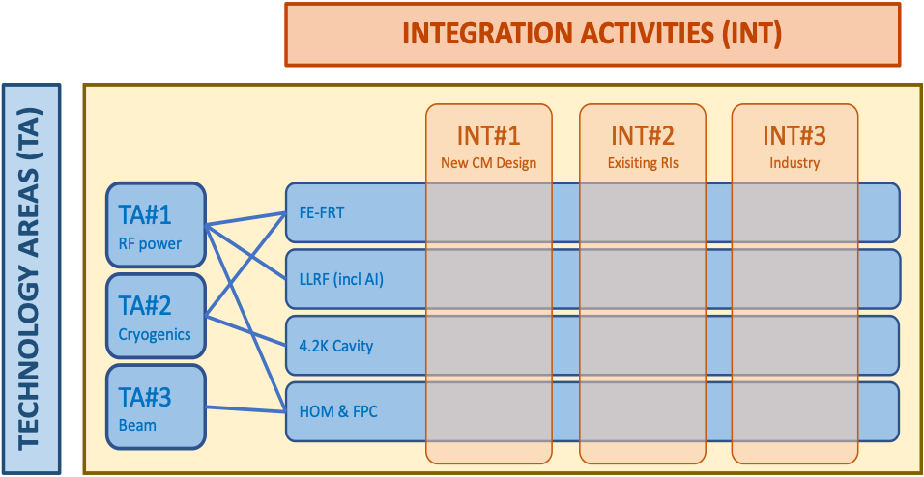

iSAS Program
Applications under this initiative include
Task 1.1 Coordination of R&D on FE-FRT (HZB)
Task 1.2 FE-FRT for 400 MHz transient beam loading compensation in the LHC (CERN),
Task 1.3 FE-FRT systems for microphonics compensation in 1.3 GHz SRF cavities (HZB),
Task 1.4 FE-FRTs for energy recovery linac (ERL) applications (CNRS, HZB),
Task 6.2 ? retrofitting FE-FRTs into existing HL-LHC cryomodules (CERN)
Ferroelectric materials for Tasks 1.2 and Task 1.3 were fabricated and are being currently tested at CERN and HZB.

Slide 3

A New Era in SRF Frequency Control
FRTs provide ultra-fast frequency adjustment without mechanical motion,
Enable electronic, room-temperature control of cavity detuning,
Offer response times capable of active microphonics compensation, thereby significantly reducing RF amplifier power requirements.
FE-FRTs are drawing strong interest from CERN and other major accelerator centers for transient detuning correction, beam loading compensation, and fast variable attenuation in high-power RF distribution systems. Additional applications include fast control of phase-locked magnetrons.
First Workshop on Ferro-Electric Fast Reactive Tuners (FE-FRTs) Dec 2025, Berlin Germany. https://events.hifis.net/event/2275/
Euclid Techlabs collaborates with many ongoing FE-FRT development programs at CERN, HZB, Daresbury/Lancaster University and Mainz University in Europe, as well as Jefferson Lab in the United States.
https://indico.ijclab.in2p3.fr/event/10302/contributions/33165/attachments/23296/33595/iSAS-kickoff_WP1_ANeumann_150424.pdf

Slide 4
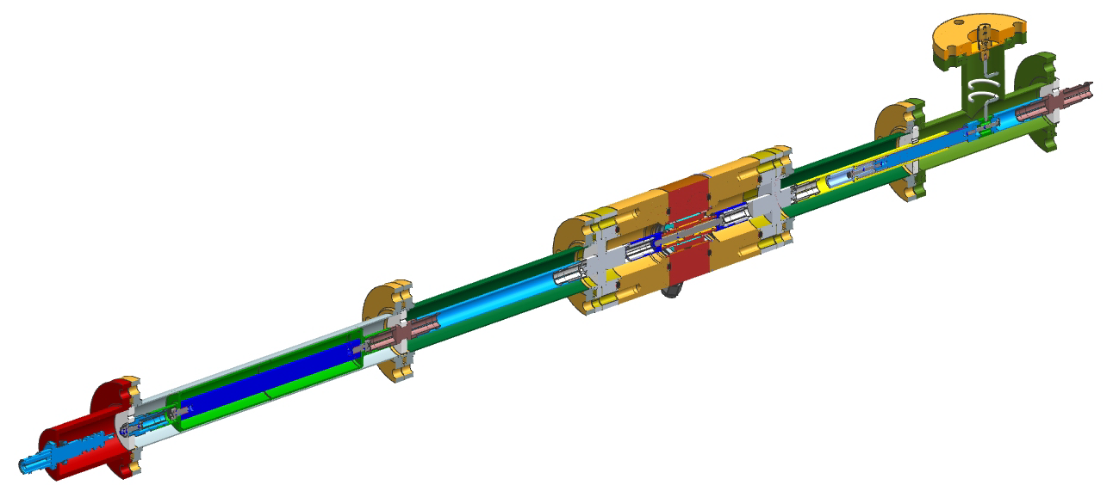
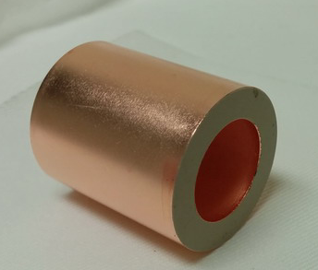
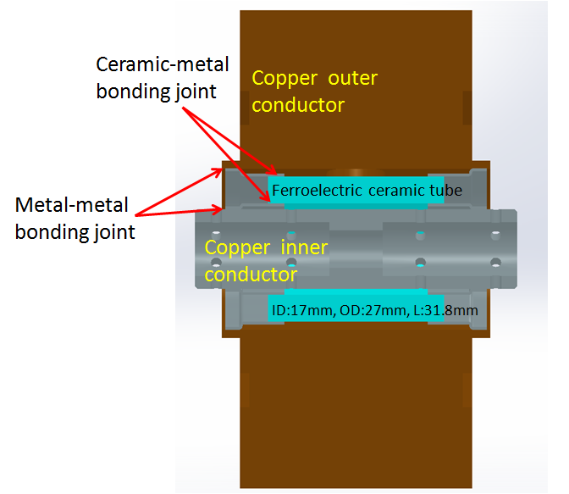
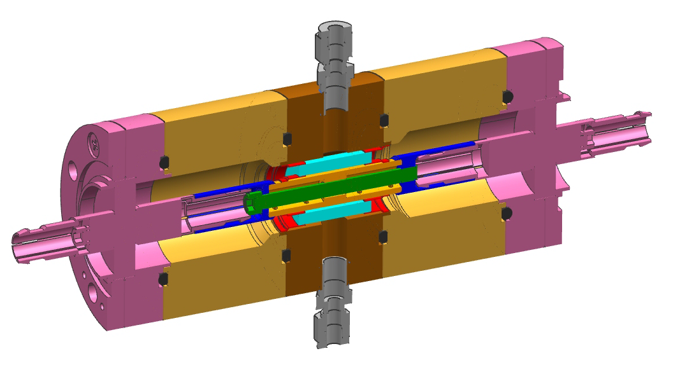
BST Based Tuner Design (assembly)
design of S. Kazakov and V. Yakovlev

Slide 5
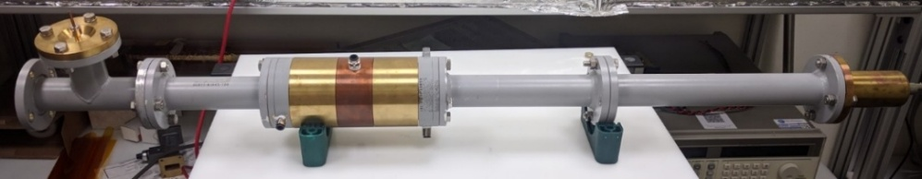

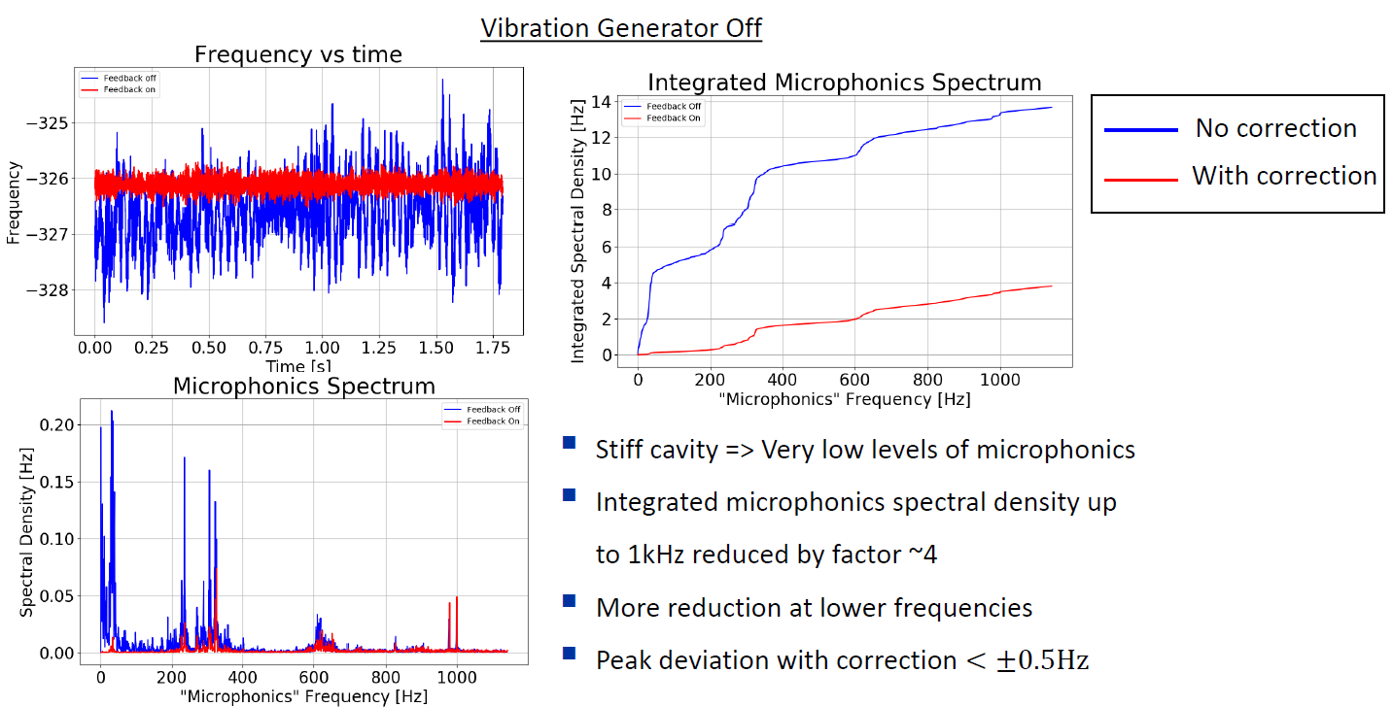
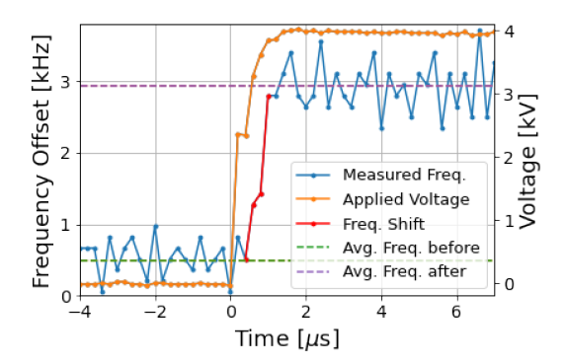
Microphonic Suppression at CERN
N. Shipman, et al., IPAC’21,
Measured at CERN frequency response at 600 ns of a cavity to a 4 kV high voltage pulse
Courtesy of N.Shipman and A.Macpherson.
First ever Ferroelectric Fast Reactive Tuner (FE-FRT) test with a superconducting cavity

Slide 6
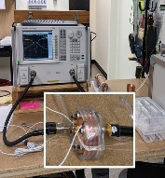

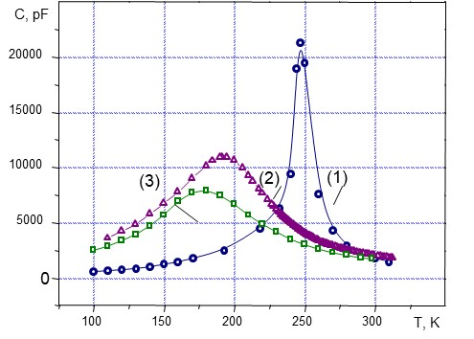
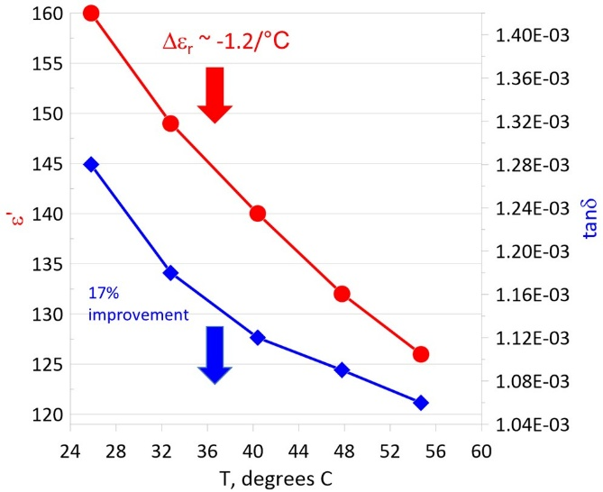
Fast Tuning Ferroelectric Material
Ɛ
350
300
250
200
150
Dielectric constant has to be low (~ 100-150)
Loss factor has to be low ~ 1x10⁻³ at 1 GHz and ~1x10⁻⁴ at 100 MHz
Tuning range has to be high ~ 6-8% at 1.5kV/mm
Can be done with (Ba, Sr)TiO₄+Mg oxides
Dielectric constant of pure BST > 1000, and it’s lossy. To reduce both eps and tanδ, one has to develop a mixture (solid solution) of BST ferroelectric and low loss linear ceramic
Curie temperature dependence on Mg-oxide content. Curie temperature shift with Mg based oxide from ~300K down
to ~ 180K-200K region.
Dielectric constant and tanδ measurements in the temperature range T=20⁰С-60⁰С at 400 MHz for the BST(M) ferroelectric material: tanδ=1.3×10⁻³ T=22⁰С and ~ 17% improvement at T=55⁰С.
A.Macpherson, CERN, https://events.hifis.net/event/2275/contributions/20221/attachments/4893/10290/Workshop_141125_ALM.pdf
Notes:
A

Slide 7
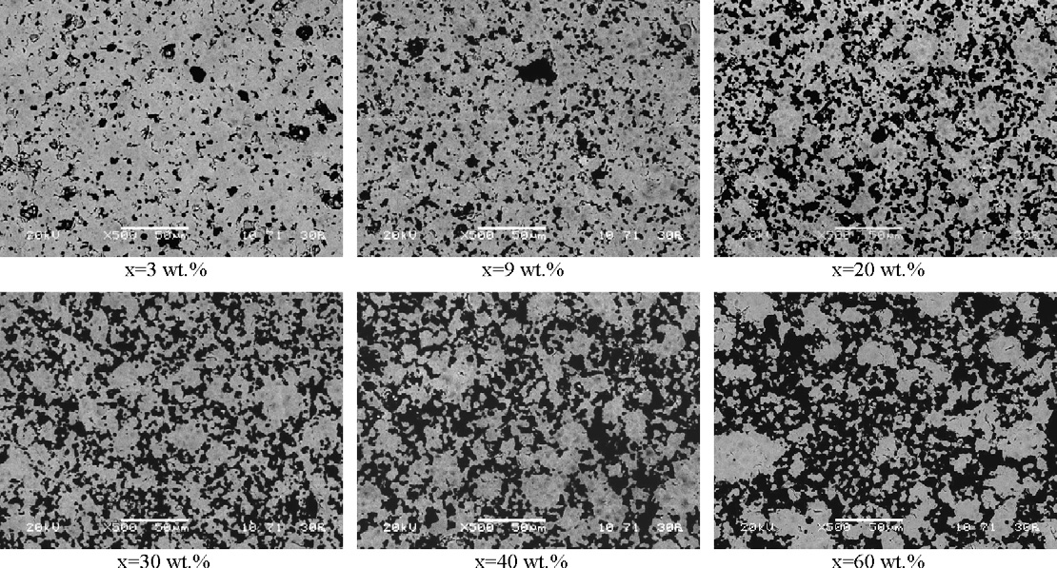
Grain size vs. % Mg,Ti oxide additives
Large grains imply:
Higher tunability ,
Higher loss and lower breakdown strength,
heterogeneous field distribution at the interfaces (especially if no metallization is used).
Microstructure (SEM) of ceramic samples of the BaTiO3/SrTiO3 (55/45) + x wt.% Mg2TiO4 system.

Slide 8
SEM analysis of the grain size of the BST (M) ferroelectric
Well-balanced, dense microstructure: BST continuous, Mg₂TiO₄/MgO form fine intergranular network — ideal “optimized” configuration.
BST-matrix microstructure with fine MgO and Mg₂TiO₄ phases distributed along triple junctions and grain boundaries — a configuration ideal for reducing dielectric loss and improving breakdown strength while retaining good tunability.
SEM image of ceramic sample BTO/STO D 55/45 C wt.% MgO/Mg2TiO4 D 30/30 additives.
Maintains high dielectric uniformity and breakdown field.
Achieves good tunability (~20% at 20kV/cm).
Minimizes loss due to suppressed domain wall motion at the Mg-based boundary network.

Slide 9
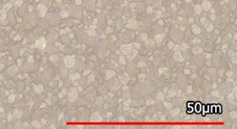
Optical Image analysis of the grain size of BST (M)
The grains are well-developed and equiaxed, with clear boundaries and minimal porosity.
The average grain size
is around 6-10 µm.
the average grain size here is smaller than the earlier SEM microstructures (~10–15 µm).This sample looks more finely leading to:
Higher breakdown strength, lower dielectric loss, but unchanged tunability compared with the coarser (10–15 µm) batches.

Slide 10
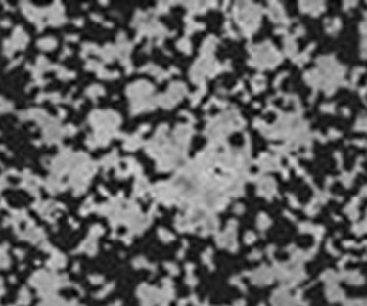
Small grain size reduces BST tunability
10 µm
J.W. Liou, B.S. Chiou. Jap. J. of Appl. Phys. 36 (1997) 4359.

Slide 11
A rule of thumb for reliable dielectric uniformity and breakdown strength:
The effective dielectric “averaging volume” (i.e., the ferroelectric layer thickness) 10× the grain size, to avoid local field nonuniformities from individual grains.
Typical practical thicknesses (used in FRT tuners, bulk disks): 0.3–1.0 mm
This ensures that:
The applied electric field is averaged over many grains (reducing domain-level nonuniformities).
Local polarization anisotropy and grain-boundary effects don’t dominate tunability or loss.
Mechanical stability and breakdown strength remain acceptable for tens of kV/cm operation.

Slide 12
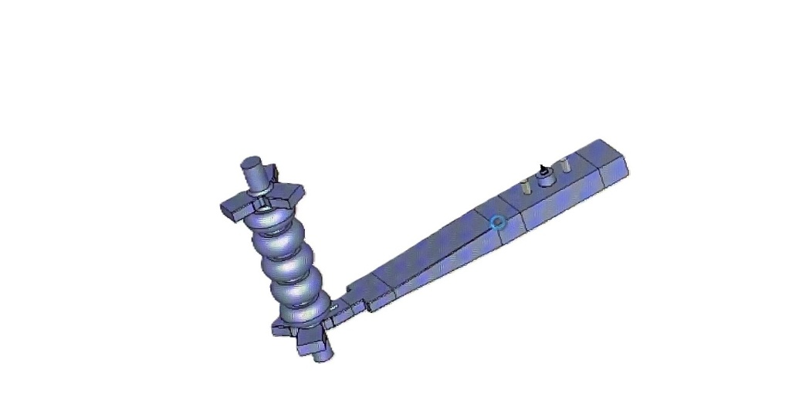
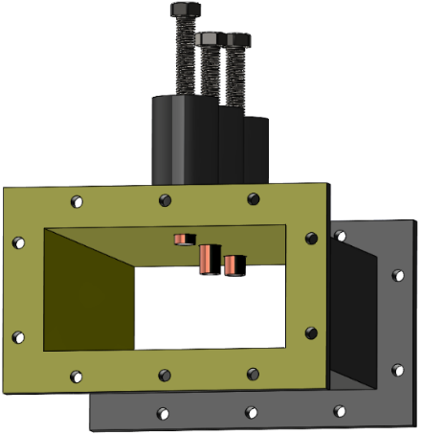
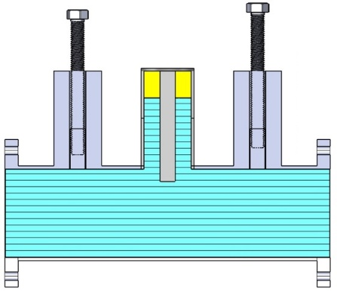
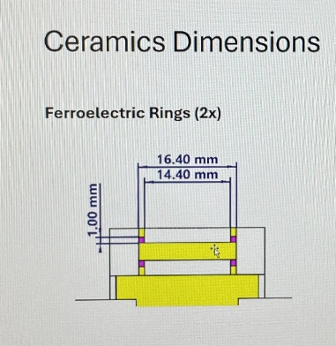
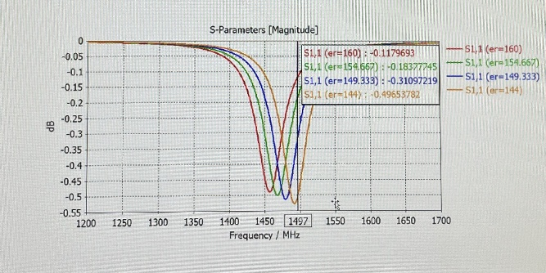
Tree-stub tuner for variable loads, CEBAF
A. Hutton, A.Costilla, SBIR, JLab
Ferroelectric tuning element consists of two rings,
OD 16.4 mm, ID 14.4 mm, 1x1mm cross-section
Using a three-stub tuner to minimize the reflected power only works if the load has a constant impedance, which is often, but not always, true. If the load is varying in time, the best that can be done is to match the stub tuner to the average value.
Desing of Alex Costilla, Jlab
In collaboration with JLab

Slide 13
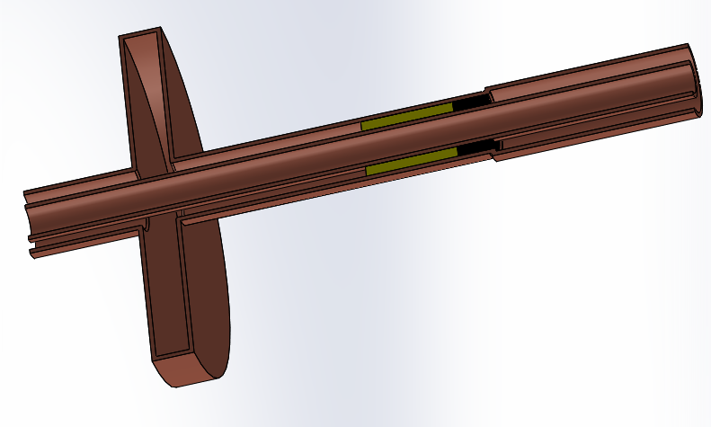
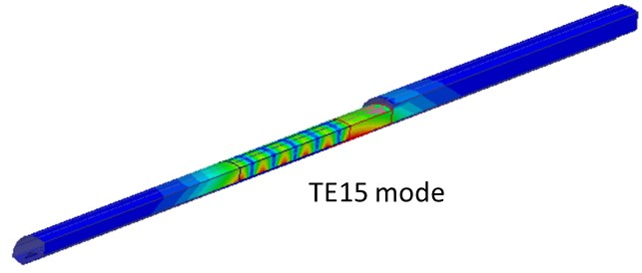
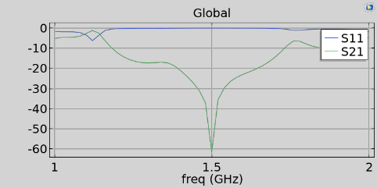
FE-FRT for microphonic compensation, CEBAF
HOM
f = 1500 MHz, r/Q = 1288 Ω/m, Q₀ = 3 × 10⁹, and Qₑₓₜ = 3.2 × 10⁷). The reflection amplitude, S₁₁, –0.20 dB and –0.24 dB across dielectric constants variation from 130 to 150
The core innovation lies in a FRT integrated directly into the main coupler, eliminating the need for an additional RF port. Using a Magic-T configuration, the FRT will enable microphonics compensation in the ±30–40 Hz range for CEBAF’s C100 cavities
Desing of S.Kuzikov, Jlab

Slide 14
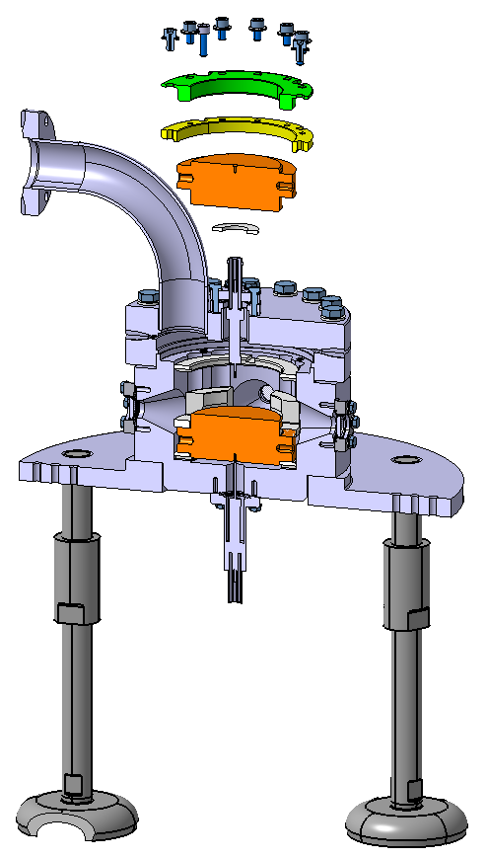
Ferroelectric material for CERN’s FE-FRT
High voltage breakdown
FE-FRT for transient detuning in HL-LHC
Material characterization studies at 400 and 800MHz
HV breakdown tests.
OD – 3 mm, Thickness – 0.3mm
Sample preparation:
Diamond saw cutting of slices
Grinding/polishing procedure for optical finish
Cleaning by US bath, alcohol wipe and 120°C bake
Provider: Industry partner Euclid Techlabs:
Water jet cutting → surface polish → vacuum bake
Compression w/o brazing with diamond machined copper parts
Reached 7.2 V/µm
(Axel Neumann’s talk)
A. Macpherson et al. FE-FRT Workshop. Berlin, Germany 2025

Slide 15
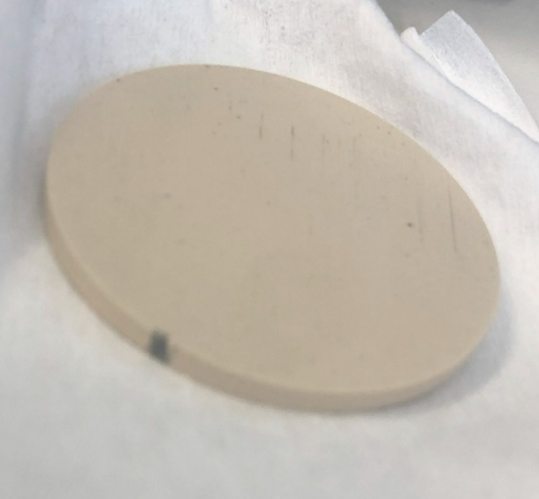
Ferroelectric material for HZB FRT
40 mm
Target: Develop and build an FE-FRT for microphonics compensation of a multi-cell SRF cavity at 1.3 GHz → demonstrate a reduction of required RF power
We assume more a problem of gaps between electrodes and samples (voltage drop across gap) → sample preparation, surface quality, electrical contact
All this improved after Euclid refurbished FERMAT, but still questions remain open →
(WP 1 Axel Neumann’s talk)
Euclid improved FERMAT compression system for better repeatability
▪sample with preliminary quantitate measurement of permittivity vs. voltage and temperature at 1.3GHz
Damage from breakdown in FERMAT at 9kV (3.6V/µm) in 2.3bar N₂ atmosphere.
N. Shipman et al.. FE-FRT Workshop. Berlin, Germany 2025

Slide 16
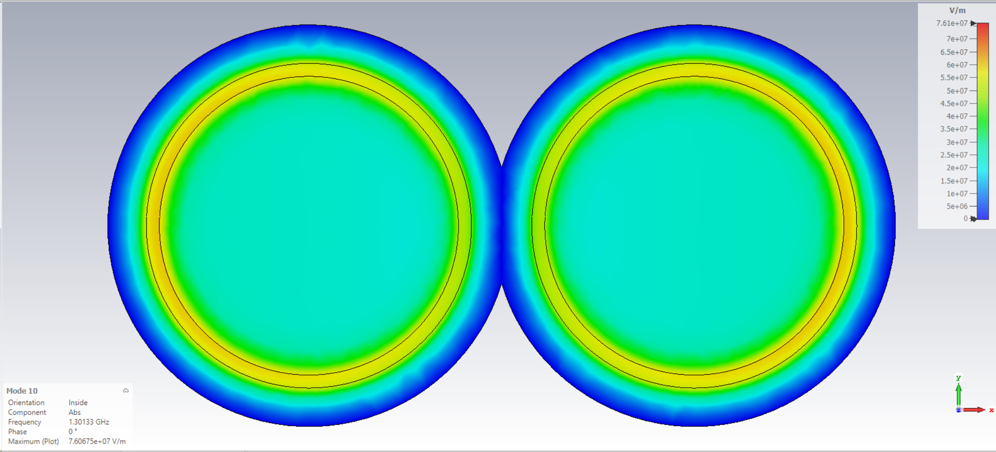


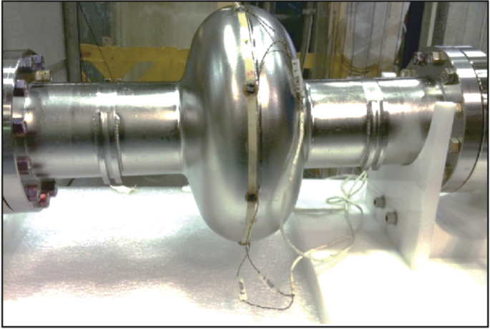
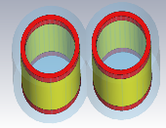
Ferroelectric elements for coming FRT projects
Dipole mode E field
At 1.3 GHz the FE ring tends to small sizes sub-20 mm
A key goal for the UK team was minimizing the temperature rise
A novel solution is to operate the FRT in a dipole mode
Dissipation is spread over two phase locked resonators
Nb3Sn cavities are brittle and tuning may damage the film. An FE-FRT is fundamentally limited in power by the room temperature FE loaded resonator. A SC mechanical actuated reactive tuner (SMART) could have a larger FoM but would not be fast enough to cover microphonics. SASE will investigate combining these two either in series or parallel.
Mechanical tuner
R. Monroy-Villa et al. SRF 2025
G. Burt. FE-FRT Workshop. Berlin, Germany 2025

Slide 17
In conclusion,
A new ferroelectric ceramic material, BST(M) (Barium Strontium Titanate with Mg-based additives), has been developed, offering optimized parameters that satisfy the requirements for Ferroelectric Fast Reactive Tuners (F-FRT), including microphonic compensation, transient detuning, and fast switching.
The first F-FRT prototype was designed, fabricated, and successfully demonstrated at CERN. More advanced high-power designs and prototypes are currently under development.
SEM and optical microimaging analysis confirmed an optimized grain size in the range of ~ 5–10 µm for the BST(M) material, which provides optimal tunability, low loss factor, high breakdown strength, and excellent mechanical hardness.
For current projects (CERN, HZB, JLab) and upcoming projects (Mainz, Liverpool), the ferroelectric elements are considered in a ring shape with diameters of 15–40 mm and thicknesses of 0.3–1.0 mm, optimized to match the ceramic parameters and application requirements.

