Slide 1
Euclid Techlabs for WP2
Chunguang Jing
Euclid Techlabs, LLC
4/24/2026, iSAS 2nd Annual Meeting

Slide 2
Euclid’s Participation with WP2
July 2025: invited and agreed to participate WP2
Nov. 2025: attended the kickoff meeting
Feb. and April 2026: attended two routine meetings to update activities

Slide 3
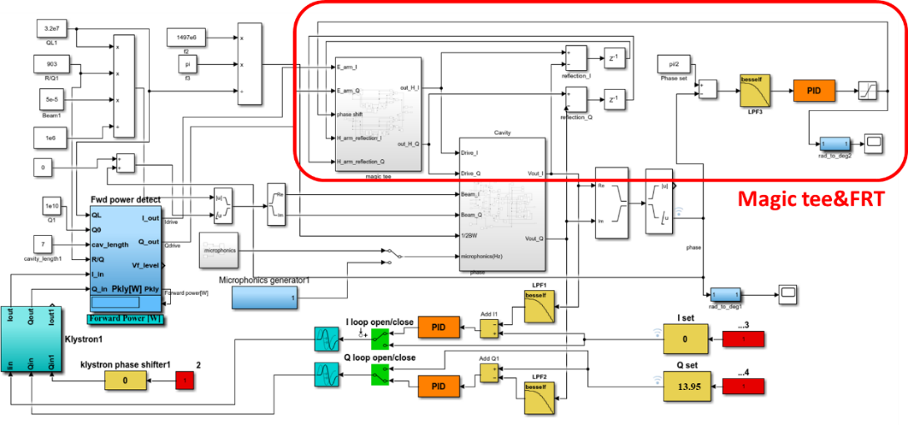
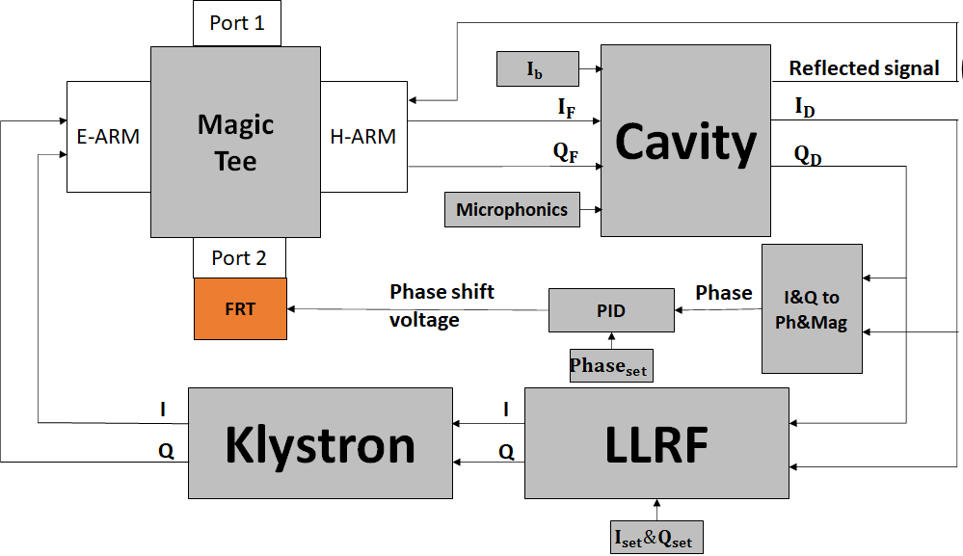
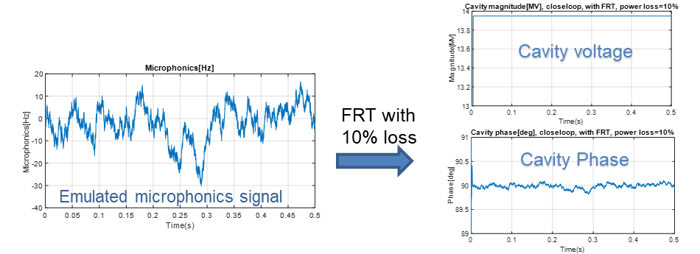
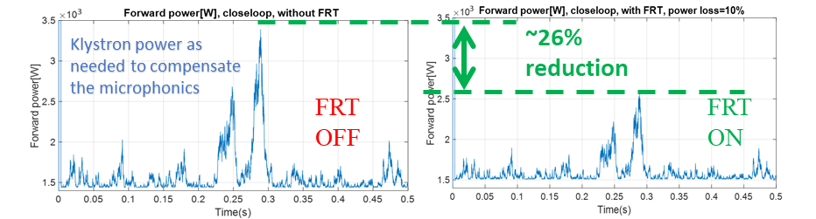
Euclid’s previous work that is relevant to WP2
Simulink modeling of the FRT microphonics compensation via the single FPC of CEBAF Cavity

Slide 4
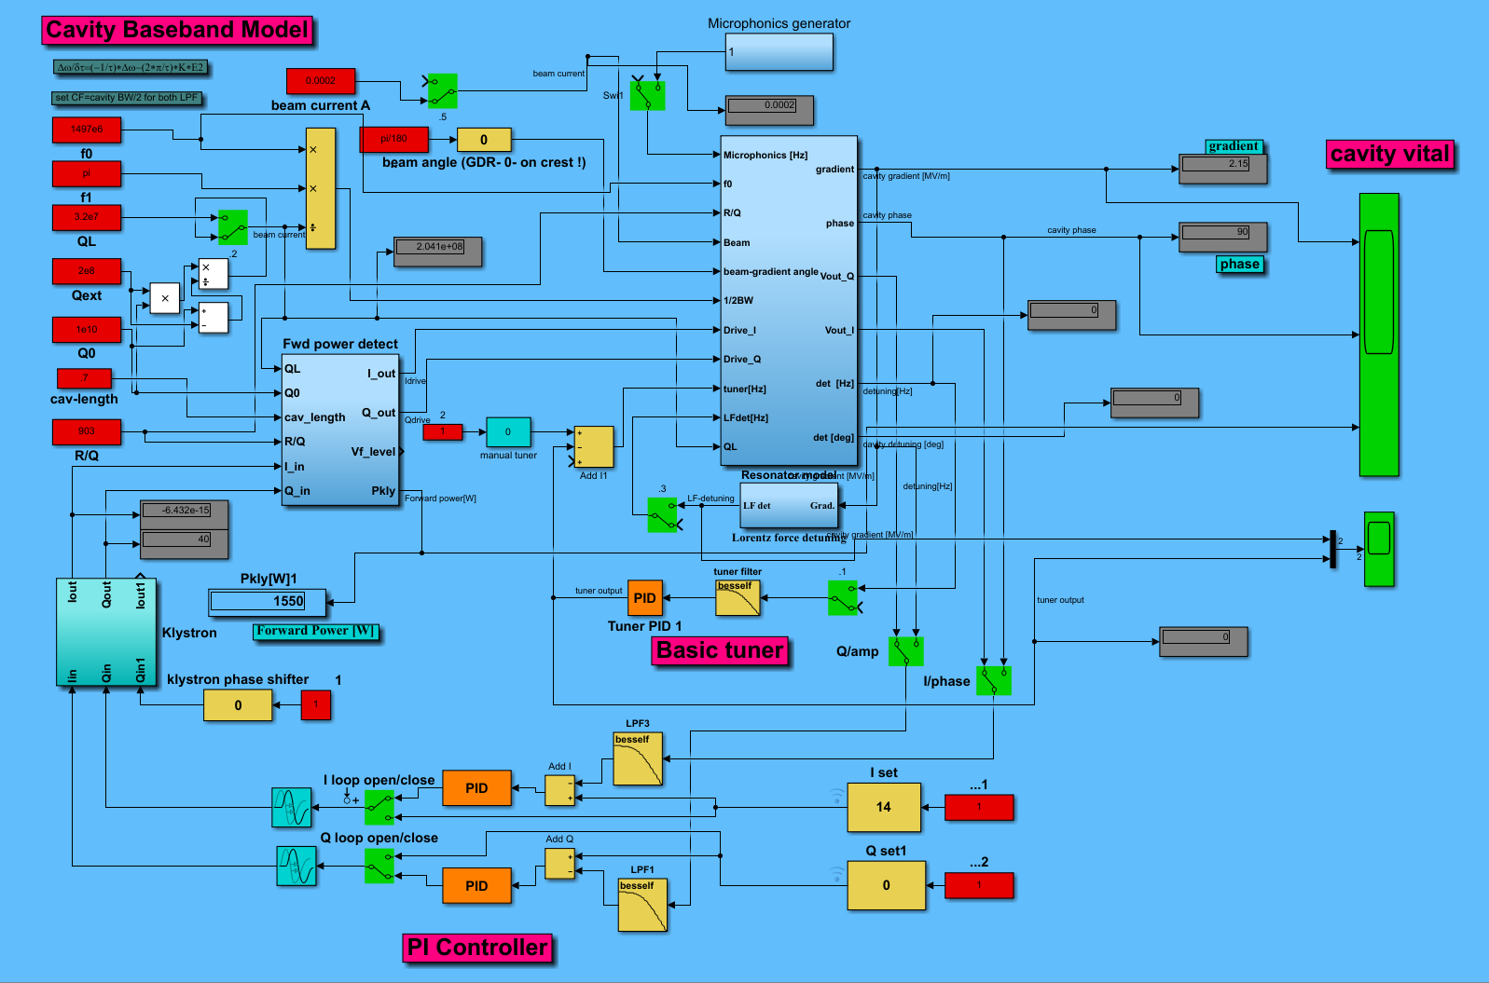

Euclid’s current work that is relevant to WP2
Euclid-Jlab collaborative work: FR-3Stub-Tuner in place of conventional 3Stub Tuner
Simulink model of adding Qext control
Lorentz force detuning
Frequency tuner turned off

Slide 5
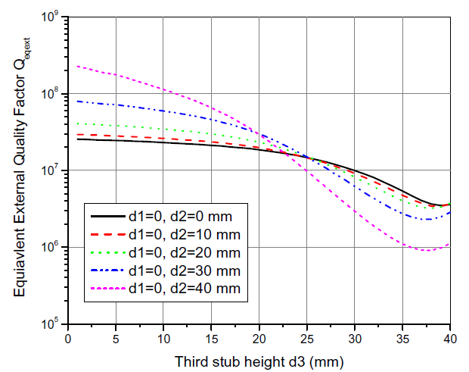
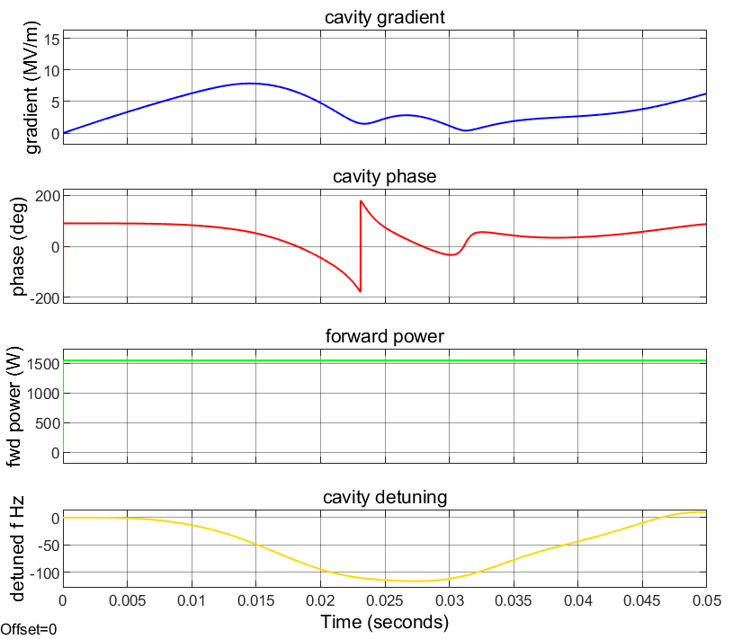
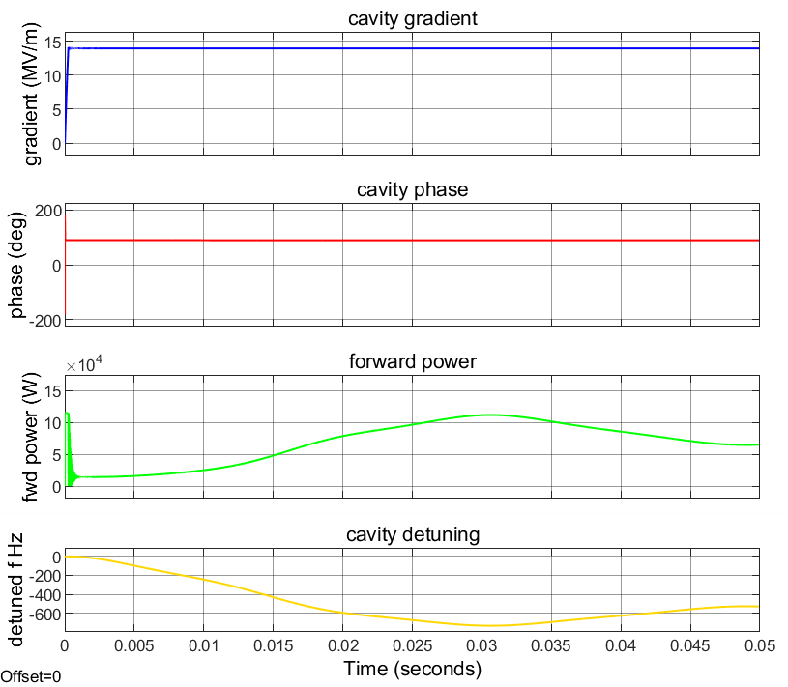
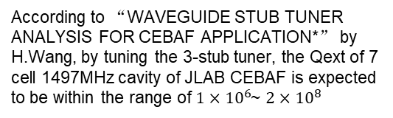


Working in progress (FR-3Stub-Tuner under development, its transfer function (impedance vs. DC bias) will be applied to the control model)
One example: only one klystron feedback loop (no piezo tuner)
According to “WAVEGUIDE STUB TUNER ANALYSIS FOR CEBAF APPLICATION*” by H.Wang, by tuning the 3-stub tuner, the Qext of 7 cell 1497MHz cavity of JLAB CEBAF is expected to be within the range of $1×{10}^{6}$~ $2×{10}^{8}$
Introduce Lorentz force detuning to the model, low Qext helps to maintain gradient but cause more frequency detuning and consumes more power from klystron.
Beam current=50uA, Qext= $2×{10}^{8}$
Beam current=50uA, Qext= $2.7×{10}^{6}$

Slide 6
Summary
  Euclid has certain experiences in developing FRT control for Microphonics compensation.
  Euclid is working on control for the under-developed FR-3Stub-Tuner
  Euclid is willing to stay at iSAS industry platform, seeking for collaborative opportunities

Slide 7
Acknowledgements
DOE, Office of Science Nuclear Physics, SBIR Program
Our collaborators
  JLab: Alex Castilla Loeza, Sergey Kuzikov, R. Rimmer, T. Powers, C. Hovater, T. Plawski
  BNL, I. Ben-Zvi
  CERN: A. Macpherson, F. Gerigk, E. Jensen,
  Fermilab: V. Yakovlev, S. Kazakov
  HZB: N. Shipman, Axel Neumann, Jens Knobloch, N. Shipman

