Slide 1


Governing Board meeting iSAS Berlin meeting
24th April, 2026
All information contained in this presentation and any accompanying documents is for iSAS project only, and must be treated as strictly confidential.
Any dissemination, distribution or other use of this information without the consent of its owner is prohibited.
Funded by the European Union. Views and opinions expressed are however those of the authors only and do not necessarily reflect those of the European Union or the European Commission. Neither the European Union nor the granting authority can be held responsible for them.

Slide 2
Governing Board meeting
Agenda
Agenda items
  Welcome and Introduction (P McIntosh, 5 min)
  Status of CA, GA and NDA (P McIntosh, 5 min)
  Proposed project extension (A De- Valera, 10 min)
  Project Risk summary (A De-Valera, 15 min)
  RF2.0 Interfacing (A Stocchi, 15 min)
  Next Project and GB Meetings (P McIntosh, 5 min)
  AOB and Summary (P McIntosh, 5 min)
Presentation(s) available on:
iSAS yearly meeting in Berlin Indico page

Slide 3
Consortium agreement, NDA, Amendment
Shared NDA for industrial partners done
Amendment (AMD) to the Grant Agreement done
Consortium Agreement (CA) done
CEA confirmed 23/4
Amendment (AMD) to the Grant Agreement to be started ~first half of Y4
A 1 year project extension to expect

Slide 4
Proposed project extension
A 1 year project extension to expect (from M48 Feb 2028 to M60 Feb 2029)
Milestone and Deliverable impacts
Delays because of procurement difficulties in WP6
  WP6.5 Assembly & test of adapted cryomodule (CEA, CNRS)
    Assembly of adapted CM from M39 May 2027 to M51 May 2028
    Report on test of adapted CM from M46 Dec 2027 to M57 Nov 2028
Delays due to the closure purpose of the deliverables considered (CNRS)
  M58 Dec 2028 WP5.3 Parametric design for a sustainable CM with iSAS techn.
  M58 Dec 2028 WP9.5 Report on energy saving performance of iSAS techn.
  M60 Feb 2028 WP9.2 Final reports of the achievement in the WPs
Addition that might follow in a project management perspective (CNRS)
  M59 Jan 2029 WP9.1 Organisation of 5th & final project meeting and report
Organisation impacts
A new AMD will be needed to validate the project extension
  To start towards the middle of RP2 (from ~M37-M43 to have a more precise & realistic viewpoint of the modifications to be made to the work plan)
  To be finalised before the end of RP2 M48 Feb 2028 (still within GA’s time limits)

Slide 5
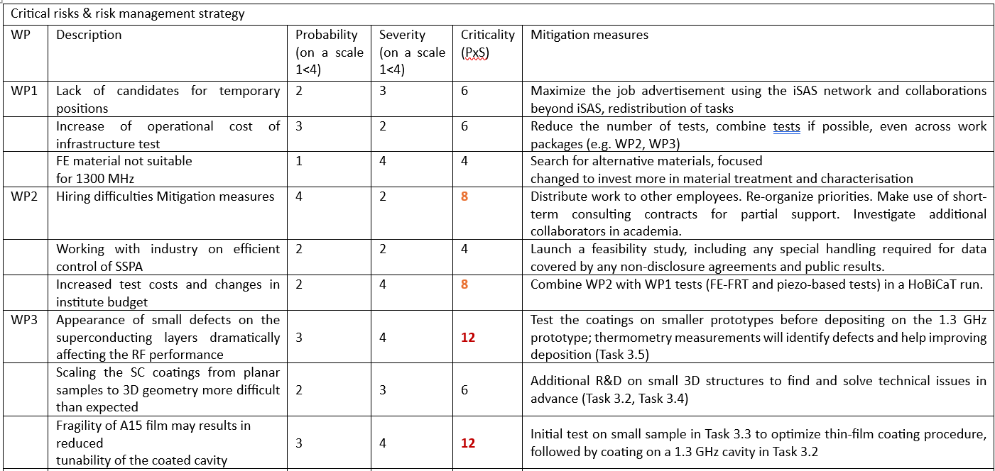
Project Risk summary
Top 3 risks per WP incl. mitigation

Slide 6
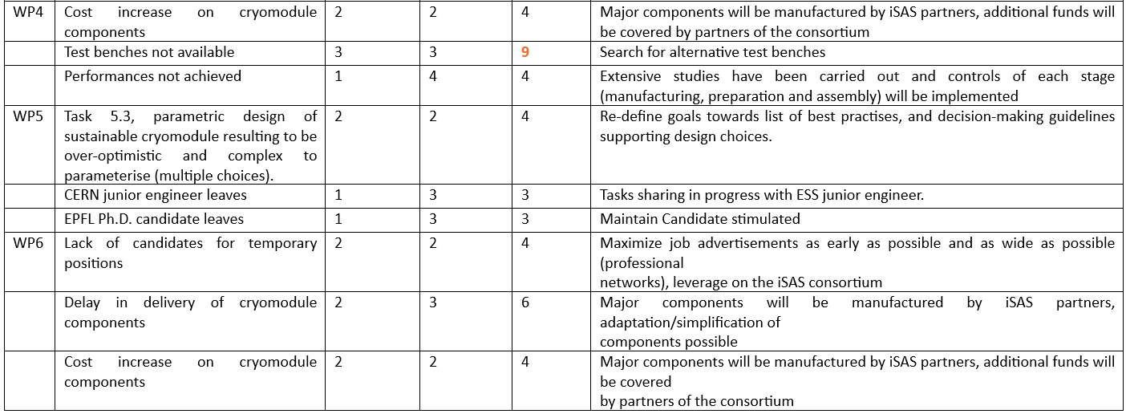
Project Risk summary
Top 3 risks per WP incl. mitigation

Slide 7
RF2.0 Interfacing
Interdependencies
Key expertise availability risk
Key INFRA availability risk
Late results from iSAS would impact new project’s ability to deliver on time
Organisation impacts
Overlap foreseen of 8 to 20 months
  New project would start June 2027 (iSAS project month 40, Y4)
  iSAS closes M48 Feb 2028 (or even M60 Feb 2029 if extension accepted)
To take into account iSAS work plan overlap & interdependencies while developing new project
Benefits anticipated
CERN strategic engagement increased (FCC)
iSAS project impact increased by developing new projects
Recognition by EC request

Slide 8
Next Project and GB Meetings
iSAS project Indico page
  Review meeting – June 1st 09:00 to 12:30 am CET
  Coordination panel – June 2 at 10 am CET
  GB meeting – tbd, in 3rd trimester 2026
  3rd annual project meeting in Lund (tbc) – tbd, in 1st trimester 2027
    Governing board incl.

Slide 9
Thank you!

Slide 10
Back up

Slide 11
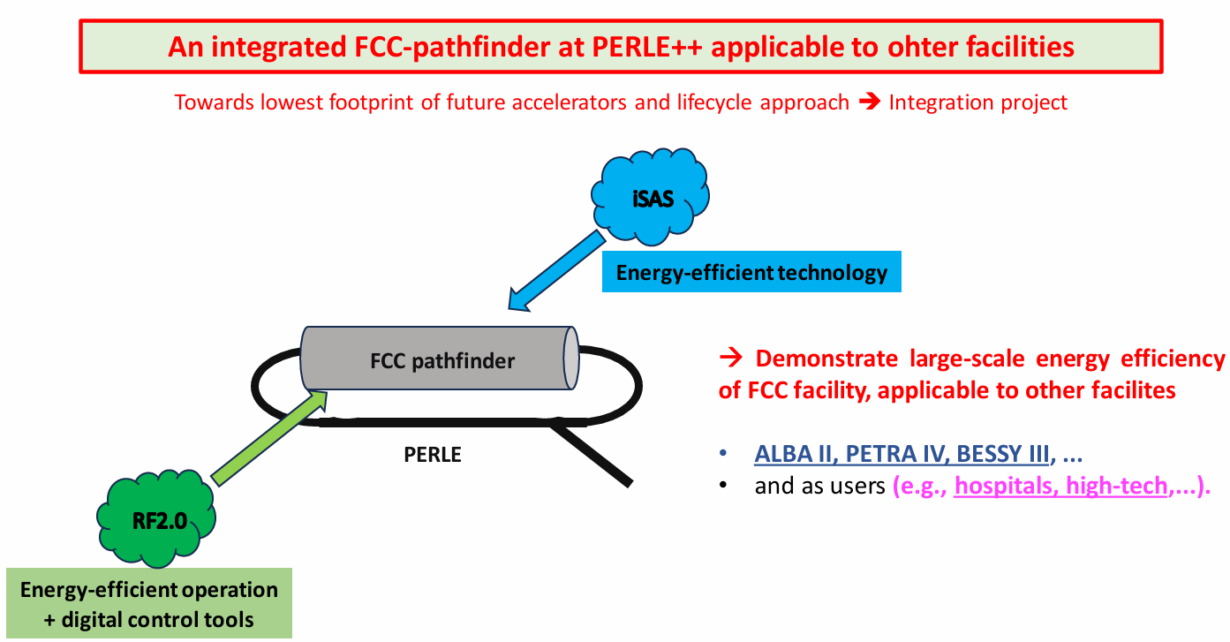
RF2.0 Interfacing

Slide 12
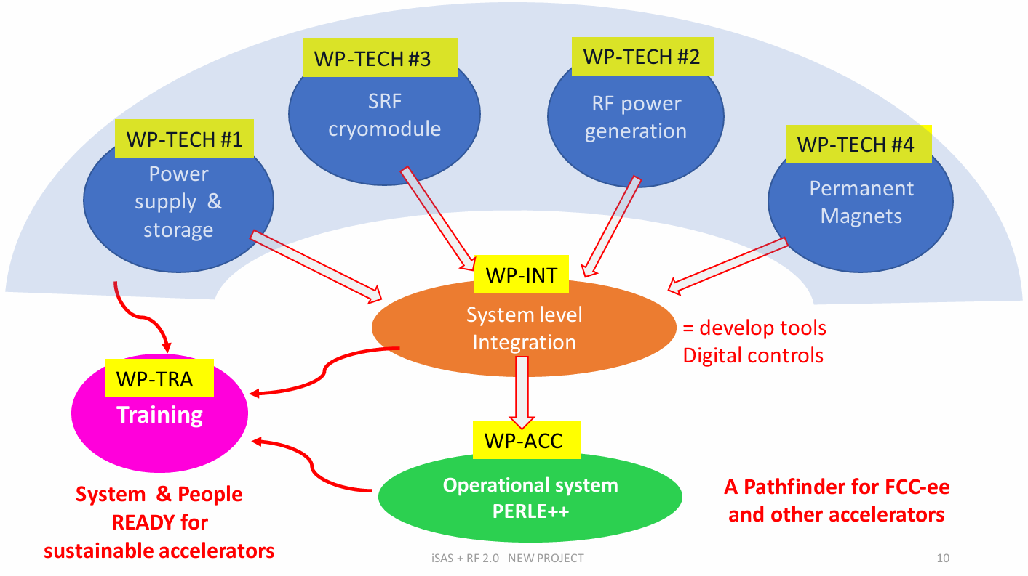
RF2.0 Interfacing

Slide 13
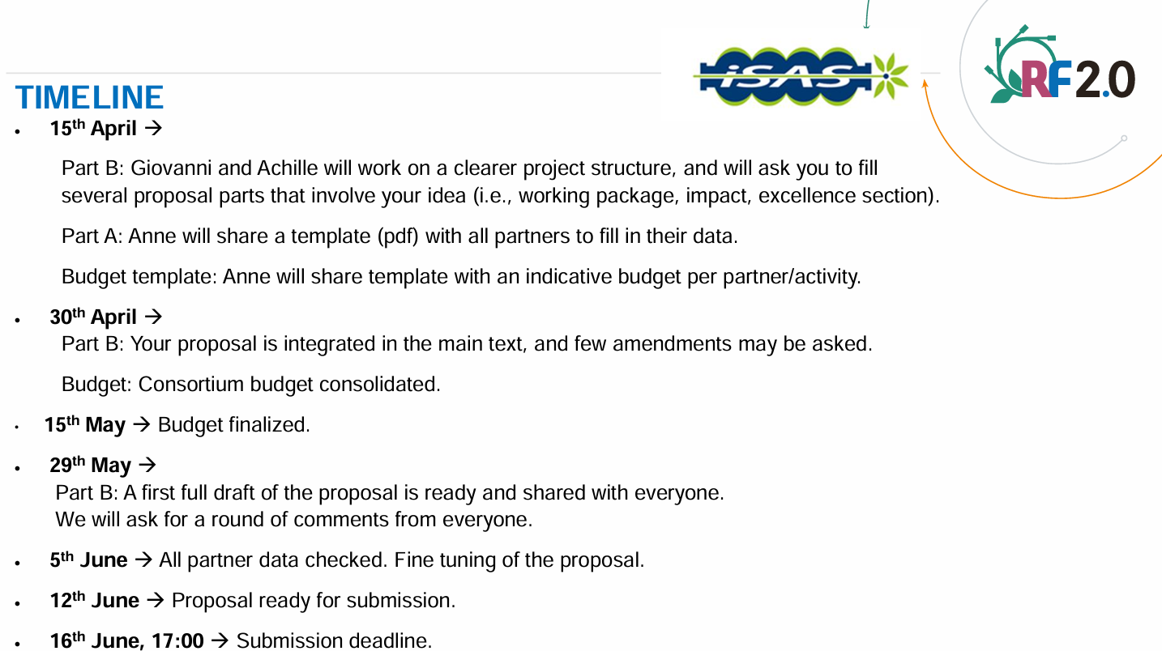

Slide 14
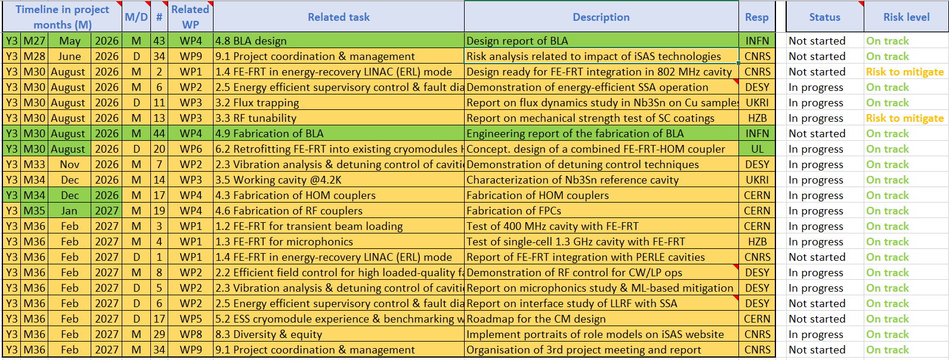
Work plan
Milestones & Deliverables status by timeline for the 3rd project year

Slide 15
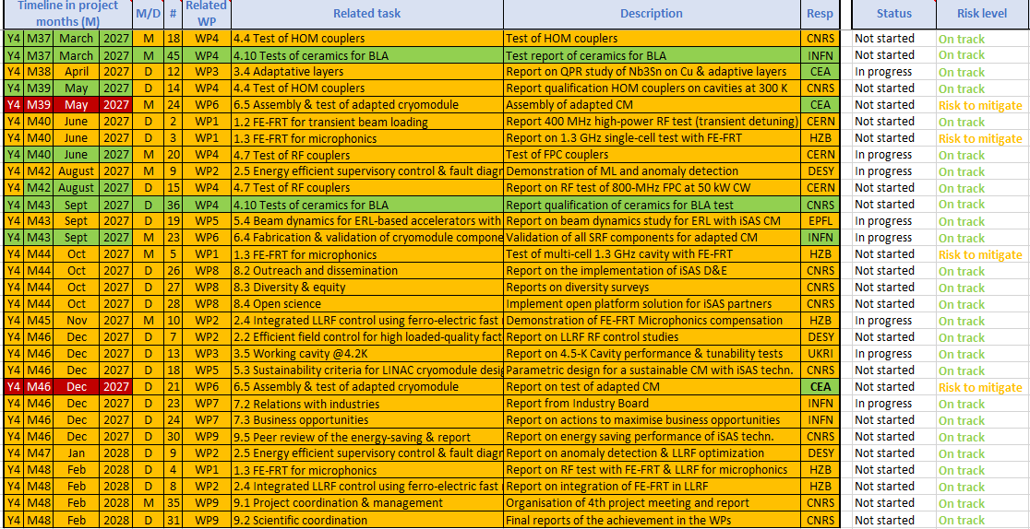
Work plan
Milestones & Deliverables status by timeline for the 4th project year

Slide 16
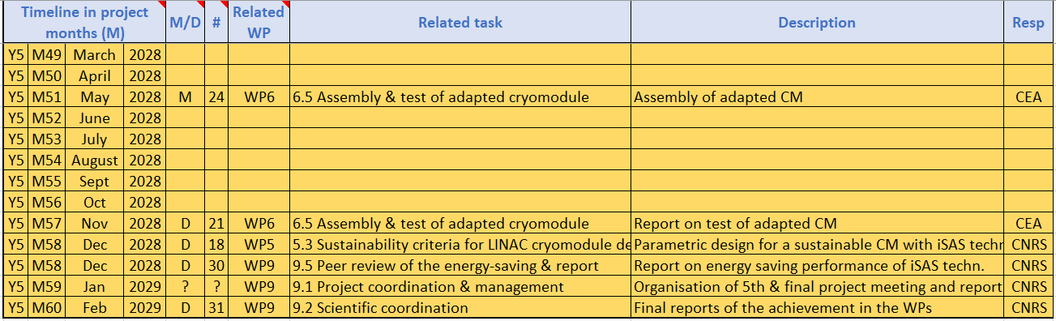
Work plan
Milestones & Deliverables status by timeline for the 5th project year (if extension, tbd)

