Slide 1



New Project iSAS + RF 2.0
Innovate for Sustainable
Accelerating Systems
Join for the next call INFRA-TECH-2026-01-01
Into a nEw PROJECT
Short presentation: the project is currently under development
and the content and the structure is not yet fully finalized.
Funded by the European Union. Views and opinions expressed are however those of the authors only and do not necessarily reflect those of the European Union or the European Commission. Neither the European Union nor the granting authority can be held responsible for them.

Slide 2
Framework of the INFRA-TECH-2026—01-01
INFRA-TECH-2026-01-01
10M€ project
The aim of this topic is to deliver innovative scientific instrumentation, tools, digitalisation, methods and solutions which advance the state-of-art of research infrastructures (RIs) in the EU and Associated Countries and show transformative potential in RIs operation. The related developments, which underpin the provision of improved and advanced services, should lead RIs to support new areas of research and/or a wider community of users, including industrial users.
Proposals should include at least two different research infrastructures as beneficiaries each of them being an ESFRI research infrastructure a European Research Infrastructure Consortium (ERIC) or another research infrastructure that is an international European research organisation

Slide 3
Framework of the INFRA-TECH-2026—01-01
Expected Outcomes
enhanced scientific competitiveness of European research infrastructures
enhanced research infrastructure capacity to address research challenges and EU policy priorities;
increased greening and resilience of research infrastructures;
increased efficiency of research infrastructures through digitalisation;
increased collaboration of research infrastructures with universities, research organisations and industry, fostering an innovation ecosystem that provides the foundations for the development of innovative companies and startups while considering EU technological sovereignty;
fostering the uptake of innovation outside the scientific research market, through co-development with industry of advanced technologies for research infrastructures;
integration of research infrastructures into local, regional, national and global innovation systems and promotion of entrepreneurial culture.
Proposal aspects
Proposals should address the following aspects, as relevant:
Research and development of new scientific instrumentation, tools, digitalisation, and methods for research infrastructures;
Their technology validation and prototyping;
Training of RI staff for the operation and use of these new solutions; when relevant, developing skills on technical validation to industrial standards;
The innovative potential for industrial exploitation of the solutions and/or for the benefits of the society, including technology concept or validation in laboratory for use by SMEs startups or scaleups.
To minimise the research infrastructures’ environmental footprint and increase resilience e.g. with respect to energy consumption, climate-related aspects or use of critical components and materials, greening and resilience aspects should be addressed for all proposed scientific instrumentation, tools, methods, digitalisation, and solutions.
Proposals should include at least two different research infrastructures as beneficiaries each of them being an ESFRI research infrastructure a European Research Infrastructure Consortium (ERIC) or another research infrastructure that is an international European research organisation

Slide 4
iSAS and RF 2.0 → new project
The two projects -iSAS and RF 2.0- had already been in contact in the past
During the mid-term review, the European reviewers recommended to RF 2.0 project to strengthen synergies between RF 2.0 and iSAS projects
Steps taken
RF2.0 + iSAS 1st concept paper prepared (iterative process) in December 2025
Discussions inside iSAS and RF 2.0 –Dec 2025 – Jan 2026)
Ideas structured into WPs at Barcelona meeting Feb 26th-27th at RF2.0 annual meeting (ALBA)
Coordinator chosen: Giovanni De Carne, RF2.0 project coordinator from KIT
TIARA meeting March 18th for presentation & comments
A project structure proposed (see this presentation with 4 slides !)
Present/Next steps
Core writing team setting up
Feedback from the different WP (see later) for the 1th May and cost evaluation to fit into 10M€
Proposal to be submitted to INFRATECH call by 16th June 2026 (very tight)

Slide 5
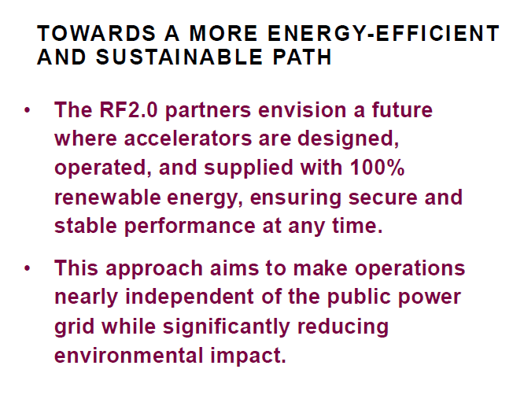














iSAS and RF 2.0 in the nutshell
The objective of iSAS is to innovate those technologies that have been identified as being a common core of SRF accelerating systems and that have the largest leverage for energy savings with a view to minimizing the intrinsic energy consumption in all phases of operation
Innovate for Sustainable
Accelerating Systems
In the landscape of accelerator-driven RIs, solutions are being developed to reuse the waste heat produced, to develop energy-efficient magnets and to operate facilities on opportunistic schedules when energy is available. The iSAS project has a complementary focus on the energy efficiency of the SRF accelerating technologies themselves.
LNL
Milano

Slide 6
Is an integration project to optimise the power use from grid to particle beams
Significantly reduce the overall energy consumption of particle accelerators by developing an integrated system-level approach of the technologies successfully developed in the RF2.0 and iSAS projects + additional ones which have addressed the energy-use efficiency of
the external power delivery to the accelerator and operation (RF 2.0)
the internal power use of the accelerator (iSAS)
The project also aims at developing digital controls at the system level that are not available to designers and operators, and guidance for adoption in existing and future facilities. For the first time an integrated standardization of energy sustainability solutions for entire particle accelerator systems will be developed, together with energy-efficiency performance monitoring tools

Slide 7


Project structure
Inputs from RF2.0 & iSAS
Device level
Re-usable magnets
Magnetrons
Device-to-System
Cryomodule
SSA (Technology & System integration)
System level
UPFC @ CERN
Geothermal
Sustainable computing
Training, Transfer to industry
Strong Link/Hardware
System-to-Sustainability
Energy monitoring
LCA software
Strong Link/Hardware
Weak Link/Data
Demonstration stage: integrated system-level approach of the technologies
              PERLE++
              Several Single-site demonstrators

Slide 8
WP1 – Requirement analysis for future accelerators
WP12 – Training & Transfer
Device Level supported by previous research
RF tech
RF
design
Magnet
design
Pow. Elec.
Analysis
AI-computing
NEW
NEW
WP 6
WP2 – Magnetrons
(Stabilization of RF sources
WP3 – Re-Usable Magnets
WP6b – System Level SSA (DC)
WP7 – UPFC @ CERN
WP8 - Geothermal
WP9 – Sustainable Computing
NEW
NEW
WP4 - IoT
WP5 – Cryomodule
« FCC »
WP6a – Converter Level SSA (800, 1.3)
Grid data
Materials
Power
flexibility
Energy
reduction
Energy reduction
WP10 – LCA Software
WP11 – Energy Monitoring
Energy
potential
NEW
LCA
assessment
Just arrived
LCA
strategy
WP13 – PERLE++
Single-site Demonstrators (DESY, XFEL, HZB, CERN, Soleil, MAX IV, KARA,ESS)

Slide 9
WP structure
WP | Description | Laboratories involved (tentative list) | Demonstrator
WP1 | management | KIT, all | -
DEVICE LEVEL
WP2 | FE-FRT for Magnetron | HZB, IJCLAB | HZB , PERLE ++
WP3 | Re-Usable Magnets | HZB, Soleil, Fraunhofer, IJCLAB | several and PERLE++
DEVICE-TO-SYSTEM LEVEL
WP4 | iOT | IJCLab, CERN (Thalès)
WP5 | FCC Cryomodule | CERN, IJCLAB, LPSC, ESS | PERLE++
WP6 | SSA (500MHz,800MHz,1.3GHz) | IJCLAB, ALBA, DESY, ESS (Jema-France, Commtia, Cryoelectra) | PETRA IV, ALBA, IJCLAB and PERLE++
SYSTEM LEVEL
WP7 | UPFC | CERN, KIT | CERN
WP8 | Geothermal | KIT
WP9 | Sustainable Computing | DESY, KIT | DESY
SYSTEM-TO-SUSTAINABILITY LEVEL
WP10 | LCA | KIT, MAX IV, LPSC, IJCLAB, HZB,ESS | PERLE++
WP11 | Energy Monitoring | CERN | CERN
WP12 | Training and Tranfert | MAX IV, Ineustar, HZB, ALBA, IJCLab, LPSC
WP13 | PERLE++ | IJCLab, LPSC, CERN, HZB | PERLE++

Slide 10
An integration project
to optimise the power use from grid to particle beams
  Device, Device-to-System and System Levels
  System-to-Sustainability : creating tools - Energy monitoring and LCA
  Validation of all these innovative solutions in an exiting accelerator facilities (DESY, XFEL, HZB, CERN, Soleil, MAX IV, KARA,ESS) and in a single site for several validations PERLE++

Slide 11
Back up slides

Slide 12
Importance of Energy-saving and sustainability in ESPP2026
Technologies -Accelerator science and technology
Several technology approaches directly address the requirement of greater sustainability for future accelerator-based facilities. These include superconducting magnets and resonators operated at higher cryogenic temperature, superconducting current links, use of permanent magnets, and more efficient RF power sources, complemented by a more extensive use of robotics and artificial intelligence.
…R&D efforts to enhance the sustainability and energy efficiency of accelerators from design to operation and decommissioning should be supported.
Sustainability and environmental impact
For new proposed projects, a detailed life cycle assessment should be carried out at each stage, from concept to design and implementation, in order to quantify and minimise environmental impact.
The particle physics community should continue and intensify its efforts to develop and adopt sustainable solutions.

Slide 13
WP2
Stabilization of RF sources for more efficient and cost-effective RF operation of accelerators.
Standard frequency is the EU-XFEL frequency of 1.3 GHz which allows us to maximize the project's short- and long-term impact, by addressing both magnetron stabilization and rapid phase shifting for very effective vector-sum control. This allows one to implement efficient and cost-effective RF operation by enabling several cavities to be run simultaneously with a single efficent, low-cost RF power supply (e.g. IOT). Such an approach is the base-line for the upgrade of the EU-XFEL to long-pulse/CW operation. Hence, building on the developments in iSAS, this system could be easily retrofitted an existing facility, while also laying the foundation for future magnetron developments for accelerators.
We identified the most critical items and compiled a list of milestones designed to maximize this output and minimize costs. Once proven, the concept could be directly applied to the stabilize CW magnetrons at lower frequency (such as PERLE/FCC) by appropriate scaling.
Arguments:
Ultra-fast, low loss phase shifter itself is the key component for magnetron stabilization
Essential ancillary is a high-power capable FRT with high voltage pulser and the associated scheme to drive the cw saw tooth signal for constant frequency correction
The developments build upon iSAS FRT know-how. In iSAS2 this would be advanced to enable rapid discharge between ramp up/down for magnetron control.
Key is to maintain low losses for phase shifting at high RF power: The FRT Figure of Merit (FoM) is the key parameter
Two areas for demonstrators:
  Frequency and phase locking to demonstrate the pre-requisites for magnetron stabilization
  Phase and amplitude manipulation to boost capabilities of vector sum control
1.3 GHz advantage:
  More applications: E.g., Magnetron stabilization (still relatively low TRL within iSAS2) and direct application (higher TRL within iSAS2) for vector-sum control targeting a key ESFRI facility (XFEL).
  The normally prohibitively expensive high power RF hardware needed for the project is already available at HZB and can be considered in-kind contribution (high-power RF sources and passive RF components)
Future shifting to FCC/PERLE frequency is considered low-risk and would actually improve performance (FoM improves with decreasing frequency).
We recommend the development of an RF chain with two phase shifters at 1.3 GHz and the demonstration of phase and amplitude manipulation in a vector sum topology in the HoBiCaT test facility with two TESLA cavities simultaneously. This demonstration is the setup closest to final implementation in a machine such as CW-XFEL.
The resulting setup will provide hardware which is “magnetron-ready.” Once a 1.3 GHz magnetron is available, e.g. via the EPITA project, frequency and phase locking could be demonstrated with minor adjustments. Furthermore, the developed hardware will be widely applicable to facilities based on TESLA technology.

Slide 14
From Electromagnets to Permanent Magnets (HZB, IJCLab, …)
(Lesson learned from RF 2.0 motorized PM magnet; gradients tuning , slow mechanical, fast electrical tuner, ALBA, MAX IV, HZB…)
WP 3
Permanent Magnets
Use of most of the PM material (150kg) from an old Undulator in BESSYII for Recycling @ Fraunhofer.
The material will be powdered and reshaped into small blocks for a Test-Undulator and large blocks for PM-based Magnets.
Additionally, new PM blocks by VAC (Mil-Std) with the same size as the large blocks will be ordered, for comparison
Different PM block will be individually measured and used for prototyping:
  Dipole- and/or QP-Magnet for PERLE that could be based on BESSYIII concepts incl. Test and installation in PERLE
  Magnet prototyping for BESSYIII (QPs, DPs)
  Test-Undulator
Assembly and Magnetic measurements of test magnets and prototypes

Slide 15
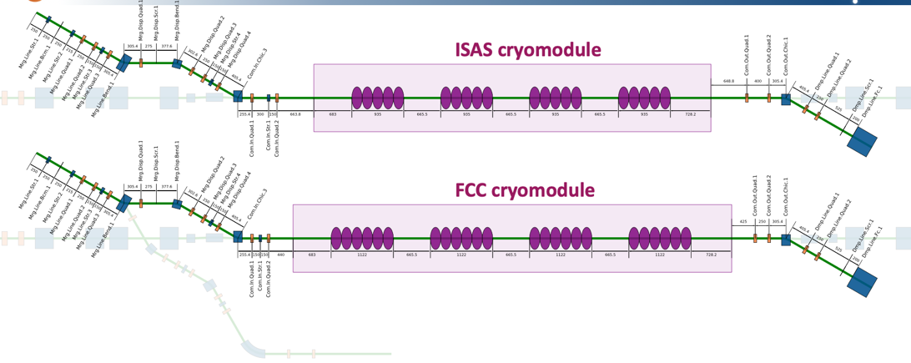
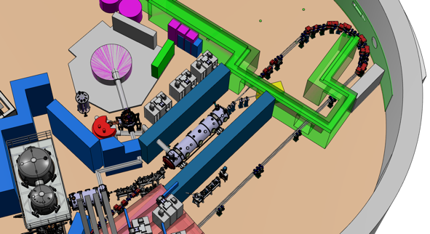
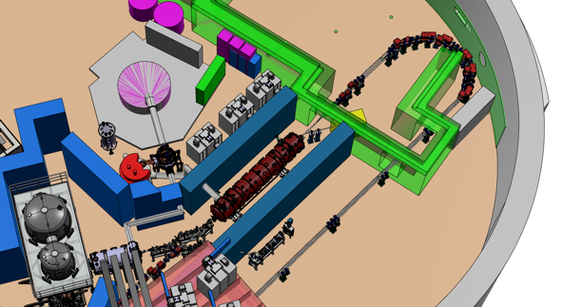
WP5 : SRF cryomodule
Develop an innovative FCC-ee cryomodule (lessons learned from iSAS)
First
Avec CM PERLE
Avec CM FCC
With the first cryomodule
With the FCC cryomodule
In addition, in PERLE we can test different power sources SSA and IoT, developed in this project

Slide 16
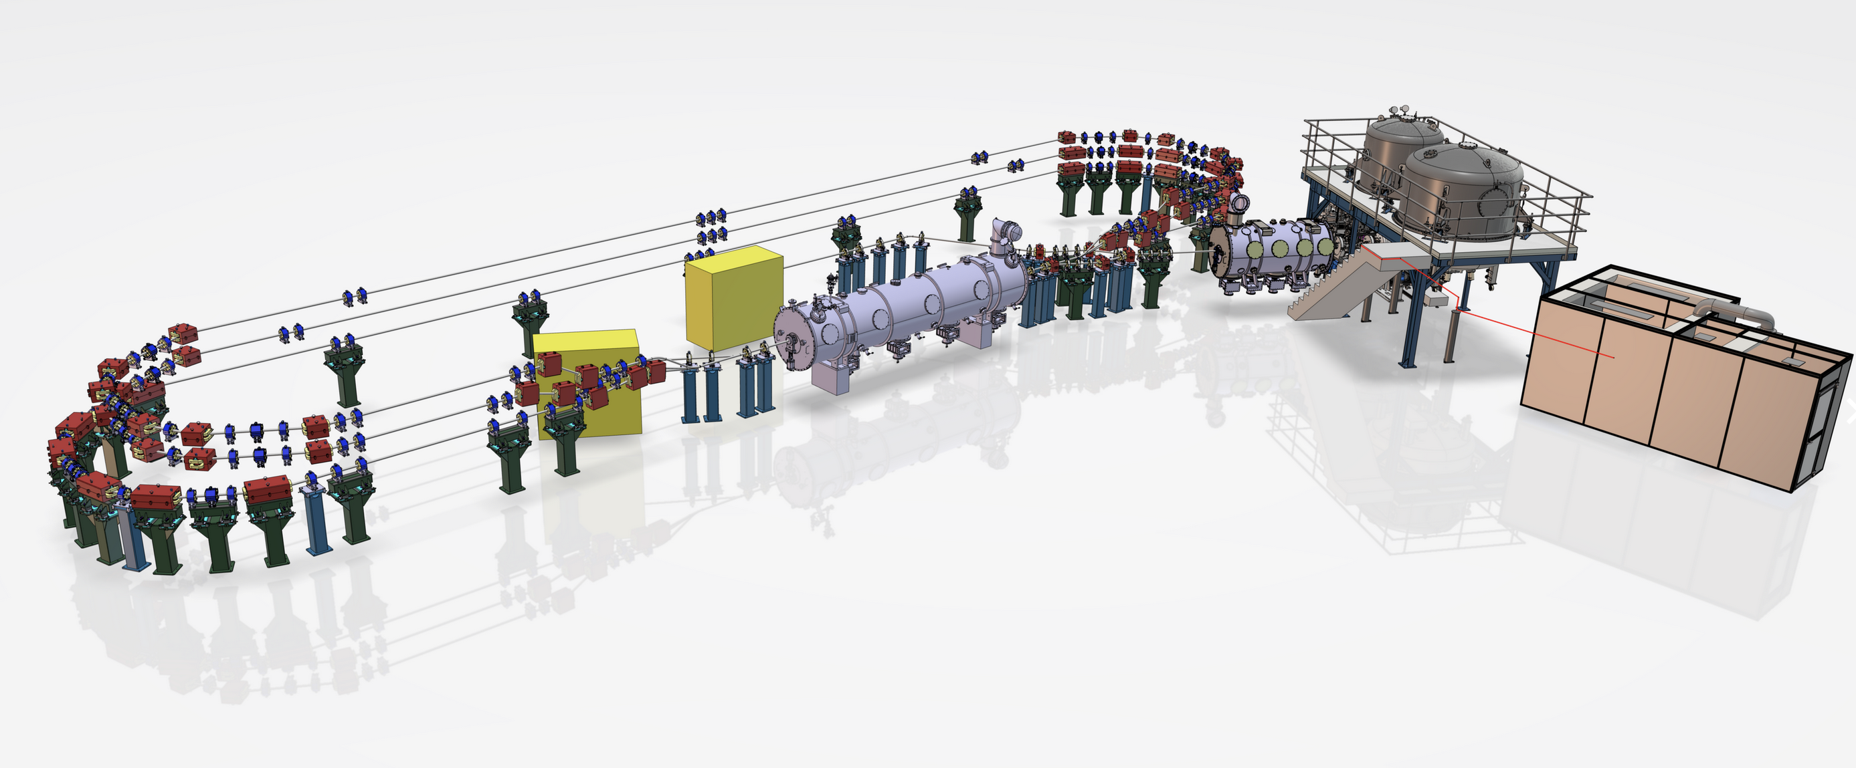
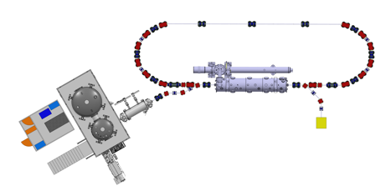
Two phases :
1-turn ; 3-turns
PERLE @250 MeV 3-turns (ERL demonstrator)
PERLE @89 MeV 1-turn
(ERL demonstrator, FCC-ee test facility)
adapting PERLE to host all the innovations-→ PERLE++
operating PERLE++ as a Pathfinder to demonstrate energy efficiency solutions for future colliders (FCC-ee), based on LCA

Slide 17
UPFC (Unified Power Flow Controller) -like demonstrator to increase resilience of accelerators (for FCC). Never tried before in an accelerator system.
WP7
Regulating power supply and storage
High TRL 7-8 with available commercial solution
In continuation of RF2.0 : correlation of electrical disturbances and their impact on the accelerator operation
Network analysis to define system requirements
Technology:
  STATCOM (shunt Q compensation)
  DVR (series V ride-through capabilities)
  Shared DC-link (w/optional energy storage)
  Design and manufacturing through industrial suppliers of small scale (~3-500kW) demonstrator.
Installation on a test bench and, if operations will allow, on CERN MV network:
  Dummy load for proof of design and validation
  Sensitive load (selected LHC 18kV feeder for system testing)

Slide 18
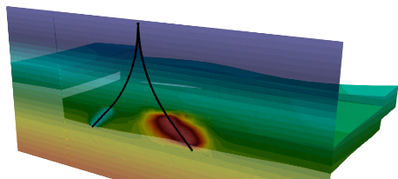

WP8
Regulating power supply and storage
Geothermal systems for energy storage.
Important for cooling accelerator needs (KIT,…)
Energy damand, infrastructure mapping, subsurface optimization, storage scenarios, geological context, economic impact
HT-ATES system representation
RF2.0: major focus on electrical energy optimization;
New Idea: shift the attention on heating systems and ways to store long-term energy → High Temperature Acquifer Thermal Energy Storage (HT-ATES) systems. Large potential in storing GWh of thermal energy, to be used for cooling purposes. To be combined with renewables and electrical storage systems.
HT-ATES energy storage potential in Upper Rhine region

Slide 19
WP6. SSA
RF power generation
800MHz SSA optimised design (CERN, IJCLab,ESS)
  Development of a modified RF amplifier with optimized transistors
  Industrial partners JEMA FRANCE and Ampleon (TBC).
500MHz (ALBA)
  design and development of a Shared DC Distribution for Multi-Frequency SSAs to Improve Overall System Redundancy, Availability, and Efficiency
  Industrial partners Commtia
1.3GHz (DESY,)
  A 1.3GHZ amplifier with dedicated pulsed power supply for the upgrade of XFEL. Aim is to cut the alimentation only during the pulses
  Industrial partners CryoElectra

Slide 20
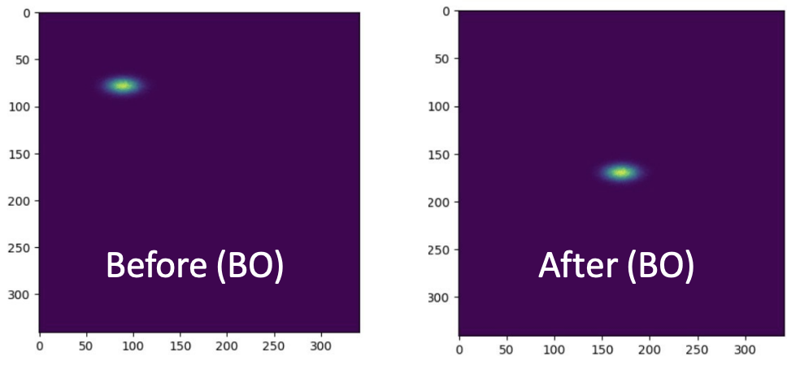
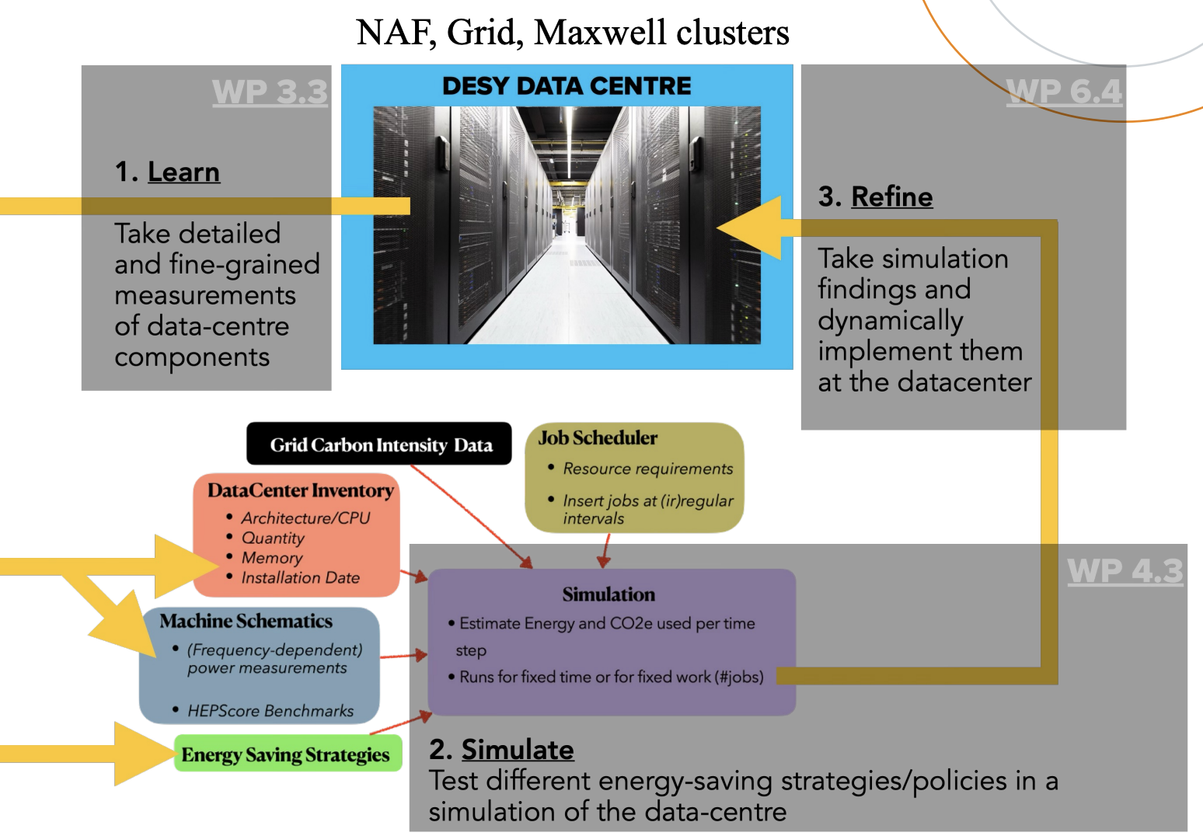
WP9
System level digital controls
Sustainable computing features embedded already in the new PETRA IV.
Digitalization for optimizing accelerator operations (KIT, DESY…)
RF2.0: beam positioning correction by means of Bayesian optimization; digital twin of accelerator and High Power Computing (HPC) center; forecasting renewables;
New Idea: develop a central software brain tool, able to integrate the intelligence of accelerators (all sysytems), data centers and renewables, in a single decision-making tool. This will allow to exploit the maximum power flexibility of accelerators and their connected facilities.
Bayesian optimization of beam positioning
Approach for developing the HPC Digital Twin

Slide 21
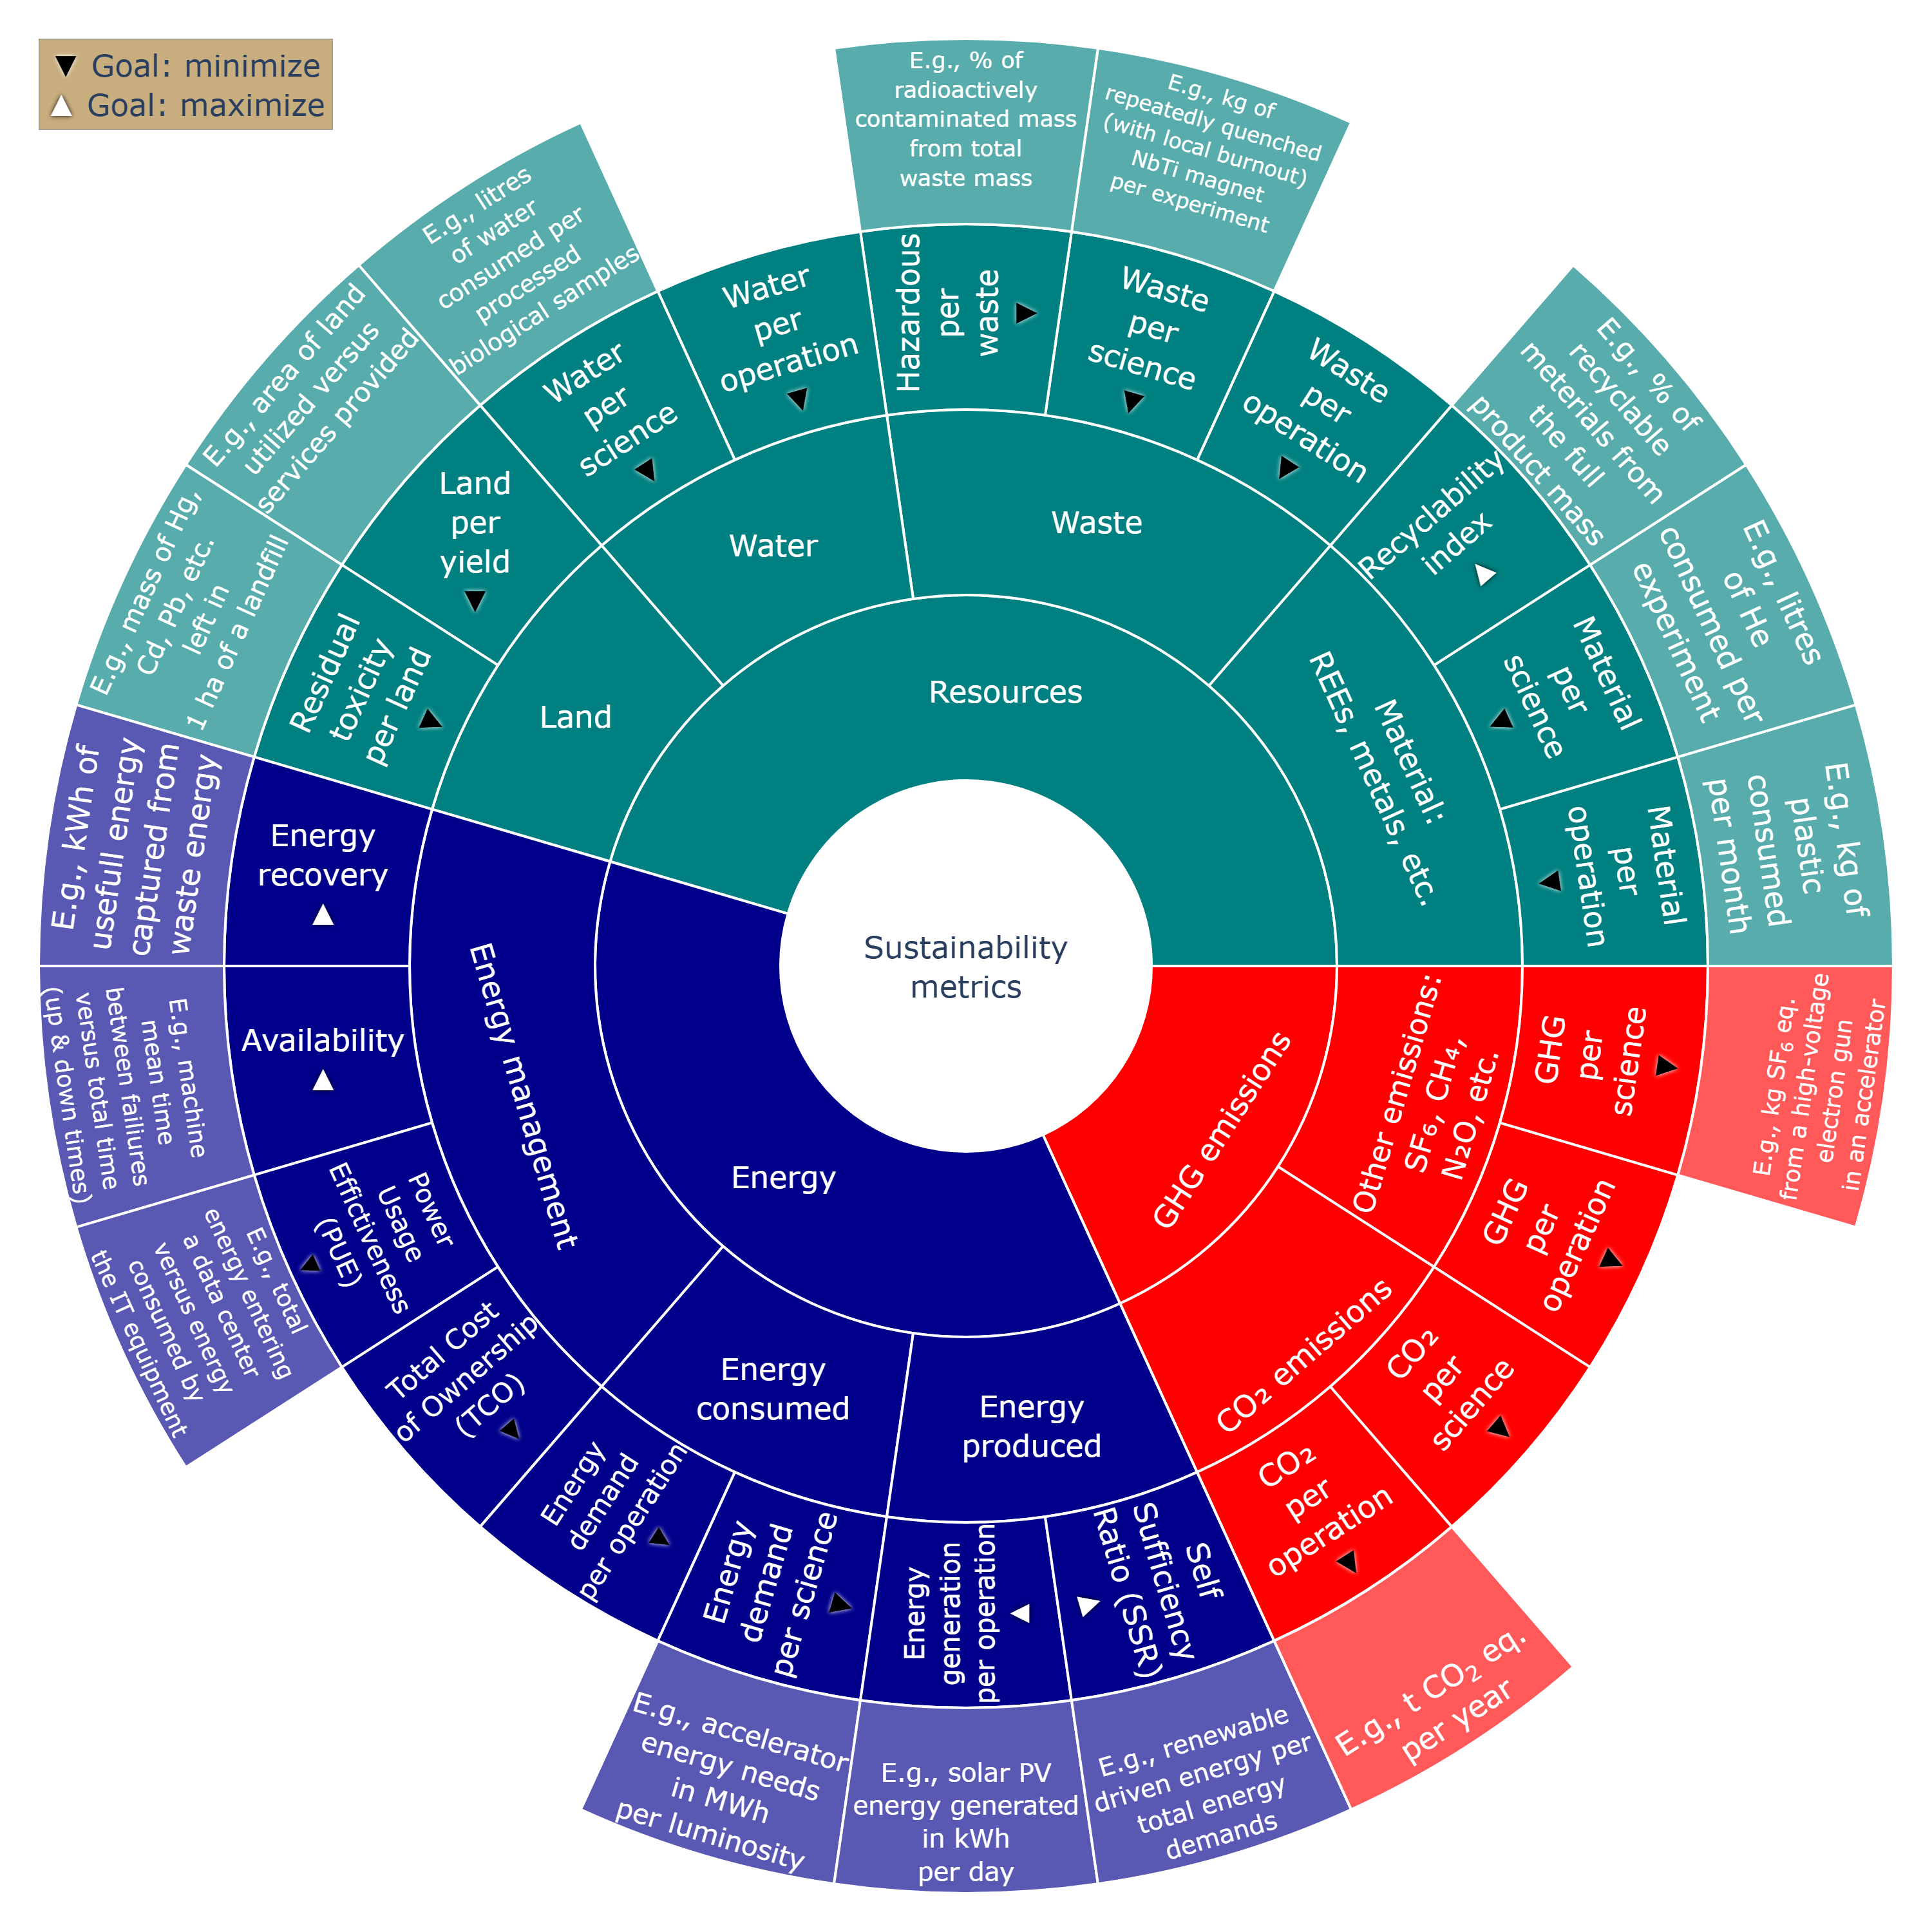
Long-Term LCA Analysis for future facilities to be able to quantify the impact of the new project
WP10 Developing the LCA framework to quantify the benefits
(look for possible overlap/synergyes with iRIS)
RF2.0: Initial LCA, energy and costs analysis for several RF2.0 facilities. iSAS evaluation of the operational cost saving by comparing the electrical consumption with and without the technology in similar conditions
New idea: Develop a software tool to calculate the LCA, of future accelerator to demostrate the benefits to implement the solutions developped in this project.
From the componets level to system level (developped in this project)
Validation of the tool in PERLE and ALBA II
First sustainability analysis of accelerators

Slide 22

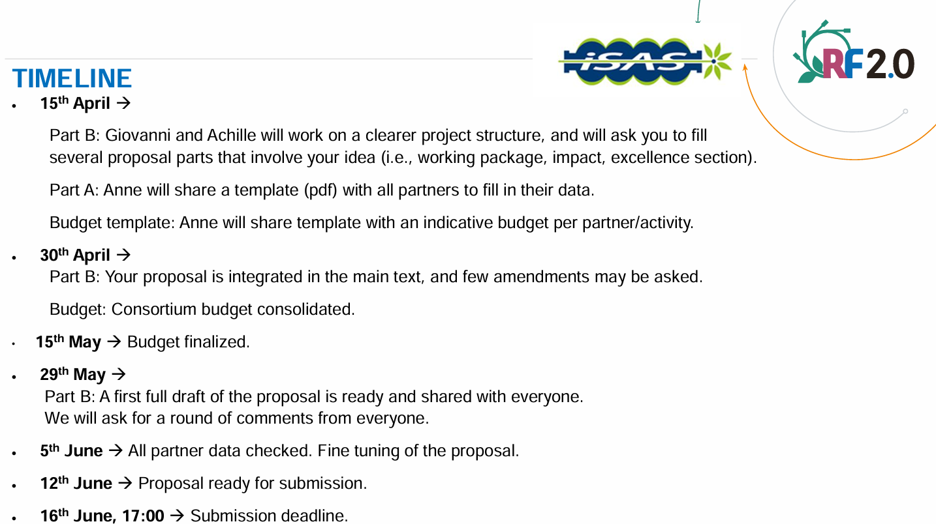

Slide 23
