Slide 1
COFFEE
(Cracow-Orsay Fission Fragment Exclusive Experiments) project
Michał Ciemała,IFJ PAN
Jonathan Wilson, IJCLab
17/11/2025, Workshop IFJ PAN – IJCLab

Slide 2
Presentation plan
COFFEE project general information and goals
Status of the preparation for the CCB IFJ PAN experiment of the proton induced fission of ²³²Th
HPGe at ALTO/IJC Lab – status
IJCLab activity in 2026 planned NFS/GANIL experiment: fission of ²³²Th
COFFEE 2025 requested founding, and used one; requested founding for 2026
Conclusions

Slide 3
COFFEE (Cracow-Orsay Fission Fragment Exclusive Experiments)
COFFEE PROJECT GOALS:
•Spectroscopic study nuclear fission using complimentary techniques at CCB and ALTO including IJCLab@GANIL NFS: Spectroscopy of fast neutron-induced fission
•CCB: high energy proton induced fission (control of compound nucleus excitation energy)
•ALTO: light charged particle, HI induced fission and spontaneous fission (FROZEN)
•To add value to existing setups/equipment/detectors and best exploit current common expertise

Slide 4
COFFEE (Cracow-Orsay Fission Fragment Exclusive Experiments)
COFFEE PROJECT COMPLIMENTARITIES
• Experience with development of hybrid spectroscopy systems at CCB, ALTO (and Warsaw) we developed detection systems which exploit synergies between different types of detectors (Scintillators, Ge, Semiconductor, etc.). Easy integration only recently possible due to fully digital electronics. Scope for technical improvements.
• Existing collaborative activities: Recent nu-Ball2 project at ALTO. The gamma decay from high-lying states and giant resonances excited in stable isotopes via (p, p’) and (n,n’) reactions. Evaluation of the nuclear theory virtual services Theo4Exp implemented at IFJ PAN. Development of the PARIS Array towards 4π.
• Mutualizable equipment: Ge detectors, PARIS 2pi, DSSD (Warsaw), fission fragment detectors, etc.

Slide 5
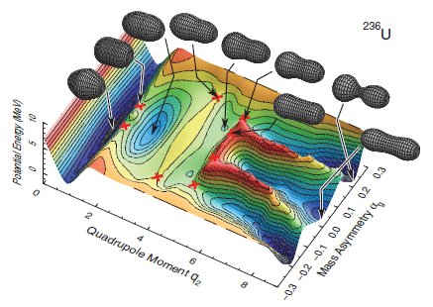
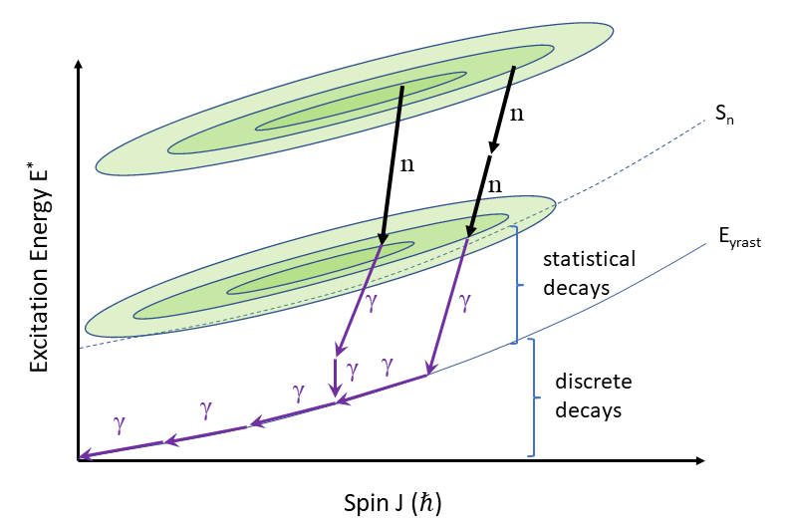
Fission - motivation
A’, Z’, v’,
E*’, L’
A, Z, v ,
E*, L
Ichikawa et al., PRC (2012)
PES topography (system A and Z) and E*_{ini}
Outcome depends on: Dynamics
Fragment entry point (E*, L)
Fundamental nuclear properties
Fragments A_{1,2} , Z_{1,2} , TKE=KE₁+KE₂
Possible observables in experiment: Neutrons M_{n} , E_{n}
γ-rays M_{γ} , E_{γ}

Slide 6
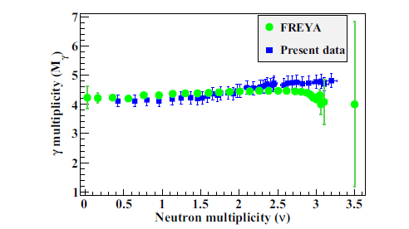
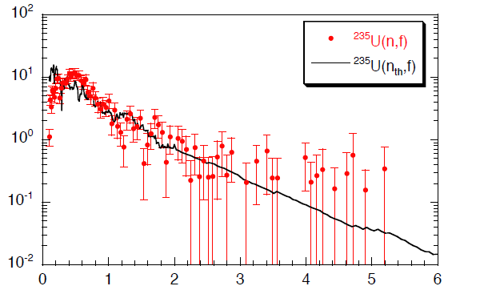
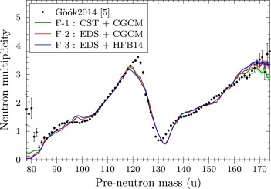
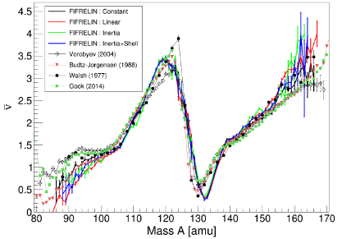
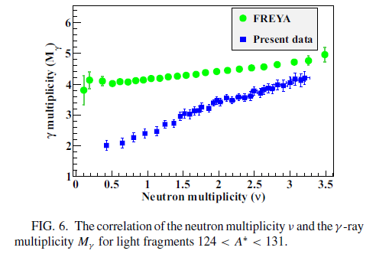
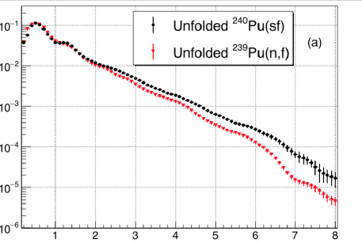
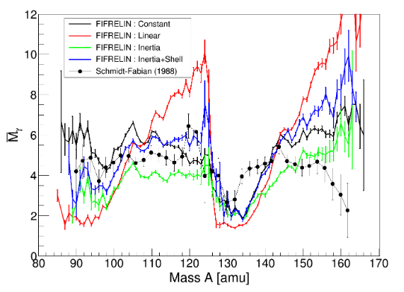
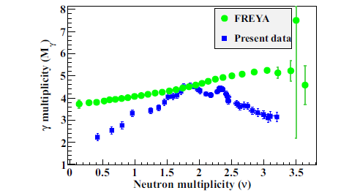
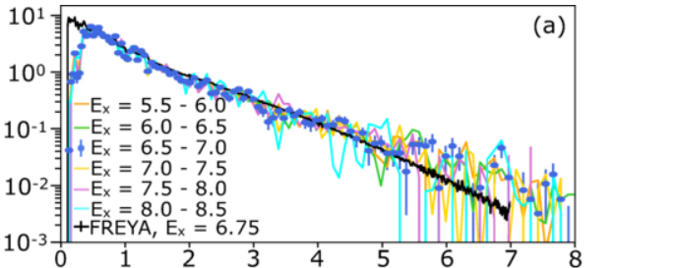
Fission - motivation
Expt ²⁵²Cf
Model
Oberstedt et al.,
PRC (2013)
Expt ²⁵²Cf
Models
85<A<123
Expt ²⁵²Cf
Model
V. Piau et al., Phys. Lett. B 837, 137648 (2023)
Expt ²⁵²Cf
Models
Normalized γ yield/fision
124<A<131
Chzyh et al.,
PLB (2018)
Expt ²⁵²Cf
Model
Gjestvang et al.,
PRC (2021)
²⁴⁰Pu(d,p)f
Thulliez et al., EPJ Web Conf (2016)
132<A<166
Wang et al., PRC (2016)
Complex and possibly « perverse » interplay between the plenty of aspects affecting fission
E_{γ} (MeV)
Fission physics and
general nuclear
properties
Many open questions…
Generation of E* and L, and sharing between the fiss. Frag. at scission
Nuclear binding energy and shell effects
Nuclear level density
γ-ray strength function

Slide 7
Scientific Program
Fission studies at CCB
Use of (p,p’) reactions at around 200 MeV to induce fission and detect outgoing protons in the KRATTA detectors. Control the excitation energy of the compound nuclear system up to several tens of MeV. With the addition of plastic scintillators to detect fission fragments the following questions can be addressed:
• Study of the transition from asymmetric to symmetric fission modes as a function of excitation energy, in a region complementary to IJCLab or GANIL / NFS;
• First information on the PFGS in region -> possible new signature of the « thorium » anomaly;
• Study of possible collective excitations (PDR, GDR) in fission fragments;
• The high excitation energies at CCB will allow study of the fission of ²³²Th as well as of sub-actinide nuclei such as ²⁰⁸Pb, ¹⁹⁷Au, ¹⁹⁶Pt, ¹⁸⁶W, etc. where fission barrier heights are around 25-30 MeV. Measure Prompt Fission Gamma-ray spectra as a function A and E* for each system.

Slide 8
Accepted (2024) experiment at CCB:
Evolution of prompt fission γ-ray emission with excitation energy and the Thorium anomalies
IFJ PAN Krakow (Poland): C. Schmitt, M. Ciemała, M. Kmiecik, A. Maj, B. Fornal, P. Bednarczyk, N. Cieplicka-Orynczak, M. Matejska-Minda, L. Iskra, M. Ziębliński, J. Łukasik, P. Kulessa, P. Pawłowski, J. Grębosz, K. Mazurek, I. Dedes, B. Sowicki, et al.
IJCLab Orsay (France): J.N. Wilson, M. Lebois, I. Matea, et al.
IPHC Strasbourg (France): C. Schmitt, D. Curien, F. Didierjean, O. Dorvaux, G. Duchêne, J. Dudek, N. Kumar, M. Moukaddam, L. Stuttgé
ELI-NP (Romania): D. Balabanski, A. State, et al.
GANIL Caen (France) : M. Lewitowicz, A. Lemasson, D. Ramos
USC (Spain) : M. Caamano
INFN and U. Milano (Italy): A. Bracco, G. Benzoni, F. Camera, A. Giaz, S. Leoni, O. Wieland
CEA Cadarache (France): O. Litaize
TIFR Mumbai (India): V. Nanal, I. Mazumdar
NIPNE Bucharest (Romania): M. Stanoui, F. Rotaru, C. Petrone, S. Calinescu, S. Ise
University of York (UK): D. Jenkins, R. Wu

Slide 9
GOAL Improve the knowledge on fission and fundamental nuclear properties
 Energetics of fission (viz. generation and sharing of E* and L)
 Origin of the « thorium anomaly »
PROBE High-fold coincidences between γ-rays and “standard” fission observables:
fragment mass, kinetic energy, and neutron evaporation
METHOD Inelastic proton scattering on a special actinide: ²³²Th (p, p’)f
 system of « anomalous » behavior and crucial for the Th-U cycle
TOOL Innovative experimental setup combining PARIS, KRATTA, and plastic
scintillators at CCB
RELEVANCE Unique data set with Prompt Fission Gamma Spectrum sorted according
to the fission channel and excitation energy in a poorly understood region
IMPACT Enlarge the physics case of the Cracow facility

Slide 10
Reconstruct the fission-fragment “entry point”
to get insight into E* and L at the moment of
scission for specific fragment mass splits by
measuring the prompt γ-ray and n decay
Proposed approach
Fission detectors
⇨ A, TKE
PARIS ⇨ M_{n} , E_{n}^{sum}
PARIS ⇨ PFGS, M_{γ} , E_{γ}^{sum}
PARIS ⊗ fission detectors
 PFGS over [0-30] MeV and estimate of M_{n} as a function of mass and TKE splits
PARIS ⊗ fission detectors ⊗ KRATTA for inelastic scattering
 Evolution with initial excitation energy E*_{ini}

Slide 11
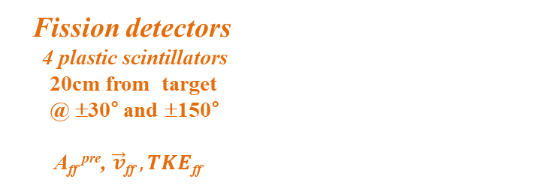
Experimental approach and Set Up
Inelastic scattering
p + ²³²Th → p’ + ²³²Th* (E* up to ~ 30MeV)
^{(160Mev) (400μg/cm2)}
Event-by-event
 E* - tagged fission of ²³²Th
 Ff’s (A, TKE)
 PFGS and PFNS
^{p’}
^{n}
²³²Th
^{p}
^{γ}
Ff1
²³²Th*
Ff2
KRATTA
32 triple telescopes
40cm from target
from 6° to 18°
E_{p’} , ϑ_{p’}
PARIS
42 phoswiches
27cm from target
@ ±45, 90, 135°
PFGS, E_{γ}^{sum}, M_{γ} ,
PFNS, M_{n}
Fission detectors
4 plastic scintillators
20cm from target
@ ±30° and ±150°
A_{ff} ^{pre}, $\vec{v}\text{ff} , TKE$_{ff}

Slide 12
Accepted (2024) experiment at CCB:
Evolution of prompt fission γ-ray emission with excitation energy and the Thorium anomalies
We asked for 38 UT beam time (160 MeV proton energy).
Fragments from the IAC recomendation: „IAC recognises the importance of comprehensive studies of the fission reaction, for which many unknowns are not yet fully resolved, although the studies are conducted since decades. […] In summary, IAC finds the proposal highly interesting and important, opening fission studies as a new experimental field at CCB, in conjecture with the COFFEE project. […]„
We were granted with 19 UT beam time to prove that experiment can provide results at the CCB facility.

Slide 13
Setup at CCB
Coincident measurement of scattered protons gamma rays and fission fragments.
Experimental setup equipped with detectors:
• 32 KRATTA telescopes measurement of the angle and energy of scattered protons,
• 4 large volume LaBr3 detectors(3.5”x8”) and
at least 2 PARIS clusters + 8 phoswiches (26 phoswiches),
• fission fragment detection system (to be added – under commisioning)

Slide 14
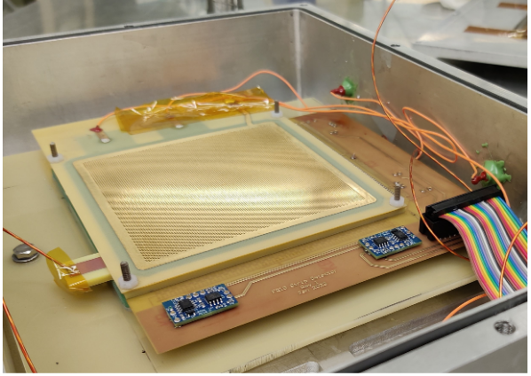
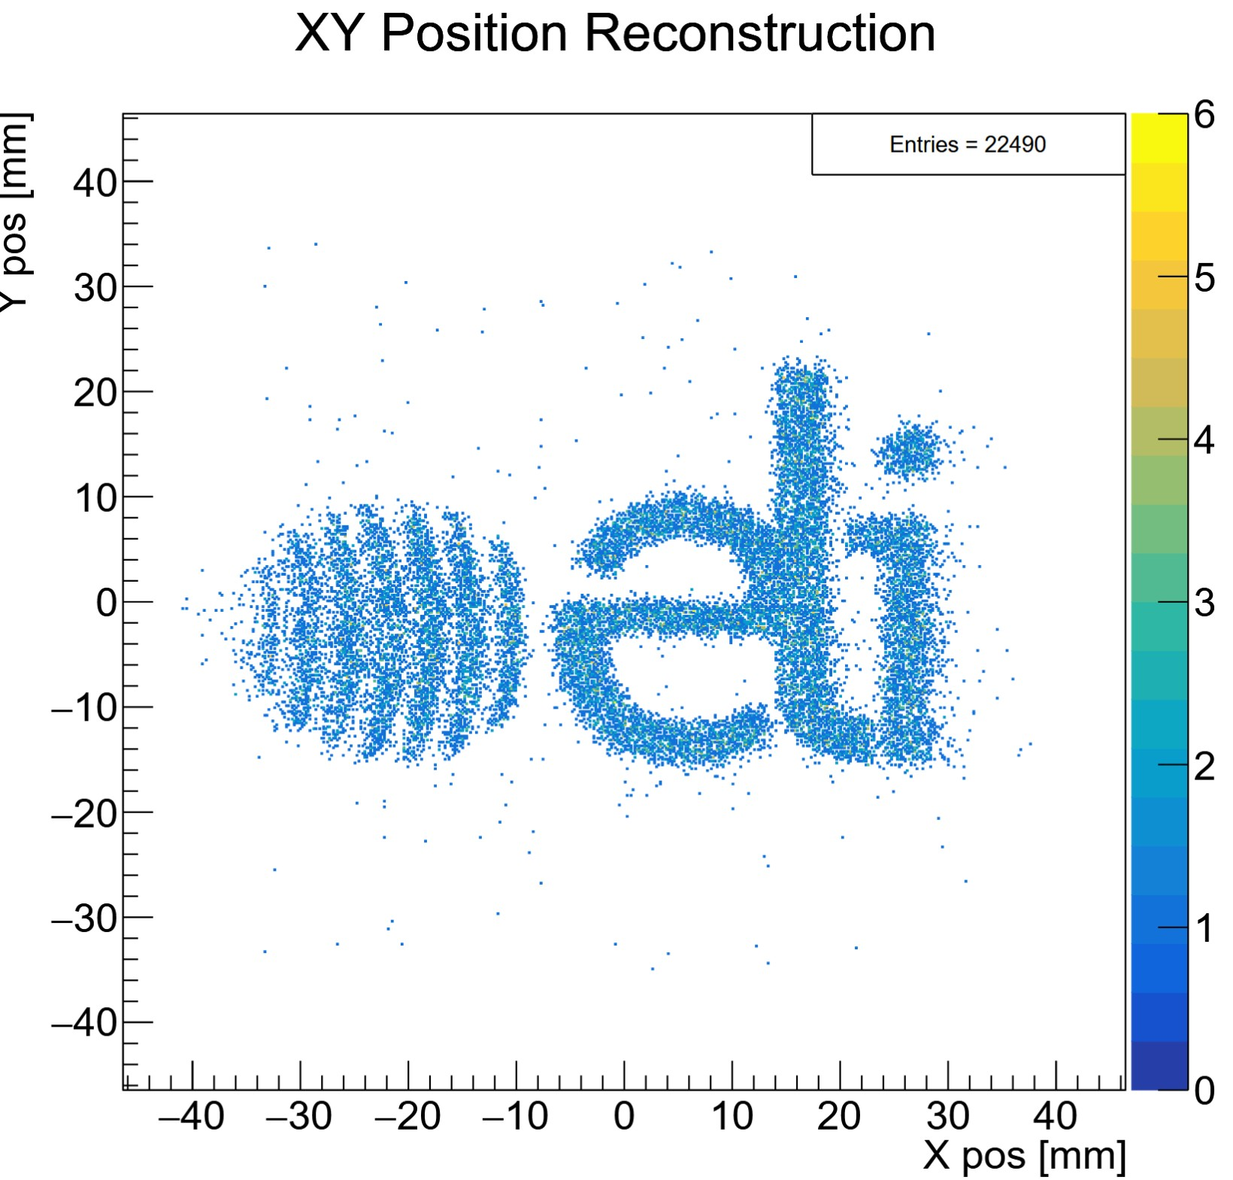

Fission detectors, requirements and progess
• It is necessary to use detectors for fission fragments with good time (~ 1 ns) and position (~ 1 mm) resolution.
We started collaboration with ELI-NP. group, D. Balabanski, A. State,
which develop THGEM detectors.
•First prototypes made at ELI-NP, preliminary tests performed,
visit of M.C. and B. Sowicki in Romania in June 2025.
•Goal to test THGEM detector provided by ELI-NP at IFJ PAN in 2025 with use of ²⁵²Cf.
• Four (or in the best case 8) detectors may be ready in 2026, first checks of the possible.
First test of one module at CCB – 24-25 November 2025
300 µm spatial resolution
700 ps timing capabilities

Slide 15
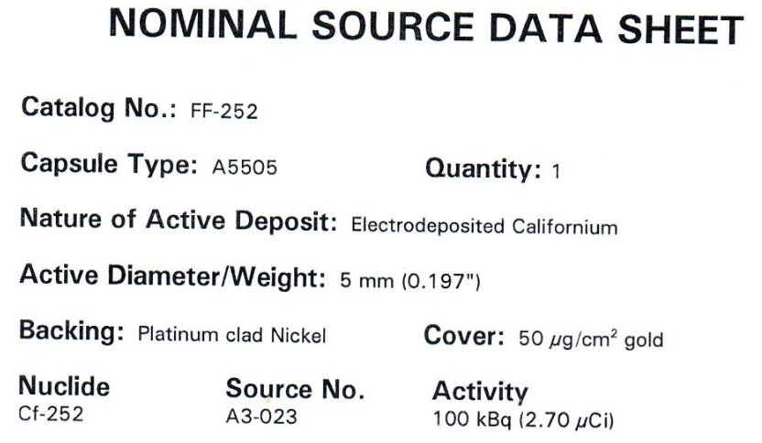
Fission detectors, ²⁵²Cf source, electronic noises
• For commissioning of the THGEM fission detectors, we need ²⁵²Cf source.
• Available at IFJ PAN source was bought in 2001 with (100 kB) -> now ~200 Bq.
• IFJ PAN bought new (100 kBq) ²⁵²Cf source with delivery data before end of September 2025.
• Ongoing process of finding sources of electronic noise
in the CCB building with try to remove/reduce it.

Slide 16
Targets
We need at least two thin Th targets, thickness of 500 – 1000 ug/cm²
Radioprotection service at IJCLab permitted its target lab to proces production. Problems of the target lab solved (after flooding) – targets (3 items) will be made in December 2025.
Possible other solutions (backup ones):
• LNL Legnaro (< 1 mg/cm² thickness),
• GSI/FAIR thorium fluoride (ThF4) target in stock with good thicknesses (300-500 ug/cm²).

Slide 17
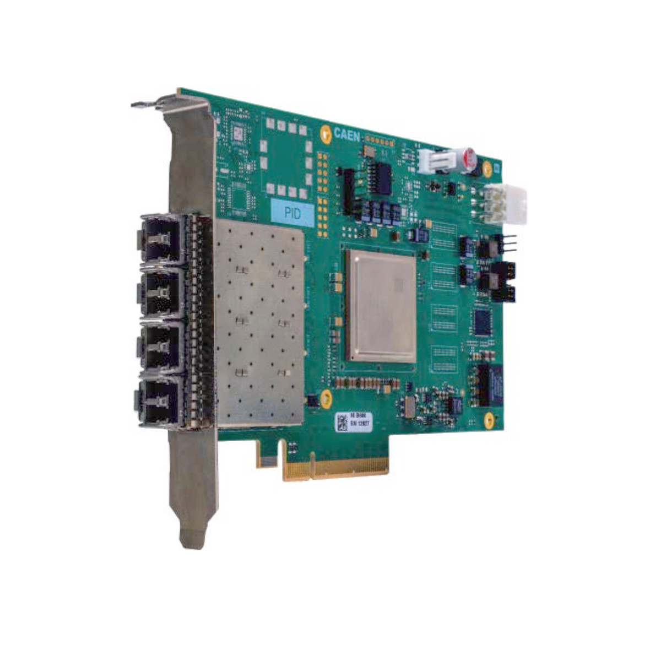
DAQ, improvements
• For the fission detector readout we can use existing DAQ (MBS based) with added TDC and use of V1730 digitizer channels.
• To optimize general DAQ performance we are working on:
use of PHA firmware for the KRATTA digitizers (V1724) -> change from „oscilloscope” mode
change of the DAQ from MBS to xDAQ with fiber readout basing on CAEN A5818 modules
(we apply to IFJ PAN director for the founding of sourch readout cards).
• Electronic improvement possible if grant application (M.C. as PI) to polish institution NCN
will be positively evaluated.

Slide 18
HPGe at ALTO/IJC Lab - status
Loan Pool
10 working
5 poor signals and currently unusable
5 no signals
Gammapool
3 detectors requiring factory repair
Refurbishment needed
COFFEE project at IJCLab require 20 working HPGe detectors
Refurbishment cost estimated between 40 and 100 k euros.
Due to problems with finding solution to repair on site (IJCLab) other possibilites are taken into account.

Slide 19
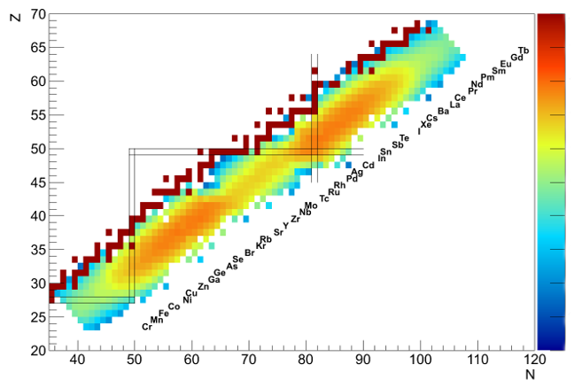
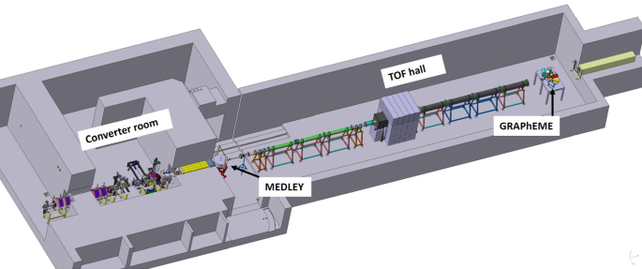
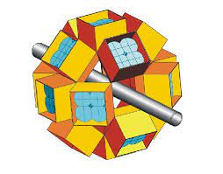
J. Wilson et al., High resolution γ-ray spectroscopy of fast-neutron induced fission of ²³²Th
NFS/GANIL experiment – to be performed in 2026
E877_23
EXOGAM
NFS facility

Slide 20
The ν-Ball collaboration
Al-Adili Ali (Uppsala University)
Algora Alejandro (IFIC (CSIC-Univ. of Valencia))
Benzoni Giovanna (INFN - Milano)
Blazhev Andrey (IKP, University of Cologne)
Bottoni Simone (Università degli Studi di Milano and INFN)
Bunce Michael (National Physical Laboratory)
Chatel Carole (TU Darmstadt, GSI)
Ciemała Michał (Institute of Nuclear Physics PAN, Krakow, Poland)
Clement Emmanuel (CNRS)
De France Gilles (GANIL)
Dessagne Philippe (CNRS)
Dragić Aleksandar (Institute of Physics, Belgrade)
Fijalkowska Aleksandra (Faculty of Physics, University of Warsaw)
Fornal Bogdan (IFJ PAN, Krakow)
Fraile Luis Mario (Universidad Complutense de Madrid)
Gandolfo Elisa Maria (GSI)
Gjestvang Dorthea (University of Oslo)
Hadynska Klek Katarzyna (Heavy Ion Laboratory University of Warsaw)
Hauschild Karl (CSNSM)
Henning Greg (IPHC)
Henrich Corinna (TU Darmstadt)
Hiver Corentin (IJCLab)
Ilić Strahinja (University of Novi Sad)
Iskra Lukasz (Institute of Nuclear Physics PAN)
Jovancevic Nikola
Kerveno Maelle (CNRS/IPHC)
Kmiecik Maria (IFJ PAN Krakow)
Knežević David (TUM, FRM2, PGAA)
Korgul Agnieszka (Faculty of Physics, University of Warsaw)
Kröll THorsten (TU Darmstadt)
LEDOUX XAVIER (GANIL)
Leoni Silvia (University of Milano and INFN)
Ljungvall Joa (IPHC)
Lopez-Martens Araceli (CSNSM)
Maj Adam (IFJ PAN Krakow)
Matea Iolanda (IJCLab Orsay)
Miernik Krzysztof (University of Warsaw)
Milanović Tamara (Institute of Nuclear Sciences "Vinča", University of Belgrade, Serbia)
Napiorkowski Pawel (University of Warsaw, Heavy Ion Laboratory)
Pascu Sorin (University of Surrey)
Pasqualato Giorgia (IJCLab)
REGAN PATRICK (University of Surrey)
Rezynkina Kseniia (ONFN-Padova)
Schmitt Christelle (IPHC Strasbourg)
Thisse Damien (Cea Saclay)
Vandebrouck Marine (CEA Saclay IRFU/DPhN)
Verney David (Institut de Physique Nucléaire d'Orsay)
Warr Nigel (Institute for Nuclear Physics, University of Cologne)
Wrzosek-Lipska Katarzyna (University of Warsaw, Heavy Ion Laboratory)

Slide 21
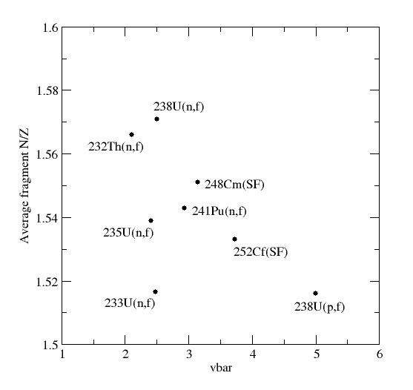
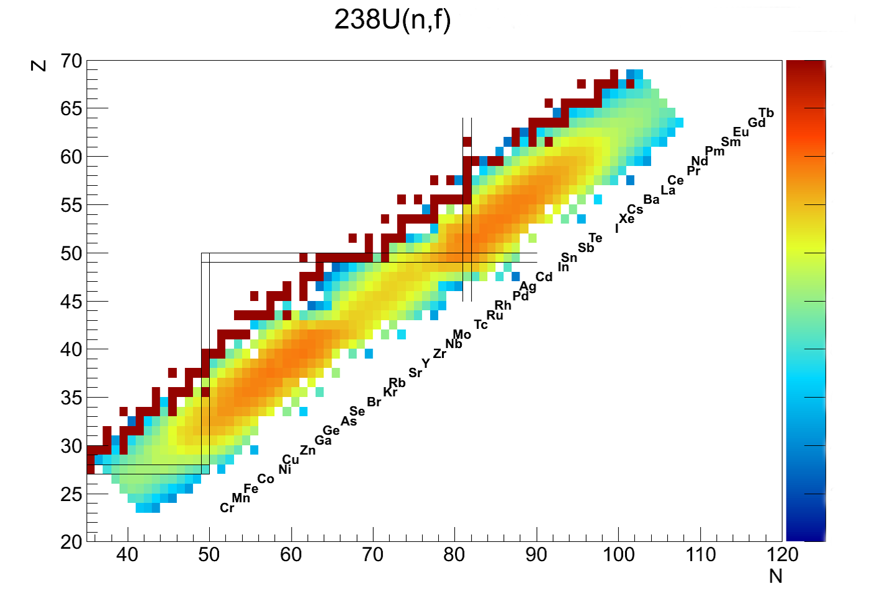

Why do spectroscopy of fast neutron-induced fission?
It is useful for both the study of Nuclear Structure and the Nuclear Fission process
We can access the most neutron rich production mechanisms available ²³²Th(n,f) and ²³⁸U(n,f)
Since the fragments stop in 1-2 ps we can study with direct kinematics (v/c=0)
v/c = 0 gives the ultra-high resolving power of Ge intrinsic resolution
$R\text{∝}$ $\frac{1}{{(ΔE)}^{3}}$
But all fragments produced together
Exoticity
Too hot!
Complementary technique to inverse kinematics

Slide 22
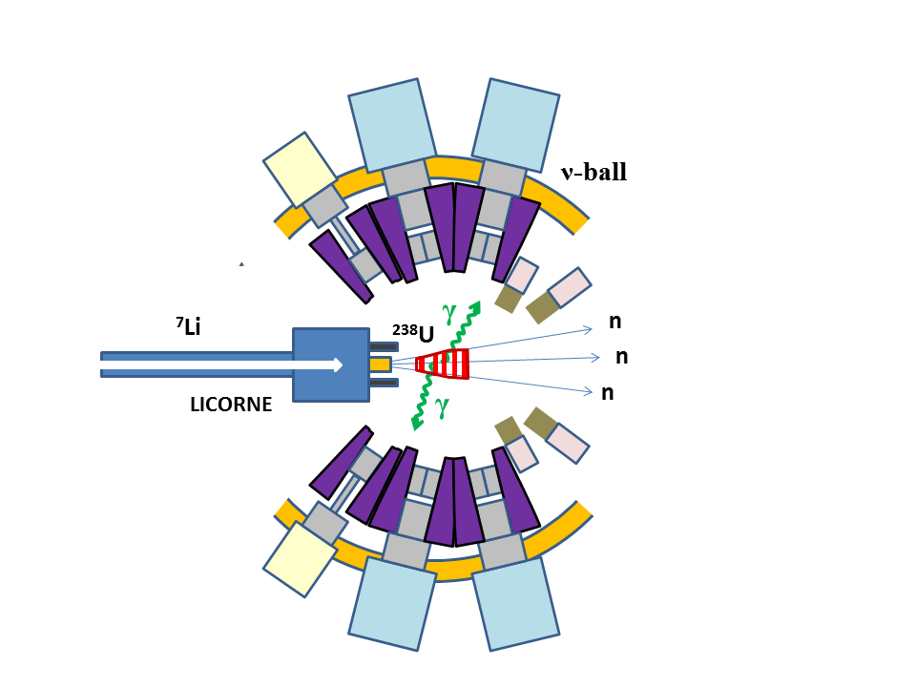
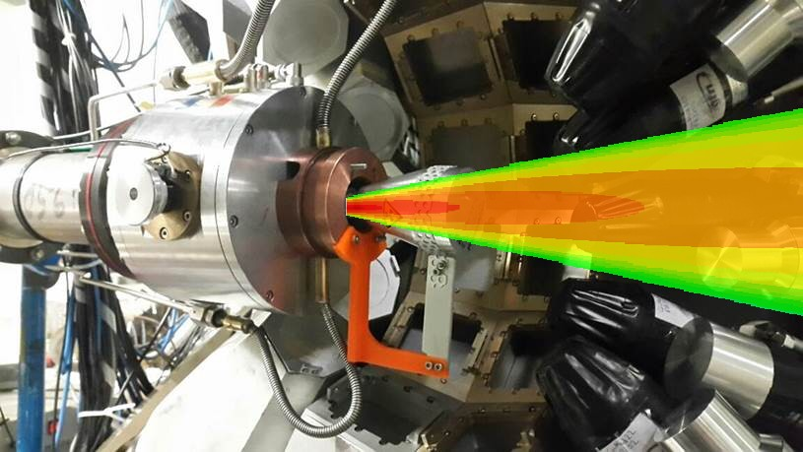
LICORNE/ν-ball coupling principle at ALTO
LICORNE: The unique inverse kinematics neutron source of the ALTO facility
Primary beam (400ns – pulsed)
2 x 10¹¹ /s
Samples
Secondary beam
2 x 10⁷ /s
Gas target
up to 10⁵ fissions/s
⁷Li (16 MeV)
H₂
1.5 MeV neutrons
²³⁸U
²³²Th
~100 g
200 nA
3 x 10²⁰ atoms/cm²

Slide 23
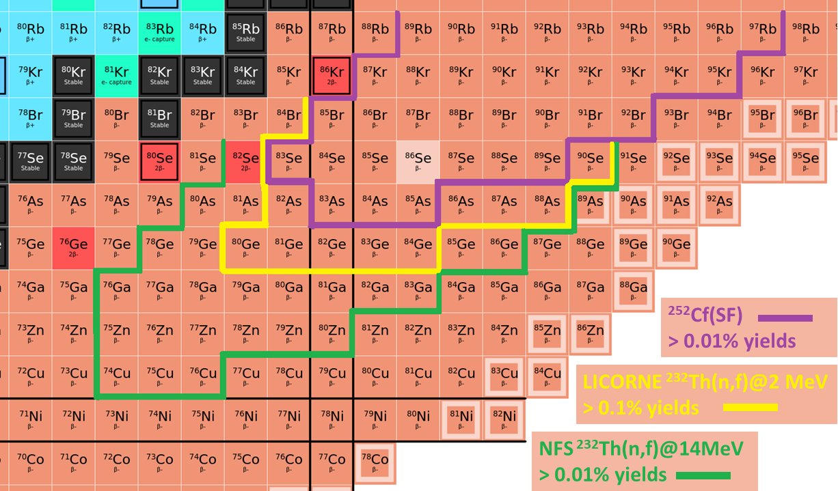
Nuclei accessible via gamma spectroscopy in direct kinematics

Slide 24
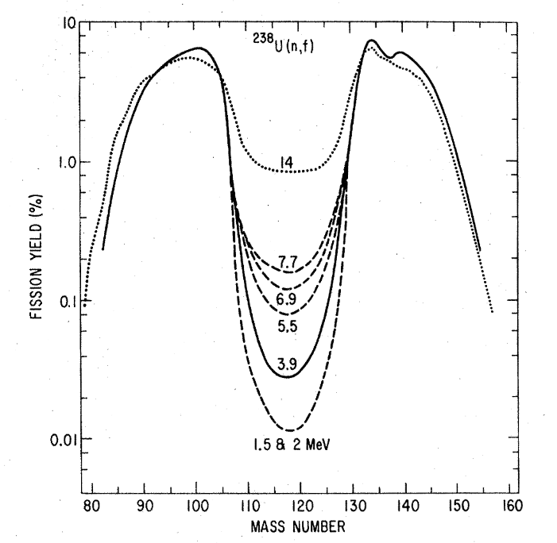
Fission studies: Evolution of fission yields with incident neutron energy
Detailed study of the ingrowth of the symmetric fission mode with incident energy. Measure evolution of A/Z distributions.
Yield measurements through determination of the total intensity of discrete gamma rays which feed the first excited states (even-even nuclei). Accuracy 20-30%.
Benchmark γ−γ coincidence intensities with ²⁵²Cf source measurement.
4⁺
2⁺ sidefeeding
2⁺
0⁺ sidefeeding
S. Nagy, Phys. Rev. C 17, 1 163 (1978)
0⁺

Slide 25
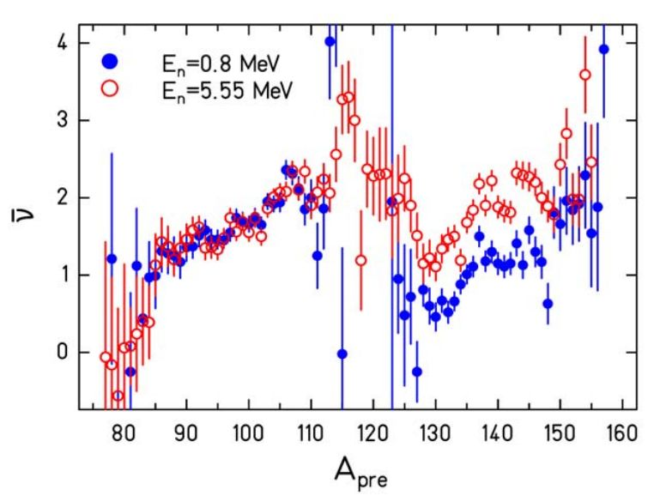
Fission studies: Test of the fission energy sorting mechanism
K-H. Scmidt and B. Jurado, Phys. Rev. Lett. 104 212501 (2010)
Extra excitation energy is expected to flow from light to heavy fragment due to differences in level densities
In our proposed experiment, heavy fragment yields would be expected to move towards stability with increasing E_{n}
A. A. Naqvi et al., Phys. Rev. C 34 1 218 (1986)
²³⁷Np

Slide 26
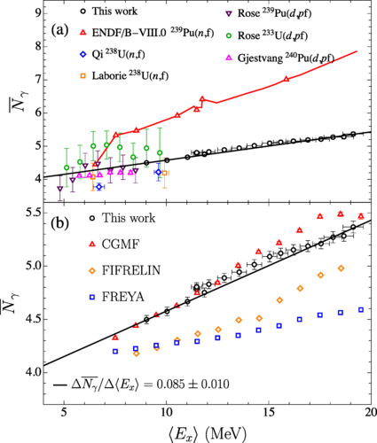
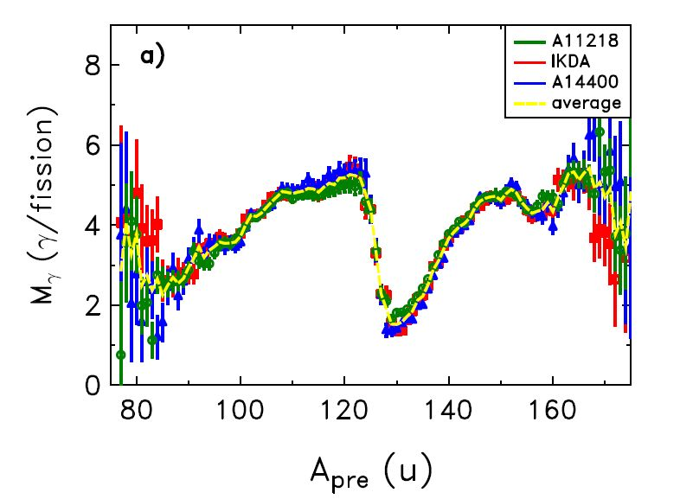
Evolution of gamma multiplicities with energy: angular momentum effects
For cold fission single fragment gamma multiplicities and <I>, sawtooth patterns recently observed
M. Travar et al., Phys. Lett. B817 136293 (2021)
J.N. Wilson et al., Nature 590, 566–570 (2021)
N.Ghia Phys. Rev. C 107, 014612

Slide 27
Open questions on angular momentum effects we hope to address
How does the spin sawtooth pattern change with increasing excitation energy as the symmetric fission mode begins to dominate?
Is the intrinsic angular momentum generation mechanism for the symmetric fission mode the same as for the asymmetric?
Does some pre-scission spin feed through to the final fragments or does it go into the relative motion (orbital angular momentum)?
What happens to the correlation between partner fragment spins when there is a significant source of pre-scission angular momentum?

Slide 28
COFFEE 2025 – what was requested
For 2025 at IFJ CCB:
• electronic modules to connect fission detectors into the existing setup, estimated 20 k EUR,
• flanches, cables and small components, estimated 2 k EUR.
For 2025 at IJCLab:
• factory regeneration of one HPGe, estimated 12 k EUR,
• Th targets for CCB experiment, estimated 500-1000 EUR.

Slide 29
COFFEE 2025
M. Ciemała, on behalf of spokesperson Ch. Schmitt, M. Ciemała, and J. Wilson, 28/09/2025 during the IFJ PAN CCB IAC meeting.
J.N. Wilson, presentation invité - Adam Maj Jubilee, 27/08/25.
Successful application for IFJ PAN Ph.D (Kasia Gajewska) student "Bourse France Excellence Doctorat 2026" from the French Embassy. This will provide financing for her visits to IJC Lab of up to 4 months starting in 2026. She is supervised by Bogdan Fornal and Lukasz Iskra at IFJ PAN.
Funding and Expenses within the IFJ PAN – IJCLab Collaboration:
a) Purchase of two CAEN A5818 cards, contract dated 17/10/2025, total cost €9,778.50 (gross), with delivery scheduled by 15/01/2026;
b) Minor mounting components required for the installation of THGEM detectors, with an estimated maximum cost of ~€500 (gross).
c) IJCLab side – preparation of the ²³²Th targets (December 2025)
Total costs: approximately €10,000
Publication:
C. Hiver, J.N. Wilson et al., Acta Physica Polonica 18 2A-25 (2025)
High-resolution studies of isomeric states in 236U with the nu-Ball2 spectrometer

Slide 30
COFFEE 2026 – requested funding
For 2026 at IFJ CCB:
• electronic module for the HV CAEN A7030DN (12 channeels), cost around 10000 EUR
• two week visit(s), for participation in the measurements during 2026 at GANIL/NFS, cost estimated to 1900 EUR
For 2026 at IJCLab:
•two weeks visit(s), for participation in the measurements during 2026 at CCB, cost estimated to 1900 EUR,
• Th targets for CCB experiment, estimated 500-1000 EUR (in case not made in Dec 2025)
• factory regeneration of one HPGe, estimated 12 k EUR.

Slide 31
Conclusions
Ongoing preparation for accepted by CCB IAC first COFFEE experiment in Krakow: Evolution of prompt fission γ-ray emission with excitation energy and the Thorium anomalies.
Depending on the checks of the THGEM detector at IFJ PAN environment we may be ready for the experiment around the middle of 2026. DAQ should be ready as well as targets, other necessary improvements of the setup are being implemented.
Due to problems with HPGe deteector renovation at IJCLab main activity on the French side of the project moved to NFS@GANIL experiment which should be performed during year 2026.

Slide 32
Thank you for your attention!

