Slide 1
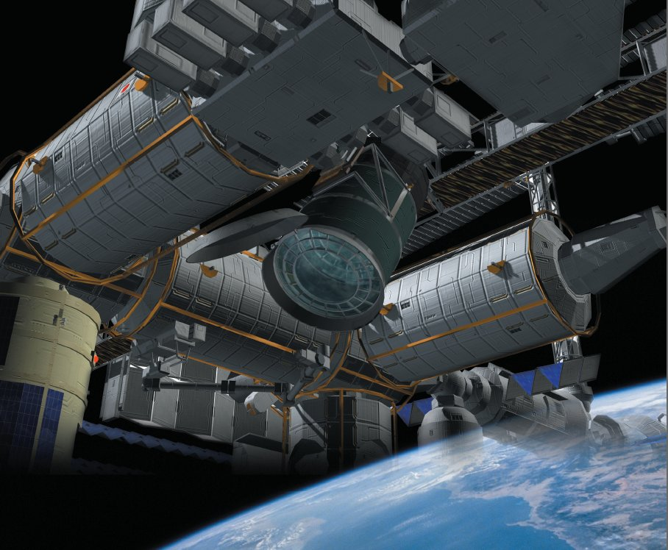


COSMIC RAYS IN SPACE WITH JEM-EUSO TELESCOPE
Sylvie Dagoret-Campagne
Physicist
LAL
Notes:
I am going to present briefly the JEM-EUSO project and try to explain in which context the SimInOle ANR
is very useful. It is a large UV camera foreseen to be installed over the ISS by an International collaboration leaded by JAPAN.

Slide 2
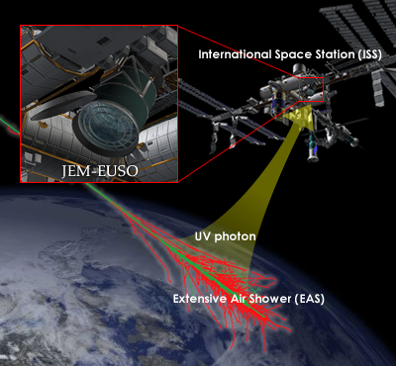
The physics Theme
Notes:
The goal is to observe the hugest Air Showers that develops in the troposphere.
Those giant Air Showers are induced by the arrival of the most energetic cosmic rays coming from
Galaxies further from our local galaxy cluster.

Slide 3
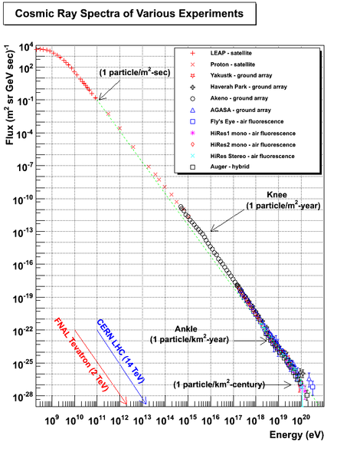
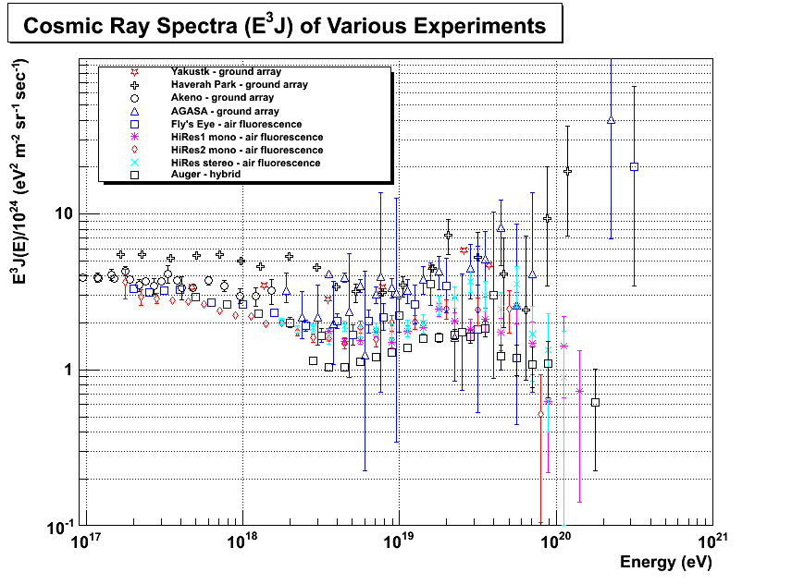
SCIENTIFIC KNOWLEDGE ON COSMIC RAYS
End of Spectrum measurement
(J : defined by nb of CR per surface, solid angle, time,energy unit )
Flux : J
At the end
E³ x J
Cutoff « GZK»
Main physical interest
Notes:
The current scientific knowledge on the cosmic rays can be summarized on this plots giving
The spectrum, that is to say the Flux or nb of CR per surface unit, solid angle unit, time and energy units versus its energy.
It is amazing that the flux ranges over 32 orders or magnitude and the energy over 11 orders of magnitude.
Such large range is quite unusual in physics.
What is the more puzzling is the shape of the spectrum at the end, at energies above 10^20 eV.
Its existence is now established but its details poorly known due to the lack of statistics.
More statistics would provide powerful hints on the source location (extreme CR engine) in the universe, the acceleration mechanism
Involved inside.

Slide 4
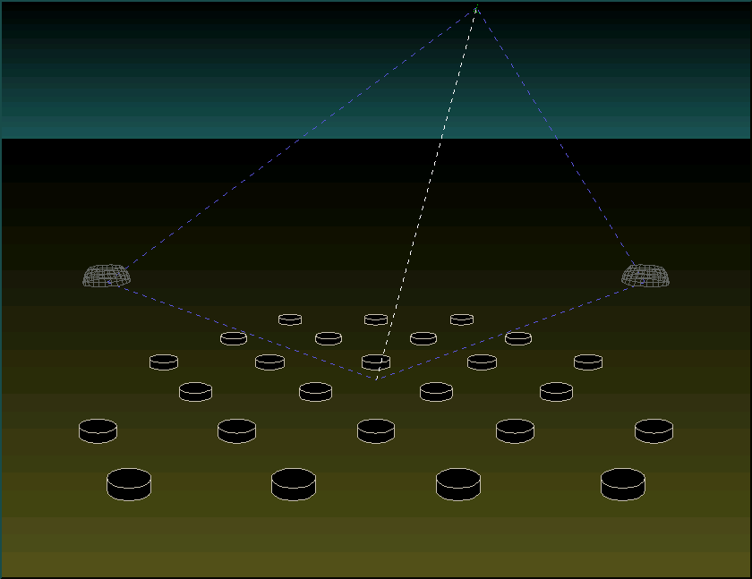
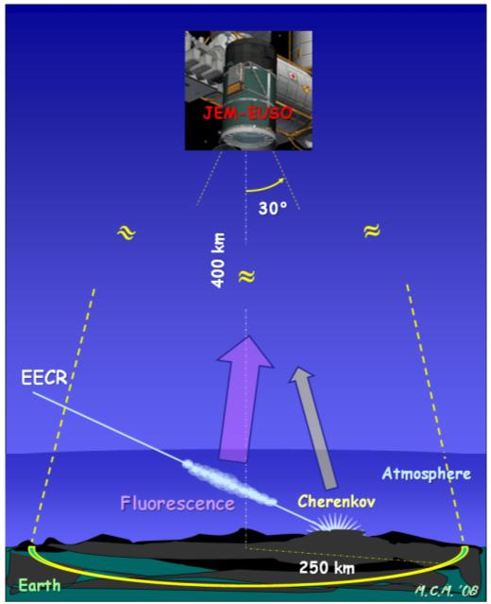
Why Going in Space : the size of the observatory
7 km/s
P. Auger Observatory at ground:
Surface of 3000 km²
JEM-EUSO in Space :
Surface 5.2 10⁵ – 1.2 10⁶ km²
Notes:
The largest cosmic rays observatory ever built is the Pierre Auger Observatory.
It covers a surface at ground of 3000 km^2.
It runs since 2004 and at recorded up to now no more than 2 events above 10^20 eV.
It is not sufficient to understand the famous GZK cutoff.
The idea is to go in space, to cover a surface 100 greater by increasing its distance by a factor 10.
Calculation gives a possible increase of statistics by a factor 15-50 depending on the tilt angle.

Slide 5
Lower priority physics : Non cosmic rays studies
Slow phenomena !, large timescale
Meteor detection down to the micro-gram
  Bright luminosity in the UV range
  Statistic poorly known at low mass
Bright atmospheric phenomena-lightning
  Huge light background
  opportunity to correlate them with CR
Notes:
Even if one want to do only cosmic ray physics, other atmospheric phenomena will occur frequently in our data.
We can consider them either as slow but usually luminous background or as other interesting physics subjects.
It is the case of meteors crossing the filed of view of JEM-EUSO or the strange lightning effects in the upper atmosphere.
It could be fascinating if we could prove that cosmic rays may induce such strange things.

Slide 6
The Instrument
Collection surface:
S_{coll} = 5m² (2m x 2.6m)
Field of View:
FOV ~ ±30° x ±30°
Pixels:
~ 3.5 x 10⁵ pixels
FOV(pixel) =0.1° (~700 m)
Collection time sampling:
τ_{coll}= 2.5 μs (~700 m)
Actual Focal surface shape
Notes:
In brief, here is the split view of the Instrument.
This camera consists in a set of 3 plastic lenses which focus the UV rays on a focal surface which electronics details
are not presented in this talk.
Look at the actual focal surface, which shows the Air Shower imprints.

Slide 7
How an Air Shower Event looks like in our detector ?
JEM-EUSO sees a factor 10⁻³ photons less than in Auger telescopes !
Nb photo
electrons
70%→ 93%
7%→ 30%
Event view in Focal Plane
pixel size δ=0.1°
3D view of an Air Shower
δτ =2.5 μs (GTU for Gate Time Unit)
Number of photoelectrons
Detected versus time
80 μs – 20 km
Notes:
On the left you can see the imprint of an air shower in the focal plane.
On the right, by measuring the photon arrival time, the shower is seen in 3D.
Due to the shower-telescope distance, JEM-EUSO see almost a factor 1000 less photons than Auger.
This picture shows the shower profile showing the photon detection efficiency after lenses, after the
photodetection on the focal surface.
These numbers for JEM-EUSO have been improved since the old Euso time by a factor between 5-10.

Slide 8
Main night Background
Sky background:
Nightglow,
Zodiacal light,
Stars, planets,
Moon,
Cities,
Irreducible background:
40 MHz/pixel
100 pe/PMT/GTU
1.5 pe/pixel/GTU
Need a trigger with high background rejection factor
Notes:
We expect irreducible sky background inside JEM-EUSO of many different origins which can vary at the second or minute time scale, but negligibly at the
event time scale.
It translated into JEM-EUSO numbers as 40 MHz per pixel or 1.5 photoelectron per pixel per GTU.
Inside this background , the trigger system has to identify faint shower imprint.
A high level rejection and selective trigger is needed

Slide 9
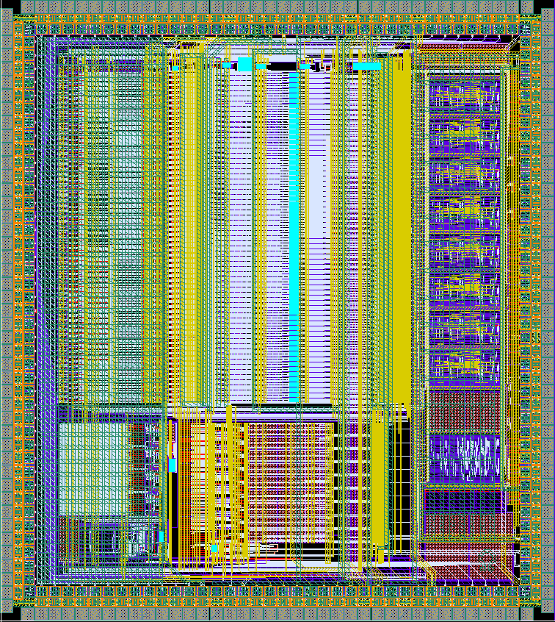
Trigger hierarchy to filter out the background
1 to 2 pe per pixel
per GTU
400 kHz/channel
Level 0
Sky background,
LAL ASIC SPACIROC
output
FPGA/PDM Logic
Track search
Algorithm over
2300 pixels during 9 GTU (EWHA/Italy)
7Hz/PDM
(3. 10⁻³ Hz/channel)
BG Rejection factor 10⁸
Level 1&2
DAQ
Shower Pattern
recognition
based on
Statistical algorithm
(LAL,Germany)
0.1 Hz/Full detector
6 10⁻⁴ Hz/PDM
BG rejection factor
~ 10000
Level 3
Air Shower rate 10 ⁻³ Hz
Notes:
The electronic channels produce 3x10⁵ numbers every 2.5 microseconds.
This huge amount of data has to be reduced strongly to recognize real Air shower
Which rate is estimated to occur at a rate of 10⁻³ Hz.
For this strong on-line filtering, the detector includes a hierarchical triggering system consisting in
Three levels.
The first and second level will be hardcoded in an digital device called a FPGA.
The last filtering system will validate the data recording after operating the final
event selection.
It will be implemented in a programmable device called a DSP.
In the SIMINOLE project, we wish to design it using the
State of the art statistical algorithms that include the knowledge
From simulations.

Slide 10
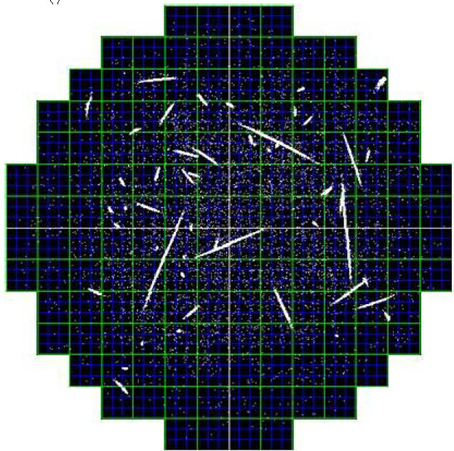
Trigger Algorithm to be developed in SIMINOLE framework
A digital processor (DSP) handles 8 PDM (a square of 48 x 48 pixels) for the trigger (kind of pattern recognition in space and time)
Input rate : 56 Hz
Output rate : 5x 10 ⁻³ Hz
background rejection : 10 ⁴
selection efficiency ~ 100% above 5 10¹⁹ eV
L2 Triggered PDM
Boundary of a Triggered PDM
Notes:
Each of these square consist in a matrix of 48 x48 pixels.
They may include a sizeable fraction of a shower.
A programmable hardware device called a DSP for digital processor handles ON-LINE the local triggers issued from some of eight squares called the PDM.
It tries to match pieces of Air Showers coincident in space and time with neighboring PDM.
The input rate is tuned to be 60 Hz per DSP. The output rate must be kept below 5x 10^-3 Hz.
The rejection factor has to be 10^4.

Slide 11
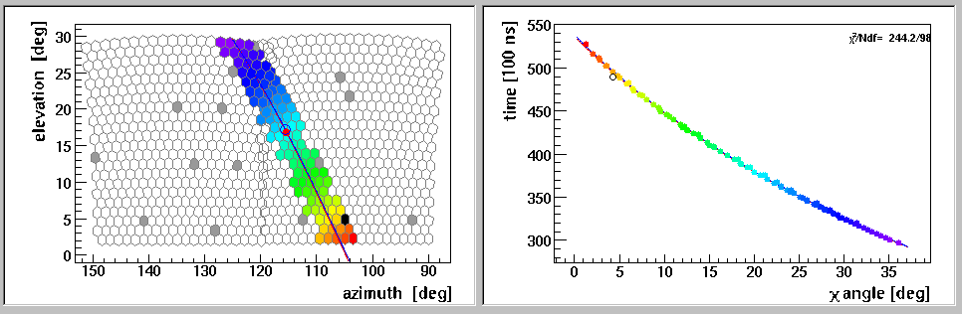
Geometrical Reconstruction similar to that in Auger in mono
3 unknown parameters t₀, R_{p}, Χ₀
In monocular , need to see the
non-linearity of the tan function
(sufficient number of pixels)
Measurement of the angular velocity
Notes:
This is a nice picture showing the principle by which one can calculate the incident angle of a Shower in Auger.
The geometrical reconstruction is based by the measurement of the arrival time of the signal in the pixels.
The relation between this time and the pixel angles is given by this formula or shown on this plot.
JEM-EUSO reconstruction is similar excepts the Rp parameter is about 10 time larger.

Slide 12
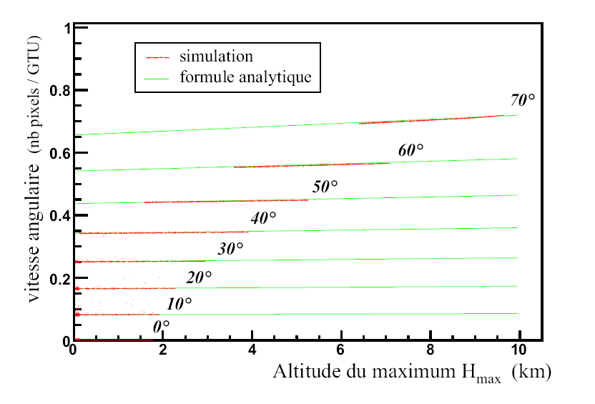
Geometrical reconstruction in JEM-EUSO : Measurement of the zenithal angle by the angular velocity in the shower detector plane
ω angular speed at maximum
(number of pixel crossed
during a time unit)
ω₀ idem for a horizontal shower
h_{max} altitude of shower max
h_{jem} altitude of JEM-EUSO
Notes:
This sketch shows how one can deduce the zenith angle of a shower by
measuring the speed of the spot as it moves from one pixel to the next pixel.
This plot show the angular speed of this spot normalized to the one of an horizontal shower.
By this angular speed, one can extract the zenith angle.
It 1 for theta=90° and turn to zero for theta-> 0°.
It depends very slightly of the altitude of the shower development.

Slide 13
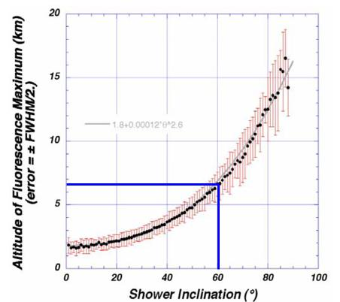
The acceptance problem
Clear sky coverage for JEM-EUSO ~30%
Shower maximum must be above cloud top height,
Clouds reduce the acceptance.
Cloud monitoring is mandatory
shower max altitude
vs zenith angle
Notes:
The problem with JEM-EUSO is the sky coverage by the clouds.
It is estimated, JEM-EUSO will get clear sky only 30% of its exposure time.
In other cases the view is partially masked.
Showers can be reconstructed if their maximum is above the cloud ceiling.
I think one must include some modeling about the meteorology, the clouds physics
Inside the 3rd level Trigger will be useful.

Slide 14
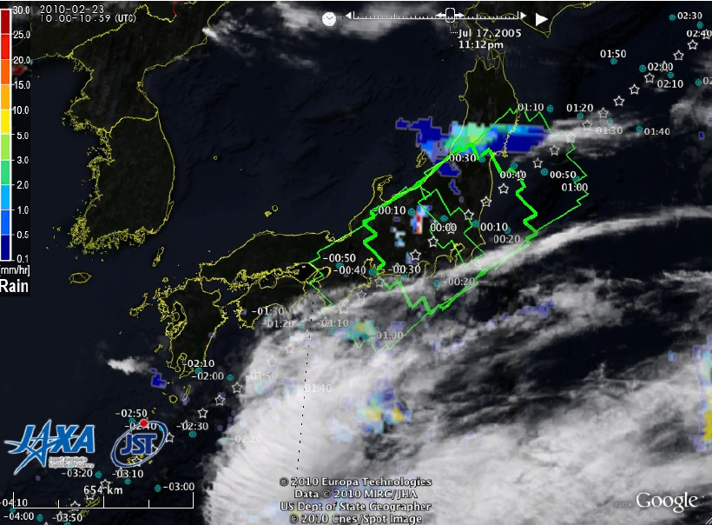
625 km
430 km
Infra red picture every 30 sec in 1/ FOV
Lidar shot every 10 sec (3-5 directions)
Notes:
This picture illustrates the clouds problem. The detector is like a gruyère cheese with many holes.
Continuous sky Monitoring will be performed.
This may be useful to acquire the knowledge about the weather depending on where the ISS
Is on its orbit.

Slide 15
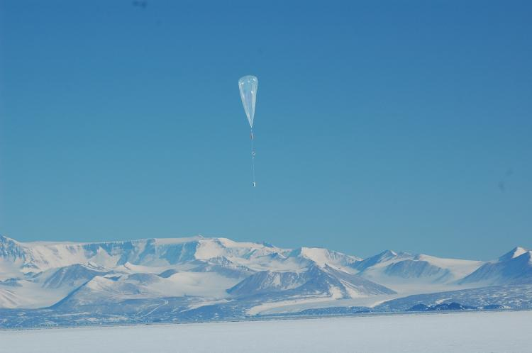
EUSO-BALLOON ~2013
Flight a 4-PDM (144 MAPMTs, ~10000 pixels in 2013)
40 km altitude
FOV ~ 20° half angle
  1pixel has 0.4° and see 280 m
Short flight (few hours) in Golfe de Gascogne or over Mediterranean See
Long flight at Kiruna/Sweden
Goals
Test of the embarked electronics : PMT + ASIC +FPGA (trigger)
Works in hard conditions of temperature, pressure
Background measurements (Airglow)
Signal tests with a Lidar
Trigger Tests
Notes:
We plan to build a pre-space flight little EUSO experiment which will fly 2 years before JAXA rocket lauch.
It will be the opportunity to learn a lot about the sky background and to test the
Triggers level L1 & L2 in realistic background conditions.

Slide 16
Conclusion
JEM-EUSO need application of utilities that are the subject of SIMINOLE project
3rd level Trigger (on-line)
  The background rejection and selection algorithm
  Shower modeling and atmosphere/clouds modeling
Air shower reconstruction (off-line)
  Shower modeling as well as atmosphere , clouds & aerosols modeling
Atmosphere & detector simulations
Pre-flight balloon experiment for tuning algorithms
  Simulation must start now

Slide 17
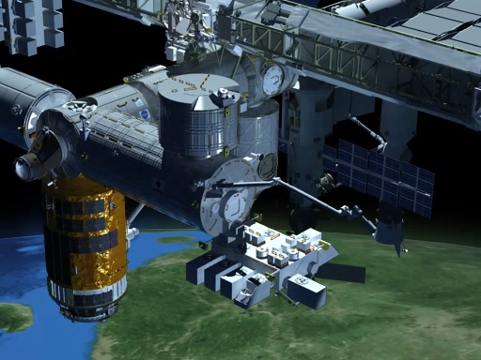
JEM-EUSO accomodation on the ISS
(~2015-2017)

