Slide 1


Simulation of quadrupoles on opera
Jana Souyani
Supervision:Hadil ABUALROB

Slide 2
Outline
Collaboration in PERLE
PERLE Lattice
What is PERLE
My work
Future work

Slide 3


My lovely university

Slide 4
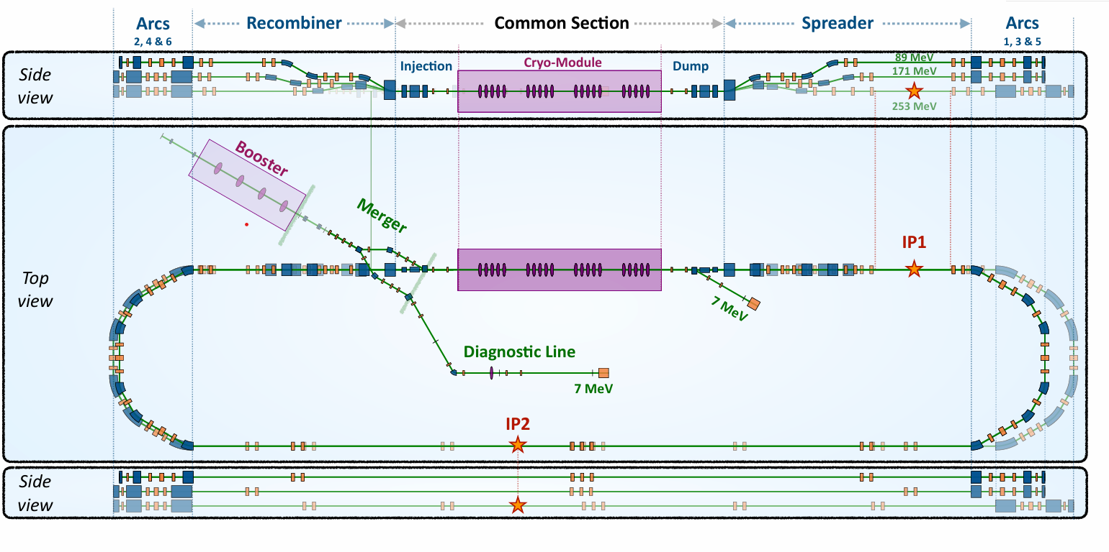
PERLE Lattice 250 MeV version

Slide 5
What is PERLE ?
PERLE (Powerful Energy Recovery LINAC for Experiments): is an accelerator with 3 turns ,after 3 turns the maximum beam energy will be 250 MeV
Quadrupoles focus the beam in one plane and defocus it in the other plane
To achieve focusing in both planes need series of quadrupoles
Dipoles used to bend the beam (control the direction )

Slide 6
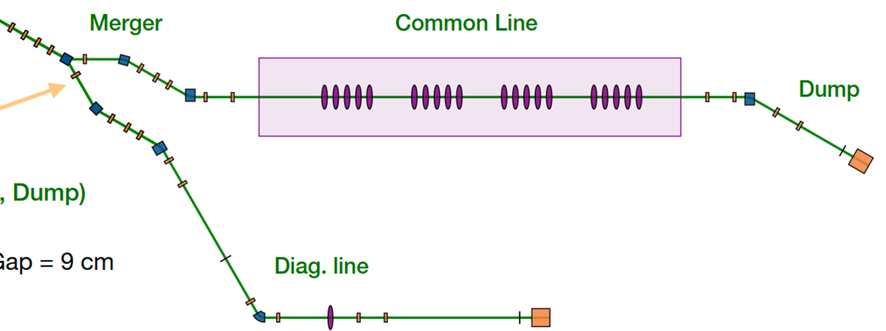


My work where is it ?
Length of quads =5 cm
Number (24)

Slide 7

3 Quadrupoles (cross talk study)
APERTURE =76 mm

Slide 8
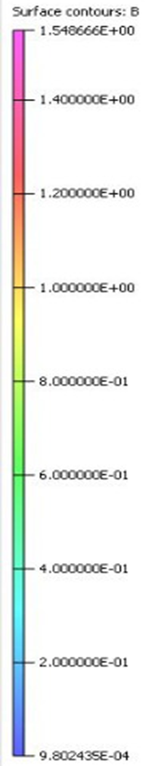
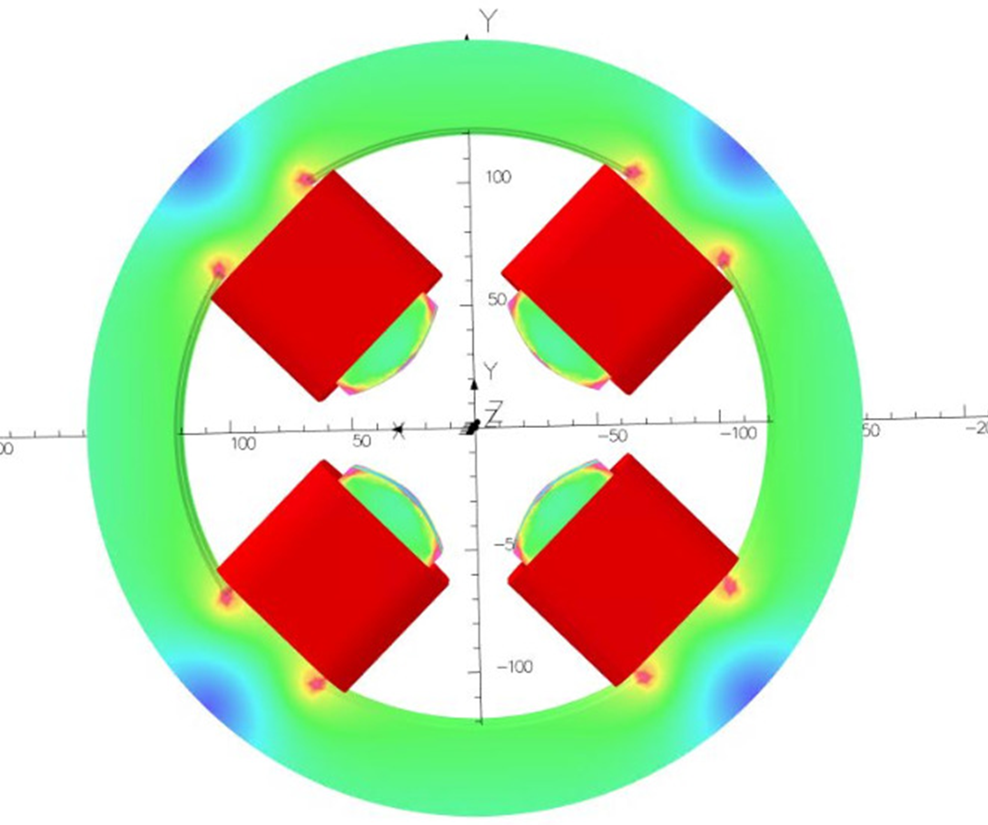
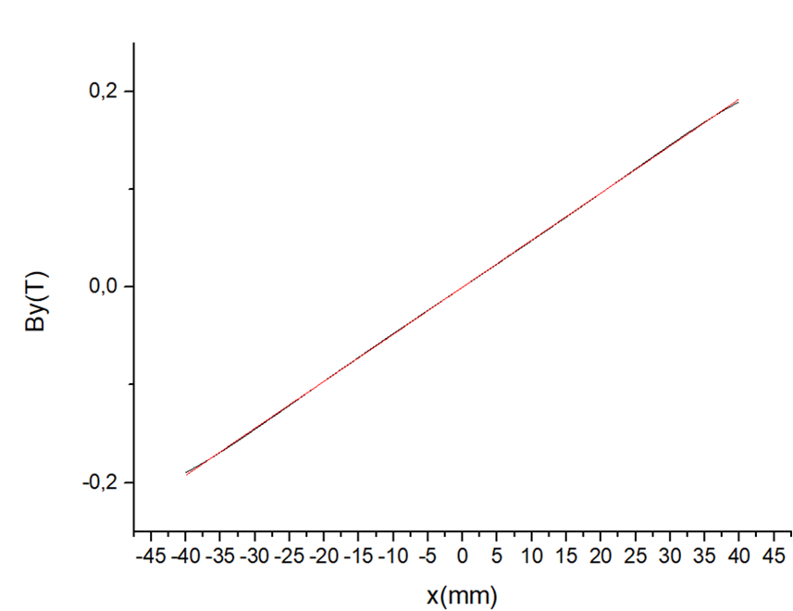
First design
Required to be achieved is Gradiant =4.5 T/m
Parameter | value | unit
Gradient (G) | 4.81 | T/m
NI for quadrupole | 11171.65 | A.turn
N (for quadrupole) | 48 | turns
N (for one coil) | 12 | turns
I (for quadrupole) | 60.48 | A
A (for coil) | 480 | mm²
current density (J) | 1,512 | A/mm²
A (for conducter) | 40 | mm²
Resistance ® | 0.952 | mΩ
power | 3.4822 | watt
z
X

Slide 9
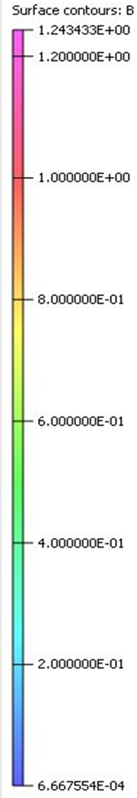
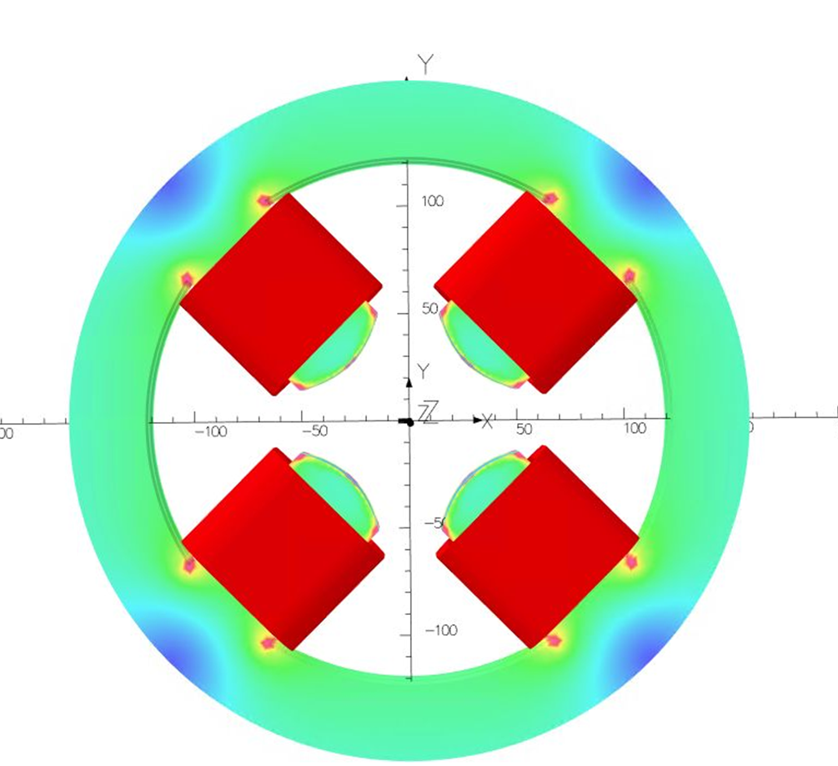
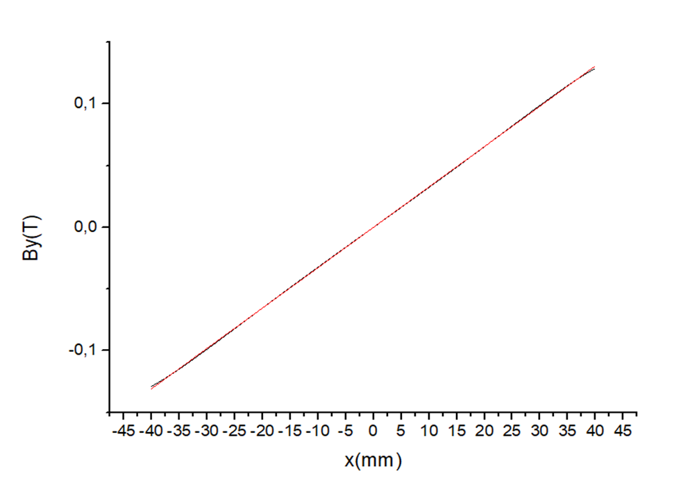
Second Design of quadrupole
Required to be achieved is Gradiant =3 T/m
Parameter | value | unit
Gradient (G) | 3.27 | T/m
NI for quadrupole | 7896.8 | A.turn
N (for quadrupole) | 48 | turns
N (for one coil) | 12 | turns
I (for quadrupole) | 41.129 | A
A (for coil) | 480 | mm²
current density (J) | 1.028 | A/mm²
A (for conducter) | 40 | mm²
Z
X
It’s great !!!

Slide 10
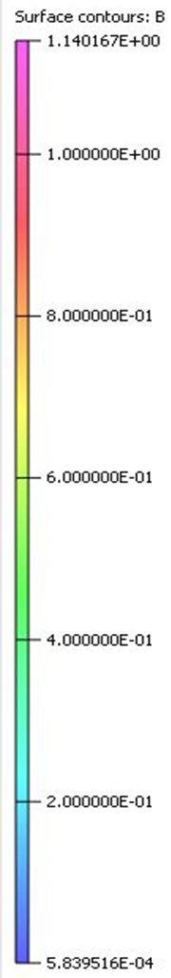
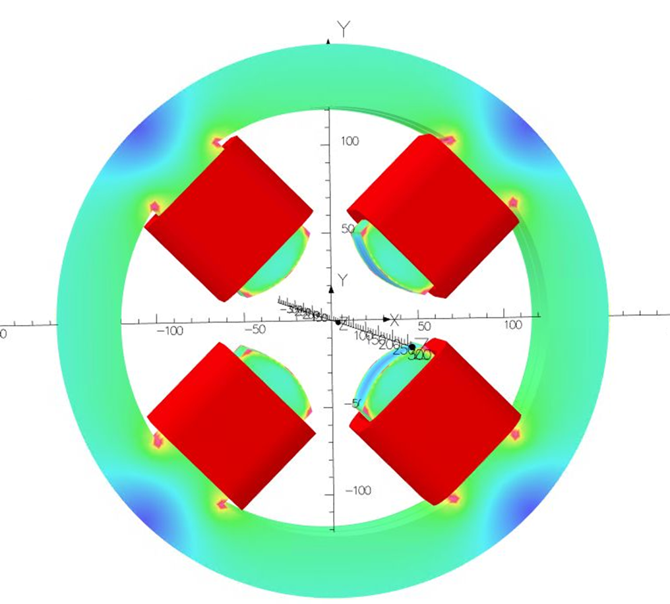
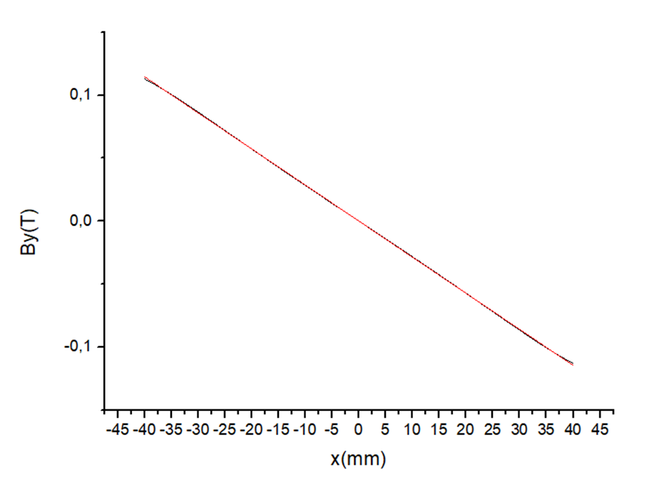
Third design
Required to be achieved is Gradiant =-2.5 T/m
Parameter | value | unit
Gradient (G) | -2.86 | T/m
NI for quadrupole | 7896.8 | A.turn
N (for quadrupole) | 48 | turns
N (for one coil) | 12 | turns
I (for quadrupole) | 41.129 | A
A (for coil) | 480 | mm²
current density (J) | -0.9 | A/mm²
A (for conducter) | 40 | mm²
X
Z

Slide 11
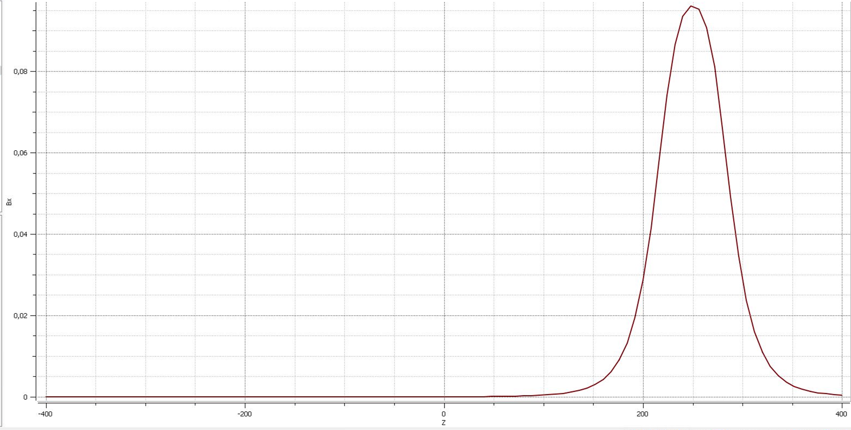
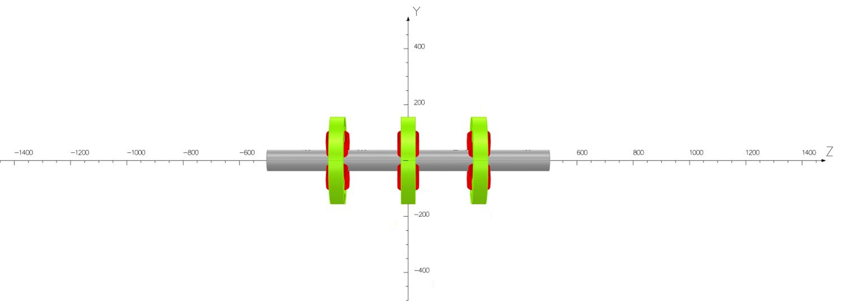
Model of 3 quadrupoles (cross talk) first study
Physical dimension of com.In.Quad.10
Physical dimension of com.In.Quad.20
Physical dimension of com.In.Quad.30
com.In.Quad.20 is off
Y
com.In.Quad.10 is off
com.In.Quad.30 is on
Bx(T)
z
X
Z(mm)

Slide 12
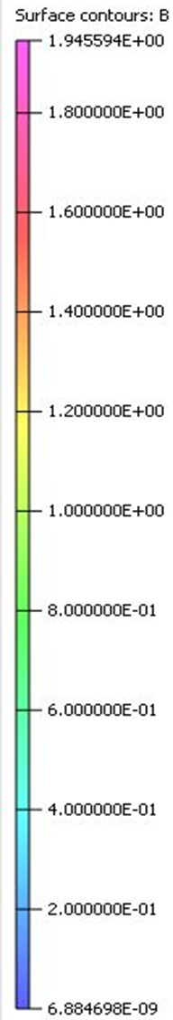
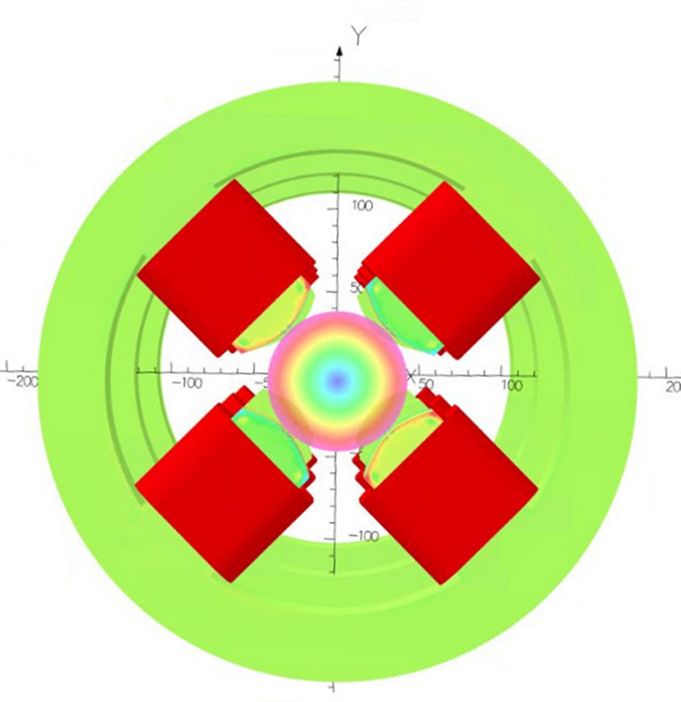
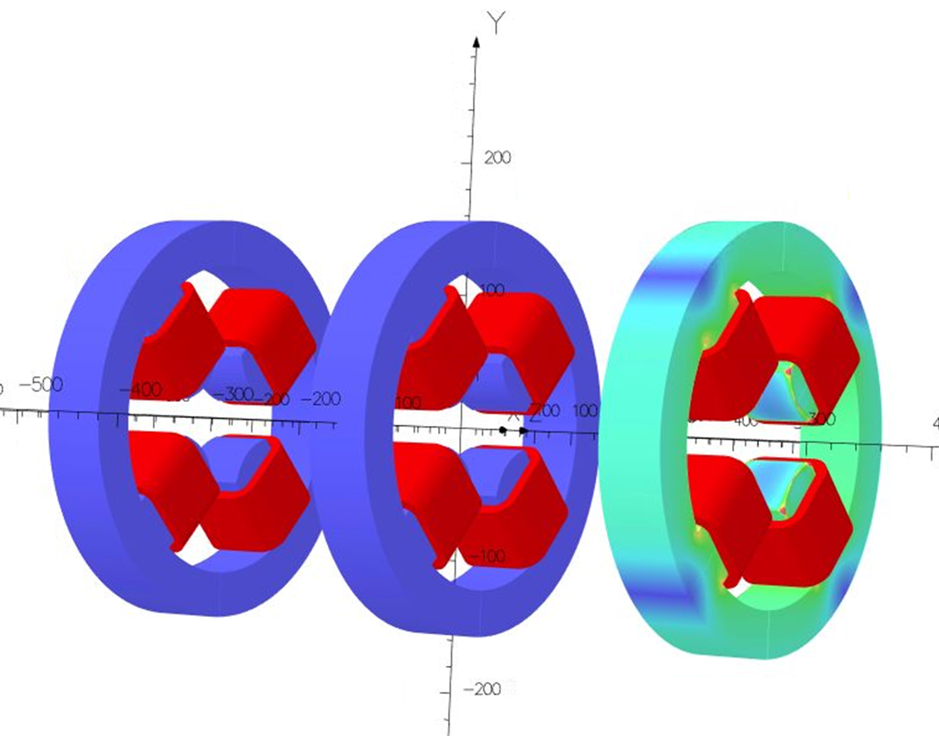
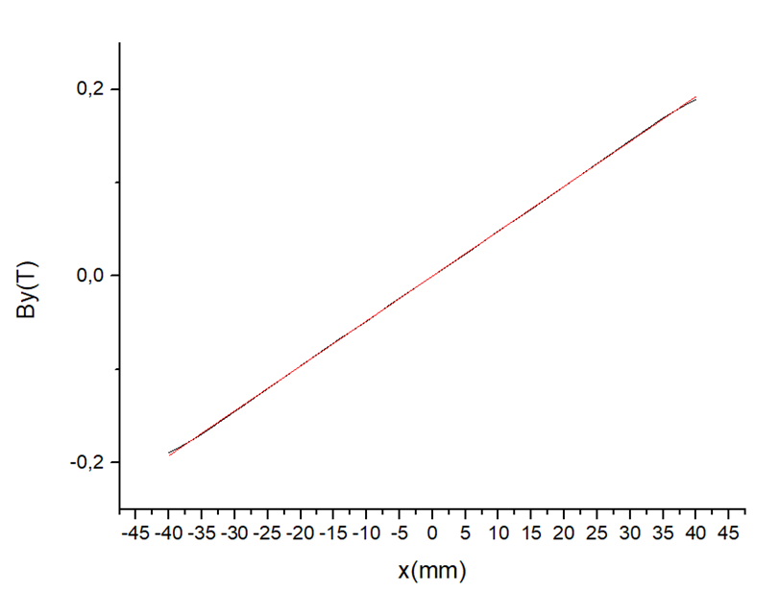
Magnetic flux density in the yoke & center of quad
Gradient for com.In.Quad.30 =4.81 T as alone !!!

Slide 13
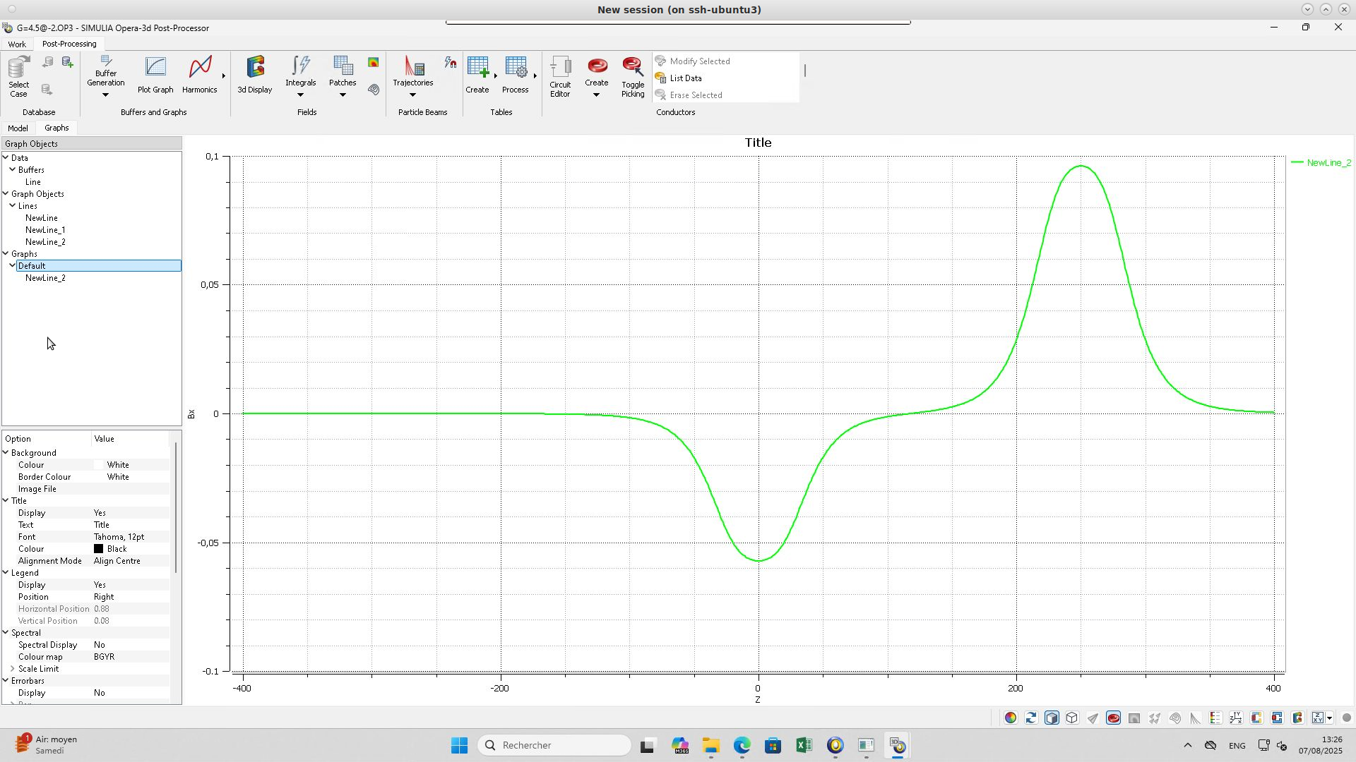
Second study
Physical dimension of com.In.Quad.10
Physical dimension of com.In.Quad.20
Physical dimension of com.In.Quad.30
com.In.Quad.20 is on
Bx(T)
com.In.Quad.10 is off
com.In.Quad.30 is on
Z(mm)

Slide 14
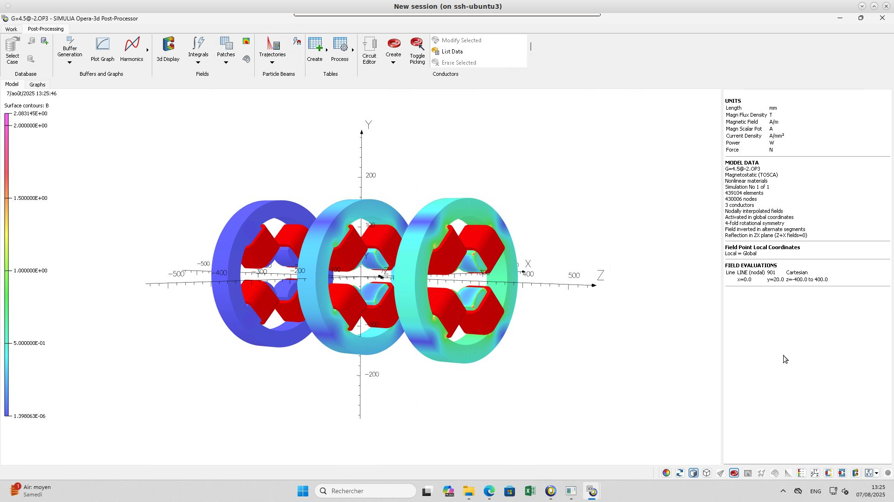
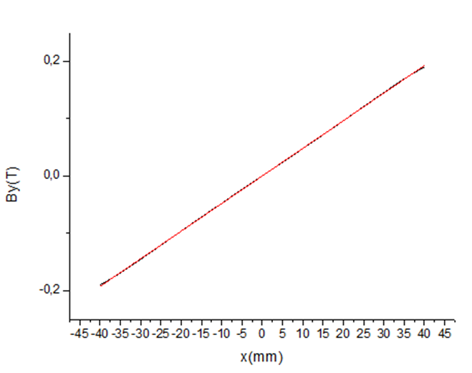
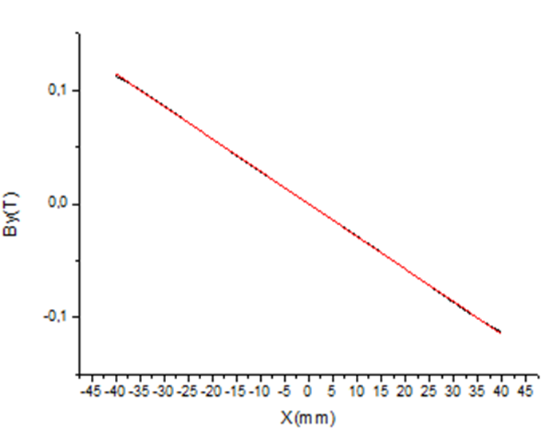
Magnetic flux density in the yoke & Gradient
Gradient for com.In.Quad.30 =4.81 T as alone !!!
Gradient for com.In.Quad.20 =-2.86 T as alone !!!
Good job Jana!!!

Slide 15
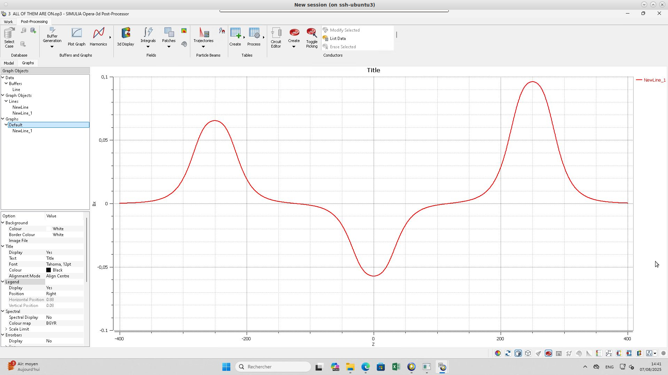
Third study
Physical dimension of com.In.Quad.10
Physical dimension of com.In.Quad.20
Physical dimension of com.In.Quad.30
com.In.Quad.20 is on
com.In.Quad.10 is on
com.In.Quad.30 is on
Bx(T)
Z(mm)

Slide 16
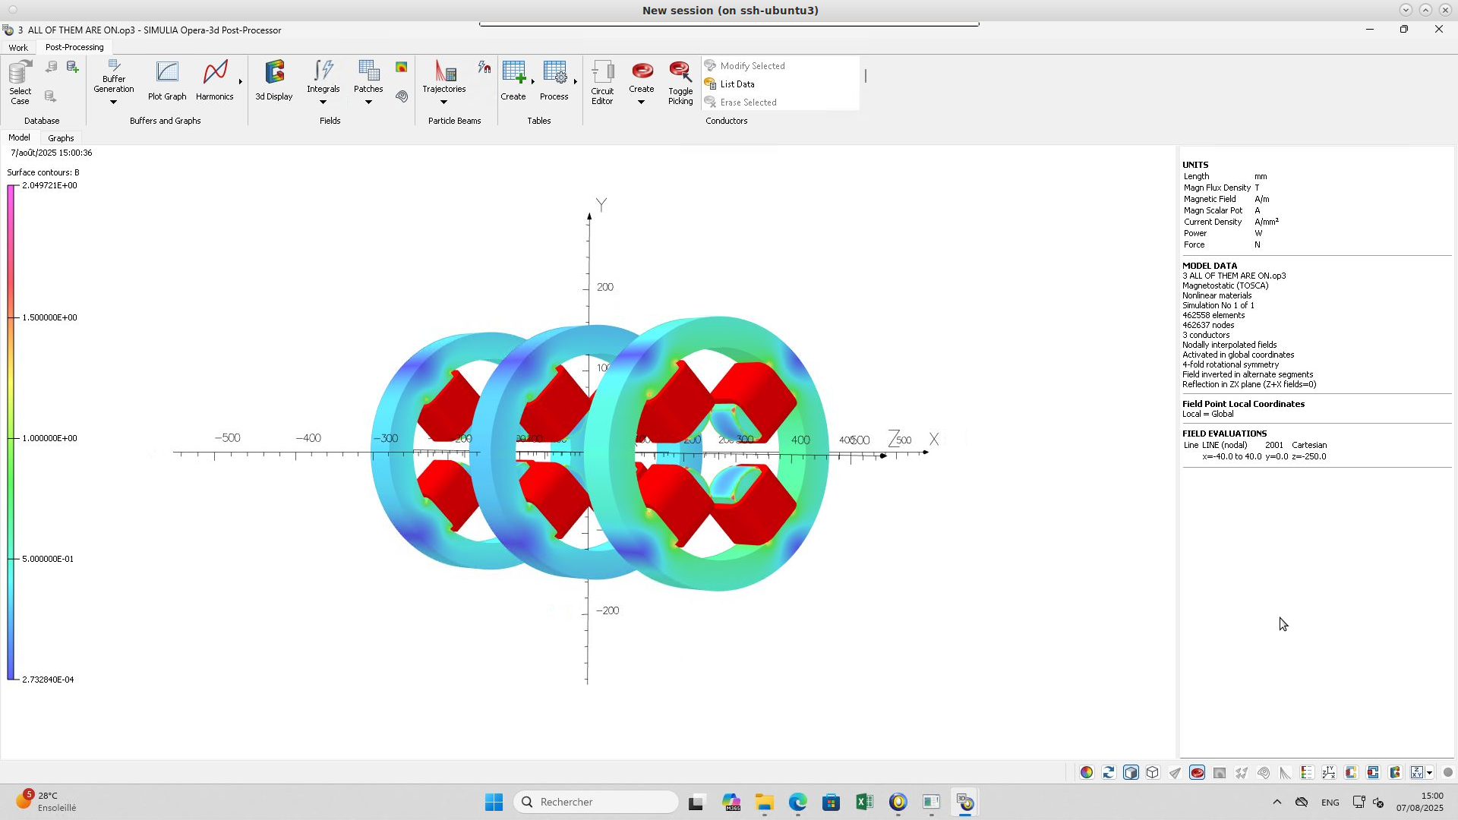

Magnetic flux density in the yoke & Gradient
Gradient for com.In.Quad.30 =4.81 T as alone !!!
Excellent work !!!
Y
Gradient for com.In.Quad.10 =3.27 T as alone !!!
Gradient for com.In.Quad.20 =-2.87 T, alone is 2.86 !!!

Slide 17
Future work
According to the 3 Studes the quadrupoles design approximately acceptable
finish model of 3 quads
Design dipole

