Slide 1




Uncertainty-Aware AI Models for Systematic Uncertainty Modeling and Robust Higgs Boson Detection within the FAIR Universe – HiggsML Uncertainty Challenge
Supervised by :
ROUSSEAU David and CHAKKAPPAI Ragansu

Slide 2
Table of Contents
Introduction
- Particle Physics, Higgs Boson, and the ATLAS Experiment
- Overview of the FAIR Universe Project
Challenges in Particle Detection
- Systematic Uncertainties: TES, JES, MET, etc.
My Project Overview
- (Contains all project components and details)
Internship Weekly Activities
- What I Did Each Week: Tasks, Learning, and Progress
Data Visualizations
- Key Visual Results: Histograms, ROC, Calibration, Loss Curves
Results and Conclusions
- Summary of Findings
Upcoming Work Plan

Slide 3
Particle Physics, Higgs Boson, ATLAS Experiment & FAIR Universe Project
Particle Physics Overview:
Study of fundamental particles and forces by colliding protons at CERN’s Large Hadron Collider (LHC).
ATLAS Detector:
One of the LHC’s main experiments recording billions of collision events.
Measures energy, momentum, and type of particles produced in collisions.
🌀 What Happens in a Collision?
Particles collide → new particles created → detectors (like ATLAS) record their movement.
Each event generates a huge amount of data (momentum, angles, energies, etc.).
had
Jet
lep
Notes:
Particle Physics Goal:
Study the fundamental building blocks of matter and forces by smashing particles at high energy.
Large Hadron Collider (LHC):
World’s largest particle accelerator at CERN.
Collides protons at near light speed, creating new particles.
ATLAS Detector in CERN:
One of the main LHC experiments detecting collision products.
Measures energies, momenta, and types of particles emerging from collisions.
Produces huge datasets (~millions of events), each with many features.
The Higgs Boson:
A fundamental particle linked to the mechanism giving mass to others.
Discovered in 2012, confirming a key part of the Standard Model.

Slide 4
FAIR Universe Overview:
  Collaborative project between major research institutions (LBNL, Université Paris-Saclay, UW, ChaLearn).
  Builds large-scale AI platforms for high-energy physics and cosmology.
Challenge Goal:
  Develop AI models that are robust to systematic uncertainties.
  Improve trustworthiness of physics insights from machine learning.
HiggsML Uncertainty Challenge:
  Focused on Higgs boson detection with realistic detector uncertainty modeling.
  Encourages innovation in systematic-aware ML algorithms.
Notes:
Develops large-scale AI platforms and benchmarks for high-energy physics and cosmology.
Focuses on building uncertainty-aware AI models that are robust to detector systematics.
Hosts the HiggsML Uncertainty Challenge aimed at improving Higgs boson detection under systematic variations.

Slide 5
Challenges in Particle Detection: Systematic Uncertainties
What are Systematic Uncertainties?
Systematic uncertainties (or systematics) are biases or errors inherent to the measurement process that consistently affect data in a predictable way.
Measurement Errors & Biases:
Detector imperfections cause uncertainties in measurements (energy, momentum). From calibration, detector resolution, and environmental effects during experiments.
Key Systematics:
  TES (Tau Energy Scale): Uncertainty in measuring the energy of tau leptons.
  JES (Jet Energy Scale): Uncertainty in the measured energy of particle jets.
  MET (Missing Transverse Energy): Uncertainties due to detector noise and mismeasurements affecting invisible particles’ energy.
Impact:
Systematic uncertainties can bias physics results if not properly accounted for, leading to false conclusions.

Slide 6
My Project Overview
Build a machine learning pipeline to classify events from particle physics experiments into:
✅ Signal → Higgs boson decays
❌ Background → Other processes (e.g., ttbar, ztautau, diboson)
Project Components:
Model training on physics data
Handling systematic uncertainties
  → Train SystModel for each systematic
Model tunning
→ Adjust model settings to improve performance
Testing and validation
Analyse robustness and calibration :
  - ROC curves
  - Calibration curves
  - Feature distributions,
  - Score distributions (histograms and stacked histograms)
  - Neural net loss curves (if using NN)
  - models tracking and comparisons (using MLFLOW)
    Generating physics-aware metrics:
    - gamma (γ) and beta (β), used to compute μ̂ (mu hat) and Δμ̂ (uncertainty in mu)
    Logs everything using MLflow for tracking experiments.
What is classification in ML ?
Classification means teaching a computer model how to tell the difference between different categories

Slide 7
What is Classification in Machine Learning?
Classification is a type of machine learning task where the goal is to assign a label to input data based on patterns it learns.
Simple Example:
If you show a model pictures of:
🐱 Cats
🐴 Horses
...it learns to tell whether a new picture is a cat or a horse.
This is called binary classification — because there are two options.
🐾 Ear Shape | 🐎 Has Mane? | 🐾 Tail Length | Label
Pointy | No | Short | 🐱 Cat
Rounded | Yes | Long | 🐴 Horse
Pointy | No | Short | 🐱 Cat
Rounded | Yes | Long | 🐴 Horse
🎯 Our Case: Physics Classification
In our project, we want the model to classify collision events from particle physics into:
✅ Signal → Events that may contain a Higgs boson
❌ Background → All the other events (like ttbar, ztautau, etc.)
Just like the cat vs dog example —
Here it's Higgs vs non-Higgs.
Back to summary

Slide 8
What Are Systematics?
Systematic uncertainties = Non-random, structured errors.
🔍 Example:
If a detector consistently overestimates particle energy → both signal and background are mismeasured in a biased way.
It's a data transformation utility that simulates real-world measurement uncertainties in high-energy physics — like when a detector mismeasures the energy of a tau or a jet.
Why it matters:
A model may perform well on ideal data
But in real conditions (with systematics), its performance may shift
So, we train two models per systematic uncertainty:
One with +10% variation
One with −10% variation
Back to summary

Slide 9
Model Types
In this project, I used
Neural Networks (NN) and Boosted Decision Trees (BDT)
Both used to train the main model that classifies Signal vs Background events.
Also used to train separate systematics models to handle detector uncertainties.
BDT🌲
NN🧬

Slide 10
Boosted Decision Tree (BDT)
What is a Decision Tree?
A decision tree splits data by testing features at each node, creating branches, and assigning class labels at the leaves to classify samples step-by-step.
Definition:
A BDT combines many simple decision trees into an ensemble that improves classification by focusing on previous errors (boosting).
Implementation:
Uses XGBoost (eXtreme Gradient Boosting), a high-performance library.
Key Features:
  Automatically handles missing values and feature importance.
  Fast and scalable (used in many Kaggle-winning solutions).
  Requires less tuning compared to NNs.
Training:
  Scales features using StandardScaler.
  Trains using XGBClassifier with sample weights.
Tuning (optional):
  Can tune n_estimators, max_depth, learning_rate, etc.
  Default settings already perform well for most tasks.

Slide 11
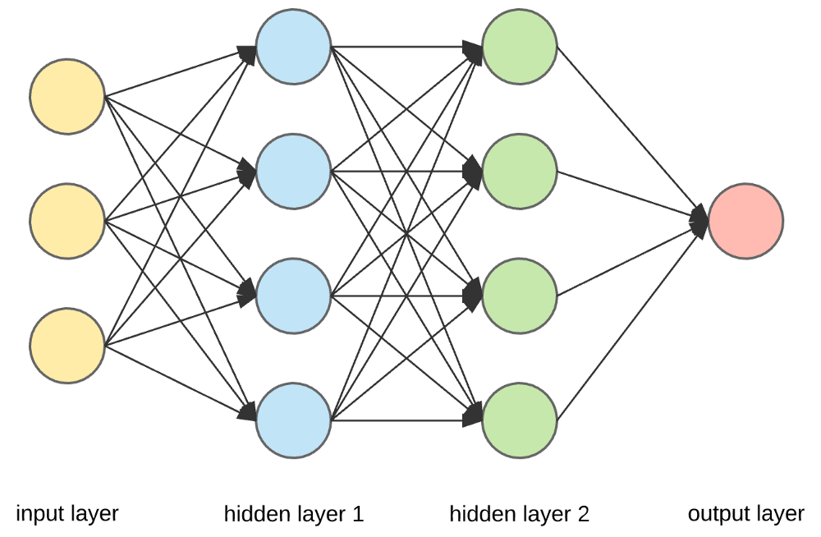
Neural Network (NN)
Definition:
A neural network mimics the human brain by using layers of interconnected neurons that learn complex, non-linear patterns.
Initial Architecture in This Project:
  6 hidden layers of varying size: [64, 64, 32, 32, 16, 16]
  30 epochs , batsh_size = 32
  Dropout [0.3 , 0.3] + Batch Normalization.
  Output layer: 1 node with sigmoid activation (for binary classification).
  Scales features using StandardScaler.
  Uses Adam optimizer and binary_crossentropy loss.
  Includes:
    Early stopping (avoid overfitting)
    Learning rate scheduler
Tuning Options (for performance optimization):
  Layer depth & width → number of hidden layers and neurons
  Dropout rates → prevent overfitting
  Activation functions (e.g., relu, tanh)
  Batch size & epochs
  Optimizer & learning rate
  Regularization → L1/L2 penalties

Slide 12
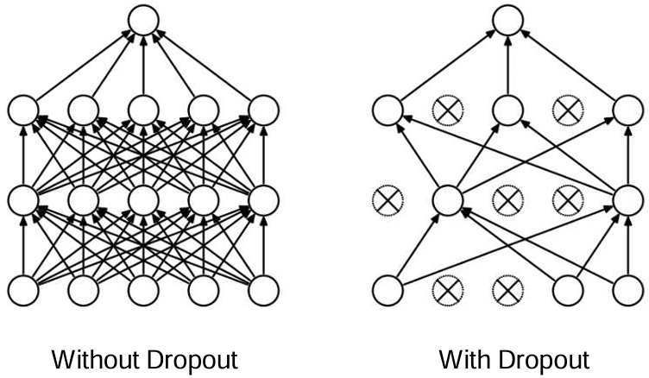
Dropout regularization

Slide 13
Dataset Summary
2,000,000 events
31 physics features
PRI_* → Primary measurements - Measurements directly from the detector
DER_* → High-level physics features Derived/calculated from primary inputs
Labels (Binary class labels): 1 = Signal , 0 = Background
Detailed_labels: Multiclass category:
  ztautau (Background)
  diboson (Background)
  ttbar (Background)
  htautau (Signal)
Weights: Event weights for accounting for simulation/statistical effects

Slide 14
▶️ Primary Physics Inputs (PRI)
Measurements directly from the detector: (16)
PRI_lep_pt, PRI_lep_eta, PRI_lep_phi: Lepton momentum and direction
PRI_had_pt, PRI_had_eta, PRI_had_phi: Hadronic tau candidate
PRI_jet_leading_pt, PRI_jet_leading_eta, PRI_jet_leading_phi: Leading jet
PRI_jet_subleading_pt, PRI_jet_subleading_eta, PRI_jet_subleading_phi: Subleading jet
PRI_n_jets: Number of jets
PRI_jet_all_pt: Total jet transverse momentum
PRI_met, PRI_met_phi: Missing transverse energy (MET)
📈 Derived Features (DER)
High-level physics features calculated from primary inputs: (12)
DER_mass_transverse_met_lep
DER_mass_vis
DER_pt_h
DER_deltaeta_jet_jet
DER_mass_jet_jet
DER_prodeta_jet_jet
DER_deltar_had_lep
DER_pt_tot
DER_sum_pt
DER_pt_ratio_lep_had
DER_met_phi_centrality
DER_lep_eta_centrality

Slide 15
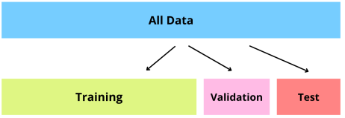
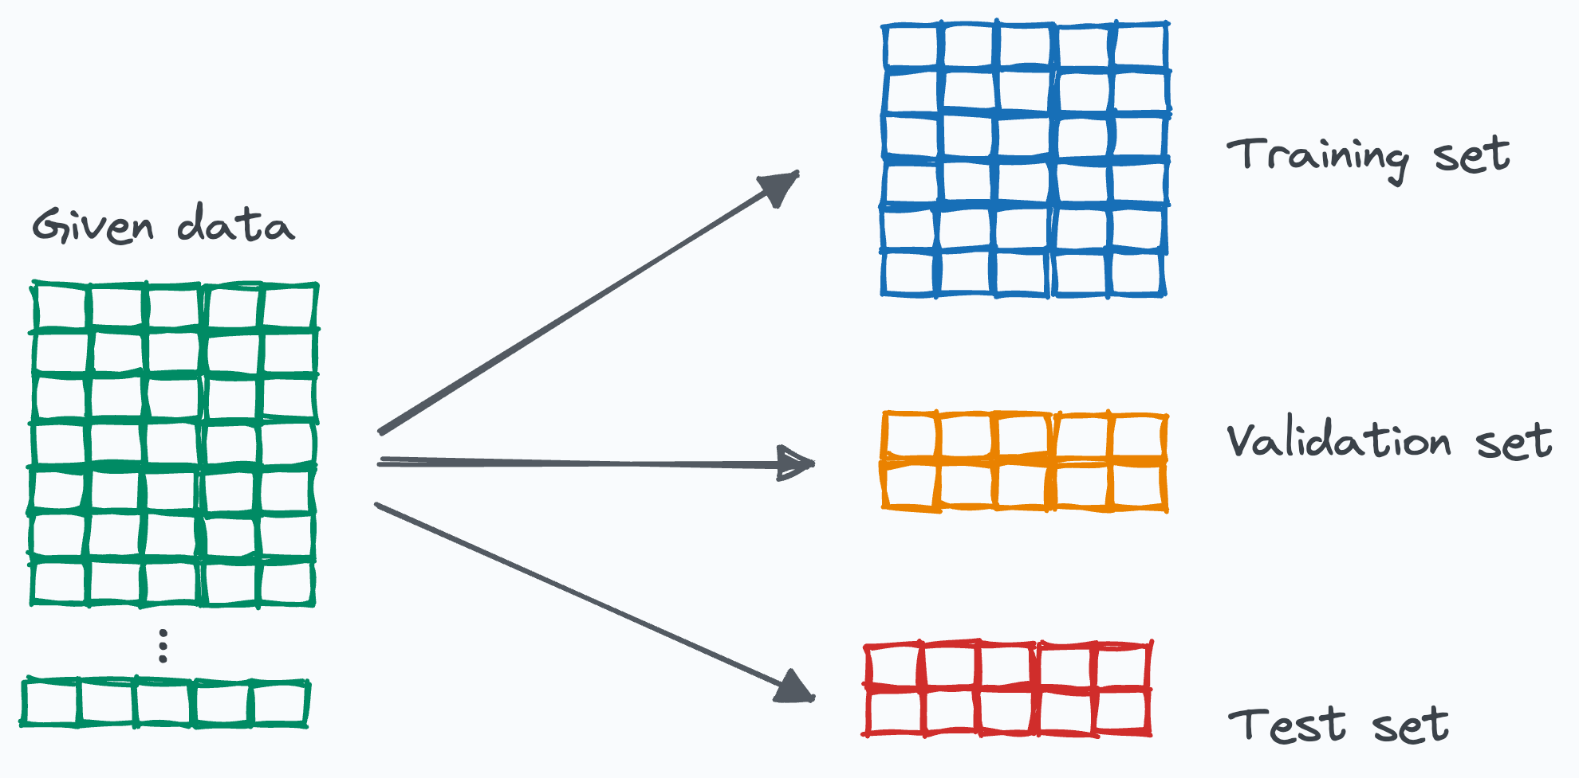
Dataset Splits:

Slide 16
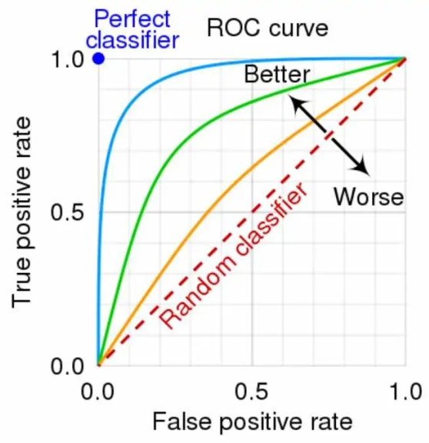

ROC curves
ROC (Receiver Operating Characteristic) curve shows the trade-off between True Positive Rate (Sensitivity) and False Positive Rate at various threshold settings.
The Area Under the Curve (AUC) quantifies the overall ability to discriminate signal from background.
A higher AUC (close to 1) means better performance.
Useful to compare different models and tune thresholds.

Slide 17
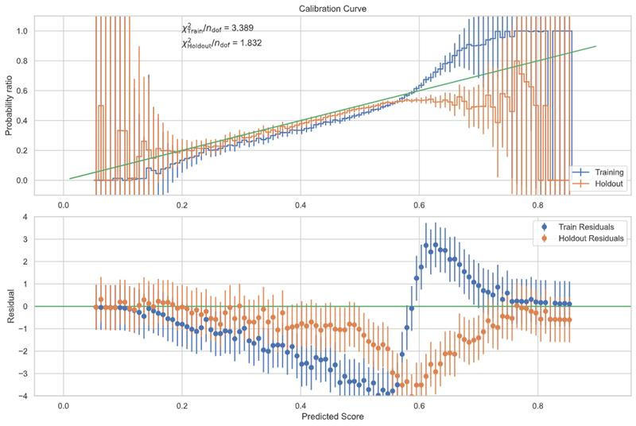
Calibration Curve
Shows how well predicted probabilities match actual outcomes.
A perfectly calibrated model’s curve lies on the diagonal
(predicted = observed).
Helps identify if the model is overconfident or underconfident.
Important for physics applications where probability interpretation matters.
It compares the predicted probability from your ML model (like XGBoost or NN) against the true fraction of signal events in bins of those predicted scores.
a normalized χ2 per degree of freedom uased to summarize calibration quality.

Slide 18
Score Distributions
Histograms show predicted scores for signal and background.
Stacked histograms break down background by detailed labels (e.g., ttbar, diboson).
Clear separation between classes indicates strong classification power.
Used to visualize how well the model distinguishes events.

Slide 19
CONTENTS OF the internship
Week 1–2
1
Understood the project goals and data structure.
Visited CERN for exposure to current physics research.
Integrated MLflow for experiment tracking and version control.
Began modifying the model and logging key metrics.
2
Week 3
Started Optimizing and cleaning the codebase.
Introduced and began coding ROC curves and calibration graphs for performance evaluation.
Started planning for systematic uncertainty modeling.
Week 4
3
Trained and improved the model’s predictive performance.
Conducted feature analysis to identify impactful variables.
Improved code structure and added clear documentation.
Solving logical issues
Notes:
The ROC curve plots the True Positive Rate (TPR) against the False Positive Rate (FPR) at different threshold settings.
TPR (Sensitivity / Recall): Proportion of actual positives correctly predicted.
FPR: Proportion of actual negatives wrongly predicted as positive.
The ROC curve plots the True Positive Rate (TPR) against the False Positive Rate (FPR) at different threshold settings.
TPR (Sensitivity / Recall): Proportion of actual positives correctly predicted.
FPR: Proportion of actual negatives wrongly predicted as positive.
------
The calibration curve evaluates how well a model’s predicted probabilities match the true likelihood of an event.
In other words, if your model says:
"This event has a 70% chance of being a Higgs signal"
... then, over many such predictions, about 70% of those events should actually be Higgs signals. That's calibration.
Top: Probability Ratio vs. Predicted Score
Y-axis = Empirical probability / Predicted probability
(i.e., how close predictions are to reality)
Green diagonal = Perfect calibration
Bars = Uncertainty (error bars) per bin
Bottom: Residual Plot (True − Predicted)
Shows where your model is systematically biased
Ideally, points should hover around zero

Slide 20
Current progress
Weeks 5-6
Resolved a critical bug in systematic variation plotting, leading to more accurate evaluation.
Improved neural network calibration and began incorporating Brier Score as a new evaluation metric.
Transitioned to LCG computing environments using SSH and SLURM, and started using Linux tools in the workflow.
Gained hands-on experience in debugging, remote computing, and model evaluation techniques.
Faced and solved challenges related to plotting logic and software compatibility.
Set the foundation for deeper calibration analysis, regularization studies, and further systematic modeling enhancements.

Slide 21
Data visualizations

Slide 22
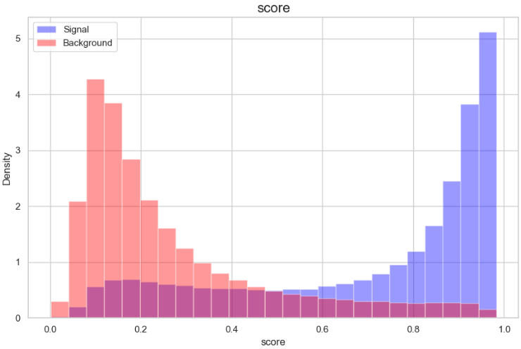

Slide 23
RESULTS

Slide 24
Running main classifier on BDT and systematics models also

Slide 25
MINUS
Notes:
📈 Why Do You Have a Calibration Curve for “Plus” and “Minus”?
Because the core question is:
Does my model still make reliable predictions even when systematic uncertainties shift the data?
Case: Good in Middle (0.4–0.7), Bad at Edges (0–0.3 and 0.8–1.0)
Common. Happens due to:
Class imbalance: not many events in extreme probability regions
Model overconfidence: tends to push outputs to 0 or 1 when unsure
Regularization issues (e.g., dropout) increasing bias
Limited representation in tails (rare physics signals live there!)
This is problematic for μ̂, because:
You may overcount false positives at high scores
Or undercount true signals at low-confidence
🚩 Calibration poor everywhere
Model fundamentally mismatched (e.g., wrong architecture, poor feature selection)
Model never learned meaningful uncertainty → all predictions are misleading
Would show off-diagonal curve with high residuals throughout
🟨 Calibration perfect in training but bad in holdout
Overfitting
Model learned training-specific quirks, not generalizable patterns
You'd see a good calibration curve in blue (train), but not in orange (holdout)
🟩 Calibration good in “minus” but bad in “plus”
That specific systematic strongly affects signal/background separation
Possibly your model is fragile to shifts in energy scale, resolution, etc.
You may need:
Data augmentation (simulate more systematics)
Smoother model (no dropout, better calibration layer)
Robust features (less sensitive to systematics)

Slide 26
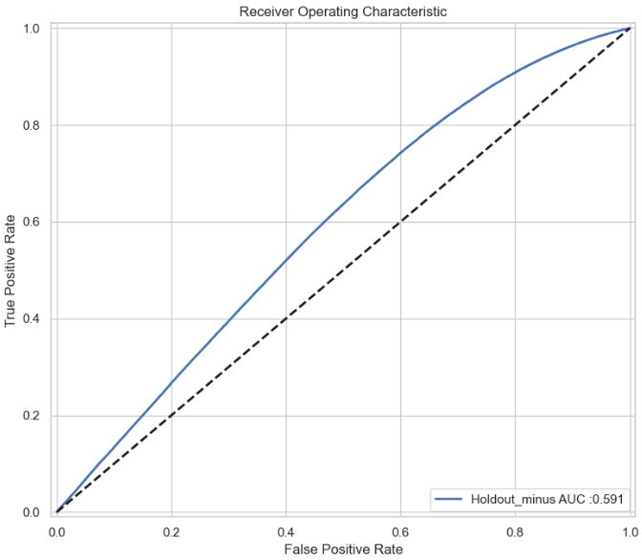

Slide 27
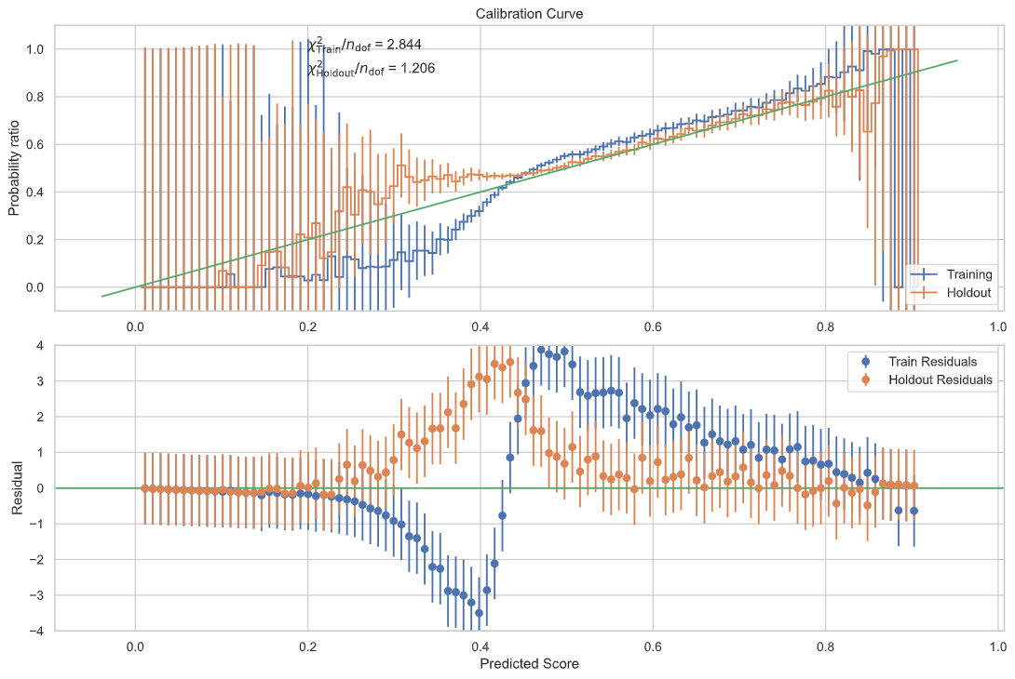
PLUS

Slide 28
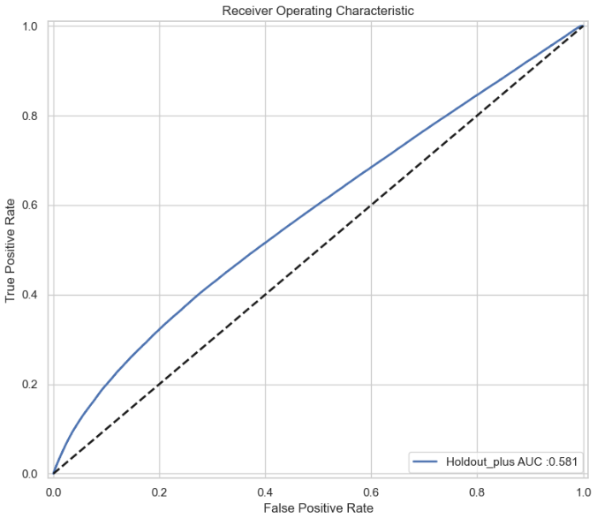

Slide 29
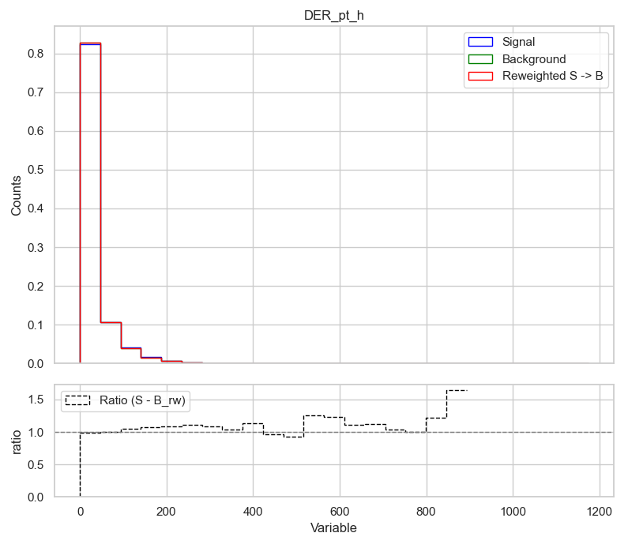

Slide 30
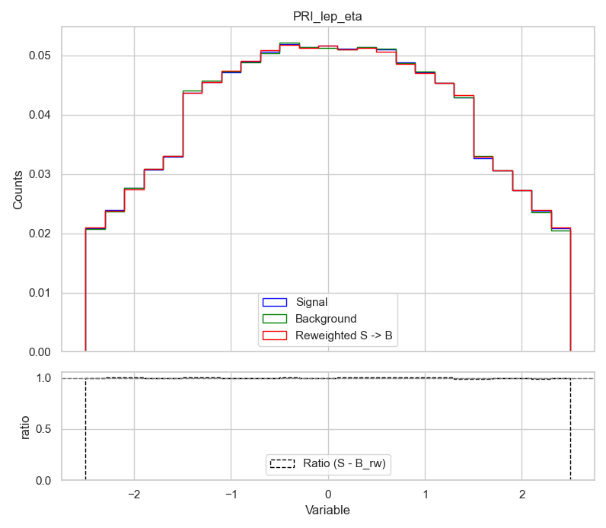

Slide 31
Running main classifier on NN and systematics models also
Notes:
🟡 Bias
How far off your model's average predictions are from the true outcomes.
High bias = underfitting: model is too simple, can’t capture patterns
Example: predicting 0.5 for every event, even when many are true signal
🔵 Variance
How much your model’s predictions fluctuate between different datasets or training runs.
High variance = overfitting: model captures noise, not general patterns
Example: great on training, poor on validation/holdout
3. Residual Plots (from calibration curves)
🚨 High Bias:
Residuals stay above or below zero in many bins
→ Systematic miscalibration
🚨 High Variance:
Residuals are noisy, inconsistent between train and holdout
→ Model predictions change too much depending on the data

Slide 32
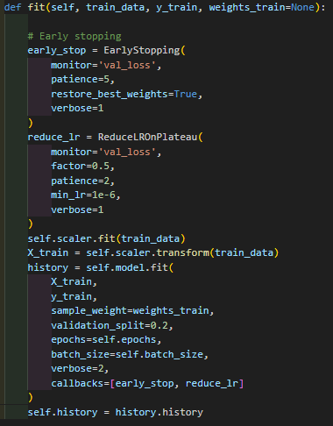
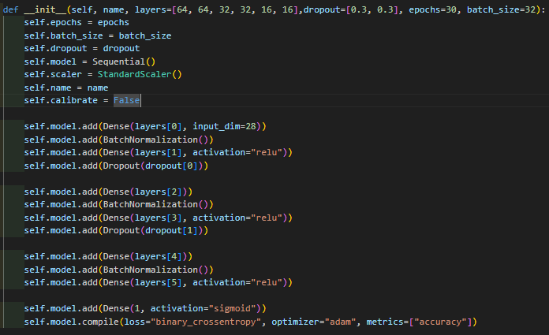

Slide 33
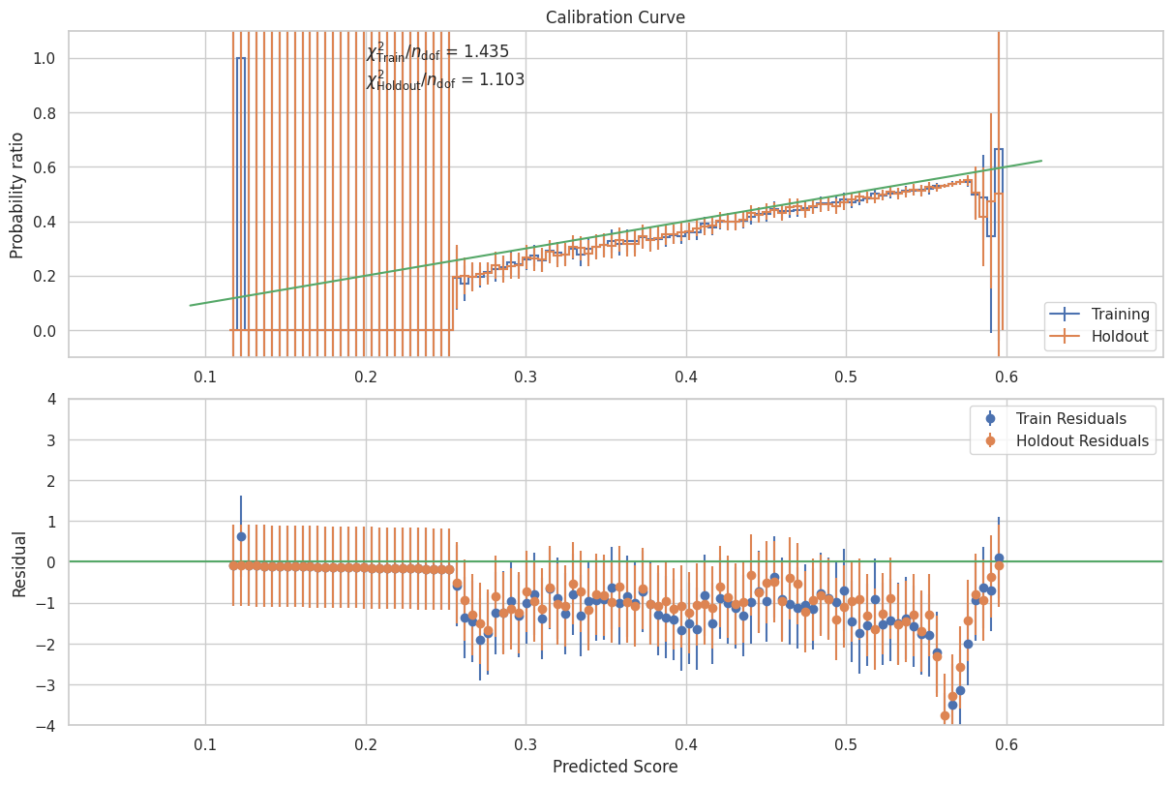
MINUS
Notes:
Case: Good in Middle (0.4–0.7), Bad at Edges (0–0.3 and 0.8–1.0)
Common. Happens due to:
Class imbalance: not many events in extreme probability regions
Model overconfidence: tends to push outputs to 0 or 1 when unsure
Regularization issues (e.g., dropout) increasing bias
Limited representation in tails (rare physics signals live there!)
This is problematic for μ̂, because:
You may overcount false positives at high scores
Or undercount true signals at low-confidence
🚩 Calibration poor everywhere
Model fundamentally mismatched (e.g., wrong architecture, poor feature selection)
Model never learned meaningful uncertainty → all predictions are misleading
Would show off-diagonal curve with high residuals throughout
🟨 Calibration perfect in training but bad in holdout
Overfitting
Model learned training-specific quirks, not generalizable patterns
You'd see a good calibration curve in blue (train), but not in orange (holdout)
🟩 Calibration good in “minus” but bad in “plus”
That specific systematic strongly affects signal/background separation
Possibly your model is fragile to shifts in energy scale, resolution, etc.
You may need:
Data augmentation (simulate more systematics)
Smoother model (no dropout, better calibration layer)
Robust features (less sensitive to systematics)

Slide 34
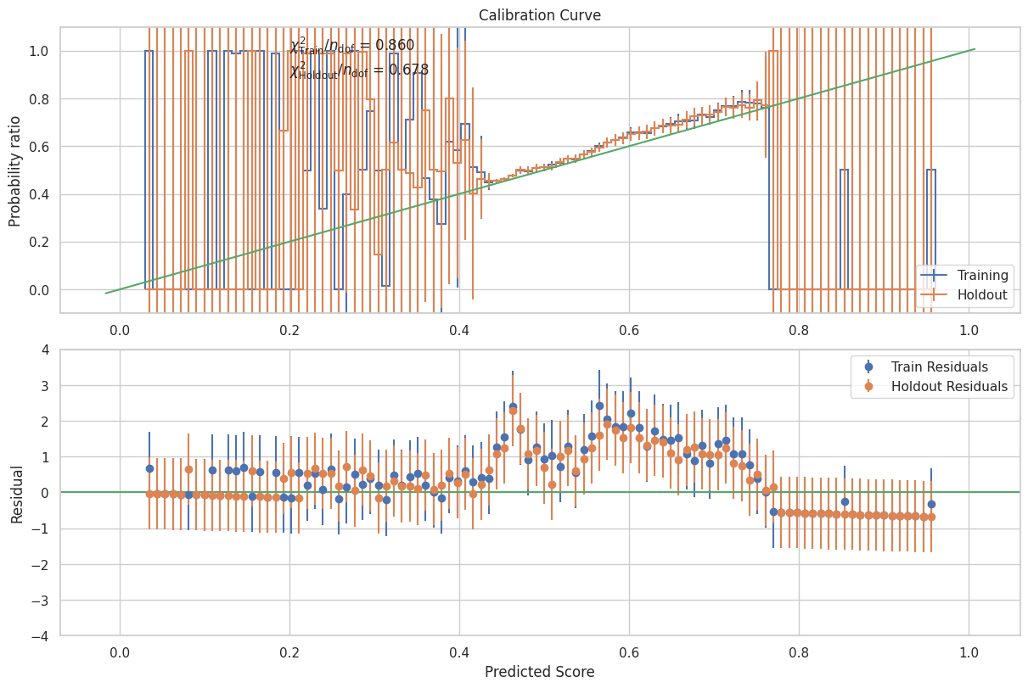
PLUS

Slide 35
What is the upcoming work plan ?
Perform deeper analysis of the calibration curve focusing on bias and variance in model predictions.
Study and experiment with dropout, regularization, and other techniques to control overfitting and improve calibration.
Investigate how these techniques affect shifts in calibration and model performance graphs.
Integrate and analyze Brier Score as an evaluation metric, studying its correlation with calibration quality.
Continue learning and applying Linux to improve workflow efficiency.
Focus on improving the model’s handling of systematic uncertainties both technically (code) and conceptually (methodology).
Maintain steady progress on refining uncertainty-aware AI models in the coming weeks.

