Slide 1
SOLEIL Timing and synchronization System
AI-DIA-PST-I-2168
2025-12-17

Slide 2
SOLEIL
2025-11-07

Slide 3
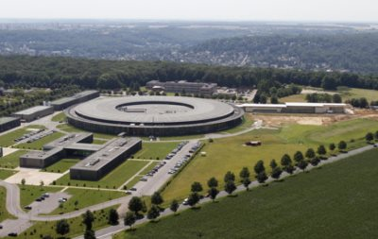
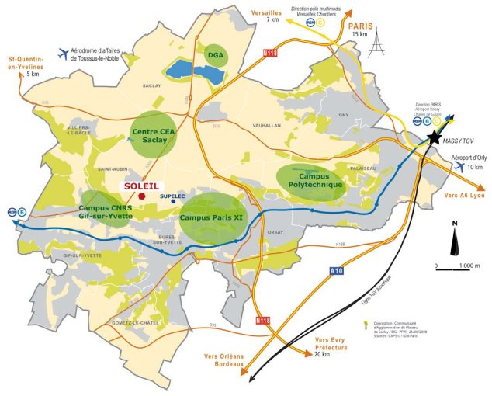
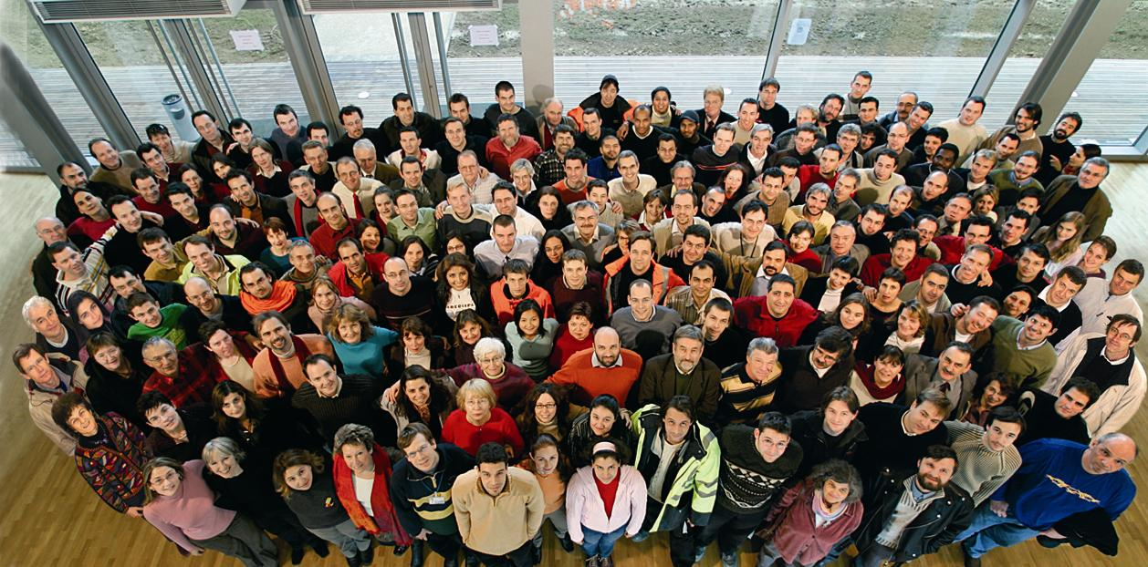
SOLEIL
SOLEIL is a research center that produces and uses synchrotron light.
This ultra-bright radiation is 10,000 times brighter than that of the sun.
It is used to study samples and materials in order to find out more about their structure and properties. The extreme brightness of SOLEIL will make it possible to make observations on a submicronic scale on materials.
SOLEIL is among 40 major scientific establishments in France.
The staff is about 370 persons + 2500 researchers / year

Slide 4
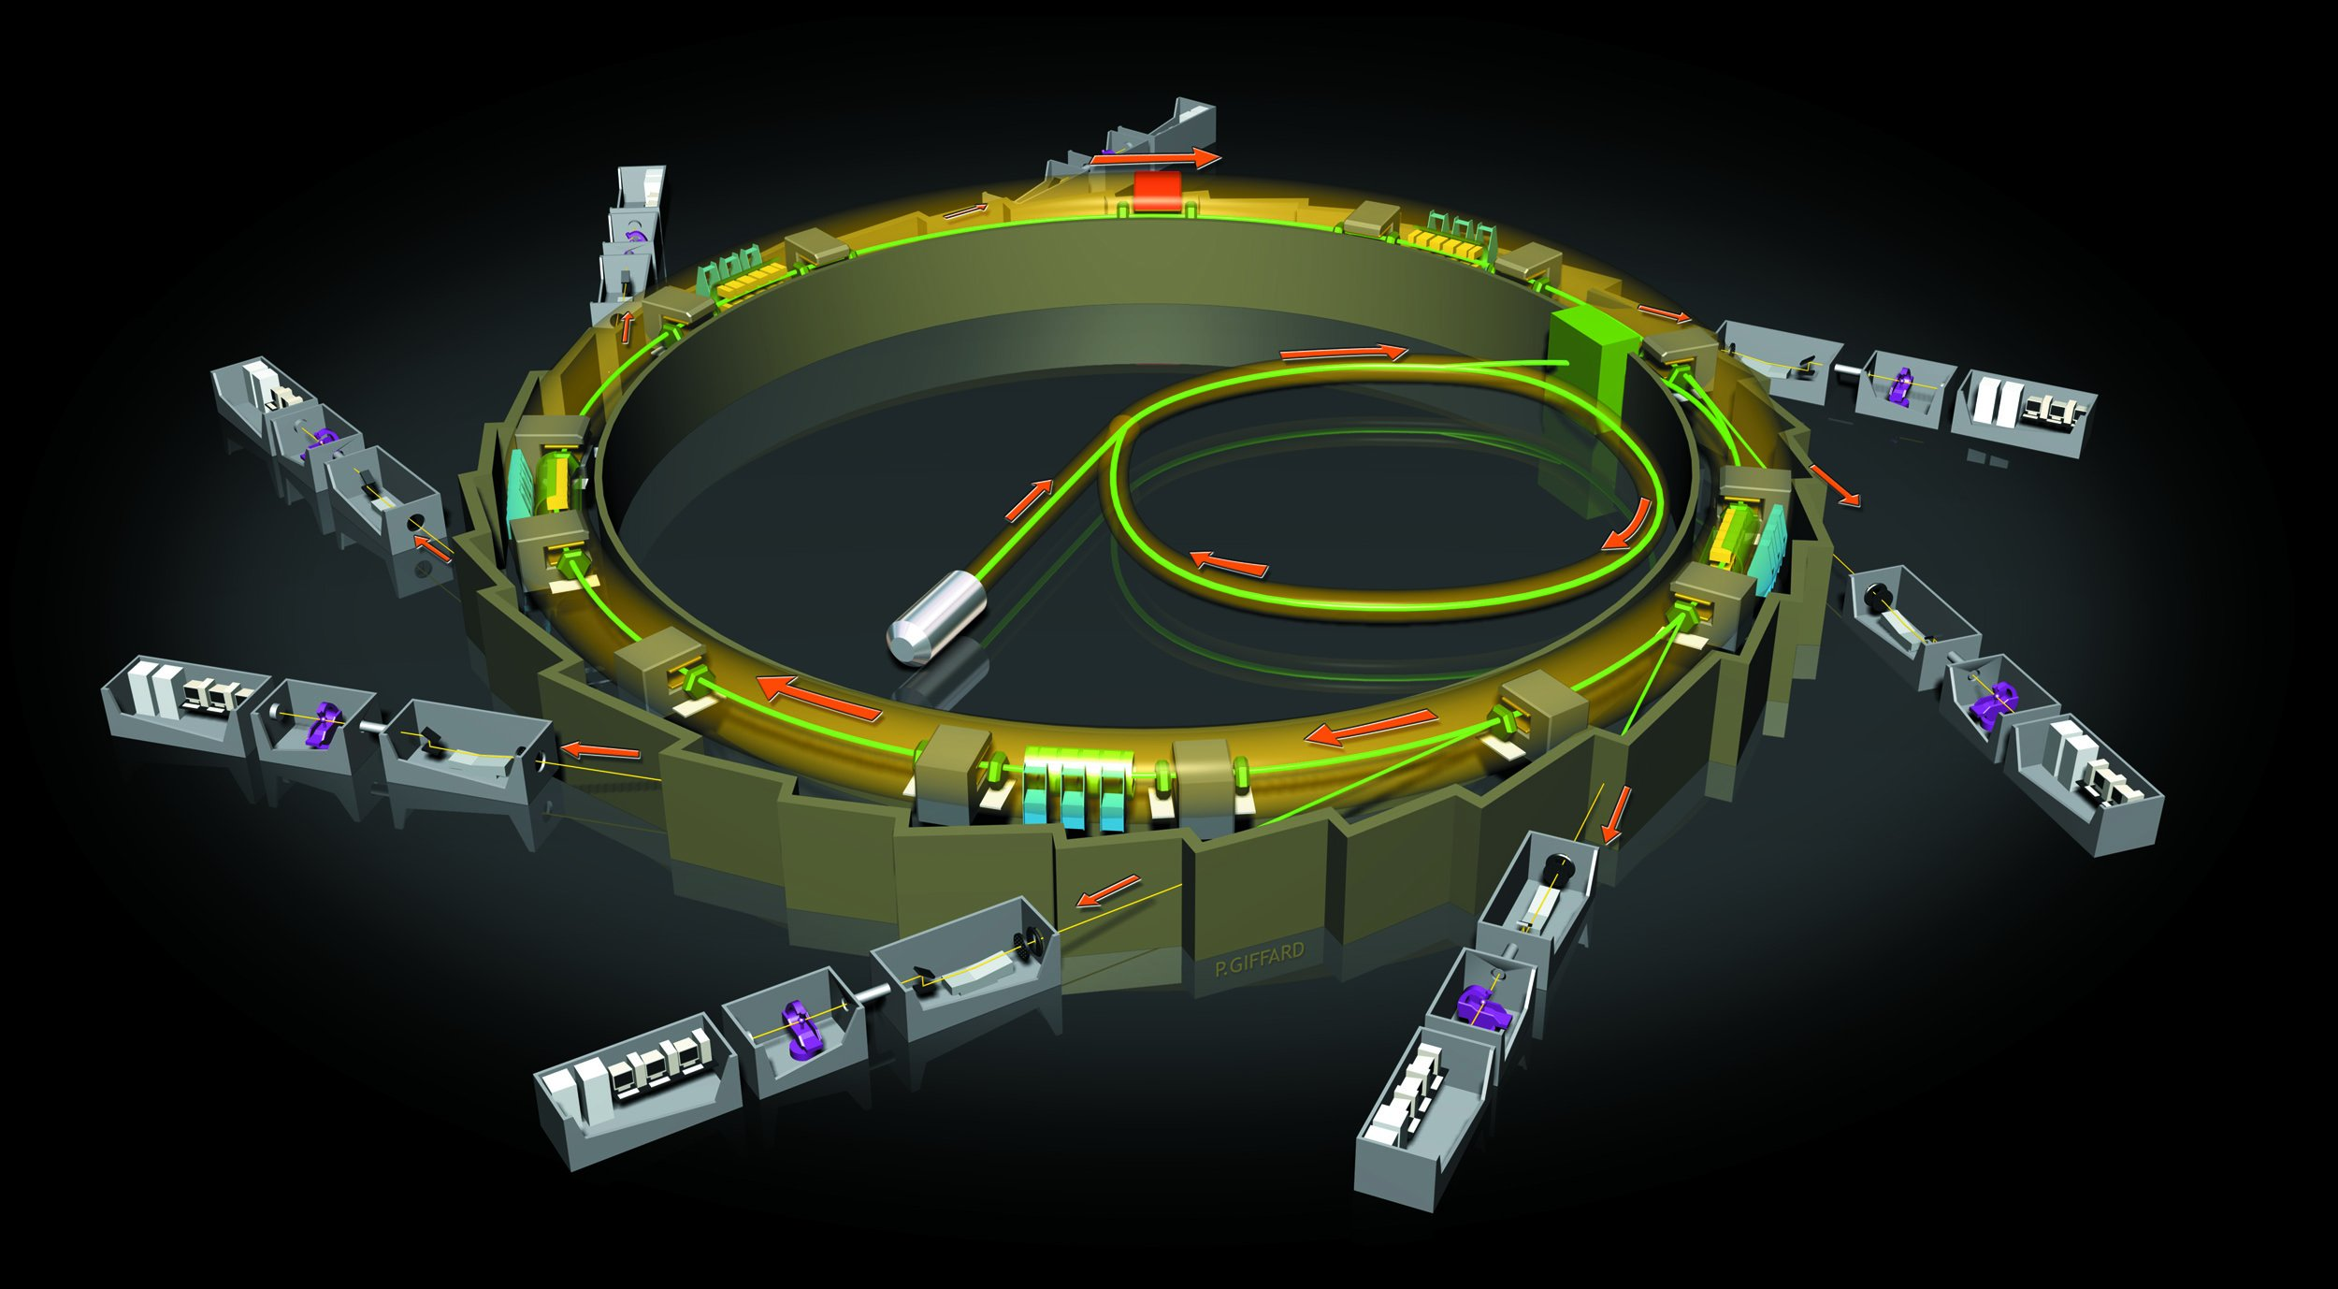
SOLEIL
Storage ring 2,75 GeV, 354 meter circumference
Booster 110 MeV
LINAC
16 meter long
Electron cannon
Laboratory
29 Beamlines

Slide 5
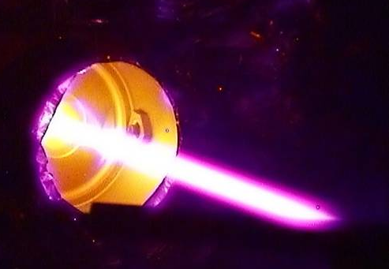
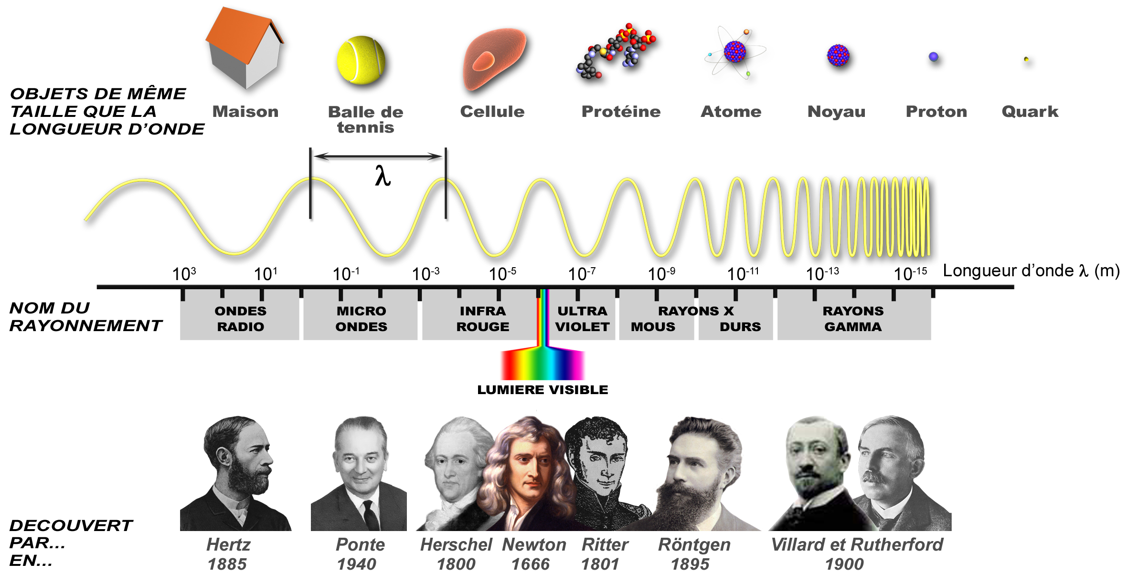
SOLEIL

Slide 6
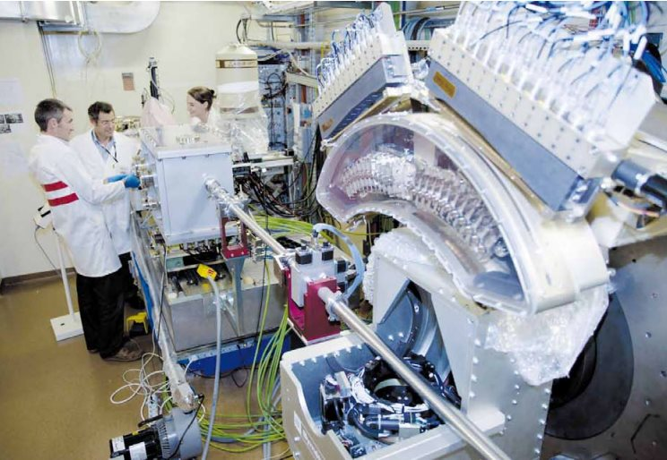
SOLEIL
Agribusiness
Biology
Origin of life - The natural asymmetry of biomolecule
Cosmetics
Chemistry
Electronic
A major advance in microelectronics: The production of graphene semiconductor nano-ribbon
Buildings - Public works
Transport
Materials
SOLEIL sheds light on the secret of the Stradivarius varnish
Medicine
Liver transplants - SOLEIL synchrotron offers a safer method of deciding in a few minutes if a donor liver can be transplanted
Huntington’s disease - The structure of inclusions in patients’ brains revealed by IR microspectroscopy
Diagram of the hepatitis c virus
Energy
Environment and eco-industries
Etc.

Slide 7
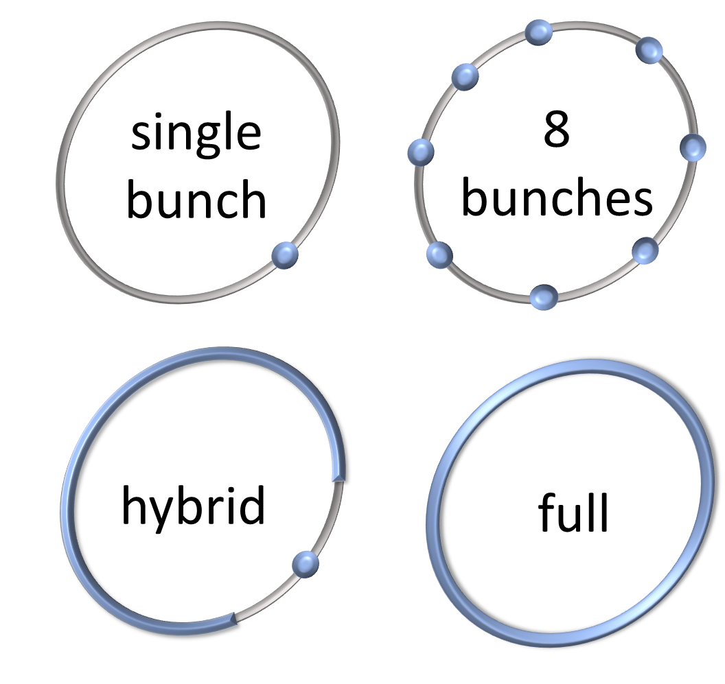
SOLEIL
Filling modes

Slide 8
SOLEIL
Top-up
Top-up injection
Top-up injection
Top-up injection
Top-up injection
501 mA
497.7 mA
Current in the storage ring
#2 - 5 mn
#2 - 5 mn

Slide 9
Machine timing system

Slide 10
Soleil timing system
Machine synchronization system
RF
Beam lines synchronization system

Slide 11
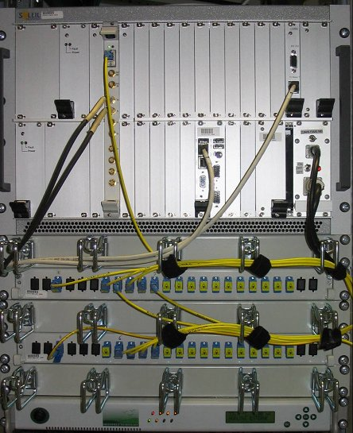
Machine timing system
Current system
The current system is based on master/slaves event architecture developed by subcontractor for SOLEIL.
It has been very reliable since 2006.
The aim of the machine’s timing system of Soleil:
To trigger all devices (LINAC, Kicker, Septum, etc.) needed to bring electrons from the LINAC to the storage ring.
To fill the storage ring with a specific pattern defined by users.
To manage the top-up mode.

Slide 12
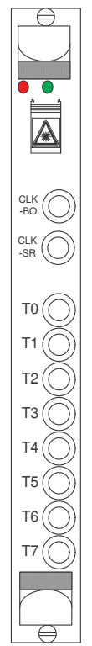
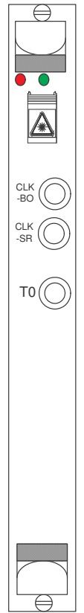
Machine timing system
Machine Timing System
LOCAL
LOCAL LINAC
Vers cartes LOCAL
Vers cartes LOCAL
Vers cartes LOCAL
Vers cartes LOCAL
REP_OPT
REP_OPT
REP_OPT
REP_OPT
Fibre optique
REP_OPT
TIMPO II
2.94 Hz
230V
50 Hz
CENTRAL
u
a
e
s
é
R
RF_DIV
176 MHz
CLK-RF
352.202MHz

Slide 13
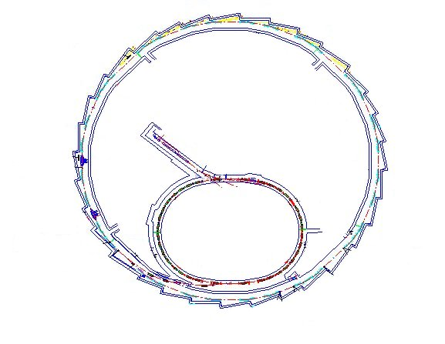
Machine timing system
Dual delay system:
Greenfield Technology system
LOCAL
Tinj + 0
Tinj (#20ms)
Tinj + 96 ns
Text (#170ms)
CENTRAL
LOCAL
Text + 0
Text + 133ns

Slide 14

Machine timing system
CENTRAL system
Broadcast the events (pre-charge, injection, extraction, continuous trigger, software on demand).
Broadcast the clocks (booster, storage ring).
Manage the injection / extraction cycle.
User configurable delay for events (steps of 1/CLK-BOO #522 ns)
256 events

Slide 15
Machine timing system
CENTRAL
Selection of the bunch inside ¼ of the storage ring with the fine delay inside CENTRAL (and the LOCAL LINAC)
Pre charge Delay | BOO injection Delay
00 | 20
SR injection Delay
¼ SR | bunch
50 | 12
1027 | 595
66 | 14
50 | 32
416
Pre charge
event
Injection
event
Pre charge
LOCALs
Injection
LOCALs
Extraction
event
Bunch
delay
event 3
Storage ring injection
LOCALs
LOCAL LINAC
bunch delay
12 ; 595 ; 14 ; …
event 2

Slide 16
Machine timing system
Injection
Pré-charge
LINAC
Extraction
event 1
event 2
event 3
T1 ms
T2 ms
T3 ms
T’1 ms
T’2 ms
T’3 ms
# 340 ms
# 340 ms
# 340 ms
Cycle n°1
Cycle n°2
Cycle n°3
¼ SR delay(1)
¼ SR delay(2)
¼ SR delay(3)
Bunch delay(1)
Bunch delay(2)
Bunch delay(3)
Coherency between ¼ SR delay and bunch delay is warranty by having both of them inside the CENTRAL system

Slide 17
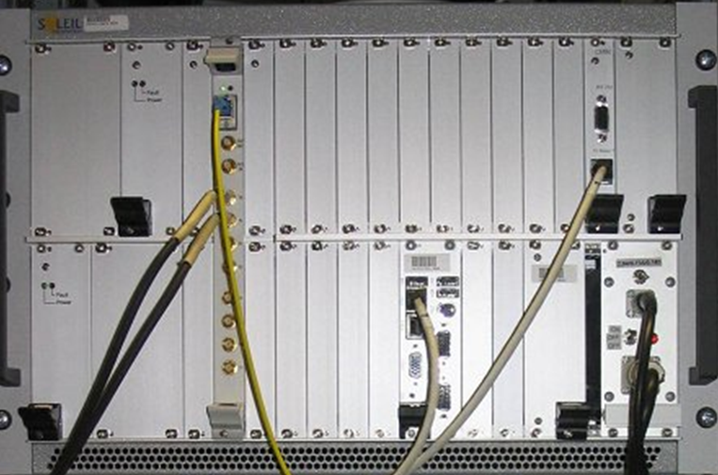
Machine timing system
LOCAL boards
Booster and Storage ring clocks outputs.
8 TTL trigger outputs.
0 to 340 ms delay adjust by step of 5.64 ns.
10 µs pulse width.
Each output’s event and delay can be configured.
#15 – 25 ps RMS jitter.
Skew < # ns between boards (fixe).

Slide 18
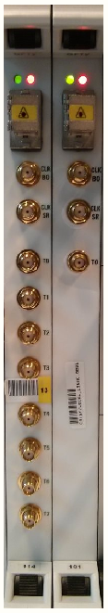
Machine timing system
LOCAL LINAC board (SPM)
Booster and Storage ring clocks outputs.
1 TTL trigger output.
0 to 340 ms delay adjust by step of 5.64 ns.
0 to 357 ns bunch delay adjust by step of # 80 ps.
10 ns pulse width.
#15 – 25 ps RMS jitter.
4 modes.
LPM
SPM

Slide 19

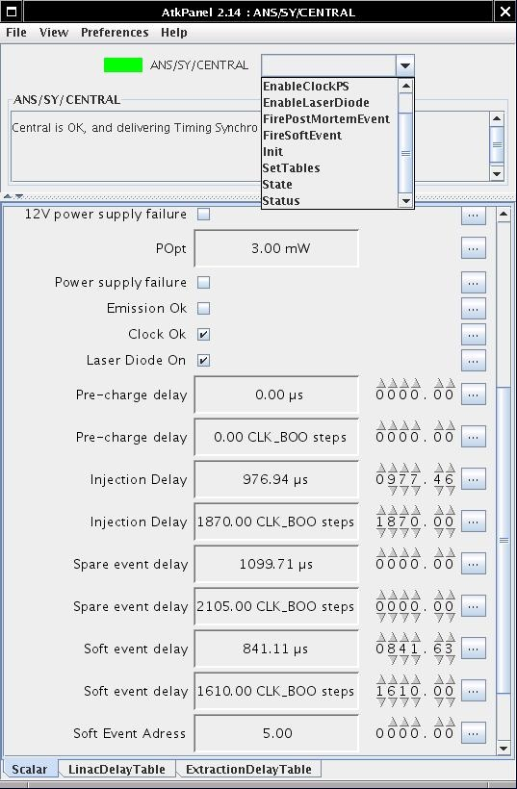
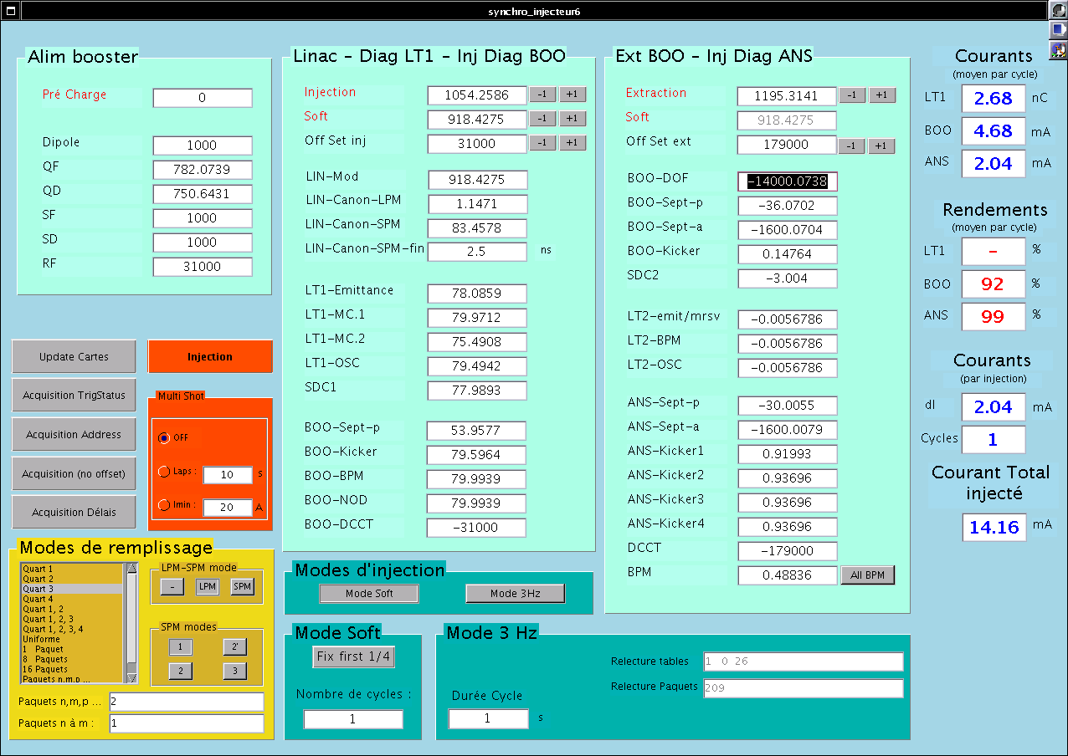
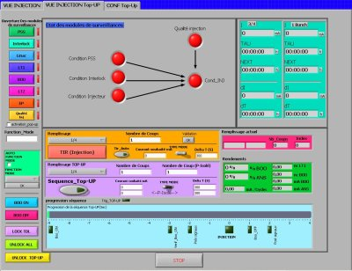
Machine timing system
Tango Devices
Matlab
LabView

Slide 20
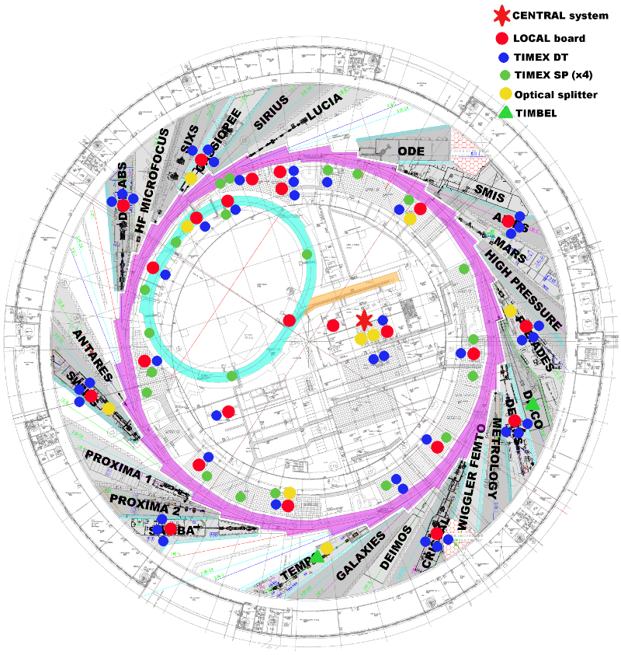
1 CENTRAL.
25 LOCALs.
1 LOCAL LINAC.
9 optical splitters
> #150 duplication boards

Slide 21
Beamlines synchronization system

Slide 22
Beamlines synchronization system
Beamlines needs:
Trigger XP devices synchronously to the electron bunch.
Top-up gating.
Laser pomp-probe synchronization.
Machine provides to Beamlines:
RF signal.
CLK-SR (Machine clock).
Pre top-up and beam lost trigger

Slide 23
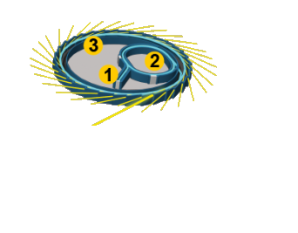
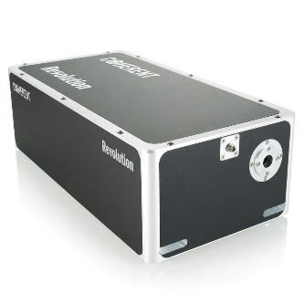
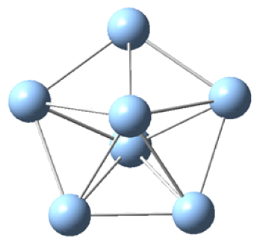

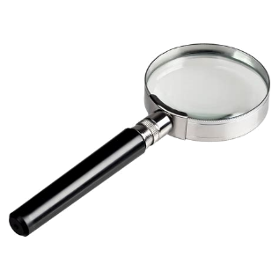
Beamlines synchronization system
Pump-probe XP
Probe
Pump
Detector

Slide 24
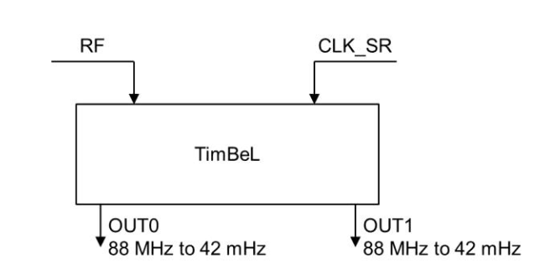
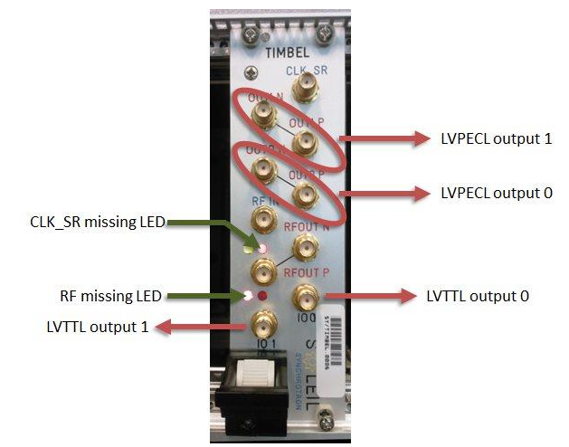
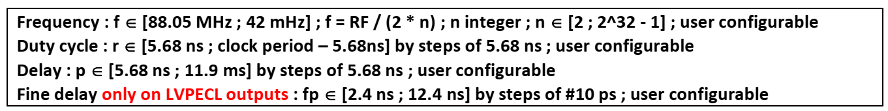
Beamlines synchronization system
TimBeL board

Slide 25
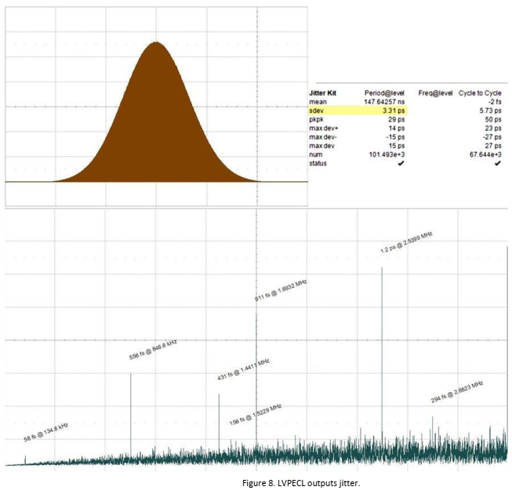
Beamlines synchronization system

Slide 26

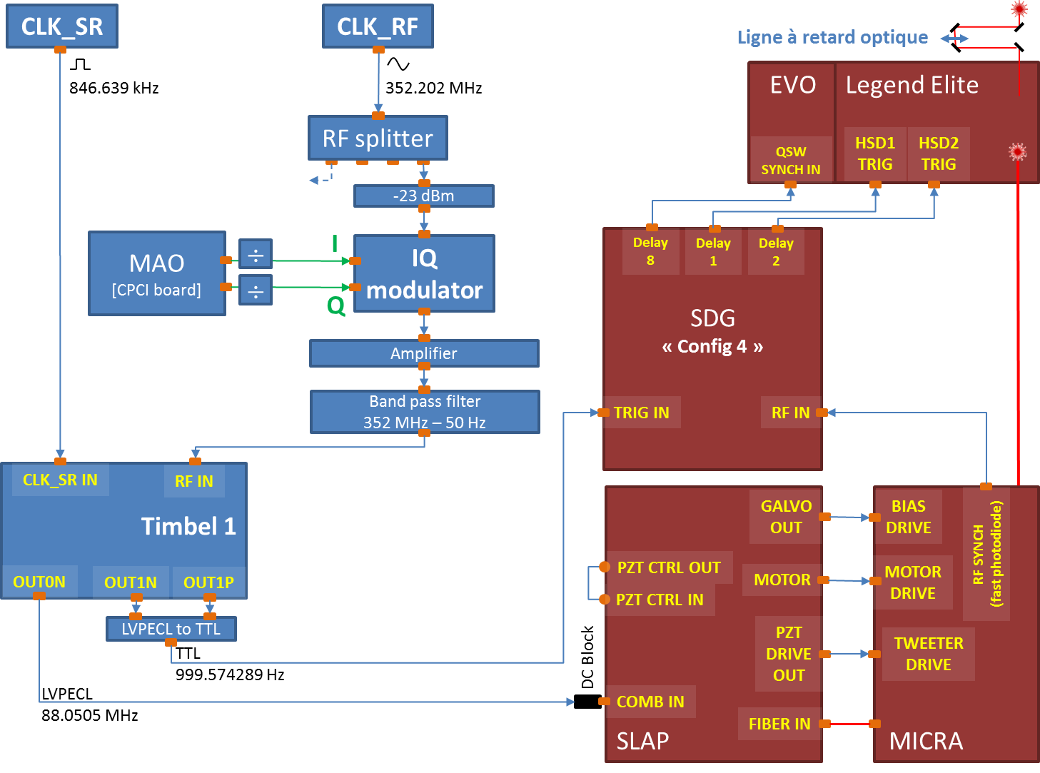
Beamlines synchronization system
Beamlines lasers

Slide 27
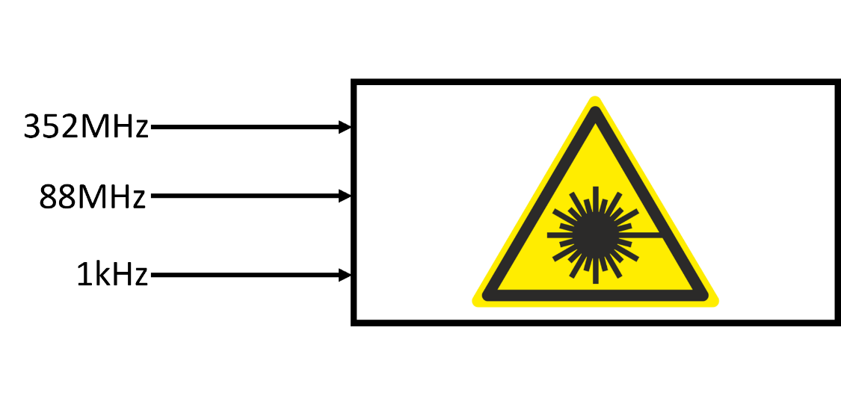
Beamlines synchronization system
Beamlines lasers requirements:
CLK-RF (CLK-RF harmonic) with phase shift capacity: oscillator.
CLK-RF / n (88 MHz or 44 MHz) with phase shift capacity: oscillator reference.
Laser trigger (CLK-RF / 846 = 1 kHz) with configurable delay.
Additional requirements:
Oscillator and oscillator reference: continuous shift without jump.
Laser trigger: no hole in the clock.
Excellent oscillator clocks phase noise of #10 fs.
Sub picosecond resolution.
➔ Machine signals and TimBeL are not enough and not good enough

Slide 28
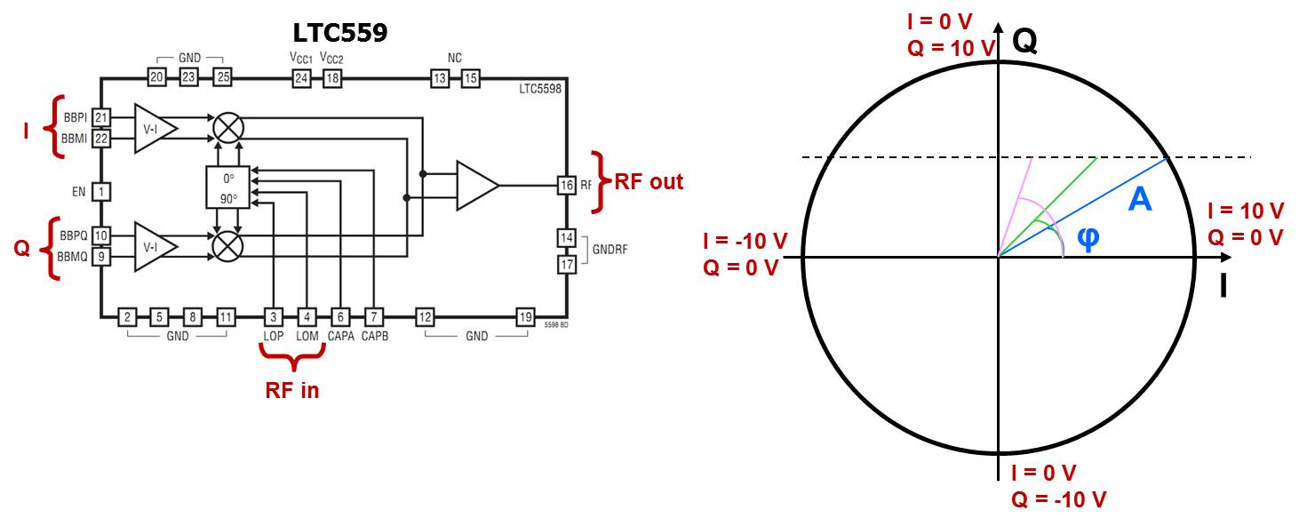
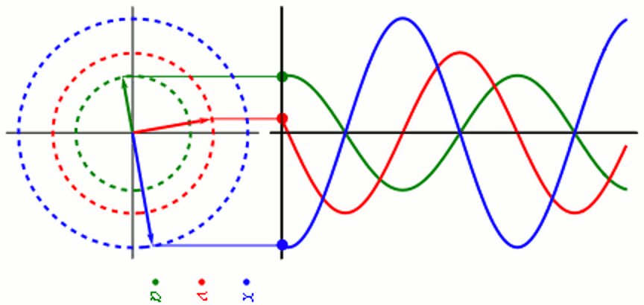
Beamlines synchronization system
IQ modulator

Slide 29
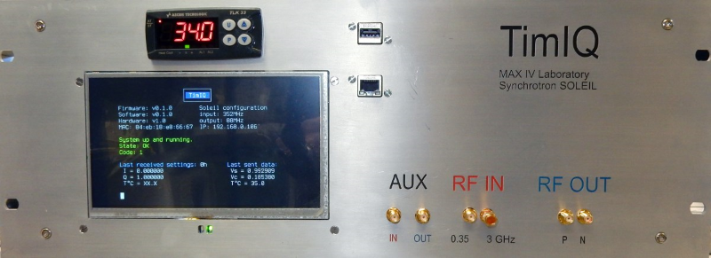
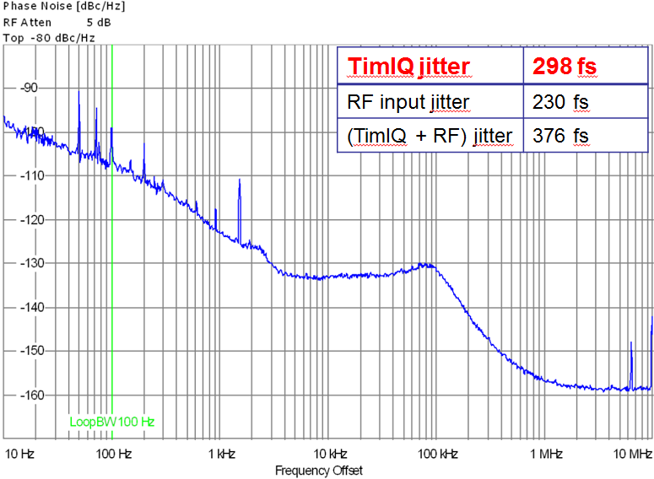
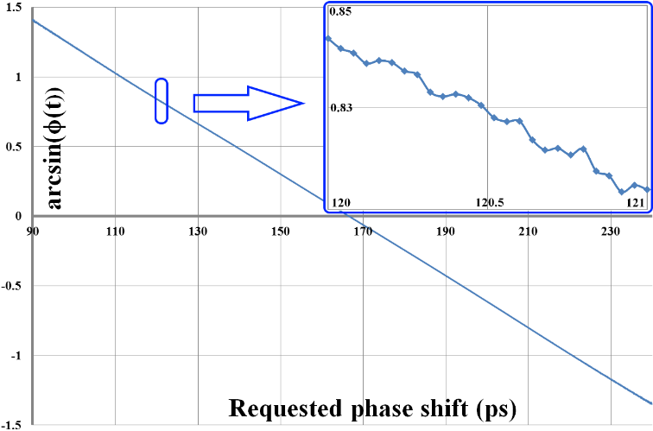
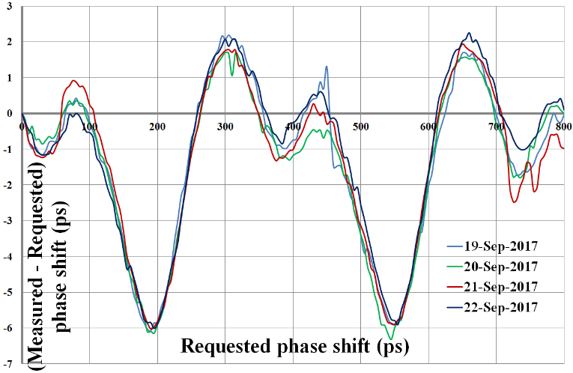
Beamlines synchronization system
IQ modulator: TimIQ (https://gitlab.com/ohwr/project/timiq)
The TimIQ system is an IQ modulator allowing to phase shift a radio frequency clock with a resolution of 40 fs and an accuracy of 8 ps. It allows to drive with a high precision lasers oscillators.
352 MHz or 3GHz input
40 fs resolution
8.2 ps peak to peak precision and periodic error with a good repeatability
Less than 300 fs phase noise jitter [10 Hz ; 10MHz] @ 88 MHz
+/- 0.1°C temperature stabilized
Readback of the offset
Real open hardware (KiCAD, FreeCAD, LibreCAD) and open software

Slide 30
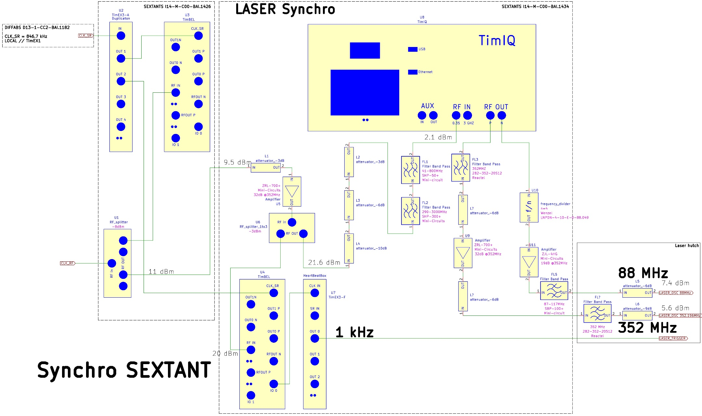
Beamlines synchronization system
Sextant

Slide 31

Failures

Slide 32


Failures
Hardware is reliable!
Software system is not!!!
Software
Human errors
Hardware

Slide 33
SOLEIL II

Slide 34
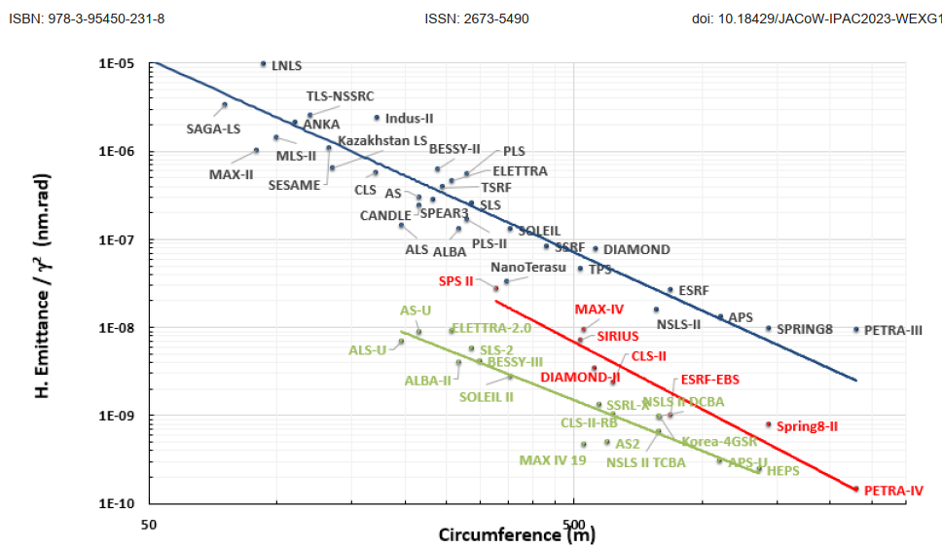
SOLEIL II
SOLEIL II:
40 times smaller, circular electron beam
Better coherency
Increase of the flux
L. Hoummi - IPAC 2023

Slide 35
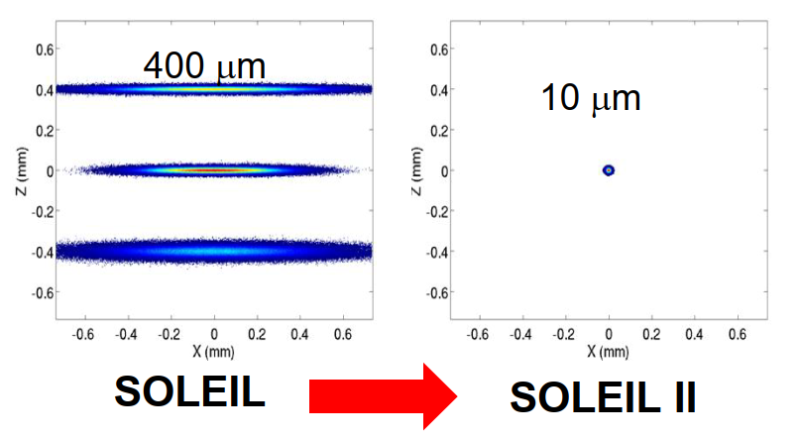
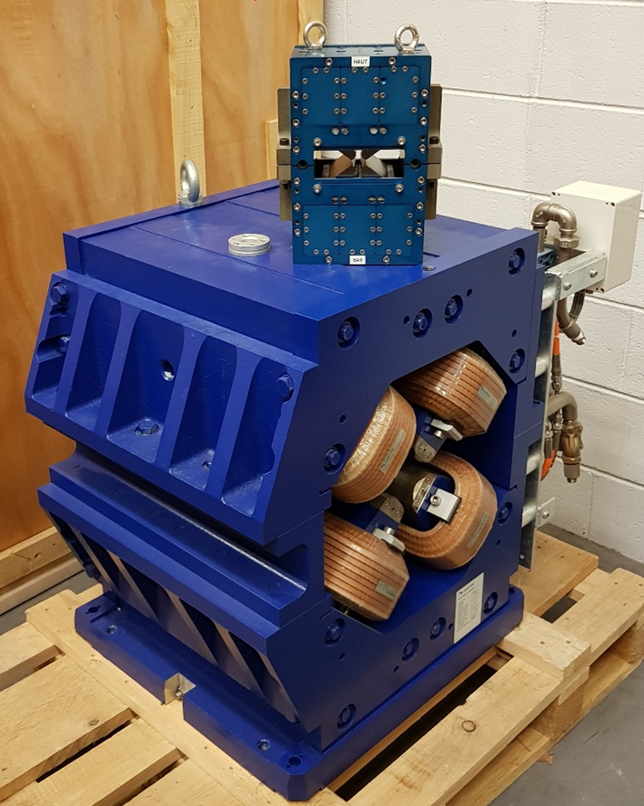
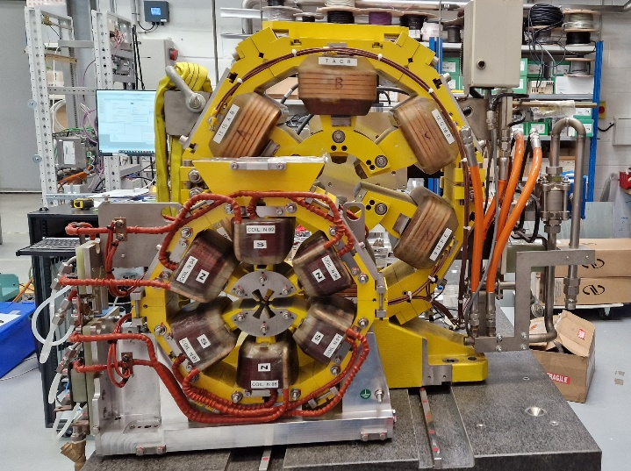
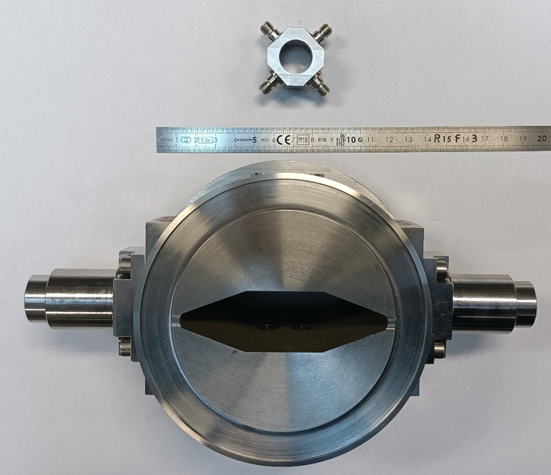
SOLEIL II

Slide 36






Timing system upgrade
Fully designed for SOLEIL’s needs
Reliable
Integrated with the control room software
Based on WR and adapted by ESRF to be used in synchrotrons
Under continues upgrade and development (WHIST, CITY, next CITY)
Does not depend on any specific manufacturer
Open hardware
Fully dependent upon Greenfield Technology
Any modification or update must be summited to Greenfield Technology
Expensive
Paid support
Need some additional development to be used at SOLEIL (CITY)
Control software need to be rewrite

Slide 37
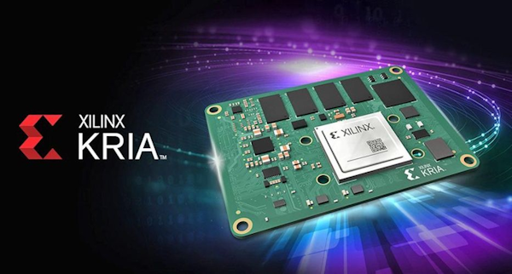
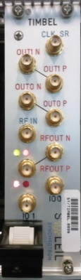
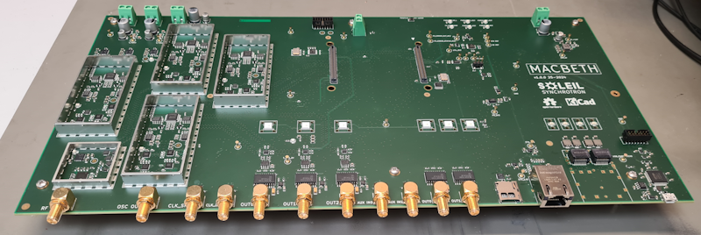

Beamlines timing system upgrade
Beamlines timing system : MACBETH (https://gitlab.com/ohwr/project/macbeth)
Good jitter
Good resolution
Multiple outputs
Flexibility
Etc.
+

Slide 38
Thank you

