Slide 1





Journées annuelles 2025 GDR SCIPAC et Instrumentation Faisceau
The IDROGEN System
A high data rate acquisition system synchronized by an enhanced White Rabbit node
IJCLab : Scientific themes : Astroparticles, Astrophysics & Cosmology, Nuclear physics, High Energy Physics, Accelerator Physics, Theory, Heath, Energy
Daniel Charlet, Antoine Back, Nawal Belouchrani, Cédric Esnault, Christophe Joly, Christelle Soulet, Monique Taurigna, Chafik Cheikali, *Gaetan Seuillot, *Mathias Vecchio, *Sid Ali Cherrati
Paris Observatory : Scientific themes : Time and frequency metrology, time and frequency transfer, inertial sensors, space-time reference frames, theory, epistemology
LTE : Paul-Eric Pottie, Michel lours
Obs Nancay : Cédric Viou
LPSC: Olivier Bourrion
17/12/2025

Slide 2
Agenda
Introduce the White Rabbit technology and how it works
Role of the IDROGEN board
Some projects examples
17/12/2025
Journées annuelles 2025 GDR SCIPAC et Instrumentation Faisceau

Slide 3

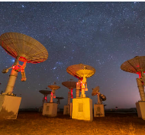


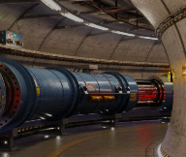
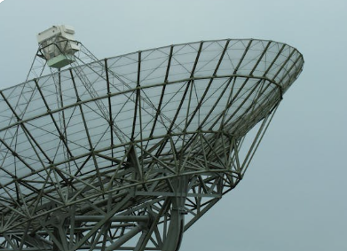

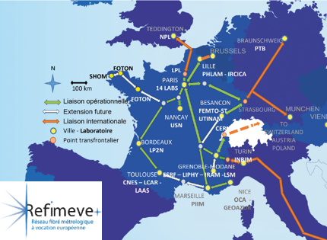
White Rabbit and its areas
White Rabbit is a sub-nanosecond timing and frequency distribution technology developed by CERN & GSI, with a range of applications in distributed systems where timing precision is critical
Synchronizing thousands of nodes in accelerators chains
(eg CERN, FAIR …)
Precise coordination
of antenna and sensor networks
Infrasturctures like REFIMEVE for distributing
Time & frequency references
Time synchronization in critical transaction networks
Particle accelerators
& high-energy physics
Astronomy
Advanced Radar
Quantum networks
Financial sector
Telecomunications
Metrology
& National timing
Timing for widely distributed detector arrays
Tests for synchronized quantum nodes & secure communications
Precision time for critical communication infrastructure
Journées annuelles 2025 GDR SCIPAC et Instrumentation Faisceau

Slide 4
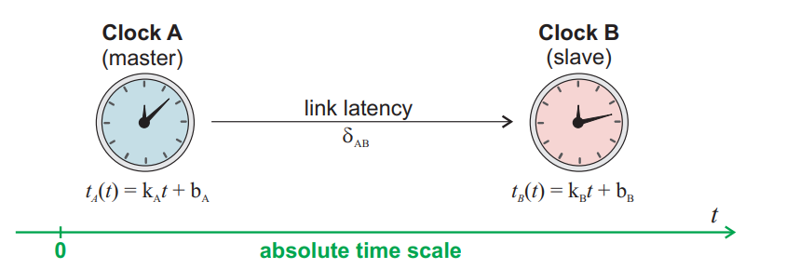
Technical Principles
White Rabbit is a high precision synchronization technology based on Ethernet.
It synchronizes multiple devices on a network with sub-nanosecond precision.
White Rabbit Operation (Key concepts)
SyncE (Synchronous Ethernet):
shares a common frequency clock
PTP (Precision Time Protocol IEEE1588)
Message exchange to measure/deduce delays
Ultra-fine phase measurement:
Extremely precise phase alignment between clocks via DDMTD Phase tracking (Digital Dual Mixer Domain)
Delivering synchronous clock and 1PPS via optical link
Tomasz Włostowski : Precise time and frequency transfer in a White Rabbit network
Delivering synchronous clock 10 MHz, 1PPS and timestamping via optical link
17/12/2025
Journées annuelles 2025 GDR SCIPAC et Instrumentation Faisceau

Slide 5
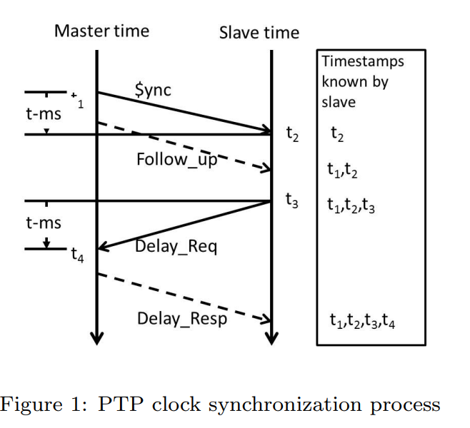
TECHNOLOGY OVERVIEW : Precision Time Protocol
Precision Time Protocol (IEEE 1588):
Protocol that allows devices to align their local clocks to a master clock by exchanging timing information.
Devices send timestamps (send and receive times), which allows calculation of propagation delays and clock offset
Key points:
Measures and corrects clock offset
Uses timestamps in exchanged messages
Enables deduction of propagation delay
Better precision than standard networks, but insufficient alone for sub-ns accuracy targeted by White Rabbit
White Rabbit: Sub-Nanaosecond Timing over Ethernet P.P.M. Jansweijera , H.Z. Peeka , E. de Wolfb,a,
17/12/2025
Journées annuelles 2025 GDR SCIPAC et Instrumentation Faisceau

Slide 6
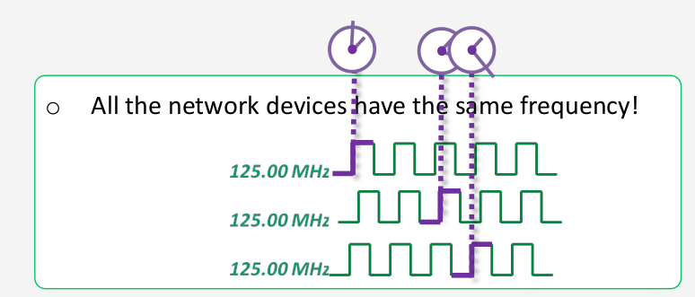
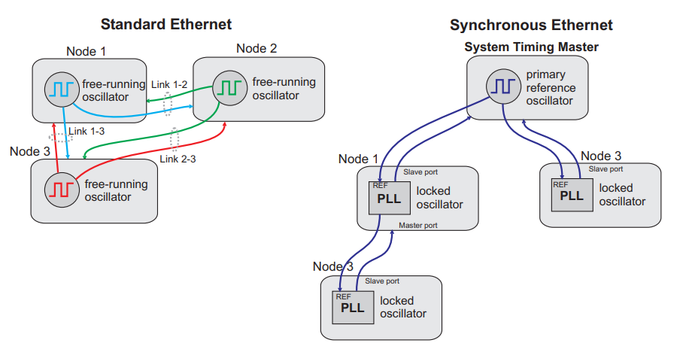
TECHNOLOGY OVERVIEW : Synchronous Ethernet (Sync-E)
SYNTONIZATION => SAME FREQUENCY
SyncE:
A method that allows all devices on a network to share the same clock frequency over Ethernet.
The receiver recovers the clock from the incoming signal, so all nodes “tick” at the same rate.
SyncE does not provide absolute time (like UTC), but ensures local clocks do not drift from each other
Key points:
- Frequency synchronization, at the physical network layer
Provide a stable base for DDMTD
17/12/2025
Journées annuelles 2025 GDR SCIPAC et Instrumentation Faisceau
Tomasz Włostowski : Precise time and frequency transfer in a White Rabbit network

Slide 7
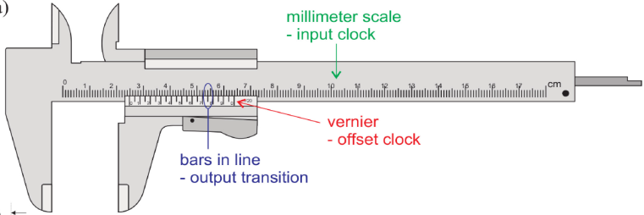
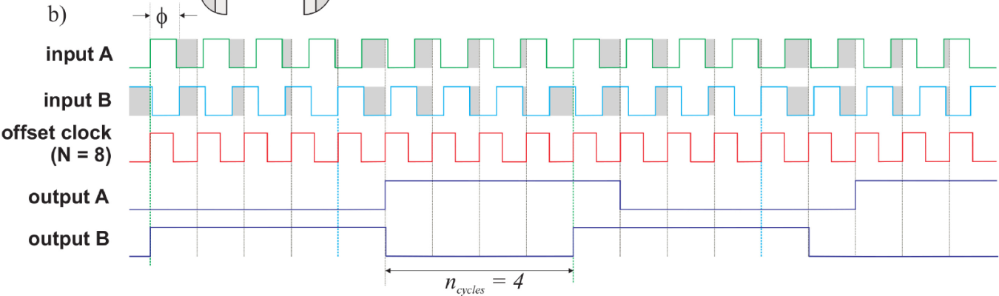
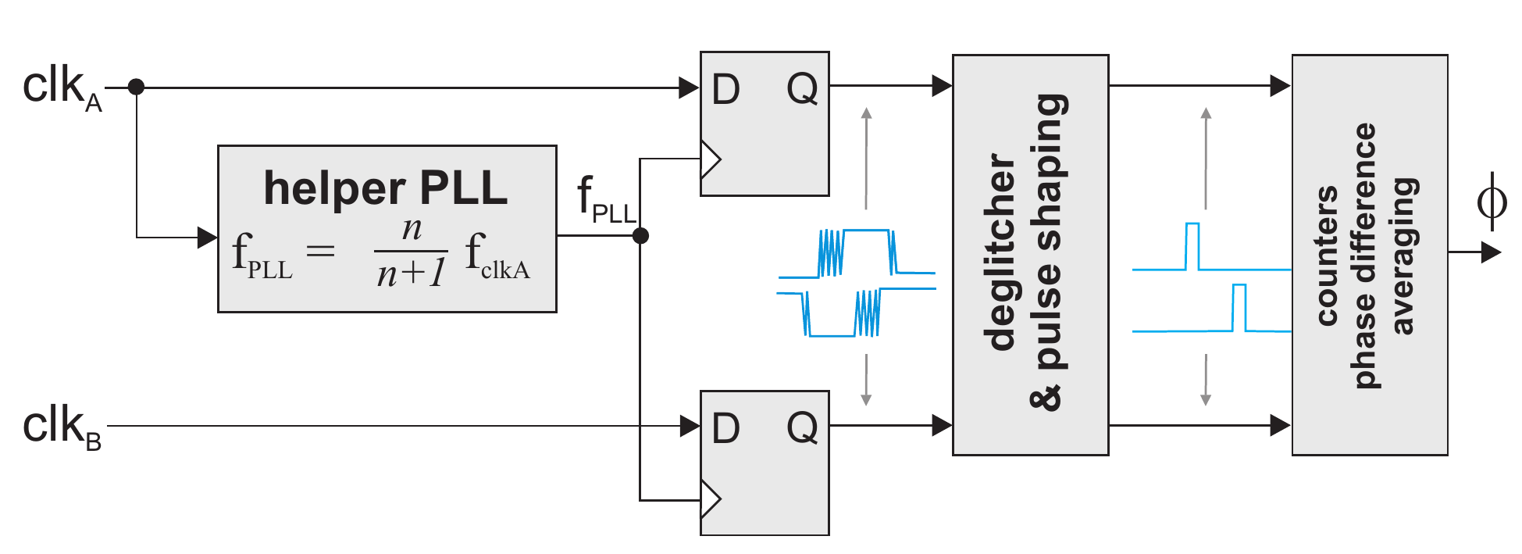
TECHNOLOGY OVERVIEW : Digital Dual Mixer Time Domain
SYNCHRONISATION=> SAME PHASE
DDMTD (Digital Dual Mixer Time Difference):
A technique for measuring the phase difference between two clock signals with extremely fine resolution.
In WR, DDMTD allows very precise alignment to a master clock’s phase.
Key points:
Very high-precision phase measurement
Resolution better than timestamp alone
Complements PTP to reach sub-nanosecond
Essential for demanding applications like LLRF
17/12/2025
Journées annuelles 2025 GDR SCIPAC et Instrumentation Faisceau
Tomasz Włostowski : Precise time and frequency transfer in a White Rabbit network

Slide 8

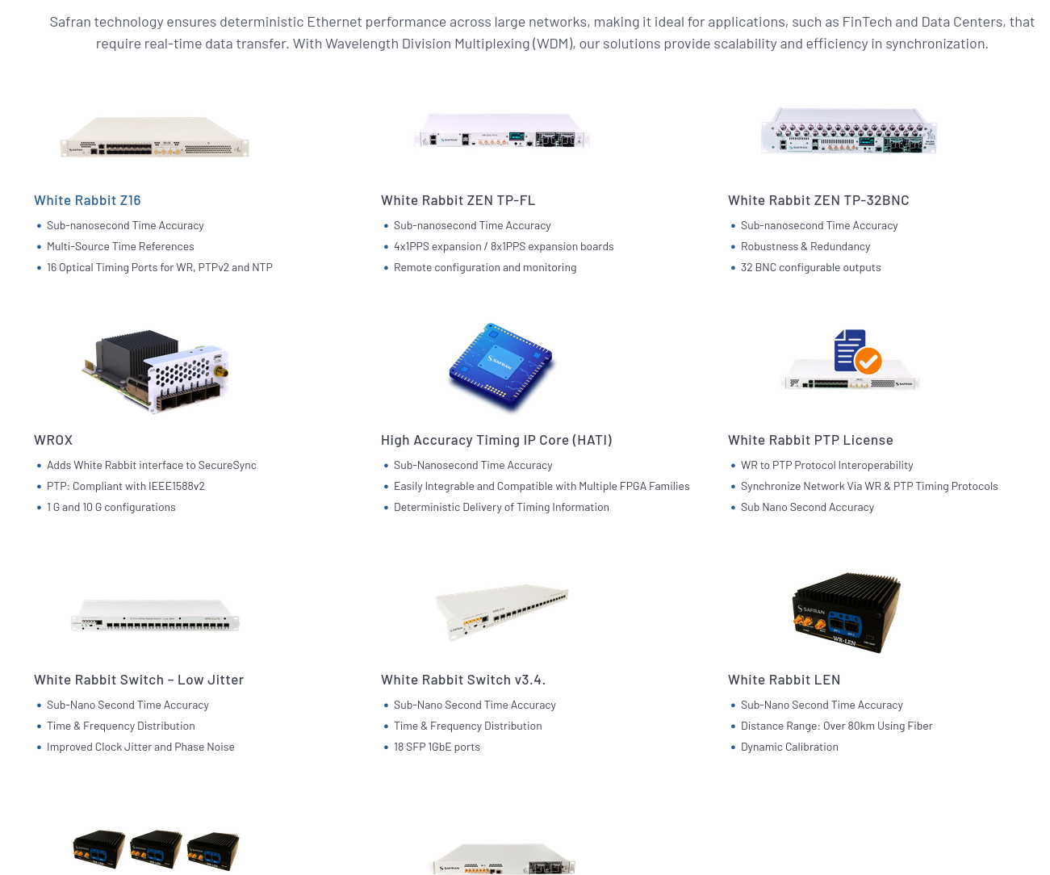
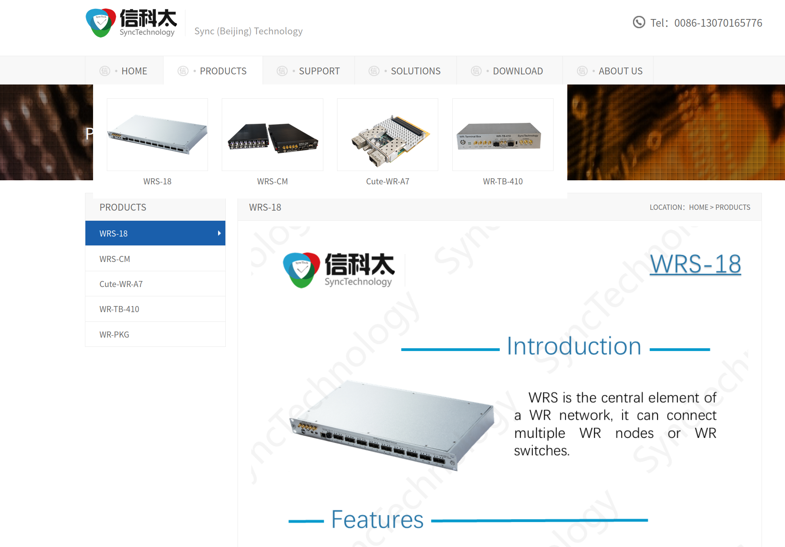
On the shelf White Rabbit solution
https://safran-navigation-timing.com/solution/white-rabbit-solutions/
http://www.synctechnology.cn/en_detaile.aspx?ClassID=1
Courtesy : Daniel Charlet
17/12/2025
Journées annuelles 2025 GDR SCIPAC et Instrumentation Faisceau

Slide 9
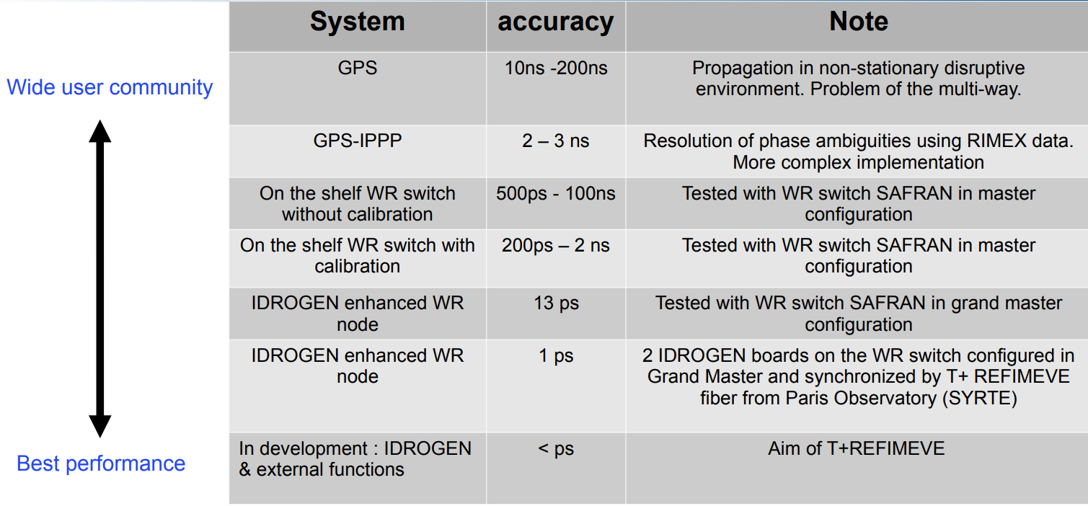
Accuracy system comparison
Courtesy : Daniel Charlet
17/12/2025
Journées annuelles 2025 GDR SCIPAC et Instrumentation Faisceau

Slide 10
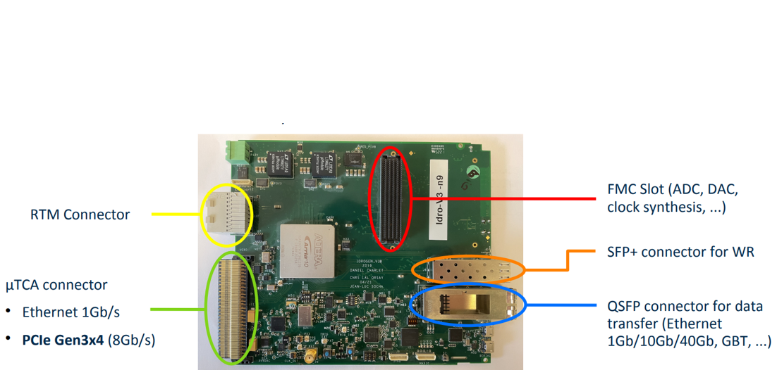
THE IDROGEN BOARD
The IDROGEN board:
Full White Rabbit node designed for precision synchronization (based on CERN schematic) and high performance data acquisition by IJCLAB.
It integrates WR mechanism (PTP, SyncE, DDMTD) in FPGA hardware, allowing it to act as a synchronized endpoint in a WR network
Key points:
Integrate WR core
Can operate as slave node or a local grand master
Integrate with high-speed data acquisiton using standard procole
Fully re-configurable
Courtesy : Antoine Back
17/12/2025
Journées annuelles 2025 GDR SCIPAC et Instrumentation Faisceau

Slide 11
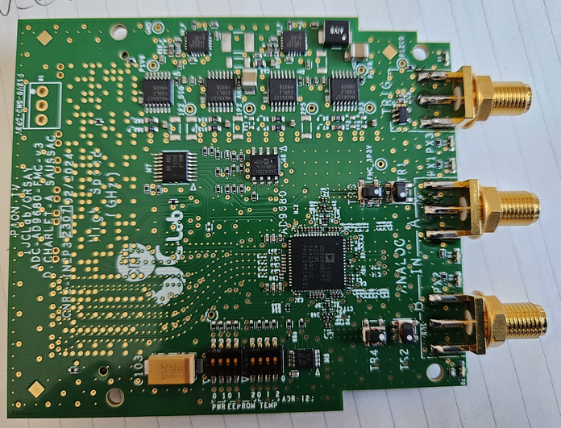
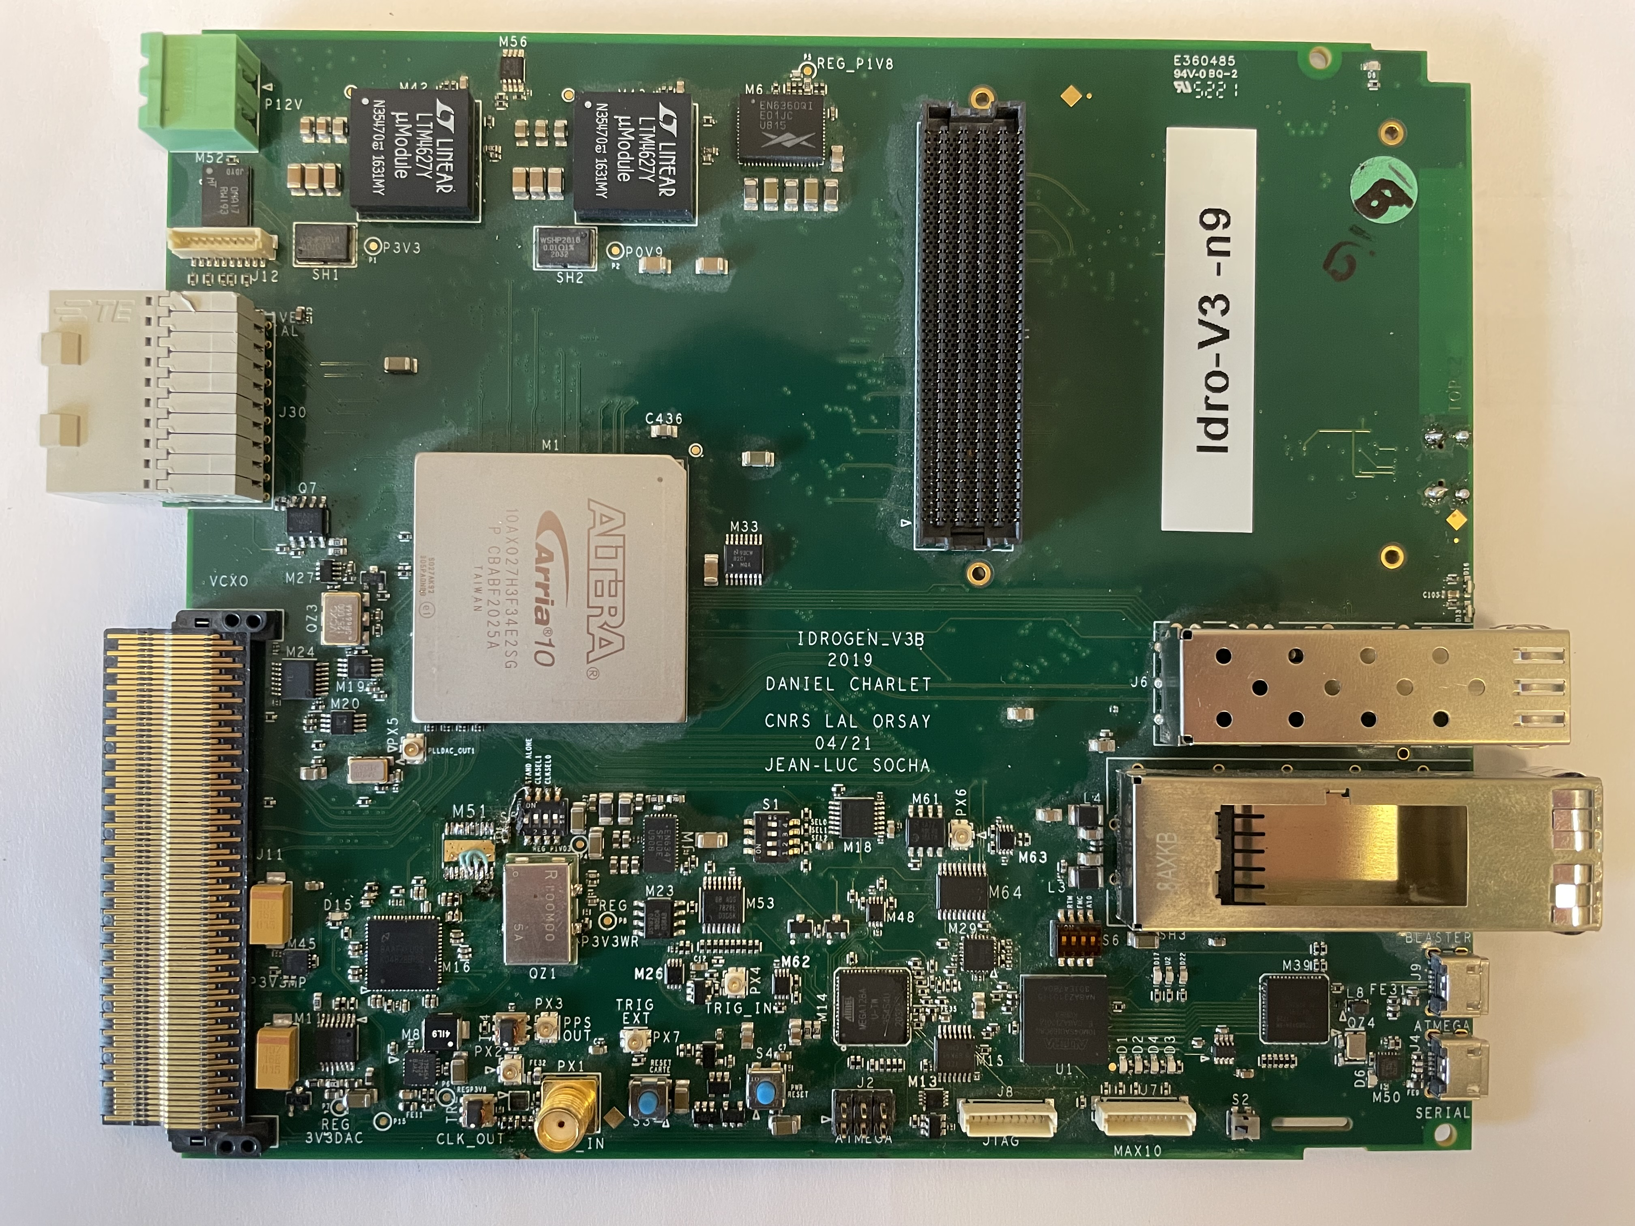
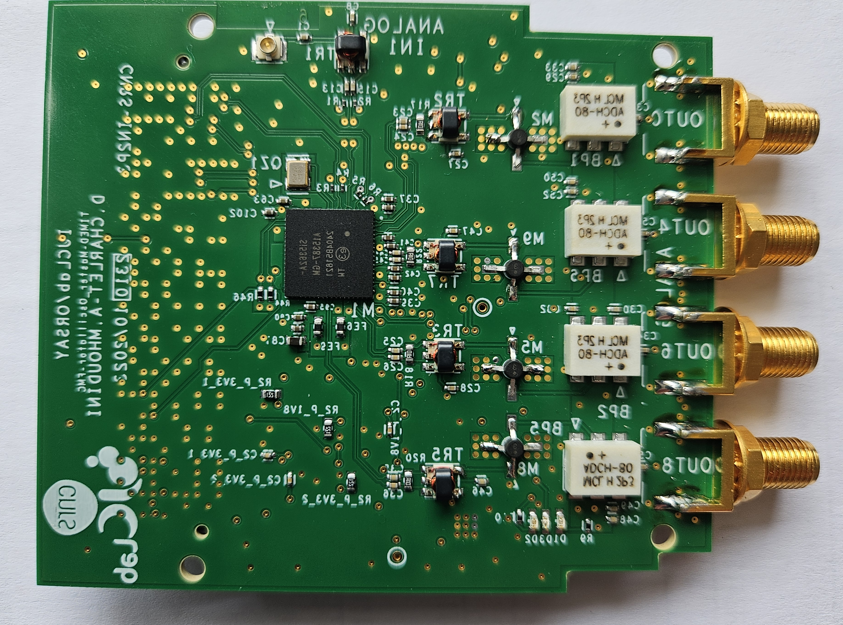
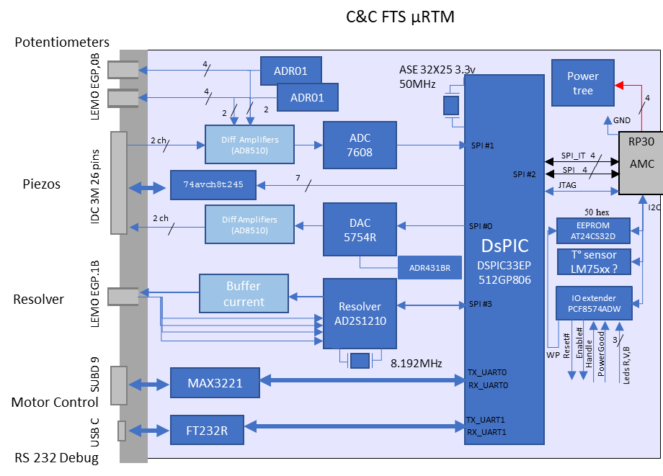
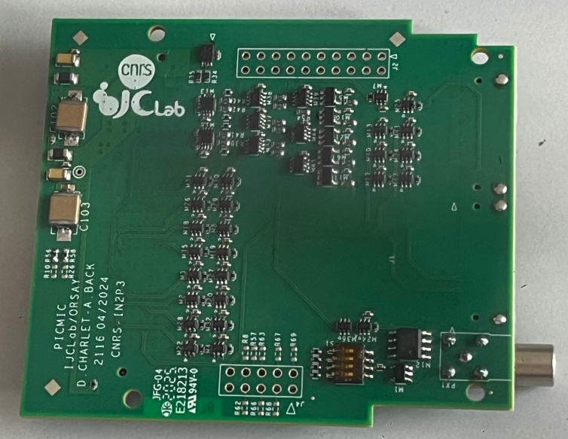
C&C Frequency Tuning system
IDROGEN Eco-system
ADC FMC
Ongoing:
500 MSps 4 channels
3GSps 2 channels
Timing disciplined by WR distribution µRTM
REFGEN FMC
Acquisition board 16 channels
17/12/2025
Journées annuelles 2025 GDR SCIPAC et Instrumentation Faisceau

Slide 12
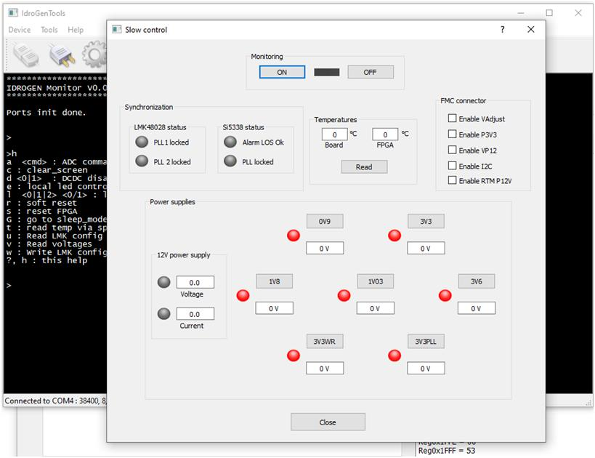
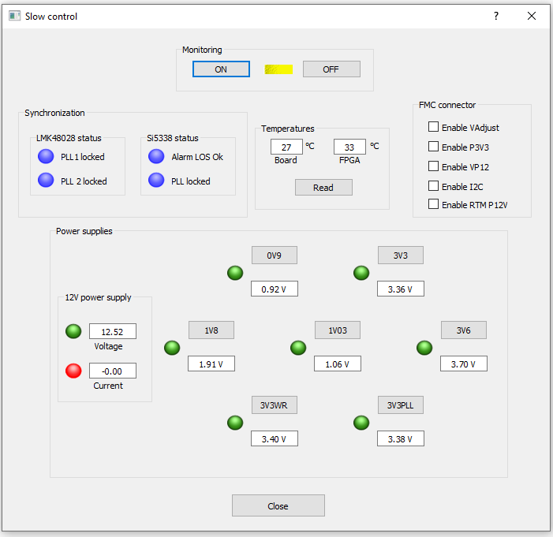

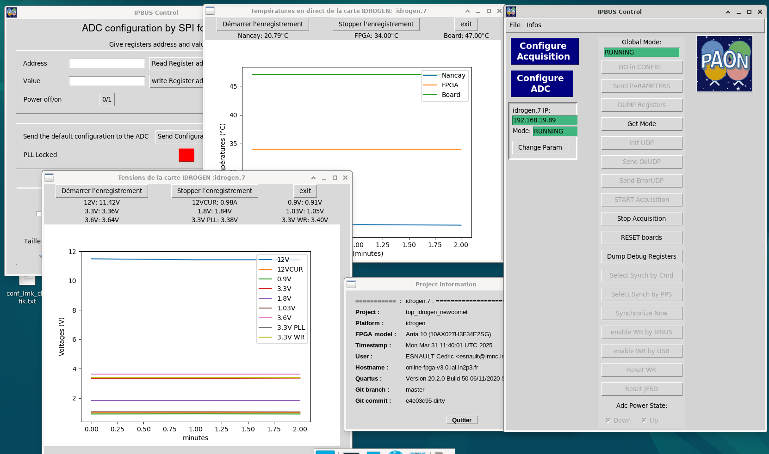
IDROGEN: softwares
Configuration GUI tools over USB and Ethernet
Power, PLL, FMC, ADC configuration
Monitoring GUI for power supplies and temperature monitoring
Slow control library and tools (I2C, SPI, WR diagnostic, …)
Frame viewer
Acquisition software
17/12/2025
Journées annuelles 2025 GDR SCIPAC et Instrumentation Faisceau
Courtesy : Daniel Charlet

Slide 13

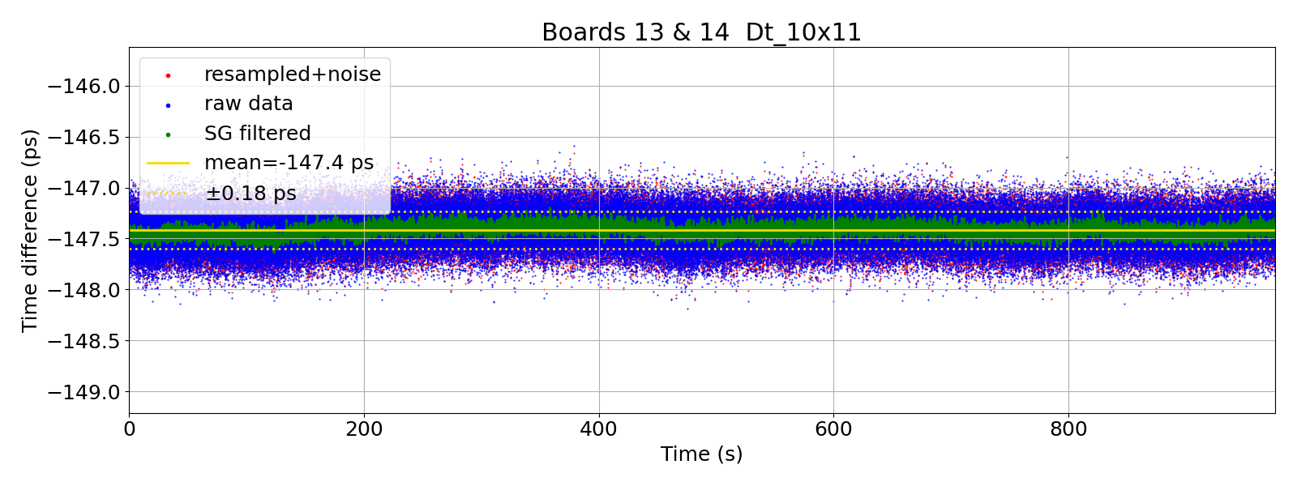
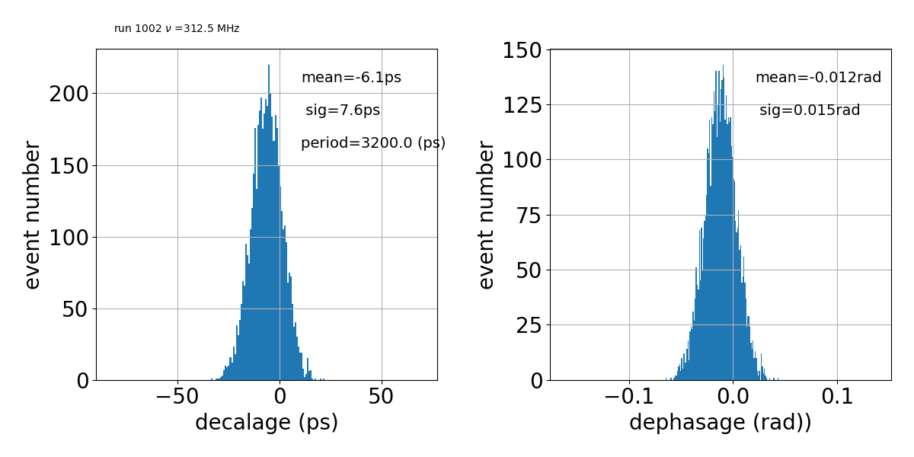
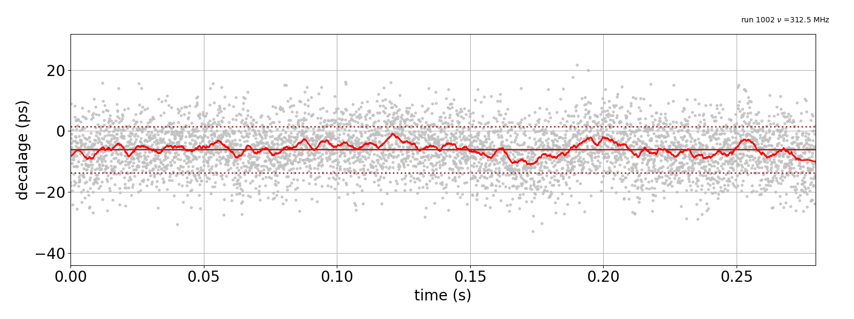
1GSPS ADC board: Synchronization performance
Bandwidth (single board): ~500Mhz (1GHz → 1.5GHz)
2 IDROGEN boards synchronized by WR
2 channels 1GSPS 14b ADC
Same RF signal (312.5MHz) split on boards
FFT 8k point
Cross correlation
2 channels on a single IDROGEN
Time difference measurement : 180fs
Two IDROGEN boards
Time difference measurement : 2.2ps
17/12/2025
Journées annuelles 2025 GDR SCIPAC et Instrumentation Faisceau

Slide 14
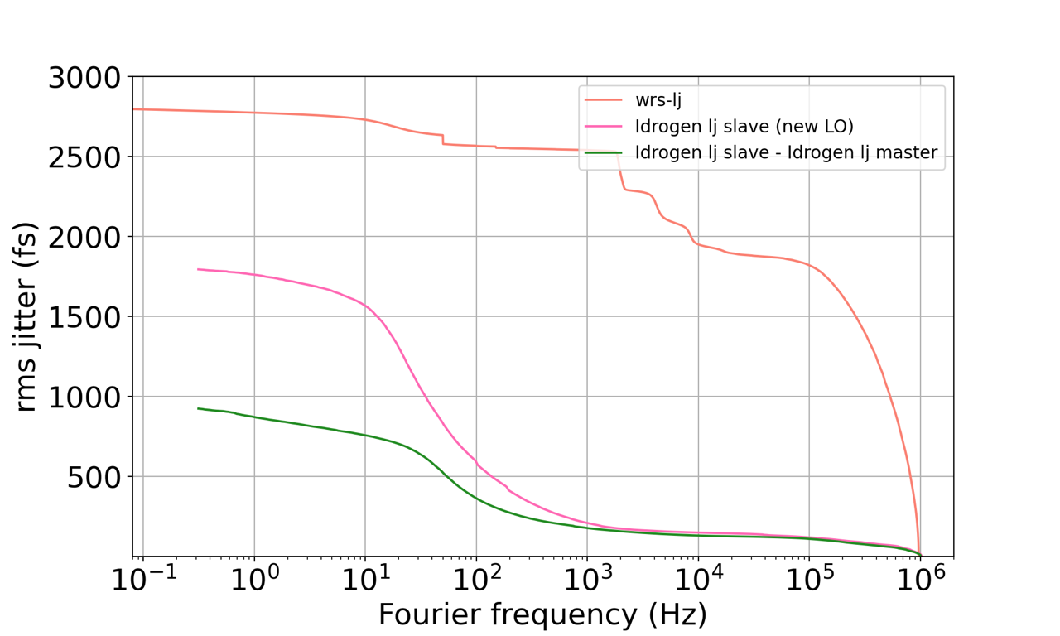
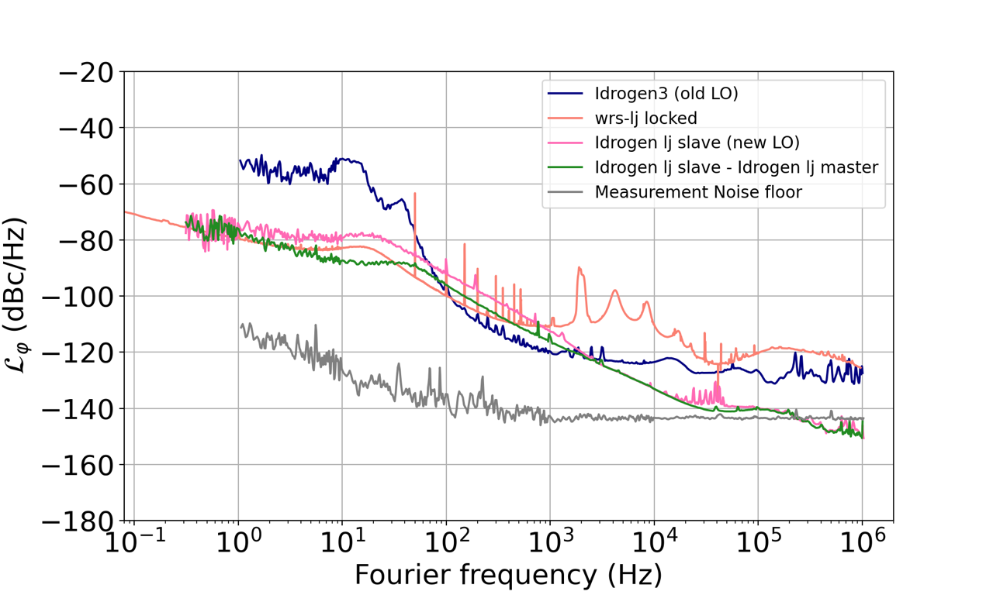
IDROGEN board performance
Phase noise measurement
Integrated jitter according to integration range
Absolute measurement
Residual noise
Variation of lower bound of integration range.
Upper bound fixed at 1 MHz
Jitter: [1Hz- 1MHz] : 580fs in slave mode
Jitter: [1Hz- 1MHz] : 260 fs in master mode
IDROGEN BOARD: 4x better than Switch Low Jitter from Safran/Seven Solution
17/12/2025
Journées annuelles 2025 GDR SCIPAC et Instrumentation Faisceau
Courtesy : Daniel Charlet

Slide 15
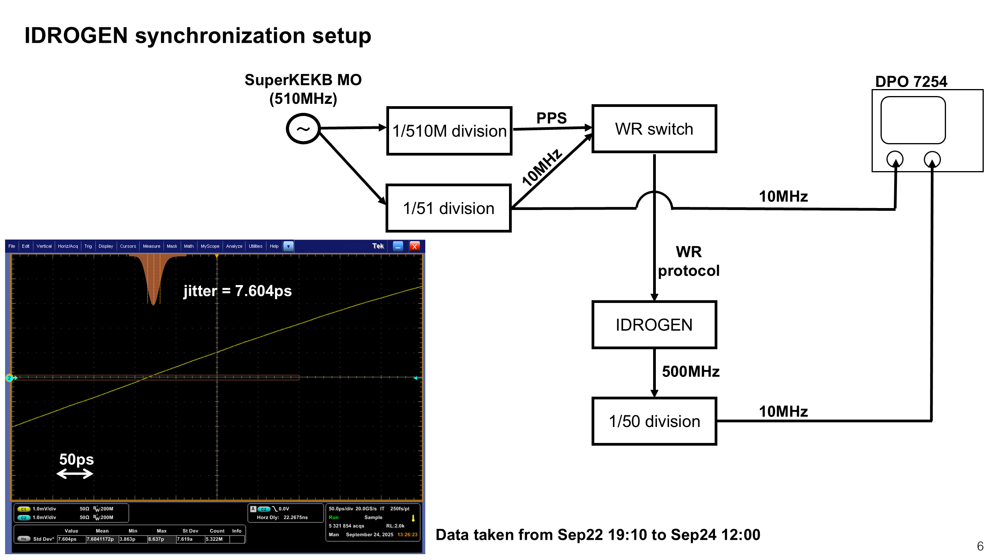
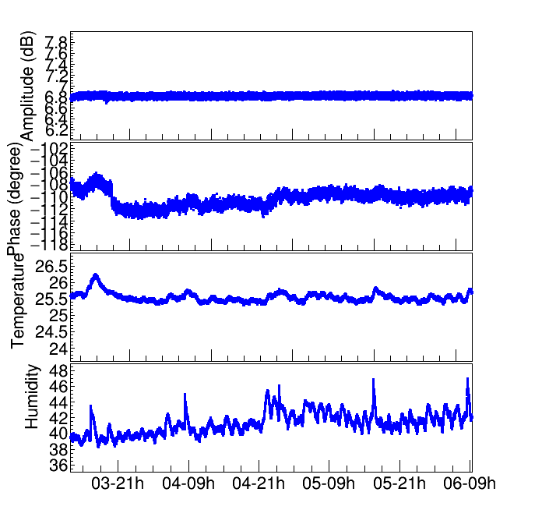
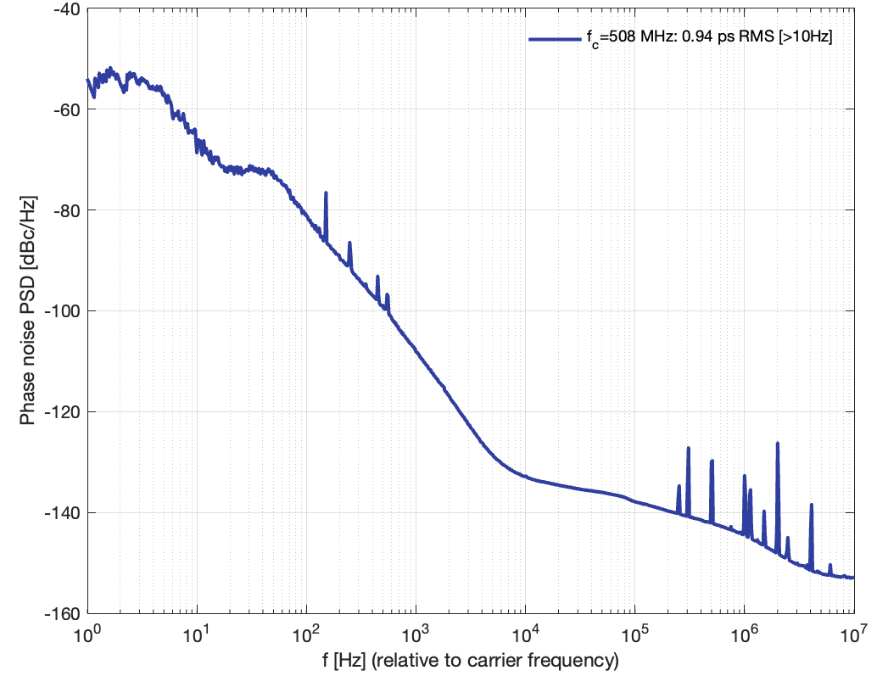
SuperKEKb : Master oscillator distribution
509MHz
Frequency offset: [10Hz → 10MHz] ; RMS jitter: 940fs at 508 MHz
17/12/2025
Journées annuelles 2025 GDR SCIPAC et Instrumentation Faisceau
Courtesy : Daniel Charlet

Slide 16

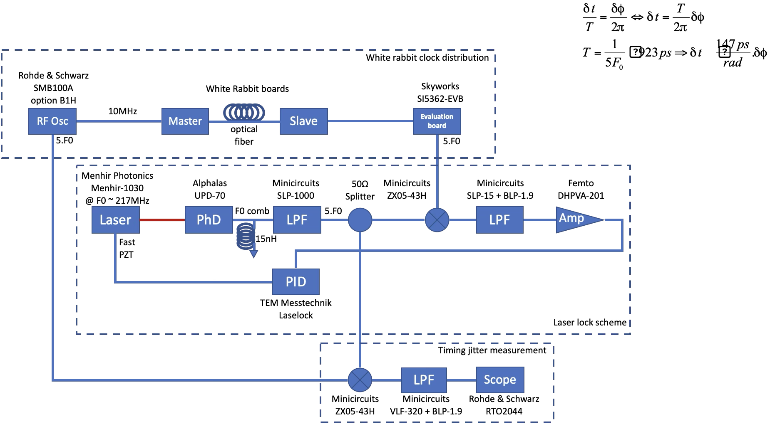
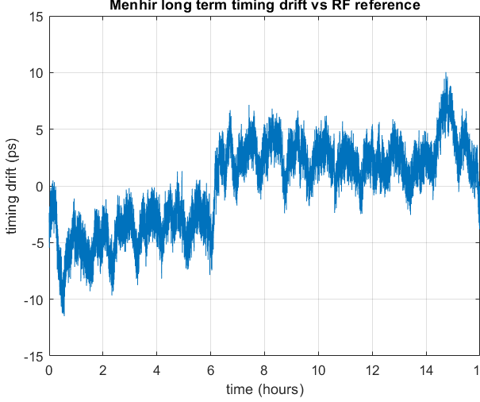
Laser synchronization
IDROGEN 1 : GM → IDROGEN 2 slave
Fiber length 5Km → 100Km
Preliminary results
17/12/2025
Journées annuelles 2025 GDR SCIPAC et Instrumentation Faisceau
Courtesy : Aurélien Martens

Slide 17
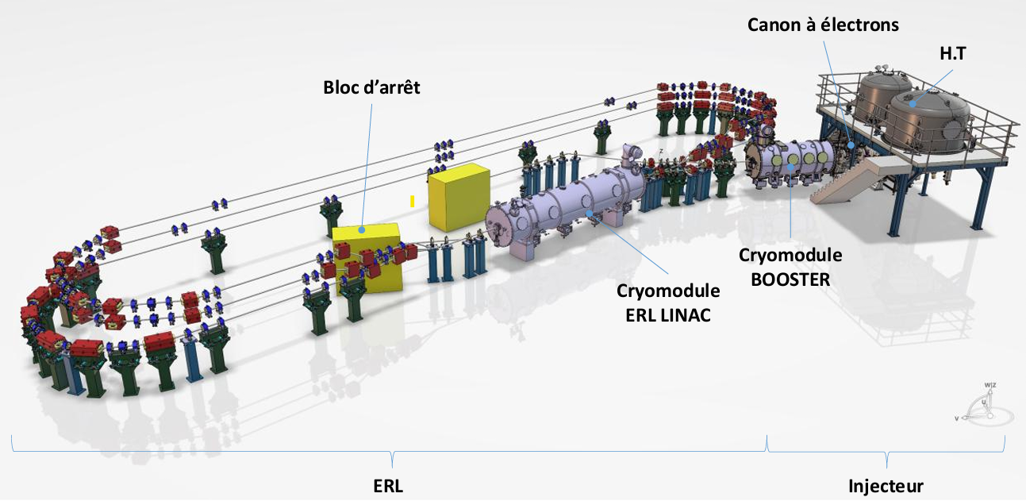
Objectives
In systems like Low Level RF (LLRF) for accelerators, separate modules must share a coherent time and frequency reference
Poor synchronization lead to phase errors and performances loss
Standard networks cannot reach sub-nanosecond precision.
Journées annuelles 2025 GDR SCIPAC et Instrumentation Faisceau

Slide 18
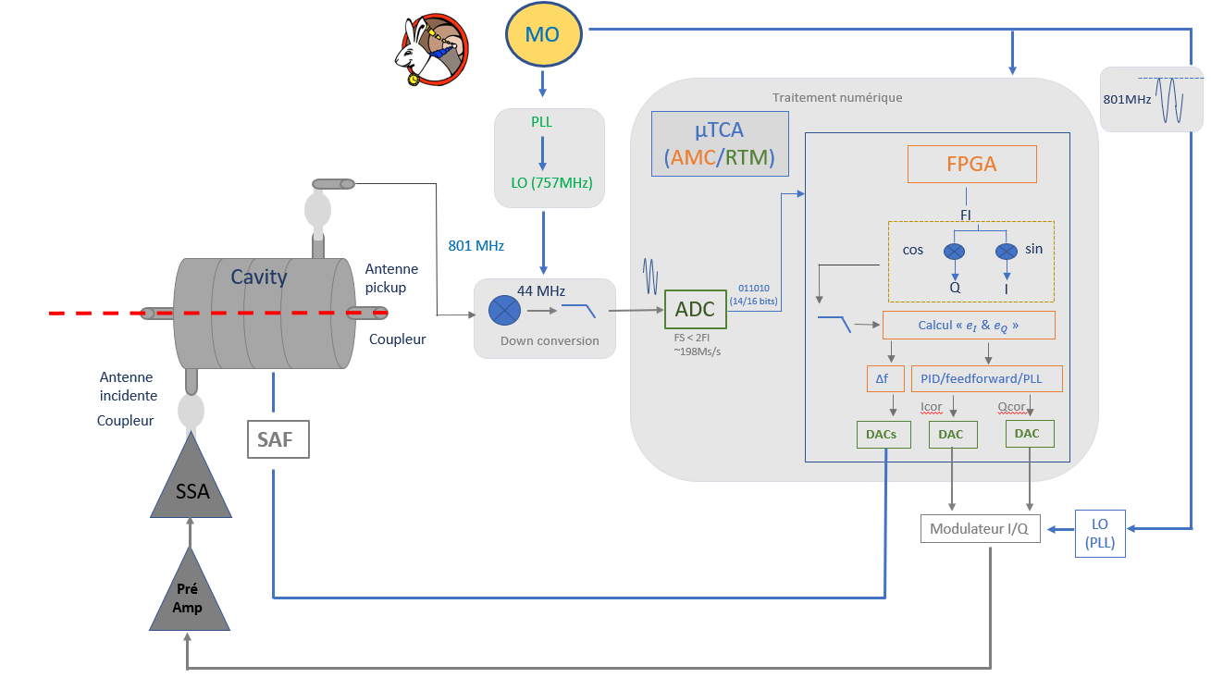
Context & Synchronization need
Low Level RF:
Real-time control and regulation system for RF cavities:
Real-time measurement of the cavity (amplitude and phase)
Real-time correction (feedback loop)
Uses highly precise synchronization (White Rabbit)
Stabilizes beam performance (field/beam)
Controls the amplifiers for signal generation
Operator interface: global synchronization
LLRF Requirements to be confirmed by beam dynamics: based on 0.1° (phase) & 0.1% (amplitude)
Journées annuelles 2025 GDR SCIPAC et Instrumentation Faisceau

Slide 19
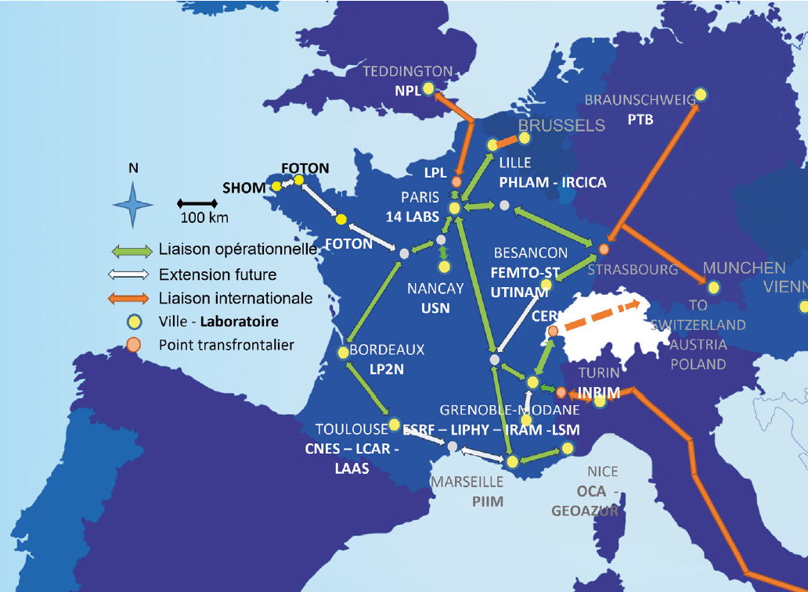
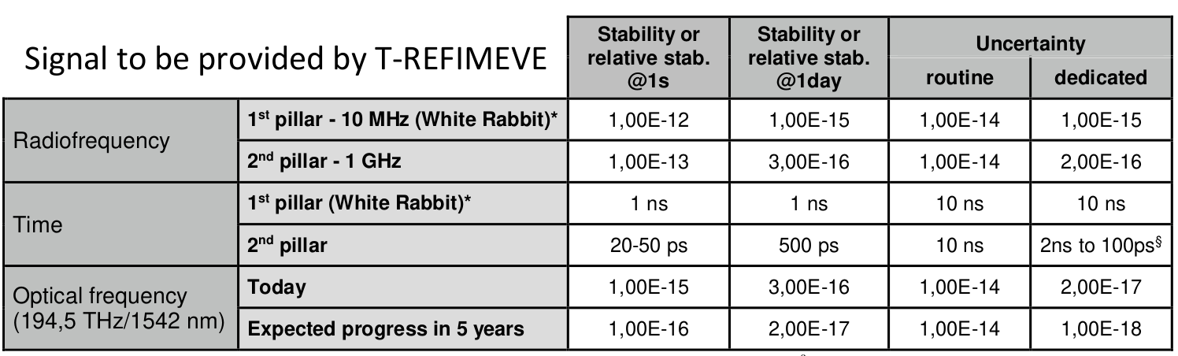

Distributed Master Oscillator (DMO)
Time and frequency
Atomic Clock
LTE
PARIS
REFIMEVE: french network distributing time and frequency references over optical fiber.
SYRTE (LTE): Paris Observatory, provides highly precise references
WR carries these references to end users
17/12/2025
Journées annuelles 2025 GDR SCIPAC et Instrumentation Faisceau

Slide 20
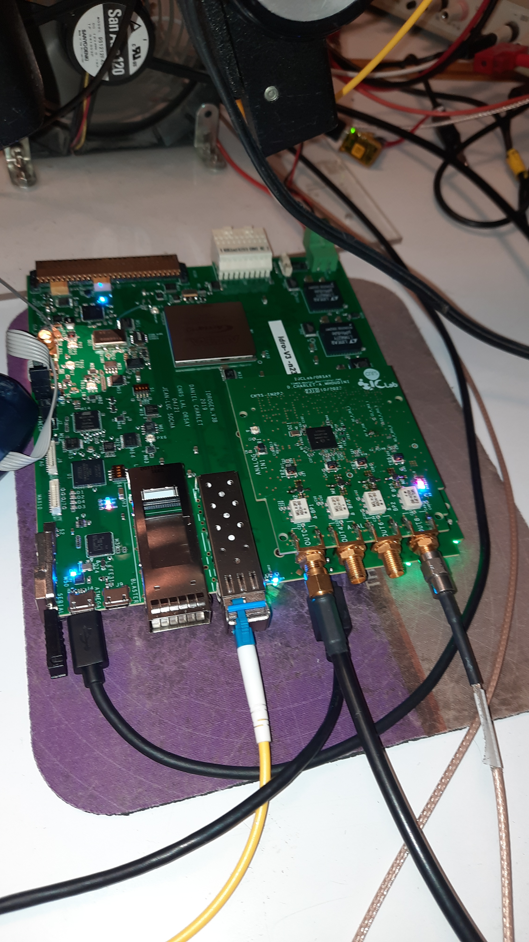
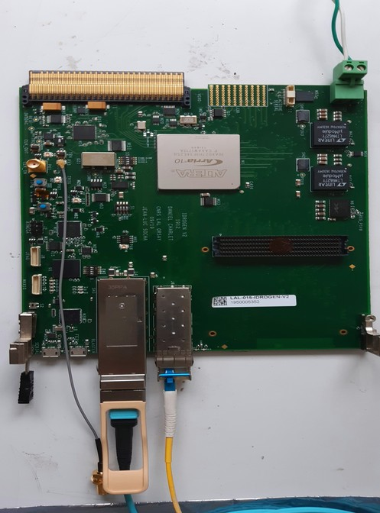
Distributed Master Oscillator (DMO)
Fractionnal PLL (FPLL) FMC (on test)
Replace very expensive system with recent, 30€ component
Generate arbitrary frequency disciplined by WR clock
Frequency resolution 1 Hz
Phase noise system: 1 ps (1 Hz, 10 MHz)
~0.3° RMS phase jitter at 375MHz below 1Hz
4 outputs 10KHz to 1.3GHz (2.75GHz: SI5361H chip)
Rubidium
10MHz + PPS
REFGEN FMC board
With a SI5362
Frequency distribution Amplifier
10 MHz (synchronization of Scopes, …)
IDROGEN board
IDROGEN board
200.395 MHz (LLRF reference)
400.79 MHz (Laser reference)
Crate
MTCA
801.58 MHz (Accelerator reference)
Grand Master Mode
Switch Mode
Or others frequencies in function of need
for diagnostics
Mode Slave
17/12/2025
Journées annuelles 2025 GDR SCIPAC et Instrumentation Faisceau
Courtesy : Daniel Charlet

Slide 21

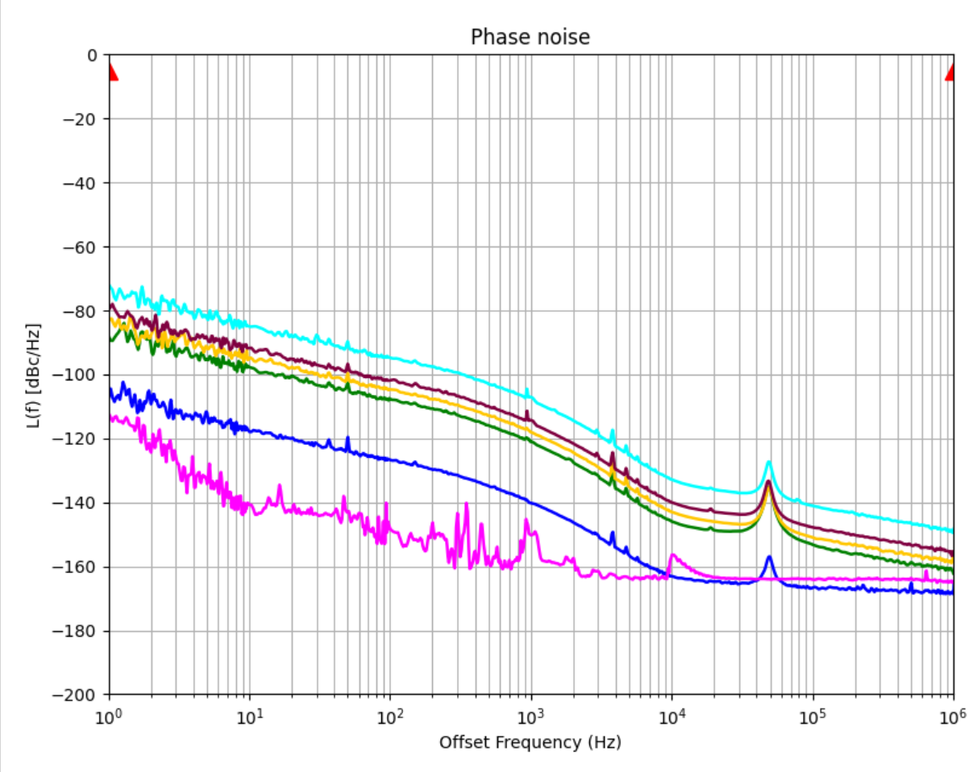
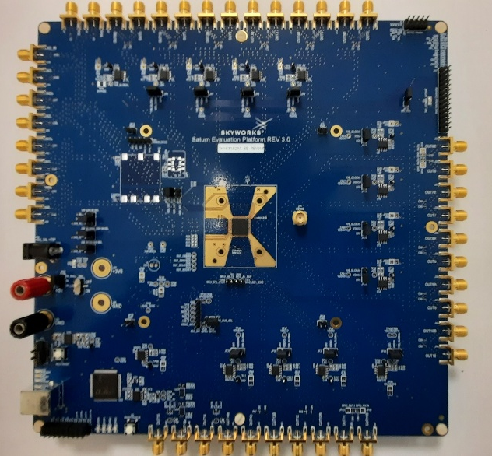
New PLL : preliminary results
SKY 63102
Jitter (rms) 400.79MHz@offset range [1Hzto 1MHz] =282fs
Jitter (rms) 176.1MHz@offset range [1Hzto 1MHz] =282fs
Jitter (rms) 125MHz@offset range [1Hzto 1MHz] =285fs
Jitter (rms) 88MHz@offset range [1Hzto 1MHz] =284fs
Jitter (rms) 10MHz@offset range [1Hzto 1MHz] =249fs (Rubidium)
Rubidium
10MHz
Jitter (rms) 10MHz@offset range [1Hzto 1MHz] =150fs (Morion) from LTE
Jitter (rms) 10MHz
@offset range [1Hzto 1MHz]
=150fs
-10fs better than Si5362 used on FMC REFGEN board in offset range [12kHz to 1MHz] → validated
- Need characterization in the offset range [1Hz to 1MHz]
17/12/2025
Journées annuelles 2025 GDR SCIPAC et Instrumentation Faisceau

Slide 22

IDROGEN: roadmap and future directions
IDROGEN_V4
Development for Q4 2025, mass production mid 2026
Replacement of obsolete components
Versatility Improvement
FMC-AD42JB69 (in development)
4 channels 250MSPS 16bits
FMC-ADC 3GSPS
White Fox (Highly improved White Rabbit)
Development with LTE
Sub 100-fs performance (prototype in development)
Improve short term performance (ongoing development)
10Gb/s White Rabbit firmware
IDROGEN_v5
New FPGA familly AGILEX
PERLE:
Improvements of slave IDROGEN jitter
Improvements by PTPrate & SoftPLL
17/12/2025
Journées annuelles 2025 GDR SCIPAC et Instrumentation Faisceau
Courtesy : Daniel Charlet

Slide 23
Conclusion
IDROGEN:
Very promising results with IDROGEN board (sub-picosecond RMS jitter)
New board version (v4) to be developed in Q1 of 2026
Focus on essential hardware development
PERLE:
Timegen board to be finalised
FTS board to be finalised
Installation of WR testbench
Bring WR switch
17/12/2025
Journées annuelles 2025 GDR SCIPAC et Instrumentation Faisceau
Courtesy : Daniel Charlet

Slide 24
Thank you for your attention
17/12/2025
Journées annuelles 2025 GDR SCIPAC et Instrumentation Faisceau

