Slide 1
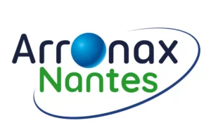
ARRONAX: Accelerator for Research in Radiochemistry and Oncology at Nantes AtlantiX F. Haddad Prof. Nantes Université GIP Arronax / Subatech

Slide 2

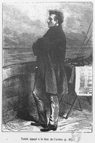
ARRONAX: Accelerator for Research in Radiochemistry and Oncology at Nantes AtlantiX
The name ARRONAX is a tribute to Jules Verne, born in Nantes in 1828.
Aronnax is the name of the main character of the novel «twenty thousands leagues under the sea » published in 1870
Professor ARONNAX
3 main fields of investigations :
Radionuclides and radiopharmaceuticals production for nuclear medicine
Research in related fields using our beams: Radiolysis, Radiobiology, nuclear physics, …
Training of students

Slide 3
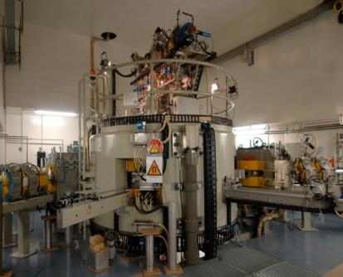
Arronax un accélérateur dédiés à la recherche en santé
Production d’isotopes
Utilisation des faisceaux
Médecine nucléaire
Recherche en physique nucléaire
Recherche en chimie nucléaire
Radiobiologie
Radiolyse
Protonthérapie
Contrôle non destructif
Endommagements
Tests de détecteurs

Slide 4
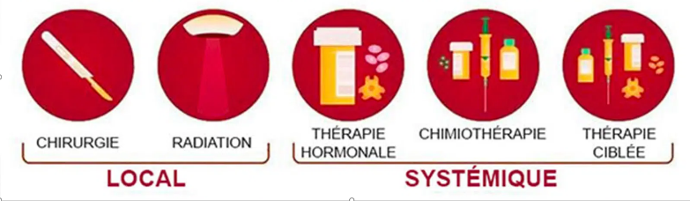

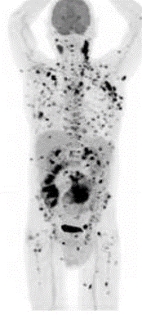
Cancer treatment
Cancer remains a leading cause of death globally, accounting for over 9.7 million deaths in 2022 and a Cancer incidence world wide of 19,98 million per year
Typical treatment strategy in cancerology is based on combination of treatment modalities and depends on the characteristics of the disease:
Surgery
External radiotherapy
Hormone therapy
Chemotherapy
Targeted therapies including nuclear medicine
Local
SYSTEMIC

Slide 5
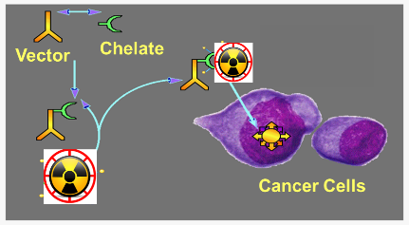
Nuclear Medicine
Nuclear medicine uses open sources (radionuclides)
Application
Imaging and diagnosis (X-rays, γ-rays , β⁺ emitters)
(e.g., PET, SPECT)
Therapy (α particles, β⁻ particles , Auger electrons)
Targeted Radionuclide Therapy (TRT)
Targeting Strategy
In some cases, the radionuclide can be used directly: I-131 for thyroid or Rb-82 for cardiology …
But, in most cases, a vector molecule (chemical molecules, peptides, antibodies … ) is needed to target the cells of interest.

Slide 6

We are all different
There is differences between patients:
Some are obvious : age, gender, height, weight, …
Some others are more subtle as biological constants, or genetic characteristics, …
There is a need to personalize treatment

Slide 7
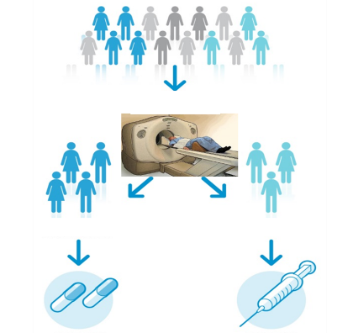
Theranostics
It is a treatment strategy that combines therapeutics with diagnostics as for example using matched pairs of radionuclides (⁶⁸Ga/¹⁷⁷Lu, ⁶⁴Cu/⁶⁷Cu,..).
Localized lesions
Define the biodistribution of a therapeutic agent to anticipate its effect
Select patients which are expected to response to the therapeutic agent
Calculate the optimal activity to be injected
Evaluate the response after treatment
The Right Drug To The Right Patient For The Right Disease
At The Right Time With The Right Dosage

Slide 8
Targeted internal radiotherapy with β emitters
Activity injected to patient:
~few GBq

Slide 9
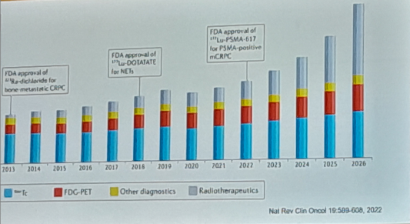
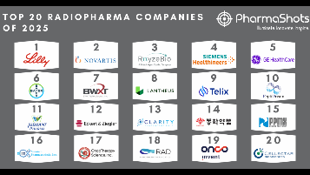
Nuclear medicine at a glance
50 million nuclear medicine procedures performed annually
→ 90% for diagnostic purpose
Rapid evolution over the last 20 years:
2000s: FDG becomes gold standard for PET imaging in oncology
2005: FDA approval of Zevalin (⁹⁰Y-ibritumomab) for hematologic cancers
2013: FDA approval of first alpha therapy using ²²³Ra
2017: FDA approval of ¹⁷⁷Lu-DOTATATE for neuroendocrine tumours
2022: FDA approval of ¹⁷⁷Lu-PSMA for metastatic prostate cancer
Targeted radiotherapies now available
→ Most pharmaceutical companies have launched nuclear medicine programs

Slide 10
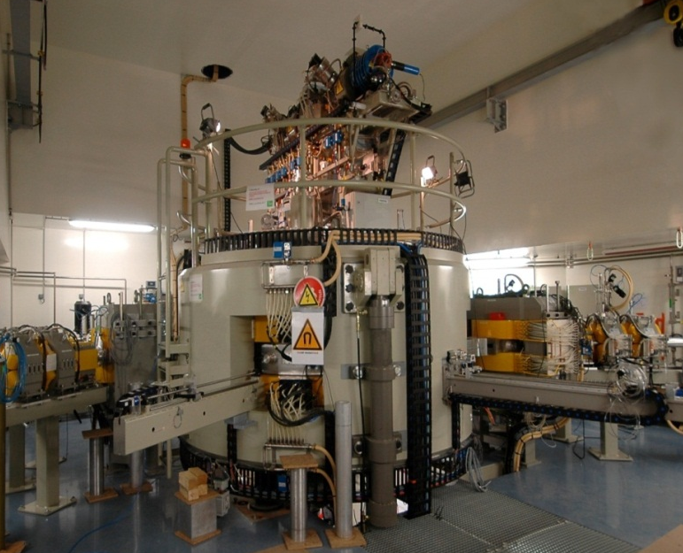
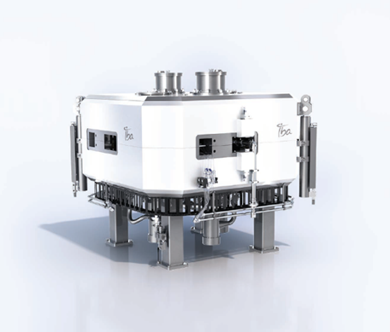
ARRONAX: Accelerator for Research in Radiochemistry and Oncology at Nantes AtlantiX
3 main fields of investigations :
Radionuclides and radiopharmaceuticals production for nuclear medicine
Research in related fields using our beams: Radiolysis, Radiobiology, nuclear physics, …
Training of students
Cyclone@Kiube 180 µA
Creation date 2008
First beams (Jan. 2011)
2 cyclotrons (C70XP and Kiube 180)
1 radiopharmacy (2018)
60 workers (including Phd students)
ISO 9001 certify since 2014
Key numbers :

Slide 11
ARRONAX beam characteristics
With our cyclotrons with have access to a wide range of projectiles and beam energies at high intensity:
 | Projectiles | Particules accélérées | Energie (MeV) | Intensité (µA) | Modalités du faisceau | Nombre de casemate
C70XP | Proton | H- | 30-70 | 750 | dual | 5
 |  | HH+ | 35 | 50 | mono | 3
 | Deutons | D- | 15-35 | 50 | dual | 5
 | Alpha | He++ | 70 | 70 | mono | 3
IK18 | Protons | H- | 18 MeV | 180 | dual | 1
70 MeV proton beam: Sr-82
30 MeV proton beam: Ti-44
16 MeV deuteron beam : Cu-64, Hg197m
26 MeV deuteron beam : Cu-67
31 Mev deuteron beam: Pb-203
68 MeV alpha beam: At-211, Ru-97
18 MeV proton beam: F-18 (made by CPF - curium)
16 MeV proton beam: Cu-64
We are taking advantage of all beams available :

Slide 12
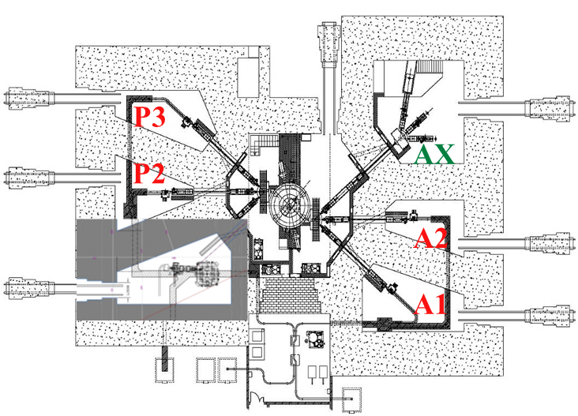
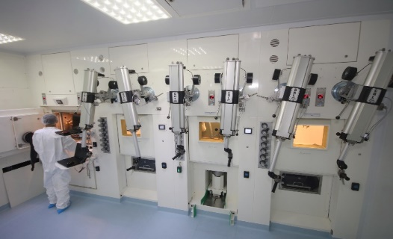


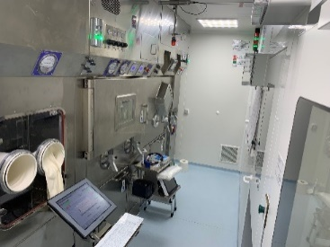
ARRONAX Facility
A versatile facility:
2000 m² of restricted area
2 cyclotrons
4 vaults for isotope production
1 vault with 3 beam line for research (2 horizontal and 1 vertical)
3 lines of hot cells for radionuclides production
A radiopharmacy with 3 lines of hot cells for sterile radiopharmaceuticals production
Several clinical trials performed using Ac-225, Lu-177 and Cu-64 and soon new ones with At-211 (IMPD approved by ANSM – bladder cancer).
The 200th clinical dose produced on October 10th

Slide 13
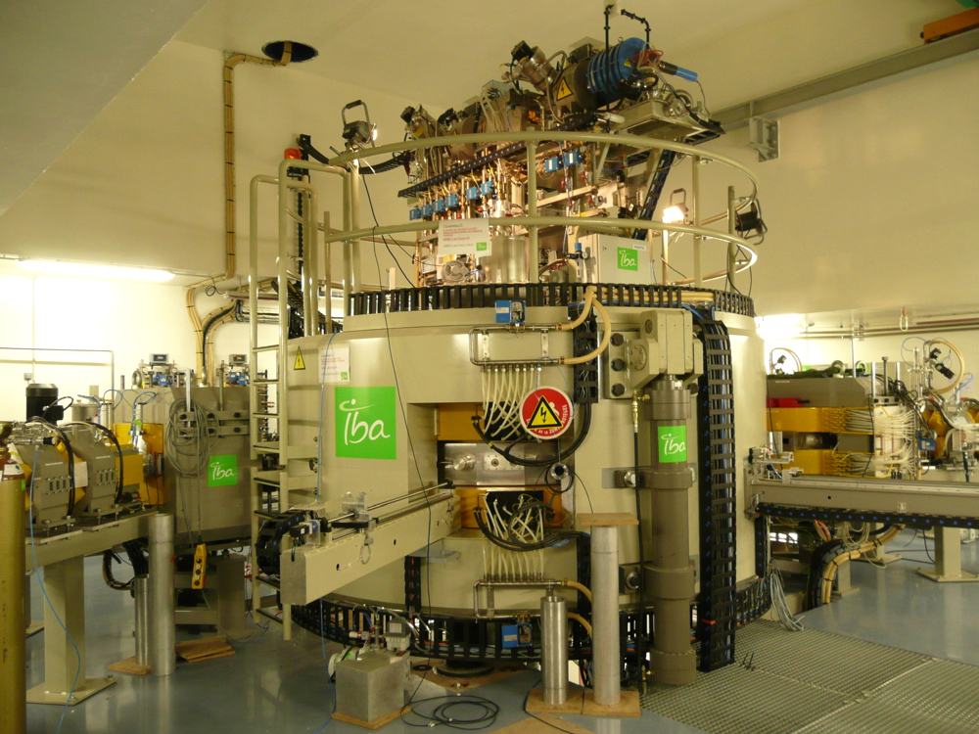
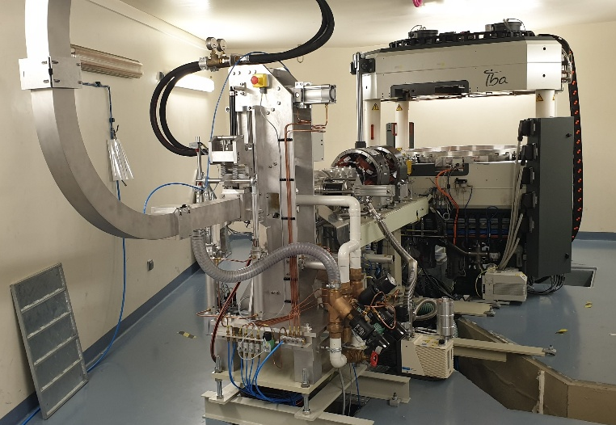
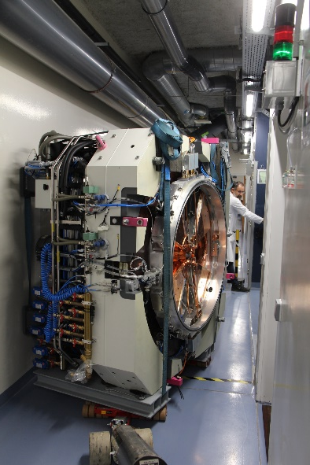
ARRONAX beam characteristics
Main characteristics of the C70XP:
Multi-particle
High energy
High intensity
enlarge the scope of possible nuclear reactions for isotope production
low cross section phenomena usable
Neutron source with industrial capabilities possible
Large quantities to serve several users
Main characteristics of IK18:
Cyclotron kiube 180
1 beamline connected to a solid target station
1 high power solid target station of the C70XP type connected to the existing rabbit system

Slide 14
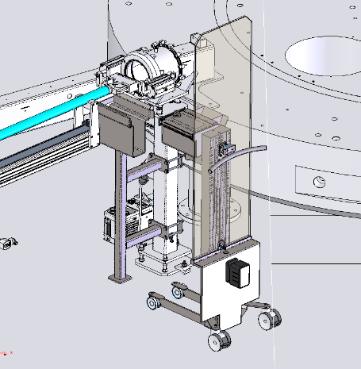
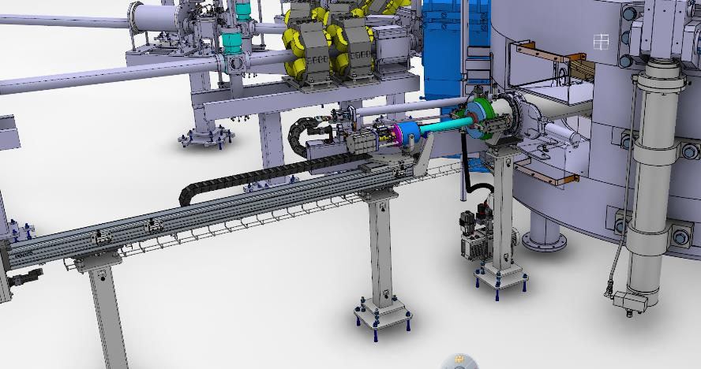
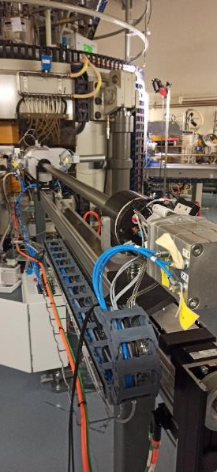
How to acces variable alpha energies?
Upgrade of the machine :
Development of an internal target to intercept the beam at the right energy (28-29 MeV)
No more need to degrade the beam energy and better control of At-210 production
Limitation will be now the target itself
Commissionning under way
Target handling after irradiation
Our Goals: improve both the quality and the quantities of the final product

Slide 15



Pipeline Arronax
Physics Chemistry pre Clinical Clinical
clinical trials Routine
Sr-82
Cu-64
At-211
Cu-67
Hg-197m
Ti-44/Sc-44
Pb-203
Lu-177
Ru-97
Ac-225
Ge-71
New developments on Auger emitters

Slide 16
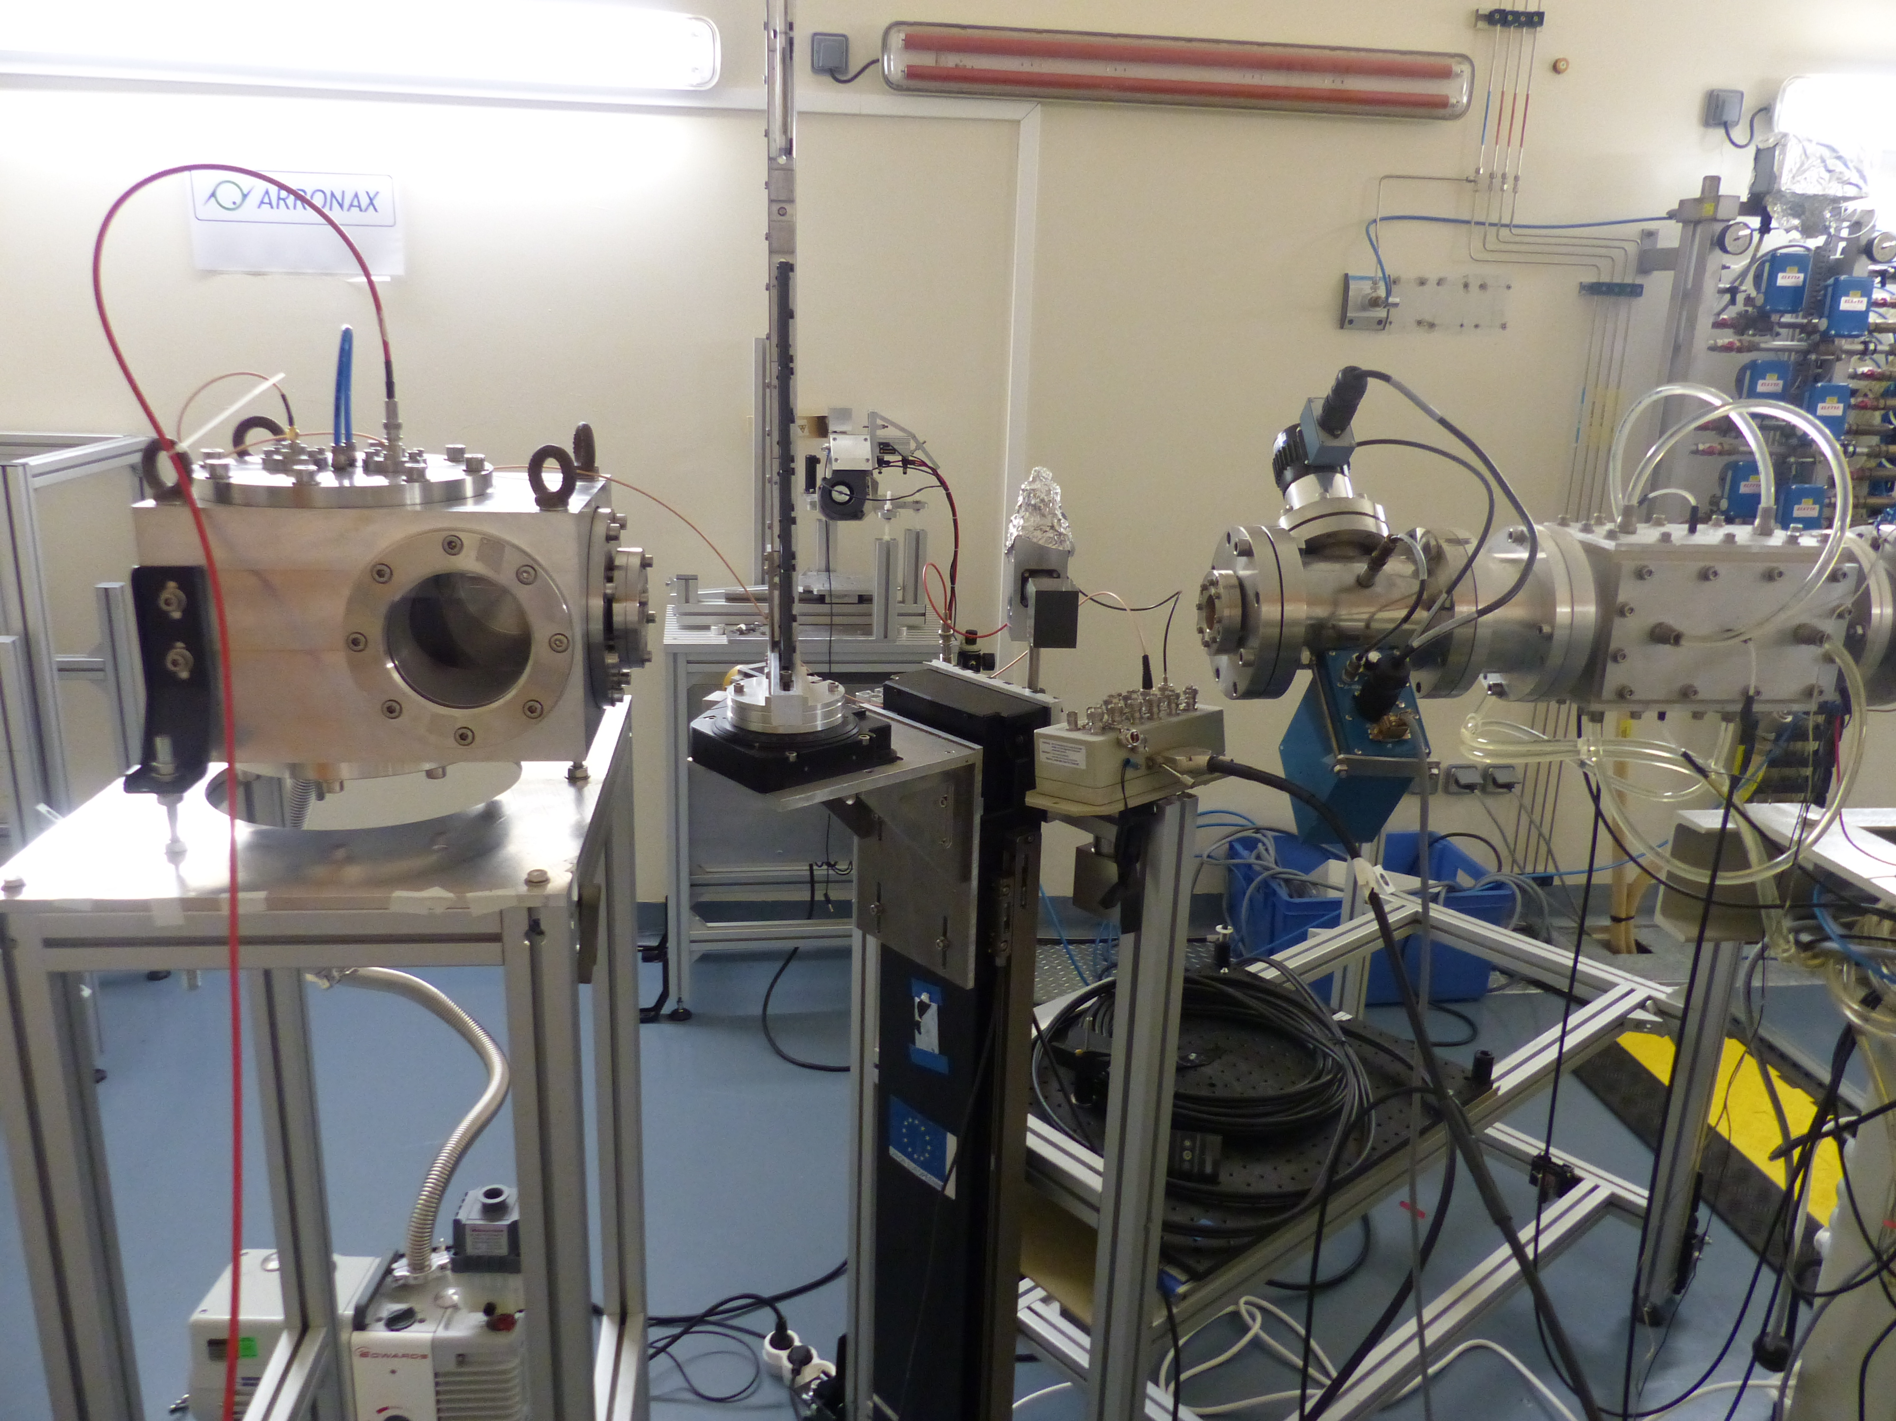
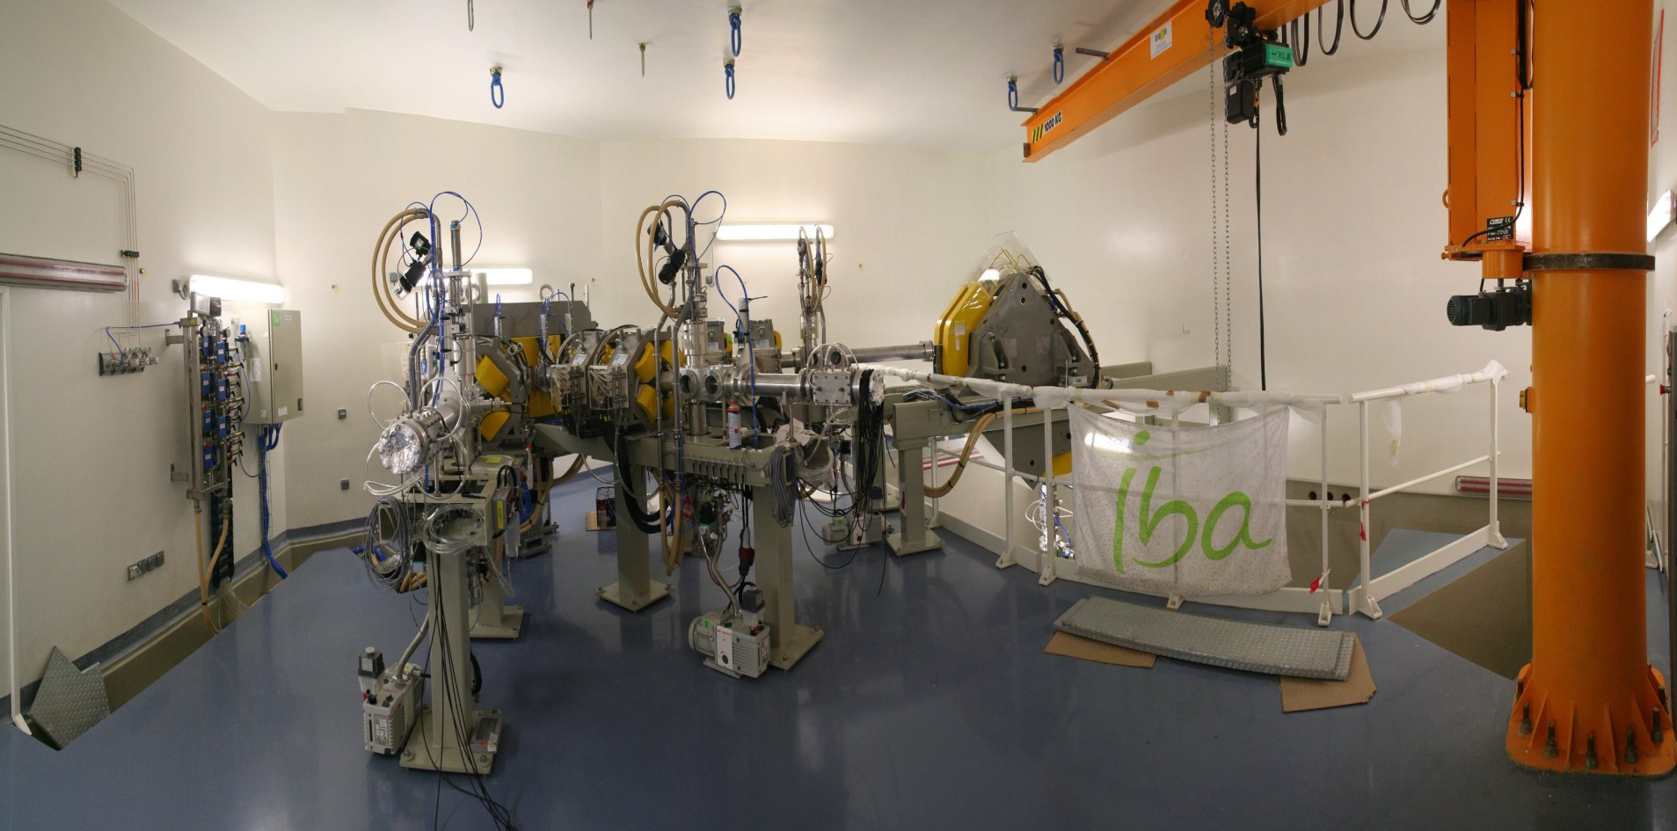
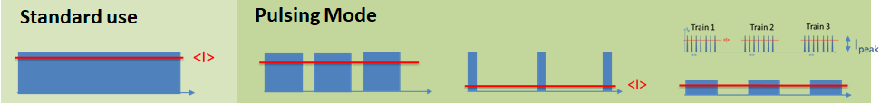
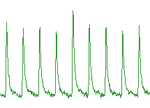
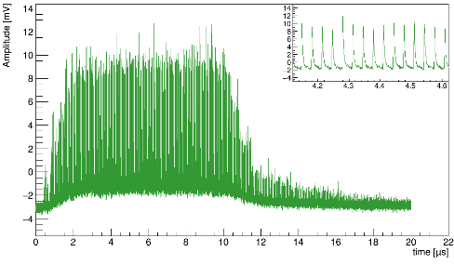
The experimental vault AX @ Arronax
Casemate AX
Important work done by F. Poirier et al on a beam pulsing device
Important work done by C. Koumeir on beam shaping for experiment in AX
33ns
5 cm
Radiochromic film

Slide 17

Few examples of experiments at ARRONAX:
Management of small animal irradiation in AX vault using our animal housing facility
Irradiation
Nuclear data
Cross section measurements for radionuclide production
Bunch Counting : up to 100 particles par bunch (<1nA)
Train Counting : up to 1µA (FLASH)
Archeometry
Determine the gilding thickness to understand the mediaeval manufacturing techniques
Detector testing
DORN detector that went on the moon
Notes:
Utilisateurs : les laboratoires de santés (INSERM, CNRS, centre de lutte contre le cancer, CHU), la plupart des laboratoire de l'IN2P3 ont eu une équipe qui a travaillé chez nous (LPSC, LLR, IP2I, IJCLab, Subatech, LPC Caen, GANIL, LPC clermont, IPHC, Omega, CEA ...)

Slide 18
Conclusions
Arronax possesses 2 cyclotrons:
a versatile C70XP cyclotron allowing a wide range of radionuclide production as well as irradiation research.
A kiube-180 cyclotron (named IK18) under final commissioning for F-18 and Cu-64 production mainly
GIP ARRONAX is producing radionuclides but also radiopharmaceuticals for research in nuclear medicine
GIP ARRONAX is conducting research with beams in diverse areas
After more than 15 years of operations, several upgrades are ongoing to increase services for users:
Rejuvenation to compensate for component obsolescence (2M€)
An internal target system to irradiate our alpha beam at 28 MeV directly (under commissioning)
These work can only be achieved through collective work at all scales (local, national and international)l and with all partners (academia and industry)

Slide 19
The GIP Arronax evolution in time
Projet initial : "un cyclotron à Nantes pour une recherche à dimension européenne en médecine nucléaire et radiochimie
Partners of European projects
PRISMAP and NOAR
ISO -9001
certification
Création du
GIP Arronax
First in Human Ac225-PSMA-R2
Première
production
de Sr-82
Sr-82:
FDA and GMP agreement
2025:
commissioning of the new cyclotron
Commissionning of the internal target
2007
2011
2012
2013
2014
2017
2018
2019
2020
2023
2024
……..
1980
Jannuary
2018
2019
Commissionning
Ouverture de l’Annexe de la Pharmacie à usage intérieur
Today
New buldings
Large projects funded at the national level
Equipex ArronaxPlus
Labex IRON
First clinical dose ever produced at our site
Sr-82 approved in 8 european countries
More than 500 000 patients have benefited of our Sr-82 ain the USA since 2012
More than 20 000 euroepean patients have benefited of our Sr-82 since 2020
More than 200 clinical doses for clinical trials produced in our radiopharmacy

Slide 20
Thank you for your attention
The ARRONAX project is supported by:
the Regional Council of Pays de la Loire
the Université de Nantes
the French government (CNRS, INSERM)
the European Union.
This work has been, in part, supported by grants from the French National Agency for Research (ANR):
"Investissements d'Avenir", Equipex Arronax-Plus noANR-11-EQPX-0004, Labex IRON noANR-11-LABX-18-01.
"France 2030 investment plan" under the references I-SITE NExT (ANR-16-IDEX-0007) and Labex DHOLMEN.

