Slide 1

FCC-ee High Energy Booster emittance tuning in CEA-Saclay
A.Chance, B.Dalena, Q.Bruant*
Thanks to: R.Tomas, J.Keintzel (CERN)

Slide 2
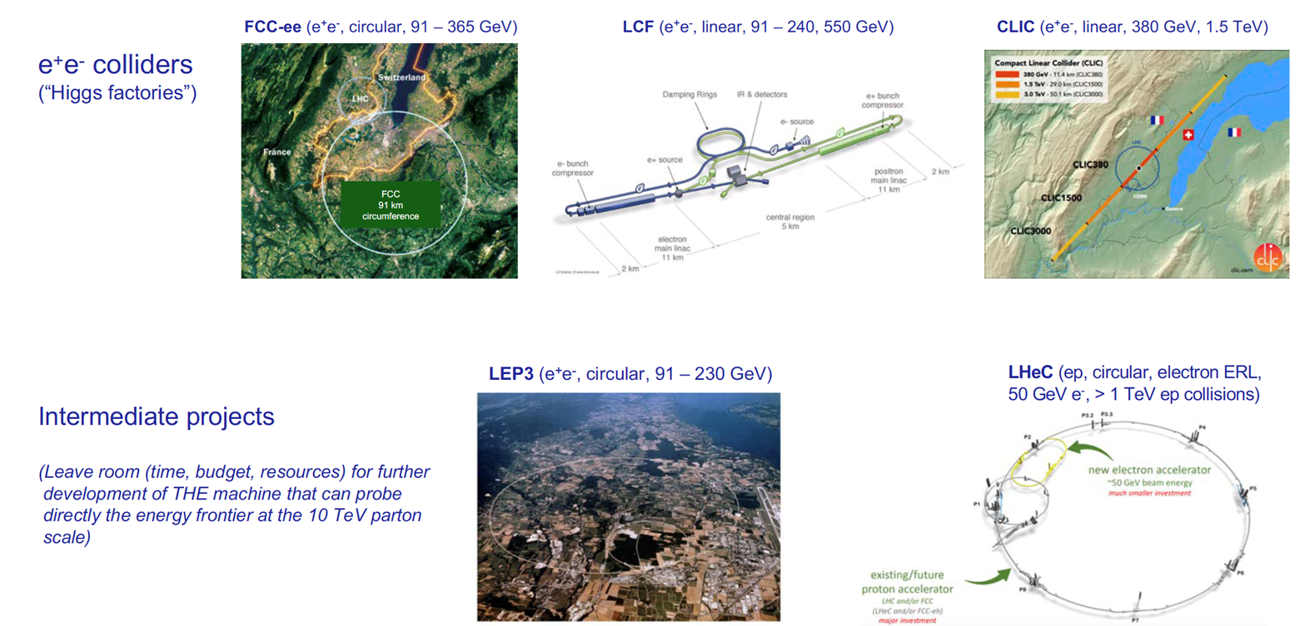
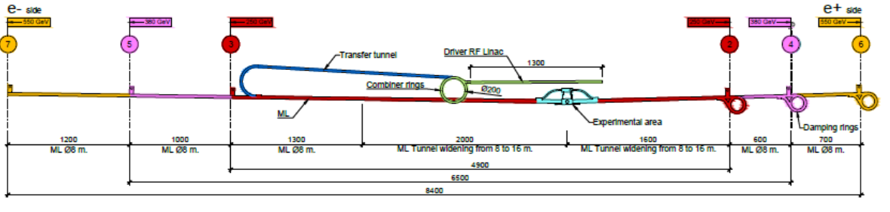
next CERN collider after HL-LHC
HAHLF (asymmetric, e+ conv., e- plasma wakefield)
HAL
K. Jakobs, ESPP open symposium
also: FCC-hh “fast-track” and/or HE-LHC

Slide 3
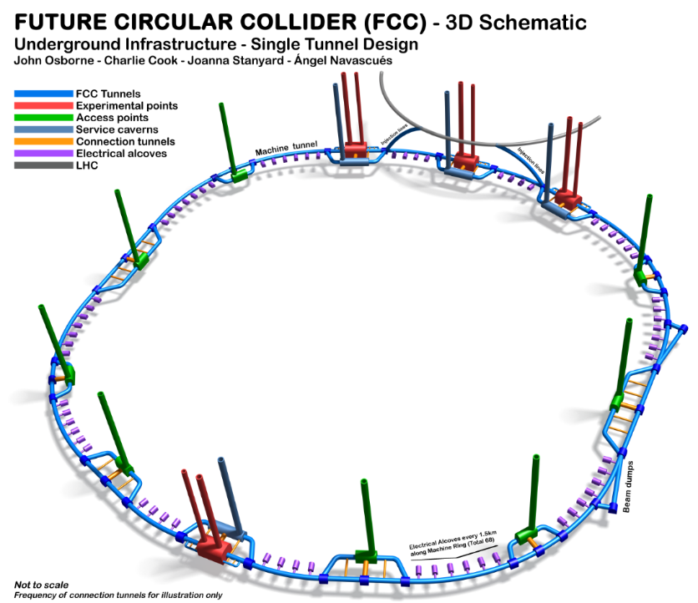

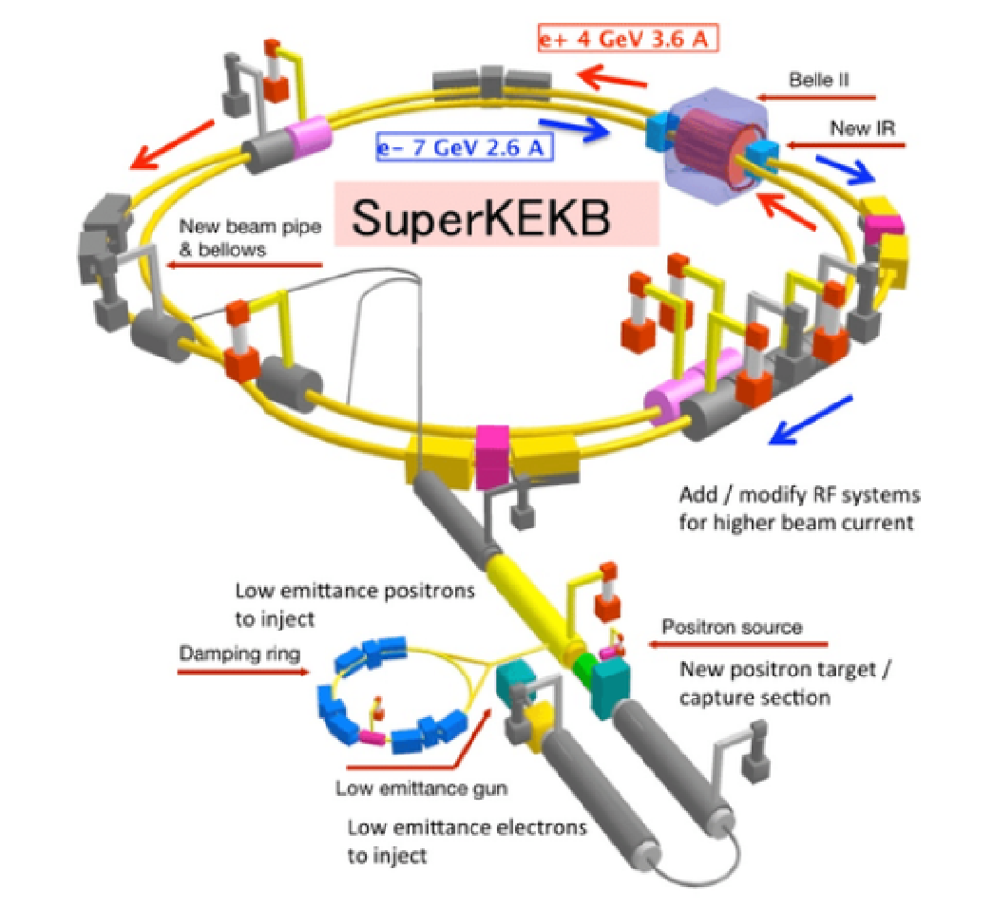
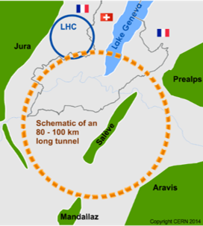


Future Circular Colliders
International FCC collaboration (CERN as host lab) to study:
91 km tunnel infrastructure in Geneva area, site specific
e⁺e⁻ collider (FCC-ee), as first step
Feasibility study published in March
Future Circular Collider Feasibility Study Report Volume 2 - CERN Document Server
<- Use of SuperKEKB as a test bench

Slide 4
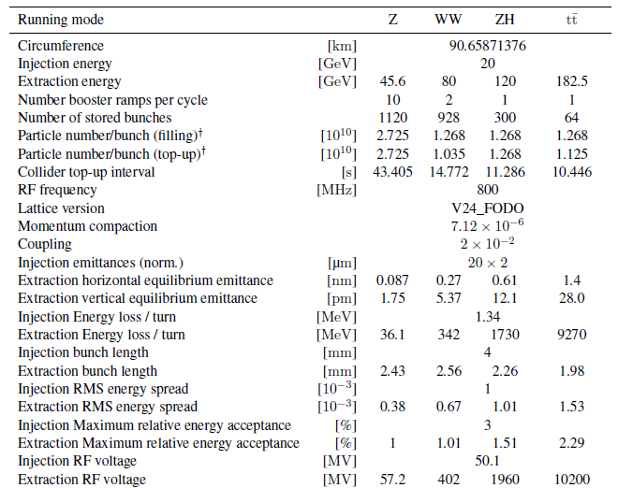
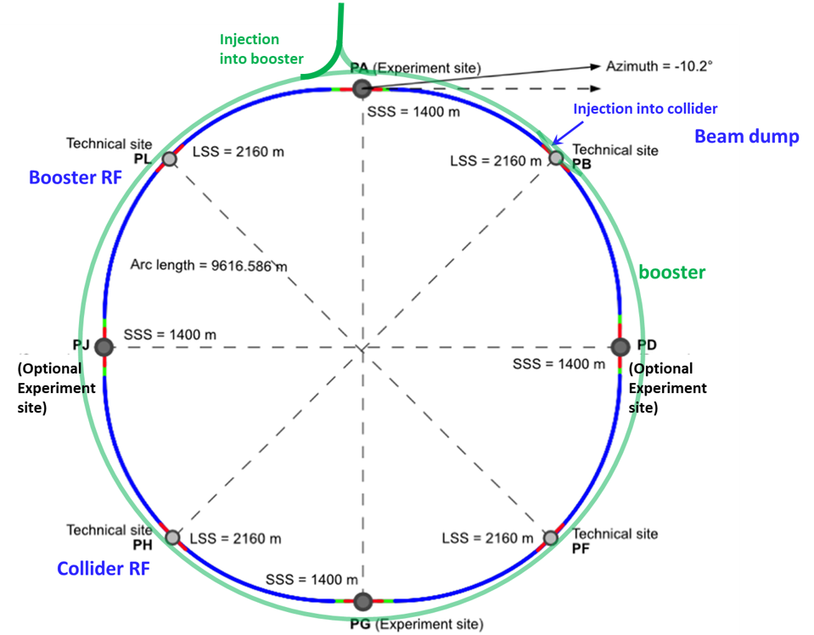
Booster parameter table
We assume an injection efficiency of 80% between the booster and the collider.

Slide 5
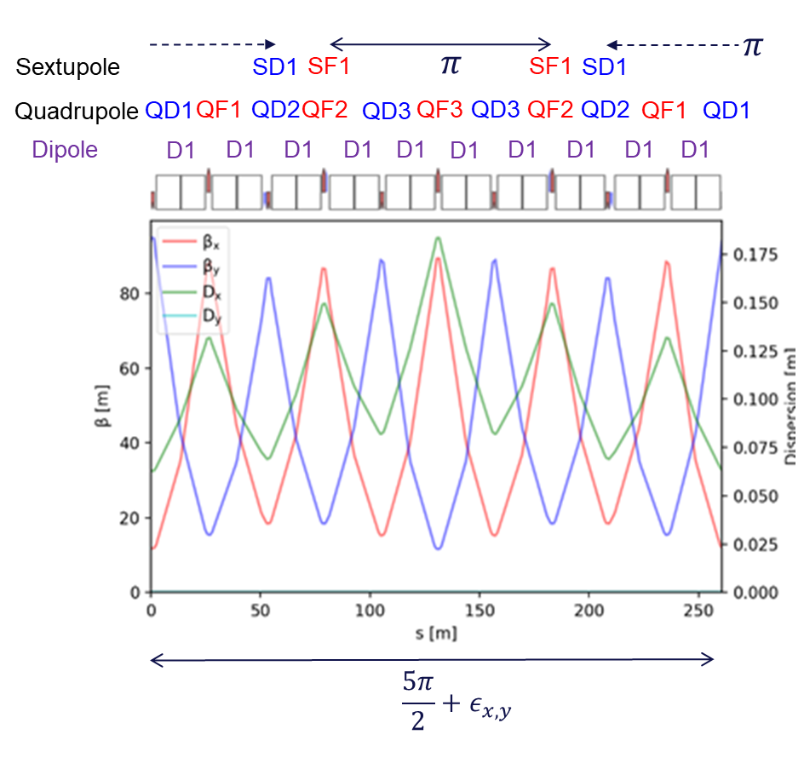
Baseline optics: FODO
Made of about 5 FODO cells of 52 m.
6 quadrupole families with about the same strength
to have a phase advance of π between the pair of sextupoles
to adjust the tune of the arc cell to get the target global tune.
1 dipole corrector + 1 BPM per quadrupole:
Horizontal when QF
Vertical when QD
Cell length adjusted to follow the collider arc periodicity.

Slide 6
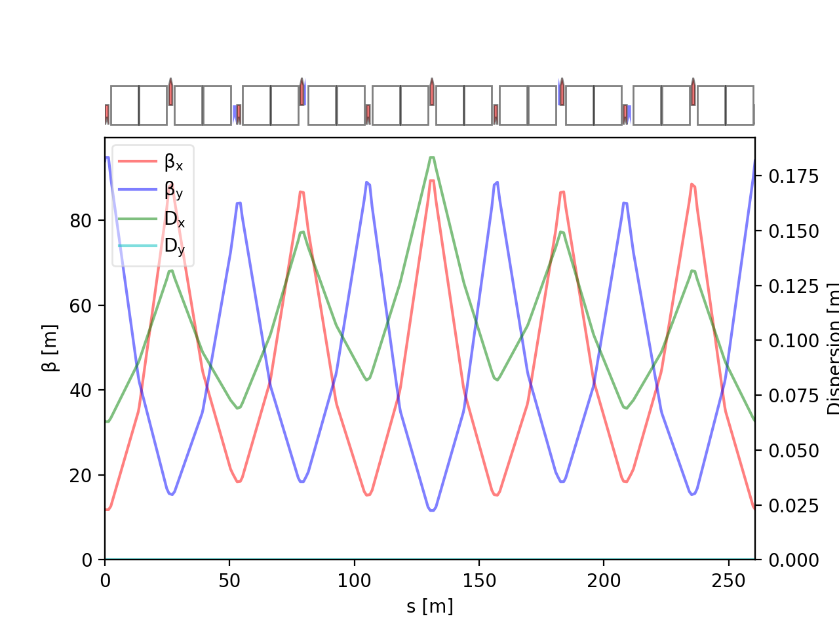
Errors and Correctors
D1
F1
D2
F2
D3
F3
D3
F1
Error type | σ value
Dipole relative field error | 10⁻³
Quadrupole relative field error | 2 x 10⁻⁴
Sextupole relative field error | 2 x 10⁻⁴
Main dipole roll error | 300 μrad
Offset quadrupoles | 200 µm (girder) + 50 µm
Main Quadrupoles roll | 300 μrad
Offset BPMs | 200 µm (girder) + 50 µm
Offset sextupoles | 200 µm (girder) + 50 µm
F2
D2
MQ
BPM
MS
MQ
MS
BPM
= skew quad corrector
(568)
= normal quad corrector
(560)
= orbit corrector
(~2800)
Errors are randomly distributed in arcs
(PDF=Truncated gaussian @3σ).

Slide 7
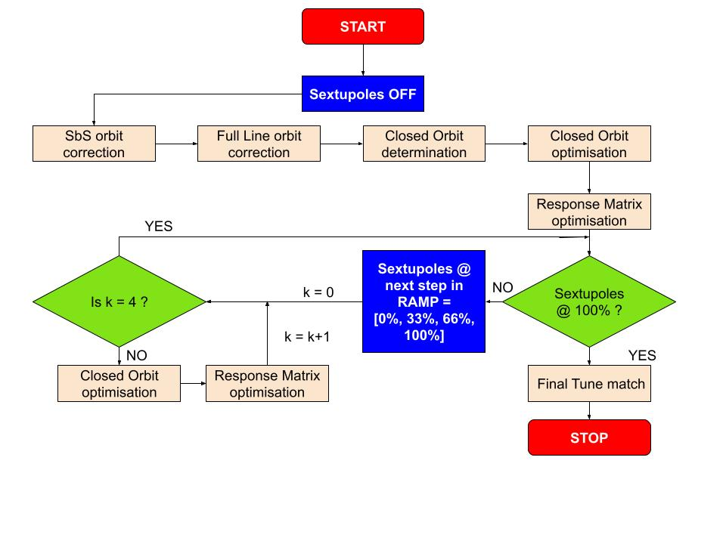
Correction Strategy
Response matrix divided in two matrices :
normal quad correctors
μ_{x}, μ_{y}, Q_{x}, Q_{y}, D_{x}
skew quad correctors
Re{f₁₀₀₁}, Re{f₁₀₁₀}, Im{f₁₀₀₁}, Im{f₁₀₁₀}, D_{y}
Sextupole RAMP ensure limited effect due to interplay between sextupole strength and imperfections
100 seeds simulated

Slide 8
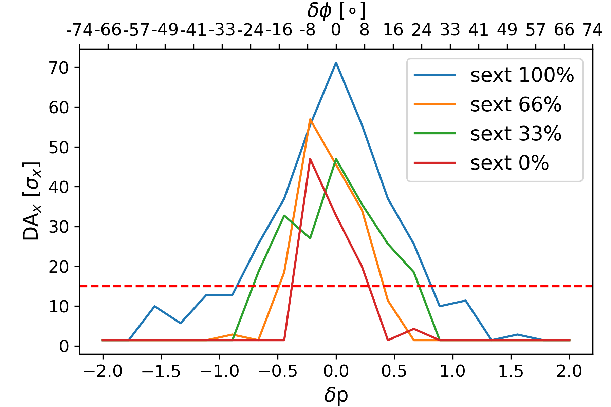
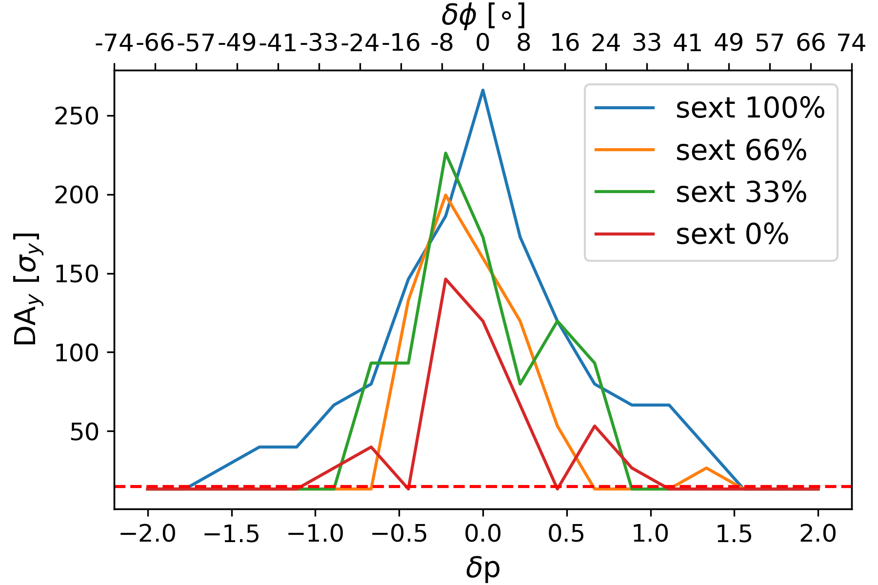
Momentum Acceptance (wrt sextupole ramp)
MA seems to be large enough at each step of the ramp.
High Energy LINAC can provide dedicated single bunches with .05% energy spread.

Slide 9
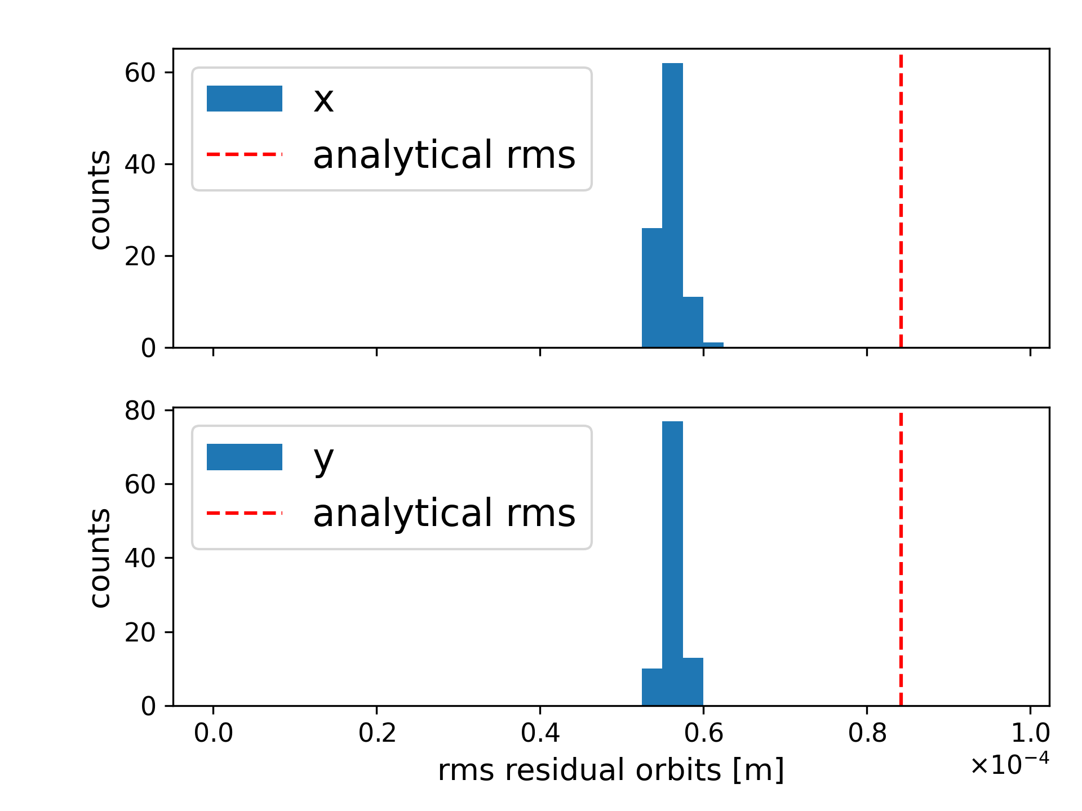
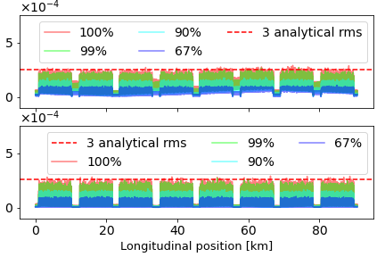
Residual Orbit
|x| [m]
|y| [m]
RMS residual orbits below analytical value
Absolute orbit excursion below .3mm
100 successful seeds

Slide 10
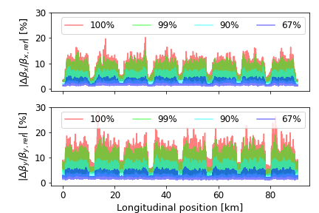
Beta-beating
Limitation of Beta-beating under 20% for 99% of seeds
⅔ of the seeds show Beta-beating below 5% in both planes
Vertical plane seems higher than horizontal
add quad correctors?
100 successful seeds

Slide 11
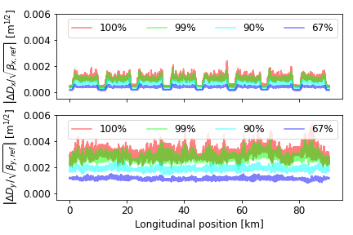
Normalized dispersion
Horizontal normalized dispersion kept under 2x10⁻³ m^{1/2}
Vertical normalized dispersion twice as high as horizontal
add some skew correctors in straight sections ?
Use full response matrix instead of two separated matrices ?
100 successful seeds

Slide 12
Correctors integrated strength
Corrector type | E [GeV] | 3 x RMS
Orbit X | 20 (inj) | 2.5 mT.m
 | 182.5 (ttbar) | 23 mT.m
Orbit Y | 20 (inj) | 2.6 mT.m
 | 182.5 (ttbar) | 24 mT.m
Normal Quad | 20 (inj) | 0.11 T.m⁻¹.m
 | 182.5 (ttbar) | 0.96 T.m⁻¹.m
Skew Quad | 20 (inj) | 0.05 T.m⁻¹.m
 | 182.5 (ttbar) | 0.39 T.m⁻¹.m
100 successful seeds

Slide 13
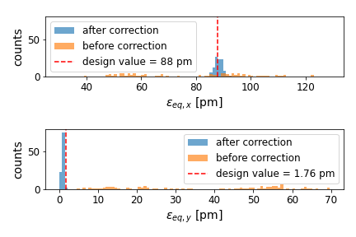
Equilibrium Emittance
Emittance in both planes are centered around the design values
100% stability, all seeds converging

Slide 14
Impact of dipole field quality on emittance tuning
Errors are randomly distributed in arcs
(PDF=Truncated gaussian @3σ).
Error type | σ value
Dipole relative field error | b1 rand 10⁻³
 | b2 sys ±1 x 10⁻⁴
 | a2 sys ±1 x 10⁻⁴
Quadrupole relative field error | 2 x 10⁻⁴
Sextupole relative field error | 2 x 10⁻⁴
Main dipole roll error | 300 μrad
Offset quadrupoles | 200 µm (girder) + 50 µm
Main Quadrupoles roll | 300 μrad
Offset BPMs | 200 µm (girder) + 50 µm
Offset sextupoles | 200 µm (girder) + 50 µm
the impact up to 1 unit of relative a2/b2 on the final emittance and the residual optic distortions is in the shadow of the others errors
the success rate of the strategy for -1 unit of b2 is very low.
need further optimization of the strategy

Slide 15
Recap
Orbit excursion kept below 3×10⁻⁴ m in both plane
Beta-beating:
below 20% in both planes for 99% of seeds
below 5% in both planes for 67%
Normalized dispersion:
horizontal: below 2×10⁻³ m^{1/2}
vertical: twice as high
90% of coupling RDTs below .04
Correctors integrated strength:
dipoles: 3×RMS below 25mT.m
quadrupoles: 3×RMS below 1T.m⁻¹m
Final emittance close to target values

Slide 16
Perspectives
Investigate the loss of stability for -1.10-4 systematic b2 error
Introduce longitudinal misalignment
Study tapering at ttbar energy to correct distortion due to SR
Compute DA with errors and corrections
Further optimisation of correction scheme:
Correctors position and number,
Study of correctors correlation, non-linear approach

Slide 17
Back-up

Slide 18
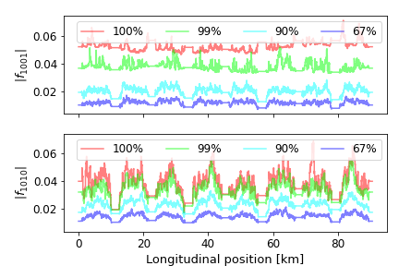

Resonance Driving Terms
100 successful seeds

Slide 19
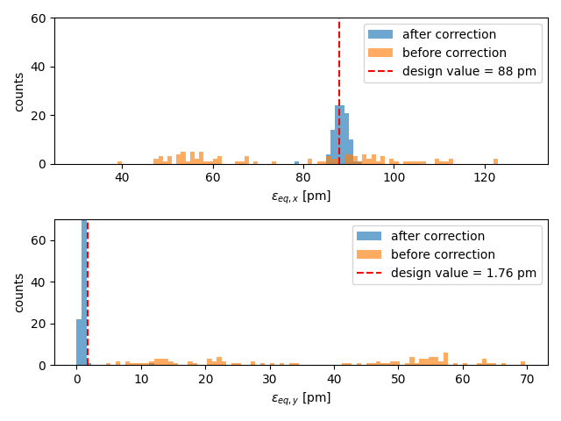
Impact of 1 unit of b2/a2 on emittance tuning
FCC week 2025
Errors are randomly distributed in arcs
(PDF=Truncated gaussian @3σ).
Error type | σ value
Dipole relative field error | b1 rand 10⁻³
 | b2 sys 1 x 10⁻⁴
 | a2 sys 1 x 10⁻⁴
Quadrupole relative field error | 2 x 10⁻⁴
Sextupole relative field error | 2 x 10⁻⁴
Main dipole roll error | 300 μrad
Offset quadrupoles | 200 µm (girder) + 50 µm
Main Quadrupoles roll | 300 μrad
Offset BPMs | 200 µm (girder) + 50 µm
Offset sextupoles | 200 µm (girder) + 50 µm
Fcc week 2025
https://gitlab.cern.ch/fcc-optics/fcc-ee-heb/-/tree/error_mitigation/Orbit_cpymad

Slide 20
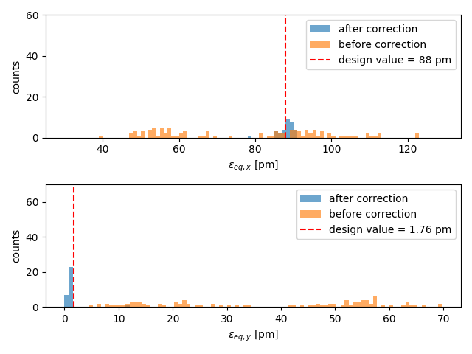
Impact of -1 unit of b2/a2 on emittance tuning
Step failing | # seeds
Full Line orbit correction/close Orbit | 45
Response matrix optimization sext OFF | 4
Sext RAMP 33/66/100 | 2/8/4
Closed orbit optimization sext ON | 5
Response matrix optimization sext ON | 4
FCC week 2025
+ b2 sys -1 x 10⁻⁴

Slide 21
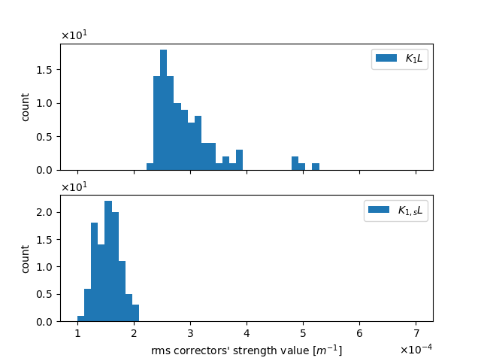
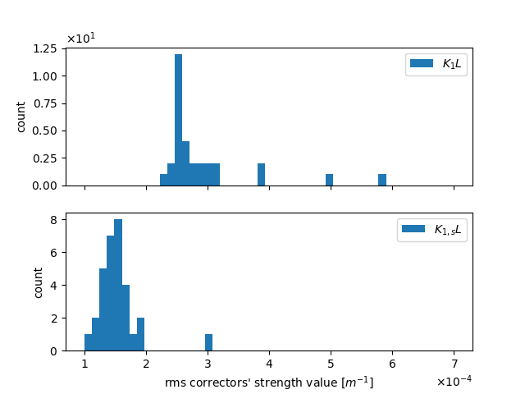
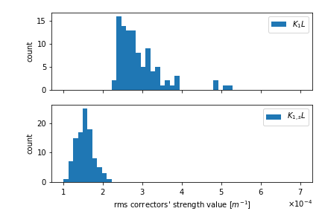
correctors strenght
dominated by offsets in the sextupoles and field errors and roll of the quadrupoles.
+ a2, b2 sys 1 x 10⁻⁴
FCC week 2025
+ a2, b2 sys -1 x 10⁻⁴
stat 100 seeds
stat 100 seeds
stat 28 seeds

