Slide 1



PALLAS
laser-plasma injector test facility: Simulations
Kalyani SWAIN
Postdoctoral Researcher, CNRS/IJClab/IN2P3
kalyani.swain@ijclab.i2p3.fr
IJClab | K SWAIN | 16/12/2025 | Arronax

Slide 2
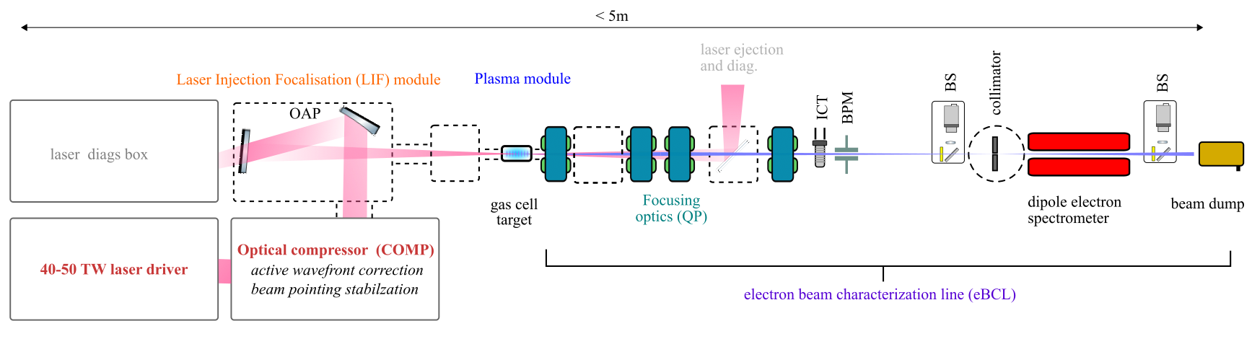
Objective:
The aim is to study the laser wakefield acceleration (LWFA) of electrons and with continuous 10Hz operation aiming to generate an electron beam of
Energy:150-250 MeV,
Energy spread <5%,
charge > 30pC,
normalized emittance < 2µm
The PALLAS test facility [(IJClab 2019)] includes:
Advanced Laser-control and optimization
Plasma target development [(Drobniak, Baynard, Cassou, et al. 2023),(Drobniak 2023)]
Electron beam characterisation and transport (Guyot 2025)
Advanced simulations and surrogate models.
IJClab | K SWAIN | 16/12/2025 | Arronax

Slide 3
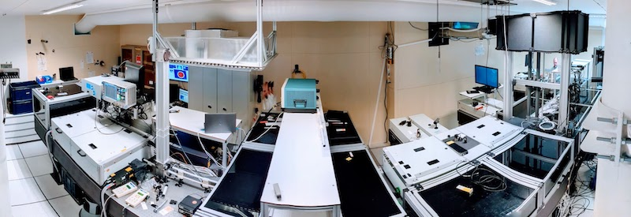
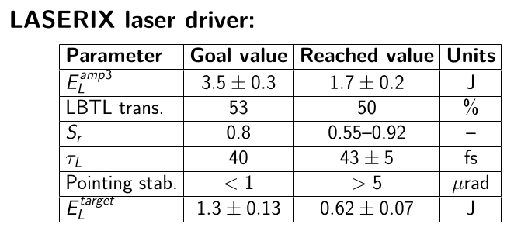
Commissioning Progress:
Phase-I
Phase-II: upgrade of high energy laser amplifier to reach the goal value.
On going laser commissioning now currently 2.8 J
Implement active beam pointing stabilization
Improved high energy laser diagnostics
Electron beamline diagnostics:
Charge Measurement: Turbo-ICT (Bergoz)
Beamscreens: High-resolution YAG:Ce (200 µm thickness) 17 µm resolution (Scheimpflug), OTR (planned)
BPMs: Button-type, lab-made Soleil design.
Electron Beam Spectrometer: Resistive dipole (Bmax = 0.8 T, 17◦ bend, R = 1150 mm, gap = 50 mm), dipole field mapped, 3D-printed UHV Y-chamber, 80 mm × 30 mm YAG:Ce screens, sub-percent energy resolution (100–300 MeV)
Control command and acquisition:
Tango, automatised archiving, timestamping, ∼ 90 % of instrumentation integrated.
Web-based Taranta GUI for commissioning.
IJClab | K SWAIN | 16/12/2025 | Arronax

Slide 4
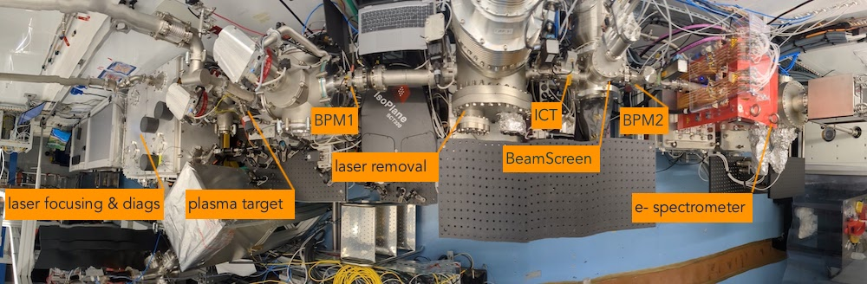
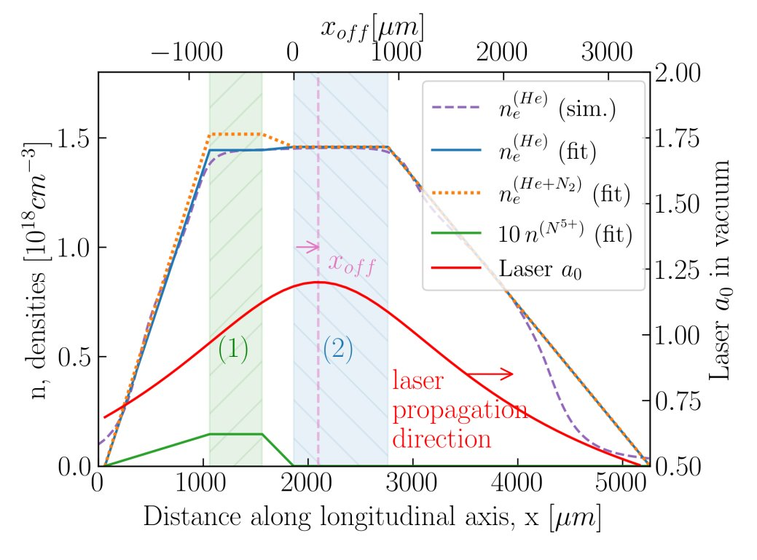
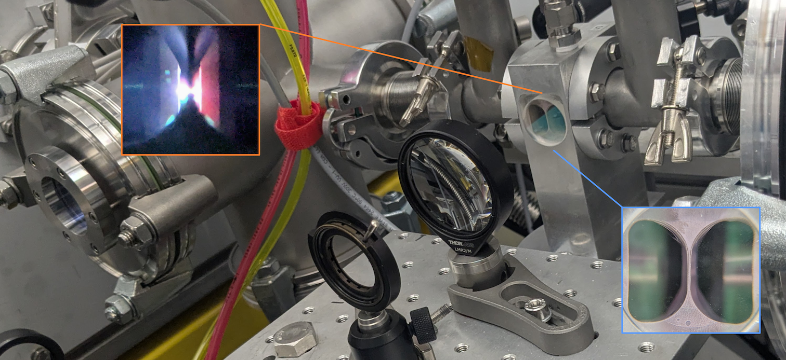
Plasma Target:
Two-chamber gas cell prototype for ionisation injection, fully integrated in the beamline.
Adjustable doping rate from 0.5 % to 100 % (He: background gas; N2: dopant).
Density range 0.5 − 12 × 10¹⁸ cm³.
The density profile is obtained using the open-source fluid simulation library OpenFOAM.
*More detail: J Serhal et al, today's talk
IJClab | K SWAIN | 16/12/2025 | Arronax

Slide 5
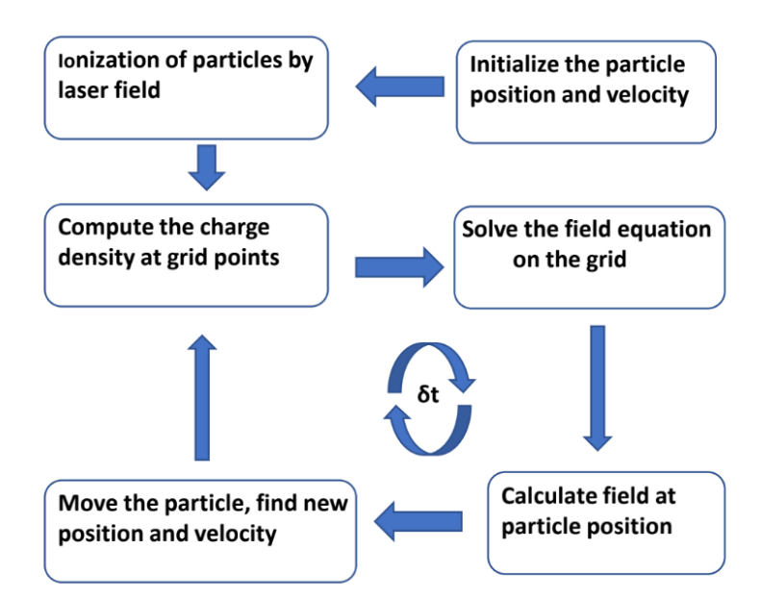

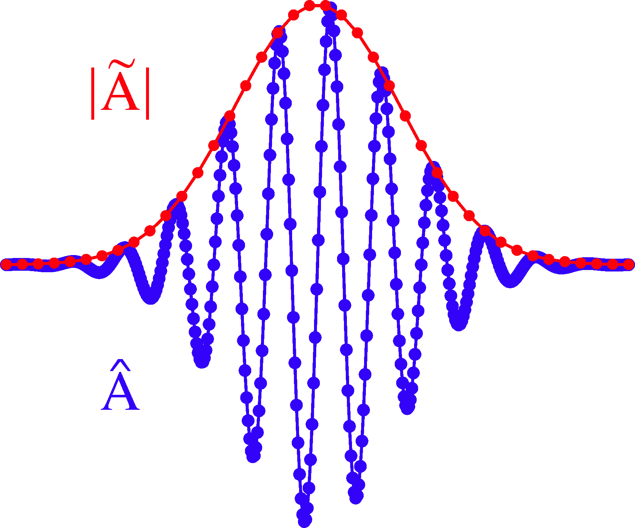
Particle in cell simulation:
SMILEI PIC simulation with the Envelope model to optimize laser and plasma parameters (e.g- a0, x0ff, pressure, cN2) using
https://smileipic.github.io
Random Scan ​
Bayesian optimisation​
IJClab | K SWAIN | 16/12/2025 | Arronax

Slide 6
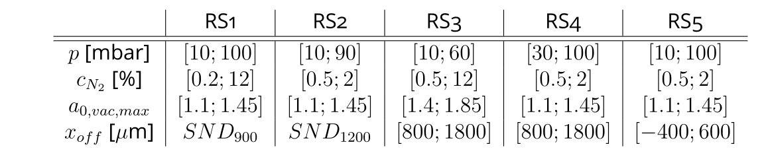
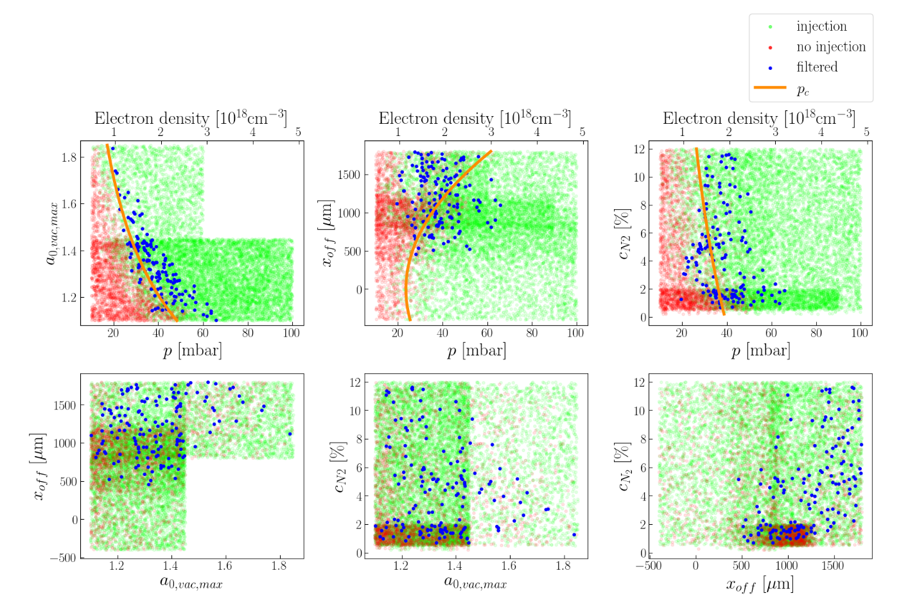
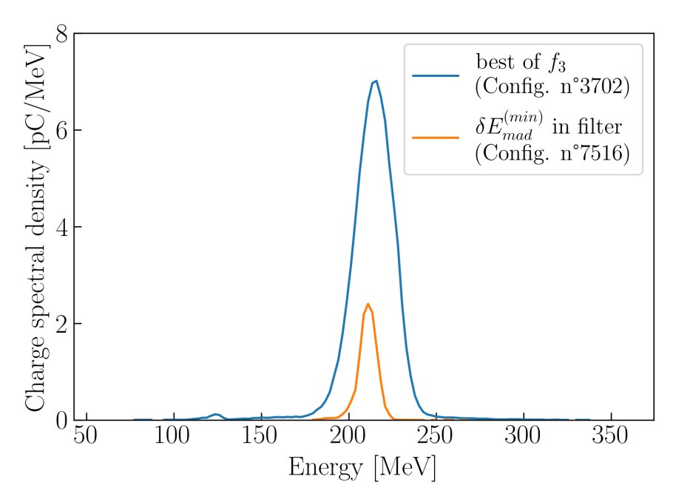
Random Scan:
Drobniak, Baynard, Bruni, et al. 2023:
IJClab | K SWAIN | 16/12/2025 | Arronax

Slide 7
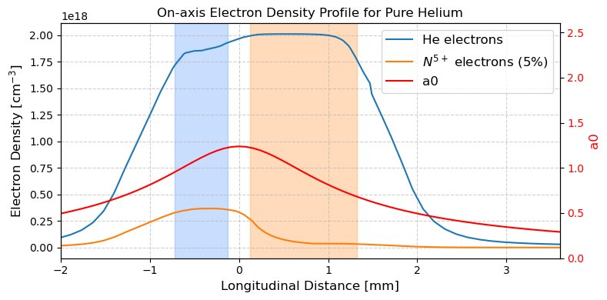
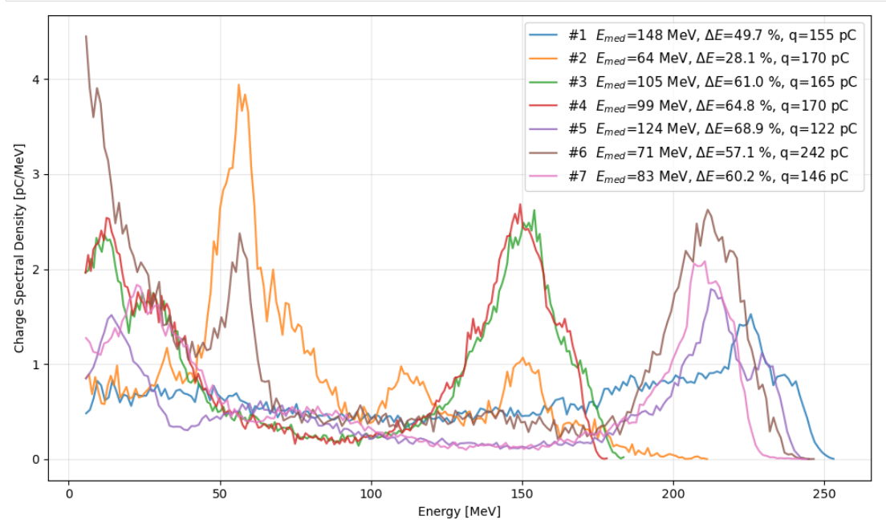
Bayesian optimization:
J Serhal, Phd
P = 58-64 mbar; cN2 = 11-15%; X_off = 1.6-2.2mm; a_0 ~ 1.6
IJClab | K SWAIN | 16/12/2025 | Arronax

Slide 8
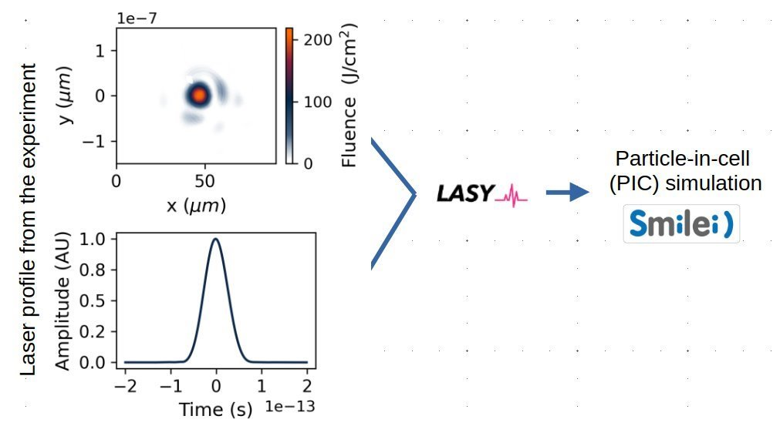
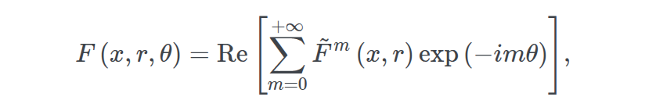
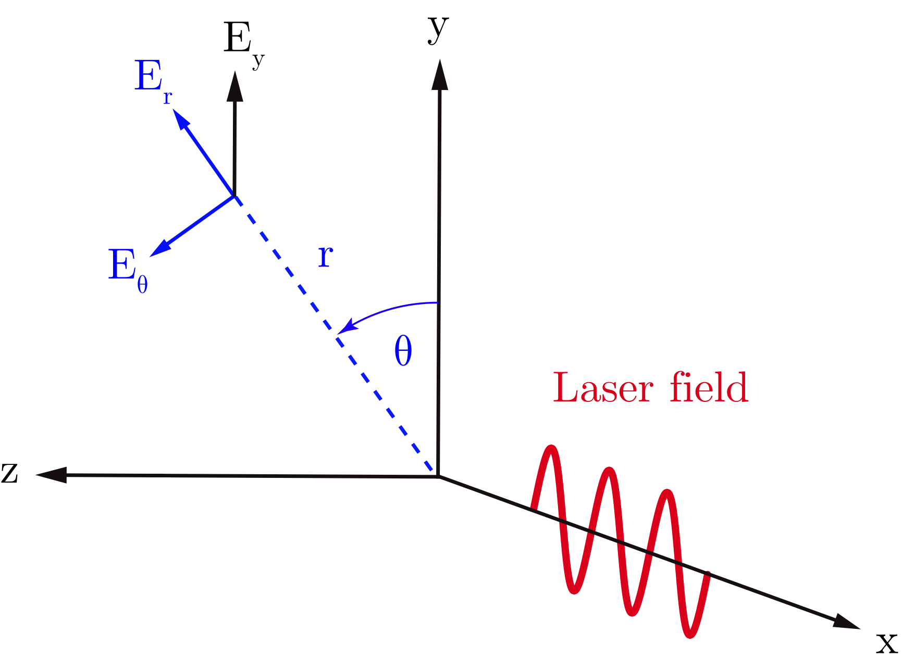
High fidelity simulations: AM Cylindrical
Azimuthal mode (AM) decomposition in cylindrical geometry:
Allows 2D simulation to capture 3D effects and reduces the computational cost compared to the full 3D cartesian.
Real laser profile from experiment:
https://github.com/LASY-org/lasy
A. Lifschitz et al., J. Comp. Phys. 228, 5 (2008)​
https://smileipic.github.io/
I. Zemzemi, PhD thesis
IJClab | K SWAIN | 16/12/2025 | Arronax

Slide 9
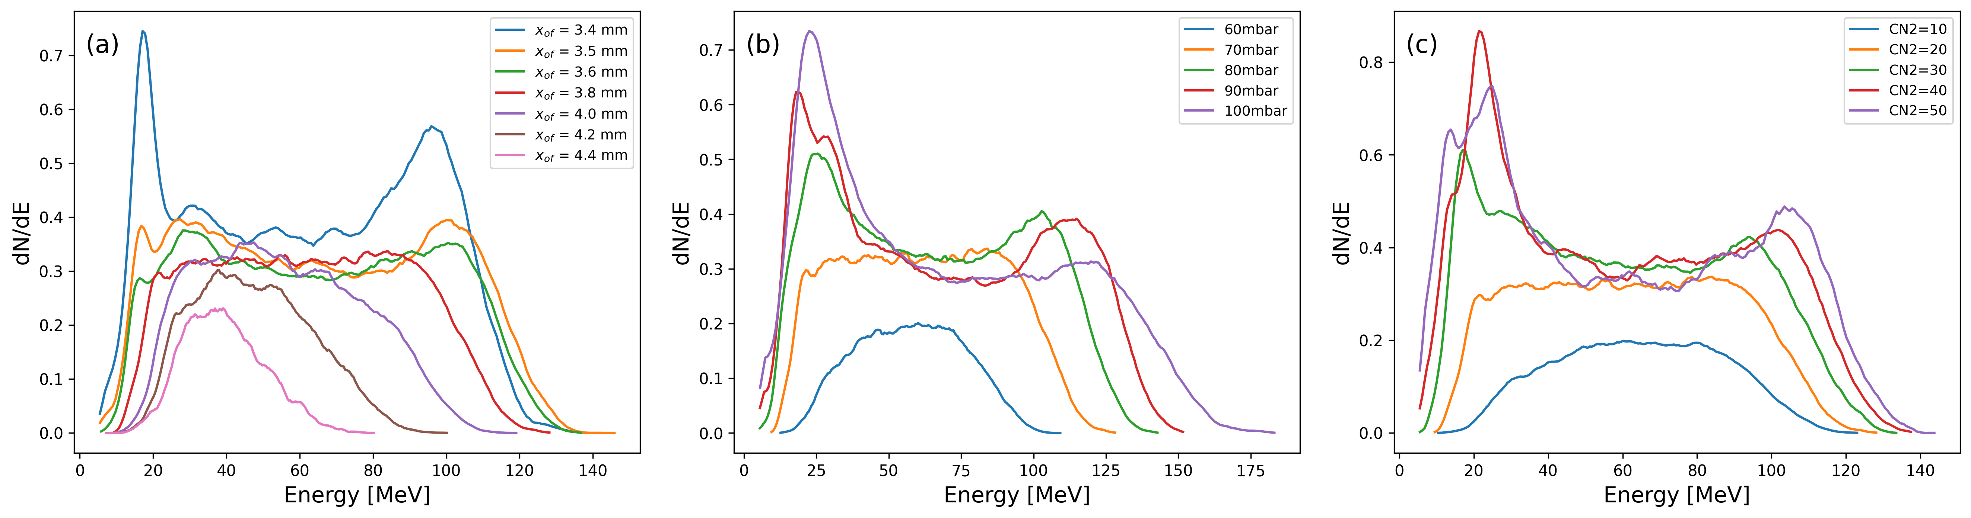
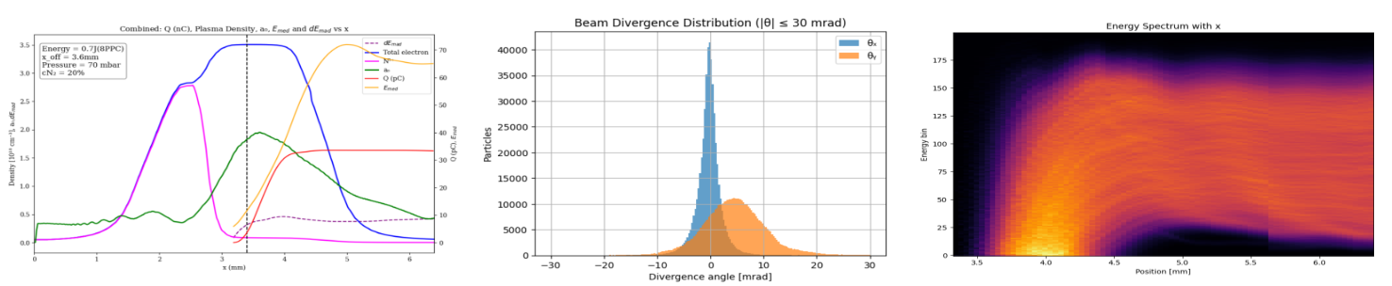
IJClab | K SWAIN | 16/12/2025 | Arronax

Slide 10
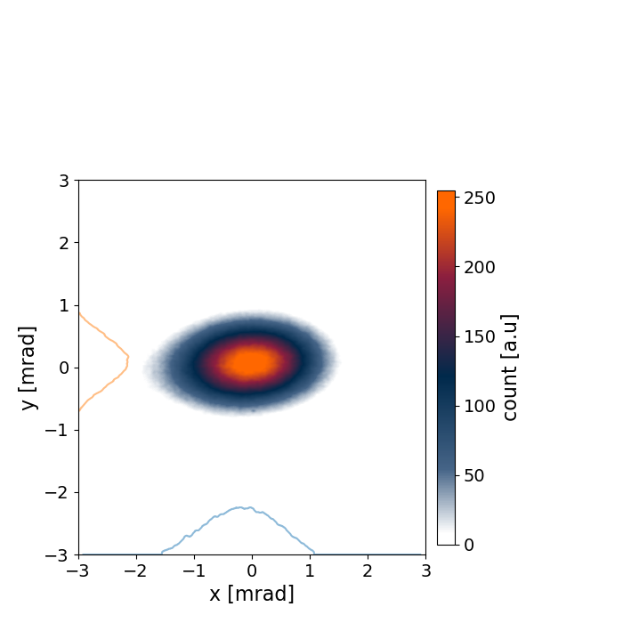
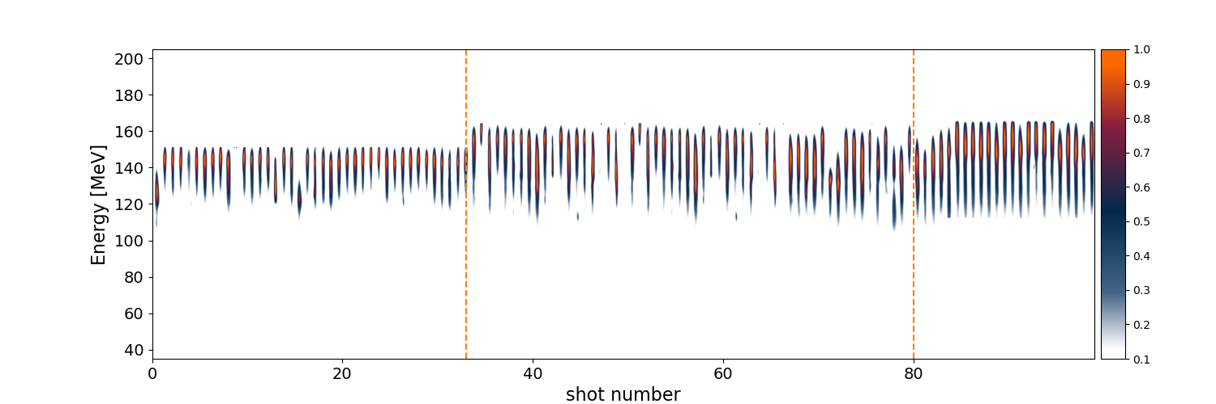
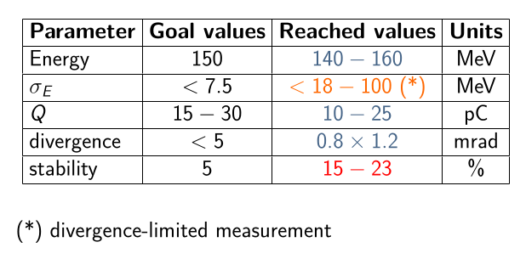
First electron beam parameters obtained:
The first electron beams produced have been used for the debugging of the characterization beamline using limited laser driver energy (< 0.9 J).
Spectrum shot scan sequence of 100 consecutive shots at 1 Hz and beam profile at 2.7 m from the source without stabilisation on the laser pointing. P = 75 mbar, cN2 = 35 %.
IJClab | K SWAIN | 16/12/2025 | Arronax

Slide 11
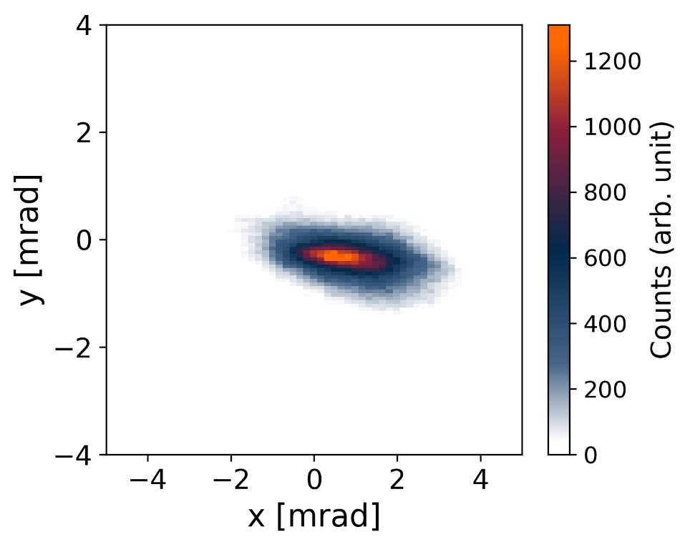
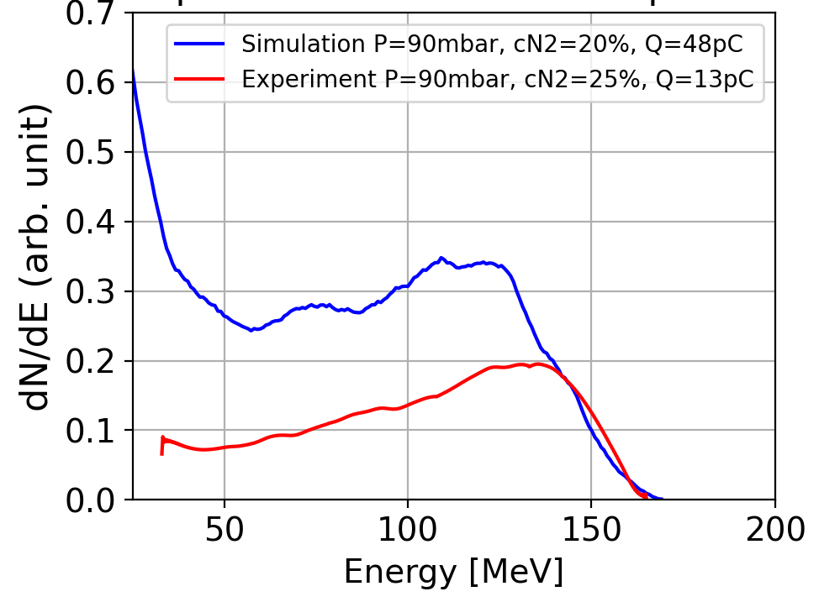
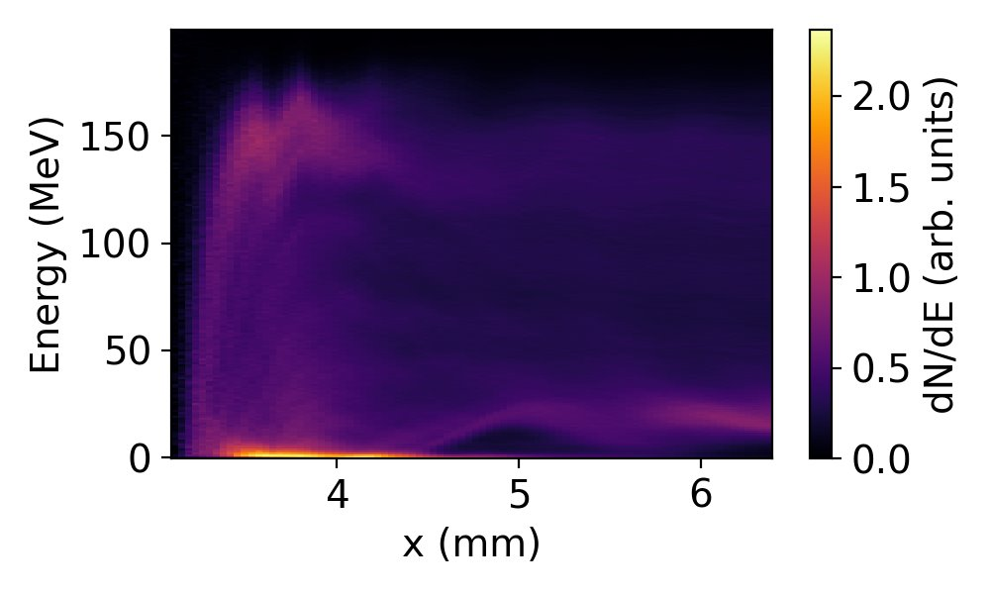
Comparison: simulation and experiment
The spatio-temporal coupling (STC) in the simulation with the realistic laser profile is on the way.
IJClab | K SWAIN | 16/12/2025 | Arronax

Slide 12
Other simulations and modeling activities:
Surrogate model studies for laser plasma accelerator.
G Kane et al, Surrogate Models studies for laser-plasma accelerator electron source design through numerical optimisation​ ​,https://doi.org/10.48550/arXiv.2408.15845
Electron Beamline studies: RF-track beam tracking code. (M. Lenivenko, phd ).
Collimator studies: GEANT4 using surrogate models (A. Sytov, M. Lenivenko, phd).
Gradients of the quadrupoles are optimized with Bayesian Optimization using Xopt to achieve: Focused beam before the EM dipole and the best possible resolution on the spectrometer.
IJClab | K SWAIN | 16/12/2025 | Arronax

Slide 13
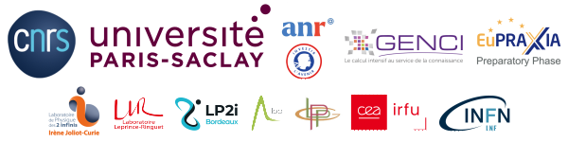

Conclusion:
In first commissioning run, we successfully achieved 140 − 160 MeV electron beam energy with an energy spread of < 18 − 100 MeV, charges of 15 − 25 pC, divergences below 2 mrad, and a stability of 15 %.
Next run, the focus will be on improving the laser energy on the target (> 1.3 J), active beam pointing stabilisation and enhancing the transverse beam quality.
https://gitlab.in2p3.fr/pallas
Collaboration:
IN2P3/IJClab
permanent staff: E. Baynard, C. Bruni, K. Cassou, J.-N. Cayla, J.L. Coacolo, V. Dalifar, J. Demailly, D. Douillet, P. Drobniak, P. Gauron, A. Gonnin, E. Jules, G. Iaquaniello, S. Kazamias, V. Kubytsky, V. Lafage, E. Legay, B. Lucas, Y. Peinaud, K. Malkinski, O. Neveu, L. Perot, M. Pittman.
phd students: M. Lenivenko, M. Pintonato, J. Serhal, G. Kane(2025), C. Guyot(2024), P. Drobniak(2023)
IN2P3/LLR : A. Beck, A. Cauchois, A. Mahjoub, A. Specka.
IN2P3/LP2I-B : A. Huber, A. Maitrallain, C.-E. Demonchy, M. Tarisien
​
National level with​
LPGP: F. Massimo et al.​
LOA: J. Gauthier, L. Ononenko, P. Rousseau, C. Thaury et al.​
LLR: Arnaud Beck,​
International within EuPRAXIA and DMLab​
LNF-INFN: A. Biagioni, G. Costa, L.Crincoli et al.​
DM-lab (DESY,KIT): M. Kirchen (DN EPACE), M. Fuchs (CNRS MITI 2024) ​
​
Industrial partnership : Amplitude Laser; Imagine Optics​
IJClab | K SWAIN | 16/12/2025 | Arronax

Slide 14
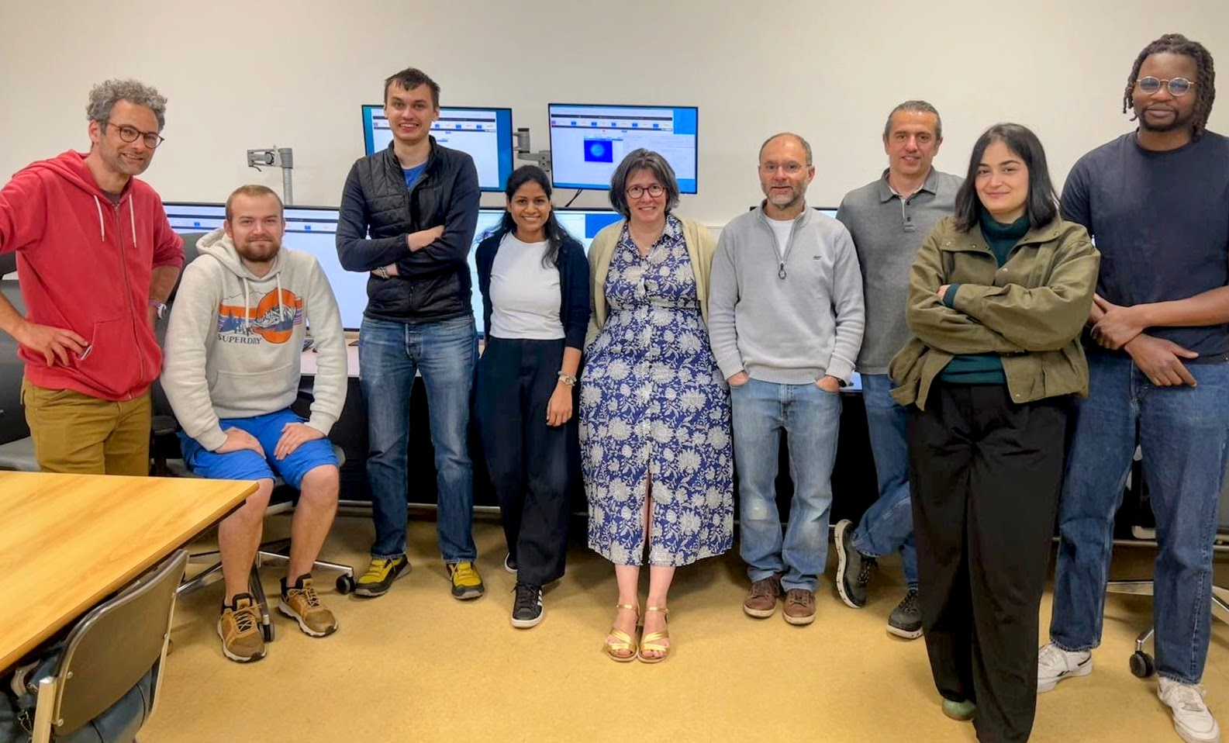
Thank you!
IJClab | K SWAIN | 16/12/2025 | Arronax

