Slide 1


Plasma, Laser, Action
First Shots from PALLAS
Laser Plasma Accelerator at IJCLab
Jana Serhal.
December 16th
Journees annuelles 2025 GDR SCIPAC et Instrumentation Faisceau

Slide 2
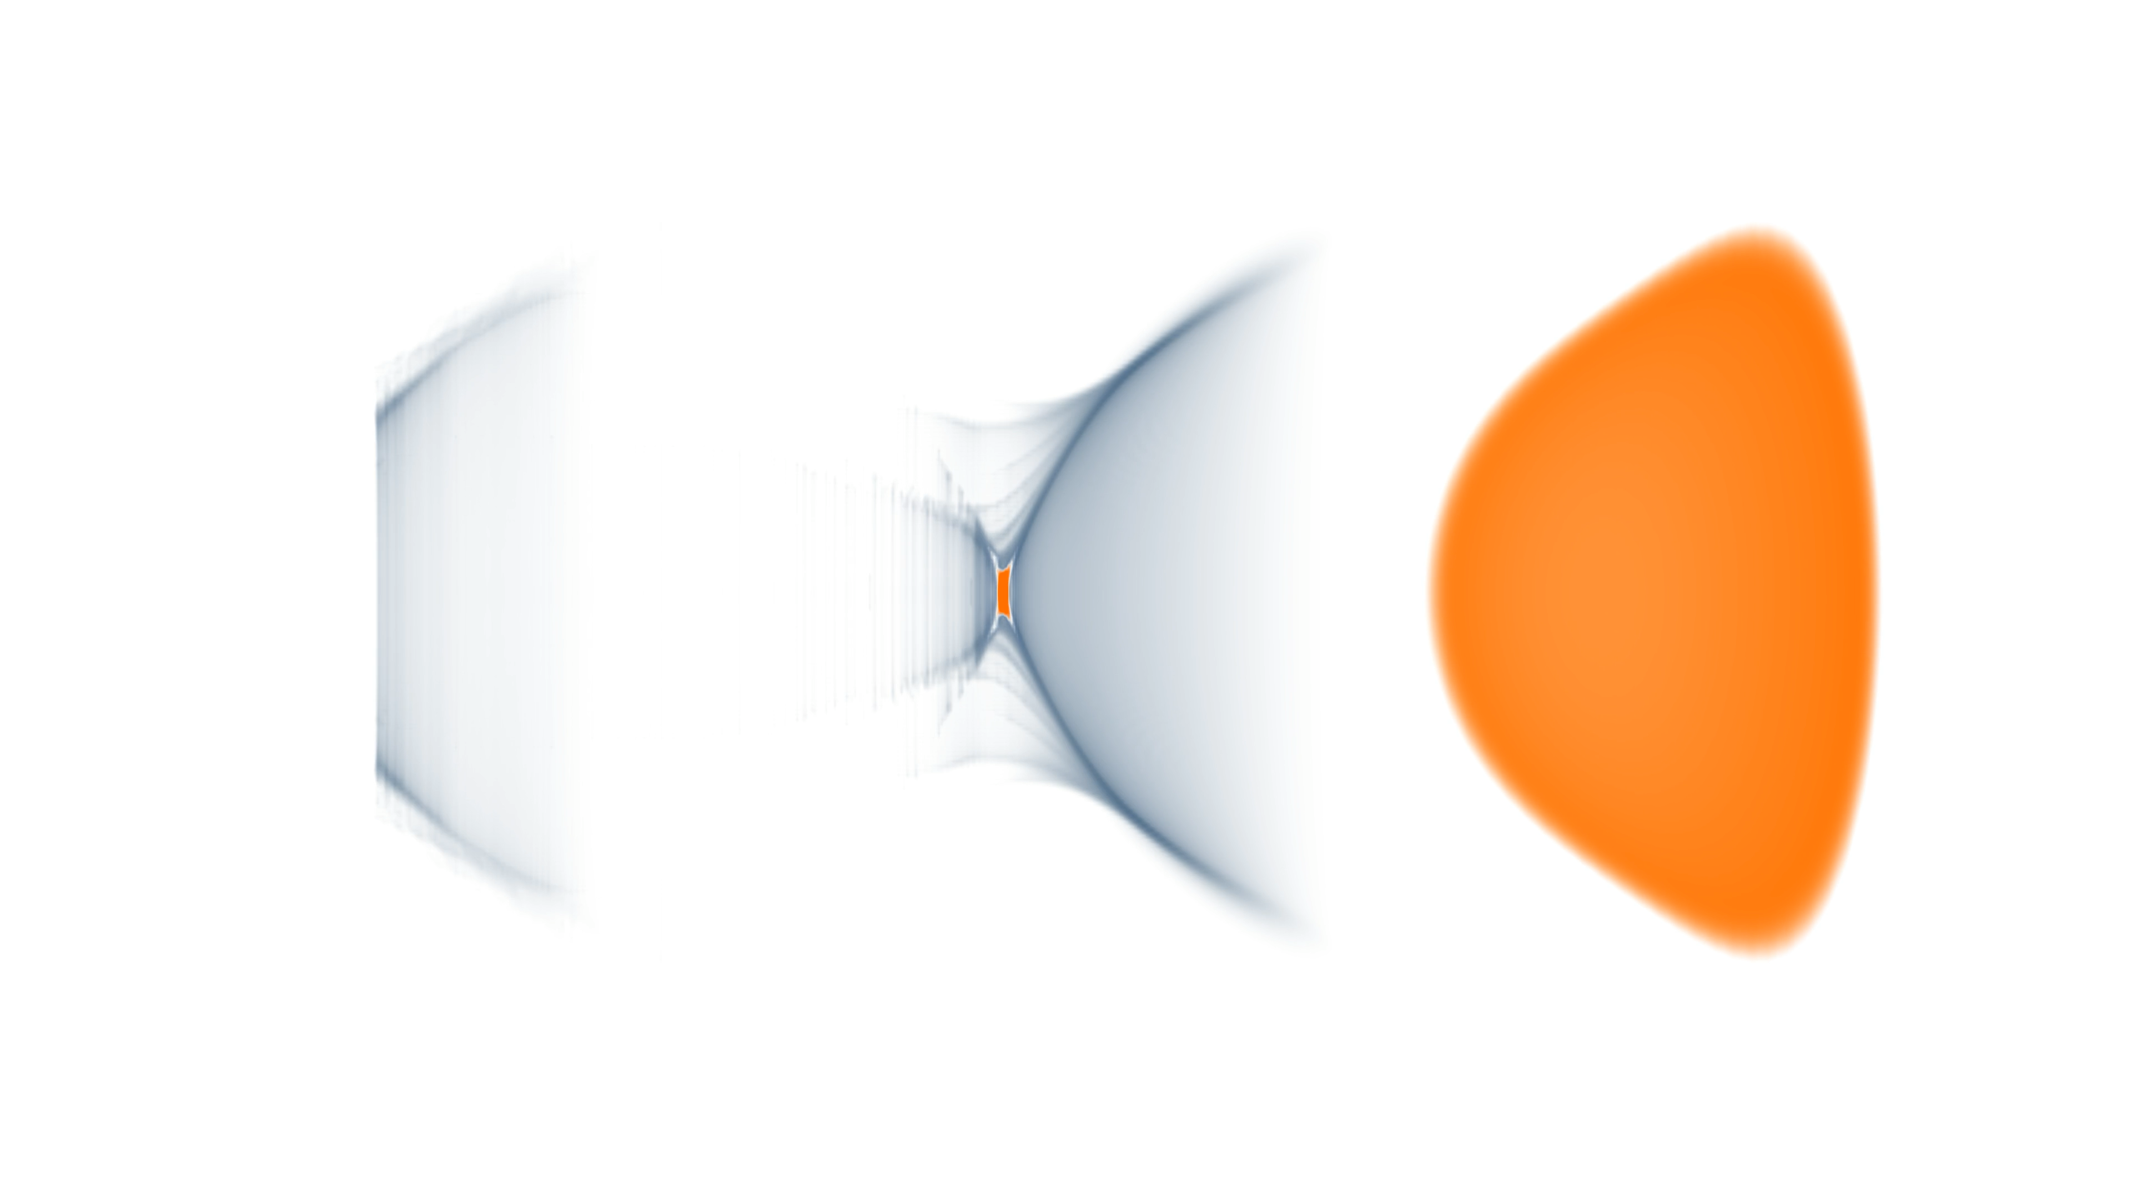
Laser Plasma Acceleration:
Concept and Mechanism
High-intensity laser beam (≅${1.10}^{18}W/cm^{2}$ )
Drives a plasma wakefield in a gas target.
Electrons can be trapped and accelerated in this wake.
Gradient: ~100 GV/m → 1000× conventional accelerators.

Slide 3
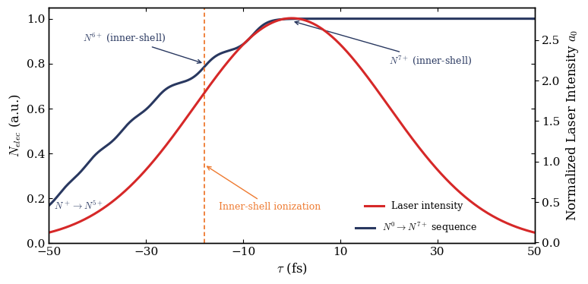
How to Inject Electrons into the Wakefield?
Ionization injection: high-Z dopant (N₂) in low-Z gas (He).
Electrons born inside the wake are automatically trapped and accelerated to high energies.

Slide 4

How to Inject Electrons into the Wakefield?
Only electrons moving close to the wake’s phase velocity can be trapped and accelerated.
        $$v_{electron}=v_{phase,wakefield}$$
N⁶⁺,N⁷⁺ trapped electrons

Slide 5
PALLAS: Laser-Plasma Injector
🎯 Core Objectives:
Aiming for “high-quality beam” laser-plasma injector (LPI) facility working in Continuous 10 Hz operation
⚡️ Precision Laser Control
Improve beam stability: pointing, energy, wavefront
Increase system uptime and reduce operator dependence
⚙️ Target Systems
Develop structured gas cells for reliable electron injection
Focus on material robustness and power handling at 10 Hz operation
💥 Electron Beam Studies
Baseline beam characterisation and first control tests

Slide 6

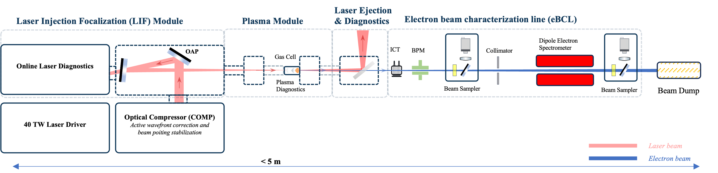
PALLAS: Laser-Plasma Injector
Current Laser System:
40 TW, 1.4–1.6 J, 45 fs
1 Hz rep rate
Stability: 11–13 µrad (PV)
Targer Laser System:
3J, 40 fs
10 Hz rep rate
Stability < 1 µrad (PV)

Slide 7
The Setup
PALLAS: Laser-Plasma Injector

Slide 8
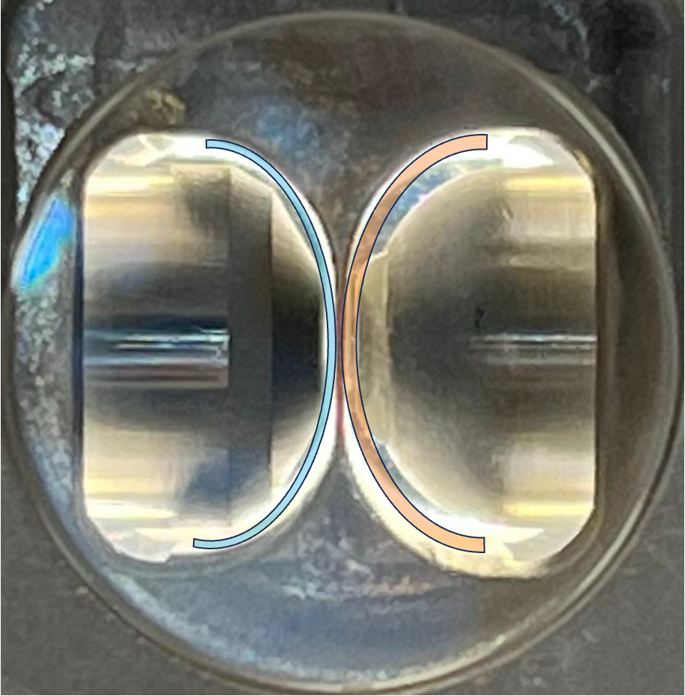
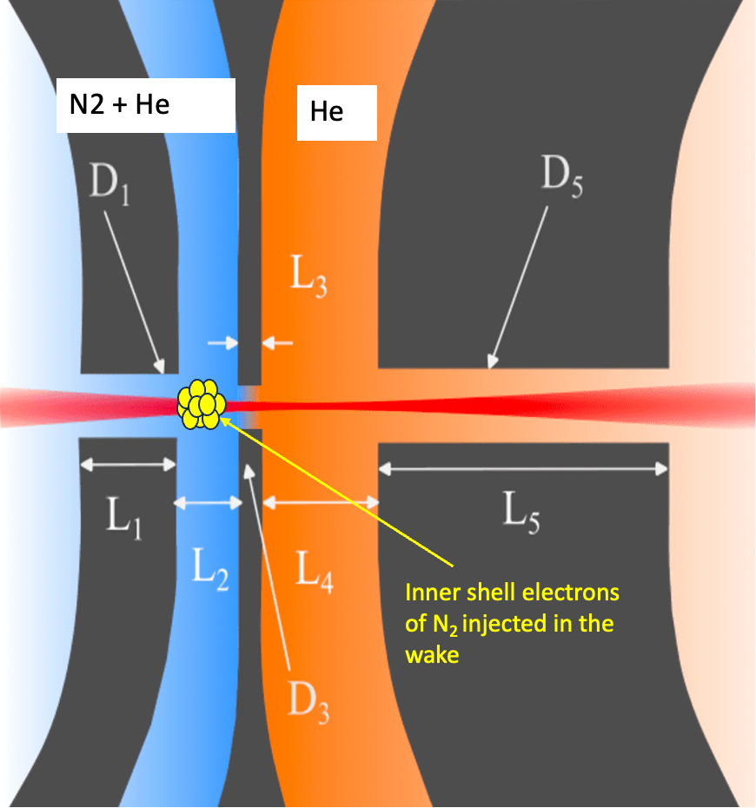
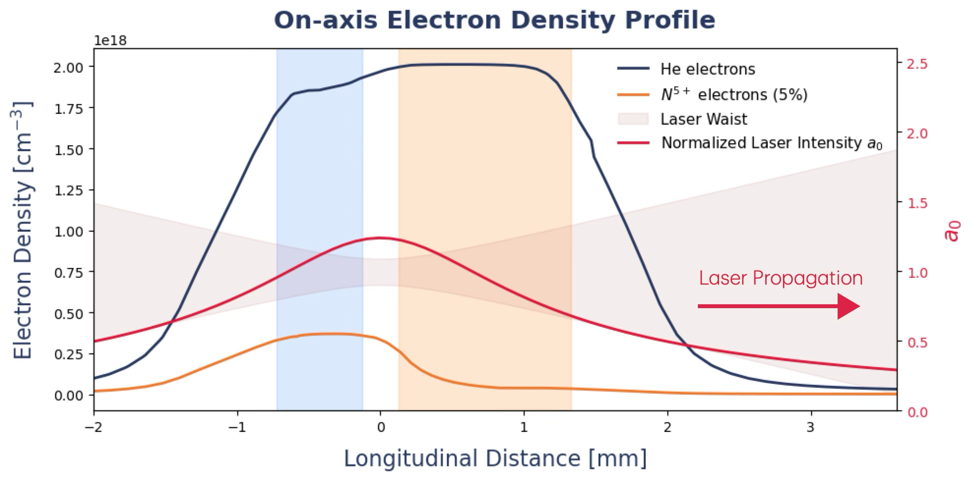
Two-Chamber Gas Cell: Injection & Acceleration
• Injection chamber (blue): N₂/He mixture → ionisation injection
• Acceleration chamber (orange): pure He for energy gain
• Gas profiles: validated with computational fluid dynamics simulations
1 cm
Plasma diagnostics:
• Probe beam for electron density
• Spectral diagnostics for dopant localisation via spectral emission lines

Slide 9
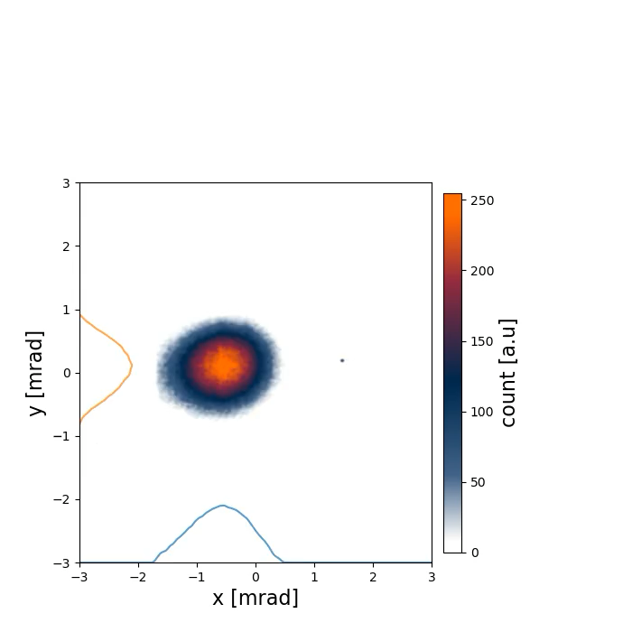
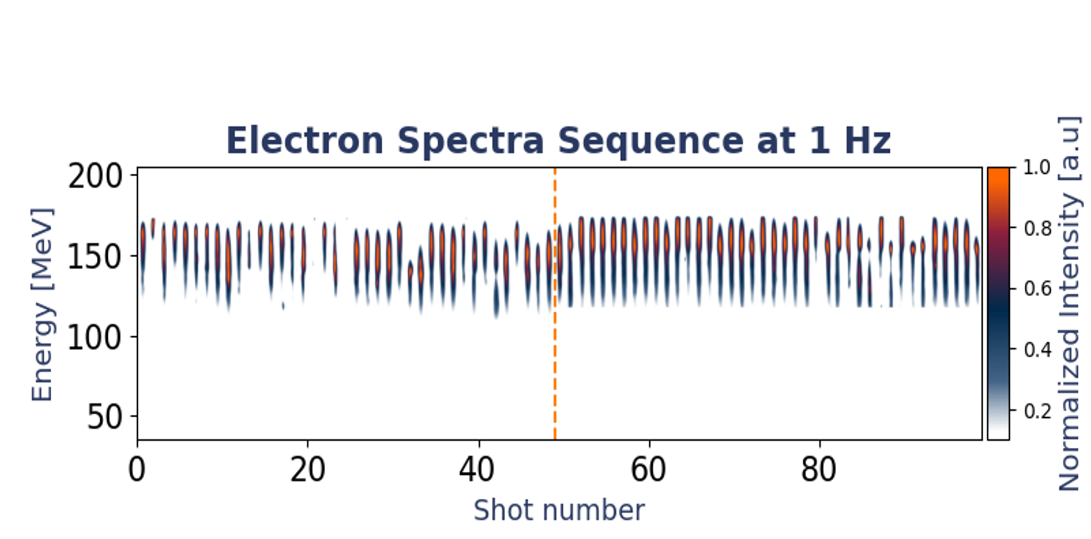
Electron Beam: First Results
First electron beams observed at 1 Hz operation with pressure P=75 mbar and N2 concentration cN2 = 35 % .

Slide 10
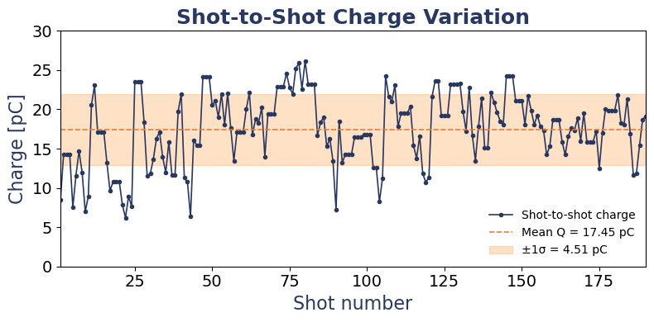
Electron Beam: First Results
First electron beams observed at 1 Hz operation with pressure P=75 mbar and N2 concentration cN2 = 35 % .

Slide 11
Electron Beam: First Results
Key Takeaway
• First beams observed at 1 Hz commissioning
• 140–160 MeV, 10–25 pC, divergence <2 mrad
• Stability 15–23%, energy spread broad (no focusing yet)
•• Next steps: higher laser energy on target, pointing stabilisation, 10 Hz operation…
Parameter | Goal | Achieved
Energy (Emed) [MeV] | 150 | 140-160
Energy Spread (𝜎E ) [MeV] | <7.5 | 18-100 ^{(✛)}
Charge (Q) [pC] | 15-30 | 10 -25
Divergence (𝜃) [mrad] | <5 | 0.8 x 1.2
Stability [%] | 5 | 15 -23

Slide 12
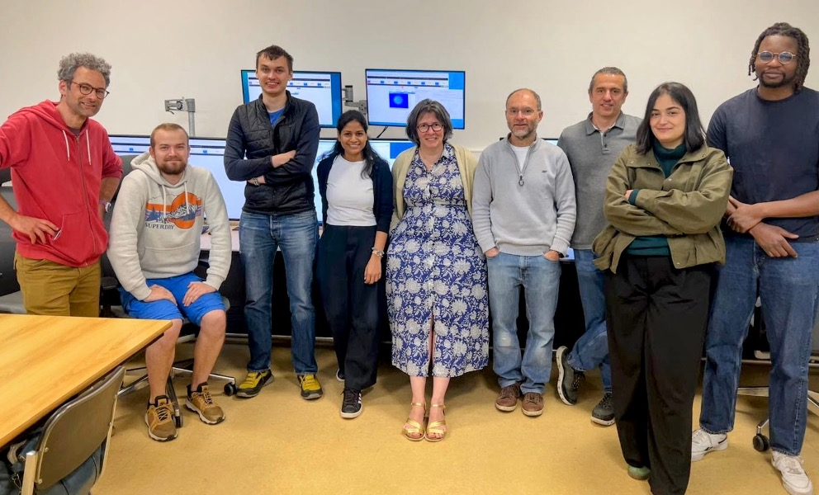
The Team
Baynard, Elsa
Beck, Arnaud
Cassou, Kevin
Cayla, Jean Noel
Coacolo, Jean Louis
Douillet, Denis
Gonnin, Alexandre
Huber Arnaud
Iaquaniello, Gregory
Kane, Gueladio
Kazamias, Sophie
Lenivenko, Mykyta
Lucas, Bruno
Malkinski Konrad
Neveu, Olivier
Peinaud, Yann
Pintonato Marceau
Pittman, Moana
Serhal, Jana
Specka, Arnd
Swain, Kalyani

